Slide 1
An FPGA-Based Frame-Buffered Bridge from MIPI CSI-2 to SPI for Low-Speed Microcontrollers
A simulation study of a store-and-forward camera bridge, confirmed on silicon
Camera
MIPI CSI-2, 80-1500 Mbps
FPGA bridge
frame buffer, store-and-forward
Microcontroller
SPI, up to 25 MHz
Giorgi Kharatishvili · September 2026
Notes:
Good morning. My name is Giorgi Kharatishvili.
This talk is about a bridge between two worlds that do not speak the same speed. On one side, a camera sensor talking MIPI CSI-2 at hundreds of megabits per second per lane. On the other side, a small microcontroller with an SPI port that tops out at a few tens of megabits.
I built an FPGA bridge between them. I designed it and characterised it in simulation, and at the end I will show you that it also runs on real hardware.

Slide 2
The rate mismatch
25 Mbps
A FIFO cannot fix a sustained rate mismatch -- it only defers the overflow.
SPI at 25 MHz, one MOSI line -- the MCU's ceiling
80 - 1500 Mbps
No microcontroller can absorb the stream directly: the lane is faster than the MCU's entire bus.
Any FIFO fills at the lane rate and empties at the SPI rate. It buys time, then it overflows.
So the fix cannot be a bigger buffer for the rate. It has to change the average input rate.
That means controlling the source: let the camera send only when the bridge can take a whole frame.
one CSI-2 lane: 80 Mbps at the slowest, 400 typical
3x - 60x
the input is this much faster than the output
2
Notes:
Let me start with the numbers, because the numbers define the problem.
SPI at 25 megahertz is 25 megabits per second. One data line, one bit per clock. That is the ceiling for a typical microcontroller.
A single CSI-2 lane runs at 80 megabits at the very slowest. Typically 400. Up to one and a half gigabits. So the input is somewhere between three and sixty times faster than the output.
The natural instinct is: put a FIFO in between. And this is the key sentence of the whole talk: a FIFO cannot fix a sustained rate mismatch. It only defers the overflow. The FIFO fills at the lane rate, drains at the SPI rate, and when it is full, you lose data. A bigger FIFO just means you lose data later.
So the fix cannot be a bigger buffer for the rate. It has to change the average input rate. And the only way to do that is to control the source — to let the camera send only when the bridge can take an entire frame.

Slide 3
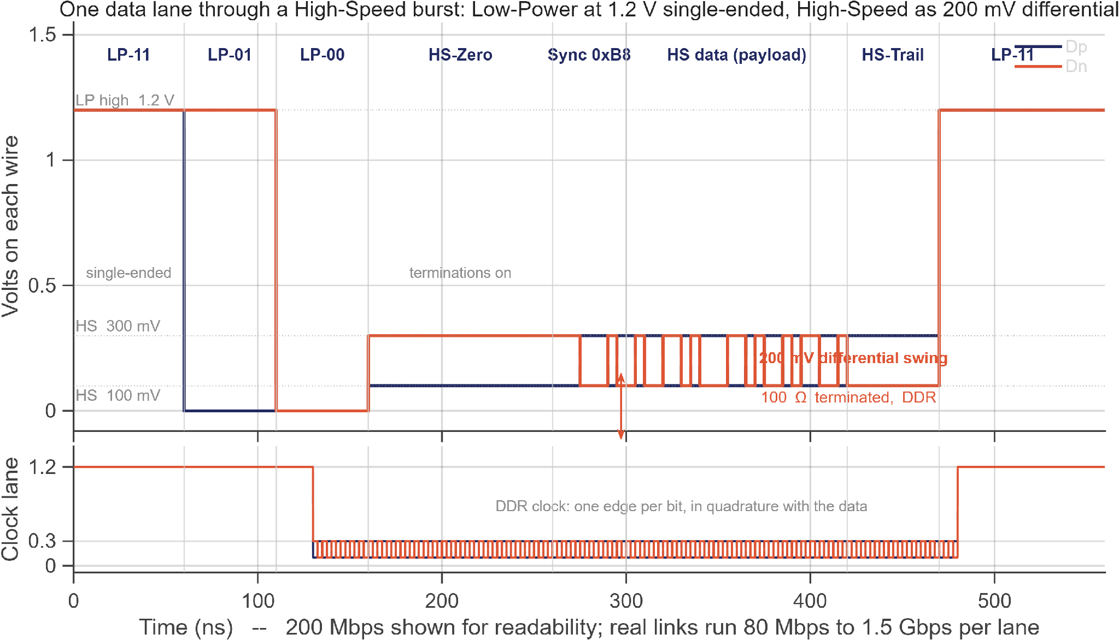
How the D-PHY works electrically
Low-Power mode
Single-ended: each wire swings 0 to 1.2 V
Slow, about 10 Mbps -- used for idle (LP-11), to request a burst (LP-01, LP-00), and for control
No termination; the receiver is high-impedance
High-Speed mode
Differential and small: wires at about 100 and 300 mV -- a 200 mV swing around a 200 mV common mode
100 ohm termination switched in at the receiver
80 Mbps to 1.5 Gbps per lane; DDR, one bit per clock edge
Clock lane runs in quadrature with the data lanes
A burst: LP-11 -> LP-01 -> LP-00 -> HS-Zero -> sync byte 0xB8 -> data -> HS-Trail -> LP-11. The receiver waits out a settle time after LP-00, then hunts for the sync byte. Every packet -- Frame Start, pixel lines, Frame End -- travels inside one of these bursts, and the lanes drop back to Low-Power in between.
4
Notes:
Before the protocol, the wire. This is one data lane through a complete burst, and the clock lane underneath.
The D-PHY has two modes on the same two wires.
Low-Power mode is single-ended. Each wire swings between zero and 1.2 volts, like ordinary logic. It is slow — about ten megabits — and it is used for idle, which is both wires high, LP-11; for requesting a burst, which is the sequence LP-01 then LP-00 you see here; and for control signalling. No termination; the receiver is high-impedance.
High-Speed mode is differential and small. The two wires sit at about 100 and 300 millivolts — a 200-millivolt swing around a 200-millivolt common mode — with a 100-ohm termination switched in at the receiver. That is where the data goes: 80 megabits up to one and a half gigabits per lane, double data rate, one bit on every clock edge. The clock lane runs in quadrature with the data.
So a burst looks like this: LP-11, LP-01, LP-00, then High-Speed zero while the terminations settle, then the sync byte 0xB8, then the data, a trail bit, and back to LP-11. The receiver waits out a settle time after LP-00 and then hunts for the sync byte.
Every packet — Frame Start, each pixel line, Frame End — travels inside one of these bursts, and between packets the lanes drop back to Low-Power. Keep that picture; the next slide is what the bridge does with it.

Slide 4
The idea: gate the source, buffer the frame
MCU
SPI master
Bridge
frame buffer + control
Camera
CSI-2 source, gated
1 CAPTURE_REQ
2 CAM_TRIG
frame buffer
holds one whole frame
filled at lane rate,
drained at SPI rate,
never both at once
4 FRAME_READY (interrupt)
3 one frame bursts in at lane rate
5 SPI drain: any clock, any chunk
6 buffer released, re-arm
No real-time requirement on the MCU at all.
The cost moves from bandwidth to memory.
It can read 256 bytes, go service another interrupt for 10 ms, and come back. The camera cannot start a new frame until the last one has been fully read.
The buffer must hold an entire frame -- that is the resource this design spends.
3
Notes:
Here is the design in one picture.
The microcontroller asks for a frame. It pulses one pin, CAPTURE_REQ. The bridge relays that to the camera as a trigger. The camera bursts exactly one frame at full lane rate into the frame buffer. When the frame is complete, the bridge raises FRAME_READY — an interrupt to the microcontroller.
Now the microcontroller reads the frame over SPI. At any clock it likes. In any chunk size it likes. It can read 256 bytes, go and service another interrupt for ten milliseconds, and come back. Nothing is lost, because the camera cannot start a new frame until this one has been fully read out.
When the last byte leaves, FRAME_READY drops and the bridge re-arms.
Because the camera is gated between frames, the average input rate is whatever the SPI drain allows. Nothing overflows. And — this is the point I want you to remember — there is no real-time requirement on the microcontroller firmware at all.
The cost moves from bandwidth to memory. The buffer has to hold a whole frame. That is the resource this design spends, and later I will show you exactly how that trade-off looks.

Slide 5
working principal
CS is not the frame delimiter
Bad frames are never advertised
The MCU owns CS and will split a frame into chunks sized to its DMA buffer. The read pointer persists across CS deassertion and resets only when the whole frame has been read.
Uncorrectable header ECC, payload CRC mismatch, or wrong byte count aborts the frame: FRAME_READY stays low and a sticky error bit is set. The MCU only ever sees complete, verified frames.
Reading early returns 0x00
Before FRAME_READY, or past the end of a frame, MISO returns zeros and the pointer does not move. Defined behaviour, never garbage.
6
Notes:
Four decisions make the microcontroller side trivial. I call them the protocol contract.
First: chip select is not the frame delimiter. The microcontroller owns chip select, and it will split a frame into chunks that fit its DMA buffer. So the read pointer persists across chip select, and only resets when the whole frame has been read.
Second: bad frames are never advertised. If the header ECC is uncorrectable, or the payload CRC fails, or the byte count is wrong, the frame is aborted. FRAME_READY stays low and a sticky error bit is set. The microcontroller only ever sees complete, verified frames. Firmware never has to validate anything.
Third: reading early returns zeros. Before FRAME_READY, or past the end of a frame, MISO returns zero and the pointer does not move. Defined behaviour, never garbage.
Fourth: the frame size is a compile-time constant known to both ends. Zero protocol overhead. If you ever want runtime discovery, a four-byte header read is a trivial addition.
The state machine at the top is the whole capture lifecycle: IDLE, ARMED on a request, FILL from Frame Start, READY after Frame End when all checks pass, and back to IDLE when the last byte is read.

Slide 6
Simulation methodology
CSI-2 transmitter model
SPI master model
Byte-exact checker
width, height, pixel format
1 / 2 / 4 lanes, selectable at run time
lane rate 200-800 Mbps
per-lane launch skew
sensor blanking (VTS) and frame rate
gated by CAM_TRIG, like a real sensor
mode 0, MCU is master
any clock: swept 1-50 MHz
arbitrary chunk sizes, CS toggling mid-frame
reads until the frame is complete
compares every received byte to what the camera sent
counts ECC / CRC / size / skew errors
measures fill time, drain time, cycle, frames per second
one binary covers the whole lane matrix
Sweeps
confirm
matrix
resolutions
clock, skew, blanking
12 runs: RAW8/10/12 x 1/2/4 lanes x 640/800/960-px lines
180 runs: 64x48 to 1280x720, 3 formats, 3 lane counts, 4 rates
64x48 -> 1280x720, all formats, full capture cycle
SPI 1-50 MHz; lane skew 0-192 bits; sensor VTS 528-960 lines
8
Notes:
Now, how I measured all this.
Three pieces. A parametric CSI-2 transmitter model: width, height, pixel format, one to four lanes selectable at run time, lane rate from 200 to 800 megabits, per-lane launch skew, and sensor blanking. An SPI master model that behaves like real firmware: any clock, arbitrary chunk sizes, chip select toggling in the middle of a frame. And a byte-exact checker that compares every received byte to what the camera sent, counts every error type, and measures fill time, drain time, cycle time and frames per second.
Then the sweeps. Twelve confirm runs across formats, lane counts and line lengths. A matrix of 180 runs from 64 by 48 up to 1280 by 720, three formats, three lane counts, four rates. A resolution sweep. An SPI clock sweep from 1 to 50 megahertz. Lane skew. Sensor blanking.
192 configurations in total.

Slide 7
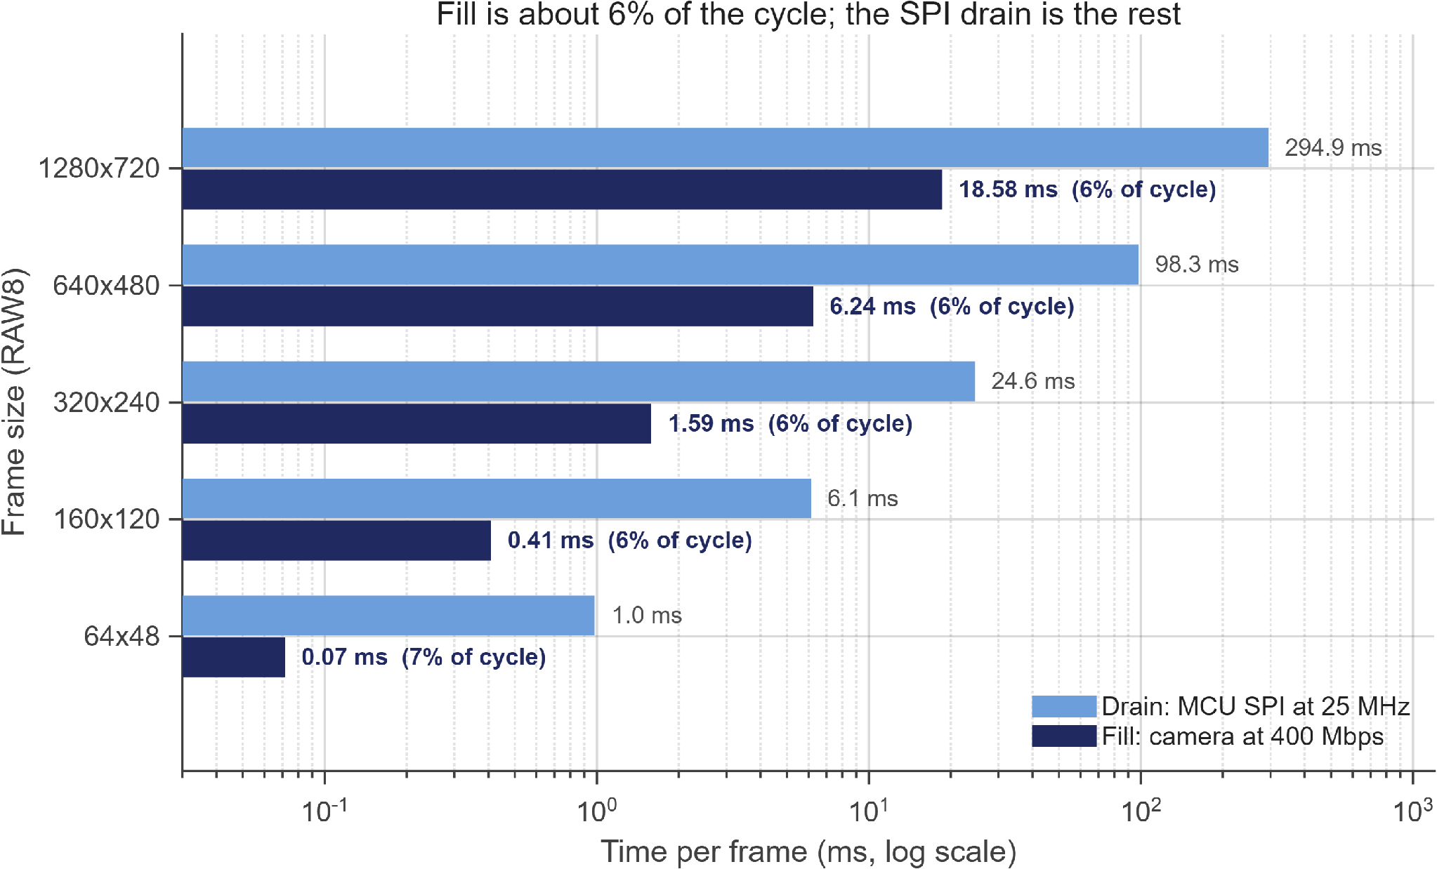
Result: fill is about 6% of the cycle
~ 6 %
of each cycle is camera fill; the SPI drain is the other 94%
Fill at 400 Mbps vs drain at 25 MHz SPI, RAW8. Log scale; both axes are measured in simulation.
Notes:
This chart decides the buffer architecture.
For five frame sizes, from 64 by 48 up to 1280 by 720, the dark bar is the camera filling the buffer at 400 megabits, and the light bar is the microcontroller draining it at 25 megahertz. Log scale.
Fill is six to seven percent of the cycle. Every size. The drain is the other 94 percent.
That asymmetry answers a question people always ask: why not a ping-pong double buffer? Because double-buffering could only overlap fill with drain — and fill is six percent. You would pay twice the memory for six percent more throughput. Single buffer. The measurement settles it.
The small chart on the right is a side experiment. If the sensor free-runs at 30 frames per second instead of being triggered, fill time follows the sensor's own frame timing — it is just the fraction of active lines times the frame period, not the lane rate. The six percent is the triggered case, which is the design point.

Slide 8
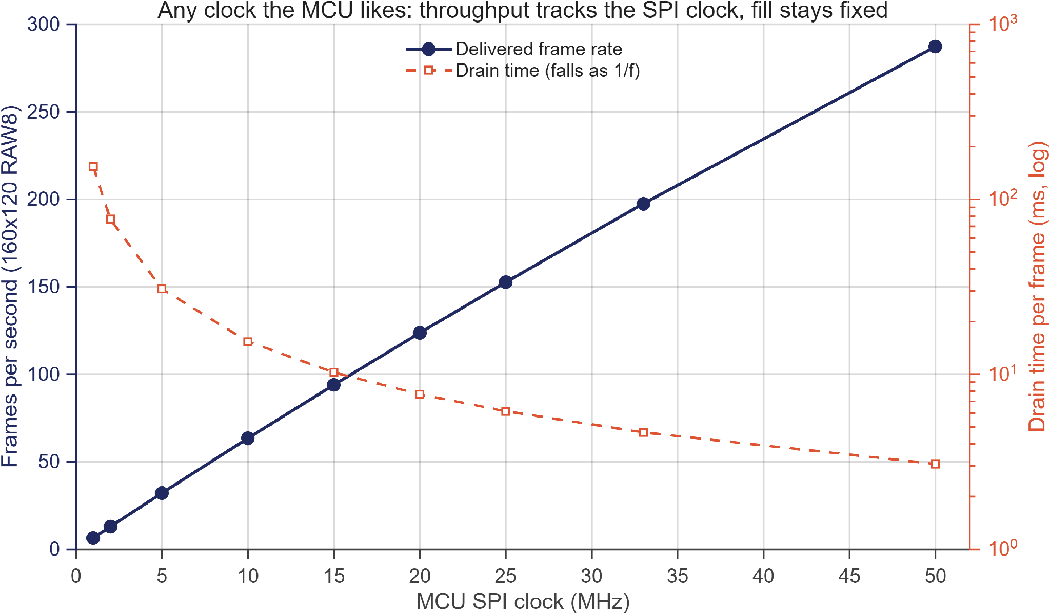
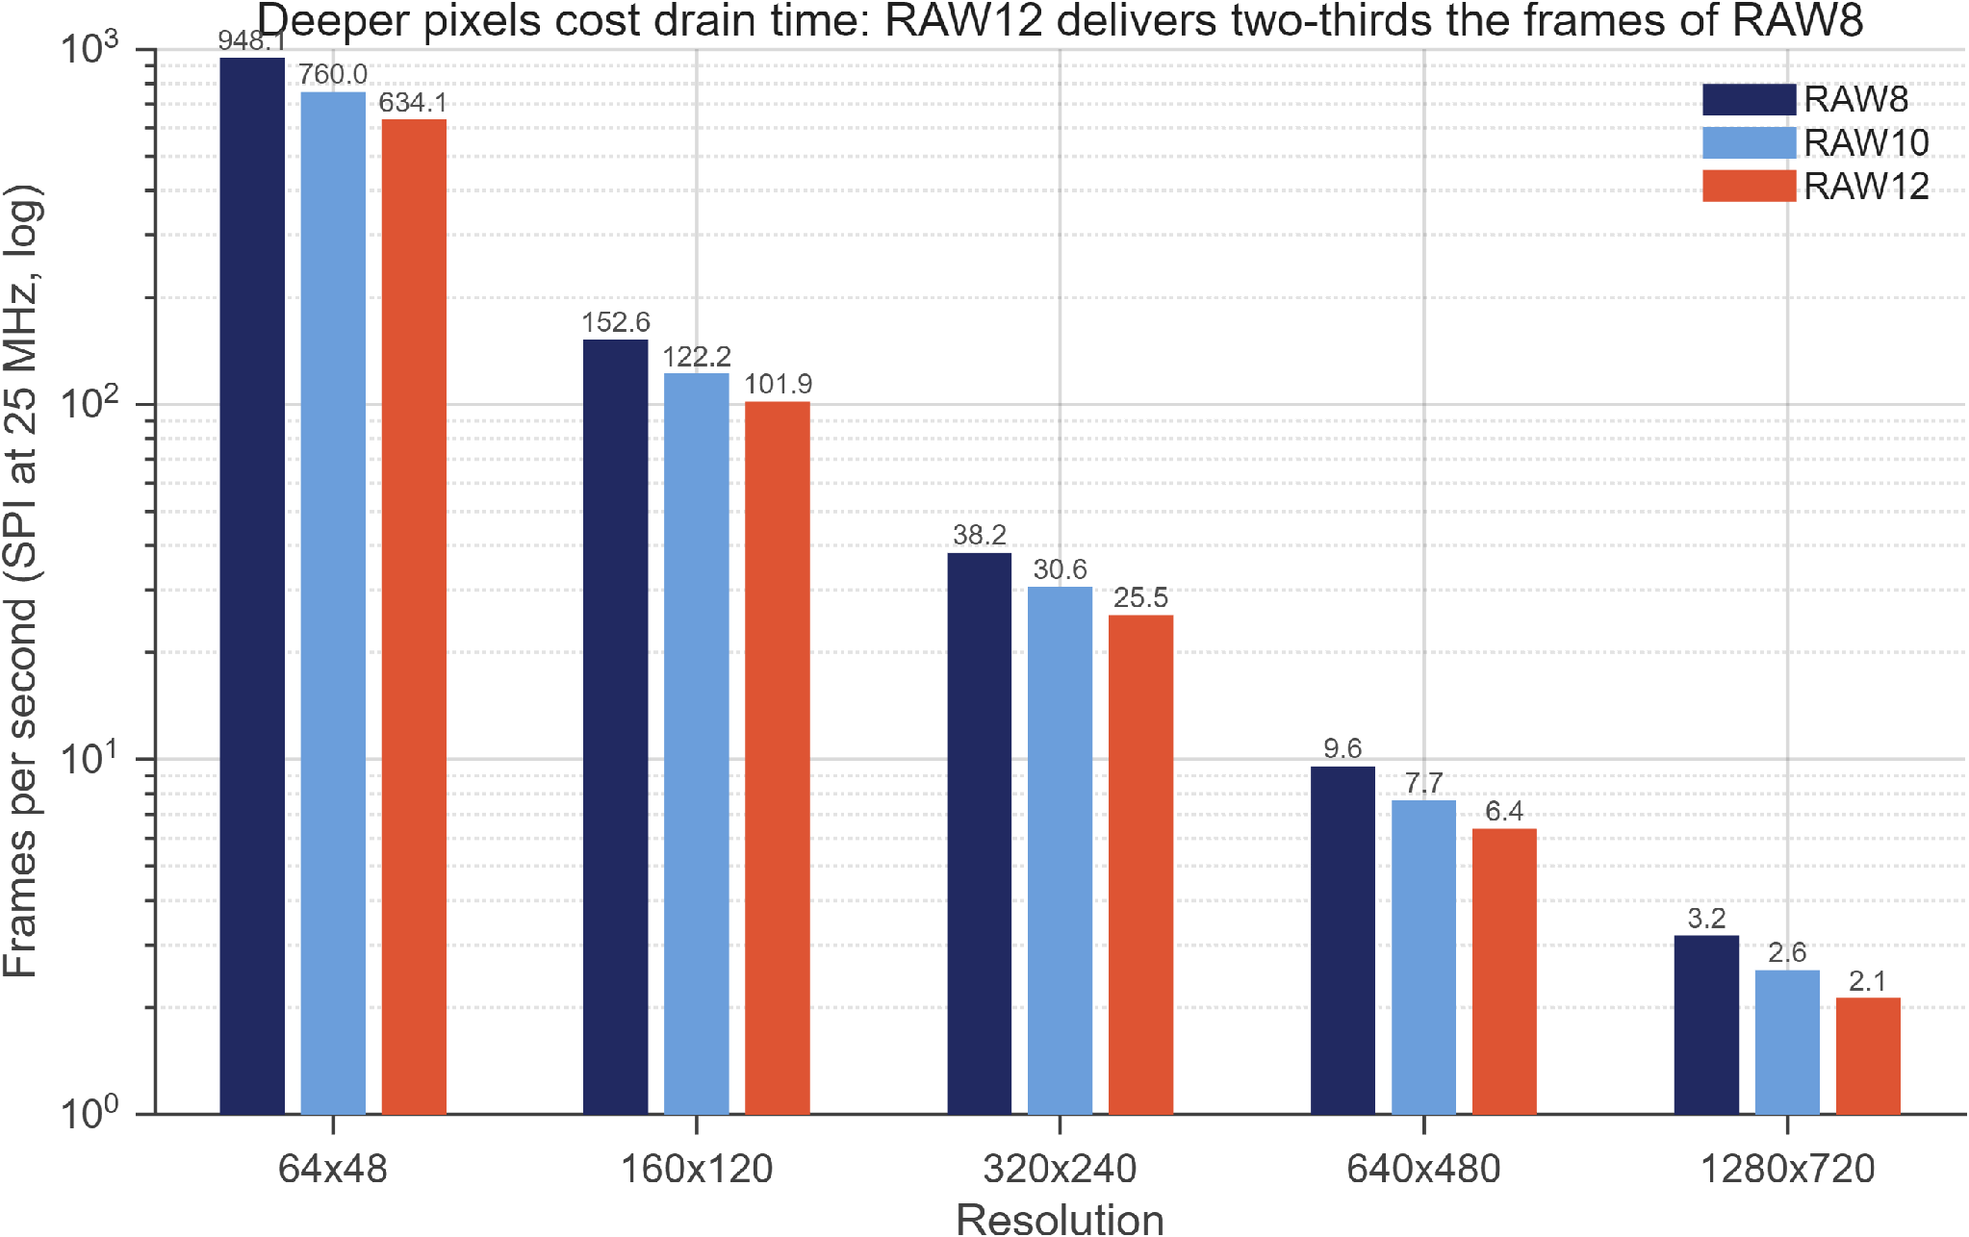
Result: throughput
160x120 RAW8. Fill is fixed by the camera; drain falls as 1/f, so frames per second track the SPI clock: 6.5 at 1 MHz, ~150 at 25 MHz, ~290 at 50 MHz.
SPI at 25 MHz. Bytes per frame set the drain, so RAW10 and RAW12 cost frames in proportion: RAW12 delivers about two-thirds the rate of RAW8.
The MCU's clock is the throughput knob, and it is the only one. Resolution and pixel depth set bytes per frame; the SPI clock sets how fast they leave. Nothing on the camera side is in the loop.
11
Notes:
Two charts on throughput.
On the left, I sweep the microcontroller's SPI clock from 1 to 50 megahertz on a 160 by 120 frame. Fill is fixed by the camera. Drain falls as one over f. So the delivered frame rate tracks the SPI clock almost linearly: six and a half frames per second at 1 megahertz, about 150 at 25, about 290 at 50.
On the right, at a fixed 25 megahertz, I compare pixel formats. Bytes per frame set the drain, so deeper formats cost frames in proportion: RAW12 delivers about two-thirds the frame rate of RAW8.
The message: the microcontroller's clock is the throughput knob, and it is the only one. Resolution and pixel depth set how many bytes there are; the SPI clock sets how fast they leave. Nothing on the camera side is in the loop.

Slide 9
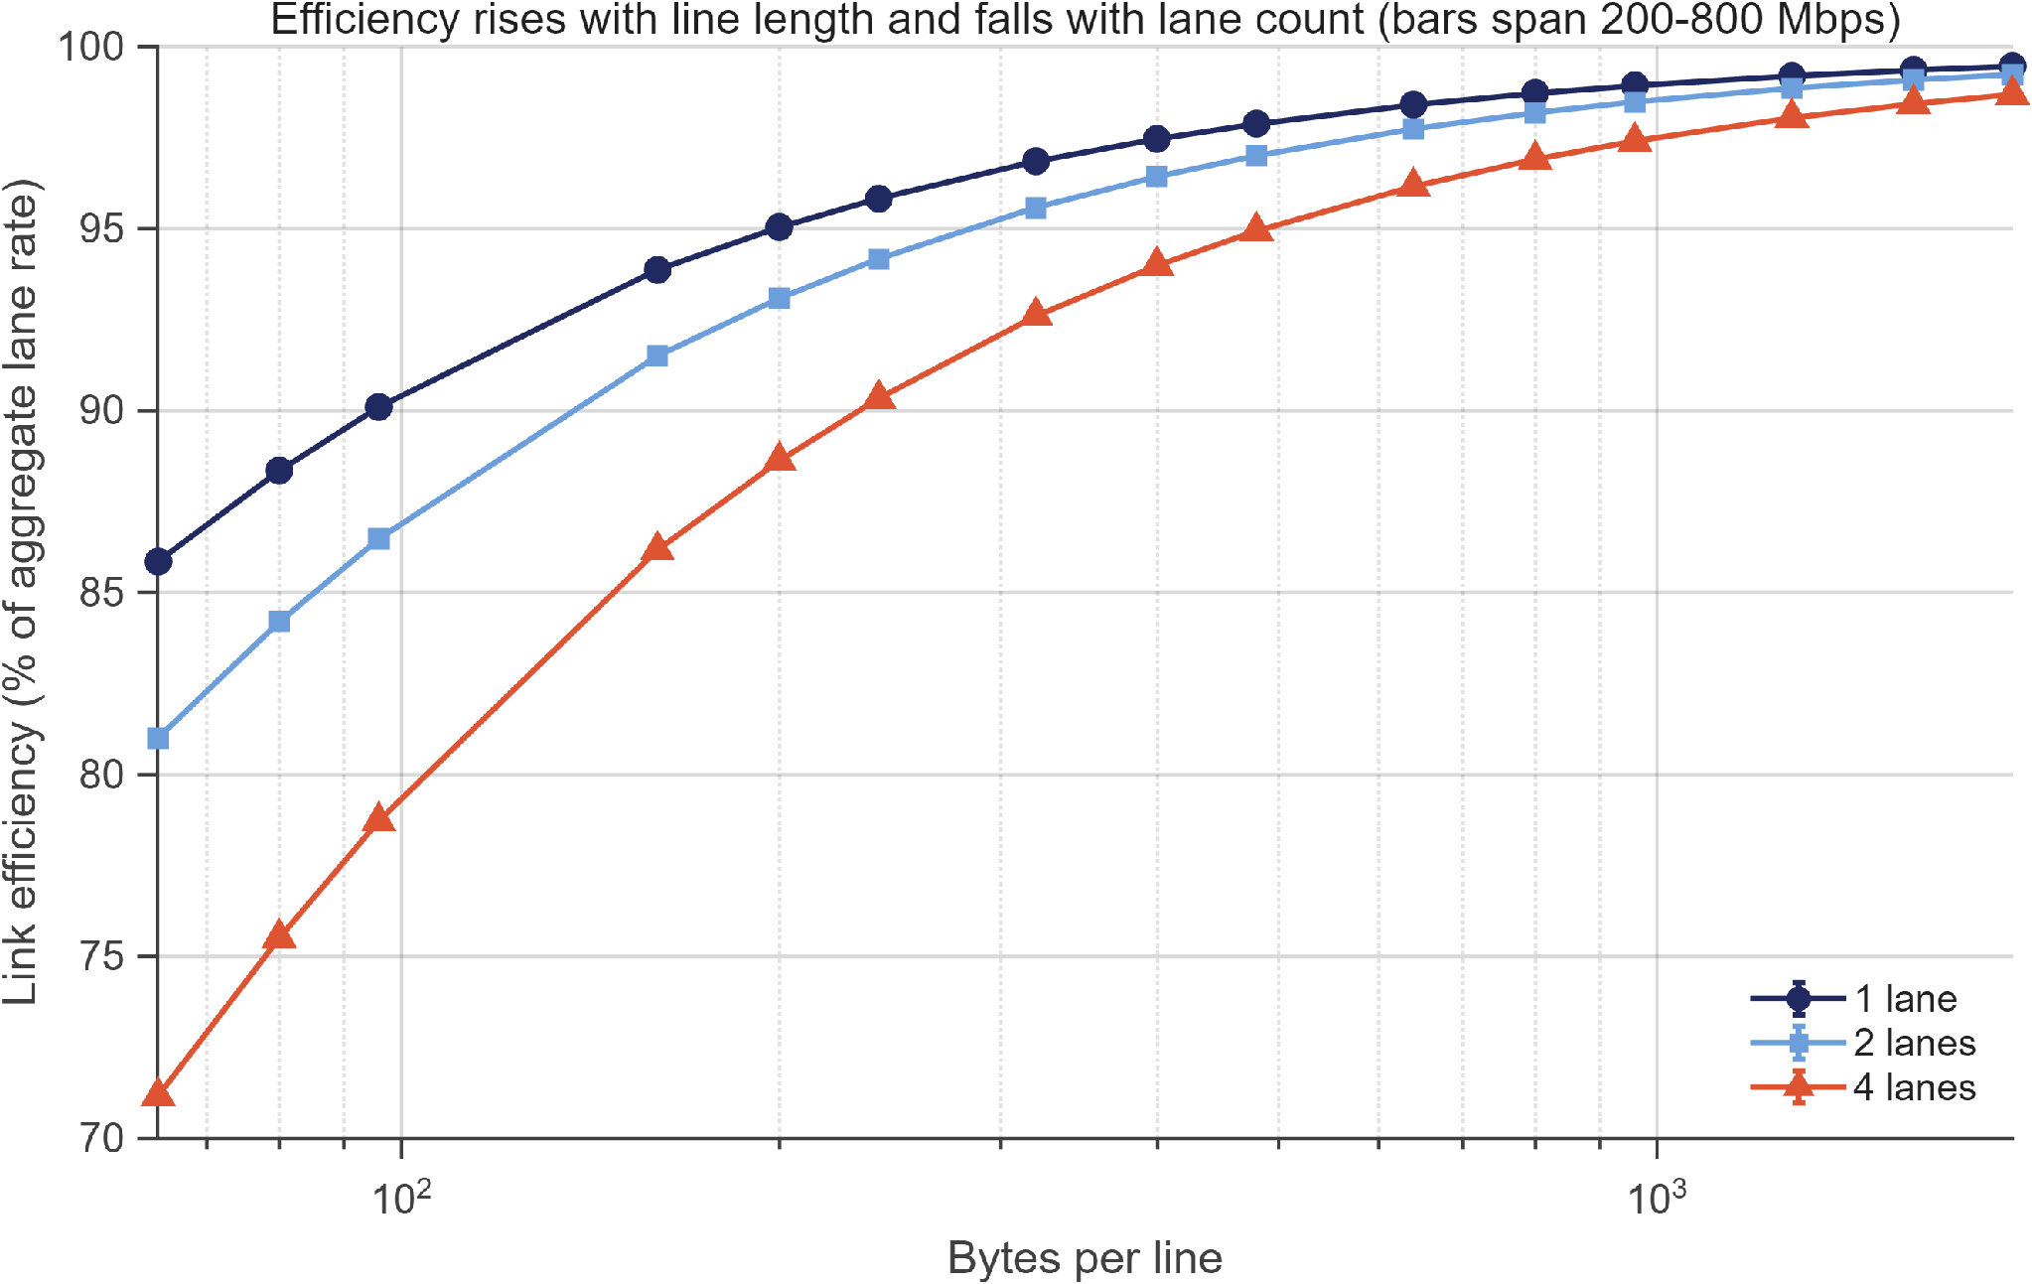
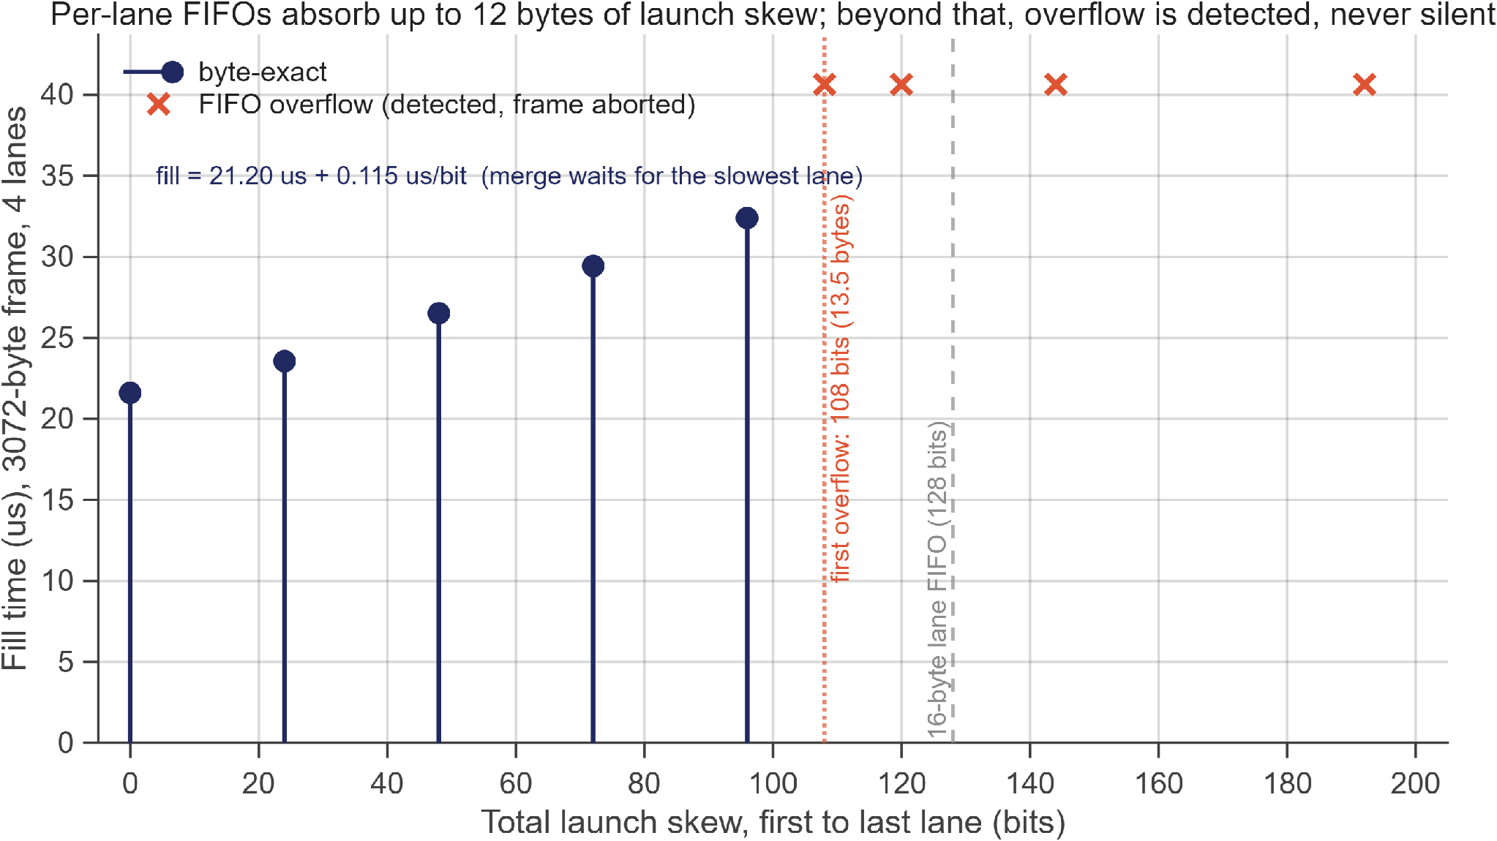
Result: lanes and skew
Link efficiency vs bytes per line. Each point averages 200/400/600/800 Mbps; the error bars are that spread -- efficiency is rate-independent. Every lane pays its own HS entry and sync, so more lanes on a short line cost more.
4 lanes, lane k launched k x skew late. Per-lane 16-byte FIFOs keep the merge byte-exact up to 96 bits (12 bytes) of total skew; from 108 bits the overflow is detected and the frame aborted. Fill grows 0.115 us per bit as the merge waits for the slowest lane.
Efficiency depends on line length and lane count, not on line rate. Skew is absorbed up to the FIFO depth, and beyond it fails loudly, never silently.
12
Notes:
Two results about the multi-lane receiver.
On the left, link efficiency — the fraction of the aggregate lane rate that arrives as pixels — against bytes per line, for one, two and four lanes. Efficiency rises with line length and falls with lane count. Four lanes on a 64-byte line: 71 percent. Any lane count on a 1600-byte line: over 99 percent. Every lane pays its own high-speed entry and sync overhead, so more lanes on a short line cost more.
Each point averages the 200, 400, 600 and 800 megabit runs, and the error bars are that spread. They are tiny. Efficiency is independent of rate, because the overhead is a fixed number of bytes per lane per burst.
On the right, launch skew between lanes. Four lanes, lane k launched k times the skew late. The per-lane 16-byte FIFOs keep the merge byte-exact up to 96 bits — 12 bytes — of total skew. From 108 bits, the FIFO overflows. And this is the important part: the overflow is detected and the frame is aborted. It never produces a silently corrupted frame. Fill time grows about 0.1 microseconds per bit of skew, because the merge waits for the slowest lane.

Slide 10
Hardware confirmation
Captured through the full chain: OV5640 -> 2-lane D-PHY -> Zynq PL -> BRAM -> SPI -> STM32 -> USB -> host. 1920 x 39: the top 39 of 1080 lines, which is what a 96 KB buffer holds of a 2.6 MB frame. Reconstructed on the host, horizontal correlation +0.979.
Zybo Z7-10 · Pcam 5C · STM32F446
2 lanes · 210 Mbps per lane
24 of 60 BRAM tiles
Xilinx XC7Z010, OV5640 sensor, Nucleo-F446RE
RAW10, 1080p at 15 fps, data type 0x2B
96 KB frame buffer; the same store-and-forward RTL
The simulated design runs on silicon.
The sensor is configured over I2C from the microcontroller through a bidirectional repeater in the FPGA fabric, because the Pcam's I2C pins terminate on the PL.
14
Notes:
One slide on hardware.
This is a Zybo Z7-10 with a Pcam 5C camera and an STM32F446 microcontroller. Two lanes at 210 megabits per lane, RAW10, 1080p at 15 frames per second. The frame buffer is 96 kilobytes — 24 of the chip's 60 block RAM tiles — so the capture is the top 39 lines of a 1080-line frame.
The image is a real capture through the complete chain: sensor, D-PHY, FPGA, block RAM, SPI, microcontroller, USB, host. Reconstructed on the host with a horizontal correlation of 0.979.
The point of this slide is one sentence: the simulated design runs on silicon.

Slide 11
Thank you
Future work
Questions?
Giorgi Kharatishvili
Notes:
Future work, briefly.
A runtime frame-size header, for sensors that change mode. Partial-frame windows for sensors larger than the buffer, so the captured region is chosen rather than just the top. A larger buffer where the FPGA allows it — though the drain fraction says double-buffering is still not the lever. A testbench where buffer size and source size are independent parameters. And extending the skew study from launch skew to per-lane rate mismatch.
Thank you. I am happy to take questions.

