Slide 1

Neural Network data transfer in embedded environment
08.09.2026 | Giorgi jgharkava, Chimezie eguzo

Slide 2
CONTENT
Background/aim
State of the art
Method
DMA setup
Data flow
Devmem
AXI DMA Driver
Technical challenges
Measurements
Final version

Slide 3
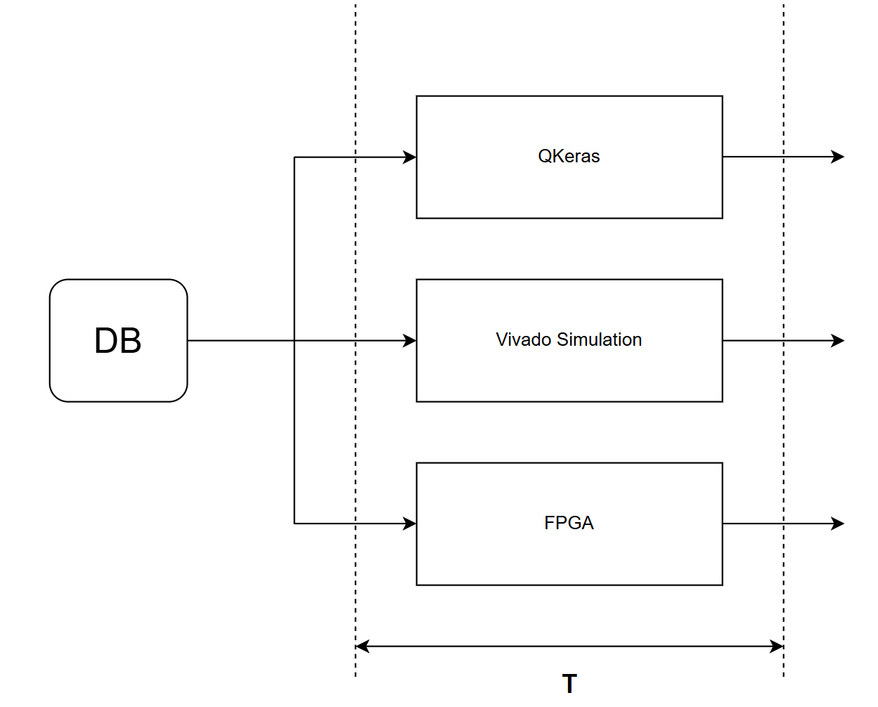
background
Data
NN Classification
FPGA Involvement
Qkeras
  Toolkit for creating quantized NN
Vivado
  Simulation
FPGA
  Testbed

Slide 4
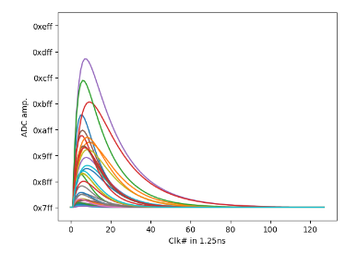
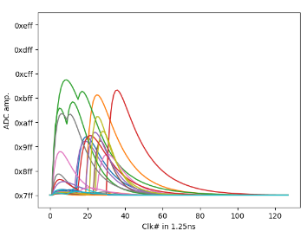
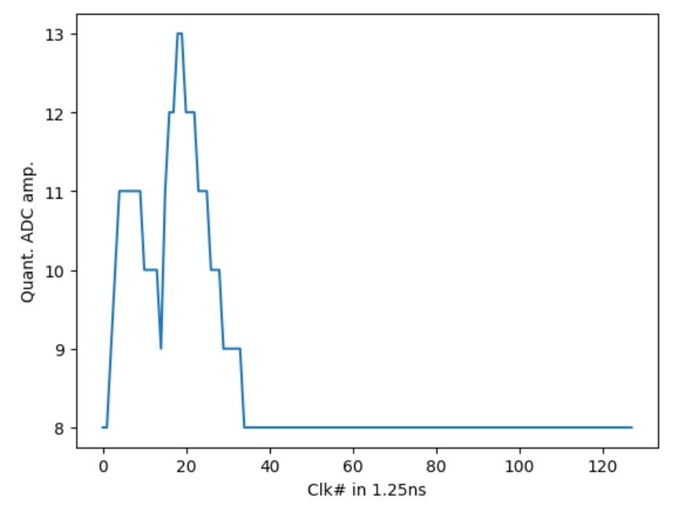
data
Typical “good” SiPM signal
Signal parameters:
  128 samples
  12-bit resolution
Ready to proceed to NN
Aim – optimize information transfer
Double SiPM signal/Double SiPM empiric signal

Slide 5
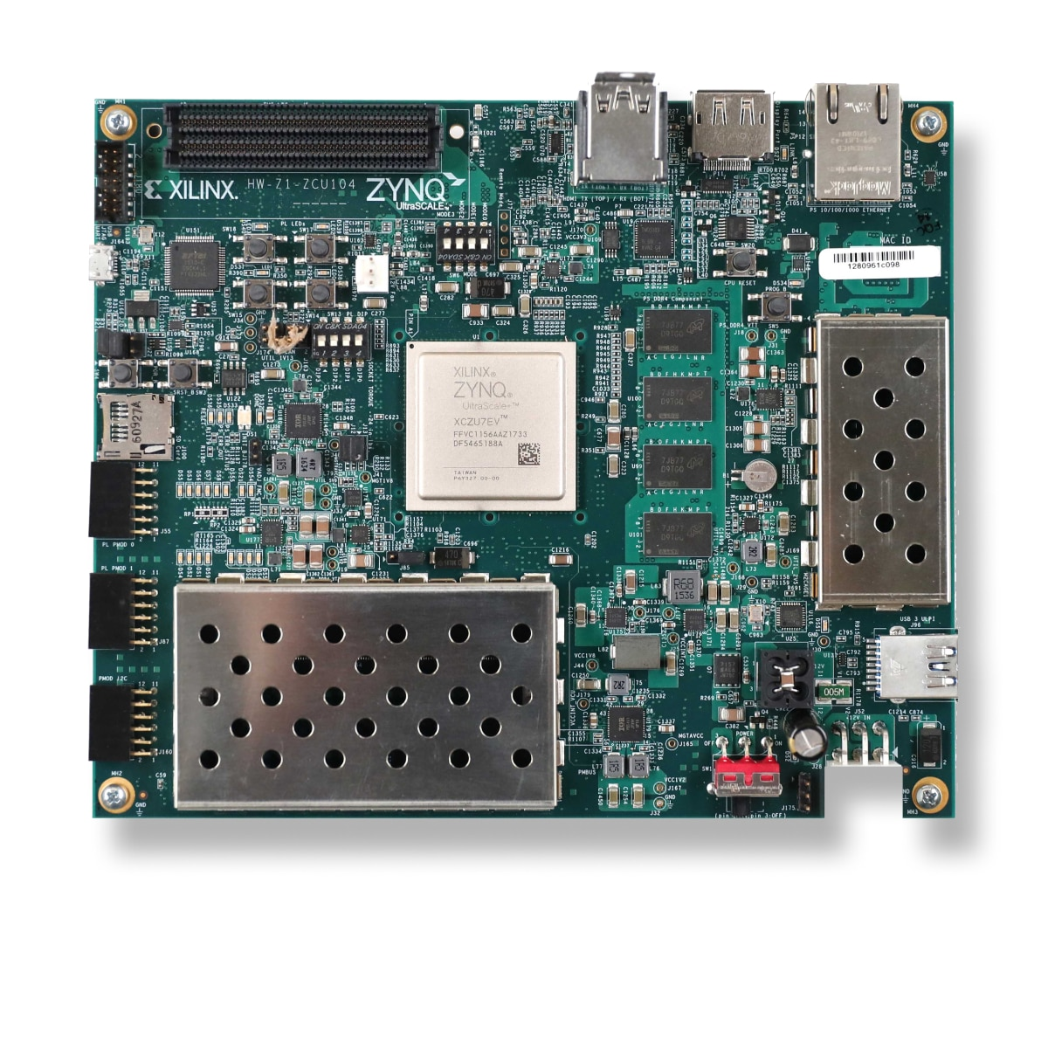
board
ZCU104
ARM Processor + FPGA Programmable Logic
Embedded Linux
FPGA acceleration
High-speed interfaces
Hardware/Software co-design
Great two-in-one environment for design and testing, with substantial resources

Slide 6
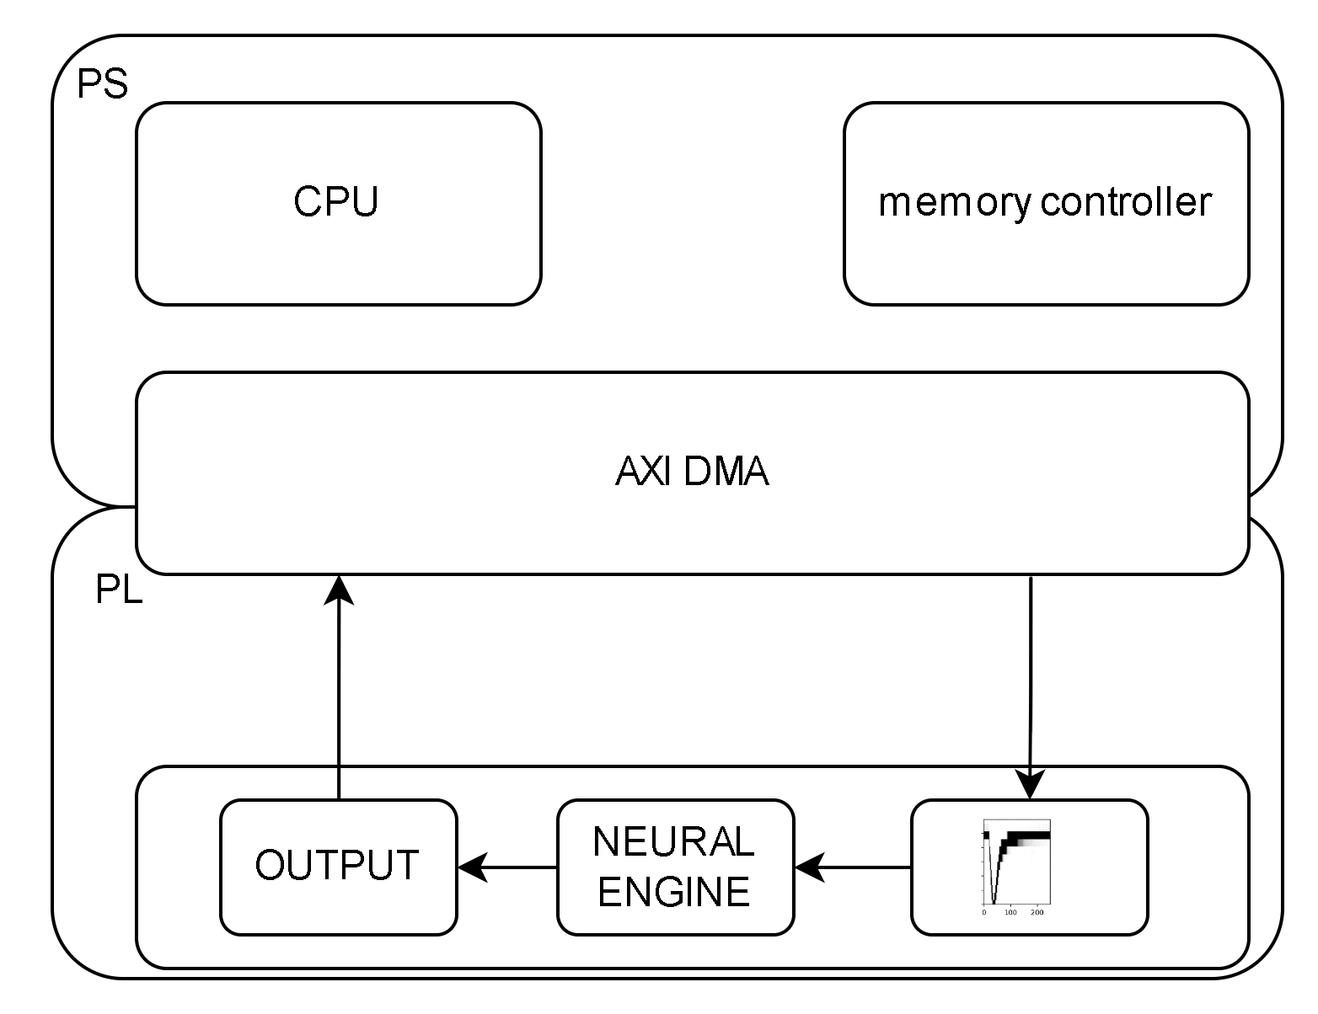
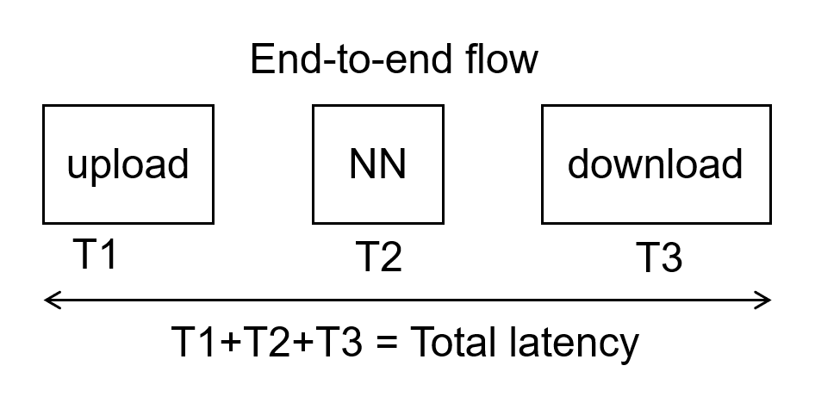
AIM
Dataflow outline on FPGA
End-to-end PS–PL dataflow design
FPGA as testbed
Dataflow design outline
Main concepts
  PL side
  PS side
  AXI DMA
  NN delay
SiPM
  Note: NN design isn’t scope of the thesis

Slide 7
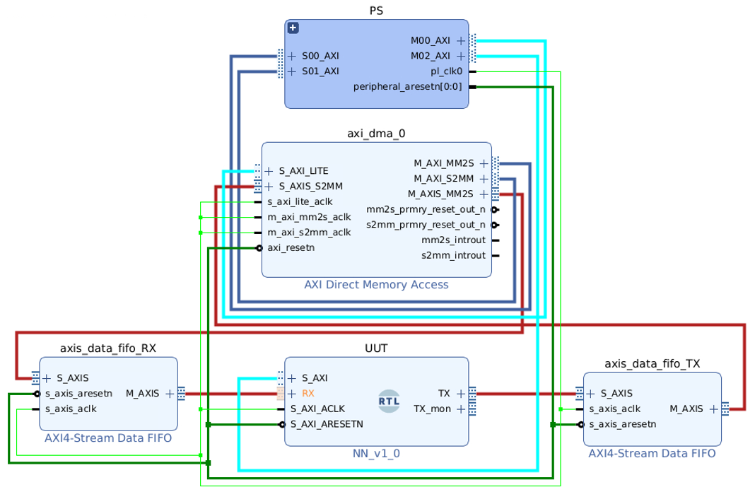
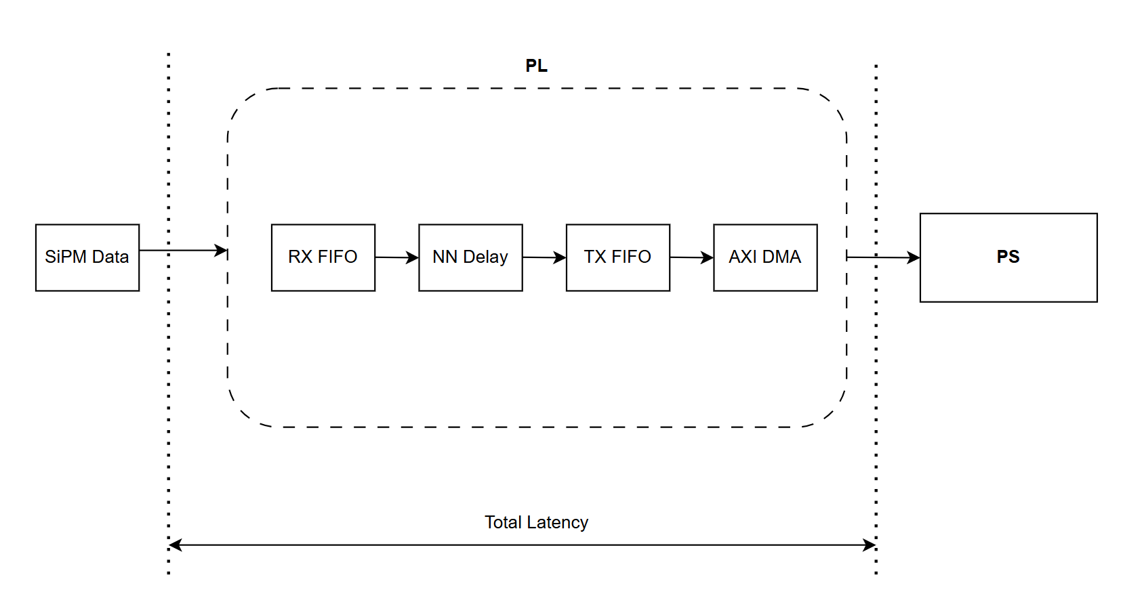
method

Slide 8
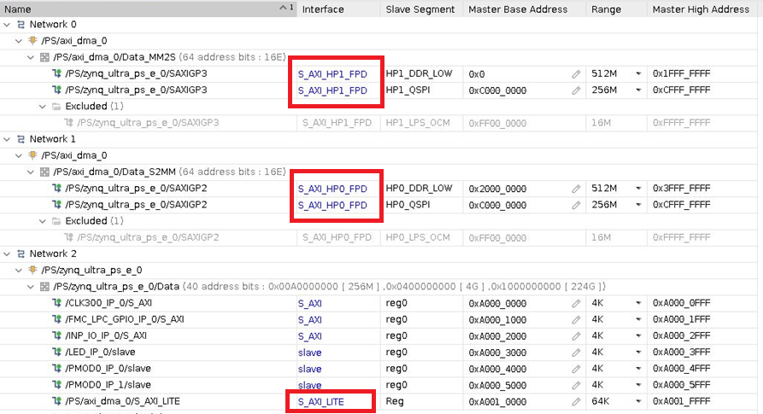
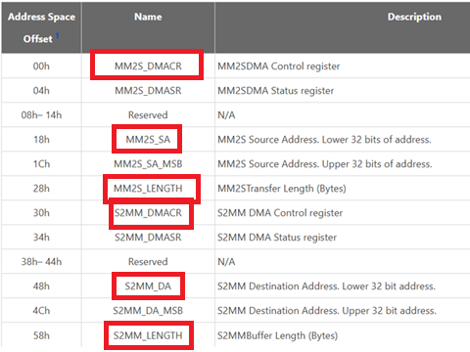
Dma setup
Direct Register Mode
Bits to observe
Addresses

Slide 9
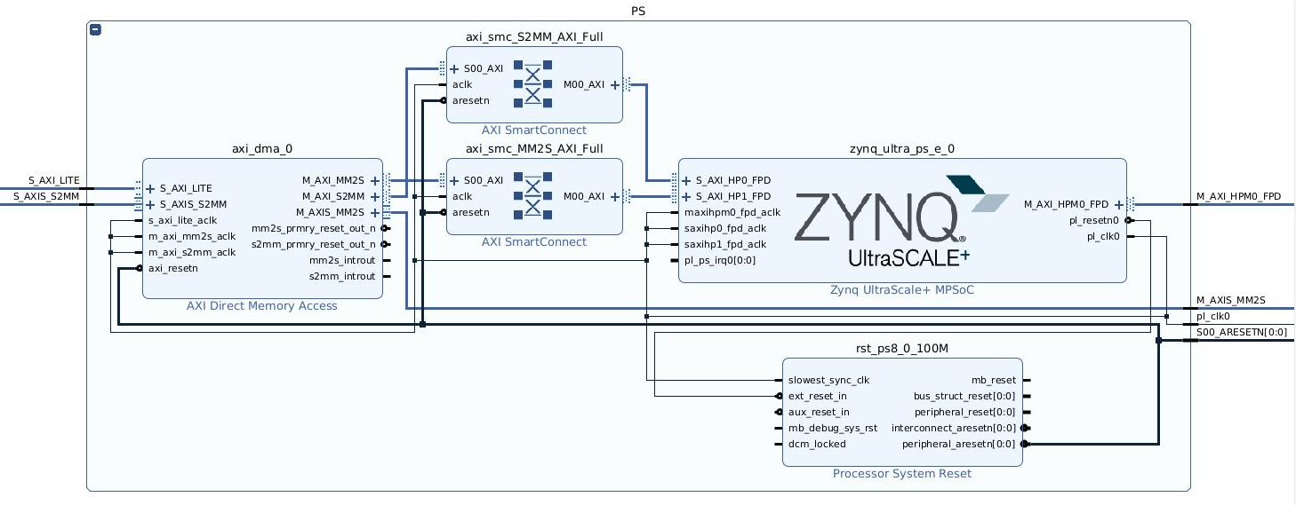
PS side
DMA data = Axi-stream handled in PL

Slide 10
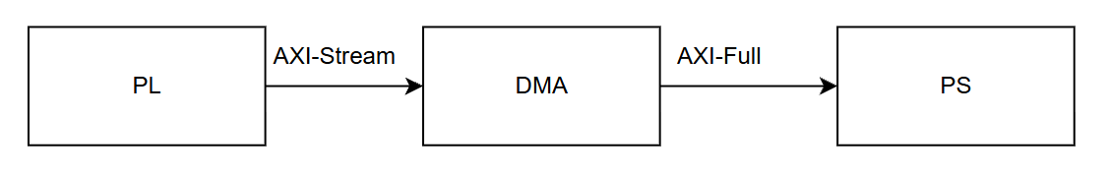
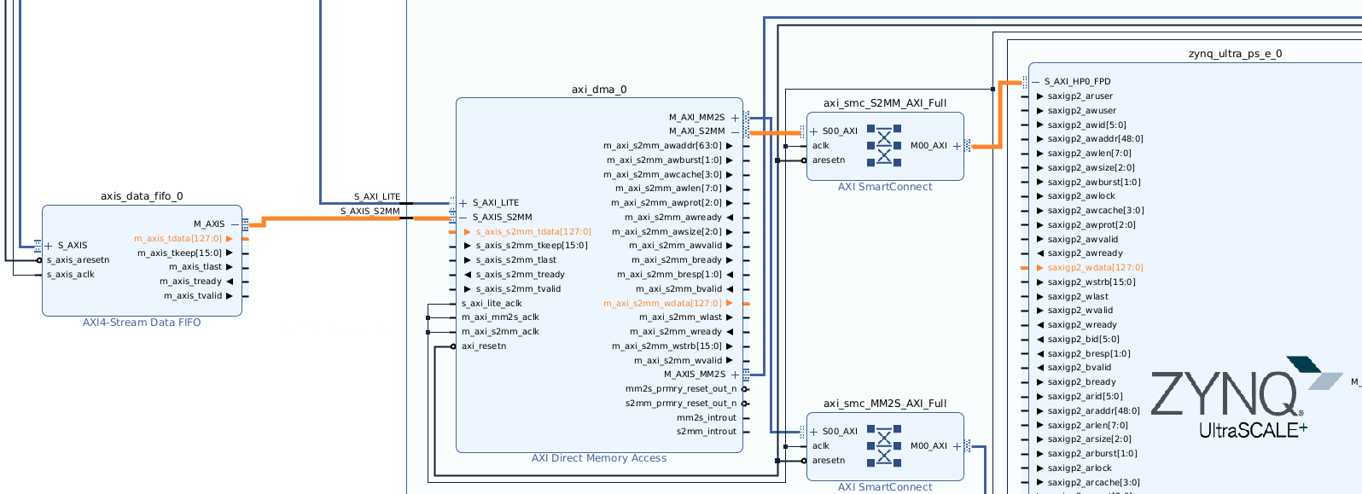
S2MM
S2MM – takes care of streaming data from peripheral and writing it directly to the PS

Slide 11
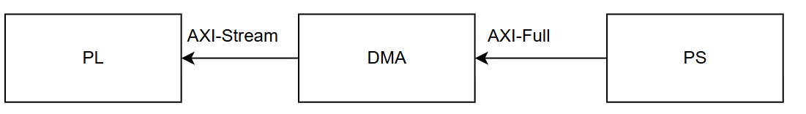
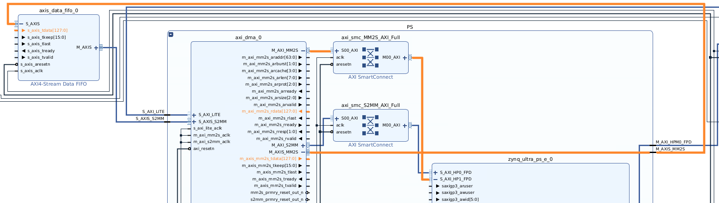
mm2s
MM2S – takes care of reading from system and sending to peripheral

Slide 12
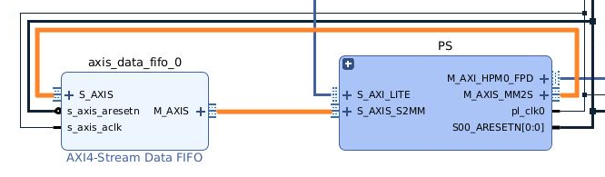
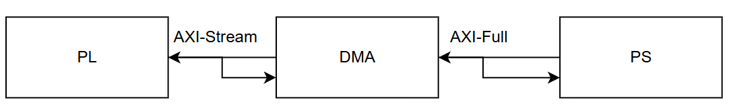
Data-Ps
Overview
Loopback

Slide 13
minimal DEVMEM test
amd-edf:~$ sudo su
Password:
amd-edf:/home/amd-edf# cd
amd-edf:~# devmem2 0xAF000018
/dev/mem opened.
Memory mapped at address 0xffffbe372000.
Read at address 0xAF000018 (0xffffbe372018): 0x00000010
amd-edf:~# devmem2 0xAF000018 w 0x1000
/dev/mem opened.
Memory mapped at address 0xffff96eb6000.
Read at address 0xAF000018 (0xffff96eb6018): 0x00000010
Write at address 0xAF000018 (0xffff96eb6018): 0x00001000, readback 0x00001000
amd-edf:~# devmem2 0xAF000018
/dev/mem opened.
Memory mapped at address 0xffffa9c18000.
Read at address 0xAF000018 (0xffffa9c18018): 0x00001000

Slide 14
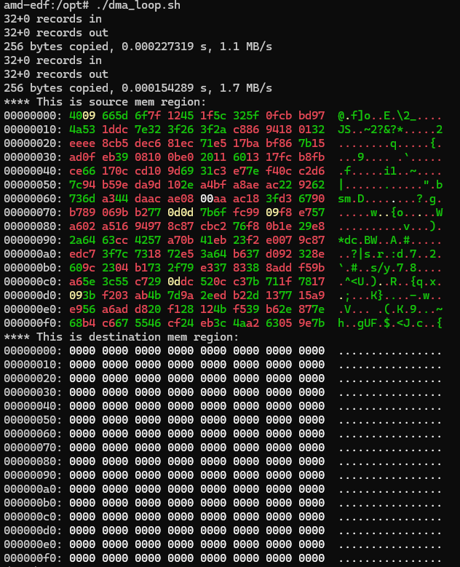
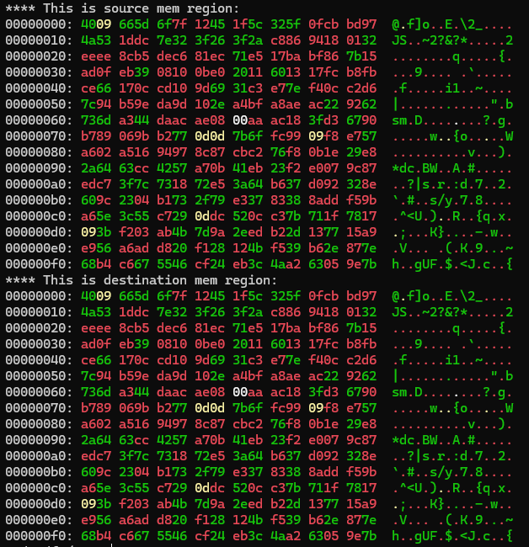
DMA PS-pL-PS demo
Read at address 0xAF000030 0x00010003
Write at address 0xAF000030 0x00000001, readback 0x00000001
Read at address 0xAF000048 0x20000000
Write at address 0xAF000048 0x20000000, readback 0x20000000
Read at address 0xAF000058 0x00000100
Write at address 0xAF000058 0x00000100, readback 0x00000100
Read at address 0xAF000000 0x00010003
Write at address 0xAF000000 0x00000001, readback 0x00000001
Read at address 0xAF000018 0x10000000
Write at address 0xAF000018 0x10000000, readback 0x10000000
Read at address 0xAF000028 0x00000100
Write at address 0xAF000028 0x00000100, readback 0x00000100
# DMA_CTRL start S2MM
devmem2 $((DMA_BASE+0x30)) w $((0x1))
# DMA_DA S2MM
devmem2 $((DMA_BASE+0x48)) w $((S2MMOFFSET))
# DMA_Length S2MM
devmem2 $((DMA_BASE+0x58)) w $((DDRSIZE))
# DMA_CTRL start MM2S
devmem2 $((DMA_BASE+0x00)) w $((0x1))
# DMA_SA MM2S
devmem2 $((DMA_BASE+0x18)) w $((MM2SOFFSET))
# DMA_Length MM2S
devmem2 $((DMA_BASE+0x28)) w $((DDRSIZE))
Mem before … … and after

Slide 15
dma_loop.sh listing
amd-edf:/opt# cat dma_loop.sh
#!/bin/bash
DMA_BASE=0xAF000000
# SUM Sample = 32bit
MM2SOFFSET=0x10000000
S2MMOFFSET=0x20000000
DDRSIZE=0x00000100
DMALENGTH=$((DDRSIZE )) # in bytes
# Prefill RAM source
dd if=/dev/random of=/dev/mem bs=8 seek=$((MM2SOFFSET/8)) count=$((DDRSIZE/8))
# Clear RAM target
dd if=/dev/zero of=/dev/mem bs=8 seek=$((S2MMOFFSET/8)) count=$((DDRSIZE/8))
function print_mem() {
echo "**** This is source mem region:"
dd if=/dev/mem of=/dev/stdout skip=$((MM2SOFFSET/8)) bs=8 count=$((DDRSIZE/8)) status=none | xxd
echo "**** This is destination mem region:"
dd if=/dev/mem of=/dev/stdout skip=$((S2MMOFFSET/8)) bs=8 count=$((DDRSIZE/8)) status=none | xxd
}
print_mem # before...
# DMA_CTRL start S2MM
devmem2 $((DMA_BASE+0x30)) w $((0x1))
# DMA_DA S2MM
devmem2 $((DMA_BASE+0x48)) w $((S2MMOFFSET))
# DMA_Length S2MM
devmem2 $((DMA_BASE+0x58)) w $((DDRSIZE))
# DMA_CTRL start MM2S
devmem2 $((DMA_BASE+0x00)) w $((0x1))
# DMA_SA MM2S
devmem2 $((DMA_BASE+0x18)) w $((MM2SOFFSET))
# DMA_Length MM2S
devmem2 $((DMA_BASE+0x28)) w $((DDRSIZE))
print_mem # ...after

Slide 16
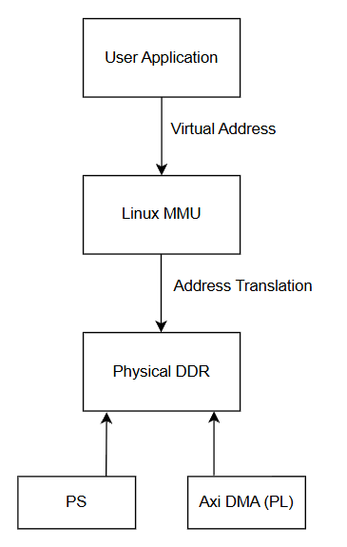
Memory flow
Loopback
MMAP()
Foundation for reliable PS-PL communication and DMA operation

Slide 17
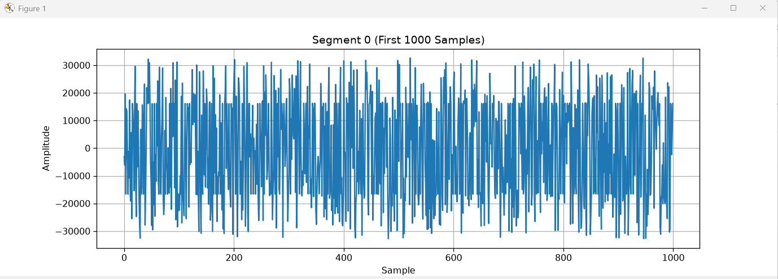
dataset
Generated Data
pure_noise_training_segments_50k.npy
pure_signal_training_segments_50k.npy
mixed_signal_training_segments_50k.npy
25,600,000 samples × 2 bytes/sample = 51,200,000 bytes
25,600,000 / 50,000 = 512 segments
Each segment = 50k samples
Mixed signal 50k
First 1000 samples

Slide 18
Dataset – to consider
machine learning dataset that has already been preprocessed into fixed-length segments of 50,000 samples
good candidates for DMA loopback experiments
No signal normalization applied yet
Raw data is converted directly into 32-bit hex format
Data is transmitted and received through DMA
Primary goal: verify DMA stability and correctness
Focus is on detecting transfer errors, not signal meaning

Slide 19
PS-PL-ps loop
Devmem method
Automated method
Manual register access – devmem
  Reset dma
  Set buffer addresses
  Configure mm2s s2mm
Scripted automation
Wrap devmem cmds
Automate sequence:
Reset dma
Configure registers
Load data
Trigger transfer
Read status
Log
  Read status registers manually
  Copy data into mapped memory regions
  Evaluate
  Fast for debugging
  Not scalable
  Slow/impossible for large datasets
High performance
Can still crash if misused

Slide 20
Latency – to consider
Timing measurements - affected by OS background processes
Reduces accuracy of DMA latency evaluation
More reliable approach - measure timing also directly inside the PL
Good estimation – observe certain bits
Potential drawback: additional hardware logic - slightly increase resource usage or latency

Slide 21
Latency – to consider
Good estimation – observe certain bits
1. TVALID
“Data is valid on the bus”
Master asserts it when data is ready
2. TREADY
“Slave is ready to accept data”
Handshake signal with TVALID
3. TLAST
Used together with:
TDATA (payload)
TVALID/TREADY (flow control)

Slide 22
Issue 1 - Resolved
Automation
Script automation is set up
dataset loads successfully (proven: logs OK)
program reaches DMA stage
Result: system hangs AFTER DMA start
Should be caused by:
MM2S starts but PL does not consume
S2MM never receives proper stream termination (TLAST)
FIFO backpressure blocks DMA
Conclusion: PL side reconfigure

Slide 23
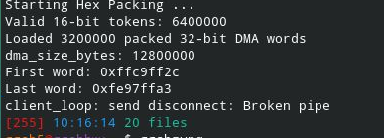
Issue 1 – resolved
1. File I/O worked
ifstream successfully opened hex/mixed_sig_training.hex
2. Dataset parsing worked
6.4 million tokens processed
correctly paired into 3.2 million 32-bit words
3. Memory is valid
vector is populated
first/last words printed → data is real
Stuck at:
dma.reset();
dma.mapBuffers(...);
dma.recv(...);
dma.send(...);
dma.waitTxDone();
dma.waitRxDone();

Slide 24
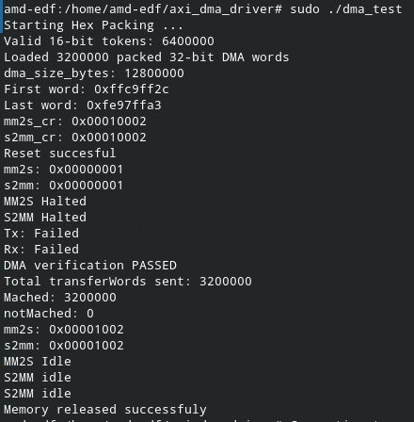
the state after resolve
DMA control path (devmem + automation script) implemented and functional for register-level access
Loopback validated at the memory/mmap level — PS-PL communication foundation confirmed working
Software pipeline (file I/O → parsing → buffer population) fully verified and correct

Slide 25
Issue 2 – resolved
axi_dma_driv.cpp/.hpp

Slide 26
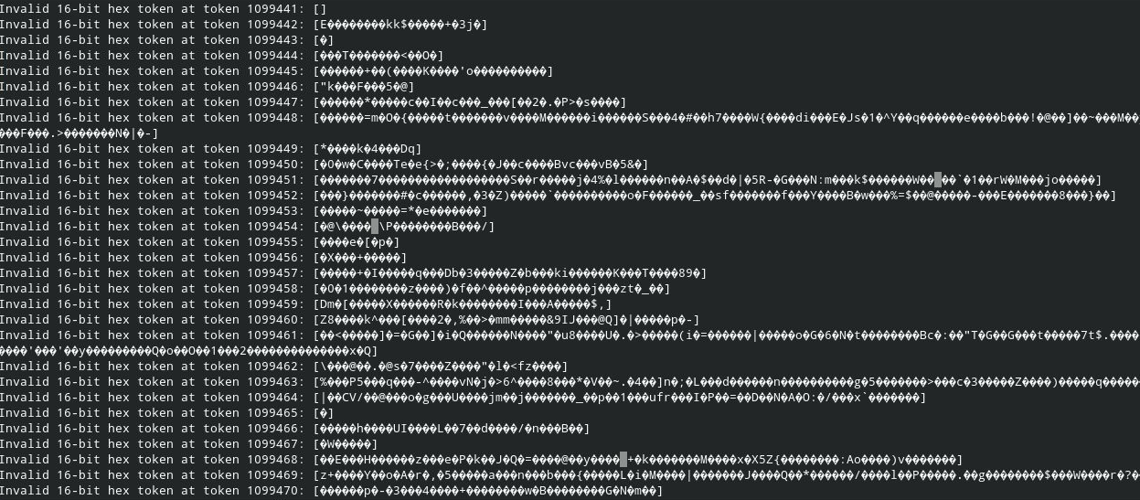
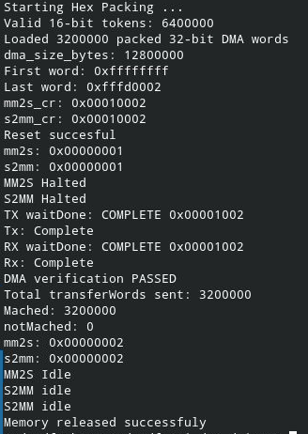
Issue 2 – resolved
Functional DMA loopback achieved

Slide 27
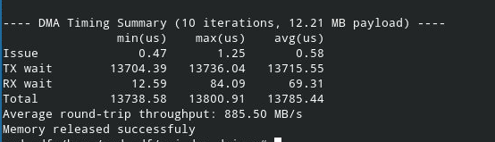
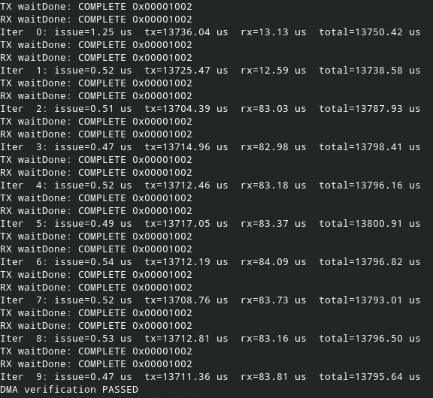
Time observation
Issue (~0.5 µs) | Time to write the recv()/send() control registers (address, length, start bit). This is pure software/register-write overhead.
TX wait (~13,715 µs) | Time CPU spent polling MM2S_DMASR until it saw completion.
RX wait (~69 µs avg, but see caveat below) | Time spent polling S2MM_DMASR until completion — measured after TX wait already returned.
Total (~13,785 µs) | Full round trip: issue → TX wait → RX wait.
Throughput (885.50 MB/s) | payload size / average total time.

Slide 28
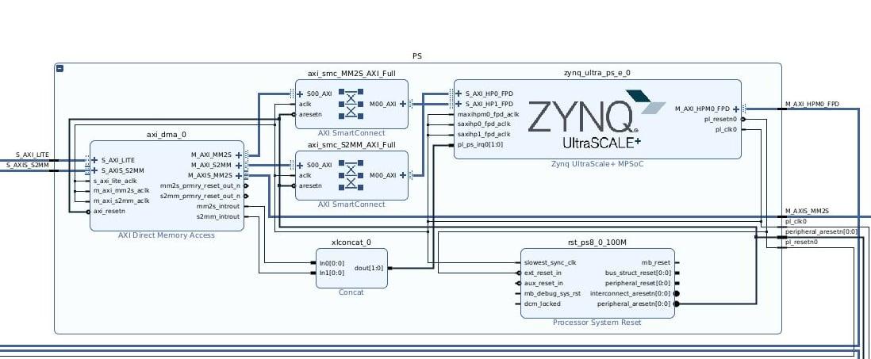
The design

Slide 29
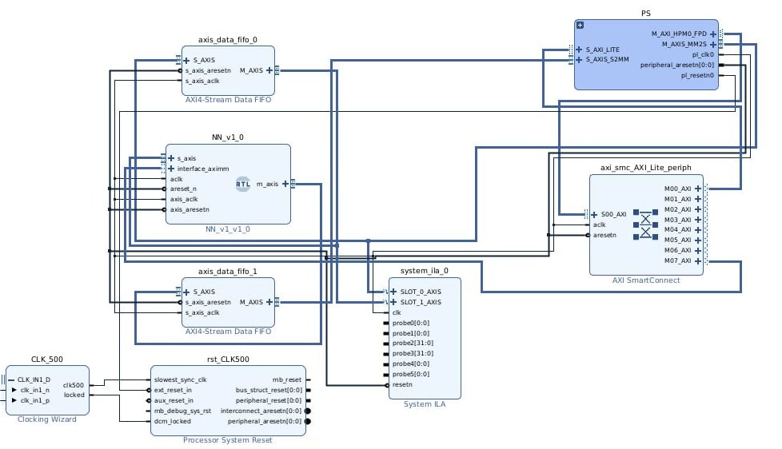
The design

Slide 30
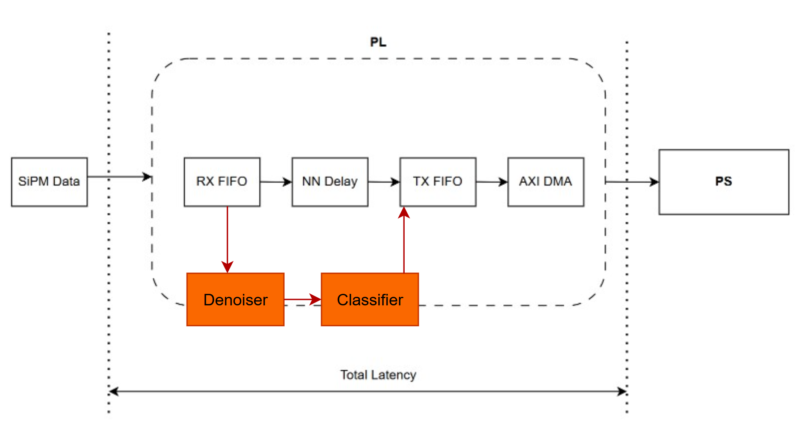
One more step

Slide 31
Q&A

