Slide 1

Seismic Signal Prediction from an Accelerometer Array towards Online Newtonian Noise MitigatioN BY FPGA
Master thesis Final
25-08-2026 | Elguja Abuladze
შოთა რუსთაველის საქართველოს ეროვნული სამეცნიერო ფონდის მხარდაჭერით [GHZ-25-005] / This work was supported by Shota Rustaveli National Science Foundation of Georgia (SRNSFG) [GHZ-25-005]

Slide 2
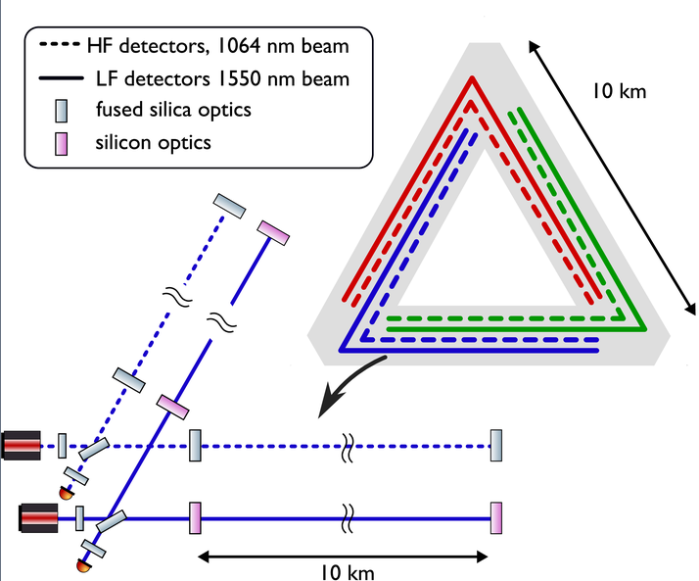
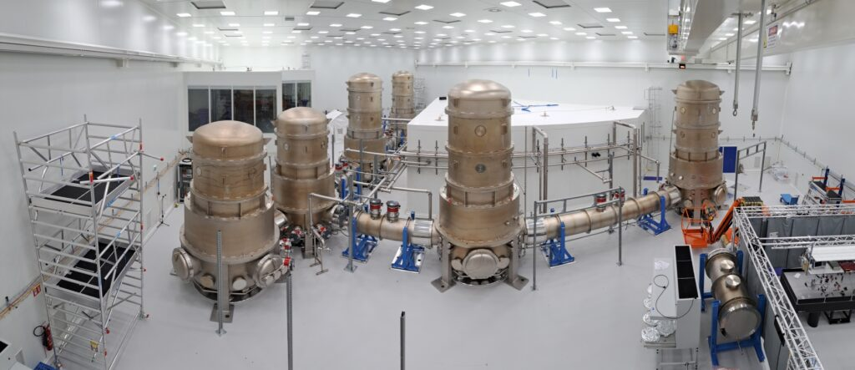
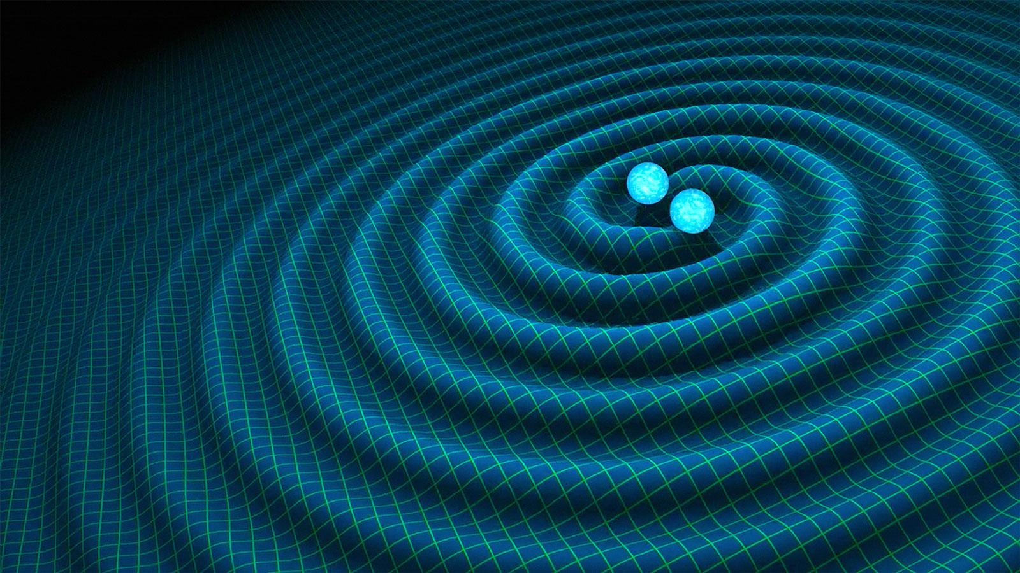
background
Einstein Telescope – What it is and how it works
Detection of gravitational waves using laser interferometry
Enables multimessenger observations of the universe
Significantly improved sensitivity compared to current detectors (LIGO/Virgo)
Limited by environmental noise sources (e.g., Seismic noise)
ET Pathfinder: experimental platform in Maastricht for development and validation of ET concepts

Slide 3
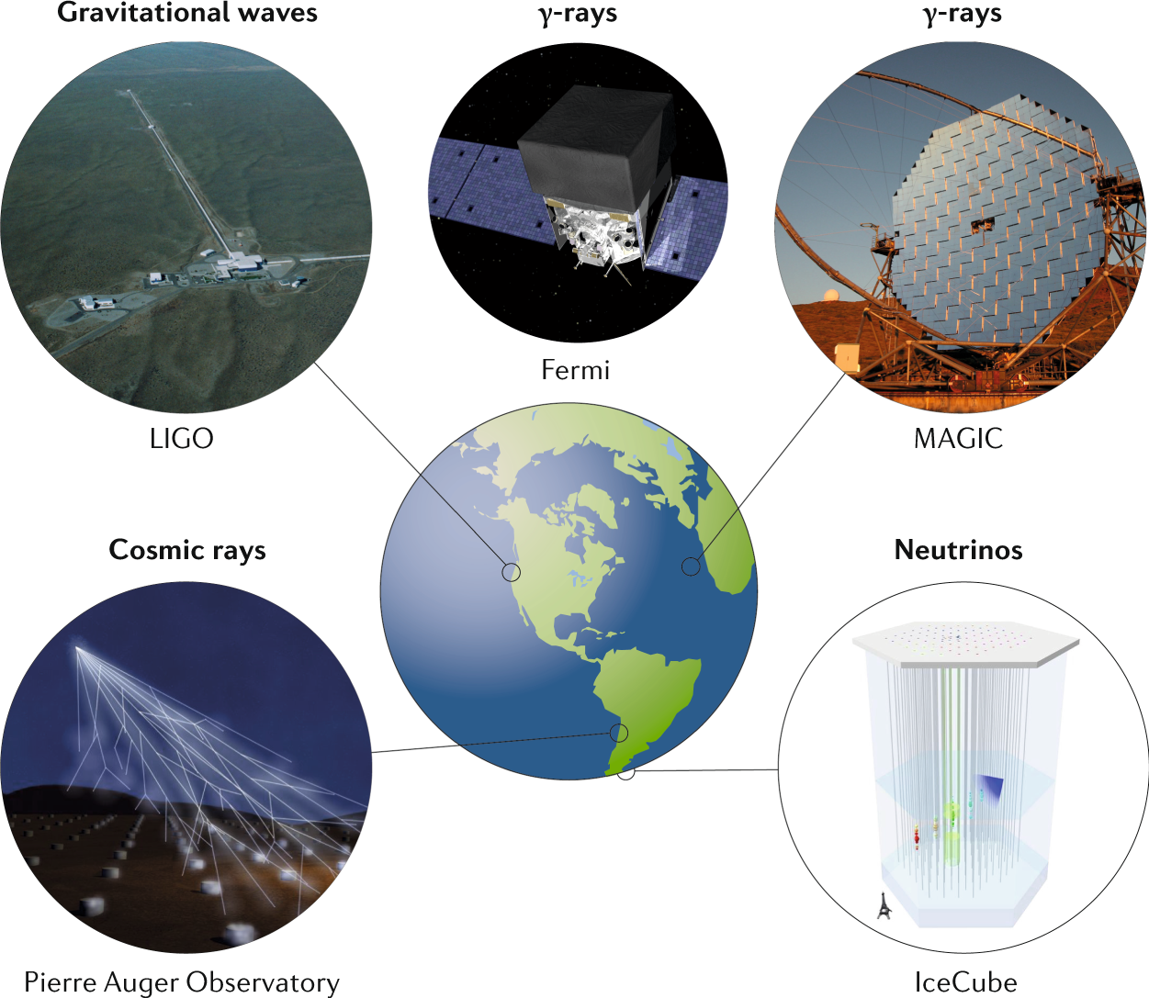
background
Multimessenger
Combines observations from different types of signals(gravitational waves, electromagnetic radiation…)
Provides a more complete understanding of astrophysical events
Example: binary neutron star merger
  detected via gravitational waves (LIGO/Virgo)
  detected via gamma rays (Fermi)
Requires real-time detection and rapid communication to enable follow-up observations

Slide 4
background
What changes due to FPGA
  Advantages
  Real-time processing ( ~ 1ms @ 1000Hz)
  Low and deterministic latency
  Streaming, parallel, and pipelined processing
  Constraints
  Limited on-chip resources: BRAM, DSP, LUT, and FF
  Fixed-point quantization and hardware-aware model optimization
  Model architecture must be supported by the HLS toolchain

Slide 5
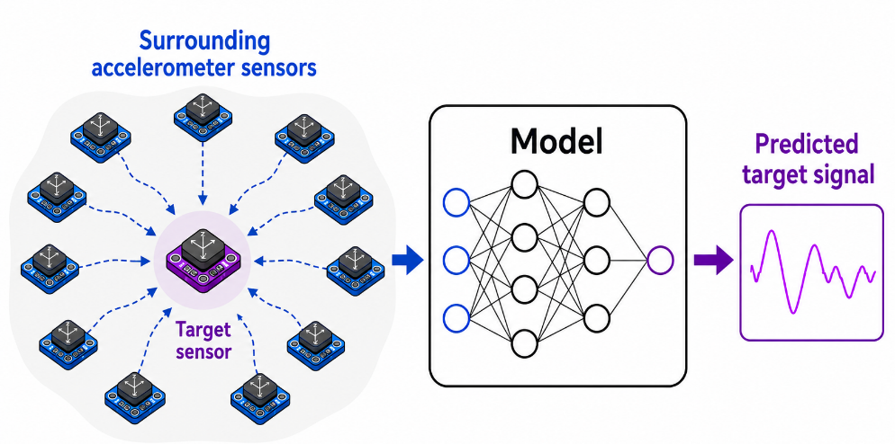
Methodology
Sensor arrays, as proxy measurements
prediction of the target sensor from the others
Window Size = w
CH N+1 | t-w |  | t-3 | t-2 | t-1
CH 1 |  | …
CH 2 |  | …
CH 3 |  | …
 | : |  | : | : | :
CH N |  | …
Current Prediction
of Target Sensor
CNN
Surrounding Sensors
(Channel per Axis)
t
CH N + 1

Slide 6
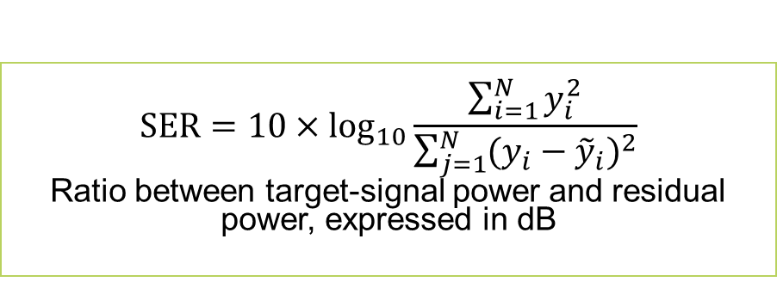
methodology
Model performance evaluation
Correlation
SER
Frequency domain evaluation
Residual analysis
Primary evaluation metric
Higher SER indicates better reconstruction.
$$SER=10×\log_{10}{\frac{\sum_{i=1}^{N}{y_{i}^{2}}}{\sum_{j=1}^{N}{{(y_{i}−{\tilde{y}}_{i})}^{2}}}}$$
Ratio between target-signal power and residual power, expressed in dB
Time-domain and frequency-domain metrics are combined because no single metric fully describes reconstruction quality.

Slide 7
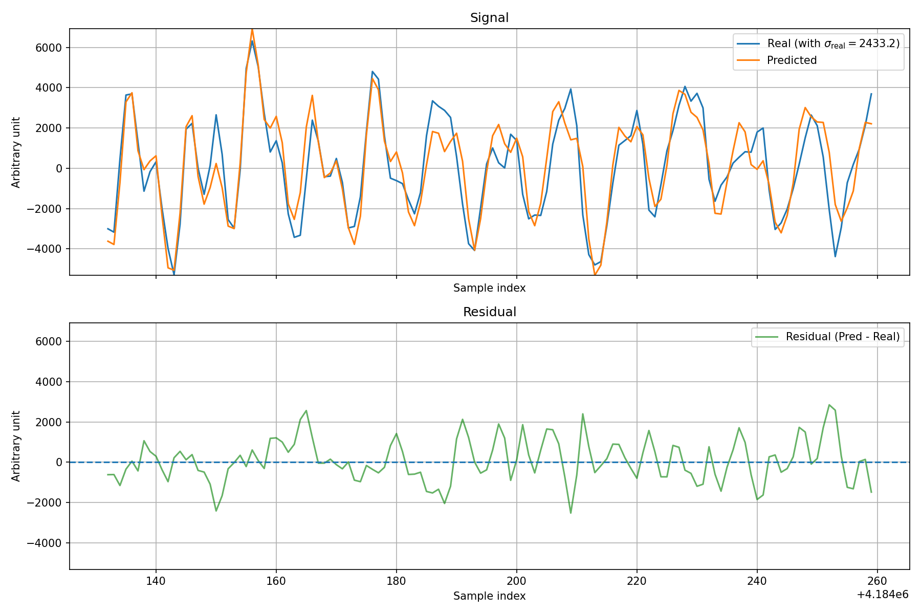
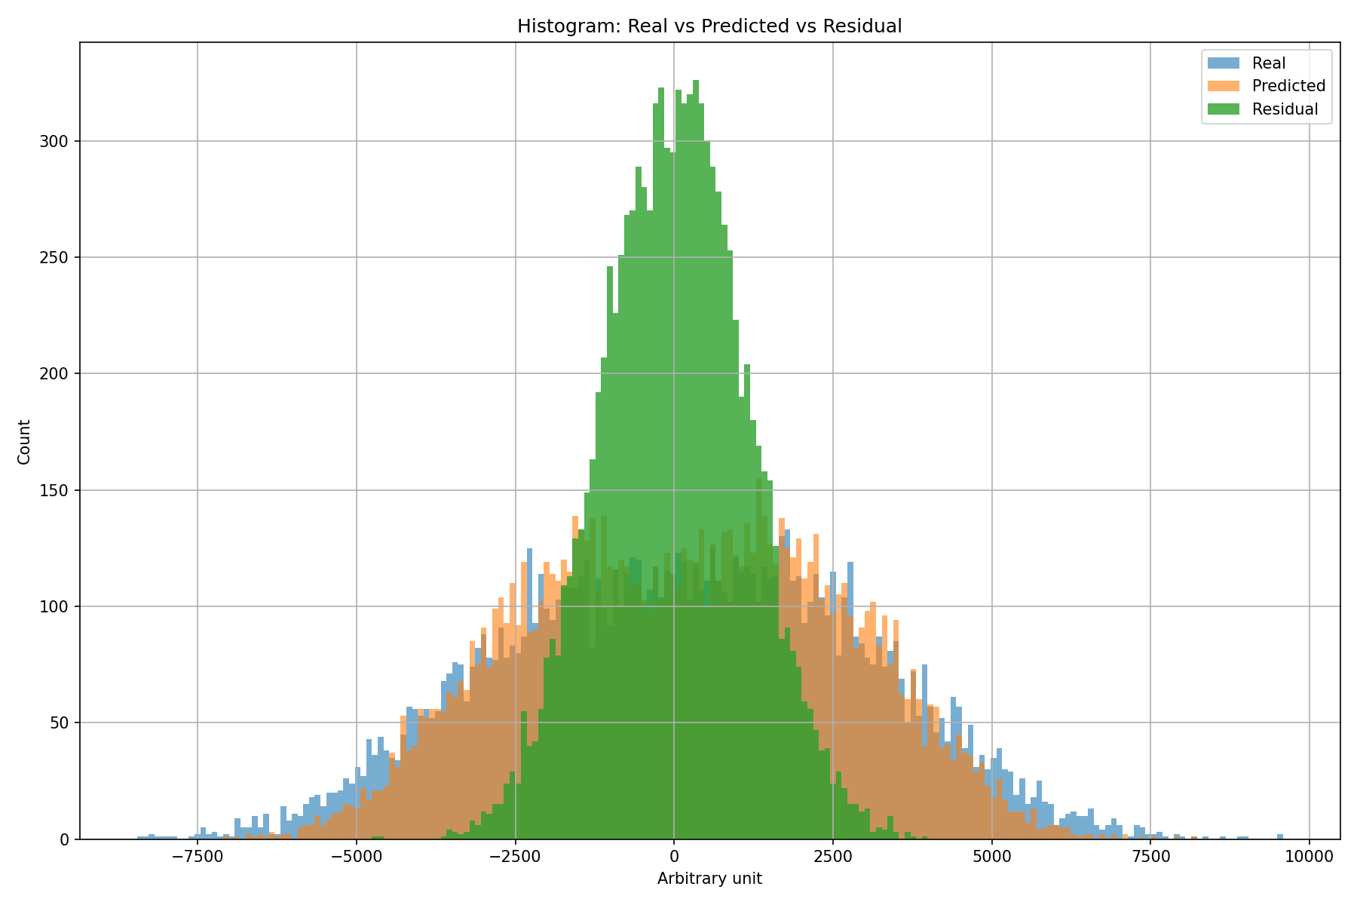
methodology
Residual analysis

Slide 8
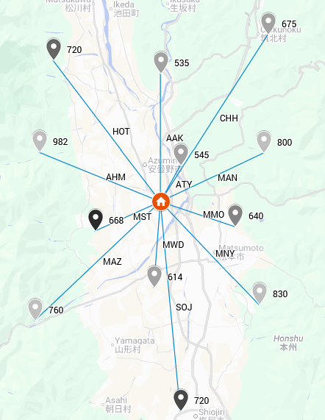
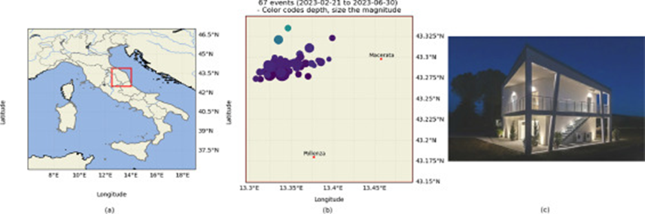
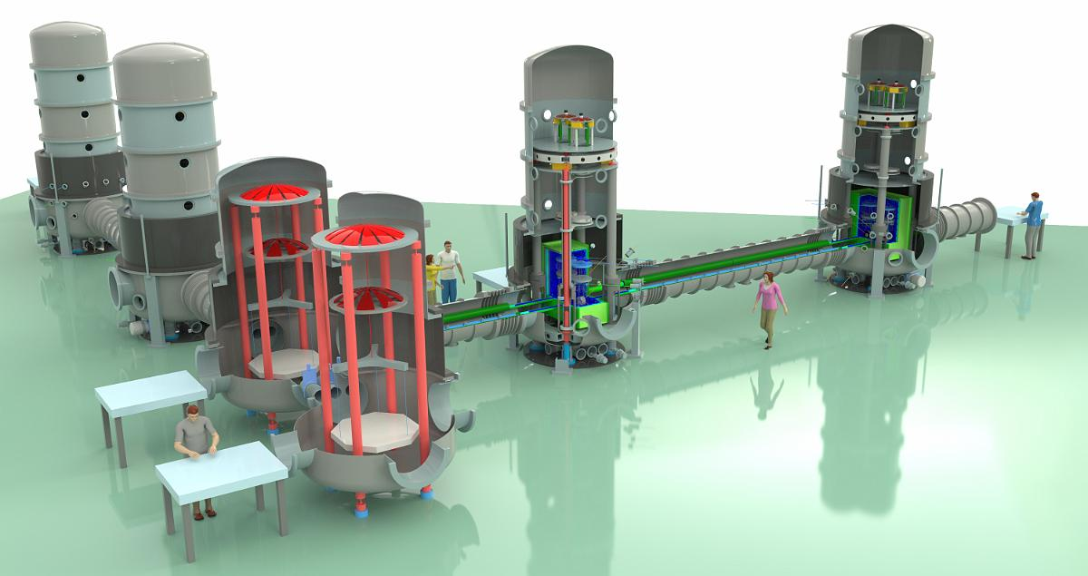
Methodology
Datasets and preprocessing
ETPF – Corridonia – Hi-Net
 | ETPF | Corridonia | Hi-Net
Dataset size | 30 hours + 8 days | ~ 2 hours | 12 hours
Sampling rate and Bit rate | 500 Hz, 24-bit resolution | 250 Hz, 20-bit resolution | 100 Hz, 27-bit resolution
Number of channels | 13 vertical | 5 three-axial sensors (15 channels) | 13 vertical

Slide 9
Selected Model Architectures
Optuna selected different temporal windows and model depths for the two datasets
*sampling rate: 500 Hz
Model A
Model B
Hyperparameter | Search space
Window size | 64–300 samples*
Learning Rate | 5 × 10⁻⁵ – 10⁻³
Batch size | 1 – 128
Optimizer | Adam, RMSprop
Dropout | 0.0 – 0.6
Conv. Layers | 1 – 4
Channels | 4 – 256
Kernel size | 1 – 128
ReLU | True/False
Hidden | 4 – 256
Input (signal)
(240, 12)
Input (signal)
(87, 12)
Conv + BatchNorm+ ReLu + Dropout
Conv + BatchNorm+ ReLu + Dropout
2x
Linear (16,256)
Linear (32, 64)
Model A — optimized on ETPF
Model B — optimized on Corridonia

Slide 10

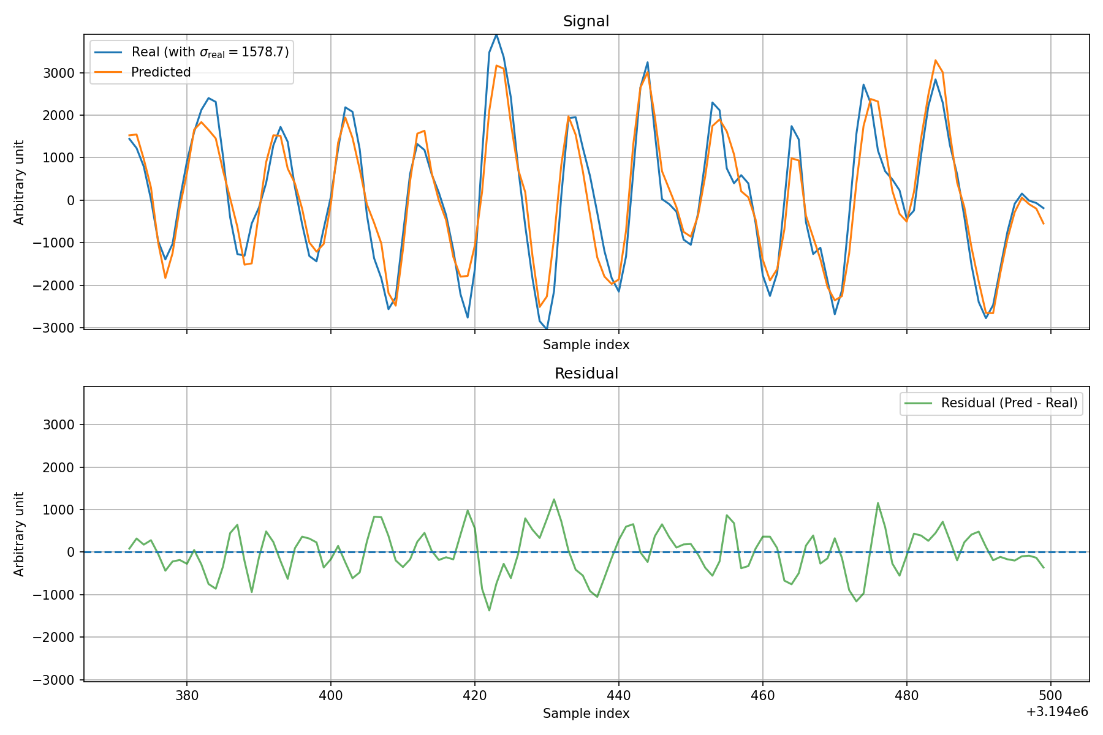
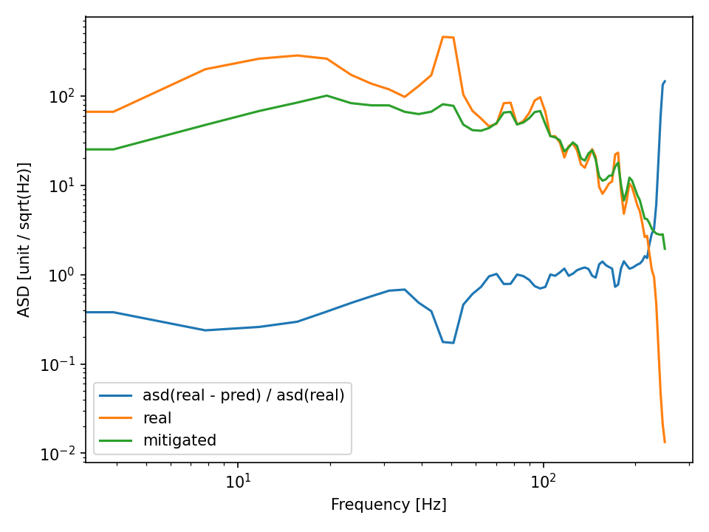
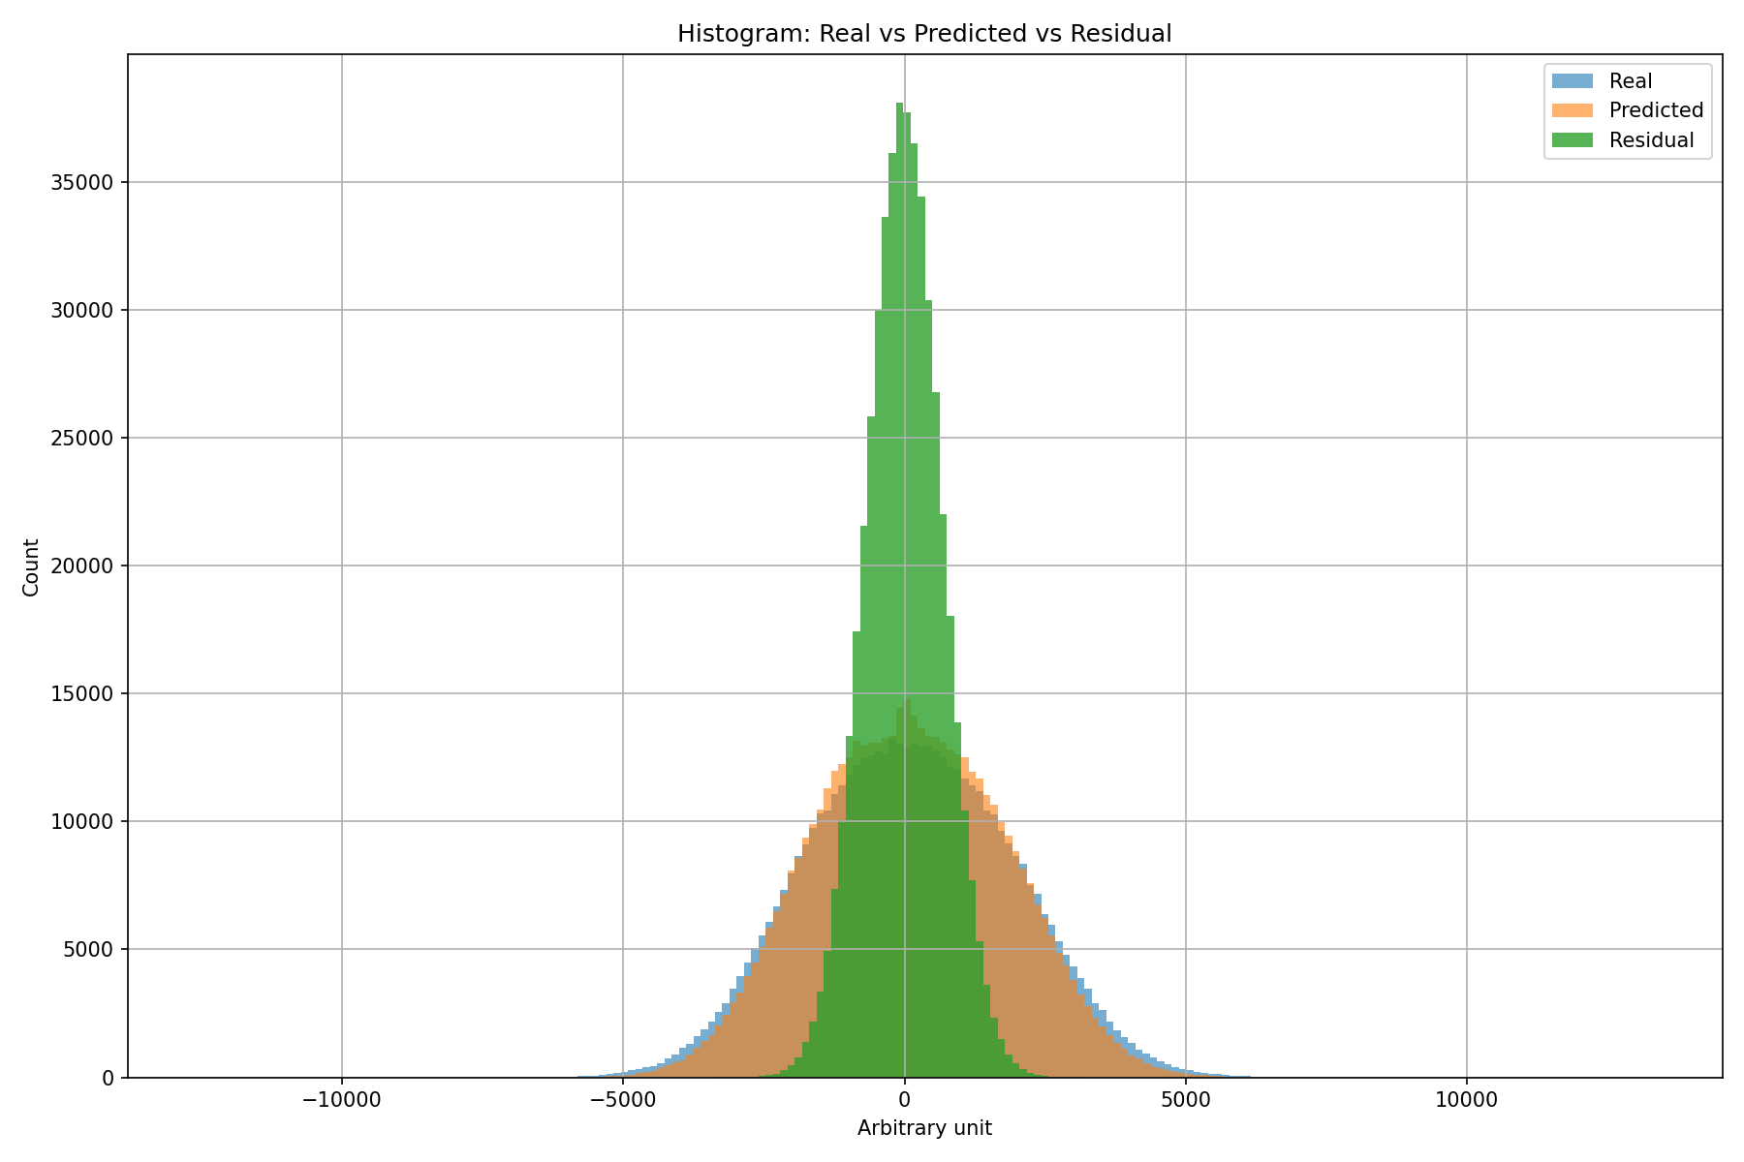
Offline results - etpf
Primary evaluation dataset
Most model development and evaluation in this thesis is based on ETPF measurements.
Continuous, high-resolution recordings enable detailed analysis of seismic noise.
Measurements collected at ET Pathfinder provide an experimentally relevant environment for ET-related seismic studies.
The additional eight-day recording enables evaluation over changing long-term noise conditions.
We gratefully acknowledge the active collaboration of the ET Pathfinder team.

Slide 11
Offline results - etpf
SER heatmap
Each cell represents a separately trained model; the main value is its SER.
Rows indicate target sensors; columns indicate the sensor removed from the inputs.
Diagonal cells represent nominal training with not any sensor removed.
Removing some sensors improves SER, showing that certain input channels can reduce prediction quality.
Colors are normalized per row; σ=0.11 values show the change relative to the nominal result and are comparable across rows.

Slide 12
Fpga implementation
PyTorch
Neural-network deployment workflow
The model is constructed and trained in PyTorch.
The trained model can be exported to ONNX as a framework-independent representation.
The trained PyTorch model is converted directly using hls4ml.
hls4ml generates synthesizable HLS C++ code.
HLS synthesis converts the design into RTL for FPGA implementation.
hls4ml
ONNX
HLS C++
RTL

Slide 13
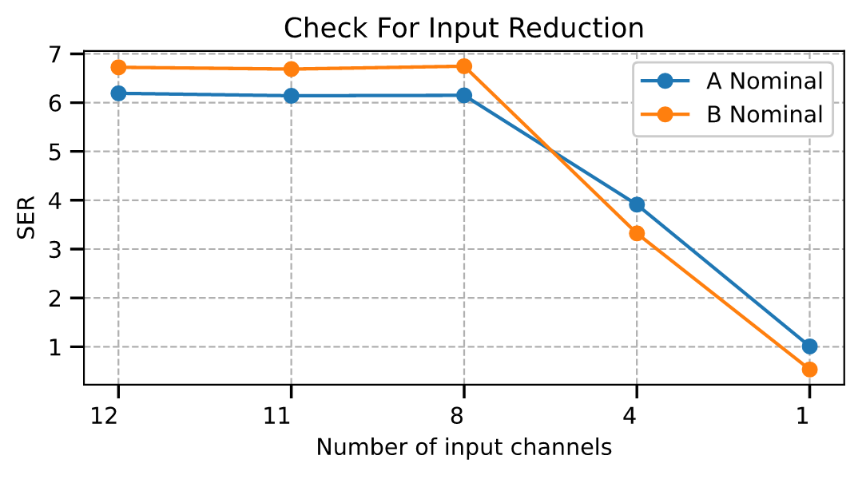
Fpga implementation
The HLS-estimated clock period ranges from 3.61 to 4.63 ns
the target period is 5 ns.
Footprints
Reducing the number of input channels has little effect on DSP utilization.
Removing less informative channels reduces BRAM, FF, and LUT utilization.
Performance remains nearly unchanged down to eight input channels, but decreases significantly below this point.
The estimated inference latency remains approximately 0.464 ms for all channel configurations.
The estimated neural-network-core latency is below the 1 ms sampling interval, indicating computational feasibility at 1 kHz.
Resource Utilization for Model B
(Model A pending due to ONNX issues)
Input channels | BRAM (18K) | DSP | FF (K) | LUT (K)
1 | 402 | 71 | 91 | 73
4 | 409 | 70 | 95 | 73
8 | 417 | 70 | 101 | 76
11 | 422 | 71 | 105 | 77
13 | 426 | 71 | 108 | 78
22 | 444 | 73 | 119 | 82
ZCU216 | 2160 | 4272 | 850 | 425

Slide 14
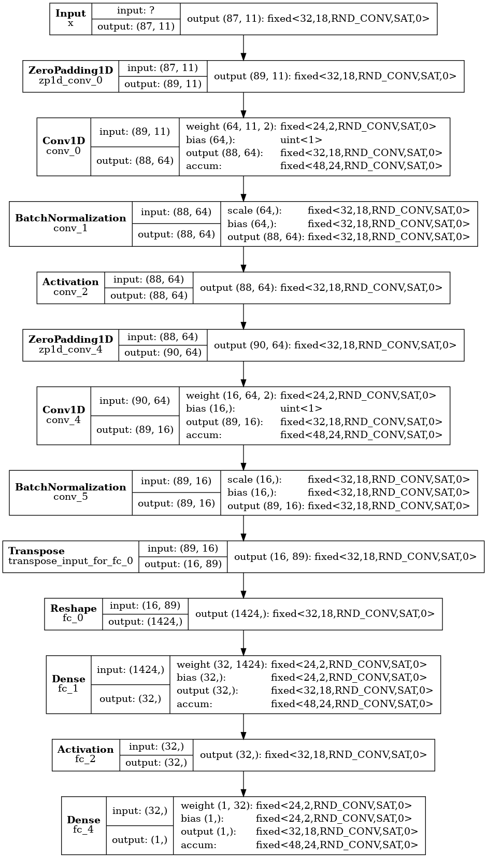
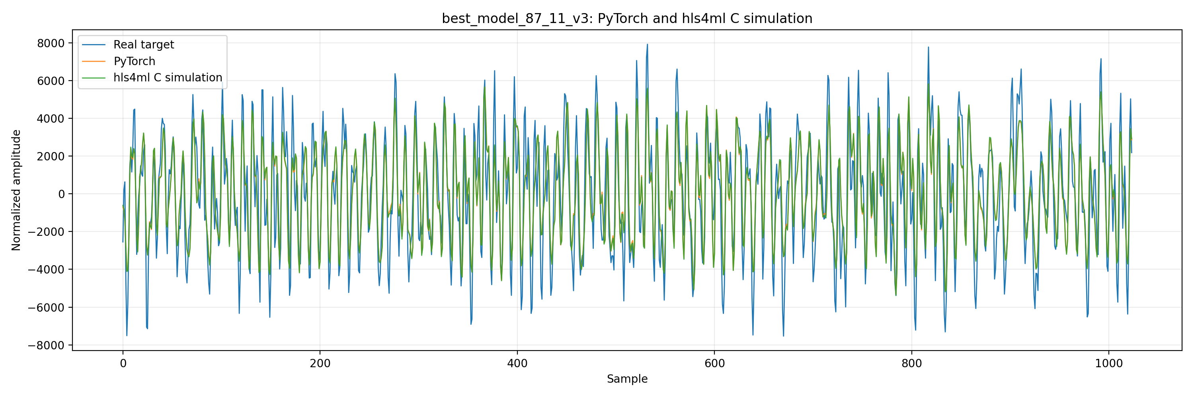
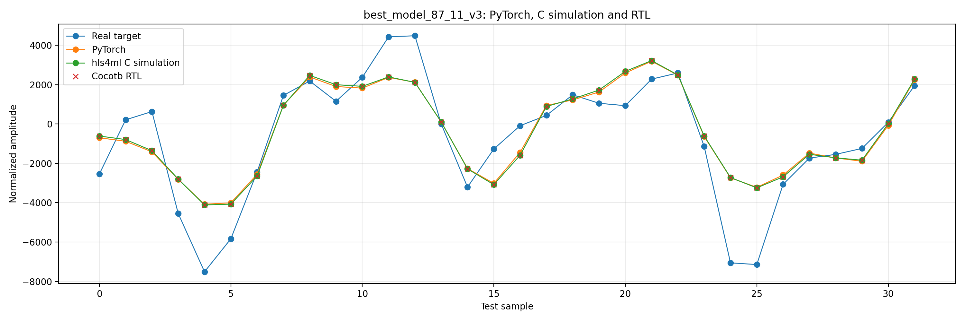
Fpga implementation
cocotb

Slide 15
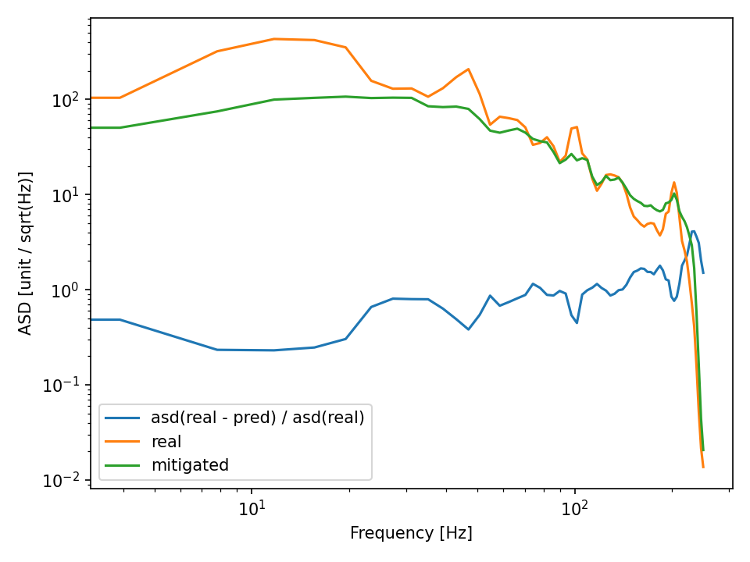
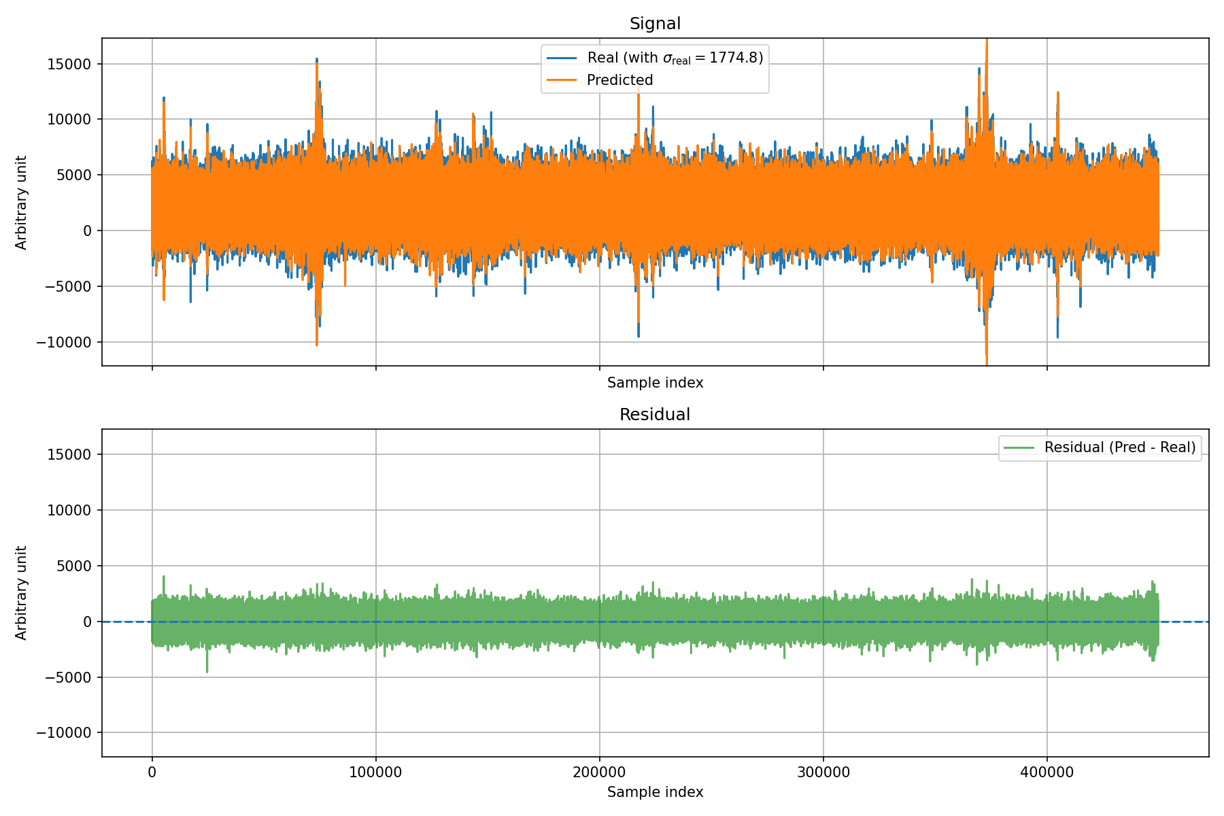
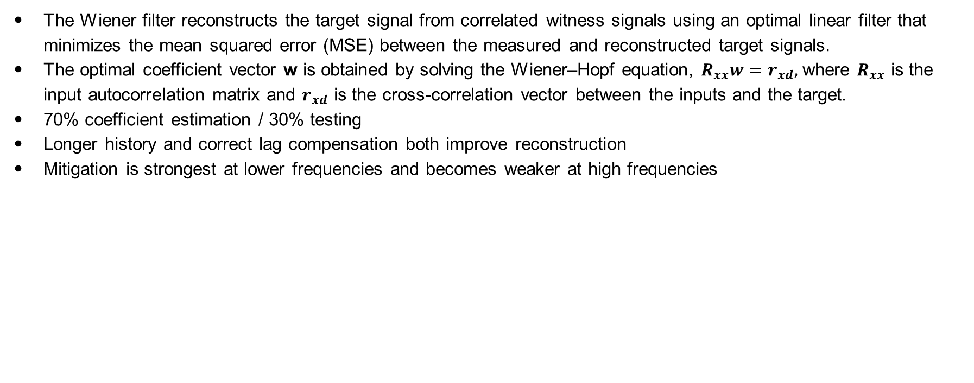
Wiener FILTER
The Wiener filter reconstructs the target signal from correlated witness signals using an optimal linear filter that minimizes the mean squared error (MSE) between the measured and reconstructed target signals.
The optimal coefficient vector w is obtained by solving the Wiener–Hopf equation, $R_{xx}w=r_{xd},$ where $R_{xx}$ is the input autocorrelation matrix and $r_{xd}$ is the cross-correlation vector between the inputs and the target.
70% coefficient estimation / 30% testing
Longer history and correct lag compensation both improve reconstruction
Mitigation is strongest at lower frequencies and becomes weaker at high frequencies
Window Size | Lag Offset | SER | Correlation
240 | 8 | 9.77dB | 0.946
240 | 0 | 8.74dB | 0.931
87 | 8 | 8.57dB | 0.928
87 | 0 | 7.60dB | 0.909

Slide 16
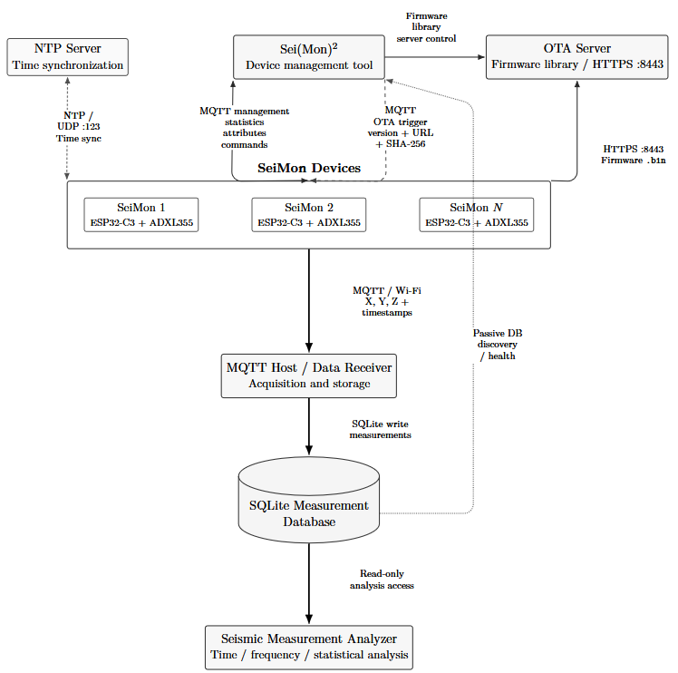
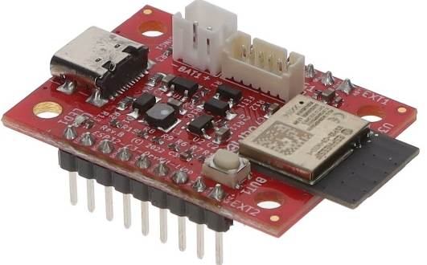
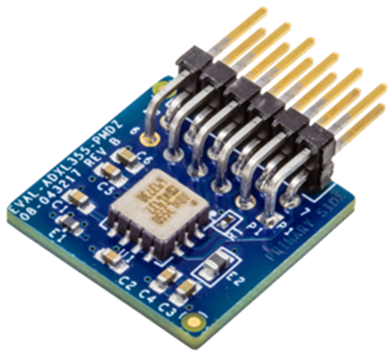
Network and data exchange
SeiMon: ESP32-C3 + ADXL355
MQTT/Wi-Fi measurement streaming
NTP/SNTP time synchronization
SQLite measurement storage
Remote monitoring, commands, and OTA updates
Read-only time, frequency, and statistical analysis
OTA updates completed in less than 30 seconds, with validation and rollback support.

Slide 17
MEASUREMENT PIPELINE THROUGHPUT
ADXL355 Sampling Rate and MQTT Transmission Test
500 Hz, QoS 1: unstable, with 36.2% local queue loss and MQTT disconnections
1000 Hz, QoS 0: highest stable tested configuration, with 0% local queue loss
2000 Hz, QoS 0: local throughput limit approached, with 1.9% queue loss
Configuration | Queue loss
125 Hz, QoS 1 | 0.0%
250 Hz, QoS 1 | 0.0%
500 Hz, QoS 1 | 36.2%
500 Hz, QoS 0 | 0.0%
1000 Hz, QoS 0 | 0.0%
2000 Hz, QoS 0 | 1.9%
Why did QoS 0 help?
QoS 1 requires delivery acknowledgements.
Test conditions and limitations: Tests were performed using a nearby mobile hotspot with strong RSSI values of approximately −23 to −25 dBm. Queue loss was measured locally on the ESP32; broker-side reception and database storage were not verified. End-to-end performance must therefore be evaluated separately in the FZJ network.

Slide 18
conclusion
reconstruction is feasible when the witness sensors measure a sufficiently coherent local seismic field.
Performance depends strongly on the target channel, time interval, sensor geometry, and training-data distribution.
ETPF produced the most useful results; Corridonia and most Hi-Net configurations showed weak cross-sensor predictability.
Channel selection can reduce FPGA resources and sometimes improve SER.
Full FPGA integration, inter-node timing accuracy, and end-to-end delivery in the FZJ network remain to be validated.

Slide 19
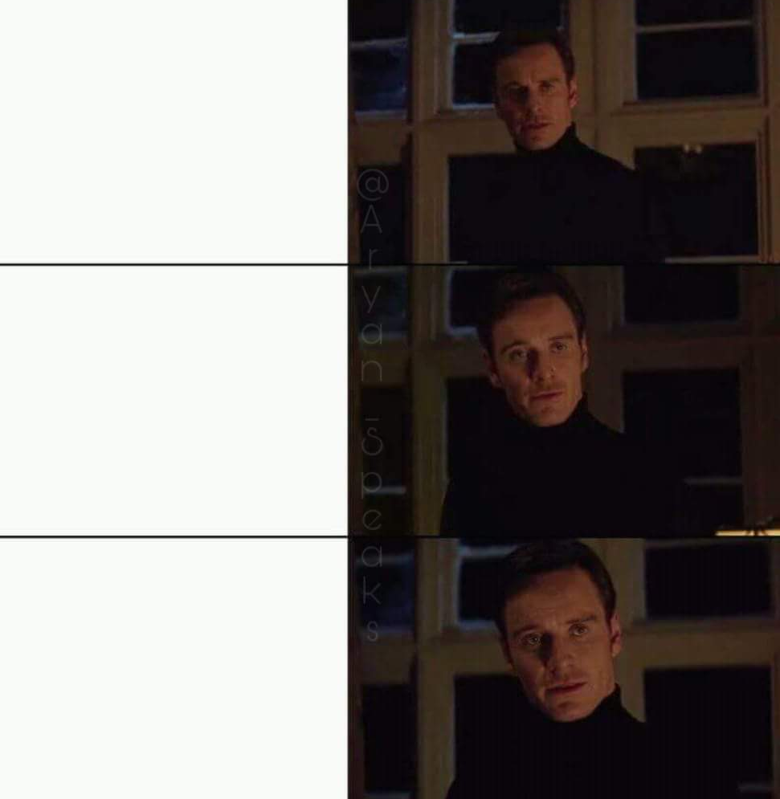


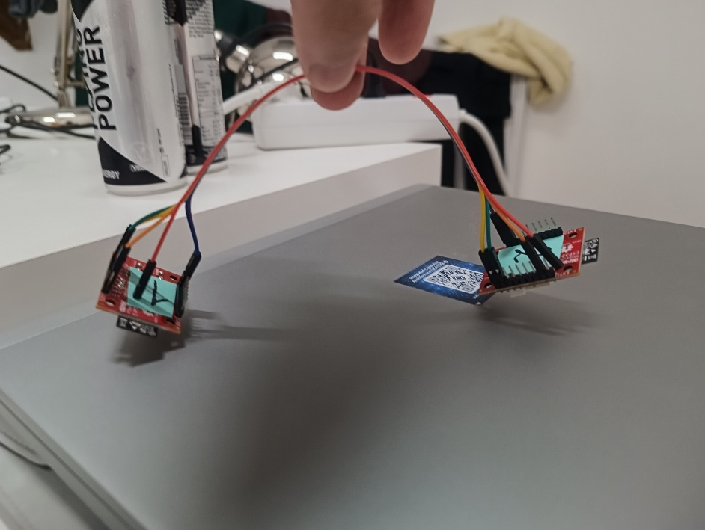
Thank you for your attention
Show me perfect bridge
Questions? Comments? Advice?
I said perfect !
Georgian-German Science Bridge
Perfection

Slide 20
TIMELINE from master thesis proposal
March
April
May
June
July
August
Data Analysis
Data Processing
Model Development
System Integration
Experimental Validation
Write thesis

Slide 21
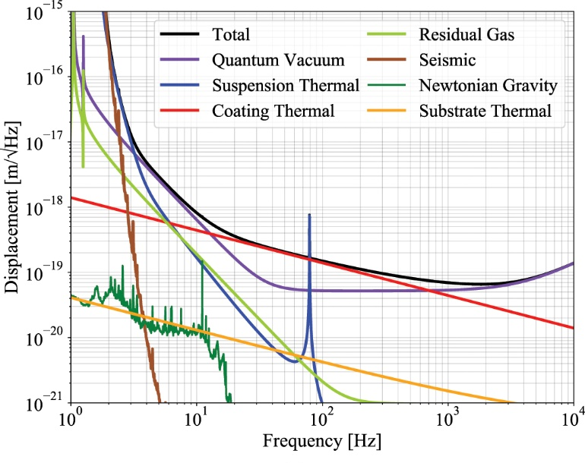
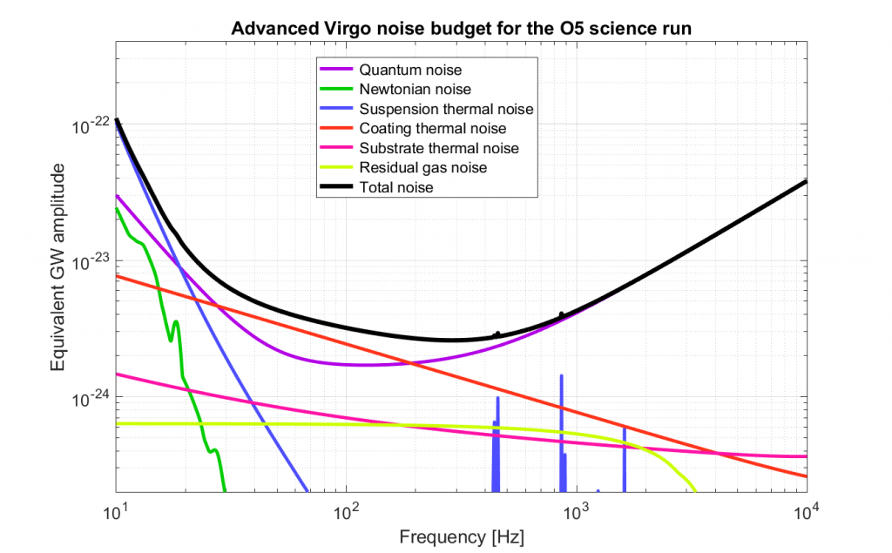
background
Projection of displacement sensitivity for the
ETpathfinder operating At 1550 nm laser light and 18 K
Problem Statement
Seismic activity causes fluctuations in the ground, which generate ground waveforms (seismic waves).
These fluctuations, which introduce seismic noise into the measurement signal.
These density fluctuations generate gravitational forces, which disturb the interferometer mirrors.
This effect, known as Newtonian noise, cannot be shielded or mechanically isolated.
It represents a limitation, especially at low frequencies (see plot).
It must be estimated using external sensors and subtracted from the interferometer signal.

Slide 22

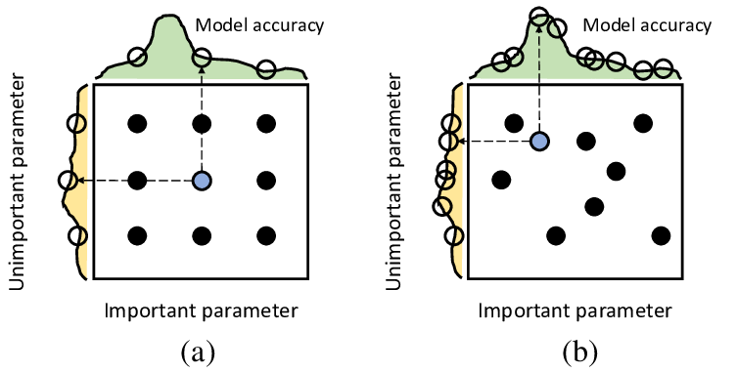
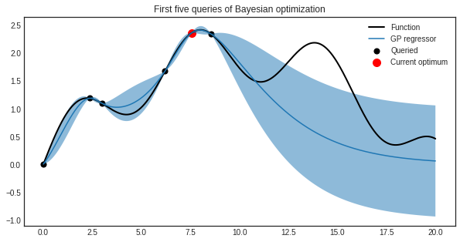
Methodology
Hyperparameter optimization
There are too many possible combinations
Parameters interact with one another and relationship is not trivial
It takes time to make good evaluation of each model
Manual search | Grid search | Random search | Bayesian optimization

Slide 23
methodology
Model performance evaluation
Correlation
SER
Frequency domain evaluation
Residual analysis
Idealized baseline study
Primary evaluation metric
Higher SER indicates better reconstruction.
$$SER=10×\log_{10}{\frac{\sum_{i=1}^{N}{y_{i}^{2}}}{\sum_{j=1}^{N}{{(y_{i}−{\tilde{y}}_{i})}^{2}}}}$$
Ratio between target-signal power and residual power, expressed in dB
Time-domain and frequency-domain metrics are combined because no single metric fully describes reconstruction quality.

Slide 24

Methodology
Optuna flow
Study
| Pruner and sampler parameters
Trial
Suggest hyperparameters
Build model with hyperparameters
Train each epoch
Promising trial?
Prune trial
Define search space
Store result

Slide 25
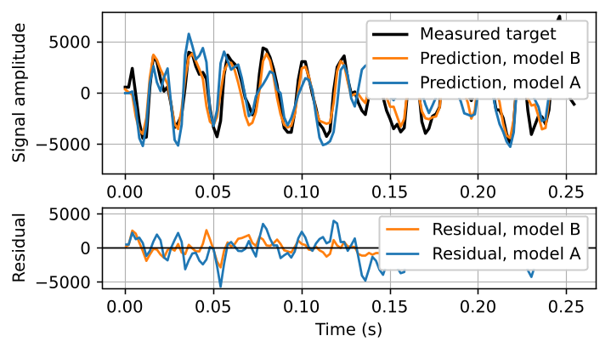
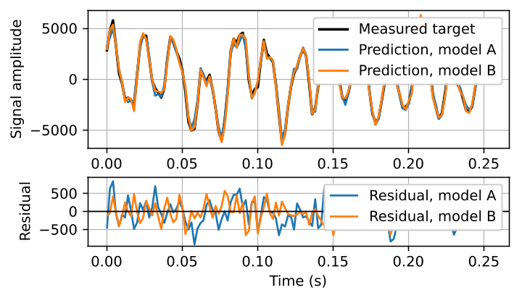
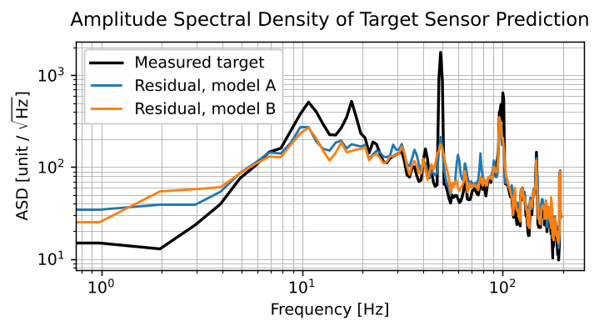
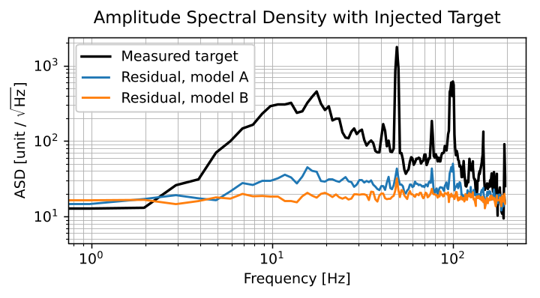
Methodology
Idealized baseline study
Injected ground truth (GT), i.e. target
sensor data, among the input channels
for model testing (upper bound baseline).
Window Size = w
CH N+1 | t-w |  | t-3 | t-2 | t-1
CH 1 |  | …
CH 2 |  | …
CH 3 |  | …
 | : |  | : | : | :
CH N |  | …
CH N+1 |  | …
Current Prediction
of Target Sensor
Surrounding Sensors
(Channel per Axis)
CNN
t
CH N+1

Slide 26
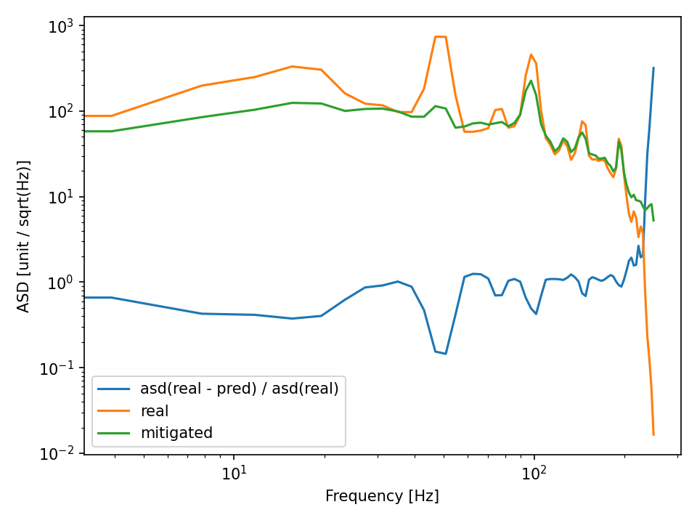
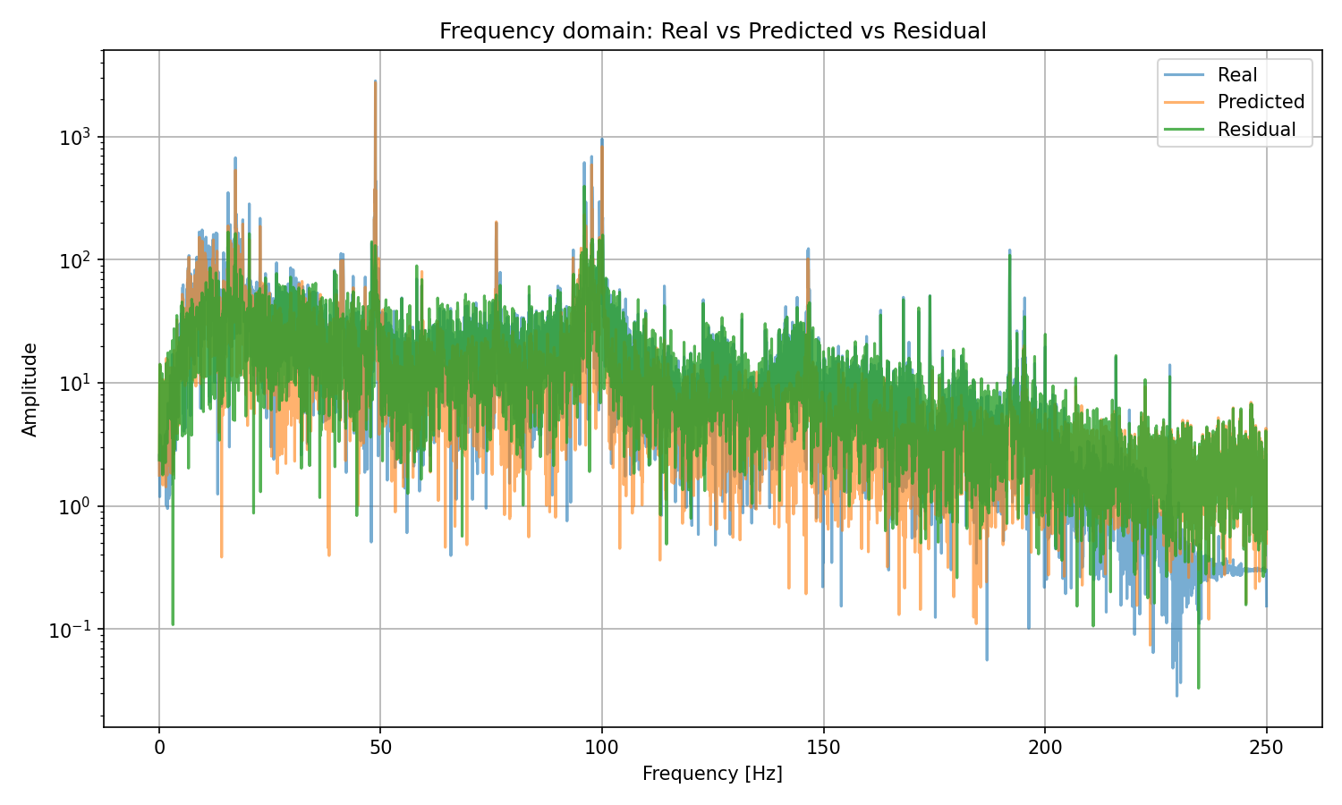
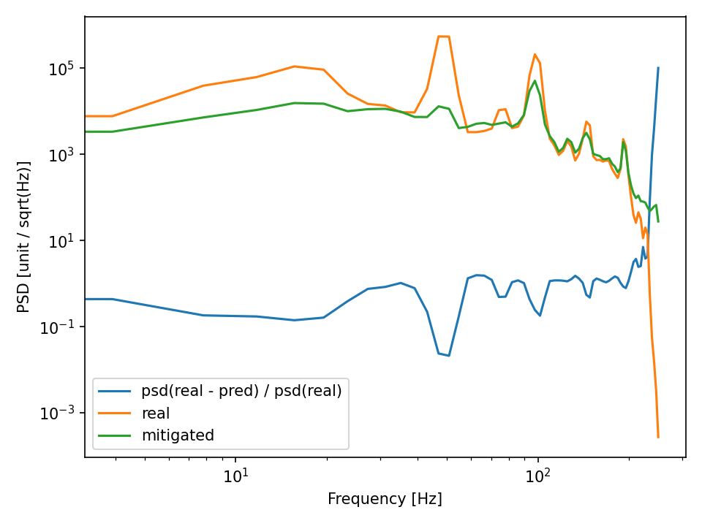


methodology
Frequency domain evaluation
$$ASD\left(f\right)= \sqrt{PSD\left(f\right)}= \sqrt{S_{xx}(f)}$$
$S_{xx}(f)$ was estimated using Welch’s method

Slide 27
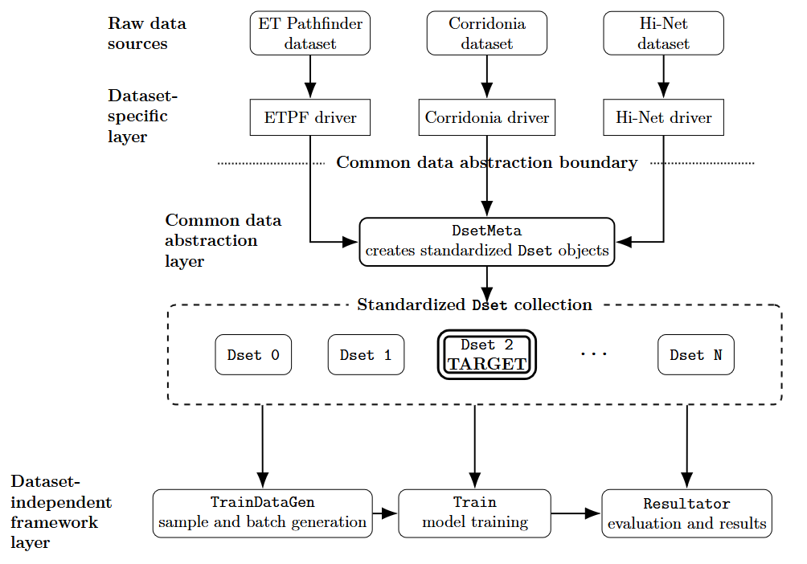
Methodology
Abstraction for database generalisation

Slide 28
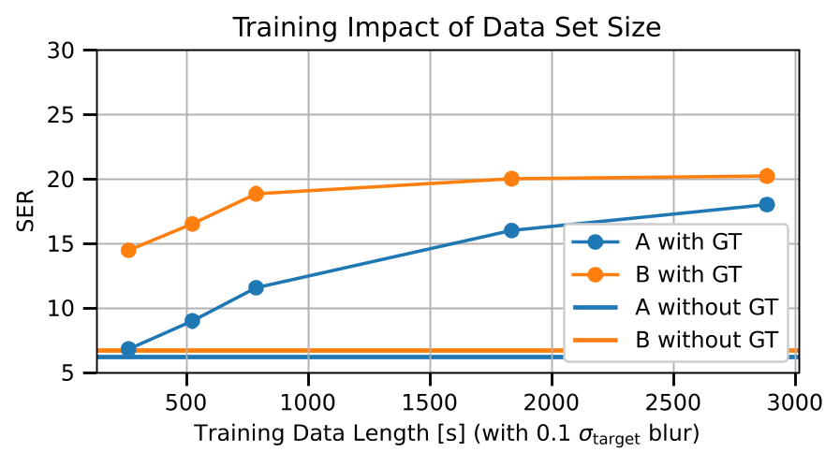
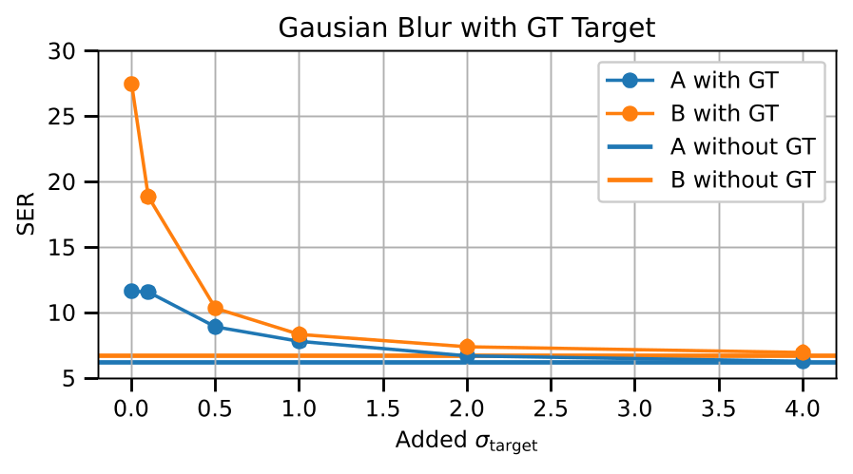
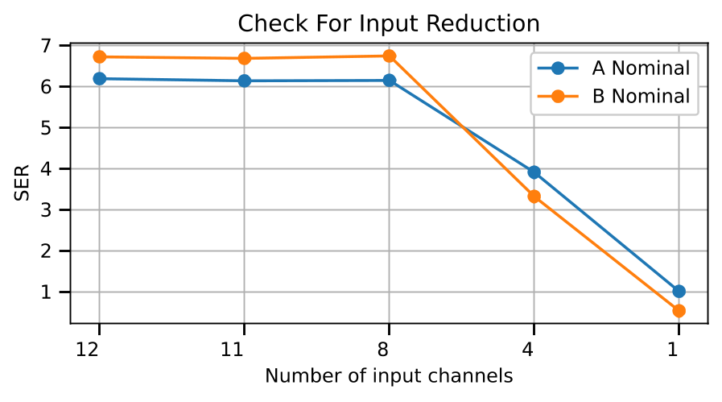
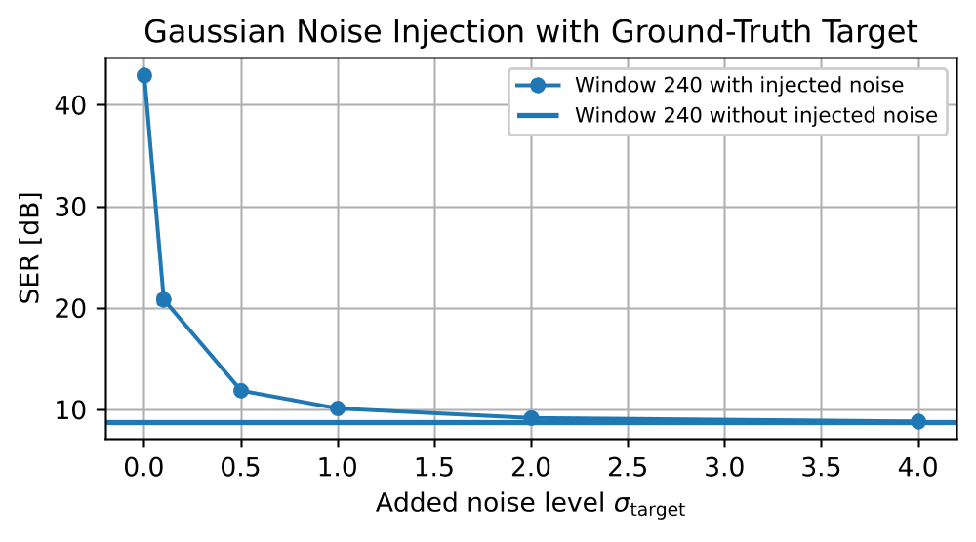
Offline results - etpf
Sanity checks - Idealized baseline study
Wiener filter

Slide 29
Fpga implementation
FLOW TRAINING + INFERENCE
Offline Training (CPU/GPU)
deploy
Inference (FPGA)
Preprocessing
(FPGA friendly)
Train network
(PyTorch)
Hls4ml/ ONNX
HDL
Neural Network
Seismo data
Preprocessing
(FPGA friendly)
HDL
Neural Network
…
Prediction
Offline data
verification
verification
Sensor data
Sensor data
Sensor data
Sensor data
Sensor data
Seismo data
Less than ~1ms

Slide 30
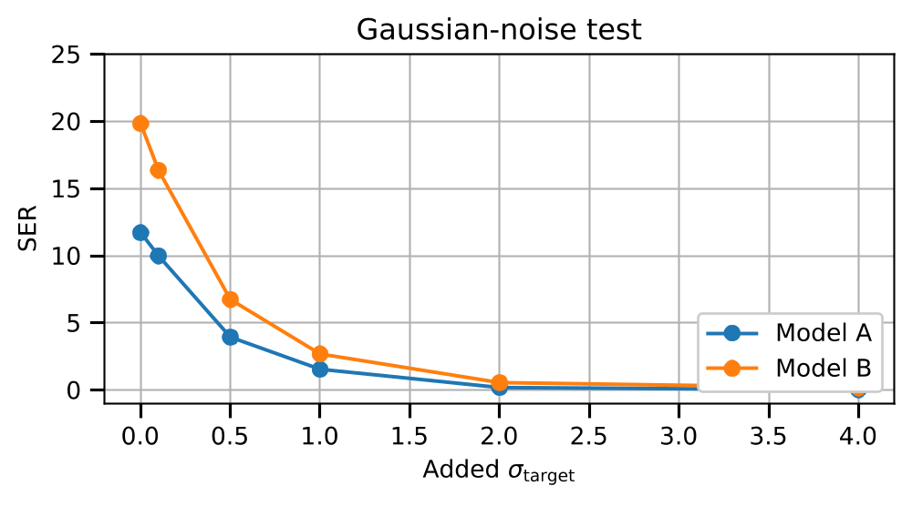
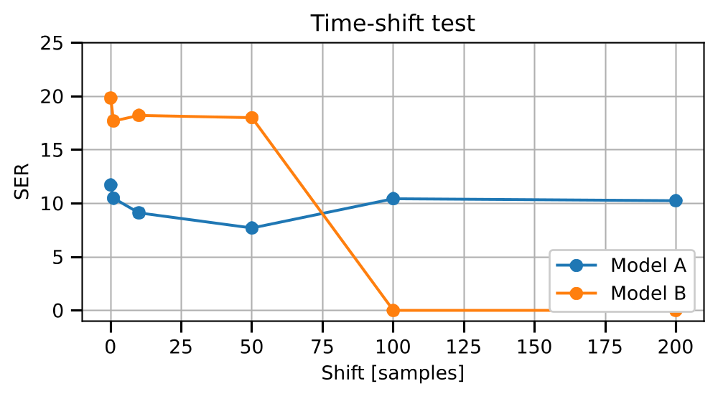
Offline results - CorRidonia
Event Generalization and Sanity Checks
Reconstruction performance was poor despite testing different models
Low inter-sensor coherence/correlation indicated weak predictability of the target from neighboring sensors
With only the surrounding sensors, SER decreased to approximately 1 dB.
Model A was more tolerant to time shifts because of its longer historical window.
Therefore, Corridonia was not well suited to the spatial waveform-reconstruction task
Spatial reconstruction requires sufficiently correlated witness sensors. A dataset containing multiple simultaneous channels is not automatically suitable.

Slide 31
Offline results - etpf
Sanity checks - Idealized baseline study
Could not train much longer, see next slide
Wiener filter

Slide 32
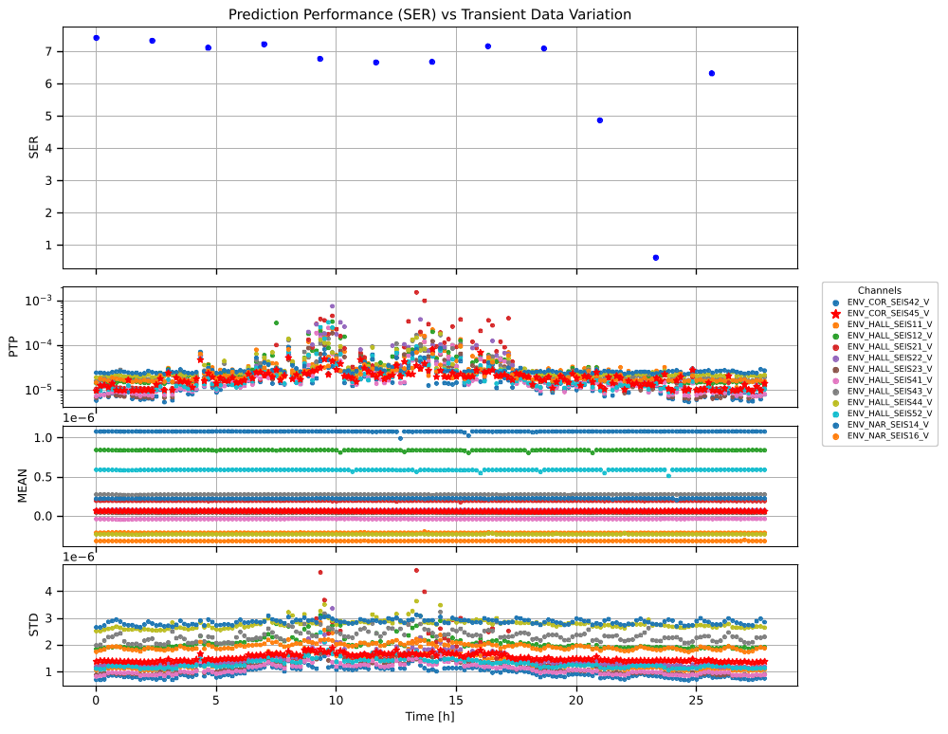
Offline results - etpf
Train same model on different time slices
HALL – cleanroom
COR – corridor NAR – noisy area

Slide 33
Offline results - etpf
Peak-to-PEAK, Mean, STD - per Ch
Peak-to-peak amplitude and standard deviation increase during working hours, while the channel means remain comparatively stable.
This pattern is consistent with increased daytime activity at the site.

Slide 34
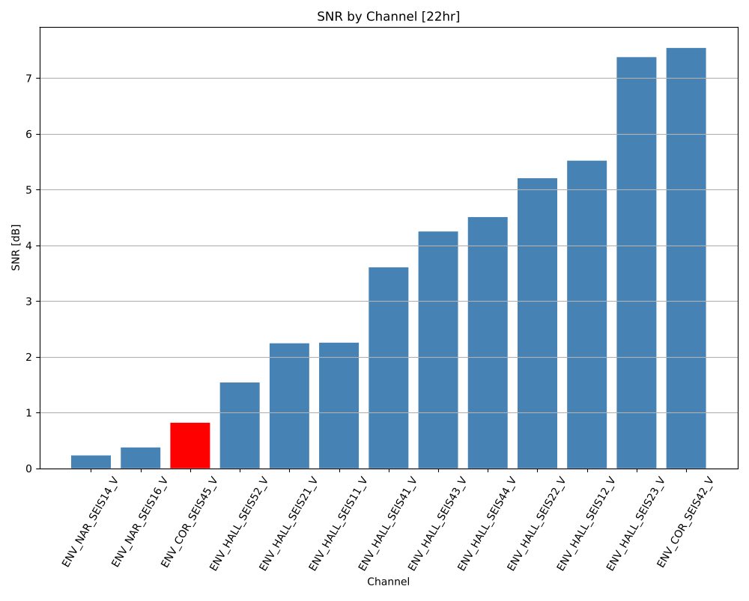
Offline results - etpf
Same slice different channels
Same 22:00 time interval evaluated for each target channel
Reconstruction performance varies strongly across channels
The primary target channel (red) is among the most difficult to reconstruct
Performance degrades when the test-data distribution differs from the training-data distribution

Slide 35
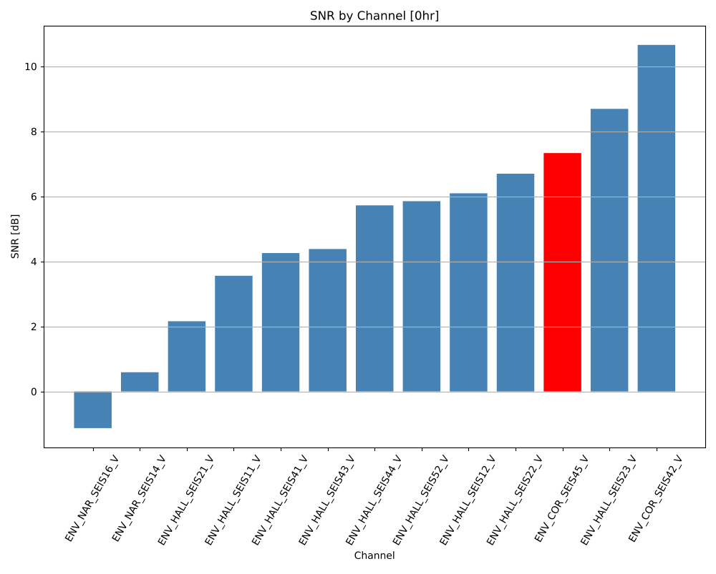
Offline results - etpf
Same slice different channels
Same analysis repeated for the 00:00 time slice
The primary target channel (red) reaches approximately 7.3 dB
Reconstruction performance therefore depends on both the target channel and the time-dependent seismic conditions
The negative value indicates unsuccessful reconstruction for one channel

Slide 36
More questions than answers
So another 8 days
Sharp SER reductions occurred repeatedly and were not unique to the original 20–22 h interval.
Some drops coincided with increased peak-to-peak amplitude and standard deviation, but these statistics did not explain every degradation.

Slide 37
Offline results - etpf
Peak-to-PEAK, Mean, STD - per Ch

Slide 38

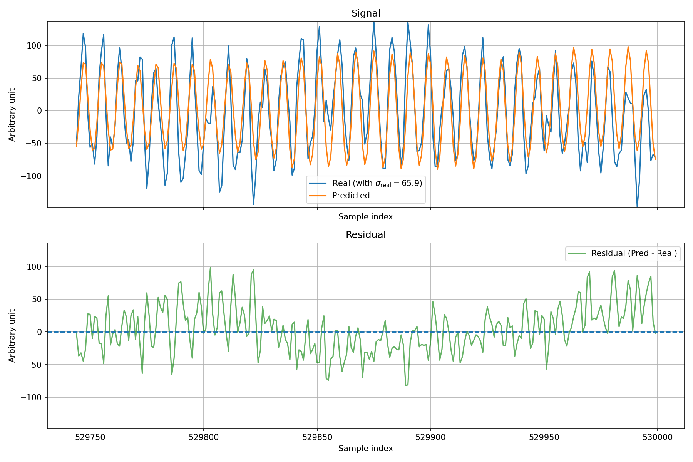
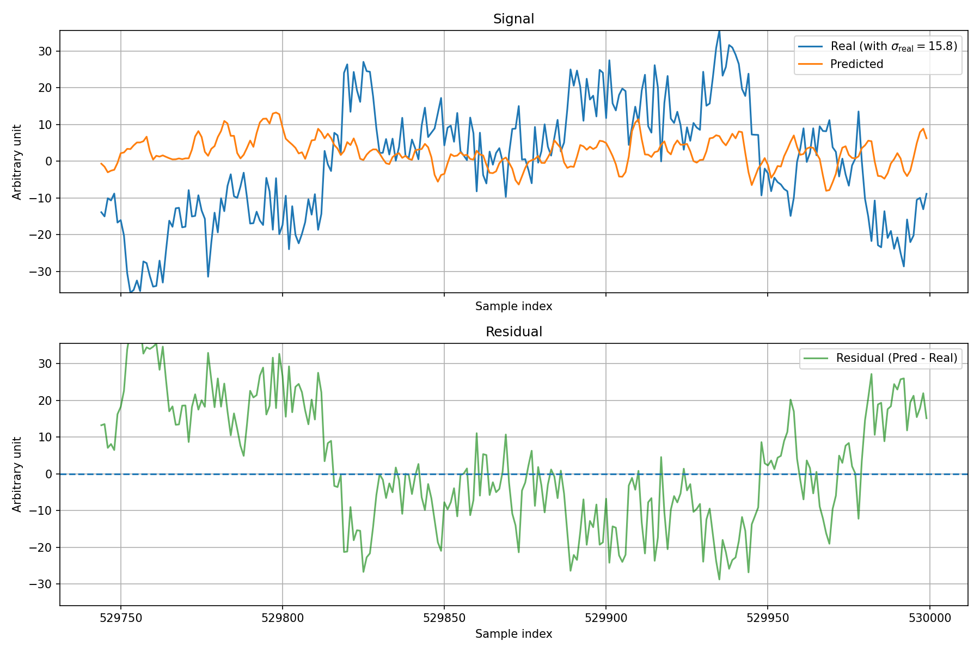
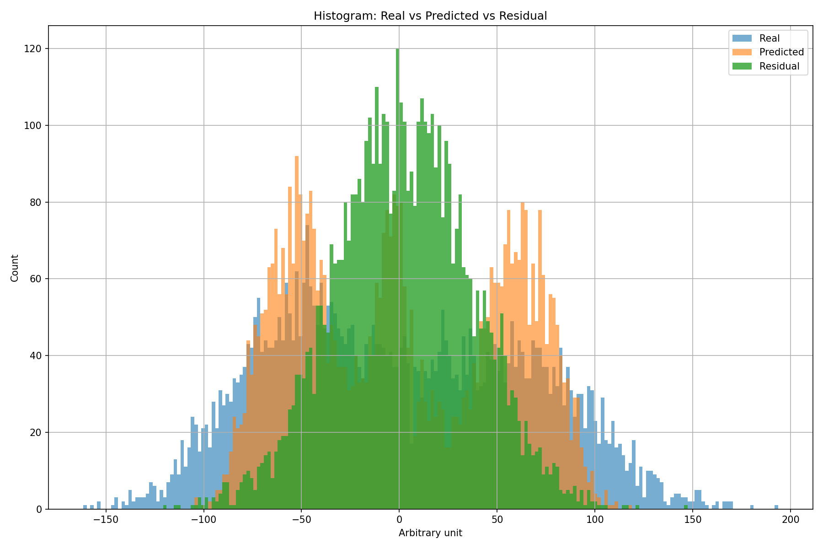



Offline results – Hi-net
HOT
SER: 5.39
CCH
SER : -0.02
Reconstruction Across Widely Separated Stations
Hi-net provides a large-scale spatial test beyond the local ETPF and Corridonia arrays.
Reconstruction performance is strongly station-dependent: HOT reaches 5.39 dB, while CCH remains near 0 dB.
Large station spacing reduces shared seismic information and introduces propagation delays.
Station geometry and local geological conditions can strongly affect predictability.
DC components were removed before the final evaluation.
HOT was the main successful case; most other evaluated targets remained below approximately 1 dB.
Cross-station reconstruction is possible for some station configurations, but it does not generalize uniformly across the Hi-net network.

Slide 39

Offline results – Hi-net
Recording divided into 100 evaluation segments
Channel-specific DC offsets remain relatively stable
Statistical distributions differ strongly across stations and axes
These differences may contribute to station-dependent reconstruction performance
Hi-net is not statistically homogeneous: prediction models must handle different amplitude scales, and occasional high-energy transients.

Slide 40
Wiener — ROBUSTNESS
The noise-injection test demonstrates a strong dependence on the target channel’s temporal autocorrelation.
The comparison with the NN is not fully equivalent: the Wiener filter uses current reference-sensor samples, whereas the NN predicts the next sample using only previous measurements.
Relative SER uncertainty: σrel​=0.11
SER at Different Time Intervals [dB]
Sensor | 0.5 h | 1 h | 1.5 h | 2 h | 2.5 h | 3 h | 3.5 h | 4 h | 4.5 h | 5 h
COR_SEIS42 | 7.79 | 7.38 | 7.18 | 6.09 | 7.81 | 7.66 | 8.06 | 8.04 | 7.2 | 7.22
HALL_SEIS44 | 6.98 | 6.6 | 6.52 | 4.54 | 6.75 | 6.67 | 6.94 | 6.48 | 6.07 | 3.88
NAR_SEIS16 | 3.8 | 3.56 | 3.66 | 3.63 | 3.7 | 3.62 | 3.69 | 3.76 | 3.57 | 3.11

Slide 41

System architecture
Predictions
Real-time path : Sensors → MQTT → FPGA
Storage path : Sensors → MQTT → Database
Control path : User interface → MQTT → Sensor nodes

