Slide 1

Experimental Investigation of Mutual Coupling in a Dense Antenna Array for a
Multi‐Channel Wideband GPR System
08.09.2026| Mukeria Tamazi| Student AT Agricultural university of georgia
Notes:
Hello everyone, My name is Tamazi Mukeria. I am an engineering student at the Georgian Agricultural university, and over the past months I have been working at Forshungszentrum Juelich, in the Institute of technology and Engineering. Today I want to share a little bit about antenna-measurement system We built.
In this multi antenna project we need to know how each antenna and antenna array behaves, and how behaviour changes when we go from 1 antenna to multiple antennas, to do so we build this measurement system:

Slide 2
Agenda
Introduction
Objectives
Design & Setup
Results
Conclusion

Slide 3
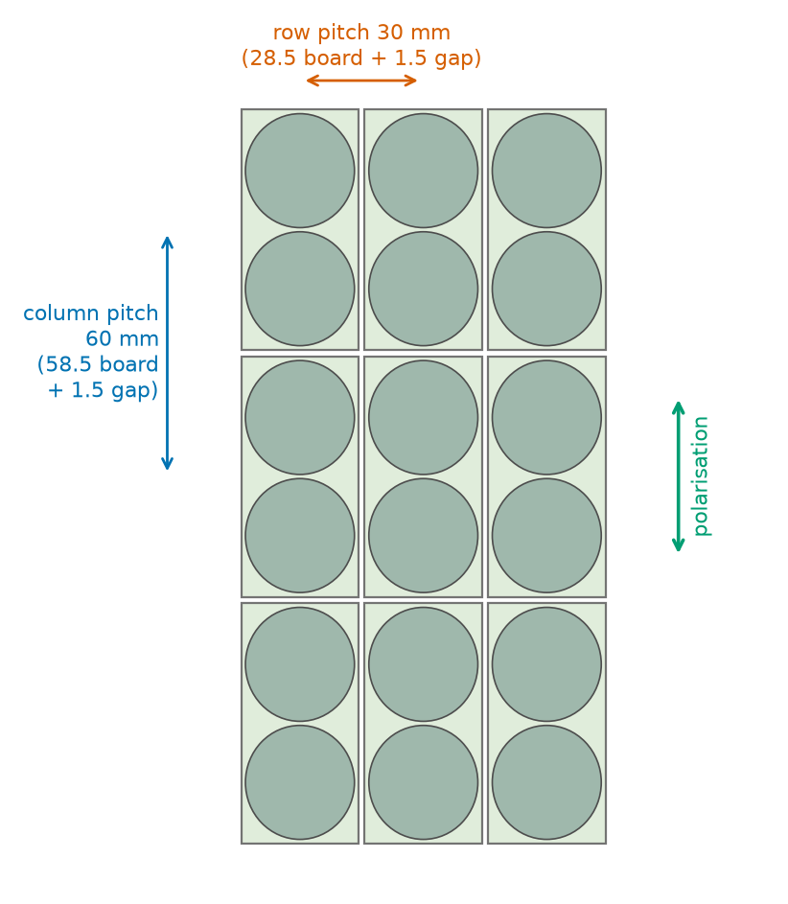
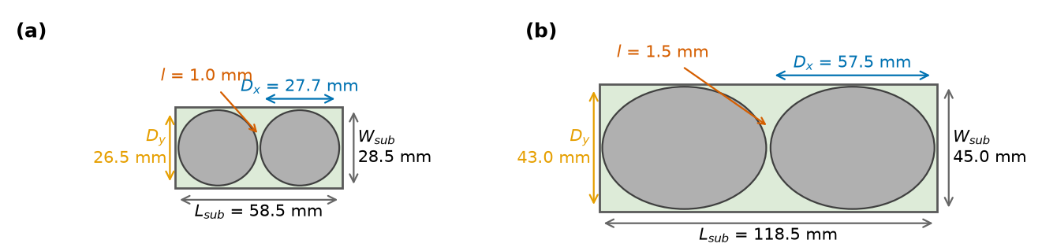
The problem
What are the challenges in this specific design?
At small separations every element changes its neighbours
Power that leaves through a neighbour might never reach the soil
In wideband range different frequencies act differently
Version 8
Version 9

Slide 4
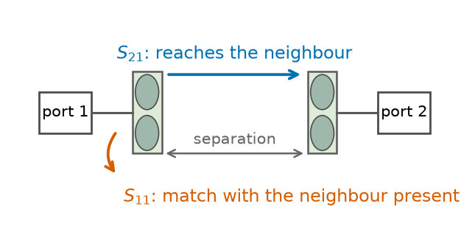
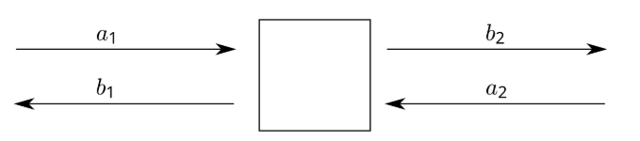

Thesis Objectives
Five questions
Coupling as a function of Separation (S21)
How neighbours change the input match (S11)
Farfield Behavioure change
Whether measurement and simulation agree
Derive practical recommendations
Scattering parameters - Wikipedia
Scattering parameters - Wikipedia

Slide 5
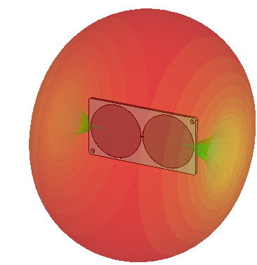
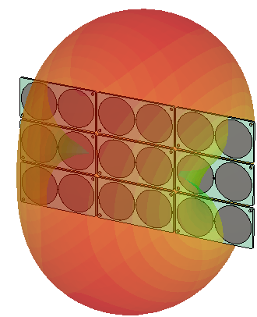
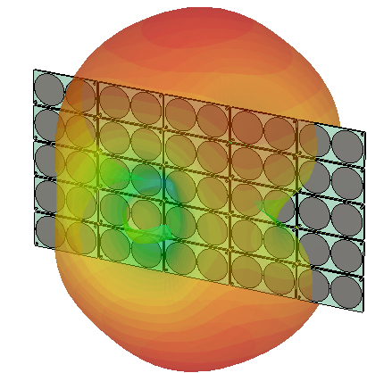
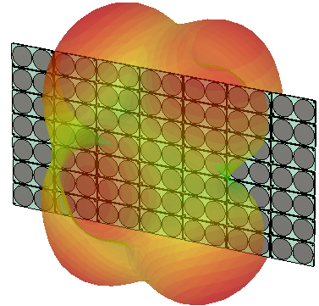
Simulations
CST Studio Suite 2025
FIT Solver with -40 dB accuracy
Simulations with different array sizes and separations
Farfield monitors at 450MHz, 900MHz, 1350MHz and 1500MHz
Exported Directivity and Realised Gain in Ludwig 3 Coordinate system

Slide 6
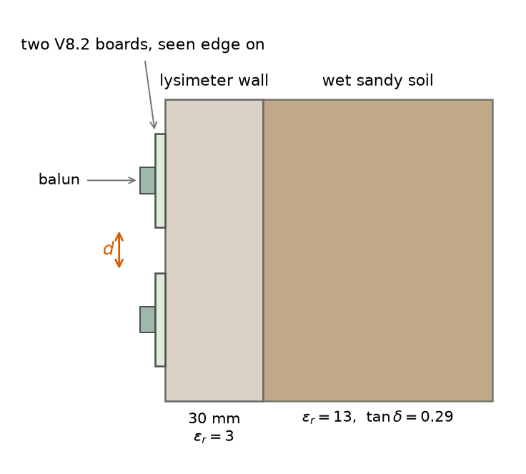
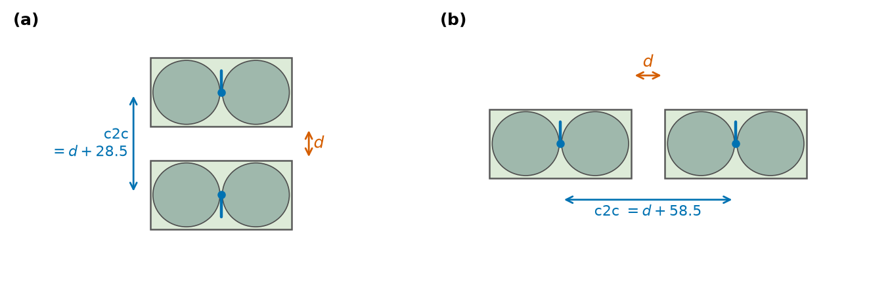
Simulations
CST Studio Suite 2025
Simulations with different c2c separations
Simulations in different environments
Simulations with and without balloon
Side-by-side
Colinear

Slide 7
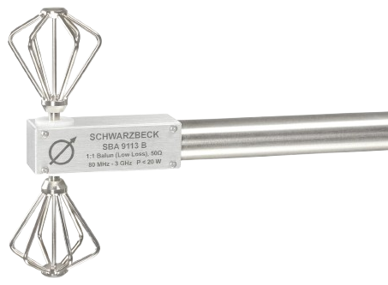
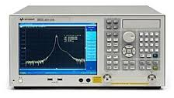

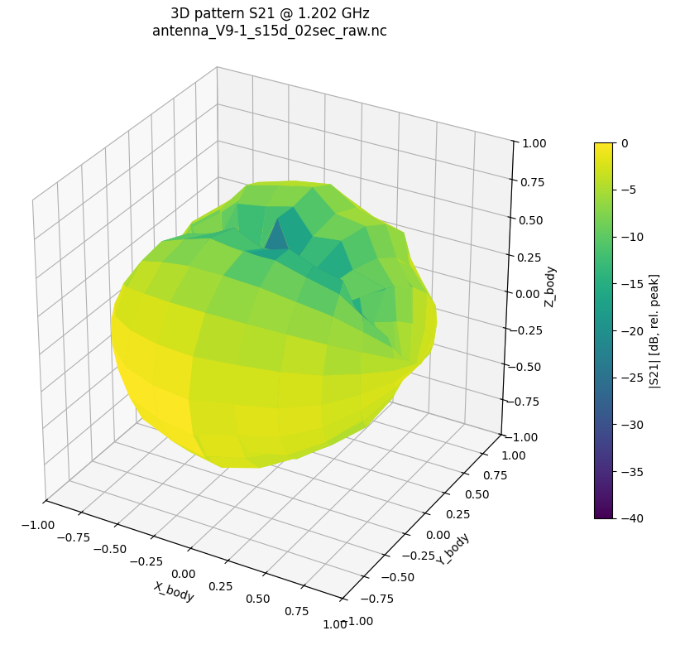
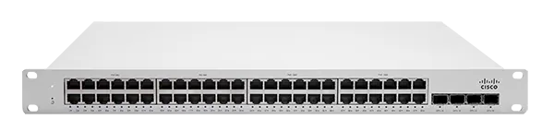
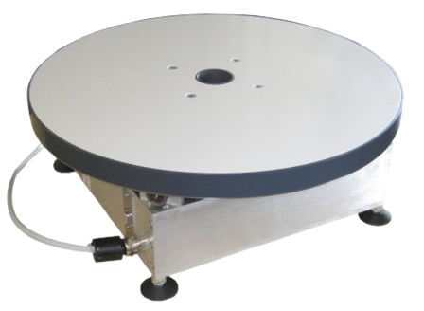
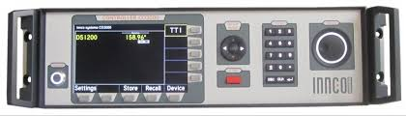
Measurements
Inside of anechoic chamber
Turntable Setup
Keysight - e5071c
theta
Schwarzbeck – SBA 9113 B
Warning!!!
Be cearfull with cables
Ethernet
Coaxial
Optical
Custom NA & CO Drivers
Innco-systems:
DE3600
CT0800
PHI
Innco-systems - CO3000

Slide 8
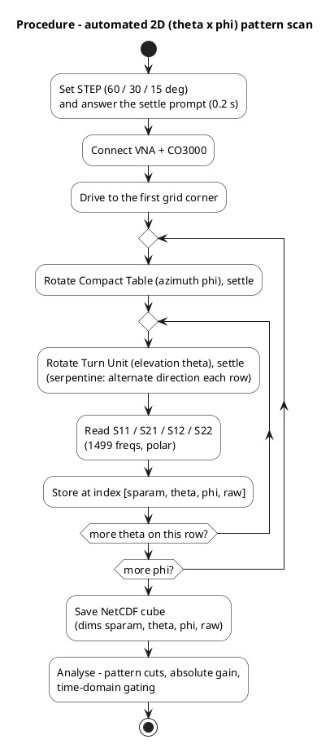
Measurements
Turntable Setup
theta
Innco-systems:
DE3600
CT0800
PHI

Slide 9
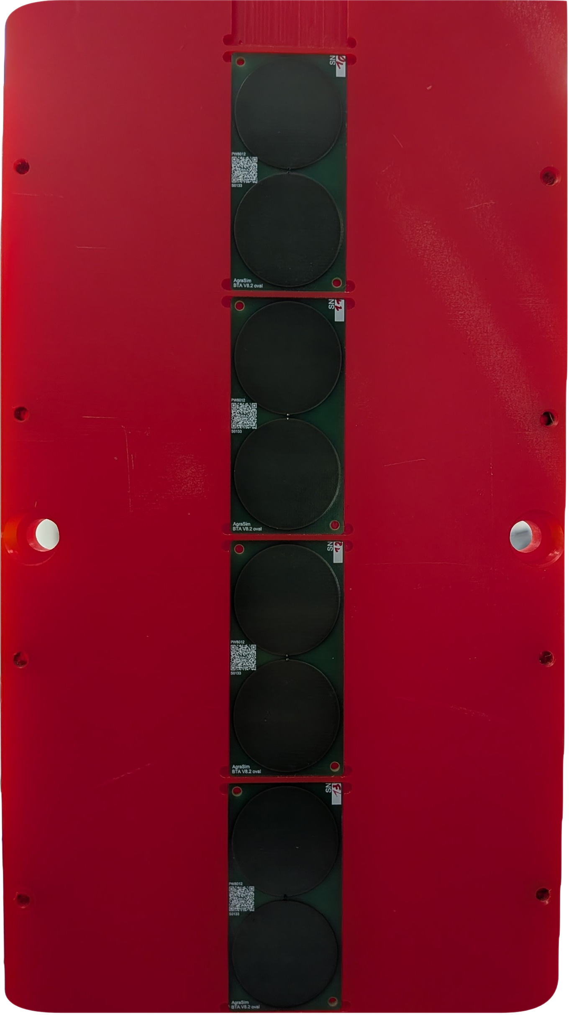
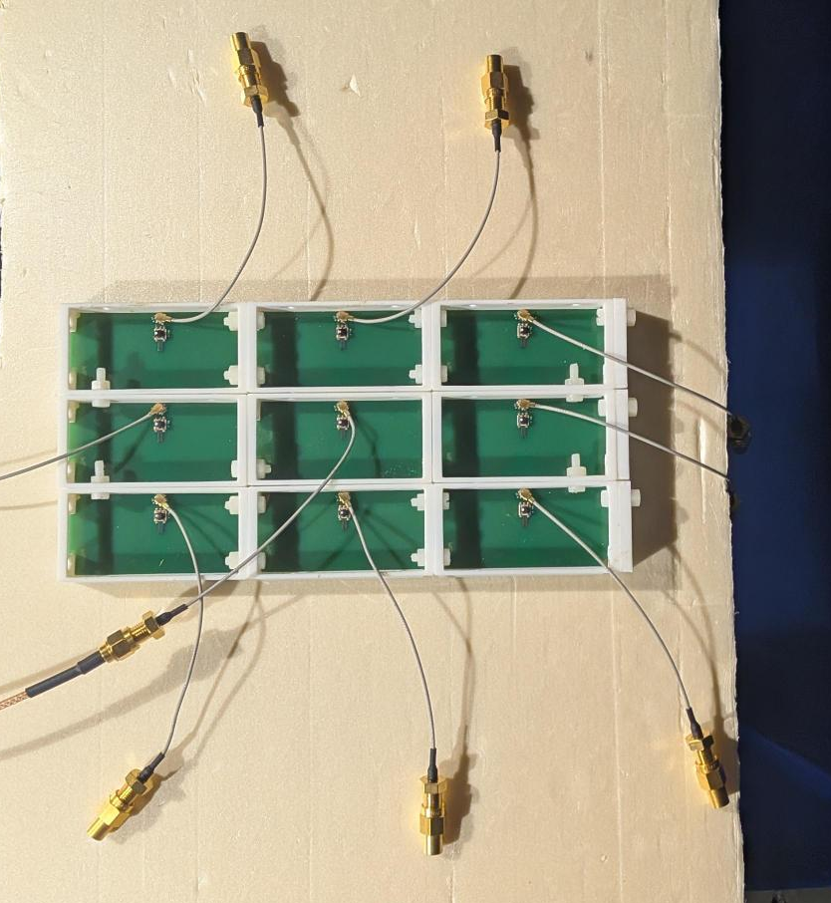
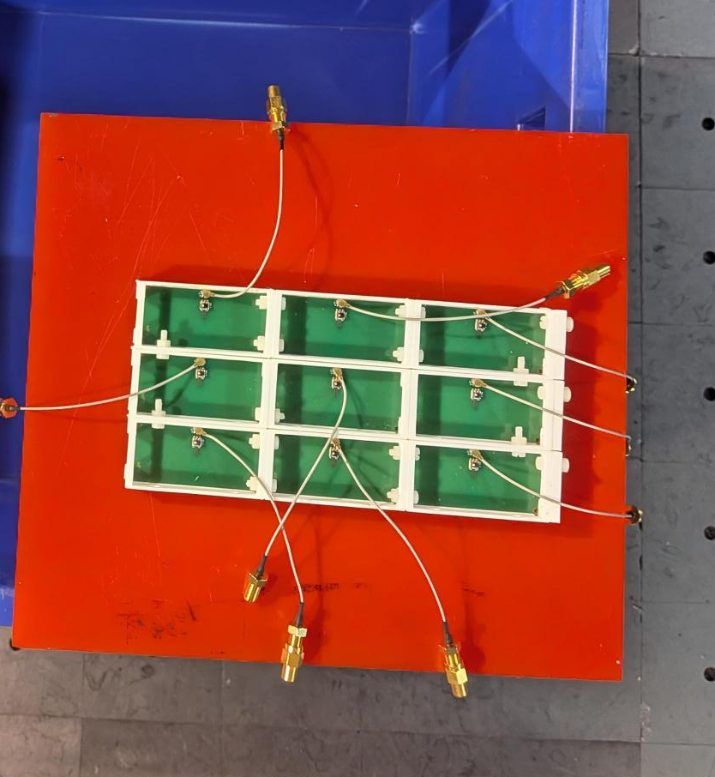
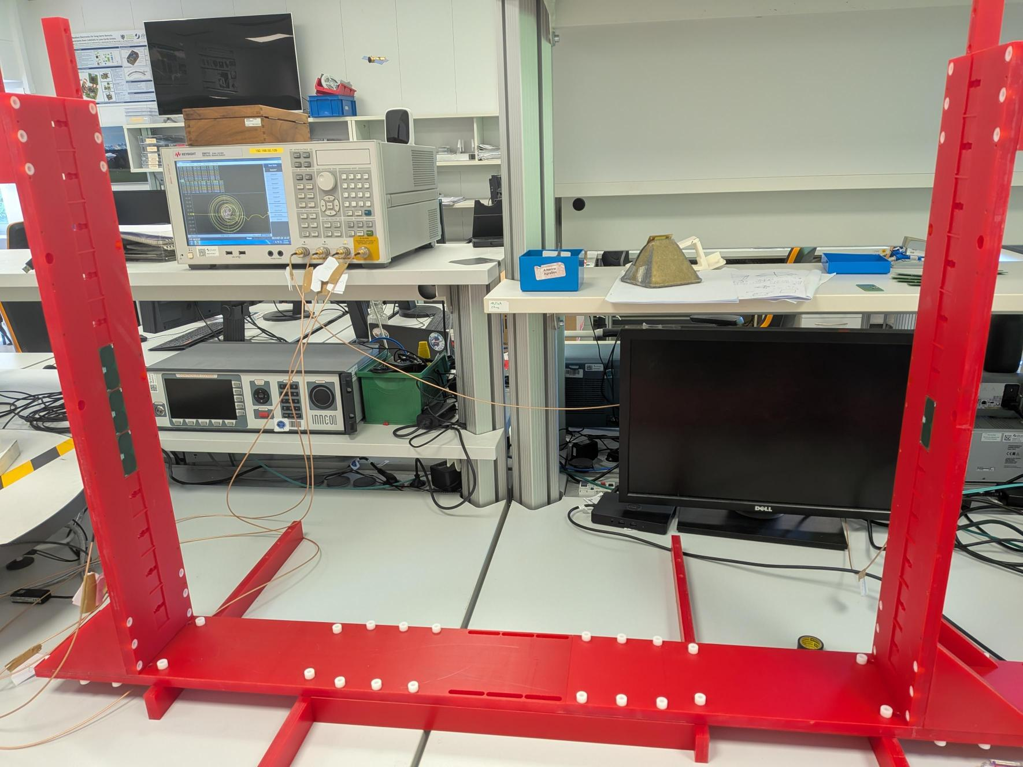
Measurements
Bench Measurements
S parameter measurements in different environments
Red material for lysimeter wall substitute
Occupancy ladder

Slide 10
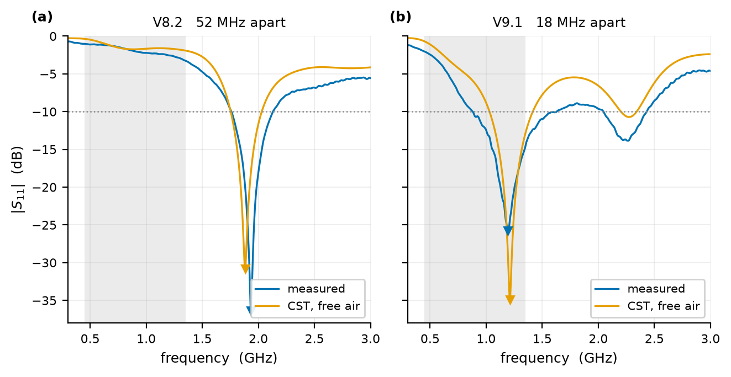
Results, Element In Isolation
Input Match, Measurement and Simulation
V8.2
  Measured resonance 1934 MHz
  Simulated resonance 1882 MHz
  Measured -10dB band (1760 MHz, 2130 MHz)
  Simulated -10dB band (1754 MHz, 2027 MHz)
V9.1
  Measured resonance 1194 MHz
  Simulated resonance 1212 MHz
  Measured -10dB band (882 MHz, 1628 MHz)
  Simulated -10dB band (1032 MHz, 1414 MHz)
Notes:
V82 width 370 MHz Measured and 273 MHz simulated
Input match measured against simulation, for (a) V8.2 and (b) V9.1. Triangles mark the resonances and the design band is shaded

Slide 11
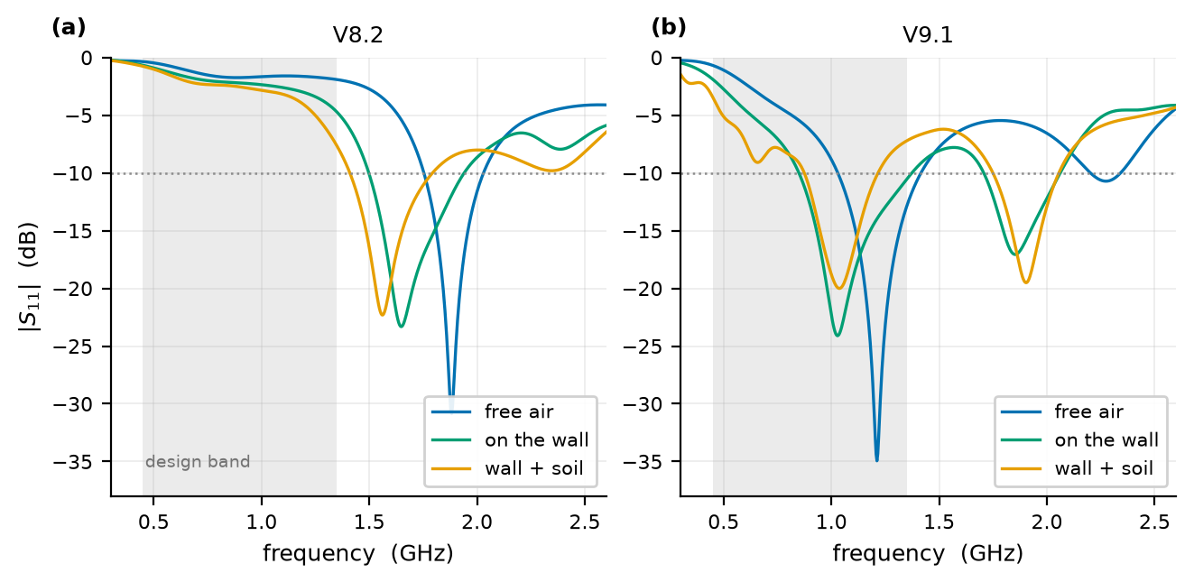
Results, element in isolation
Input Match In Environments, simulation
V8.2 resonance
  Free Space 1882 MHz
  On the wall 1648 MHz
  Wall + soil 1563 MHz
V9.1 resonance
  Free Space 1212 MHz
  On the wall 1028 MHz
  Wall + soil 1036 MHz
All the Version 9.1 resonance is inside the design band and All the Version 8.2 are out of it
Notes:
Simulated input match of (a) V8.2 and (b) V9.1 in
free Space,
against a 22 mm lysimeter wall, and
with 100 mm of wet sandy soil behind the wall
(c) Peak realised gain of the same six models.
every V8.2 resonance lies above the design band, every V9.1 resonance inside it.

Slide 12
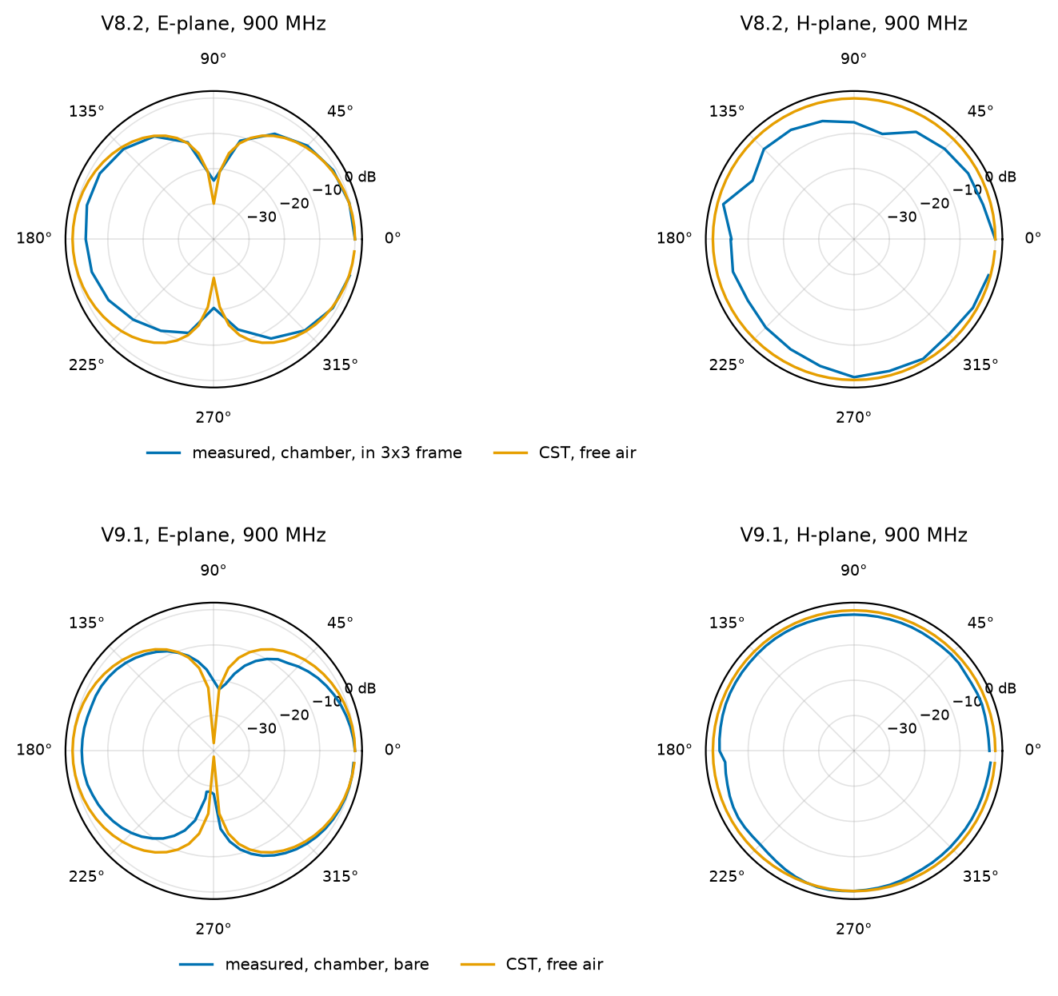
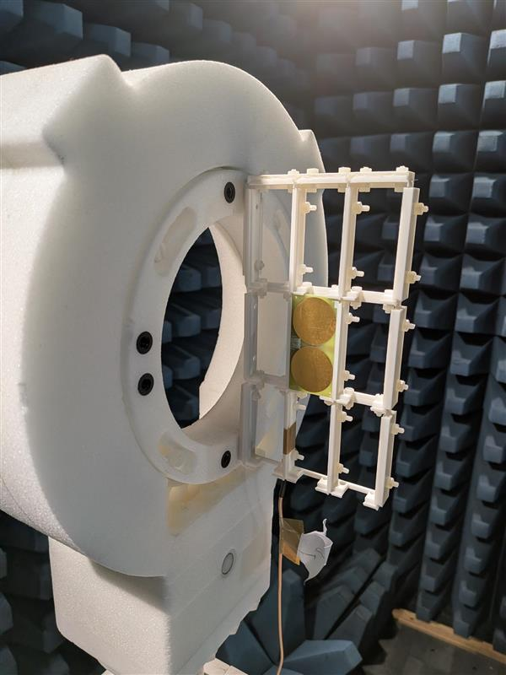
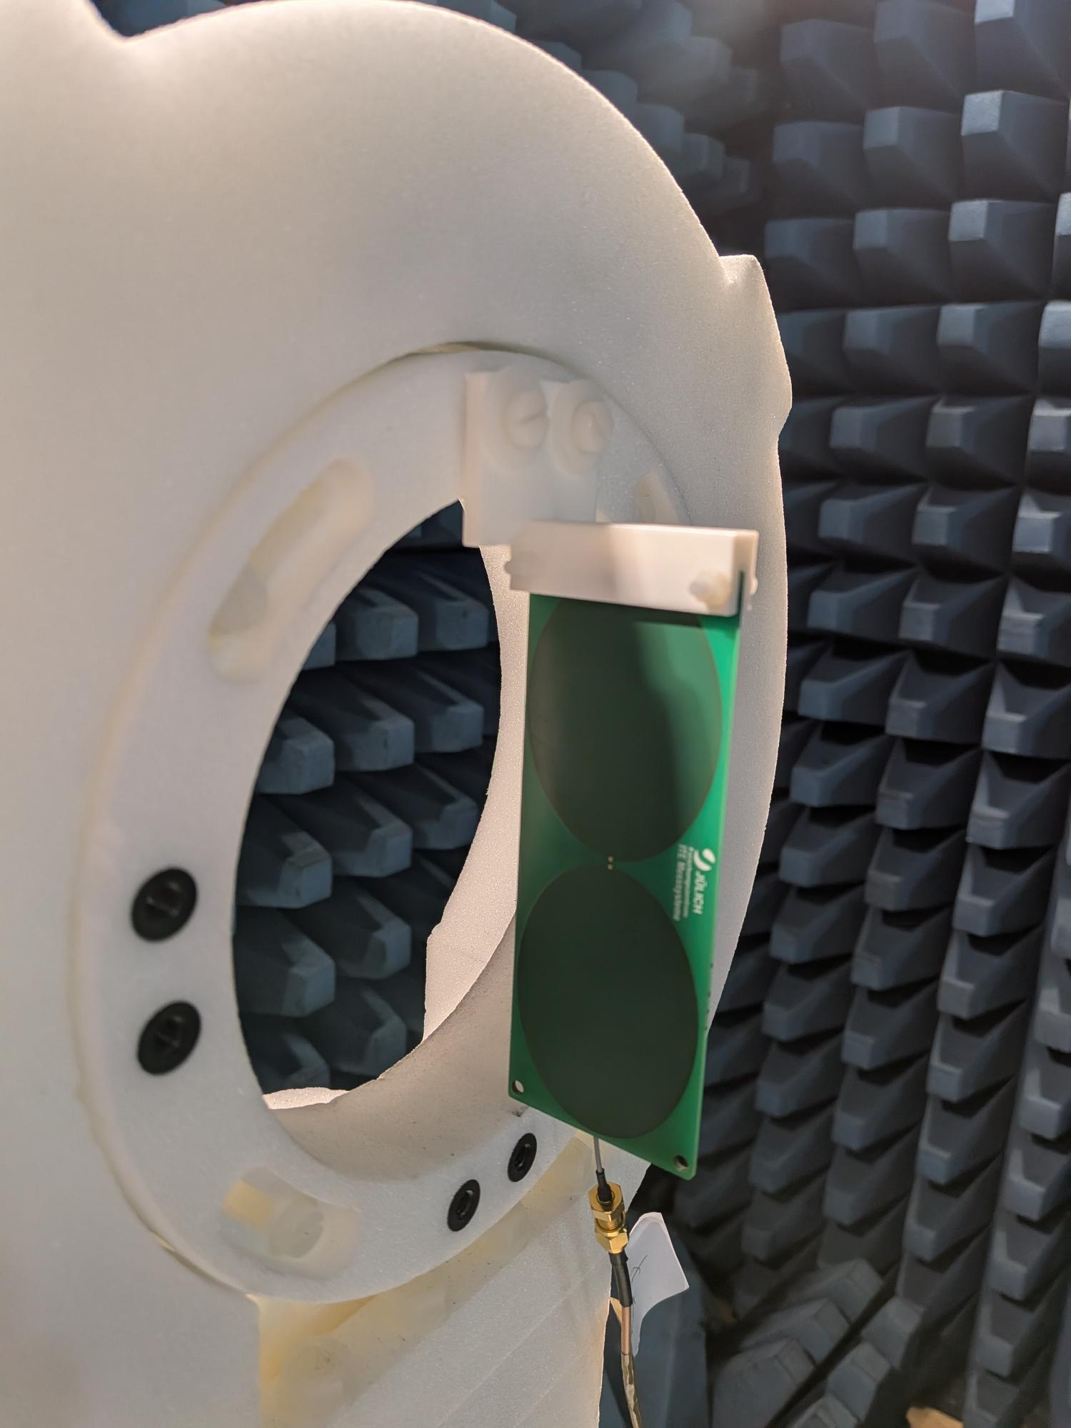
Results, element in isolation
Principle-Plane Cuts At 900 MHz, Measured / Simulated
V8.2, measured alone in the 3x3 frame
  E-plane HPBW 89.6 / 88.5 deg
  E-plane null -23.4 / -29.9 dB
  H-plane within 3 dB 42 / 100 %
V9.1, measured bare
  E-plane HPBW 75.3 / 83.4 deg
  E-plane null -28.4 / -38.3 dB
  H-plane within 3 dB 98 / 100 %
Notes:
Radiation patterns at 900 MHz:
Measured in the anechoic chamber
Simulated free‐space patterns
Each normalised to its own peak.

Slide 13
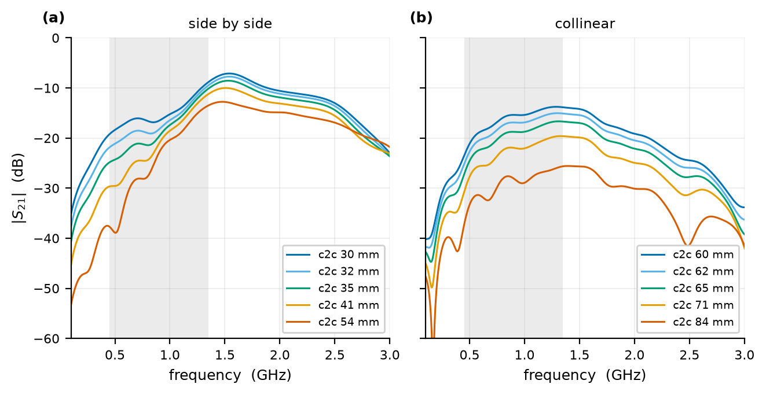
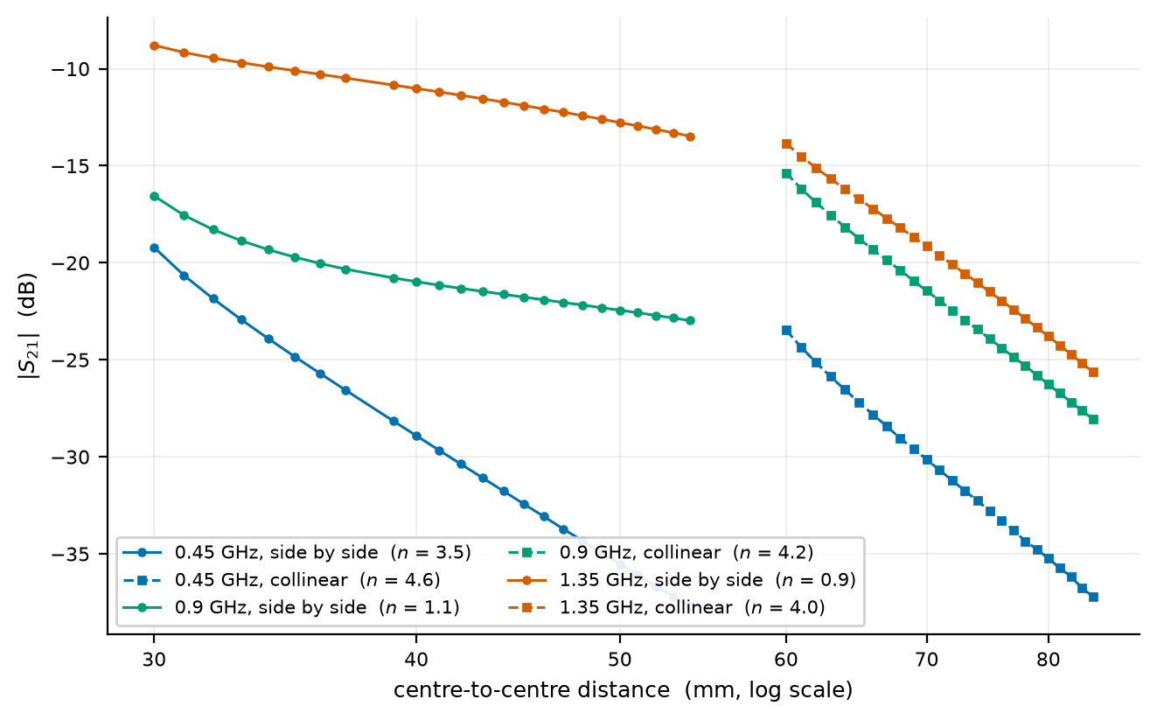
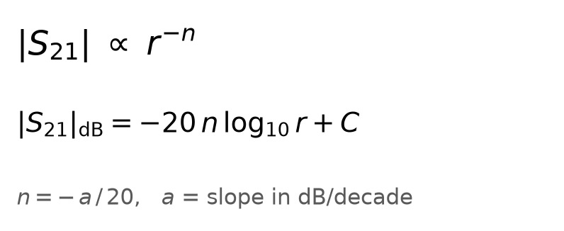
Results, Coupling Between two elements
Coupling As a Function Of Spacing (S21), Simulation
S21 Curve per separation
  Side by side sweep
  Collinear sweep
The same sweeps
  Each curve at one frequency

Slide 14
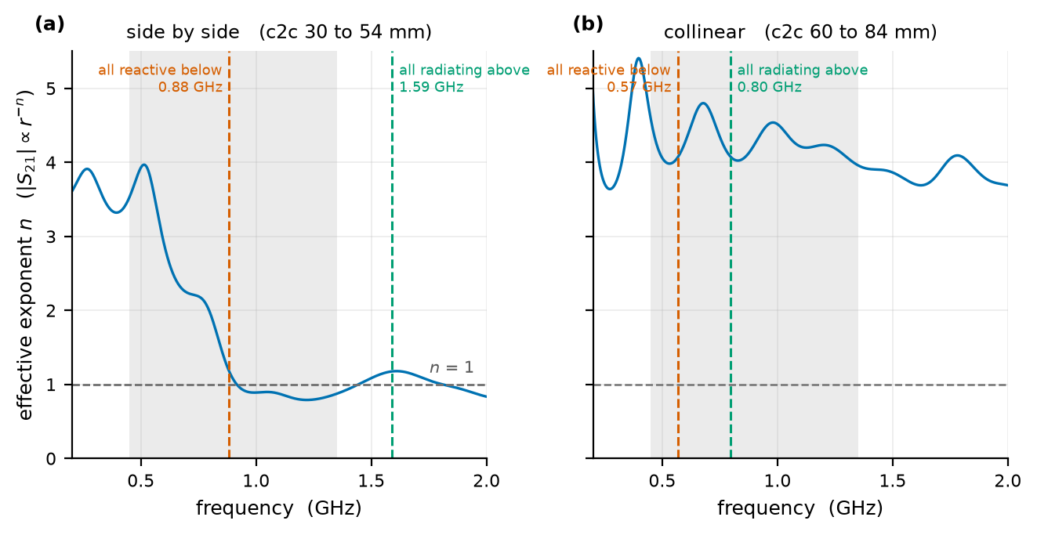
Results, Coupling Between two elements
Coupling As a Function Of Spacing (S21)
Side by side
  Side by side changes regime
  Near-To-Far transition
Collinear
  4.6 / 4.2 / 4.0 at 450 / 900 / 1350 MHz
  Positioned in each others nulls

Slide 15
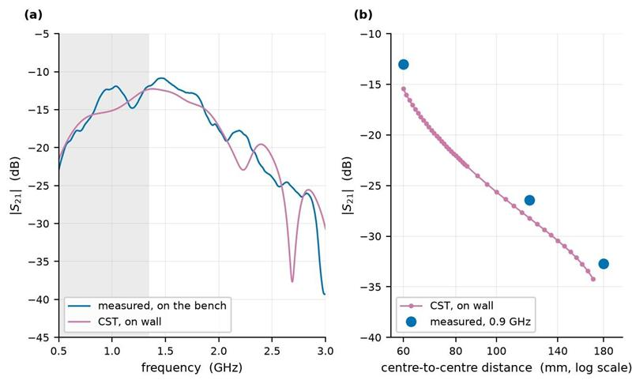
Results, Coupling Between two elements
Measurement Against Simulation, Colinear Pair
The bench was never free space
  The boards were mounted on the column
  Column Material is very close to lysimeter-wall
Measurement follows On wall Simulation
  In simulations wall was in front of the antennas
  In measurements wall was behind the antennas
  Measured n = 2.08, on simulated n = 1.9

Slide 16
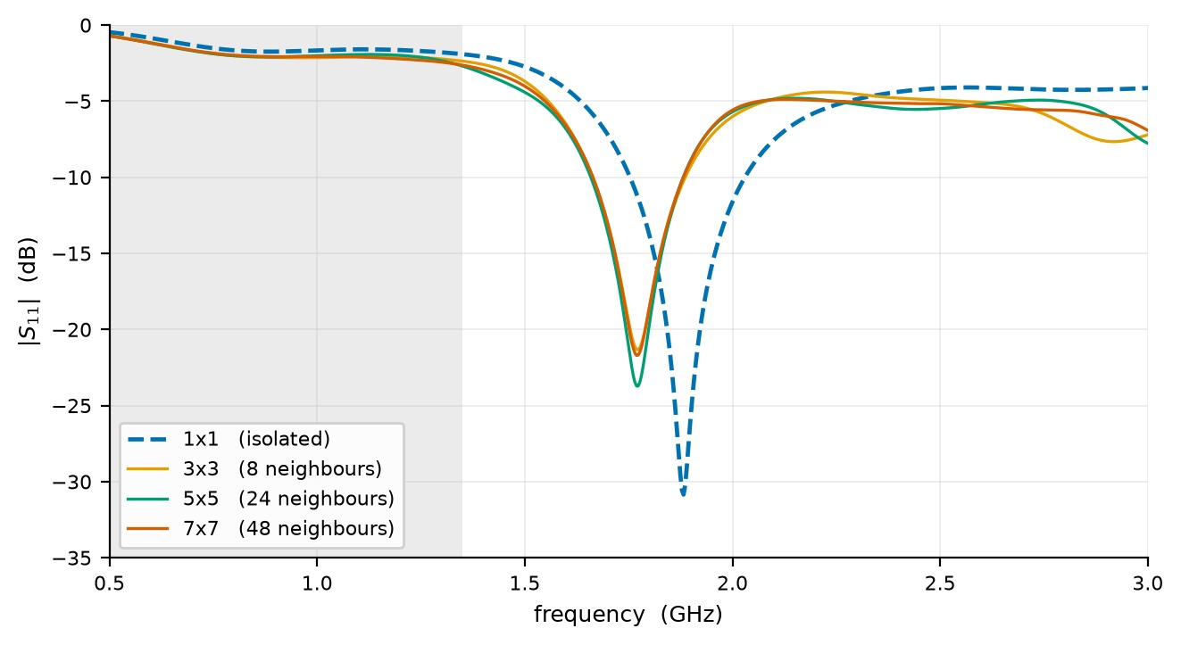
Results, The element inside the array
Input Match Against Array Size, Simulated in Free Space
In-band median |S11|, free air
  1x1 -1.62 dB
  3x3, 8 neighbours -2.05 (-0.44)
  5x5, 24 neighbours -1.96 (+0.09)
  7x7, 48 neighbours -2.07 (-0.11)
Resonance
  1882 / 1773 / 1769 / 1769 MHz
The first ring moves it 109 MHz
  the next two rings move it 4

Slide 17
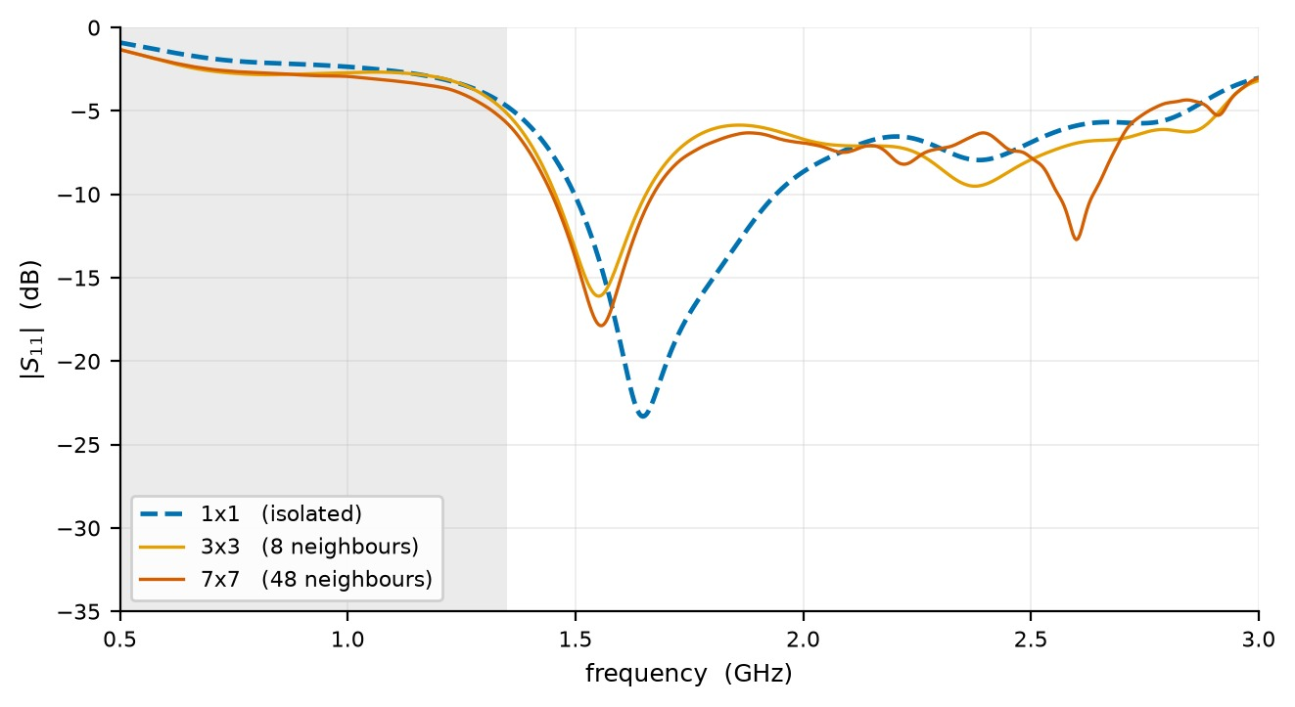
Results, The element inside the array
Input Match Against Array Size, Simulated On The Wall
In-band median |S11|, on the wall
  1x1 -2.20 dB
  3x3, 8 neighbours -2.73 (-0.53)
  7x7, 48 neighbours -2.85 (-0.12)
Resonance
  1648 / 1551 / 1555 MHz
The same convergence as in free air
  first ring -0.5 dB, about 100 MHz
  outer rings -0.1 dB, 4 MHz

Slide 18
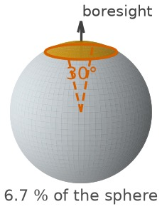
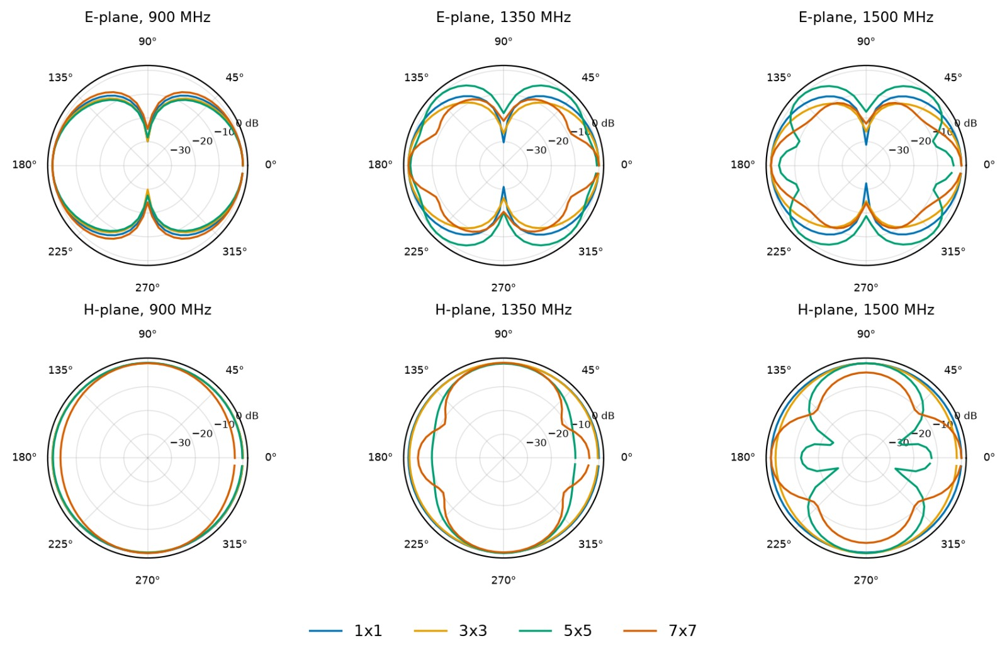
Results, The element inside the array
E and H plane Cuts As The Array Grows, Simulation in Free Space
Forward share, 30 deg cone
  1x1 / 3x3 / 5x5 / 7x7
900 MHz
  9.6 / 10.1 / 9.9 / 6.4 %
1350 MHz
  9.7 / 10.1 / 2.4 / 2.2 %
1500 MHz
  9.8 / 8.8 / 0.5 / 5.9 %
Of all the power the element radiates, the share that leaves
inside a 30 deg cone about boresight:
share = P(inside the cone) / P(total radiated)
Mismatch cancels; an isotropic radiator gives 6.7 %.

Slide 19
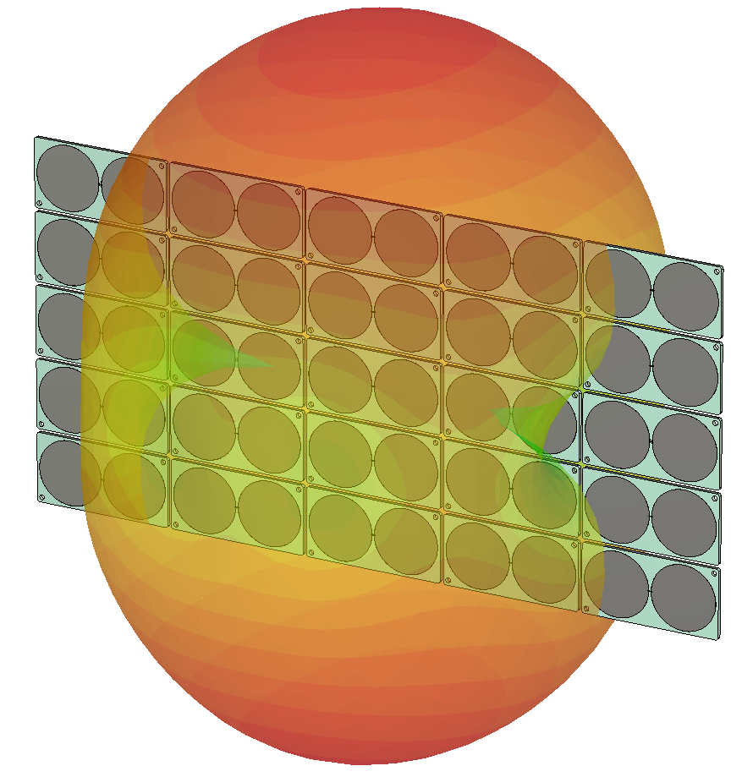
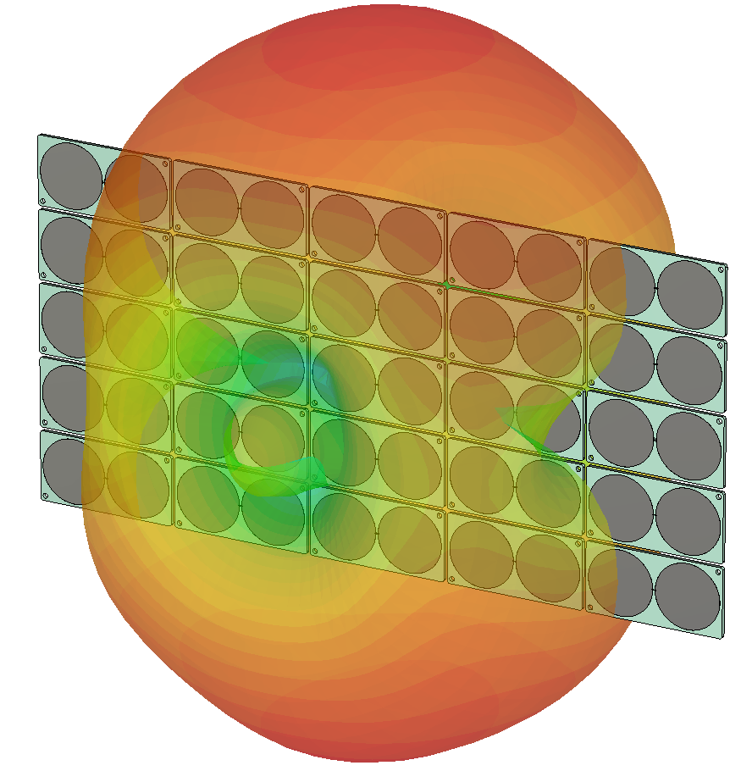
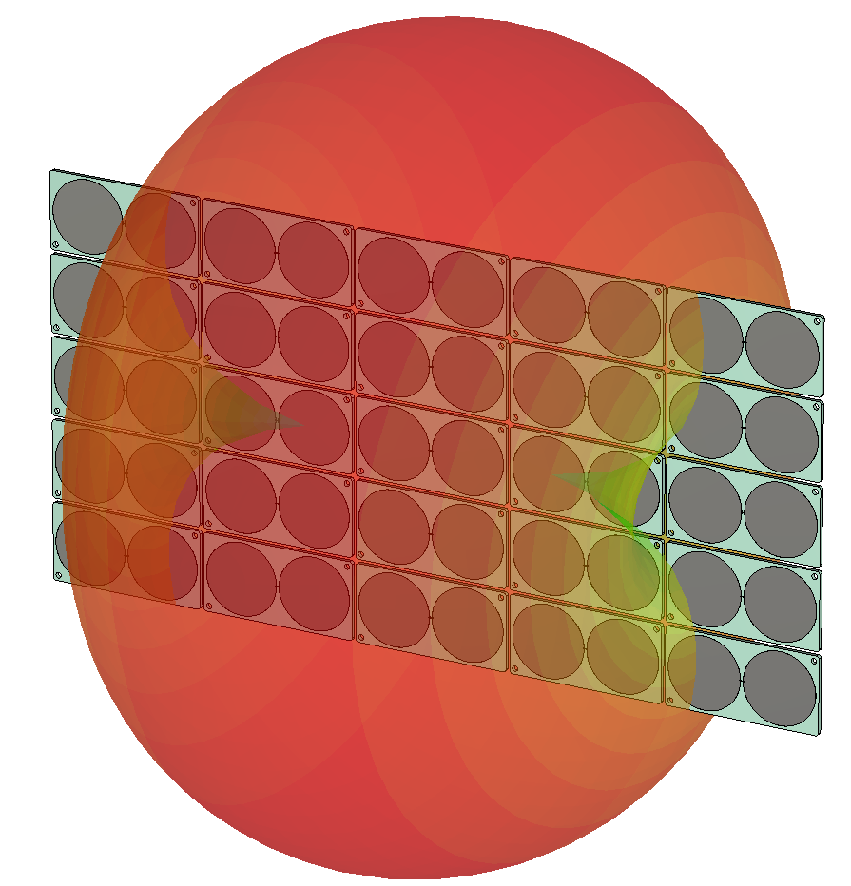
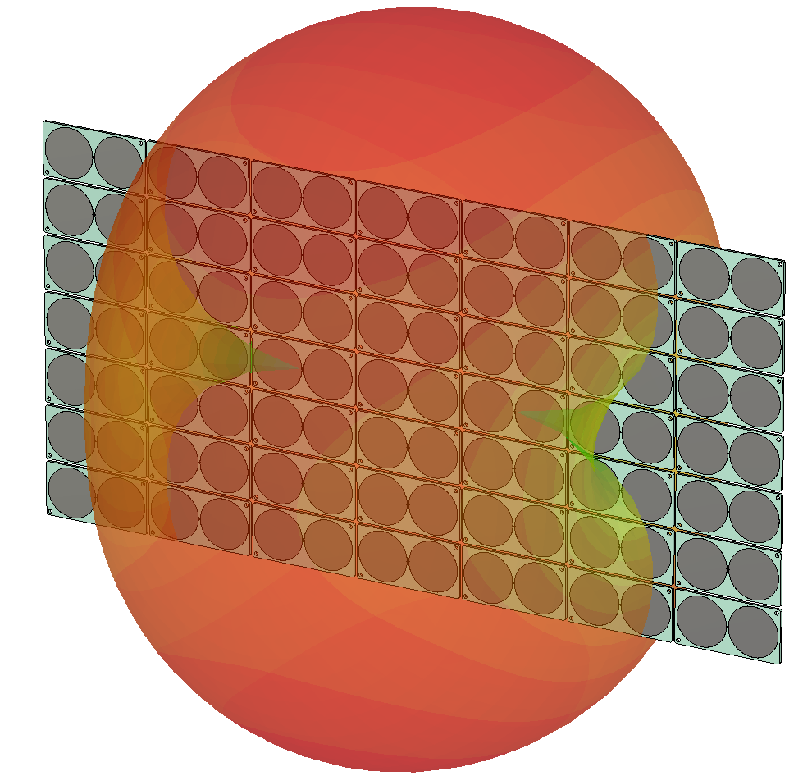
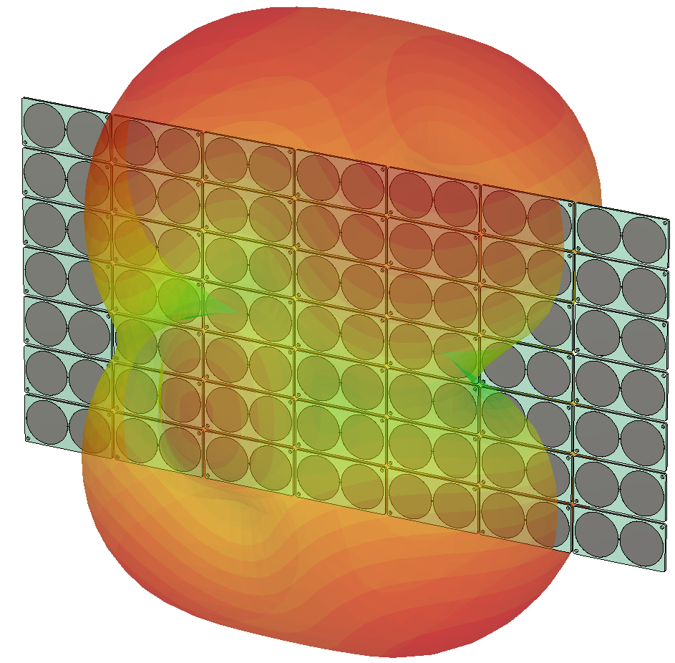
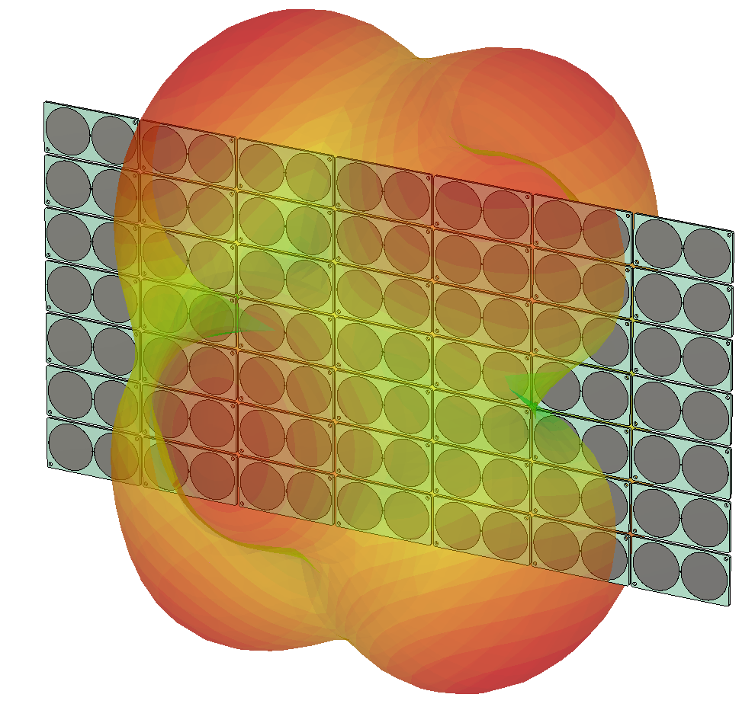
Results, The element inside the array
Simulated Farfield Radiation Paterns for 5x5 and 7x7 arrays
900 MHz
1350 MHz
1500 MHz
5x5
7x7

Slide 20
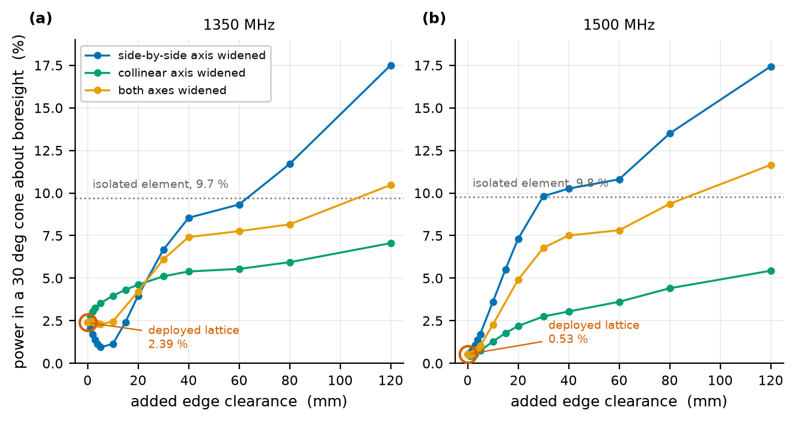
Results, Element Inside the array
Separation Sweeps For 5x5 Array In Free Space
Forward share, 30 deg cone, widening the lattice
  at 1350 / 1500 MHz
Deployed lattice
  2.4 / 0.5 %
Side-by-side pitch, 30 to 150 mm
  17.5 / 17.4 %, past the isolated element
Collinear pitch, 60 to 180 mm
  7.1 / 5.4 %

Slide 21
Conclusion
Short Answers to the Five Objectives
Coupling as a function of Separation (S21)
  Side by side n = 3.5 to 1, colinear n = 5 to 4
How neighbours change the input match (S11)
  It converges and nearest neighbours are important
Farfield Radiation Pattern
  Does not converge and dielectric makes it worse
Whether measurement and simulation agree
  A few measurements that was conducted match closely to simulations
Derive practical recommendations
  Next Slide

Slide 22
Conclusion
Recommendations
For array layout
  Separation is a real lever: 0.5(at d = 1mm) to 17.4(at d = 180mm) % forward share at 1500 MHz
  Increasing side-by-side separation showed best results
  Reduce of dielectric material as much as possible

Slide 23
Thank you
Questions welcome

