Slide 1
Scalable Multi-Channel GPR Tomography System
Antenna Optimisation
08.09.2026 | PhD student: Rati Chkhetia | Supervisors: Prof. Zaza Metreveli, Dr. Achim Mester

Slide 2
Agenda
Introduction
  Project Background
  Objectives
Antenna Optimisation
  Analysis of the Current Antenna
  Design of the new Antennas
  Manufacturing and Verification
Conclusions and Outlook

Slide 3
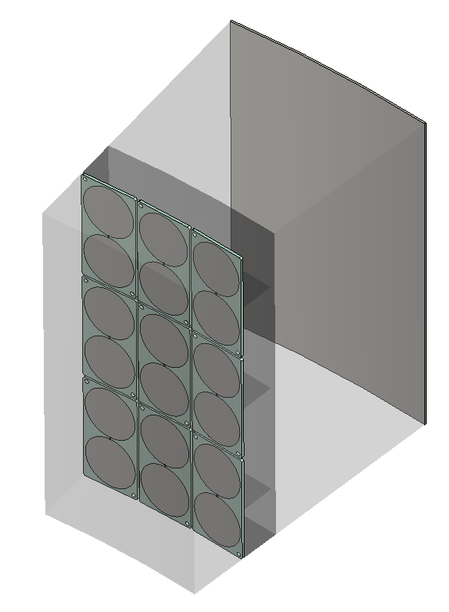
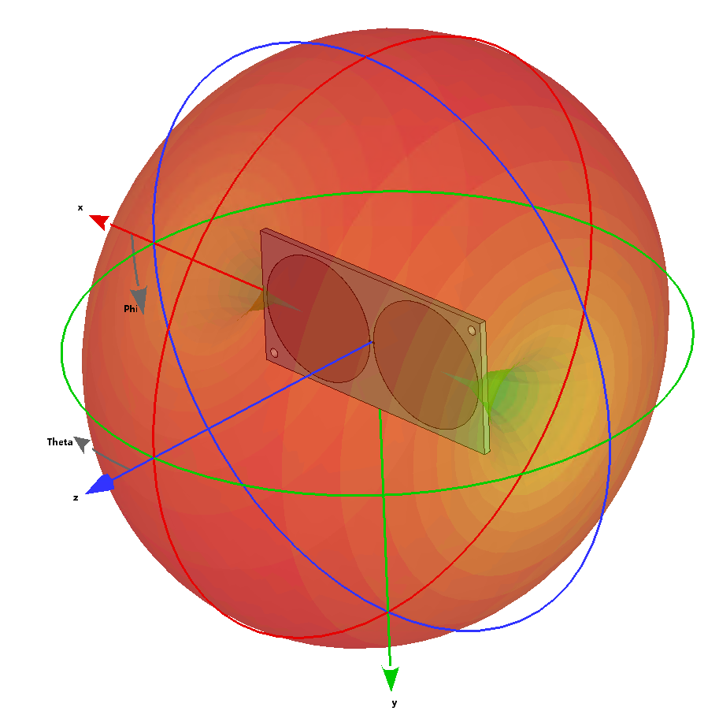
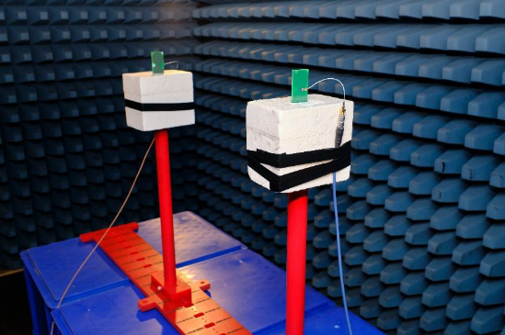
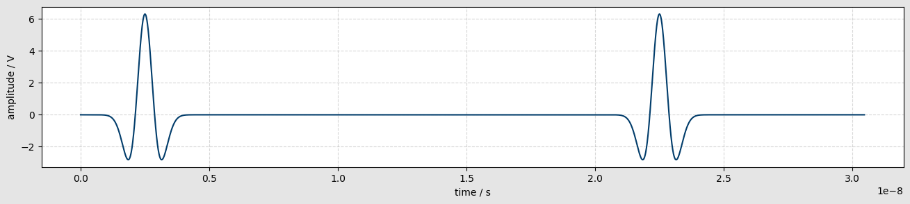
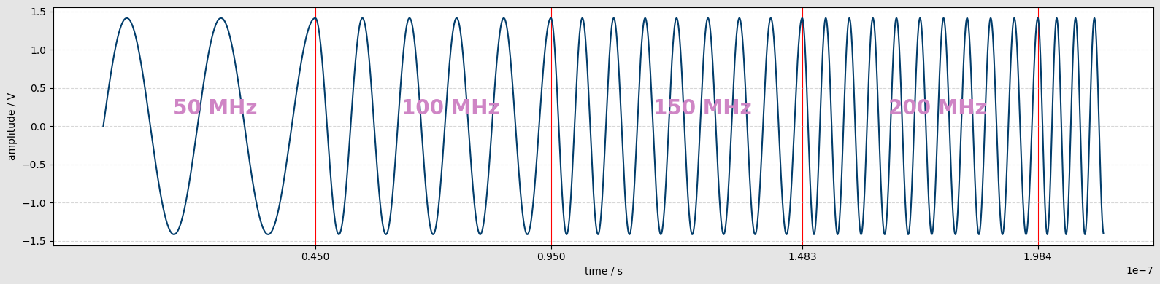
PhD Objectives
Optimize Antenna
Improve signal-to-noise ratio
Current implementation: Impulse GPR
idle time
Example of continuous-wave signal: Stepped Frequency Continuous Wave (SFCW)
Section of a tile modeled in CST studio.
3D Directivity pattern of a single element.
Measurement setup in the EMC chamber.
Antenna requirements:
  Frequency range of 500 MHz to 1500 MHz.
  Linear phase characteristics.
  Nearly uniform unidirectional radiation pattern.
  Minimal crosstalk.
Our methods:
  Simulations in CST Studio Suite.
  Manufacturing and characterization of the new designs.
Milestones
Comparison of the 3 measurement sequences (Impuse, SFCW, Chirp) using:
Numerical simulations
Experimental measurements

Slide 4
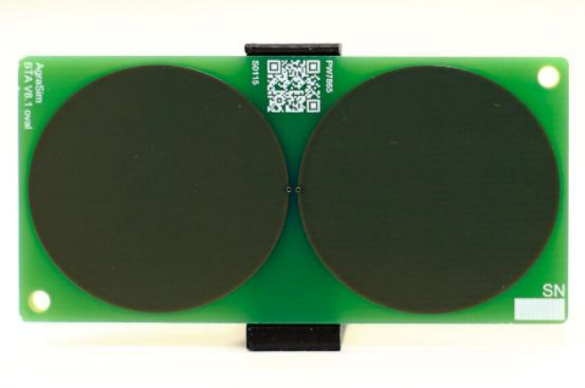
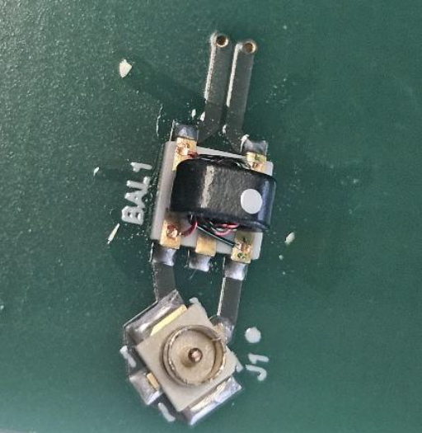
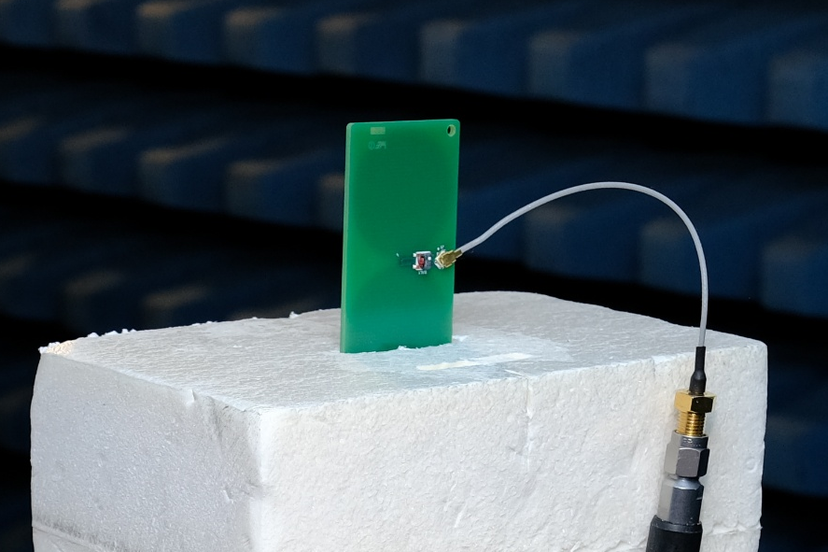
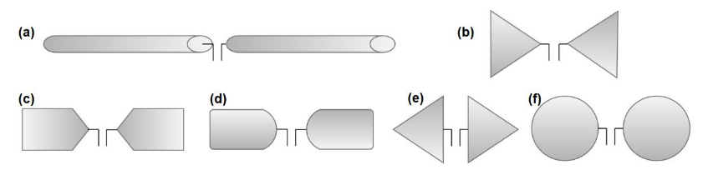
Existing Antenna Design
Antenna topology: elliptical dipole.
PCB substrate: FR-4 (𝜀_{r}=4.3)
Design goals:
  Wide bandwidth and low ringing.
  Compact size.
Antenna Dimensions.
Manufactured antenna.
Typical dipole antenna shapes [1].
BAL1: Mini-Circuits TC1-1-13MG2
J1: Molex U. FL male connector.
Antenna connected to the SMA cable through
SMA - U. FL adapter.
[1] L. Pajewski, F. Tosti, and W. Kusayanagi, “Antennas for GPR Systems,” in Civil Engineering Applications of Ground Penetrating Radar, A. Benedetto and L. Pajewski, Eds., Cham: Springer International Publishing, 2015, pp. 41–67. doi: 10.1007/978-3-319-04813-0_2.

Slide 5
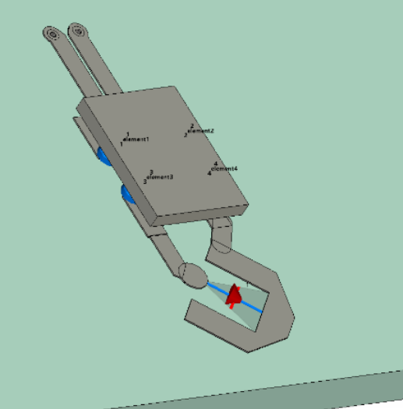
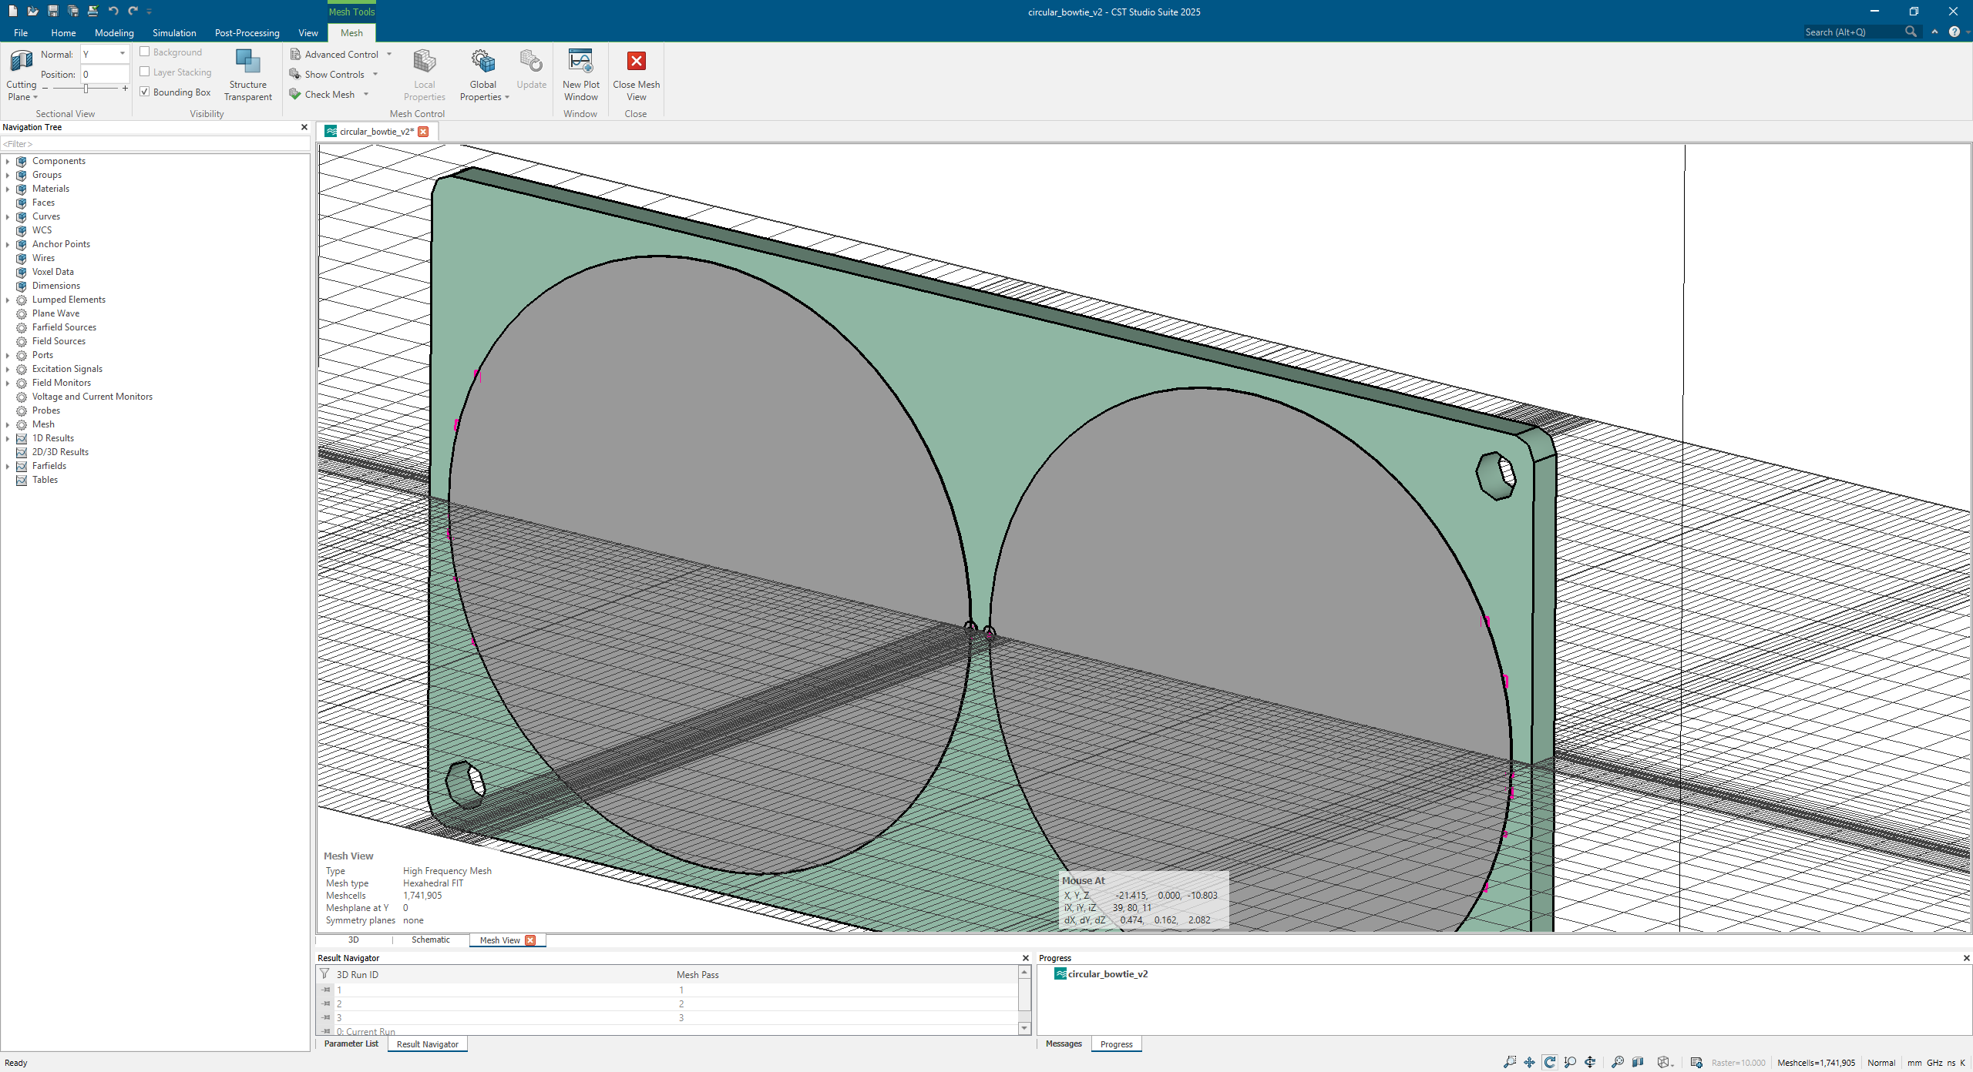
Antenna Modeling and Simulation
Modeling
Simulation
Substrate – lossless FR-4, 𝜀_{r}=4.3.
Copper traces – PEC (Perfect Electric Conductor).
Balun – Multipin lumped element (S-parameters from the manufacturer).
Solver: Finite Integration Technique (FIT).
Mesh: Hexahedral.

Slide 6
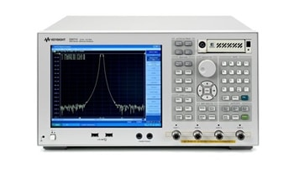
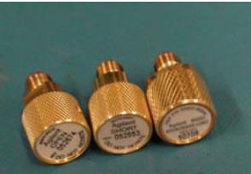
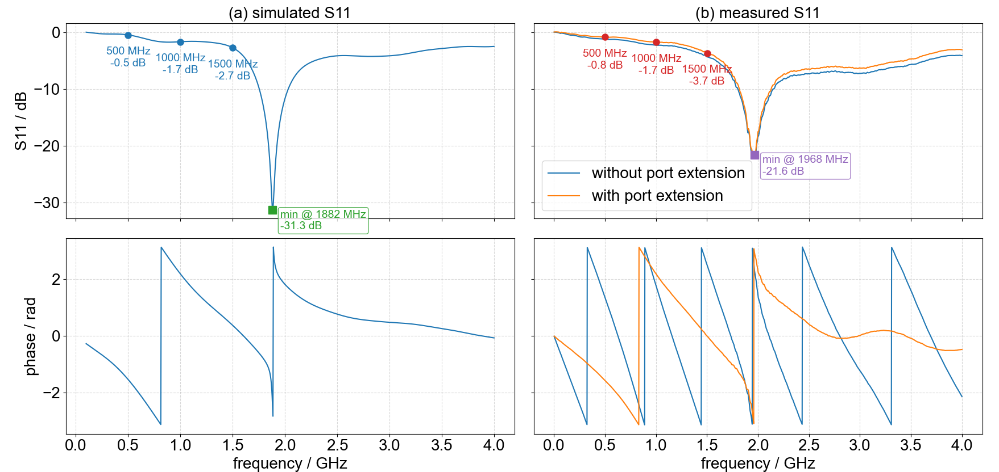
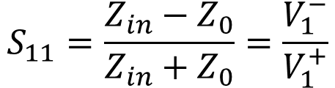
Characterization of the Existing Antenna
Step 1: Reflection Coefficient $S_{11}$
VNA: Keysight E5071C
Calibration kit: 85052D
Processing:
  - Port extension to account for calibration error.
Calibration Reference Plane
$$S_{11}=\frac{Z_{in}−Z_{0}}{Z_{in}+Z_{0}}=\frac{V_{1}^{−}}{V_{1}^{+}}$$
dB | Voltage Ratio | Power Ratio
-10 | 0.32 | 0.1
-6 | 0.5 | 0.25
-3 | 0.71 | 0.5
-1 | 0.89 | 0.79

Slide 7
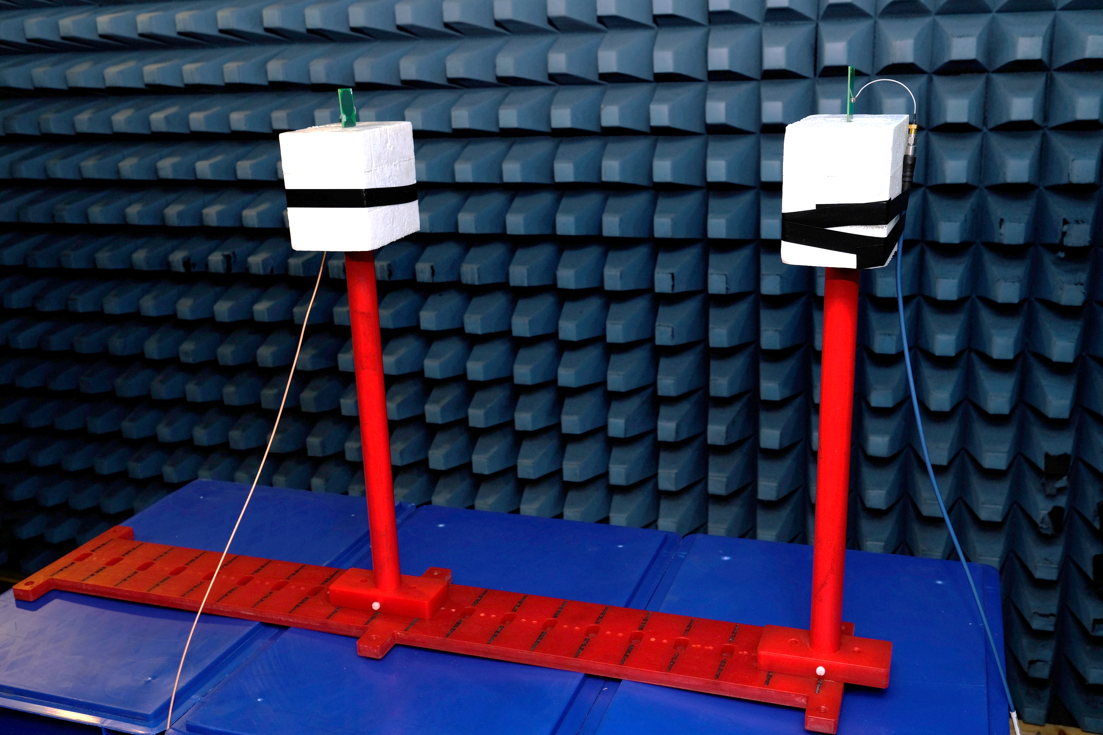
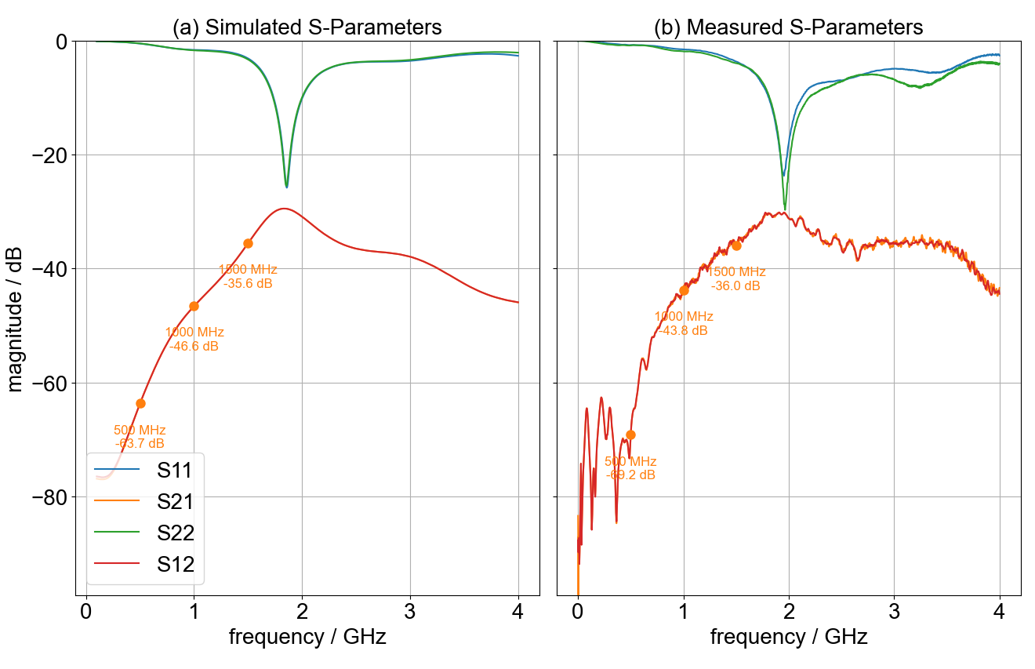
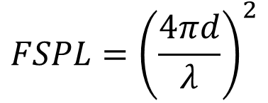
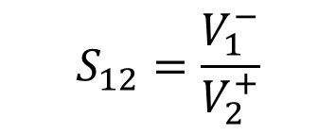
Characterization of the Existing Antenna
Step 2: 2-port Setup
$$FSPL={\left(\frac{4πd}{λ}\right)}^{2}$$
d=0.5 m
frequency / MHz | 𝐹𝑆𝑃𝐿 (dB)
500 | 20.4
1000 | 26.4
1500 | 29.9
$$S_{12}=\frac{V_{1}^{−}}{V_{2}^{+}}$$
dB | Voltage Ratio | Power Ratio
-20 | 0.1 | 0.01
-40 | 0.01 | 0.0001
-60 | 0.001 | 0.000001

Slide 8
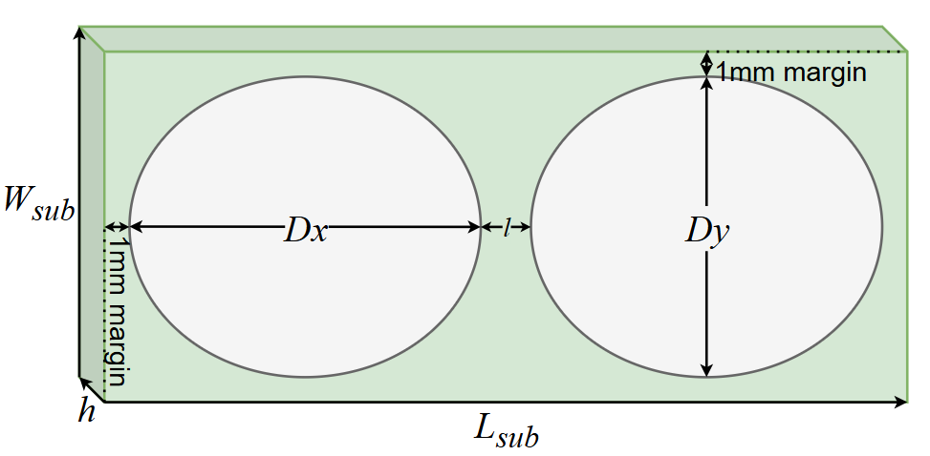
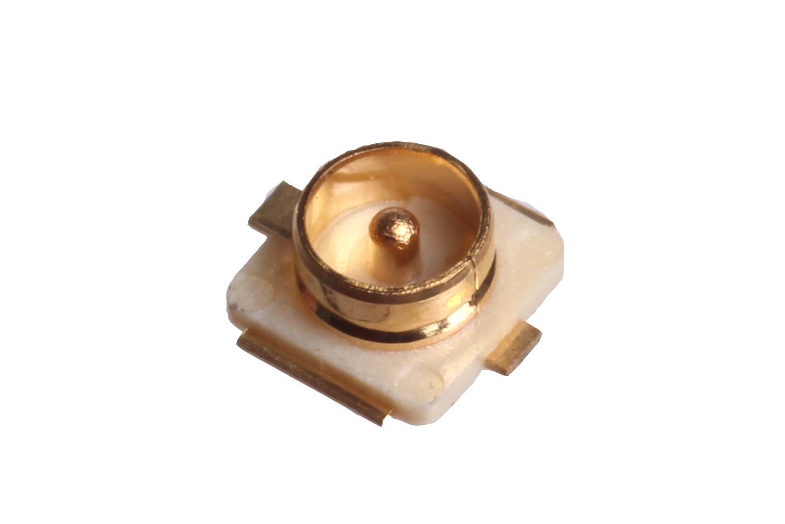
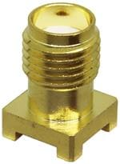
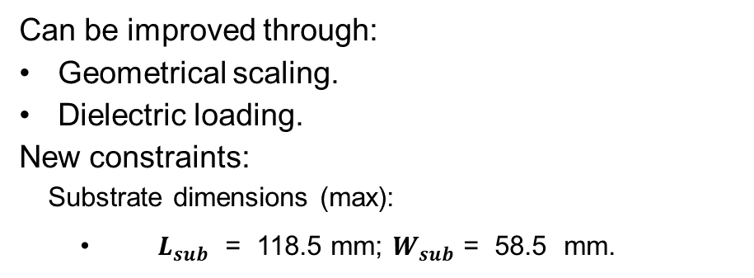
Areas for Improvement
Antenna Efficiency
Connector
U. FL
Surface-mount SMA
What we gain:
Better lifecycle.
No need of an adapter.
What we (might) lose:
Bigger footprint – influence on the antenna characteristics.
Can be improved through:
Geometrical scaling.
Dielectric loading.
New constraints:
  Substrate dimensions (max):
  $L_{sub}$ = 118.5 mm; $W_{sub}$ = 58.5 mm.

Slide 9
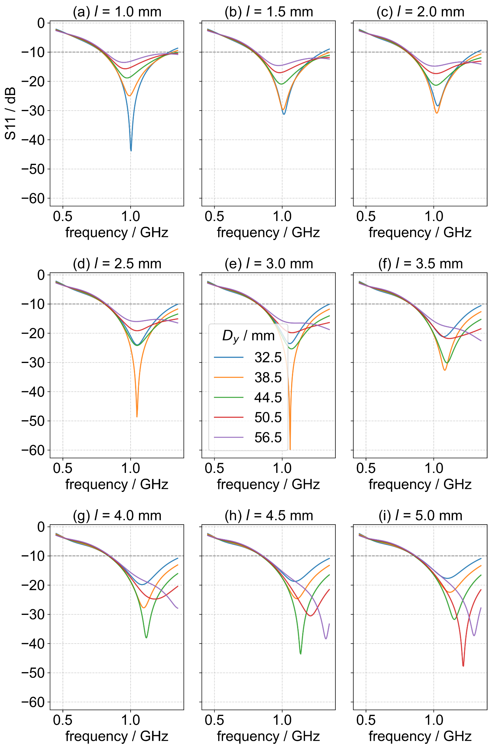
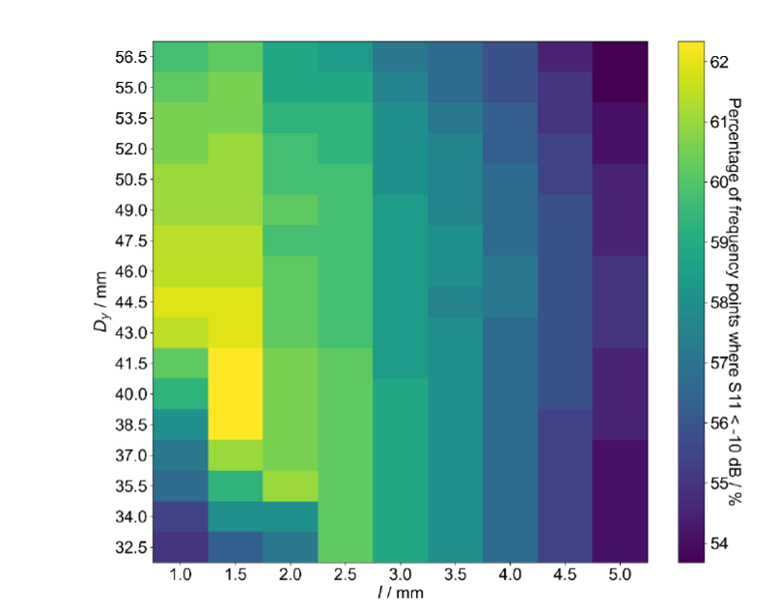
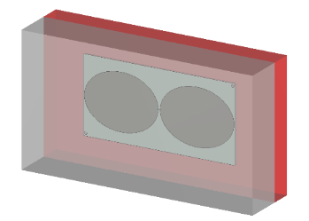
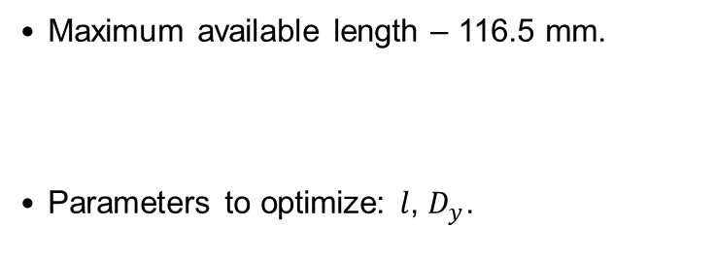

Scaled Elliptical Dipole Optimization
[1] R. Chkhetia, L. Schreckenberg, A. Mester, E. Zimmermann, and G. Natour, “Optimization of a 900 MHz Elliptical Dipole Antenna for a GPR Monitoring System,” 2026.
Maximum available length – 116.5 mm.
Parameters to optimize: $l$, $D_{y}$.
$$D_{x}=\frac{116.5−l}{2}$$
Heatmap of the coverage ratio from the coarse parameter sweep.
Model includes near-field environment:
dielectric frame (red)
lysimeter wall (white).
𝑆11 results from the coarse parameter sweep.

Slide 10
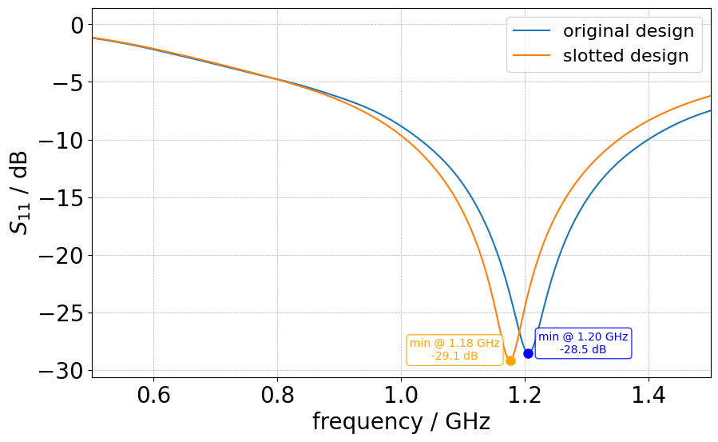
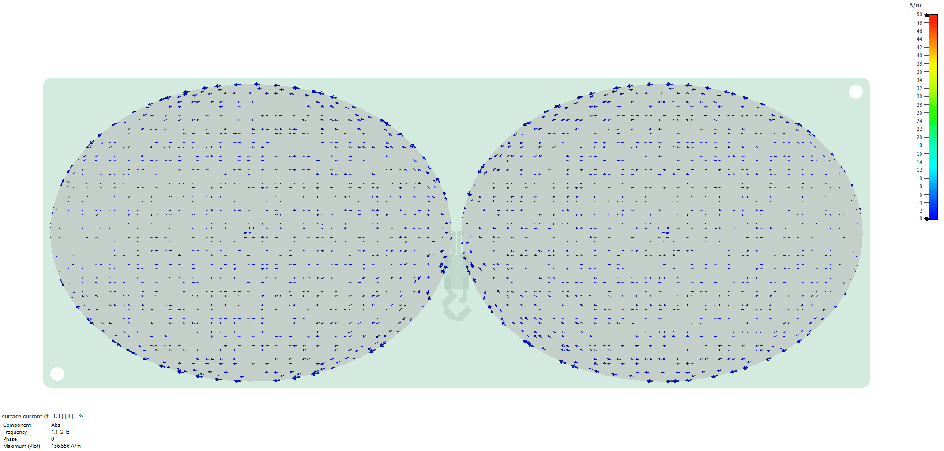
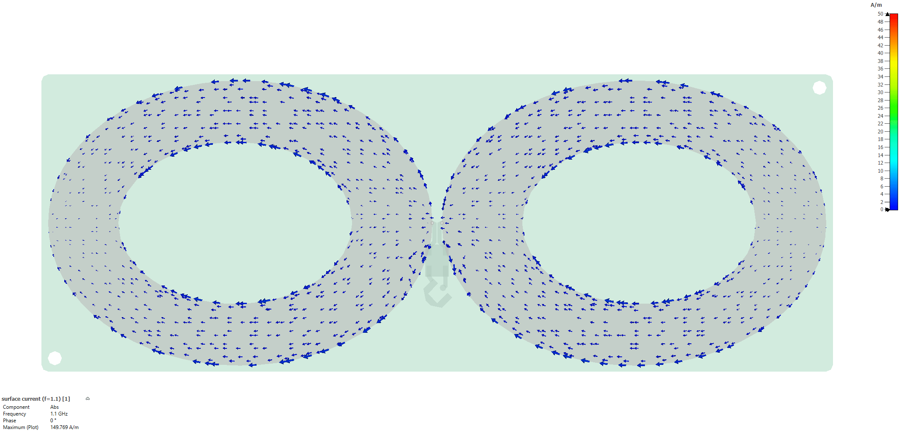
Slot Loading
Advantages:
Better performance at lower frequencies.
Needs to be investigated:
Effects on time-domain performance, radiation patterns.
30 mm
24.2 mm
Original design
Slotted design

Slide 11
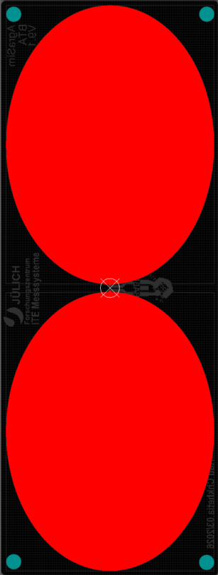
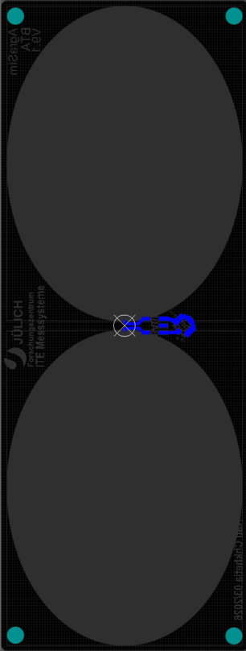
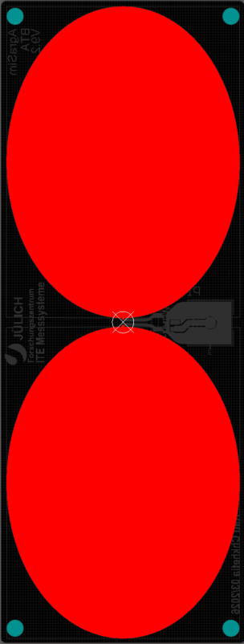
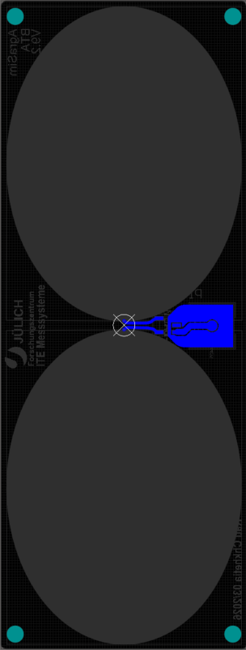
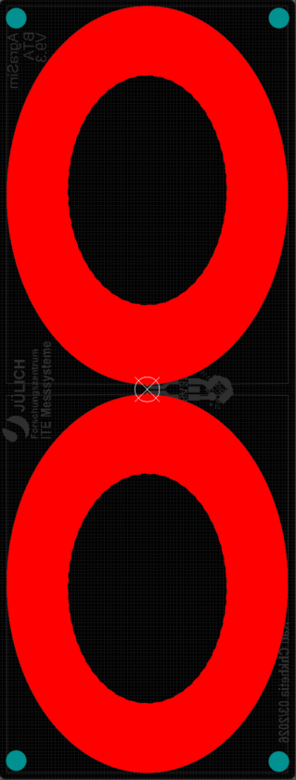
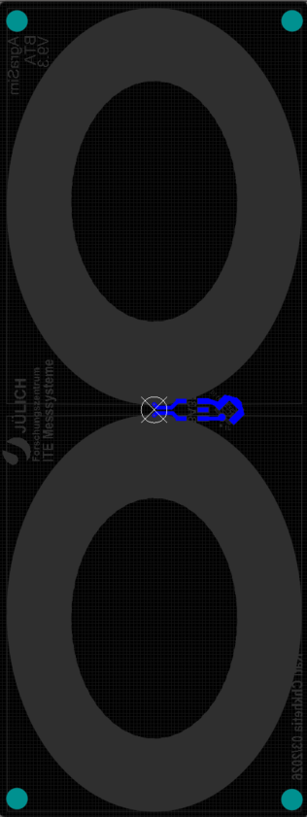
Scaled Antenna Designs (Altium)
V 9.1
Top layer Bottom Layer
V 9.2
Top layer Bottom Layer
V 9.3
Top layer Bottom Layer

Slide 12
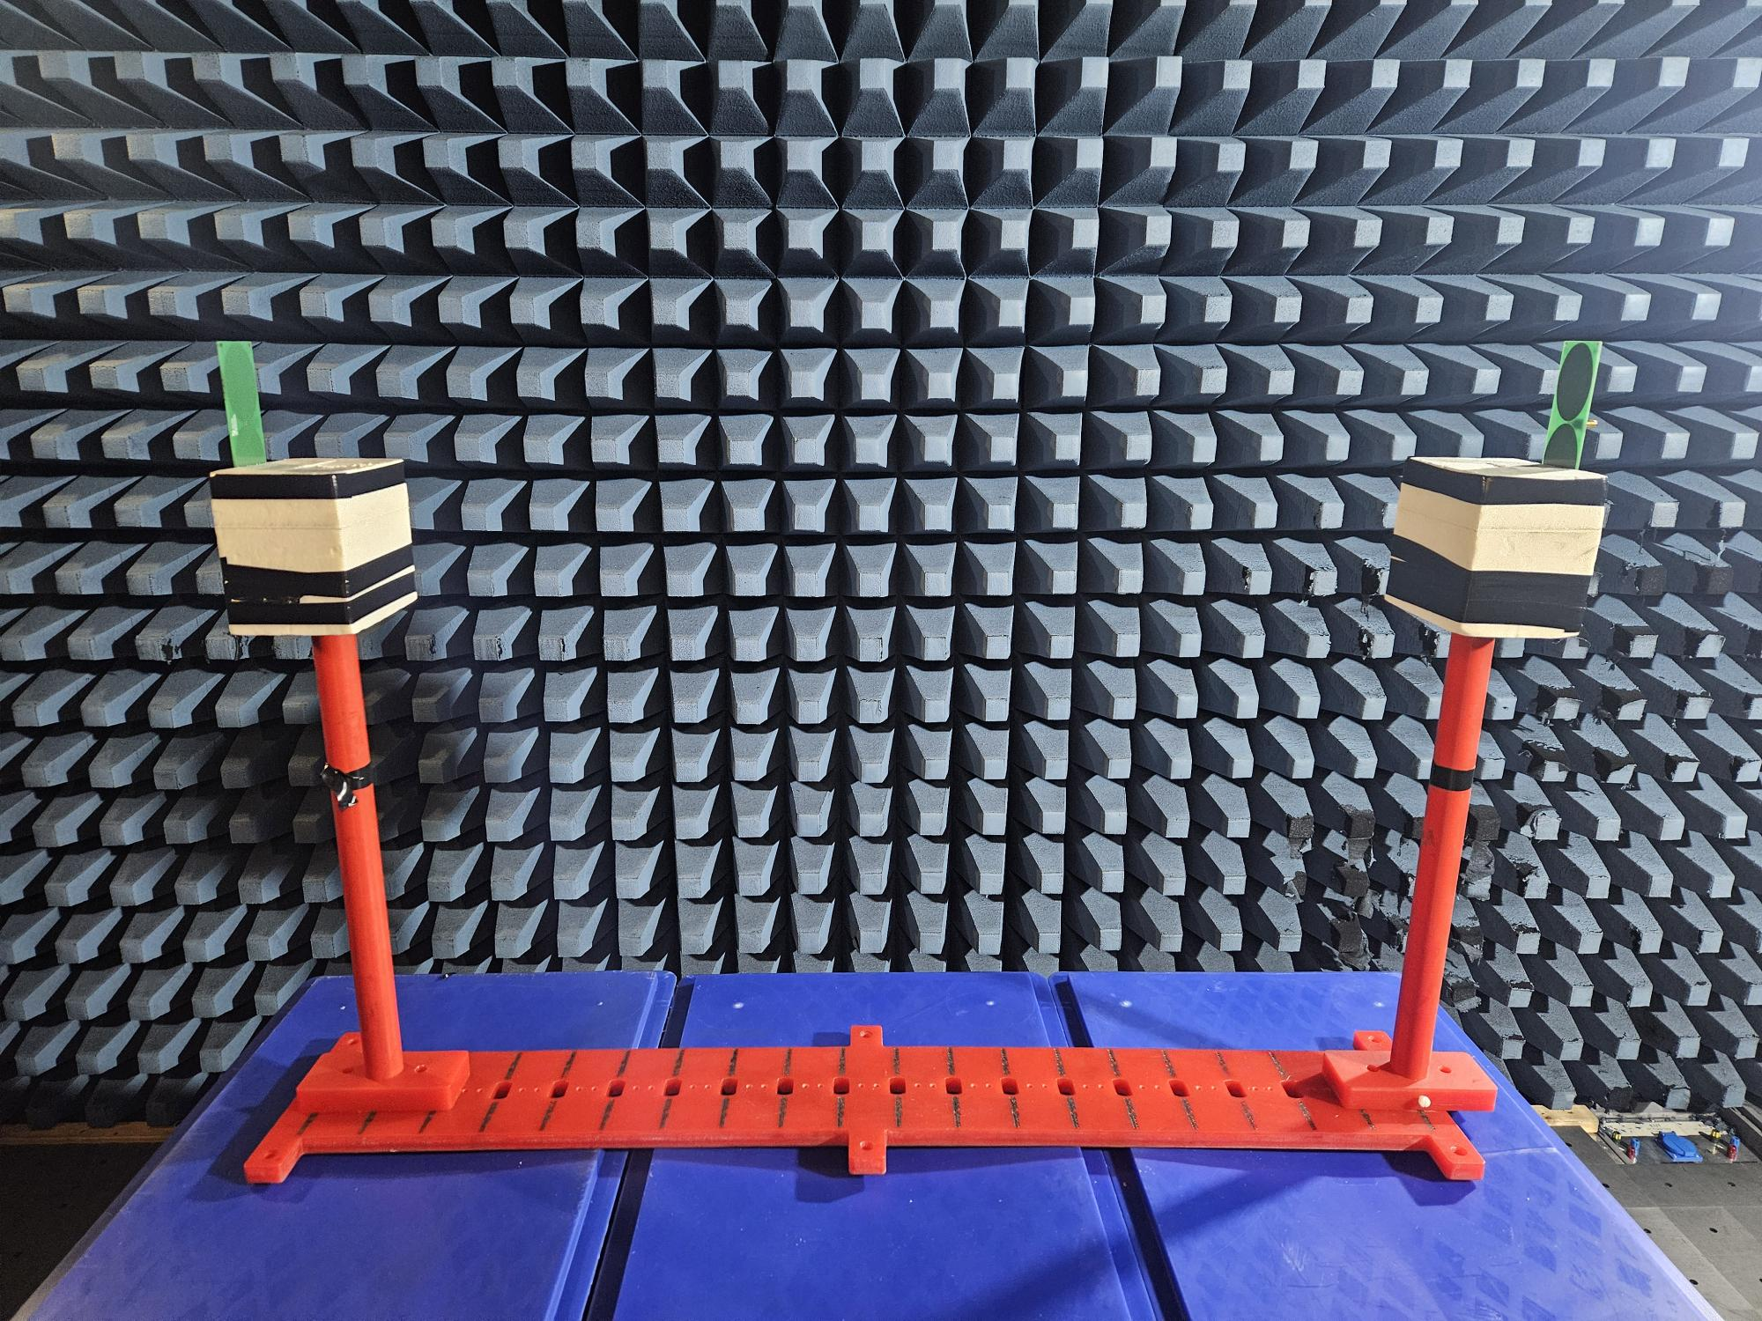
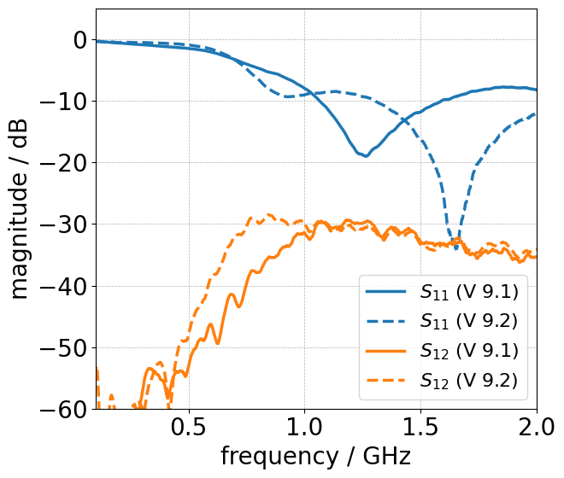
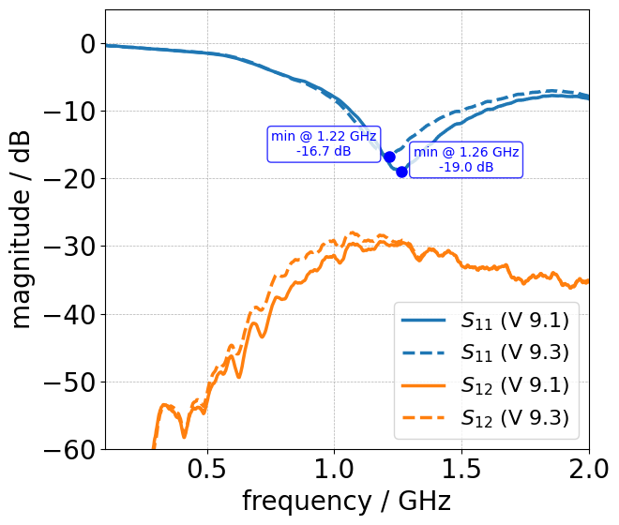
First Measurements with Scaled Designs
S₁₂
Influence of the SMA connector
Influence of slot loading
S₁₁
2-port measurements were conducted in the anechoic chamber.
Distance between the antennas: 1 m.

Slide 13
Conclusions and Outlook
Existing antenna design was characterised and primary areas of improvement were identified:
  Inefficient radiation due to small size.
  Mechanically instable connector.
New antenna were designed:
  Scaled antenna (v 9.1) achieves reflection coefficient of better than -10 dB in the upper part of the operating band.
Implemented Python script for inversion
Short-term plans for the antenna optimization:
Directivity patterns (ongoing work, Tamazi Mukeria).
Crosstalk analysis (ongoing work, Tamazi Mukeria).
Implement GPR inversion for a multi-channel system.
Test different antenna configurations to improve resolution.

Slide 14
Thank you for your attention!

