Slide 1
Integrated Computing Architectures at FZJ
08.09.2026 | André Zambanini

Slide 2
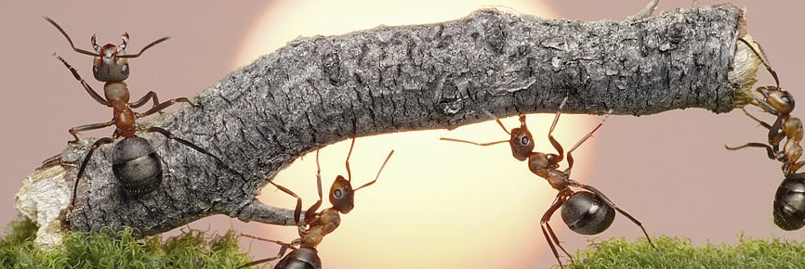
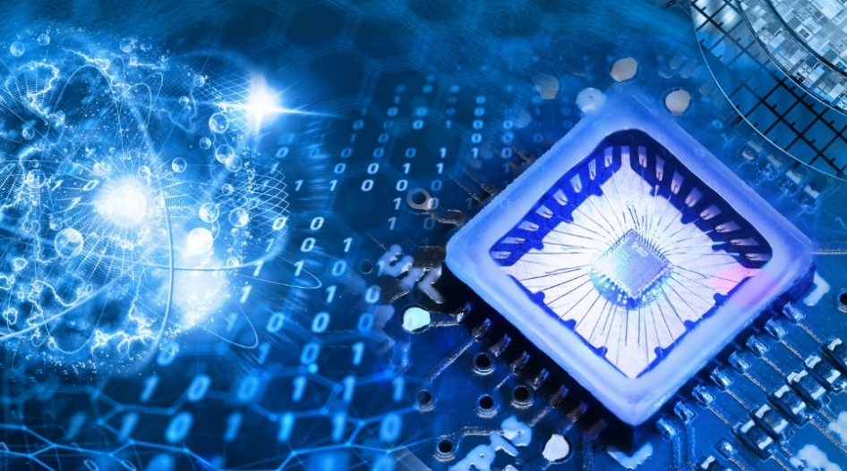
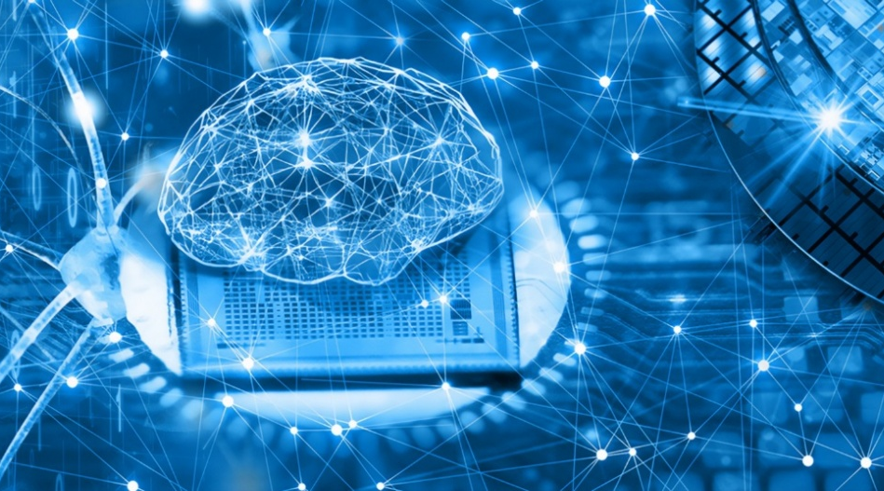
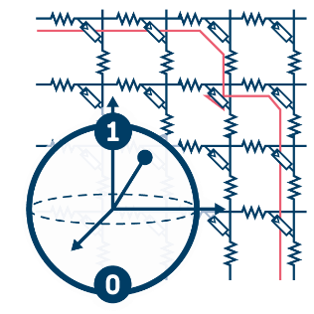
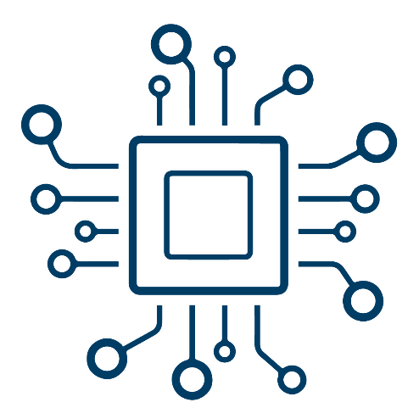
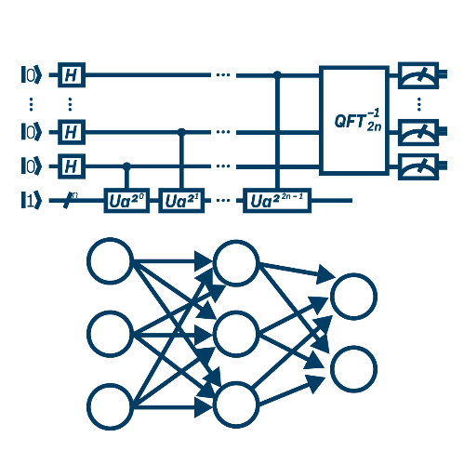
Integrated Computing Architectures
~60 people (staff, post-docs, PhDs)
Semiconductors enable Future Computing architectures
  High integration, VLSI scalability
System integration of memristors, qubits, etc.
  → Algorithms, hardware and physics co-design
System modeling of hardware implementations
  → Application requirements and error mitigation / correction
Quantum Computing
Neuromorphic Computing
Novel Devices
Qubit Memristor
…
Integrated Computing Architectures
Applications
Algorithms
Methods
…
Notes:
Overlap between NC and QC

Slide 3

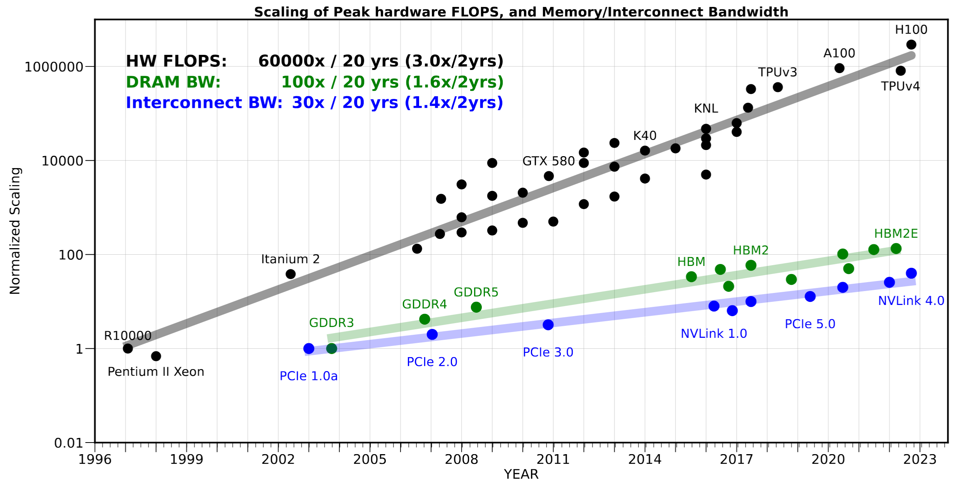
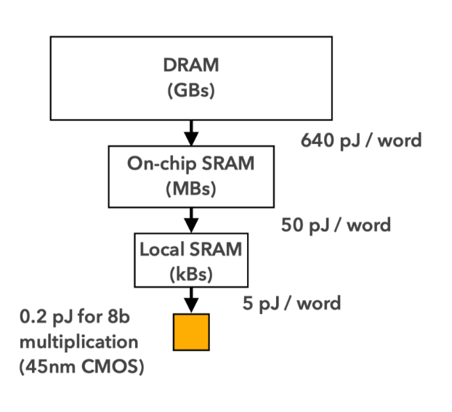
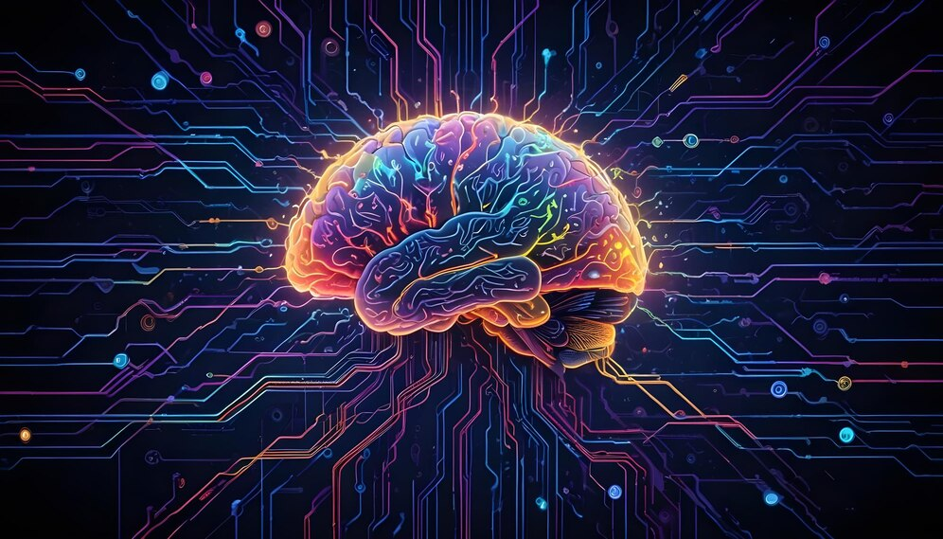
Performance Scaling Limited by Memory?
Neuromorphic
Computing
Energy Footprint of
Computing vs. Data Movement
Scaling of Computing vs. Memory Bandwidth
Horowitz, M., “Computing’s Energy Problem
(and what we can do about it)”, IEEE ISSCC, 2014
Gholami A, et al. „AI and Memory Wall“, arXiv (2024). [https://arxiv.org/abs/2403.14123]
How to overcome the memory limitations?
NC!
BIOLOGICAL INSPIRATION:
Memory Integral Part of the Computing

Slide 4
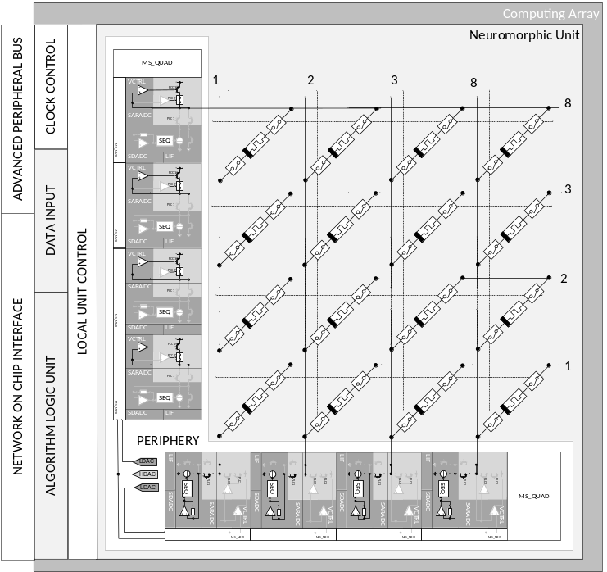
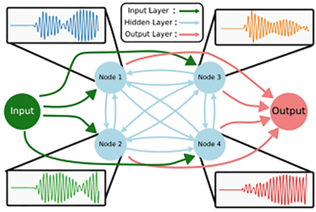
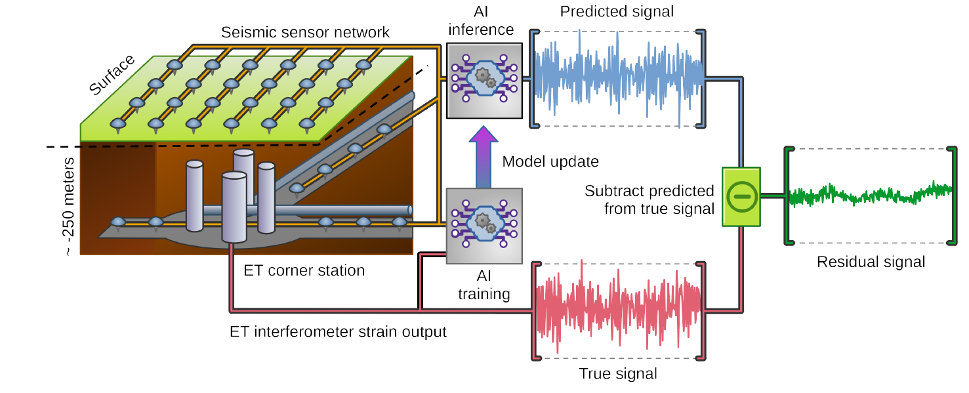
Focus Topics in Neuromorphic Computing
Neuromorphic
Computing
Crossbar Arrays
Oscillatory Neural Networks
Edge AI Applications

Slide 5
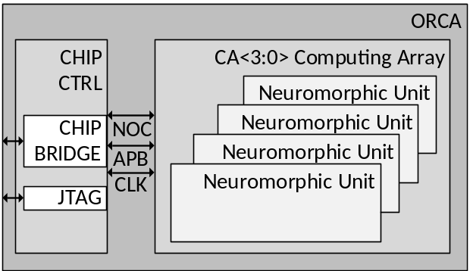
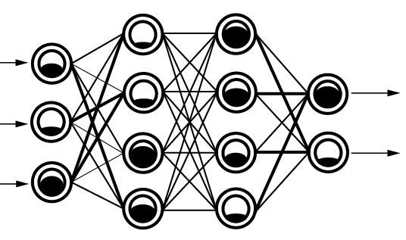
Crossbar Arrays used for Computing in Memory
Neuromorphic
Computing
Crossbar arrays are the basis for computing in memory (CIM)
Memristors: non-volatile,
high-density
Alternative nodes possible
System design important
(network on chip, analog interconnects)
ORCA / D1: Integrated Memristors
Neural Network
Crossbar Arrays
Oscillatory Neural Networks
Edge AI Applications

Slide 6
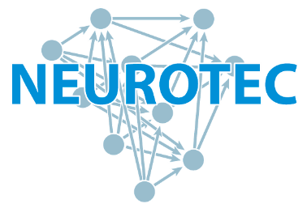

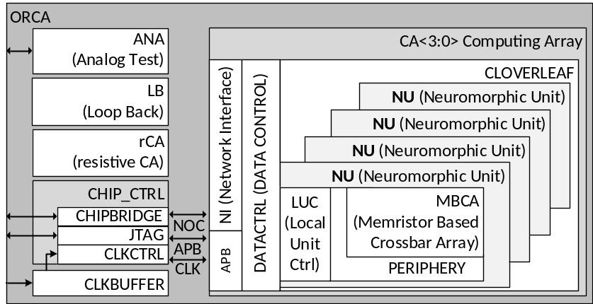
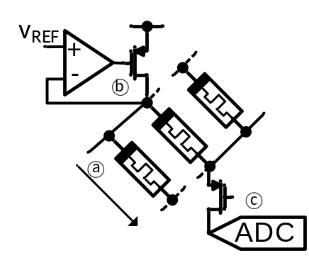
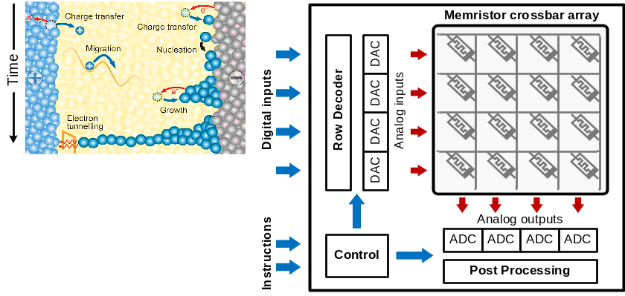
NEUROTEC II: Demonstrator System
Platform for Multiple Bio-Inspired Computing Paradigms
Versatile Demonstration Vehicle
4 programmable memristive crossbar arrays with
> 65.000 memristors co-integrated (post-processing)
2560 8-bit ADC and 4-bit DAC integrated
Automatic memristor control enabled
Flexible Interfaces
Network on Chip (NoC)
Chipbridge for direct NoC access
Standard JTAG programming interface
→ Different bio-inspired computing paradigms
Concept developed in close collaboration within FZJ
Crossbar Arrays
Oscillatory Neural Networks
Edge AI Applications

Slide 7
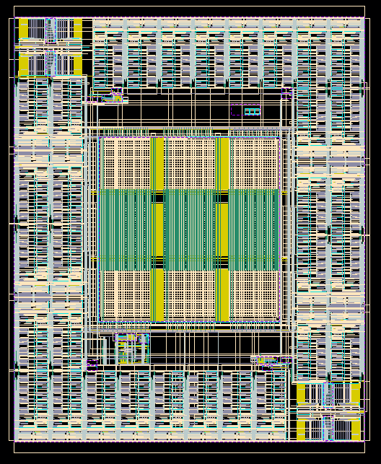
NEUROTEC II: Demonstrator System
Platform for Multiple Bio-Inspired Computing Paradigms
Versatile Demonstration Vehicle
4 programmable memristive crossbar arrays with
> 65.000 memristors co-integrated (post-processing)
2560 8-bit ADC and 4-bit DAC integrated
Automatic memristor control enabled
Flexible Interfaces
Network on Chip (NoC)
Chipbridge for direct NoC access
Standard JTAG programming interface
→ Different bio-inspired computing paradigms
Concept developed in close collaboration within FZJ
128 8-bit ADCs
Nominal: 200 MSample/s
900 µm
Crossbar Arrays
Oscillatory Neural Networks
Edge AI Applications
750 µm

Slide 8
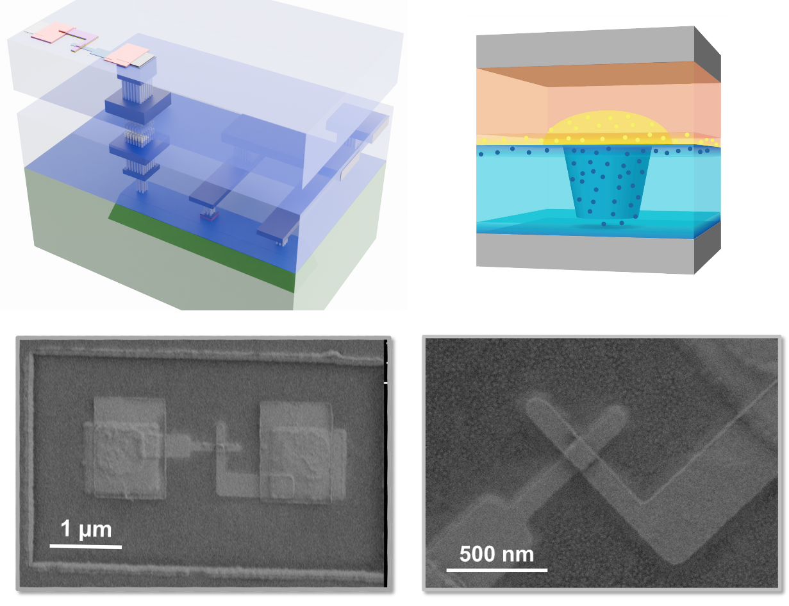
NEUROTEC II: Memristor Integration
State-of-the-Art Memristor Integration
Fab-level RRAM: binary memory with controller
→ no access to the device
Research-level: memristor off-chip, wirebonding at best
→ scale-up issues and strong parasitic effects
Goal: True Memristor Integration into/onto CMOS
Robust 180 nm CMOS for prove of principle
Modern 28 nm CMOS for scalable and high-performance
  Issues: full wafer (too)expensive, MPW chiplets small and fully processed, copper complicated in clean rooms, …
  → tricky integration, but doable
Outlook: integration into BEOL on 22 nm FD-SOI planned
Memristor deposition by PGI-7 & HNF @ FZJ
Crossbar Arrays
Oscillatory Neural Networks
Edge AI Applications

Slide 9
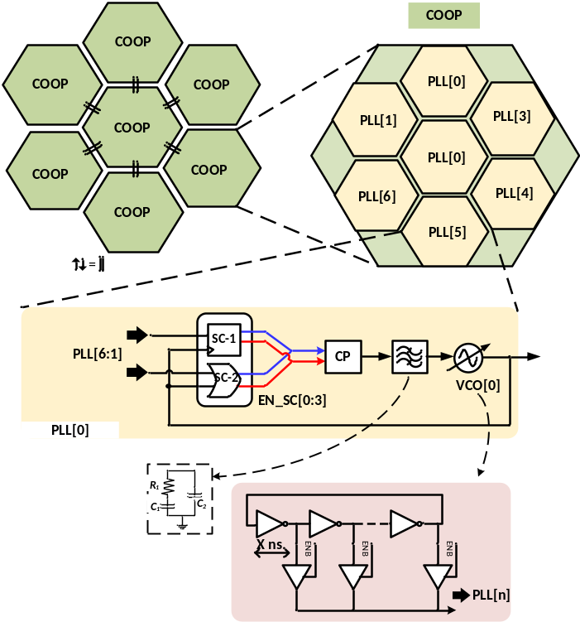
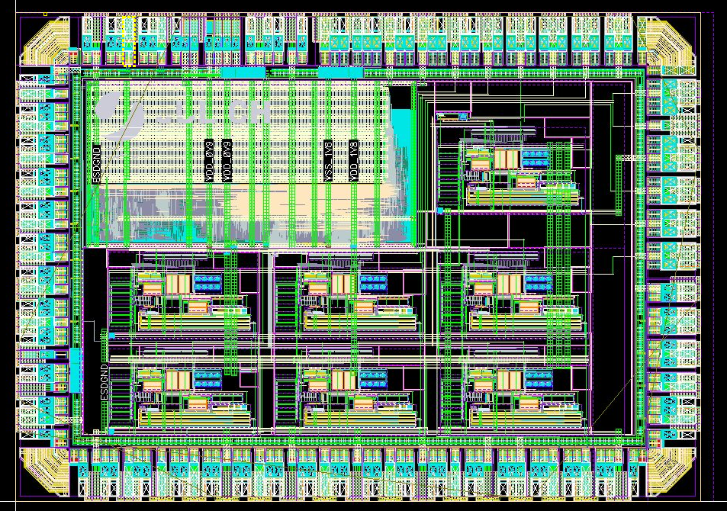
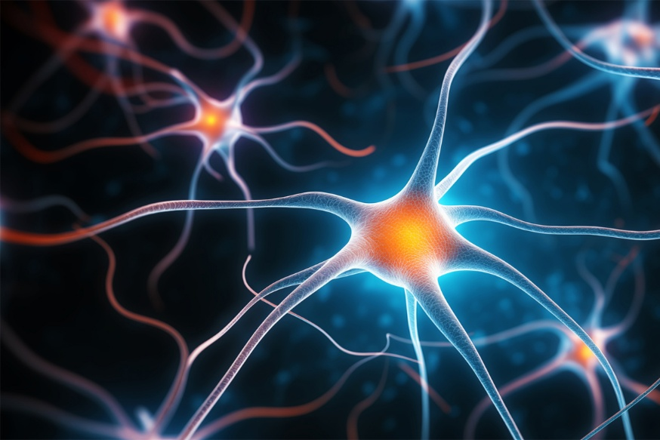
The Magic Lies in the Coupling
Neuromorphic
Computing
1.4 mm
Brain-inspired computing: processing based on overlay of oscillations
Coupling of oscillators
Information is in the phase
Analog and mixed-signal circuits for Pattern Recognition
SRAM
PLL 7
1.0 mm
JTAG RISC-V
PLL 2
PLL 6
PLL 4
PLL 1
PLL 3
PLL 5
Chip Layout
Crossbar Arrays
Oscillatory Neural Networks
Edge AI Applications

Slide 10
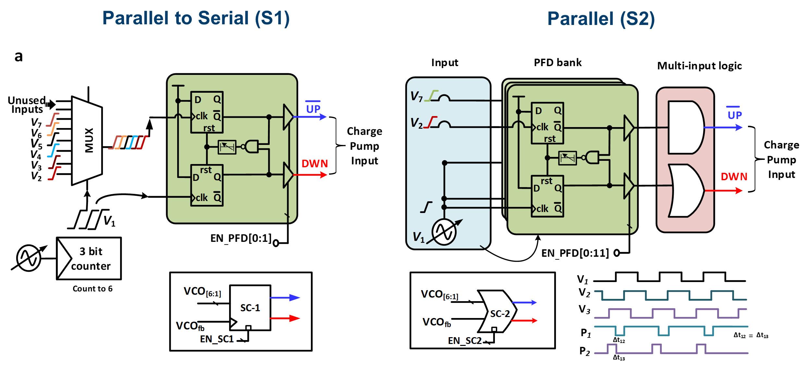
Coupled Oscillator System
Neuromorphic
Computing
architecture
Configurable coupling
Crossbar Arrays
Oscillatory Neural Networks
Edge AI Applications
S.Y. Nayaz, A. Ashok, et.al, „Scalable 28nm IC implementation of coupled
oscillator network featuring tunable topology and complexity“,
https://arxiv.org/abs/2505.10248

Slide 11
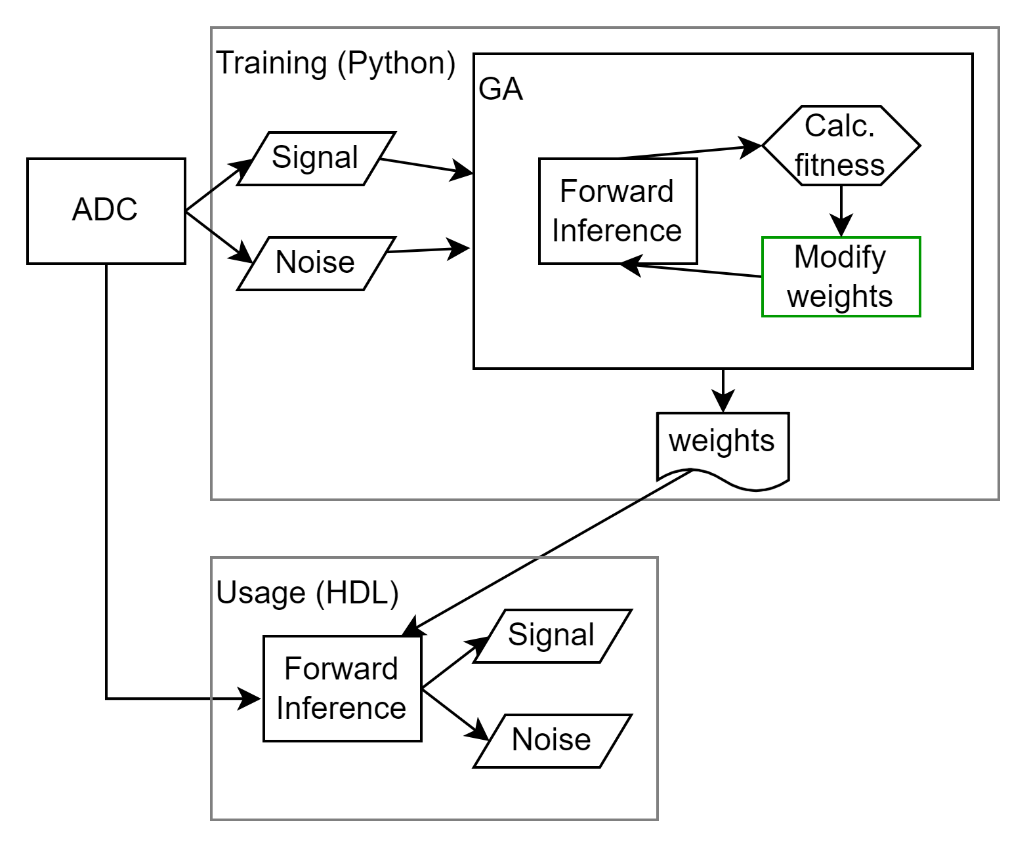
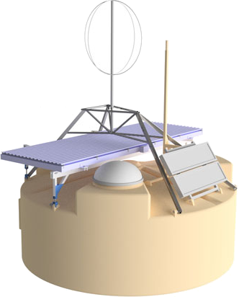
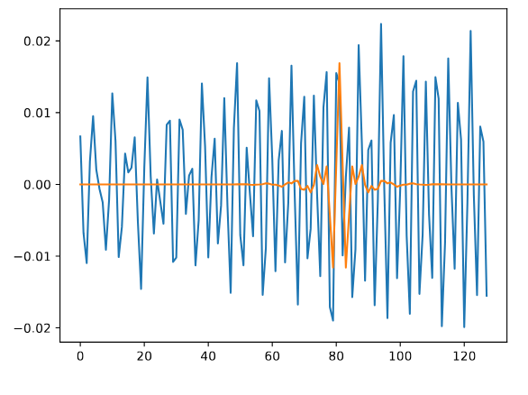
Edge AI Applications: Reuse of our Developments
Neuromorphic
Computing
Applications, demo‘ing the potential of Edge AI,
e.g. Einstein Telescope
Low-energy, low-latency use cases
Goal: Systems with crossbars or ONNs
→ Hardware Demonstrator
Online Feature Detection @ Pierre Auger Observatory
Algorithm Development and On-Device Training
Online Noise Mitigation @ Einstein Telescope
Crossbar Arrays
Oscillatory Neural Networks
Edge AI Applications

Slide 12
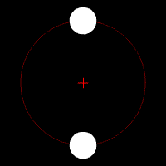
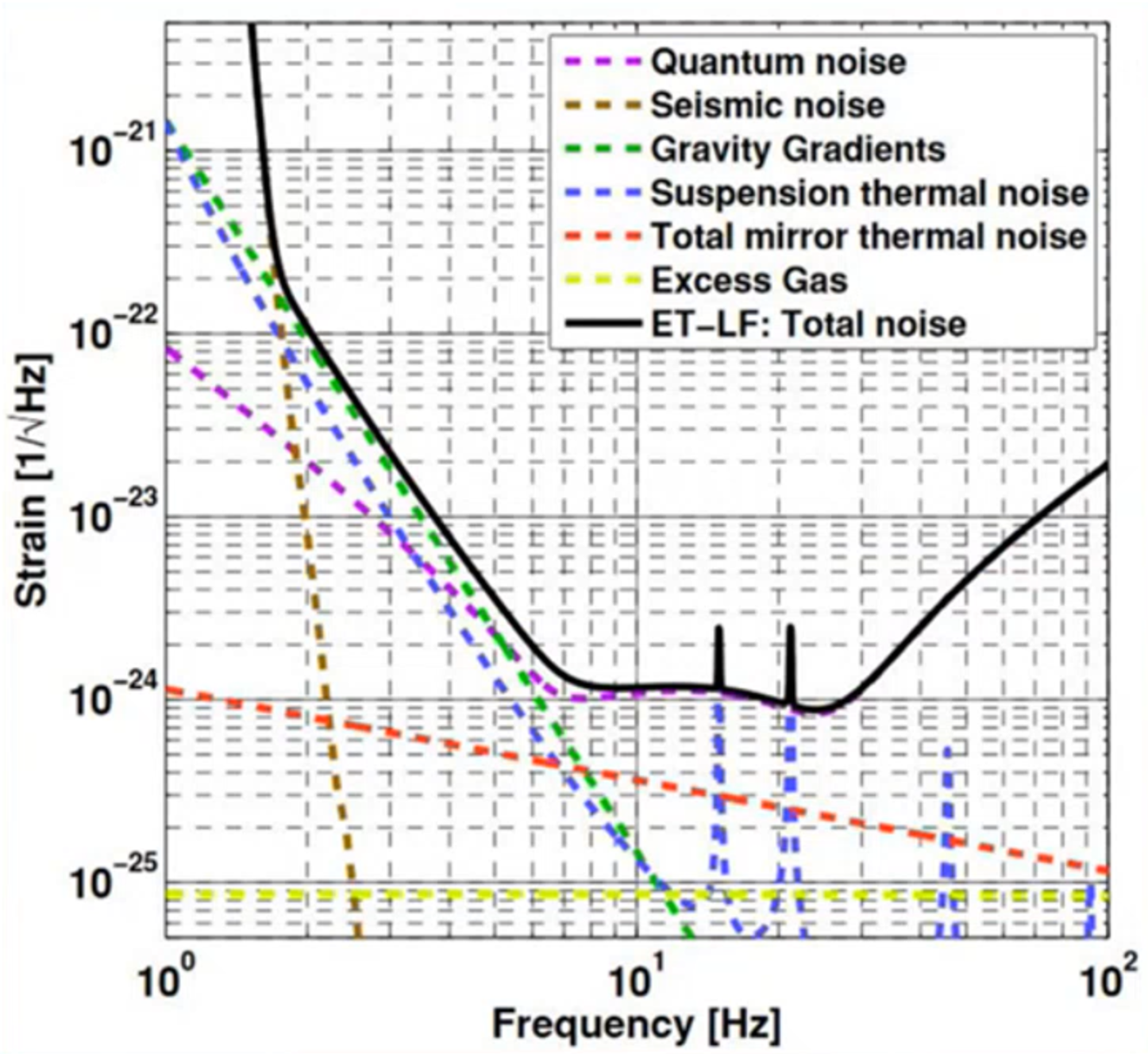


Online Newtonian Noise Prediction for ET
Neuromorphic
Computing
Binary Star System
When approaching: increasing frequency
(src: Wikimedia)
Multi-Messenger Observation
Gravitational waves can predict collision
→ The earlier we get aware of an event, the more time we have to redirect other detectors
Goal: Online Newtonian Noise Mitigation
Real-time readout and data processing of sensor network
Complex transfer function for noise prediction
Approach: FPGA-based Neural Networks
Einstein Telescope Noise Impacts
→ Low-freq. dominated by seismic noise
Seismic Sensor Network around Detector
→ Enable noise prediction based on AI
In collaboration with:
Crossbar Arrays
Oscillatory Neural Networks
Edge AI Applications

Slide 13

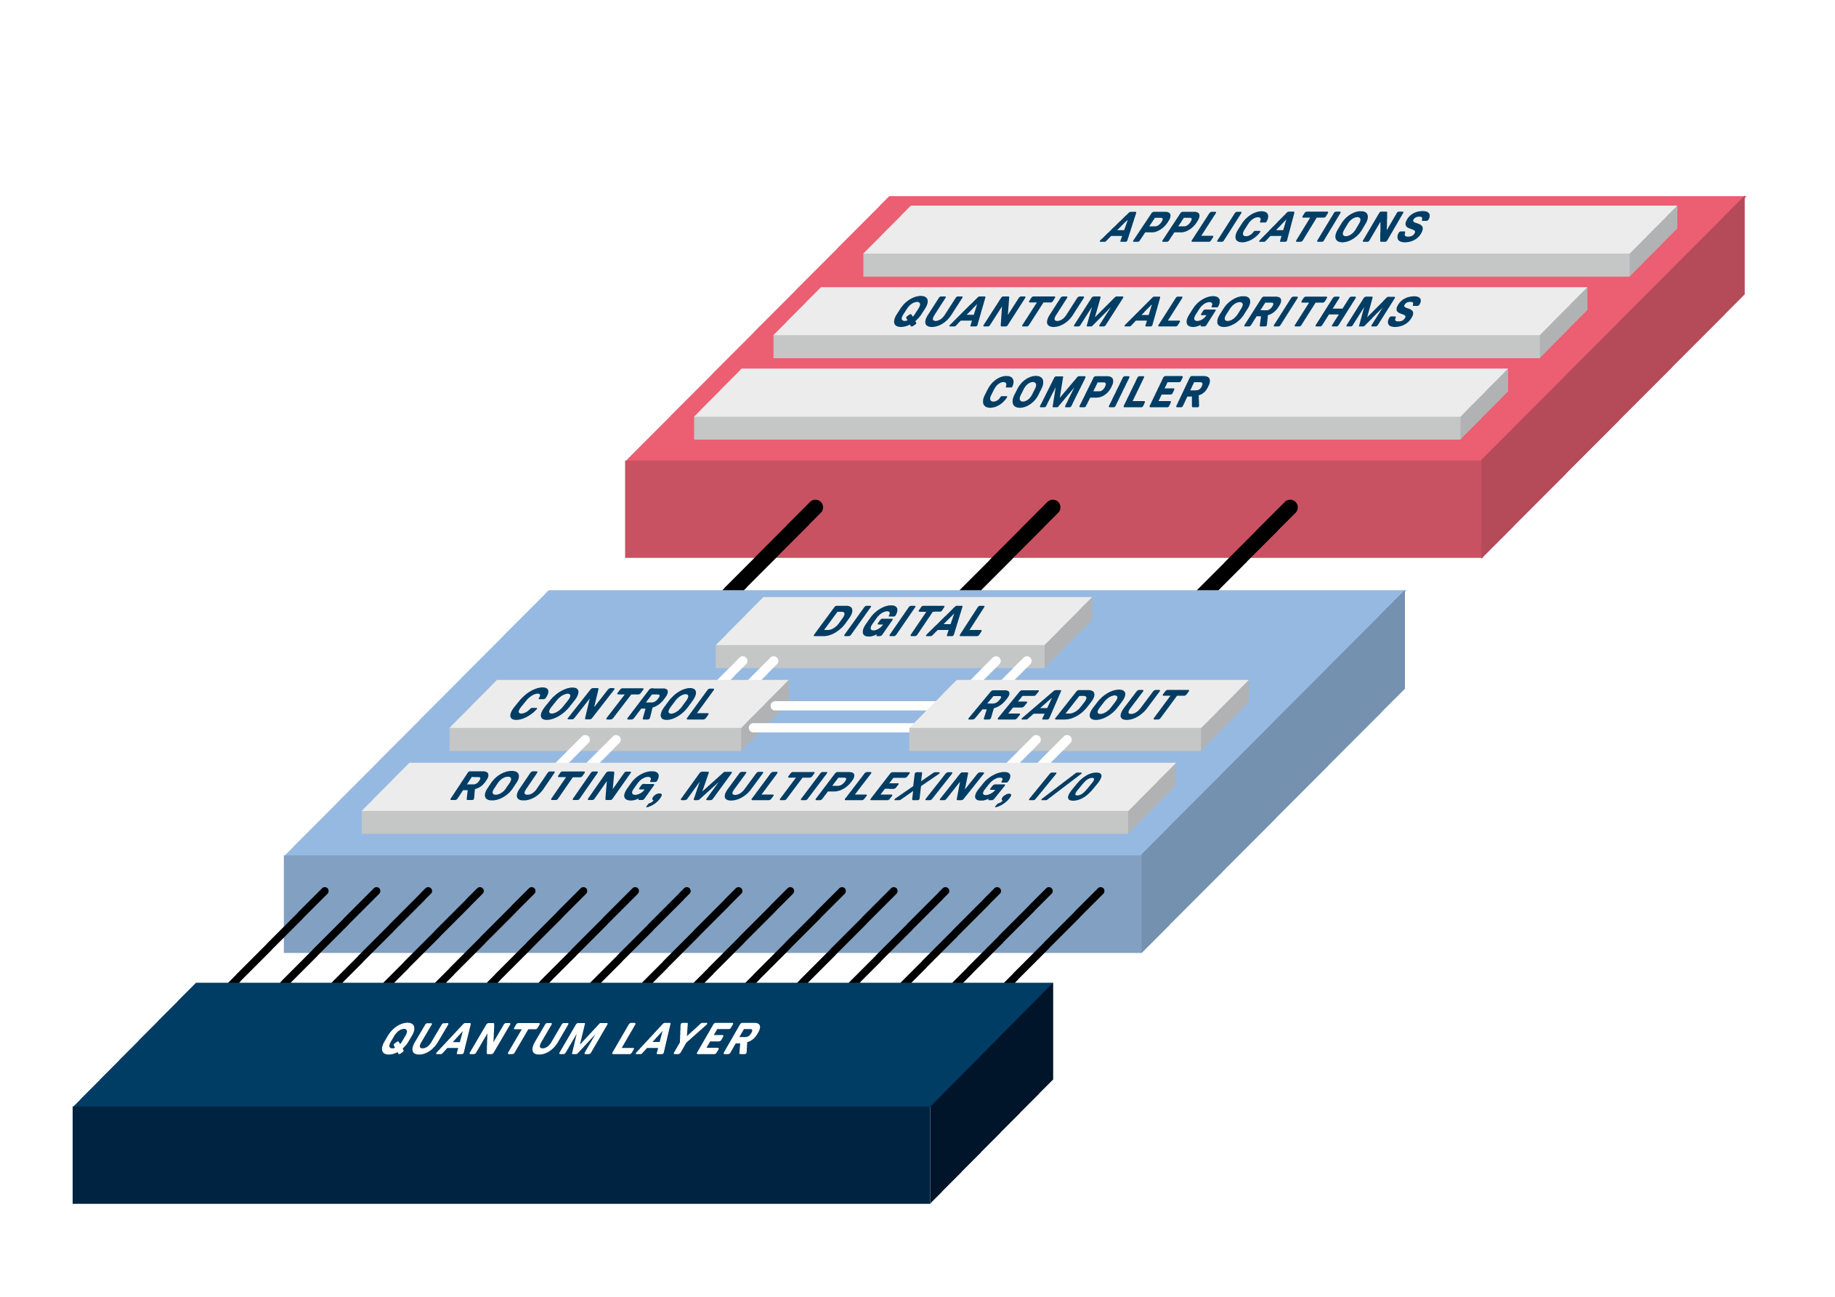
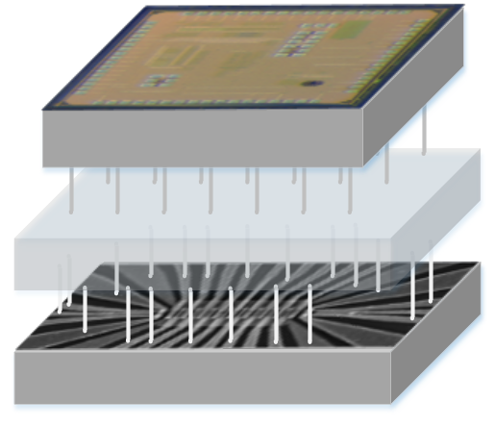
Integration with CMOS Electronics
Quantum
Computing
Benefit From Existing Infrastructure To Scale Up
CLASSICAL COMPUTER
300 K
cryogenic electronics
QUANTUM-CLASSICAL INTERFACE
OUR FOCUS AREA
QUANTUM PROCESSOR
100 mK
qubit

Slide 14

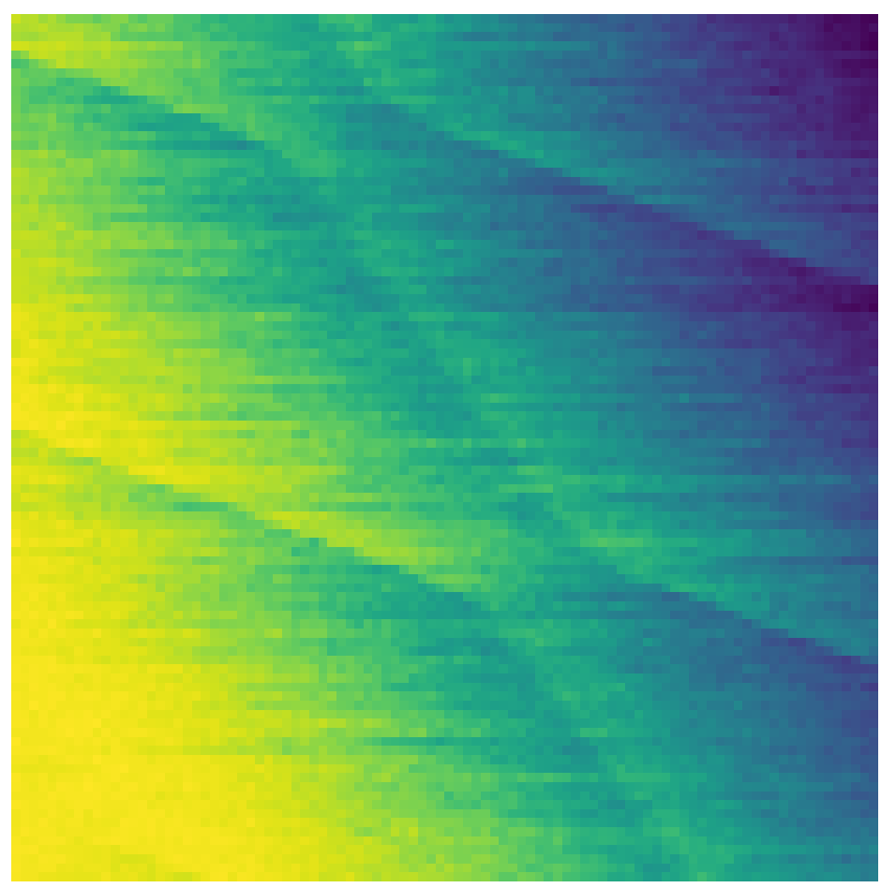
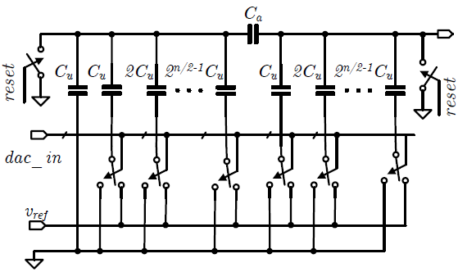


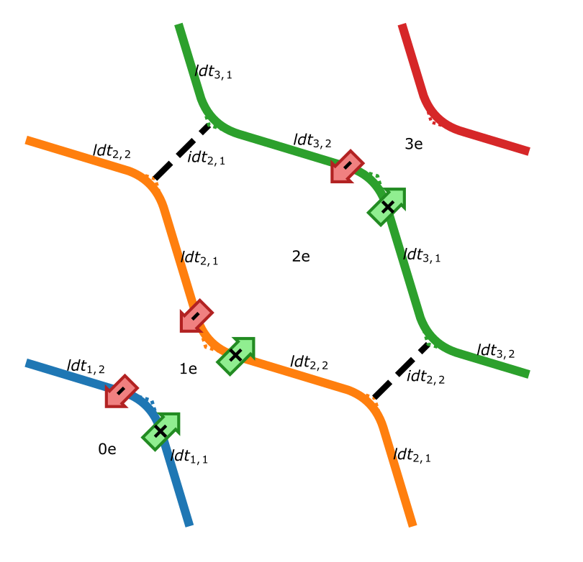
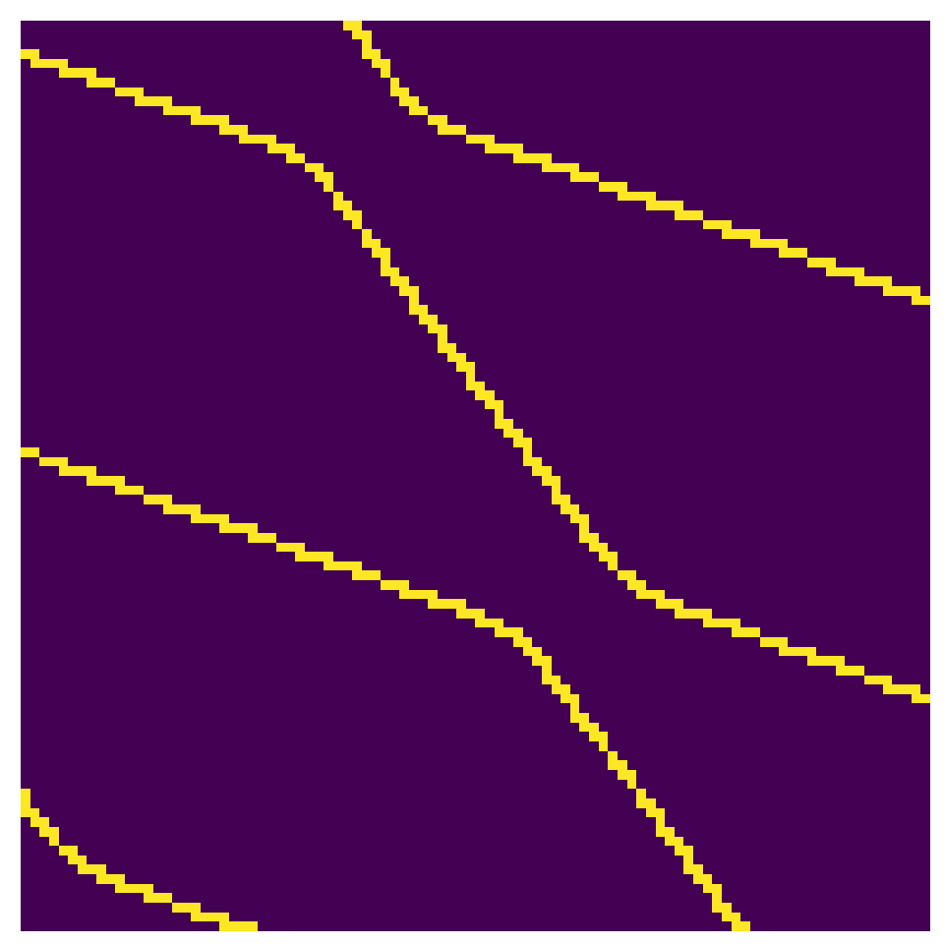
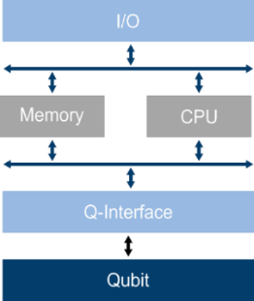
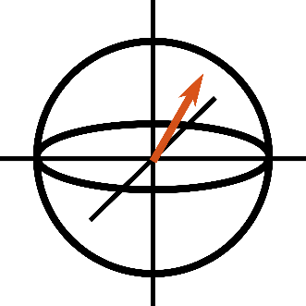
System Modelling, Design and algorithmics
Quantum
Computing
MODELLING
CO-SIMULATION
MODELLING / SIMULATION
TRAINING / DETECTION
schematic
CSD Data
electronic Architecture
Physics model
Geometric model
Automated Detection
SYSTEM DESIGN
AUTOMATED TUNING

Slide 15
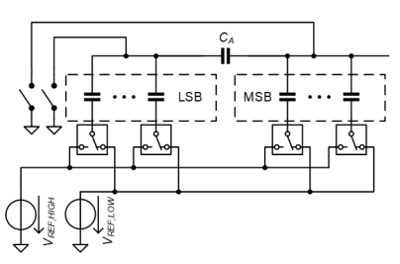
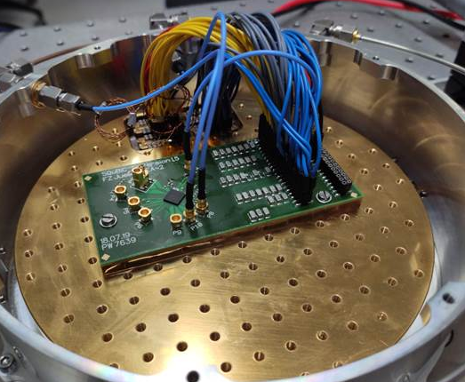
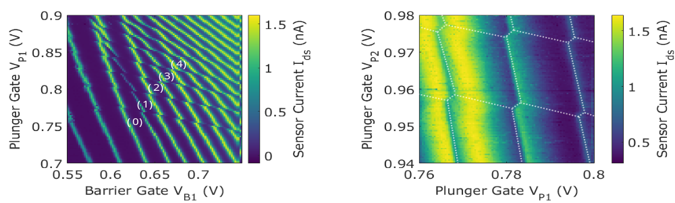
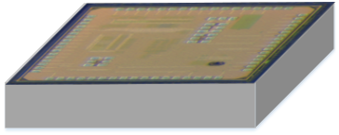
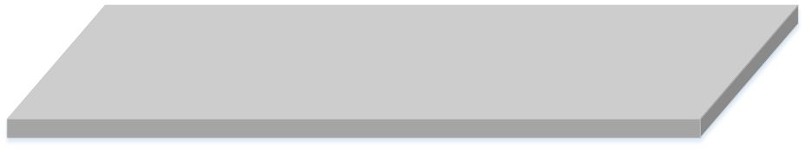
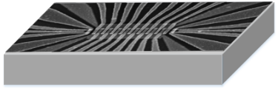
Cryogenic Circuit Design and Measurement
Quantum
Computing
CryogeniC Circuit design
Schematic
design
Implemented circuits
Test device SETUP
Cryo
Setup
Verification Results
Cryogenic MeasurementS

Slide 16

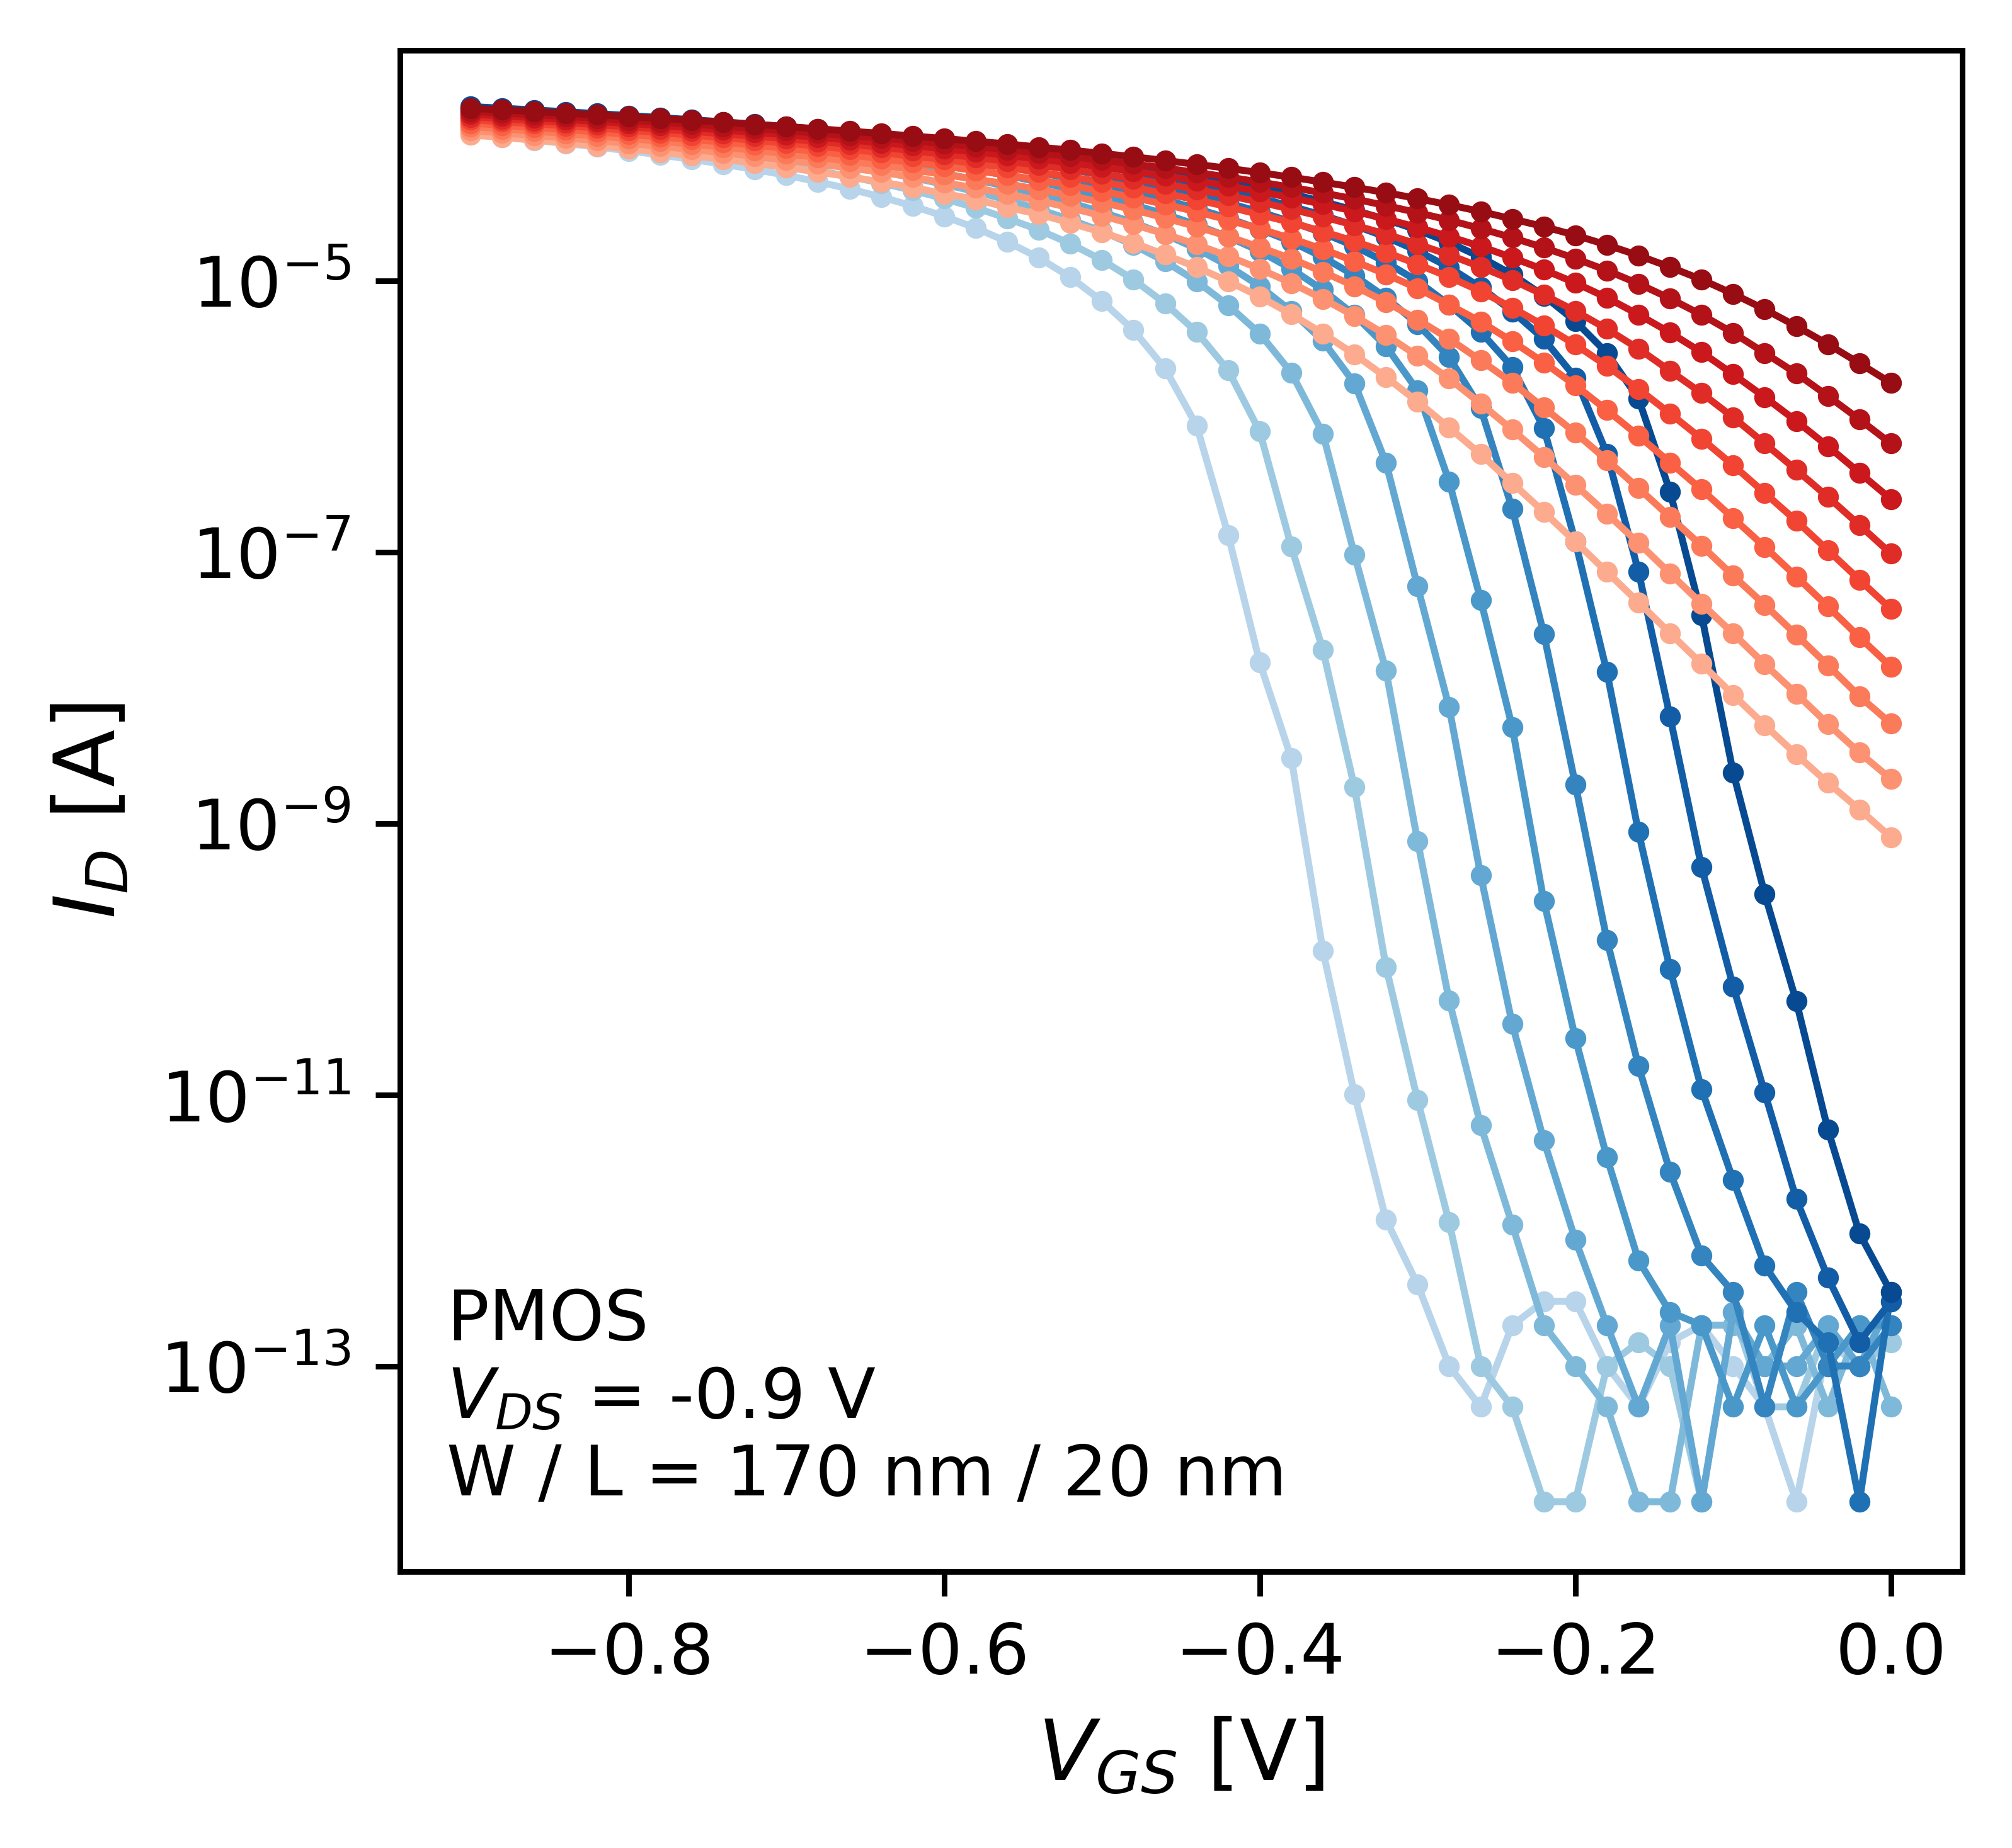
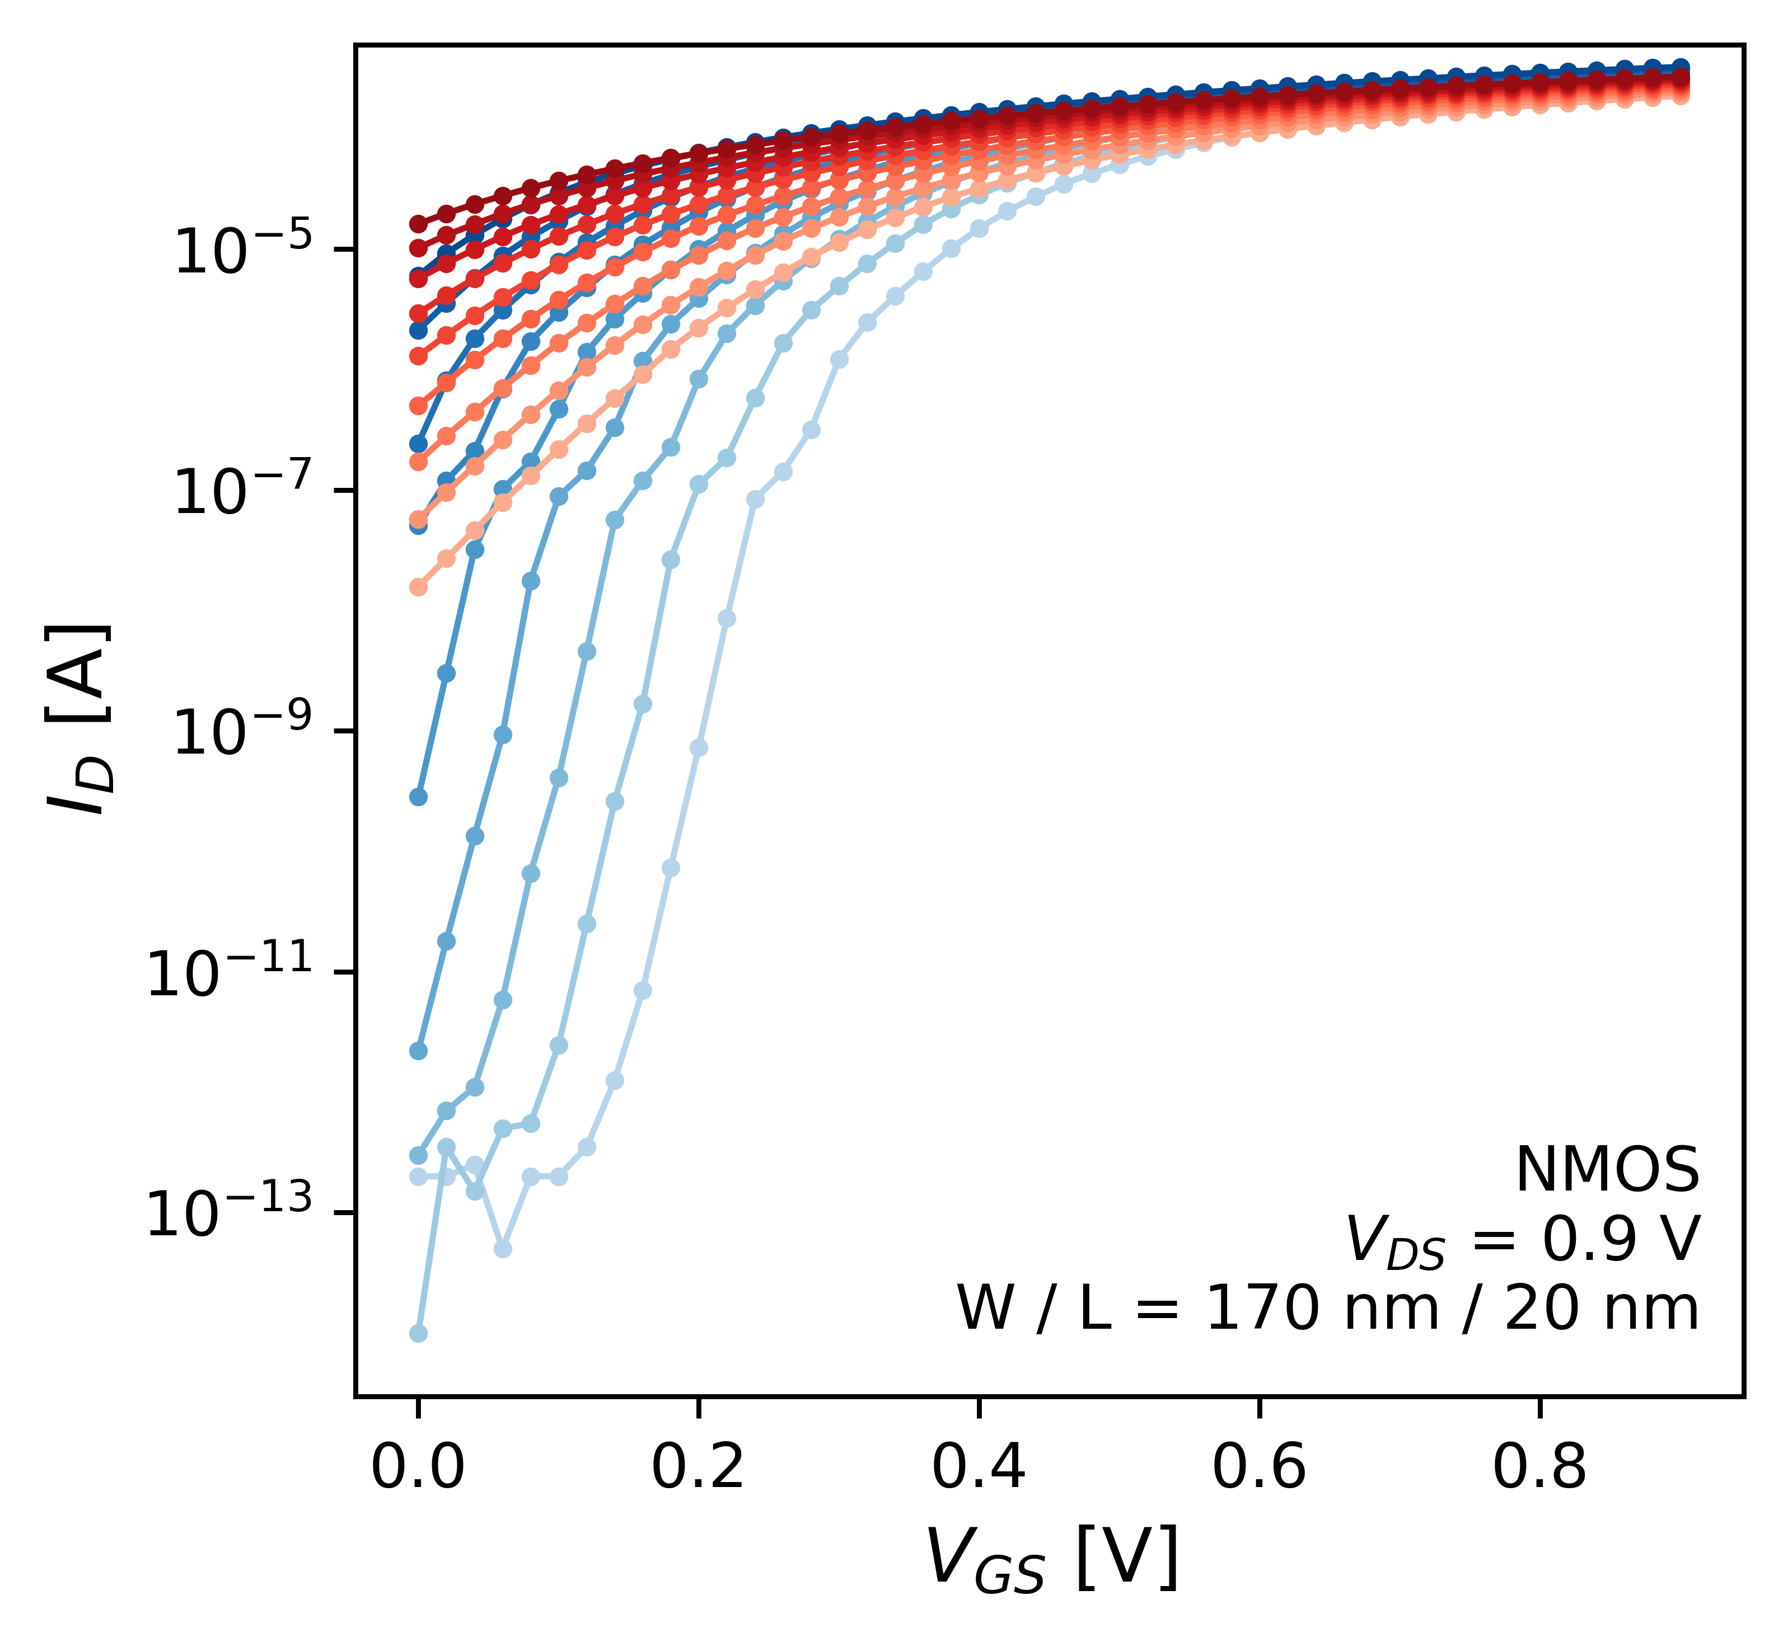
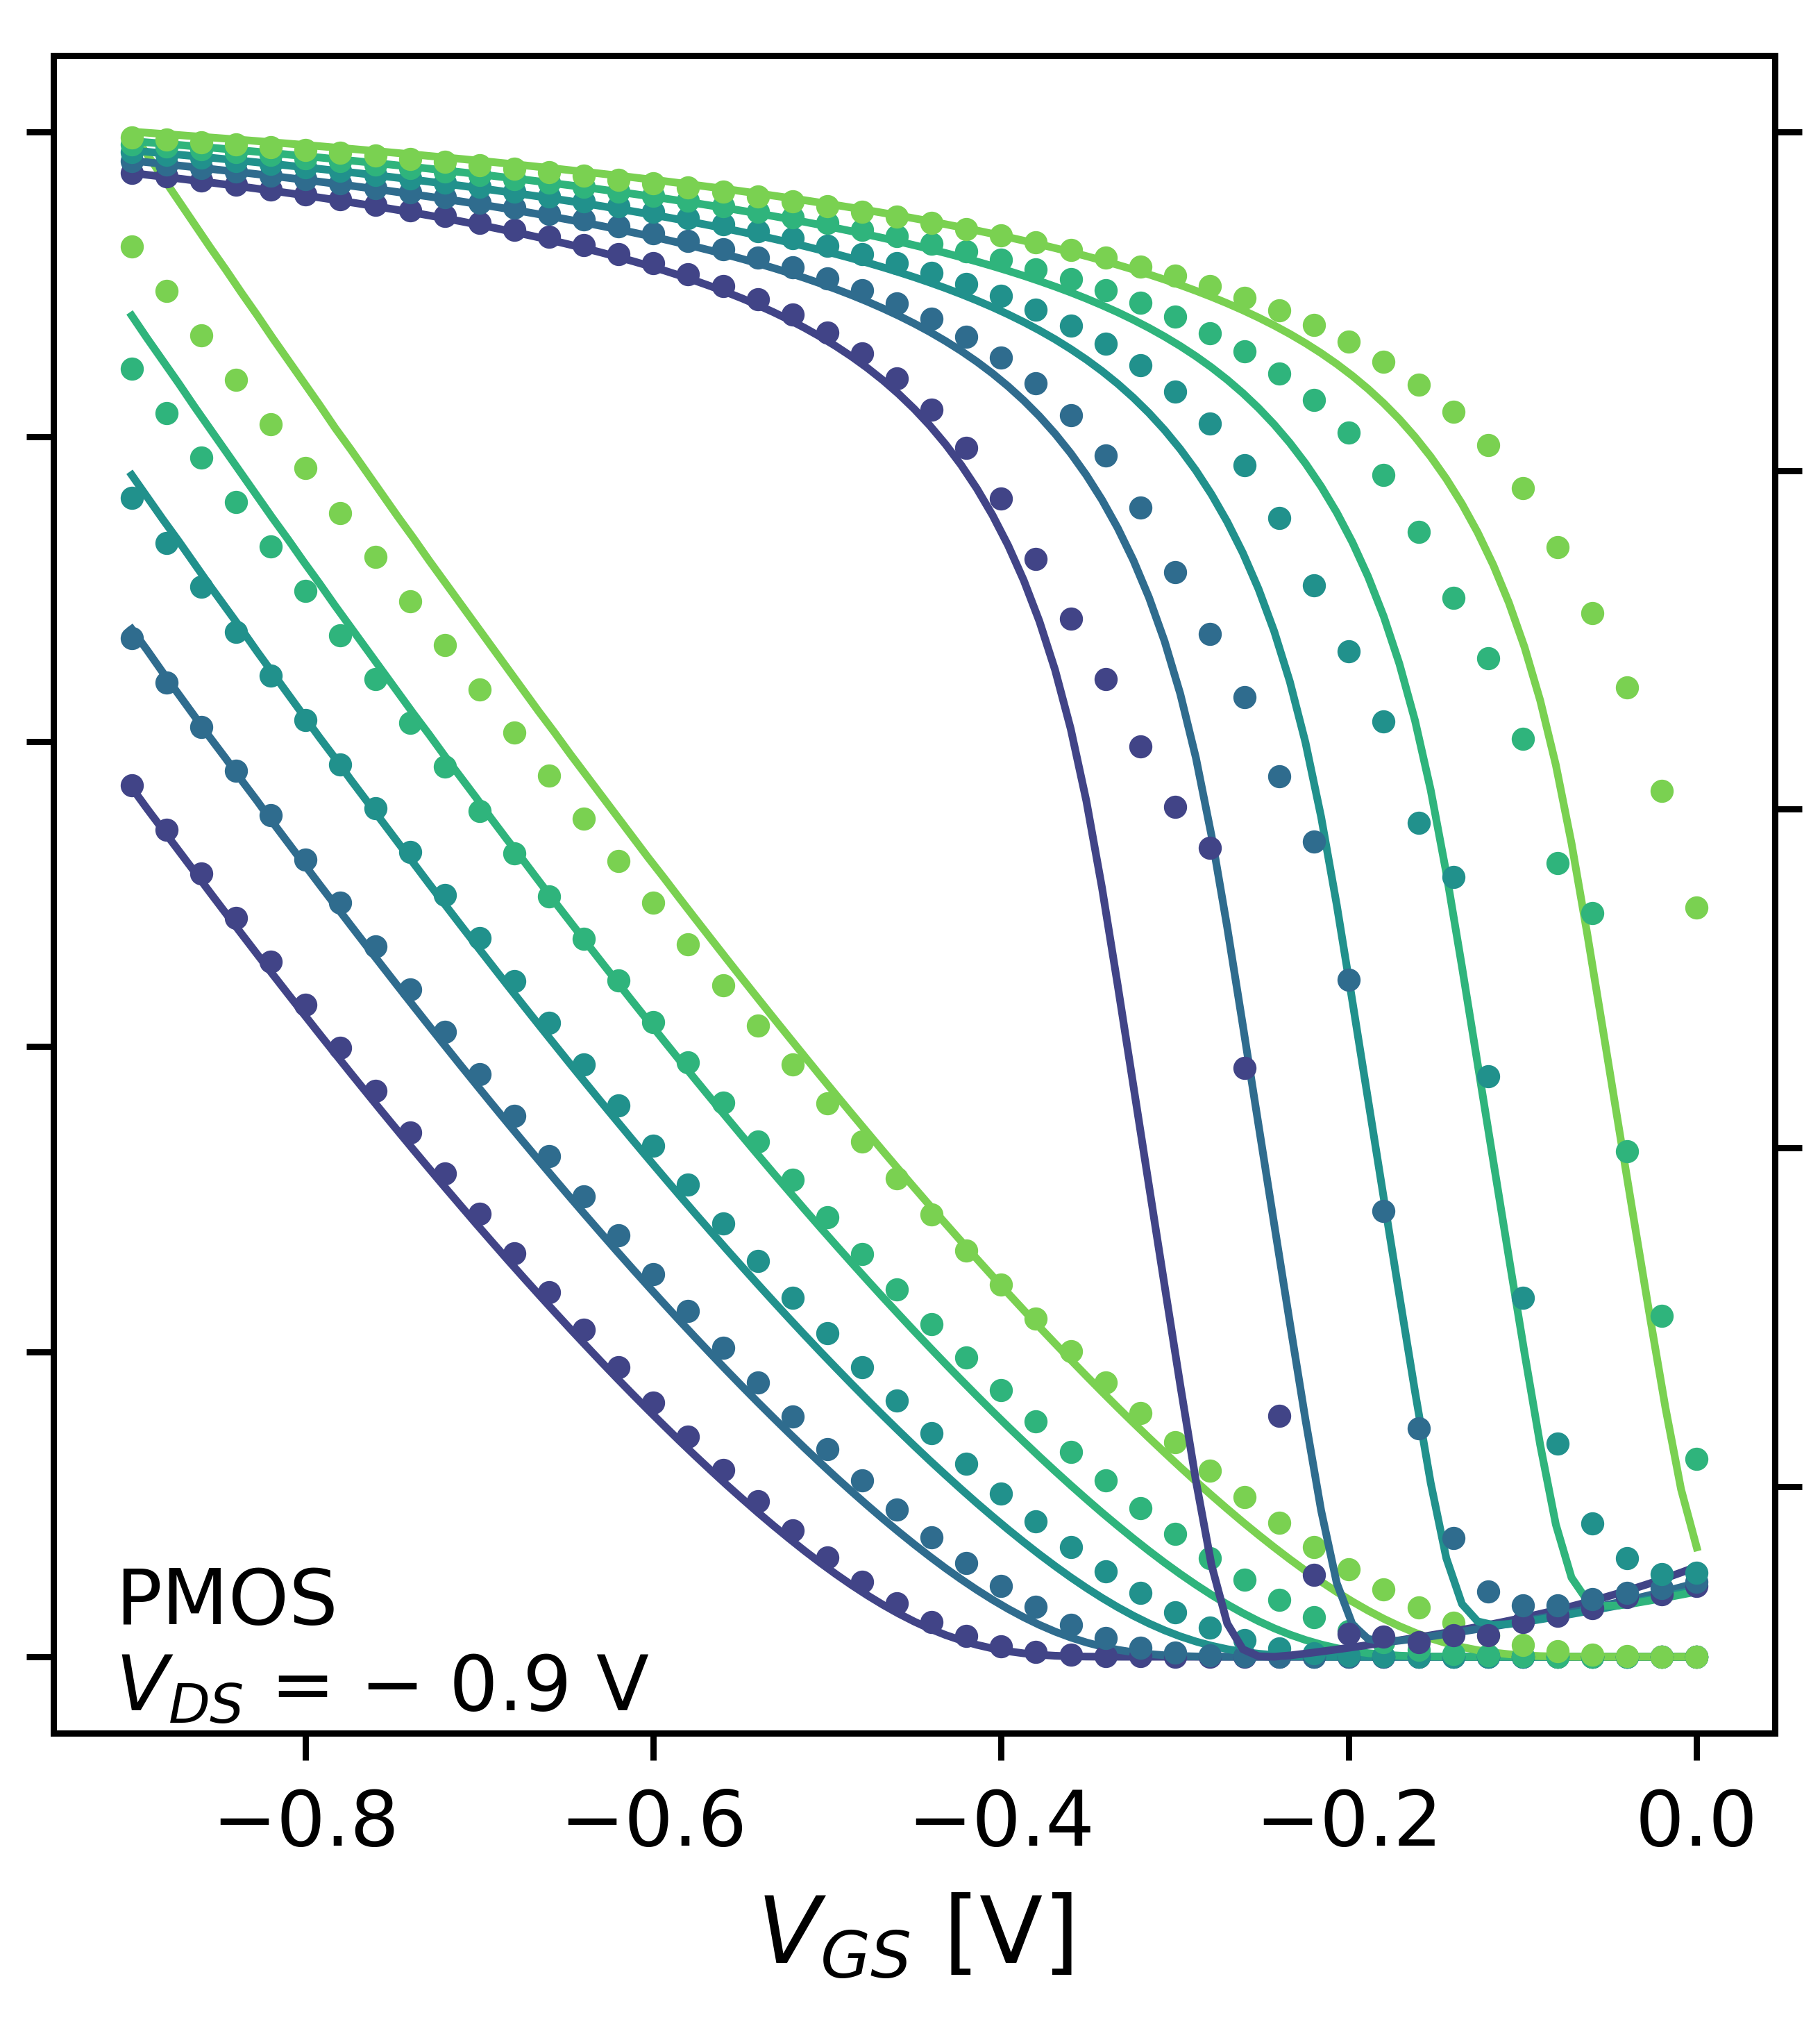
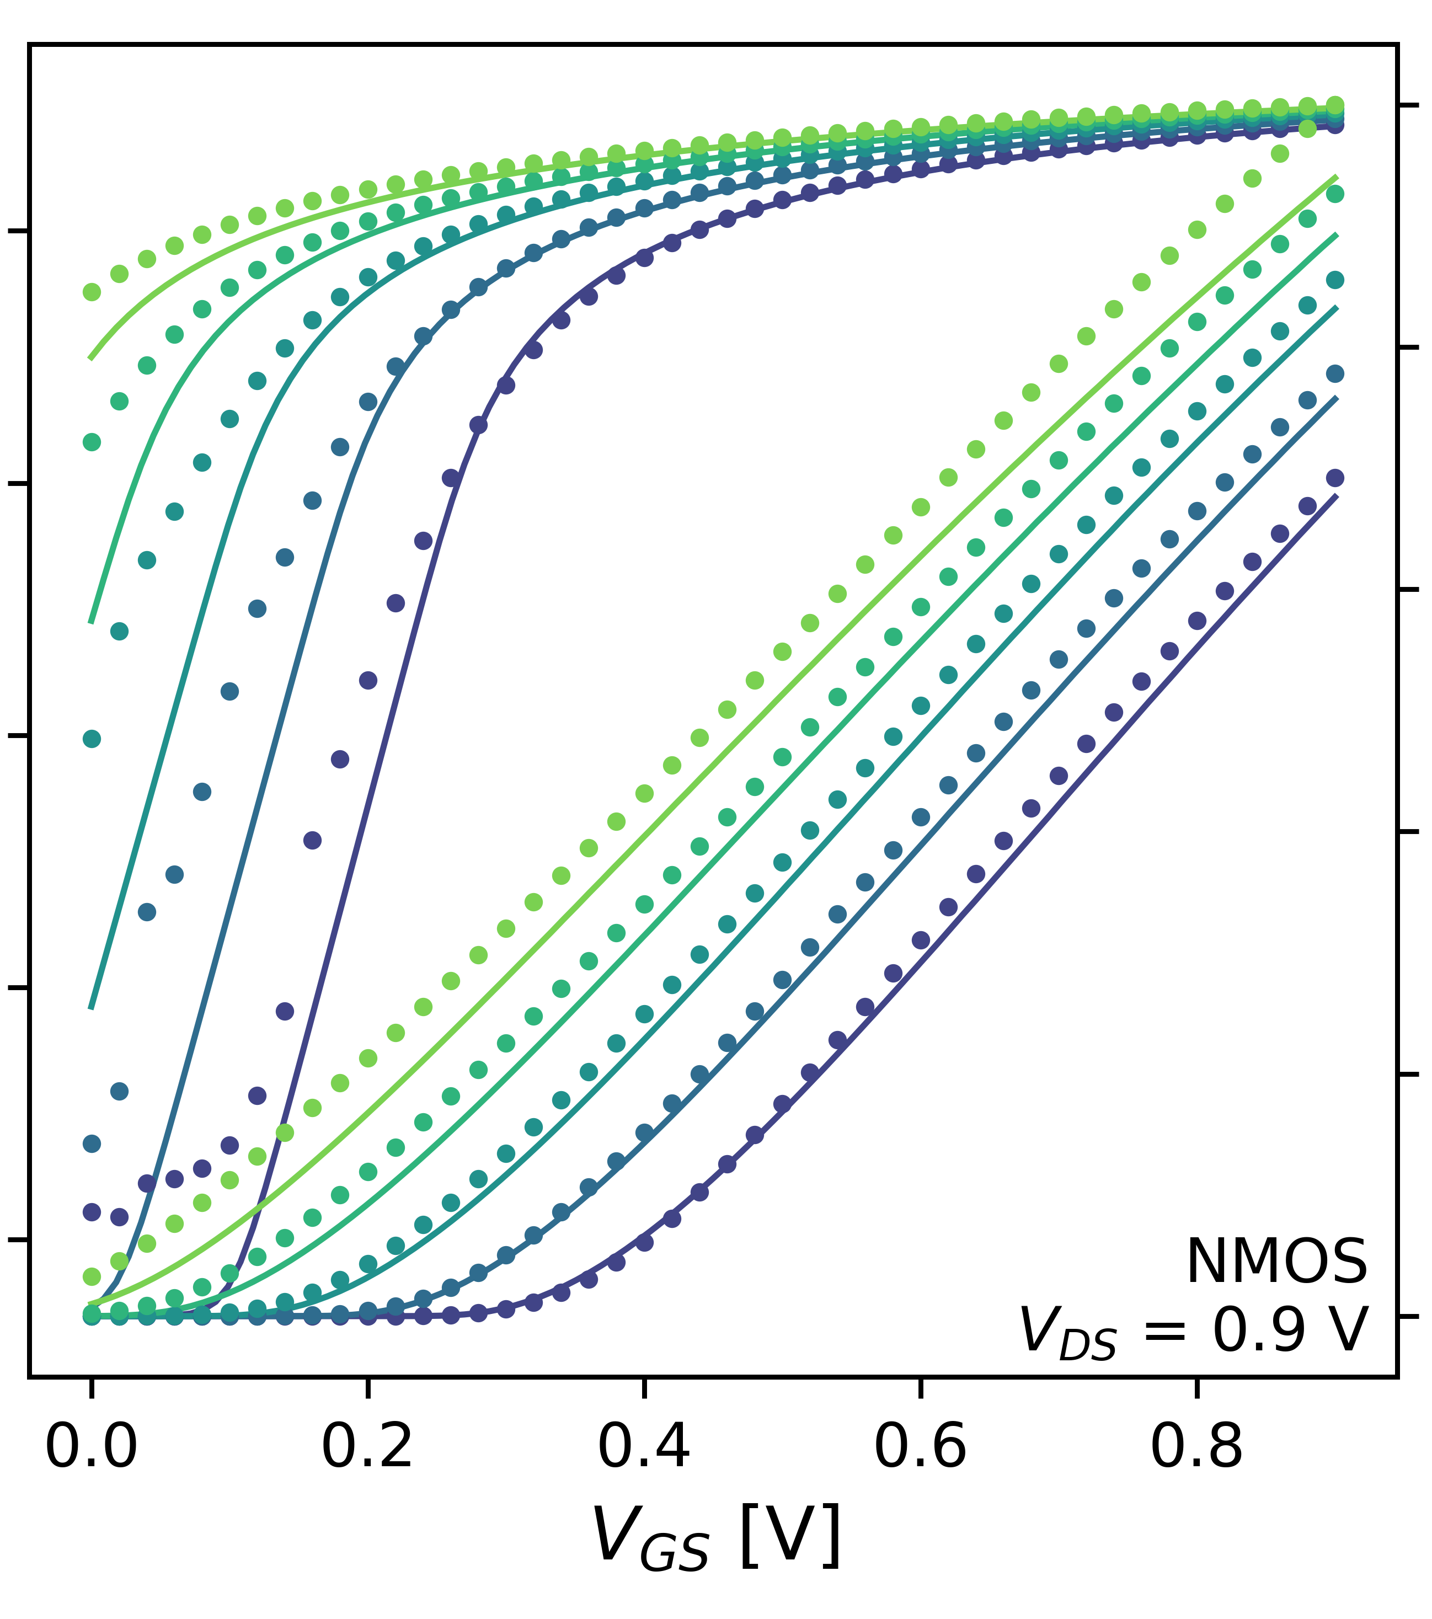
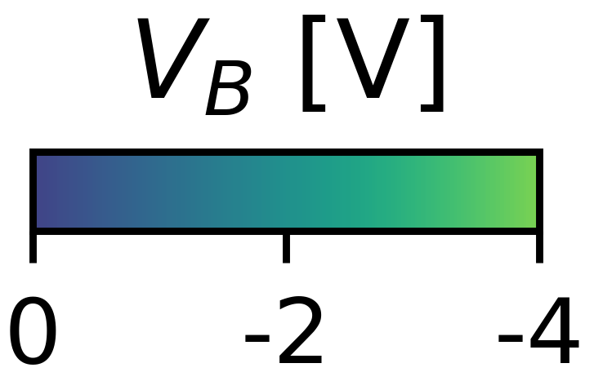
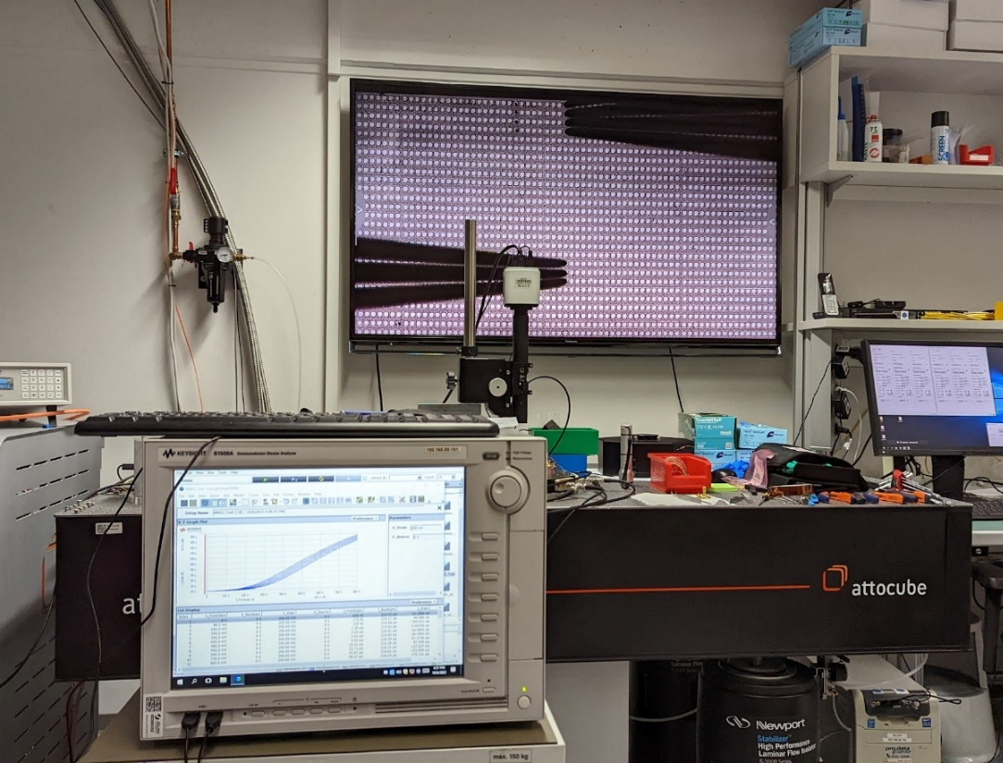
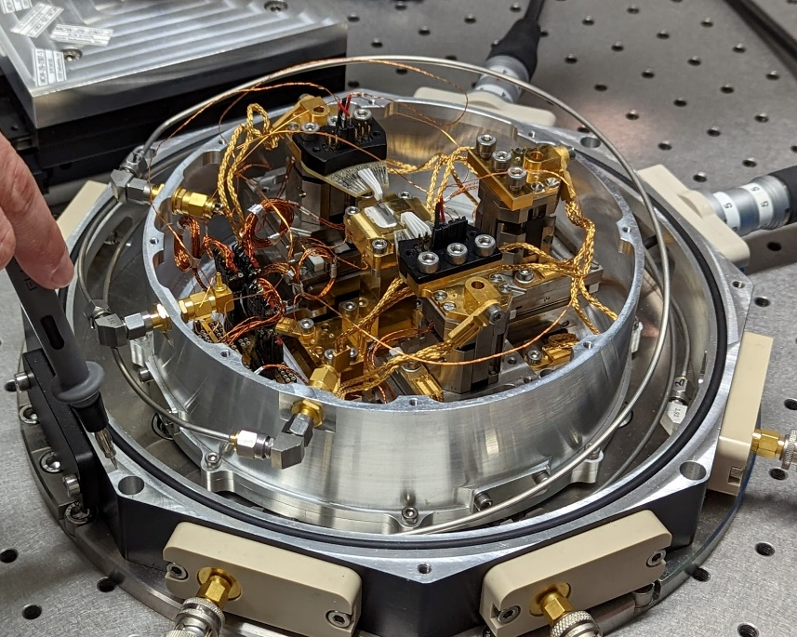







Cryogenic Measurements
Inputs for a Cryo-PDK for 22 nm CMOS
Short-Channel I-V-Curves [1]
Setup @ ICA | FZJ: T_{min} ~ 7 K
Transistor Arrays
60 K Stage
I_{D} [a.u.]
7 K
7 K
Analyzer
300 K Stage
Input Data for BSIM-IMG Based Modeling
done by
AdMOS GmbH
DUT
Cryogenic Model Library
The QSolid project acknowledges the support of the Federal Ministry of Education and Research (BMBF) within the framework program “Quantum technologies – from basic research to market” (Grant No. 13N16149).
Related to DRD7.4a
Source: [2]

Slide 17

Summary
Integrated Computing Architectures
Semiconductors Enable
Future Computing Architectures
  High integration, VLSI scalability
System Integration of Memristors, Qubits, etc.
  Algorithms, hardware and physics co-design
System Modeling of Hardware Implementations
  → Application requirements and error mitigation / correction
Quantum Computing
Neuromorphic Computing
Notes:
Overlap between NC and QC

