Slide 1



Application Of Modified Cyclodextrin Derivatives For The Recognition Of Enantiomers, Isotopologues, And Isotopomers Of Psychoactive Compounds In Capillary Electrophoresis
Irakli Apriamashvili Tbilisi State University
Supervisor: Academician Bezhan Chankvetadze

Slide 2
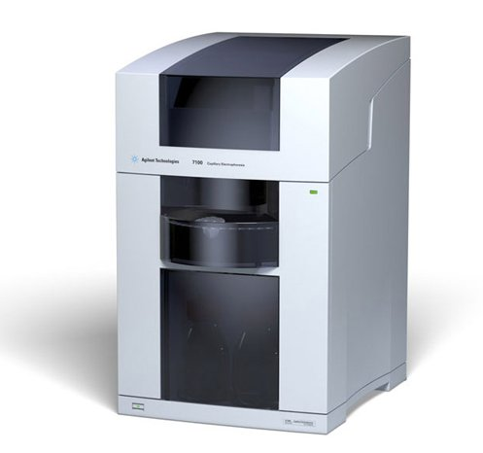
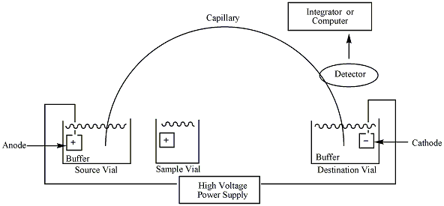
Capillary Electrophoresis

Slide 3
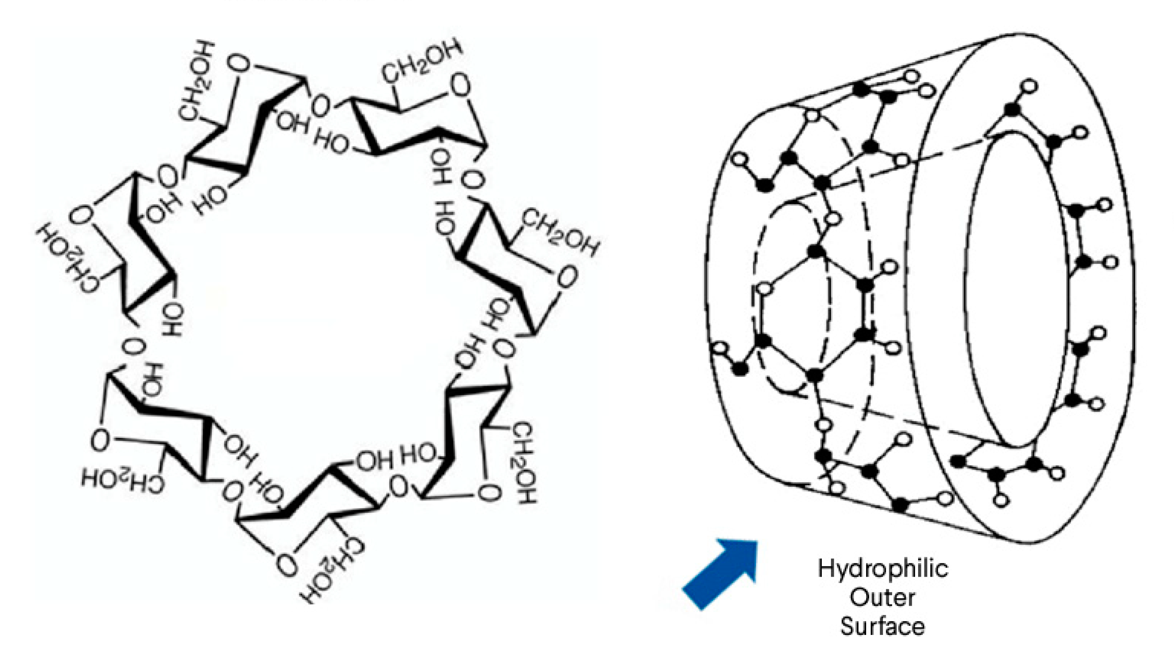
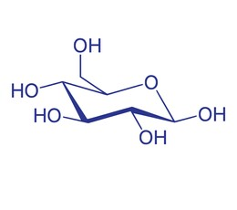
cyclodextrines

Slide 4
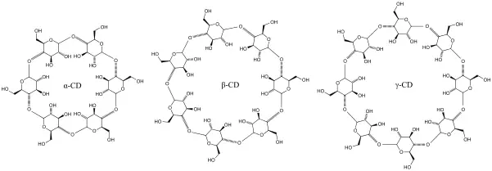
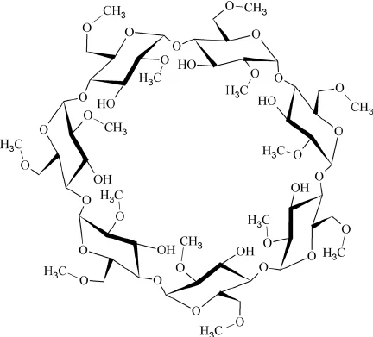
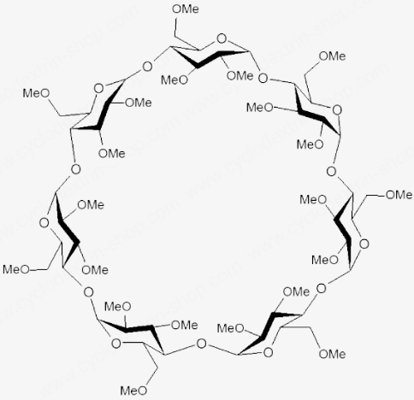
heptakis(2,6-di-O-methyl)-β-cyclodextrine
heptakis(2,3,6-tri-O-methyl)-β-cyclodextrine

Slide 5
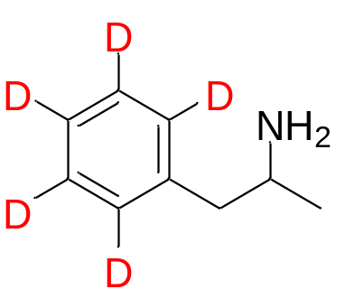
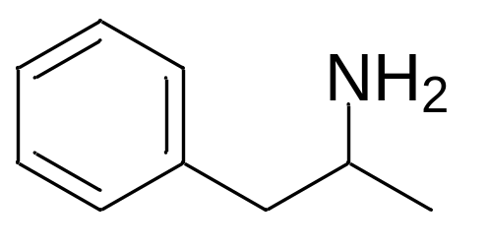
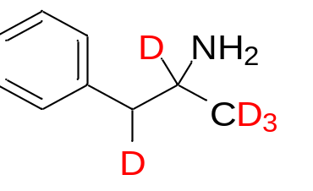
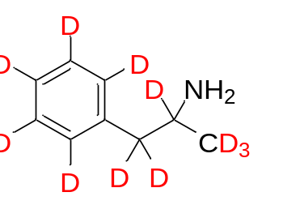
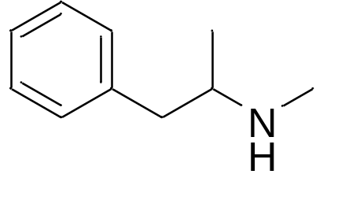
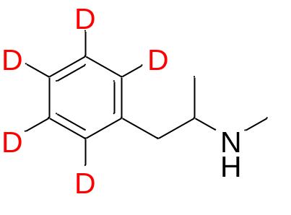
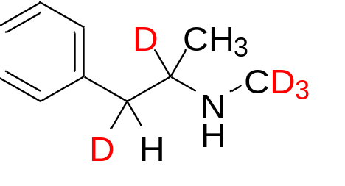
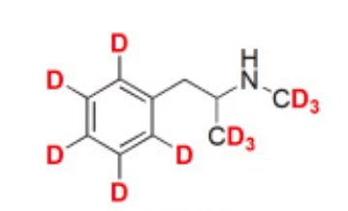
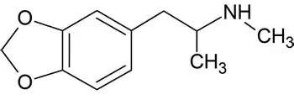
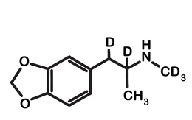


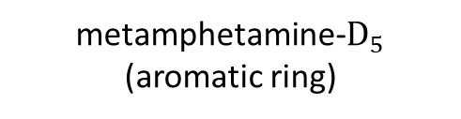




studied substances
amphetamine-$D_{5}$
(aromatic ring)
amphetamine$−D_{5}$(sidechain)
amphetamine
amphetamine-$D_{11}$
$$H_{3}$$
metamphetamine
metamphetamine-$D_{5}$
(aromatic ring)
metamphetamine-$D_{5}$(sidechain)
metamphetamine-$D_{11}$
3,4-methylendioxy-metamphetamine (MDMA)
3,4-methylendioxy-metamphetamine (MDMA) $D_{5}$

Slide 6
experiment conditions
buffer: H₃PO₄(150mM)+ Triethanolamine (pH 3.1)
sample in: 10mM H₃PO₄
capilary effective length: 90cm
voltage: 30kv
temperature: 15℃

Slide 7
unmodified cyclodextrines

Slide 8
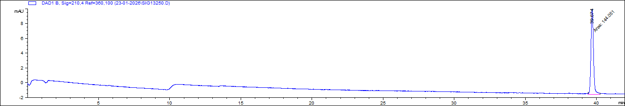
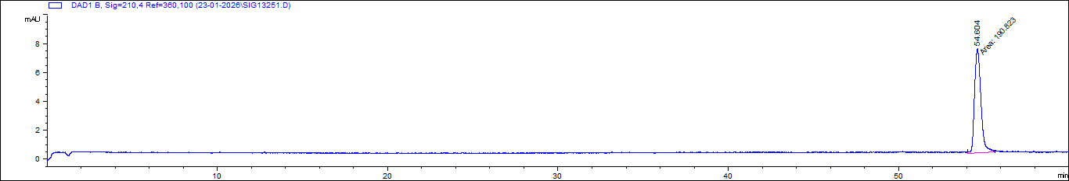
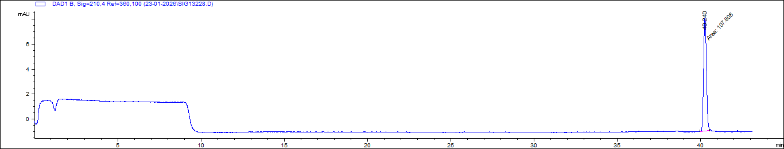
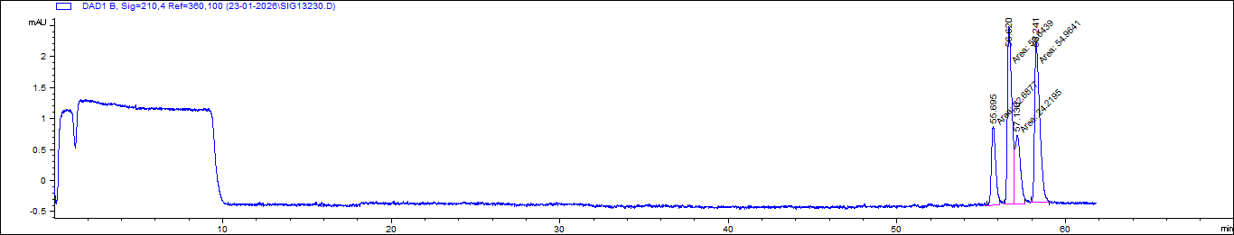
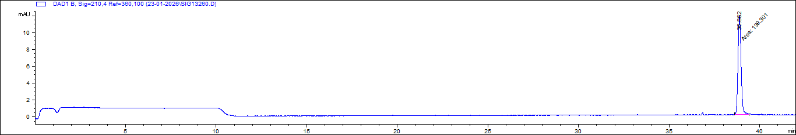
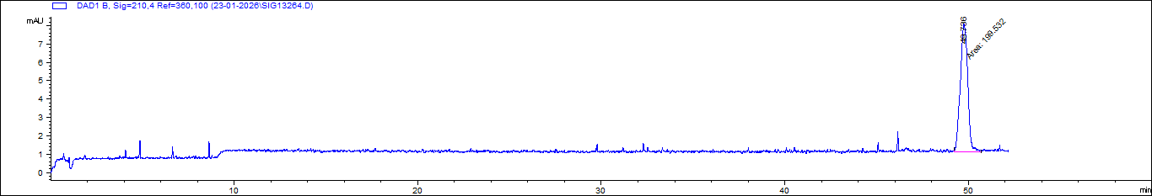
MET+MET-d11
Buffer: H₃PO₄+TEA (pH 3.1)
Achiral analysis
MET+MET-d11
Buffer: H₃PO₄+TEA (pH 3.1)
Additive: 20 mg/mL α-CD
MET+MET-d11
buffer: H₃PO₄+TEA (pH 3.1)
Achiral analysis
MET+MET-d11
buffer: H₃PO₄+TEA (pH 3.1)
Additive: 3.5 mg/mL β-CD
MET+MET-d11
Buffer: H₃PO₄+TEA (pH 3.1)
Achiral analysis
MET+MET-d11
Buffer: H₃PO₄+TEA (pH 3.1)
Additive: 50 mg/mL γ-CD

Slide 9
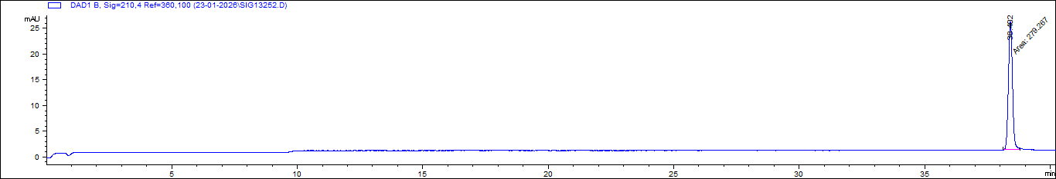
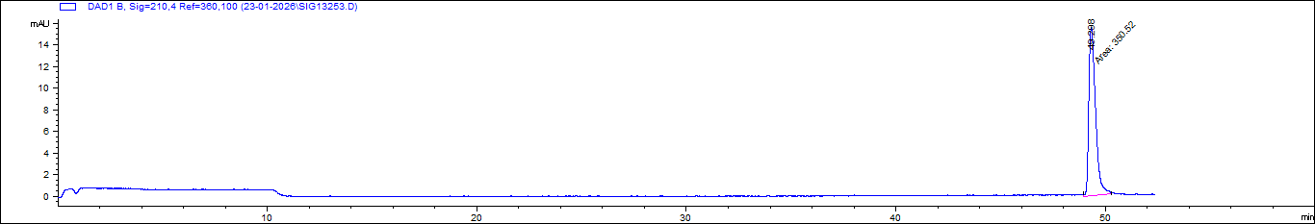
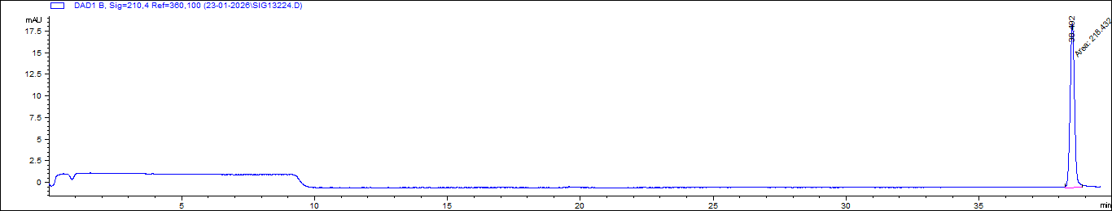
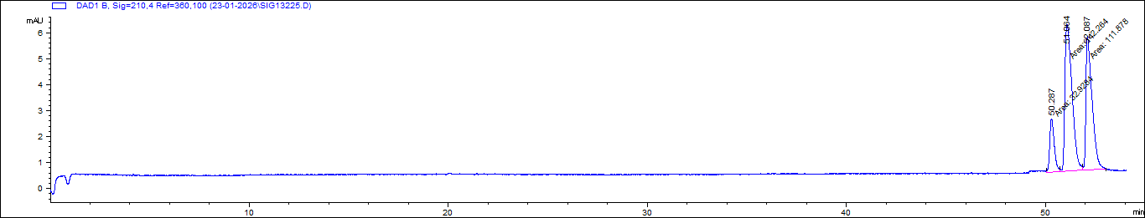
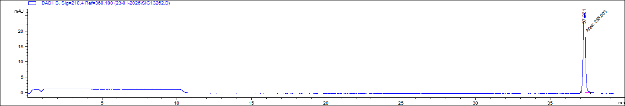
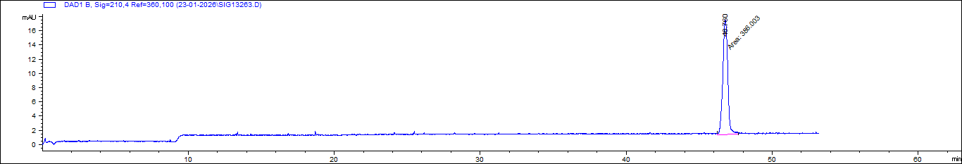
AMP+AMP-d11
Buffer: H₃PO₄+TEA (pH 3.1)
Achiral analysis
AMP+AMP-d11
Buffer: H₃PO₄+TEA (pH 3.1)
Additive: 20 mg/mL α-CD
AMP-AMP-d11
buffer: H₃PO₄+TEA (pH 3.1)
Additive: 3.5 mg/mL β-CD
AMP-AMP-d11
buffer: H₃PO₄+TEA (pH 3.1)
Achiral analysis
AMP+AMP-d11
Buffer: H₃PO₄+TEA (pH 3.1)
Achiral analysis
AMP+AMP-d11
Buffer: H₃PO₄+TEA (pH 3.1)
Additive: 50 mg/mL γ-CD

Slide 10
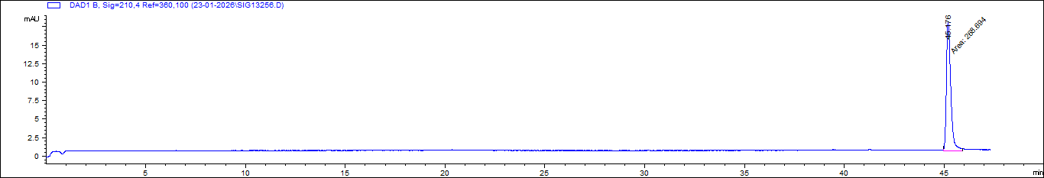
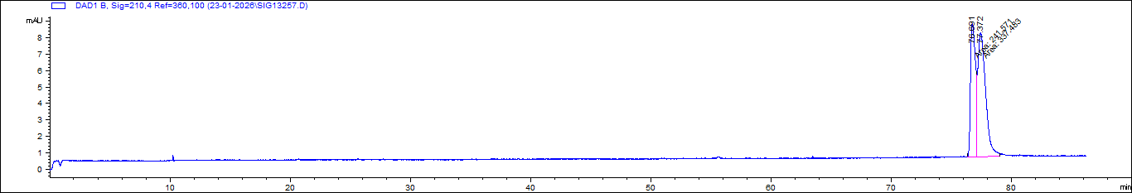
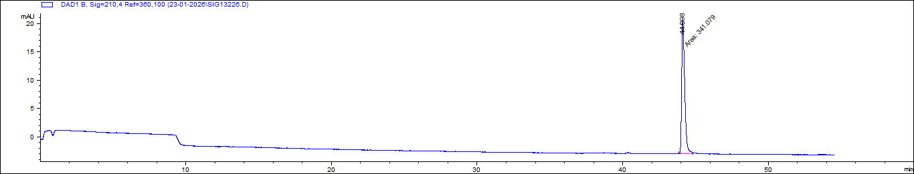
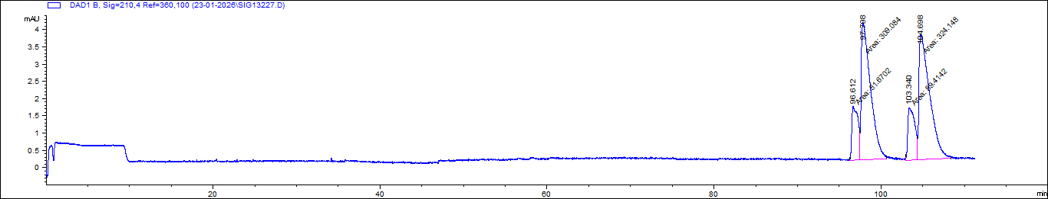
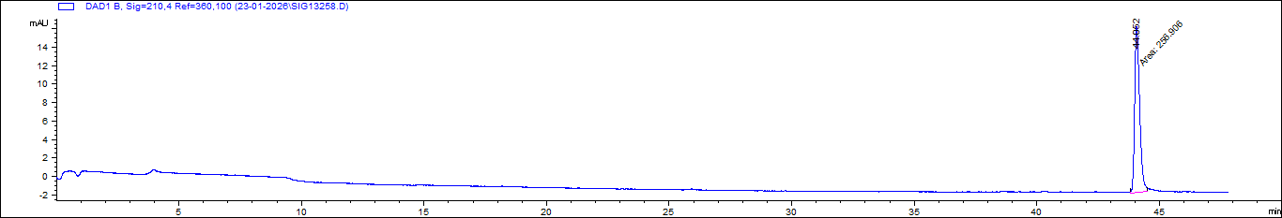
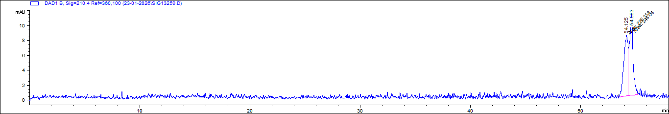
MDMA+MDMA-d5
Buffer: H₃PO₄+TEA (pH 3.1)
Achiral analysis
MDMA+MDMA-d5
Buffer: H₃PO₄+TEA (pH 3.1)
Additive: 20 mg/mL α-CD
MDMA+MDMA-d5
buffer: H₃PO₄+TEA (pH 3.1)
Achiral analysis
MDMA+MDMA-d5
buffer: H₃PO₄+TEA (pH 3.1) Additive: 3.5 mg/mL β-CD
MDMA+MDMA-d5
Buffer: H₃PO₄+TEA (pH 3.1)
Achiral analysis
MDMA+MDMA-d5
Buffer: H₃PO₄+TEA (pH 3.1)
Additive: 50 mg/mL γ-CD

Slide 11
heptakis(2,3,6-tri-O-methyl)-β-cyclodextrine

Slide 12
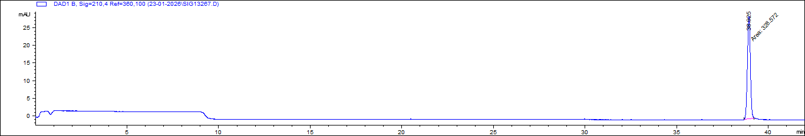
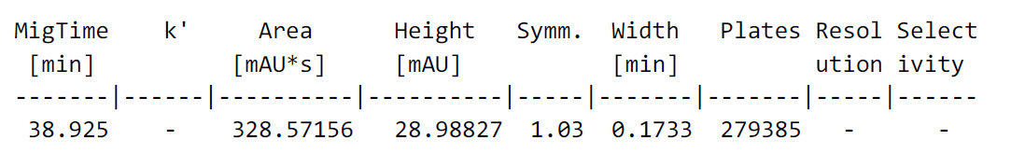
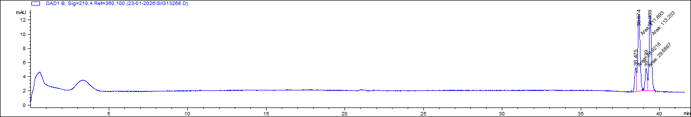
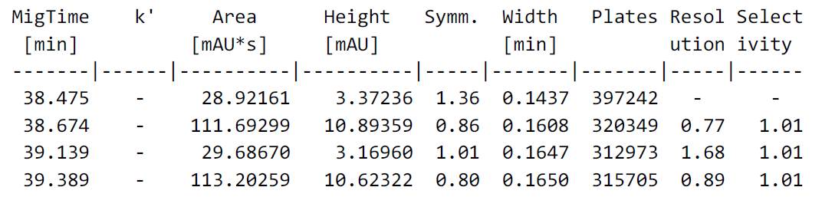
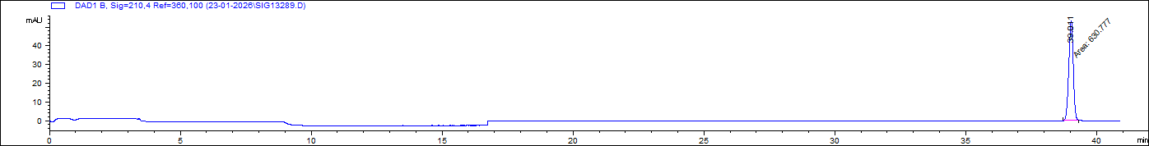
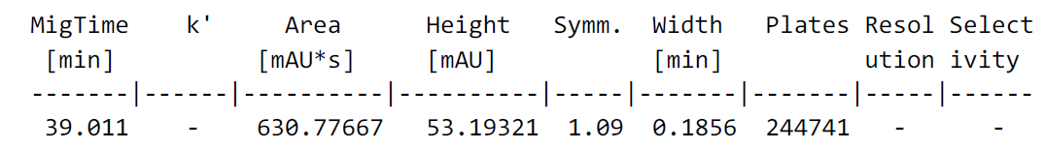
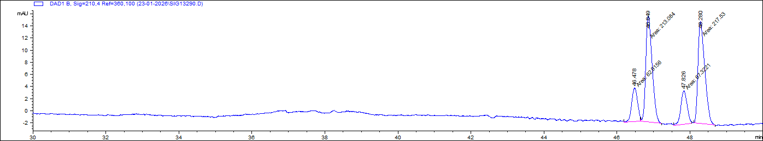
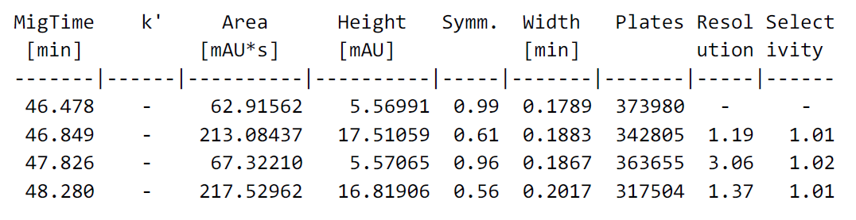
AMP+AMP-d11
Buffer: H₃PO₄+TEA (pH 3.1)
Achiral analysis
AMP+AMP-d11
Buffer: H₃PO₄+TEA (pH 3.1)
Additive: 50 mg/mL Heptakis
(2,3,6-tri-O-methyl)-β-cyclodextrine
AMP+AMP-d11
Buff: H₃PO₄+TEA (pH 3.1)
Achiral analysis
AMP+AMP-d11
Buff: H₃PO₄+TEA (pH 3.1)
Additive: 100 mg/mL Heptakis(2,3,6-tri-O-methyl)-β-cyclodextrine

Slide 13
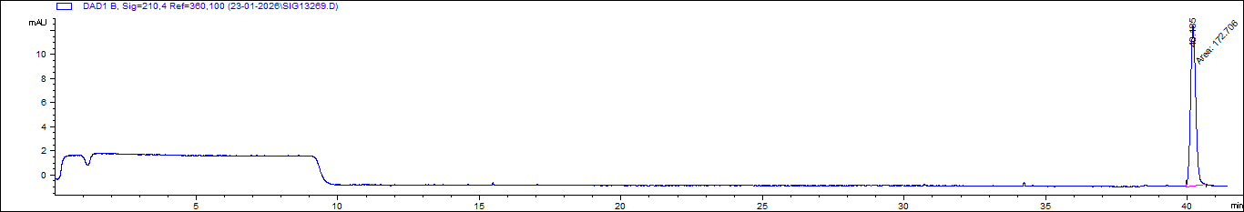
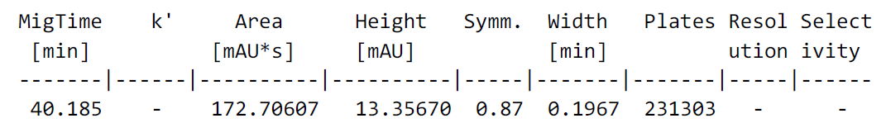
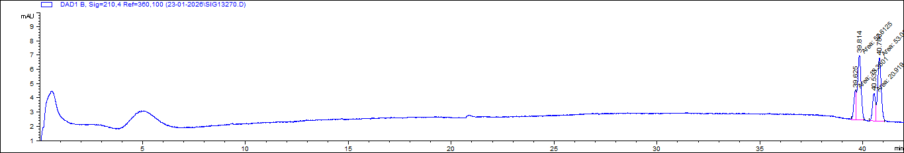
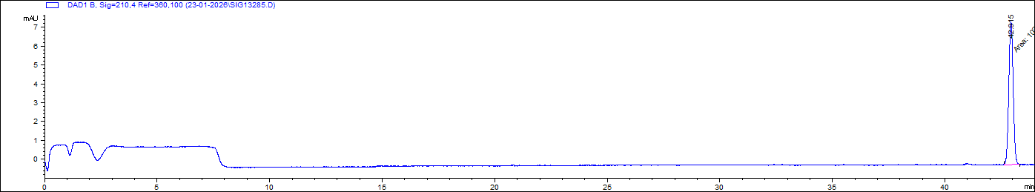
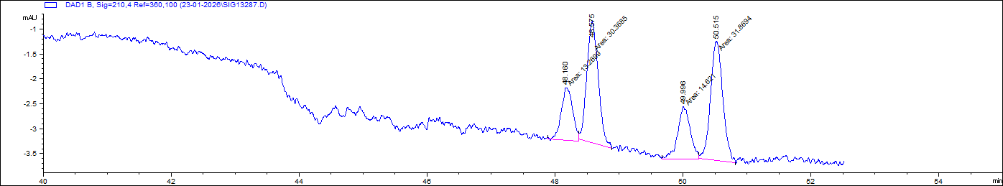
MET+MET-d11
Buffer: H₃PO₄+TEA (pH 3.1)
Achiral analysis
MET+MET-d11
Buffer: H₃PO₄+TEA (pH 3.1)
Additive: 50 mg/mL Heptakis
(2,3,6-tri-O-methyl)-β-cyclodextrine
MET+MET-d11
Buff: H₃PO₄+TEA (pH 3.1)
Achiral analysis
MET+MET-d11
Buff: H₃PO₄+TEA (pH 3.1)
Additive: 100 mg/mL Heptakis(2,3,6-tri-O-methyl)-β-cyclodextrine

Slide 14
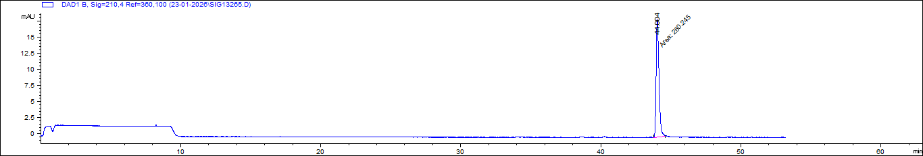







MDMA+MDMA-d5
Buffer: H₃PO₄+TEA (pH 3.1)
Achiral analysis
MDMA+MDMA-d5
Buffer: H₃PO₄+TEA (pH 3.1) Additive: 50 mg/mL Heptakis(2,3,6-tri-O-methyl)-β-cyclodextrine
MDMA+MDMA-d5
Buffer: H₃PO₄+TEA (pH 3.1)
Achiral analysis
MDMA+MDMA-d5
Buffer: H₃PO₄+TEA (pH 3.1)
Additive: 100 mg/mL Heptakis
(2,3,6-tri-O-methyl)-β-cyclodextrine

Slide 15
heptakis(2,6-di-O-methyl)-β-cyclodextrine

Slide 16




MET-d5 (aromatic ring)+MET-d5 (side chain)
Buffer: H₃PO₄+TEA (pH 3.1)
Achiral analysis
MET-d5 (aromatic ring)+MET-d5 (side chain)
Buffer: H₃PO₄+TEA (pH 3.1)
Additive: 20 mg/mL Heptakis
(2,6-di-O-methyl)β-cyclodextrine

Slide 17




MET-d5 (aromatic ring)+MET-d5 (side chain)
Buffer: H₃PO₄+TEA (pH 3.1)
Achiral analysis
MET-d5 (aromatic ring)+MET-d5 (side chain)
Buffer: H₃PO₄+TEA (pH 3.1)
Additive: 35 mg/mL Heptakis
(2,6-di-O-methyl)β-cyclodextrine

Slide 18
heptakis(2,3,6-tri-O-methyl)-β-cyclodextrine and heptakis(2,6-di-O-methyl)-β-cyclodextrine mixture

Slide 19




AMP+AMP-d11
Buffer: H₃PO₄+TEA (pH 3.1)
Achiral analysis
AMP+AMP-d11
Buffer: H₃PO₄+TEA (pH 3.1)
Additive: 20 mg/mL
heptakis (2,6-di-O-methyl)-
(2,3,6-tri-O-methyl)-β-cyclodextrine

Slide 20




MET-d5 (aromatic ring)+MET-d5 (side chain)
Buffer: H₃PO₄+TEA (pH 3.1)
Achiral analysis
MET-d5 (aromatic ring)+MET-d5 (side chain)
Buffer: H₃PO₄+TEA (pH 3.1)
Additive: 20 mg/mL heptakis (2,6-di-O-methyl)-(2,3,6-tri-O-methyl)-β-cyclodextrine

Slide 21




MET-d5 (aromatic ring)+MET-d5 (side chain)
Buffer: H₃PO₄+TEA (pH 3.1)
Achiral analysis
MET-d5 (aromatic ring)+MET-d5 (side chain)
Buffer: H₃PO₄+TEA (pH 3.1)
Additive: 25 mg/mL heptakis (2,6-di-O-methyl)-(2,3,6-tri-O-methyl)-β-cyclodextrine

Slide 22




MET-d5 (aromatic ring)+MET-d5 (side chain)
Buffer: H₃PO₄+TEA (pH 3.1)
Achiral analysis
MET-d5 (aromatic ring)+MET-d5 (side chain)
Buffer: H₃PO₄+TEA (pH 3.1)
Additive: 35 mg/mL heptakis (2,6-di-O-methyl)-(2,3,6-tri-O-methyl)-β-cyclodextrine

Slide 23





MET-d5 (aromatic ring)+MET-d5 (side chain)
Buffer: H₃PO₄+TEA (pH 3.1)
Achiral analysis
MET-d5 (aromatic ring)+MET-d5 (side chain)
Buffer: H₃PO₄+TEA (pH 3.1)
Additive: 40 mg/mL heptakis (2,6-di-O-methyl)-(2,3,6-tri-O-methyl)-β-cyclodextrine
MET-d5 (aromatic ring)+MET-d5 (side chain)
Buffer: H₃PO₄+TEA (pH 3.1)
Additive: 50 mg/mL heptakis (2,6-di-O-methyl)-(2,3,6-tri-O-methyl)-β-cyclodextrine

Slide 24
conclusion
Modified cyclodextrine mixture gives interesting isotopologue seperation.
This study proves that modified cyclodextrines can be used for isotopomer seperation.

Slide 25
Thanks for your attention

