Slide 1
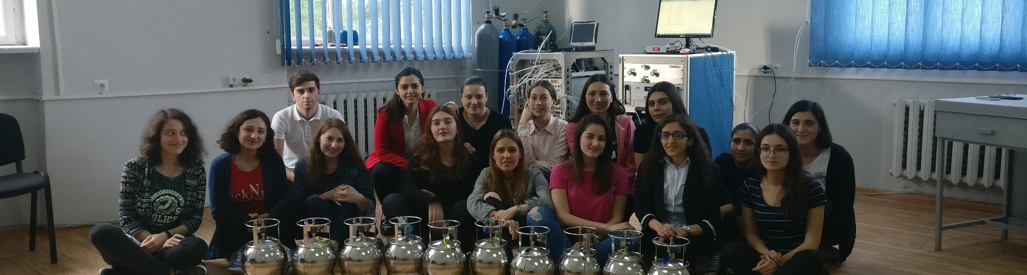

Current status and perspectives of the SMART|AtmoSim_Lab
And the net4cities Project
2026/09/07 I ROBERT WEGENER, GIORGI JIBUTI

Slide 2
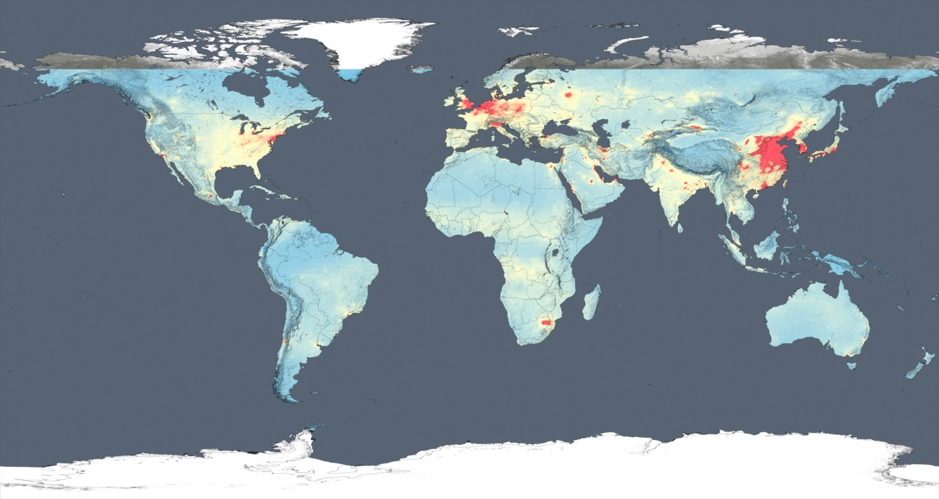
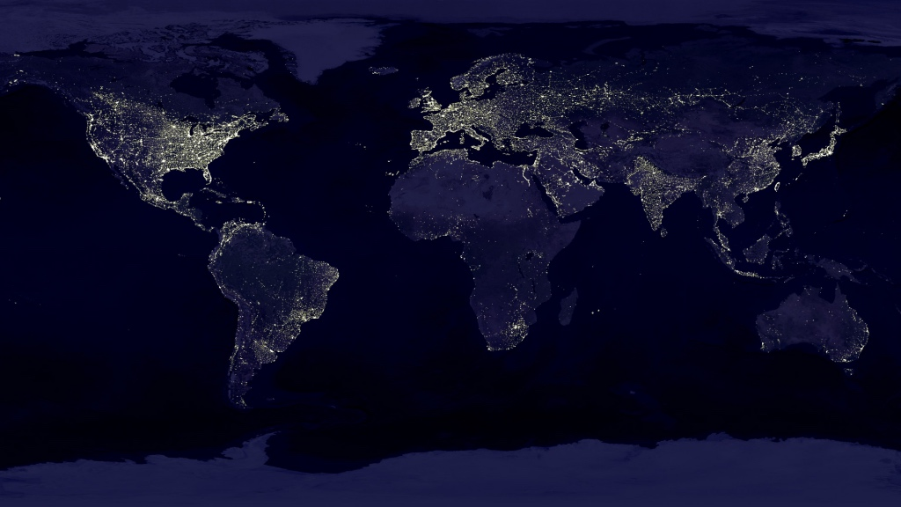

Air Pollution – A Global Perspective
© NASA's Goddard Space Flight Center, Trent L. Schindler (USRA): Ellen T. Gray (ADNET): Kayvon Sharghi (USRA): Producer
Bryan Duncan (NASA/GSFC):Lok Lamsal (USRA):

Slide 3
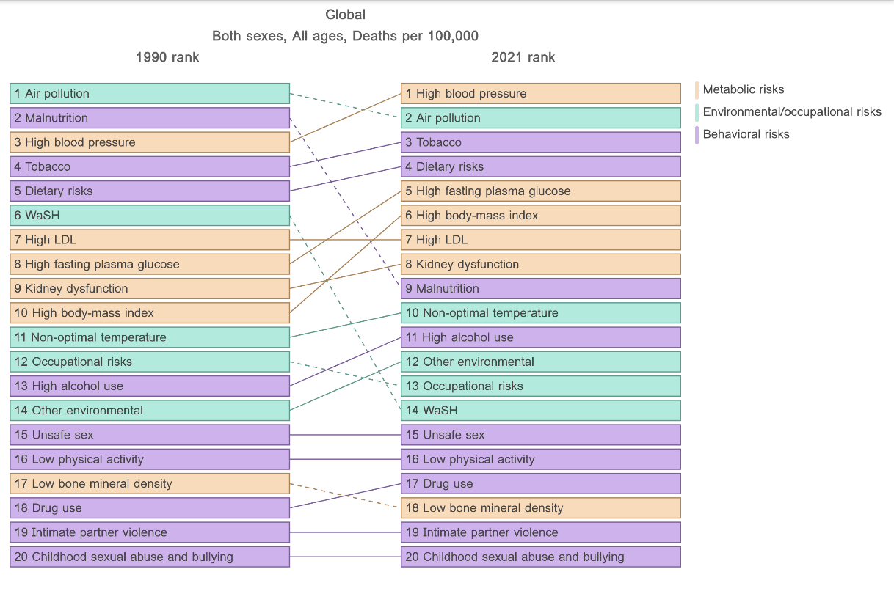

Is Air Quality still an important issue ?
Health Metrics and Evaluation (IHME)
On a global scale air pollution is the 2nd leading risk factor for death.
https://www.healthdata.org/

Slide 4
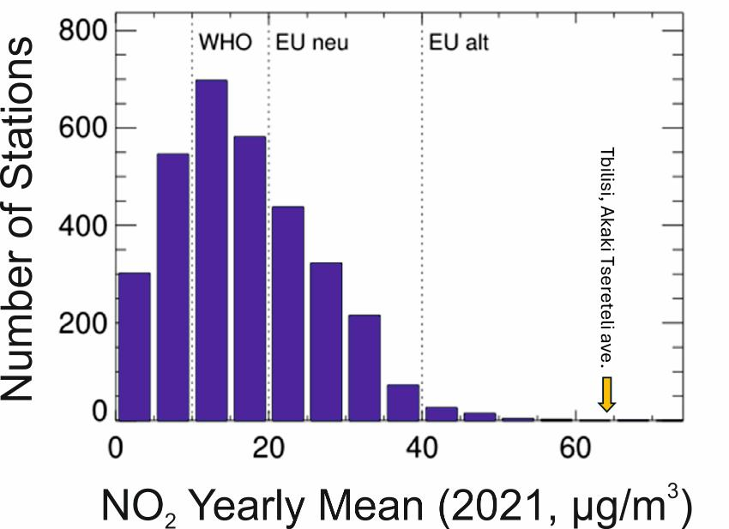
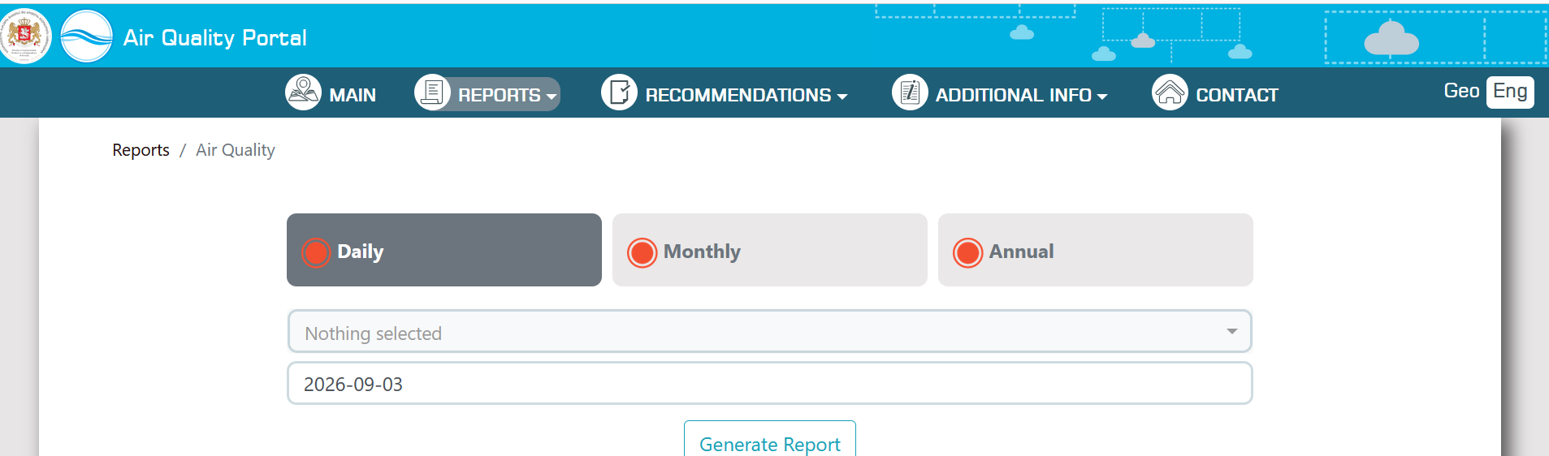
Air Pollution in Georgia
Situation in Georgia (2023)
Mean NO₂ at: Tsereteli Av. 64µg/ m³
Highest in EU: 55µg/m³

Slide 5
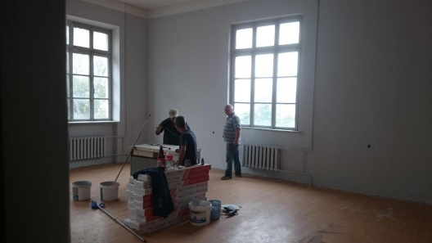
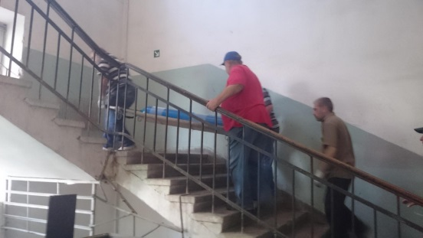
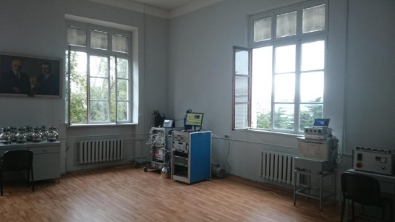
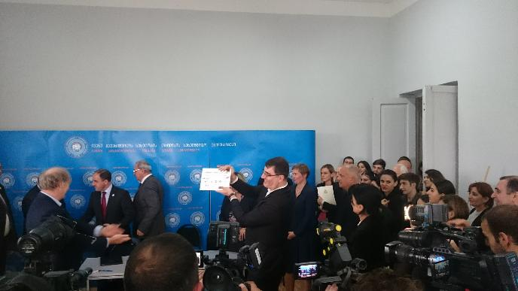
SMART|AtmoSim_Lab The Start

Slide 6
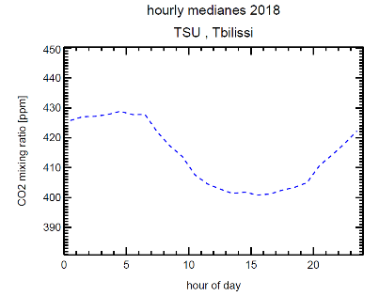
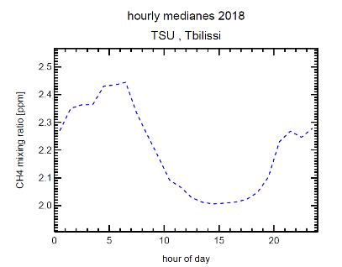
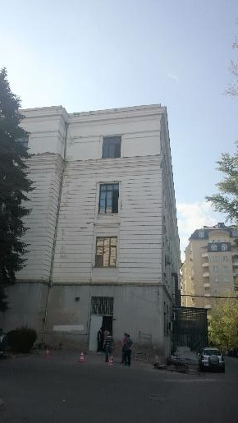
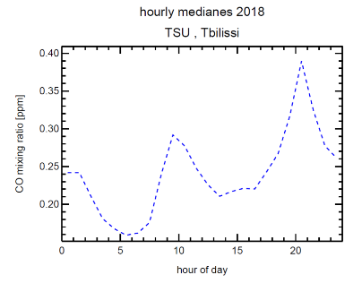
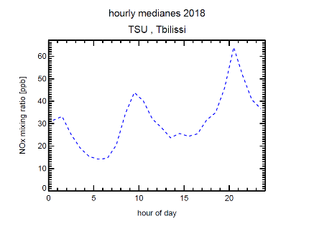
First ATMO_SimLab Data
sunrise
sunset

Slide 7

SMART|AtmoSim_Lab The Start

Slide 8
Combing Science and Teaching
No. | Author |  | Title
1 | Ms. Ana Chokheli |  | Concentration of nitrogen dioxides in Tbilisi
2 | Ms. Nino Kirtadze |  | Concentration of carbon oxides in Tbilisi
3 | Ms. Natia Badzgaradze |  | Evaluation of air pollution during rush hours in Tbilisi at I. Chavchavadze avenue
4 | Ms. Tamuna Lapachi |  | Evaluation of air pollution outside rush hours in Tbilisi at I. Chavchavadze avenue
5 | Ms. Megi Choniashvili |  | Optimization of air sampling for pollution analysis
6 | Ms. Mariam Lazariashvili |  | Evaluation of cost-effective carbon monoxide sensors for atmospheric analysis
7 | Ms. Nino Macharashvili |  | Evaluation of cost-effective ozone sensors for atmospheric analysis
8 | Ms. Maka Popiashvili |  | Evaluation of cost-effective nitrogen monoxide sensors for atmospheric analysis
9 | Ms. Lina Ugulava |  | Evaluation of cost-effective nitrogen dioxide sensors for atmospheric analysis
10 | Ms. Tsira Shalashvili |  | Comparison of canister air sampling analysis with online measurements
11 | Ms. Leone Akmeteli |  | Suitability of Alphasense Sensor for Measuring Concentration of Particulate Matter in the Atmosphere
12 | Ms. Lia Kirtadze |  | Nitrous Oxides Contamination in Atmosphere
13 | Mr. Ilia Aduashvili |  | Carbon monoxide measurement in atmosphere using cost-effective sensors and unmanned aerial vehicle
14 | Mr. Levan Turmanidze |  | Ozone measurement in atmosphere using cost-effective sensors and unmanned aerial vehicle
15 | Ms. Monika Kartvelishvili |  | Nitrogen oxides measurement in atmosphere using cost-effective sensors and unmanned aerial vehicle

Slide 9
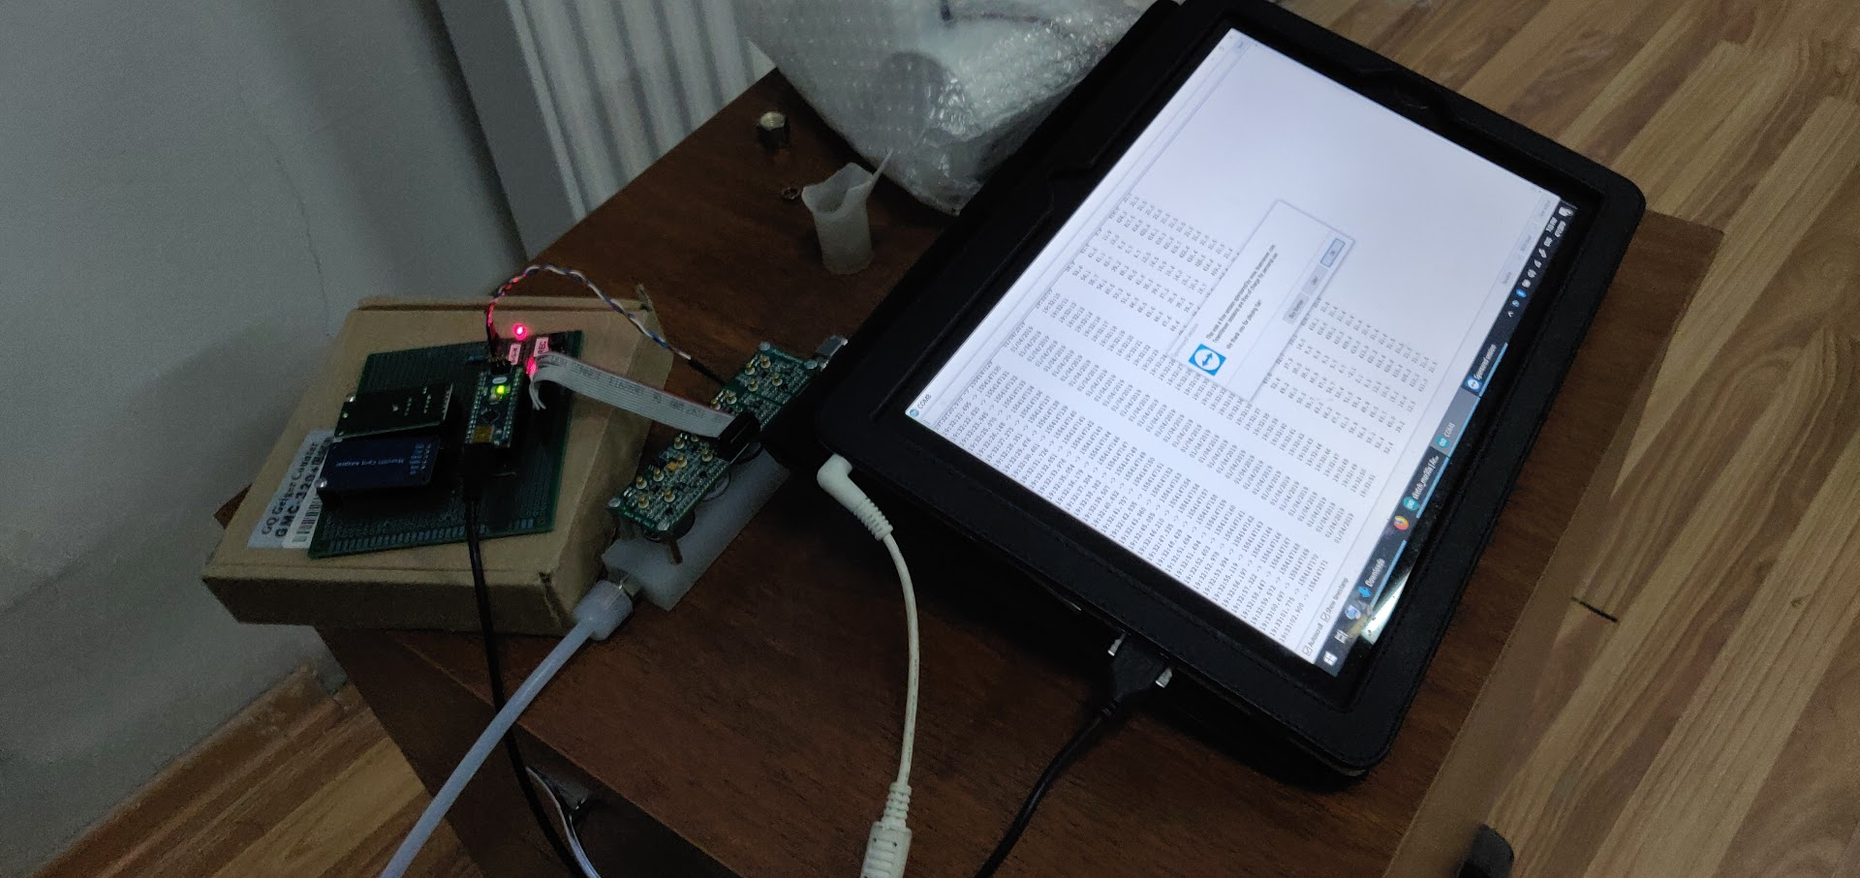
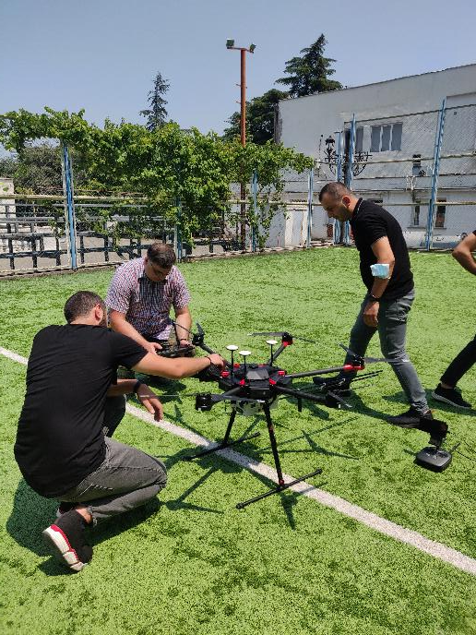
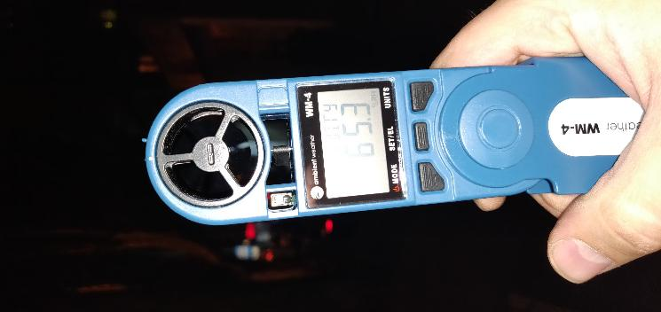
ATMO_SimLab Projects
PROJECTS
Measurement platform for low-cost sensors (with SMART|EDM_LAB)
aerial measurements (UAV, drone)
Sensor Project with National Environmental Agency
Erasmus + project “Educational for Drone (eDrone)
net4cities
Measurement platform for low-cost sensors (with SMART|EDM_LAB)
aerial measurements (UAV, drone)
Sensor Project with National Environmental Agency
Measurement platform for low-cost sensors (with SMART|EDM_LAB)
aerial measurements (UAV, drone)
Sensor Project with National Environmental Agency
Erasmus + project “Educational for Drone (eDrone)
Measurement platform for low-cost sensors (with SMART|EDM_LAB)
Measurement platform for low-cost sensors (with SMART|EDM_LAB)
aerial measurements (UAV, drone)

Slide 10
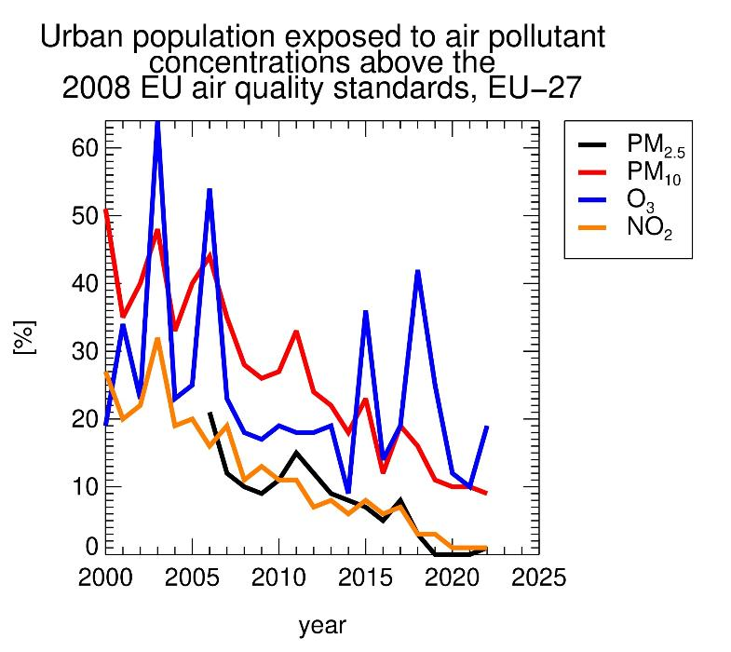
The European Air Quality Policy
A success story
In 2008 an EU defined an objective for ambient air quality.
In 2008 an EU defined an objective for ambient air quality.
There are more than 4.000 monitoring stations.
In 2008 an EU defined an objective for ambient air quality.
There are more than 4.000 monitoring stations.
The number of persons exposed to the major air pollutants have been drastically reduced.
In 2008 an EU defined an objective for ambient air quality.
There are more than 4.000 monitoring stations.
The number of persons exposed to the major air pollutants have been drastically reduced.
Still, 300,000 Europeans die prematurely due to air pollution.

Slide 11
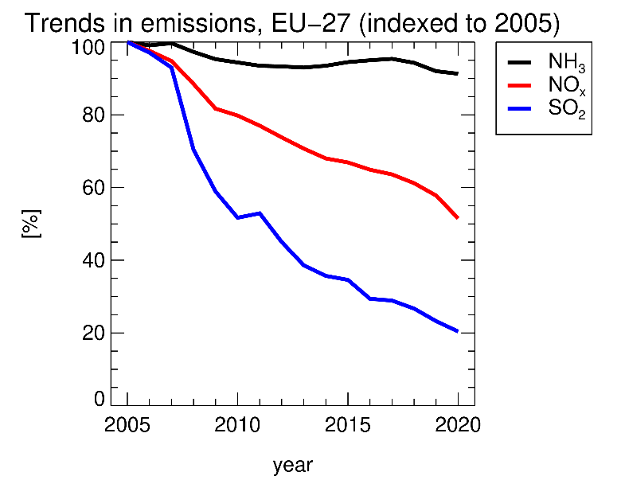
Pollutants of Emerging Concern
Ammonia
Successful measures to reduce emissions can push other pollutants into the foreground
The "classic" air pollutants are less emitted because of stricter limit values.
SO₂, the main cause of acid rain, was removed by flue gas desulphurisation units in power plants.
The "classic" air pollutants are less emitted because of stricter limit values.
The "classic" air pollutants are less emitted because of stricter limit values.
SO₂, the main cause of acid rain, was removed by flue gas desulphurisation units in power plants.
Nitrogen oxides, which mostly originate from traffic, have been reduced by catalytic converters in vehicles.
The "classic" air pollutants are less emitted because of stricter limit values.
SO₂, the main cause of acid rain, was removed by flue gas desulphurisation units in power plants.
Nitrogen oxides, which mostly originate from traffic, have been reduced by catalytic converters in vehicles.
Other compounds, such as ammonia, are hardly regulated at all.

Slide 12

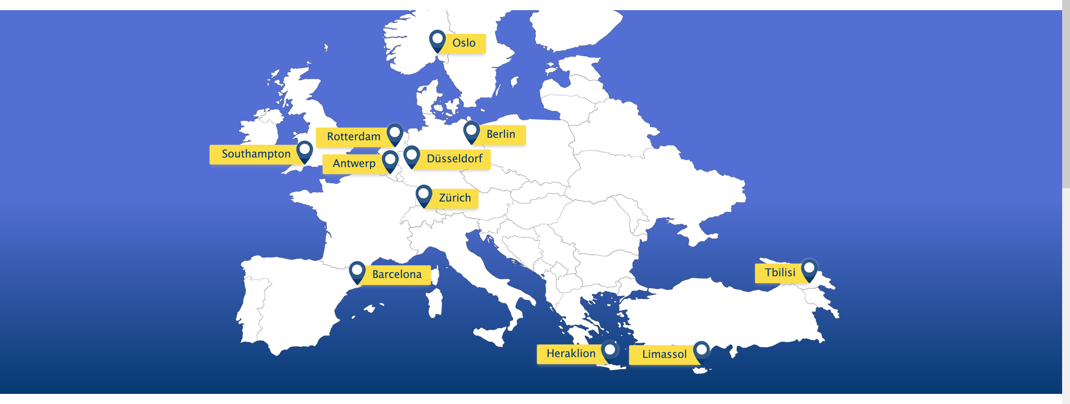
The net4cities project

Slide 13
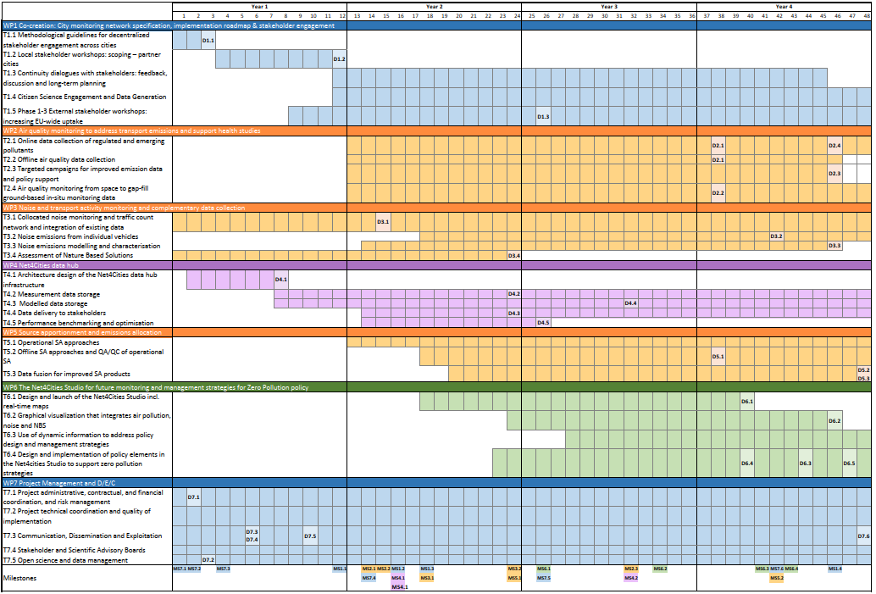
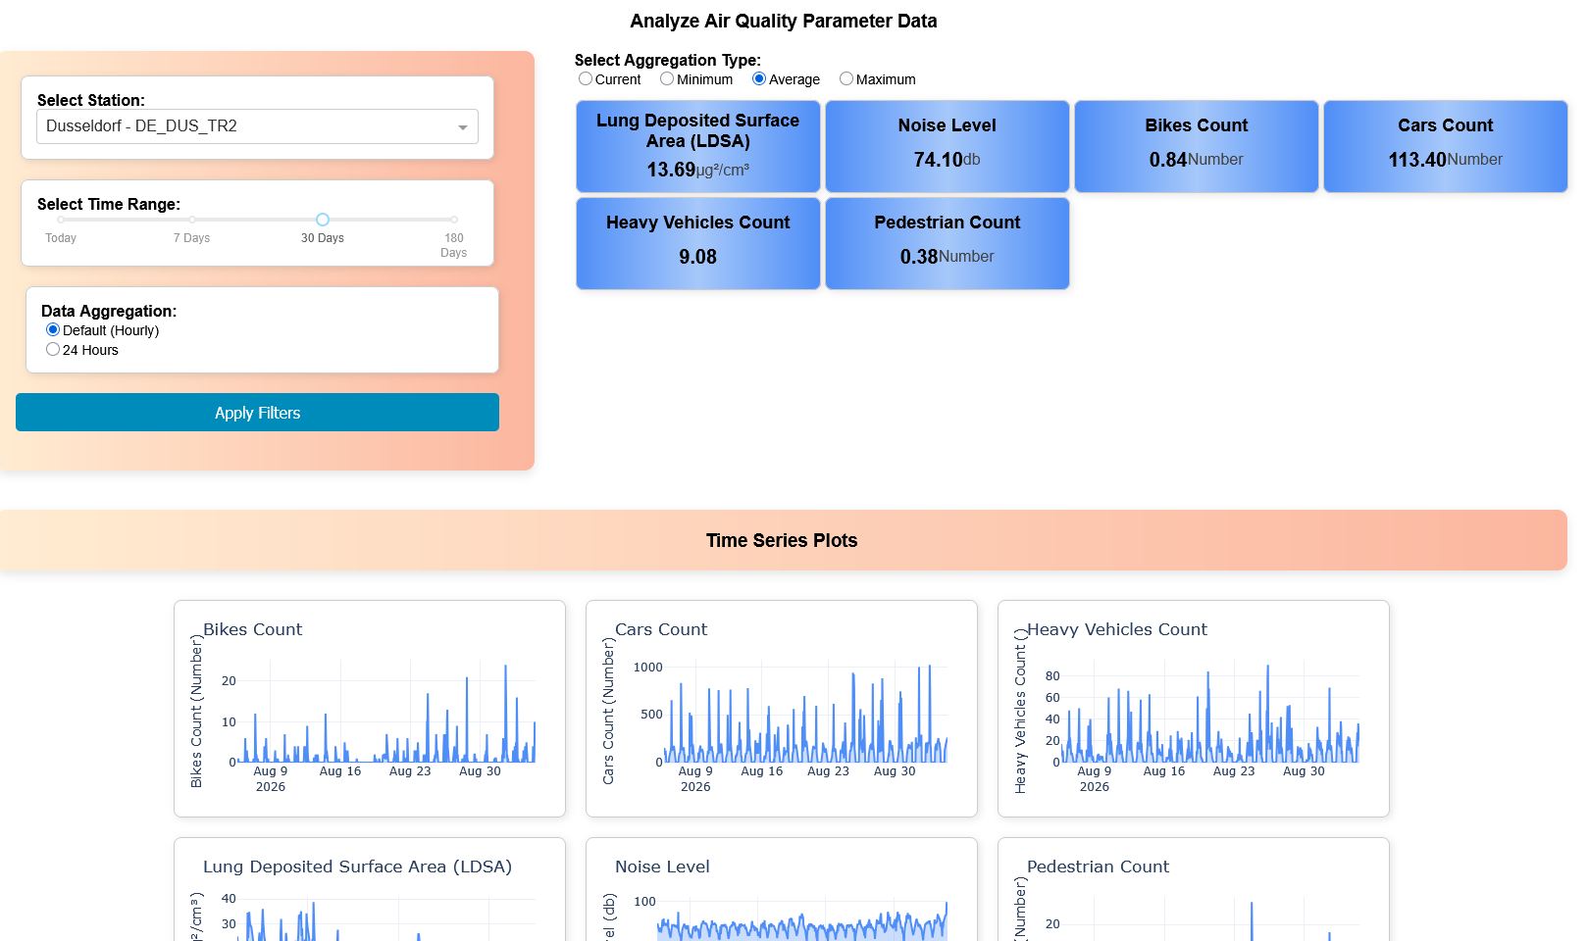
Project Timeline
2024
2025
2026
2027
Measurements
Datahub https://net4cities.eu/dashboard/
Net4cities Studio

Slide 14
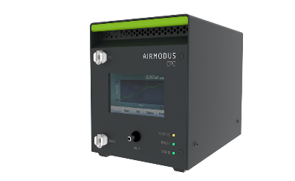
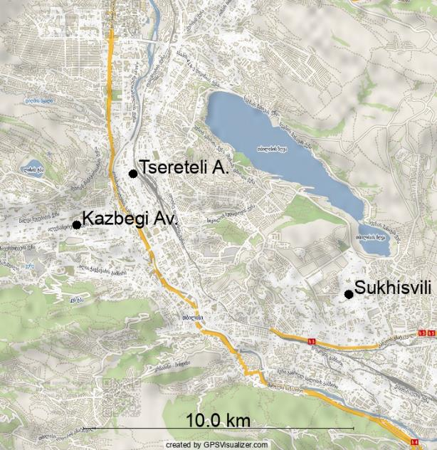
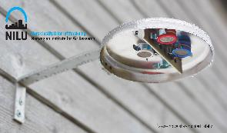
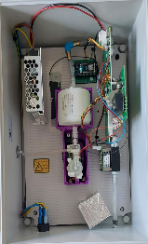
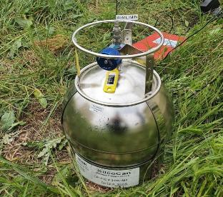
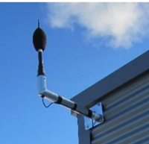

Installations in Tbilisi
Ultra fine particle monitors
Ultra fine particle monitors
LDSA monitors
Ultra fine particle monitors
LDSA monitors
Canister sampling
Noise monitors
Ultra fine particle monitors
LDSA monitors
Canister sampling
Cooperation of TSU (AtmoSimLab) and National Environmental Agency nea.gov.ge

Slide 15
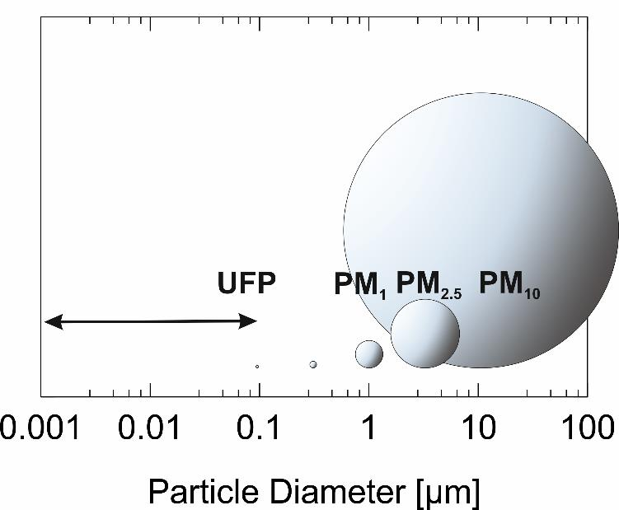
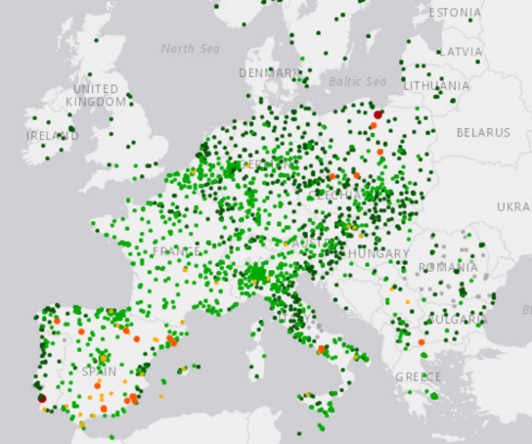
Pollutants of Emerging Concern
Ultrafine particles
Ultrafine Particles
At measuring points, particulate matter is recorded as PM₁₀ (particle mass < 10µm or PM_{2.5} (<2.5µm).
Ultrafine particles in the nanometre range are thus overlooked.
At measuring points, particulate matter is recorded as PM₁₀ (particle mass < 10µm or PM_{2.5} (<2.5µm).
At measuring points, particulate matter is recorded as PM₁₀ (particle mass < 10µm or PM_{2.5} (<2.5µm).
Ultrafine particles in the nanometre range are thus overlooked.
Ultrafine particles have different sources than heavier particles, but are more dangerous because they can penetrate deep into the lungs.
At measuring points, particulate matter is recorded as PM₁₀ (particle mass < 10µm or PM_{2.5} (<2.5µm).
Ultrafine particles in the nanometre range are thus overlooked.
Ultrafine particles have different sources than heavier particles, but are more dangerous because they can penetrate deep into the lungs.
While there are thousands of measuring stations for PM10 across Europe, only a handful of measuring stations measure ultra-fine dust.

Slide 16
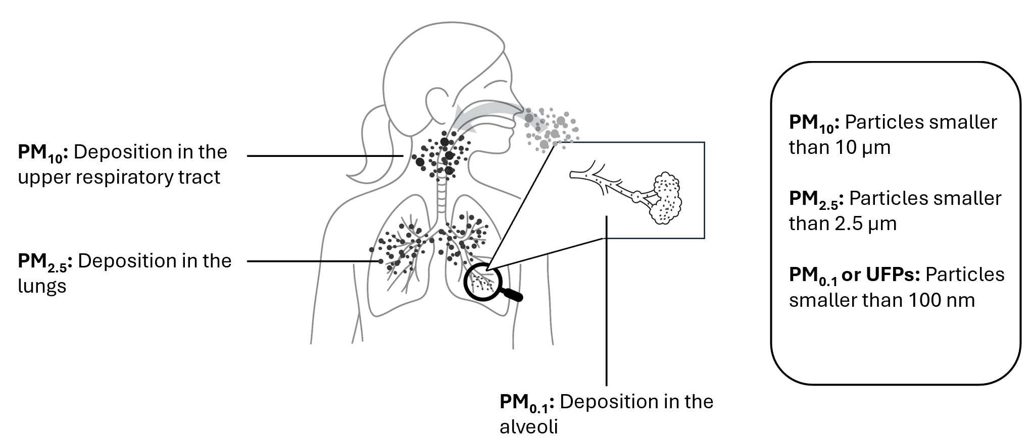
Pollutants of Emerging Concern
Lung Deposited Surface Area
LDSA
surface area that deposit in the human respiratory tract [in μm²/cm³ of air inhaled dust]
measured directly
Seasonal averages 35 to 50 μm²/cm³
Midday concentrations typically fall between 25 and 40 μm²/cm³

Slide 17
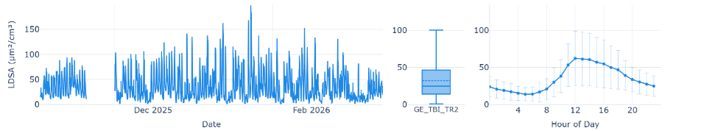

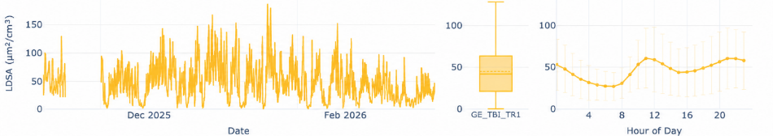
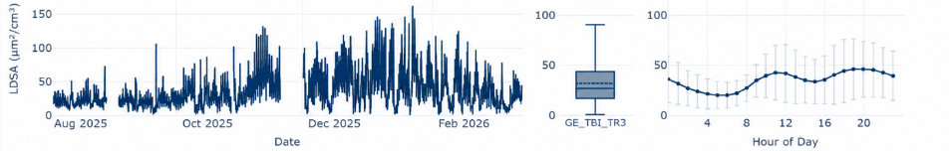
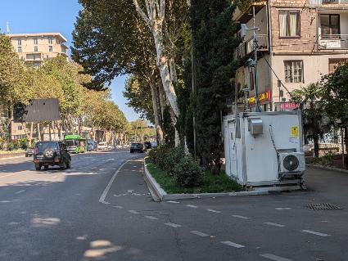
LDSA in Tbilisi
Kazbegi
Tsereteli
Sukhisvili

Slide 18
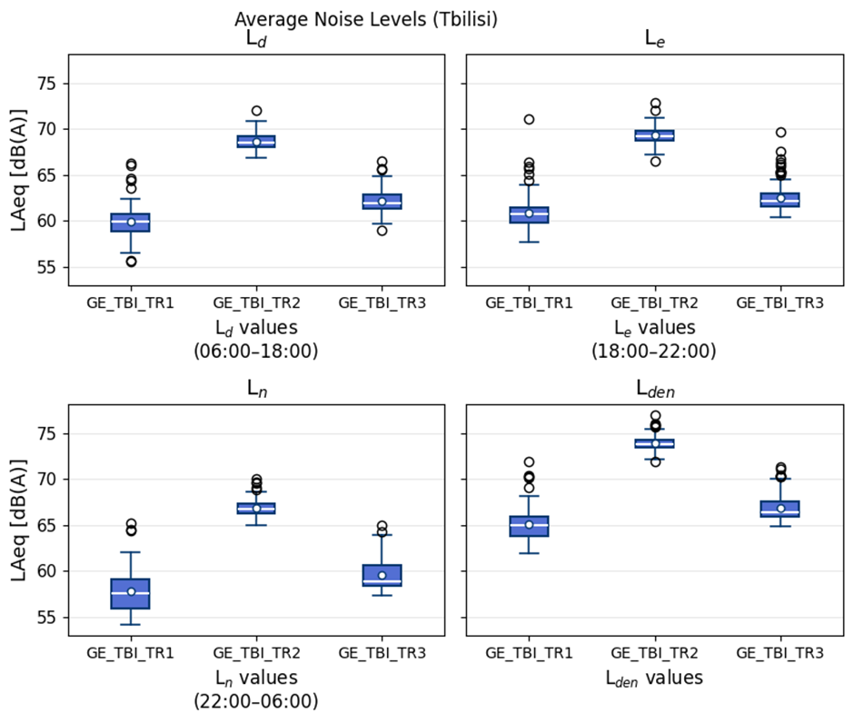
Noise in Tbilisi
Tsereteli

Slide 19
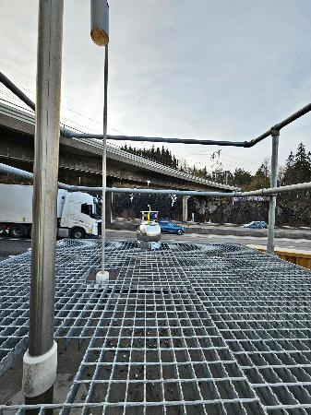
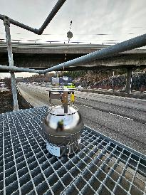
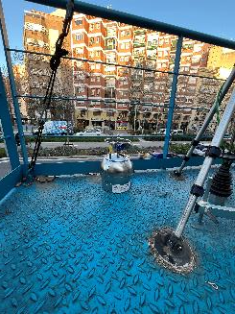
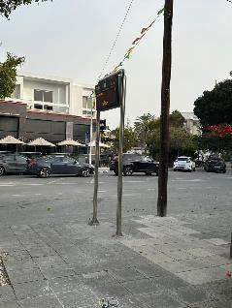
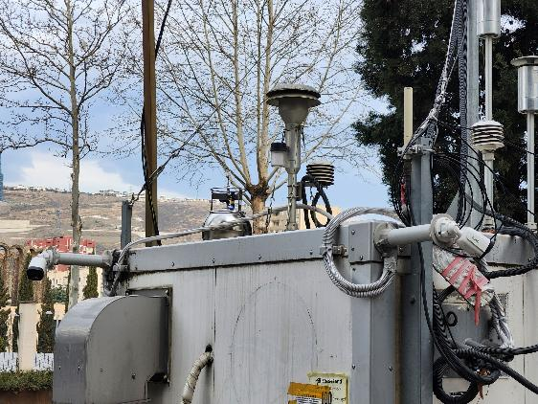
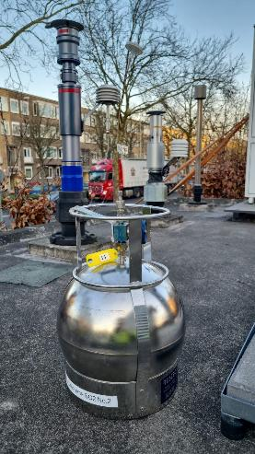
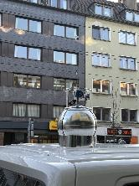
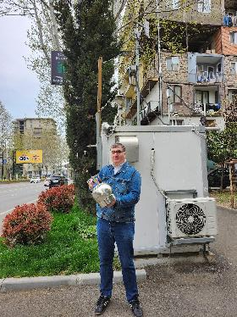
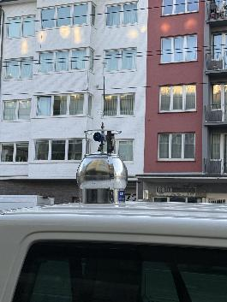
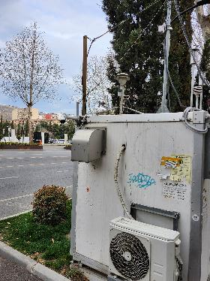
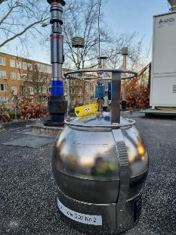
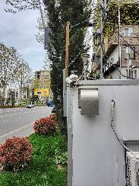
Canister Sampling
Tsereteli

Slide 20

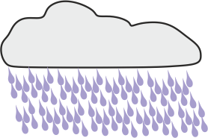





Ozone Formation
Oxidation
Aerosols
Ozone
OH
O₂
CO
CH₄
NO_{x}
SO₂
VOC
CH₄
VOC

Slide 21


Canister Analysis

Slide 22


Canister Data

Slide 23


VOCs and Ozone Production
Ozone production is determind by anthropogenic and biogenic emission !

Slide 24

Where do we go from here ?
Project Goals
Net4Cities will co-create evidence-based, tailored policy solutions for effective air and noise pollution reduction plans with the involvement of policy- and decision-makers.
Net4Cities will co-create evidence-based, tailored policy solutions for effective air and noise pollution reduction plans with the involvement of policy- and decision-makers.
Generate data on (emerging) pollutants and noise in cities from contrasting geographical and climatic locations with differing fleet compositions to support source apportionment (SA).
Net4Cities will co-create evidence-based, tailored policy solutions for effective air and noise pollution reduction plans with the involvement of policy- and decision-makers
Generate data on (emerging) pollutants and noise in cities from contrasting geographical and climatic locations with differing fleet compositions to support source apportionment (SA)
Real-time graphical visualization combining air quality, noise and NBS for all 11 partner cities

Slide 25

Where do we go from here ?
OUTLOOK
Combine online and offline data
Identification of pollution hotspots
Vertical profile measurements
Development of new sensors
“Hands on” teaching
Development/evaluation of new sensor systems

Slide 26

THANK YOU !

