Slide 1

Medical Radionuclide Production at HZDR
Nadiya Zhutova, Institute of Radiopharmaceutical Cancer Research
Georgian-German Science Bridge, September 7th to 12th 2026
Notes:
name, working at HZDR that prof. Schmidt presented earlier today. Happy to be here in Tbilisi and glad to present my institute today.

Slide 2
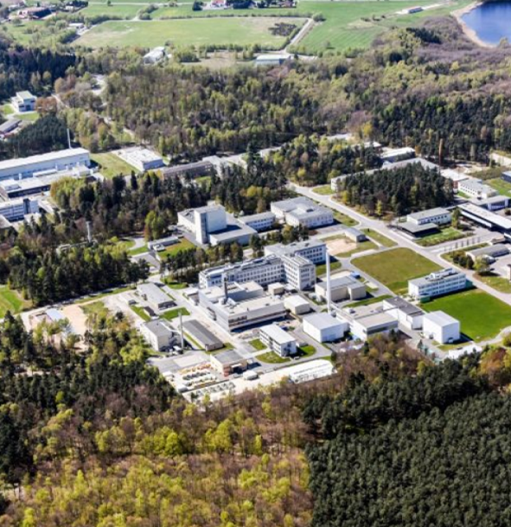
Institute of Radiopharmaceutical Cancer Research
Departments
Medicinal Radiochemistry
Radiopharmaceutical and Chemical Biology
Positron Emission Tomography
Radioimmunology
Nano-Microsystems for Life Sciences
Experimental Neurooncological Radiopharmacy
Targetry, Target Chemistry and Radiopharmacy

Slide 3

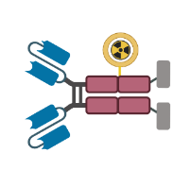
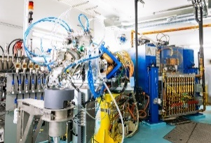
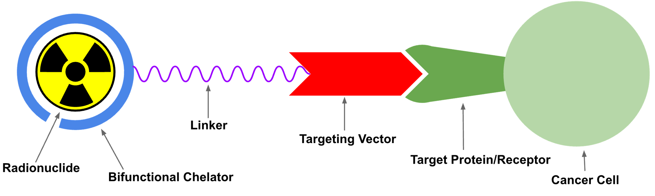
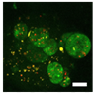
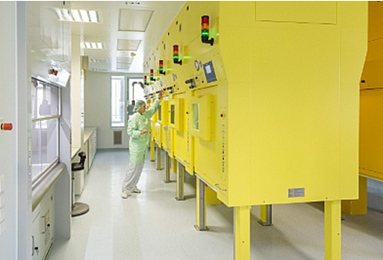
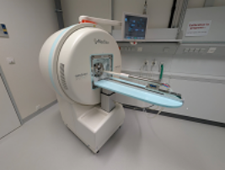
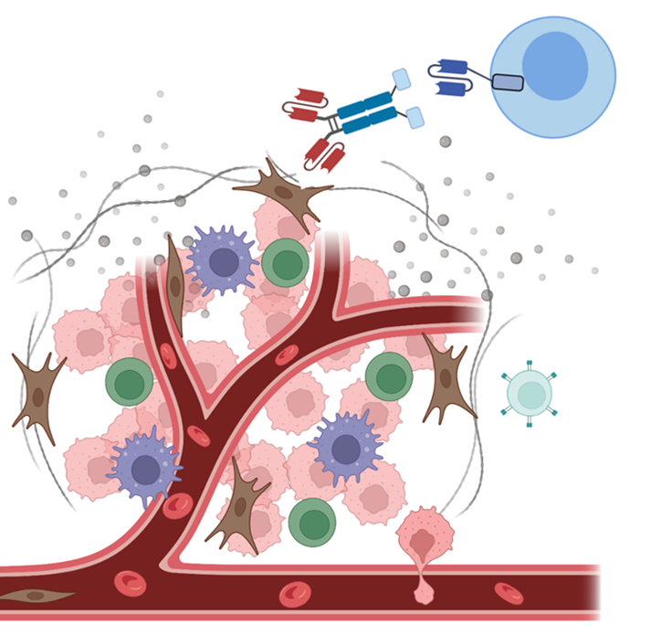
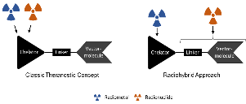
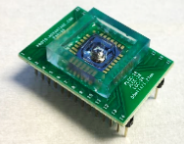
Institute of Radiopharmaceutical Cancer Research
Departments
Medicinal Radiochemistry
Radiopharmaceutical and Chemical Biology
Positron Emission Tomography
Radioimmunology
Nano-Microsystems for Life Sciences
Experimental Neurooncological Radiopharmacy
Targetry, Target Chemistry and Radiopharmacy
Radionuclide production
Radiochemistry
Development of Radiopharmaceuticals
Innovative Test Systems and Models
GMP
Innovative Test Systems and Models

Slide 4
Institute of Radiopharmaceutical Cancer Research
Departments
Medicinal Radiochemistry
Radiopharmaceutical and Chemical Biology
Positron Emission Tomography
Radioimmunology
Nano-Microsystems for Life Sciences
Experimental Neurooncological Radiopharmacy
Targetry, Target Chemistry and Radiopharmacy

Slide 5
Institute of Radiopharmaceutical Cancer Research
Departments
Medicinal Radiochemistry
Radiopharmaceutical and Chemical Biology
Positron Emission Tomography
Radioimmunology
Nano-Microsystems for Life Sciences
Experimental Neurooncological Radiopharmacy
Targetry, Target Chemistry and Radiopharmacy

Slide 6
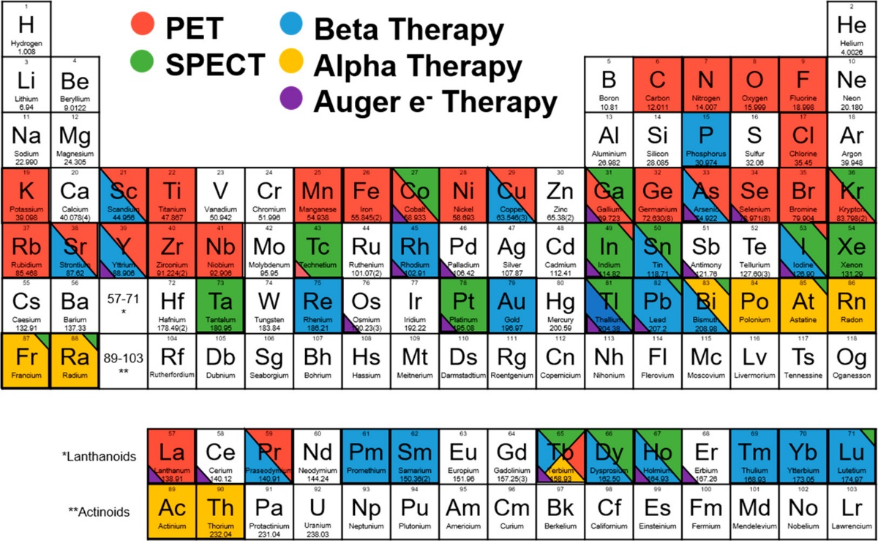
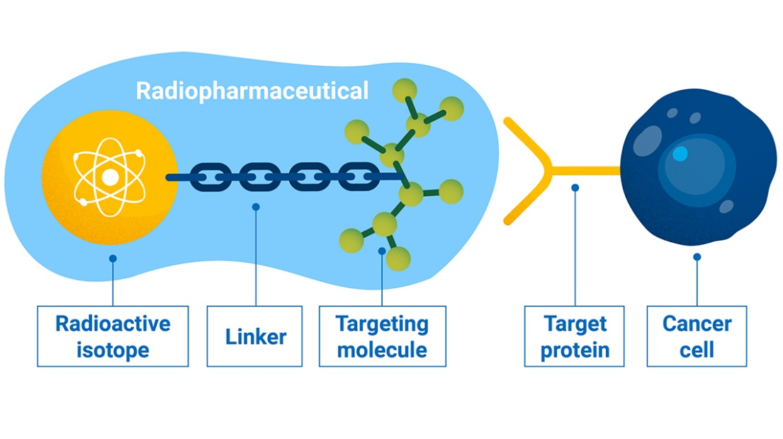
Radiopharmaceuticals
Diagnostics & Therapeutics
What is it and how does it work?
A radiopharmaceutical is a drug that specifically targets certain cells or functions in the body and uses radioactive isotopes for diagnostics or therapy.
Fig. from: [1] Kostelnik, T.I. and Orvig, C., Chem. Rev. 2019, 119, 2, 902.
© A.Vargas/IAEA

Slide 7
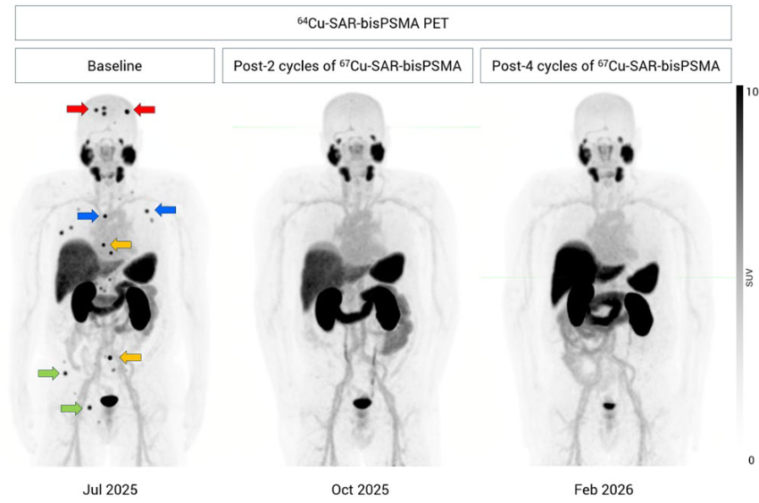

Radiopharmaceuticals
What is it and how does it work?
Diagnostics & Therapeutics
A radiopharmaceutical is a drug that specifically targets certain cells or functions in the body and uses radioactive isotopes for diagnostics or therapy.
© Clarity Pharmaceuticals, Quarterly Activity Report, March 2026
© A.Vargas/IAEA
© Kostelnik, T.I. and Orvig, C., Chem. Rev. 2019, 119, 2, 902.

Slide 8
Radiopharmaceuticals
True theranostic matched pairs:
    ^{43/44}Sc/⁴⁷Sc
    ^{61/64}Cu/⁶⁷Cu
    ⁸⁶Y/⁹⁰Y
    ¹²³I/¹³¹I
    ^{152/155}Tb/^{149/161}Tb
    ²⁰³Pb/²¹²Pb
What is it and how does it work?
Diagnostics & Therapeutics
© Kostelnik, T.I. and Orvig, C., Chem. Rev. 2019, 119, 2, 902.
© Clarity Pharmaceuticals, Quarterly Activity Report, March 2026

Slide 9
Theranostics
When Diagnostics and Therapy unite
Diagnostics & Therapeutics
True theranostic matched pairs:
    ^{43/44}Sc/⁴⁷Sc
    ^{61/64}Cu/⁶⁷Cu
    ⁸⁶Y/⁹⁰Y
    ¹²³I/¹³¹I
    ^{152/155}Tb/^{149/161}Tb
    ²⁰³Pb/²¹²Pb
© Kostelnik, T.I. and Orvig, C., Chem. Rev. 2019, 119, 2, 902.
Task: get the right radionuclide, in the right purity and amount
© Clarity Pharmaceuticals, Quarterly Activity Report, March 2026

Slide 10
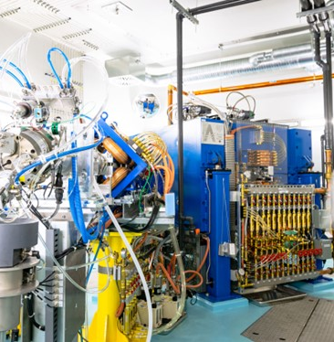
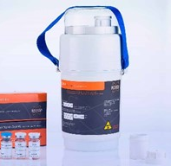
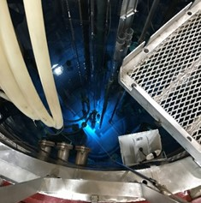
Production of Medical Radionuclides
What are the ways?
TR-FLEX Cyclotron (Fig. M. Wendler, HZDR)
Examples: ^{43/44}Sc, ^{61/64}Cu
Accelerator produced
PERTECTOR Mo-99/Tc-99m
radionuclide generator © by ROTOP
Examples:
⁶⁸Ge/⁶⁸Ga, ⁹⁹Mo/^{99m}Tc
RA-06 Nuclear Reactor, Argentina (Fig. S. A. Brühlmann)
Examples:
¹⁶¹Tb, ¹⁷⁷Lu
Generator
produced
Reactor produced

Slide 11
Production of Medical Radionuclides
What are the ways?
TR-FLEX Cyclotron (Fig. M. Wendler, HZDR)
Examples: ^{43/44}Sc, ^{61/64}Cu
Accelerator produced
PERTECTOR Mo-99/Tc-99m
radionuclide generator © by ROTOP
Examples:
⁶⁸Ge/⁶⁸Ga, ⁹⁹Mo/^{99m}Tc
RA-06 Nuclear Reactor, Argentina (Fig. S. A. Brühlmann)
Examples:
¹⁶¹Tb, ¹⁷⁷Lu
Generator
produced
Reactor produced
Notes:
In cyclotrone we accelerate hydrogen ions, that are later extracted as protons

Slide 12









Cyclotron-Based Production of Medical Radionuclides
What are the steps to follow?
Selection of the Nuclear Reaction
Target Preparation
    Solid, Liquid or Gas Targets
Target Irradiation (and Parameters Optimization)
Purification – radionuclide extraction
Target Recycling

Slide 13
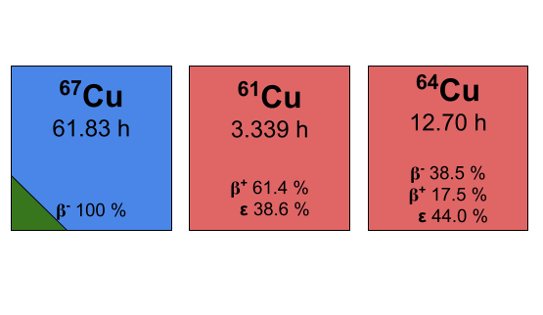
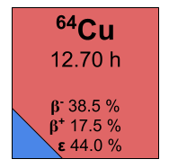
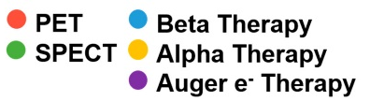
Cyclotron-Based Production of Medical Radionuclides
Choose your superhero
Diagnostics Therapeutics
True theranostic matched pairs:
    ^{43/44}Sc/⁴⁷Sc
    ^{61/64}Cu/⁶⁷Cu
    ⁸⁶Y/⁹⁰Y
    ¹²³I/¹³¹I
    ^{152/155}Tb/^{149/161}Tb
    ²⁰³Pb/²¹²Pb

Slide 14
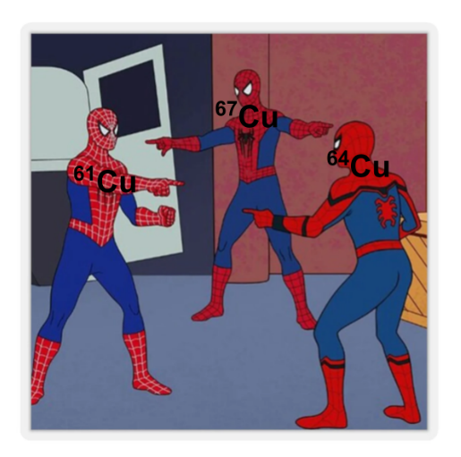
Cyclotron-Based Production of Medical Radionuclides
Choose your superhero
Diagnostics Therapeutics
Same element, different applications!
CopperNostics@HZDR

Slide 15
Cyclotron-Based Production of Medical Radionuclides
Choose your superhero
Diagnostics Therapeutics
Same element, different applications!
CopperNostics@HZDR

Slide 16
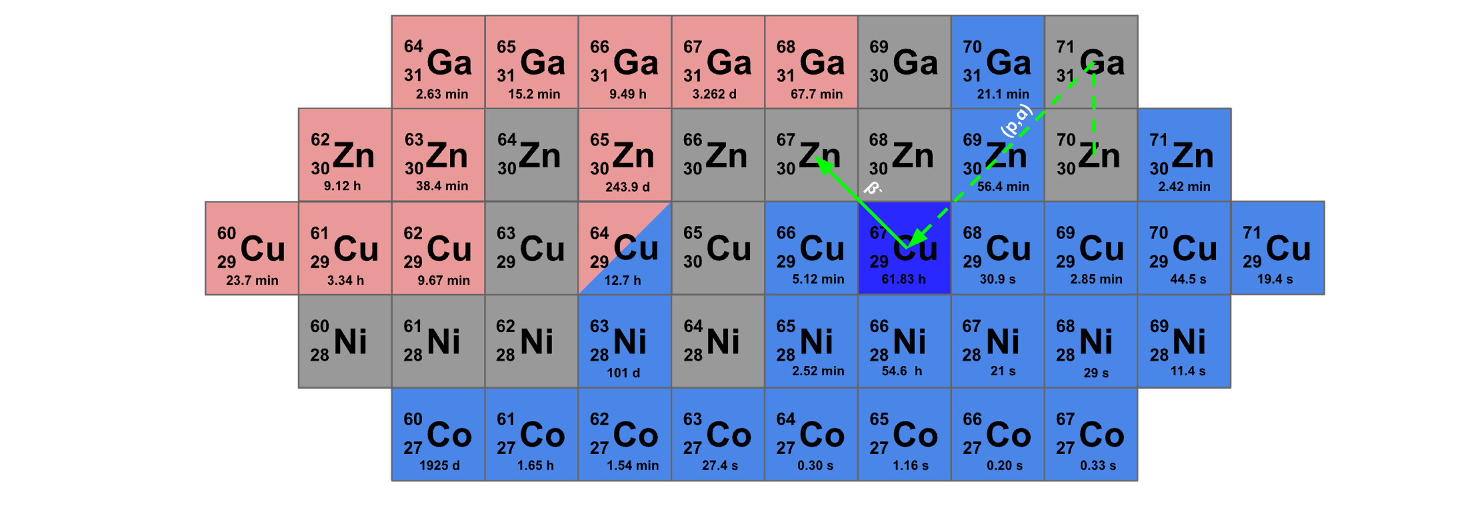
Nuclear Reaction Selection
The ⁷⁰Zn(p,α)⁶⁷Cu nuclear reaction

Slide 17
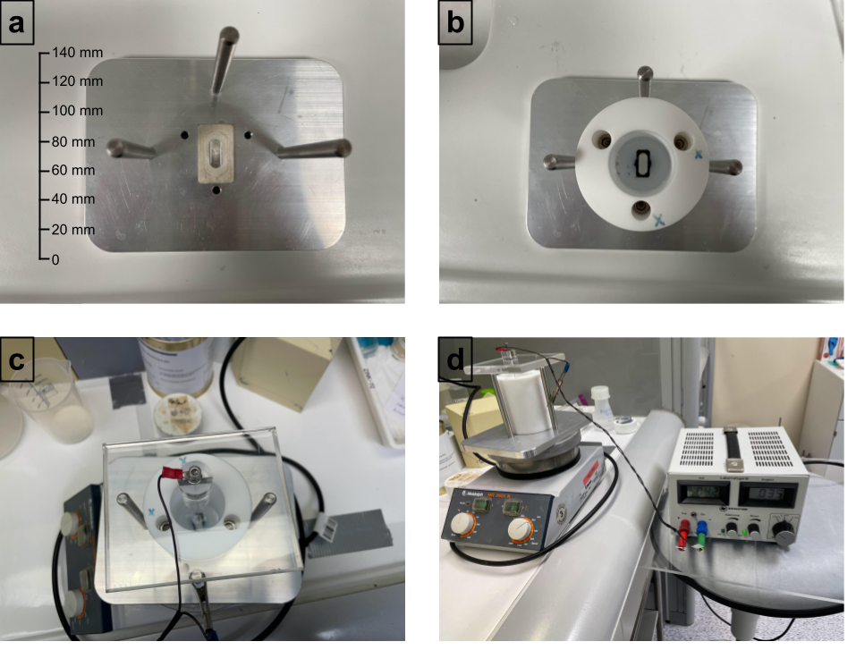
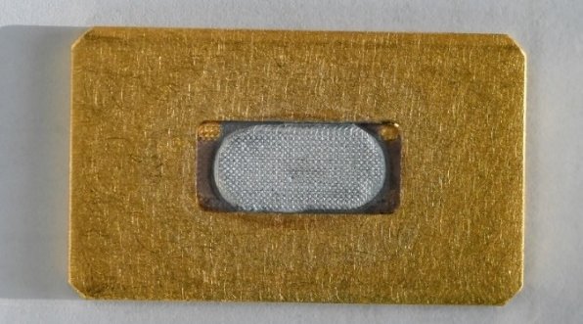
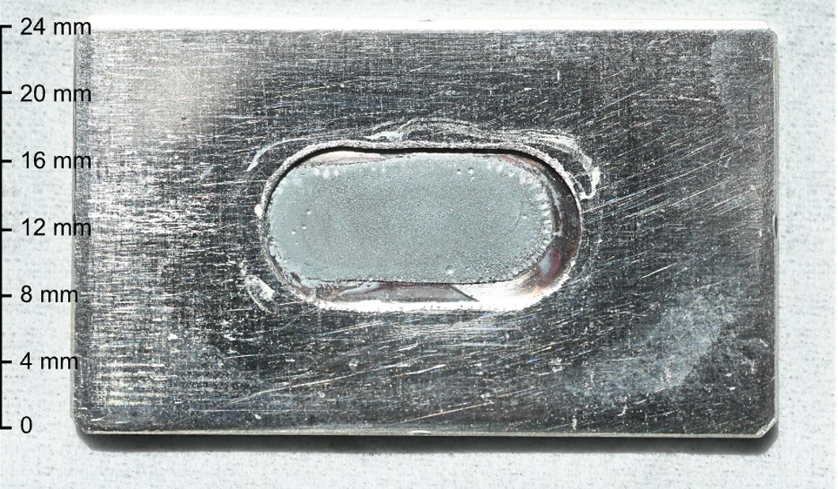
Target Preparation
Solid Targets - ⁶⁷Cu
Target Electrodeposition:
Starting from fresh or recycled ⁷⁰Zn
Electrodeposition onto gold or silver backing
Electrodeposited ⁷⁰Zn target from fresh
[⁷⁰Zn]ZnSO₄ solutions onto gold.
Electrodeposited ⁷⁰Zn target from recycled
[⁷⁰Zn]ZnSO₄ solutions onto silver.
Electroplating device used for ⁷⁰Zn electrodeposition.
Brühlmann, S.A., et al. Pharmaceuticals 2023, 16, 314.
Notes:
70Zn 97.5% enrichment

Slide 18
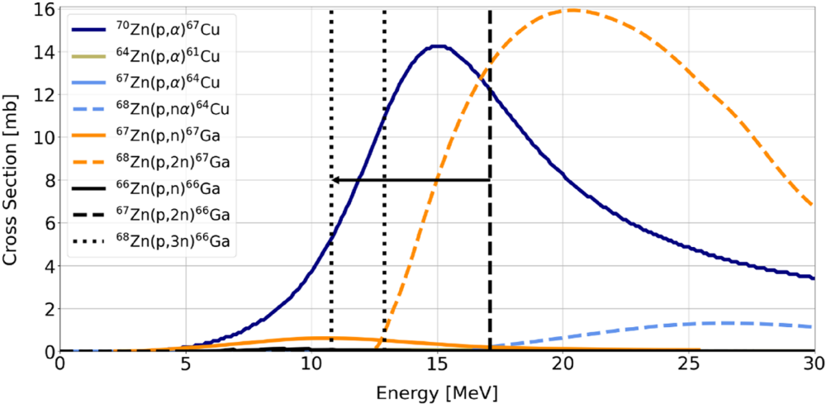
Target Irradiation
Influence of the projectile energy on the nuclear reaction
The ⁷⁰Zn(p,𝛼)⁶⁷Cu Reaction:
Irradiation energy below 17 MeV to reduce ⁶⁷Ga co-production
Water cooled energy degrader developed in-house
Relevant cross sections weighted for the target abundancy.
Brühlmann, S.A., et al. Radiochimica Acta 2026: 2, 114.
Notes:
⁶⁷Ga has a half-life of about 78.3 hours. Vertical dashed line- incident proton energy, dotted lines – proton exiting energies

Slide 19
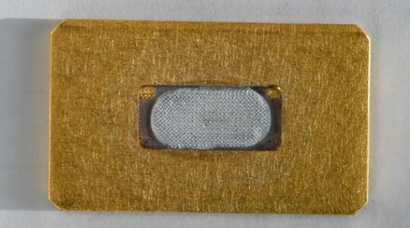
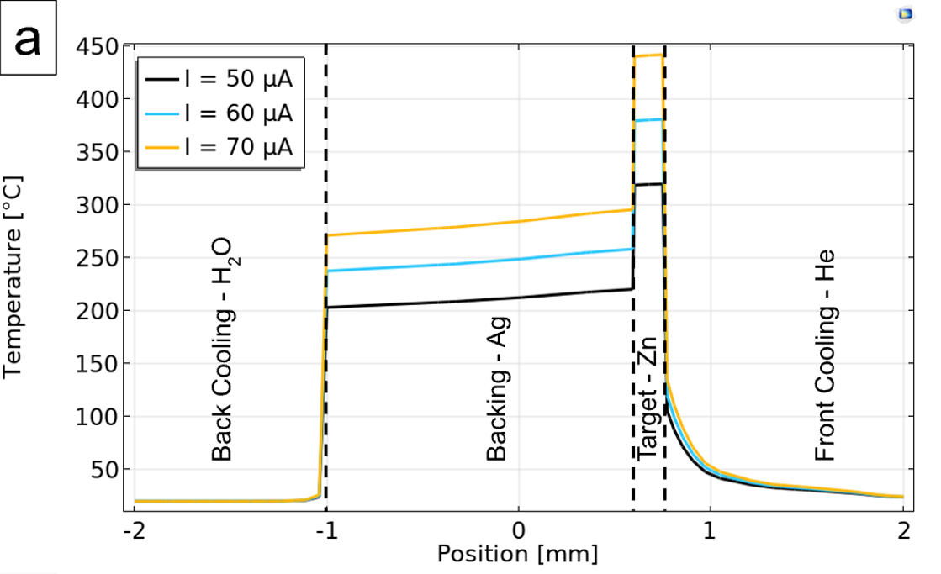
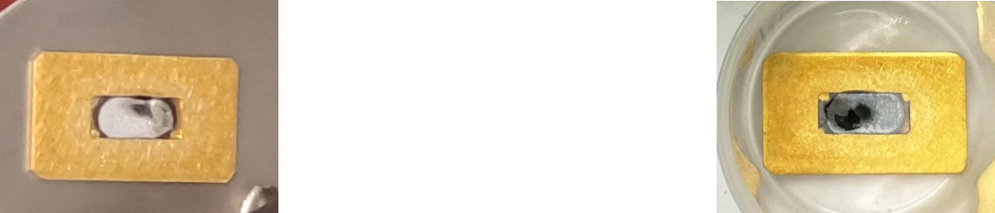
Target Irradiation
Zinc Target
Solid targets: thermal input
Proton Beam
Helium Cooling
Gold Backing
Zinc Target
Gold/Silver Backing
Water Cooling
Target scheme including water and helium cooling
    Melting Point of Zinc: 420°C!
Melted zinc targets with a gold backing
Temperature profile of a target when using different beam currents
Notes:
we irradiate @ 60 micro amps

Slide 20
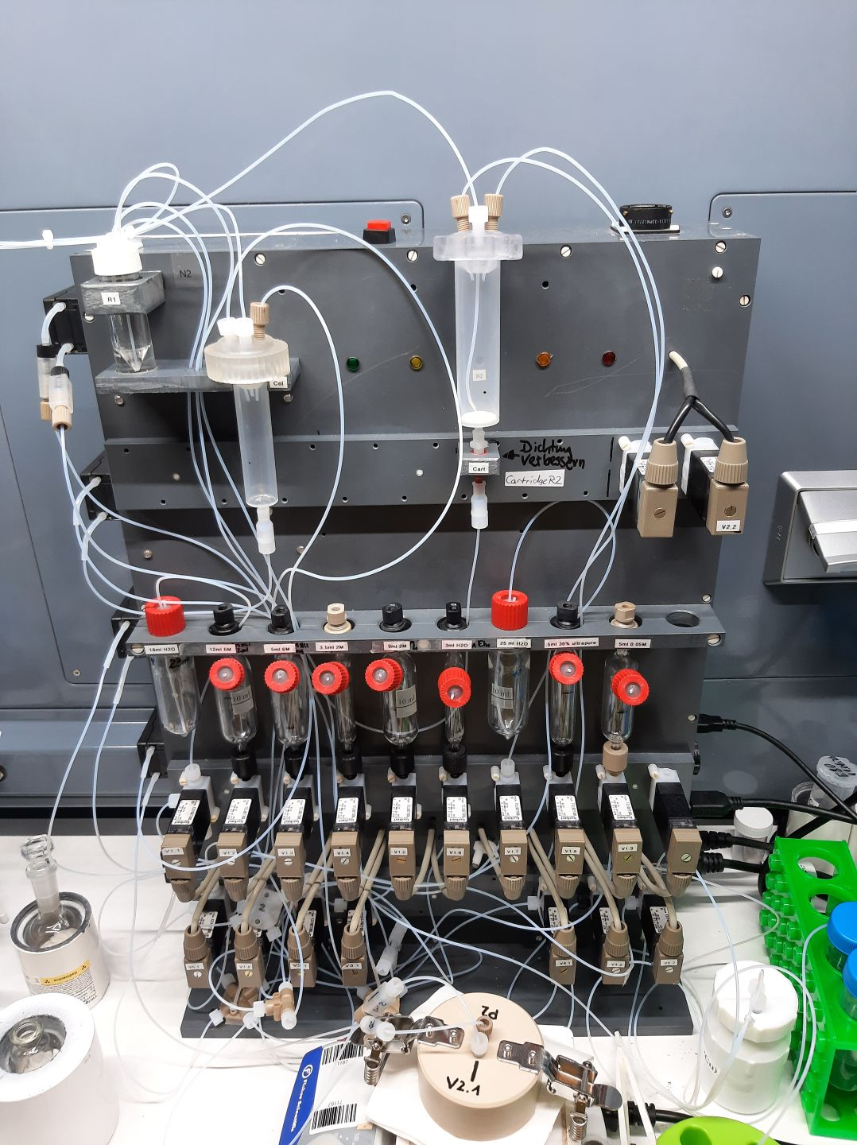
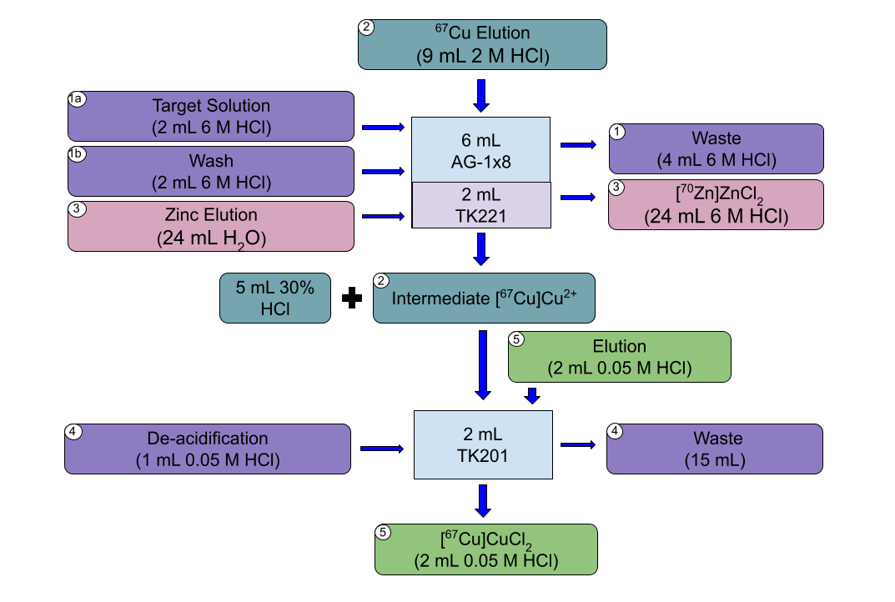
Radiochemical Purification
Radionuclide extraction – ⁶⁷Cu
8-15 h decay time after irradiation (decay of shorter-lived radionuclides)
Two separation columns: AG-1x8+TK221 and TK201
Overall Efficiency: above 75%
2-Step Purification Scheme for ⁶⁷Cu
Purification Module for ⁶⁷Cu
Brühlmann, S.A., et al. EJNMMI radiopharm. chem. 2024, 9, 3.

Slide 21

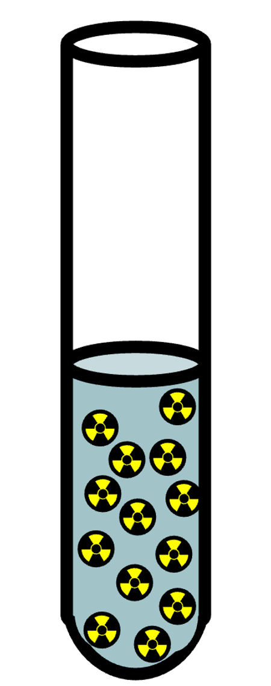

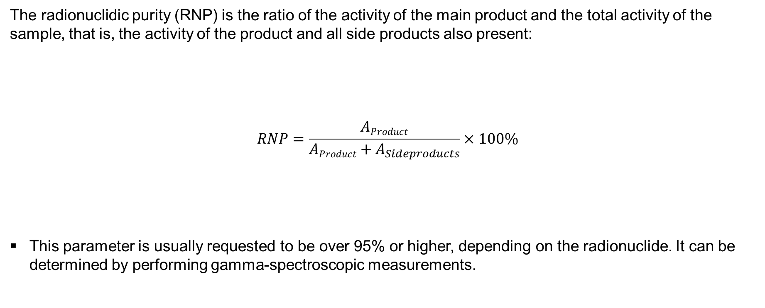
Product Characterization – Quality Control
Radionuclidic Purity – Radioactive Impurities
The radionuclidic purity (RNP) is the ratio of the activity of the main product and the total activity of the sample, that is, the activity of the product and all side products also present:
$$RNP=\frac{AProduct}{AProduct+A_{Sideproducts}}×100\%$$
This parameter is usually requested to be over 95% or higher, depending on the radionuclide. It can be determined by performing gamma-spectroscopic measurements.
RNP = 100 %
RNP < 100 %
Notes:
as well - (apparent) molar activity to see stable impurities (ICP-MS)
test radiolabelling and verification by radio-TLC

Slide 22
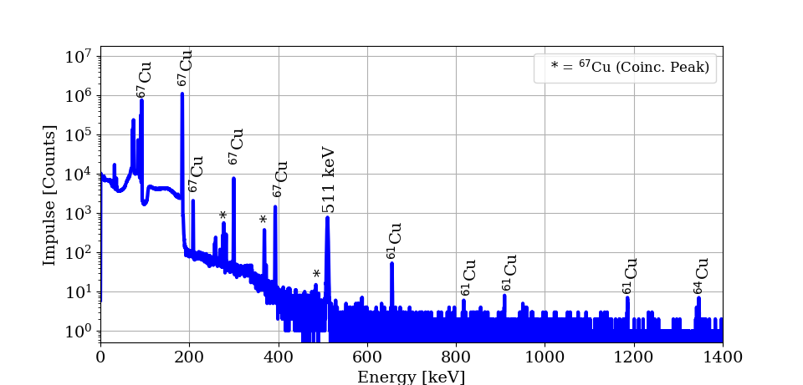
Product Characterization
Radionuclidic Purity – ⁶⁷Cu
Main radioimpurities: ⁶¹Cu and ⁶⁴Cu (shorter half-lives than ⁶⁷Cu)→ The RNP increases with the time
>99 % 18 h after irradiation, >99.5 % 24 h after irradiation
Gamma-spectroscopy of the [⁶⁷Cu]CuCl₂ solution (14 h after irradiation).
Brühlmann, S.A., et al. Pharmaceuticals 2023, 16, 314.
Notes:
511 keV – electron-positron annhilation peak, ⁶⁷Ga has a half-life of about 78.3 hours
as well - (apparent) molar activity to see stable impurities (ICP-MS)
test radiolabelling and verification by radio-TLC

Slide 23
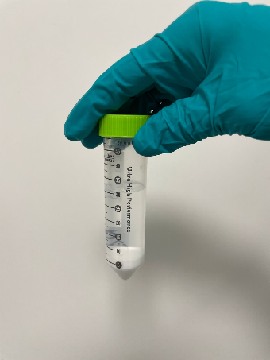
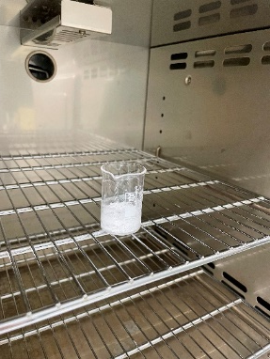
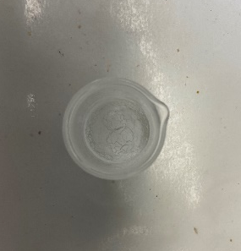
Recovery of Target Material
Target recycling – ⁷⁰Zn for ⁶⁷Cu
Precipitation of [⁷⁰Zn]Zn(OH)₂:
Addition of 6 M NaOH until pH 9
Centrifugation, separation of the supernatant, and subsequent washing (x5)
(Drying of the precipitate and annealing)
Recovered material used for a new round of electroplating
Precipitated and centrifugated [⁷⁰Zn]Zn(OH)₂.
Drying of the [⁷⁰Zn]Zn(OH)₂.
[⁷⁰Zn]ZnO recovered after annealing.
Brühlmann, S.A., et al. Pharmaceuticals 2023, 16, 314.

Slide 24


Summary: Radionuclides produced at the HZDR
HZDR’s current radionuclide portfolio
PET Radionuclides:
¹¹C, ¹⁸F, ⁶¹Cu, ⁶⁴Cu, ⁸⁹Zr & ¹³³La
SPECT Radionuclides:
⁶⁷Ga, ¹²³I, ¹³¹Ba
β⁻-emitting Radionuclides:
⁶⁷Cu
Conversion and Auger Electron Emitters:
¹³⁵La, ^{197(m)}Hg

Slide 25
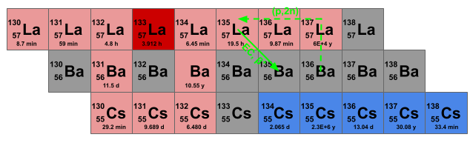
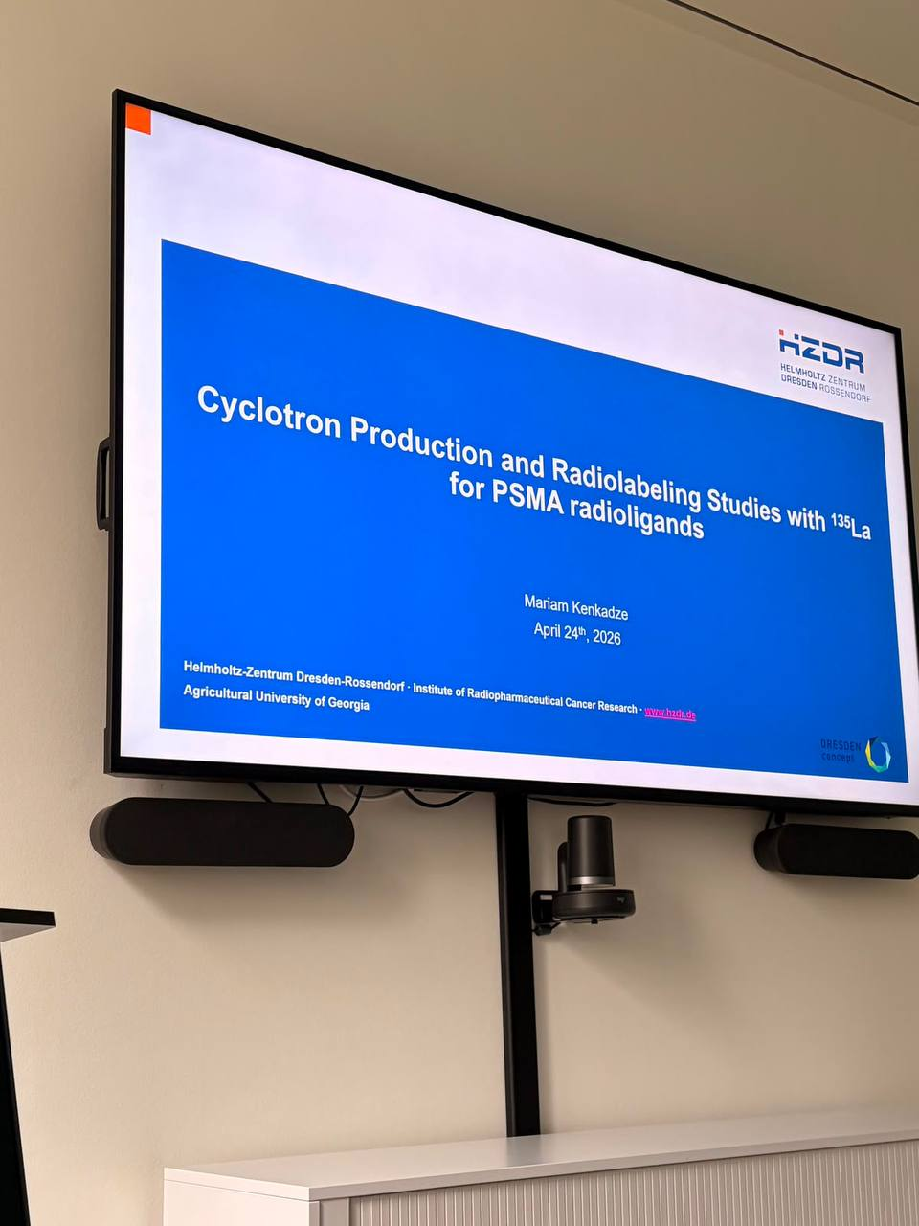
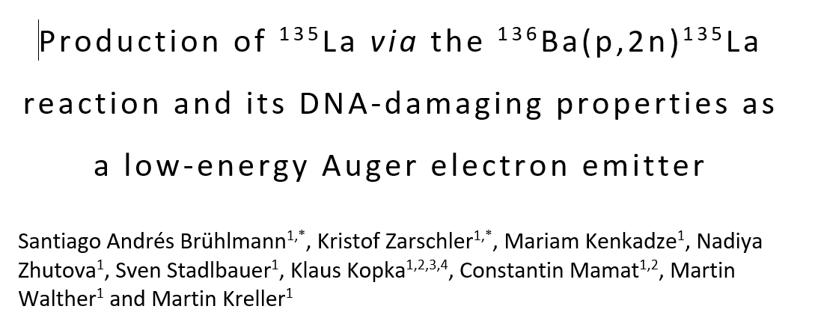
GGSB – Internship at HZDR
Successful case
In March-April 2026 Mariam Kenkadze worked on the project
“Cyclotron Production and Radiolabeling Studies with ¹³⁵La for PSMA radioligands”
Scheme of the ¹³⁶Ba(p,2n)¹³⁵La nuclear reaction
Results from Mariam’s internship were included in the article that is going to be published soon

Slide 26
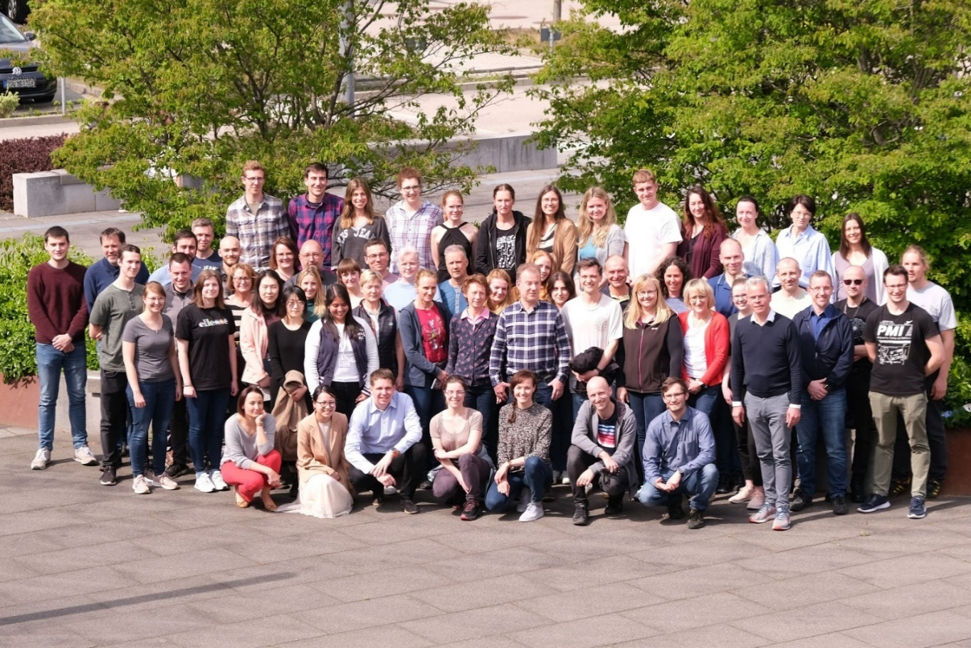

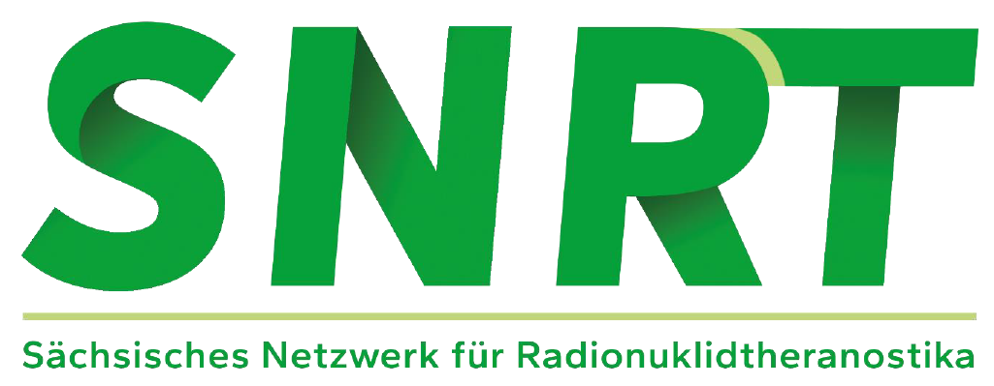

Thank you! გმადლობთ!
Institute of Radiopharmaceutical Cancer Research
Curious about an internship with us?
Send me an email: n.zhutova@hzdr.de
← or contact me on LinkedIn
Notes:
გმადლობთ (pronounced roughly gmadlobt)

