Slide 1


SMART |Biomarker_Lab:
Bridging Diagnostics and Therapy
07.09.2026 | Bernd Neumaier

Slide 2
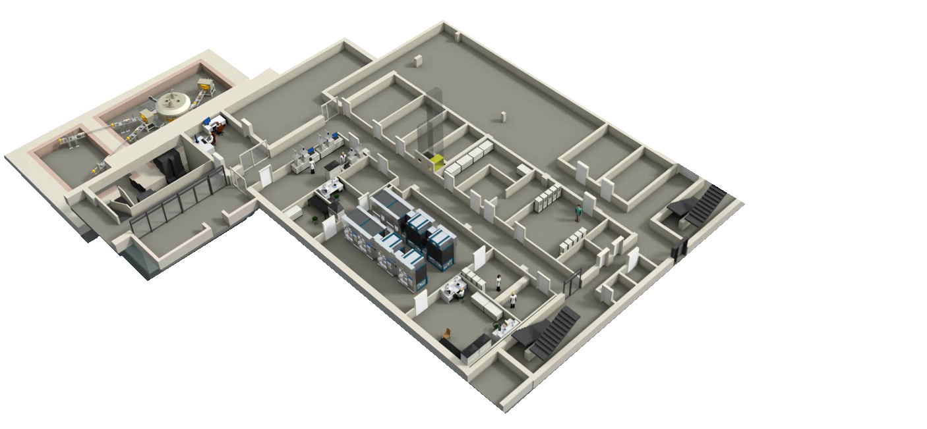
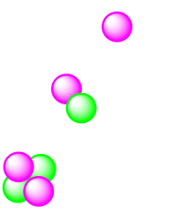



Cyclone® 30 - 350:
Accelerated Ions: H⁻, D⁻, and ⁴He₂⁺
Extracted Ions: H⁺ (Proton), D⁺ (Deuteron), 4He₂⁺ (Alpha)
Extraction System: Carbon Foil Stripper Carousel
Guaranteed Extracted Current: 350 μA (H⁺), 50 µA (D⁺ and 4He₂⁺)
Energy: Adjustable from 15 to 30 MeV (Protons), 9 to 15 MeV (Deuterons), Fixed Energy at 30 MeV (Alpha)
Cyclotron Weight:
50 tons
Diameter:
2.9 meters
Height:
3.9 meters (Total)
Power Consumption:
~ 25 kW in Vacuum Standby
~ 90-110 kW at 30 MeV 350µA Protons in Dualbeam
~ 80 kW at 30 MeV 50 µA Alphabeam
Main Magnet:
45 tons of Steel
4 tons of Copper
10 kW Power in Coils
RF System:
Dee Angle - 30°
Power Loss per Dee – 10 kW
Frequency: 33 MHz (Fixed)
End Amplifier Stage – 40 kW
Ion Sources:
Multicusp
Discharge Power – 1 kW
ERC SuperNanogam
RF Power – 200 kW
RF Frequency – 14.5 GHz
Source Voltage – 10 to 30 kV
R
¹⁸F
¹¹C
¹⁵O
¹³N
INFRASTRUCTURE
IBA Cyclone® 30XP; E = 15 - 30 MeV
Hot cells for radiochemical isolation
Clean room for radiopharmaceutical production
^{34m}Cl
⁶¹Cu
⁶²Cu
¹²⁴I
⁷⁷Br
^{94m}Tc
⁷³Se
³⁸K
²²⁵Ac
²¹¹At
^{193m}Pt
^{117m}Sn
adionuclide production at FZJ (INM-5)
...
...
RESEARCH HUB
Radionuclide production
Radiopharmaceutical development program
Preclinical evaluation
Clinic – High-precision medicine
$$Proton$$
$$Deuteron$$
$$Helium$$
1

Slide 3
01
Concept of theranostics
What is theranostics?
Rationale for theranostics
02
Clinically established examples
PSMA-targeting theranostics for prostate cancer
SSTR-targeting theranostics for neuroendocrine tumors
03
Radiometal- and radiohalogen-based theranostics
Outline.
Background
Astatine-211 for alpha therapy
04
Stability challenges and solutions
In vivo dechelation of radiometal-based theranostics
Enzymatic dehalogenation of radiohalogen-based theranostics
05
Outlook
Remaining challenges
Future perspectives

Slide 4
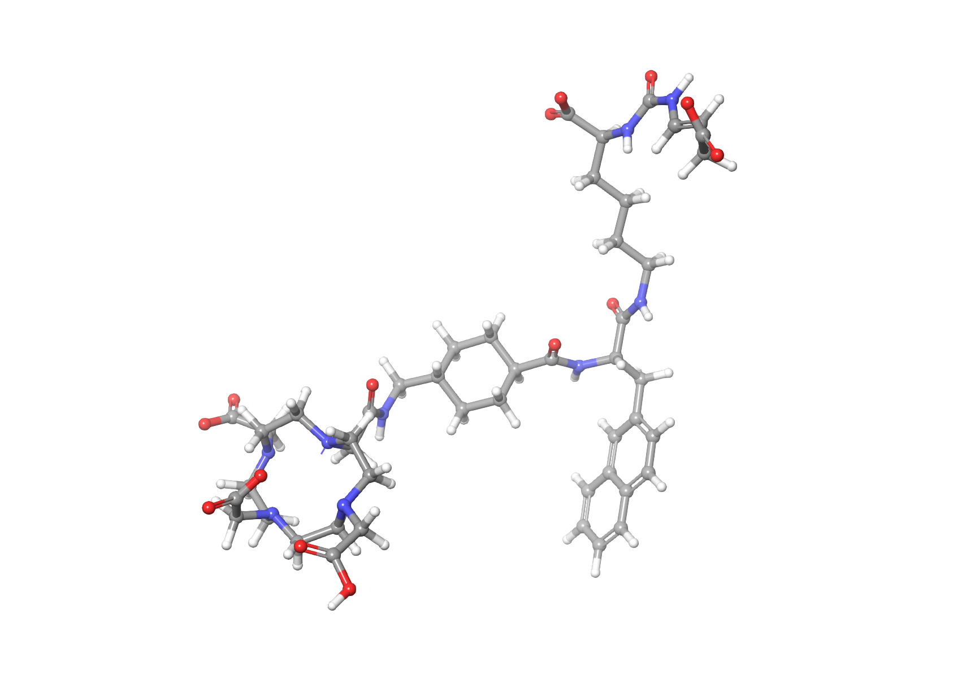
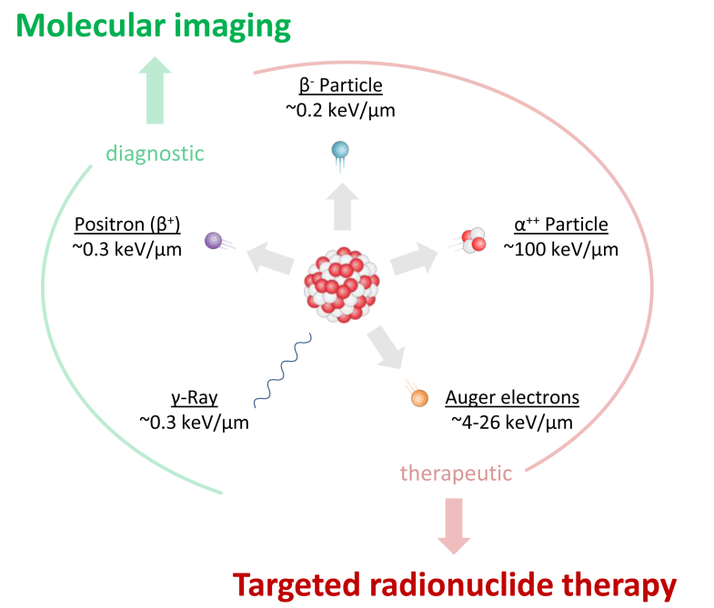
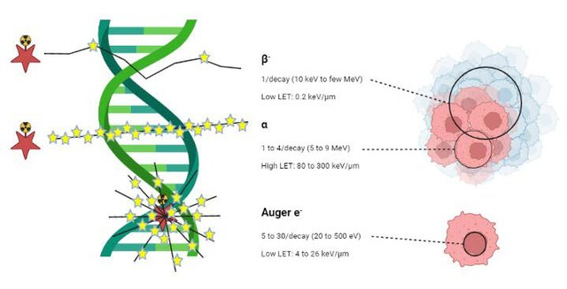

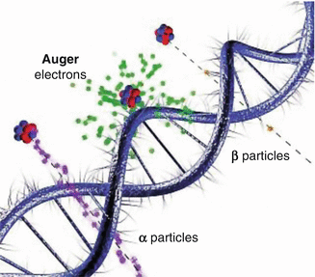
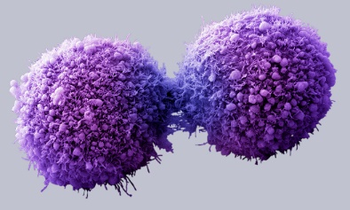


Theranostics
Pairs of diagnostic and therapeutic molecules with common structure and disease-associated target
W
Diagnostic / therapeutic radionuclide
hat is theranostics?
Target
vector
Combination of diagnosis and therapy
Shared molecular targeting vector
Enables patient selection and therapy monitoring
Cornerstone of precision nuclear medicine
Molecular
target
Cancer
cell

Slide 5
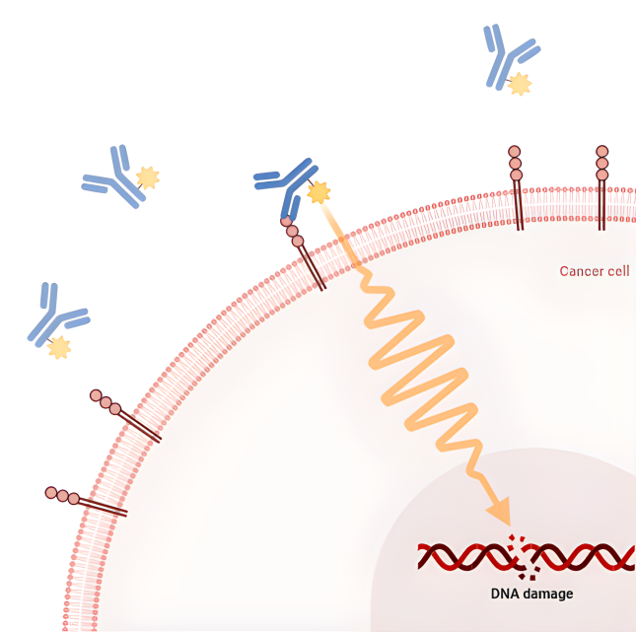
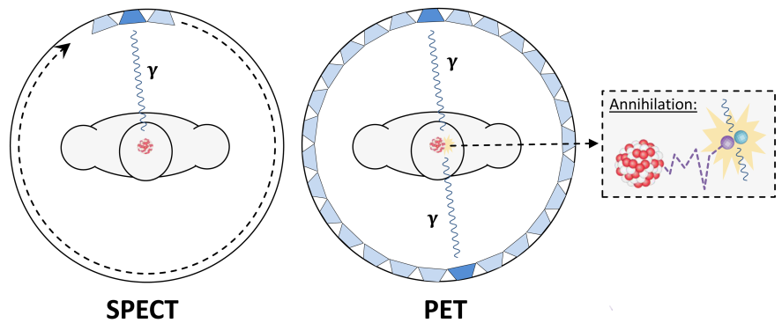
Theranostics
Pairs of diagnostic and therapeutic molecules with common structure and disease-associated target
W
hat is theranostics?
Diagnostic radionuclide
PET/SPECT imaging
Therapeutic radionuclide
Radioligand therapy
Combination of diagnosis and therapy
Shared molecular targeting vector
Enables patient selection and therapy monitoring
Cornerstone of precision nuclear medicine
Detection of disease location
Monitoring of disease progression
Patient selection for radioligand therapy
Assessment of therapy response
Targeted treatment
Target
vector
Molecular
target
Cancer
cell

Slide 6
Theranostics
Pairs of diagnostic and therapeutic molecules with common structure and disease-associated target
W
Diagnostic / therapeutic radionuclide
hat is theranostics?
Combination of diagnosis and therapy
Shared molecular targeting vector
Enables patient selection and therapy monitoring
Cornerstone of precision nuclear medicine
Target
vector
Molecular
target
Cancer
cell

Slide 7



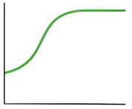







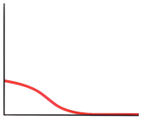
R
Current medicine
(„One treatment fits all“)
ationale for Theranostics
Desired effect
Target expression heterogeneity
Personalized dosimetry
Improved therapeutic index
Early response assessment
No effect
Cancer patients
Therapy
Adverse effect
Notes:
Theranostics, a blend of therapeutic and diagnostic, uses the same molecular target for both imaging and treating disease—primarily cancer—to enable highly personalized, targeted care
. The rationale is to use diagnostic isotopes to confirm receptor expression (e.g., PSMA, SSTR) before delivering precision radiation therapy to tumors while sparing surrounding healthy tissue.

Slide 8



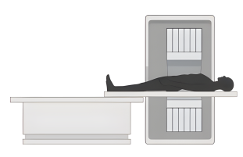



R
Future medicine
(Personalized treatment)
ationale for Theranostics
Target expression heterogeneity
Personalized dosimetry
Improved therapeutic index
Early response assessment
Cancer patients
Diagnostics
Personalized therapy

Slide 9


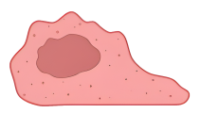
¹²⁴I
¹³¹I
T
(β⁺, t_{1/2} = 4.2 d)
(β─, t_{1/2} = 8.0 d)
PET
⁶⁴Cu
⁶⁷Cu
β-therapy
(β⁺, t_{1/2} = 12.7 h)
(β─, t_{1/2} = 2.6 d)
⁶⁸Ga
¹⁷⁷Lu
heranostic Pairs
(β⁺, t_{1/2} = 68 min)
(β─, t_{1/2} = 6.6 d)
Imaging
Therapy
Same vector, different radionuclides
Diagnostic: PET / SPECT
Therapeutic: β− or α emitters
Example: Ga-68 / Lu-177

Slide 10
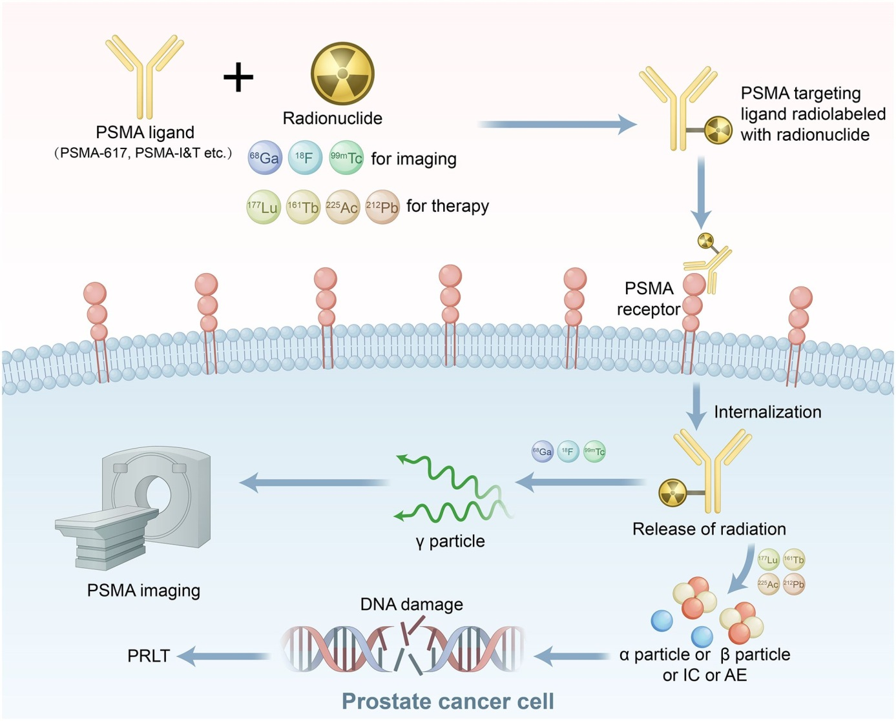
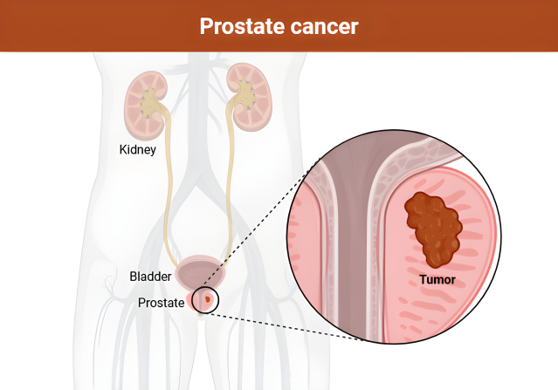
C
linically Established Example I: PSMA
Prostate-specific membrane antigen (PSMA)
[⁶⁸Ga]PSMA-617 for PET imaging
[¹⁷⁷Lu]PSMA-617 for therapy
High clinical impact in mCRPC
Xiao et al. 2026

Slide 11


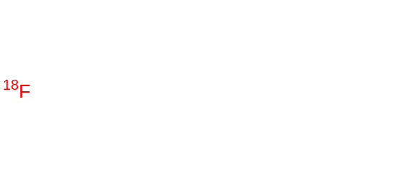
Common PSMA-targeting radioligands
C
linically Established Example I: PSMA
PSMA-617
Prostate-specific membrane antigen (PSMA)
[⁶⁸Ga]PSMA-617 for PET imaging
[¹⁷⁷Lu]PSMA-617 for therapy
High clinical impact in mCRPC
= ⁶⁸Ga, ¹⁷⁷Lu, ⁹⁰Y, ²²⁵Ac, ¹⁶¹Tb, etc.
PSMA-11
JK-PSMA-7
= ⁶⁸Ga
= ¹⁸F

Slide 12
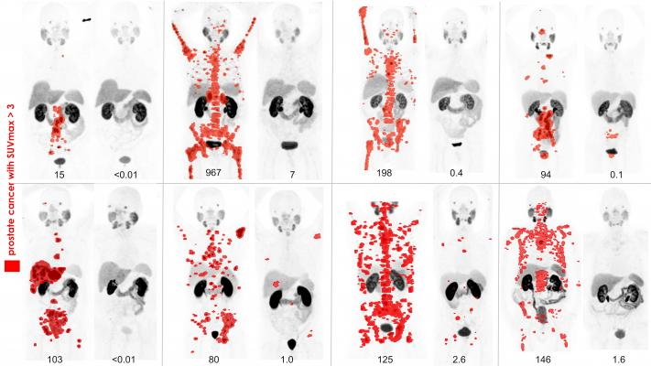
C
[⁶⁸Ga]PSMA11 PET before and 3 months after treatment with [¹⁷⁷Lu]PSMA-617 in patients with metastatic prostate cancer
linical Impact of PSMA Theranostics
Patient selection by PET
Therapy monitoring
Improved progression-free survival
Emerging α-therapy variants (²²⁵Ac)
Hofman et al. 2018

Slide 13
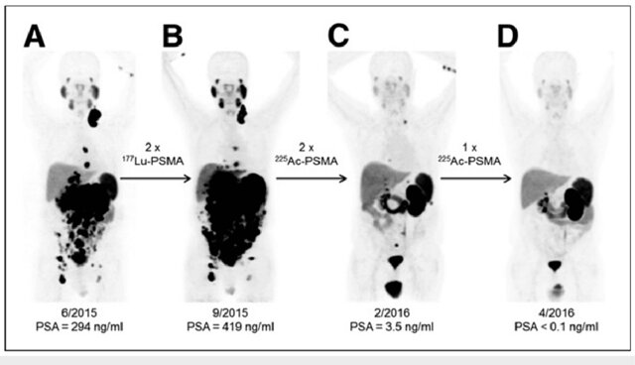
C
[¹⁷⁷Lu]PSMA-617 and [²²⁵Ac]PSMA-617 in a patient with metastatic prostate cancer
linical Impact of PSMA Theranostics
Patient selection by PET
Therapy monitoring
Improved progression-free survival
Emerging α-therapy variants (²²⁵Ac)
Kratochwil et al. 2016

Slide 14
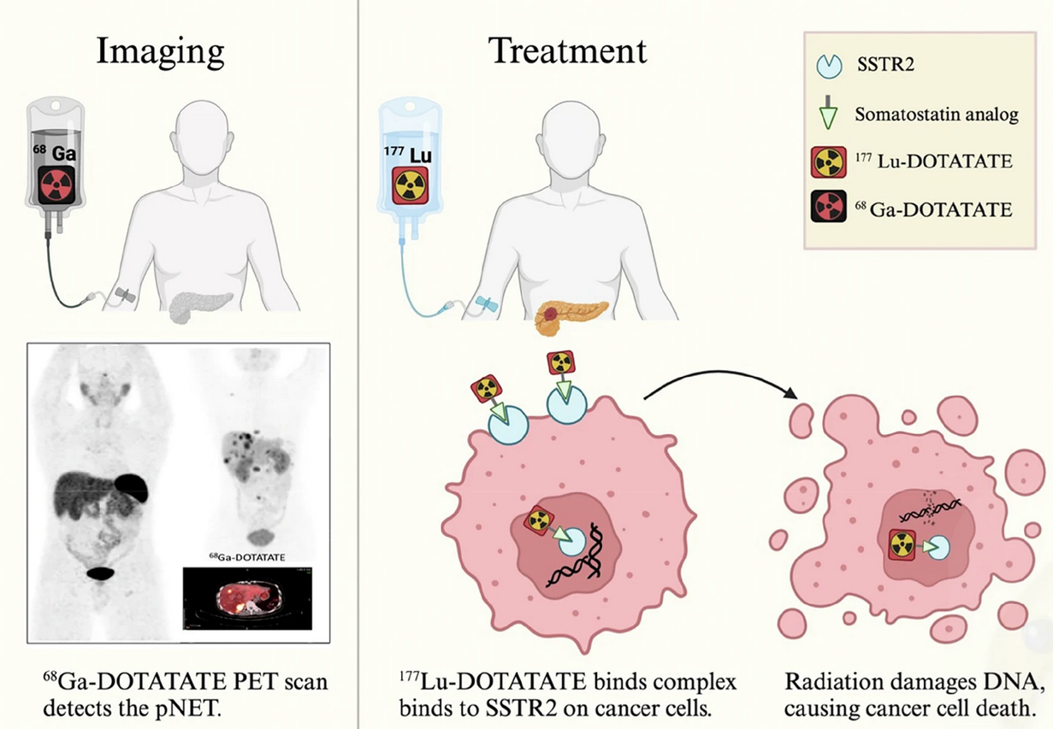
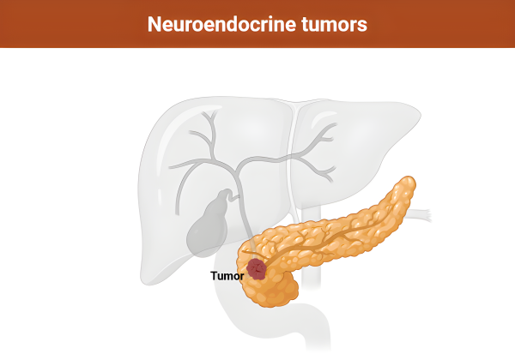
C
linically Established Example II: Somatostatin Receptors
Neuroendocrine tumors
[⁶⁸Ga]DOTATATE imaging
[¹⁷⁷Lu]DOTATATE therapy
NETTER-1 trial success
Karimi et al. 2025

Slide 15
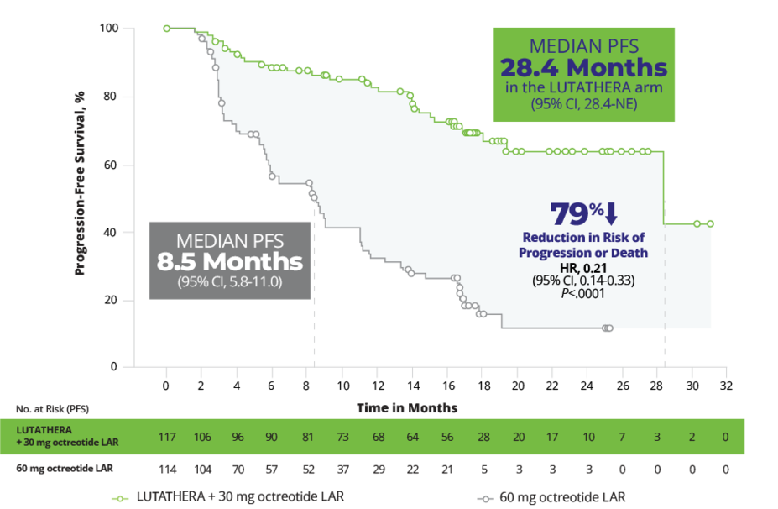
C
NETTER-1: Phase III trial with [¹⁷⁷Lu]DOTATATE (LUTHATHERA) for neuroendocrine tumors
Linical Impact of SSTR-Theranostics
Neuroendocrine tumors
[⁶⁸Ga]DOTATATE imaging
[¹⁷⁷Lu]DOTATATE therapy
NETTER-1 trial success
https://www.lutathera-hcp.com/2l-netter-1-efficacy

Slide 16
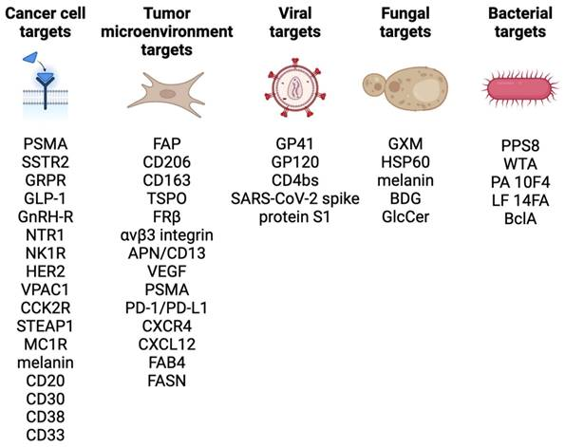
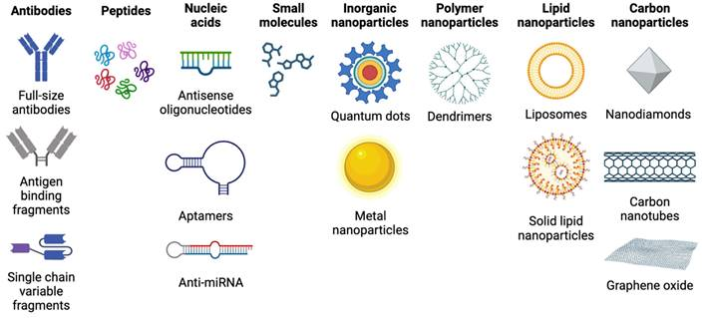
E
xpanding the Theranostic Toolbox
New targets (FAP, CXCR4, GRPR)
Small molecules, peptides, antibodies
Matching physics to biology
Nelson et al. 2024

Slide 17
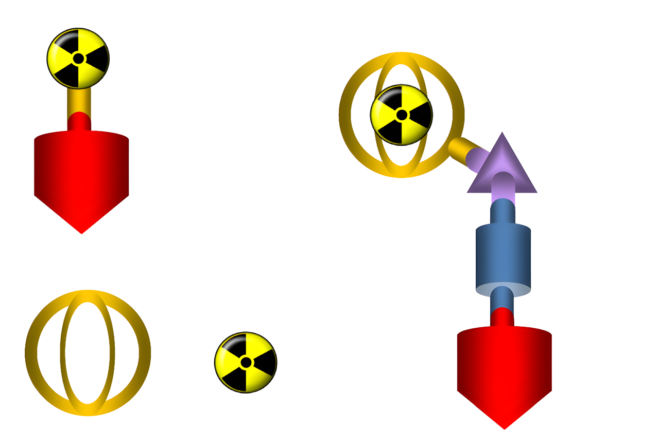
R
Bifunctional chelator
Radiometal
adiometals in Theranostics
Linker
Radionuclide
Spacer
Diagnostic: ⁶⁸Ga, ⁶⁴Cu
Therapeutic: ¹⁷⁷Lu, ⁹⁰Y, ²²⁵Ac
Require stable chelation
Mild labeling conditions essential
Targeting vector
Targeting vector
Standard radionuclides
(covalent labeling)
Radiometals
(chelator-based labeling)
Mod. from Roesch & Martin 2022

Slide 18
R
Bifunctional chelator
Radiometal
adiometals in Theranostics
Linker
Diagnostic
Therapeutic
⁶⁸Ga
¹⁷⁷Lu
Spacer
Diagnostic: ⁶⁸Ga, ⁶⁴Cu
Therapeutic: ¹⁷⁷Lu, ⁹⁰Y, ²²⁵Ac
Require stable chelation
Mild labeling conditions essential
⁸⁶Y
⁹⁰Y
Targeting vector
⁶⁴Cu
⁶⁷Cu
Radiometals
(chelator-based labeling)
¹³³La
²²⁵Ac
Mod. from Roesch & Martin 2022

Slide 19
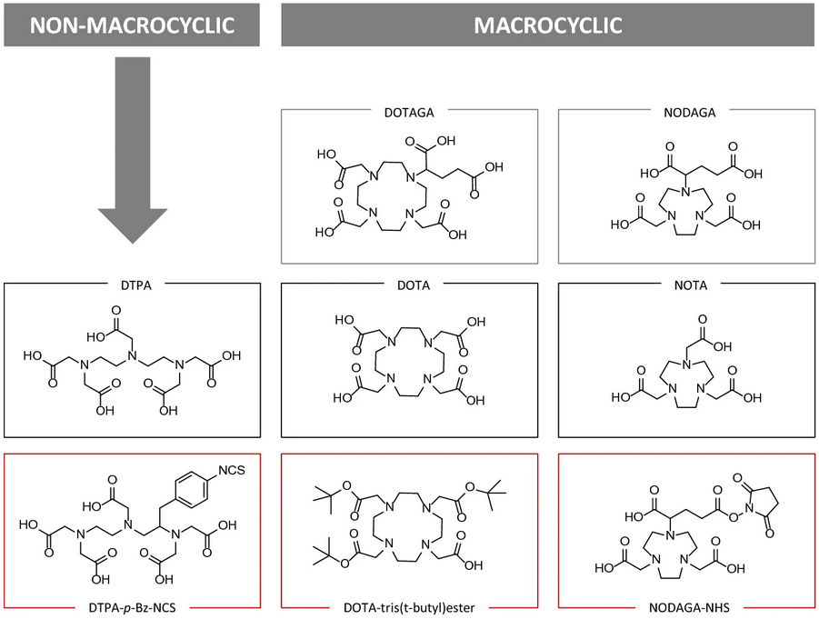

B
ifunctional Chelators
Link targeting vector to radiometal
High thermodynamic and kinetic stability
Examples: DOTA, NOTA, DTPA
Roesch & Martin 2022

Slide 20
R
Diagnostic
Therapeutic
adiohalogens as Theranostic Nuclides
¹⁸F
²¹¹At
α-therapy
PET
¹²⁴I
¹³¹I
β-therapy
¹²³I / ¹²⁴I for SPECT / PET
¹³¹I for β therapy
²¹¹At for α therapy
Chemically versatile
¹²³I
⁷⁷Br
Auger therapy
SPECT
¹²⁵I
^{80m}Br

Slide 21
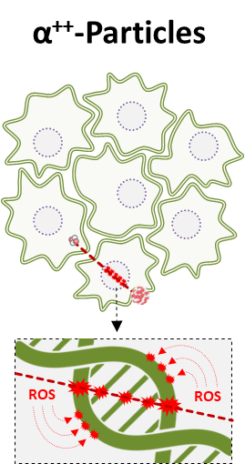
A
α-Particles
58,2
%
211
At
0.785
MeV
85
7.214
h
statine-211 for Alpha Therapy
211
Po
84
41,8
%
516
5.98
MeV
ms
207
Bi
High linear energy transfer (LET)
Short tissue range
Ideal for micrometastatic disease
Major challenge: bond stability
100 %
83
7.60 MeV
31.55 a
207
Pb
82
100
%
stable
2.397
MeV
- Low range (µm) -
- High LET (~100 keV/µm) -

Slide 22


α
Therapy Hub
²¹¹At-Production & Logistics
21

Slide 23

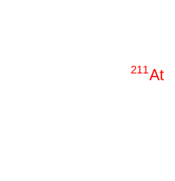

α
Copenhagen
Therapy Hub
Warsaw
²¹¹At-Production & Logistics
Nantes
22

Slide 24
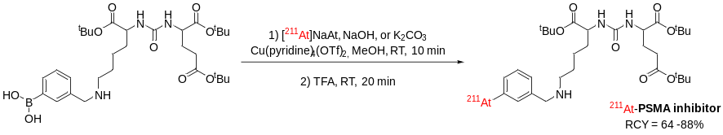
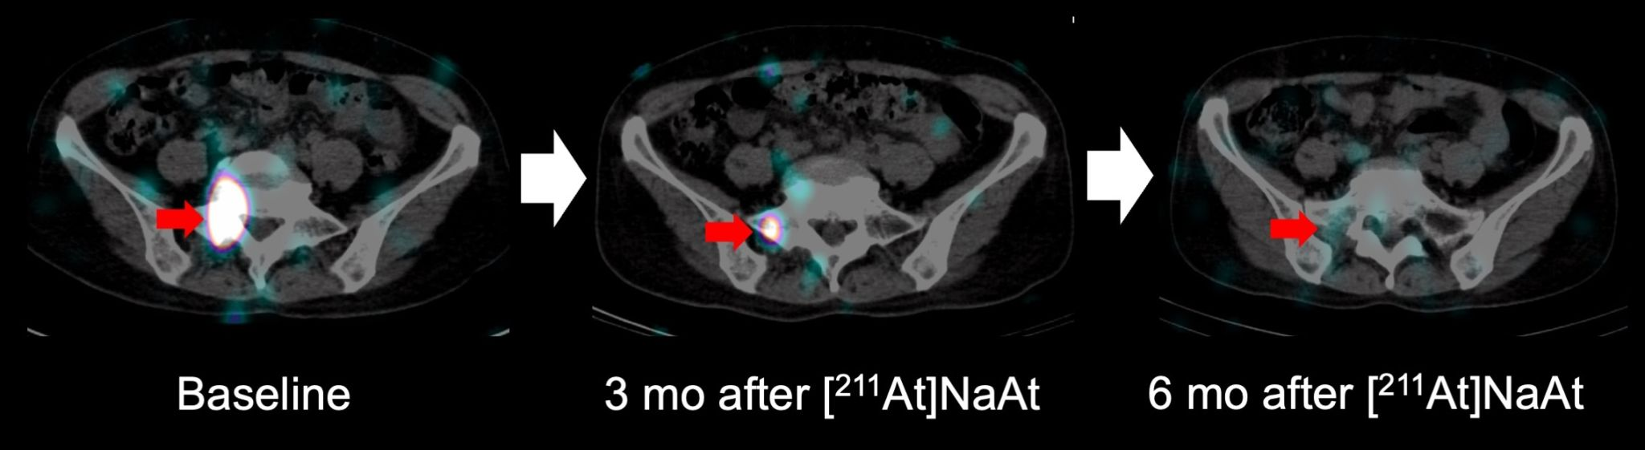
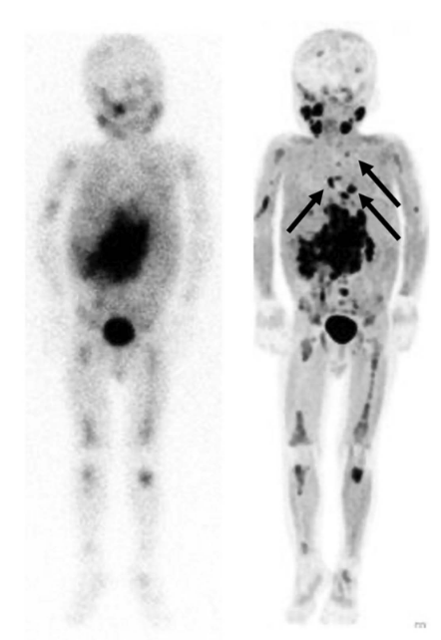
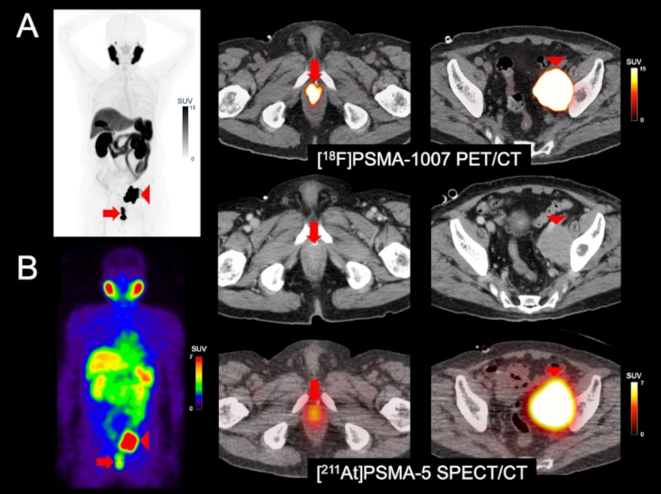
C
Target | Diagnostic radioligands | Therapeutic radioligands
Sodium iodide symporter (NIS) | [¹²³I]NaI | [¹³¹I]NaI [²¹¹At]NaAt
Norepinephrine transporter (NET) | [¹²³I]MIBG [⁷⁶Br]MBBG [¹⁸F]MFBG [¹⁸F]FIBG [¹⁸F]FPBG | [¹³¹I]MIBG [²¹¹At]MABG
Prostate-specific membrane antigen (PSMA) | [¹⁸F]PSMA-1007 [¹²⁴I]MIP-1095 [¹²³I]MIP-1072 | [²¹¹At]PSMA-5 [¹³¹I]MIP-1095
L-type amino acid transporter 1 (LAT1) | [¹⁸F]FET [¹²³I]IMT | [²¹¹At]At-NpGT [¹³¹I]IPA
linical trials with
At-211
Emerging platform for targeted α-therapy
Early clinical studies demonstrate feasibility and safety
Strong interest across multiple tumor indications
Foundation for next-generation theranostic strategies
Notes:
Pre-treatment [¹⁸F]PSMA-1007 PET/CT (A) and [²¹¹At]PSMA-5 SPECT/CT (B) images showed similar distribution patterns, with high uptake in recurrent/metastatic lesions (left: maximum intensity projection, right: fusion and contrast-enhanced CT images). Both images revealed high accumulation in the soft tissue mass within the prostate area (SUVmax = 60.7 on [¹⁸F]PSMA-1007 PET and 4.9 on [²¹¹At]PSMA-5 SPECT) (arrows) and in the enlarged left external iliac lymph node metastasis (SUVmax = 143.7 and 17.6, respectively) (arrow heads). Physiological accumulation was similarly observed in both modalities in the salivary glands, liver, spleen, small intestine, and kidneys, with no detectable urinary excretion. This image provides proof-of-concept for a theranostic approach using the ¹⁸F/²¹¹At-labeled compound pair.

Slide 25
C
Target | Diagnostic radioligands | Therapeutic radioligands
Sodium iodide symporter (NIS) | [¹²³I]NaI | [¹³¹I]NaI [²¹¹At]NaAt
Norepinephrine transporter (NET) | [¹²³I]MIBG [⁷⁶Br]MBBG [¹⁸F]MFBG [¹⁸F]FIBG [¹⁸F]FPBG | [¹³¹I]MIBG [²¹¹At]MABG
Prostate-specific membrane antigen (PSMA) | [¹⁸F]PSMA-1007 [¹²⁴I]MIP-1095 [¹²³I]MIP-1072 | [²¹¹At]PSMA-5 [¹³¹I]MIP-1095
L-type amino acid transporter 1 (LAT1) | [¹⁸F]FET [¹²³I]IMT | [²¹¹At]At-NpGT [¹³¹I]IPA
linical trials with
At-211
Higher linear energy transfer (α-therapy)
Short tissue range, reduced off-target toxicity
Potential for improved tumor cell kill in resistant disease
Notes:
Pre-treatment [¹⁸F]PSMA-1007 PET/CT (A) and [²¹¹At]PSMA-5 SPECT/CT (B) images showed similar distribution patterns, with high uptake in recurrent/metastatic lesions (left: maximum intensity projection, right: fusion and contrast-enhanced CT images). Both images revealed high accumulation in the soft tissue mass within the prostate area (SUVmax = 60.7 on [¹⁸F]PSMA-1007 PET and 4.9 on [²¹¹At]PSMA-5 SPECT) (arrows) and in the enlarged left external iliac lymph node metastasis (SUVmax = 143.7 and 17.6, respectively) (arrow heads). Physiological accumulation was similarly observed in both modalities in the salivary glands, liver, spleen, small intestine, and kidneys, with no detectable urinary excretion. This image provides proof-of-concept for a theranostic approach using the ¹⁸F/²¹¹At-labeled compound pair.

Slide 26
C
linical trials with
At-211
Higher linear energy transfer (α-therapy)
Short tissue range, reduced off-target toxicity
Potential for improved tumor cell kill in resistant disease
Target | Diagnostic radioligands | Therapeutic radioligands
Sodium iodide symporter (NIS) | [¹²³I]NaI | [¹³¹I]NaI [²¹¹At]NaAt
Norepinephrine transporter (NET) | [¹²³I]MIBG [⁷⁶Br]MBBG [¹⁸F]MFBG [¹⁸F]FIBG [¹⁸F]FPBG | [¹³¹I]MIBG [²¹¹At]MABG
Prostate-specific membrane antigen (PSMA) | [¹⁸F]PSMA-1007 [¹²⁴I]MIP-1095 [¹²³I]MIP-1072 | [²¹¹At]PSMA-5 [¹³¹I]MIP-1095
L-type amino acid transporter 1 (LAT1) | [¹⁸F]FET [¹²³I]IMT | [²¹¹At]At-NpGT [¹³¹I]IPA
Notes:
Pre-treatment [¹⁸F]PSMA-1007 PET/CT (A) and [²¹¹At]PSMA-5 SPECT/CT (B) images showed similar distribution patterns, with high uptake in recurrent/metastatic lesions (left: maximum intensity projection, right: fusion and contrast-enhanced CT images). Both images revealed high accumulation in the soft tissue mass within the prostate area (SUVmax = 60.7 on [¹⁸F]PSMA-1007 PET and 4.9 on [²¹¹At]PSMA-5 SPECT) (arrows) and in the enlarged left external iliac lymph node metastasis (SUVmax = 143.7 and 17.6, respectively) (arrow heads). Physiological accumulation was similarly observed in both modalities in the salivary glands, liver, spleen, small intestine, and kidneys, with no detectable urinary excretion. This image provides proof-of-concept for a theranostic approach using the ¹⁸F/²¹¹At-labeled compound pair.

Slide 27
C
Target | Diagnostic radioligands | Therapeutic radioligands
Sodium iodide symporter (NIS) | [¹²³I]NaI | [¹³¹I]NaI [²¹¹At]NaAt
Norepinephrine transporter (NET) | [¹²³I]MIBG [⁷⁶Br]MBBG [¹⁸F]MFBG [¹⁸F]FIBG [¹⁸F]FPBG | [¹³¹I]MIBG [²¹¹At]MABG
Prostate-specific membrane antigen (PSMA) | [¹⁸F]PSMA-1007 [¹²⁴I]MIP-1095 [¹²³I]MIP-1072 | [²¹¹At]PSMA-5 [¹³¹I]MIP-1095
L-type amino acid transporter 1 (LAT1) | [¹⁸F]FET [¹²³I]IMT | [²¹¹At]At-NpGT [¹³¹I]IPA
linical trials with
At-211
α-emitting analogue of 131I-MIBG
Enhanced cytotoxicity in neuroblastoma
Potential efficacy in MIBG-avid resistant tumors
Notes:
Pre-treatment [¹⁸F]PSMA-1007 PET/CT (A) and [²¹¹At]PSMA-5 SPECT/CT (B) images showed similar distribution patterns, with high uptake in recurrent/metastatic lesions (left: maximum intensity projection, right: fusion and contrast-enhanced CT images). Both images revealed high accumulation in the soft tissue mass within the prostate area (SUVmax = 60.7 on [¹⁸F]PSMA-1007 PET and 4.9 on [²¹¹At]PSMA-5 SPECT) (arrows) and in the enlarged left external iliac lymph node metastasis (SUVmax = 143.7 and 17.6, respectively) (arrow heads). Physiological accumulation was similarly observed in both modalities in the salivary glands, liver, spleen, small intestine, and kidneys, with no detectable urinary excretion. This image provides proof-of-concept for a theranostic approach using the ¹⁸F/²¹¹At-labeled compound pair.

Slide 28
C
linical trials with
At-211
α-emitting analogue of 131I-MIBG
Enhanced cytotoxicity in neuroblastoma
Potential efficacy in MIBG-avid resistant tumors
Target | Diagnostic radioligands | Therapeutic radioligands
Sodium iodide symporter (NIS) | [¹²³I]NaI | [¹³¹I]NaI [²¹¹At]NaAt
Norepinephrine transporter (NET) | [¹²³I]MIBG [⁷⁶Br]MBBG [¹⁸F]MFBG [¹⁸F]FIBG [¹⁸F]FPBG | [¹³¹I]MIBG [²¹¹At]MABG
Prostate-specific membrane antigen (PSMA) | [¹⁸F]PSMA-1007 [¹²⁴I]MIP-1095 [¹²³I]MIP-1072 | [²¹¹At]PSMA-5 [¹³¹I]MIP-1095
L-type amino acid transporter 1 (LAT1) | [¹⁸F]FET [¹²³I]IMT | [²¹¹At]At-NpGT [¹³¹I]IPA
Notes:
Pre-treatment [¹⁸F]PSMA-1007 PET/CT (A) and [²¹¹At]PSMA-5 SPECT/CT (B) images showed similar distribution patterns, with high uptake in recurrent/metastatic lesions (left: maximum intensity projection, right: fusion and contrast-enhanced CT images). Both images revealed high accumulation in the soft tissue mass within the prostate area (SUVmax = 60.7 on [¹⁸F]PSMA-1007 PET and 4.9 on [²¹¹At]PSMA-5 SPECT) (arrows) and in the enlarged left external iliac lymph node metastasis (SUVmax = 143.7 and 17.6, respectively) (arrow heads). Physiological accumulation was similarly observed in both modalities in the salivary glands, liver, spleen, small intestine, and kidneys, with no detectable urinary excretion. This image provides proof-of-concept for a theranostic approach using the ¹⁸F/²¹¹At-labeled compound pair.

Slide 29
C
Target | Diagnostic radioligands | Therapeutic radioligands
Sodium iodide symporter (NIS) | [¹²³I]NaI | [¹³¹I]NaI [²¹¹At]NaAt
Norepinephrine transporter (NET) | [¹²³I]MIBG [⁷⁶Br]MBBG [¹⁸F]MFBG [¹⁸F]FIBG [¹⁸F]FPBG | [¹³¹I]MIBG [²¹¹At]MABG
Prostate-specific membrane antigen (PSMA) | [¹⁸F]PSMA-1007 [¹²⁴I]MIP-1095 [¹²³I]MIP-1072 | [²¹¹At]PSMA-5 [¹³¹I]MIP-1095
L-type amino acid transporter 1 (LAT1) | [¹⁸F]FET [¹²³I]IMT | [²¹¹At]At-NpGT [¹³¹I]IPA
linical trials with
At-211
Targeted α-therapy for PSMA-expressing tumors
High potency against micrometastatic disease
Promising option for treatment-refractory prostate cancer
Notes:
Pre-treatment [¹⁸F]PSMA-1007 PET/CT (A) and [²¹¹At]PSMA-5 SPECT/CT (B) images showed similar distribution patterns, with high uptake in recurrent/metastatic lesions (left: maximum intensity projection, right: fusion and contrast-enhanced CT images). Both images revealed high accumulation in the soft tissue mass within the prostate area (SUVmax = 60.7 on [¹⁸F]PSMA-1007 PET and 4.9 on [²¹¹At]PSMA-5 SPECT) (arrows) and in the enlarged left external iliac lymph node metastasis (SUVmax = 143.7 and 17.6, respectively) (arrow heads). Physiological accumulation was similarly observed in both modalities in the salivary glands, liver, spleen, small intestine, and kidneys, with no detectable urinary excretion. This image provides proof-of-concept for a theranostic approach using the ¹⁸F/²¹¹At-labeled compound pair.

Slide 30
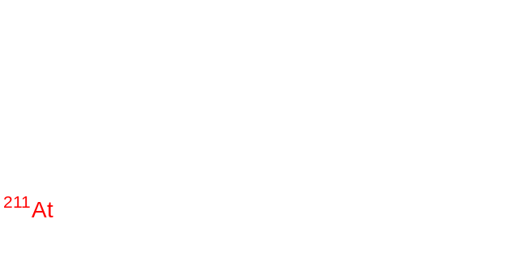
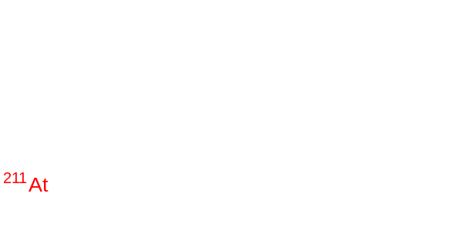

C
Linicla trials with
At-211
Targeted α-therapy for PSMA-expressing tumors
High potency against micrometastatic disease
Promising option for treatment-refractory prostate cancer
Target | Diagnostic radioligands | Therapeutic radioligands
Sodium iodide symporter (NIS) | [¹²³I]NaI | [¹³¹I]NaI [²¹¹At]NaAt
Norepinephrine transporter (NET) | [¹²³I]MIBG [⁷⁶Br]MBBG [¹⁸F]MFBG [¹⁸F]FIBG [¹⁸F]FPBG | [¹³¹I]MIBG [²¹¹At]MABG
Prostate-specific membrane antigen (PSMA) | [¹⁸F]PSMA-1007 [¹²⁴I]MIP-1095 [¹²³I]MIP-1072 | [²¹¹At]PSMA-5 [¹³¹I]MIP-1095
L-type amino acid transporter 1 (LAT1) | [¹⁸F]FET [¹²³I]IMT | [²¹¹At]At-NpGT [¹³¹I]IPA
Notes:
Pre-treatment [¹⁸F]PSMA-1007 PET/CT (A) and [²¹¹At]PSMA-5 SPECT/CT (B) images showed similar distribution patterns, with high uptake in recurrent/metastatic lesions (left: maximum intensity projection, right: fusion and contrast-enhanced CT images). Both images revealed high accumulation in the soft tissue mass within the prostate area (SUVmax = 60.7 on [¹⁸F]PSMA-1007 PET and 4.9 on [²¹¹At]PSMA-5 SPECT) (arrows) and in the enlarged left external iliac lymph node metastasis (SUVmax = 143.7 and 17.6, respectively) (arrow heads). Physiological accumulation was similarly observed in both modalities in the salivary glands, liver, spleen, small intestine, and kidneys, with no detectable urinary excretion. This image provides proof-of-concept for a theranostic approach using the ¹⁸F/²¹¹At-labeled compound pair.

Slide 31

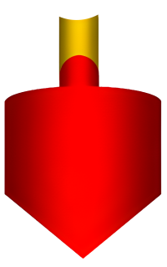

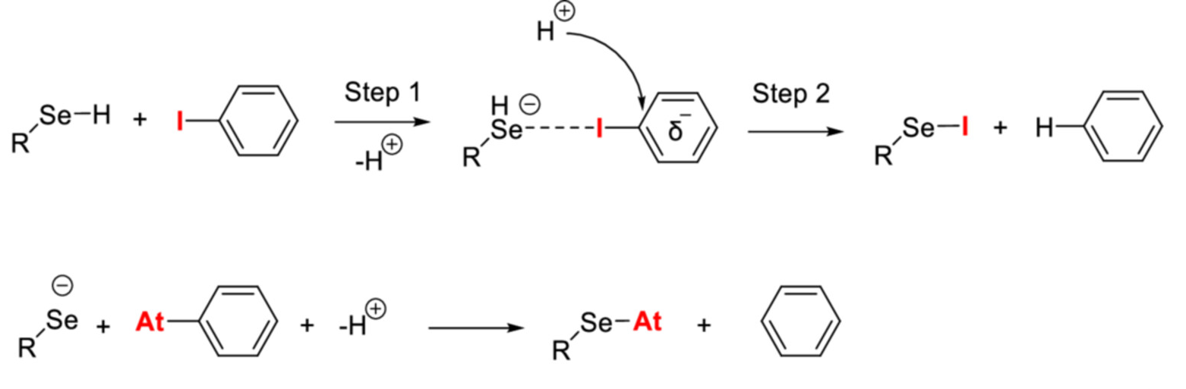
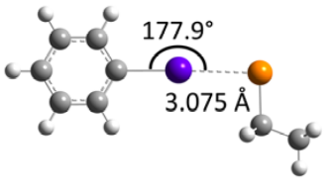
In vivo dehalogenation
R
Iodothyronine deiodinases
(type 1/3)
adiolabel Stability Challenges
In vivo dechelation (radiometals)
Dehalogenation (radioiodine, astatine)
Radiolysis
Off-target toxicity
Müller et al. 2025

Slide 32
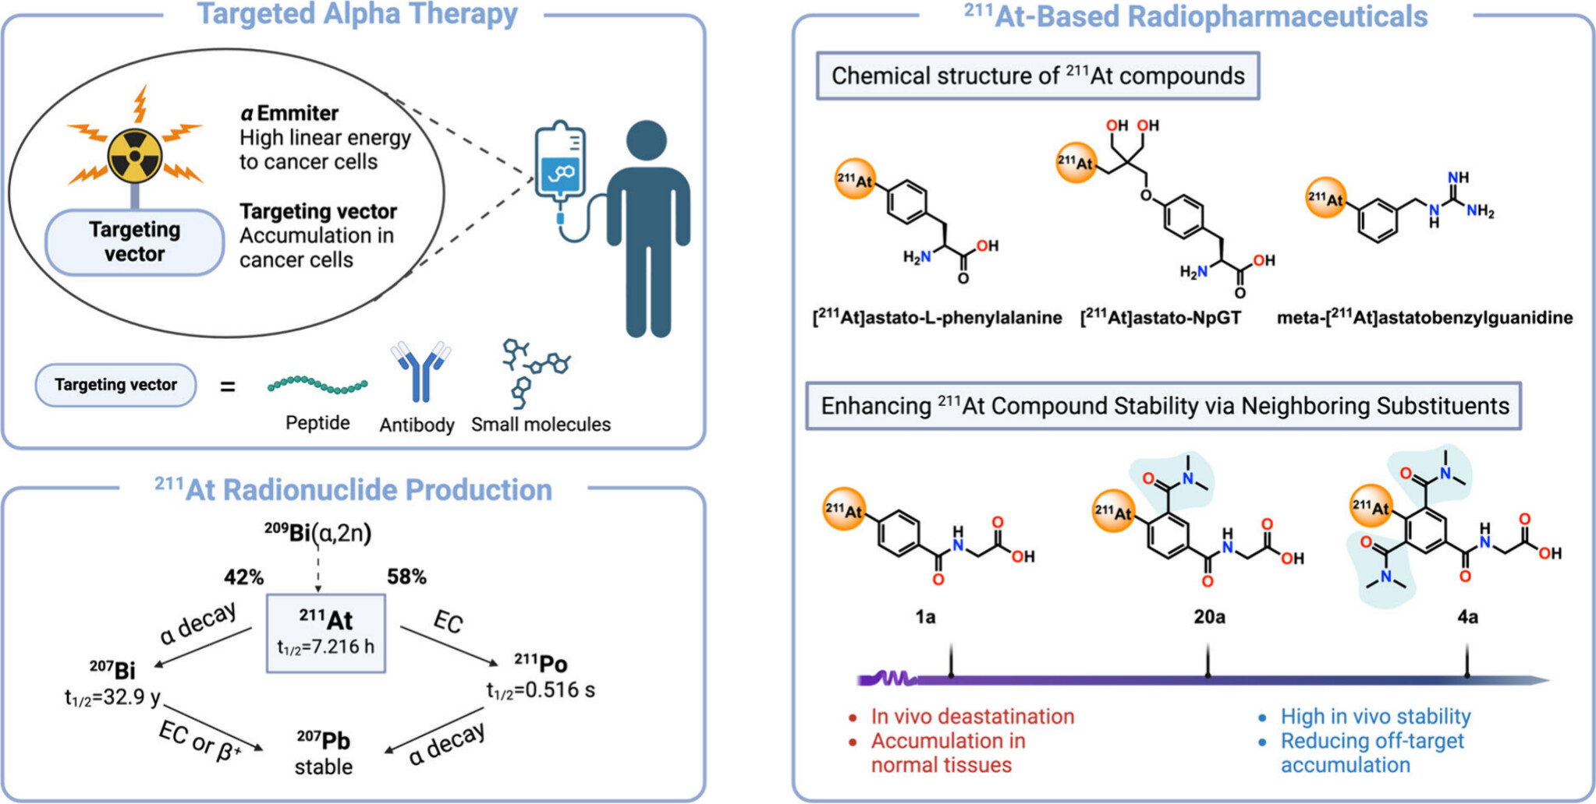
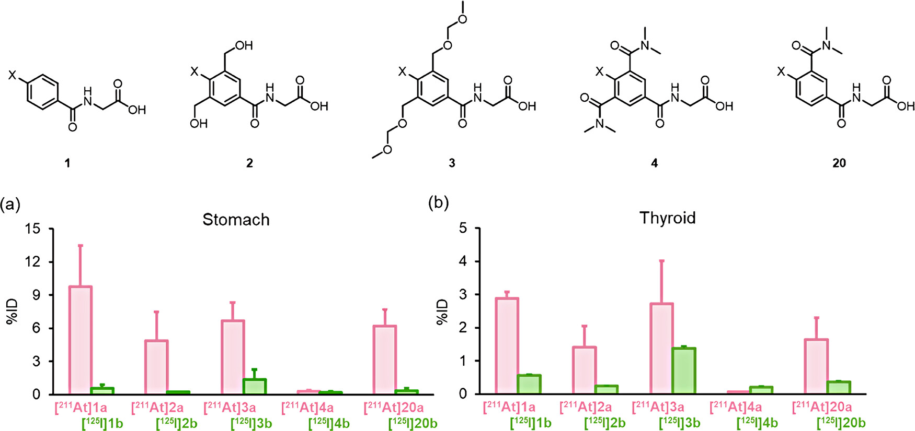
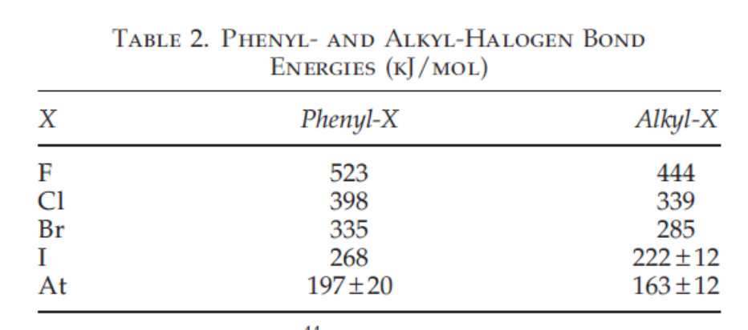
S
tability enhancement by ortho-substituent strategies
T. Zhao and S.H. Liang, ACS Medicinal Chemistry Letters 2025 16 (4), 504-507

Slide 33
S
tability enhancement by ortho-substituent strategies
T. Zhao and S.H. Liang, ACS Medicinal Chemistry Letters 2025 16 (4), 504-507

Slide 34

C
Strategies against dechelation
Charge
hemical Strategies to Improve Stability
Polarity
Improved chelator design
Stronger C–halogen bonds
Aryl vs alkyl labeling
Protective formulation strategies
Denticity
Improved chelator design
Donor atom type
Kinetics

Slide 35
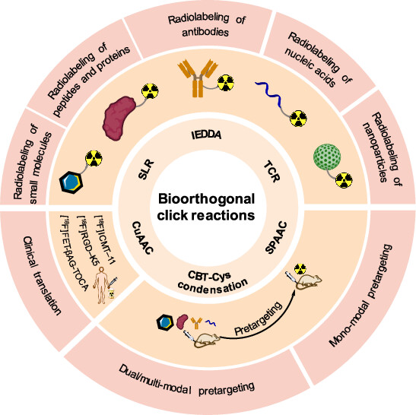
B
eyond Classical Labeling: Bioorthogonal Chemistry
Click reactions in biological systems
Fast, selective, biocompatible
Independent of biological background
Zhong et al. 2023

Slide 36
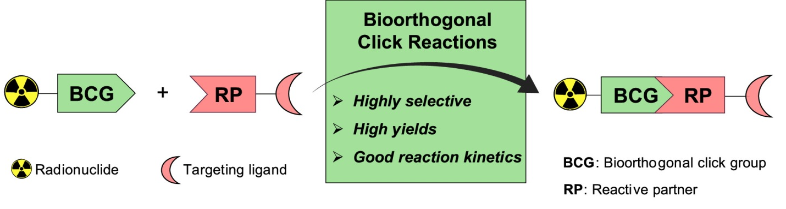

B
eyond Classical Labeling: Bioorthogonal Chemistry
Click reactions in biological systems
Fast, selective, biocompatible
Independent of biological background
Zhong et al. 2023
Notes:
A perfect bioorthogonal reaction should fulfill the following four requirements:
the reaction should take place under physiological conditions,
The reaction should be selective and inert towards the biological system,
the reaction should have fast kinetics at low concentrations, and
the reaction should not contain any natural functional groups found in biological systems

Slide 37

I
EDDA Reaction
Tetrazine–trans-cyclooctene ligation
Extremely fast kinetics
High selectivity in vivo
Adhikari et al. 2024
Notes:
The inverse electron-demand Diels–Alder (IEDDA) cycloaddition reaction between TCO and tetrazine (Tz) is considered by many the optimal bioorthogonal reaction for in vivo applications. This preference stems from its remarkably fast reaction kinetics, with very high reported rate constants (10 7 M−1 s−1 ) in physiological conditions.
The IEDDA reaction proceeds through a [4 + 2] cycloaddition between an electron-rich dienophile
(alkene or alkyne) and electron-poor diene (1,2,4,5-tetrazine) forming a highly strained bicyclic intermediate. Subsequently, a retro-Diels–Alder reaction occurs with N 2 evolution, resulting in the formation of a stable six-membered 4,5-dihydropyridazine ring.
Particularly, the fast reaction kinetics of TCO with tetrazines has gar-
nered significant attention in nuclear medicine where the TCO moiety has been actively
explored as a prosthetic group for introduction of a radioisotope to a vector molecule
or as a bioorthogonal tag for subsequent labeling of a target of interest for pretargeted
imaging and therapy. A promising application of the pretargeting approach is cancer
diagnosis and therapy, allowing the use of long circulating vectors at optimal tumor-to-
background ratios, thereby minimizing the radiation damage to non-targeted tissues.

Slide 38
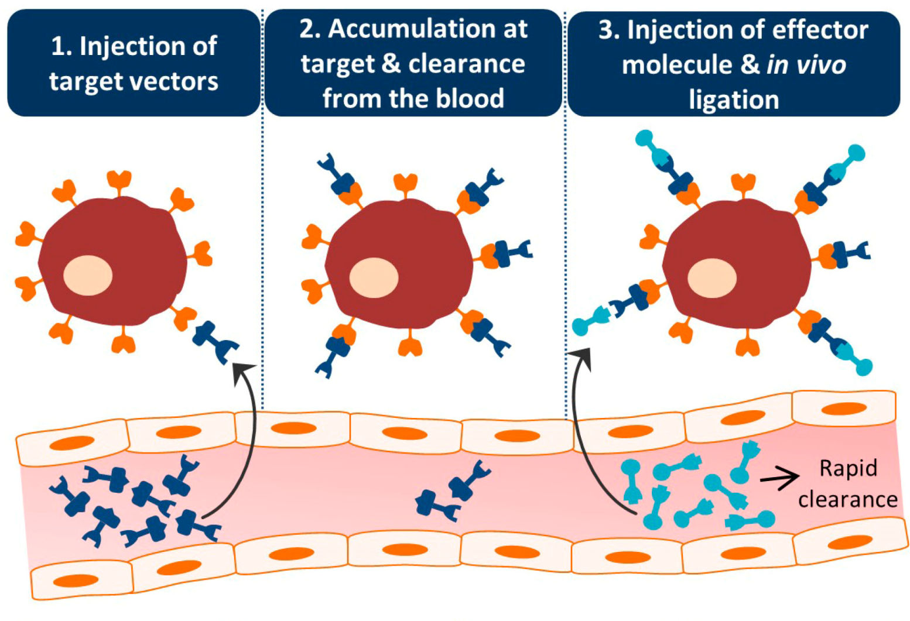
P
retargeting Concept
Step 1: Inject targeting vector
Step 2: Clearance from background
Step 3: Inject radiolabeled small molecule
Click reaction at target site
Verhoeven et al. 2019

Slide 39
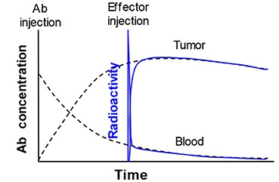
A
dvantages of Pretargeting
Rapid radioactivity accumulation in tumor
Reduced radiation burden
Improved contrast
Lower radiolysis risk
Enables short-lived radionuclides
Rapid radioactivity clearance from circulation
Liu 2018

Slide 40
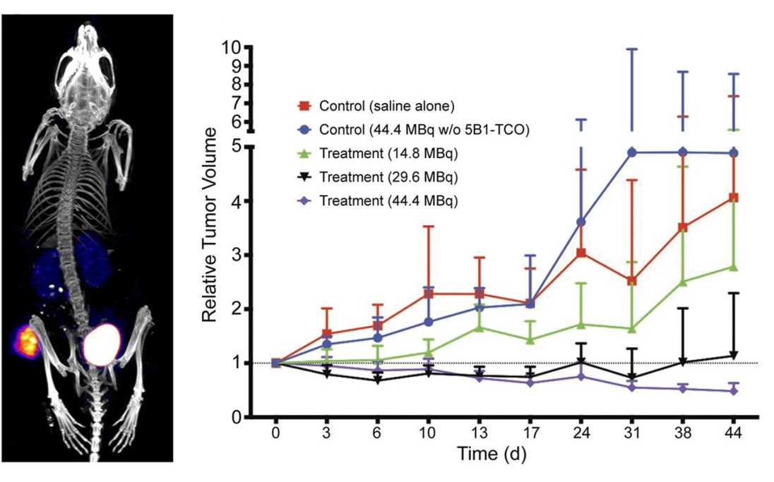

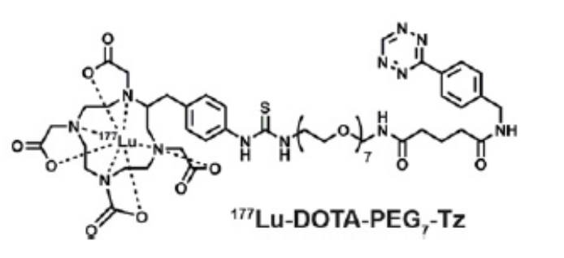
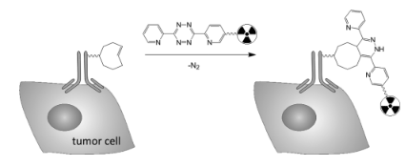
Pretargeted radioimmunotherapy of pancreatic cancer with [¹⁷⁷Lu]Lu-DOTA-PEG₇-Tz
P
retargeting in Therapy
Controls
Higher therapeutic index
Potential for α-emitters
Still under clinical development
Treatment
Houghton et al. 2017
Notes:
Toward that end, we synthesized two novel 177Lu-labeled tetrazine bearing radioligands. Next, we compared the usefulness of our
ligands for PRIT when paired with TCO-modified 5B1—a human, anti-CA19.9 mAb—in preclinical murine models of pancreatic cancer.

Slide 41
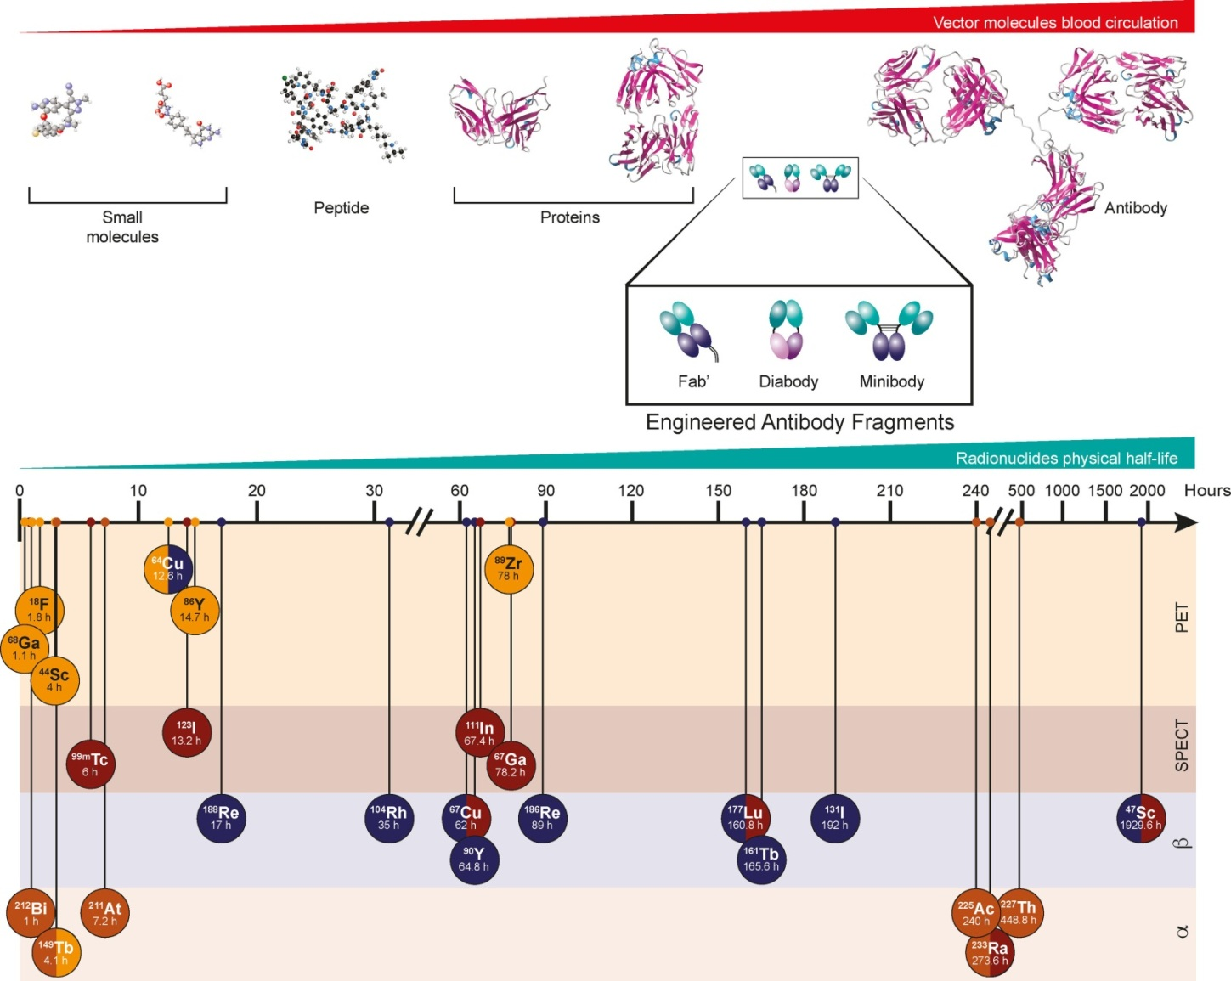
I
ntegration of Emerging Technologies
Radiometals + radiohalogens
Click chemistry + theranostics
Personalized radionuclide choice
Herrero Álvarez et al. 2021

Slide 42





R
Blood-brain barrier limitation
Poor CNS penetration of most radiopharmaceuticals
Therapy-imaging disconnect
Good imaging ≠ guaranteed therapeutic response
emaining Challenges
Manufacturing and cost barriers
High production costs, isotope scarcity, low scalability
Manufacturing complexity
Regulatory hurdles
Standardization of dosimetry
Translation to routine clinical practice
Standardization and interoperability
Requirement for standardized treatment plans
Regulatory hurdles
Slow approval of emerging radiopharmaceuticals

Slide 43




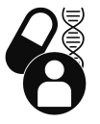
Expansion to new disease entities
Theranostics beyond oncology: neurology, cardiology, inflammation/infection, rare diseases
F
Improved target and ligand discovery
Next-generation biomarkers and targeting vectors for more selective theranostic pairs
uture Perspectives
Better radionuclide matching
Optimized isotope-vector and therapeutic-diagnostic radionuclide pairs (half-life, LET, etc.)
Expansion to new disease entities
Better radionuclide matching
Combination with AI-based imaging analysis
True personalization of nuclear medicine
AI-based imaging and dosimetry
Automation of lesion detection, segmentation, response assessment, and therapy planning
True personalization of nuclear medicine
Biology-driven patient selection and adaptive, patient-tailored treatment

Slide 44
Cancer theranostics is a rapidly evolving field
Emerging molecular targets and radiopharmaceuticals with different radiation types (e.g., α-emitters) show strong potential as next-generation theranostics
Improved dosimetry of therapeutic radiopharmaceuticals is essential
Better quantification and monitoring of treatment response are needed
These advances are key steps toward individualized precision medicine
Further work is required to refine the integration of radionuclide therapy with other cancer treatment modalities
Cancer theranostics is rapidly evolving discipline
Emerging molecular targets and radiopharmaceuticals with different radiation types (e.g., α-emitters) show strong potential as next-generation theranostics
Improved patient-specific dosimetry is essential
Better quantification and monitoring of treatment response are needed
These advances are key steps toward individualized precision medicine
Further work is required to refine the integration of radionuclide therapy with other cancer treatment modalities
Continued technological, clinical, and regulatory optimization will be key to translating innovation into routine patient care
Conclusion

Slide 45
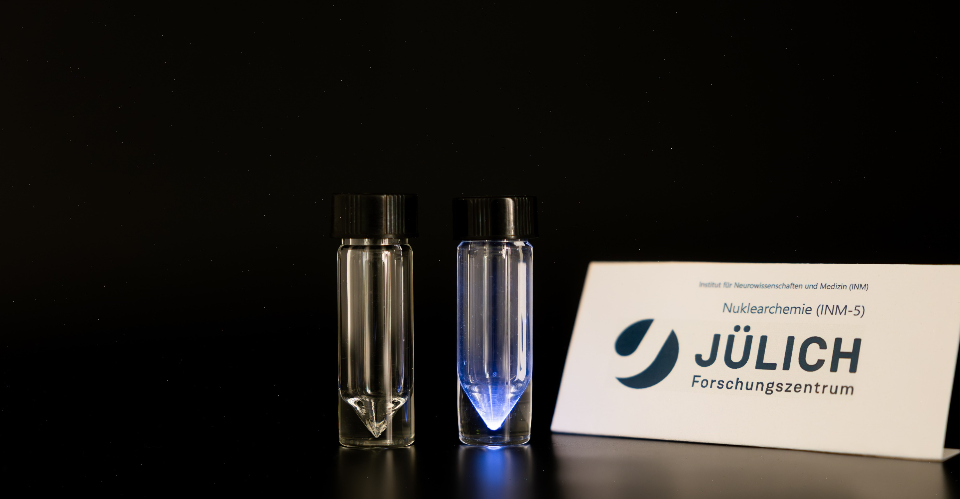
17.02.2026 | Bernd Neumaier
THANK YOU

Slide 46
Creating inspiring ideas and building brands that truly matter to people.
B
Facebook Twitter Linkedin
ALL RIGHT RESERVED © 20008-2020.
Privacy Policy protected
Smart Devices
Pellentesque nec elit purus. Vestibulum ante ipsum primis in faucibus orci luctus et ultrices posuere cubilia
Fusce a convallis velit. Vestibulum varius tellus id faucibus tempor. Aenean vitae dapibus sem.

Slide 47
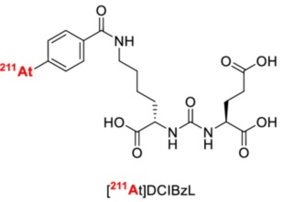




C
Strategies against dehalogenation
Guanidinomethyl functionalization
hemical Strategies to Improve Stability
Boron clusters
Neopentyl glycol scaffolds
Improved chelator design
Stronger C–halogen bonds
Aryl vs alkyl labeling
Protective formulation strategies
Radiohalogen complexation
Müller et al. 2025

Slide 48
A
dvances in Radiometal Labeling
Faster labeling kinetics
Lower temperatures
Higher molar activities
Improved compatibility with biomolecules

Slide 49
L
imitations of Radiometal-Based Systems
Chelator-dependent pharmacokinetics
Metal release in vivo
Limited radionuclide matching

Slide 50

W
hat is theranostics?
Combination of diagnosis and therapy
Shared molecular targeting vector
Enables patient selection and therapy monitoring
Cornerstone of precision nuclear medicine
Ayalew et al. 2025

Slide 51



R
¹⁸F
¹¹C
¹⁵O
¹³N
INFRASTRUCTURE
IBA Cyclone® 30XP; E = 15 - 30 MeV
Hot cells for radiochemical isolation
Clean room for radiopharmaceutical production
^{34m}Cl
⁶¹Cu
⁶²Cu
¹²⁴I
⁷⁷Br
^{94m}Tc
⁷³Se
³⁸K
²²⁵Ac
²¹¹At
^{193m}Pt
^{117m}Sn
adionuclide production at INM-5
$$Proton$$
...
...
$$Deuteron$$
$$Helium$$
Cyclone® 30 - 350:
Accelerated Ions: H⁻, D⁻, and ⁴He₂⁺
Extracted Ions: H⁺ (Proton), D⁺ (Deuteron), 4He₂⁺ (Alpha)
Extraction System: Carbon Foil Stripper Carousel
Guaranteed Extracted Current: 350 μA (H⁺), 50 µA (D⁺ and 4He₂⁺)
Energy: Adjustable from 15 to 30 MeV (Protons), 9 to 15 MeV (Deuterons), Fixed Energy at 30 MeV (Alpha)
Cyclotron Weight:
50 tons
Diameter:
2.9 meters
Height:
3.9 meters (Total)
Power Consumption:
~ 25 kW in Vacuum Standby
~ 90-110 kW at 30 MeV 350µA Protons in Dualbeam
~ 80 kW at 30 MeV 50 µA Alphabeam
Main Magnet:
45 tons of Steel
4 tons of Copper
10 kW Power in Coils
RF System:
Dee Angle - 30°
Power Loss per Dee – 10 kW
Frequency: 33 MHz (Fixed)
End Amplifier Stage – 40 kW
Ion Sources:
Multicusp
Discharge Power – 1 kW
ERC SuperNanogam
RF Power – 200 kW
RF Frequency – 14.5 GHz
Source Voltage – 10 to 30 kV
RESEARCH HUB
Radionuclide production
Radiopharmaceutical development program
Preclinical evaluation
Clinic – High-precision medicine
50

Slide 52


A
statine-211 for Alpha Therapy
High linear energy transfer (LET)
Short tissue range
Ideal for micrometastatic disease
Major challenge: bond stability
Mod. from Zhao & Liang 2025

Slide 53


R
Routes of radiometal ion loss in vivo
adiolabel Stability Challenges
In vivo dechelation (radiometals)
Dehalogenation (radioiodine, astatine)
Radiolysis
Off-target toxicity
Price & Orvig 2014

Slide 54


Pretargeted radioimmunotherapy of pancreatic cancer with [¹⁷⁷Lu]Lu-DOTA-PEG₇-Tz
P
retargeting in Therapy
Higher therapeutic index
Potential for α-emitters
Still under clinical development
Houghton et al. 2017

Slide 55

P
Common pretargeting strategies
retargeting Concept
Step 1: Inject targeting vector
Step 2: Clearance from background
Step 3: Inject radiolabeled small molecule
Click reaction at target site
Verhoeven et al. 2019

