Slide 1

The Key To Success:
How SMART_Labs enable a thriving Science Bridge
Ghaleb Natour, Forschungszentrum Jülich and RWTH Aachen University
September 07. 2026, GGSB, Tbilisi

Slide 2


Science bridges
Idea of the Science Bridges
The Georgian-German Science Bridge
The Palestinian-German Science Bridge
Cooperation with Afrika
SMART Labs
Main message

Slide 3
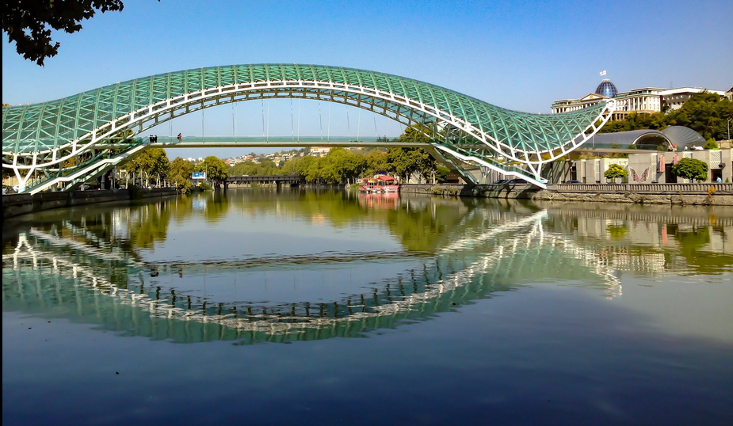
science bridges - the idea
Combining
strengths and needs of both sides of the bridge → creating sustainable cooperation
Opportunities and needs of research centers in Europe
world-class research infrastructure and need for young scientists
with
Highly motivated, theoretically trained young women and men in partner countries who often lack the opportunity to conduct experimental research.
→ Help establish opportunities for experimental research so that job opportunities for young scientists can be created in the partner country, Help sustaining excellent research

Slide 4
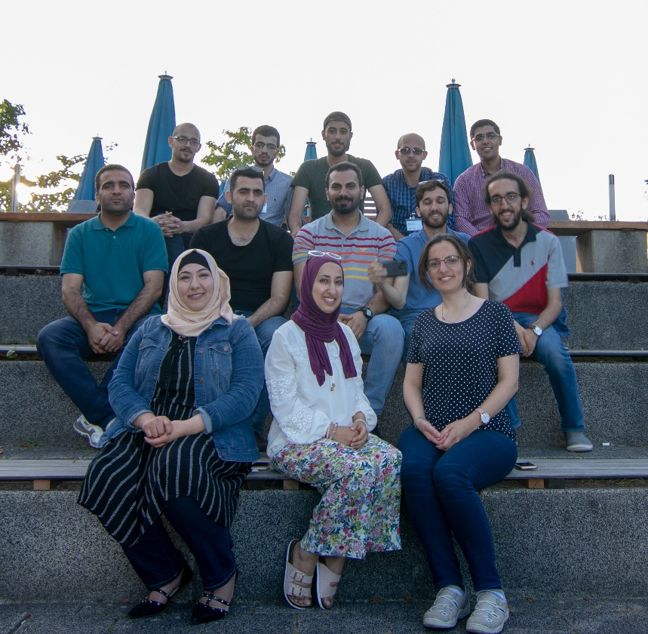
Science Bridges - Direct goals
Provide access for students and faculties to the scientific infrastructure in Germany
Support recruiting excellent students from universities of the partner country
(for research projects: BSc, MSc, PhD)
Develop long-term cooperations between scientists of both sides
Enable exchange, scientific stays, guest lectures, schools and workshops
Strengthen the development of (joint) graduate and research programs
Within the cooperation train young scientists on experiments
(e-microscopes, x-ray spectroscopy, HP computing, … )
Focus on clusters of topics relevant to the needs of the partner country
Students at the 3rd PGSB Cooperation Workshop in Jülich (2018), Source: Private

Slide 5


Georgian-German Science Bridge
since 2004

Slide 6
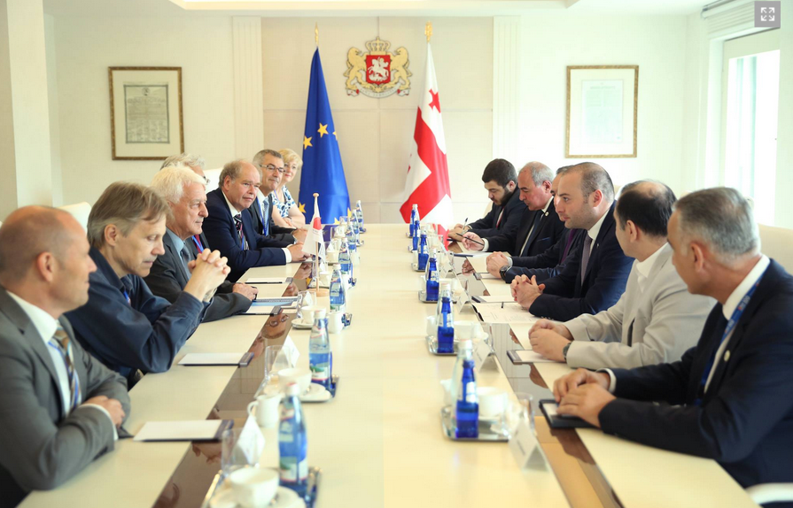
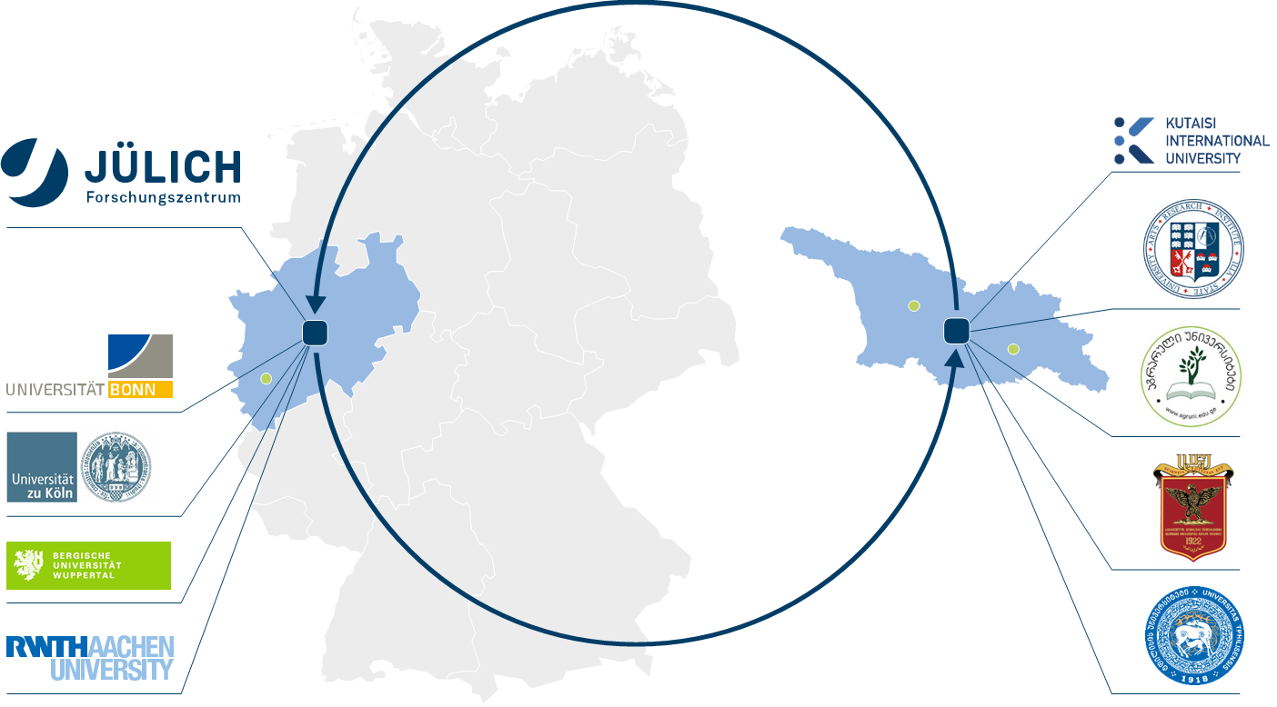
Georgian-German Science Bridge (GGSB) since 2004
Meeting with Georgian Prime Minister (2018)
Source: private
PARTNERs in Germany
Universities in Georgia
Forschungszentrum Jülich
and its partner universities:
RWTH Aachen University
University of Cologne
University of Wuppertal
University of Bonn
Tbilisi State University (TSU)
Georgian Technical University (GTU)
Agricultural University of Georgia (AUG)
Ilia State University (ISU)
Kutaisi International University (KIU)

Slide 7
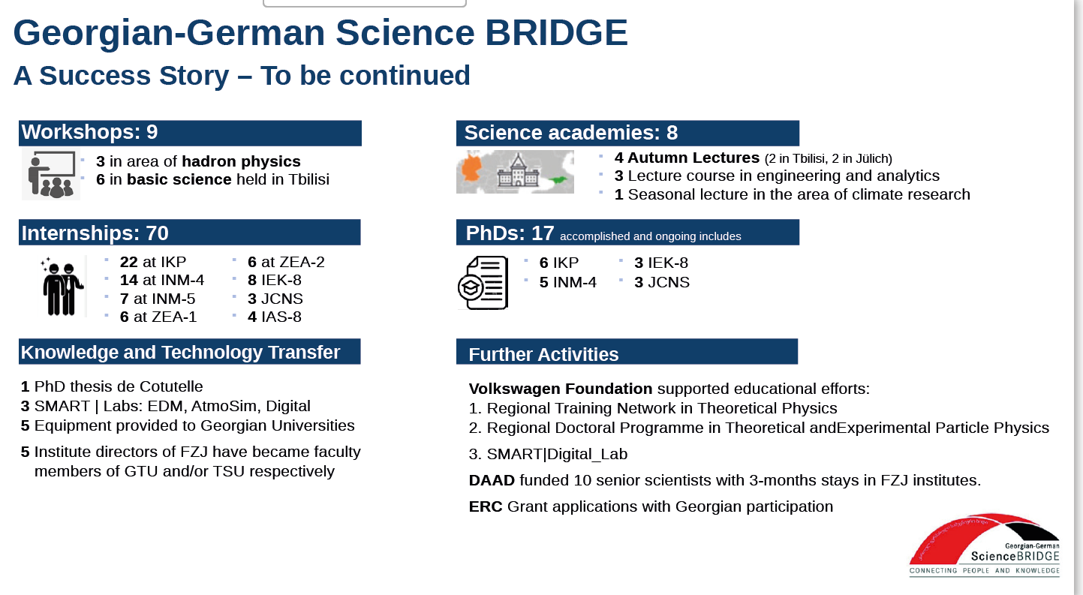
update 2026: 2 PhD, 2 Masters at ITE
From GGSB Brochure: Science Fest - The First 20 Years„ (September, 2024)
Five honorary doctorates awarded to German
scientists by AUG, GTU and TSU

Slide 8

Palestinian-German Science Bridge
PGSB
PGSB 3-2017 – 3-2025 – Pilot project, funded by BMBF
PGSB STRONG 7-2026 – 3-2034 – continued, funded by BMFTR
Strong= Strengthening
Sustainability of Technology/Training and Research creating Opportunities through Networking and Growth

Slide 9
PGSB Status of cooperation (March 2025)
> 100 fellows (BSc, MSc, ar. 50 PhD), 25 awarded PhDs - 50% female students
23 bilateral roadmaps, 7 research clusters
42 staff visits at FZJ (3 days to 10 weeks)
17 invitations to FZJ scientists to deliver lectures in Palestine
20 networking visits from students to home university per year
Trainings in science management & soft skills
Topical Workshops:
Bioelectronics
Health Science Simulations
Plant sciences
and Algae
Neuroscience Imaging
  IBI-3
  Pal Polyt. University
  IBI-7
  Birzeit University
  IBG-2
  Hebron University
  INM-4 Instituts at FZJ
  Al-Quds University

Slide 10
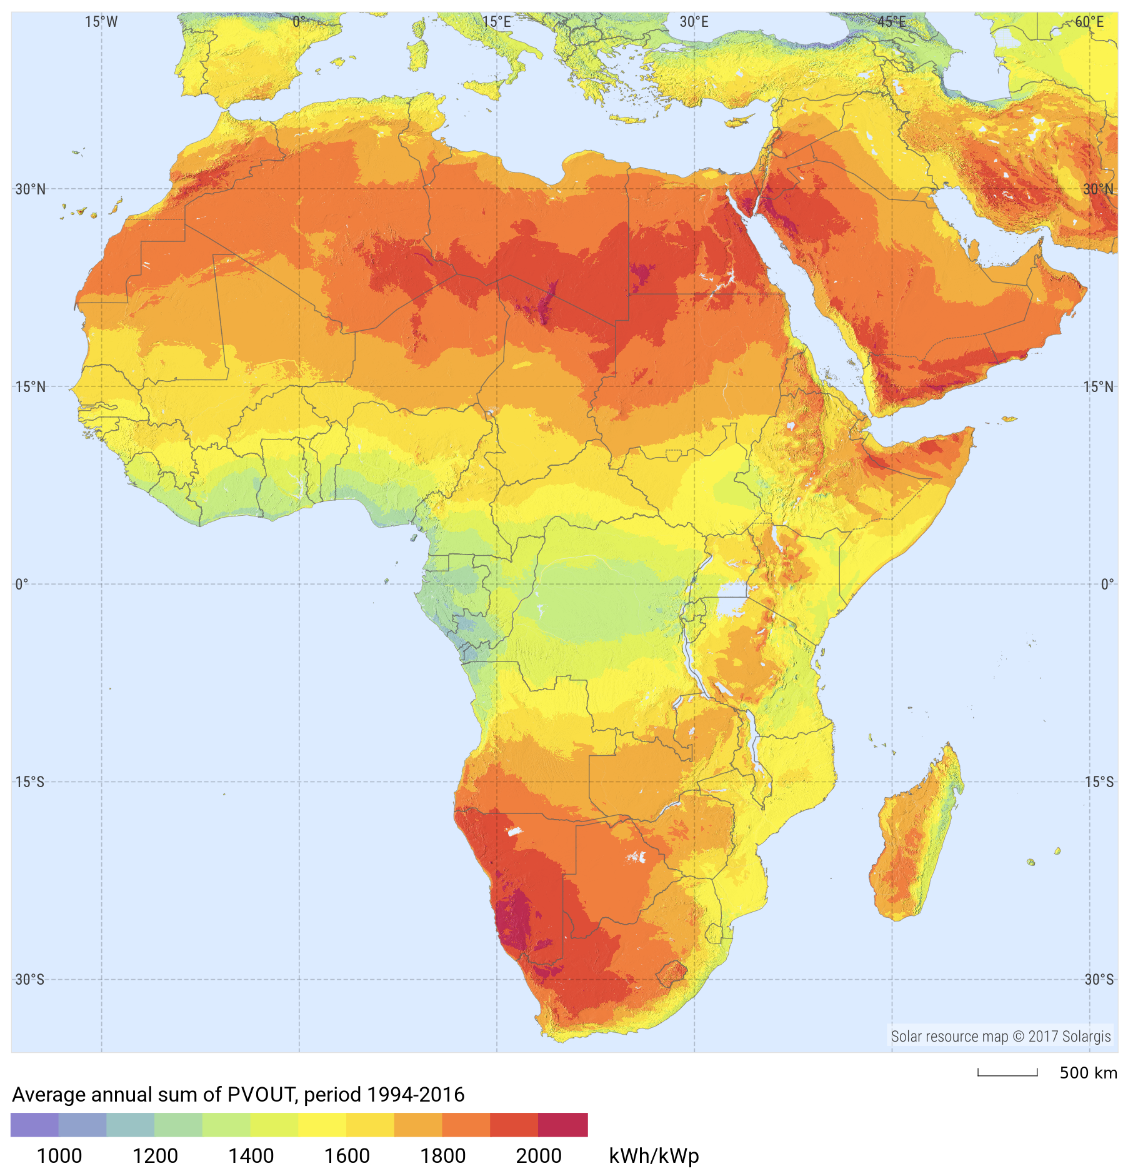
Collaborations with Africa
International MSc. Program: “Energy and Green Hydrogen“
WASCAL: West African Science Services Centre on Climate Change and Adapted Land use
H2-Atlas Afrika Projekt
Slide: FZJ-UE
Notes:
Kurz möchte ich die Aktivitäten mit den afrikanischen Ländern erwähnen
Wo FZJ und RWTH Aachen gemeinsam mit WASCAL West African Science Services Centre on Climate Change and Adapted Land use
Ein internationales Master Programm Energie und Grüner Wasserstoff

Slide 11

The Pillars
Research & Developmen
Education & Training
Transfer & Applikation
Joint Research
Cooperation in joint projects
Including BSc., MSc & PhD
Joint proposals for ext. funds
Scholarships for students
lectures and schools of scientists from both sides of the bridge
Joint degrees
Knowledge & technology
Alumni & SMART labs
Innovation
Experts and equipment

Slide 12
KNOWLEDGE TRANSFER
Science, Medicine, Applied Research, Technology
SMART|EDM_Lab
Matter/antimatter asymmetry of universe
Beam polarimetry
Technology: Detector/target design, electronics
Future focus: medical applications
Notes:
The four core pillars break down as follows:
Hier sind 2 Smartlabs genant mit 2 verschiedenne Themen Atmosphärenforschung und experimentelle Detektor technologie
Sie ermöglichen den jungen Wissenschaftlerinnen und Wissenschaftlrn Erfahrung in der Forschung in ihrem Land zu sammeln
Idealerweise haben sie vorher in Jülich die Apparatur oder den Smart Lab kennengelernt, bevor es in die Heimat Uni transferiert wird, wo sie darum z.B eine Forschungsaktivität aufbauen können

Slide 13
KNOWLEDGE TRANSFER
Science, Medicine, Applied Research, Technology
SMART|Biomarker_Lab
SMART|Biomedical Imaging_Lab
SMART|AtmoSim_Lab​
Notes:
The four core pillars break down as follows:
Hier sind 2 Smartlabs genant mit 2 verschiedenne Themen Atmosphärenforschung und experimentelle Detektor technologie
Sie ermöglichen den jungen Wissenschaftlerinnen und Wissenschaftlrn Erfahrung in der Forschung in ihrem Land zu sammeln
Idealerweise haben sie vorher in Jülich die Apparatur oder den Smart Lab kennengelernt, bevor es in die Heimat Uni transferiert wird, wo sie darum z.B eine Forschungsaktivität aufbauen können

Slide 14
KNOWLEDGE TRANSFER
Science, Medicine, Applied Research, Technology
SMART Engineering Lab
(Mechanical) Engineering Methodes
Development and construction of scientific instruments and systems
Layout, design, numerical simulations and calculations
Measurement technologies
Manufacturing technologies
Focus, miniaturisation, cryogenics, ultra high vacuum
Automation and control
…
Based on the experience at the Institute of Technology and Engineering (ITE) and other partners
Notes:
Hier sind 2 Smartlabs genant mit 2 verschiedenne Themen Atmosphärenforschung und experimentelle Detektor technologie
Sie ermöglichen den jungen Wissenschaftlerinnen und Wissenschaftlrn Erfahrung in der Forschung in ihrem Land zu sammeln
Idealerweise haben sie vorher in Jülich die Apparatur oder den Smart Lab kennengelernt, bevor es in die Heimat Uni transferiert wird, wo sie darum z.B eine Forschungsaktivität aufbauen können

Slide 15
KNOWLEDGE TRANSFER
Science, Medicine, Applied Research, Technology
SMART DataLab
Management of scientific data
FAIR; Findable, Accesssible,Interoperable,Reusable
Data acquisition
Human Machine Interface
Measurement technologies
Use of AI
HPC
…
Based on the experience at the Institute of Technology and Engineering (ITE) and other partners
Notes:
Findable: Data must have rich metadata and be assigned a globally unique, persistent identifier (like a DOI) so it can be easily located in searchable resources. [1, 2]
Accessible: Data and metadata must be retrievable via standardized protocols, ensuring authentication and authorization procedures are clear. [1, 2, 3, 4]
Interoperable: Data should use a formal, shared language and standardized vocabulary so it can be readily integrated with other datasets and applications.
Reusable: Data must be well-described with accurate attributes, released under clear usage licenses, and associated with detailed provenance so it can be replicated and repurposed

Slide 16
KNOWLEDGE TRANSFER
Science, Medicine, Applied Research, Technology
SMART any other advanced experiment
Experimental set up
REM,TEM, AFM
X-ray diffraction
surface treatment technologies (spiuttering, CVD,…)
Analytics equipment (water, soil chemical analysis)
Measurement technologies
Automation kits, robot teacing/programming
Manufacturing technologies, Laser machining, spark erosion etc..
…

Slide 17
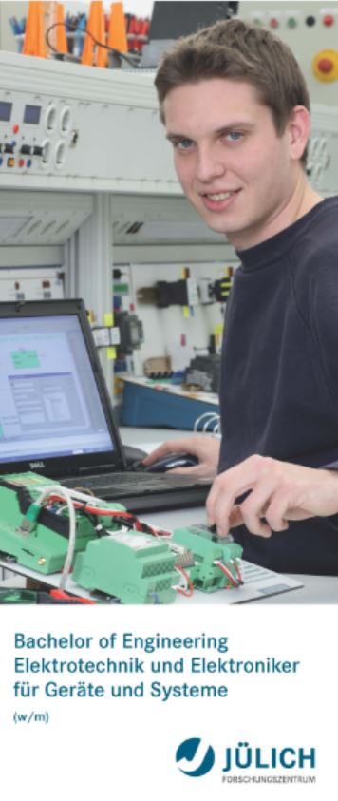
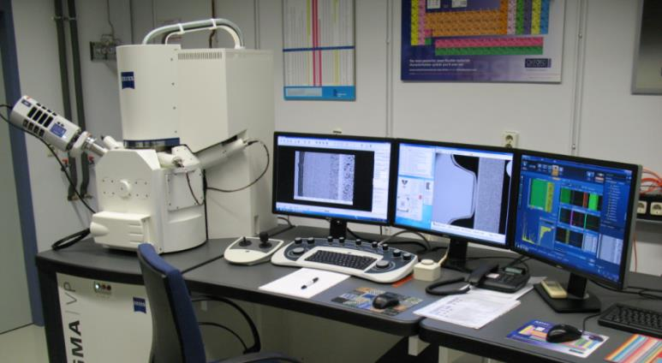
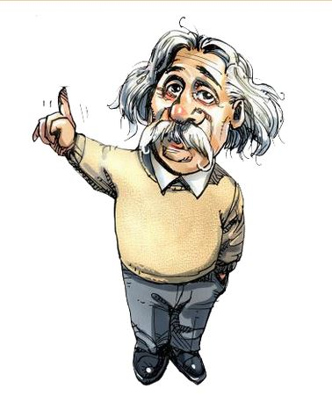
What is needed for excellent scientific research
Creative scientists
Technical equipment and instrumentation (research infrastructure)
Technical professionals (dual studies programs)
Ecosystem enabling & encouraging research (political and institutional)

Slide 18
Challenges
Focus on Returners
Prevent brain drain!
Organize the absorption and the integration of the fellows
Train/educate fellows to researchers (not only teaching staff)
Enabling fellows to write proposals and apply/receive for funds
Offer adequate positions in local universities and research institutions
Strengthen the established cooperations and make them sustainable
If the above mentioned fails, the science bridges will only have contributed to increase the number of jobless academics

