Slide 1
Research for the World of Tomorrow
The Helmholtz-Zentrum Dresden-Rossendorf
GGSB 2026 – Opportunities & Grand Challenges at HZDR
Sebastian M. Schmidt · Scientific Director HZDR

Slide 2




Helmholtz Association
Large Research Infrastructures
German Research Landscape
Universities
Leibniz Association
Basic and Applied Research
Other
The Fraunhofer-Gesellschaft
- Applied Research -
Max Planck Society
Fundamental Research
Industry

Slide 3
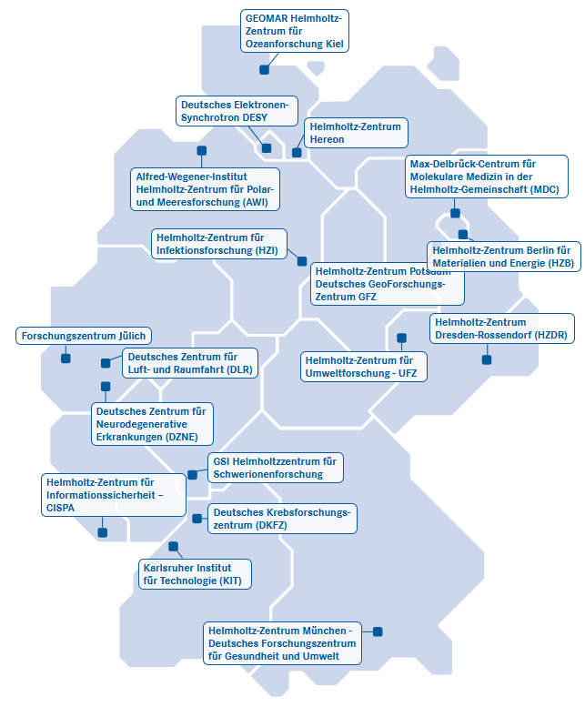
HZDR
Member of the Helmholtz Association
Created in 1995
18 autonomous Helmholtz Centers
Total annual budget of 5 billion euros
Around 46.000 employees
Annually around 2.000 joint projects with business enterprises
6 research fields:
  Energy
  Earth & Environment
  Health
  Aeronautics, Space and Transport
  Matter
  Information

Slide 4




HZDR
Member of the Helmholtz Association
Forschungszentrum Jülich (FZJ)
Helmholtz-Zentrum Dresden-Rossendorf (HZDR)
GSI Helmholtzzentrum für Schwerionenforschung

Slide 5

Helmholtz Association
Research Fields

Slide 6






Helmholtz Association
Research Fields

Slide 7
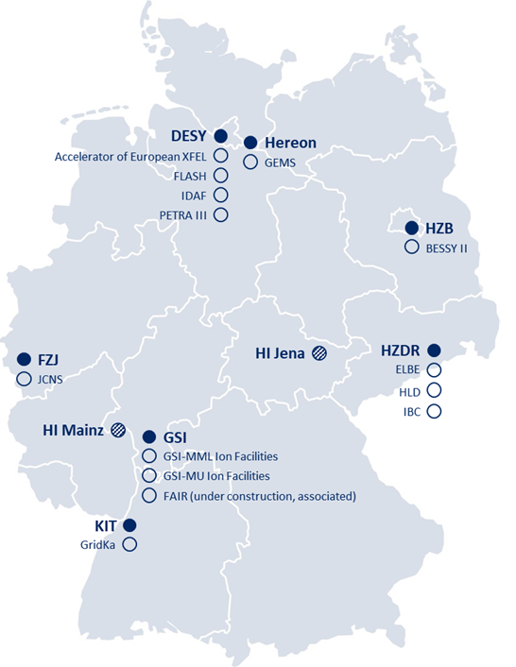







Helmholtz Matter
Seven centers
Total budget
770 M€/a
Personnel
2,750 FTE
8,000 user/a of world-class large-scale user facilities

Slide 8





















Cooperation is key
National
International
Universities
Innovation pool:
Joint project funding with BMFTR
Non-university research organizations
Industry

Slide 9
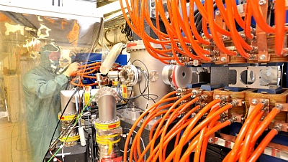
Helmholtz Matter – Mission
Make critical contributions to solving grand and future challenges
Exploring Matter & Universe: From quantum to cosmos
Addressing Global Challenges: Climate, energy, resources, health, education
Operating Unique Research Infrastructures: For science, industry & partners
Fostering Transfer & Talent: Innovation, collaboration, technological sovereignty

Slide 10
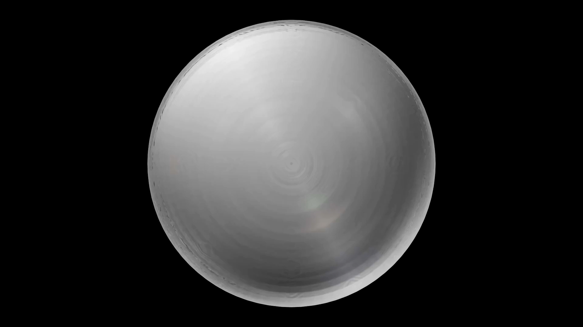

Slide 11
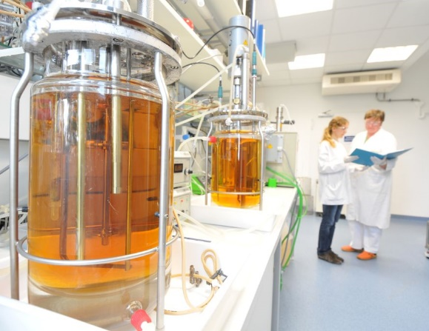
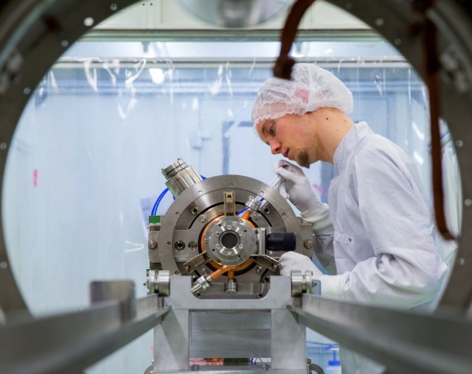

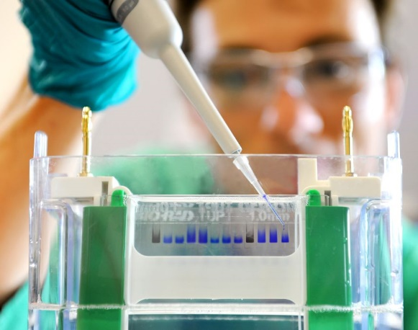





HZDR
Application-oriented Basic Research
The HZDR faces the grand challenges of our time by providing knowledge and technologies for the next generations in order to:
… develop radiation based diagnostic and therapeutic methods to combat cancer
Energy
… support the transition to sustainable industry through resource and energy efficiency, and
Matter
… research future materials and technologies under extreme conditions and develop them to the point of application.
Health
Complex research infrastructures
Close collaborations in science & industry
International Talents

Slide 12







HZDR
Facts & Figures
Research Site
Personnel
since 1956
Federal Republic and State of Saxony (90:10)
1.500 Total
700 Scientists
40 Professors
300 PhDs (100 external)
35 Apprentices
70+ Nationalities
Statistics
800 Publications
30 Nature-Publications
9 ERC-grants since 2021
4 Spin-Offs since 2021
19 Young Inv. Groups
Budget
ca. 140 Mio. €
ca. 60 Mio. € 3rd party funding
Locations
Dresden
Freiberg
Görlitz
Leipzig
Transfer
Grenoble (ESRF)
Schenefeld (XFEL)
Rostock
Entrepreneurship company
Revenue: 10 Mio. €/year

Slide 13
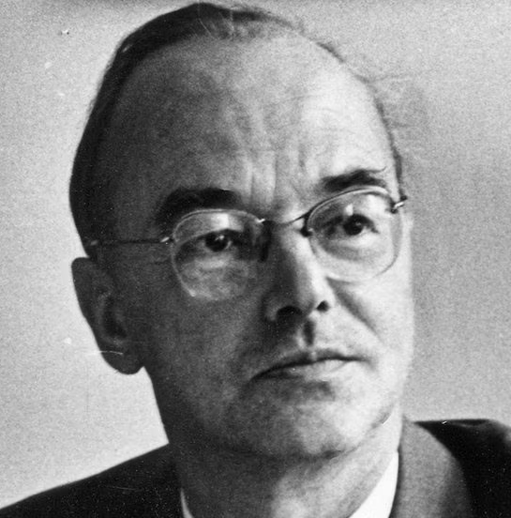

HZDR
Facts & Figures
Research Site
Personnel
since 1956
Federal Republic and State of Saxony (90:10)
1.500 Total
700 Scientists
40 Professors
300 PhDs (100 external)
35 Apprentices
70+ Nationalities
Statistics
800 Publications
30 Nature-Publications
9 ERC-grants since 2021
4 Spin-Offs since 2021
19 Young Inv. Groups
Budget
ca. 140 Mio. €
ca. 60 Mio. € 3rd party funding
Locations
Dresden
Freiberg
Görlitz
Leipzig
Transfer
Grenoble (ESRF)
Schenefeld (XFEL)
Rostock
Entrepreneurship company
Revenue: 10 Mio. €/year

Slide 14
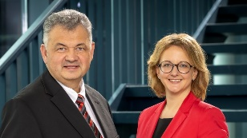

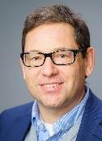
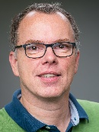
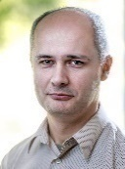
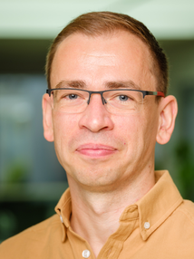
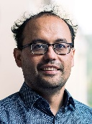
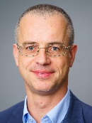

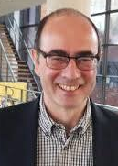
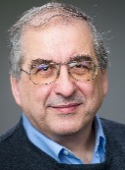
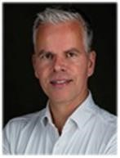
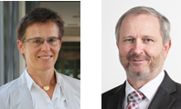
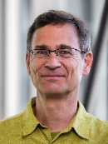
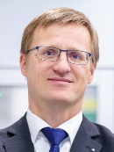

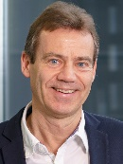
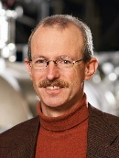
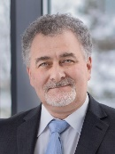


HZDR
Supervisory Board
Michael Zimmermann
Dr. Babett Gläser
Scientific Advisory Board
Prof. Ralph Aßmann
Board of Directors
Prof. S. M. Schmidt
Dr. D. Stiller
Institutes & Central Departments
ENERGY
MATTER
HEALTH
Institute
Resource Ecology
Prof. T. Stumpf
Ion Beam Physics and Material­s Research
Prof. J. Fassbender
Theoretical Physics
Prof. R. Schützhold
Radiooncology
– OncoRay
Prof. Ch. Richter
Prof. T. Kühne
CASUS
Center for Advanced Systems Understanding
HI Freiberg for Resource Technology
Prof. J. Gutzmer
High Energy Density Physics
Prof. D. Kraus
Prof. R. Redmer
Dresden High Magnetic Field Laboratory
Prof. J. Wosnitza
Radio­pharma­ceutical Cancer Research
Prof. K. Kopka
Fluid Dynamics
Prof. K. Eckert
Prof. U. Hampel
Radiation Physics
Prof. U. Schramm
Departments
Information Services and Computing
Dr. U. Konrad
Research Technology
Prof. P. Kaever
Technical Services
D. Reichelt
Chief Innovation & Transfer Officer
Dr. B. Wolf
Finance B. Gilge
Personnel
Affairs
Procurement F. Steiniger
CITO
Adminis-tration
Dr. H. Groß

Slide 15

HZDR
Research Infrastructure at seven locations
Schenefeld
Rostock
Leipzig
Görlitz
Freiberg
Grenoble

Slide 16
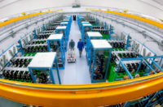

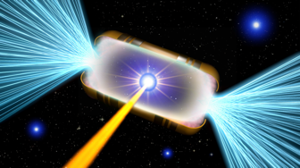

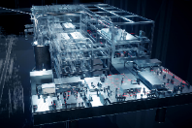
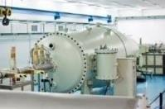

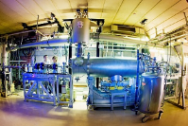
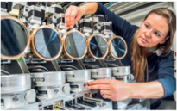


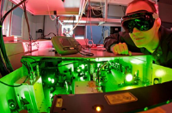
HZDR
Research Infrastructure at seven locations
HEDi
High Magnetic Field Laboratory Dresden
Schenefeld
Rostock
Helmholtz International Beamline for Extreme Fields @ European XFEL
Ion Beam Center
Leipzig
Görlitz
Freiberg
Photon and particle source
~ 1200 user/a
Rossendorf Beamline @ ESRF
Grenoble
DRACO & PENELOPE.
High-power Laser-particle Acceleration

Slide 17
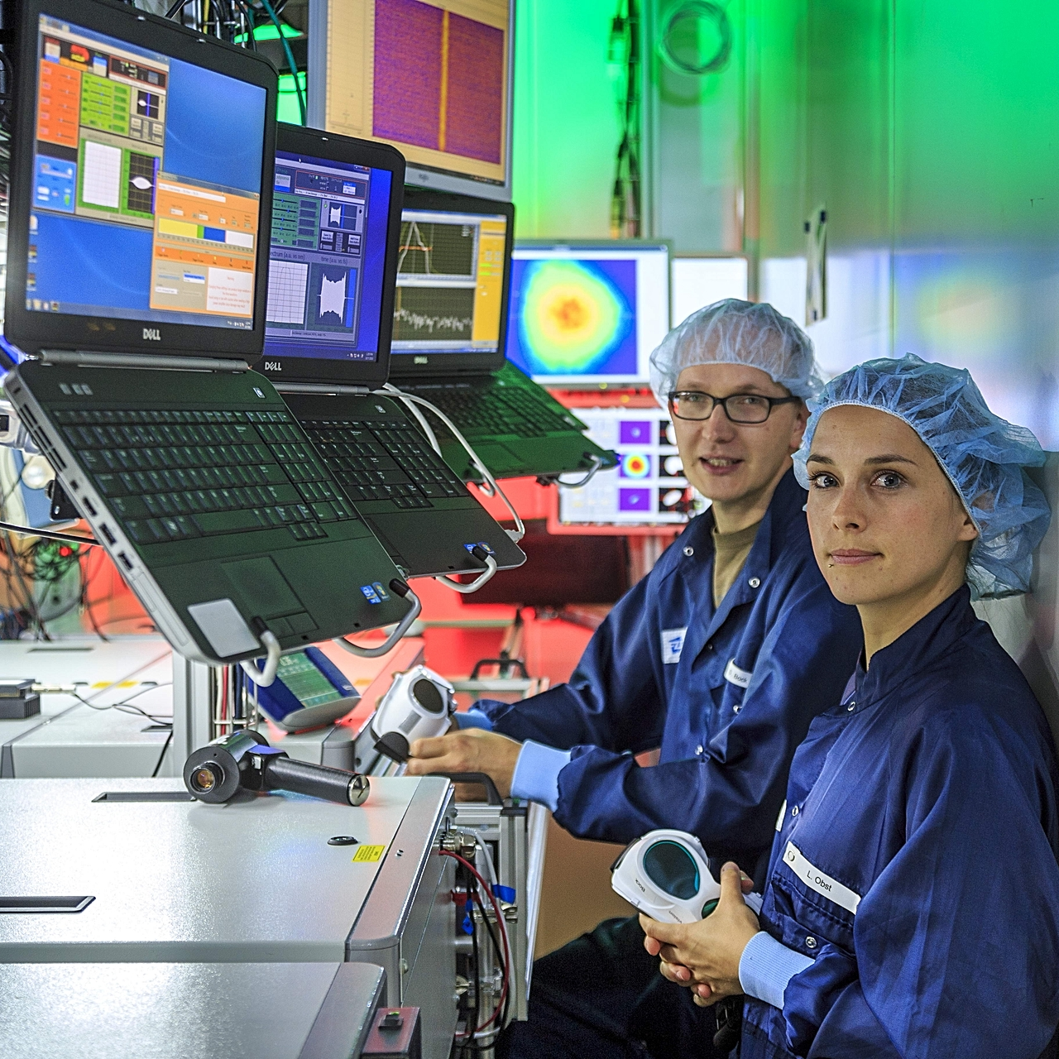
Research Field Health
Radiation Based Cancer Research
Development of Radiopharmaceuticals
Development of new imaging methods (PET, MRT)
Collaboration with Hospitals, Radiation Therapy (300 patients/year)
Digital health incl. big data analytics and socio-economic effects

Slide 18
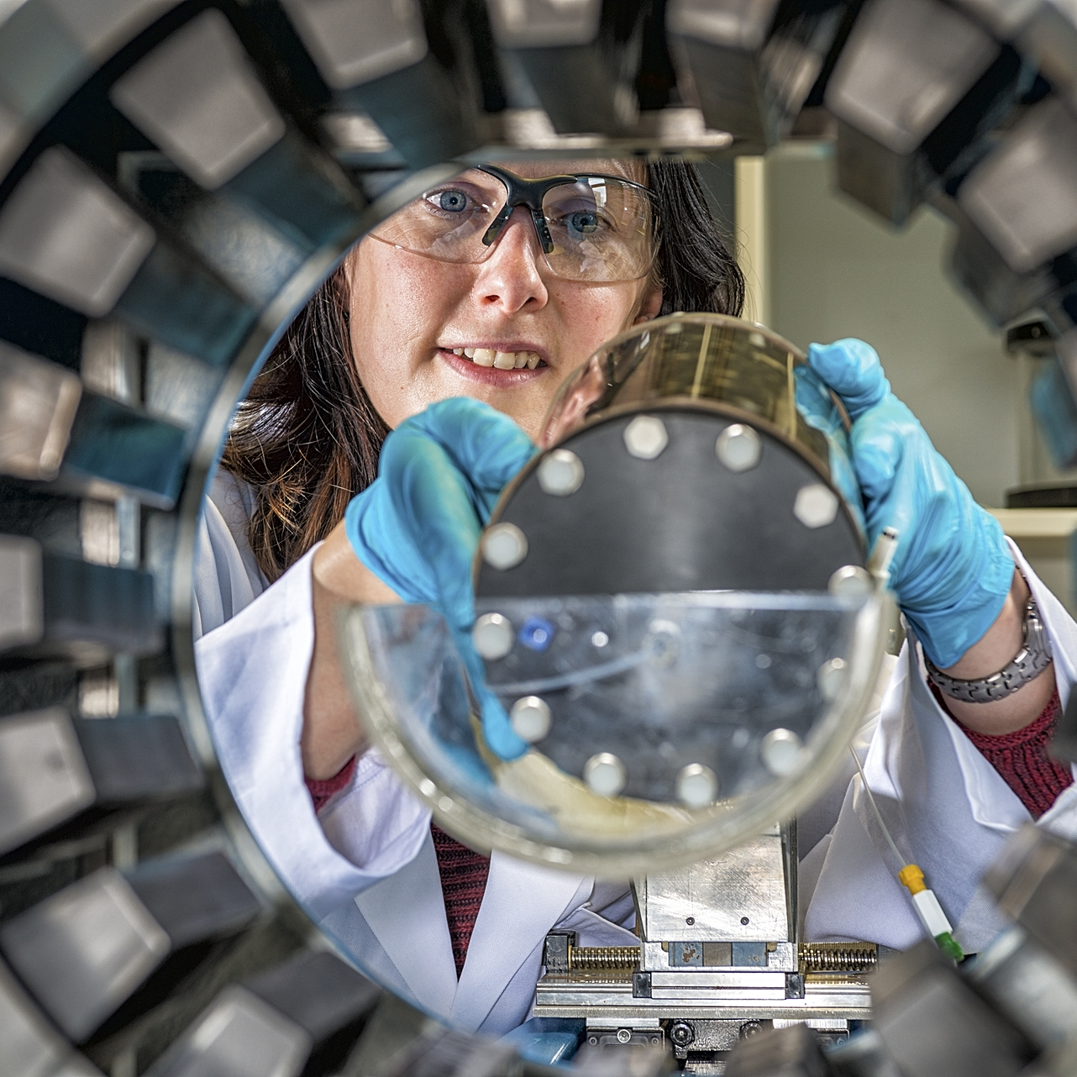
Research Field Energy
Resources & Energy
Resource and energy efficiency
Multi-method approach to sustainable circular economy
Radioecology for nuclear waste disposal and radiochemistry
Maintenance expertise in reactor safety

Slide 19
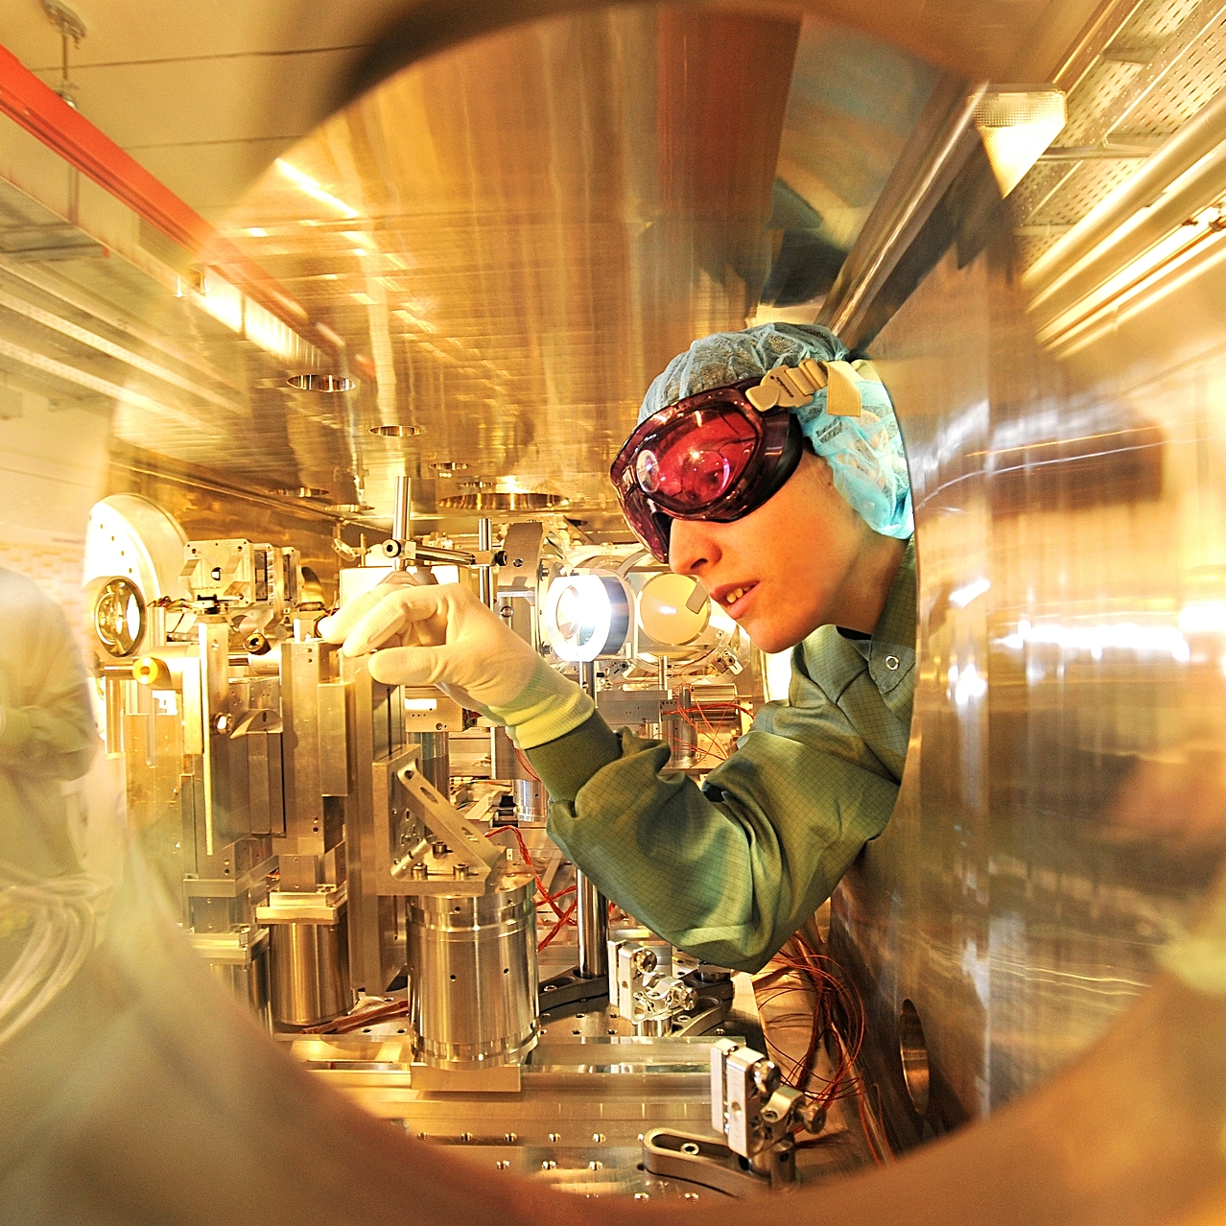
Research Field Matter
Extreme Conditions
Matter under extreme conditions
    High magnetic fields
    Intense laser pulses
    Strong fields, e.g. terahertz range
High energy density including laser fusion
Quantum-controlled properties of matter
Development of new accelerator concepts and facilities
Operation of user facilities (~ 1,200 users)

Slide 20
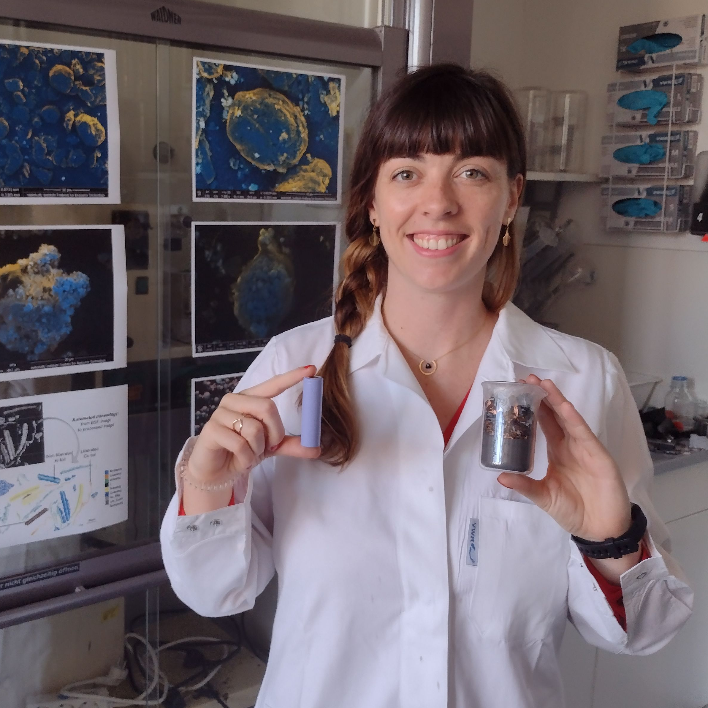
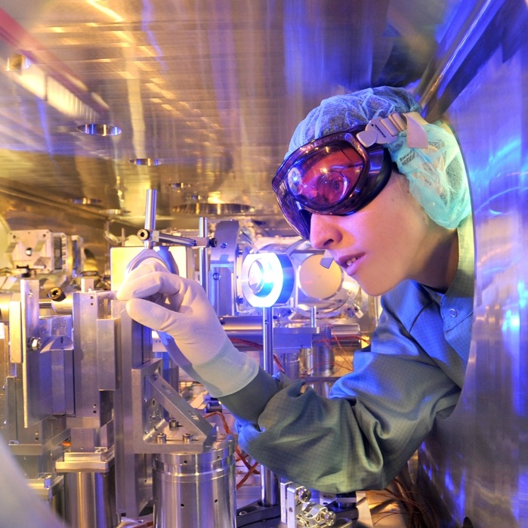
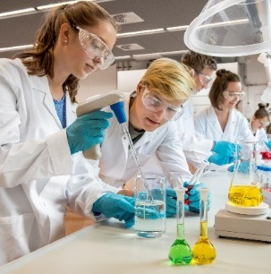
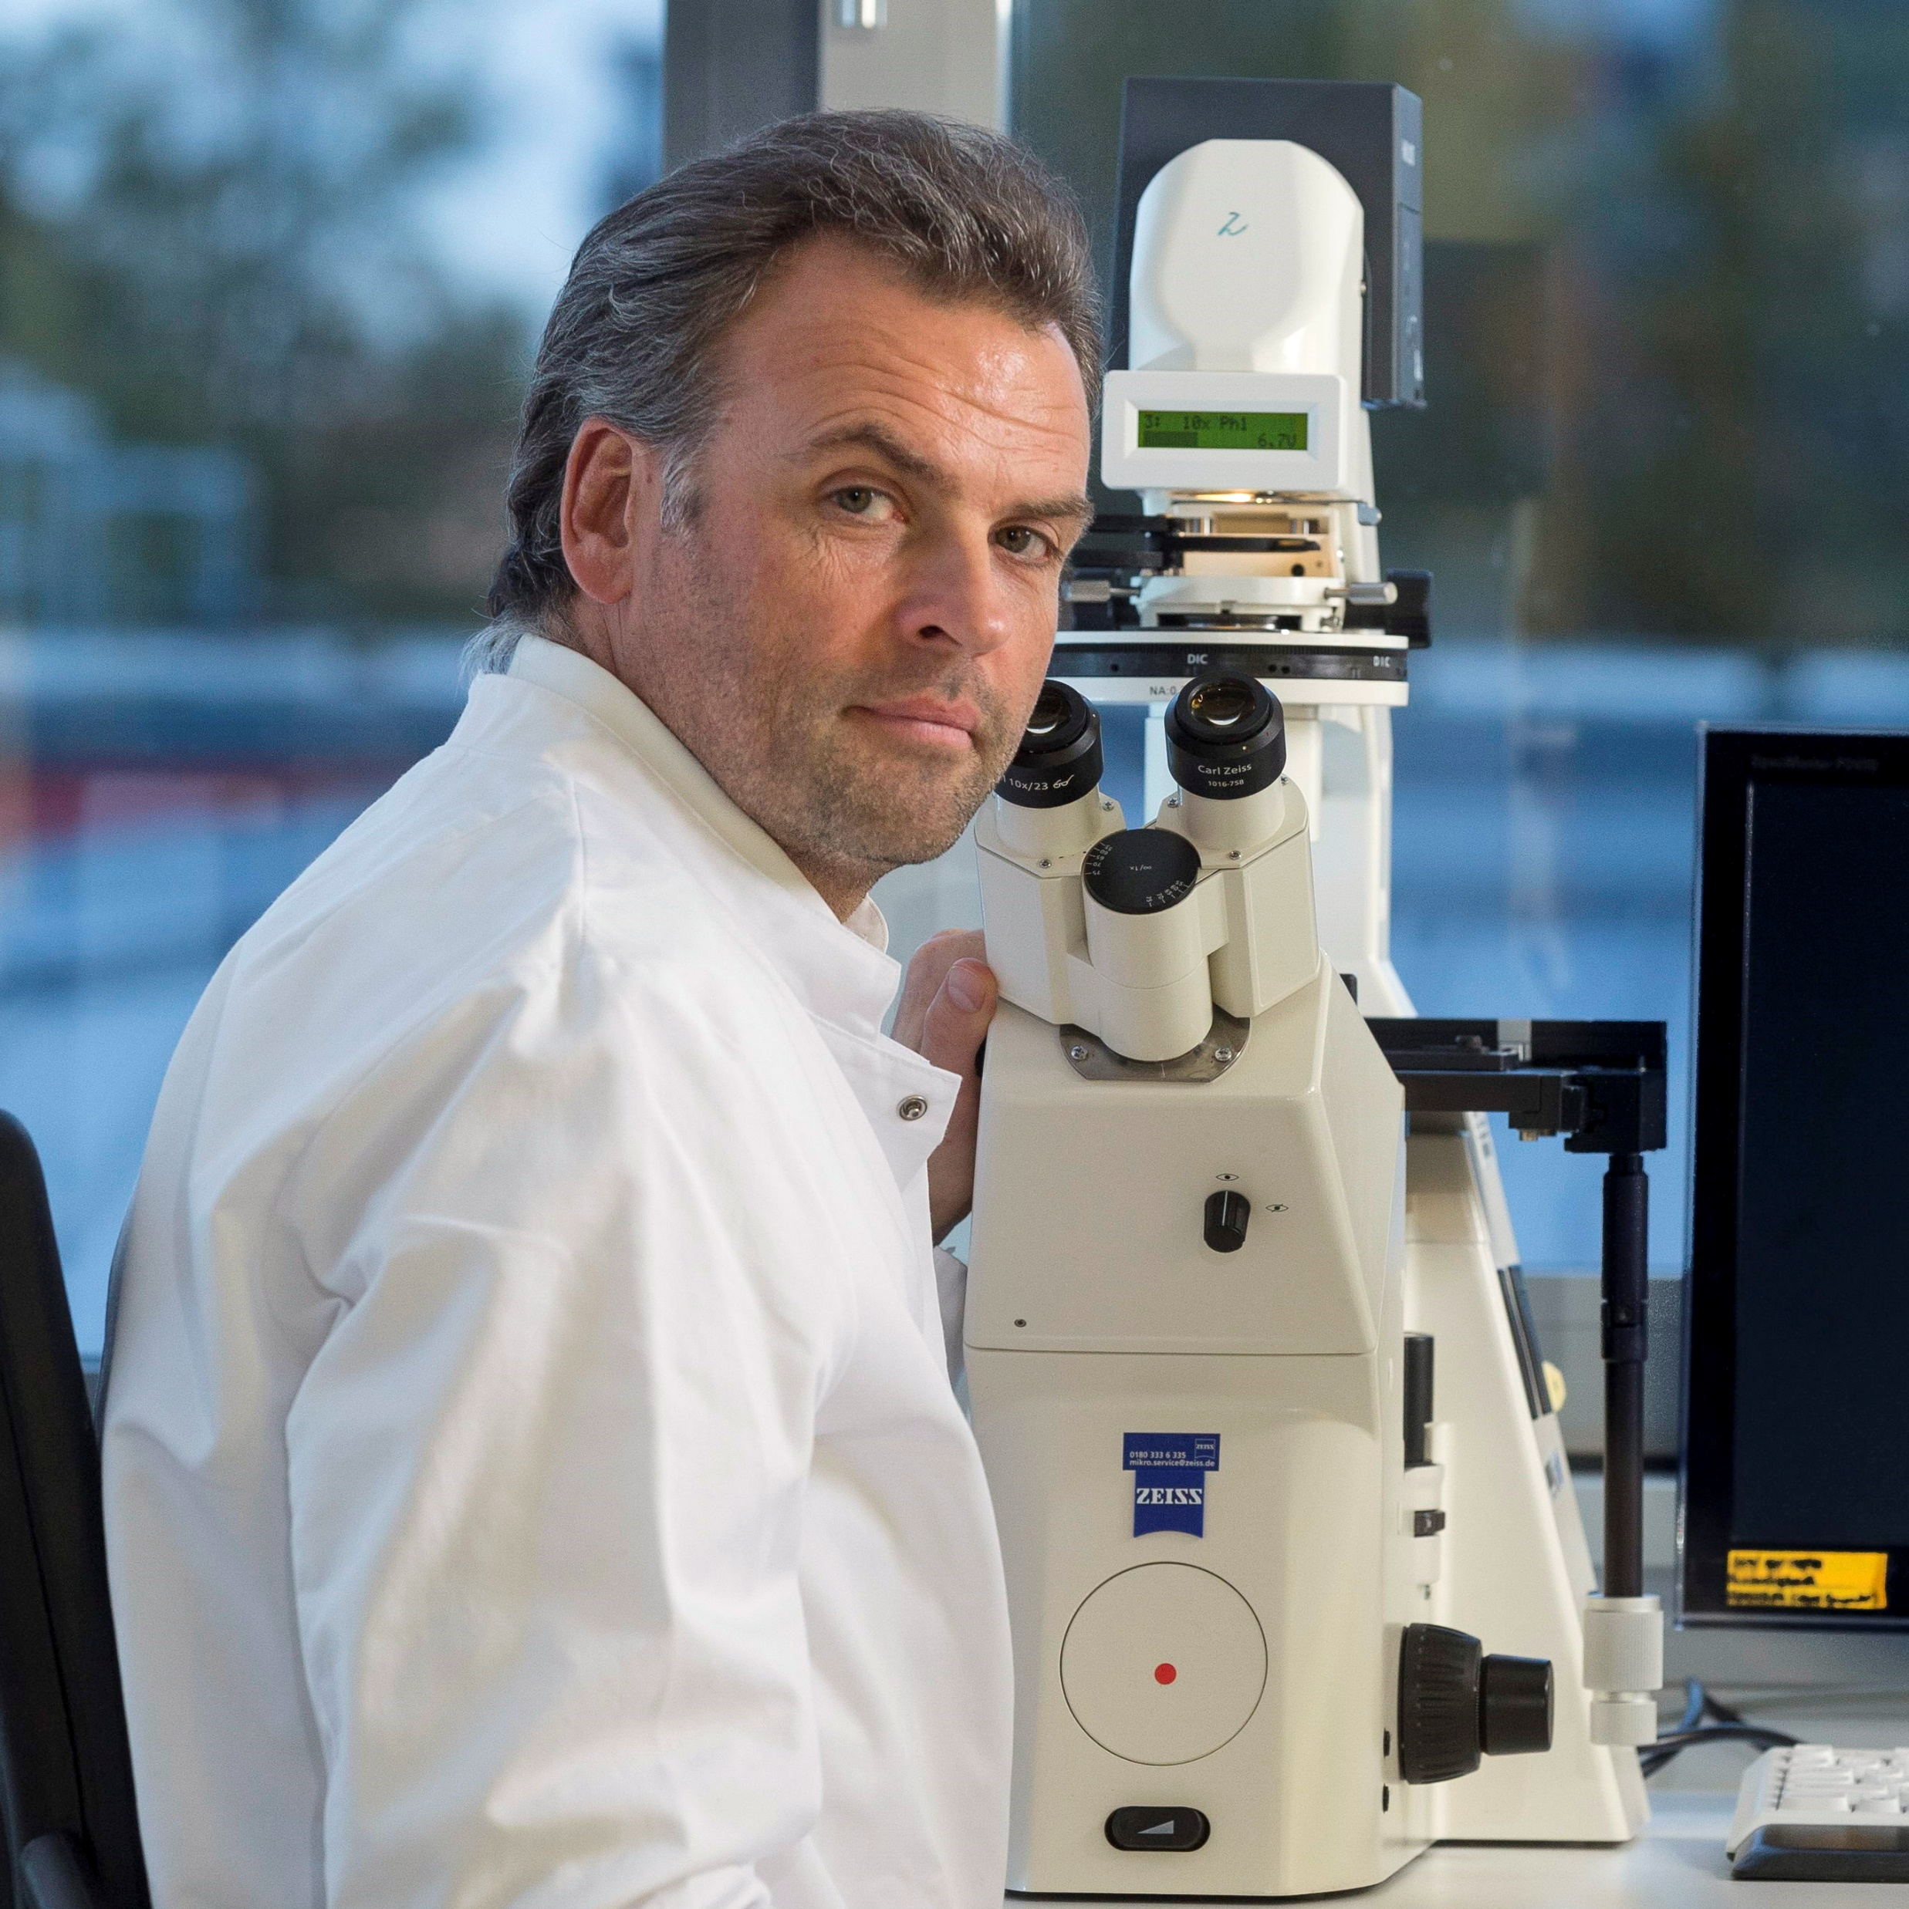
Talent Management
Promoting Excellence in Research
Career Center for Doctoral Researchers & Postdocs
Young Investigator Groups
High Potential Program
@HZDR
PhD Students
Postdocs
PhD Students
Postdocs
Young
Investigators
Young
Investigators
School Students
University Students
Apprentices
School Students
University Students
Apprentices
Scientists
Senior Scientists
Curiosity about Science
School lab „DeltaX“
Vocational Training & Dual Study Programs
Summer Student Program
Maintaining Competences
Joint appointments
Helmholtz, Senior & Bridge professorships
Mentoring programs
Attracting Talents
Keeping in Touch
20
Notes:
Einleitung in die Folie kürzer oder klick HIERHIN später

Slide 21








Talent Management
@HZDR
PhD Students
Postdocs
Young
Investigators
7
School Students
University Students
Apprentices
Scientists
Senior Scientists
Talent Management
Throughout the Entire Scientific Career
Attracting Talents
Keeping in Touch
21

Slide 22
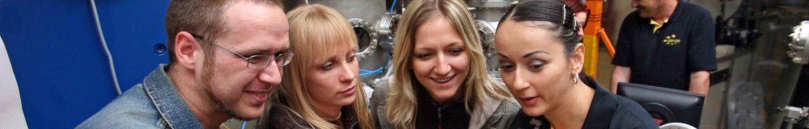

HZDR – Summer Student Program
Project and Lectures
Matching between applications and research projects
Lecture series provides insight into research @ HZDR
Accomondation and flights are covered
Who can apply?
All advanced undergraduate or master students of natural sciences (physical and life sciences) or related areas
When?
6 weeks in July - September 2027
Applications
Until February 2027
Notification of acceptance: April 2027
Contact
Yvonne Matthes - summer@hzdr.de
More
https://www.hzdr.de/summer
Notes:
Mental Care einfügen? („Personal support“?)

Slide 23

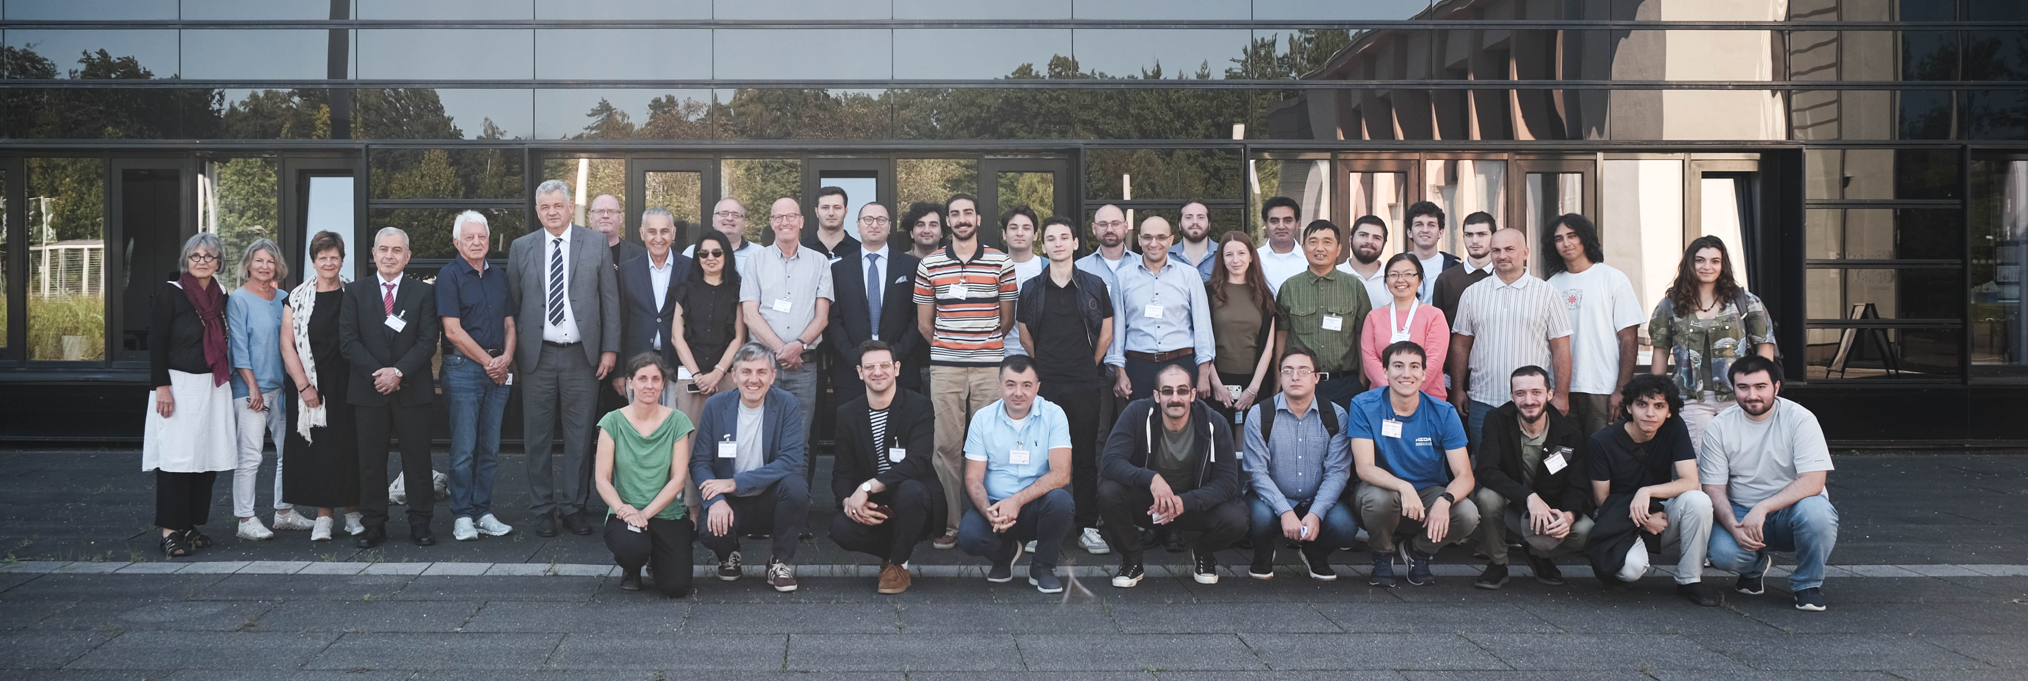





Joint Projects
2 PhDs on Magnetohydrodynamics
1 Master on Magnetohydrodynamics
Internships: 2x research technique
radiopharmacy
radiation based cancer research
Open for new projects

Slide 24
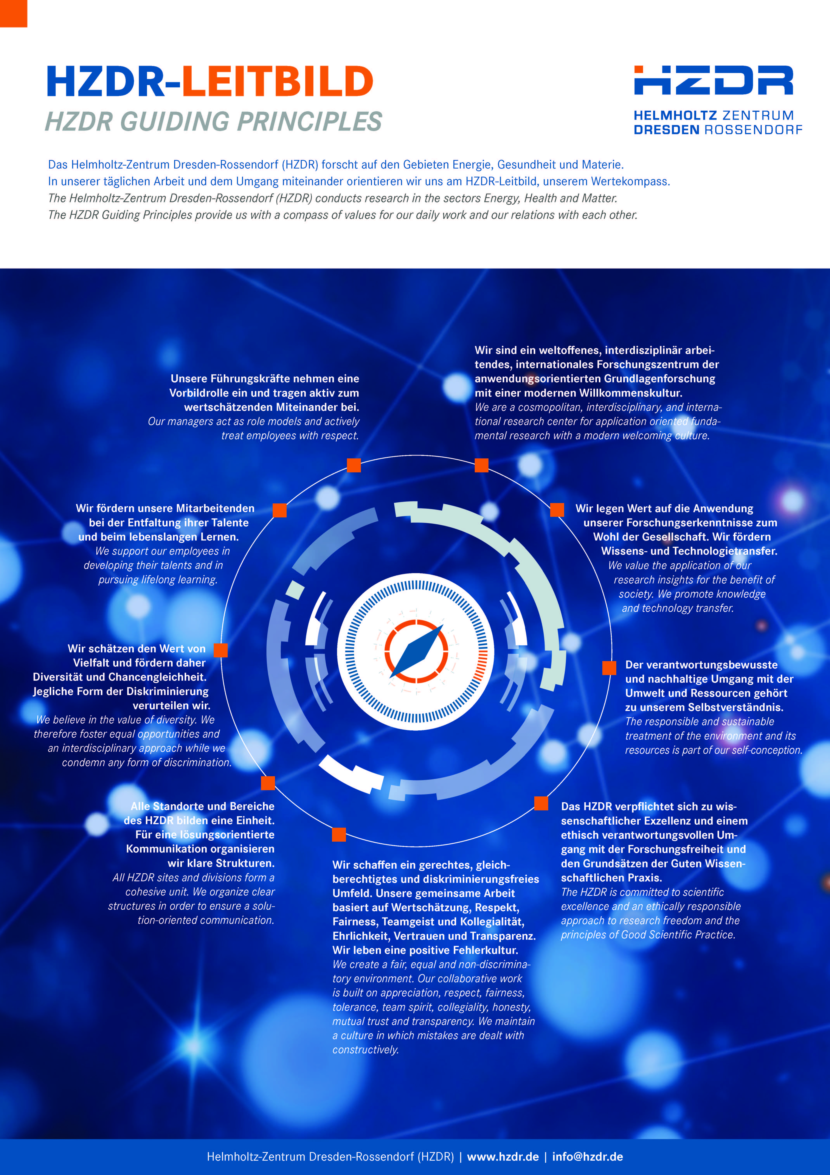
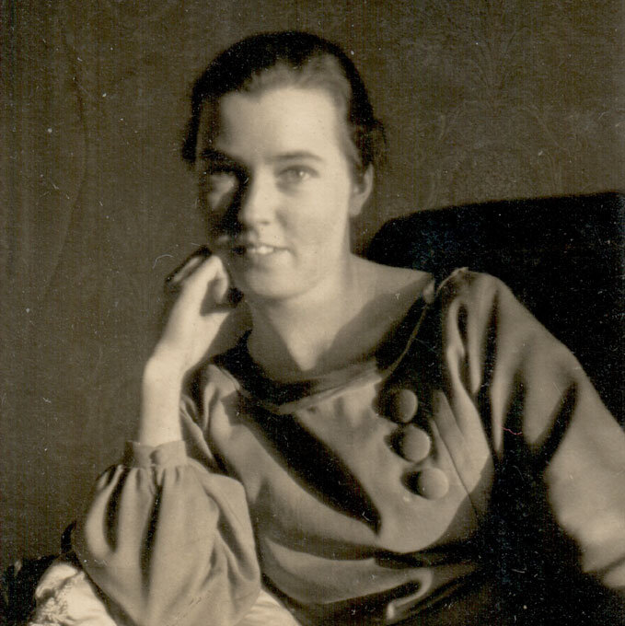


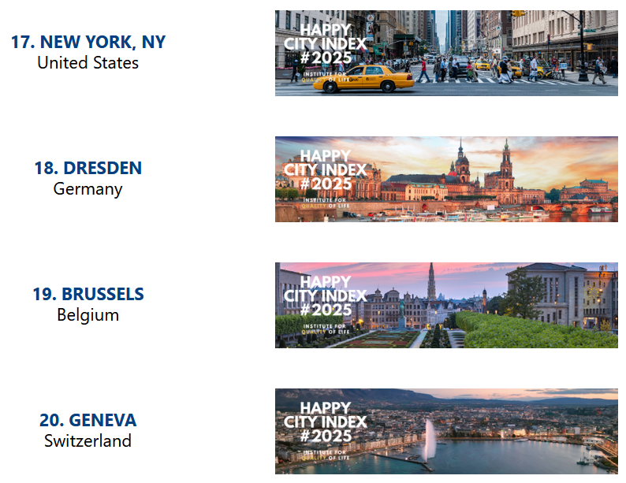

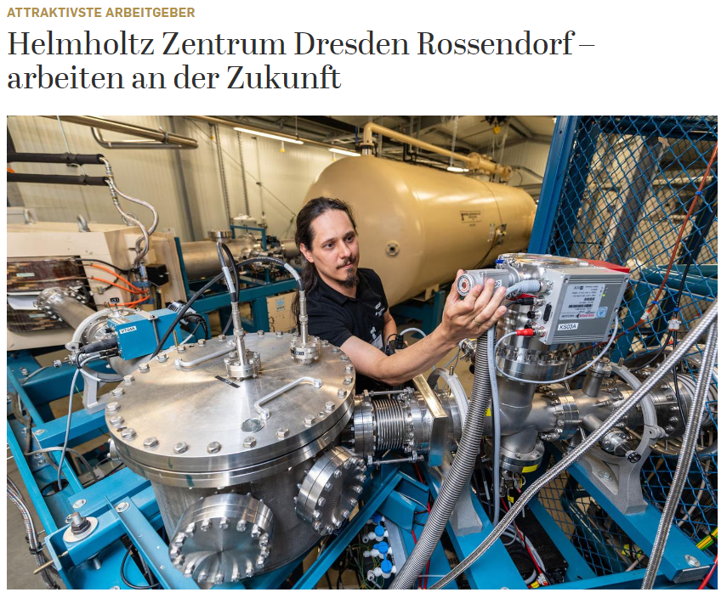
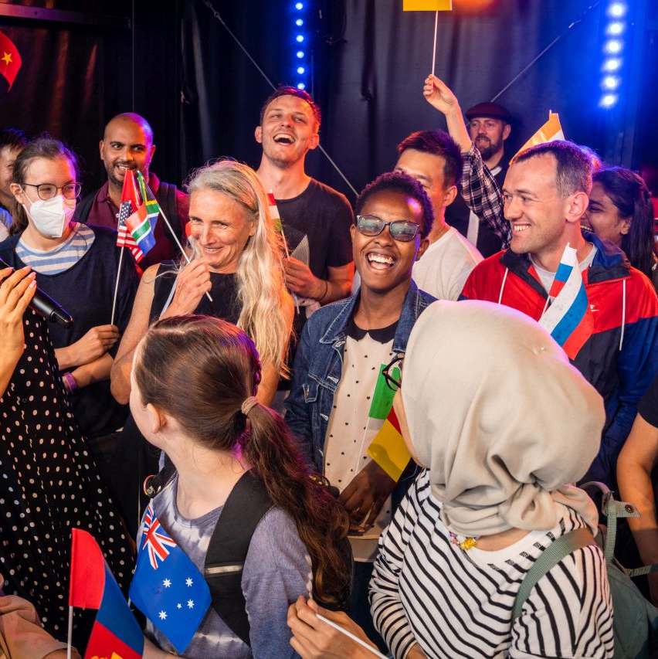

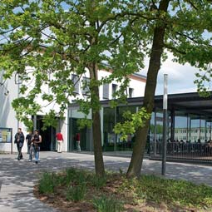

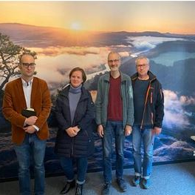
A Place to Be – Defining Values Together
Lucy-Mensing fund
Vocational training
Helmholtz Zentrum Dresden-Rossendorf
- Working for the future
Diversity
Work-Life Balance
Sustainable campus development
Room of silence

Slide 25

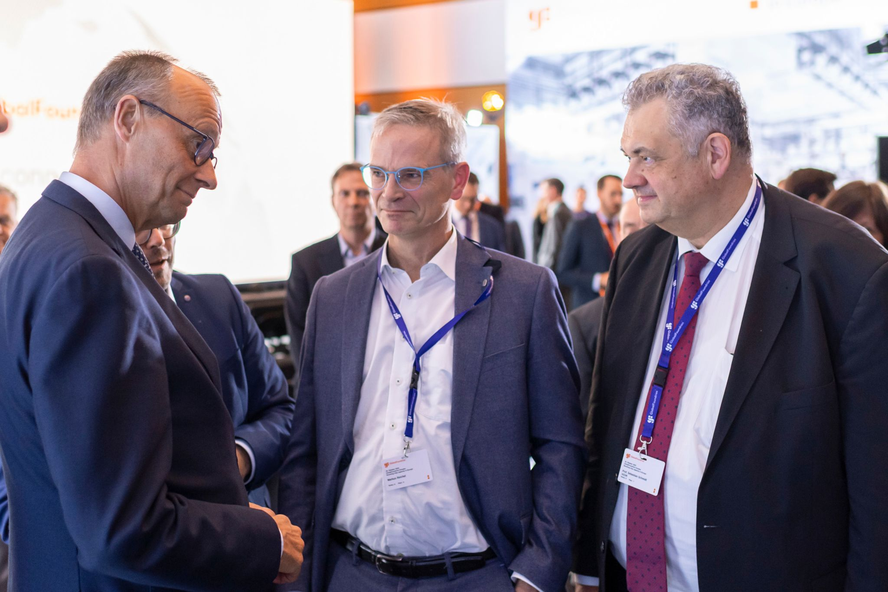
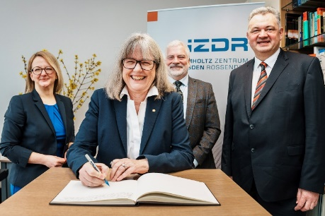
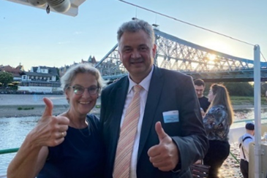







Impressions
25
25
Notes:
25

Slide 26






