Slide 1






Short review of the
Agricultural University of Georgia (AUG)
Free University of Tbilisi (FUT)
and the workshop program
Zaza Metreveli
Dean of the School of Engineering, Director of the Institute of Engineering (AUG)
September 7, 2026

Slide 2
Outline
About us:
- Agricultural University of Georgia (AUG) and the
- Free University of Tbilisi (FUT)
- Educational Programs
- Research Institutes
- Research Laboratories
Research Interests
Existing and expected cooperation of AUG/FUT with
German research institutions
Review of the workshop program

Slide 3
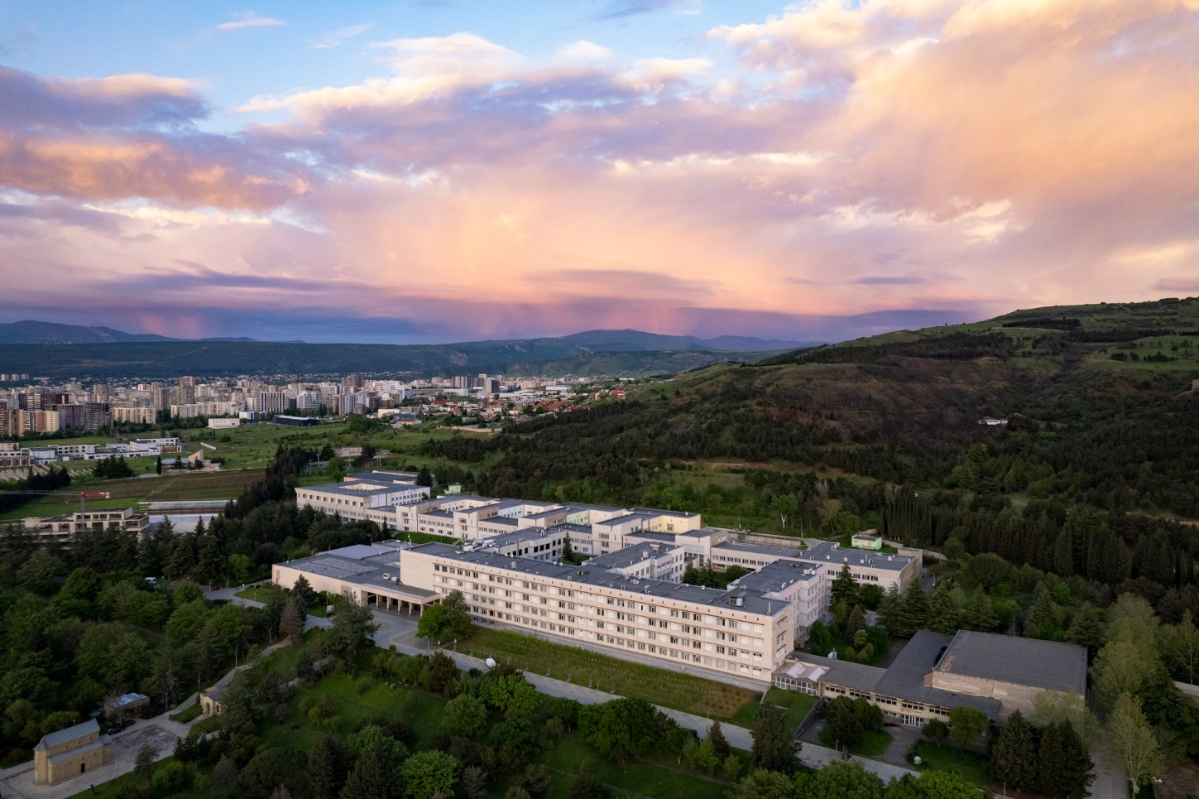
AUG and FUT
Two sibling private Universities
Founded by the Knowledge Fund,
a non-profit, charitable organisation,
founded by Mr. Kakha Bendukidze
(invested over 80 million US dollars in
higher education in Georgia)
Located at the Kakha Bendukidze
Campus
Operated under the same management

Slide 4
About US
Agricultural University of Georgia (AUG)
  Founded in 1929 as a State University, in 2012 became part of the Knowledge Fund
Educational Programs
School of Engineering Technology
Electronic and Computer Engineering
- Bachelors
- Masters
- PhD
Mechanical Engineering
- Bachelors
- PhD
Construction Engineering
- Bachelors
- Masters
- PhD

Slide 5
About US (AUG)
School of Natural Sciences and Biotechnology
Chemistry
- Bachelors
- Masters
- PhD
Biology
- Bachelors
- Masters
- PhD
Food Technology
- Bachelors
- Masters
- PhD
Viticulture and Winemaking
- Bachelors
Agricultural Sciences
Agronomy and Landscape
Management
- Bachelors
- Masters
- PhD
Business School
- Bachelors in business
administration
- Bachelors in liberal arts
Veterinary Medicine
- Integrated Master’s program
- PhD

Slide 6
About US (AUG)
Scientific-Research Institutes
AUG has 14 scientific institutes, within which operate 26 research laboratories. The university also hosts 7 independent scientific laboratories, 2 diagnostic laboratories, and approximately 30 teaching laboratories. Furthermore, the university maintains three test-research bases and five collections that house hundreds of different samples.
Konstantine Amirajibi Institute of Engineering
Institute of Entomology
Vasil Gulisashvili Institute of Forestry
Iulon Lomouri Institute of Agricultural Production
Levan Kanchaveli Institute of Plant Protection
Institute of Viticulture and Winemaking
Institute of Animal Husbandry
Institute of Microbial Biotechnology
Mikheil Sabashvili Institute of Soil Science, Agrochemistry and Melioration
Institute of Molecular Genetics
Sergi Durmishidze Institute of Biochemistry and Biotechnology
Institute of Cellular and Molecular Biology
Institute of Chemistry and Molecular Engineering
Institute of Tea, Subtropical Cultures and Tea Production

Slide 7
About US (AUG)
General Laboratories, Collections and Research Bases
General Laboratories:
Laboratory of Antimicrobial Resistance and Experimental Phagotherapy
Veterinary Clinical Laboratory
Laboratory of Mycology and Plant Pathology
Laboratory of Nematode Studies
Laboratory of Engineering Polymers
Laboratory of Food Technology
Technological Laboratory of Chemistry
Collections:
Genetic Resources Bank of Plants
Dendrological Park
Entomology Collection
Mycological Herbarium
Plant Collection
Research Bases:
Abasha Base
Anaseuli Base
Mukhrani Base

Slide 8
About US
Free University of Tbilisi (FUT)
  Founded in 2007 by the Knowledge Fund
Educational Programs
School of Mathematics, Computer Science and Engineering – MACS[E]
Bachelor’s Program in Computer Science and Mathematics;
Bachelor’s Program in Electrical and Computer Engineering;
Bachelor’s Program in Building System Engineering.
Law School
Bachelor’s Program in Law;
Master’s Program in Business Law.
School of Physics
Bachelor’s Program in Physics
School of International Relations
Bachelor’s Program in International Relations

Slide 9
About US (FUT)
School of Visual Arts, Architecture and Design School - VA[A]DS
Bachelor’s Program in Architecture;
Bachelor’s Program in Visual Arts;
Bachelor’s Program in Interior Design;
Bachelor’s Program in Visual Communication.
Graduate School of Social and Natural Sciences
Master’s Program in Social Sciences;
PhD Program in Social Sciences;
Master’s Program in Natural Sciences (Joint Program with the Agricultural University of Georgia);
PhD Program in Biology (Joint Program with the Agricultural University of Georgia);
PhD Program in Chemistry (Joint Program with the Agricultural University of Georgia);
PhD Program in Physics (Joint Program with the Agricultural University of Georgia).
Business School - ESM
Bachelor’s Program in Business Administration;
Master’s Program in Business Administration;
Master’s Program in Operations Management;
Master’s Program in Finance.
School of Governance and Social Sciences
Bachelor’s Program in Governance and
Social Sciences

Slide 10
About US (FUT)
Research Institutes
Over the course of its history, FUT has established the following research centers and institutions:
2010 – Confucius Institute;
2016 – Center for the Study of Arab Countries and Islamic World;
2018 – Institute of Asia and Africa;
2018 – Research Institute of Cognitive Neurosciences;
2023 – Memory and Anxiety Research Lab - FUMA®Lab.

Slide 11
Research Interests
Department of Electrical and Computer Engineering (ECE), AUG
In the fall of 2015, the Department of Engineering (AUG) signed the Memorandum of Understanding with Forschungszentrum Jülich GmbH (JULICH) / IKP
and joined the consortium with other Georgian Universities:
In 2017, the Department of ECE became a member of the International JEDI Collaboration
In 2023, FUT joined the consortium of Georgian Universities
Our research interests intersect with all three German research centers
FZJ – Forschungszentrum Jülich, Jülich Research Center
HZDR – Helmholtz-Zentrum Dresden-Rossendorf
GSI Darmstadt – Heavy Ion Research Center
electronics and mechanical engineering, physics, chemistry, and plant science
During this period, many of our students (more than 70) were invited for internships and to work on
their Master’s and PhD theses (financially supported by the German side and by the SRNSF)

Slide 12
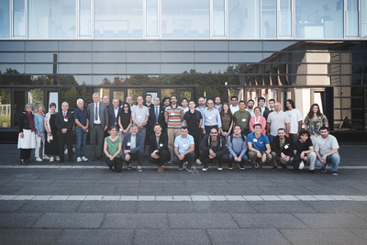
HZDR
The most recent such activity took
place in August 2025, when 7 AUG/FUT
students (out of 17 from Georgia) were
invited to HZDR to participate in the
Quali-start-Up Lecture Course
In March 2026, a chemistry student of AUG
was invited for 2 months internship to the
Institute of Radiopharmaceutical Cancer
Research. She was working under the
supervision of Dr. Martin Kreller
4 students from AUG were invited for 1.5-month internship to the Department of Research Technology at HZDR under the supervision of Prof. Dr. Peter Haever
Quali-start-Up Lecture Course at HZDR
https://www.hzdr.de/db/Cms?pOid=75512&pNid=0&pLang=en

Slide 13
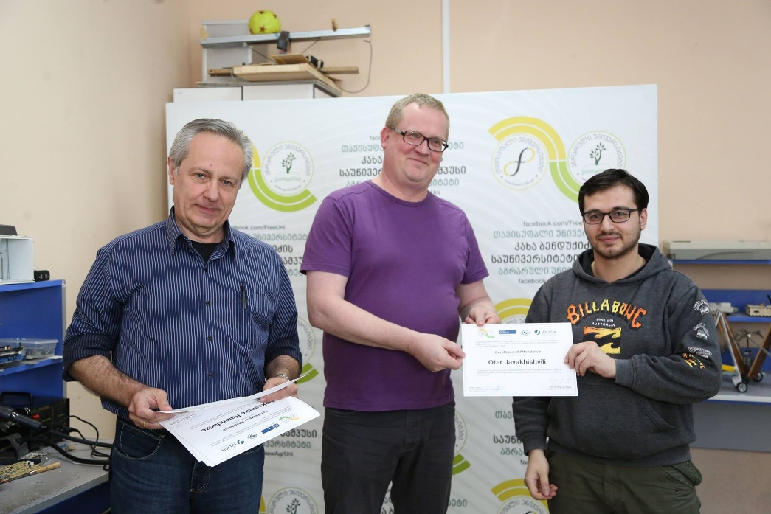
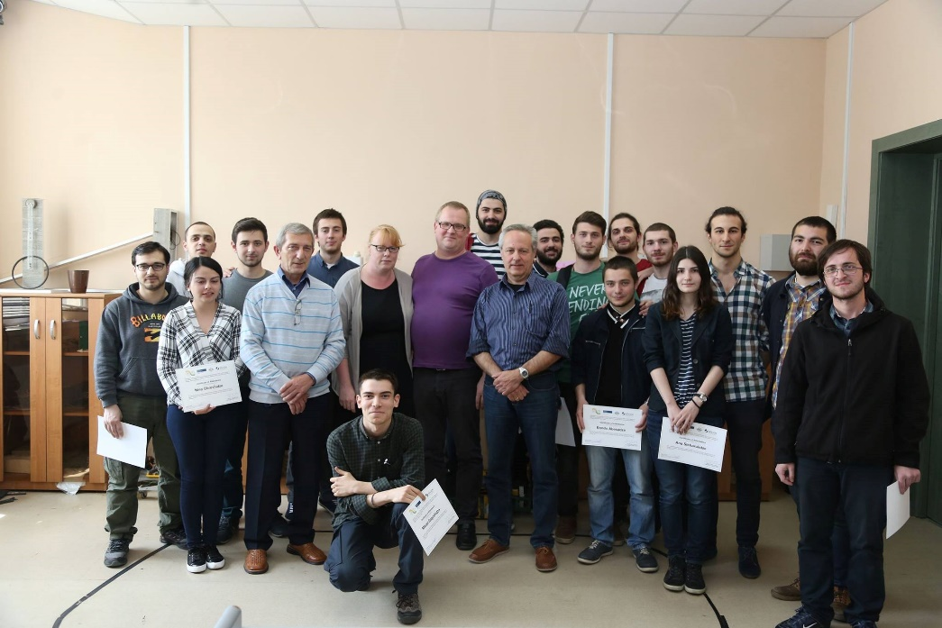
ICA|PGI-4, FZJ
Block/dedicated one-week lecture courses at AUG/FUT by Prof. Dr. Stefan van Waasen (electrical engineering)
Block lectures have already been held 5 times
The latest lecture course took place in May 2026
5 students were selected for a 1-month internship
at ICA|PGI-4 of FZJ.
They are leaving on September 13.
Currently, one PhD student and one master’s student from AUG are working on their theses at ICA
Several students completed internships, master’s, and
PhD theses at ICA
Prof. Dr. Stefan van Waasen is a distinguished professor
of AUG.

Slide 14
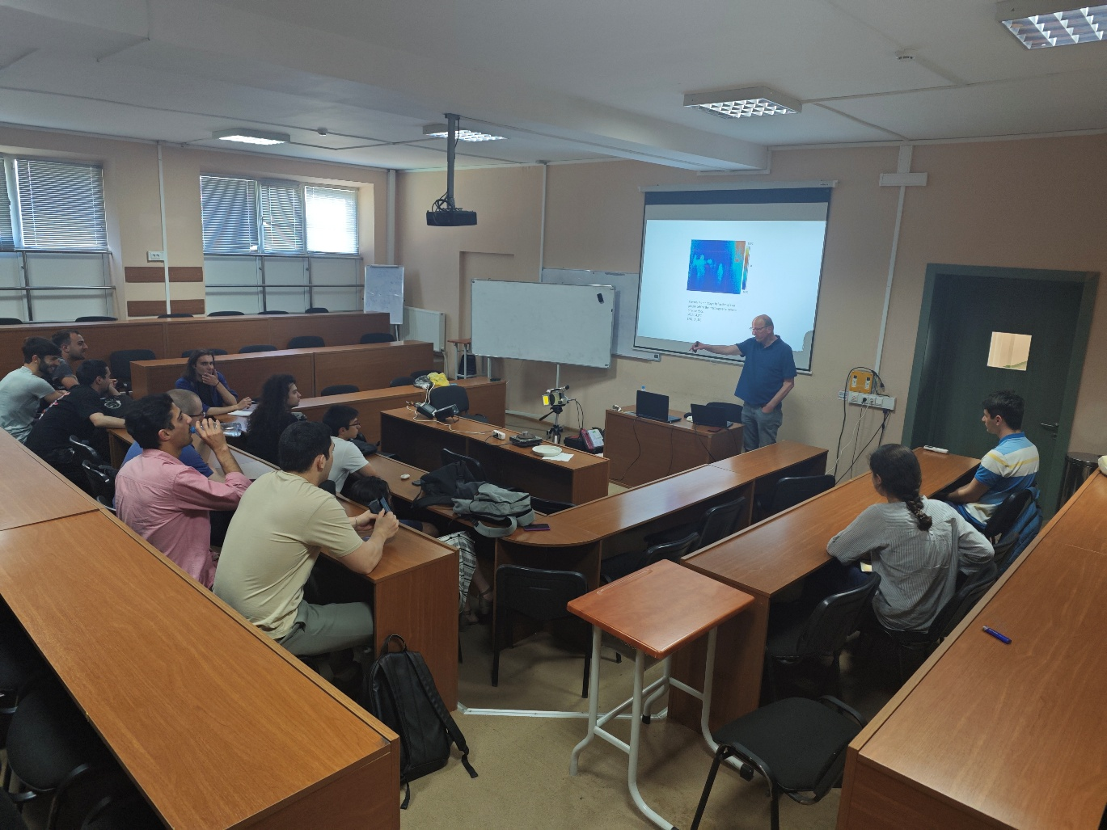
ITE, FZJ
Block/dedicated one-week lecture courses at AUG/FUT by Dr. Harald Glückler and Eberhard Rosenthal (mechanical engineering).
Block lectures have already been held 2 times.
The third lecture course starts on September 14, 2026
One of our students recently completed a one-month internship at ITE of FZJ
Currently, one PhD student and one master’s student from AUG are working on their theses at ITE
Several students completed internships at ITE

Slide 15
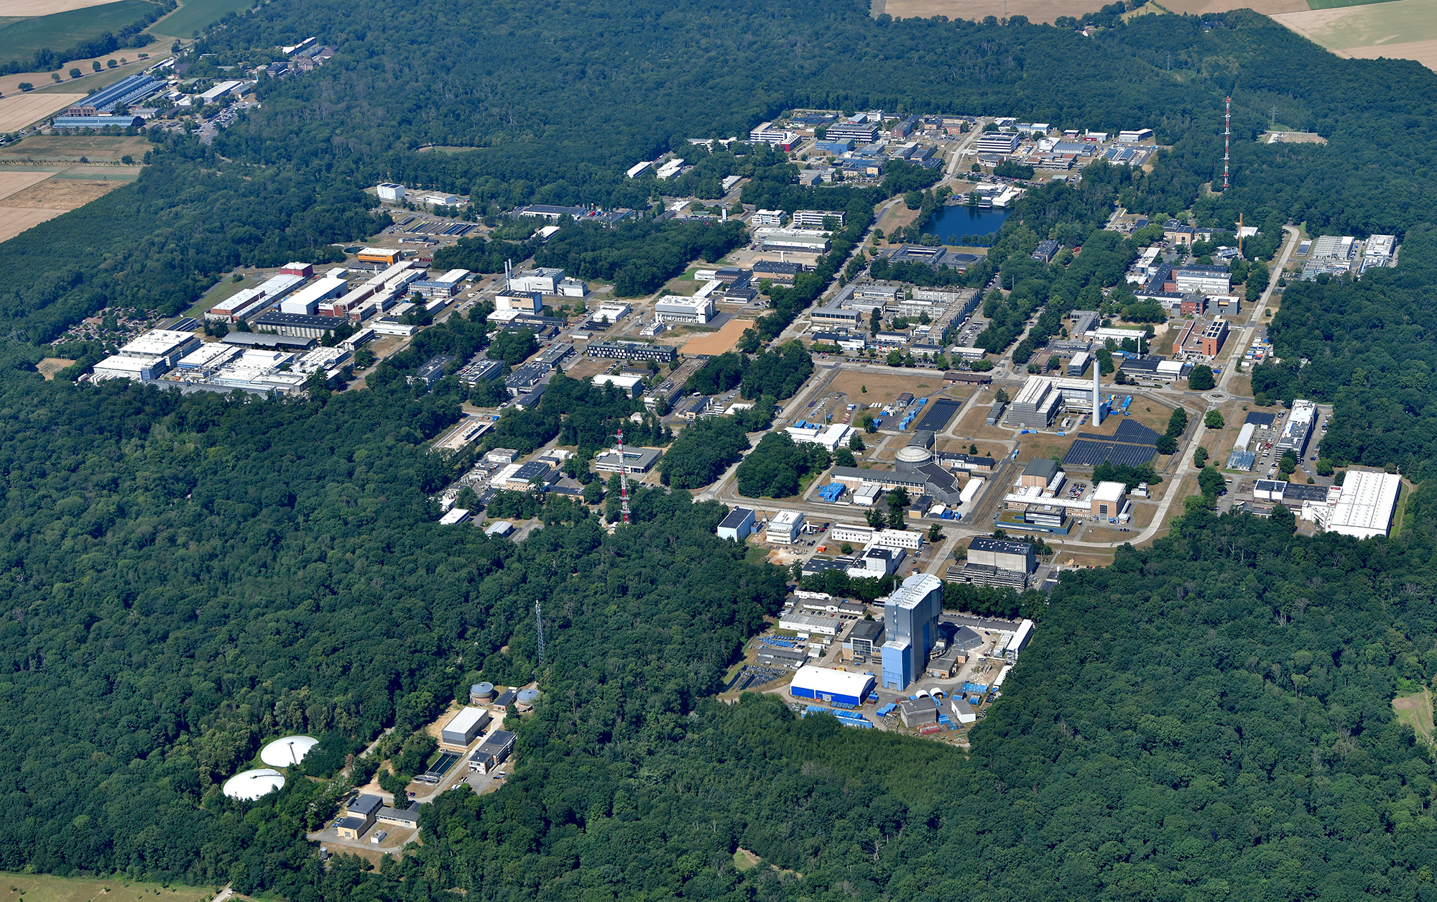
Several students from AUG/FUT completed
internships and worked on their master’s
and PhD theses at FZJ institutes:
IKP Institute of Nuclear Physics
INM-5 Institute of Neuroscience and Medicine,
Nuclear Chemistry
INM-4 Medical Imaging Physics
IBG Institute of Bio and Geosciences
Forschungszentrum Jülich

Slide 16
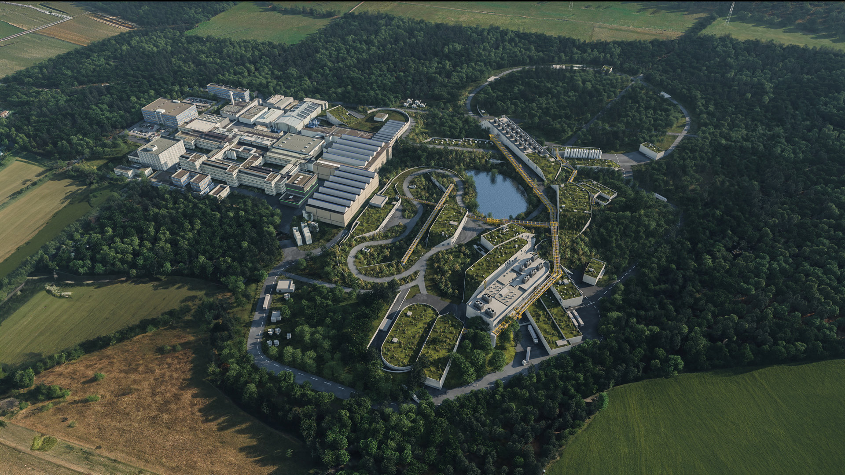
A few students from AUG completed
internships at GSI Darmstadt, working
on a future Compressed Baryonic
Matter (CBM) experiment at FAIR
accelerator center under the
supervision of
Dr. Irakli Keshelashvili
GSI Darmstadt

Slide 17
Existing and Expected Cooperation of AUG/FUT with
German Research Institutions
Supported by Volkswagen Foundation funding (VW Stiftung )
SMART|Digital_Lab – SDDL-AUG was established at AUG in cooperation with ICA|PGI-4
Was created Cluster of Field Programmable Gate Arrays (FPGA) for hardware and software development
6 master’s students worked on joint research topics throughout 2025 and up to now, funded by VW Stiftung
4 master’s theses were defended master’s thesis
Successful cooperation continues
We are looking forward to establishing other SMART|Technology_Simulation_Lab in collaboration with the ITE of FZJ
It would be important for us if it were possible to establish similar joint SMART|Labs with other German research centers as well

Slide 18
Review of Workshop Program
Information especially for students:
All presentations will be uploaded to the workshop’s web page
https://collaborations.fz-juelich.de/ikp/cgswhp/cgswhp26/index.shtml
to the agenda section
Therefore, it is important that you provide your presentation files on a memory stick
Outstanding students will be awarded a certificate of participation in the workshop

