Slide 1

Formation of Es layers by background homogeneous wind and tidal wind
Giorgi Dalakishvili,
Goderdzi G. Didebulidze, Maya Todua
Ilia State University, Space research center, Department of Atmosphere-ionosphere and Near Space,
giorgi.dalakishvili@iliauni.edu.ge
Work is supported by Grant of Shota Rustaveli National Science Foundation of Georgia FR-21-22825

Slide 2
Summary
Background, results obtained in collaboration with group of RUB
Present state-New theory of Es layer formation
Present state-International Double Degree Master Program In Atmosphere and Near Space Sciences
Areas of possible collaboration-HZDR, ISU, FZJ, RWTH

Slide 3
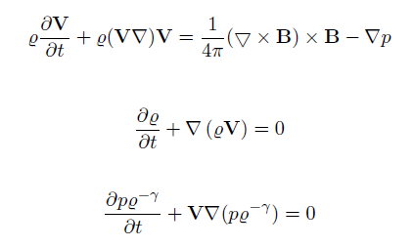
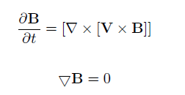




Governing equations

Slide 4
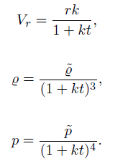
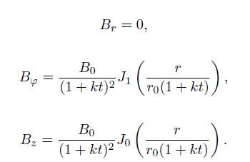
Results

Slide 5
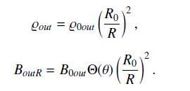

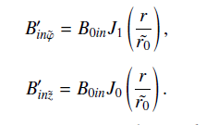

3D numerical study of MC’s evolution

Slide 6
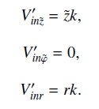

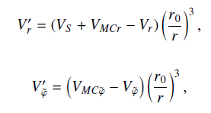



Velocity field

Slide 7
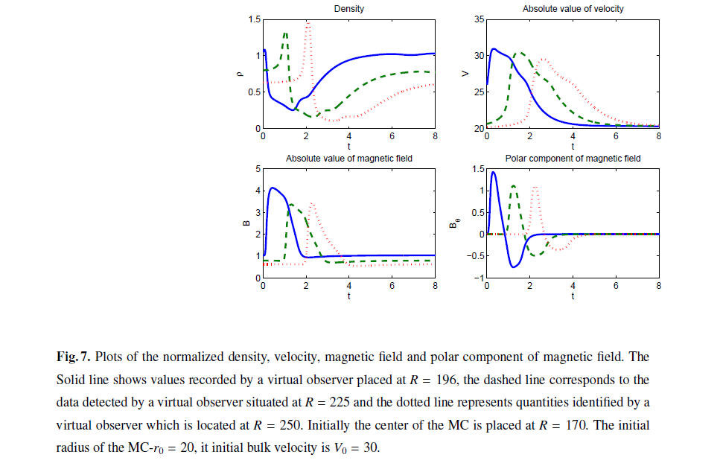

Slide 8
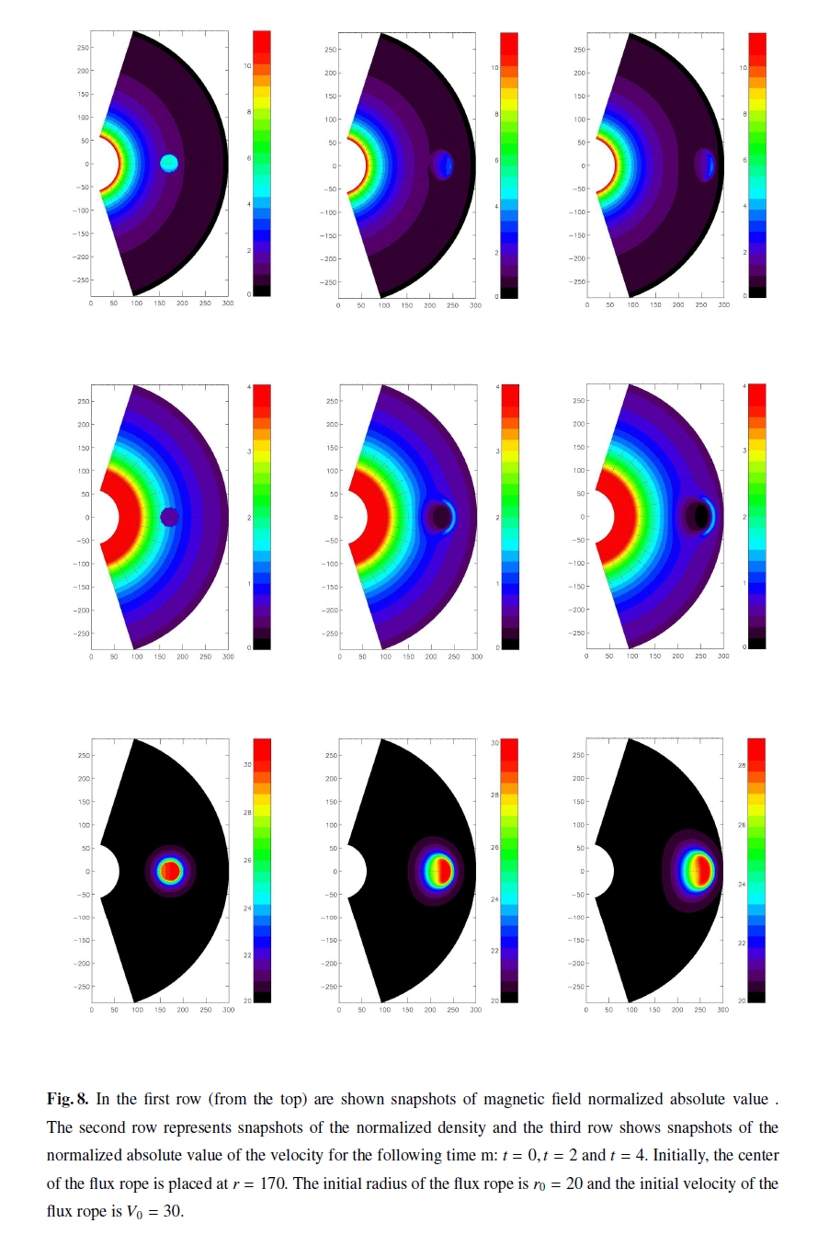

Slide 9
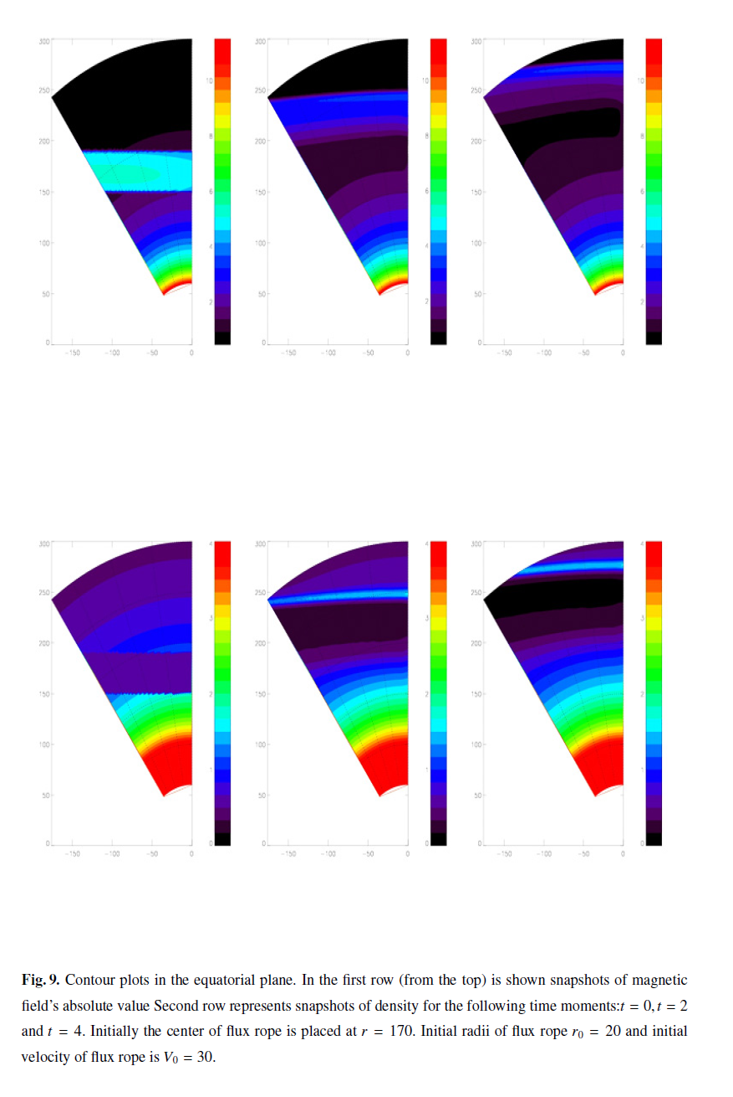

Slide 10
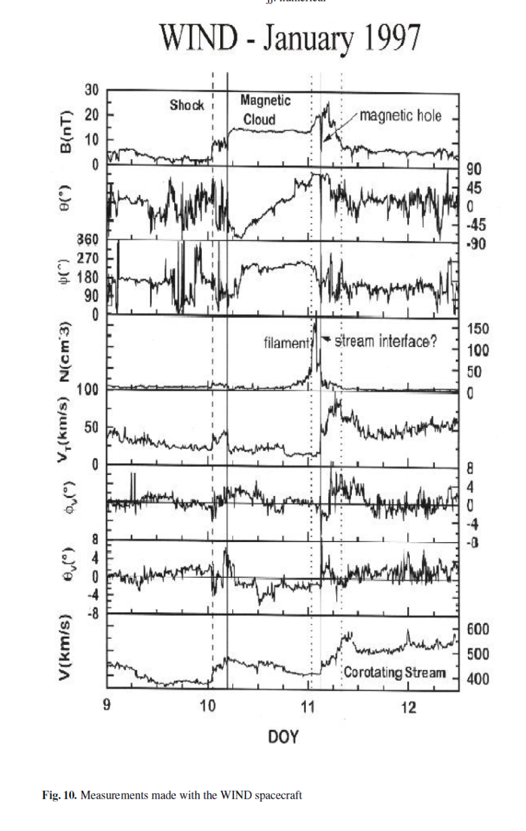
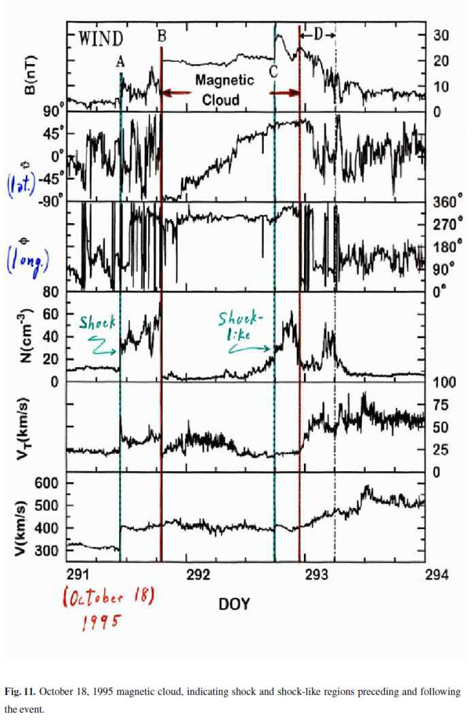

Slide 11
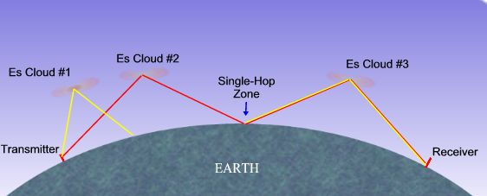

Sporadic E (Es)

Slide 12
Abstract
Theoretically and by corresponding numerical simulations it is shown that the formation and localization of sporadic E (Es) layer at its mainly observable mid-latitude lower thermosphere heights can be determined by homogeneous horizontal wind velocity direction and value. In the suggested theory, differently from 'windshear' theory, the wind direction and value, in addition to geomagnetic field and vertically changing ion-neutral collision frequency, determine the minimal negative value of the divergence of heavy metallic ions drift velocity, which in turn causes ion convergence into Es type horizontal thin layer. Here, in the upper heights of the lower thermosphere, the Es layer peak density and thickness are also controlled by ion ambipolar diffusion.
This theory does not exclude the formation of Es layer under an influence of tidal wind or atmospheric waves. The tidal wind with vertical wavelength about 40-60km additionally can influence on ion convergence into thin dense layer in region of its polarization changes. In this case the sporadic E mostly have multilayered structure, with peak heights close to regions where ion drift velocity becomes equal to zero (ion drift factor is zero) and secondary peak close to regions where tidal wind polarization changes.
In this case the lower thermosphere of the northern hemisphere, the Es layer caused by horizontal homogeneous wind can be located at height regions where (1) the ions vertical drift velocity is zero and its divergence is negative (east-northward wind), (2) the ions drift downward (northward and westward wind), which occurs more frequently, or (3) the ions drift upward (eastward wind) and their negative divergences vanish and (4) in the case of dominance of southward wind the divergence of ion drift velocity is positive, consequently ion density divergence occurs and Es type layer formation is not expectable. The Es layer density increase and its vertical motion to its expectable location are faster for greater values of the horizontal wind velocity.

Slide 13
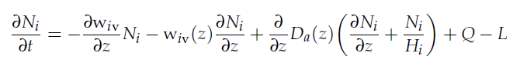
Governing equations

Slide 14
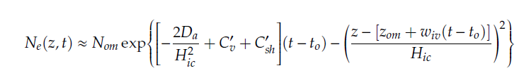
Analytical analyses
In case when C, C'=0

Slide 15
Constant Homogenious wind

Slide 16
Results for The case of Contant-Homogenious Wind

Slide 17
Results for The case of Contant-Homogenious Wind

Slide 18
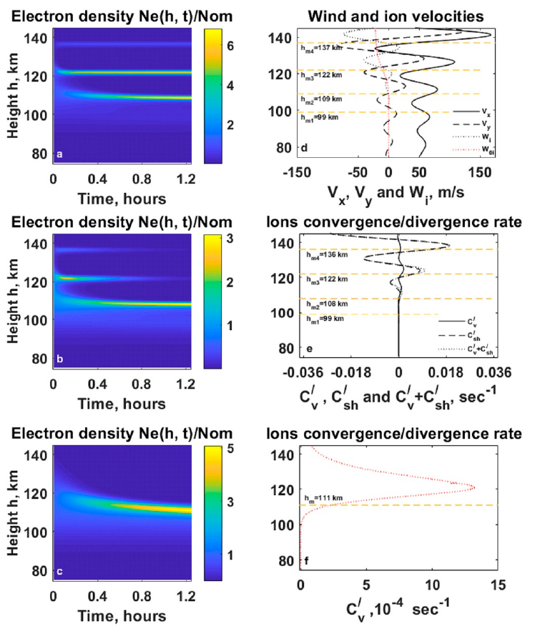
Results for the case of Atmospheric Gravity Waves

Slide 19
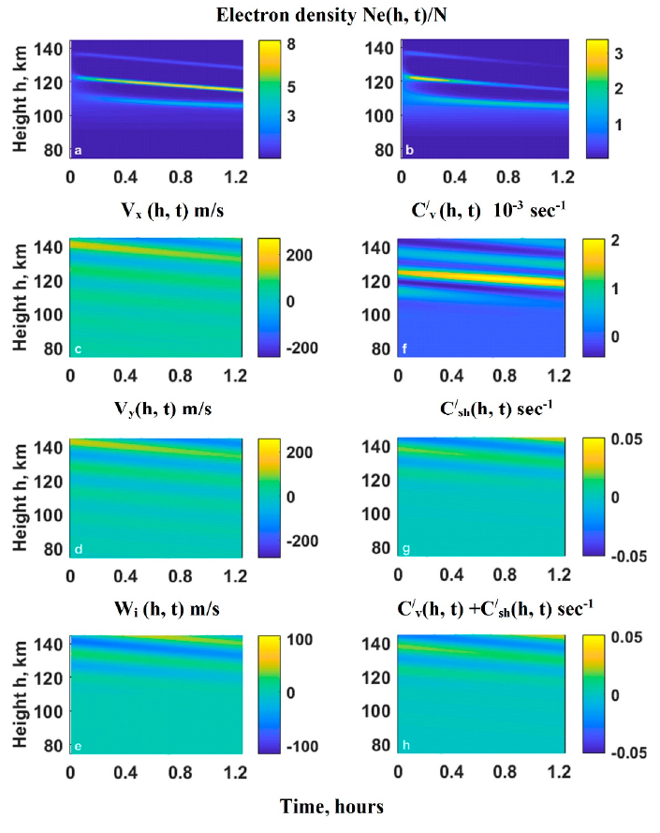
Results for the case of Atmospheric Gravity Waves

Slide 20
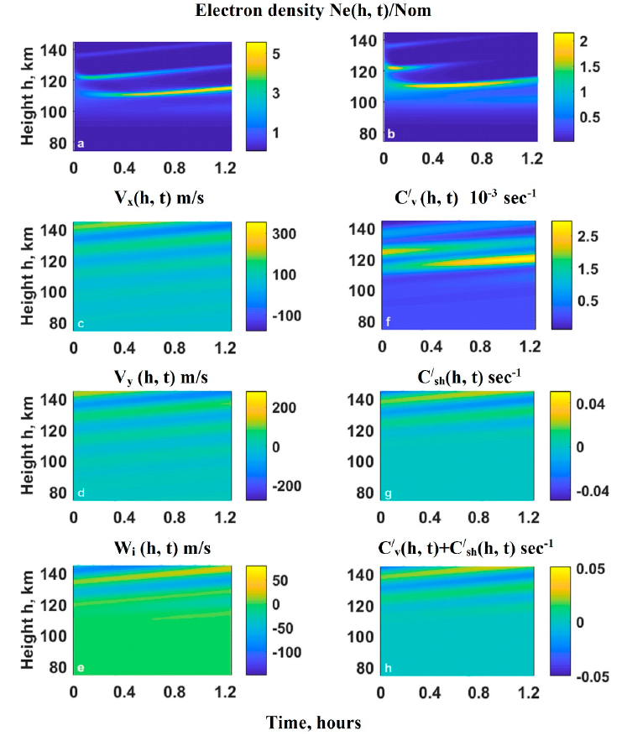
Results for the case of Atmospheric Gravity Waves

Slide 21
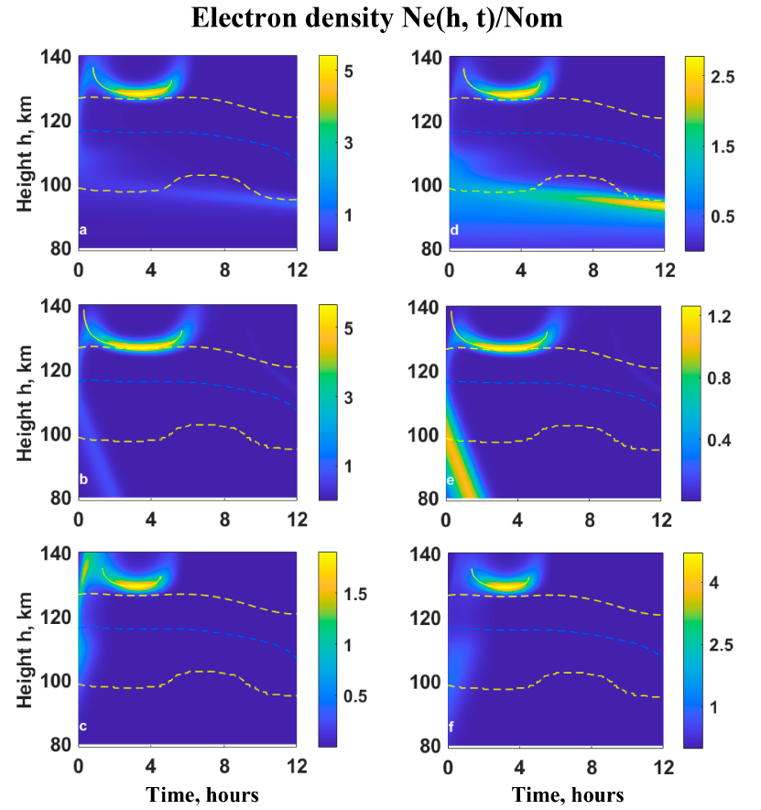
Results for the case of the Horizontal Wind Model

Slide 22





International Double Degree Master Program In Atmosphere and Near Space Sciences
Recently Enrolled four (three International and one Georgian) students

Slide 23
Areas of Possible Collaboration-HZDR, ISU, FZJ, RWTH
Atmosphere and Climate
Fluid dynamics
Computing-numerical simulations, data analyses
AI (? ☺ )

