Slide 1
Benchmarking the trackers Yannis K. Semertzidis, CAPP/IBS and KAIST
6 May 2015
IPAC15, Spin Tracking Topical Meeting
Richmond, Virginia
How do we test that we are ready?
Several simulation packages can do impressive spin/beam dynamics tracking
We need to set benchmarking goals to control inadequacies, bugs, mistakes

Slide 2
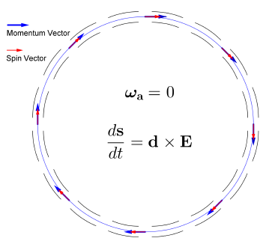
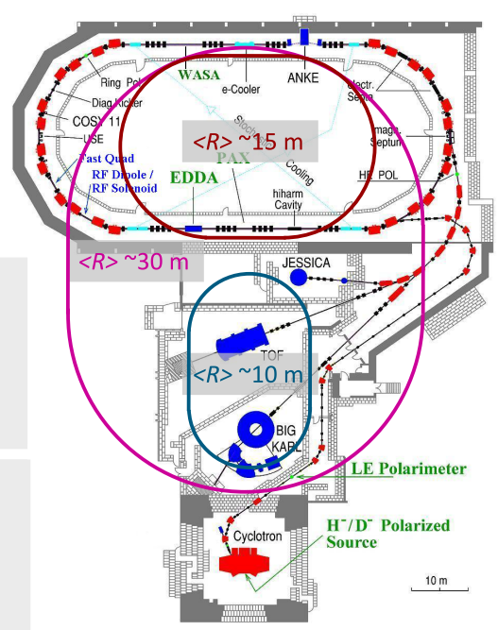
EDMs: Storage ring projects
pEDM in all electric ring at BNL
Jülich, focus on a smaller radius machine
Circumference: 800m
E-field: 4 MV/m, 3cm gap
CW and CCW stored beams
(from A. Lehrach)

Slide 3
What do we want from simulation?
Fast, efficient, accurate beam/spin dynamics simulation of beam/spin dynamics for 10³ s stored beams.
Fringe fields studies
Not all programs need to be best in everything
How do we check?

Slide 4
Setting up goals
We need to estimate
Lattice parameters
Ring admittance
Spin coherence time
Systematic errors
IBS
Wake-fields
…

Slide 5
Simulation benchmarking points
Estimate the g-2 effect of stored muons with vertical oscillations in
Continuous magnetic ring with magnetic focusing
Continuous magnetic ring with electric focusing
Estimate the g-2 effect of stored muons with some offset from the magic momentum in
Continuous magnetic ring with electric focusing

Slide 6
Simulation benchmarking points
Estimate the dγ/γ₀ and dr/r as a function of γ₀ for
All electric ring with no vertical focusing as a function of gamma
All electric ring with weak vertical focusing as a function of gamma
Do the above with and without using an RF cavity.

Slide 7
Simulation benchmarking points
The effects are all second order (not to be confused w/ higher order in fields) and critical to the success of the program for SCT, systematic errors. (See Martin’s and Selcuk’s presentations…)
More examples at (please wait for the next version as there are several typos)http://arxiv.org/abs/1503.02247

Slide 8
Fringe fields
E-field lattices with straight sections. The issues:
Multipoles
Radial E-field (due to left-right asymmetry)
See Eric Metodiev et al., for a complete study of fringe fields: Phys. Rev. ST Accel. Beams 17 (2014) 5, 074002, available at http://journals.aps.org/prstab/pdf/10.1103/PhysRevSTAB.17.074002

Slide 9
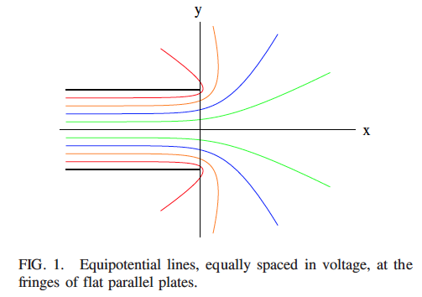
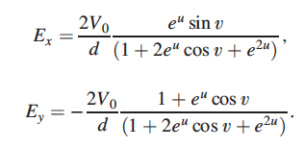
Fringe fields
Electric fringe-fields from straight plates are left/right symmetric

Slide 10
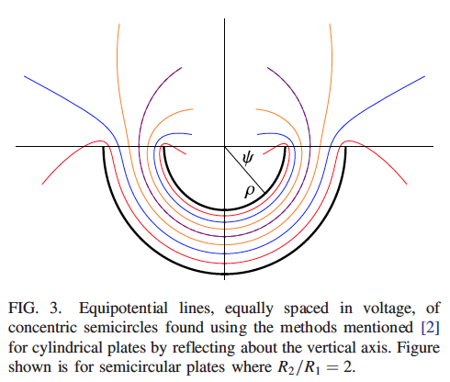
Fringe fields
Electric fringe-fields from bend plates are left/right asymmetric

Slide 11
Fringe fields
We have solved the problem analytically (exactly) and have implemented the exact solution in the tracking program.
Time step used: 1-100ps.
Assumed infinitely high plates.

Slide 12
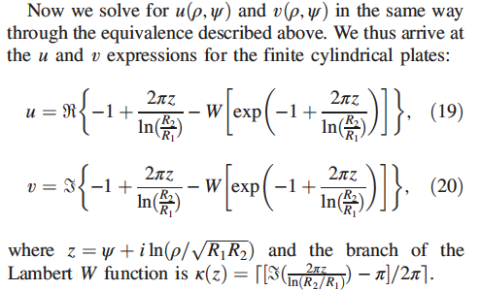
Fringe fields, coordinate inversion

Slide 13
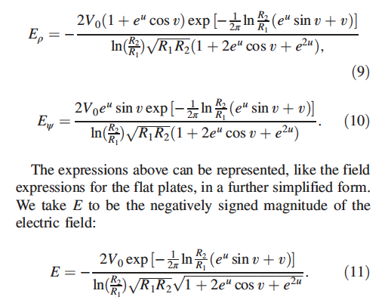
Fringe fields, Getting the E-fields for tracking

Slide 14
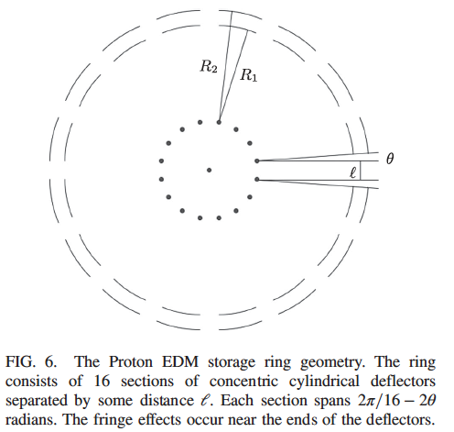
Fringe fields: to get stability
Biggest effect: cut off a θ=1mrad from every plate. (R₀ ~ 40m, 16 sections)

Slide 15
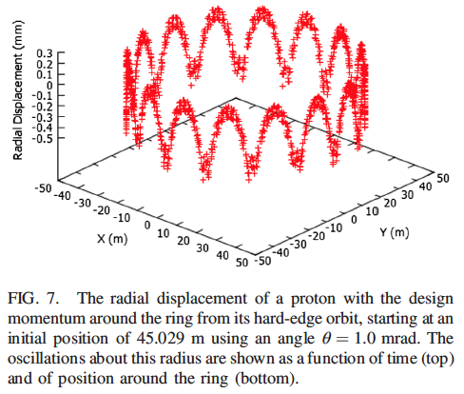
Fringe fields: radial displacement around the ring, 0.5 mm max.
No observable effect on SCT!

Slide 16
Summary
Good simulation programs can still have bugs, mistakes, limitations all relevant to Storage ring EDM
Need to benchmark: target for g-2 sensitivity level of parts per billion. Painful but necessary
Studies of
Continuous magnetic field rings w/ magn. focusing
Continuous magnetic field rings w/ electr. focusing
Continuous all electric rings w/ and w/out focusing
Fringe fields in electric rings w/ straight sections

Slide 17
Extra slides

