Slide 1
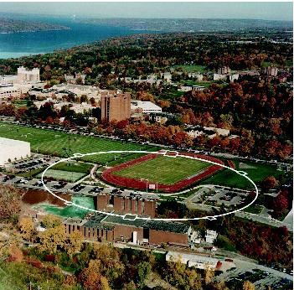


Spin Tracking Using the Bmad Software Library
David Sagan
Cornell Laboratory for
Accelerator-Based Sciences and Education

Slide 2
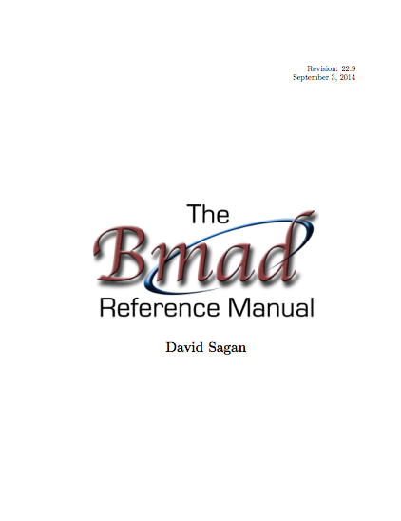
Overview
Bmad is a library toolkit.
Written in Fortran.
Object oriented from the ground up.
Has structure translation code for interfacing with C++.
Lattice files use a MAD like syntax.
Documented.
  Open Source:
  http://www.lepp.cornell.edu/~dcs/bmad/
Notes:
I want to first give an overview of Bmad since I assume that most of you haven’t used it before.

Slide 3

In the Beginning…
Brief History:
  Born at Cornell in mid 1990’s
  Started life as modest project: Just wanted to calculate Twiss functions and closed orbit.
  Initially Bmad used a subset of the MAD lattice syntax. Hence the name: “Baby MAD” or “Bmad” for short.
Over the years Bmad had evolved…
Notes:
And Baby has grown up

Slide 4

And Baby Grows Up...
Currently:
    ~100,000 lines of code
    ~1,000 routines
And it can do much more:
    X-ray simulations (both coherent and incoherent)
    Spin tracking
    Tracking with coherent synchrotron radiation
    Wakefields and HOMs
    Beam breakup simulations in ERLs
    Intra-beam scattering (IBS) simulations
    Touschek lifetime
    Frequency map analysis
    Dark current tracking
    Etc., etc.

Slide 5
Bmad Based Programs
Due to its flexibility, Bmad has been used in a number of programs including:
  tao General purpose design and simulation.
  synrad3d 3D tracking of synch photons, including reflections, within the beam chamber.
  cesrv On-line data taking, simulation, and machine correction for CESR.
  dark_current_tracker Dark current electron simulation.
  freq_map Frequency map analysis.
  ibs_sim Analytic intra-beam scattering (IBS) calculation.
  touschek_track Tracking of Touschek particles.
  etc...
Notes:
Other accel simulation libraries:
Merlin (nick walker)
Accelerator Toolkit (based upon matlab)
PTC

Slide 6
Tao: Tool for Accelerator Optics
Problem: Bmad is not a program so it cannot be used “out of the box.” for simple calculations.
Solution: Develop Tao - a general purpose simulation & design program with
  Nonlinear optimization.
  Twiss and orbit calculations
  Etc.
Additionally: Tao’s object oriented coding makes it relatively easy to extend it.
  For example: Can add custom commands to interface Tao with a control system.
Tao with Bmad gives the flexibility of a library with the convenience of a program.
JLab FEL Modeling

Slide 7
Bmad Features
Bmad has a number of features that over the years have proven useful. Among these are:
  Superposition – Define overlapping elements
  Controllers – Elements controlling attributes of other elements
  Forking – Joining lines together (EG: an injection line)
  Multipass – Beamlines sharing common elements (EG: ERL)
  Interface to Etienne Forest’s FPP/PTC code.
  Element-by-element selection of the tracking method.
  Custom elements and custom particle tracking.

Slide 8
Forking
Bmad can connect different beam lines together. Can join LINACs to injection lines to storage rings to X-ray beam lines, etc.
Example: SuperKEKB LER injection
ler
inj
ler_fork: fork, to_line = ler, to_element = injectio
inj: line = (..., ler_fork) ! injection line
ler: line = (..., injectio, ...) ! LER ring
use, inj
➔ One lattice can hold the description of the entire accelerator complex.
Notes:
To get the plot: Read lattice into Tao.

Slide 9
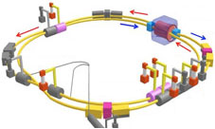
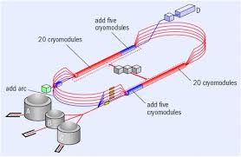
Multipass
Bmad can simulate beam lines having common elements
Example: SuperKEKB IR region:
sol: line[multipass] = (esle4000, ..., esre4000)
pt1_l: patch, ...; pt2_l: patch, ...
pt1_h: patch, ...; pt2_h: patch, ...
mm: marker
fid: fiducial, origin_ele = mm
ler: line = (pt2_l, mm, sol, pt1_l, ler_arc)
her: line = (pt2_h, --sol, fid, pt1_h, her_arc)
use, ler, her
SuperKEKB
Changes to elements in sol get reflected in both HER and LER lines.
patch
patch
sol
CEBAF
LER ref orbit
HER ref orbit

Slide 10
Etienne Forest’s FPP/PTC
Etienne Forest’s FPP/PTC simulation toolkit:
  Can construct Taylor series maps to arbitrary order via symplectic Lee integration through elements.
  Can track spin.
  Can do such things as normal form analysis to extract resonance strengths.
  [Is used in MAD-X & PTC_ORBIT]
Integration with Bmad:
  Interface routines between Bmad and PTC allow tracking of individual elements via PTC
  PTC lattices can be constructed for analysis
Alexander Molodozhentsev
PTC_ORBIT combined code KEK & SNS common activity

Slide 11
  Tracking Method Selection
Can set how each element is tracked on an element-by-element basis:
  Spin EDM
  bmad_standard Thick formulas, fast ✔
  symp_lie_ptc Symplectic tracking using PTC ✔ ✔
  runge_kutta Track through arbitrary fields ✔ ✔
  custom Tracking with custom code ?! ?!
  taylor Taylor map (generated via PTC)
  linear Linear tracking
  etc.
Example:
inflector: em_field, tracking_method = runge_kutta, field_calc = custom, ...
Advantages:
  Enables simulation of unique element types
  Can compare different tracking methods
Notes:
Shows 6 of 11 tracking methods.

Slide 12
G-2 Experiment
Dave Rubin at Cornell has been developing a simulation program to simulate the muon g-2 experiment at Fermilab
Need to simulate:
  Injection line into storage ring.
  Three dimensional field of the injection line.
  Scattering of muons as they cross the inflector wall
  Electrostatic quadrupoles
  Muon decay
Polarized Muons

Slide 13
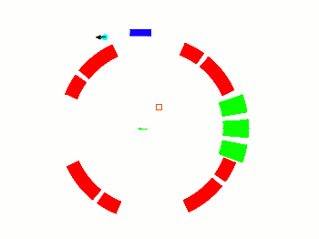
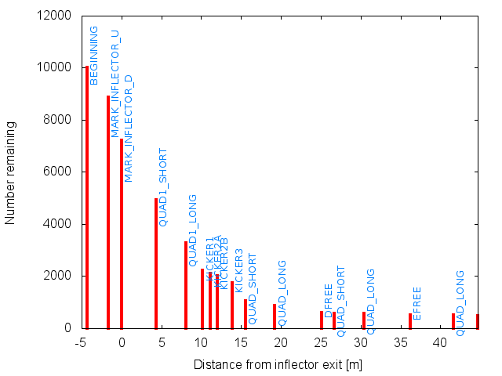

G-2 Simulation
  Bmad provided:
  Ability to define the geometry of the injection line and storage ring.
  Ability to define the geometry of the inflector wall
  Ability to define custom fields for the injection line and electrostatic quadrupoles
  Runge-Kutta tracking
Needed to develop for the program:
  Tracking of muons through the inflector wall
  muon decay [will be ported to Bmad]

Slide 14
Conclusion
Bmad provides a flexible toolkit for spin simulations

