Slide 1
Power Supply Development for JEDI Polarimeter Modules
Otari Javakhishvili 1st SMART|_Lab’s Workshop
(AUG / SMART|EDM_Lab TSU )
30.09.2017

Slide 2
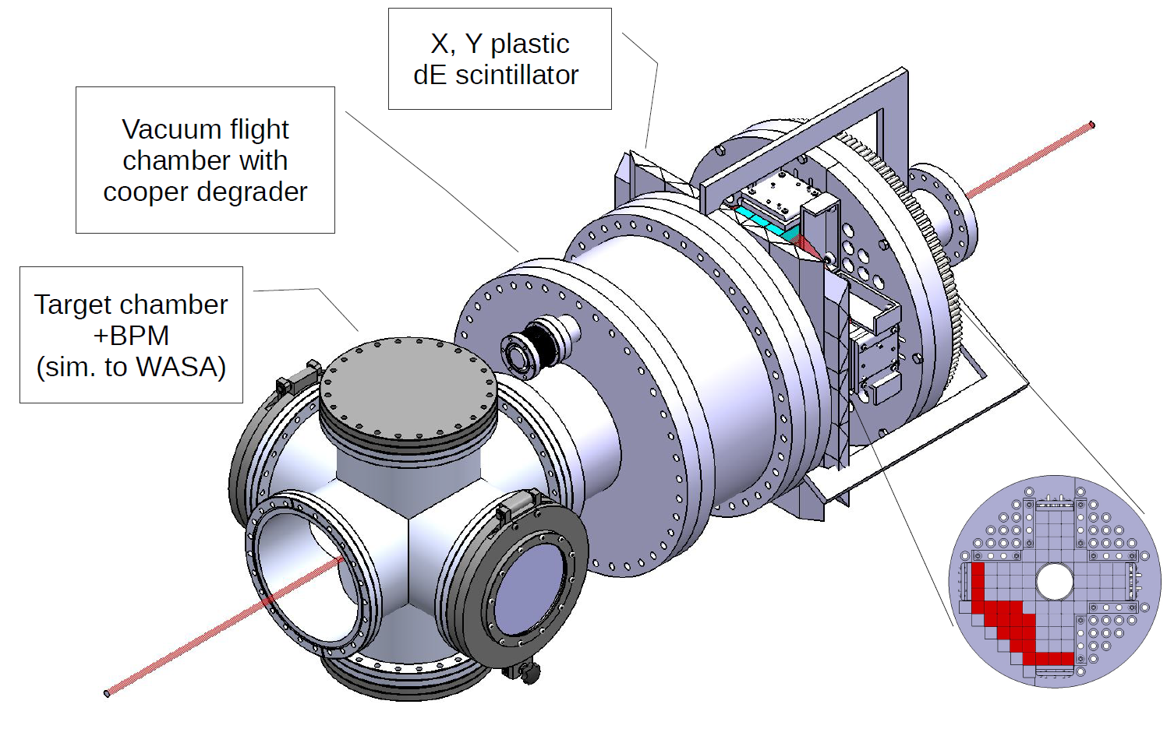
New concept of the JEDI Polarimeter
30/09/2017
Otari Javakhishvili
2

Slide 3
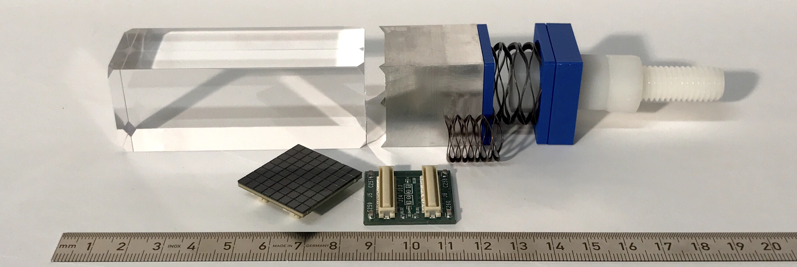
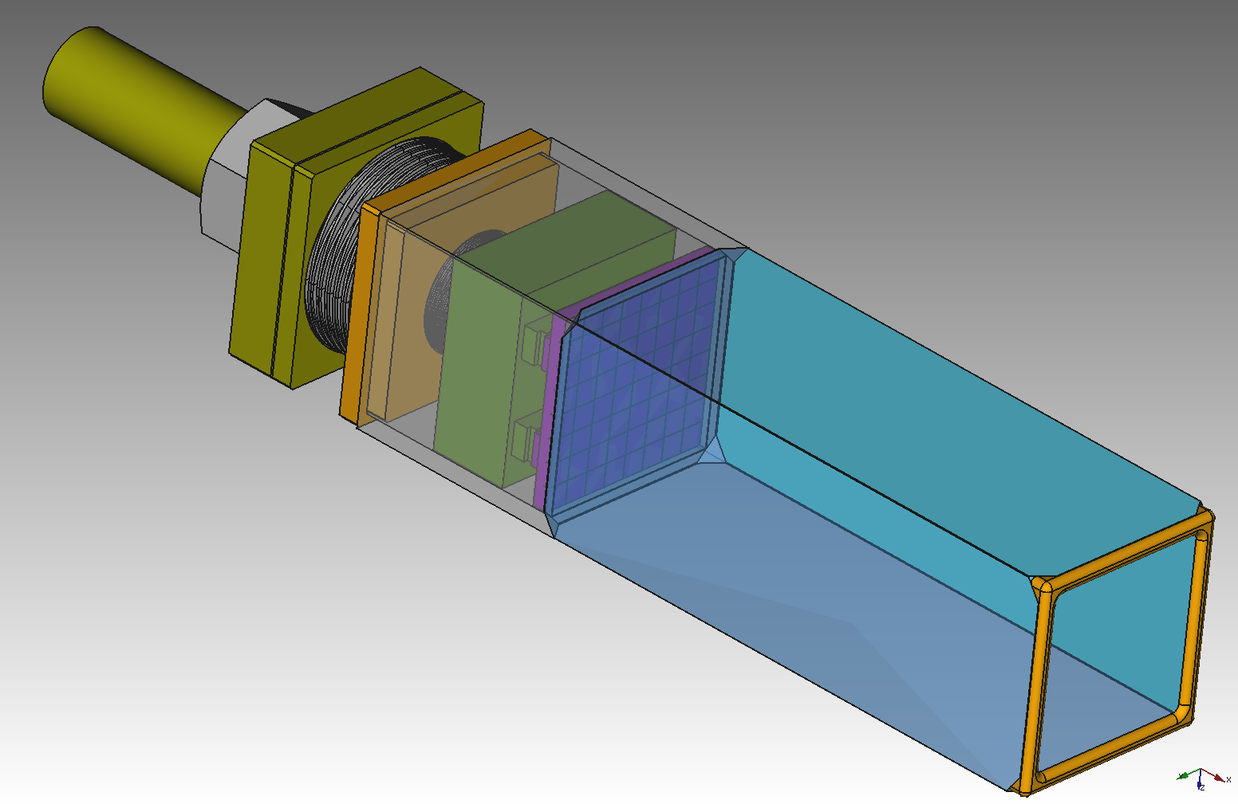
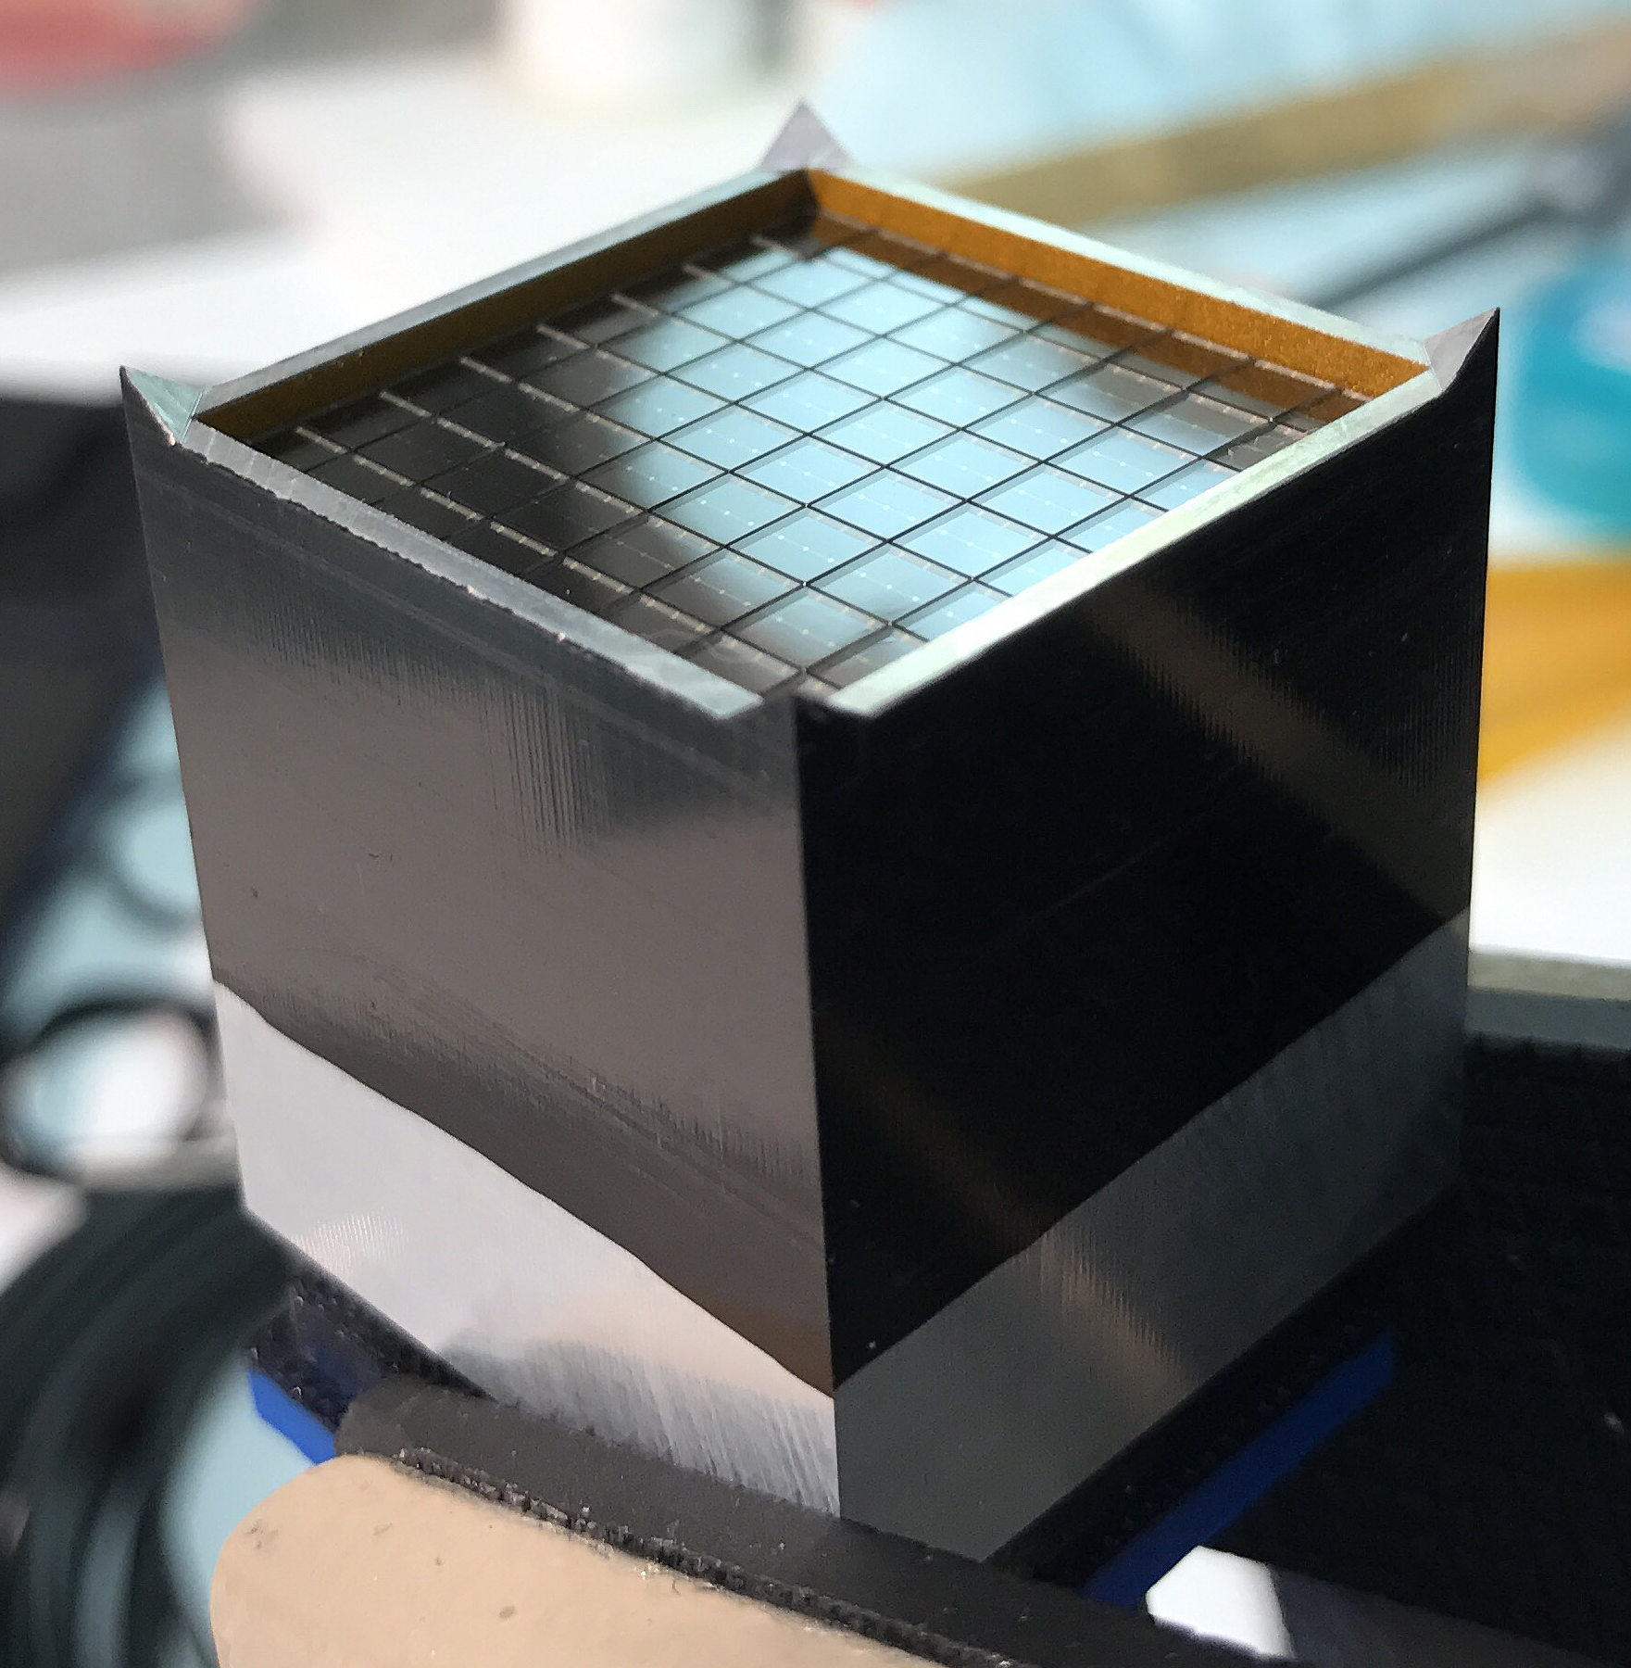
Detector module structure
Aluminum holder and wave springs for tension
LYSO Cristal 3X3X8 cm
SiPM (SensL J-series, 20µm pixel) Module and connector
30/09/2017
Otari Javakhishvili
3

Slide 4
SiPM Lab Test
Signal Generator
Power Supply
25v ~ 32v
Dark box
SiPM
Oscilloscope
(Fixed Signal)
LED Flasher
30/09/2017
Otari Javakhishvili
4

Slide 5
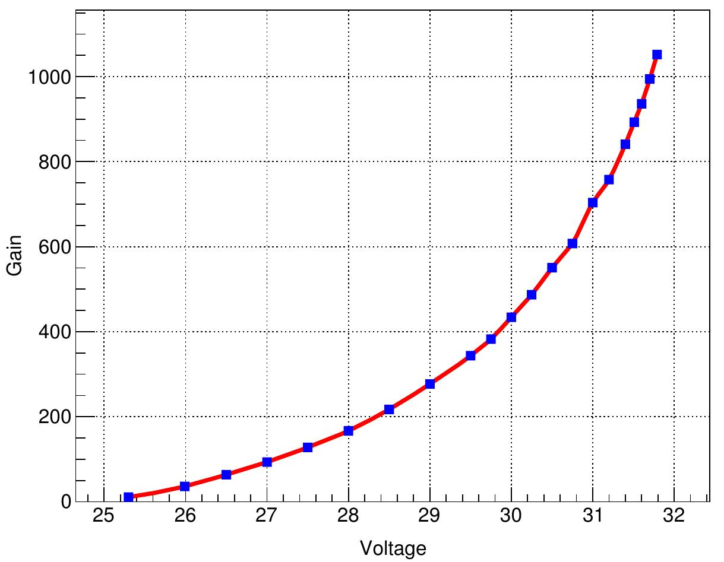
SiPM Gain vs Voltage
1mV variation ~ 0.02…0.05 % in gain
[a.u.]
Gain variation is directly related to energy resolution
Voltage [V]
LYSO energy resolution ~ 1%
Max. accepted ∆V ~ 10mV
30/09/2017
Otari Javakhishvili
5

Slide 6
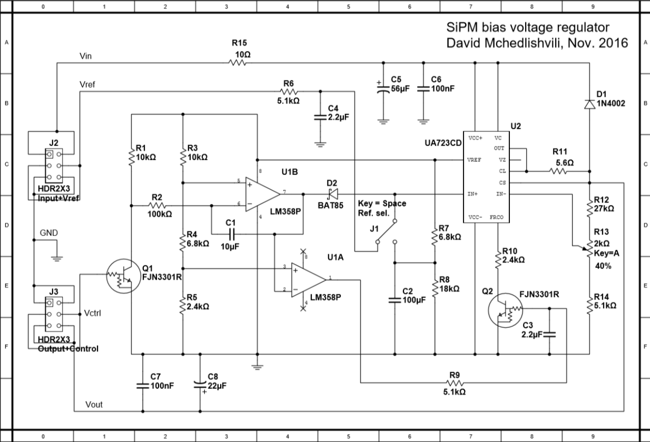
Development of a new voltage source
Basic requirements:
Modular design
High output stability (temperature, long/short term, low noise)
Remote on/off capability (currently organized using Raspberry Pi)
Voltage adjustment (currently only manual)
Linear voltage regulator part
Ramp generator and on/off part
30/09/2017
Otari Javakhishvili
6

Slide 7
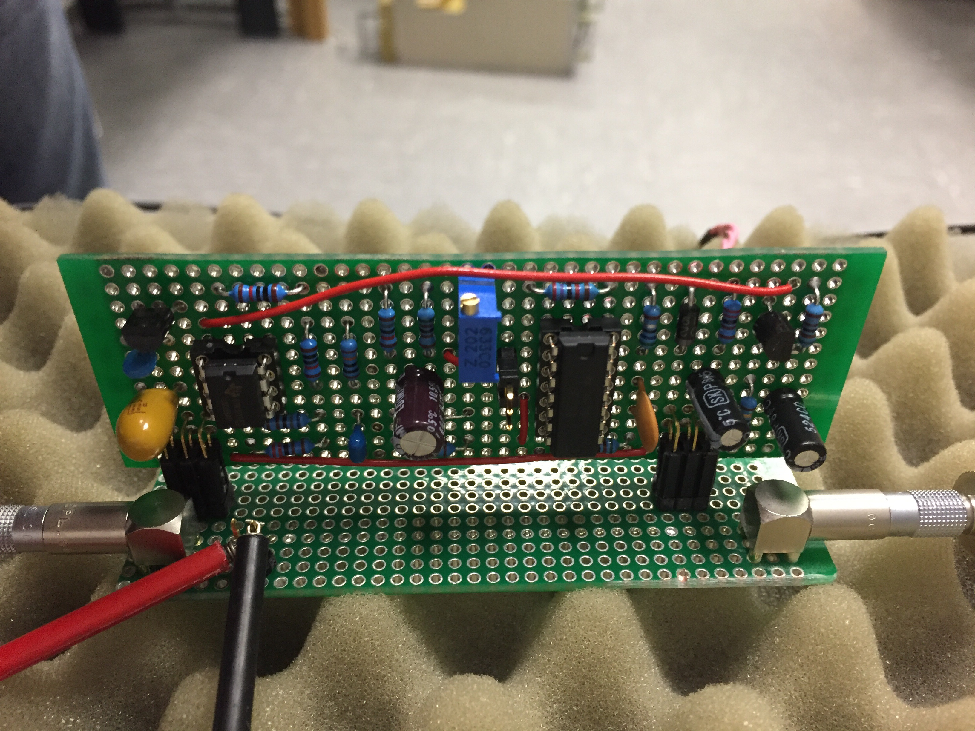
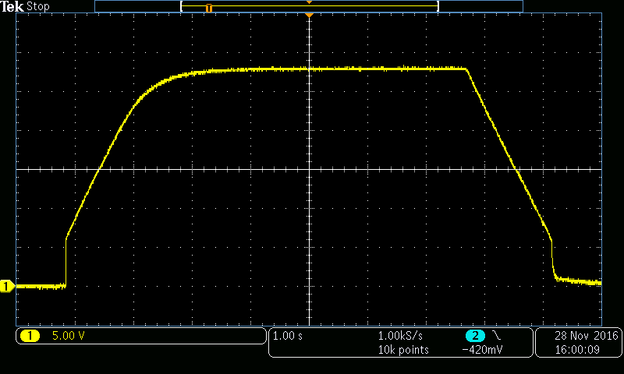
First tests
First prototype board on a test bench (using internal voltage reference)
Output on/off curve with voltage ramp
30/09/2017
Otari Javakhishvili
7

Slide 8
Power Supply Testing
The Idea:
Employ real SiPM signal from the data
Simulate SiPM loads in lab condition (no COSY beam)
Measure voltage drop at SiPM input
What was made :
Signal shape was extracted from real data
Special software was developed to generate same signal using RedPitaya
Fast current sink was designed and developed to mimic the SiPM
Same RedPitaya was used for readout
30/09/2017
Otari Javakhishvili
8

Slide 9
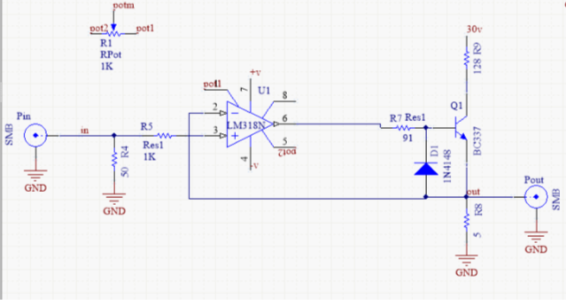
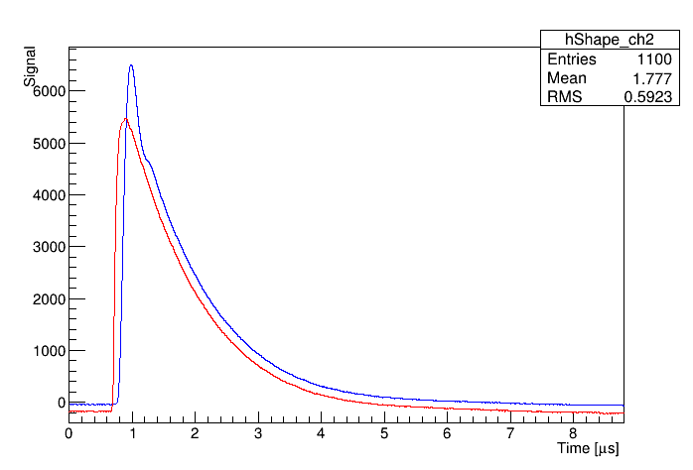
Fast current sink – First prototype
First prototype without filters
Original signal (red)
Fast current sink signal (green)
30/09/2017
Otari Javakhishvili
9

Slide 10
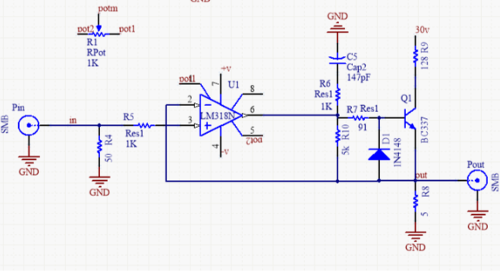
Fast current sink – Second prototype
Original signal (red)
Fast current sink signal with “snubber” filter(green)
30/09/2017
Otari Javakhishvili
10

Slide 11
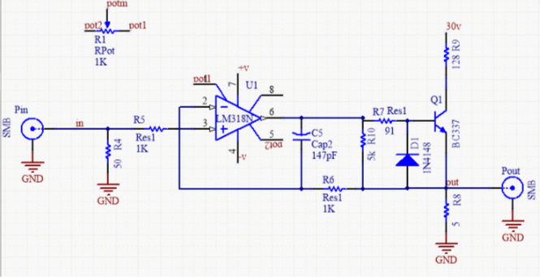
Fast current sink – Final prototype
Original signal (red)
Fast current sink signal with improved feedback and filters (green)
30/09/2017
Otari Javakhishvili
11

Slide 12
Testing Environment
RedPitaya
Signal from
generator
Signal from converter
Fast current sink
37 V
30/09/2017
Otari Javakhishvili
12

Slide 13
Power supply testing
SiPM board designed at Ferrara university, Italy
On SiPM board there is 4x2uF capacitors (red) and inductance (blue)
RedPitaya
Signal from
generator
Voltage drop
measurement
Vin 37.27
Fast current sink
30.04V
100
8uF
Power Supply
Long cable
SiPM board
30/09/2017
Otari Javakhishvili
13

Slide 14
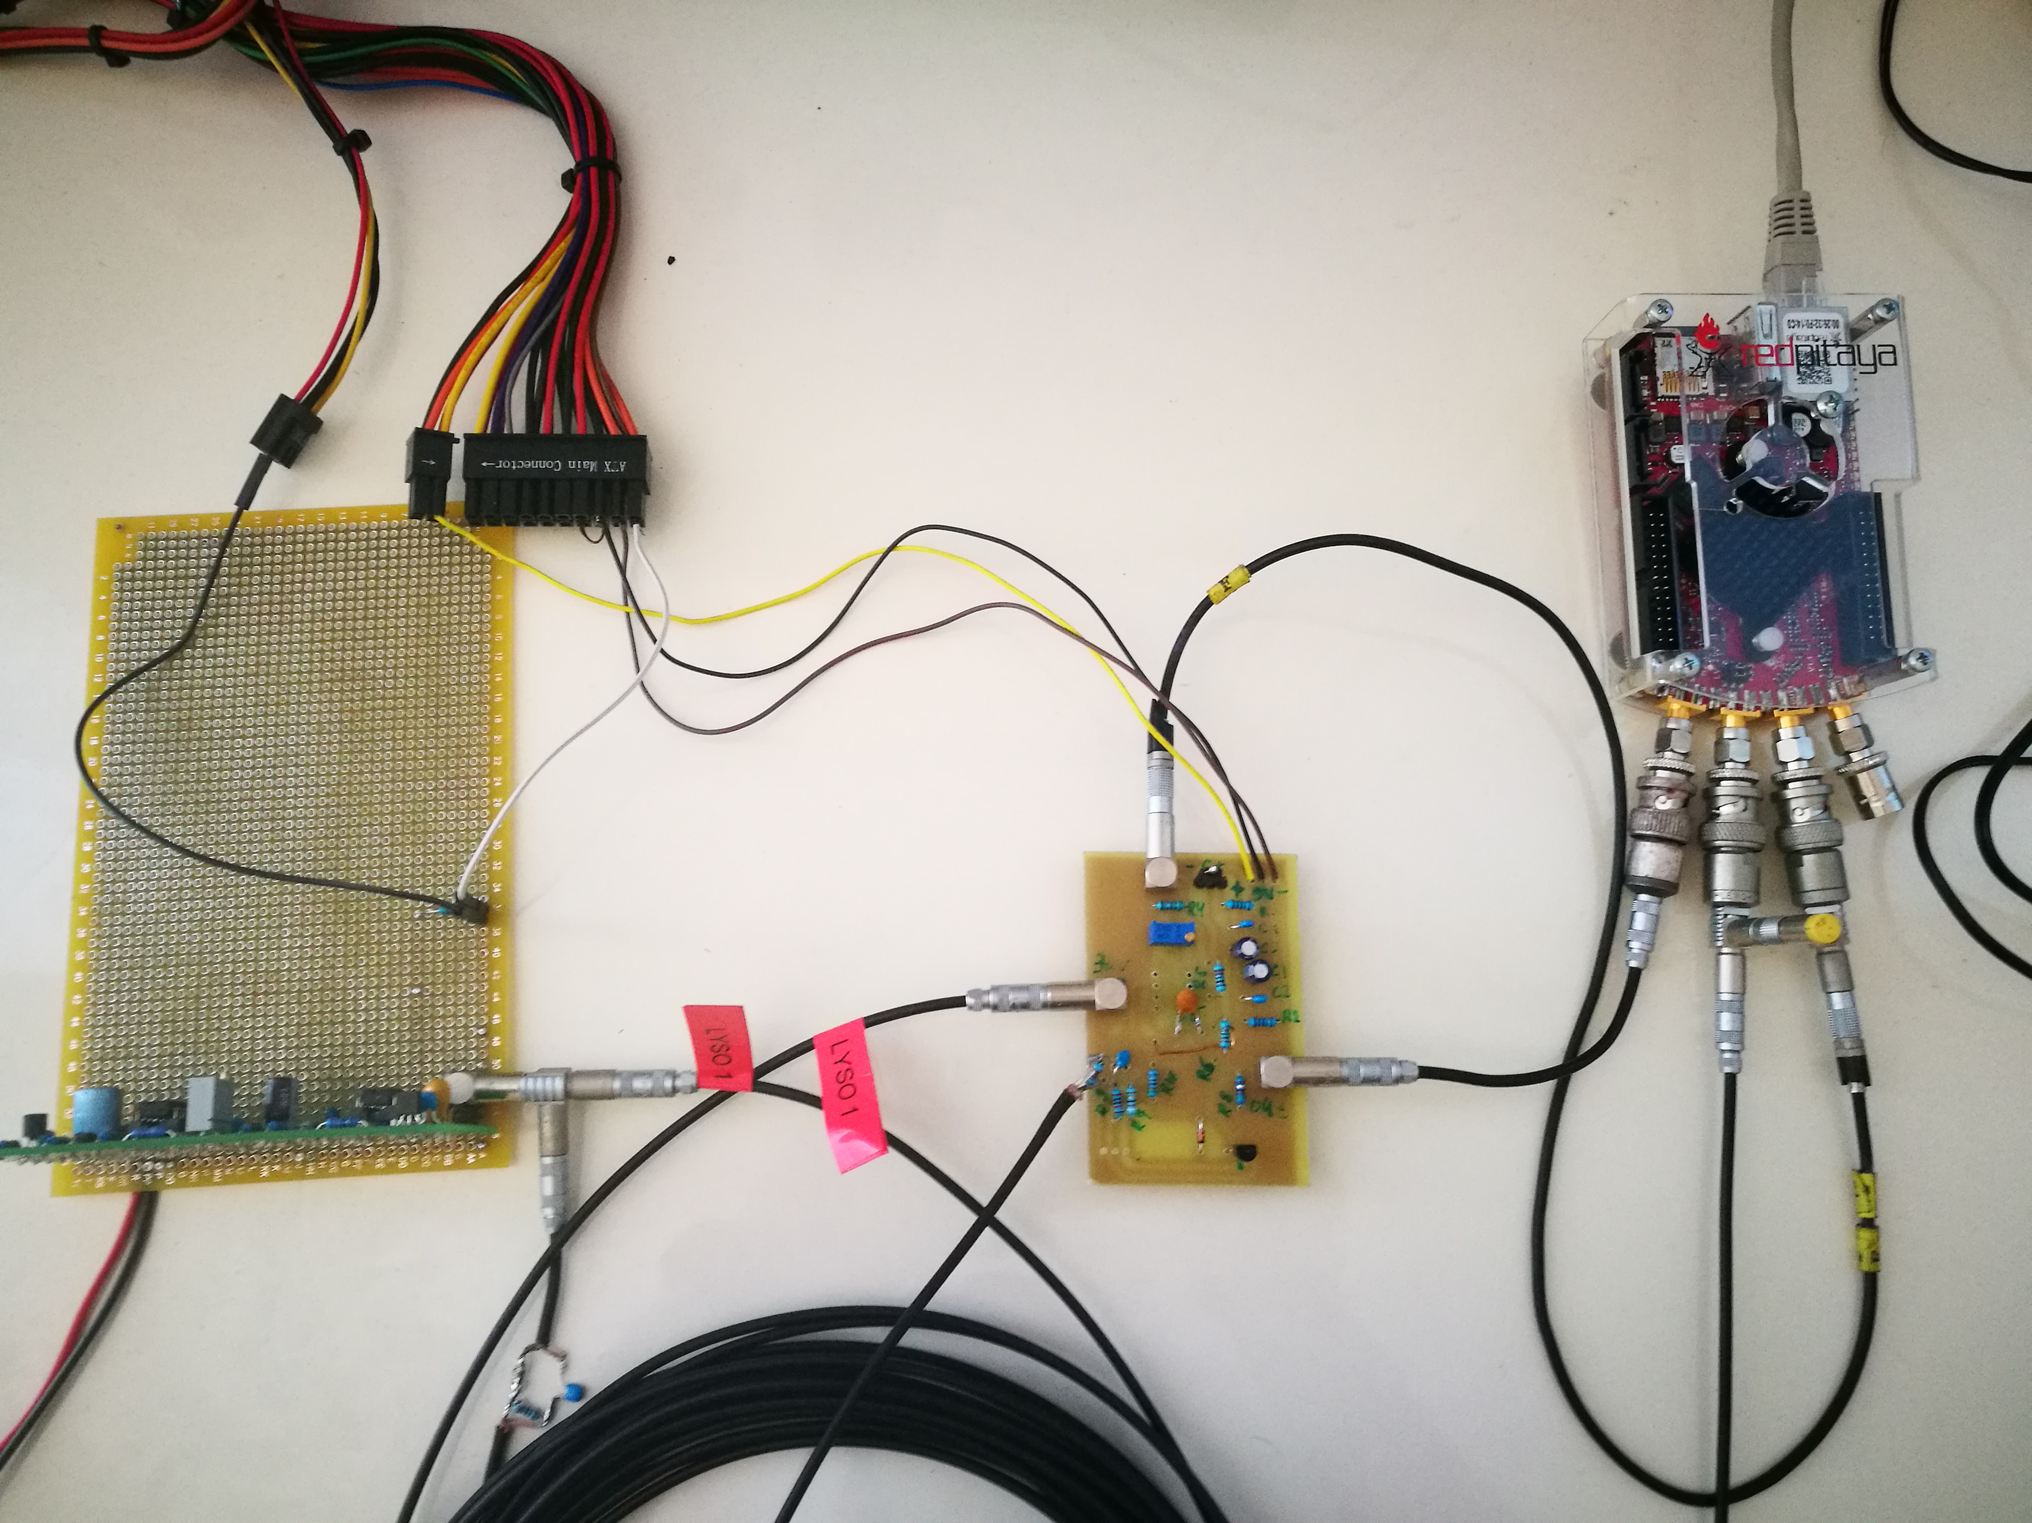
Testing Environment
PC power supply
Fast current sink
POWER SUPPLY
Red Pitaya
30/09/2017
Otari Javakhishvili
14

Slide 15
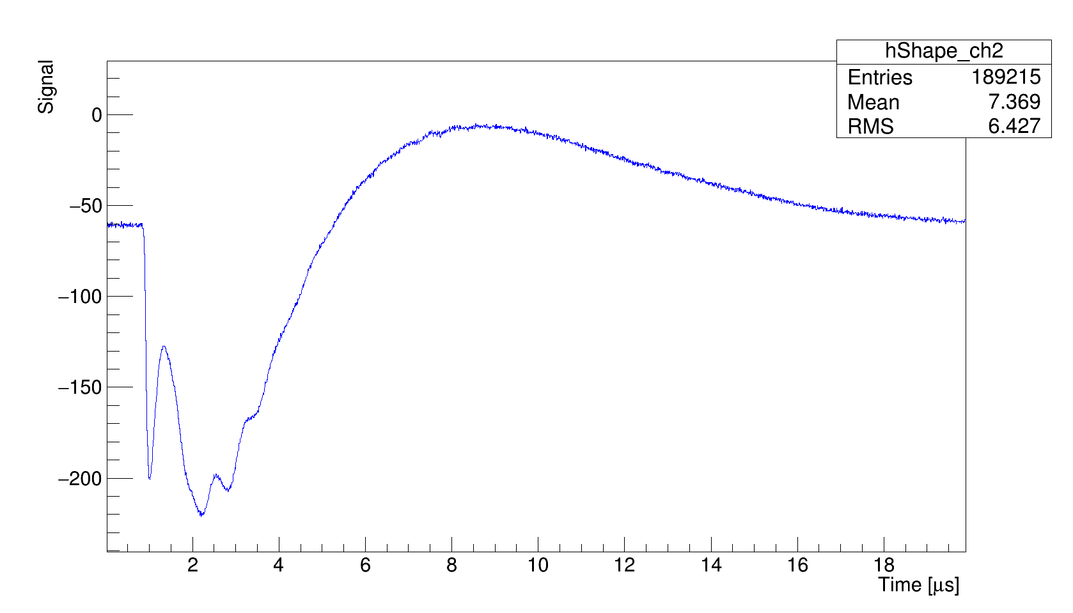
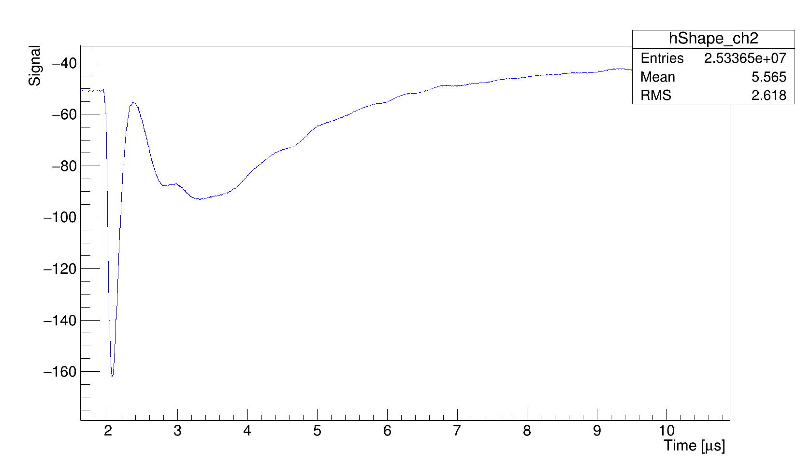
SiPM Board Test
≈21 mV Voltage drop
8uF capacitors original board
≈6 mV Voltage drop
40uF capacitors
30/09/2017
Otari Javakhishvili
15

Slide 16
Summary & Outlook
First version of modular voltage supply for SiPMs was successfully tested
Dedicated test bench was developed for SiPM power system testing
We are going to continue SiPM board tests for further improvement
Develop a multichannel voltage monitoring system for next beam time
Add current sensing and remote voltage adjustment to the supply
30/09/2017
Otari Javakhishvili
16

