Slide 1
Search for permanent electric dipole moments of protons and deuterons using storage rings
April 21, 2016 Frank Rathmann (on behalf of JEDI)
EDM Collaboration Meeting, CAPP, IBS, Daejeon, South Korea

Slide 2
Outline
Introduction
Recent Achievements
Spin coherence time
Spin tune measurement
Study of magnetic machine imperfections
Technical challenges
Toward a first direct $p,d$ EDM measurement
Conclusion

Slide 3
Five questions:
Why do we observe matter and almost no antimatter if we believe there is a symmetry between the two in the universe?
What is this "dark matter" that we can't see that has visible gravitational effects in the cosmos?
Why can't the Standard Model predict a particle's mass?
Are quarks and leptons actually fundamental, or made up of even more fundamental particles?
Why are there exactly three generations of quarks and leptons? How does gravity fit into all of this?
From http://particleadventure.org/beyond_start.html

Slide 4
Physics: Observed Baryon Asymmetry
Carina Nebula: Largest-seen star-birth regions in the galaxy
 | ${(n}_{B}−n_{\overline{B}})/n_{γ}$
Observed | $$(6.11±0.19)×{10}^{−10}$$ | WMAP+COBE (2003)
SM exp. | $$\sim {10}^{−18}$$
Why this strange number? Why not zero?
Search for new physics beyond the standard model
Mystery of missing antimatter addresses the puzzle of our existence

Slide 5
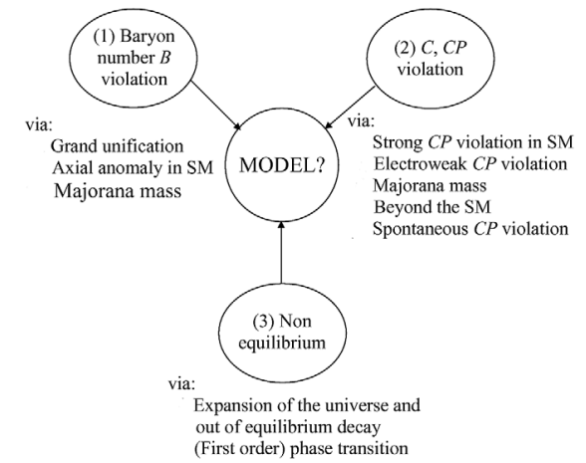
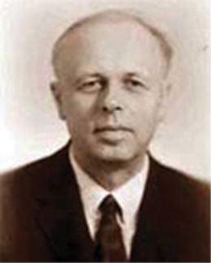
Physics: Baryogenesis
(1967)
Ingredients for baryogenesis: 3 Sakharov conditions

Slide 6
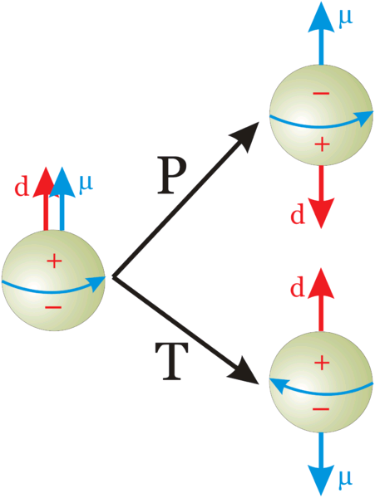
EDMs: Discrete Symmetries
Not Charge symmetric
$$\vec{d}$$
(aligned with spin)
Permanent EDMs violate both $P$and $T$symmetry.
Assuming $CPT$to hold, $CP$violated also.
Notes:
6
6

Slide 7
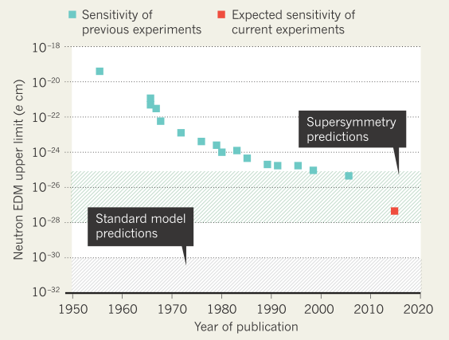
Introduction: Precision Frontier
Example: Neutron (nEDM)
Adapted from: Nature,
Vol 482 (2012)
Search for Electric Dipole Moments (EDM) of fundamental particles

Slide 8
Introduction: Why charged particle EDMs?
No direct measurements of charged hadron EDMs
Potentially higher sensitivity than neutrons
longer life time
more stored polarized protons/deuterons
larger electric fields
Approach complimentary to neutron EDM
$d_{d}=d_{p}+d_{n}⇒$ access to $θ_{QCD}$
EDM of a single particle not sufficient to identify CP-violating source
$$?$$
Charged particle EDM experiments can potentially provide a higher sensitivity than nEDM

Slide 9
EDMs: Naive estimate of the nucleon EDM scale
Khriplovich & Lamoreux (1997); Nikolaev (2012)
$CP$ & $P$ conserving magnetic moment $≈$ nuclear magneton $μ_{N}$
$$μ_{N}=\frac{e}{2m_{p}}\sim {10}^{−14}e cm$$
A non-zero EDM requires
$P$violation: the price to pay is $≈{10}^{−7}$, and
$CP$violation (from K-decays): the price to pay is $≈{10}^{−3}$
In summary:
In SM (without $θ$ term):
$$\left|d_{N}\right|≈{10}^{−7}×{10}^{−3}×μ_{N}≈{10}^{−24} e cm$$
$$\left|{d_{N}}^{SM}\right|≈{10}^{−7}×{10}^{−24}≈{10}^{−31} e cm$$
$⇒$ Region to search for BSM physics $\left(θ_{QCD}=0\right)$ using nucleon EDMs: ${10}^{−24}e cm>\left|d_{N}\right|>{10}^{−31} e cm$

Slide 10
Concept: Experimental requirements
High precision, primarily electric storage ring
alignment, stability, field homogeneity, and shielding from perturbing magnetic fields
High beam intensity ($N=4∙{10}^{10} per fill$)
Stored polarized hadrons ($P=0.8$)
Large electric fields ($E=10 MV/m$)
Long spin coherence time ($τ_{SCT}=1000 s$)
Efficient polarimetry ($analyzing power A_{y}≈0.6, f=0.005$)
$$σ_{stat}≈\frac{1}{\sqrt{N∙f}∙τ∙P∙A_{y}∙E} ⇒σ_{stat}\left(1 year\right)={10}^{−29} e∙cm$$
Goal: provide $σ_{syst}$ to the same level

Slide 11
Concept: Frozen spin Method
For transverse electric and magnetic fields in a ring, the
anomalous spin precession is described by Thomas-BMT equation:
$${\vec{Ω}}_{MDM}=\frac{q}{m}\left\{G∙\vec{B}−\frac{γG}{γ+1}\vec{β}\left(\vec{β}∙\vec{E}\right)−\left[G−\frac{1}{γ^{2}−1}\right]\frac{\vec{β}×\vec{E}}{c}\right\}$$
$$\left(G=\frac{g−2}{2}\right)$$
Magic condition: Spin along momentum vector
For any sign of $G$, in a combined electric and magnetic machine
$E=\frac{GBcβγ^{2}}{1−Gβ^{2}γ^{2}}≈GBcβγ^{2}$, where $E=Eradial$ and $B=Bvertical$
For $G>0$(protons) in an all electric ring
$G−{\left(\frac{m}{p}\right)}^{2}=0 ⇒p=\frac{m}{\sqrt{G}}=700.74 MeV/c$ (magic)
→ Magic rings to measure EDMs of free charge particles

Slide 12
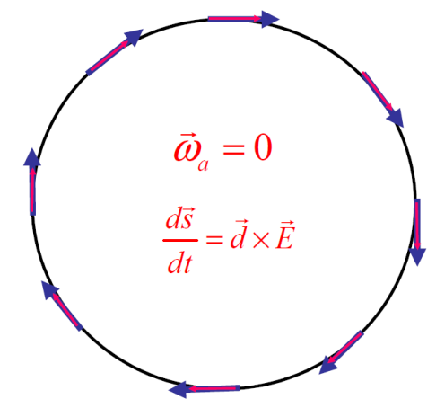
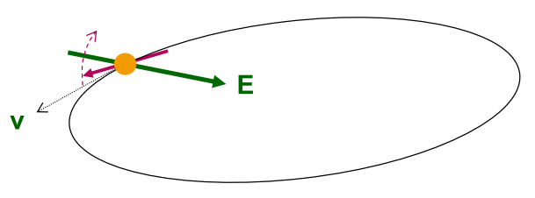
Concept: Rings for EDM searches
Place particles in a storage ring
Align spin along momentum („freeze“ horizontal spin precession)
Search for time development of vertical polarization
$${\vec{ω}}_{G}=0$$
$$\frac{d\vec{s}}{dt}=\vec{d}×\vec{E}$$
New Method to measure EDMs of charged particles:
Magic rings with spin frozen along momentum
Polarization buildup $P_{y} (t) \sim d$
Notes:
12
12

Slide 13
Concepts: Magic Storage ring
A magic storage ring for protons (electrostatic), deuterons, …
B
$${\vec{ω}}_{G}=0$$
$$\frac{d\vec{s}}{dt}=\vec{d}×\vec{E}$$
particle | $$p (MeV/c)$$ | $$T (MeV)$$ | $$E (MV/m)$$ | $$B (T)$$
proton | $$701$$ | $$232.8$$ | $$16.789$$ | $$0.000$$
deuteron | $$1000$$ | $$249.9$$ | $$−3.983$$ | $$0.160$$
$$3He$$ | $$1285$$ | 280.0 | $$17.158$$ | $$−0.051$$
Possible to measure $p$, $d$, $3He$ using one machine with $r \sim 25$ m
Notes:
13
13

Slide 14
Concept: Systematics
Magnetic fields:
Radial field $B_{r}$ mimics EDM effect when $μ×B_{r}≈d×E_{r}$
With $d={10}^{−29} e∙cm$ in a field of $E=10 MV/m$,
$B_{r}=\frac{dE_{r}}{μ_{n}}=\frac{{10}^{−31}∙{10}^{7}eV}{3.152∙{10}^{−8} eV/T}=3.1∙{10}^{−17} T$
Solution: Use two beams simultanously, clockwise (CW) and counter-clockwise (CCW), the vertical separation of the beam orbits is sensitive to $B_{r}$.
Use CW and CCW beams to tackle systematics

Slide 15
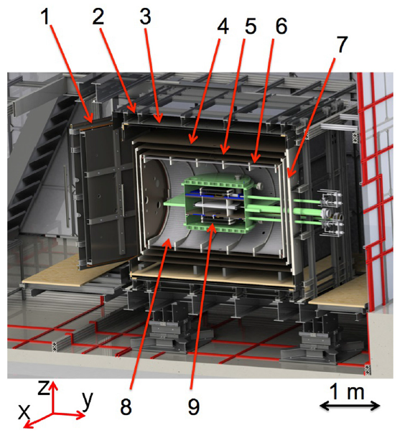
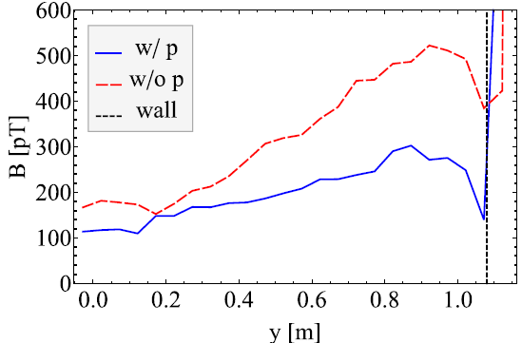
Recent Progress: Magnetic shielding
Next generation nEDM experiment under development at TUM (FRM II):
Goal: Improve present nEDM limit by factor $100$.
Experiment shall use multi-layer shield.
Applied magnetic field: $B≈1–2.5 μT$.
J. Appl. Phys. 117 (2015)
At mHz frequencies, damping of $\left|B_{ext}\right|≈1∙{10}^{6}$achieved

Slide 16
Concept: Systematics, Orbit splitting (Dave Kawall)
Splitting of beam orbits: $δy=±\frac{βcR_{0}B_{r}}{E_{r}{Q_{y}}^{2}}=±1∙{10}^{−12} m$
$Q_{y}≈0.1$ denotes the vertical betatron tune
Modulate $Q_{y}={Q_{y}}^{0}\left[1−m\cos\left(ω_{m}t\right)\right],$with $m≈0.1$
Splitting corresponds to $B≈0.4∙{10}^{−3} fT$
In one year of measurement: ${10}^{4}$ fills of $1000 s$ each $⇒ σ_{B}=0.4∙{10}^{−1}fT$ per fill
Required sensitivity ${≈1.25 fT}/{\sqrt{Hz}}$, achievable with state-of-the-art SQUID magnetometers.

Slide 17
Outline
Introduction
Recent Achievements
Spin coherence time
Spin tune measurement
Study of magnetic machine imperfections
Technical challenges
Toward a first direct $p,d$ EDM measurement
Conclusion

Slide 18
Insert: Spin closed orbit and spin tune
Spin closed orbit
one particle with
magnetic moment
makes one turn
“spin closed orbit vector”
“spin tune”
$$=2πγG$$
stable polarization
ring
if ║
A
The number of spin precessions per turn is called spin tune $ν_{s}$

Slide 19
Challenge: Spin coherence time (SCT)
We usually don‘t worry about coherence of spins along ${\hat{n}}_{co}$
Polarization along ${\hat{n}}_{co}$not affected!
At injection all
spin vectors aligned (coherent)
After some time, spin vectors get out of phase and fully populate the cone
Situation very different, when you deal with $\vec{S}⊥ {\hat{n}}_{co}$ machines with frozen spin.
Longitudinal polarization vanishes!
At injection all spin vectors aligned
Later, spin vectors are out of phase in the horizontal plane
In a machine with frozen spins the buildup time
to observe a polarization $P_{y}\left(t\right)$ is limited by $τ_{SCT}$.

Slide 20
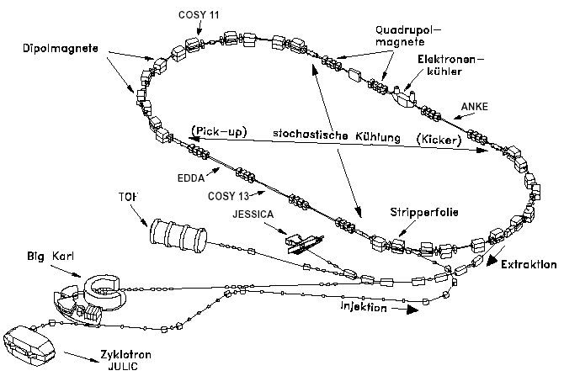
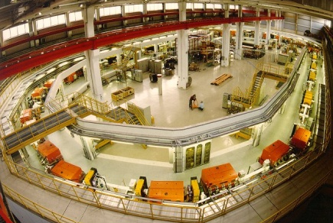
EDM at COSY: COoler SYnchrotron
Cooler and storage ring for (polarized) protons and deuterons
$$p=0.3 –3.7 GeV/c$$
Phase space
cooled internal &
extracted beams
COSY
… the spin-physics machine
for hadron physics
… an ideal starting point
for EDM search
Injector cyclotron
Notes:
20

Slide 21
Outline
Introduction
Recent Achievements
Spin coherence time
Spin tune measurement
Study of magnetic machine imperfections
Technical challenges
Toward a first direct $p,d$ EDM measurement
Conclusion

Slide 22
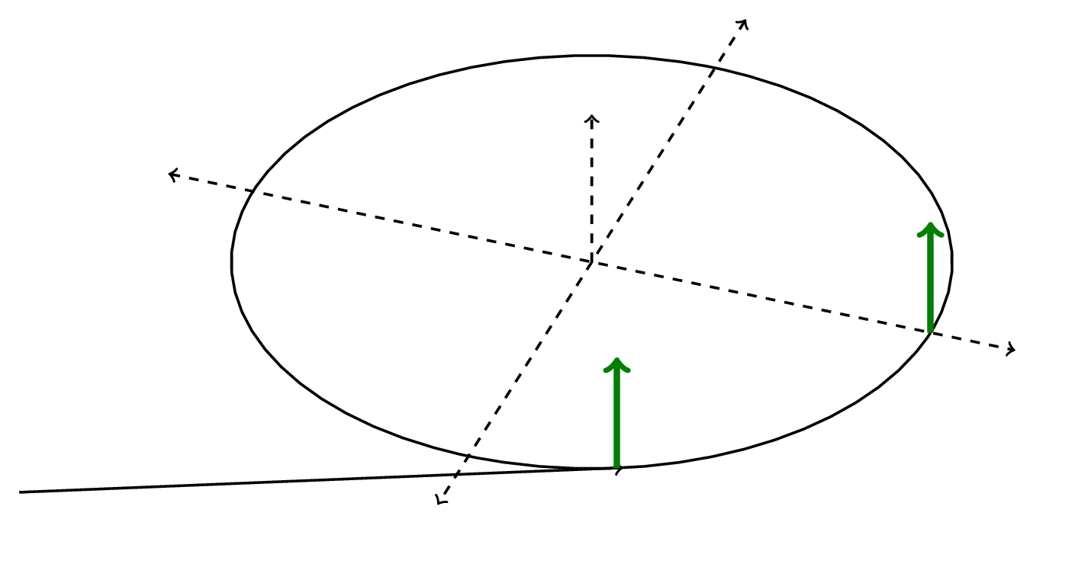
Spin coherence time: Experimental investigation
polarimeter
free precession
turn spin
Vertically polarized deuterons stored in COSY at $p≈1\frac{GeV}{c}$.
The polarization is flipped into horizontal plane with RF solenoid (takes $≈200 ms$).
Beam slowly extracted on Carbon target with ramped bump or by heating the beam.
Horizontal (in-plane) polarization determined from Up-Do asymmetry in the detector.
Experimental investigations of SCT in storage ring: Keep track of the event time and revolution time in each turn during a cycle of a few hundred seconds.

Slide 23
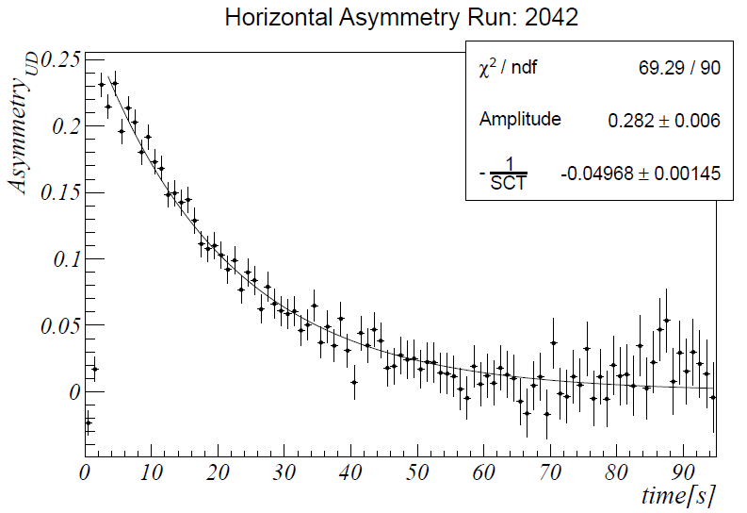
Polarimeter: Determination of SCT
Observed experimental decay of the asymmetry $ε_{UD}=\frac{N_{D}−N_{U}}{N_{D}+N_{U}}$ as function of time, $ε_{UD}(t)≈P(t)$.
$$τ_{SCT}≈20 s$$

Slide 24
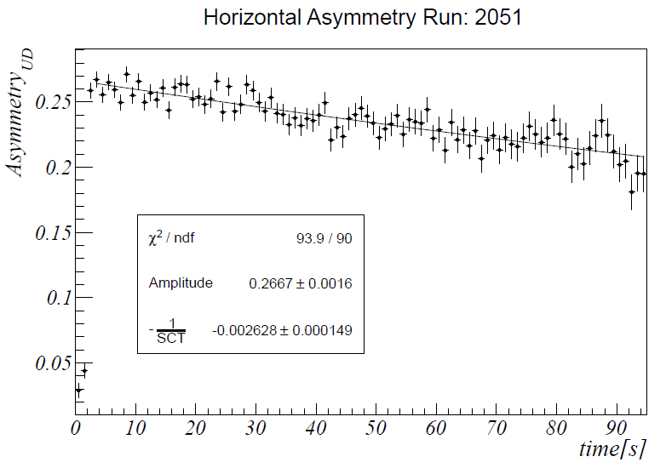
Polarimeter: Optimization of SCT
Using sextupole magnets in the machine, higher order effects can be corrected, and the SCT is substantially increased
$$τ_{SCT}≈400 s$$

Slide 25
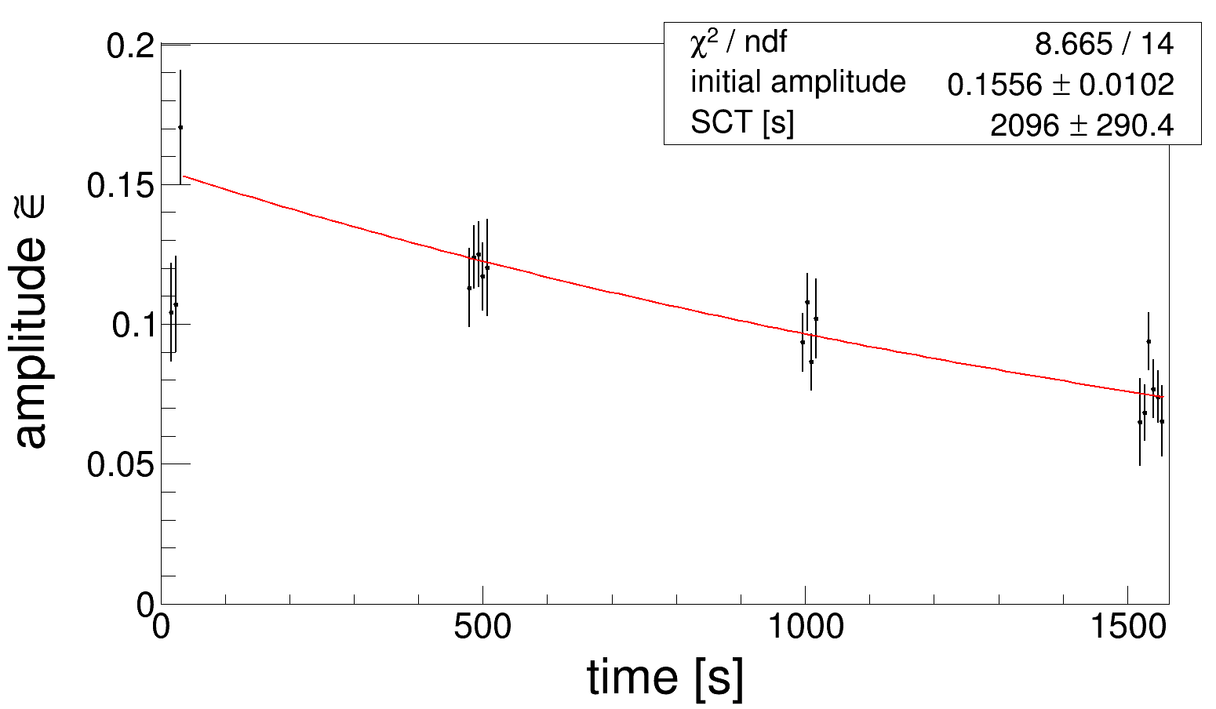
More progress on $τ_{SCT}$: Spring 2015
For further details, see talk by Ed Stephenson
Way beyond anybody’s expectations $→$ $σ_{stat}≈{τ_{SCT}}^{−1}$

Slide 26
Outline
Introduction
Recent Achievements
Spin coherence time
Spin tune measurement
Study of magnetic machine imperfections
Technical challenges
Toward a first direct $p,d$ EDM measurement
Conclusion

Slide 27
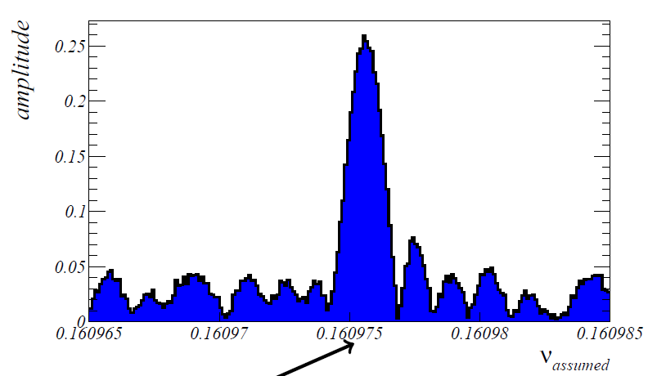
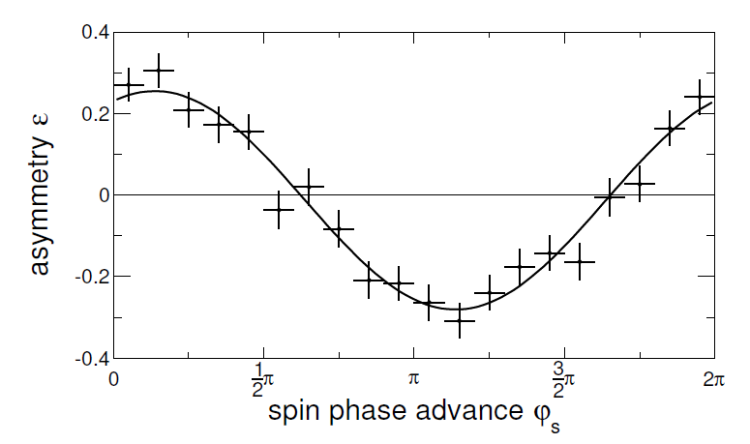
Spin tune $ν_{s}$: How to m$easure it$?
$ν_{s}≡\text{Number} \text{of} \text{spin} \text{precessions} \text{revolution}$, a priori not known ($≈γG$)
Detector rate is $≈5 kHz$, $f_{rev}=781 kHz →$ one hit in detector per $25$beam revolutions
Scan $ν_{s}$ in an interval around $γG$ and find maximum of asymmetry $ε_{UD}$
$$σ_{ν_{s}}≈{10}^{−6}$$
Solution: Map all events into one spin oscillation period

Slide 28
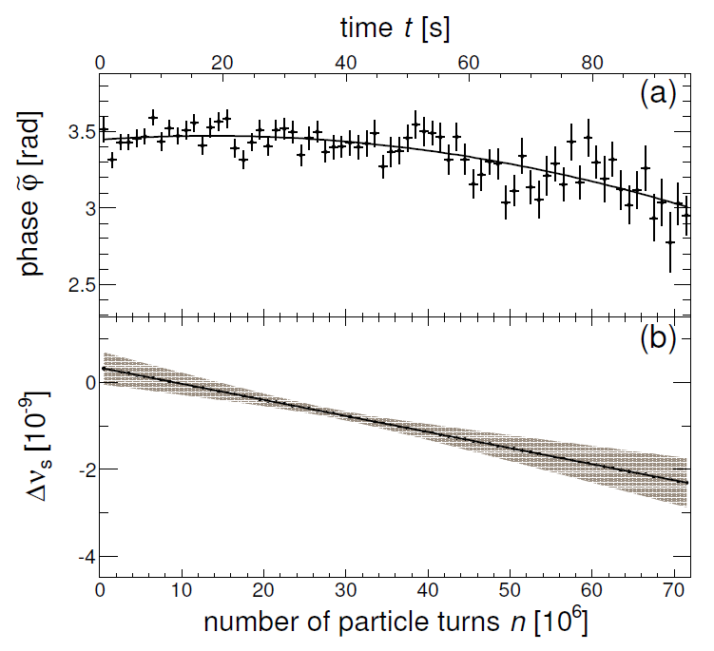
Spin tune: D$etermination of ν_{s}$
Monitor phase of asymmetry
with fixed $ν_{s}$ in a 100 s cycle.
$$ν_{s}\left(n\right)= {ν_{s}}^{fix}+\frac{1}{2π}\frac{d\tilde{φ}(n)}{dn}$$
$={ν_{s}}^{fix}+Δν_{s}(n)$
Spin tune $ν_{s}$ determined to $≈{10}^{−8}$ in 2 s time interval, and in a $100 s$cycle at $t≈40 s$ to ${≈10}^{−10}$ (PRL 115, 094801 (2015)

Slide 29
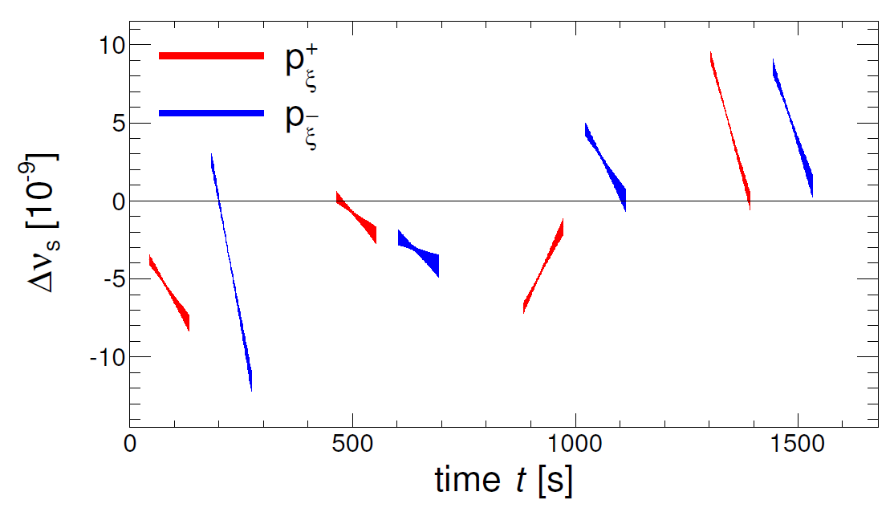
New precision tool: Spin tune determination
Observed behavior of subsequent cycles
Study long term stability of an accelerator
Develop feedback systems to minimize variations
Phase-locking the spin precession to RF devices possible

Slide 30
Outline
Introduction
Recent Achievements
Spin coherence time
Spin tune measurement
Study of magnetic machine imperfections
Technical challenges
Toward a first direct $p,d$ EDM measurement
Conclusion

Slide 31
Systematic study: Machine imperfections using two straight section solenoids
Systematic effects from machine imperfections limit the achievable precision in an EDM experiment using an RF $E×B$ Wien filter.
Idea: The precise determination of the spin tune $\left(\frac{{Δν}_{s}}{ν_{s}}≈{10}^{−10} \text{in} \text{one} \text{cycle}\right)$ can be exploited to map out the magnetic imperfections of COSY.
COSY provides two solenoids in opposite straight sections:
one of the compensation solenoids of the 70 kV cooler: $\int{B_{z}dz≈0.15 Tm}$,
The main solenoid of the 2 MV cooler: $\int{B_{z}dz≈0.54 Tm}$.
Both are available dynamically in the cycle, i.e., their strength can be adjusted on flat top.

Slide 32
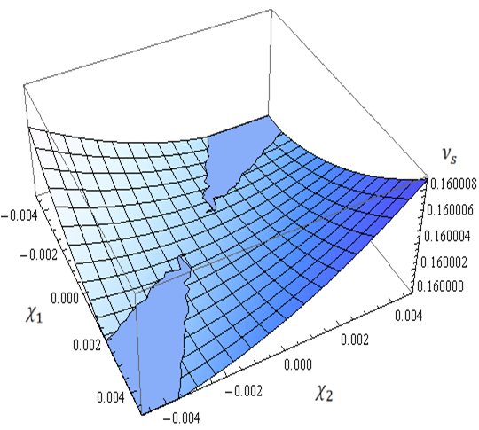
Systematic study: Simulation of one imperfection spin kick for deuterons at $970$MeV/c
Ideal machine with vanishing static imperfections: Saddle point at the origin
Intrinsic imperfection kick $α_{x} = 0.001$ shifts saddle point away from origin
sea level at $Gγ (=0.16)−5 ∙{10}^{−7}$
Location of imperfection: $Θ^{∗}=π/3$

Slide 33
Systematic study: Thomas-BMT eq. $(d≠0)$in magnetic machine
Goal: explore dynamics and systematic limitations of EDM searches in magnetic ring
$$\frac{d\vec{s}}{dt}=\vec{s}×\left({\vec{Ω}}_{MDM}+{\vec{Ω}}_{EDM}\right)$$
$${\vec{Ω}}_{MDM}=\frac{q}{m}\left\{G∙\vec{B}−\frac{γG}{γ+1}\vec{β}\left(\vec{β}∙\vec{E}\right)−\left[G−\frac{1}{γ^{2}−1}\right]\frac{\vec{β}×\vec{E}}{c}\right\}$$
$\vec{μ}=g\frac{qℏ}{2m}\vec{s}=\left(G+1\right)$ $\frac{qℏ}{m}\vec{s}$, and $\vec{d}=\frac{ηqℏ}{2m}\vec{s}$
$${\vec{Ω}}_{EDM}=\frac{ηq}{2mc}\left\{\vec{E}−\frac{γ}{γ+1}\vec{β}\left(\vec{β}∙\vec{E}\right)+c\vec{β}×\vec{B}\right\}$$
BMT for magnetic machine with $d≠0:$
$$\frac{d\vec{s}}{dt}=\frac{q}{m}\left\{G∙\vec{B}+\frac{η}{2}\left(\vec{β}×\vec{B}\right)\right\}$$
Interaction of EDM with motional E-field $(\vec{β}×\vec{B}$) tilts stable spin axis:
$${\vec{n}}_{co}={\vec{e}}_{x}\sin{ξ+{\vec{e}}_{y}\cos{ξ}}$$
$$\tan{ξ=\frac{η}{2G}β}$$
$$η=2d\frac{m}{q}$$
Misalignment of magnetic elements produces in-plane imperfection magnetic fields:
$${\vec{n}}_{co}={\vec{e}}_{x}c_{1}+{\vec{e}}_{y}c_{2}+{\vec{e}}_{z}c_{3}$$
Non-vanishing $c_{1}$ and $c_{3}$ generate background to the EDM-signal of an ideal imperfection-free machine ($c_{1}=\sin{ξ}$, $c_{2}=\cos{ξ}$and $c_{3}=0$).
The challenge is to control this background:
An accuracy $∆c_{1,3}≈{10}^{−6} rad$ amounts to a sensitivity $d={10}^{−20} e∙cm$.

Slide 34
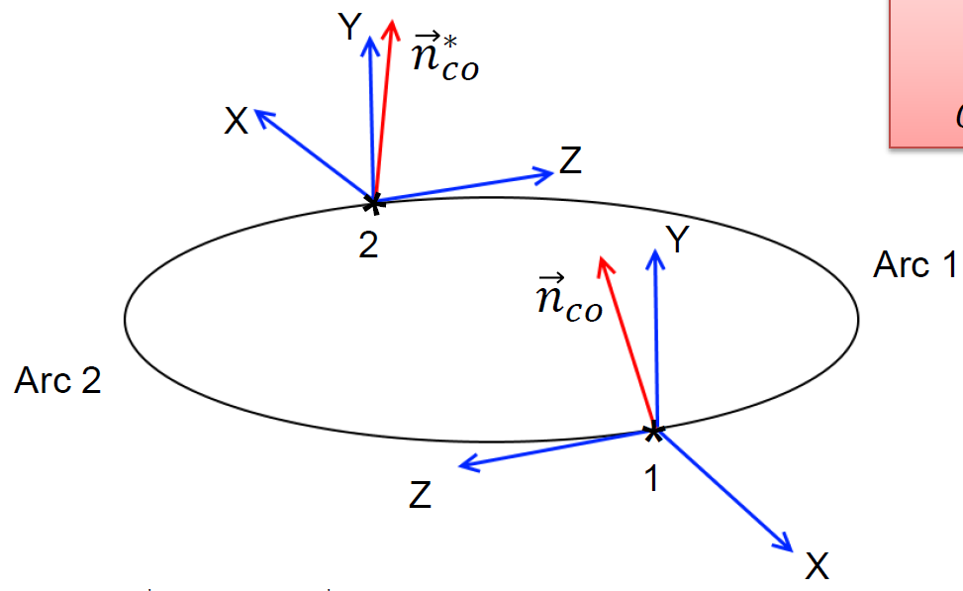
Systematic study: Imperfection measurement
Probing the in-plane imperfection fields by introducing artificial imperfections and looking for the spin tune response
Use the compensation and e-cooler solenoids in straight sections (points 1 and 2): spin kicks $χ_{1}$ and $χ_{2}$.
$${{\vec{n}}_{co}}^{∗}={\vec{e}}_{x}{c_{1}}^{∗}+{\vec{e}}_{y}{c_{2}}^{∗}+{\vec{e}}_{z}{c_{3}}^{∗}$$
$${\vec{e}}_{x}c_{1}+{\vec{e}}_{y}c_{2}+{\vec{e}}_{z}c_{3}={\vec{n}}_{co}$$
The values of ${(c}_{1},c_{2})$, and $\left(c_{3},{c_{3}}^{∗}\right)$ depend of spin kicks in non-vertical imperfection fields in the arcs $→$ spin tune perturbed:
$ν_{s}=Gγ+O({c_{1}}^{2},{c_{3}}^{2},{{c_{1}}^{∗}}^{2},{{c_{3}}^{∗}}^{2})$
Probe the in-plane imperfection fields by introducing well-known artificial imperfections $χ_{1}$ and $χ_{2}$.

Slide 35
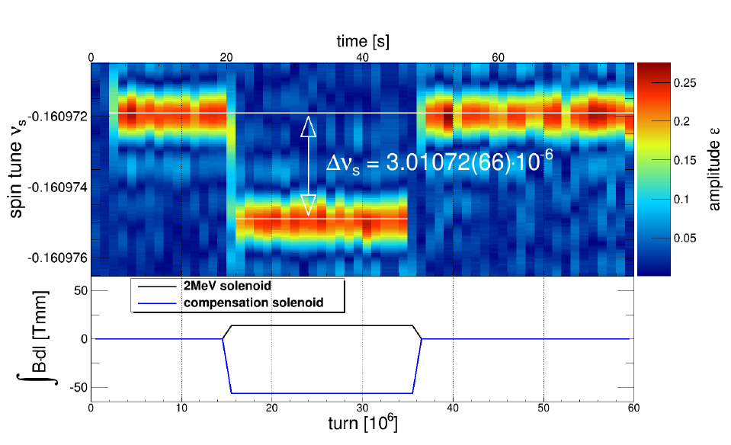
Systematic study: Measurement of spin tune shift
Take multiple measurements with different $χ_{1}$, $χ_{2}$, build a spin tune map $Δν_{s}(χ_{1},χ_{2})$

Slide 36
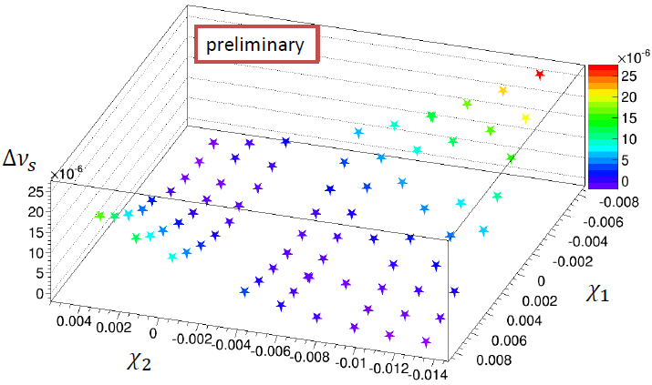
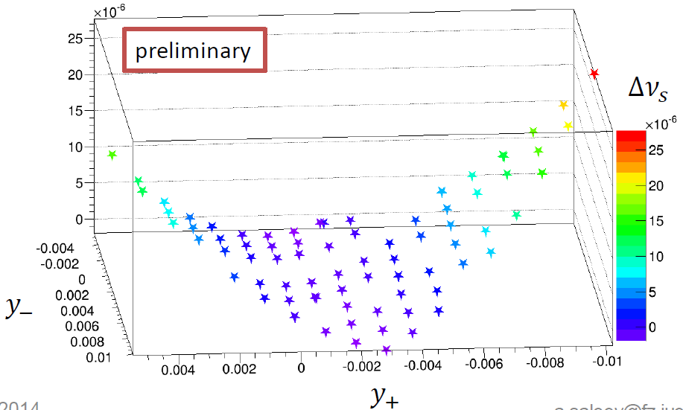
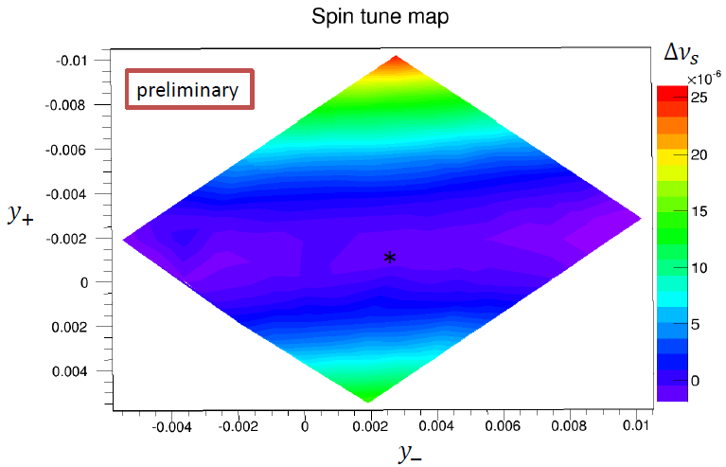
Systematic study: Mapping machine
imperfections
Map translated to
$$y_{+}=\frac{χ_{1}+χ_{2}}{2}$$ $$y_{−}=\frac{χ_{1}−χ_{2}}{2}$$
$$⇒$$
$$Δν_{s}≈{y_{+}}^{2},{y_{−}}^{2}$$
$$⇒$$
$$⇒$$
Fit map to locate saddle point
$$⇒$$
From the map taken on 18+19.09.2014, with the baseline spin tune at $υ_{s}=\text{−0.160971917 }$, one finds: $c_{3} =−0.0034±2∙{10}^{−7}$ ${c_{3}}^{∗}=−0.0021±6∙{10}^{−8}$.

Slide 37
Systematic study: Mapping imperfections
Map translated to
$$y_{+}=\frac{χ_{1}+χ_{2}}{2}$$ $$y_{−}=\frac{χ_{1}−χ_{2}}{2}$$
Extremum of spin tune map is saddle point at $y_{+},y_{−}=O(c_{3},{c_{3}}^{∗})$.
Once baseline spin tune $ν_{s}$determined, ${(c}_{3},{c_{3}}^{∗})$are only fit parameters.
Solenoids only are not sensitive to $c_{1},{c_{1}}^{∗}$ ($→$static WF with $B_{x}$ and $E_{y}$).
$$⇒$$
$$Δυ_{s}≈{y_{+}}^{2},{y_{−}}^{2}$$
$$⇒$$
$$⇒$$
$$⇒$$
New technique allows one to determine experimentally components of spin closed orbit ${\vec{n}}_{co}$ in storage ring with unprededented precision (not achievable from polarization measurements alone).

Slide 38
Outline
Introduction
Recent Achievements
Spin coherence time
Spin tune measurement
Study of magnetic machine imperfections
Technical challenges
Beam position monitors
Electrostatic deflectors
Toward a first direct $p,d$ EDM measurement
Conclusion

Slide 39
Technical challenges: Overview
Charged particle EDM searches require the development of a new class of high-precision machines with mainly electric fields for bending and focussing.
Issues are:
Electric field gradients $\left(\sim 17 \frac{MV}{m} \right)$ at $\sim 2 cm$ plate distance ☒
Spin coherence time $(≥1000 s)$ ☑
Continuous polarimetry $\left(<1 ppm\right)$ ☑
Beam position monitoring $\left(10 nm\right)$ ☒
Spin tracking ☒
These issues must be addressed experimentally at existing facilities

Slide 40
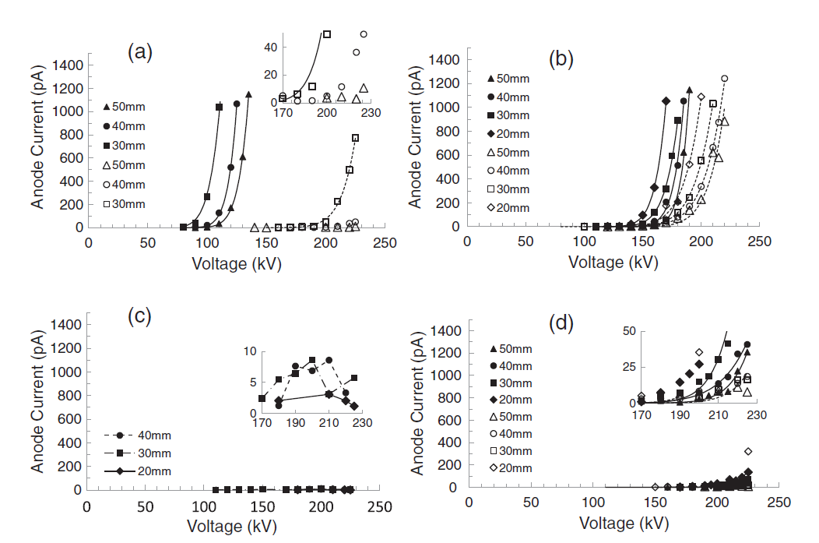
Challenge: Niobium electrodes
DPP stainless steel
fine-grain Nb
Show one slide on JLAB data HV devices
large-grain Nb
single-crystal Nb
large-grain Nb
Large-grain Nb at plate separation of a few cm yields ~20 MV/m

Slide 41
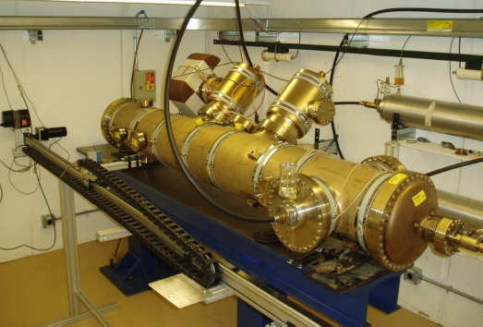
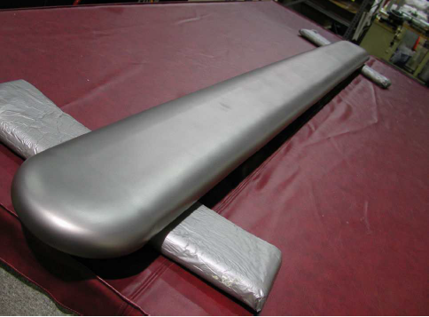
Challenge: Electric deflectors for magic rings
Electrostatic separators at Tevatron were used to avoid unwanted $\overline{p}p$ interactions - electrodes made from stainless steel
L~2.5 m
Routine operation at $1 spark/year$at $6 MV/m$
May 2014: Transfer of separator unit plus equipment from FNAL to Jülich
Need to develop new electrode materials and surface treatments

Slide 42
Challenge: Electric deflectors for magic rings
Deflector development will use scaled models $\sim 1:10$
Electric fields are the same, but voltages $<20 kV$
Avoids shielding of x-rays
Allows tests to be done in usual lab environment
Development of real size combined elements (E & B)
Begin EDM search with deuterons
Use existing dipole magnet of internal ANKE spectrometer
Allows for tests with beam
Development of new deflector materials, treatment methods towards high fields $E\sim 20 MV/m$, and combined E-B deflectors

Slide 43
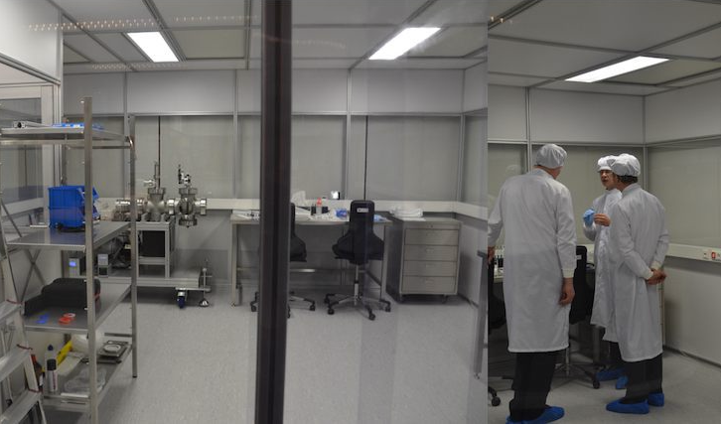
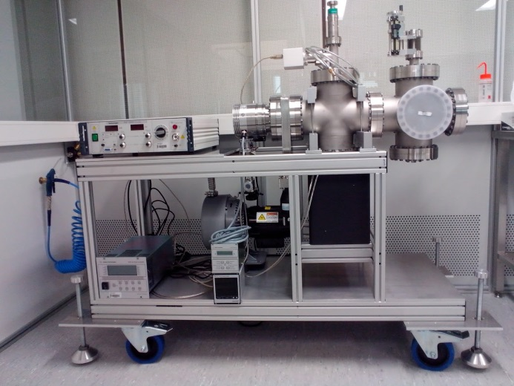
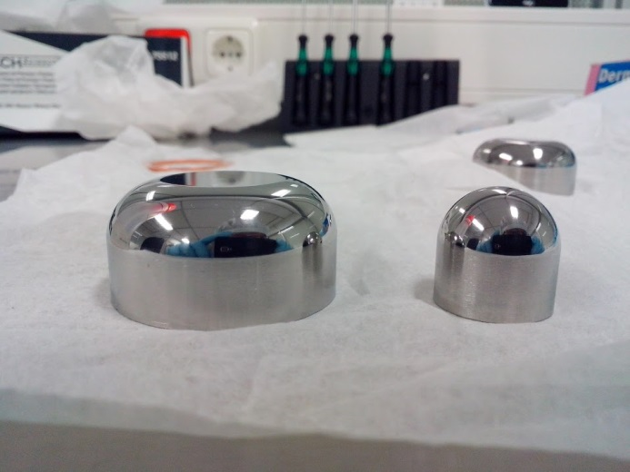
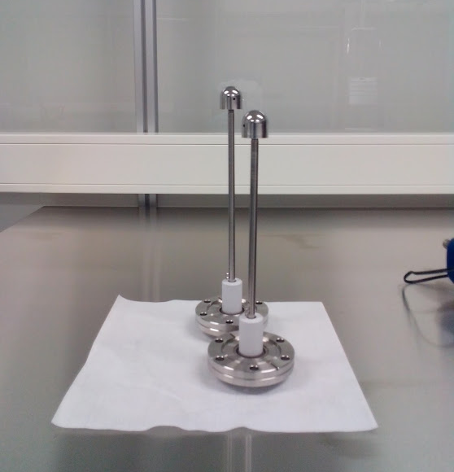
Electrostatic deflectors: Clean room at RWTH
Prof. Marquardt chairman of FZJ directors board and Prof. Schmachtenberg Rektor of RWTH Aachen
Test bench at RWTH Aachen
Development of mall scale deflector elements in cooperation with RWTH (Kirill Grigoriev).
But: Results need to be verified using 1:1 deflector models (Jülich).

Slide 44
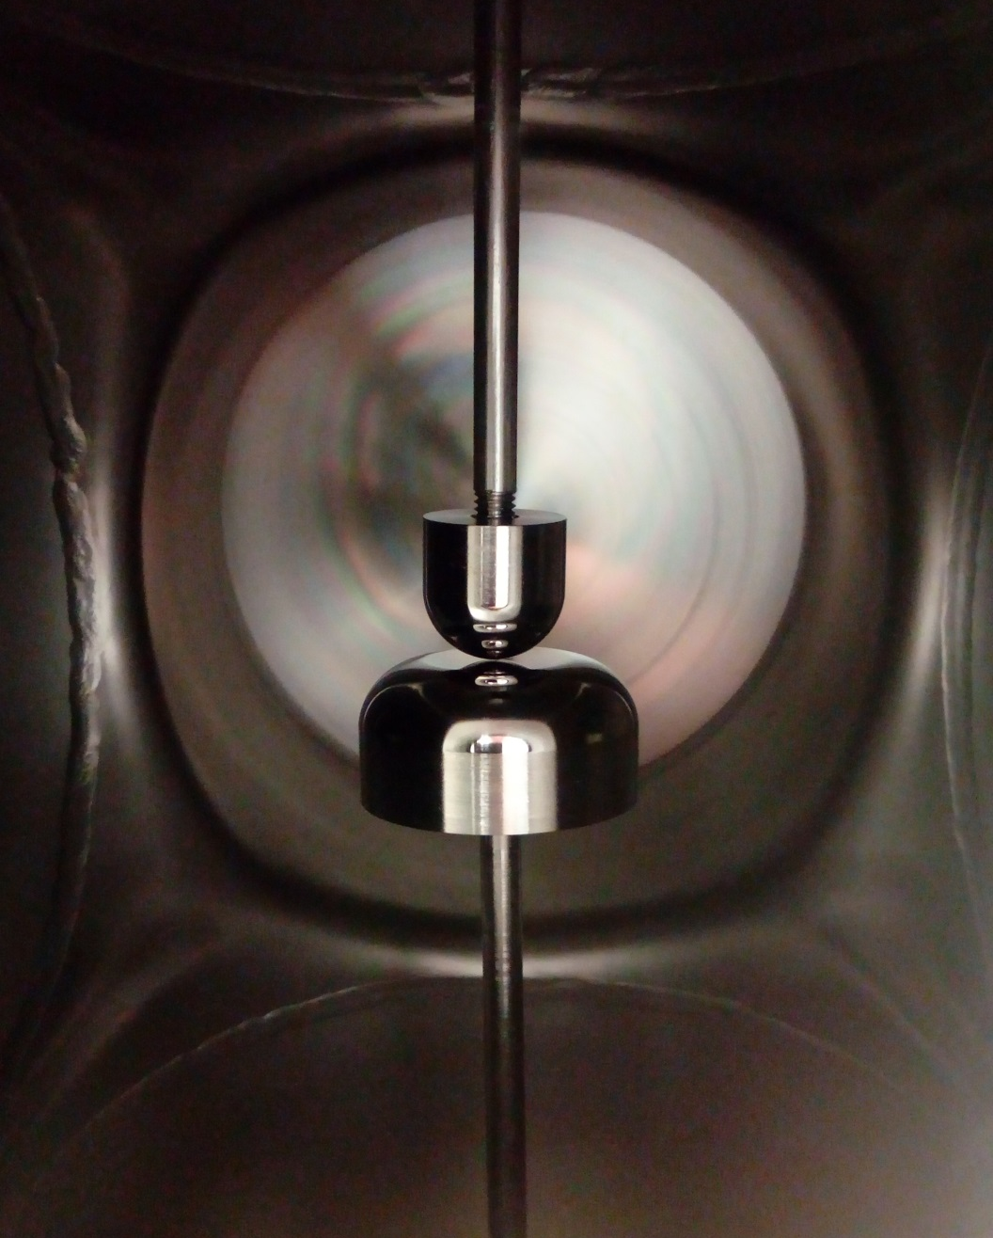
Different shape of the electrodes
Electrostatic deflectors: Some results
Material : Stainless steel, Aluminum
Mechanical polished and cleaned
Stainless steel
Two small half-spheres (R = 10mm)
17kV at 1mm distance → 17 MV/m
Half-sphere vs. flat surface
12kV at 0.05 mm distance → 240 MV/m
Aluminum
Two small half-spheres (R = 10mm)
3kV at 0.1mm distance → 30 MV/m

Slide 45
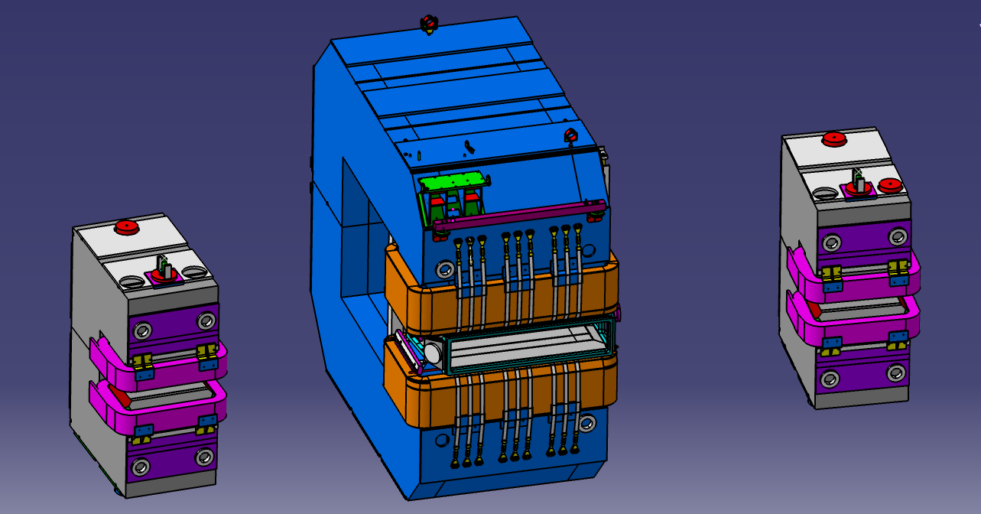
Large scale elements: ANKE chicane at COSY
D2
D3
D1
Idea (Jürgen Böker): Produce E-B deflector by insertion of
deflector element into D2 magnet chamber.

Slide 46
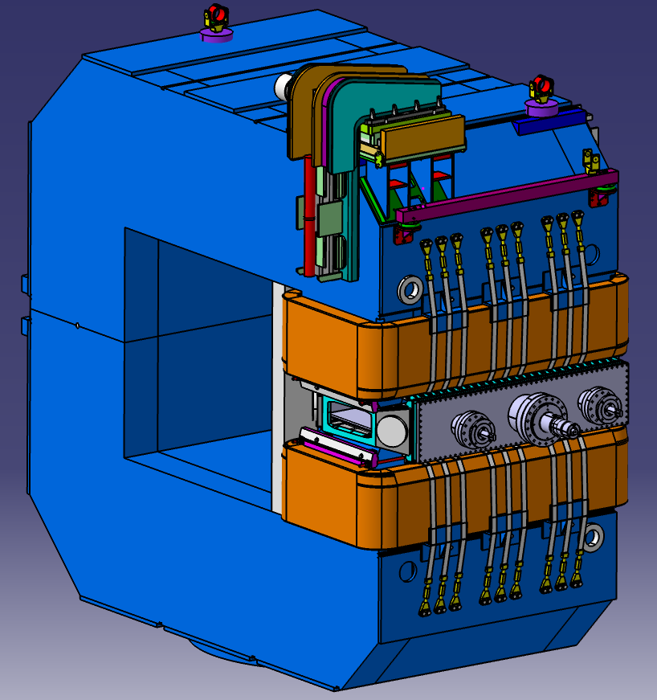
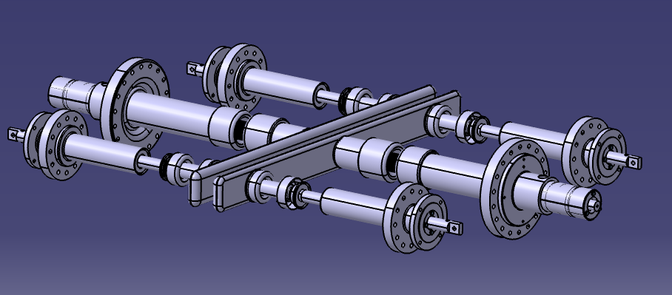
Large-scale E-B deflector development
D2 magnet: $$Bmax = 1.6 T, m = 64 t$$
Actuators
Deflector
Feed-Throughs
Deflector: Length: $1020 mm$, Height: $90 mm$, Gap: $40 − 80 mm$
Begin development with straight elements, lateron test bent elements.

Slide 47
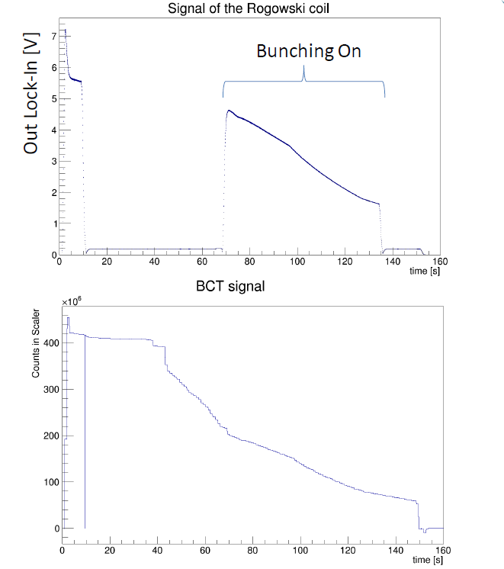
Challenge BPMs: Rogowski coil
Integral signal measures beam current
Quadrant signals sensitive to position
Installed in ANKE target chamber
Rogowski coil
Readout
BCT
Bunched beam
For bunched beams, sum signal of Rogowski coil can be used as a beam current monitor.

Slide 48
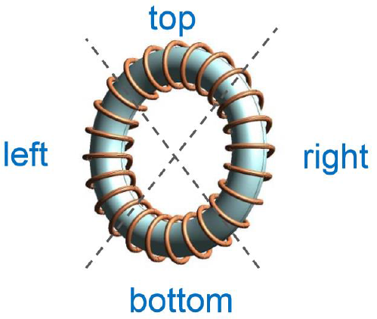
Challenge BPMs: Rogowski coil
Integral signal measures beam current
Quadrant signals sensitive to position
EDM experiments use bunched beams:
Rogowski coil system well-suited.
Small size allows for flexible installation ($→$ Stripline RF Wien filter)
up
$$x=\frac{left−right}{left+right}$$
$$y=\frac{up−down}{up+down}$$
left
right
Dynamic range
${10}^{8}−{10}^{11}$ particles
Maximum deviation from axis $≈40 mm$
Resolution: $10 nm$
down
Quadrant signals of Rogowski coil sensitive to beam position.
Tests at COSY can be carried out parasitically.

Slide 49
Outline
Introduction
Recent Achievements
Spin coherence time
Spin tune measurement
Study of magnetic machine imperfections
Technical challenges
Toward a first direct $p,d$ EDM measurement
Conclusion

Slide 50
Idea for proof-of-principle srEDM experiment
Use an RF technique:
RF device operates on some harmonic of the spin precession frequency
accumulate EDM signal with time
Use COSY for a first direct $p$ and $d$ EDM measurement

Slide 51
Direct EDM measurement : Resonance Method with „magic“ RF Wien filter
Avoids coherent betatron oscillations of beam.
Radial RF-E and vertical RF-B fields to observe spin rotation due to EDM.
Approach pursued for a first direct measurement at COSY.
$E^{∗}=0$⇒ $ER =−By$„Magic RF Wien Filter“ no Lorentz force
$→$ Indirect EDM effect
RF E(B)-field
In-plane polarization
Observable:
Accumulation of vertical polarization during spin coherence time
stored d
Polarimeter (dp elastic)
Statistical sensitivity for $dd$ in the range ${10}^{−23}$ to ${10}^{−24} ecm$ range possible.
Alignment and field stability of ring magnets
Imperfection of RF-E(B) flipper

Slide 52
First direct EDM measurement:
Resonance Method for deuterons
Parameters: beam energy $Td=50 MeV$ $LRF=1 m$
assumed EDM $dd={10}^{−24} ecm$
E-field $30 kV/cm$
$$Px$$
$$Pz$$
$$Py$$
$$ω={2πf}_{rev}Gγ$$
$=−3.402×{10}^{5} Hz$
$$turn number$$
EDM effect accumulates in $P_{y}$ (see Phys. Rev. ST AB 16, 114001 (2013))

Slide 53
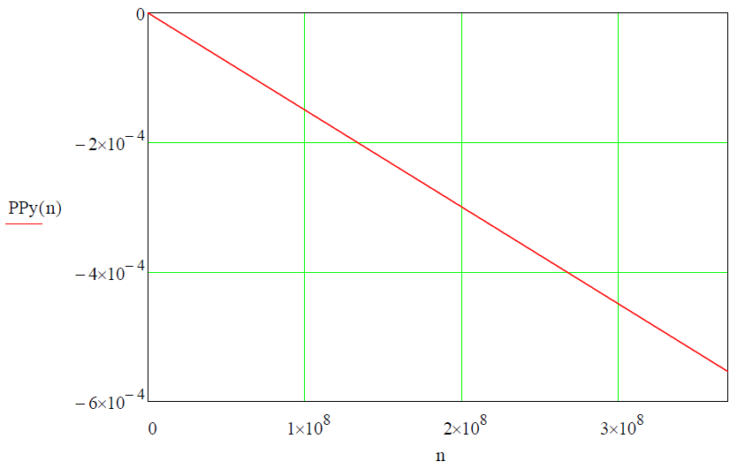
First direct Edm measurement:
Resonance Method for deuterons
Parameters: beam energy $Td=50 MeV$ $LRF=1 m$
assumed EDM $dd={10}^{−24} ecm$
E-field $30 kV/cm$
$$Py$$
$$Py$$
EDM effect accumulates in $Py$
$$turn number$$
Linear extrapolation of $Py$ for a time period of $sc=1000 s (=3.7108 turns)$ yields a sizeable $P_{y}\sim {10}^{−3}$.

Slide 54
RF $E×B$ Wien Filter: Resonance condition
Deuterons at 970 MeV/c: $β= 0.459$; $γ= 1.126$; $G = −0.142 987$
$f_{RF}=f_{rev}(γG±K)$, $K∈ℤ$
$f_{rev}≈750 kHz$
$$ν_{s}=γG=−0.16098$$
$$K$$ | $$0$$ | $$1$$ | $$−1$$ | $$2$$ | $$−2$$
$$f_{RF}/kHz$$ | $$120$$ | $$629$$ | $$871$$ | $$1380$$ | $$1621$$
Frequency range RF Wien filter prototype

Slide 55
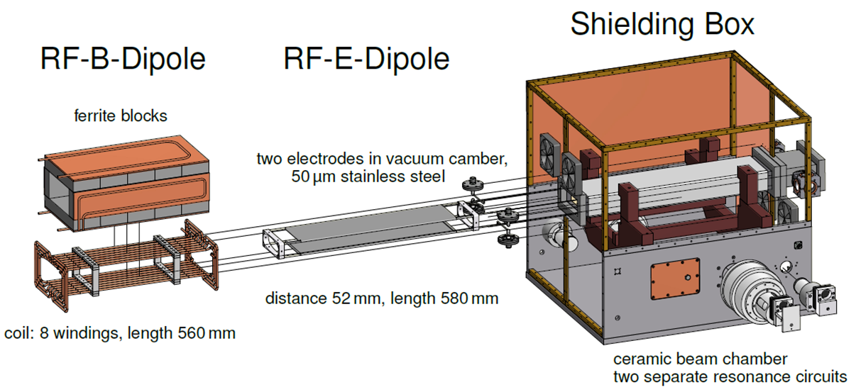
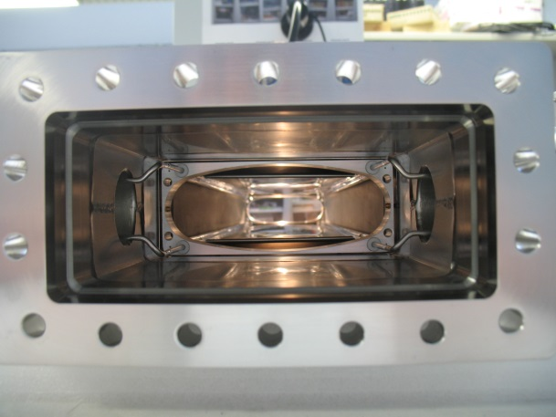
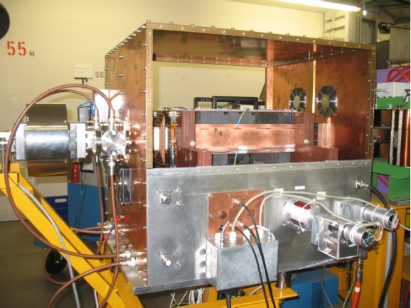
RF $E×B$ Wien Filter: Prototype commissioning
EDM measurement concept: RF Wien filter to accumulate EDM signal
Insert RF-$E_{x}$dipole into ceramic chamber

Slide 56
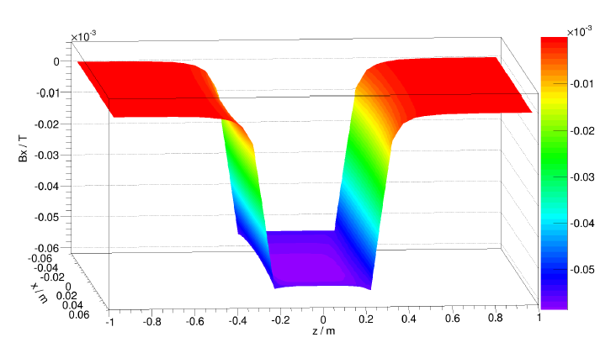
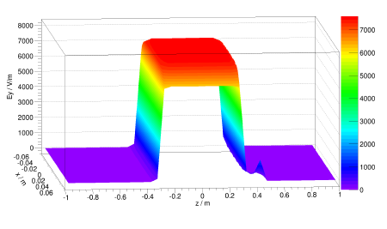
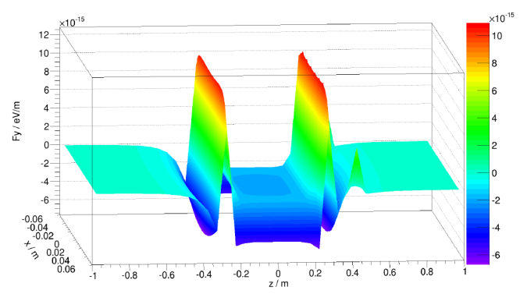
RF $E×B$ Wien Filter: Field calculations
Main field component
${\hat{B}}_{x}=0.058 mT$at $y=0$, $I=1 A,$ $$\int{{\hat{B}}_{x}dz=0.035 Tmm}$$
Main field component
${\hat{E}}_{y}=7594 V/m$at $y=0$,
$$U=395 V, \int{{\hat{E}}_{y}dz=4818 V}$$
Integral compensation of Lorentz force $\int{F_{y}dz=0}$ at $y=0$
$$Bx (T)$$
$$Ey (V/m)$$
$$Fy (eV/m)$$
$$x (m)$$
$$x (m)$$
$$x (m)$$
$$z (m)$$
$$z (m)$$
$$z (m)$$

Slide 57
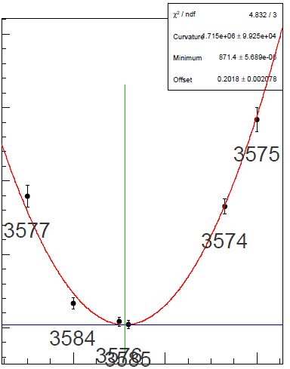
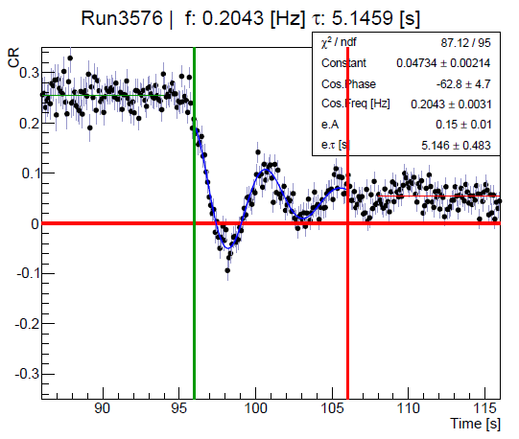
RF Wien Filter: Measurement of Resonance Strengths
Continuous polarimetry: Fixed frequency scans for resonance determination
Damping due to decoherence
Cross-ratio of UD-asymmetries used.
Minimum vertical polarization oscillation frequency gives resonance strength: $ε=\frac{f_{P_{y,min}}}{f_{rev}}$
0.35
0.30
$$Spin oscillation frequency \left(kHz \right)$$
0.25
0.20
871.4276
871.4276
871.4276
$$f_{RF} \left(kHz\right)$$

Slide 58
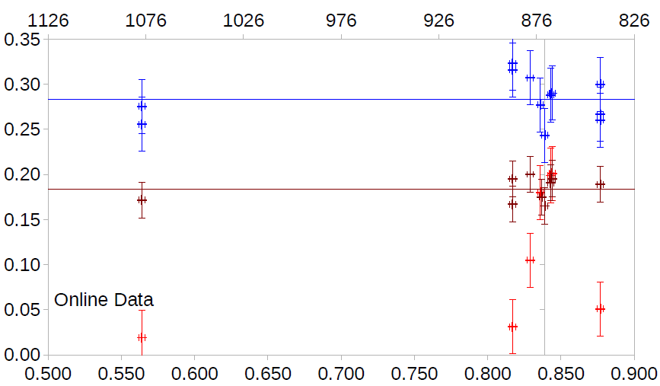
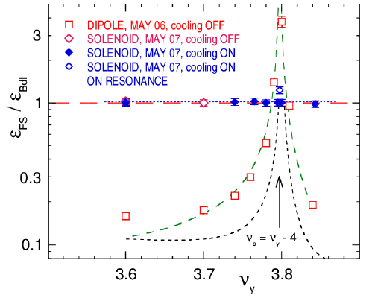
RF $E×B$ Wien Filter: Preliminary Results
RF solenoid:
$$f_{P_{y}}≈\frac{1+G}{4π}\int{\frac{{\hat{B}}_{∥}dl}{Bρ}}$$
RF Wien filter:
$$f_{P_{y}}≈\frac{1+G}{4πγ}\int{\frac{{\hat{B}}_{⊥}dl}{Bρ}}$$
RF dipole:
$$f_{P_{y}}≈\frac{1+γG}{4π}\int{\frac{{\hat{B}}_{⊥}dl}{Bρ}}$$
From driven vertical oscillation at fixed frequency
$${\left(2−Q_{y}\right)f}_{RF} \left(kHz\right)$$
From froissart-Stora scans
$$f_{P_{y}} \left(Hz\right)$$
M.A. Leonova et al., contribution to Spin 2008
$$Q_{y}$$
RF 𝐄×𝐁 Wien filter protoype performs like an RF solenoid

Slide 59
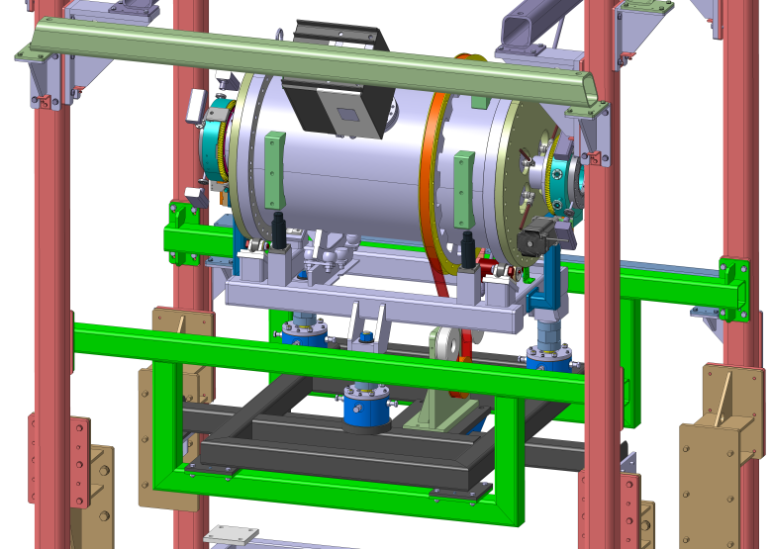
Development of waveguide RF Wien Filter
Device developed at IKP in cooperation with:
RWTH Aachen, Institute of High Frequency Technology:
Dirk Heberling, Dominik Hölscher, and PhD Student Jamal Slim
ZEA-1 of Jülich:
Helmut Soltner, Lars Reifferscheidt, Heidi Straatmann
Device will be installed in PAX low-𝛽 section

Slide 60
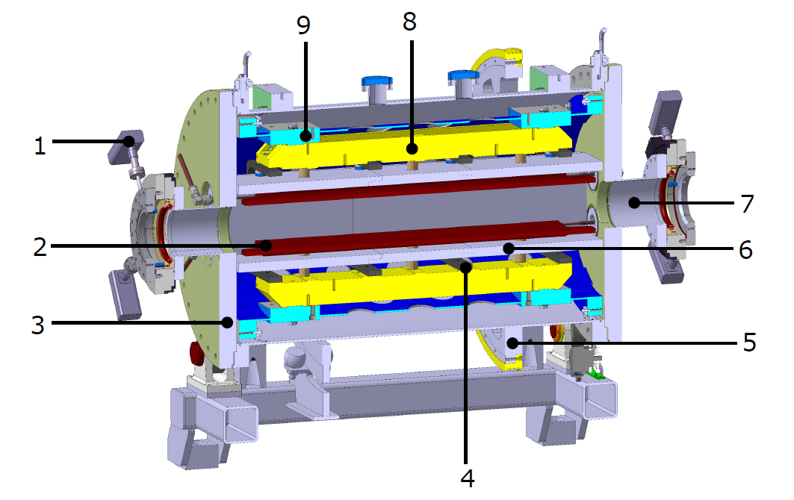
Some features of the new RF Wien filter
Waveguide provides $\vec{E}×\vec{B}$ by design.
Support structure
for electrodes
Support for geodetics
Inner support
tube
RF
feedthrough
Ferrit cage
BPM
(Rogowski coil)
Beam pipe (CF 100)
Copper
electrodes
Ferrit cage
Vacuum vessel with
small angle rotator
Mechanical
support
Belt drive for ${90}^{0}$rotation
Device rotatable by ${90}^{0}$in situ
Clamps for the Ferrit cage
Aim is to build the best possible device with respect to electromagnetic performance, mechanical tolerances, etc.
$$\sim 1 m$$

Slide 61
Internal structure of the device
Ceramic insulators
copper electrodes with the trapezium shaping at the edges
Sliding connector
to RF
Mechanical support
for electrodes
Clamps supporting the Ferrit cage
Inner support tube
Design completed, production started, device available in fall 2016.

Slide 62
Electromagnetic field simulations
Full-wave simulation with CST Microwave Studio
Each simulation required $\sim 12$hours of computer time
For details, see preprint: https://arxiv.org/abs/1603.01567
Excellent cooperation with RWTH and ZEA
Notes:
on a 4-Tesla C2075 GPU cluster2, with 2 six-cores Xeon E53 and RAM capacity of 94GB

Slide 63
Lorentz force compensation
Providing minimal integral Lorentz force requires careful shaping of electrodes and all other components
$${\vec{F}}_{L}=q(\vec{E}+\vec{v}×\vec{B})$$
Lorentz force integral with $\vec{v}$ along Wien filter axis
Mechanical design completed. Continued work on RF driving circuit.
Goal is to reach $\int{Bdl\sim 0.5 Tmm}$ possible.

Slide 64
RF $E×B$ Wien Filter: Resonance conditions
$f_{RF}=f_{rev}(γG±K)$, $K∈ℤ$
 | $$p$$ | $$f_{rev}/kHz$$ | $$G$$ | $$β$$ | $$γ$$ | $$γG$$
$$d$$ | $$970.0$$ | $$750.2$$ | $$−0.143$$ | $$0.459$$ | $$1.126$$ | $$−0.161$$
$$p$$ | $$521.1$$ | $$752.6$$ | $$1.793$$ | $$0.486$$ | $$1.144$$ | $$2.051$$
$$K$$ |  | $$−4$$ | $$−3$$ | $$−2$$ | $$−1$$ | $$0$$ | $$+1$$ | $$+2$$
$${|f}_{RF}|/kHz$$ | $$d$$ |  |  | $$1621.2$$ | $$871.0$$ | $$120.8$$ | $$629.4$$ | $$1379.6$$
 | $$p$$ | $$1545.6$$ | $$752.6$$ | $$40.3$$ | $$833.2$$ | $$1626.2$$
Frequency range RF Wien filter prototype (Gebel/Mey)
New waveguide RF Wien filter will provide resonance conditions for deuterons and protons for a number harmonics $K.$

Slide 65
Concept for first measurements
Simulations with COSY-INF. and RF Wien filter ($E_{x}$, $B_{y}$) in EDM buildup mode.
M Rosenthal et al, IBIC 2015
$$\vec{d}=\frac{ηqℏ}{2mc}\vec{S}$$
$$d=5∙{10}^{−20} e cm$$
EDM hidden underneath imperfections from magnet misalignments.
Notes:
Vertical spin buildup for closed orbit deuterons in an ideal ring, as well as for quadrupole misalignments for two different randomization seeds.
The black dots show tracking results, the colored lines are analytical estimates

Slide 66
Concept for first measurements
With an RF Wien filter of $\int{Bdl=0.05 Tmm}$, $σ_{stat}\sim 2∙{10}^{−22} e cm$ can be reached in 1000 s.
M Rosenthal et al, IBIC 2015
Randomized error standard deviation of $0.1 mm$ $→$ RMS displacements $\sim 1mm$.
Contribution to buildup from misalignments
similar to EDM for $η={10}^{−4} (d=5{∙10}^{−19} e cm)$.

Slide 67
Results from the December 2015 run at COSY
Rotate deuteron spins into ring plane and let them freely precess.
Lock the solenoid RF phase to the polarization direction of the ensemble
Use small RF solenoid amplitude to mimic polarization buildup
see talk by Ed. Stephenson for further details
Volker Hejny, Ed Stephenson
During commissioning, waveguide RF Wien filter will be rotated to observe RF phase-dependence with small amplitudes
Phase-locking works via changing of the COSY RF (first try).
Later, we will phase-lock to RF Wien filter RF.

Slide 68
Outline
Introduction
Recent Achievements
Spin coherence time
Spin tune measurement
Study of magnetic machine imperfections
Technical challenges
Toward a first direct $p,d$ EDM measurement
Conclusion

Slide 69
Timeline: Stepwise approach towards all-in-one machine
Step | Aim / Scientific goal | Device / Tool | Storage ring
1 | Spin coherence time studies | Horizontal RF-B spin flipper | COSY
 | Systematic error studies | Vertical RF-B spin flipper | COSY
2 | COSY upgrade | Orbit control, magnets, … | COSY
 | First direct EDM measurement at ${10}^{−2?}ecm$ | RF $\vec{E}×\vec{B}$ Wien filter | Modified COSY
3 | Built dedicated all-in-one ring for $p$, $d$, $3He$ | Common magnetic-electrostatic deflectors | Dedicated ring
4 | EDM measurement of $p$, $d$, $3He$ at ${10}^{−29}ecm$ |  | Dedicated ring
Time scale: Steps 1 and 2: $< 5$ years Steps 3 and 4: $> 5$ years

Slide 70
JEDI Collaboration
JEDI = Jülich Electric Dipole Moment Investigations
~100 members (Aachen, Daejeon, Dubna, Ferrara, Indiana, Ithaka, Jülich, Krakow, Michigan, Minsk, Novosibirsk, St Petersburg, Stockholm, Tbilisi, … http://collaborations.fz-juelich.de/ikp/jedi/)
~ 10 PhD students
May the force be with us!

Slide 71
Conclusion
EDMs offer new window to disentangle sources of $CP$ violation, and to explain matter-antimatter asymmetry of the universe.
First direct EDM measurements ($p, d$) at COSY ${(10}^{−2?} e∙cm)$ $<2019$
Development of a dedicated EDM storage ring ${(10}^{−29} e∙cm)$
Conceptual design report $2019$
Spin tune determination is a new precision tool for accelerator studies
Map out magnetic imperfections in a machine
Successful phase-locking of spin precession to solenoid RF
Development of high-precision spin tracking tools, incl. RF structures.
Development of electrostatic deflectors (also $E_{r}×B_{y}$), BPMs etc.
Very challenging …, but the physics is fantastic.

Slide 72
Georg Christoph Lichtenberg (1742-1799)
“Man muß etwas Neues machen, um etwas Neues zu sehen.”
“You have to make (create) something new,
if you want to see something new”

Slide 73
Publications
Experiment:
A. Lehrach, B. Lorentz, W. Morse, N.N. Nikolaev, F. Rathmann, Precursor Experiments to Search for Permanent Electric Dipole Moments (EDMs) of Protons and Deuterons at COSY, e-Print: arXiv:1201.5773 (2012).
N.P.M. Brantjes et al., Correcting systematic errors in high-sensitivity deuteron polarization measurements, Nucl. Instrum. Meth. A664, 49 (2012), DOI: 10.1016/j.nima.2011.09.055
P. Benati et al., Synchrotron oscillation effects on an rf-solenoid spin resonance, Phys. Rev. ST Accel. Beams 15 (2012) 124202, DOI: 10.1103/PhysRevSTAB.15.124202.
Frank Rathmann, Artem Saleev, N.N. Nikolaev [JEDI and srEDM Collaborations], The search for electric dipole moments of light ions in storage rings, J. Phys. Conf. Ser. 447 (2013) 012011, DOI: 10.1088/1742-6596/447/1/012011.
Z. Bagdasarian et al., Measuring the Polarization of a Rapidly Precessing Deuteron Beam, Phys. Rev. ST Accel. Beams 17 (2014) 052803, DOI: 10.1103/PhysRevSTAB.17.052803.
F. Rathmann et al. [JEDI and srEDM Collaborations], Search for electric dipole moments of light ions in storage rings, Phys. Part. Nucl. 45 (2014) 229, DOI: 10.1134/S1063779614010869.
D. Eversmann et al. [JEDI Collaboration], New method for a continuous determination of the spin tune in storage rings and implications for precision experiments, Phys. Rev. Lett. 115, 094801 (2015), DOI: 10.1103/PhysRevLett.115.094801
Theory:
J. Bsaisou, J. de Vries, C. Hanhart, S. Liebig, Ulf-G. Meißner, D. Minossi, A. Nogga, A. Wirzba, Nuclear Electric Dipole Moments in Chiral Effective Field Theory, Journal of High Energy Physics 3, 104 (2015), DOI:10.1007/JHEP03(2015)104

Slide 74
Anouncement
Hadron Physics Summer School 2016
September 5-9, 2016 at Jülich
In case you are interested, please visit
http://collaborations.fz-juelich.de/ikp/hpss2016/ for further information. Registration is now open.

