Slide 1
Search for Permanent Electric Dipole Moments
(Proposal for the 1st half of 2015)
December 15, 2014 Frank Rathmann on behalf of JEDI
1st Meeting of the COSY Beam Advisory Committee (CBAC)

Slide 2
Outline
Introduction
Recent Achievements
  Spin coherence time
  Spin tune measurement
  Commissioning of RF Wien filter
  Study of machine imperfections
Proposed studies 1st half of 2015

Slide 3
Preamble: The burning questions?
Why do we observe matter and almost no antimatter if we believe there is a symmetry between the two in the universe?
What is this "dark matter" that we can't see that has visible gravitational effects in the cosmos?
Why can't the Standard Model predict a particle's mass?
Are quarks and leptons actually fundamental, or made up of even more fundamental particles?
Why are there exactly three generations of quarks and leptons? How does gravity fit into all of this?
From http://particleadventure.org/beyond_start.html

Slide 4
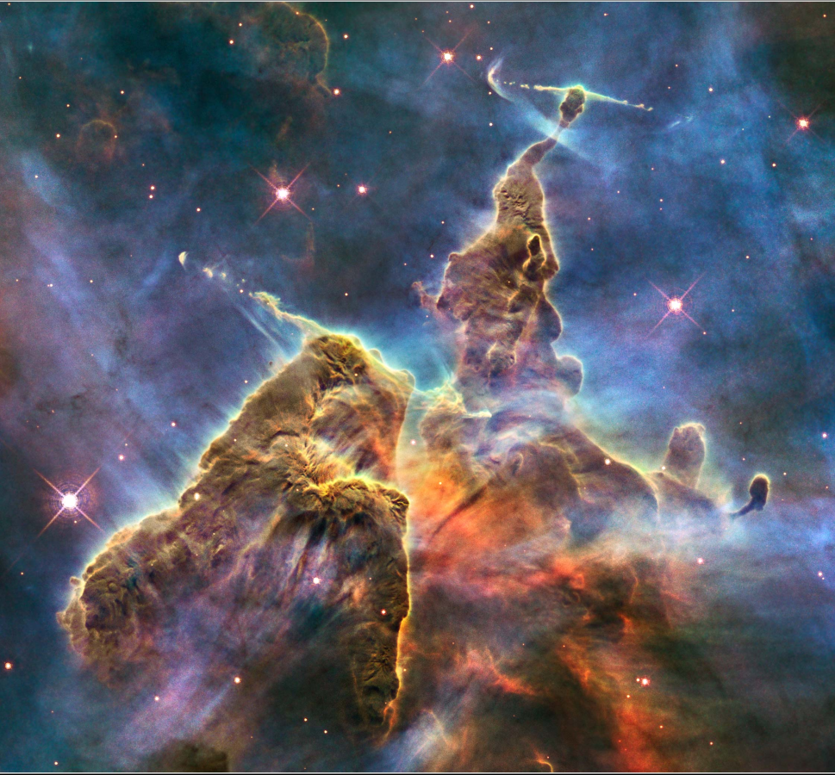
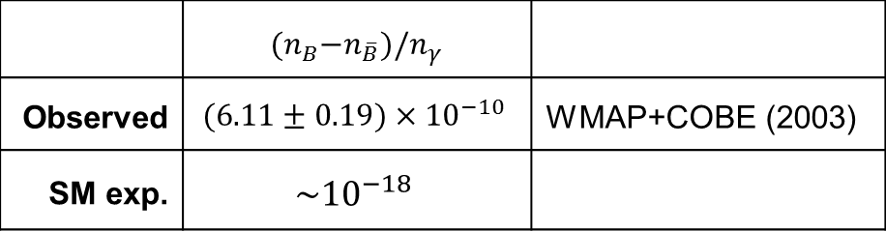
Physics: Observed Baryon Asymmetry
Carina Nebula: Largest-seen star-birth regions in the galaxy
 | ${(n}_{B}−n_{\overline{B}})/n_{γ}$
Observed | $$(6.11±0.19)×{10}^{−10}$$ | WMAP+COBE (2003)
SM exp. | $$\sim {10}^{−18}$$
Why this strange number? Why not zero?
Mystery of missing antimatter addresses the puzzle of our existence

Slide 5
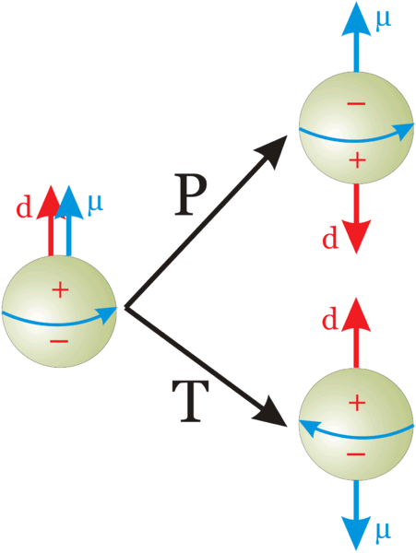
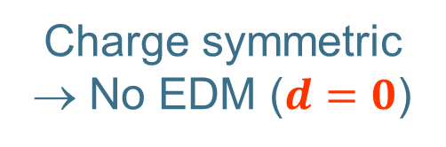
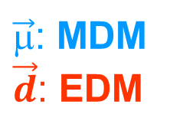
Physics: Fundamental Particles
Charge symmetric
→ No EDM ($d=0$)
$\vec{μ}$: MDM
$\vec{d}$: EDM
Do particles (e.g., electron, nucleon) have an EDM?

Slide 6

EDMs: Discrete Symmetries
Not Charge symmetric
$\vec{d}$(aligned w/ spin)
Permanent EDMs violate P and T.
Assuming CPT to hold, CP violated also.
Notes:
6
6

Slide 7

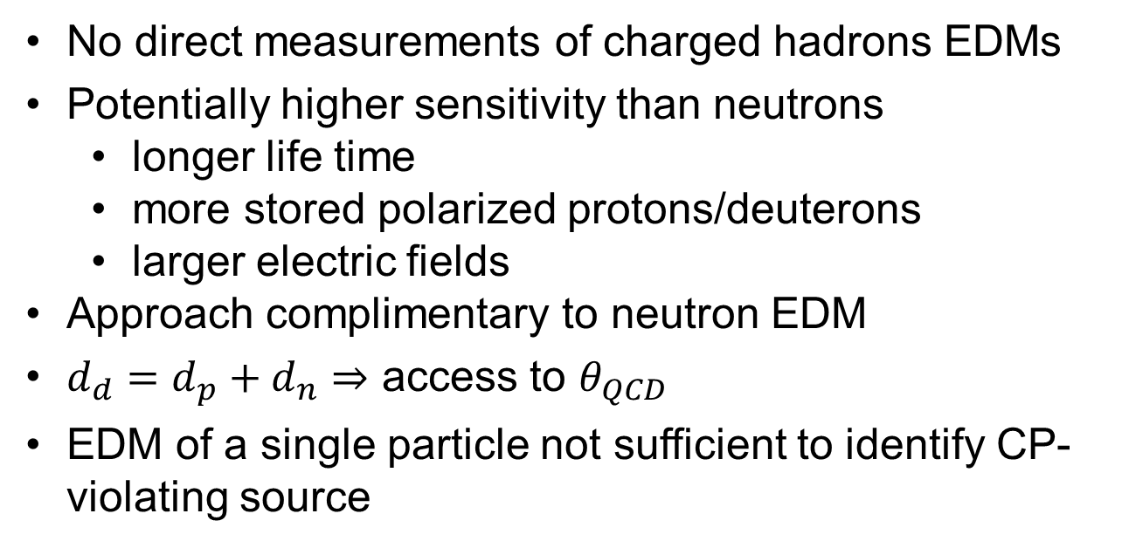
Introduction: Why charged particle EDMs?
No direct measurements of charged hadrons EDMs
Potentially higher sensitivity than neutrons
  longer life time
  more stored polarized protons/deuterons
  larger electric fields
Approach complimentary to neutron EDM
$d_{d}=d_{p}+d_{n}⇒$ access to $θ_{QCD}$
EDM of a single particle not sufficient to identify CP-violating source
$$?$$
New approach, with potentially higher sensitivity

Slide 8
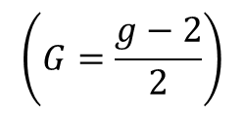
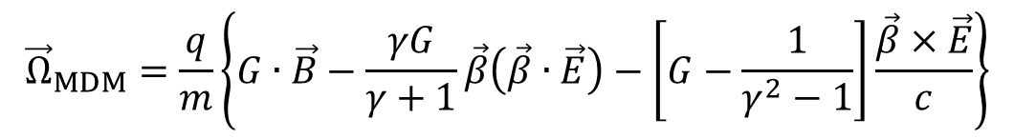
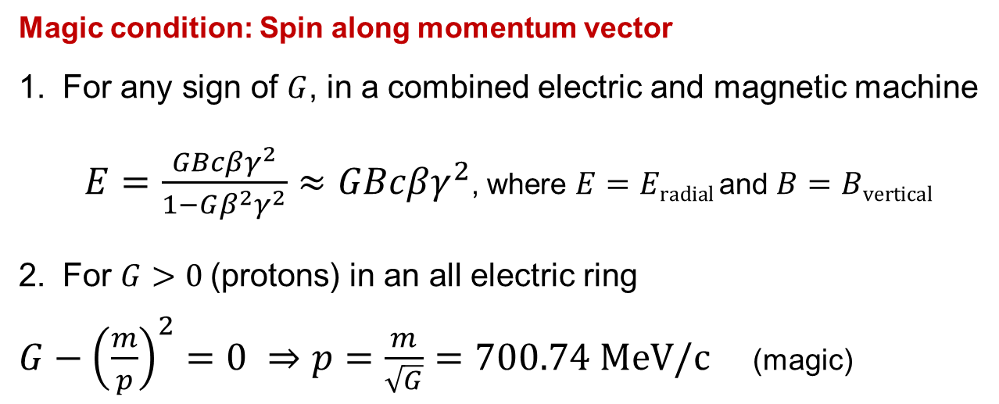
Concept: Frozen spin Method
For transverse electric and magnetic fields in a ring, the
anomalous spin precession is described by Thomas-BMT equation:
$${\vec{Ω}}_{MDM}=\frac{q}{m}\left\{G∙\vec{B}−\frac{γG}{γ+1}\vec{β}\left(\vec{β}∙\vec{E}\right)−\left[G−\frac{1}{γ^{2}−1}\right]\frac{\vec{β}×\vec{E}}{c}\right\}$$
$$\left(G=\frac{g−2}{2}\right)$$
Magic condition: Spin along momentum vector
For any sign of $G$, in a combined electric and magnetic machine
$E=\frac{GBcβγ^{2}}{1−Gβ^{2}γ^{2}}≈GBcβγ^{2}$, where $E=Eradial$ and $B=Bvertical$
For $G>0$(protons) in an all electric ring
$G−{\left(\frac{m}{p}\right)}^{2}=0 ⇒p=\frac{m}{\sqrt{G}}=700.74 MeV/c$ (magic)
→ Magic rings to measure EDMs of free charge particles

Slide 9
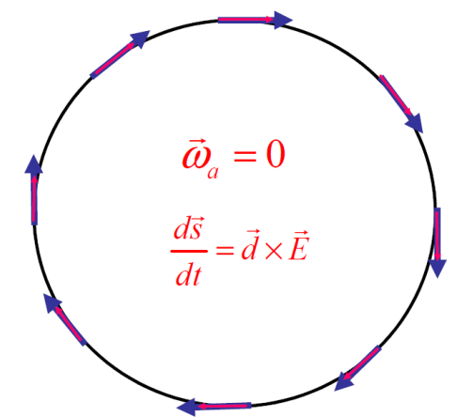
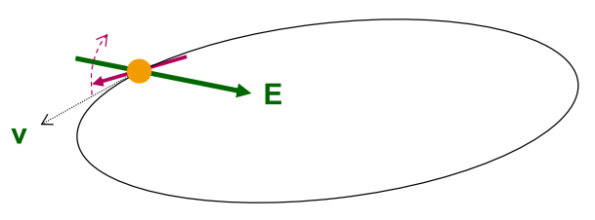


Concept: Rings for EDM searches
Place particles in a storage ring
Align spin along momentum („freeze“ horizontal spin precession)
Search for time development of vertical polarization
$${\vec{ω}}_{G}=0$$
$$\frac{d\vec{s}}{dt}=\vec{d}×\vec{E}$$
New Method to measure EDMs of free charged particles:
Magic rings with spin frozen along momentum
Notes:
9
9

Slide 10
Outline
Introduction
Recent Achievements
  Spin coherence time
  Spin tune measurement
  Commissioning of RF Wien filter
  Study of machine imperfections
Proposed studies 1st half of 2015

Slide 11
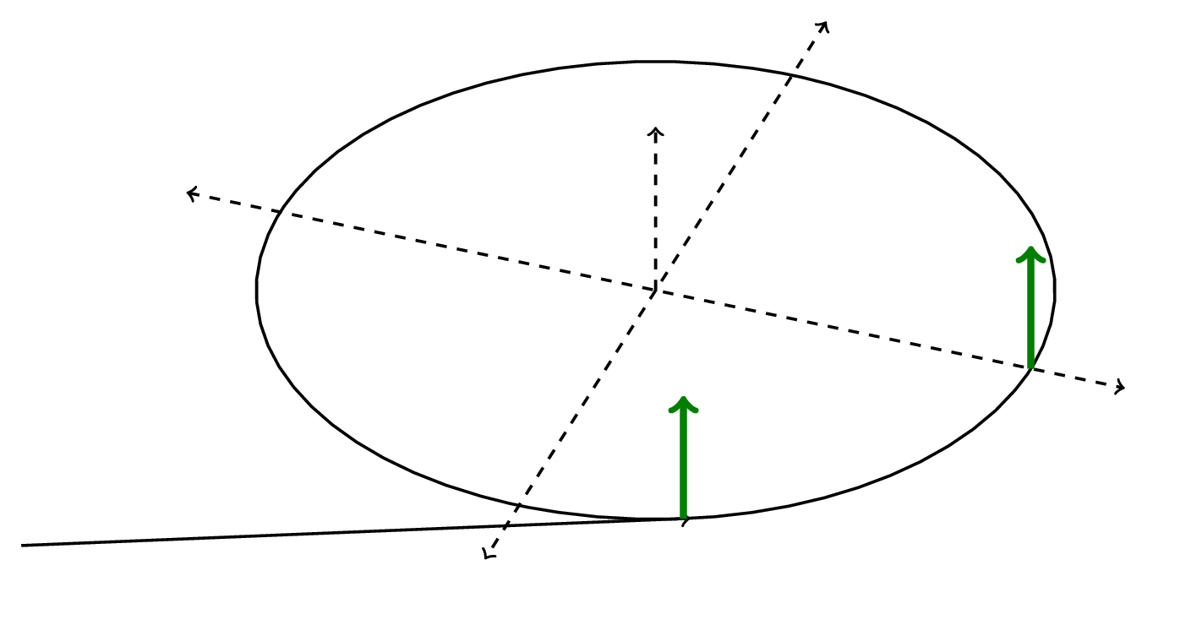
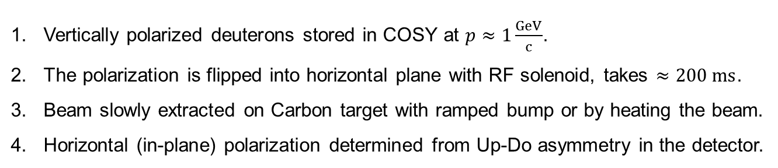
Spin coherence time: Experimental investigation
polarimeter
free precession
turn spin
Vertically polarized deuterons stored in COSY at $p≈1\frac{GeV}{c}$.
The polarization is flipped into horizontal plane with RF solenoid, takes $≈200 ms$.
Beam slowly extracted on Carbon target with ramped bump or by heating the beam.
Horizontal (in-plane) polarization determined from Up-Do asymmetry in the detector.
Experimental investigations of SCT in storage ring: Keep track of the event time and revolution time in each turn during a cycle of a few hundred seconds.

Slide 12
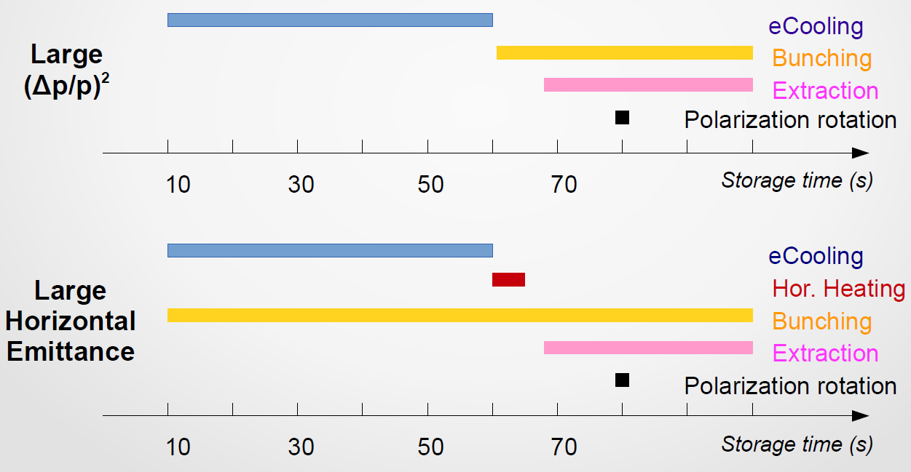
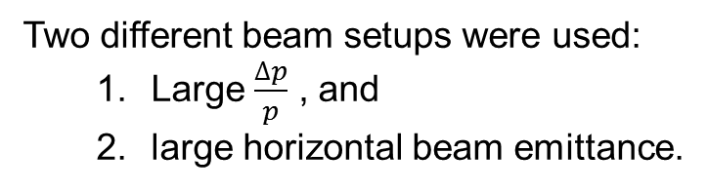
Spin coherence time: Beam setups
Two different beam setups were used:
  Large $\frac{∆p}{p}$ , and
  large horizontal beam emittance.

Slide 13
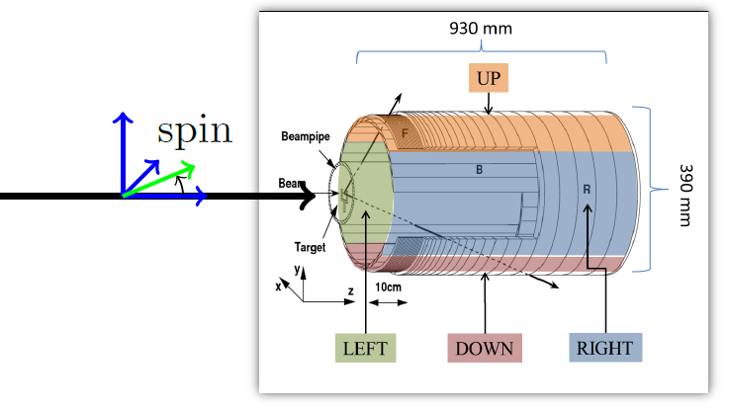
Polarimeter: Experimental investigation of SCT
D$euterons at p≈1 GeV/c$, $γ=1.13$ and $ν_{s}=γ∙G=−0.161$
$N_{U,D}∝1±\frac{3}{2}p⋅A_{y}⋅\sin\left(ν_{s}f_{rev}t\right),$ where $f_{rev}≈781 kHz$

Slide 14
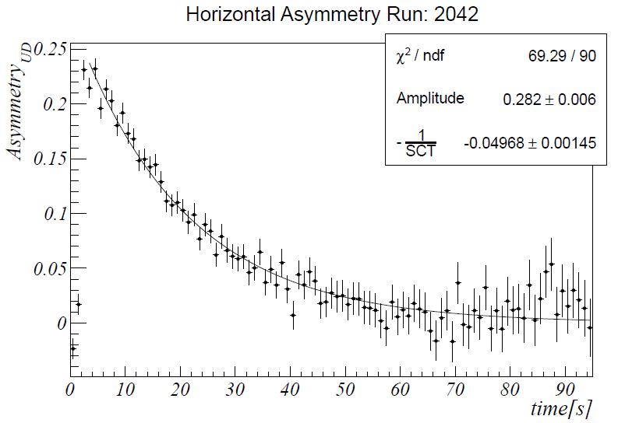
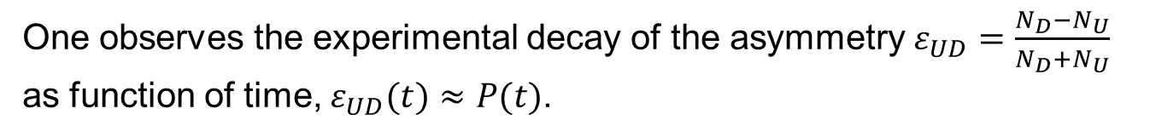

Polarimeter: Determination of SCT
One observes the experimental decay of the asymmetry $ε_{UD}=\frac{N_{D}−N_{U}}{N_{D}+N_{U}}$ as function of time, $ε_{UD}(t)≈P(t)$.
$$τ_{SC}≈20 s$$

Slide 15
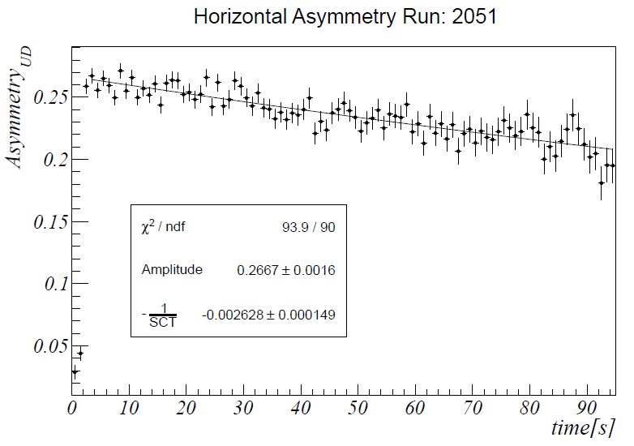

Polarimeter: Optimization of SCT
Using sextupole magnets in the machine, higher order effects can be corrected, and the SCT is substantially improved
$$τ_{SC}≈400 s$$

Slide 16
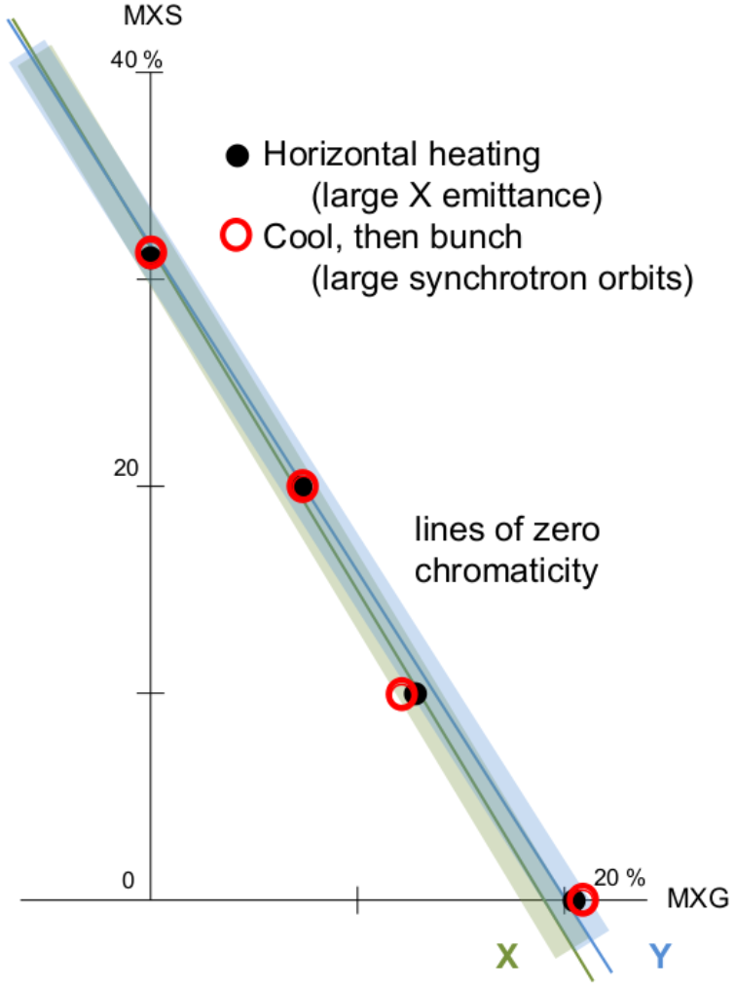
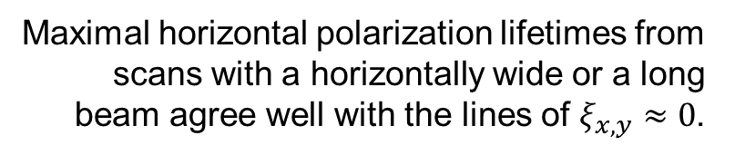
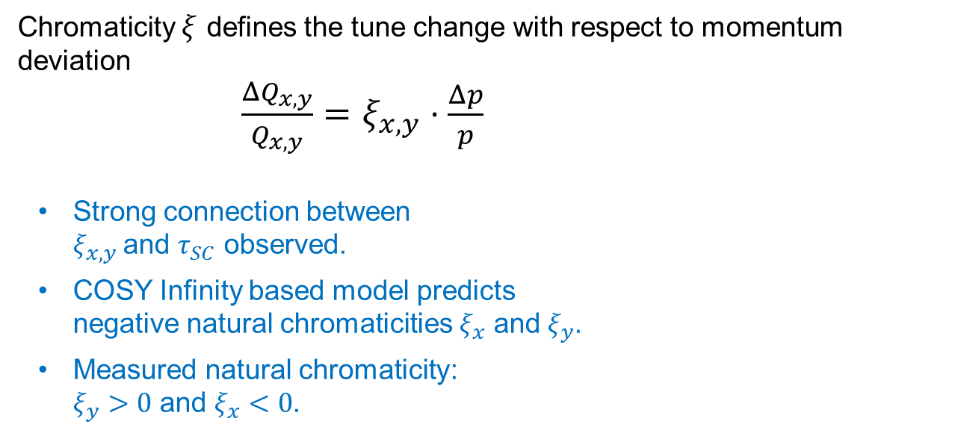
SCT: Chromaticity studies
Chromaticity $ξ$ defines the tune change with respect to momentum deviation
$\frac{{ΔQ}_{x,y}}{Q_{x,y}}=ξ_{x,y}⋅\frac{Δp}{p}$
Strong connection between
$ξ_{x,y}$and $τ_{SC}$ observed.
COSY Infinity based model predicts
negative natural chromaticities $ξ_{x}$ and $ξ_{y}$.
Measured natural chromaticity:
$ξ_{y}>0$ and $ξ_{x}<0$.
Maximal horizontal polarization lifetimes from scans with a horizontally wide or a long beam agree well with the lines of $ξ_{x,y}≈0$.
Crucial for achieving a large $τ_{SC}$ is careful adjustment of $ξ_{x,y}$.

Slide 17
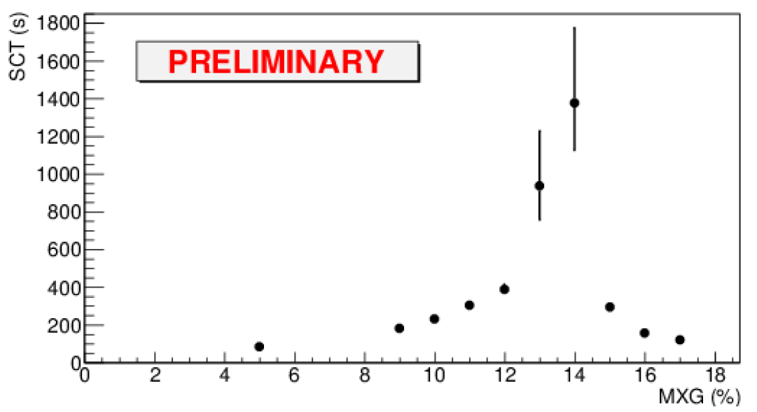
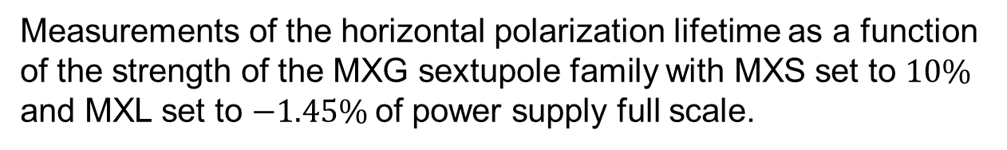
SCT: Optimization
Measurements of the horizontal polarization lifetime as a function of the strength of the MXG sextupole family with MXS set to $10\%$ and MXL set to $−1.45\%$of power supply full scale.
Excellent progress towards the SCT goal for pEDM: $SCT\sim 1000$s

Slide 18
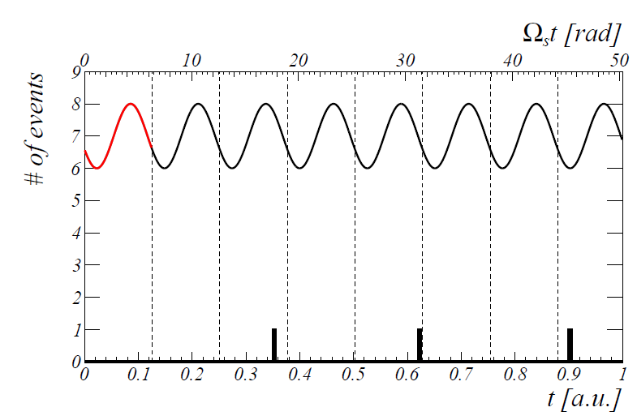
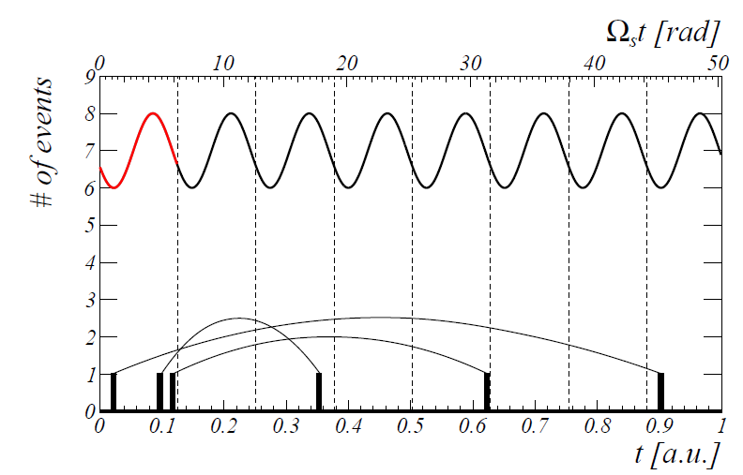
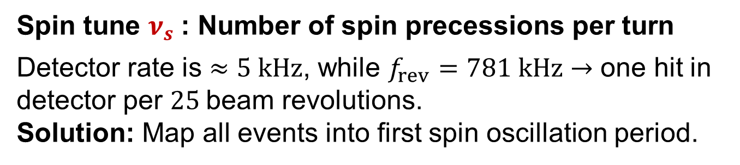
Spin tune: How to find $ν_{s}$?
Spin tune $ν_{s}$: Number of spin precessions per turn
Detector rate is $≈5 kHz$, while $f_{rev}=781 kHz→$ one hit in detector per $25$beam revolutions.
Solution: Map all events into first spin oscillation period.

Slide 19
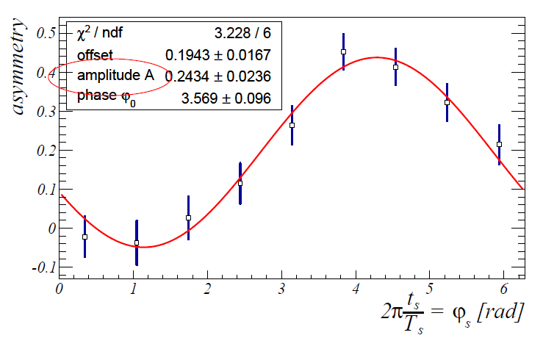
Spin tune: How to find $ν_{s}$?
Of course, this only works when $T_{s}=\frac{1}{ν_{s}f_{rev}}$ was correct

Slide 20
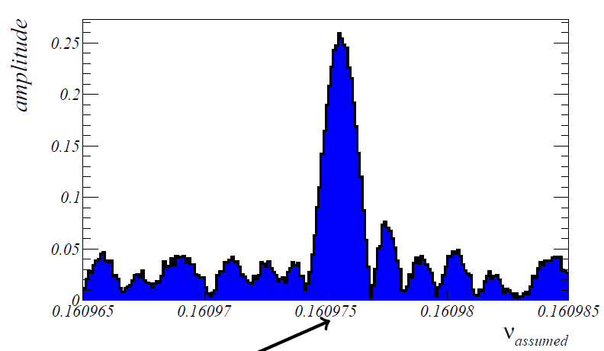
Spin tune: Scan of $ν_{s}$
Pick $ν_{s}$ with maximum amplitude of asymmetry.

Slide 21
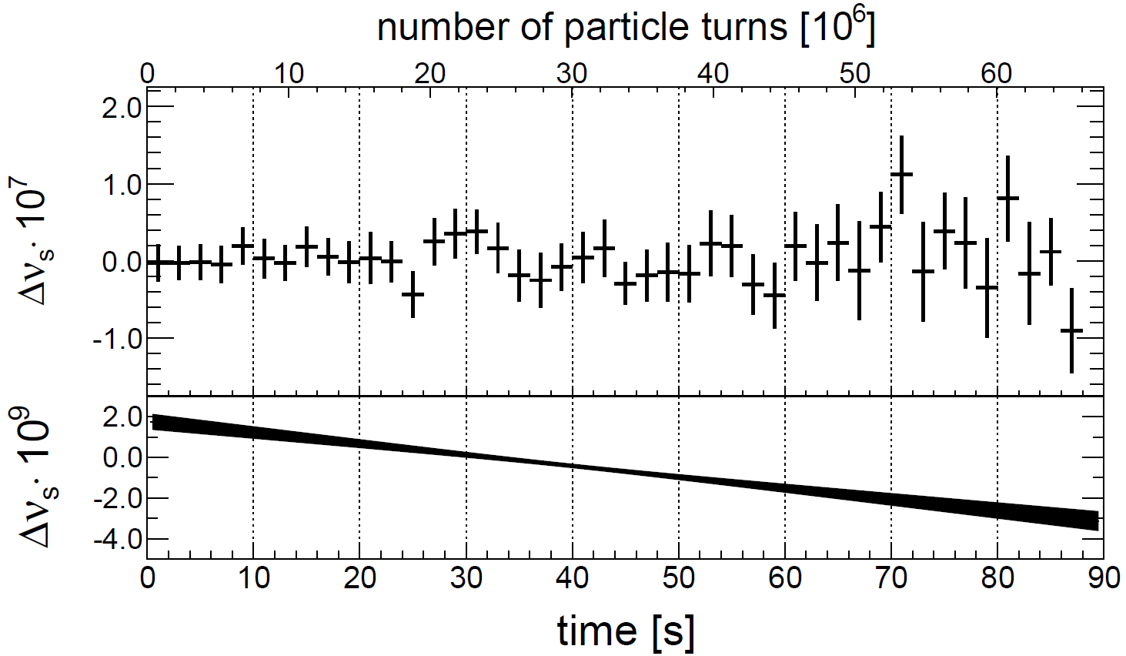
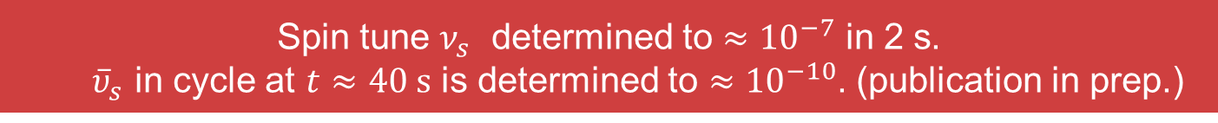
Spin tune: D$etermination of ν_{s}$
Spin tune $ν_{s}$ determined to $≈{10}^{−7}$ in 2 s.
${\overline{υ}}_{s}$ in cycle at $t≈40 s$ is determined to ${≈10}^{−10}$. (publication in prep.)

Slide 22
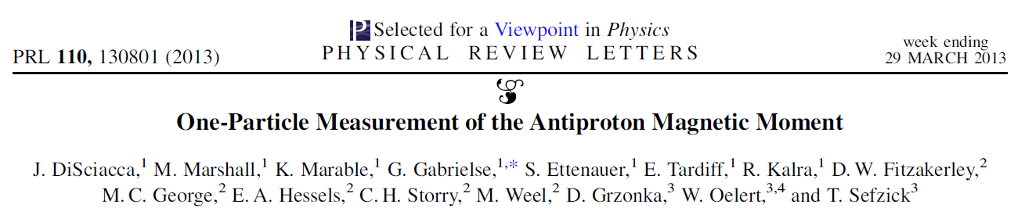
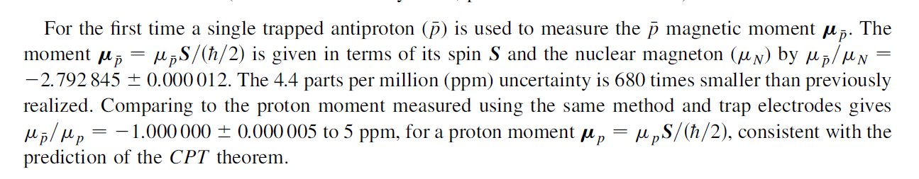
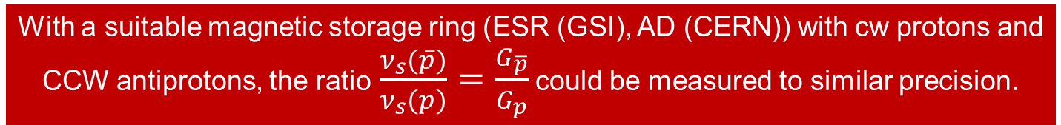
New physics: Option for polarized antiprotons
JEDI is capable to determine the spin tune (number of spin revolutions per turn) $ν_{s}=γG$of deuterons in COSY with a precision of ${≈10}^{−10}$.
With a suitable magnetic storage ring (ESR (GSI), AD (CERN)) with cw protons and CCW antiprotons, the ratio$\frac{ν_{s}(\overline{p})}{ν_{s}(p)}=\frac{G_{\overline{p}}}{G_{p}}$ could be measured to similar precision.

Slide 23
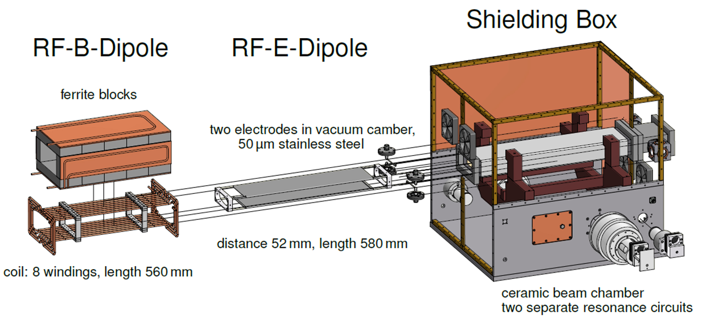
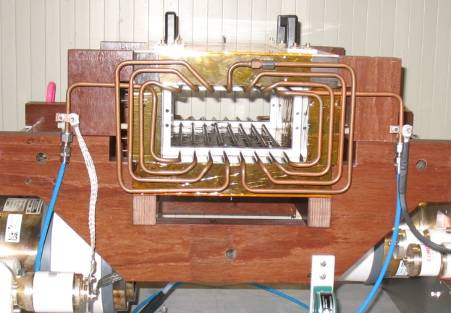
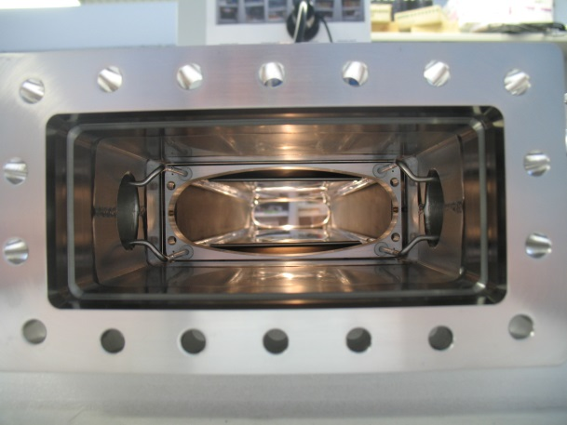
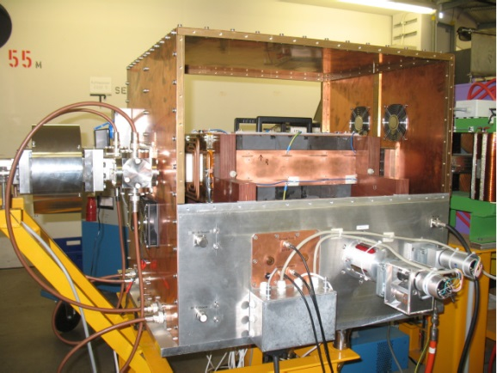

    RF $E×B$ Wien Filter: Prototype commissioning
Precursor EDM concept: Use RF Wien filter to accumulate EDM signal
Insert RF-$E_{x}$dipole into ceramic chamber

Slide 24
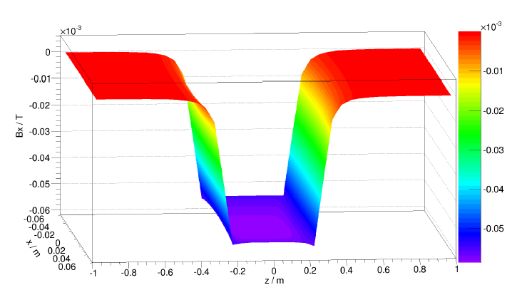
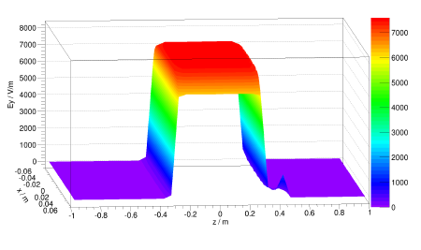
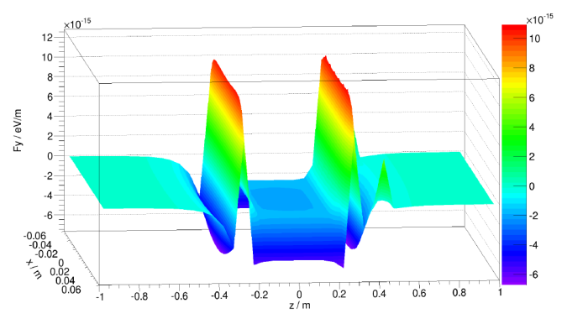
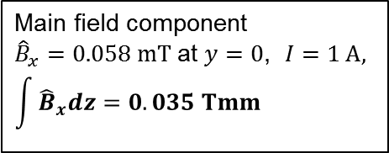









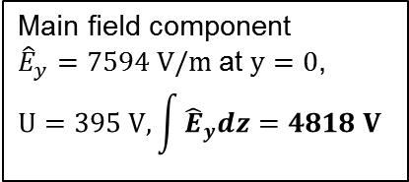
    RF $E×B$ Wien Filter: Field calculations
Main field component
${\hat{B}}_{x}=0.058 mT$at $y=0$, $I=1 A,$
$$\int{{\hat{B}}_{x}dz=0.035 Tmm}$$
Main field component
${\hat{E}}_{y}=7594 V/m$at $y=0$,
$$U=395 V, \int{{\hat{E}}_{y}dz=4818 V}$$
Integral compensation of Lorentz force $\int{F_{y}dz=0}$ at $y=0$
$$Bx (T)$$
$$Ey (V/m)$$
$$Fy (eV/m)$$
$$x (m)$$
$$x (m)$$
$$x (m)$$
$$z (m)$$
$$z (m)$$
$$z (m)$$

Slide 25
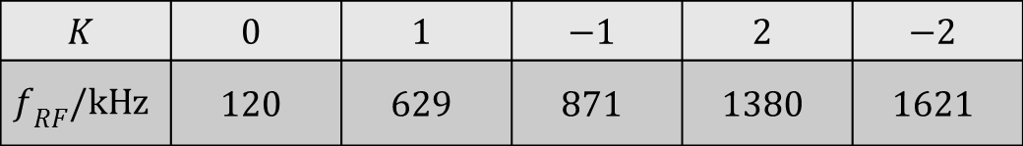
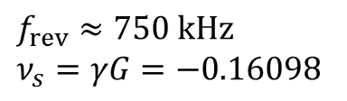
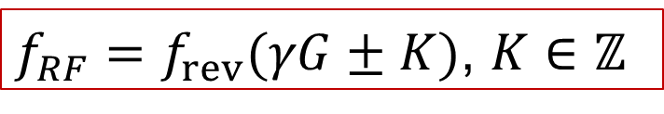
    RF $E×B$ Wien Filter: Resonance condition
Deuterons at 970 MeV/c: $β= 0.459$; $γ= 1.126$; $G = −0.142 987$
$f_{RF}=f_{rev}(γG±K)$, $K∈ℤ$
$f_{rev}≈750 kHz$
$$ν_{s}=γG=−0.16098$$
$$K$$ | $$0$$ | $$1$$ | $$−1$$ | $$2$$ | $$−2$$
$$f_{RF}/kHz$$ | $$120$$ | $$629$$ | $$871$$ | $$1380$$ | $$1621$$
Frequency range RF Wien filter

Slide 26
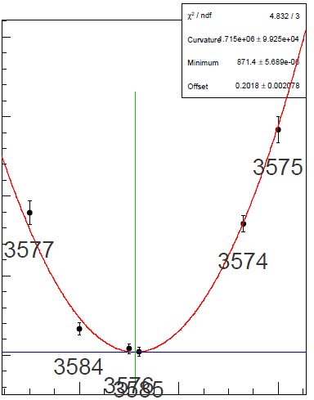
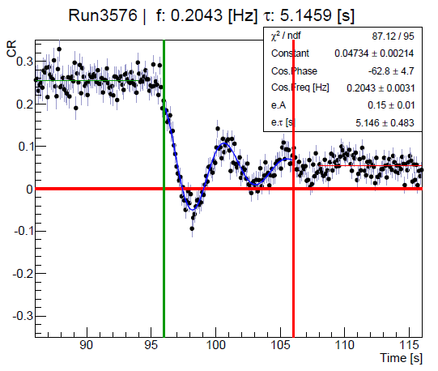



    RF Wien Filter: Measurement of Resonance Strengths
Continuous polarimetry: Fixed frequency scans for resonance determination
Damping due to decoherence
Cross-ratio of UD-asymmetries used.
Minimum vertical polarization oscillation frequency gives resonance strength:
$ε=\frac{f_{P_{y,min}}}{f_{rev}}$
0.35
0.30
$$Spin oscillation frequency \left(kHz \right)$$
0.25
0.20
871.4276
871.4276
871.4276
$$f_{RF} \left(kHz\right)$$

Slide 27








    RF $E×B$ Wien Filter: Preliminary Results
RF solenoid:
$$f_{P_{y}}≈\frac{1+G}{4π}\int{\frac{{\hat{B}}_{∥}dl}{Bρ}}$$
RF Wien filter:
$$f_{P_{y}}≈\frac{1+G}{4πγ}\int{\frac{{\hat{B}}_{⊥}dl}{Bρ}}$$
RF dipole:
$$f_{P_{y}}≈\frac{1+γG}{4π}\int{\frac{{\hat{B}}_{⊥}dl}{Bρ}}$$
From driven vertical oscillation at fixed frequency
$${\left(2−Q_{y}\right)f}_{RF} \left(kHz\right)$$
From froissart-Stora scans
$$f_{P_{y}} \left(Hz\right)$$
M.A. Leonova et al., contribution to Spin 2008
$$Q_{y}$$
RF 𝐄×𝐁 Wien filter performs like an RF solenoid

Slide 28








RF $E×B$ Wien filter: Strip line design
Strip line design provides $\vec{E}×\vec{B}$
RF
feedthrough
BPM
(Rogowski coil)
$$\int_{−L}^{L}{B_{y}dz=0.02371 Tmm}$$
Ferrit cage
$$F_{L}=\frac{1}{2L}\int_{−L}^{L}{F_{L}dz=1.8∙{10}^{−4} \frac{eV}{m}}$$
Copper
electrodes
Mechanical support
from exit flange
Device rotatable by ${90}^{0}$in situ
Device will be installed in PAX low-$β$ section
Strip-line RF 𝐄×𝐁 Wien filter available 2nd half of 2015.

Slide 29


  Systematic study: Machine imperfections using two straight section solenoids
Systematic effects from machine imperfections limit the achievable precision in a precuror experiment using an RF $E×B$ Wien filter.
Idea: The precise determination of the spin tune $\left(\frac{{Δυ}_{s}}{υ_{s}}≈{10}^{−10} \text{in} \text{one} \text{cycle}\right)$ can be exploited to map out the imperfections of COSY.
COSY provides two solenoids in opposite straight sections:
  one of the compensation solenoids of the 70 kV cooler: $\int{B_{z}dz≈0.15 Tm}$,
  The main solenoid of the 2 MV cooler: $\int{B_{z}dz≈0.54 Tm}$.
Both are available dynamically in the cycle, i.e., their strength can be adjusted on flattop.

Slide 30






Systematic study: Simulation of one imperfection kick for deuterons at $970$MeV/c
Ideal machine with vanishing static imperfections: Saddle point at the origin
Intrinsic imperfection kick $α_{x} = 0.001$
shifts saddle point away from origin
sea level at $Gγ (=0.16)−5 ∙{10}^{−7}$
Location of imperfection: $Θ^{∗}=π/3$

Slide 31










Systematic study: Thomas-BMT eq. $(d≠0)$in magnetic machine
Goal: explore dynamics and systematic limitations of EDM searches in magnetic ring
$$\frac{d\vec{s}}{dt}=\vec{s}×\left({\vec{Ω}}_{MDM}+{\vec{Ω}}_{EDM}\right)$$
$${\vec{Ω}}_{MDM}=\frac{q}{m}\left\{G∙\vec{B}−\frac{γG}{γ+1}\vec{β}\left(\vec{β}∙\vec{E}\right)−\left[G−\frac{1}{γ^{2}−1}\right]\frac{\vec{β}×\vec{E}}{c}\right\}$$
$\vec{μ}=g\frac{qℏ}{2m}\vec{s}=\left(G+1\right)$ $\frac{qℏ}{m}\vec{s}$, and $\vec{d}=\frac{ηqℏ}{2m}\vec{s}$
$${\vec{Ω}}_{EDM}=\frac{ηq}{2mc}\left\{\vec{E}−\frac{γ}{γ+1}\vec{β}\left(\vec{β}∙\vec{E}\right)+c\vec{β}×\vec{B}\right\}$$
BMT for magnetic machine with $d≠0:$
$$\frac{d\vec{s}}{dt}=\frac{q}{m}\left\{G∙\vec{B}+\frac{η}{2}\left(\vec{β}×\vec{B}\right)\right\}$$
Interaction of EDM with motional E-field $(\vec{β}×\vec{B}$) tilts stable spin axis:
$${\vec{n}}_{co}={\vec{e}}_{x}\sin{ξ+{\vec{e}}_{y}\cos{ξ}}$$
$$\tan{ξ=\frac{η}{2G}β}$$
$$η=2d\frac{m}{q}$$
Misalignment of magnetic elements produces in-plane imperfection magnetic fields:
$${\vec{n}}_{co}={\vec{e}}_{x}c_{1}+{\vec{e}}_{y}c_{2}+{\vec{e}}_{z}c_{3}$$
Non-vanishing $c_{1}$ and $c_{3}$ generate background to the EDM-signal of an ideal imperfection-free machine ($c_{1}=\sin{ξ}$, $c_{2}=\cos{ξ}$and $c_{3}=0$).
The challenge is to control this background:
An accuracy $∆c_{1,3}≈{10}^{−6} rad$ amounts to a sensitivity $d={10}^{−20} e∙cm$.

Slide 32






Systematic study: Imperfection measurement
Probing the in-plane imperfection fields by introducing artificial imperfections and looking for the spin tune response
Use the compensation and e-cooler solenoids in straight sections (points 1 and 2): spin kicks $χ_{1}$ and $χ_{2}$.
$${{\vec{n}}_{co}}^{∗}={\vec{e}}_{x}{c_{1}}^{∗}+{\vec{e}}_{y}{c_{2}}^{∗}+{\vec{e}}_{z}{c_{3}}^{∗}$$
$${\vec{e}}_{x}c_{1}+{\vec{e}}_{y}c_{2}+{\vec{e}}_{z}c_{3}={\vec{n}}_{co}$$
The values of ${(c}_{1},c_{2})$, and $\left(c_{3},{c_{3}}^{∗}\right)$ depend of spin kicks in non-vertical imperfection fields in the arcs $→$ spin tune perturbed:
$υ_{s}=Gγ+O({c_{1}}^{2},{c_{3}}^{2},{{c_{1}}^{∗}}^{2},{{c_{3}}^{∗}}^{2})$
Probe the in-plane imperfection fields by introducing well-known artificial imperfections $χ_{1}$ and $χ_{2}$.

Slide 33





Systematic study: Measurement of spin tune shift
$$t (s)$$
$$υ_{s}$$
Take multiple measurements with different $χ_{1}$, $χ_{2}$, build a spin tune map $Δυ_{s}(χ_{1},χ_{2})$

Slide 34










Systematic study: Mapping imperfections
Map translated to
$$y_{+}=\frac{χ_{1}+χ_{2}}{2}$$
$$y_{−}=\frac{χ_{1}−χ_{2}}{2}$$
$$⇒$$
$$Δυ_{s}≈{y_{+}}^{2},{y_{−}}^{2}$$
$$⇒$$
$$⇒$$
Fit map to locate saddle point
$$⇒$$
From the map taken on 18+19.09.2014, with the baseline spin tune at
$υ_{s}=\text{−0.160971917 }$, one finds: $c_{3} =−0.0034±2∙{10}^{−7}$ ${c_{3}}^{∗}=−0.0021±6∙{10}^{−8}$.

Slide 35



Systematic study: Mapping imperfections
Map translated to
$$y_{+}=\frac{χ_{1}+χ_{2}}{2}$$
$$y_{−}=\frac{χ_{1}−χ_{2}}{2}$$
$$⇒$$
$$Δυ_{s}≈{y_{+}}^{2},{y_{−}}^{2}$$
$$⇒$$
$$⇒$$
Extremum of spin tune map is saddle point at $y_{+},y_{−}=O(c_{3},{c_{3}}^{∗})$.
Once baseline spin tune $υ_{s}$determined, ${(c}_{3},{c_{3}}^{∗})$are only fit parameters.
Solenoids only are not sensitive to $c_{1},{c_{1}}^{∗}$ ($→$static WF with $B_{x}$ and $E_{y}$).
$$⇒$$
New technique allows one to experimentally reconstruct the components of the spin closed orbit ${\vec{n}}_{co}$ in a storage ring with unprededented precision (not achievable from polarization measurements alone).

Slide 36
Outline
Introduction
Recent Achievements
  Spin coherence time
  Spin tune measurement
  Commissioning of RF Wien filter
  Study of machine imperfections
Proposed studies 1st half of 2015

Slide 37
Beam request: JEDI studies with beam in 2015
    1. Explore d beams at other energies with EDDA
2. EDDA fiber target
3. Quartered Rogowski coil
4. RF Wien filter at 630 kHz
5. SCT studies with straight section sextupoles
6. Study effect of a variation of the electron cooler beam current on $τ_{SC}$
7. Beam extraction at EDDA target
with ANKE cluster or WASA pellet
new RF Wien filter
5 weeks + 1MD
(only b beam)
~ 5 weeks +1 MD
(d and p beam)
January
July
December

Slide 38




Beam Request: 1. Exploring other energies with EDDA
Up to now spin coherence times were only studied with deuterons at $T = 235.98 MeV$($p = 970 MeV/c$).
There are indications that the damping of RF-driven spin oscillations depends on the beam energy and on the harmonic $K$ (next slides).
  $→$JEDI would like to explore higher energies $T ≈ 1 GeV$with EDDA, where deuteron analyzing powers $A_{y}$ are known to be sizeable.
dC analyzing power
pC analyzing power
$$A_{y}=\frac{2}{\sqrt{3}}{iT}_{11}$$
V. P. Ladygin et al., NIM A 404, 129 (1998)
N.E. Cheung et al., NIM A 363, 561 (1995)

Slide 39





Beam Request item1: Harmonic dependence of damping time of RF solenoid driven vertical oscillations
Observed oscillating $P_{y}$, driven by RF solenoid at different harmonics $K$
$$f_{RF}=\left(γG±K\right)f_{rev}$$
Spin coherence time (s)
235 MeV
$$τ_{SC}=\frac{1}{2π^{2}C^{2}f_{rev}G^{2}γ^{2}β^{4}}{\left\langle {\left(\frac{∆p}{p}\right)}^{2}\right\rangle }^{−1}$$
Beam energy (MeV)
$$C=1−\frac{η}{β^{2}}\left(1+\frac{K}{γG}\right)$$
Theory: N.N.Nikolaev
Observation of enhancements of damping time for p and d requires more flexible polarimeter

Slide 40
Beam Request: 2. EDDA fiber target
During the studies carried out so far, the beam was extracted using electro-magnetic fields which have an influence on the spin precession.
Avoided using a fiber target which runs through the beam,
Offers possibility to study polarization and spin tune as function of position in the beam.

Slide 41


Beam Request: 3. Quartered Rogowski coil
Integral signal measures beam current
Quadrant signals sensitive to position
Installed in ANKE target chamber
Rogowski coil
Readout
BCT
Bunched
beam
For bunched beams, sum signal of Rogowski coil can be used as a beam current monitor.

Slide 42



Beam Request: 3. Quartered Rogowski coil
Integral signal measures beam current
Quadrant signals sensitive to position
EDM experiments use bunched beams:
Rogowski coil system well-suited.
Small size allows for flexible installation ($→$ Stripline RF Wien filter)
Quadrant signals of Rogowski coil sensitive to beam position.
Tests will be carried out parasitically.

Slide 43

Beam Request: 4. RF Wien filter at $630 kHz$
The commissioning of the RF Wien filter was done
at the $K=−1$harmonic ($f_{RF}=871 kHz$)
We would like to extended the studies
to the $K=1$ harmonic $\left(f_{RF}=630 kHz\right)$.

Slide 44
Beam Request: 5. SCT studies with the straight section sextupole
In the past beam times, the influence of arc sextupoles families MXS, MXG, and MXL on SCT was studied.
We would like to use the sextupoles in the straight sections as well to suppress third order field contributions.

Slide 45


Beam Request: 6. Study effect of a variation of the electron cooler beam current on $τ_{SC}$
Up to now the electron cooler beam was switched off during the idle precession of spins in the horizontal plane.
We propose to study the influence of
the electron cooler beam current on $τ_{SC}$.
Non-linear fields of the electron beam affect $τ_{SC}$by additional spin kicks.
  Magnitude of spin kicks depends on particle position inside electron beam.
Better phase-space mixing could lengthen $τ_{SC}$.
  Interplay of beam cooling and heating by intra-beam scattering beam.
Measurements should be done with continuous cooling
  Equilibrium phase-space distribution.
  Adjust cooling rate during cycle by changing electron beam current to match the intra-beam heating rate.

Slide 46
Beam Request: 7. Beam extraction onto EDDA target with ANKE cluster or WASA pellet
Extraction procedures of JEDI and srEDM experiments up to now only included ramping and white-noise heating the beam to produce interactions with the C target.
We would like to test beam extraction using an internal target (either ANKE cluster or WASA pellet target)

Slide 47

JEDI Beam Request: 1st half of 2015
We request in total 5 weeks of beam time for the activities:
  Explore other energies with EDDA $\left(1 week\right)$
  EDDA fiber target $\left(\frac{1}{2} week\right)$
  Quartered Rogowski coil at ANKE chamber $\left(parasitic\right)$
  RF Wien filter at 630 kHz $\left(1 week\right)$
  SCT studies with straight section sextupoles $\left(1 week\right)$
  Study effect of a variation of the electron cooler
  beam current on $τ_{SC}$ $\left(1 week\right)$
  Beam extraction onto EDDA target with
  ANKE cluster or WASA pellet $\left(\frac{1}{2} week\right)$
preceeded by 1 MD week.
Investigations require time consuming machine tuning.
Therefore, beam time should be scheduled as single block.

Slide 48


JEDI Collaboration
Jülich Electric Dipole Moment Investigations:
$≈$100 members (Aachen, Dubna, Ferrara, Indiana, Ithaca, Jülich, Krakau, Michigan, Minsk, Novosibirsk, St. Petersburg, Stockholm, Tbilisi, …)
Submitted Design Study to European Union (1.9.2014):
  Novel precision storage rings for Electric Dipole Moment searches
JEDI proposals:
Visit our website at
http://collaborations.fz-juelich.de/ikp/jedi/documents/proposals.shtml
Thanks go to the dedicated IKP crew, our collaborators, and the students:
  Artem, Dennis, Fabian, Fabian, Greta, Jamal, Marcel, Nils, Paul, Sebastian, Stas, and Zara

Slide 49
Publications
Experiment:
N.P.M. Brantjes et al., Correcting systematic errors in high-sensitivity deuteron polarization measurements, Nucl. Instrum. Meth. A664, 49 (2012), DOI: 10.1016/j.nima.2011.09.055
Z. Bagdasarian et al., Measuring the Polarization of a Rapidly Precessing Deuteron Beam, Phys. Rev. ST Accel. Beams 17 (2014) 052803, DOI: 10.1103/PhysRevSTAB.17.052803.
F. Rathmann et al. [JEDI and srEDM Collaborations], Search for electric dipole moments of light ions in storage rings, Phys. Part. Nucl. 45 (2014) 229,
DOI: 10.1134/S1063779614010869.
Frank Rathmann, Artem Saleev, N.N. Nikolaev [JEDI and srEDM Collaborations], The search for electric dipole moments of light ions in storage rings J. Phys. Conf. Ser. 447 (2013) 012011, DOI: 10.1088/1742-6596/447/1/012011.
P. Benati et al., Synchrotron oscillation effects on an rf-solenoid spin resonance, Phys. Rev. ST Accel. Beams 15 (2012) 124202, DOI: 10.1103/PhysRevSTAB.15.124202.
A. Lehrach, B. Lorentz, W. Morse, N.N. Nikolaev, F. Rathmann, Precursor Experiments to Search for Permanent Electric Dipole Moments (EDMs) of Protons and Deuterons at COSY, e-Print: arXiv:1201.5773 (2012).
Theory:
J. Bsaisou, J. de Vries, C. Hanhart, S. Liebig, Ulf-G. Meißner, D. Minossi, A. Nogga, A. Wirzba, Nuclear Electric Dipole Moments in Chiral Effective Field Theory, e-Print: arXiv:1411.5804.

