Slide 1

Search for permanent Electric Dipole Moments
June 3, 2013 Frank Rathmann
(on behalf of BNL-EDM and JEDI collaborations)
INPC, Firenze, Italy

Slide 2
Outline
  Introduction
  Electric Dipole Moments
  Charged particle EDM searches
    Concepts for dedicated Storage Ring searches
    Technological challenges
    Precursor Experiments
  News
  Timeline
  Conclusion

Slide 3
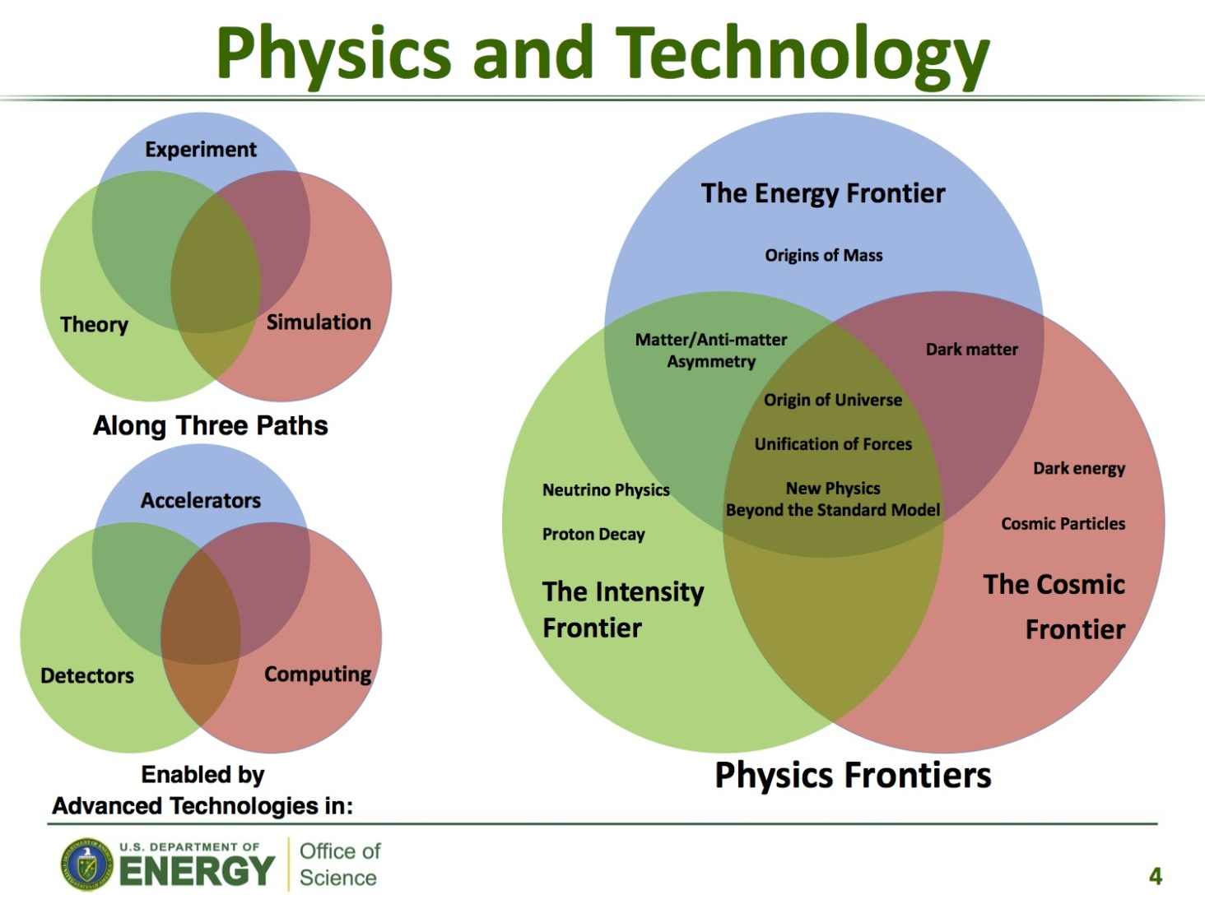
Introduction: The big challenges
Conventional HEP wisdom, but there is more than that …

Slide 4

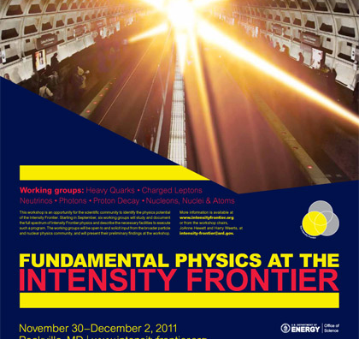
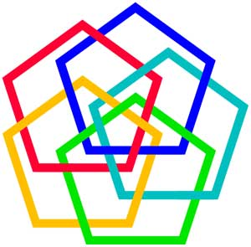
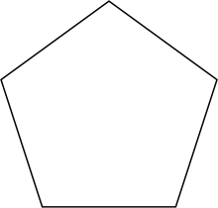
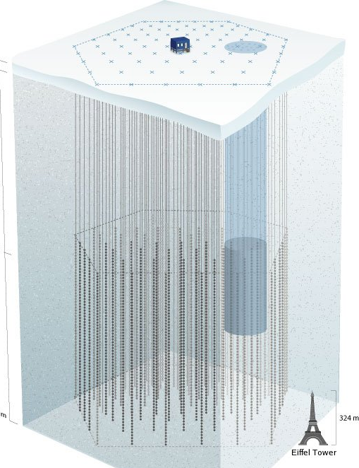
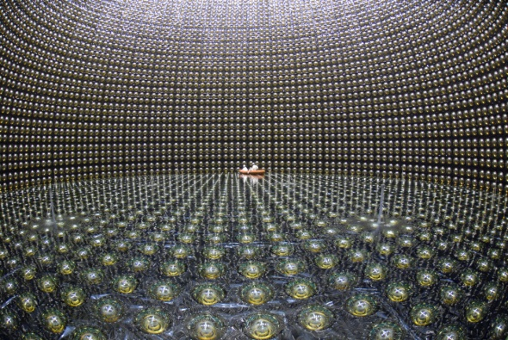
Introduction: Physics Frontiers
Search for
the origin of
mass („Higgs“),
SUSY
Secrets of
neutrinos
Energy
Intensity
Frontiers of
Physical
Sciences
Cosmic
Complexity
Quest for
„Dark Matter“
and
„Dark Energy“
(In-)stability
of the
proton
Precision

Slide 5
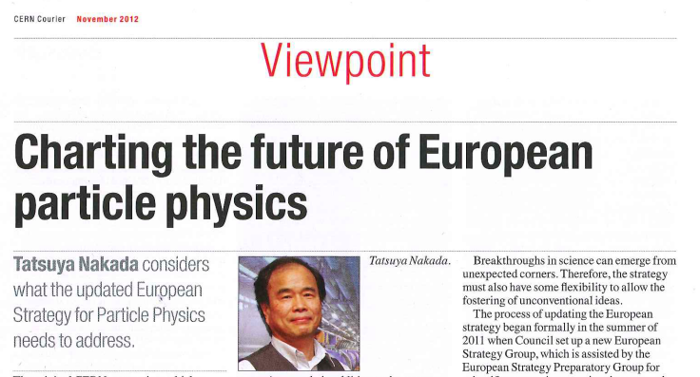
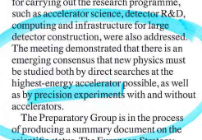
Introduction: Precision Frontier
ESPP, Cracow,
September 2012
A most promising additional frontier: Precision

Slide 6
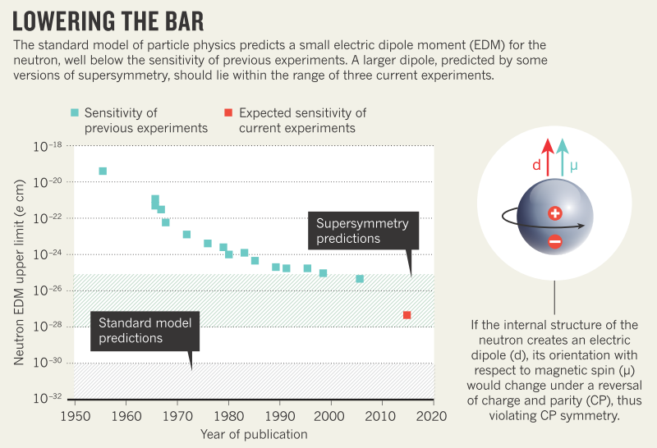
Introduction: Precision Frontier
Example: Neutron (nEDM)
Adapted from:
Nature,
Vol 482 (2012)
Search for Electric Dipole Moments (EDM) of fundamental particles

Slide 7
Outline
  Introduction
  Electric Dipole Moments
  Charged particle EDM searches
    Concepts for dedicated Storage Ring searches
    Technological challenges
    Precursor Experiments
  News
  Timeline
  Conclusion

Slide 8
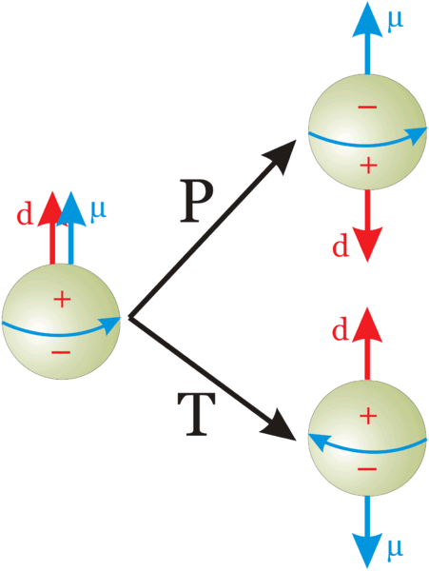
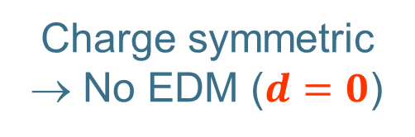
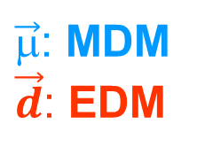
Physics: Fundamental Particles
Charge symmetric
→ No EDM ($d=0$)
$\vec{μ}$: MDM
$\vec{d}$: EDM
Do particles (e.g., electron, nucleon) have an EDM?

Slide 9

EDMs: Discrete Symmetries
Not Charge symmetric
$\vec{d}$(aligned w/ spin)
Permanent EDMs violate P and T.
Assuming CPT to hold, CP violated also.
Notes:
9
9

Slide 10
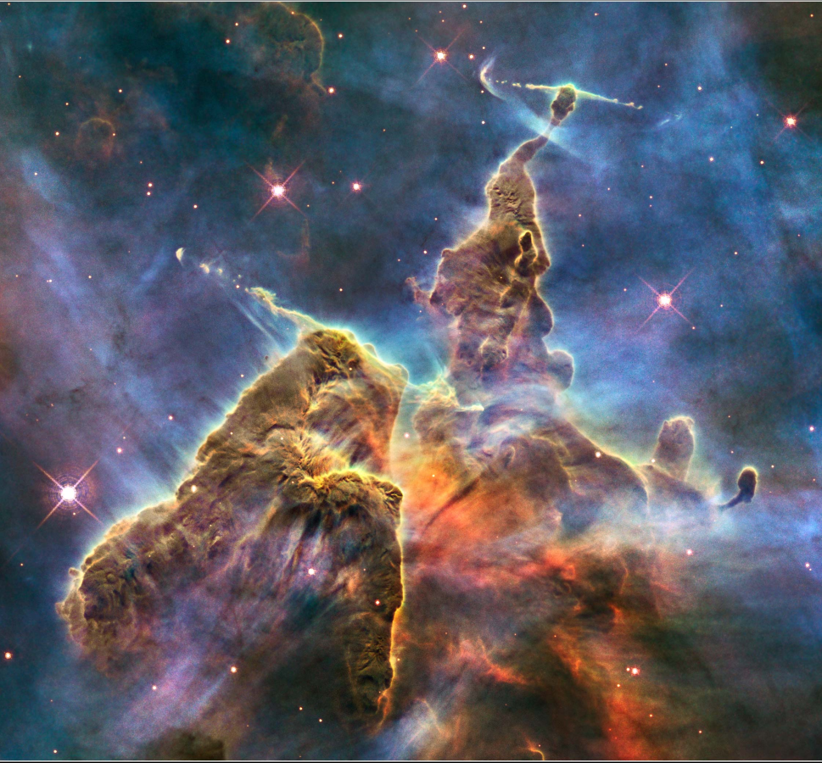
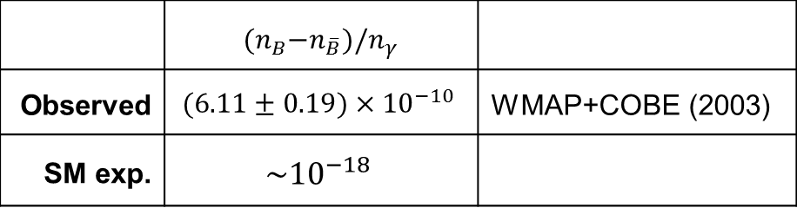
Physics: What caused the Baryon asymmetry?
Carina Nebula: Largest-seen star-birth regions in the galaxy
What happened to the antimatter?
 | ${(n}_{B}−n_{\overline{B}})/n_{γ}$
Observed | $$(6.11±0.19)×{10}^{−10}$$ | WMAP+COBE (2003)
SM exp. | $$\sim {10}^{−18}$$
Sakharov (1967): Three conditions for baryogenesis
B number conservation violated sufficiently strongly
C and CP violated, B and anti-Bs with different rates
Evolution of universe outside thermal equilibrium
The mystery of the missing antimatter (the puzzle of our existence)

Slide 11
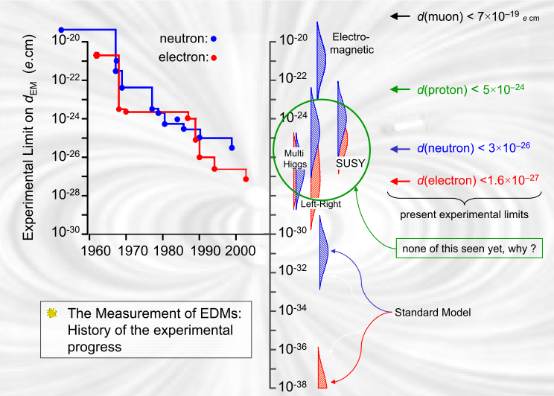
Physics: Potential of EDMs
J.M. Pendlebury: „nEDM has killed more theories than any other single expt.“

Slide 12
Outline
  Introduction
  Electric Dipole Moments
  Charged particle EDM searches
    Concepts for dedicated Storage Ring searches
    Technological challenges
    Precursor Experiments
  News
  Timeline
  Conclusion

Slide 13
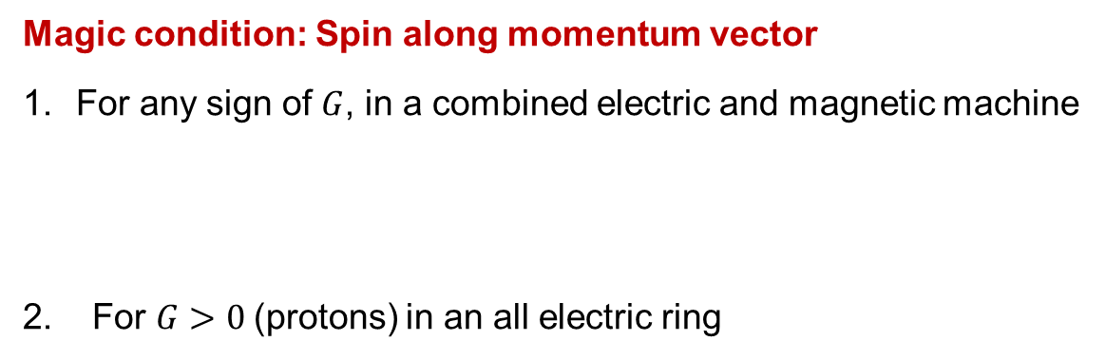

Principle: Frozen spin Method
For transverse electric and magnetic fields in a ring ( ),
anomalous spin precession is described by Thomas-BMT equation:
x
Magic condition: Spin along momentum vector
For any sign of $G$, in a combined electric and magnetic machine
2. For $G>0$(protons) in an all electric ring
$$E=Eradial$$
$$B=Bvertical$$
(magic)
→ Magic rings to measure EDMs of free charge particles

Slide 14
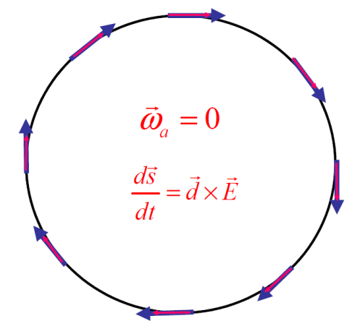
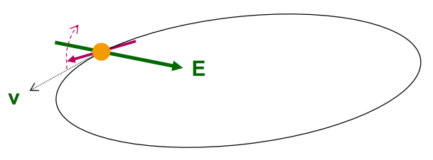
Principle: Rings for srEDM searches
Place particles in a storage ring
Align spin along momentum („Freeze“ horizontal spin precession)
Search for time development of vertical polarization
New Method to measure EDMs of free charged particles:
Magic rings with spin frozen along momentum
Notes:
14
14

Slide 15
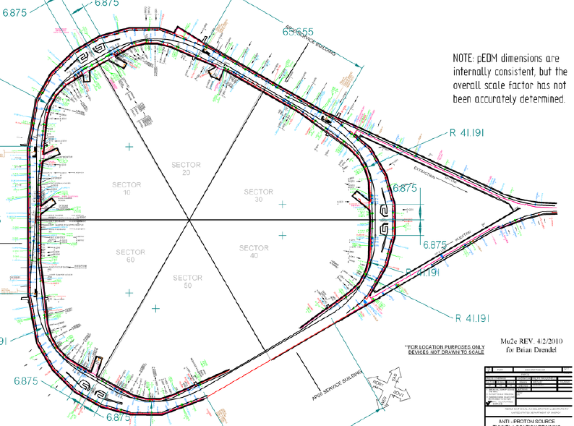
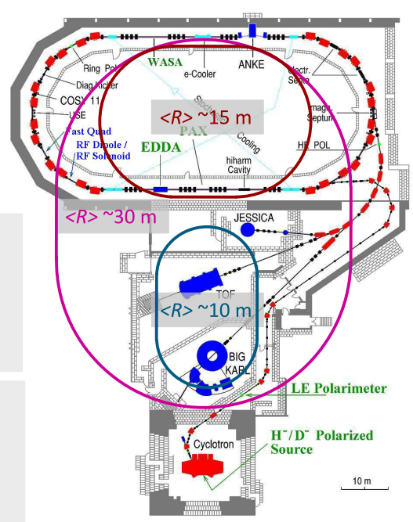
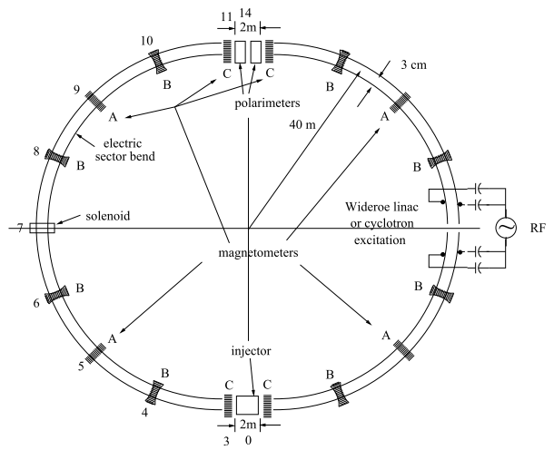
EDMs: Storage ring projects
pEDM in all electric ring at BNL
Jülich, focus on deuterons,
or a combined machine
or at FNAL
(from R. Talman)
CW and CCW propagating beams
(from A. Lehrach)
Two projects: US (BNL or FNAL) and Europe (FZJ)

Slide 16
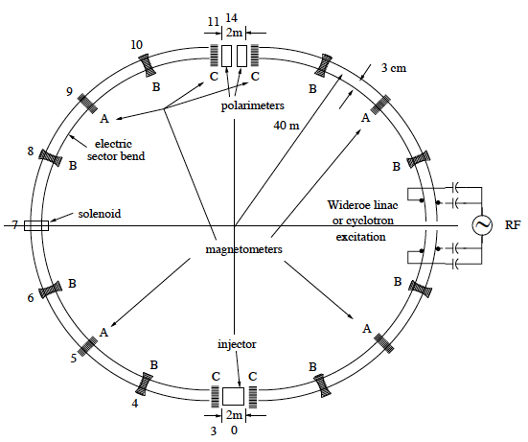
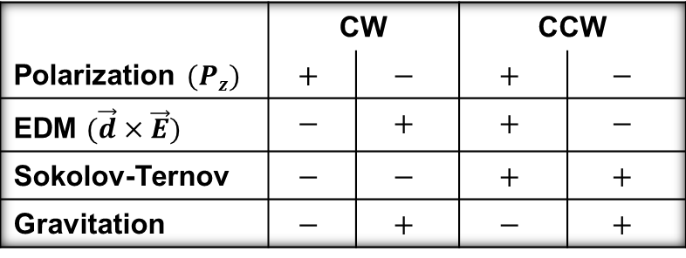
Beat systematics: BNL Proposal
2 beams simultaneously rotating in an all electric ring (cw, ccw)
CW & CCW beams cancels systematic effects
 | CW |  | CCW
Polarization $(Pz)$ | $$+$$ | $$−$$ | $$+$$ | $$−$$
EDM $(\vec{d}×\vec{E})$ | $$−$$ | $$+$$ | $$+$$ | $$−$$
Sokolov-Ternov | $$−$$ | $$−$$ | $$+$$ | $$+$$
Gravitation | $$−$$ | $$+$$ | $$−$$ | $$+$$
Status: Approved BNL-Proposal
Submitted to DOE
Interest FNAL!
Goal for protons
Many technological challenges need to be met
Notes:
16
16

Slide 17
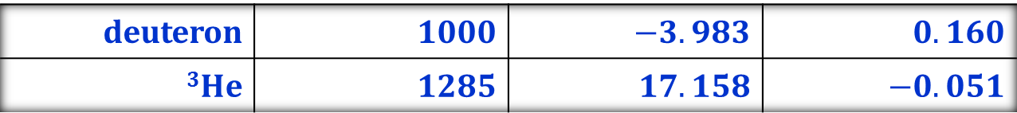
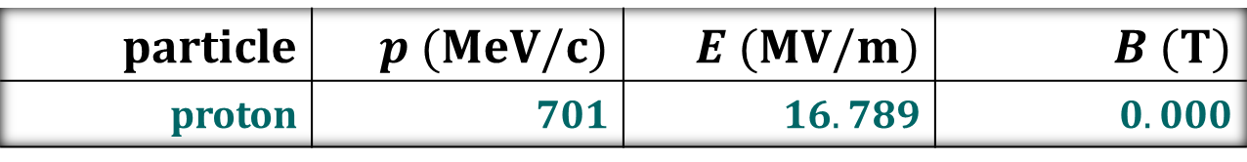
Principle: Magic Storage ring
A magic storage ring for protons (electrostatic), deuterons, …
B
particle | $$p (MeV/c)$$ | $$E (MV/m)$$ | $$B (T)$$
proton | $$701$$ | $$16.789$$ | $$0.000$$
deuteron | $$1000$$ | $$−3.983$$ | $$0.160$$
$$3He$$ | $$1285$$ | $$17.158$$ | $$−0.051$$
Possible to measure $p$, $d$, $3He$ using ONE machine with $r \sim 30$m
Notes:
17
17

Slide 18
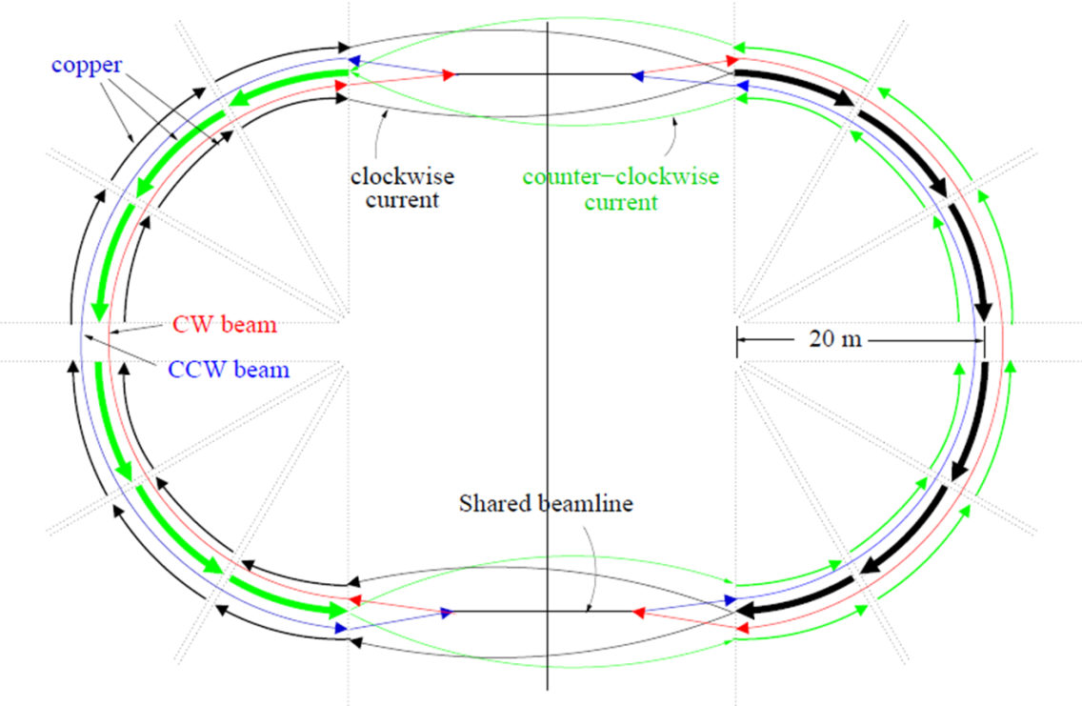
CCW & CCW with magnetic field:
Richard Talmans concept for a Jülich all-in-one machine
Iron-free, current-only, magnetic bending, eliminates hysteresis
B
A
A
Configuration generates close-to-perfect vertical B field
B

Slide 19

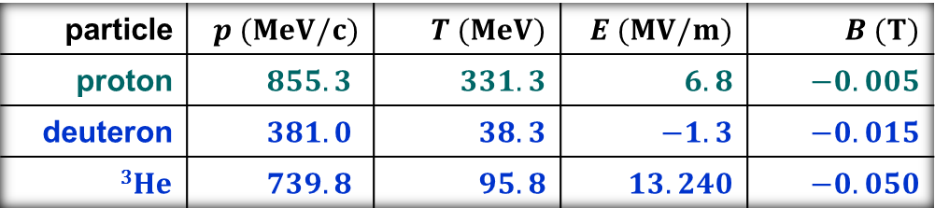
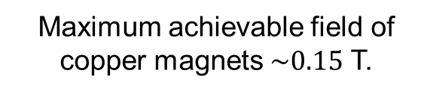

Magic ring: Jülich all-in-one machine (R. Talmans concept )
B
Maximum achievable field of copper magnets $\sim 0.15$ T.
$$r=10 m$$
particle | $$p (MeV/c)$$ | $$T (MeV)$$ | $$E (MV/m)$$ | $$B (T)$$
proton | $$855.3$$ | $$331.3$$ | $$6.8$$ | $$−0.005$$
deuteron | $$381.0$$ | $$38.3$$ | $$−1.3$$ | $$−0.015$$
$$3He$$ | $$739.8$$ | $$95.8$$ | $$13.240$$ | $$−0.050$$
Very compact machines possible for srEDM searches

Slide 20
EDMs – Sensitivity Reach
EDM search in charged baryon (systems)
pEDM
dEDM
Adapted from:
Nature,
Vol 482 (2012)
No direct measurements for proton and deuteron EDM yet !

Slide 21
Outline
  Introduction
  Electric Dipole Moments
  Charged particle EDM searches
    Concepts for dedicated Storage Ring Searches
    Technological challenges
    Precursor Experiments
  News
  Timeline
  Conclusion

Slide 22
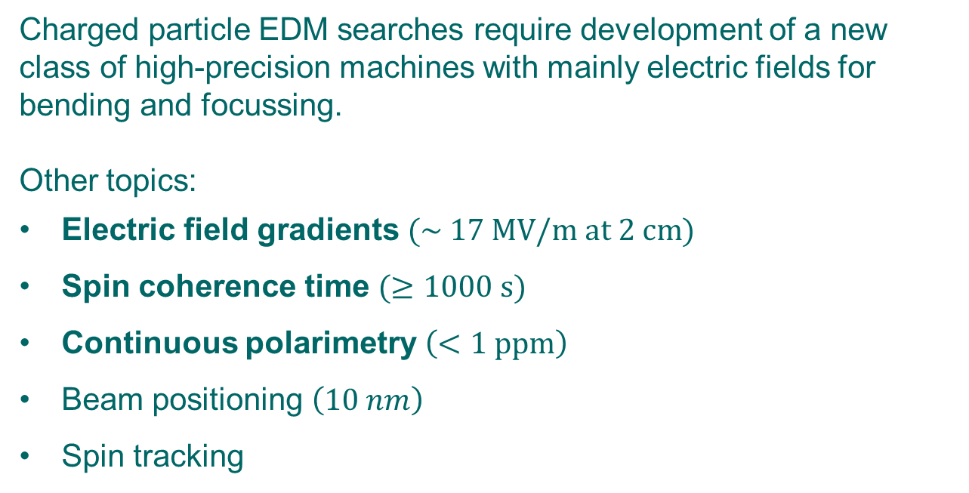
srEDM searches: Technogical challenges
Charged particle EDM searches require development of a new class of high-precision machines with mainly electric fields for bending and focussing.
Other topics:
Electric field gradients $(\sim 17 MV/m at 2 cm)$
Spin coherence time $(≥1000 s)$
Continuous polarimetry $\left(<1 ppm\right)$
Beam positioning $\left(10 nm\right)$
Spin tracking
These issues must be addressed experimentally at existing facilities

Slide 23



Challenge: Electric field for magic rings
R$adial E$field only
$$E=17 MV/m$$
$$r=24.665 m$$
Challenge to produce large electric field gradients

Slide 24
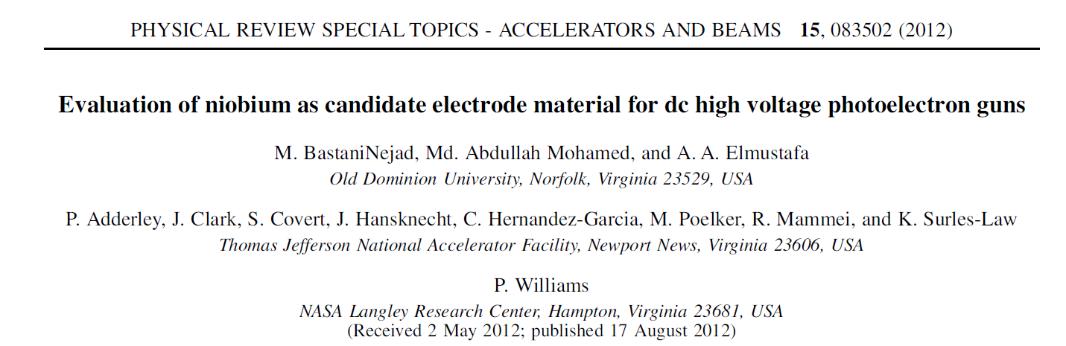
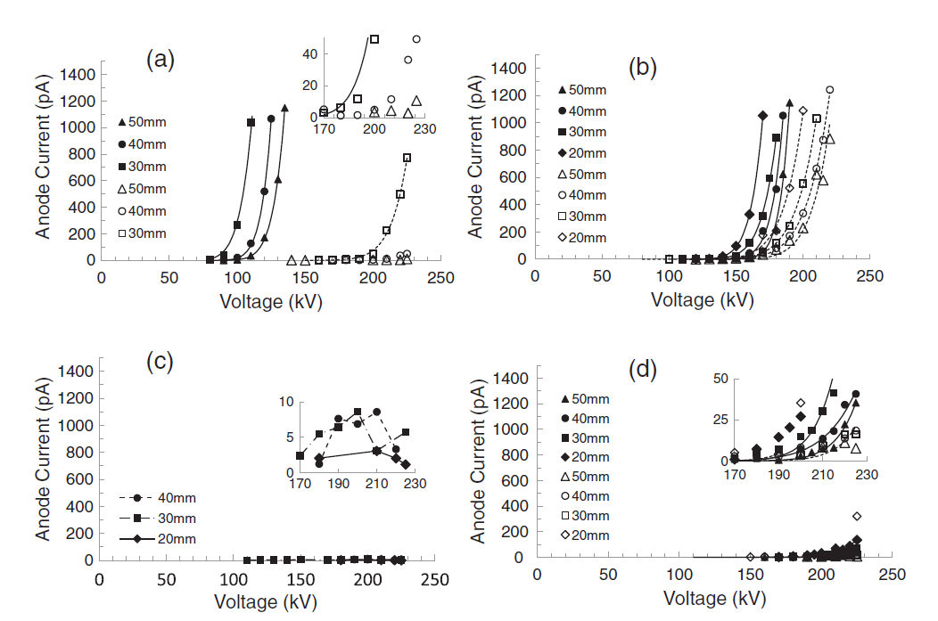
Challenge: Niobium electrodes
DPP stainless steel
fine-grain Nb
Show one slide on JLAB data HV devices
large-grain Nb
single-crystal Nb
large-grain Nb
Large-grain Nb at plate separation of a few cm yields ~20 MV/m

Slide 25
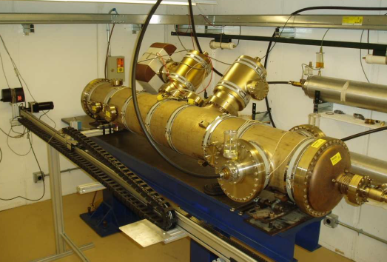
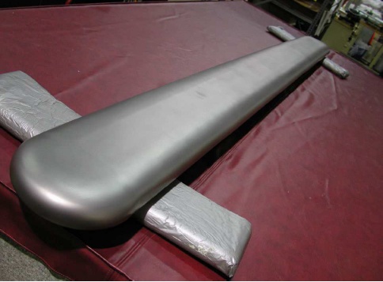

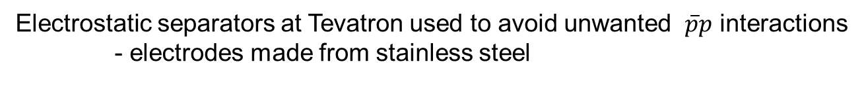
Challenge: Electric field for magic rings
Electrostatic separators at Tevatron used to avoid unwanted $\overline{p}p$ interactions
- electrodes made from stainless steel
L~2.5 m
Routine operation at $1$spark/Year at $6$MV/m
June 2013: Transfer of separator unit plus equipment from FNAL to Jülich
Need to develop new electrode materials and surface treatments

Slide 26
Challenge: Spin coherence time
Spin closed orbit
one particle with
magnetic moment
makes one turn
“spin closed orbit vector”
“spin tune”
stable polarization
ring
if ║
A

Slide 27
Challenge: Spin coherence time
We usually don‘t worry about coherence of spins along ${\hat{n}}_{co}$
Polarization not affected!
At injection all
spin vectors aligned (coherent)
After some time, spin vectors get out of phase and fully populate the cone
Situation very different, when you deal with $\vec{S}⊥ {\hat{n}}_{co}$ machines with frozen spin.
Longitudinal polarization vanishes!
At injection all spin vectors aligned
Later, spin vectors are out of phase in the horizontal plane
In an EDM machine with frozen spin, observation time is limited.

Slide 28








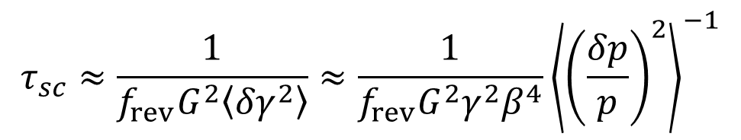

Challenge: SCT stimates (N.N. Nikolaev)
One source of spin coherence are random variations of the spin tune
due to the momentum spread in the beam
$$δθ=Gδγ$$
and
$$δγ$$
is randomized by e.g., electron cooling
$$\cos{ωt→\cos\left(ωt+δθ\right)}$$
$$τ_{sc}≈\frac{1}{f_{rev}G^{2}\left\langle {δγ}^{2}\right\rangle }≈\frac{1}{f_{rev}G^{2}γ^{2}β^{4}}{\left\langle {\left(\frac{δp}{p}\right)}^{2}\right\rangle }^{−1}$$
Estimate:
$$T_{kin}=100 MeV$$
$$f_{rev}=0.5 MHz$$
$$G_{p}=1.79$$
$$G_{d}=−0.14$$
$$τ_{sc}(p)≈3∙{10}^{3} s$$
$$τ_{sc}(d)≈5∙{10}^{5} s$$
Spin coherence time for deuterons may be 𝟏𝟎𝟎× larger than for protons

Slide 29
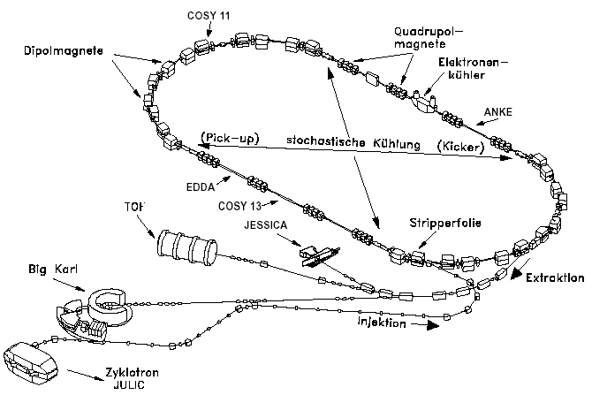
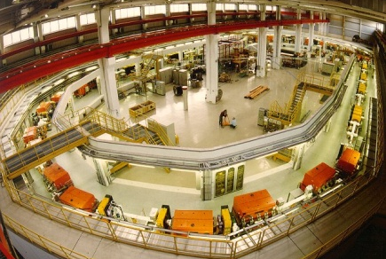
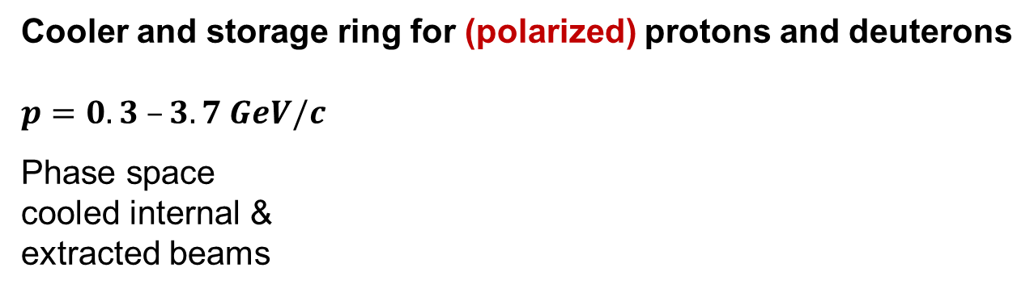
EDM at COSY: COoler SYnchrotron
Cooler and storage ring for (polarized) protons and deuterons
$$p=0.3 –3.7 GeV/c$$
Phase space
cooled internal &
extracted beams
COSY
… the spin-physics machine
for hadron physics
… an ideal starting point
for a srEDM search
Injector cyclotron
Notes:
29

Slide 30
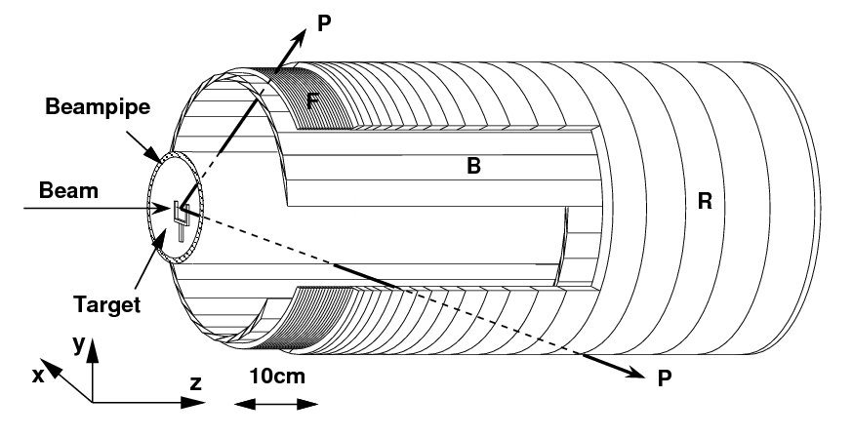
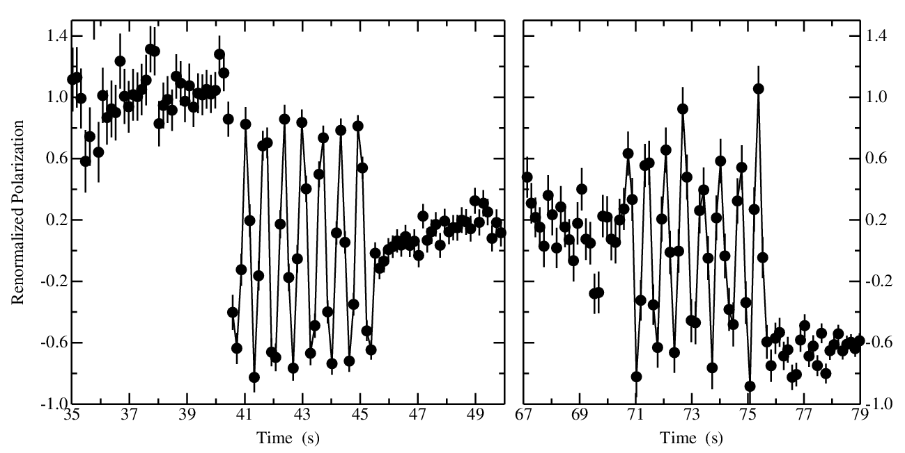
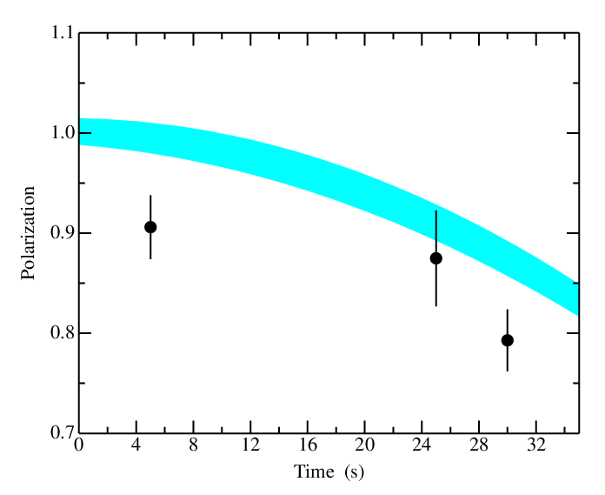



Challenge: First measurement of SCT
2011 Test measurements at COSY
Polarimetry:
Spin coherence time:
$$5 s$$
$$25 s$$
$$5 s$$
decoherence
time
oscillation
capture
from Ed Stephenson
and Greta Guidoboni

Slide 31
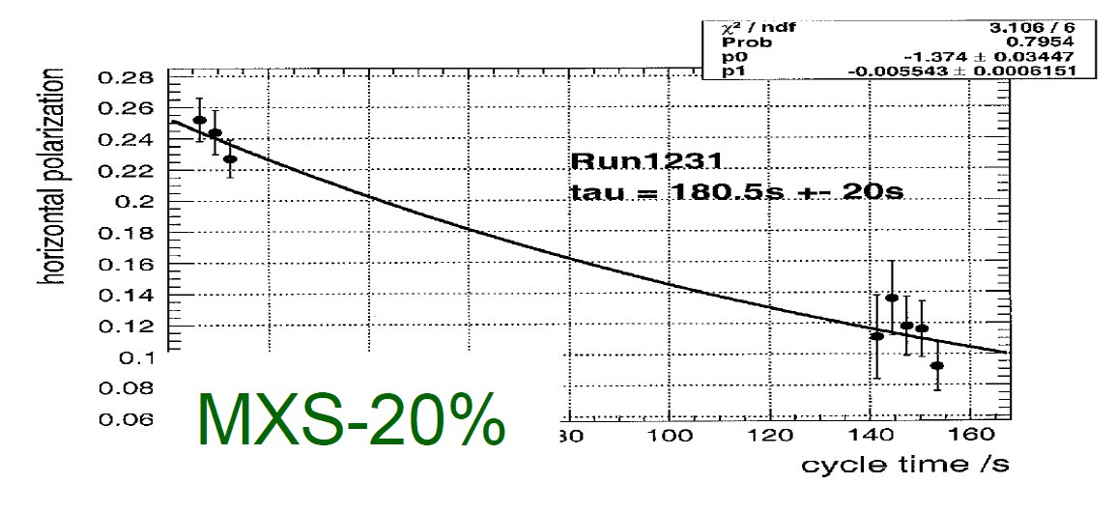
Challenge: SCT recent achievements
Result from 2012 run
from Ed Stephenson (Indiana)
and Greta Guidoboni (Ferrara)
Excellent progress towards the SCT goal for pEDM: $SCT\sim 1000$s

Slide 32
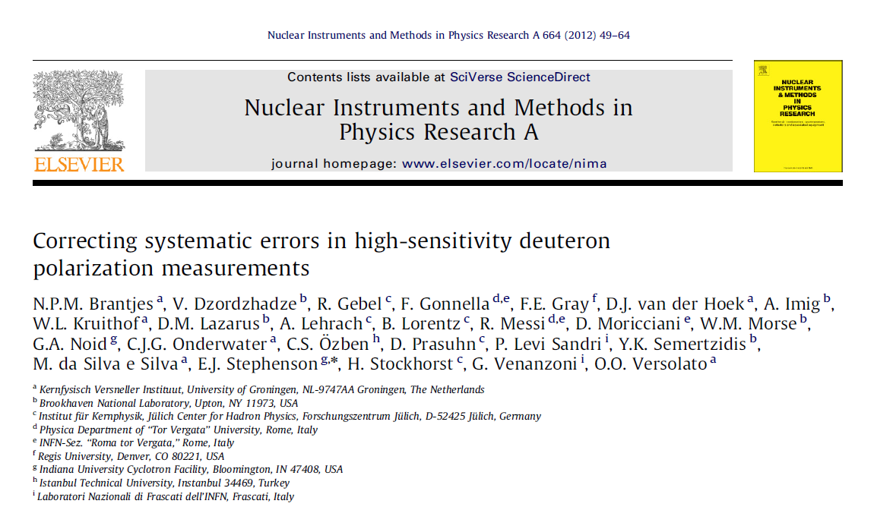
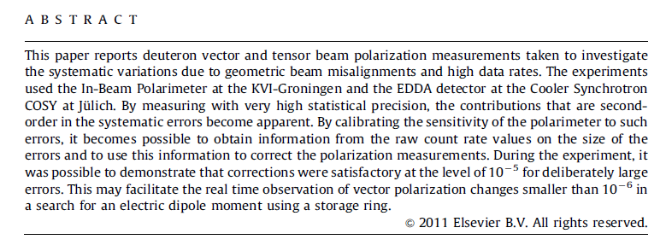
Challenge: Polarimetry
Beam polarimetry at ppm level achieved for deuteron beams

Slide 33
Outline
  Introduction
  Electric Dipole Moments
  Charged particle EDM searches
    Concepts for dedicated Storage Ring Searches
    Technological challenges
    Precursor Experiments
  News
  Timeline
  Conclusion

Slide 34
Precursor experiments: RF methods
Method based on making spin precession in machine resonant with orbit motion
Two ways:
Use an RF device that operates on some harmonics of the spin precession frequency
Operate ring on an imperfection resonance
Use existing magnetic machines for first direct EDM measurements

Slide 35
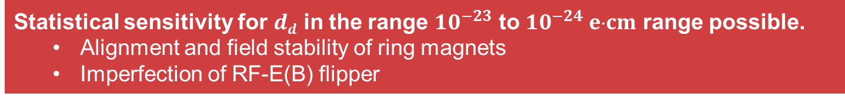
Precursor experiments:
1. Resonance Method with „magic“ RF Wien filter
Avoids coherent betatron oscillations of beam.
Radial RF-E and vertical RF-B fields to observe spin rotation due to EDM.
Approach pursued for a first direct measurement at COSY.
$E^{∗}=0$⇒ $ER =−By$„Magic RF Wien Filter“ no Lorentz force
$→$ Indirect EDM effect
RF E(B)-field
In-plane polarization
Observable:
Accumulation of vertical
polarization during spin
coherence time
stored d
Polarimeter (dp elastic)
Statistical sensitivity for $dd$ in the range ${10}^{−23}$ to ${10}^{−24} ecm$ range possible.
  Alignment and field stability of ring magnets
  Imperfection of RF-E(B) flipper

Slide 36
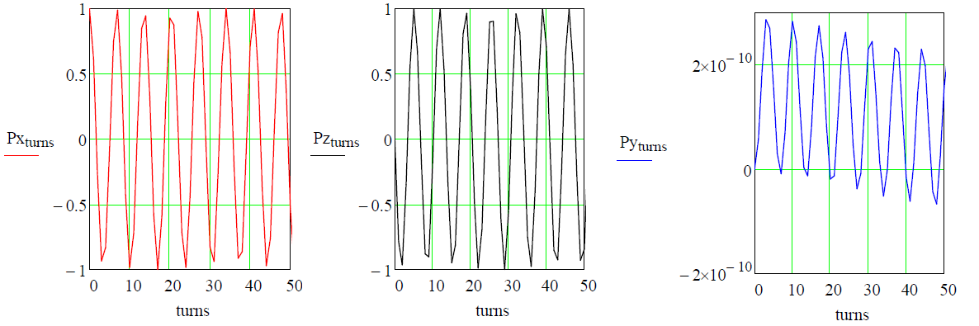


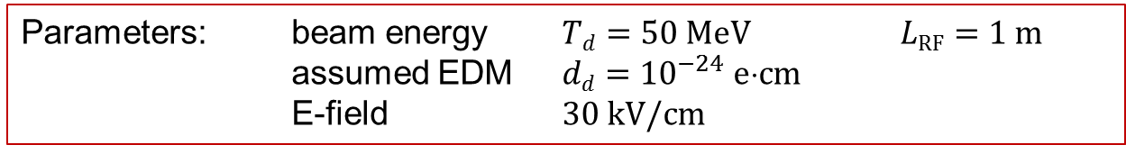


Precursor experiments:
1. Resonance Method for deuterons at COSY
Parameters: beam energy $Td=50 MeV$ $LRF=1 m$
assumed EDM $dd={10}^{−24} ecm$
E-field $30 kV/cm$
$$Px$$
$$Pz$$
$$Py$$
$$ω={2πf}_{rev}Gγ$$
$=−3.402×{10}^{5} Hz$
$$turn number$$
EDM effect accumulates in $P_{y}$

Slide 37
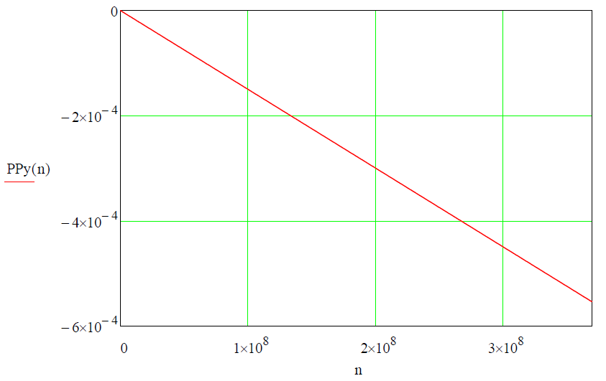

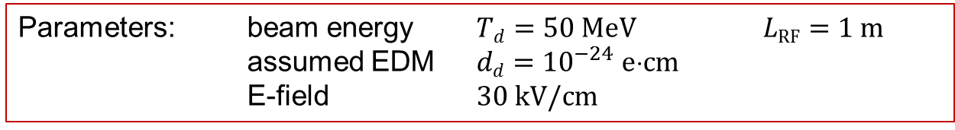



Precursor experiments:
1. Resonance Method for deuterons at COSY
Parameters: beam energy $Td=50 MeV$ $LRF=1 m$
assumed EDM $dd={10}^{−24} ecm$
E-field $30 kV/cm$
$$Py$$
$$Py$$
EDM effect accumulates in $Py$
$$turn number$$
Linear extrapolation of $Py$ for a time period of $sc=1000 s (=3.7108 turns)$ yields a sizeable $P_{y}\sim {10}^{−3}$.

Slide 38


Development: RF E/B-Flipper (RF Wien Filter)
Upgrade test flipper with electrostatic field plates ready end of year.
Build lower power version using a stripline system
Build high-power version of stripline system ($E>100$ $kV/m$)
Work by S. Mey, R. Gebel (Jülich)
J. Slim, D. Hölscher (IHF RWTH Aachen)

Slide 39



Precursor experiments:
2. Resonanct EDM measurement with static Wien Filter
Machine operated on imperfection spin resonance at $γG=2$
$$P_{x}(t)$$
without static WF
Spin rotation in phase with orbit motion
$$t (s)$$
Similar accumulation of EDM signal, systematics more difficult, strength of imperfection resonance must be suppressed by closed-orbit corrections.

Slide 40
Outline
  Introduction
  Electric Dipole Moments
  Charged particle EDM searches
    Concepts for dedicated Storage Ring Searches
    Technological challenges
    Precursor Experiments
  News
  Timeline
  Conclusion

Slide 41


New EDM collaboration established
In 2012, JEDI collaboration founded ($\sim 80$members)
Jülich Electric Dipole Moment Investigations
Spokespersons: Andreas Lehrach (Jülich)
Jörg Pretz (RWTH Aachen)
F.R. (Jülich)
May the force be with us!

Slide 42
Events in 2013
JARA-FAME kick-off January 17, 2013
  new pillar of Jülich-Aachen Research Alliance
  Samuel C. C. Ting on AMS-Experiment at ISS
JEDI collaboration meeting March 13-14, 2013
Ferrara International School Niccolò Cabeo 2013
  Physics beyond the standard model: The precision frontier
  May, 20-24 2013, IUSS, Ferrara (Italy)
Opportunities for Polarized Physics at Fermilab
  May 20-22, 2013, Fermilab, USA

Slide 43
Outline
  Introduction
  Electric Dipole Moments
  Charged particle EDM searches
    Concepts for dedicated Storage Ring Searches
    Technological challenges
    Precursor Experiments
  News
  Timeline
  Conclusion

Slide 44


Timeline:
Stepwise approach all-in-one machine for JEDI
Step | Aim / Scientific goal | Device / Tool | Storage ring
1 | Spin coherence time studies | Horizontal RF-B spin flipper | COSY
 | Systematic error studies | Vertical RF-B spin flipper | COSY
2 | COSY upgrade | Orbit control, magnets, … | COSY
 | First direct EDM measurement at ${10}^{−24}ecm$ | RF-E(B) spin flipper | Modified COSY
3 | Built dedicated all-in-one ring for $p$, $d$, $3He$ | Common magnetic-electrostatic deflectors | Dedicated ring
4 | EDM measurement of $p$, $d$, $3He$ at ${10}^{−29}ecm$ |  | Dedicated ring
Time scale: Steps 1 and 2: $< 5$ years (i.e., in POF 3)
Steps 3 and 4: $> 5$ years

Slide 45

Conclusion
Measurements of EDMs extremely difficult, but fantastic physics reach
Two storage ring projects, at BNL and Jülich
  BNL all-electric machine at magic momentum
  Jülich goes for all-in-one machine concept (deuteron)
Pursue SCT investigations at COSY
Very good prospects for first direct EDM measurements of $p$and $d$at COSY using resonance methods based on RF E(B) –fields
New collaboration established: JEDI
Both collaborations work jointly on technological challenges:
Polarimetry, SCT, E-field generation, BPMs, etc
Strong need for high precision spin tracking tools, incl. RF structures
Begin electrostatic deflector development using FNAL equipment
JEDI: Ideas to converge by fall of 2013 $→$ POF 3 Evaluation

Slide 46


Georg Christoph Lichtenberg (1742-1799)
“Man muß etwas Neues machen, um etwas Neues zu sehen.”
“You have to make (create) something new,
if you want to see something new”

Slide 47
Spares

Slide 48

Physics: Potential of EDMs
N. Arkani-Hamed (IAS, Princeton) at Intensity Frontier WS, USA (2011)

Slide 49

Physics: Limits for Electric Dipole Moments
EDM searches – only upper limits yet (in $ecm$)
Particle/Atom | Current EDM Limit | Future Goal | $ dn$equivalent
Electron | $$ 1.6 {10}^{−27}$$
Neutron | $$ 3 {10}^{−26}$$ | $${10}^{−28}$$ | $${10}^{−28}$$
$$199Hg$$ | $$ 3.1×{10}^{−29}$$ | $${10}^{−29}$$ | $${10}^{−26}$$
$$129Xe$$ | $$ 6×{10}^{−27}$$ | $${10}^{−30} –{10}^{−33}$$ | $${10}^{−26} –{10}^{−29}$$
Proton | $$ 7.9×{10}^{−25}$$ | $${10}^{−29}$$ | $${10}^{−29}$$
Deuteron | ? | $${10}^{−29}$$ | $$3 {10}^{−29} – 5×{10}^{−31}$$
Huge efforts underway worldwide to improve limits / find EDMs
Notes:
49
49

Slide 50

EDMs: Why is CPV so interesting?
CPV in the SM points to physics we do not understand
CPV is highly sensitive to physics beyond the SM (New Physics)
CPV is accessible to a wide range of experiments
New source of CPV beyond the SM required for baryogenesis
Physics beyond the Standard Model (BSM)

Slide 51
srEDM cooperations
International srEDM Network
Institutional (MoU) and Personal (Spokespersons …) Cooperation, Coordination
srEDM Collaboration (BNL)
(spokesperson Yannis Semertzidis)
JEDI Collaboration (FZJ)
(spokespersons: A. Lehrach, J. Pretz, F.R.)
Common R&D
      RHIC EDM-at-COSY
  Beam Position Monitors Polarimetry
  (…) Spin Coherence Time
  Cooling
Spin Tracking (…)
Study Group
DOE-Proposal (submitted)
First direct measurement
Ring Design
CD0, 1, …
HGF Application(s)
pEDM Ring at BNL
JEDI

Slide 52



Magnetic moment, spin, g and G
$$μ_{N}=\frac{e∙ℏ}{2∙m_{p}}=5.05078324 JT^{−1}$$
Nuclear magneton
$$\vec{μ}=g∙μ_{N}∙\frac{m_{p}}{m}∙Z∙\vec{s}$$
particle | spin $s$ | charge $Z$ | $$g$$ | $$G=\frac{g−2}{2}$$
proton | $$\frac{1}{2}$$ | $$1$$ | $$5.586$$ | $$1.793$$
deuteron | $$1$$ | $$1$$ | $$1.714$$ | $$−0.143$$
³He | $$\frac{1}{2}$$ | $$2$$ | $$−6.368$$ | $$−4.184$$

Slide 53


Operation of „magic“ RF Wien filter
Radial E and vertical B fields oscillate, e.g., with
$f_{HV}=\left(K+Gγ\right)∙f_{rev}=−54.151×{10}^{3} Hz$(here $K=0$).
beam energy
$$Td=50 MeV$$
Spin coherence time may depend on excitation and on chosen harmonics $K.$

Slide 54




Simulation of resonance Method
with Magic Wien filter for deuterons at COSY
Parameters: beam energy $Td=50 MeV$ $LRF=1 m$
assumed EDM $dd={10}^{−24} ecm$
E-field $30 kV/cm$
Linear extrapolation of $Py$ for a time period of $sc=100000 s (=3.71010 turns)$.
$$Py$$
EDM effect accumulates in $Py$
$$turn number$$

Slide 55


Why also EDMs of protons and deuterons?
Proton and deuteron EDM experiments may provide one order higher sensitivity.
In particular the deuteron may provide a much higher sensitivity than protons.
Consensus in the theoretical community:
Essential to perform EDM measurements on different targets $(p, d, 3He)$with similar sensitivity:
unfold the underlying physics,
explain the baryogenesis.

Slide 56






Magic condition: Protons
Case 2: $radial E$and $vertical B$fields
$$B>0$$
$$B<0$$
$$B>0$$
$$B<0$$
magic energy
magic energy

Slide 57


Magic condition: Deuterons
$radial E$and $vertical B$fields

Slide 58

Magic condition: Helions
$radial E$and $vertical B$fields

Slide 59



Some polarimetry issues
pC and dC polarimetry is the currently favored approach for the pEDM experiment at BNL
srEDM experiments use frozen spin mode, i.e.,
beam mostly polarized along direction of motion,
most promising ring options use cw & ccw beams.
scattering on C destructive on beam and phase-space,
scattering on C determines polarization of mainly
particles with large betatron amplitudes, and
is not capable to determine $\vec{P}=\left(\begin{matrix}P_{x} \\ P_{y} \\ P_{z}\end{matrix}\right)$ .
For elastic scattering longitudinal analyzing powers are tiny ($A_{z}$violates parity).
Ideally, use a method that would determine $\vec{P}(t)$.

Slide 60











Exploit observables that depend on beam and target polarization
$$y (up)$$
$$beam 1 \vec{P}=\left(\begin{matrix}P_{x} \\ P_{y} \\ P_{z}\end{matrix}\right)$$
$$target (or beam 2) \vec{Q}=\left(\begin{matrix}Q_{x} \\ Q_{y} \\ Q_{z}\end{matrix}\right)$$
$$θ$$
$$x (sideways)$$
Spin-dependent differential cross section for
$\vec{\left(\frac{1}{2}\right)}+\vec{\left(\frac{1}{2}\right)}→\frac{1}{2}+\frac{1}{2}$
$$φ$$
$$z (along beam)$$
$$\frac{σ}{σ_{0}}=1+A_{y}\left[\left(P_{y}+Q_{y}\right)\cos{φ}−\left(P_{x}+Q_{x}\right)sin⁡φ\right] \\ + A_{xx}\left[P_{x}Q_{x}\cos^{2}φ+P_{y}Q_{y}\sin^{2}φ+\left(P_{x}Q_{y}+P_{y}Q_{x}\right)\sin{φ\cos{φ}}\right] \\ + A_{yy}\left[P_{x}Q_{x}\sin^{2}φ+P_{y}Q_{y}\cos^{2}φ−\left(P_{x}Q_{y}+P_{y}Q_{x}\right)\sin{φ\cos{φ}}\right] \\ + A_{xz}\left[\left(P_{x}Q_{z}+P_{z}Q_{x}\right)\cos{φ}+\left(P_{y}Q_{z}+P_{z}Q_{y}\right)sin⁡φ\right] \\ + A_{zz}P_{z}Q_{z}$$
Analyzing power $A_{y}=A_{y}\left(θ\right)$
Spin correlations $A_{ij}=A_{ij}(θ)$
In $pp$scattering, necessary observables are well-known
in the range $50−2000$MeV (not so for $pd$or $dd$).

Slide 61

How could one do that, determine $\vec{P}$?
Suggestion 1: Use a polarized $\vec{H}$ storage cell target
Detector
CW
CCW
cell
Detector determines $\vec{P}$of cw & ccw beams separately, based on kinematics.
Alignment of target polarization $\vec{Q}$ along $x, y, z$ axes by magnetic fields. Leads to unwanted MDM rotations → absolute no-go in EDM experiments.

Slide 62



How could one do that, determine $\vec{P}$?
Suggestion 2: Use colliding beam from external source
$$cw beam \vec{P}=\left(\begin{matrix}P_{x} \\ P_{y} \\ P_{z}\end{matrix}\right)$$
$$probing beam \vec{Q}=\left(\begin{matrix}Q_{x} \\ Q_{y} \\ Q_{z}\end{matrix}\right)=\left(\begin{matrix}Q_{x} \\ 0 \\ 0\end{matrix}\right),\left(\begin{matrix}0 \\ Q_{y} \\ 0\end{matrix}\right), or\left(\begin{matrix}0 \\ 0 \\ Q_{z}\end{matrix}\right)$$
Detector
$$\frac{σ}{σ_{0}}=1+A_{y}\left[\left(P_{y}+Q_{y}\right)\cos{φ}−\left(P_{x}+Q_{x}\right)sin⁡φ\right] \\ + A_{xx}\left[P_{x}Q_{x}\cos^{2}φ+P_{y}Q_{y}\sin^{2}φ+\left(P_{x}Q_{y}+P_{y}Q_{x}\right)\sin{φ\cos{φ}}\right] \\ + A_{yy}\left[P_{x}Q_{x}\sin^{2}φ+P_{y}Q_{y}\cos^{2}φ−\left(P_{x}Q_{y}+P_{y}Q_{x}\right)\sin{φ\cos{φ}}\right] \\ + A_{xz}\left[\left(P_{x}Q_{z}+P_{z}Q_{x}\right)\cos{φ}+\left(P_{y}Q_{z}+P_{z}Q_{y}\right)sin⁡φ\right] \\ + A_{zz}P_{z}Q_{z}$$
Polarized ion source
(~10 MeV)
Collide two external beams with cw and ccw stored beams.
Energy could be tuned to match detector acceptance.
Polarization components of probing low-energy beam can be made large, would be selected by spin rotators in the transmission lines.
Luminosity estimates necessary

Slide 63




How could one do that, determine $\vec{P}$?
Suggestion 3: Use directly reactions from colliding beams
$$cw beam \vec{P}=\left(\begin{matrix}P_{x} \\ P_{y} \\ P_{z}\end{matrix}\right)$$
$$ccw beam \vec{Q}=\left(\begin{matrix}Q_{x} \\ Q_{y} \\ Q_{z}\end{matrix}\right)$$
Detector
CW
CCW
$$\frac{σ}{σ_{0}}=1+A_{y}\left[\left(P_{y}+Q_{y}\right)\cos{φ}−\left(P_{x}+Q_{x}\right)sin⁡φ\right] \\ + A_{xx}\left[P_{x}Q_{x}\cos^{2}φ+P_{y}Q_{y}\sin^{2}φ+\left(P_{x}Q_{y}+P_{y}Q_{x}\right)\sin{φ\cos{φ}}\right] \\ + A_{yy}\left[P_{x}Q_{x}\sin^{2}φ+P_{y}Q_{y}\cos^{2}φ−\left(P_{x}Q_{y}+P_{y}Q_{x}\right)\sin{φ\cos{φ}}\right] \\ + A_{xz}\left[\left(P_{x}Q_{z}+P_{z}Q_{x}\right)\cos{φ}+\left(P_{y}Q_{z}+P_{z}Q_{y}\right)sin⁡φ\right] \\ + A_{zz}P_{z}Q_{z}$$
Requires luminosity, $β$-functions at IP should be rather small.
Advantage over suggestion 2. is that $frev$supports luminosity.
Disadvantage is that sensitivity comes mainly from terms with $Axz$ and $Azz$.
Detailed estimates necessary.

Slide 64











Luminosity estimate for the collider option
$$Tmagic=232.8 MeV$$
$$σ(β)=\sqrt{ε∙β}$$
$$L(T,β)=\frac{N_{1}N_{2}f_{rev}(T)n_{b}}{4π{σ(β)}^{2}}$$
$$β=0.1 m$$
Conditions:
$$=1 m$$
$$N1=N2=1011$$
$$nb=4$$
$$Luminosity$$
$$β=1 m$$
$$β (m)$$ | $$σ (mm)$$
$$10$$ | $$3.2$$
$$1$$ | $$1$$
$$0.1$$ | $$0.32$$
$$β=10 m$$
$$kinetic energy (MeV)$$
Even under these very optimistic assumptions, event rate will be rather low.
$$Rate=L×pp$$
$$=3.1∙{10}^{28}{[cm}^{−2}s^{−1}]×{10}^{−27}[{cm}^{2}{mb}^{−1}]×15[mb] ≈466 s^{−1}$$

Slide 65


Symmetries
Physical laws are invariant under certain transformations.
$$P: \left(\begin{matrix}x \\ y \\ z\end{matrix}\right)→\left(\begin{matrix}−x \\ −y \\ −z\end{matrix}\right)$$
Parity:
T-Symmetry:
$$T: t → −t$$
C-parity (or Charge parity):
Changes sign of all quantized charges
electrical charge,
baryon number,
lepton number,
flavor charges,
Isospin (3rd-component)

Slide 66



New Idea: Ivan Koop‘s spin-wheel
$$\frac{d\vec{S}}{dt}=\vec{d}×\vec{E}+\vec{μ}×\vec{B}$$
B
By appropriate choice of magnetic field, the spin vector rotates fast $→$frequencies of the order kHz
Jülich has expertise in SQUIDs, people say, state-of-the art measurements allow for is ${10}^{−6}×Φ_{0}$
($Φ_{0}=2.067833758\left(46\right)×{10}^{−15} Wb)$
This would revolutionize the way we conceive EDM (and in general polarization) experiments, because frequencies become directly measureable.

Slide 67



How this would work?
Frequency
$$EDM≠0$$
Find the value of B where
spin precession frequency disappears
$$EDM=0$$
B field
$$∼ \left\langle Δy\right\rangle$$

Slide 68


SQUIDs: Precision tools for accelerators
Possible applications in accelerators, all of which are needed for srEDM experiments
  Beam current transformers
  Beam position monitors
  Beam polarimeters
Begin development with a measurement of
the noise spectrum using three coils:
  Coil 35mm away from center
  ANKE chamber
  Combined coils in same housing
    GHz range (one pickup loop)
    MHz range (several hundered loops)
  Fluxgate sensor
    kHz range
Measurement of noise spectrum at COSY in MD week, July 2013

Slide 69

New Idea: Direct measurement of electron EDM
Bill Morse: $p=15 MeV/c$, $r\sim 1.5 m$, $γ\sim 30$ (talk tomorrow)
Nobody knows where CPV is hiding, may well be in the leptonic sector
Needs a dedicated R&D effort
Very attractive:
  Tests all ingredients of srEDM experiments
  Could develop into a long-term project
Polarimetry is an issue
Goal: $<{10}^{−27}e∙cm$
Could be an option for FNAL using the electrostatic Tevatron separators

Slide 70
Projects and persons
Accelerator
Systematic error studies
Student | Topic | Responsible
Denis Zyuzin | Cosy-Infinity (final ring) | Y. Senichev
Marcel Rosenthal | Cosy-Infinity (COSY) | A. Lehrach
Artem Saleev | Cosy-Infinity | Nikolaev/Rathmann
Andrea Pesce | invariant spin axis | P. Lenisa
Lorena Magallanes (M) | Cosy-Infinity snake | A. Lehrach
Stas Chekmenev | Systematic error studies | J. Pretz

Slide 71
Projects and persons
Polarimetry
Student | Topic | Responsible
Greta Guidobini | Data analysis | P. Lenisa
Paul Maanen | Polarimeter concepts | J. Pretz
Dennis Eversmann (M) | Data analysis | J. Pretz
Fabian Hinder (M) | Polarimeter | J. Pretz
RF E/B flipper
Sebastian Mey | RF E/B flipper | J. Pretz/ R. Gebel
B field measurement
NN | Magnetometer | H. Soltner/H.-J. Krause
Electrostatic deflectors
NN | Electrostatic deflectors | A. Nass/F. Rathmann

