Slide 1
Rogowski coils as beam position monitors
Helmut Soltner and Fabian Trinkel, March 13th 2017
Kick off meeting at CERN

Slide 2
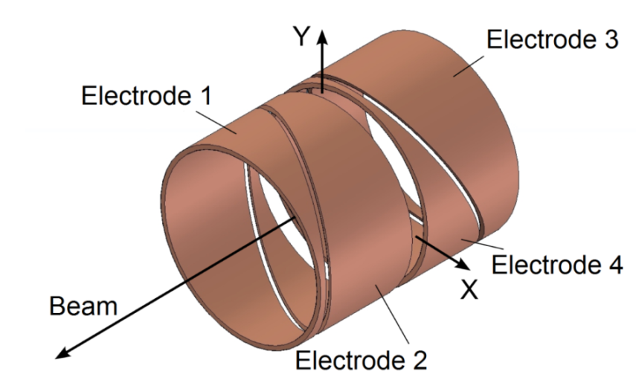
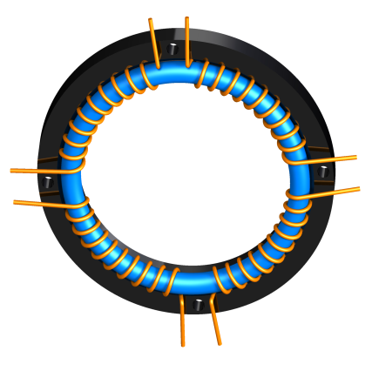
Beam Position Monitor (BPM)
Conventional method:
New Development:
Easy to manufacture
Excellent response to an RF signal
More precise position measurement with
Rogowski BPM System and a first step to
a SQUID-based BPM development
08 March 2017
2

Slide 3
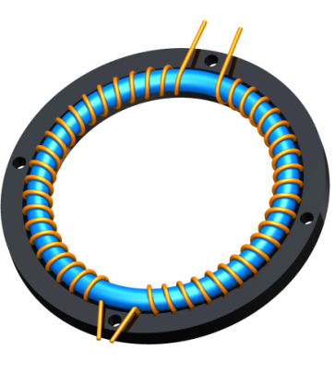
Data acquisition
1
2
Preamplifier
(13.5 dB)
Preamplifier
(13.5 dB)
COSY RF
(Lock signal)
Zurich Instruments HFL2I Lock-in amplifier
Data Acquisition (PC)
8. März 2017
3

Slide 4
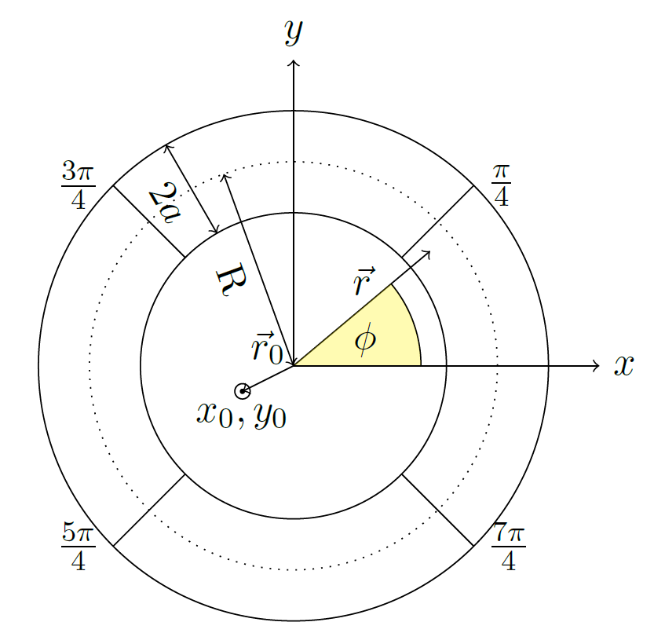
Magnetic field of particle beam
Particle Beam
Pickup-Coil
Current:
Beam Position:
Position:
Magnetic Field:

Slide 5
Magnetic field of particle beam
Vector potential

Slide 6
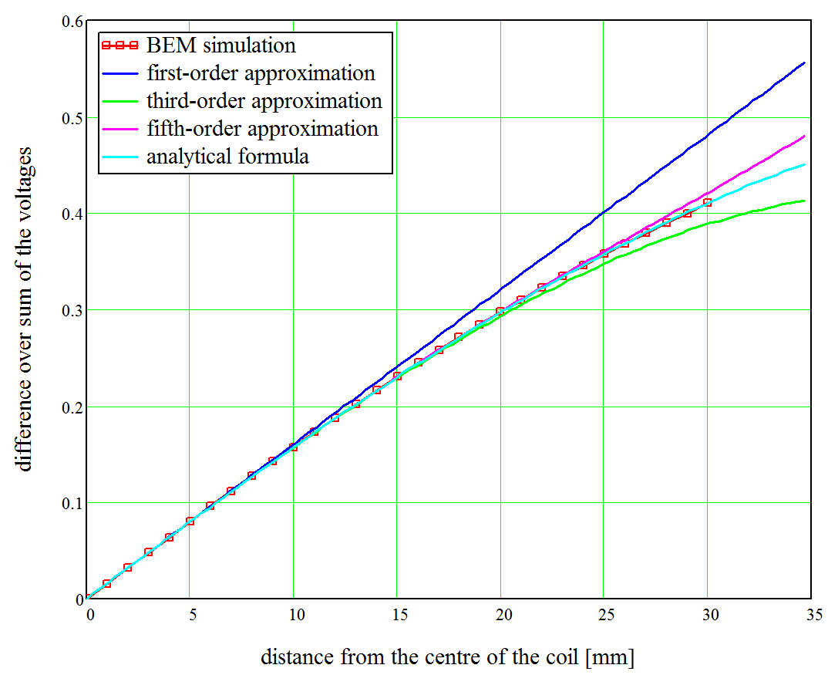
Deviations from linear model
8. März 2017
6
Notes:
6

Slide 7
Linear model
8. März 2017
7
Notes:
7

Slide 8
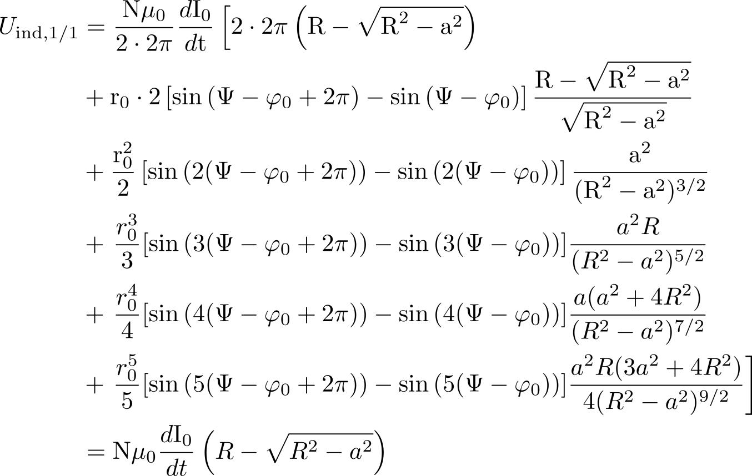
Rogowski coil configurations
 | Rogowski coil configuration
 | Full segmentation
 | Halved segmentation
 | Quartered segmentation
†
08 March 2017
† “Mutual inductances comparison in Rogowski coil with circular and rectangular cross-sections and its improvement” http://dx.doi.org/10.1109/ICIEA.2008.4582770
8
Notes:
8

Slide 9
Position determination and sensitivities
Coil parameters for sensitivities:
08 March 2017
9
Notes:
9

Slide 10
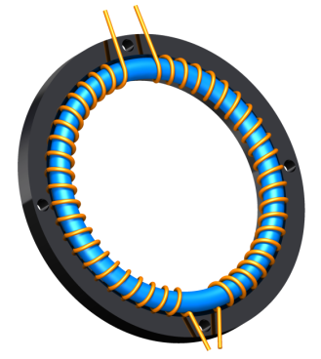
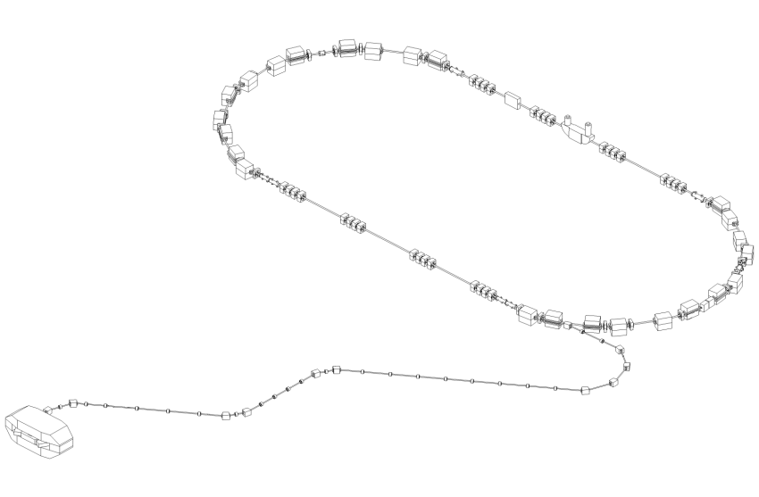
Horizontal Rogowski coil BPM in COSY
One dimensional BPM
Model prediction:
2. Interval
Assumption: vertical
orbit stays the same
1. Interval
Initial beam
position
Orbit bump 1
8. März 2017
10
Time (s)

Slide 11
Local orbit bump
Rogowski coil BPM
Horizontal displacement
a)
Beam
Corrector Magnet 1
Corrector Magnet 2
Rogowski coil BPM
Horizontal displacement
b)
Beam
Corrector Magnet 1
Corrector Magnet 2
8. März 2017
11
Notes:
11

Slide 12
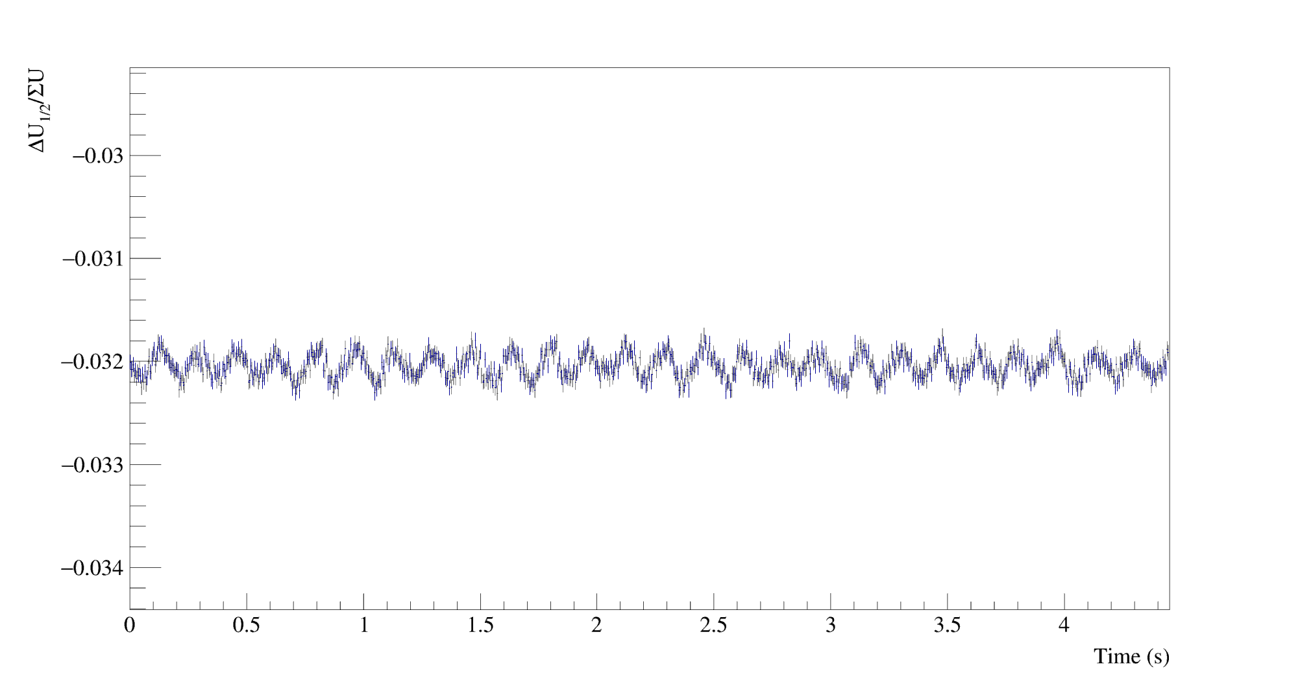
Initial horizontal voltage ratio
1. Interval
8. März 2017
12

Slide 13
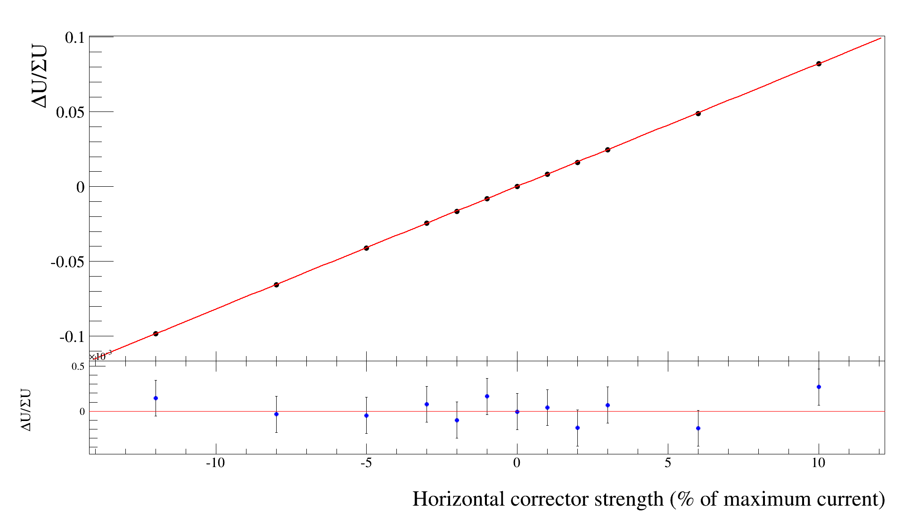
Result of the horizontal voltage ratio measurement
8. März 2017
13

Slide 14
Vertical voltage ratio measurement
Assumption:
Horizontal orbit stays the same
Vertical beam position (mm)
Initial beam
position
Continuous vertical
beam movement
Local vertical orbit bump
Time (s)
Model prediction:
Calculate:
Continuous vertical
beam movement
Time (s)
8. März 2017
14

Slide 15
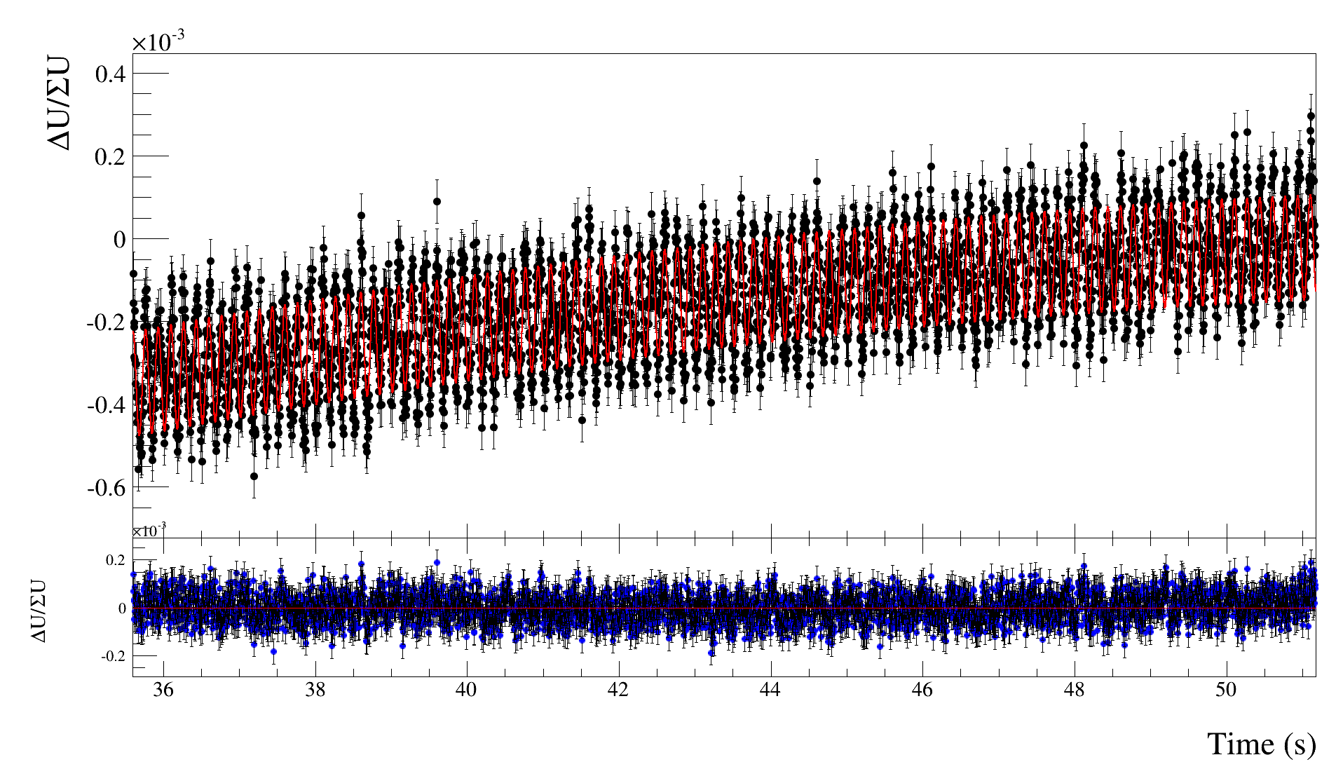
Result of the vertical voltage ratio measurement
8. März 2017
15

Slide 16
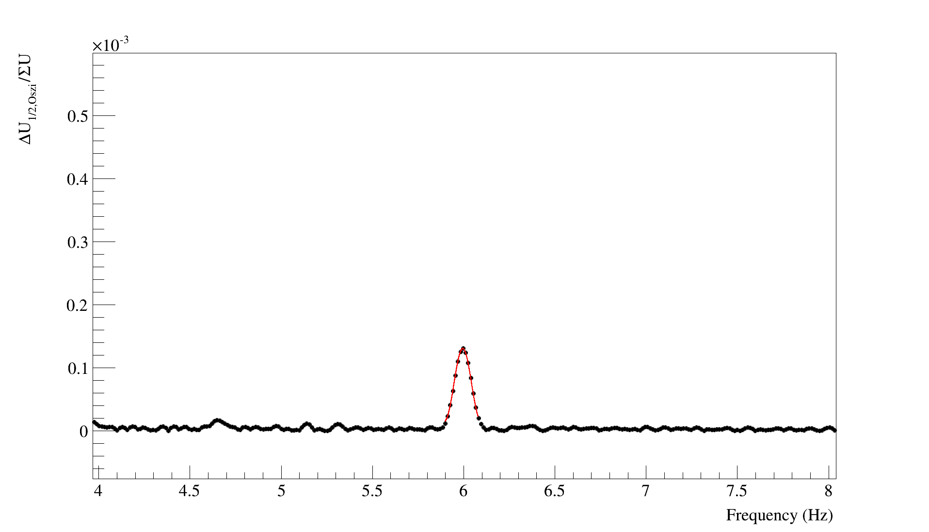
Analysis of the oscillating signal
8. März 2017
16

Slide 17
Mechanical vibrations?
Beam position measurements in the horizontal plane
Oscillation of the setup with 6 Hz?
If the setup oscillates with such a frequency, then the frequency should also appear in the Fourier spectra of the sum voltage
Applying different electron cooler timings to the beam.
Influences only beam parameters and everything else stays the same
Electron cooler timings (s)
0
10
12
15
8. März 2017
17

Slide 18
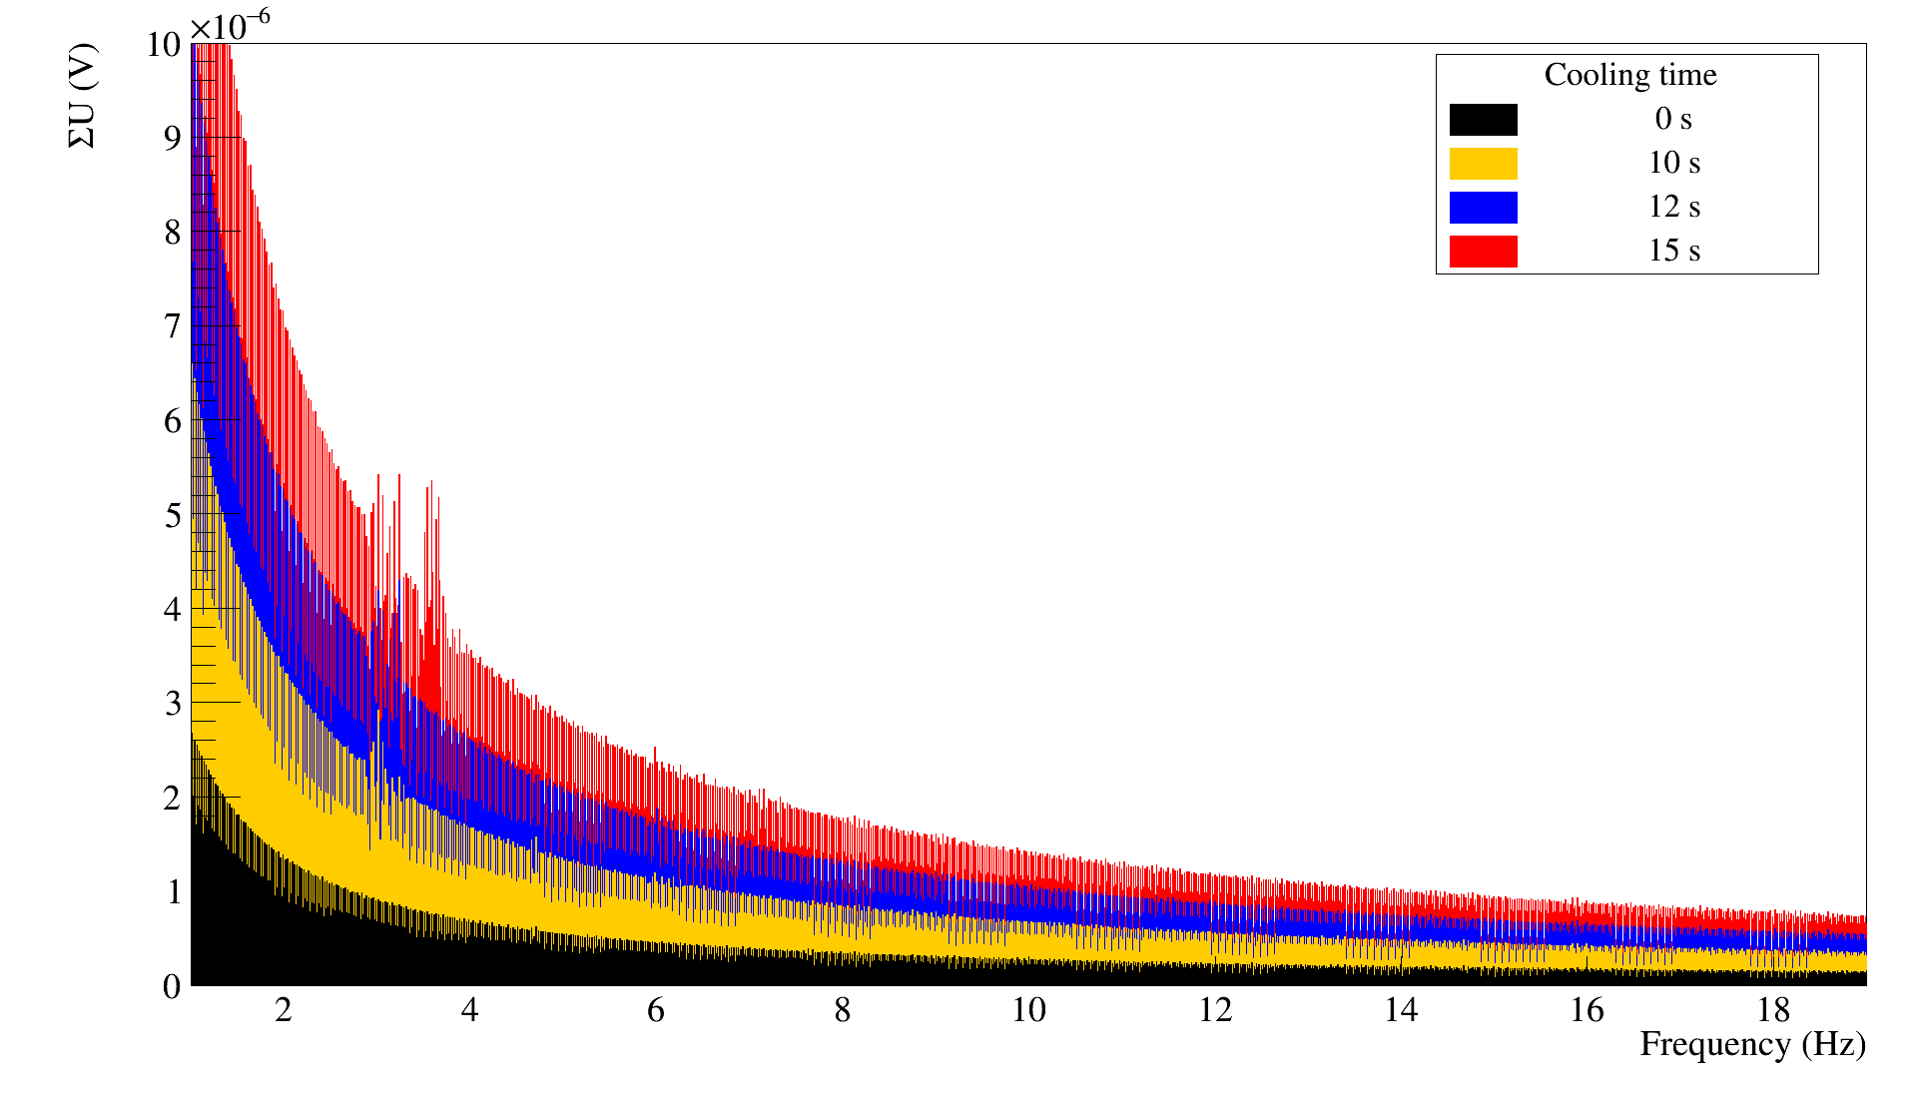
Fourier spectra sum voltage
No frequency in the spectra
The source of the measured voltage oscillation is not from the setup itself
8. März 2017
18

Slide 19
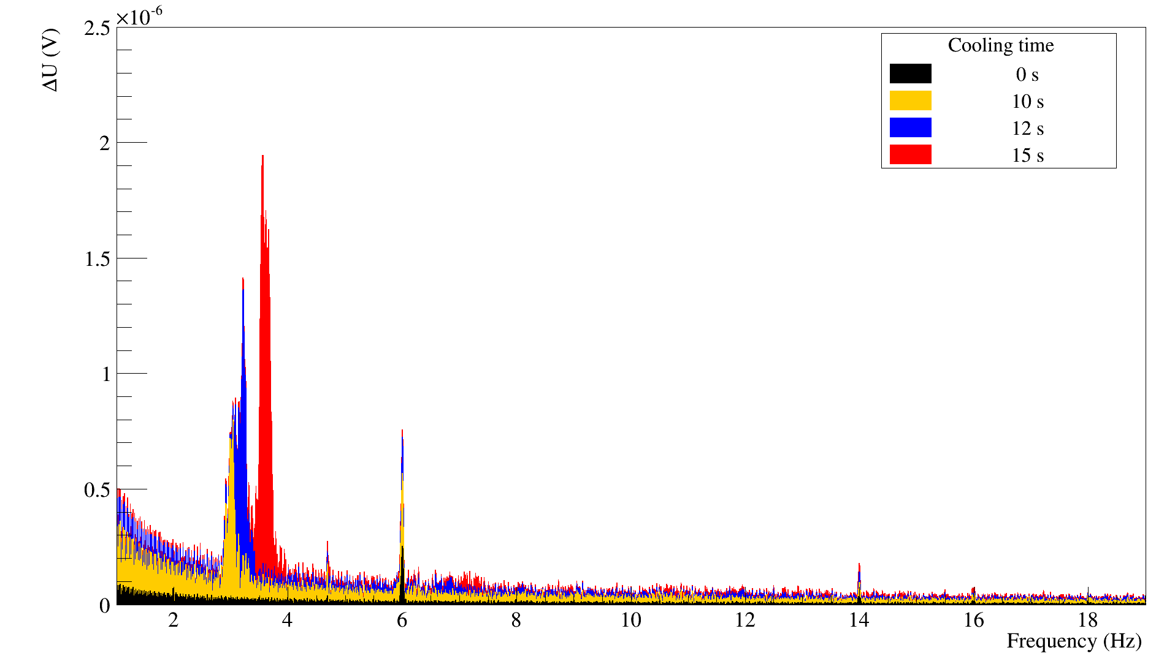
Fourier spectra difference voltage
Different frequencies are visible in the spectra
By increasing the cooling time the amplitudes for 6 and 14 Hz increase and other frequencies popping up
8. März 2017
19

Slide 20
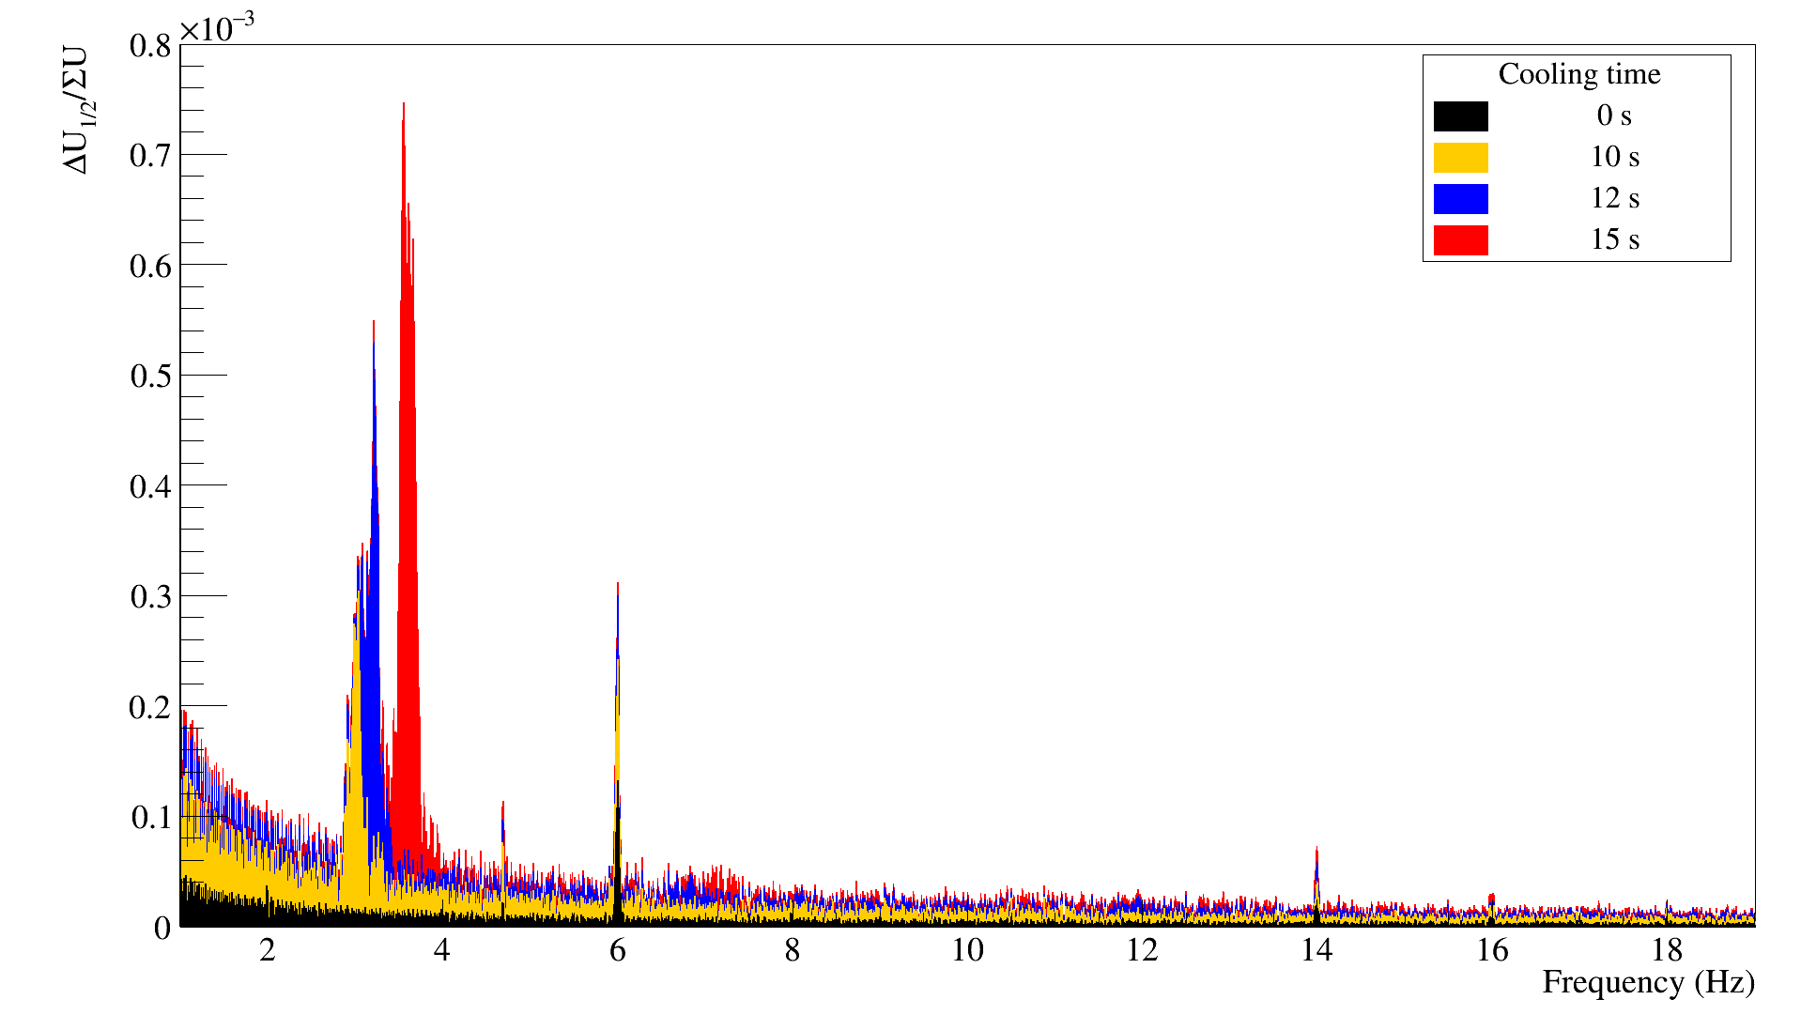
Measurement with different electron cooling durations
The source of the oscillation is the accelerator itself and not the measurement setup
8. März 2017
20

Slide 21
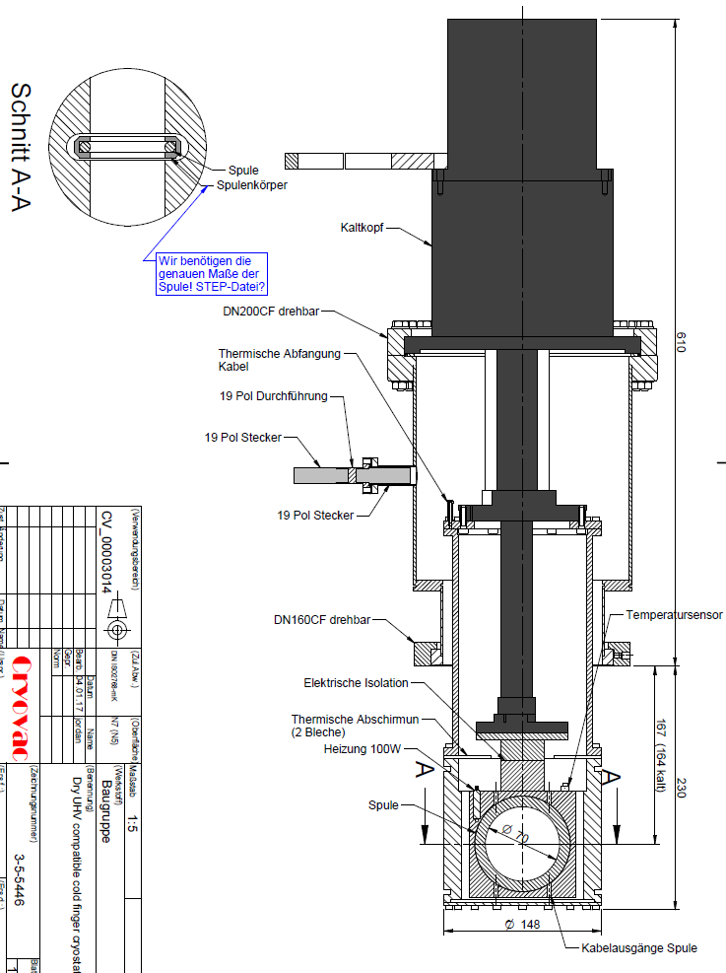
Cryostat for Rogowski coil
Cryostat for the Rogowski coil to test the setup with low temperatures in the laboratory
Next step to a SQUID-based Rogowski coil BPM to measure the position of clockwise and counter clockwise rotating beams
Installation in the accelerator
8. März 2017
21

Slide 22
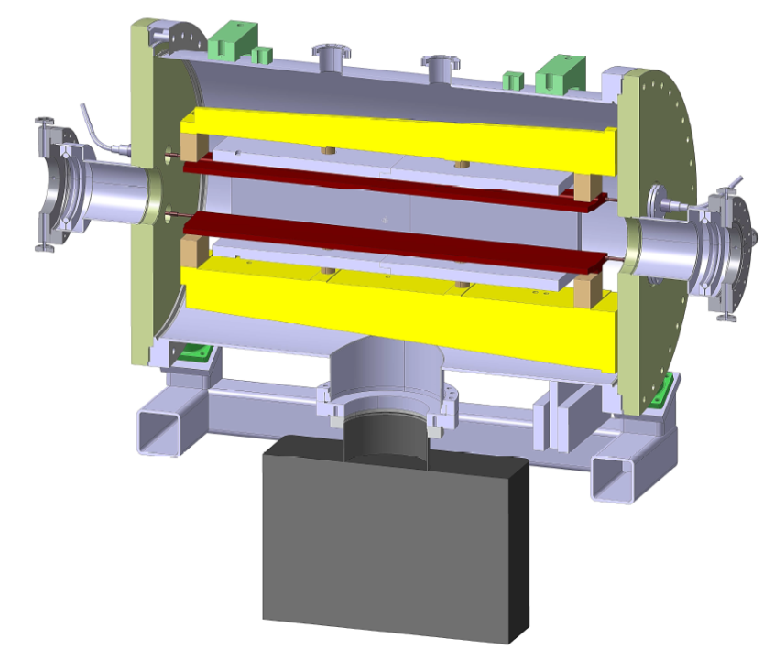
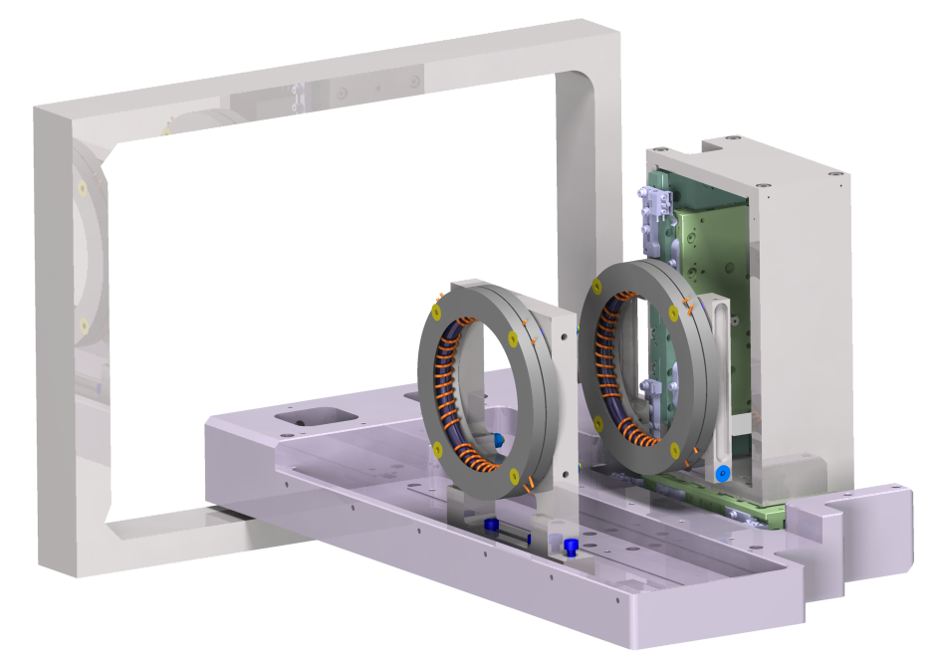
Summary and outlook
Test of the theory on data measured in the accelerator
Good agreement with the prediction and the measurement
Analysis of the oscillating voltage with different beam cooling settings
Reanalyse the data taken in December 2015 with the extended theory for two Rogowski coil BPMs, which were parted into four segments
1200 mm
E- and B- Field region
8. März 2017
22

