Slide 1
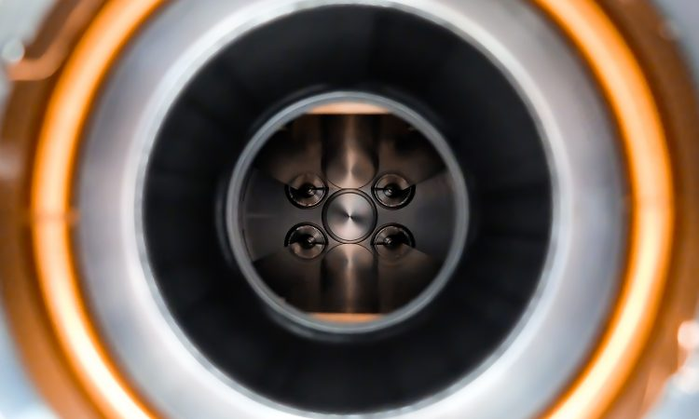
Charged Particle EDM (CPEDM)
JEDI
COSY
EDM RF Wien Filter
Contribution to ESPP Update
20.11.2018 I hans ströher (IKP, forschungszentrum jülich)

Slide 2
Science case for edm
T- (and CP-) Invariance, θ _{QCD} parameter; [matter-antimatter asymmetry]
Adopted from F. Wilczek

Slide 3
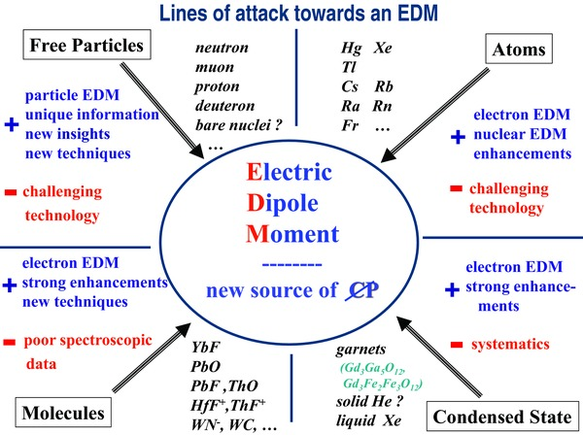
Science case for edm
Worldwide EDM Efforts
A huge
ongoing
experimental
effort …
Adopted from K. Jungmann

Slide 4
Science case for edm
Worldwide EDM Efforts
indirect limits
Experiment:
up to now only
upper limits
θ _{QCD}
CKM SM
direct measurement (also: deuteron)
Adopted from K. Kirch

Slide 5
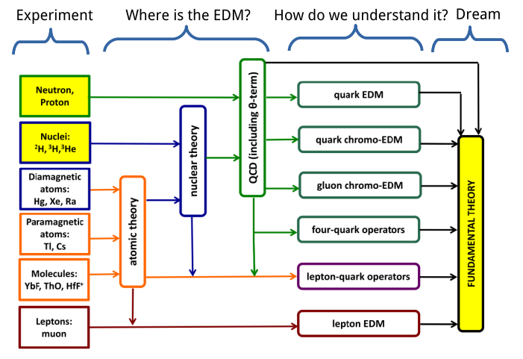
Science case for edm
Need for charged-particle EDMs (CPEDM)
Exp. input Theoretical Backgd. EDM sources Theory
Adopted from J. de Vries

Slide 6
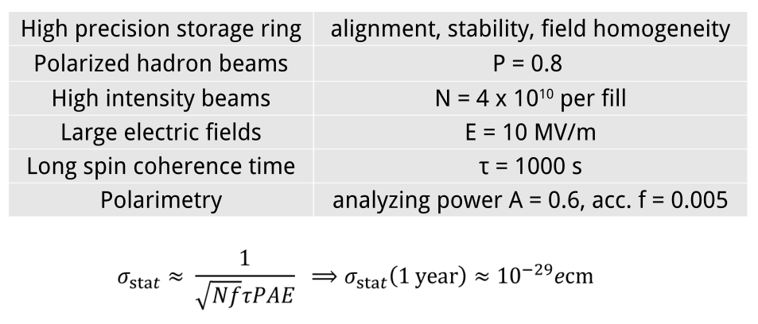
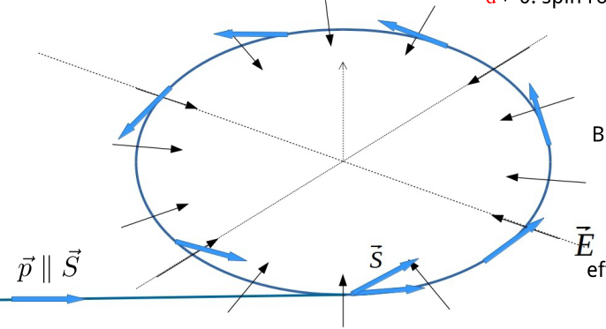
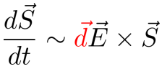
CPEDM
Charged-particle EDMs – Measurement Principle
Vertical polarization build-up of a horizontally polarized beam in a storage ring
Radial E-field
„Frozen spin“
Challenge: systematic uncertainties to same level → stepwise approach

Slide 7
CPedm
Charged Particle EDMs – Strategy
3 major steps

Slide 8
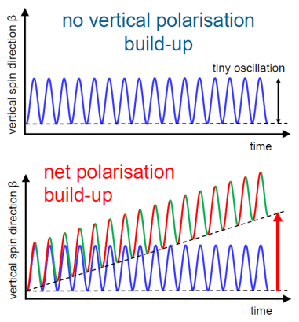
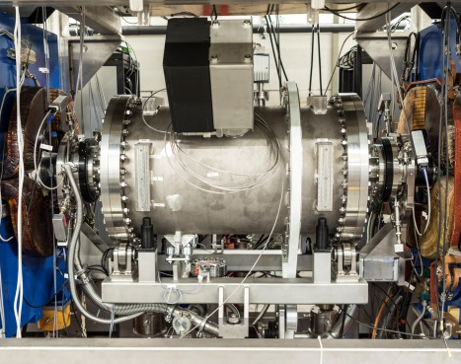
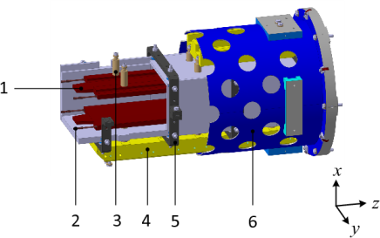
CPedm
Step-1: Precursor Experiment at COSY
Spin-motion in E- and B-fields: Thomas-BMT equation
RF-Wien filter

Slide 9
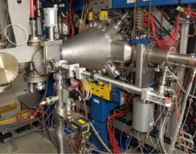
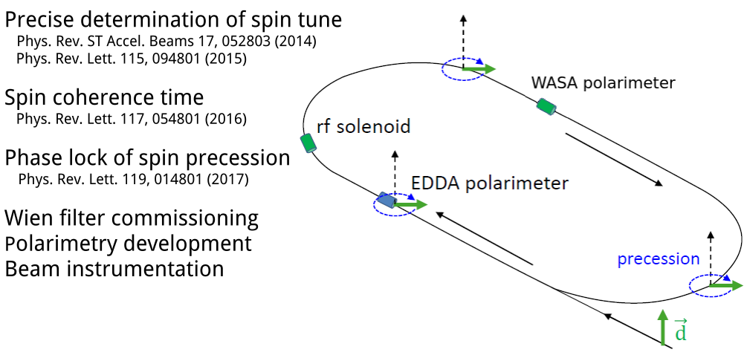
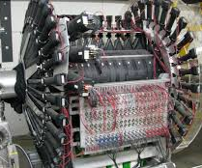
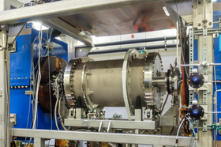
CPedm
Step-1: Precursor Experiment at COSY
Recent achievements
First dEDM measurement w/ RF Wien filter ongoing

Slide 10
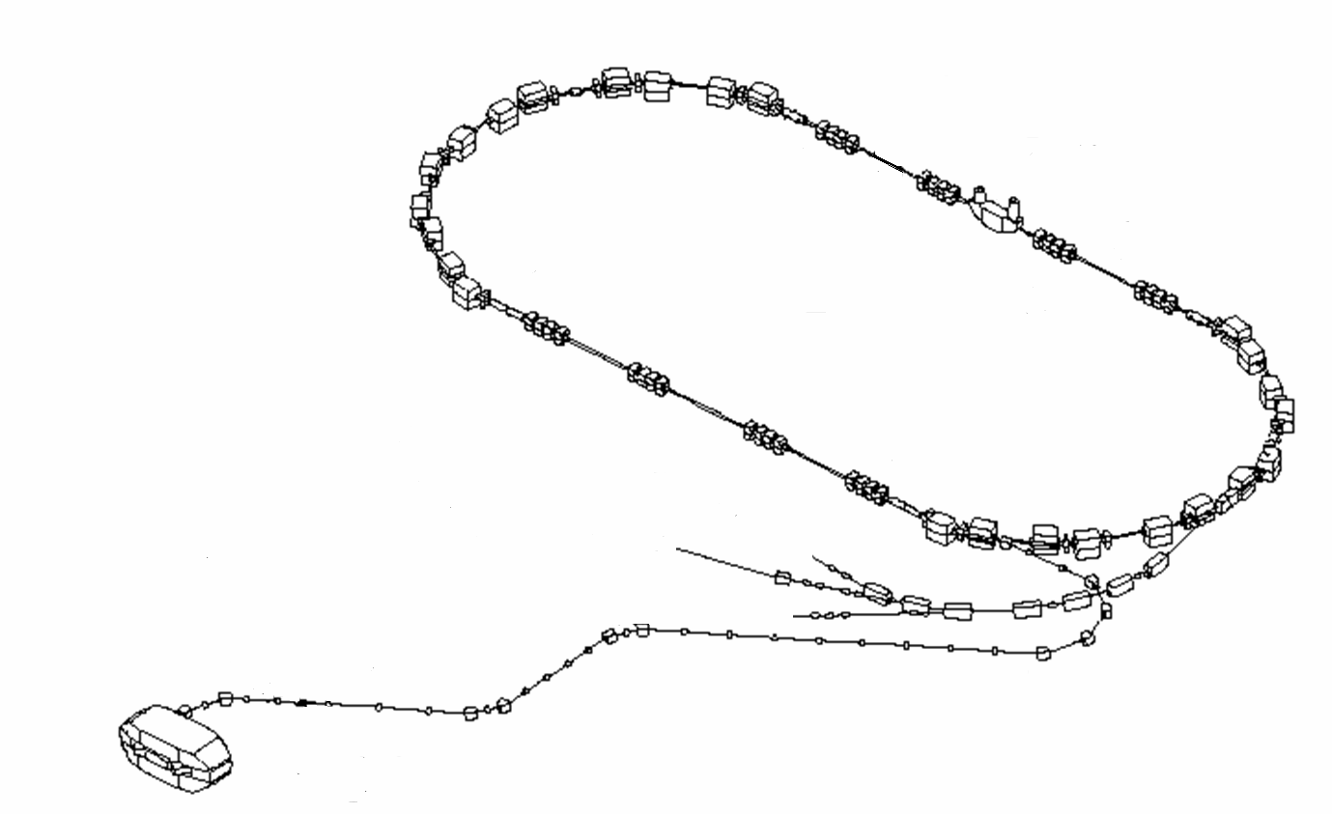
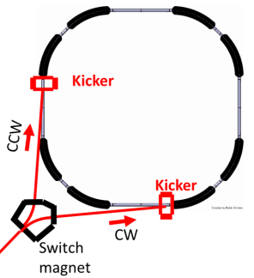
CPedm
Step 2: Prototype Storage Ring
Demonstrate/establish key-technologies
Conceptual design:
E-field ~ 6 MV/M
Circumference ~ 100 m
30 MeV all-electric p ring
Storage time
CW/CCW operation
Spin coherence time
Polarimetry
Stochastic cooling
μ_{p} effects
45 MeV E/B p ring
pEDM measurement
Option: build at COSY (← injector)

Slide 11
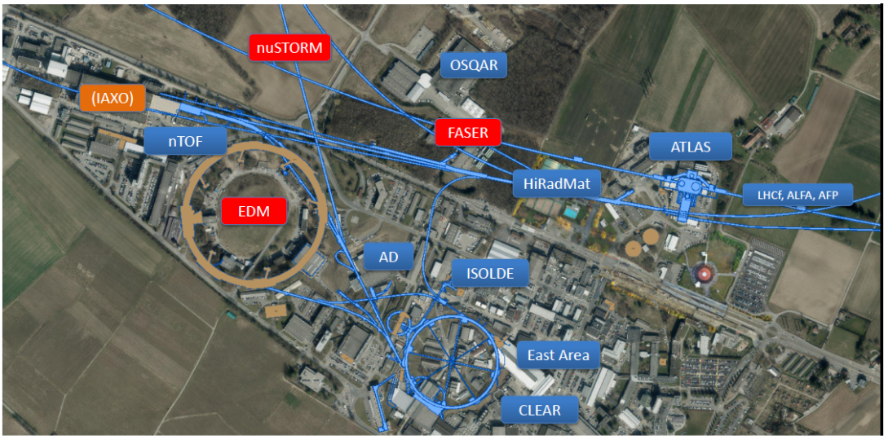
CPedm
Step-3: Final pEDM Storage Ring
All-electric CW/CCW proton precision storage ring, running at magic momentum (0,7 GeV/c)
~ 500 m ring
Option: build at CERN (infrastructure required)

Slide 12
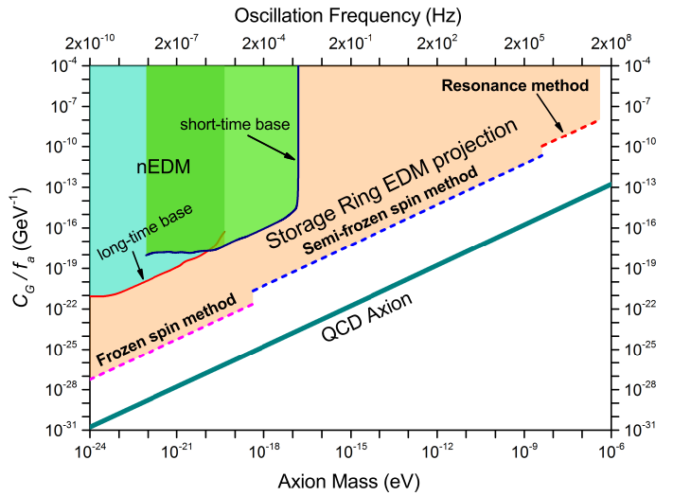
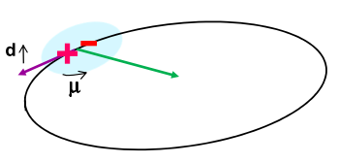
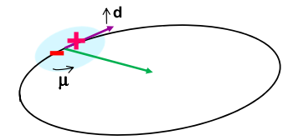
CPedm
Add-on: oscillating EDMs ←→ axion search
Use of EDM storage rings (e.g. COSY, prototype, final ring)
μ-precession (variable!) at the right frequency → build-up effect
Proof-of-principle: at one frequency (axion mass) (for p and/or d)
Scan (only for a very limited mass range)
Dedicated searches

Slide 13
Summary
Feasibility Study for an EDM Storage Ring
Electrostatic storage rings offer a unique possibility to search for important new physics (EDM, DM)
Ongoing: precursor experiment at COSY (RF Wien filter)
Next step: prototype ring (design study under preparation)
Long-term vision: precision storage ring (CW/CCW, magic momentum)
Projects discussed in the framework of Physics Beyond Colliders (PBC)
Prepare input for update of European Strategy for Particle Physics (ESPP)

