Slide 1
Commissioning of the Waveguide RF Wien Filter at COSY
Dezember 19, 2016 Alexander Nass (on behalf of JEDI)
CBAC Meeting, Bad Honnef

Slide 2
Introduction
Idea for proof-of-principle srEDM experiment
In a magnetic machine, the spin is not frozen, therefore we will use an RF technique:
RF device operates on some harmonic of the spin precession frequency
accumulate EDM signal with time
Use COSY for a first direct $p$ and $d$ EDM measurement

Slide 3
Direct EDM measurement : Resonance Method with „magic“ RF Wien filter
Avoids coherent betatron oscillations of beam.
Radial RF-E and vertical RF-B fields to observe spin rotation due to EDM.
Approach pursued for a first direct measurement at COSY.
$E^{∗}=0$⇒ $ER =−By$„Magic RF Wien Filter“ no Lorentz force
$→$ Indirect EDM effect
RF E(B)-field
In-plane polarization
Observable:
Accumulation of vertical polarization during spin coherence time
stored d
Polarimeter (dp elastic)
Statistical sensitivity for $dd$ in the range ${10}^{−23}$ to ${10}^{−24} ecm$ range possible.
Alignment, field stability of ring magnets, magnet imperfections, etc.
Imperfection of RF-$E×B$ Wien filter

Slide 4
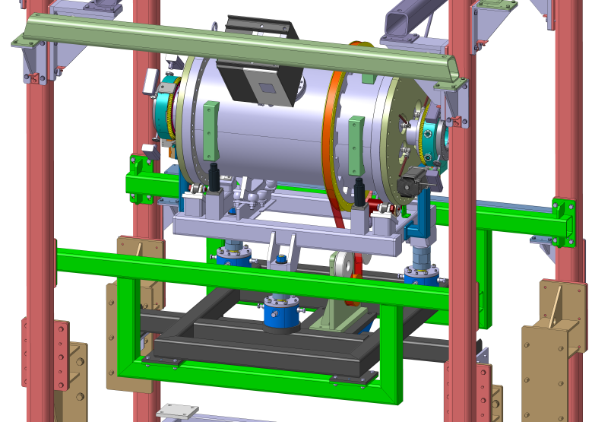
The waveguide RF Wien Filter
Device developed at IKP in cooperation with:
RWTH Aachen, Institute of High Frequency Technology:
Dirk Heberling, Dominik Hölscher, and PhD Student Jamal Slim
ZEA-1 of Jülich:
Ghaleb Natour, Helmut Soltner, Lars Reifferscheidt, Heidi Straatmann
Device will be installed in PAX low-𝛽 section

Slide 5
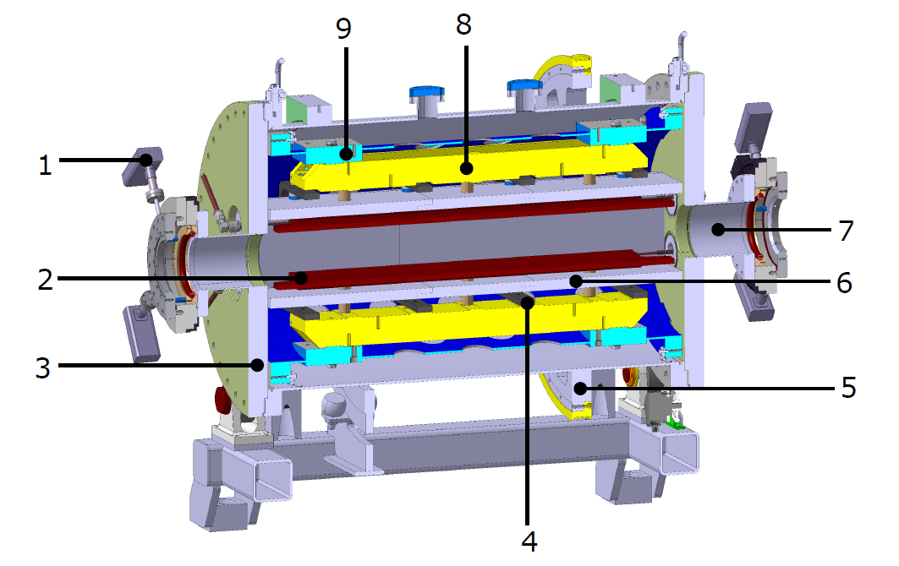
Some features of the new RF Wien filter
Waveguide design provides $\vec{E}×\vec{B}$ by design.
Support structure
for electrodes
Support for geodetics
Inner support
tube
RF
feedthrough
Ferrit cage
BPM
(Rogowski coil)
Beam pipe (CF 100)
Copper
electrodes
Ferrit cage
Vacuum vessel with
small angle rotator
Mechanical
support
Belt drive for ${90}^{0}$rotation
Device rotatable by ${90}^{0}$in situ
Clamps for the Ferrit cage
Aim is to build the best possible device with respect to electromagnetic performance, mechanical tolerances, etc.
$$\sim 1 m$$

Slide 6
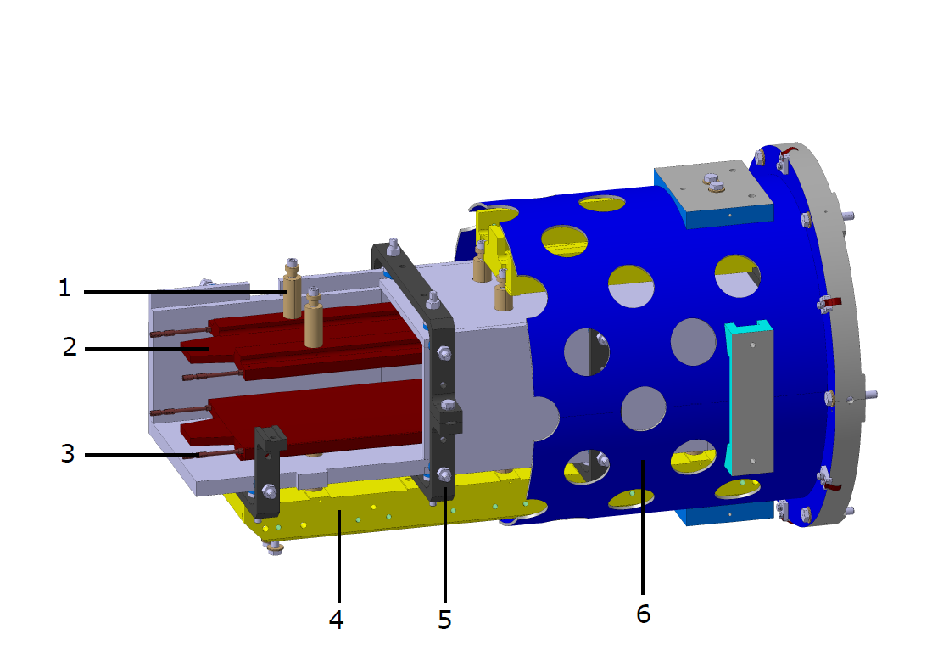
Internal structure of the device
Ceramic insulators
copper electrodes with the trapezium shaping at the edges
Sliding connector
to RF
Mechanical support
for electrodes
Clamps supporting the Ferrit cage
Inner support tube
Design completed, manifacturing of parts finished,
assembly in ZEA clean room started.

Slide 7
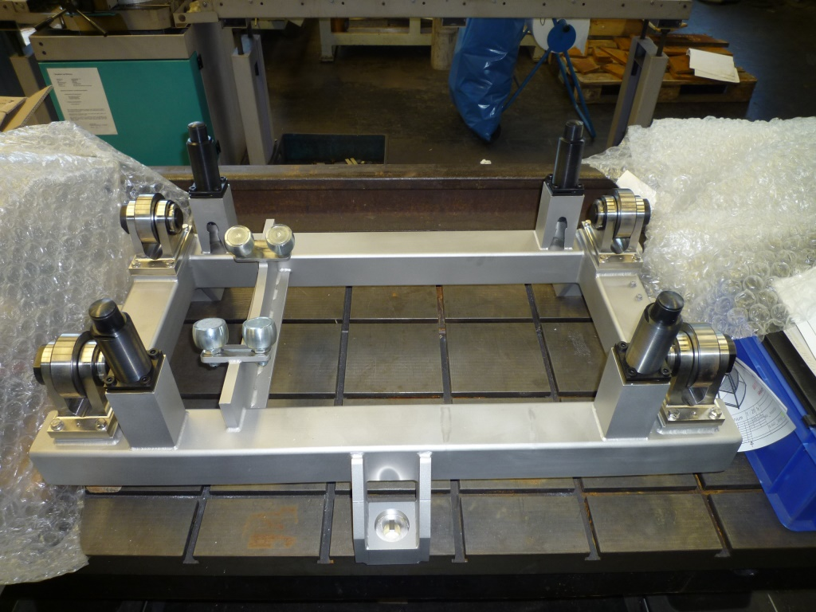
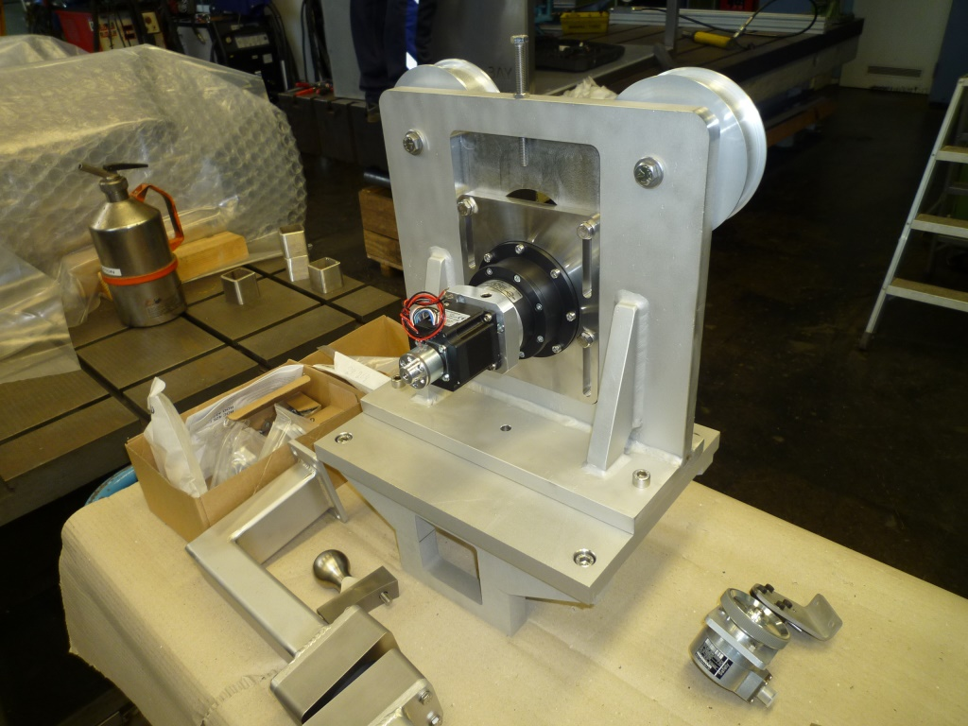
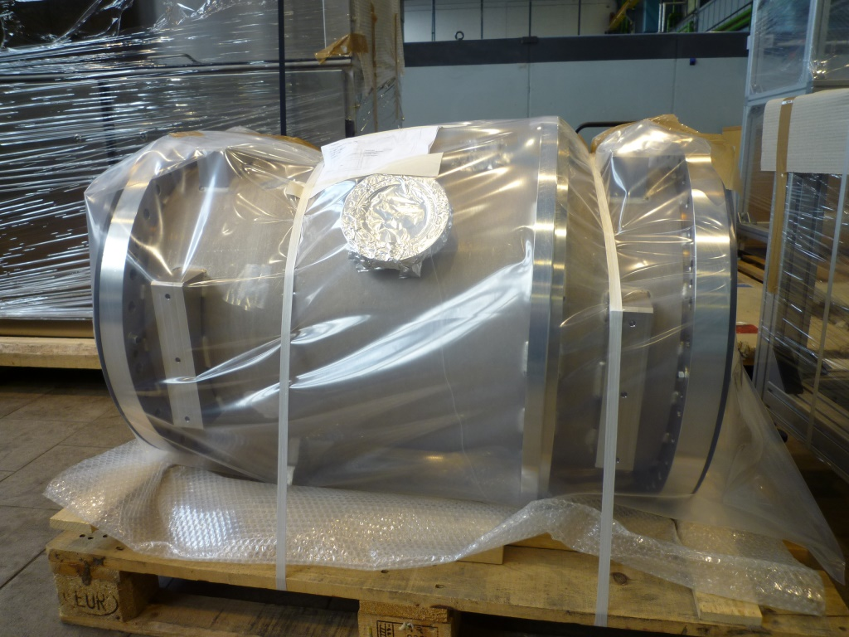
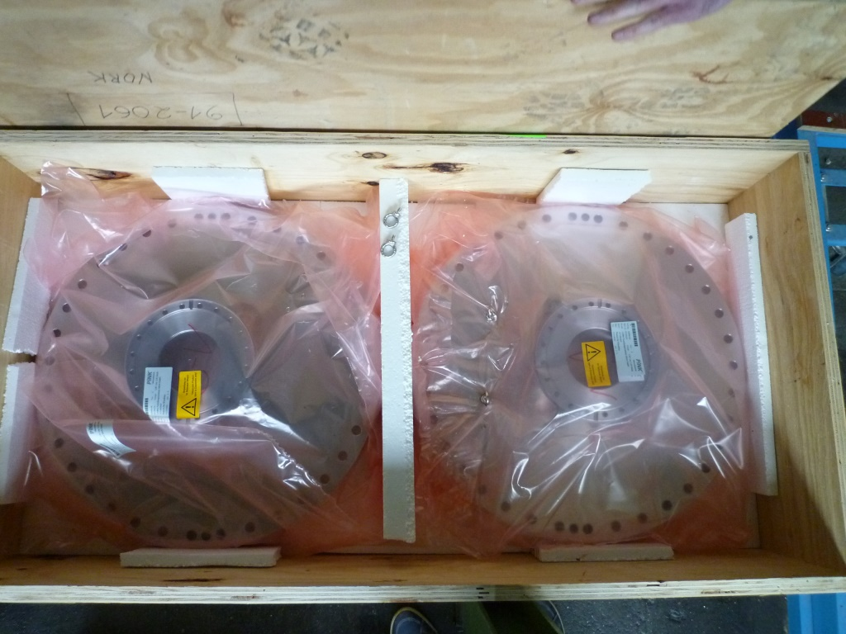
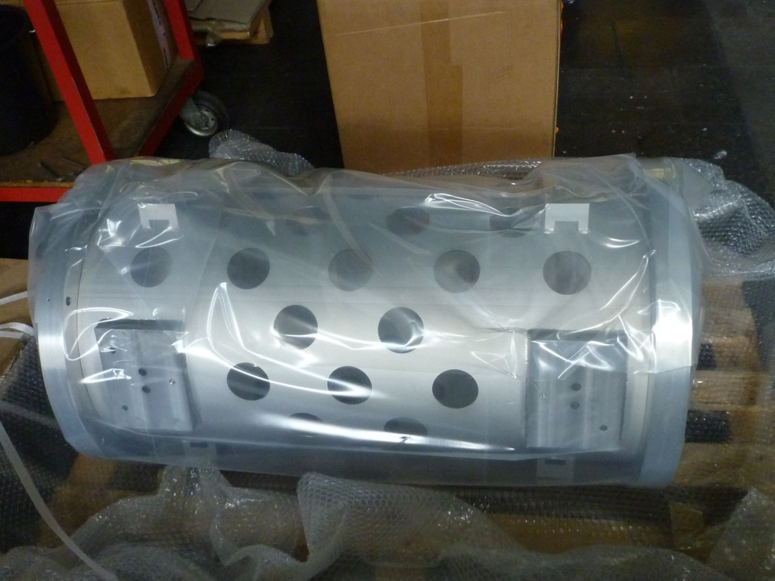
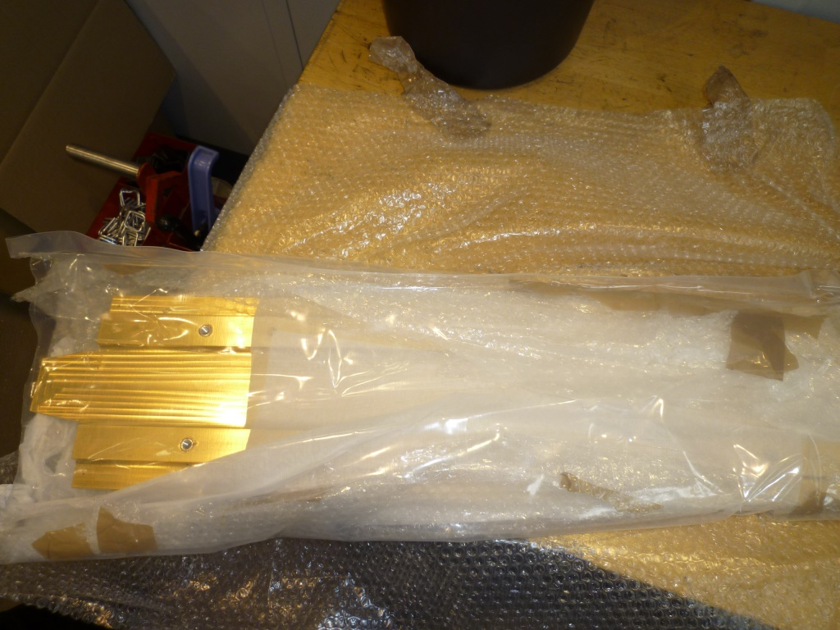
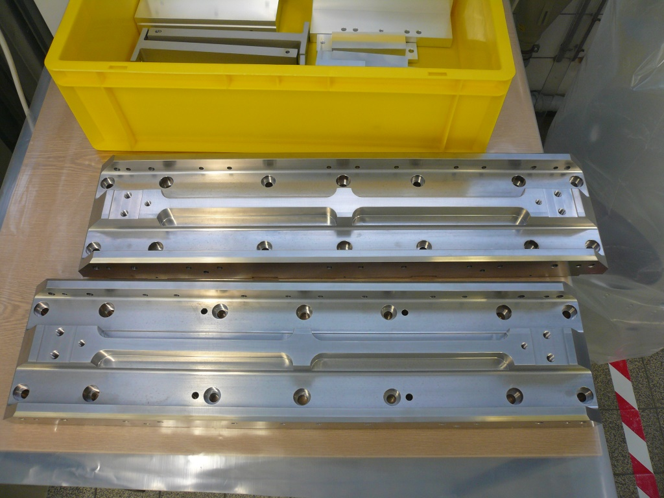
Produced Parts
Design completed, manifacturing of parts finished,
assembly in ZEA clean room started.

Slide 8
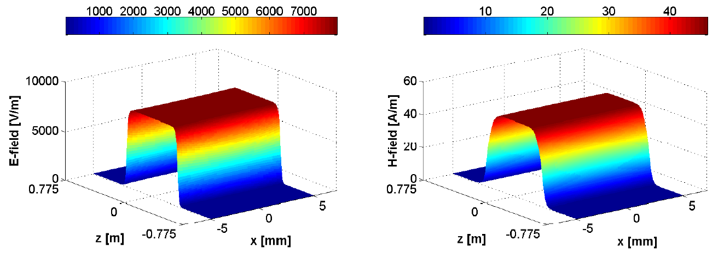
Electromagnetic field simulations
Full-wave simulation with CST Microwave Studio
Each simulation required $\sim 12$hours of computer time
Excellent cooperation with RWTH and ZEA
Notes:
on a 4-Tesla C2075 GPU cluster2, with 2 six-cores Xeon E53 and RAM capacity of 94GB

Slide 9
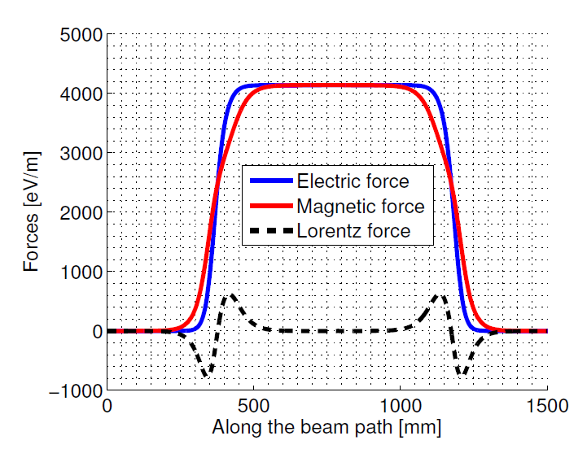
Lorentz force compensation
Providing minimal integral Lorentz force requires careful shaping of electrodes and all other components
$${\vec{F}}_{L}=q(\vec{E}+\vec{v}×\vec{B})$$
Lorentz force integral with $\vec{v}$ along Wien filter axis
Continued work on RF driving circuit $→$ to reach $\int{Bdl\sim 0.2 Tmm}$ seems possible.

Slide 10
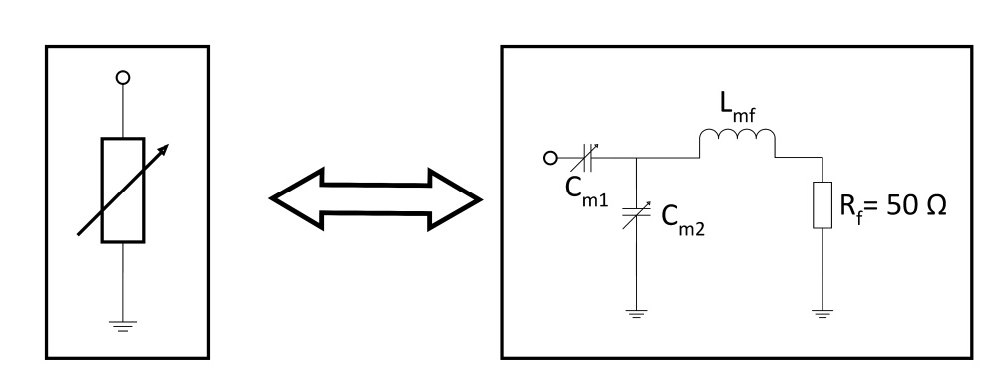
Driving circuit
Realization as a strip line with a load resistor and tuning elements (L/C).
Design layout using 4 separate power amplifiers of circuit. Circuit is supposed to be finished by beginning of february.

Slide 11
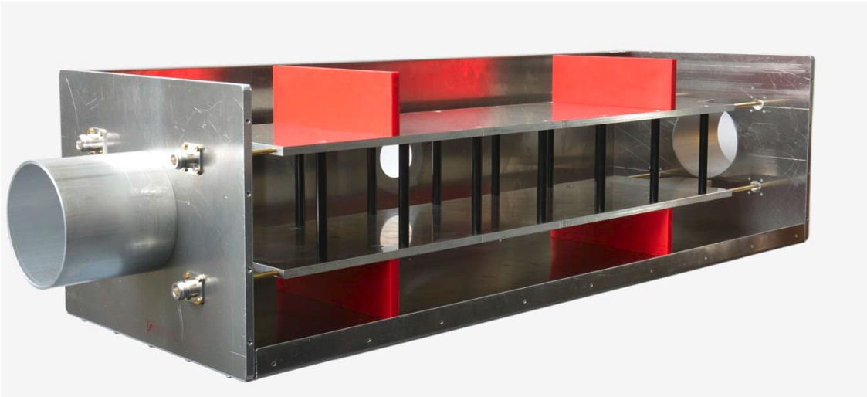
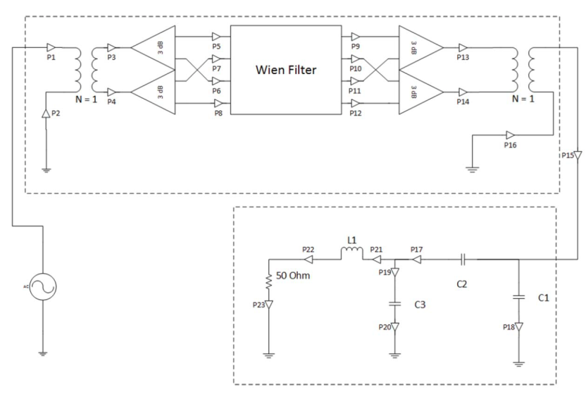
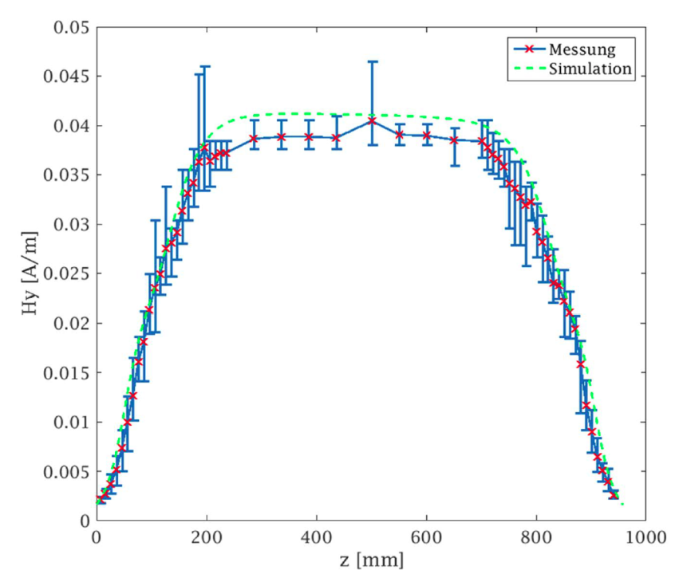
„Mock“ system
Setup of a low-power system (1 W) to verify simulations.
Courtesy of J.Slim, RWTH Aachen
Test successful, magnetic field values agree with simulations.

Slide 12
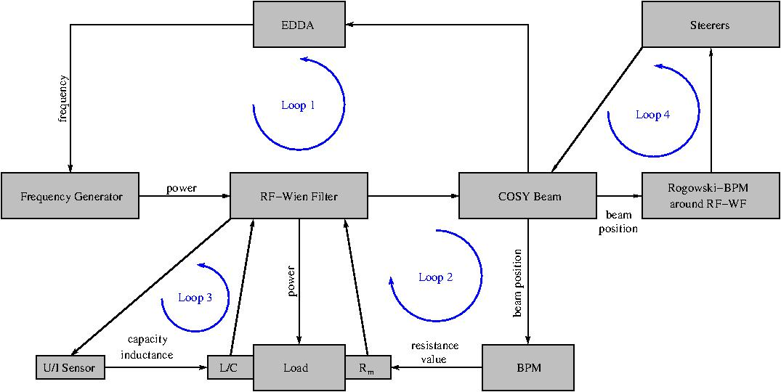
Feed back loops
Feedback loops involve components of the whole COSY ring.

Slide 13
LABVIEW Control
Driving circuit
RF Generator
Polarimeter
loop 3
Data
loop 1
loop 2
loop 1
LABVIEW
Lorentz BPM
loop 2
Data
DAQ
Rotation
Data
Motor, Position
Rogowski BPM‘s
loop 4
COSYLAB
Control and data transfer to COSY and DAQ using LABVIEW

Slide 14
Time plan 2017 / 2018
2016
2017
2018
Phase 0
Laboratory
Installation
Phase 1
Commis.
Phase 2
Commis.
Phase 3
1st Expt.
2 weeks
+1 MD
2 weeks
+1 MD
2 weeks
+1 MD
This time plan is necessary in order to achieve our goals.
Notes:
Vertical spin buildup for closed orbit deuterons in an ideal ring, as well as for quadrupole misalignments for two different randomization seeds.
The black dots show tracking results, the colored lines are analytical estimates

Slide 15
Laboratory - Phase 0 (February/March)
Setting up the driving circuit hardware
Implementation of Loop #3 – E & B phase
U, I, θ
Phase will be minimized adjusting C_{p1} and C_{p2}.
LABVIEW control.
Notes:
Vertical spin buildup for closed orbit deuterons in an ideal ring, as well as for quadrupole misalignments for two different randomization seeds.
The black dots show tracking results, the colored lines are analytical estimates

Slide 16
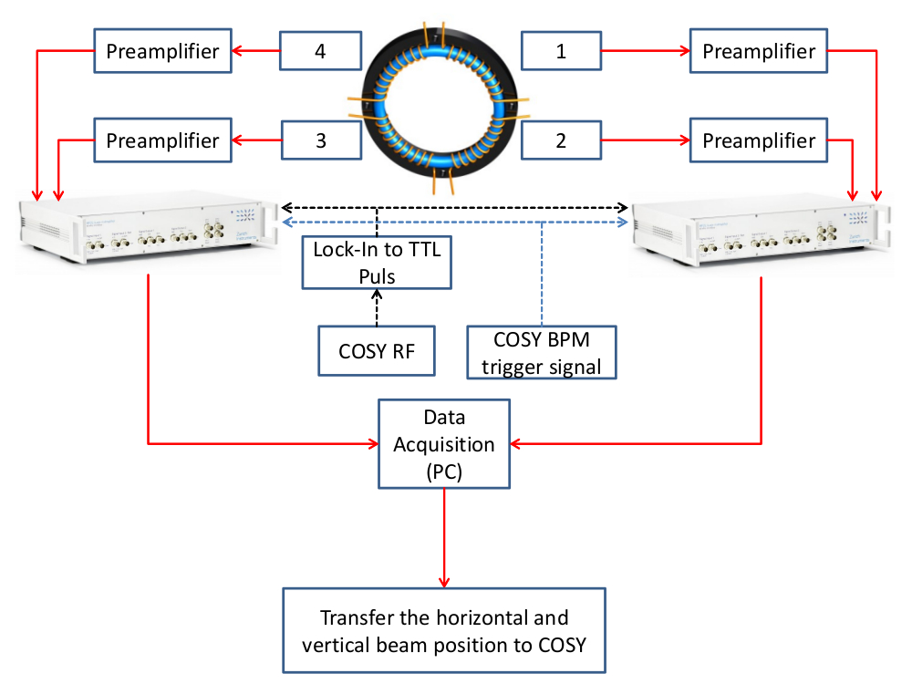
COSY – Phase 1 (Mai/June) - MD
Implementation of Loop #4 - beam positioning on axis inside the RF Wien filter:
COSYLAB
COSYLAB orbit control will use this data to control local orbit bump.
Notes:
Vertical spin buildup for closed orbit deuterons in an ideal ring, as well as for quadrupole misalignments for two different randomization seeds.
The black dots show tracking results, the colored lines are analytical estimates

Slide 17
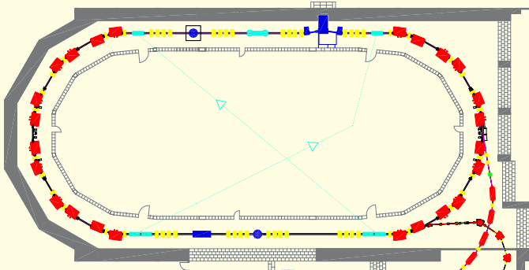
COSY – Phase 1 (Mai/June) - beam time
Implementation of Loop #2 – Minimizing Lorentz force:
x,y @ f_{RF}
R_{m} → C_{m1}, C_{m2}
BPM signal at RF Wien filter frequency used to minimize Lorentz force.
LABVIEW control, 90° (B_{x}, E_{y}).
Notes:
Vertical spin buildup for closed orbit deuterons in an ideal ring, as well as for quadrupole misalignments for two different randomization seeds.
The black dots show tracking results, the colored lines are analytical estimates

Slide 18
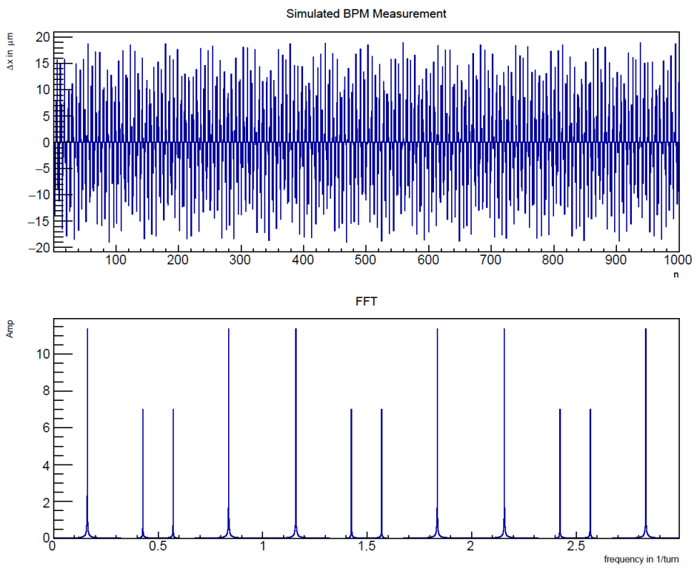
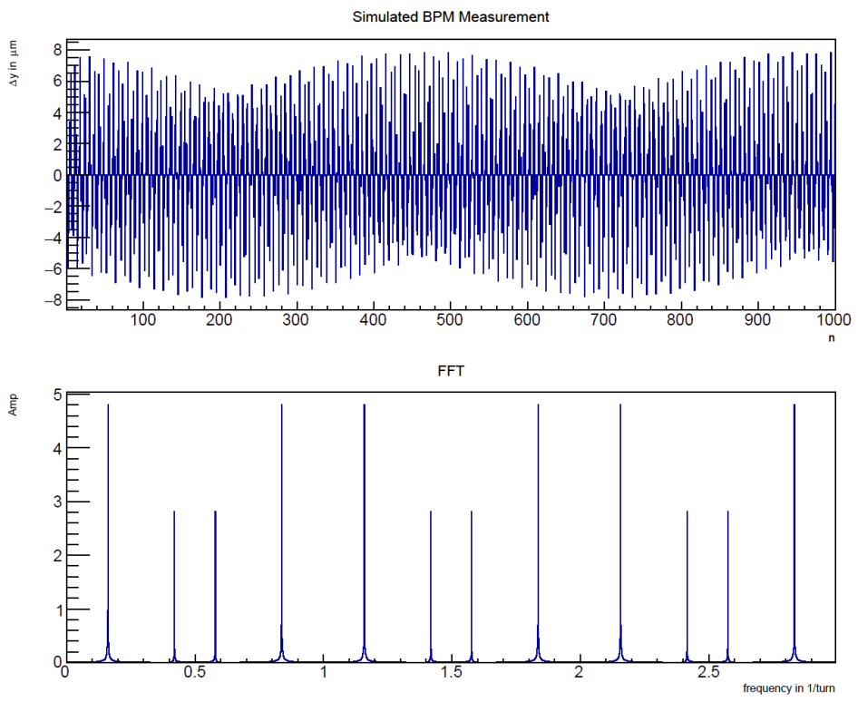
COSY – Phase 1 (Mai/June) - beam time
Simulation of Lorentz-force kick on particles and response in BPM:
Single particle, E-field only
f_{WF}
Notes:
Vertical spin buildup for closed orbit deuterons in an ideal ring, as well as for quadrupole misalignments for two different randomization seeds.
The black dots show tracking results, the colored lines are analytical estimates

Slide 19
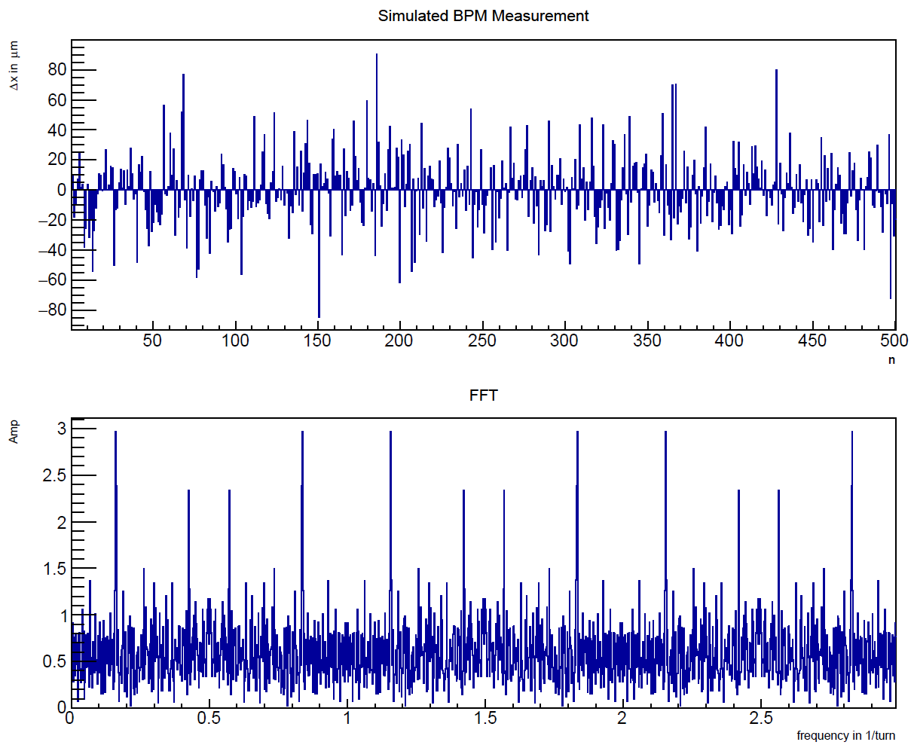
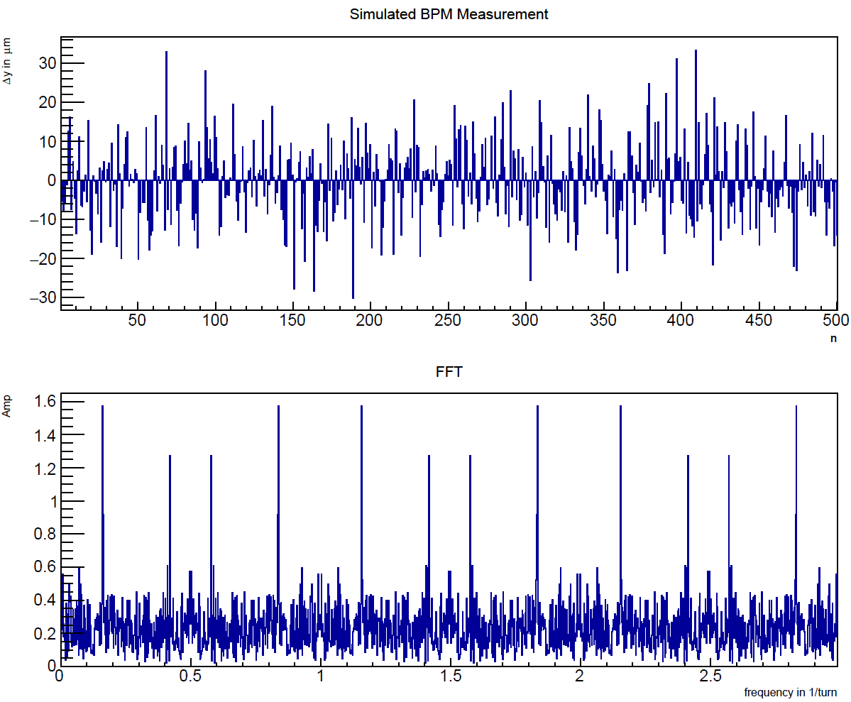
COSY – Phase 1 (Mai/June) - beam time
Simulation of Lorentz-force kick on particles and response in BPM:
50000 particles, E-field only
f_{WF}
Relative BPM sensitivity ~10nm
→ Fields can be adjusted better than 1%.
Notes:
Vertical spin buildup for closed orbit deuterons in an ideal ring, as well as for quadrupole misalignments for two different randomization seeds.
The black dots show tracking results, the colored lines are analytical estimates

Slide 20
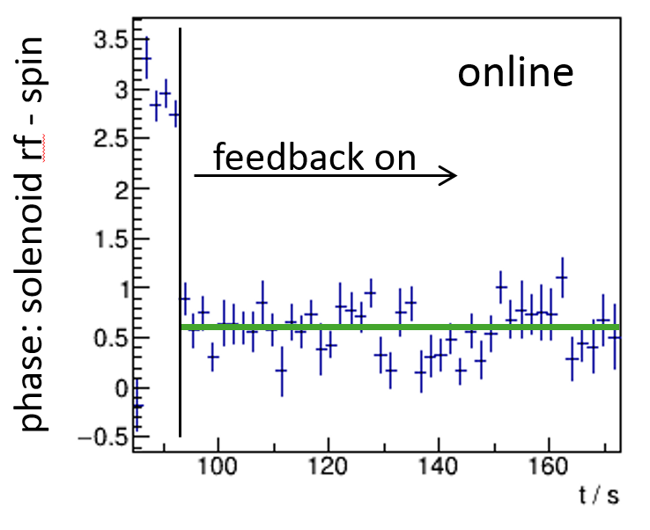
COSY – Phase 2 (September)
Implementation of Loop #1 – Spin tune feedback:
Rotation of the device
Phase lock of RF Wien filter frequency to spin precession frequency.
LABVIEW control, 90° (B_{x}, E_{y}) and 0° (B_{y}, -E_{x}).
Notes:
Vertical spin buildup for closed orbit deuterons in an ideal ring, as well as for quadrupole misalignments for two different randomization seeds.
The black dots show tracking results, the colored lines are analytical estimates

Slide 21
Publications:
Electromagnetic Simulation and Design of a Novel Waveguide RF Wien Filter
for Electric Dipole Moment Measurements of Protons and Deuterons
J.Slim et al., Nucl. Instr. Meth. A 828, (2016), 116–124
Systematic Evaluation and Quantification of Fields’ Homogeneities of the
Novel Waveguide RF Wien Filter Using the Polynomial Chaos Expansion.
In preparation

Slide 22
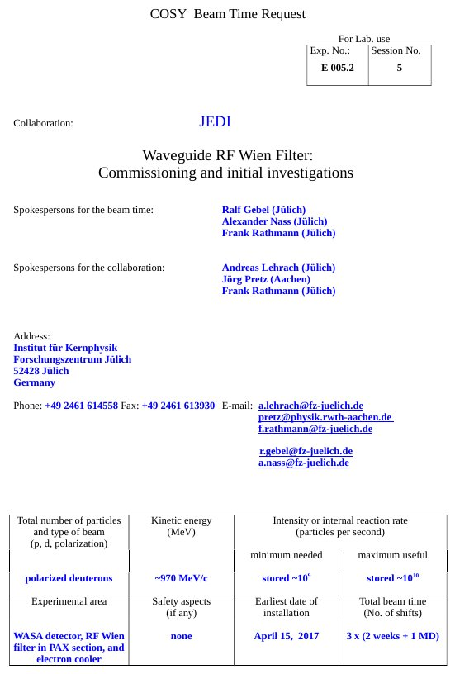
COSY Beam time request
Notes:
Vertical spin buildup for closed orbit deuterons in an ideal ring, as well as for quadrupole misalignments for two different randomization seeds.
The black dots show tracking results, the colored lines are analytical estimates

Slide 23
Back-up slides

Slide 24
RF $E×B$ Wien Filter: Resonance conditions
$f_{RF}=f_{rev}(γG±K)$, $K∈ℤ$
 | $$p$$ | $$f_{rev}/kHz$$ | $$G$$ | $$β$$ | $$γ$$ | $$γG$$
$$d$$ | $$970.0$$ | $$750.2$$ | $$−0.143$$ | $$0.459$$ | $$1.126$$ | $$−0.161$$
$$p$$ | $$521.1$$ | $$752.6$$ | $$1.793$$ | $$0.486$$ | $$1.144$$ | $$2.051$$
$$K$$ |  | $$−4$$ | $$−3$$ | $$−2$$ | $$−1$$ | $$0$$ | $$+1$$ | $$+2$$
$${|f}_{RF}|/kHz$$ | $$d$$ |  |  | $$1621.2$$ | $$871.0$$ | $$120.8$$ | $$629.4$$ | $$1379.6$$
 | $$p$$ | $$1545.6$$ | $$752.6$$ | $$40.3$$ | $$833.2$$ | $$1626.2$$
Frequency range RF Wien filter prototype (Gebel/Mey)
New waveguide RF Wien filter will provide resonance conditions for deuterons and protons for a number harmonics $K.$

