Slide 1
Commissioning of the Waveguide RF Wien Filter at COSY
December 17, 2015 Frank Rathmann (on behalf of JEDI)
CBAC Meeting, Bad Honnef

Slide 2
Outline
Introduction
Design of the Waveguide RF Wien Filter
Mechanical Design
Electromagnetic field simulations
Resonance conditions
Concept for first measurements
Results from ongoing run with phase-locked RF
Beam Request

Slide 3
Introduction
Idea for proof-of-principle srEDM experiment
In a magnetic machine, the spin is not frozen, therefore we will use an RF technique:
RF device operates on some harmonic of the spin precession frequency
accumulate EDM signal with time
Use COSY for a first direct $p$ and $d$ EDM measurement

Slide 4
Direct EDM measurement : Resonance Method with „magic“ RF Wien filter
Avoids coherent betatron oscillations of beam.
Radial RF-E and vertical RF-B fields to observe spin rotation due to EDM.
Approach pursued for a first direct measurement at COSY.
$E^{∗}=0$⇒ $ER =−By$„Magic RF Wien Filter“ no Lorentz force
$→$ Indirect EDM effect
RF E(B)-field
In-plane polarization
Observable:
Accumulation of vertical polarization during spin coherence time
stored d
Polarimeter (dp elastic)
Statistical sensitivity for $dd$ in the range ${10}^{−23}$ to ${10}^{−24} ecm$ range possible.
Alignment, field stability of ring magnets, magnet imperfections, etc.
Imperfection of RF-$E×B$ Wien filter

Slide 5
First direct EDM measurement:
Resonance Method for deuterons
Parameters: beam energy $Td=50 MeV$ $LRF=1 m$
assumed EDM $dd={10}^{−24} ecm$
E-field $30 kV/cm$
$$Px$$
$$Pz$$
$$Py$$
$$ω={2πf}_{rev}Gγ$$
$=−3.402×{10}^{5} Hz$
$$turn number$$
EDM effect accumulates in $P_{y}$ (see Phys. Rev. ST AB 16, 114001 (2013)).
To observe this, RF phase must be locked to spin precession

Slide 6
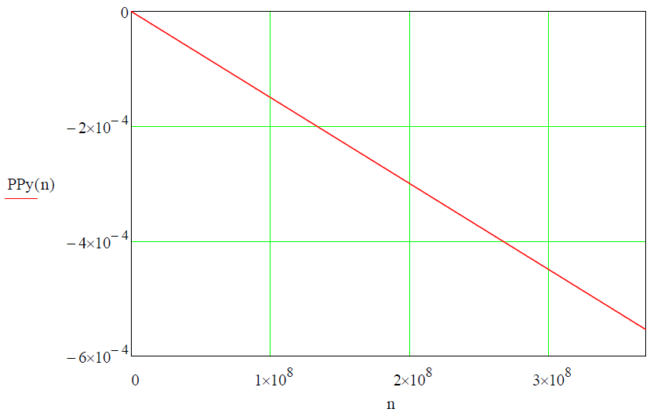
First direct Edm measurement:
Resonance Method for deuterons
Parameters: beam energy $Td=50 MeV$ $LRF=1 m$
assumed EDM $dd={10}^{−24} ecm$
E-field $30 kV/cm$
$$Py$$
$$Py$$
EDM effect accumulates in $Py$
$$turn number$$
Linear extrapolation of $Py$ for a time period of $sc=1000 s (=3.7108 turns)$ yields a sizeable $P_{y}\sim {10}^{−3}$.

Slide 7
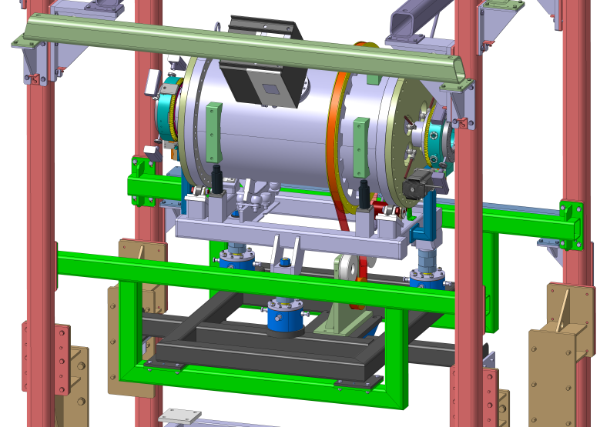
The waveguide RF Wien Filter
Device developed at IKP in cooperation with:
RWTH Aachen, Institute of High Frequency Technology:
Dirk Heberling, Dominik Hölscher, and PhD Student Jamal Slim
ZEA-1 of Jülich:
Ghaleb Natour, Helmut Soltner, Lars Reifferscheidt, Heidi Straatmann
Device will be installed in PAX low-𝛽 section

Slide 8
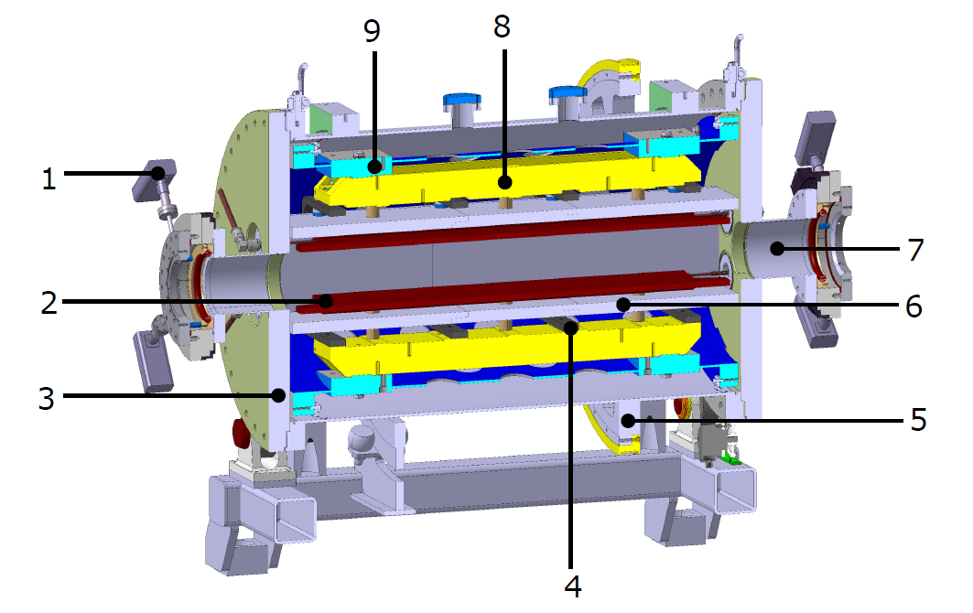
Some features of the new RF Wien filter
Waveguide design provides $\vec{E}×\vec{B}$ by design.
Support structure
for electrodes
Support for geodetics
Inner support
tube
RF
feedthrough
Ferrit cage
BPM
(Rogowski coil)
Beam pipe (CF 100)
Copper
electrodes
Ferrit cage
Vacuum vessel with
small angle rotator
Mechanical
support
Belt drive for ${90}^{0}$rotation
Device rotatable by ${90}^{0}$in situ
Clamps for the Ferrit cage
Aim is to build the best possible device with respect to electromagnetic performance, mechanical tolerances, etc.
$$\sim 1 m$$

Slide 9
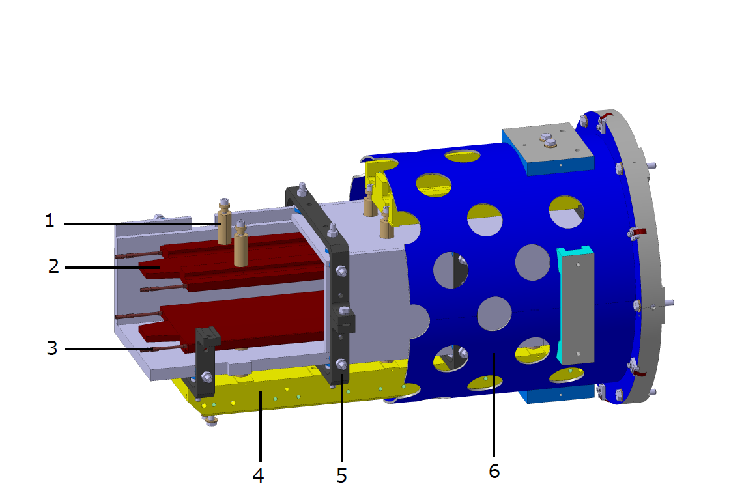
Internal structure of the device
Ceramic insulators
copper electrodes with the trapezium shaping at the edges
Sliding connector
to RF
Mechanical support
for electrodes
Clamps supporting the Ferrit cage
Inner support tube
Design completed, construction drawings are ready, available in summer 2015.

Slide 10
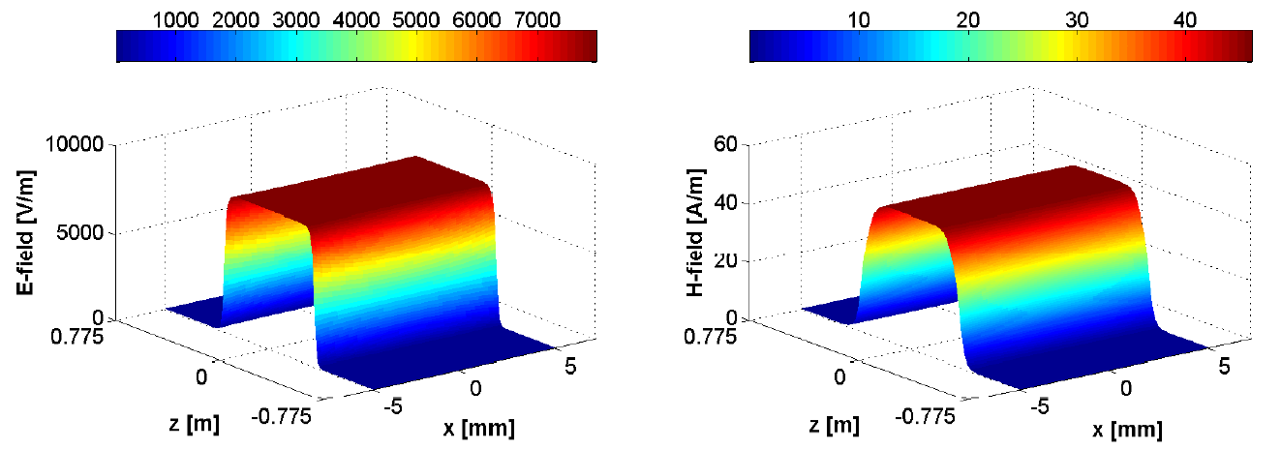
Electromagnetic field simulations
Full-wave simulation with CST Microwave Studio
Each simulation required $\sim 12$hours of computer time
Excellent cooperation with RWTH and ZEA
Notes:
on a 4-Tesla C2075 GPU cluster2, with 2 six-cores Xeon E53 and RAM capacity of 94GB

Slide 11
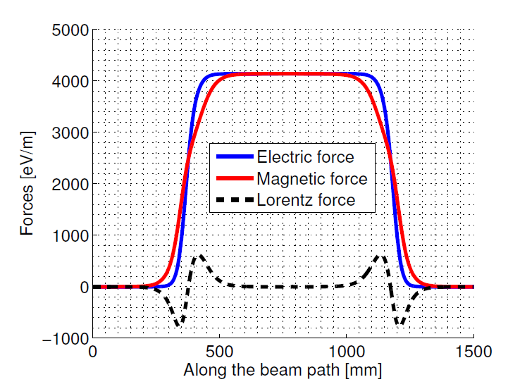
Lorentz force compensation
Providing minimal integral Lorentz force requires careful shaping of electrodes and all other components
$${\vec{F}}_{L}=q(\vec{E}+\vec{v}×\vec{B})$$
Lorentz force integral with $\vec{v}$ along Wien filter axis
Mechanical design completed. Continued work on RF driving circuit $→$ to reach $\int{Bdl\sim 0.2 Tmm}$ seems possible.

Slide 12
RF $E×B$ Wien Filter: Resonance conditions
$f_{RF}=f_{rev}(γG±K)$, $K∈ℤ$
 | $$p$$ | $$f_{rev}/kHz$$ | $$G$$ | $$β$$ | $$γ$$ | $$γG$$
$$d$$ | $$970.0$$ | $$750.2$$ | $$−0.143$$ | $$0.459$$ | $$1.126$$ | $$−0.161$$
$$p$$ | $$521.1$$ | $$752.6$$ | $$1.793$$ | $$0.486$$ | $$1.144$$ | $$2.051$$
$$K$$ |  | $$−4$$ | $$−3$$ | $$−2$$ | $$−1$$ | $$0$$ | $$+1$$ | $$+2$$
$${|f}_{RF}|/kHz$$ | $$d$$ |  |  | $$1621.2$$ | $$871.0$$ | $$120.8$$ | $$629.4$$ | $$1379.6$$
 | $$p$$ | $$1545.6$$ | $$752.6$$ | $$40.3$$ | $$833.2$$ | $$1626.2$$
Frequency range RF Wien filter prototype (Gebel/Mey)
New waveguide RF Wien filter will provide resonance conditions for deuterons and protons for a number harmonics $K.$

Slide 13
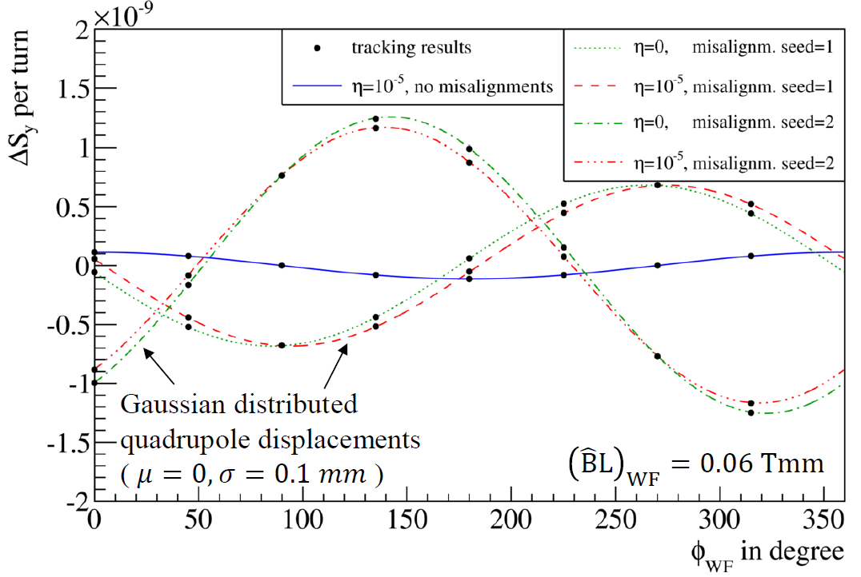
Concept for first measurements
Simulations with COSY-INF. and RF Wien filter ($E_{x}$, $B_{y}$) in EDM buildup mode.
M Rosenthal et al, IBIC 2015
$$\vec{d}=\frac{ηqℏ}{2mc}\vec{S}$$
$$d=5∙{10}^{−20} e cm$$
EDM hidden underneath imperfections from magnet misalignments.
Notes:
Vertical spin buildup for closed orbit deuterons in an ideal ring, as well as for quadrupole misalignments for two different randomization seeds.
The black dots show tracking results, the colored lines are analytical estimates

Slide 14
Concept for first measurements
With an RF Wien filter of $\int{Bdl=0.05 Tmm}$, $σ_{stat}\sim 2∙{10}^{−22} e cm$ can be reached in 1000 s.
M Rosenthal et al, IBIC 2015
Randomized error standard deviation of $0.1 mm$ $→$ RMS displacements $\sim 1mm$. Contribution to buildup from misalignments similar to EDM for $η={10}^{−4}$, $d=5{∙10}^{−19} e cm$.

Slide 15
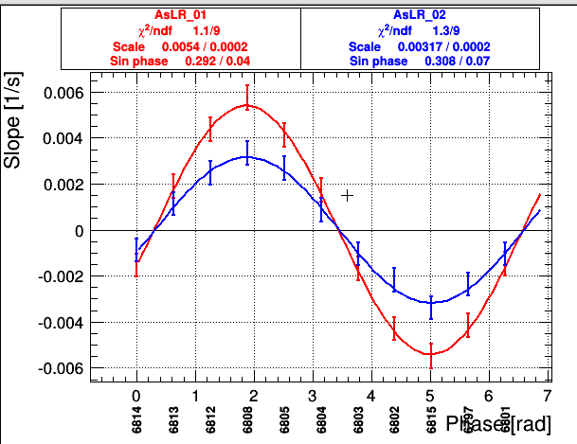
Results from the ongoing run at COSY
Rotate deuteron spins into ring plane and let them freely precess.
Lock the solenoid RF phase to the polarization direction of the ensemble
Use small RF solenoid amplitude to mimic polarization buildup
Volker Hejny, Ed Stephenson
During commissioning, waveguide RF Wien filter will be rotated to observe RF phase-dependence with small amplitudes
Phase-locking now works via changing of the COSY RF (first try). Later, we will phase-lock to RF Wien filter RF.

Slide 16
Beam Request
The waveguide RF Wien filter shall become available for first tests at COSY in the fall of 2016.
We would like to perform a first commissioning with a vector polarized deuteron beam at 970 MeV/c:
Request: two weeks of beam time preceded by one machine development (MD) week.
The commissioning time will be used to make sure that the wave guide RF Wien filter performs properly before we approach further investigations.
The commissioning beam time should be scheduled right after the JEDI experiment on EDM polarimeter database for deuterons and protons.

