Slide 1

Development of 3D Polarimeters for storage ring EDM searches
JEDI Collaboration
5.10.2012 | David Chiladze (IKP, Forschungszentrum Jülich)

Slide 2
Outline
  Introduction
  Existing polarimeter ideas
  Why do we need 3D polarimeter
  Systematic uncertainties
  Outlook

Slide 3
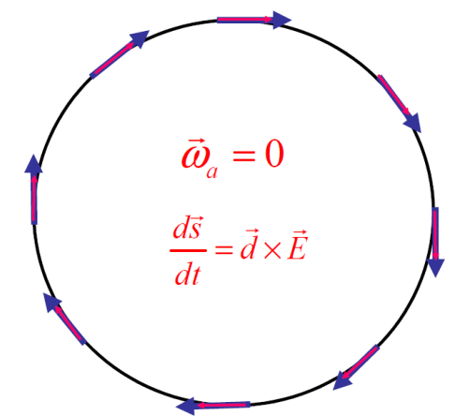
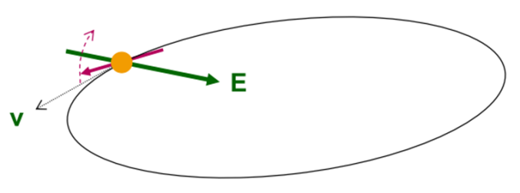
Introduction
  EDM of the particles can be measured in storage rings.
  Spin axis rotates in radial electric field
  “Freeze“ horizontal spin precession and observe polarisation changes.
α

Slide 4
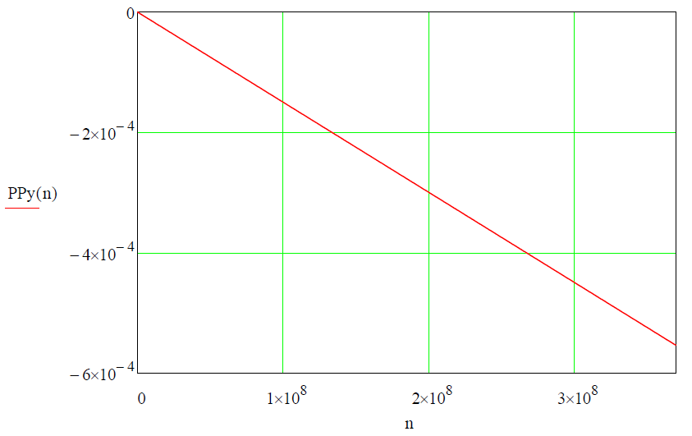
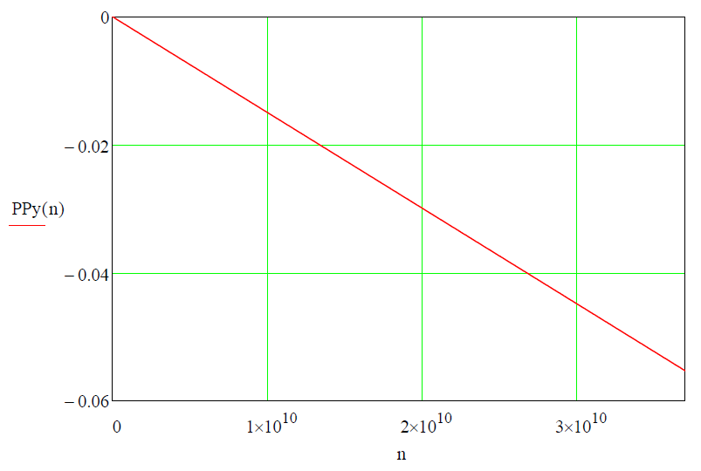
Simulation of polarization development
Case of deuterons at COSY
Parameters: beam energy T_{d}=50 MeV L_{RF} = 1m
assumed EDM d_{d}=10⁻²⁴ e·cm
E-field 30 kV/cm
τ =1000 s ( = 3.7·10⁸ turns).
τ =100000 s ( = 3.7·10⁹ turns).
P_{y}
P_{y}
EDM effect accumulates in P_{y}
EDM effect accumulates in P_{y}
Turn number
Turn number

Slide 5
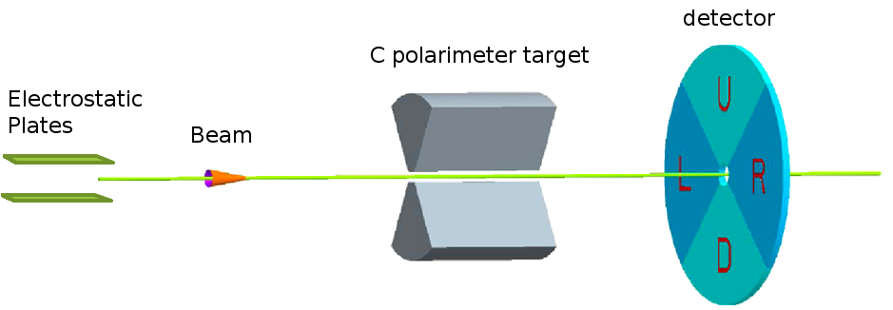
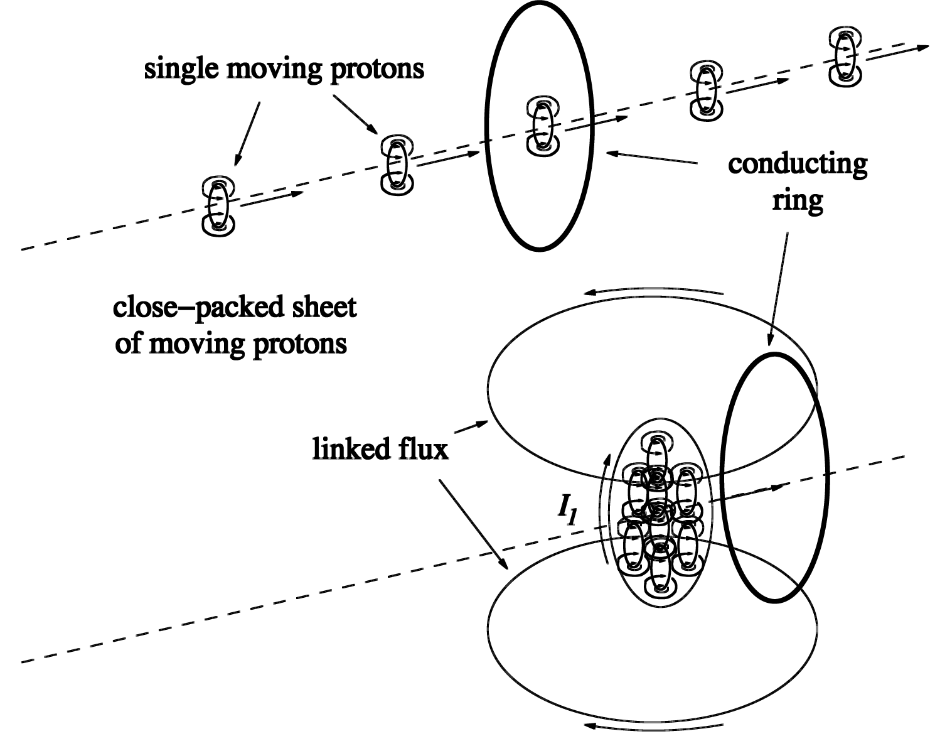
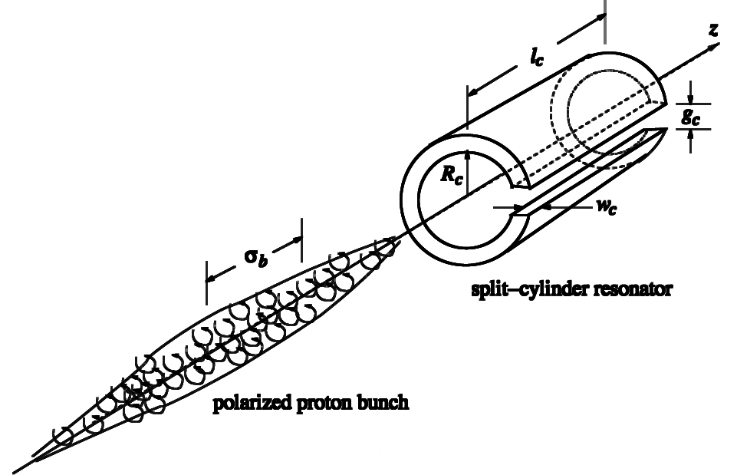
Polarimetry Options
  Carbon scattering
    Very high statistics
    Large analysing powers
    Measures only P_{y}
    Excessive beam losses
  Resonator polarimetry
    Superconducting
    split-cylinder resonator
    No beam losses
    Measures only P_{y}
BNL proposal 2011
Internal report by R.Talman

Slide 6
Concept of 3D Polarimeter
  Measurement of all components of beam and target
  polarisation
  Large angular coverage
    20° – 90° polar angle
    Almost full φ acceptance
  All spin combinations of beam and target interaction
    ➔⬅, ➔➔, ⬅➔, ⬅⬅
  Polarised target requires magnetic field not acceptable for EDM ⇒ Collider mode
Detector
Beam 1
Target

Slide 7
Concept of 3D Polarimeter
  Measurement of all components of beam 1 and beam 2
  polarisation
  Large angular coverage
    20° – 90° polar angle
    Almost full φ acceptance
  All spin combinations of beam 1 and beam 2 interaction
    ➔⬅, ➔➔, ⬅➔, ⬅⬅
Beam 2
Detector
Beam 1

Slide 8
Pros & Cons
  Better handling of systematics
  Smaller beam losses
  No change in beam phase space
  Requires very high intensity
  Lower cross-section compared with carbon
  Alignment of target polarisation along axes requires magnetic fields that leads to unwanted MDM rotations (not acceptable for EDM ⇒ Collider mode

Slide 9
Clockwise and Counterclockwise Beams
Detector
➜
➜
CW
CCW
➜
➜
➜
➜
➜
➜
  4 bunches of polarised clockwise and counterclockwise beams
  4 Interaction points
  EDM effects will be observed in both cw and ccw beams
  Determination of all components of polarisation for both beams

Slide 10
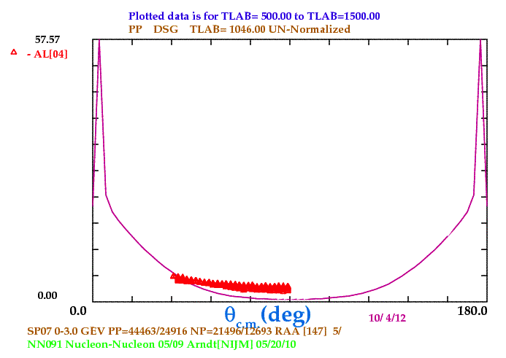






Counting Rate
Conditions:
$$β=0.1 m$$
$$Luminosity$$
$$β=1 m$$
$$β=10 m$$
$$kinetic energy (MeV)$$
Rate = L · σ_{pp} = 3.1·10²⁸[cm⁻²s⁻¹] × 10⁻²⁷[cm²mb⁻¹]×15[mb] ≈ 466 s⁻¹

Slide 11
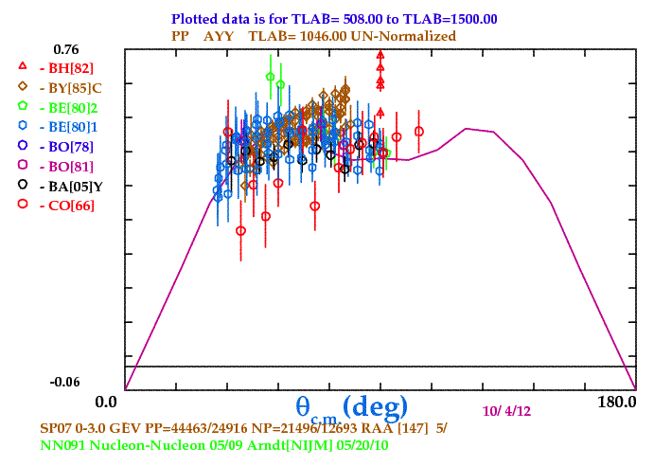
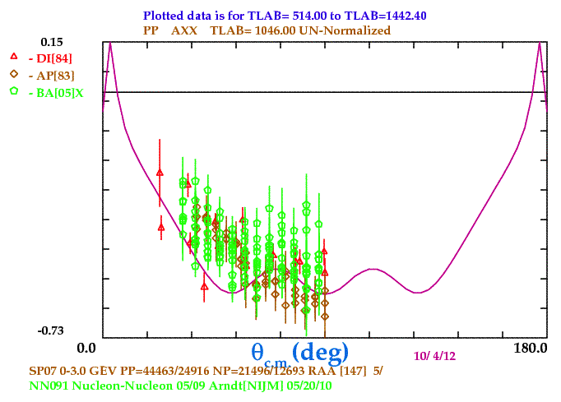
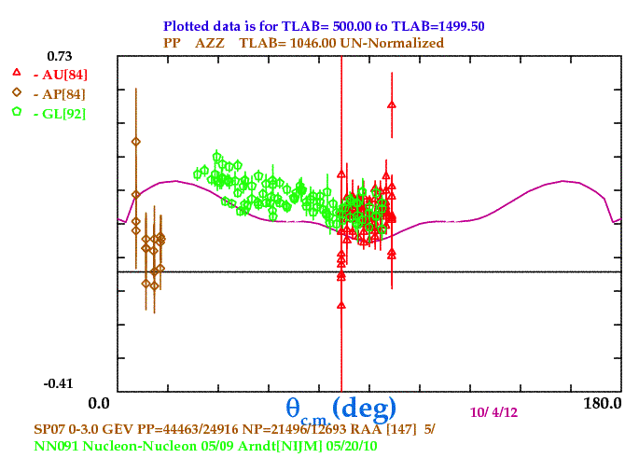
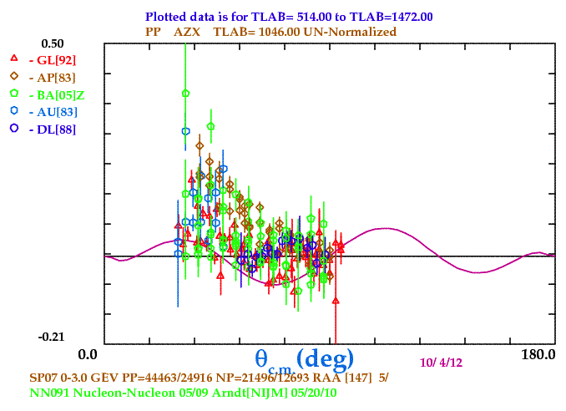
Spin Observables: T_{p} = 1046 MeV
A_{y}
C_{xx}
C_{zz}
C_{xz}

Slide 12
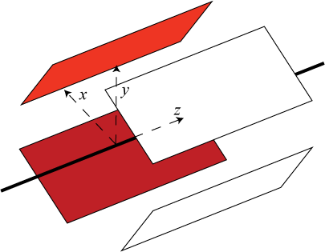
Analysis
  For each combination of polarisation 4 detector quadrants
  In each quadrant 4 different yields for different polarisation combinations
  In total 16 yields
k=1
k=2
k=3
k=4
➜
➜
Y
➜
➜
➜
➜
➜
➜
i =4
i =1
X
90°
i =3
i =2

Slide 13
Diagonal Scaling
Reduced matrix:
Detector:
Luminosity:
sum of rows:
sum of columns:
Detector quadrants
➜
➜
➜
➜
➜
➜
➜
➜
Polarisation combinations
Extraction of all components of the polarisation for beam 1 and beam 2.
Determination of luminosities.
Extraction of detector efficiencies.
Meyer, H.O. ‘Diagonal scaling and the analysis of polarization experiments in nuclear physics’, Phys. Rev. C, 56(4):2074–2079, Oct 1997.

Slide 14
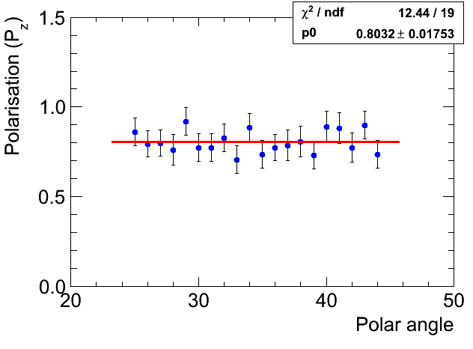
Systematic Errors
  Method to simulate 16 yields for different polarisation combinations and different detector quadrants to estimate systematic and statistical uncertainties:
  A_{y} ≈ 0.60 ± 0.01
  C_{xz} ≈ 0.20 ± 0.02
  C_{zz} ≈ 0.45 ± 0.015
0.803 ± 0.017
Systematic
uncertainties
Statistical
uncertainties
‘Polarisation response’
Very first estimations

Slide 15
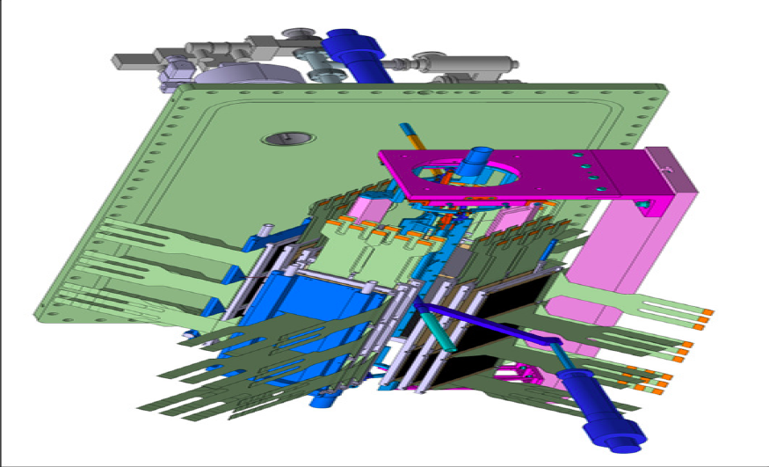
Outlook
  Collider mode seems to be best option for
  3D polarimeter
  It is preferable to prepare dediacted database for spin observables for pp and dd experiments
  PAX detectors at COSY (with snake available) will be able to contribute to creation of such databases by conducting double polarised experiments.
  Evaluation of statistical
  uncertainties
COSY beam
Three layers of
silicon detectors

