Slide 1
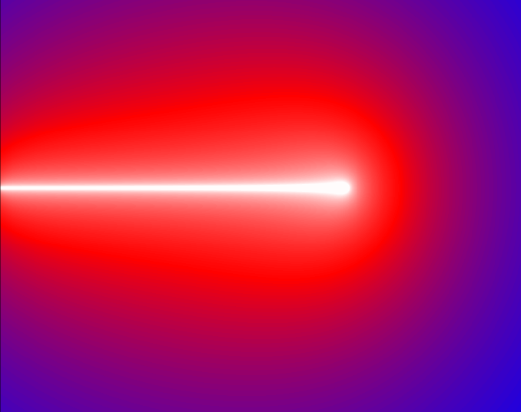
Prompt-gamma
radiation in proton
therapy – activities
of the SiFi-CC
collaboration
Aleksandra Wrońska
Jagiellonian University in Kraków
SiFi-CC group
https://bragg.if.uj.edu.pl/sificc
20th GGSB Aniversary, Tbilisi/Kutaisi, 11.09.2024

Slide 2
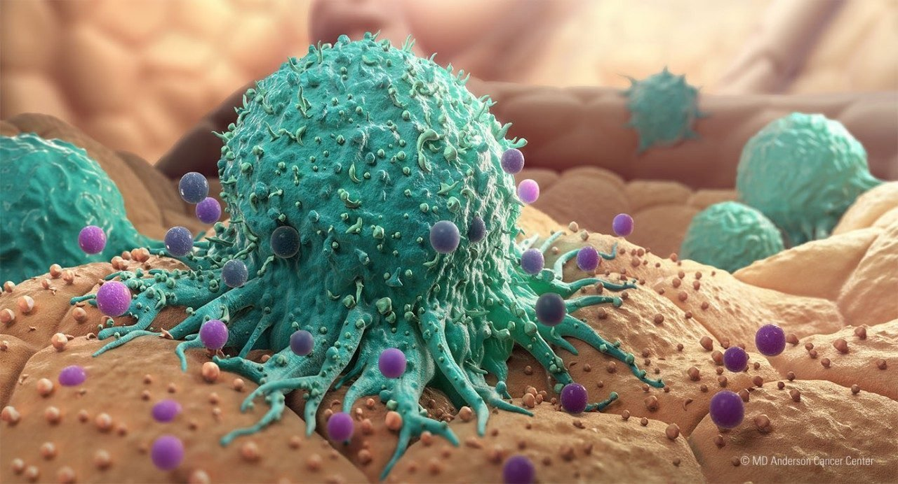
Cancer – a scare and a challenge
Statistics
Treatment methods
1 in 4 deaths caused by cancer in the EU
(Poland close to this average)
responsible for more than 35% of deaths among those aged less than 65, and under 25% amongst those aged 65 and over
>3.7 million new cases and ~1.9 million deaths/year make cancer the second most important cause of death and morbidity in Europe
main causes: tobacco and alcohol consumption, inappropriate diet, obesity and insufficient physical activity, longer life
trend: increasing...
Surgery
Chemotherapy
Radiotherapy
Immunotherapy (Nobel 2018)

Slide 3
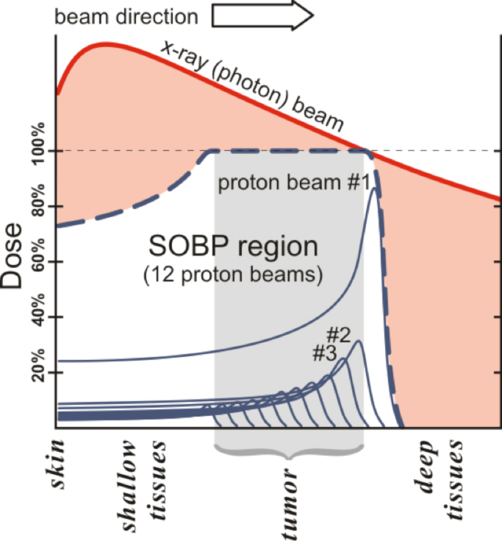
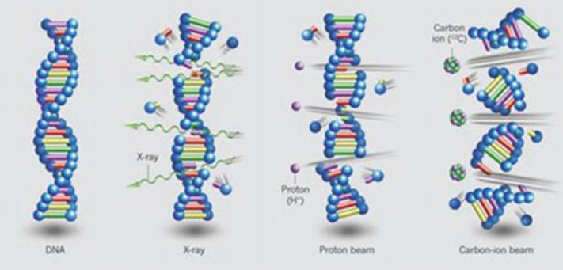
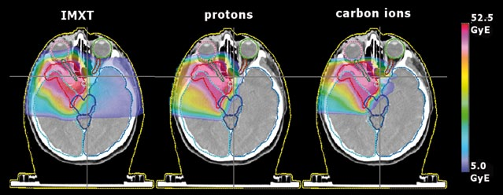
X-ray versus hadron therapy
Tumour irradiation – important way of treatment
Advantages of hadron therapy compared to X-rays:
Conformal dose distribution
Biological effectiveness
Marcos dAvila Nunes, Springer 2015
Levin et al.., British J of Cancer 2005
NuPECC, Nuclear Physics for Medicine 2014

Slide 4
Proton therapy - history

Slide 5
Developments in hadron therapy
First patient irratiation 1954 at Berkeley (2 years after tests with mice)
Subsequent improvements:
utilization of Bragg peak
tests with other ion species
fractionated delivery
utilization of spread-out Bragg peak (ripple filters)
technology transfer from research institutes to hospitals
commercial companies enter the field
modern CT+PET assisted evaluation of treatment plans based on sophisticated computersimulations
multi-field irradiations, scanningwith pencil beam
>140 therapy centres operational, and counting...
PRECISE AND SELECTIVE TREATMENT

Slide 6
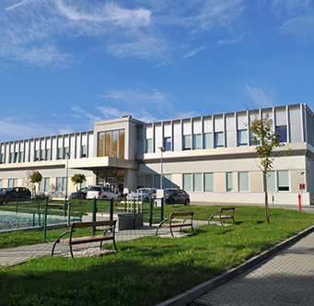
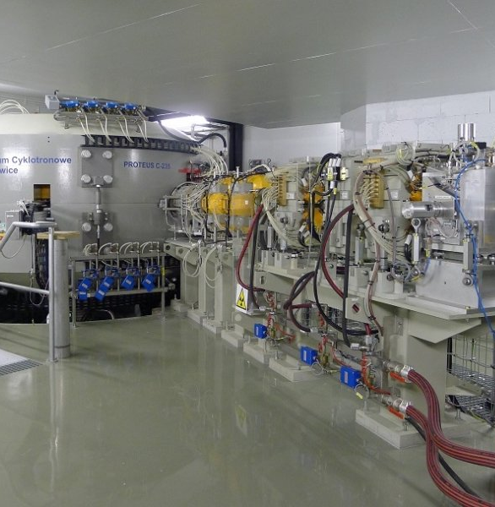
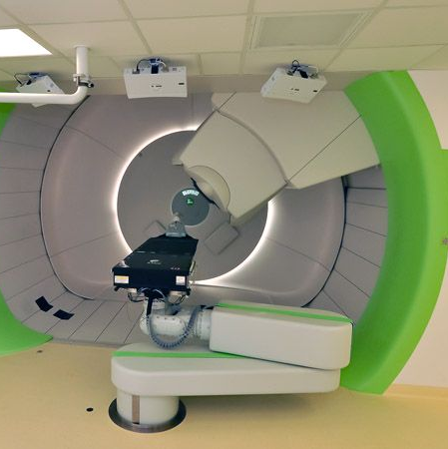
Kraków proton therapy centre: Cyclotron Centre Bronowice
Modern equipment, iba Proteus C235 cyclotron, 2 gantries + eye
2013 – first beam
2016 – first patient
Experienced team
Today: ~40 patients / day, including children

Slide 7
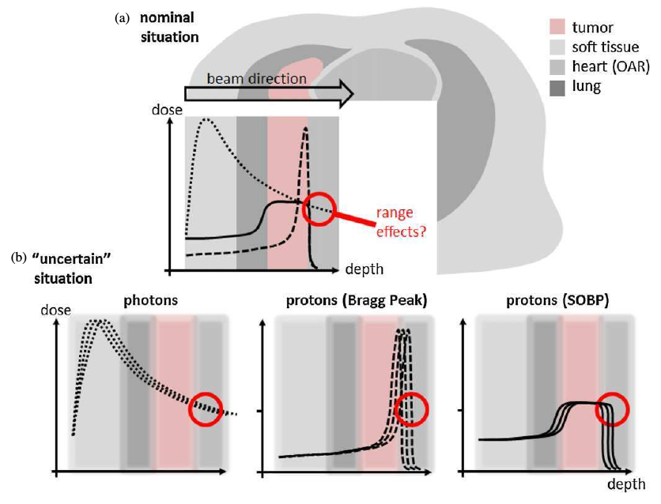
Can we do better in proton therapy?
Safety margins: from a few mm up to > 1 cm
Patient positioning
Anatomical changes
Infections
Uncertainties of treatment planning
Reduction of margins?
Online monitoring of therapy
Determination of Bragg peak position in real time, spot-by-spot
Maybe even spatial dose distribution...?
Knopf, Lomax, PMB 2013

Slide 8
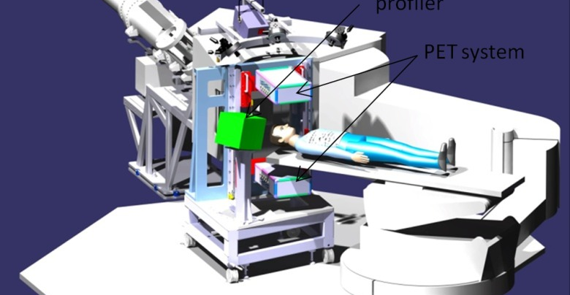
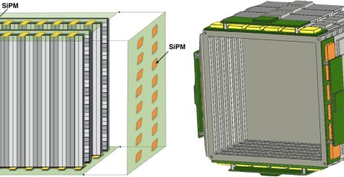
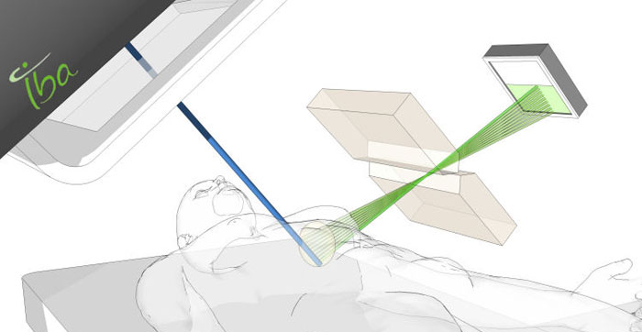
How to monitor PT?
Secondary radiation correlated with dose distribution
Protons, neutrons - useful in C-ion therapy:
Dose Profiler (CNAO) Traini et al., Physica Medica 65, 2019
MONDO (CNAO) Mirabelli et al., IEEE Trans. Nucl. Sci. 65, 2018
β+ emitters (PET):
INSIDE (CNAO) Bisogni et al., J. Med. Imaging 4, 2017
J-PET (UJ) Baran et al., MSS/MIC 2019
Prompt-gamma radiation:
OncoRay+IBA (Dresden) Richter et al., Radiotherapy and Oncology 1 118, 2016,
MGH Boston Hueso-Gonzalez et al., PMB 63, 2018, Xie et al. Int. J. of Rad. Oncol. Biol. Phys. 99 210 2017
Many others review: Wrońska, Dauvergne in Radiation Detection Systems, CRC Press 2021

Slide 9
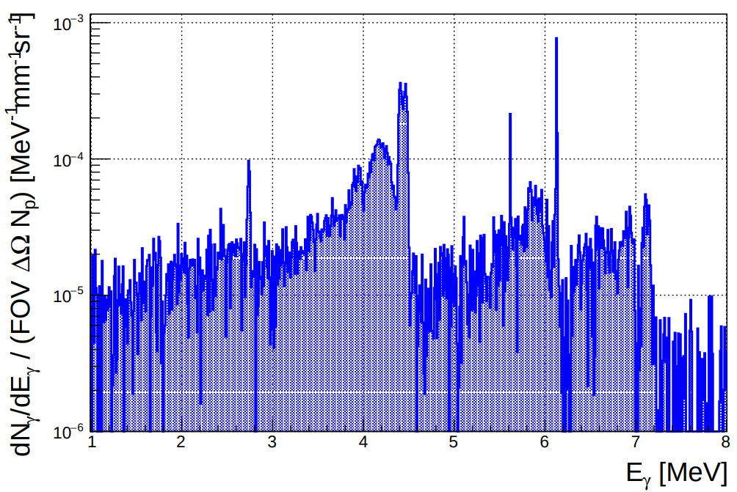
Prompt gamma – working conditions
Large count rates (n×10⁵ s⁻¹)
Typical spot: t=10 ms, N_{p}~10⁸
Background from other secondaries (neutrons)
N_{γ}/N_{p}~0.15
Energy range 1-7 MeV (continuum + discrete transitions)
Detection system of large efficiency, rate capability and fast DAQ needed
Wrońska, Dauvergne in Radiation Detection Systems, CRC Press 2021

Slide 10
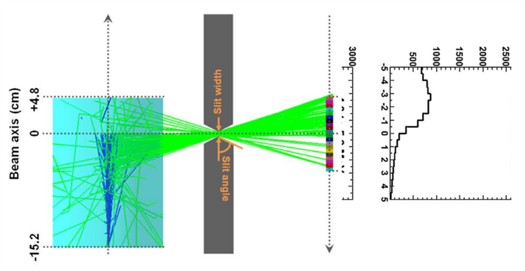
Prompt-gamma radiation (PG)
Status
Dream
Beam range monitoring under tests in clinical conditions (PG spectroscopy, slit camera) Richter et al., Radiotherapy and Oncology 1 118 , 2016 Xie et al., Int. J. Rad. Oncol. Biol. Phys 99 210, 2019 Hueso-Gonzalez et al., PMB 63, 2018
1d information
Registeration of PG vertex distribution (Compton cameras)
"Translation" of this distribution to the spatial distribution of deposited dose Liu, Huang Physica Medica 69, 2020
Full 3d information
Smeets et al., Phys Med Biol 57 (2012)​

Slide 11
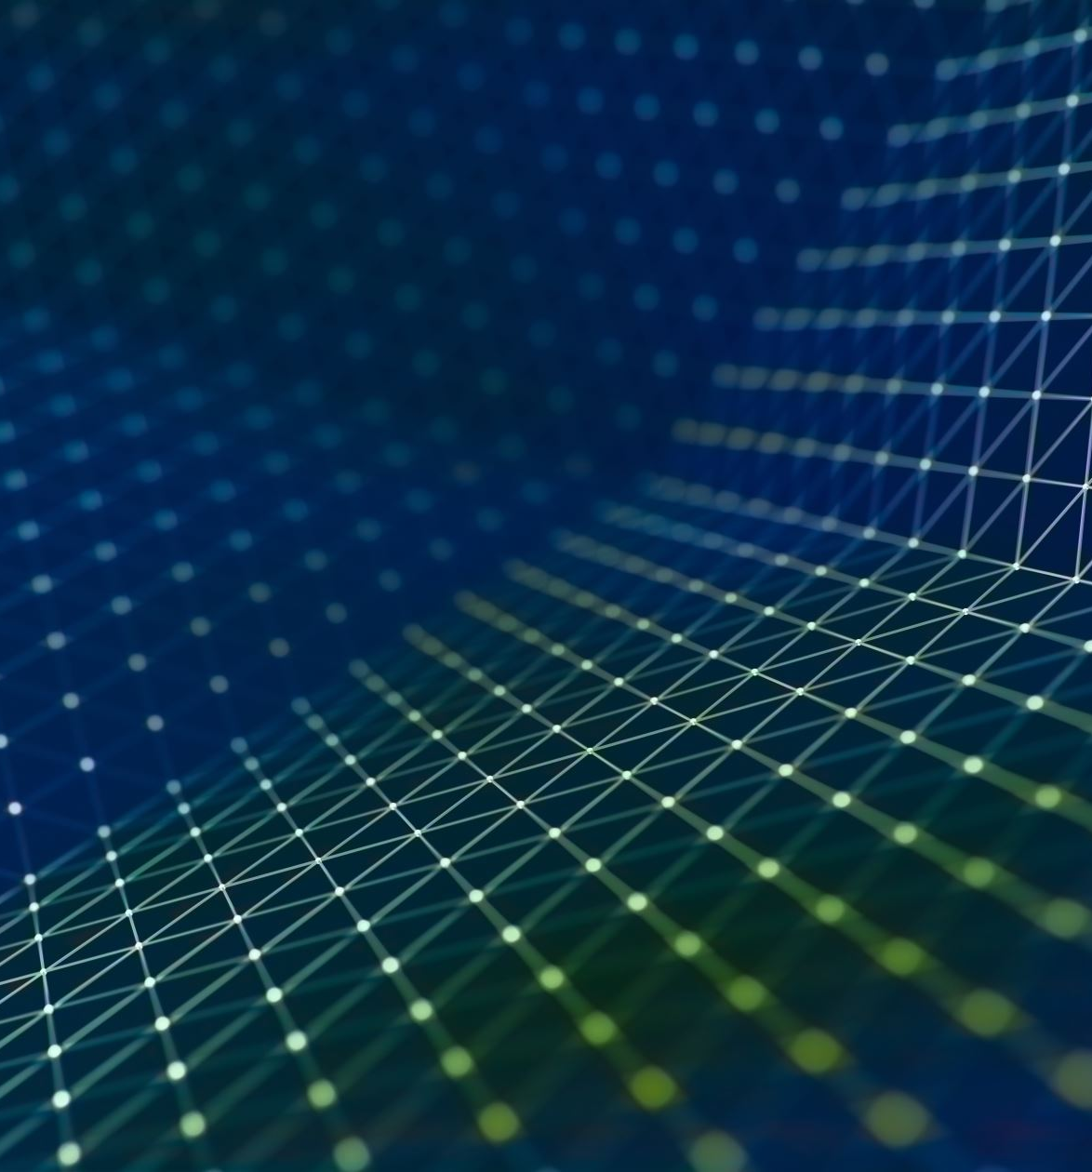
PG – our activities
γCCB: characterization of PG – experiments
Monte-Carlo simulations + validation
SiFi-CC setup for beam range monitoring
Beam-activated tumour tracers

Slide 12
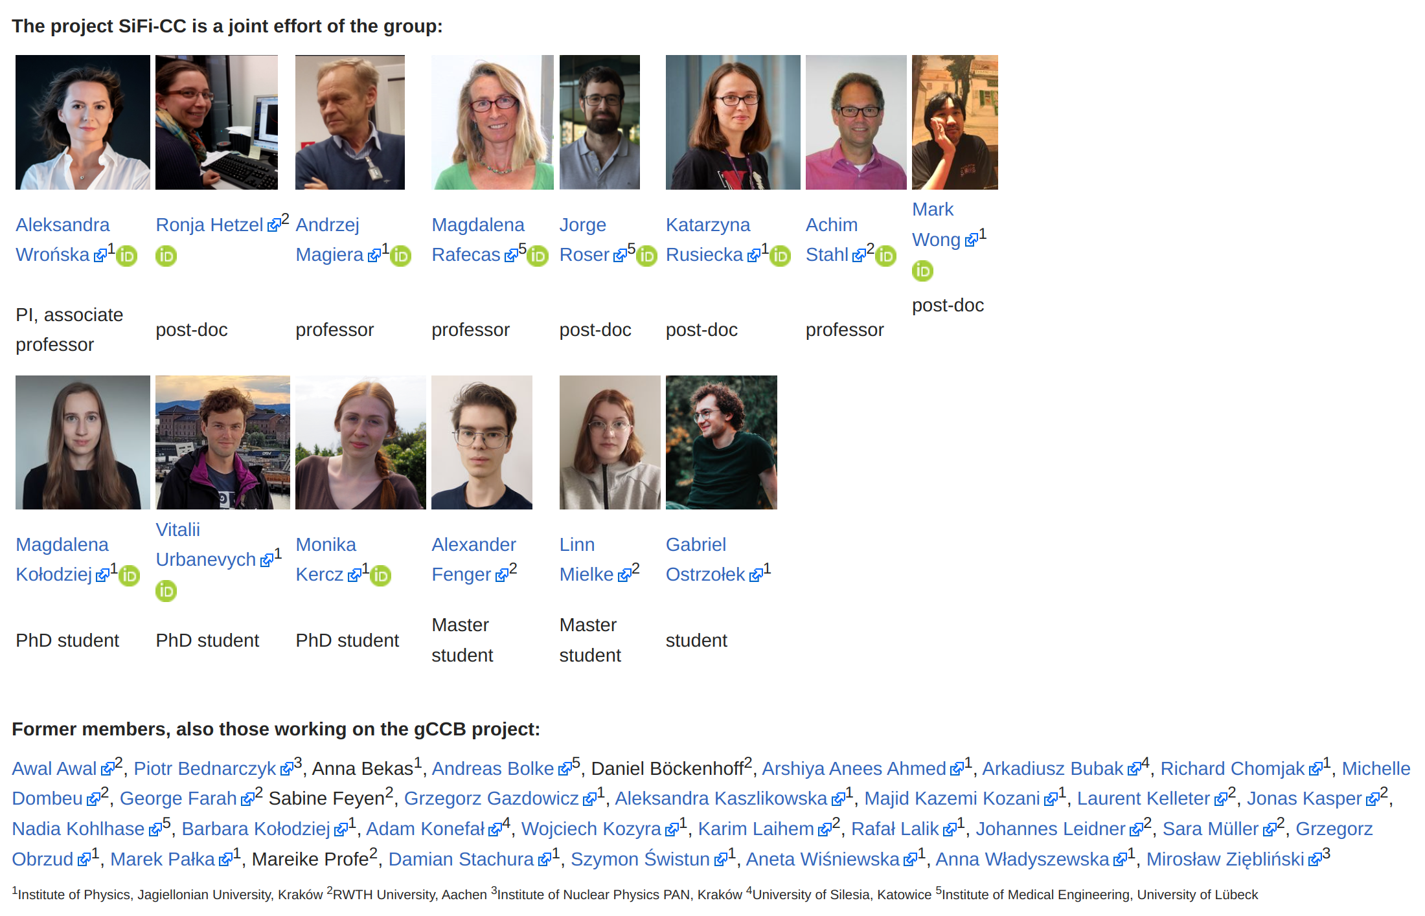
The group

Slide 13
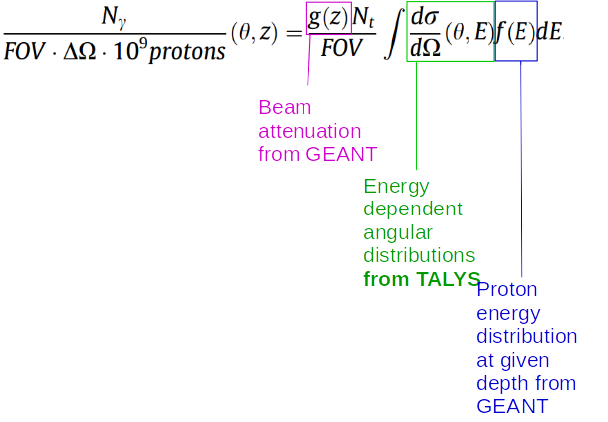
γCCB – experimental characterization of PG
Experiments: CCB, HIT, CCB
Spectroscopy HPGe detector with ACS
Phantoms with different elemental composition
T_{p}=70, …, 230 MeV
Different detection angles
Focus: lines 4.44 MeV and 6.13 MeV
Results confronted with TALYS and literature data
Details of correlation PG-dose
Kelleter, Wrońska et al., Physica Medica 34, 2017 Wrońska et al., Acta Phys. Pol. B 48, 2017
Wrońska, Kasper et al., Physica Medica 88, 2021

Slide 14
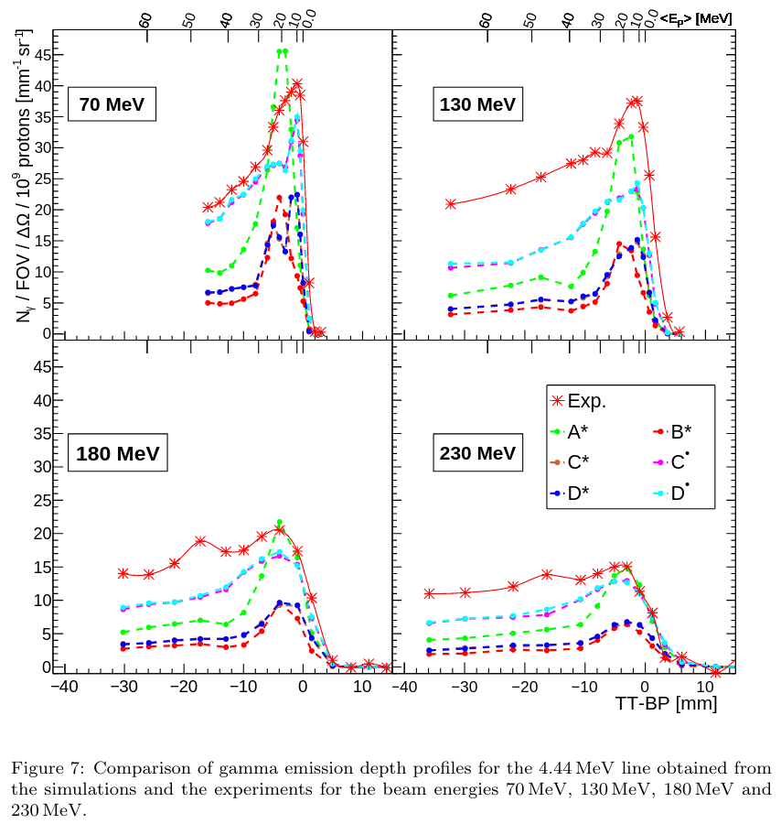
γCCB – validation of simulations
Comparison of simulated and measured PG emission from a PMMA phantom irradiated with proton beam
Various G4 versions and physics lists
Newest not always means best...
Best match for G4 v10.4.2, QGSP_BIC_HP
Theoretically better QGSP_BIC_AllHP does not reproduce line shapes
...but best match also has issues (unphysical lines in spectrum)
Wrońska, Kasper et al., Physica Medica 88, 2021
Notes:
Unphysical lines: 3.21 (transition from Hoyle state), 6.05 - radiative deexcitation of 1st oxygen state (forbidden)

Slide 15
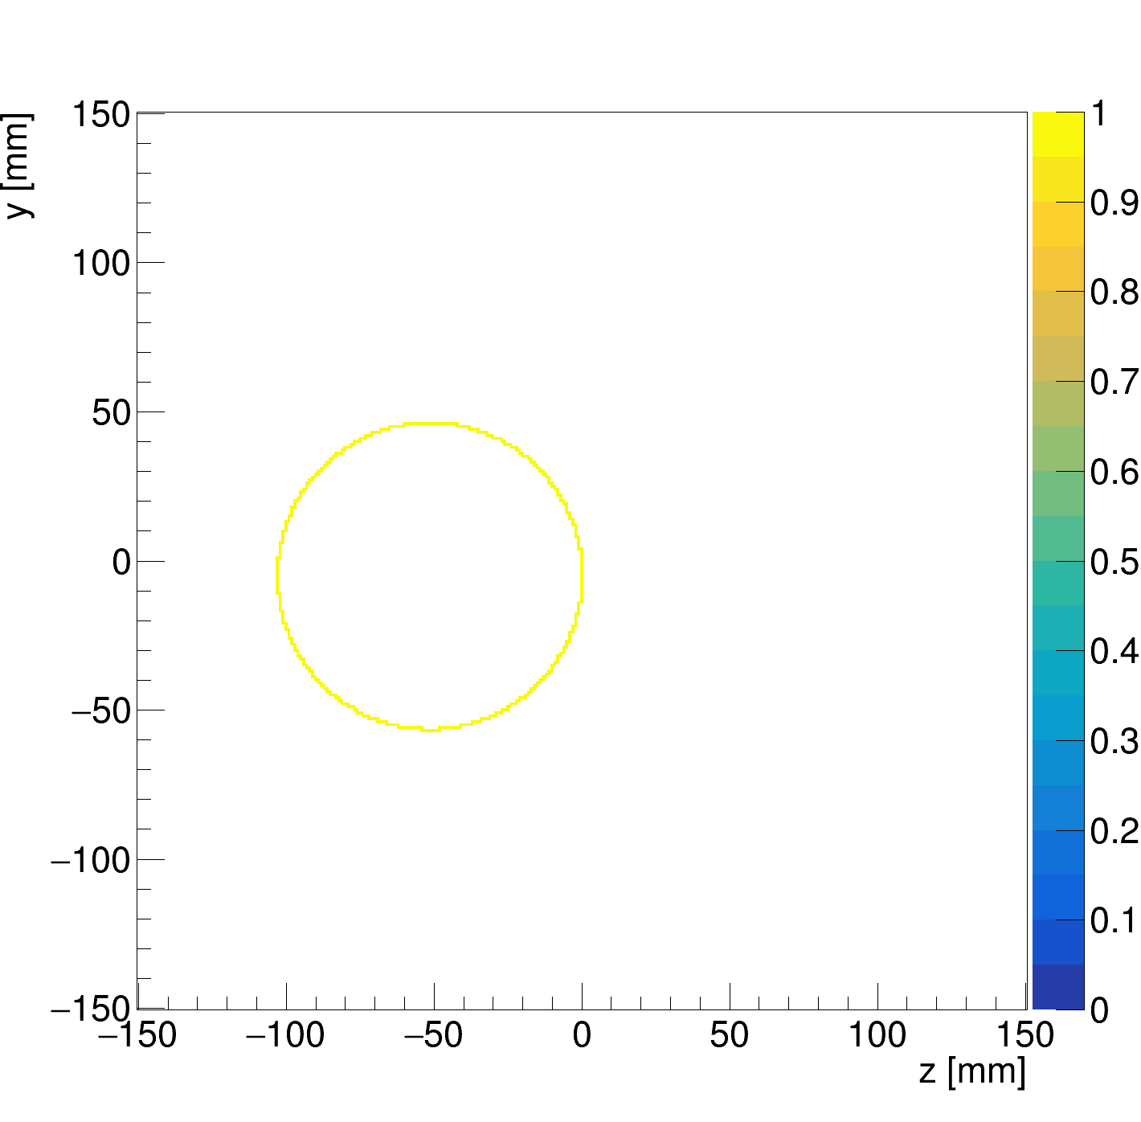
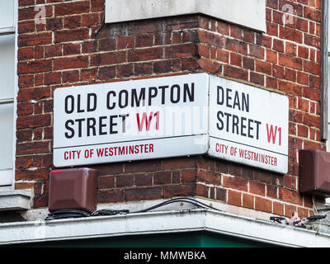
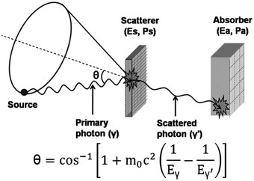
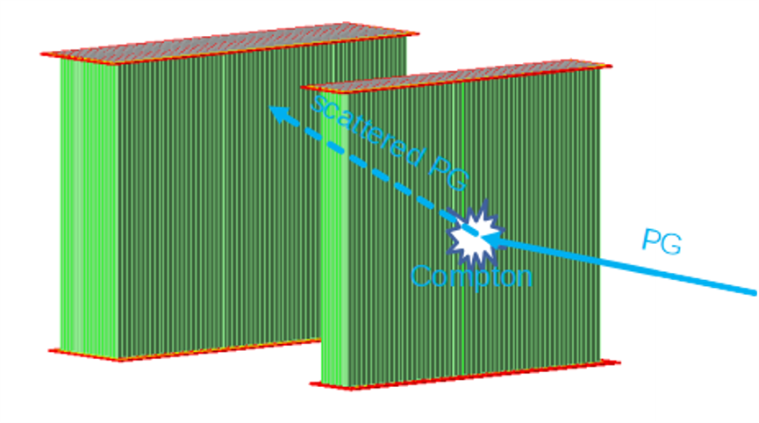
SiFi-CC: Compton camera for PGI
SiPM and scintillating Fibers based Compton Camera
Arrays of LYSO fibres => large efficiency
1mm x 1mm x 100 mm (small prototype) 2mm x 2mm x 100 mm (full-scale)
Dual readout via SiPMs:
1:1 coupling (small)
4:1 coupling (full-scale)
Granularity => pile-up !
DAQ with selective coincidence trigger => large data throughput
L. Mielke, M.Sc.. thesis, RWTH Aachen, 2024

Slide 16
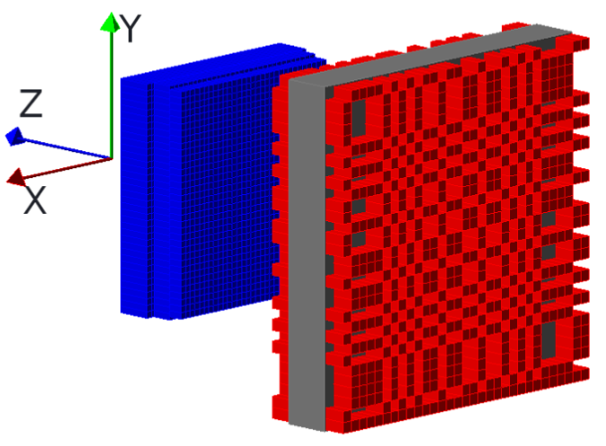
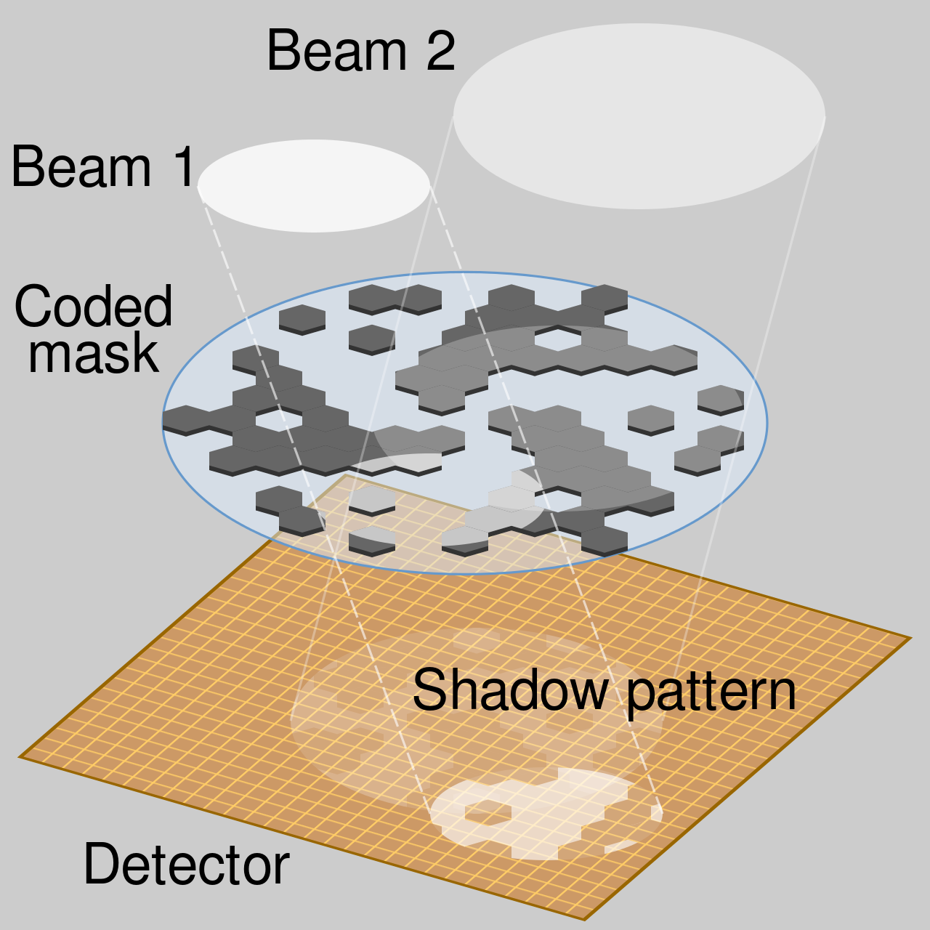
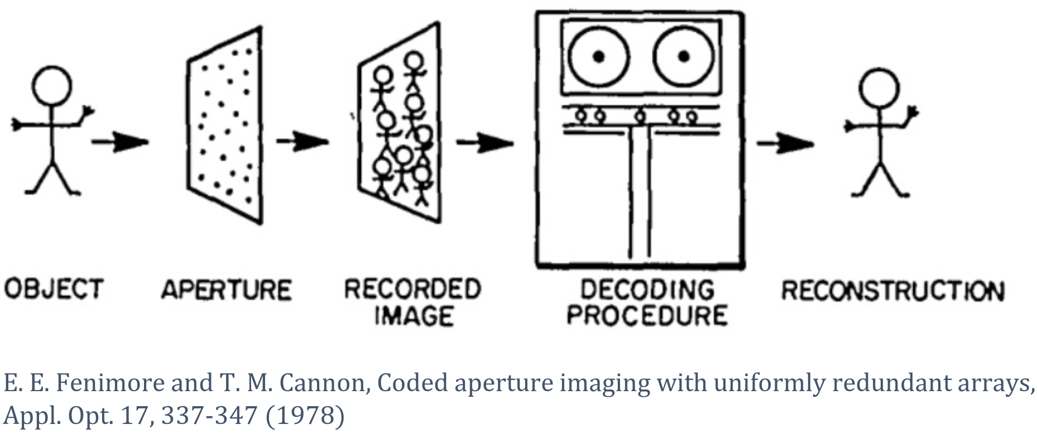
By-product: coded-mask setup (CM)
Technique used in astronomy, also for γ sources (far field)
So far not tested experimentally for PT
2d image
Larger statistics than in a single-aperture camera
Will this work for the near field?
Sun et al., Rad. Phys. Chem. 174 (2020)
By Cmglee - Own work, CC BY-SA 3.0, https://commons.wikimedia.org/w/index.php?curid=47569900

Slide 17
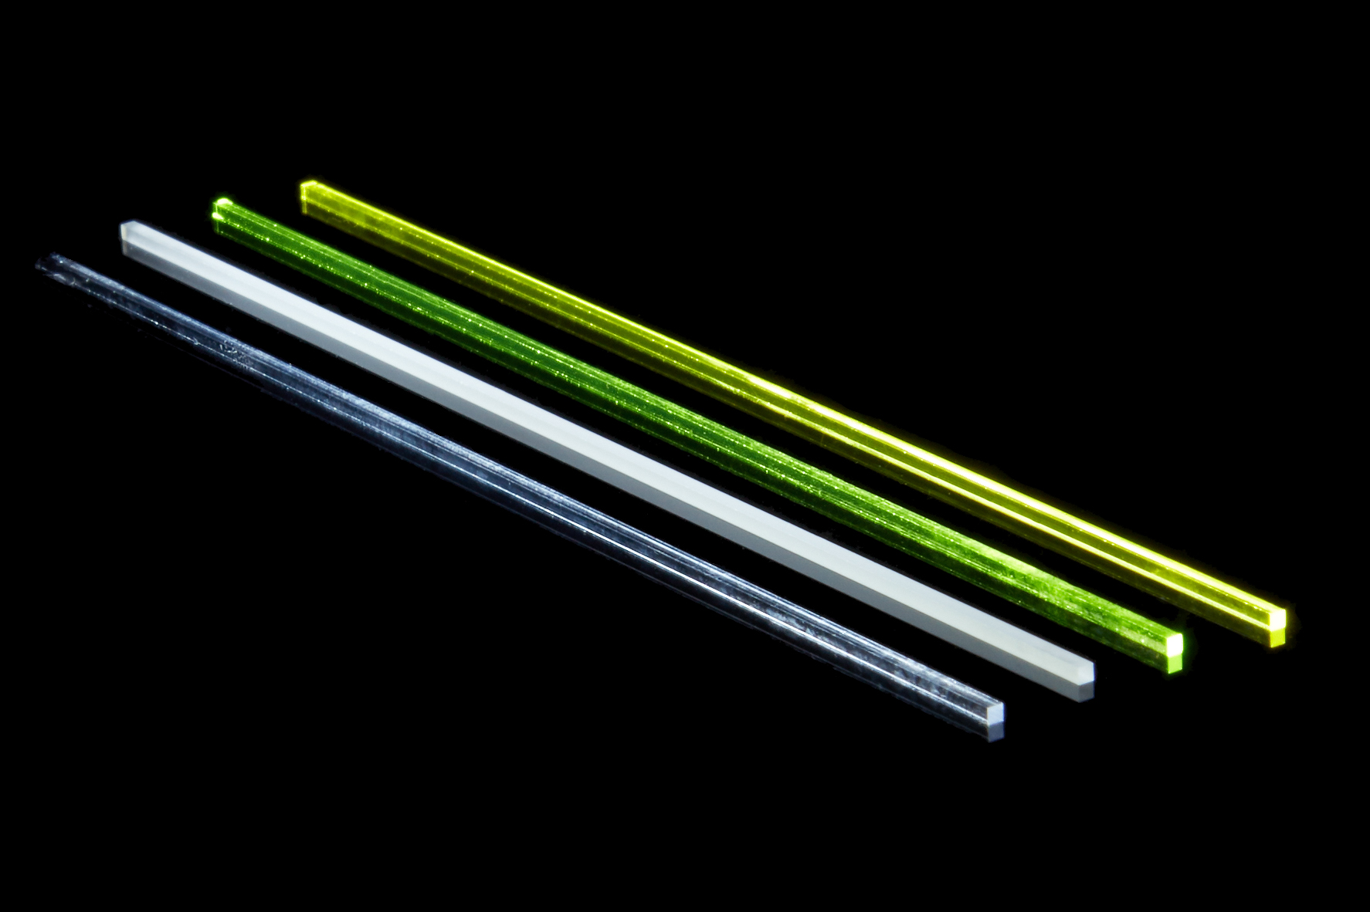
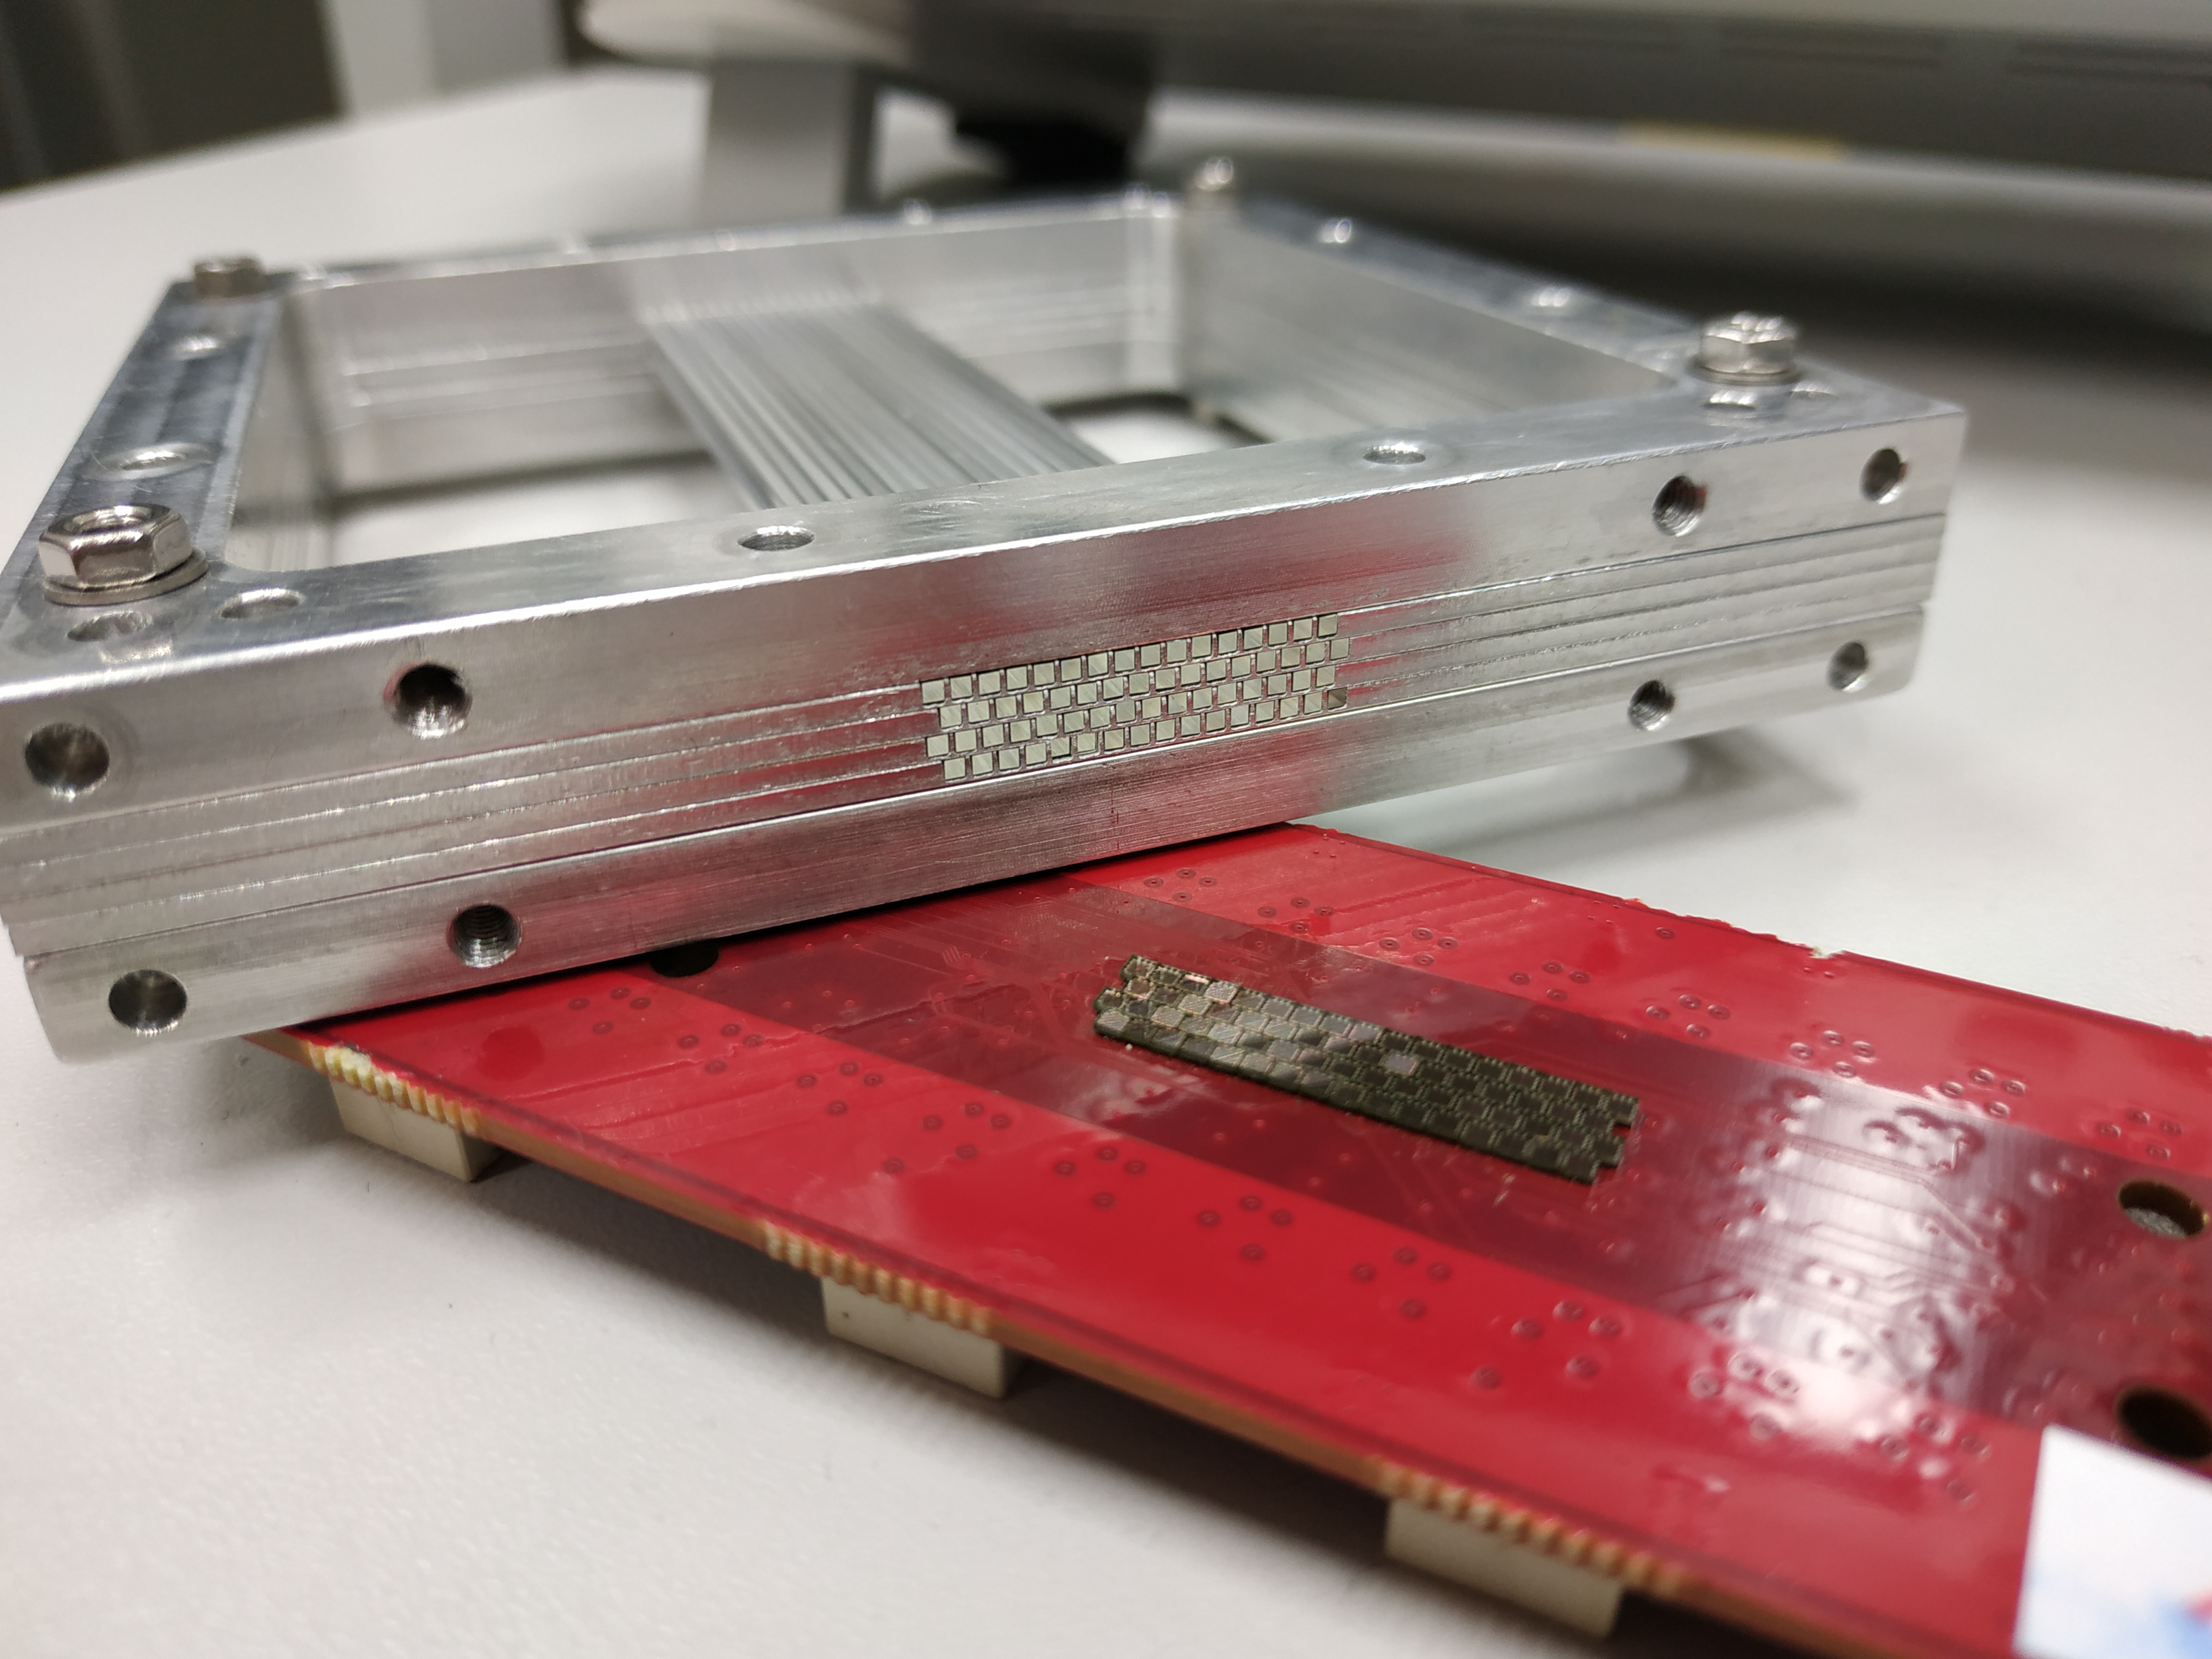
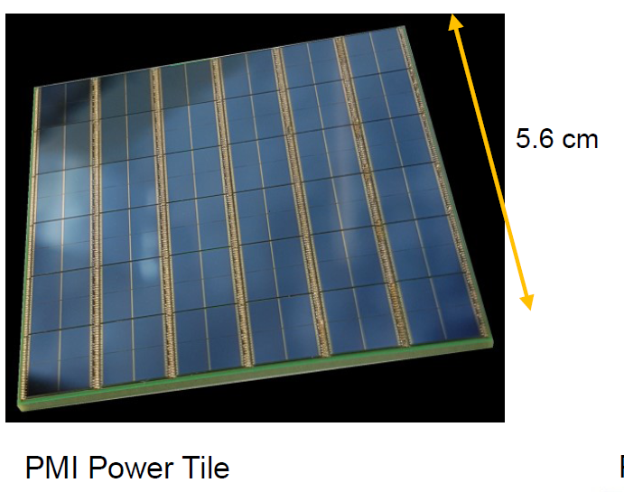
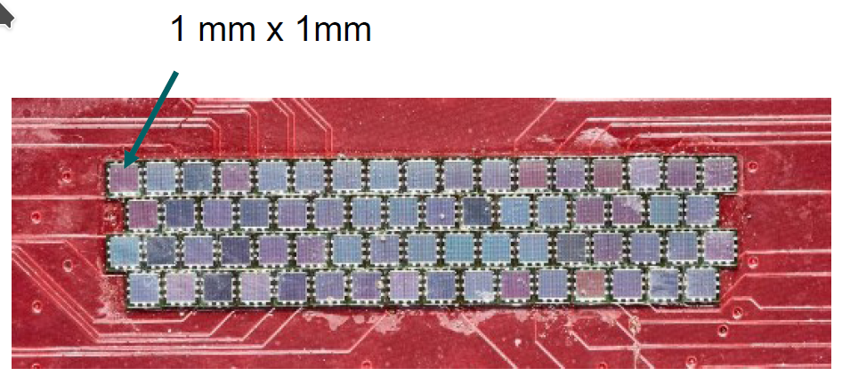
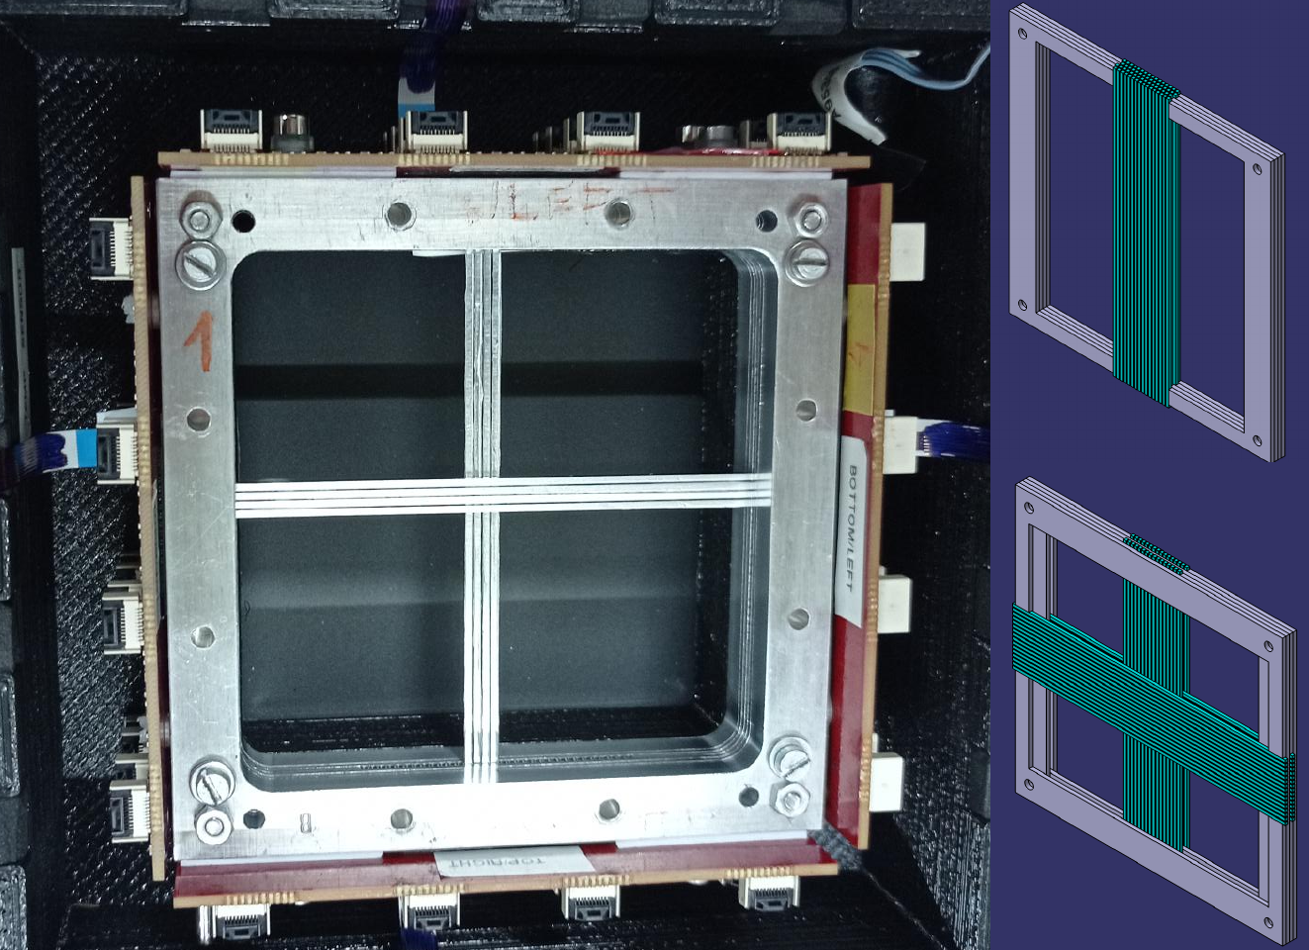
SiFi-CC - prototyping
Investigation of fibre properties
Energy resolution?
Position resolution (along the fibre)?
Rusiecka et al., ISMART2018 (Springer) Rusiecka et al., JINST 16, 2021
Construction of a small module prototype
4 layers
64 fibres
re-arrangable Rusiecka, PhD thesis in preparation, Jag. Uni. 2022
Data analysis software J. Kasper, PhD thesis, RWTH Aachen 2022
Image reconstruction software
Kohlhase et al., IEEE Trans. Rad. Plas. Med. Sci. 4, 2020
FEE+DAQ – classical/digital SiPMs
Schug, Schulz et al., PMB 61, 2016
Scintillating fibres
Classical SiPMs custom array
Phillips, digital SiPMs

Slide 18
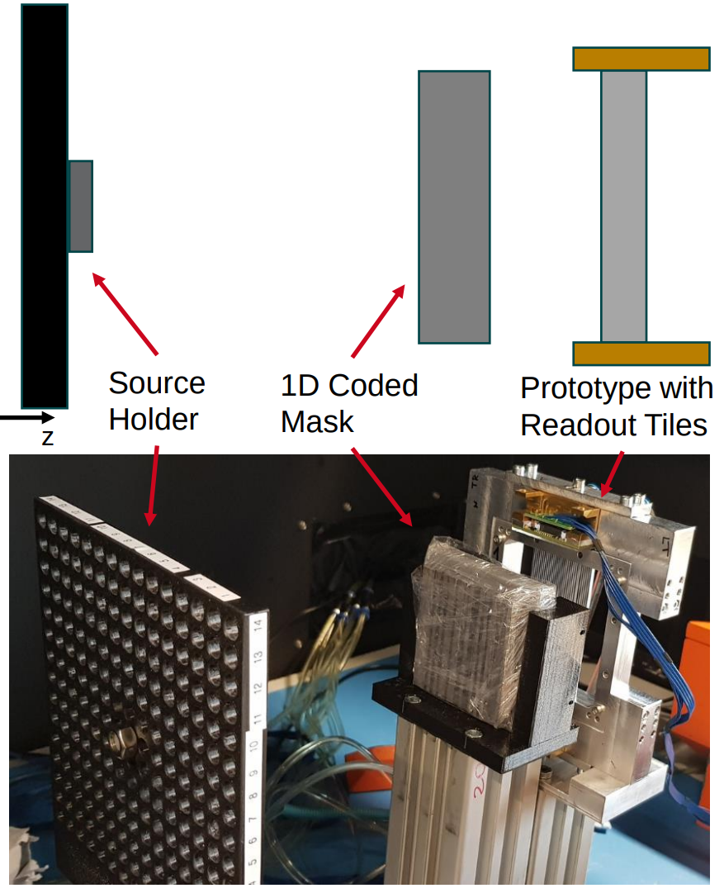
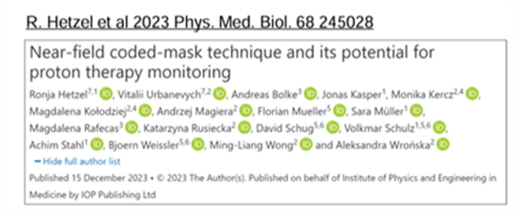
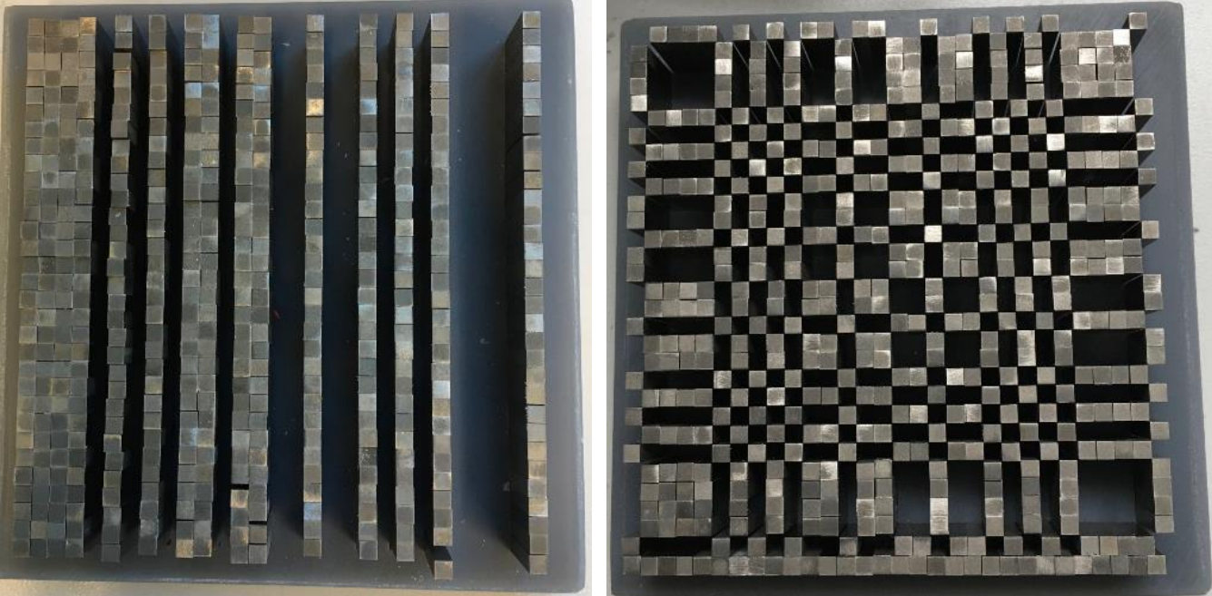
SiFi-CC – setup lab tests
Raw data – hit map
Reco image
Calibration
Collective effects (optical cross-talk)
Test CM setup
1d with our prototype + PowerTiles
2d with PET stack + PowerTiles
This works!
Next step: continuous source
²²Na
V. Urbanevych
S. Müller, DPG SM 2022

Slide 19
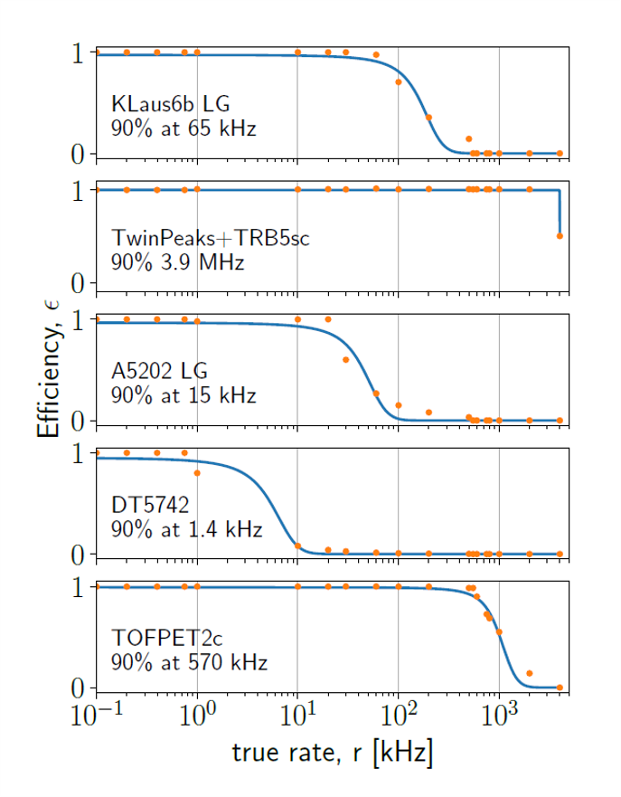
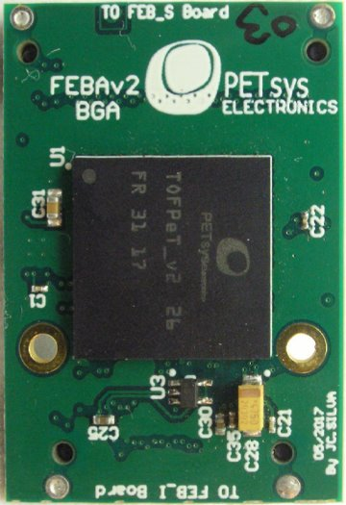
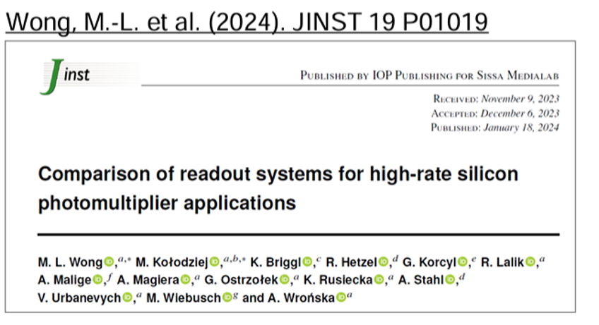
FEE+DAQ – comparative studies
5 FEE+DAQ systems: TOFPET2c, A5202, KLauS6b, TwinPeaks+TRB5sc, DT5742
Compared features:
energy & time resolution
dead time
efficiency
dynamic range

Slide 20
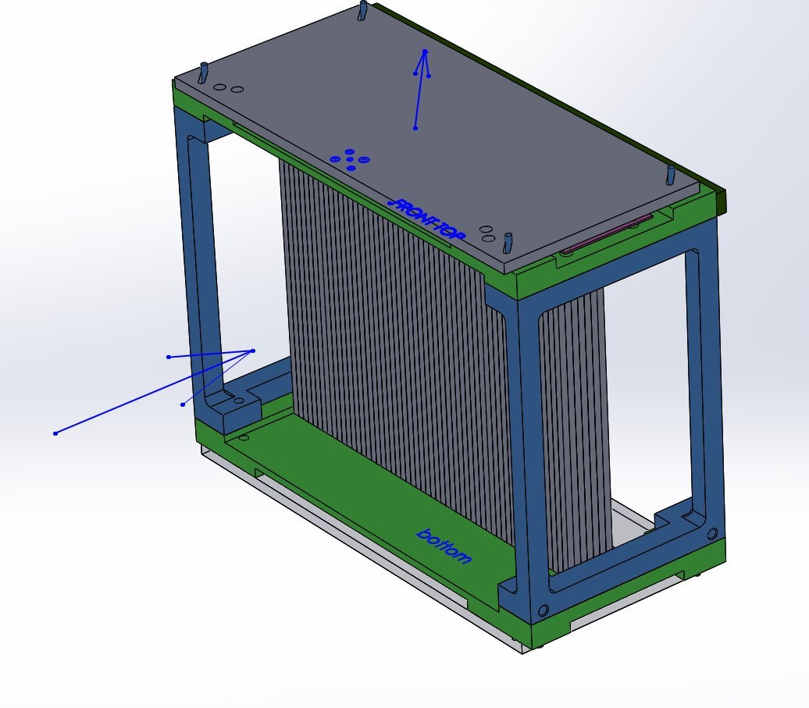
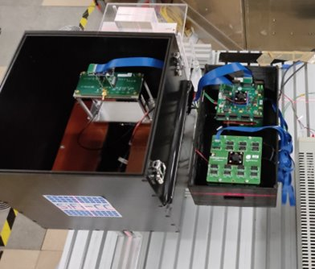
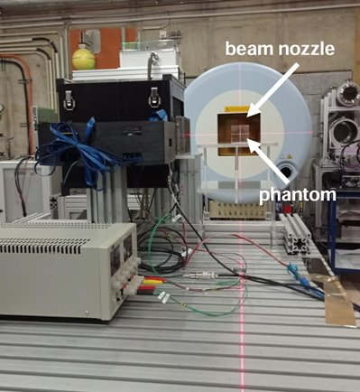
First detector module
Top and bottom SiPM boards shifted diagonally by half pitch
First module - scatterer​
7 layers of LYSO fibers, 55 fibers in each layer​ + Al wrapping
Fiber pitch 2 mm​
Broadcom SiPM arrays (4 x 4 pixels, 16 x 16 mm²) mounted on custom PCBs​
DAQ: TOFPET2 by PETsys
Tested with the proton beam at HIT in coded mask mode (1D and 2D)​
20

Slide 21
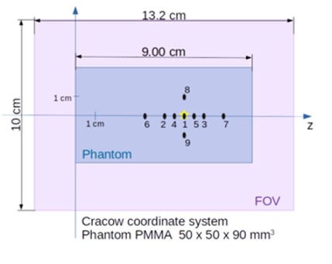
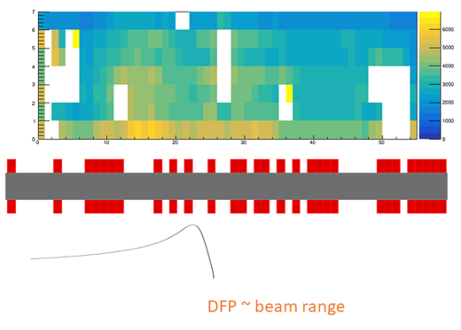
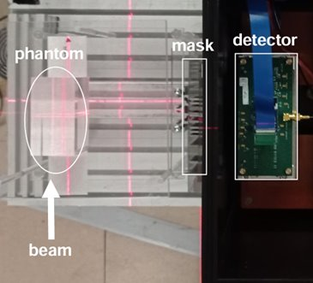
First tests with a proton beam at HIT
Irradiation plan:
Hit map - input for MLEM algorithm
measurement

Slide 22
First tests with a proton beam at HIT
PRELIMINARY
DATA
image
reconstruction
evaluation

Slide 23
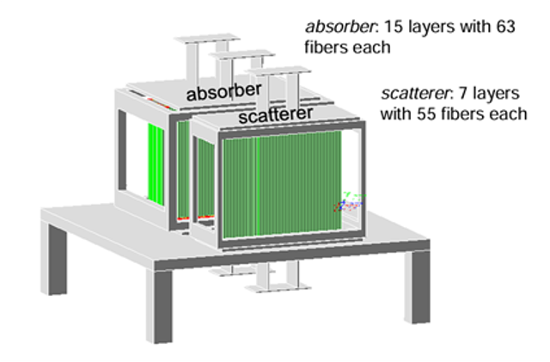
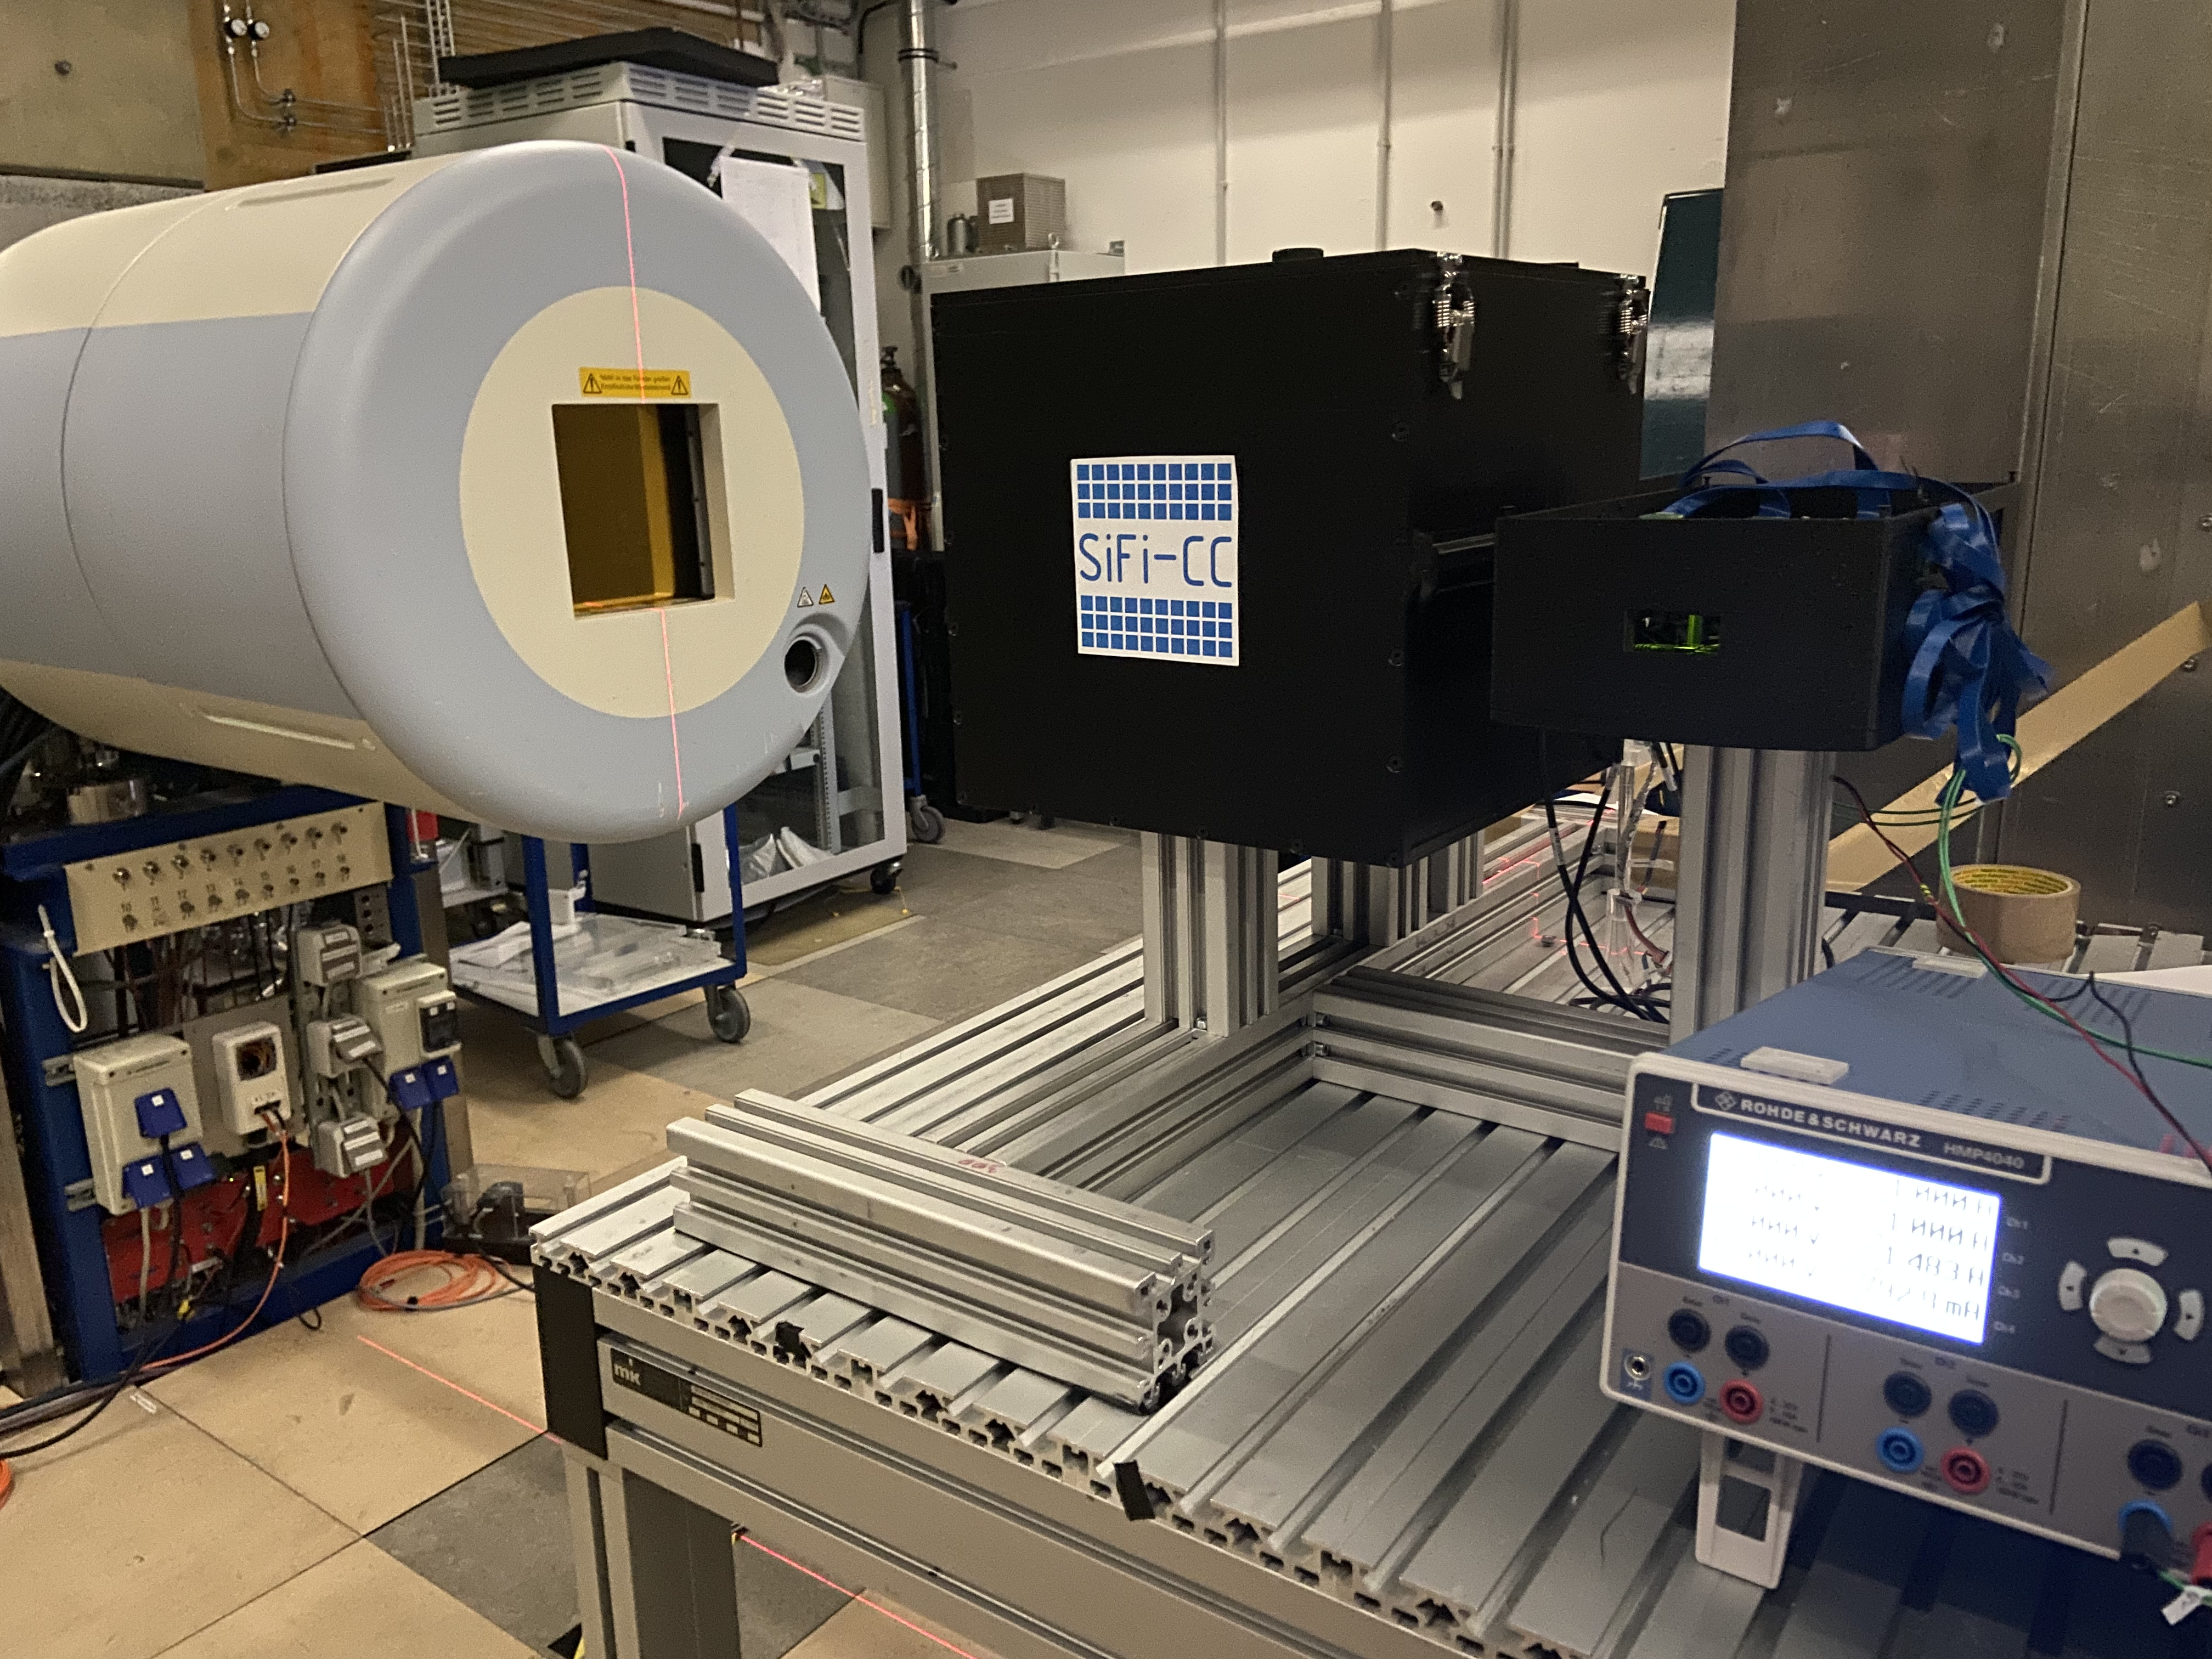
What's next with SiFi-CC?
Scatterer reassembly
Tests with a proton beam in the CC mode
Tests with a proton beam in the coded mask mode
Construct absorber, full detector ready
Linn Mielke

Slide 24
Beam-activated tumour tracers
PG = a footprint of elemental composition
Are cancerous tissues significantly different from the healthy ones? NOT ALL
Can we selectively deliver a selected element to tumour?? YES (PET, BNCT)
Limitations:
Lack of toxicity
Absent in body
Selective delivery feasible
Stable, emits gamma only when excited by proton beam
Unique energy of discrete transitions, preferably 1.5-3 MeV
Short deexcitation time
Large cross section at Bragg peak, i.e. for small proton energies
Similar in concept (though inversed logic) to Magalhaes Martins, Sci. Rep. 11, 2021
Method proposed by several people about the same time (A. Stahl, G. Gazdowicz from SiFi-CC, also G. Cartechini from Trento Uni.)
Cai et al., Molecules 25, 2020 Maughan et al., Med. Phys. 24, 1997
https://agenda.infn.it/event/23656/contributions/120652/

Slide 25
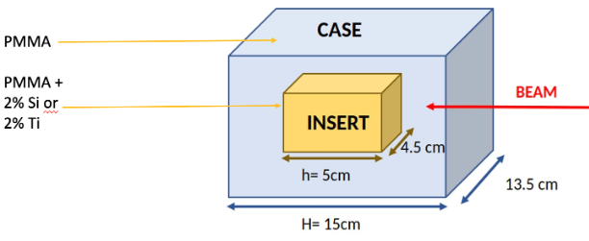
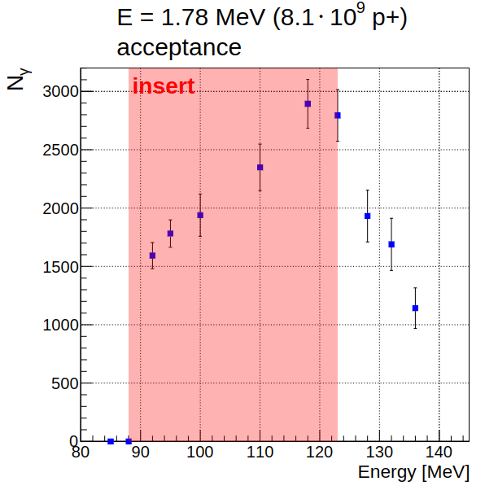
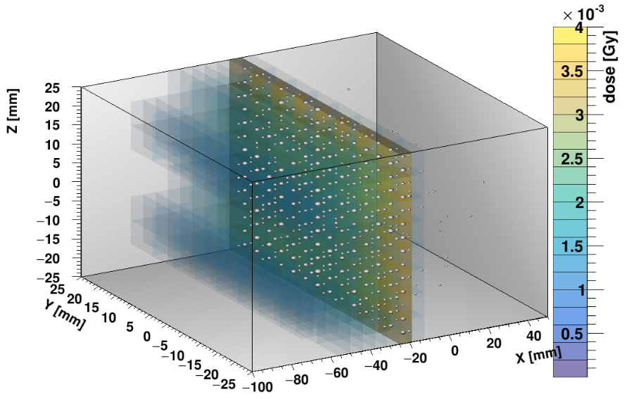
Search for tracers
A. Kaszlikowska, B.Sc., Jag Uni, 2021
B. Beus, B.Sc., RWTH Aachen, 2021
TALYS
Promising σ(E) dependence: Mg, Ca, Si
Simulations to assess signal significance
How to selectively deliver to tumour? Nanoparticles! Biology: a group of M. Parlińska from INP PAS in Kraków
Initial results:
2% mass concentration feasible for Si and Ti (MTS tests)
Signal appears for a proximal layer when BP contained in the tumour
Signal drops when BP moves downstream of tumour
Results of cell-culture studies encouraging
B. Kołodziej, M.Sc., Jag Uni, 2022
Paper under review in Int. J. Radiat. Oncol. Biol. Phys.

Slide 26
Summary
PG radiation is a hot topic in medical physics
Within the γCCB and SiFi-CC projects:
We characterized in detail the PG emission in PT
We validated the simulation tools (GEANT4, TALYS)
We are building a dual-modality SiFi-CC setup for beam range monitoring in PT
We are testing a method of tumour tracers activated by a proton beam
Educational aspects: work done mainly by students and PhD students.
Example of an intenese (though informal) Polish-German collaboration, with a Georgian support.

Slide 27
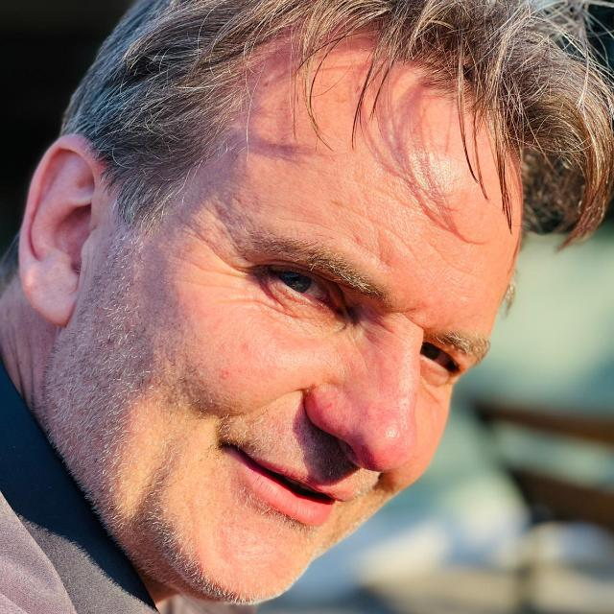
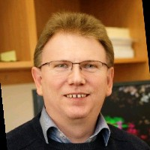
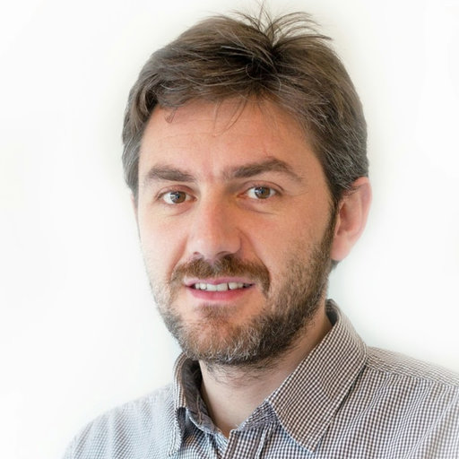
About bridges...

Slide 28
Back-up slides

Slide 29
Rate capability at HIT
Detector operable in clinical conditions
Intensity scan: no saturation observed within uncertainty
Rate per channel at max. Beam intensity: 31 kcps
DAQ limit: 480 kcps → detector operable also at cyclotron rates
Synchrotron proton beam structure
29

Slide 30
Other activities - simulations
Ronja Hetzel Jonas Kasper Linn Mielke
Monika Kercz
30

Slide 31
Other activities – event classification
Awal Awal Alexander Fenger Philippe Clement
31

Slide 32
Other activities – image reconstruction
Magdalena Rafecas Nadia Kohlhase Andreas Bolke Jorge Roser Vitalii Urbanevych (CM)
LM-MLEM with four-dimensional image space (energy-space). Takes into account polychromatic PG spectrum and unknown E0
Statistical iterative algorithm: model for detector response (i.e. System Matrix, sensitivity) is essential (Muñoz et al., 2020, PMB)
Number of iterations: 20 (+ median filter after final iteration)
The spectral part of all obtained 4D images exhibit an accumulation around 4.44 MeV The shifts extracted from the images are mostly consistent with the 5 mm nominal values
32

Slide 33
Variability
Parameter similar to attenuation length of scintillating light, but more straightforward – shows by how much annihilation peak shifted throughout the position scan along the fiber. Determined for left and right side separately, but usually both values consistent.
p₀ – value of attenuation function at 0 mm p₁₀₀ – value of attenuation function at 100 mm
Scatterer preliminary data
Best achieved variability so far: 60-65% (single fiber samples 1.68 x 1.68 mm² and fiber stack 1.28 x 1.28 mm²)
This corresponded to position resolution ~20 mm!
Best achieved variability with 1.94 x 19.4 mm² single fiber sample: ~40 % (~30 mm position resolution)
33

