Slide 1
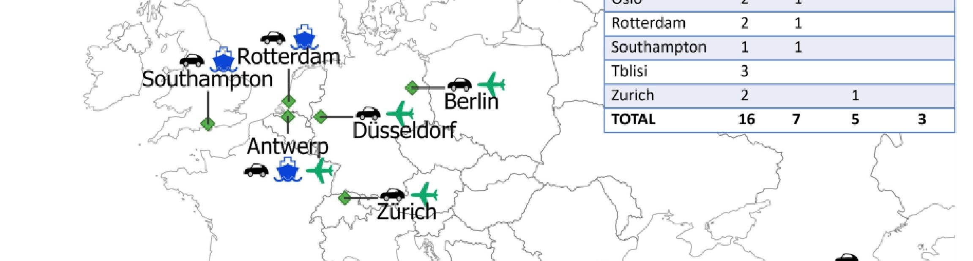
Air Quality in European Cities
The net4cities Project
2024/09/12 I ROBERT WEGENER

Slide 2
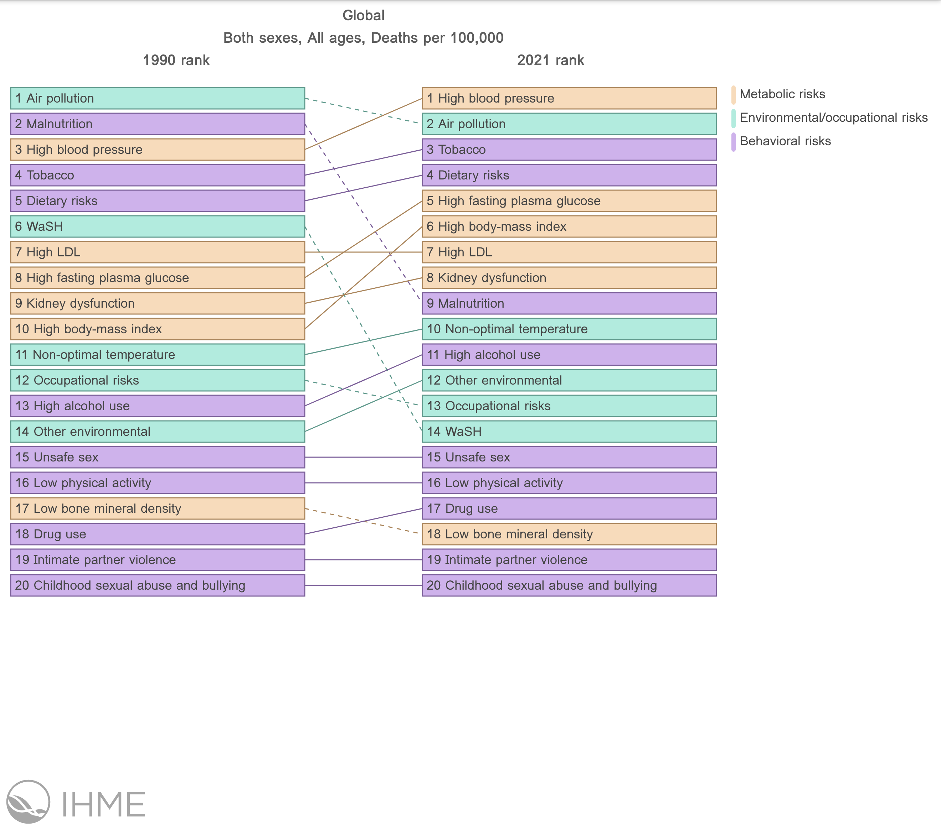
Is air quality still an important issue ?
Health Metrics and Evaluation (IHME)
On a global scale air pollution is the 2nd leading risk factor for death.
https://www.healthdata.org/

Slide 3
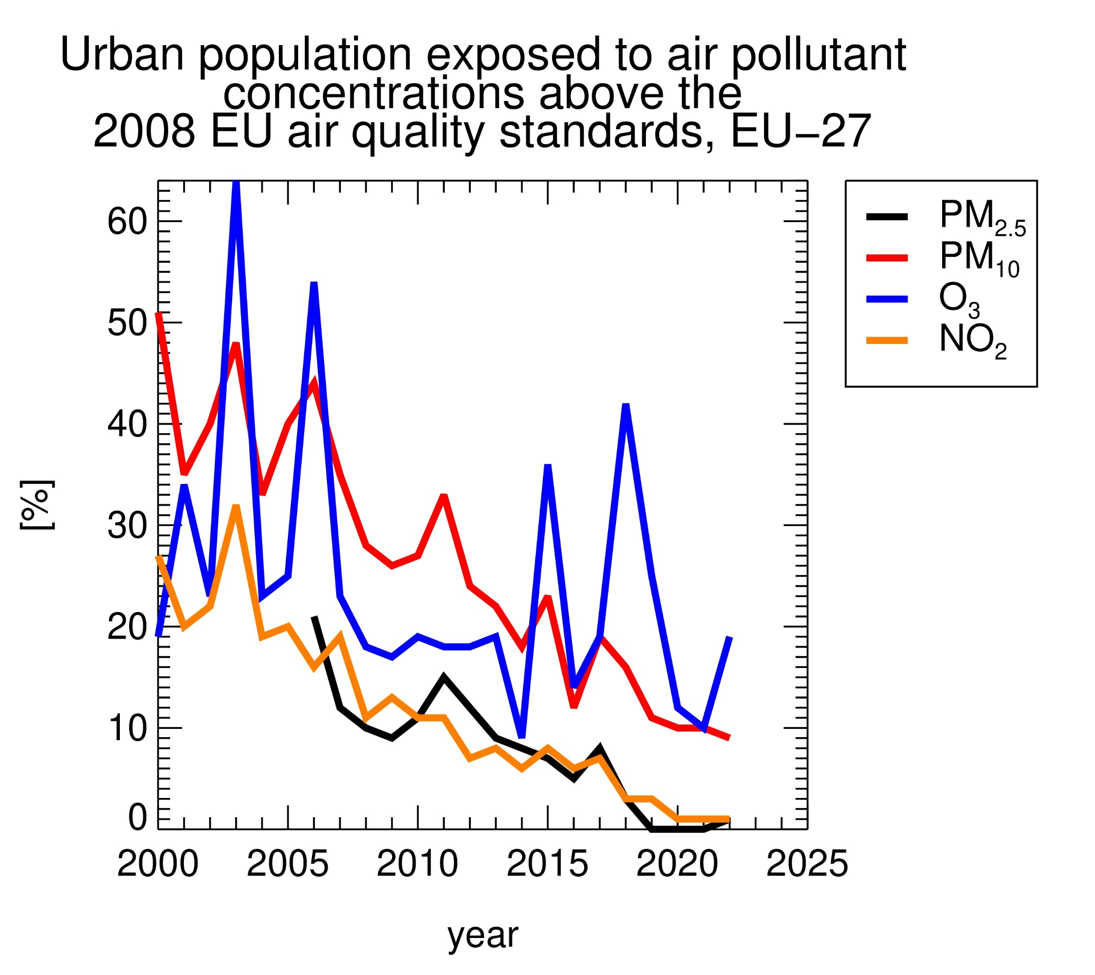
The European Air Quality Policy
A success story
In 2008 an EU defined an objective for ambient air quality.
In 2008 an EU defined an objective for ambient air quality.
There are more than 4.000 monitoring stations.
In 2008 an EU defined an objective for ambient air quality.
There are more than 4.000 monitoring stations.
The number of persons exposed to air pollutants at concentrations larger than the limit values have been drastically reduced.
In 2008 an EU defined an objective for ambient air quality.
There are more than 4.000 monitoring stations.
The number of persons exposed to air pollutants at concentrations larger than the limit values have been drastically reduced.
Still, 300,000 Europeans die prematurely due to air pollution.

Slide 4
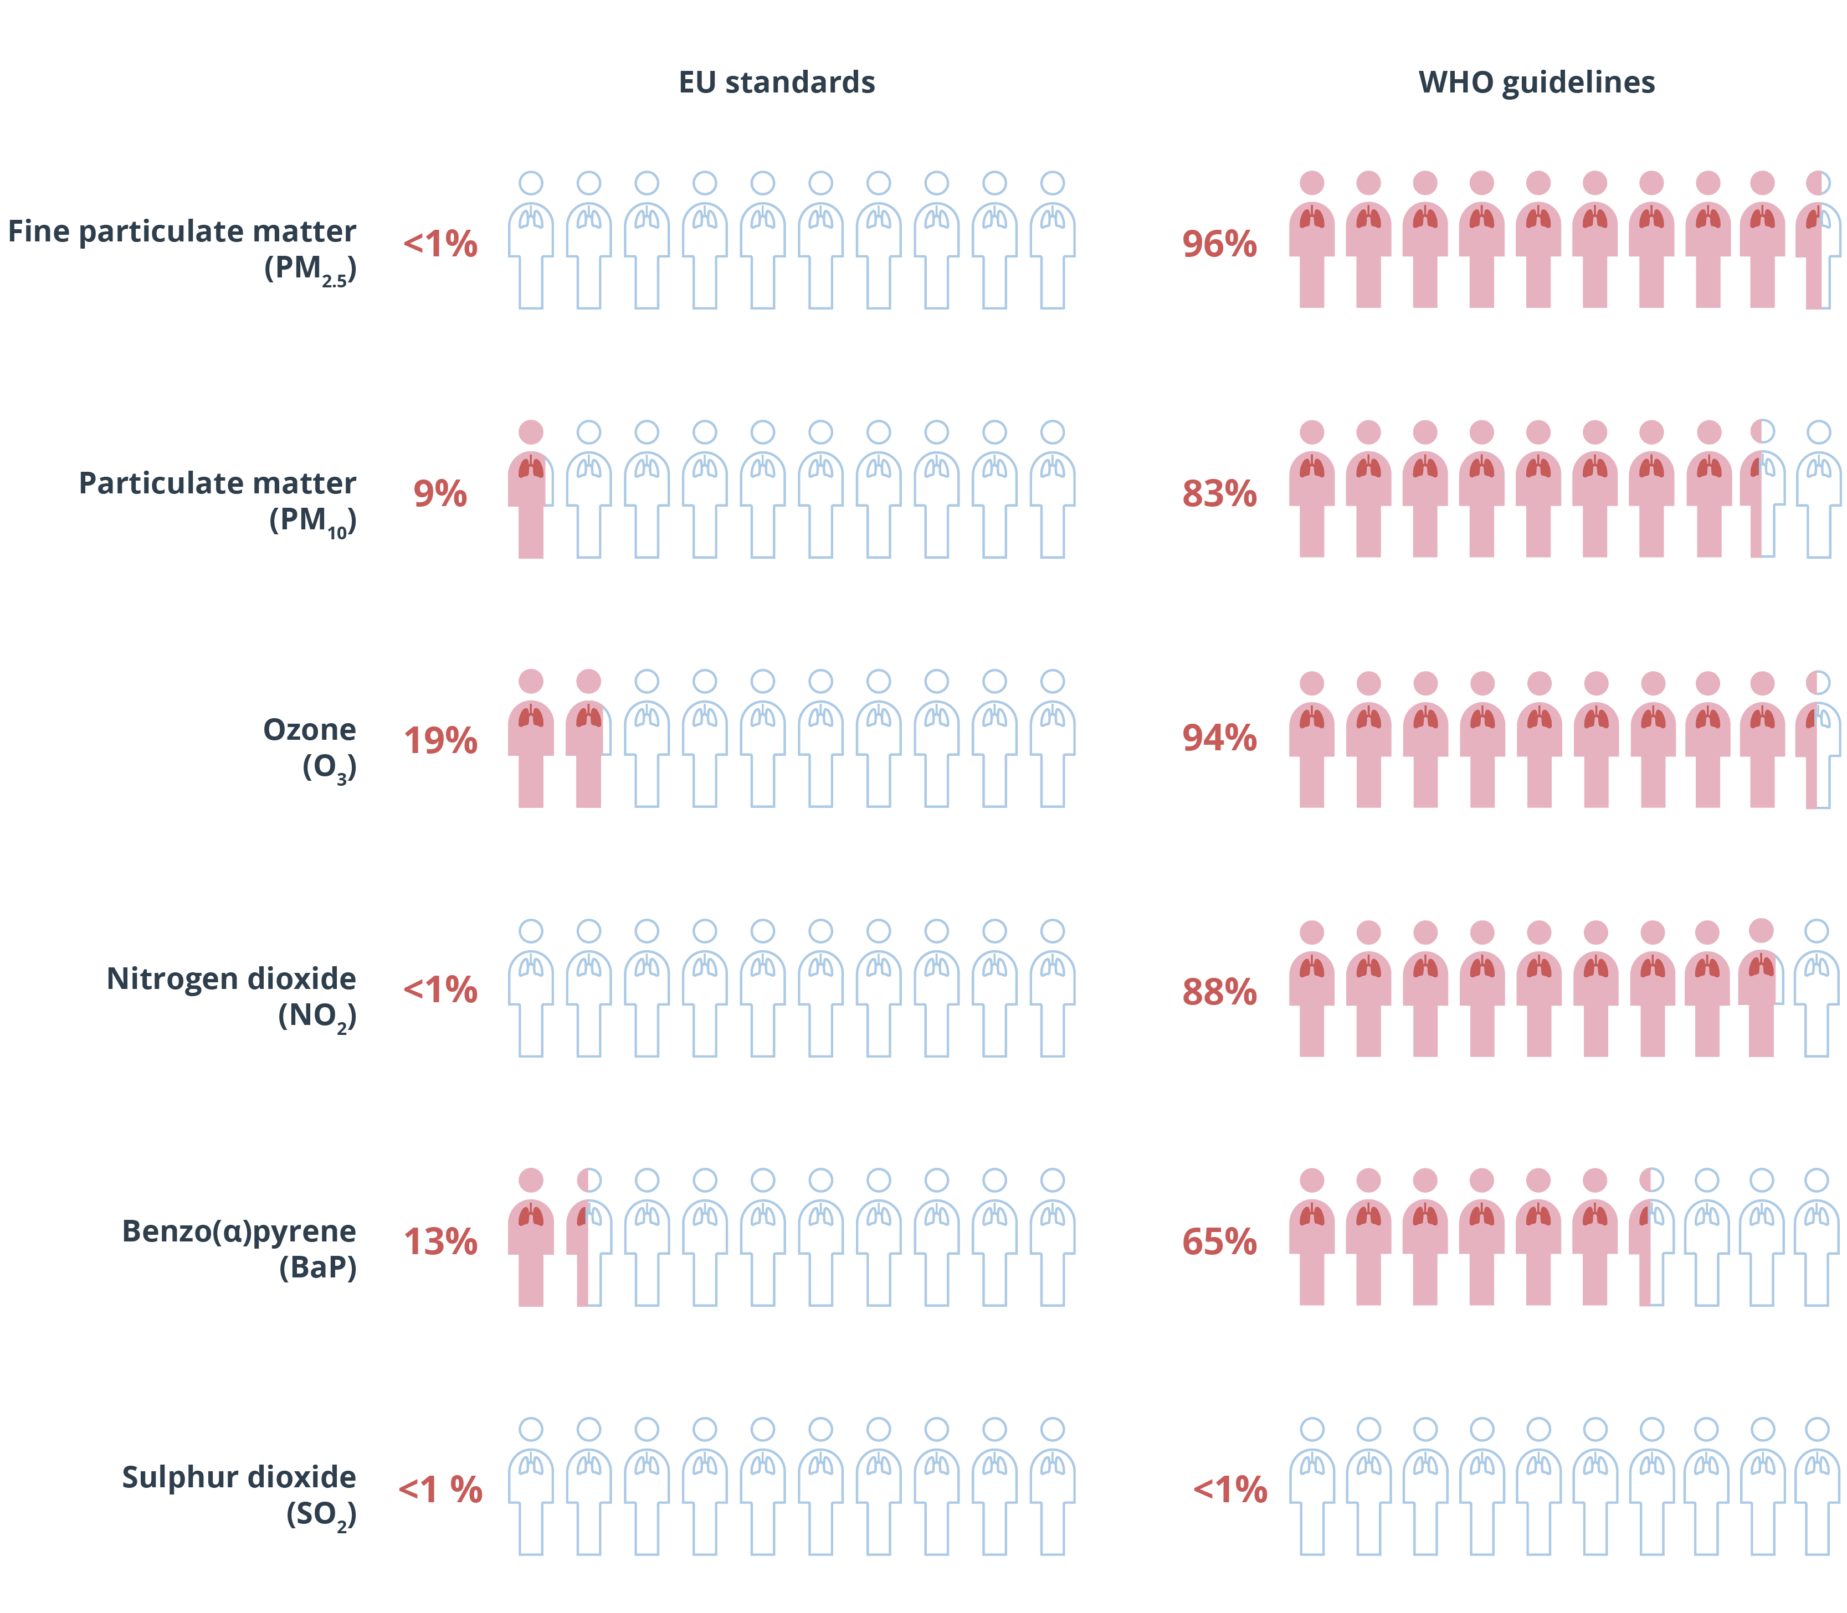
The European Air Quality
Are the limit values strict enough ?
Share of the EU urban population exposed to air pollutant above
2021: WHO published a new air quality guideline.
2021: WHO published a new air quality guideline.
adverse effect of pollutants below the limit values considered.
2021: WHO published a new air quality guideline.
adverse effect of pollutants below the limit values considered.
Most of the European populations still live under unhealthy conditions.
2021: WHO published a new air quality guideline,
adverse effect of pollutants below the limit values considered.
Most of the European populations still live under unhealthy conditions
EU Action Plan: Towards a Zero Pollution for Air, Water and Soil
https://www.eea.europa.eu/publications/europes-air-quality-status-2024

Slide 5
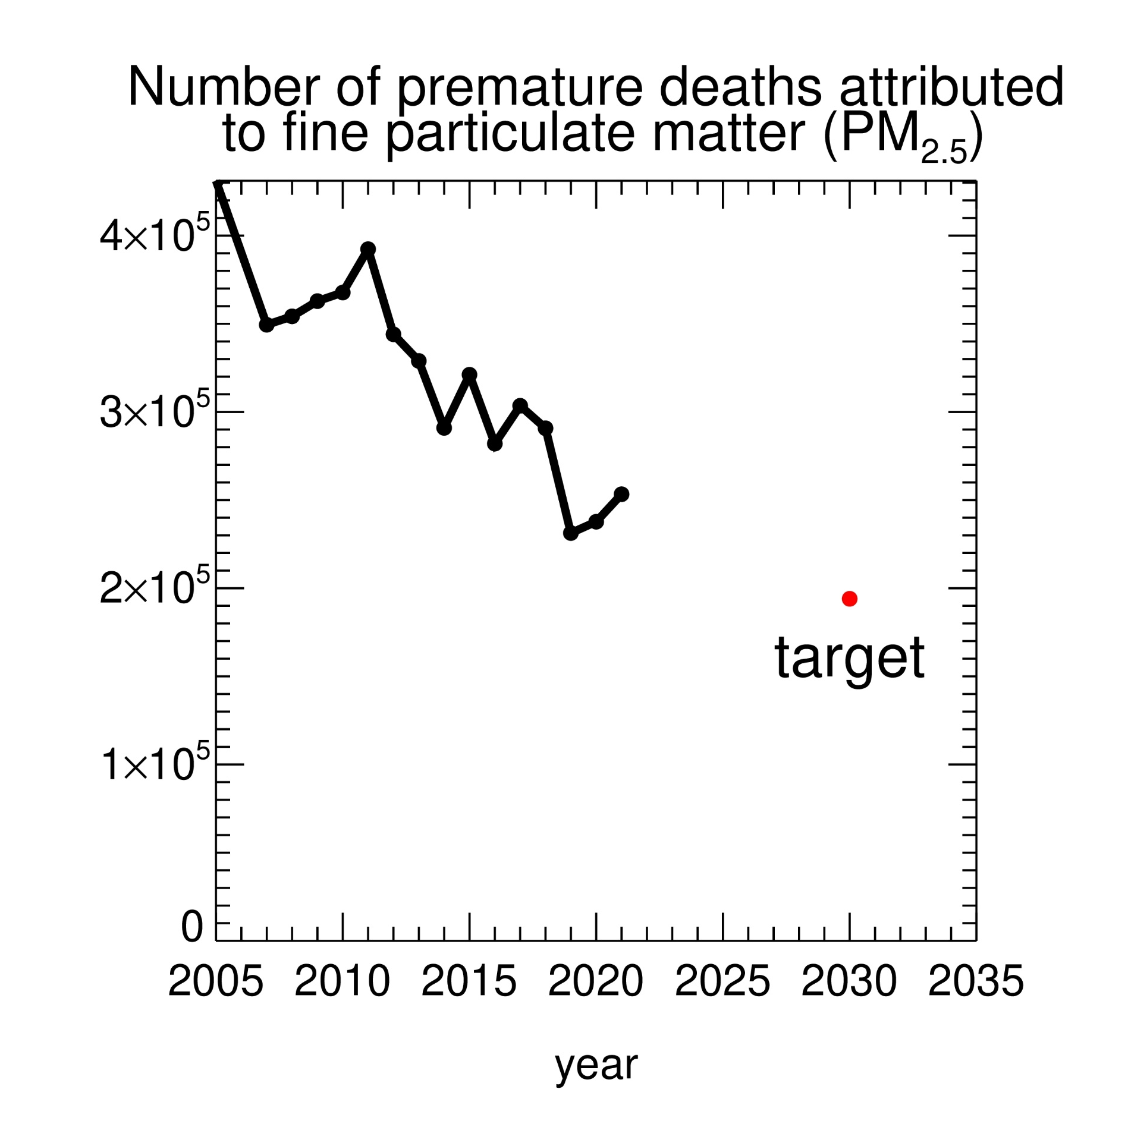
The European Air Quality Policy
The EU action plan
Reduce the number of premature deaths caused by air pollution by 55% before 2030.
Reduce the number of premature deaths caused by air pollution by 55% before 2030.
Stricter thresholds for pollution.
Reduce the number of premature deaths caused by air pollution by 55% before 2030.
Stricter thresholds for pollution.
Enhancing the right to clean air, improved access to justice.
Reduce the number of premature deaths caused by air pollution by 55% before 2030.
Stricter thresholds for pollution.
Enhancing the right to clean air, improved access to justice.
Monitoring pollutants of emerging concern

Slide 6
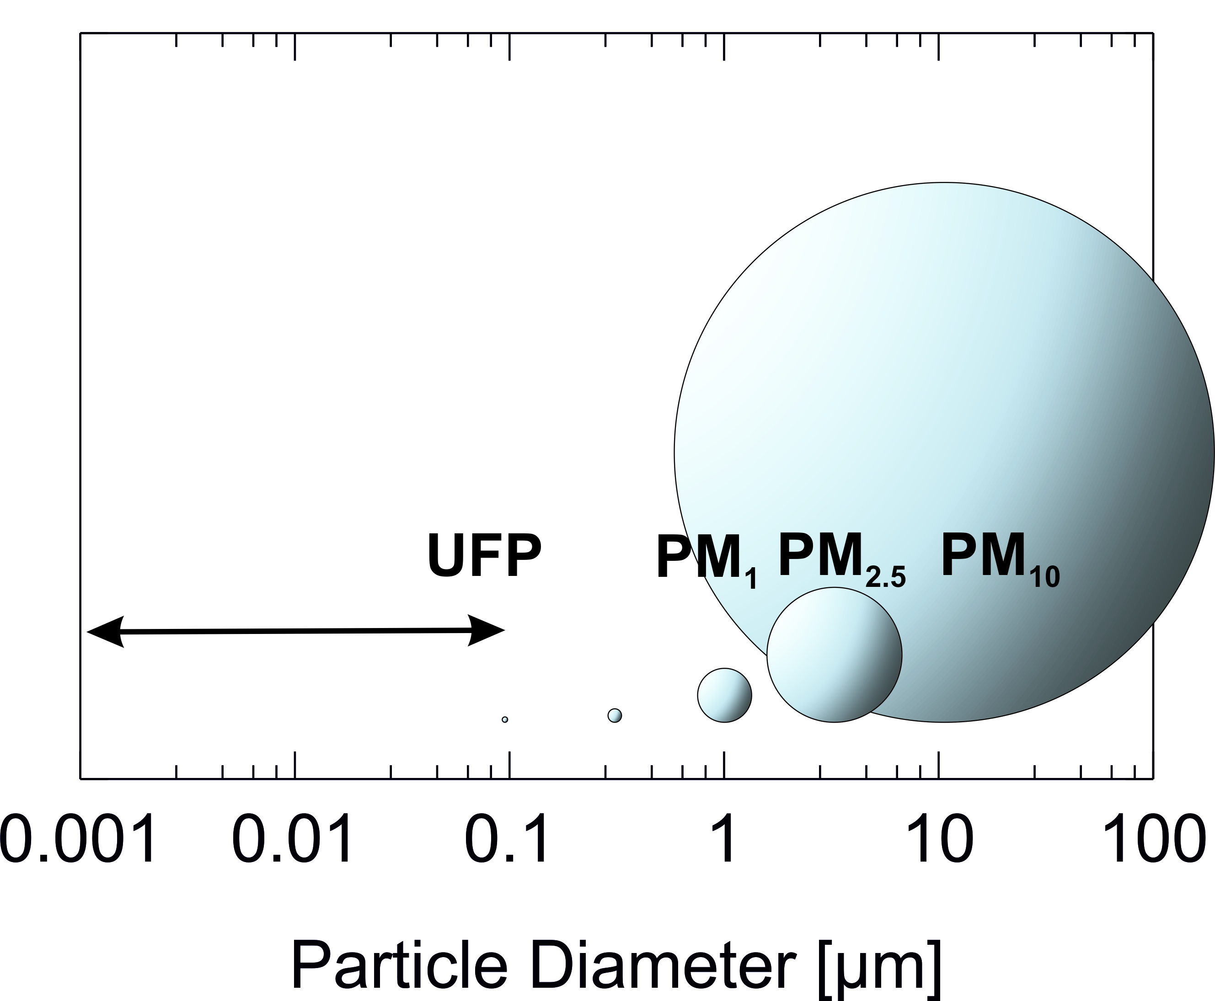
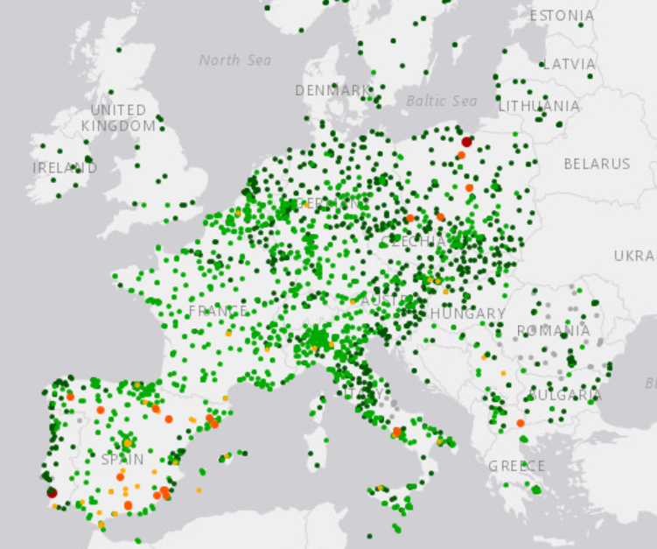
Pollutants of Emerging Concern
Ultrafine particles
Ultrafine Particles
At measuring points, particulate matter is recorded as PM₁₀ (particle mass < 10µm or PM_{2.5} (<2.5µm).
Ultrafine particles in the nanometre range are thus overlooked.
At measuring points, particulate matter is recorded as PM₁₀ (particle mass < 10µm or PM_{2.5} (<2.5µm).
At measuring points, particulate matter is recorded as PM₁₀ (particle mass < 10µm or PM_{2.5} (<2.5µm).
Ultrafine particles in the nanometre range are thus overlooked.
Ultrafine particles have different sources than heavier particles, but are more dangerous because they can penetrate deep into the lungs.
At measuring points, particulate matter is recorded as PM₁₀ (particle mass < 10µm or PM_{2.5} (<2.5µm).
Ultrafine particles in the nanometre range are thus overlooked.
Ultrafine particles have different sources than heavier particles, but are more dangerous because they can penetrate deep into the lungs.
While there are thousands of measuring stations for PM10 across Europe, only a handful of measuring stations measure ultra-fine dust.

Slide 7
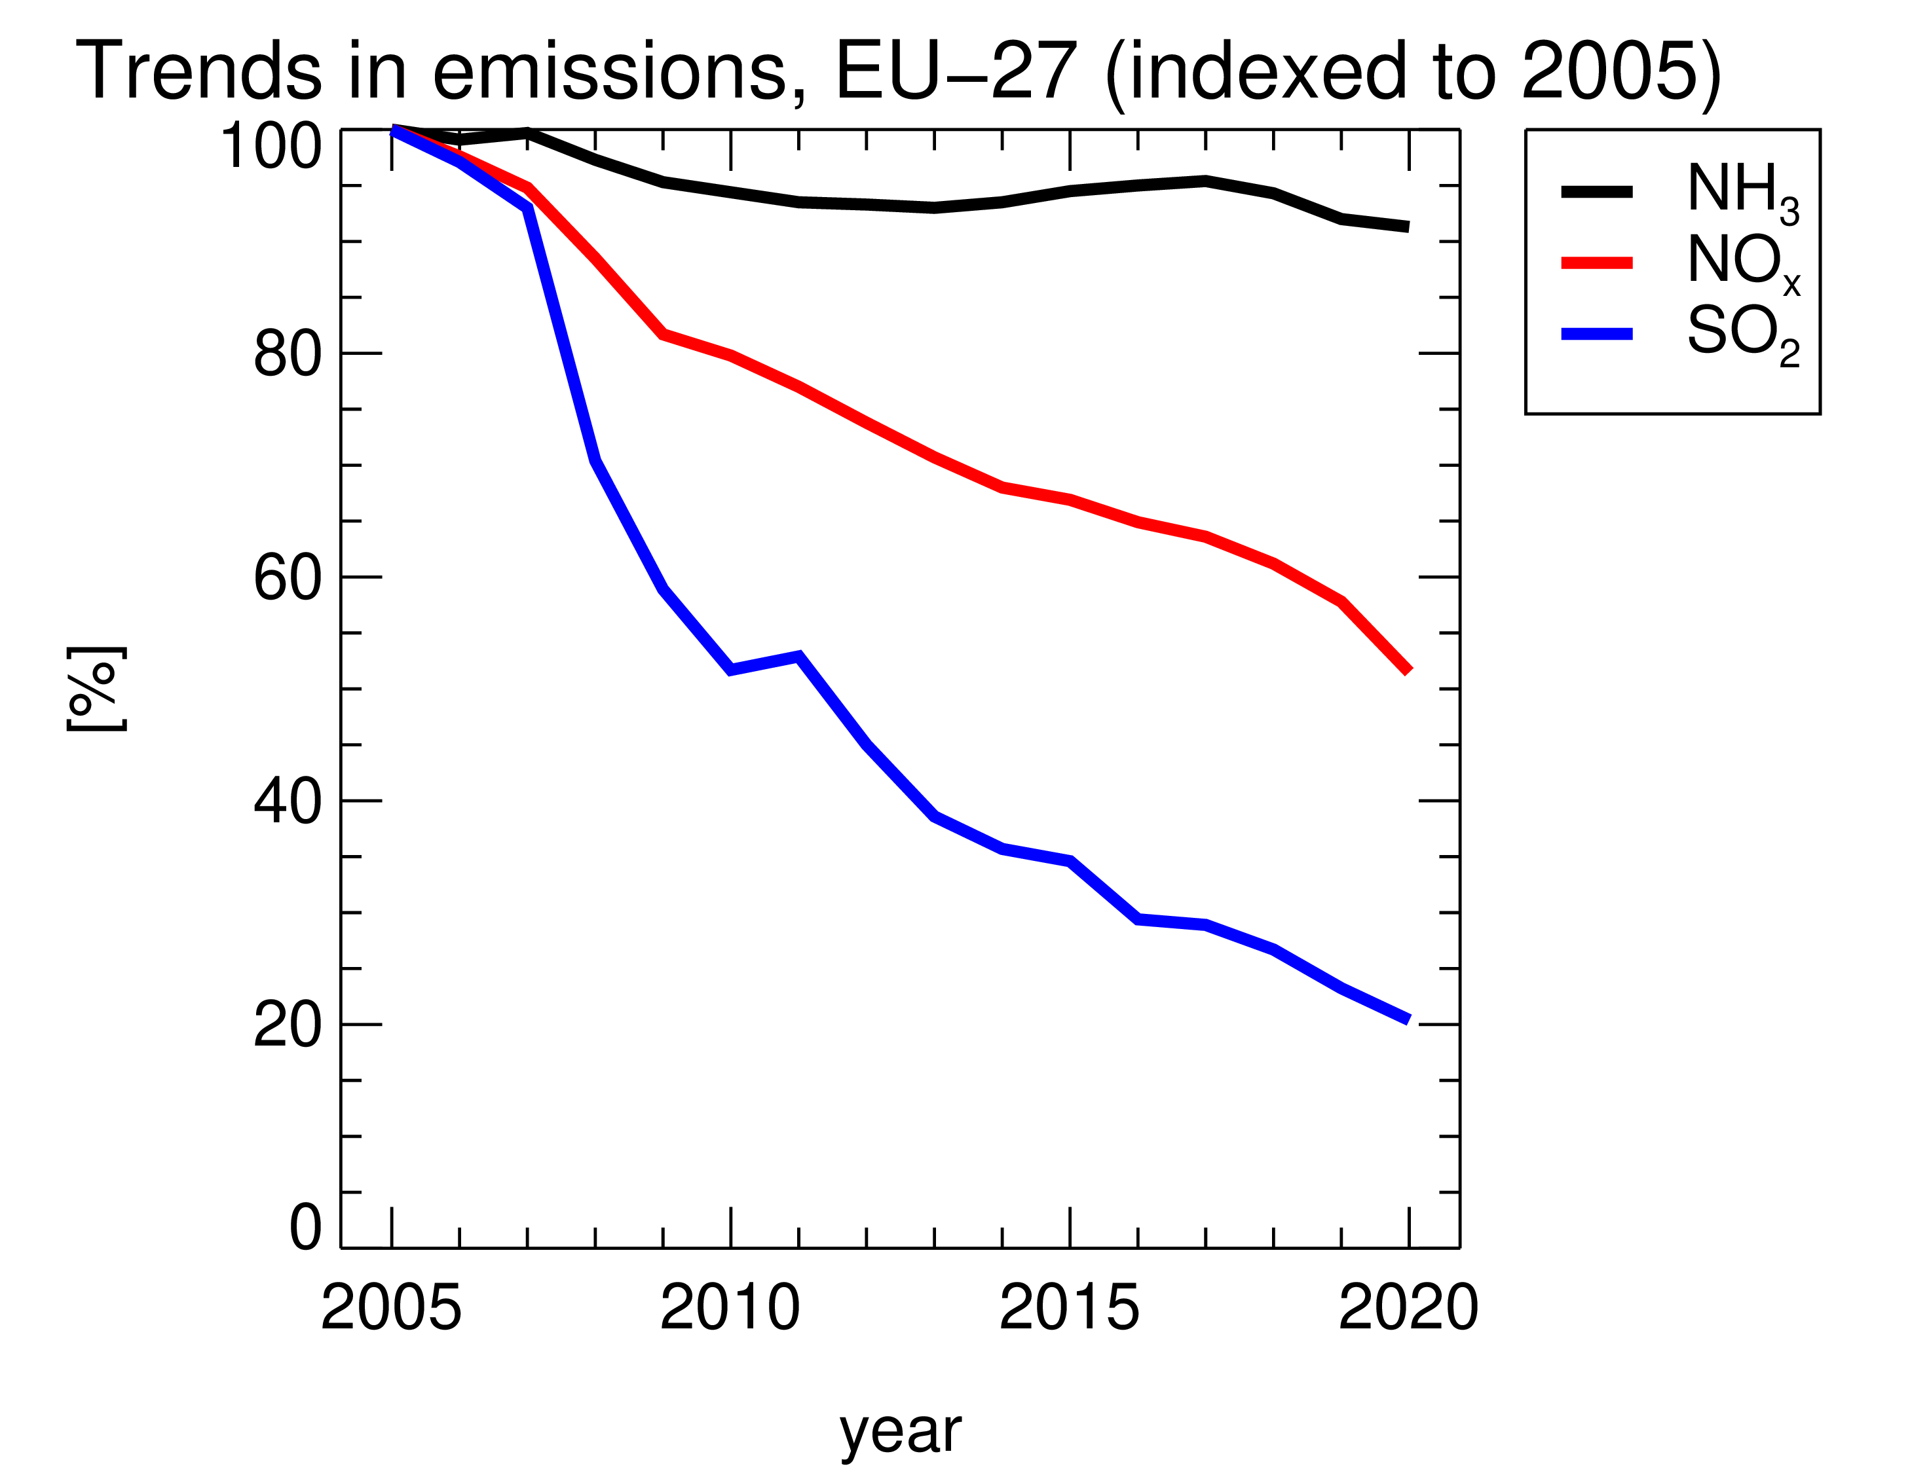
Pollutants of Emerging Concern
Ammonia
Successful measures to reduce emissions can push other pollutants into the foreground
The "classic" air pollutants are less emitted because of stricter limit values.
SO₂, the main cause of acid rain, was removed by flue gas desulphurisation units in power plants.
The "classic" air pollutants are less emitted because of stricter limit values.
The "classic" air pollutants are less emitted because of stricter limit values.
SO₂, the main cause of acid rain, was removed by flue gas desulphurisation units in power plants.
Nitrogen oxides, which mostly originate from traffic, have been reduced by catalytic converters in vehicles.
The "classic" air pollutants are less emitted because of stricter limit values.
SO₂, the main cause of acid rain, was removed by flue gas desulphurisation units in power plants.
Nitrogen oxides, which mostly originate from traffic, have been reduced by catalytic converters in vehicles.
Other compounds, such as ammonia, are hardly regulated at all.

Slide 8
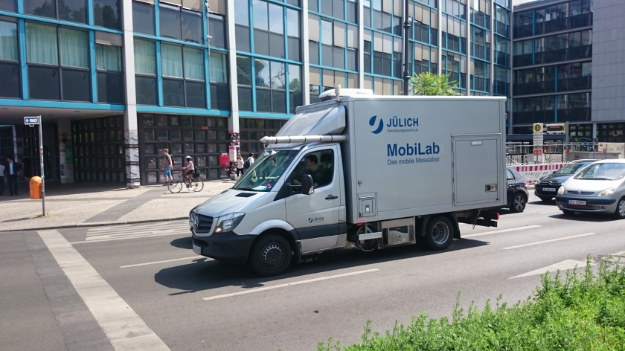
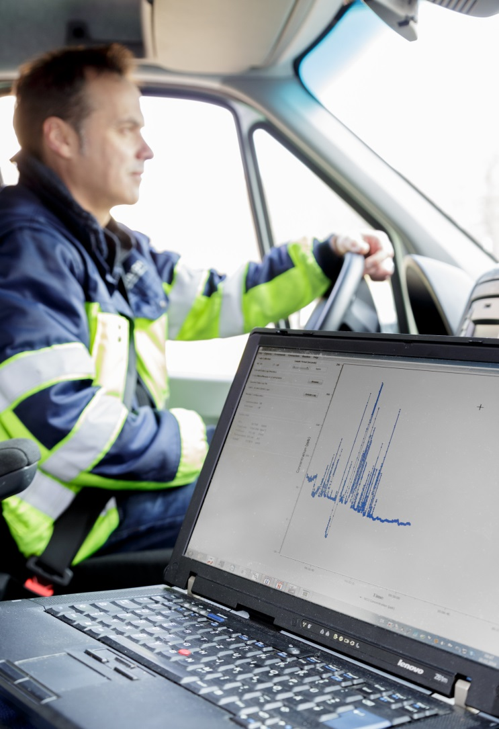
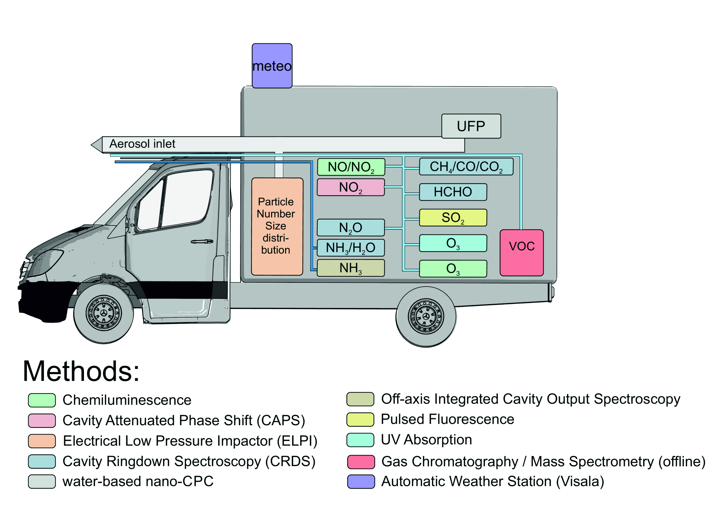
Pollutants of Emerging Concern
Monitoring
Mobile Air Quality Measurements can give insights into the emerging pollutants
In Jülich, we have equipped a van with mobile analytics.
Since we also take measurements while driving, we can create a map of the pollution levels.

Slide 9
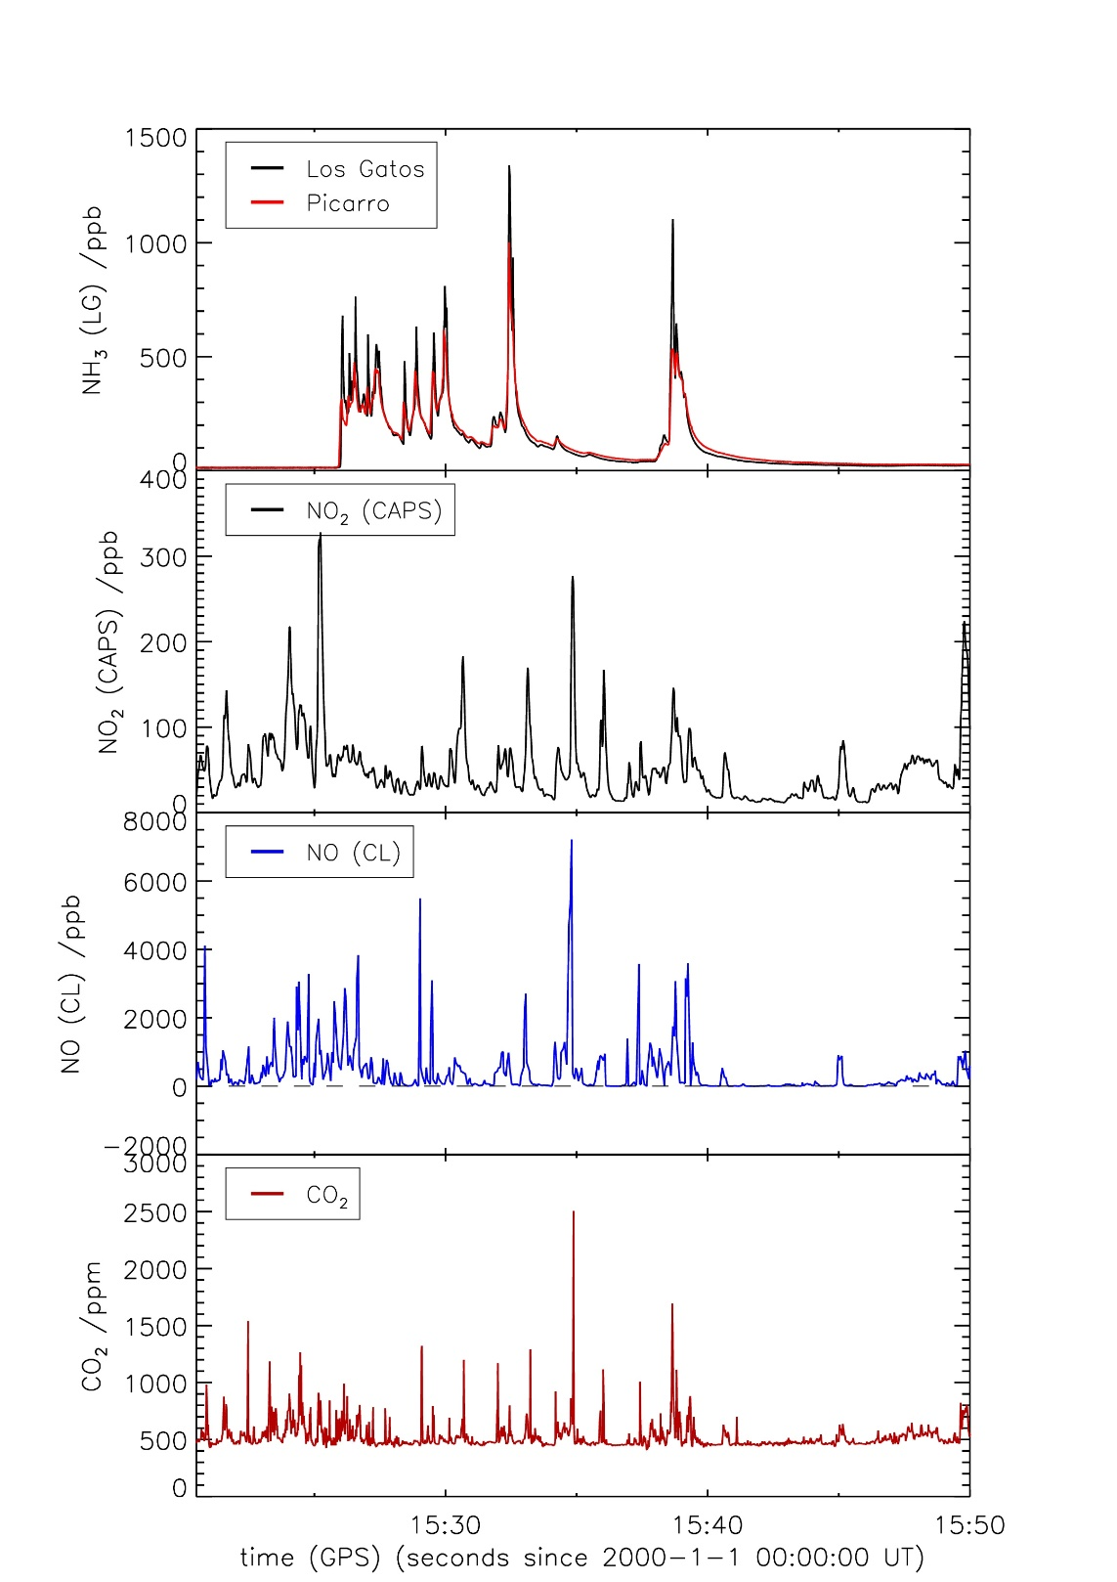
Pollutants of Emerging Concern
New sources of pollutants
Mobile Air Quality Measurements can give insights into the emerging pollutants
Modern EURO6 vehicles use urea to reduce nitrogen oxides.
If the production and consumption of ammonia are not exactly in balance, the vehicles emit ammonia instead of nitrogen oxides.
Modern EURO6 vehicles use urea to reduce nitrogen oxides.
Modern EURO6 vehicles use urea to reduce nitrogen oxides.
If the production and consumption of ammonia are not exactly in balance, the vehicles emit ammonia instead of nitrogen oxides.
During mobile measurements, we find concentrations that are up to 100 times higher than the background.
Modern EURO6 vehicles use urea to reduce nitrogen oxides.
If the production and consumption of ammonia are not exactly in balance, the vehicles emit ammonia instead of nitrogen oxides.
During mobile measurements, we find concentrations that are up to 100 times higher than the background.
More systematic monitoring of ammonia is needed.
CO(NH₂)₂ → NH₃ + HNCO
HNCO + H₂O → NH₃ + CO₂
2NH₃ + NO + NO₂ → 2N₂ + 3H₂O

Slide 10
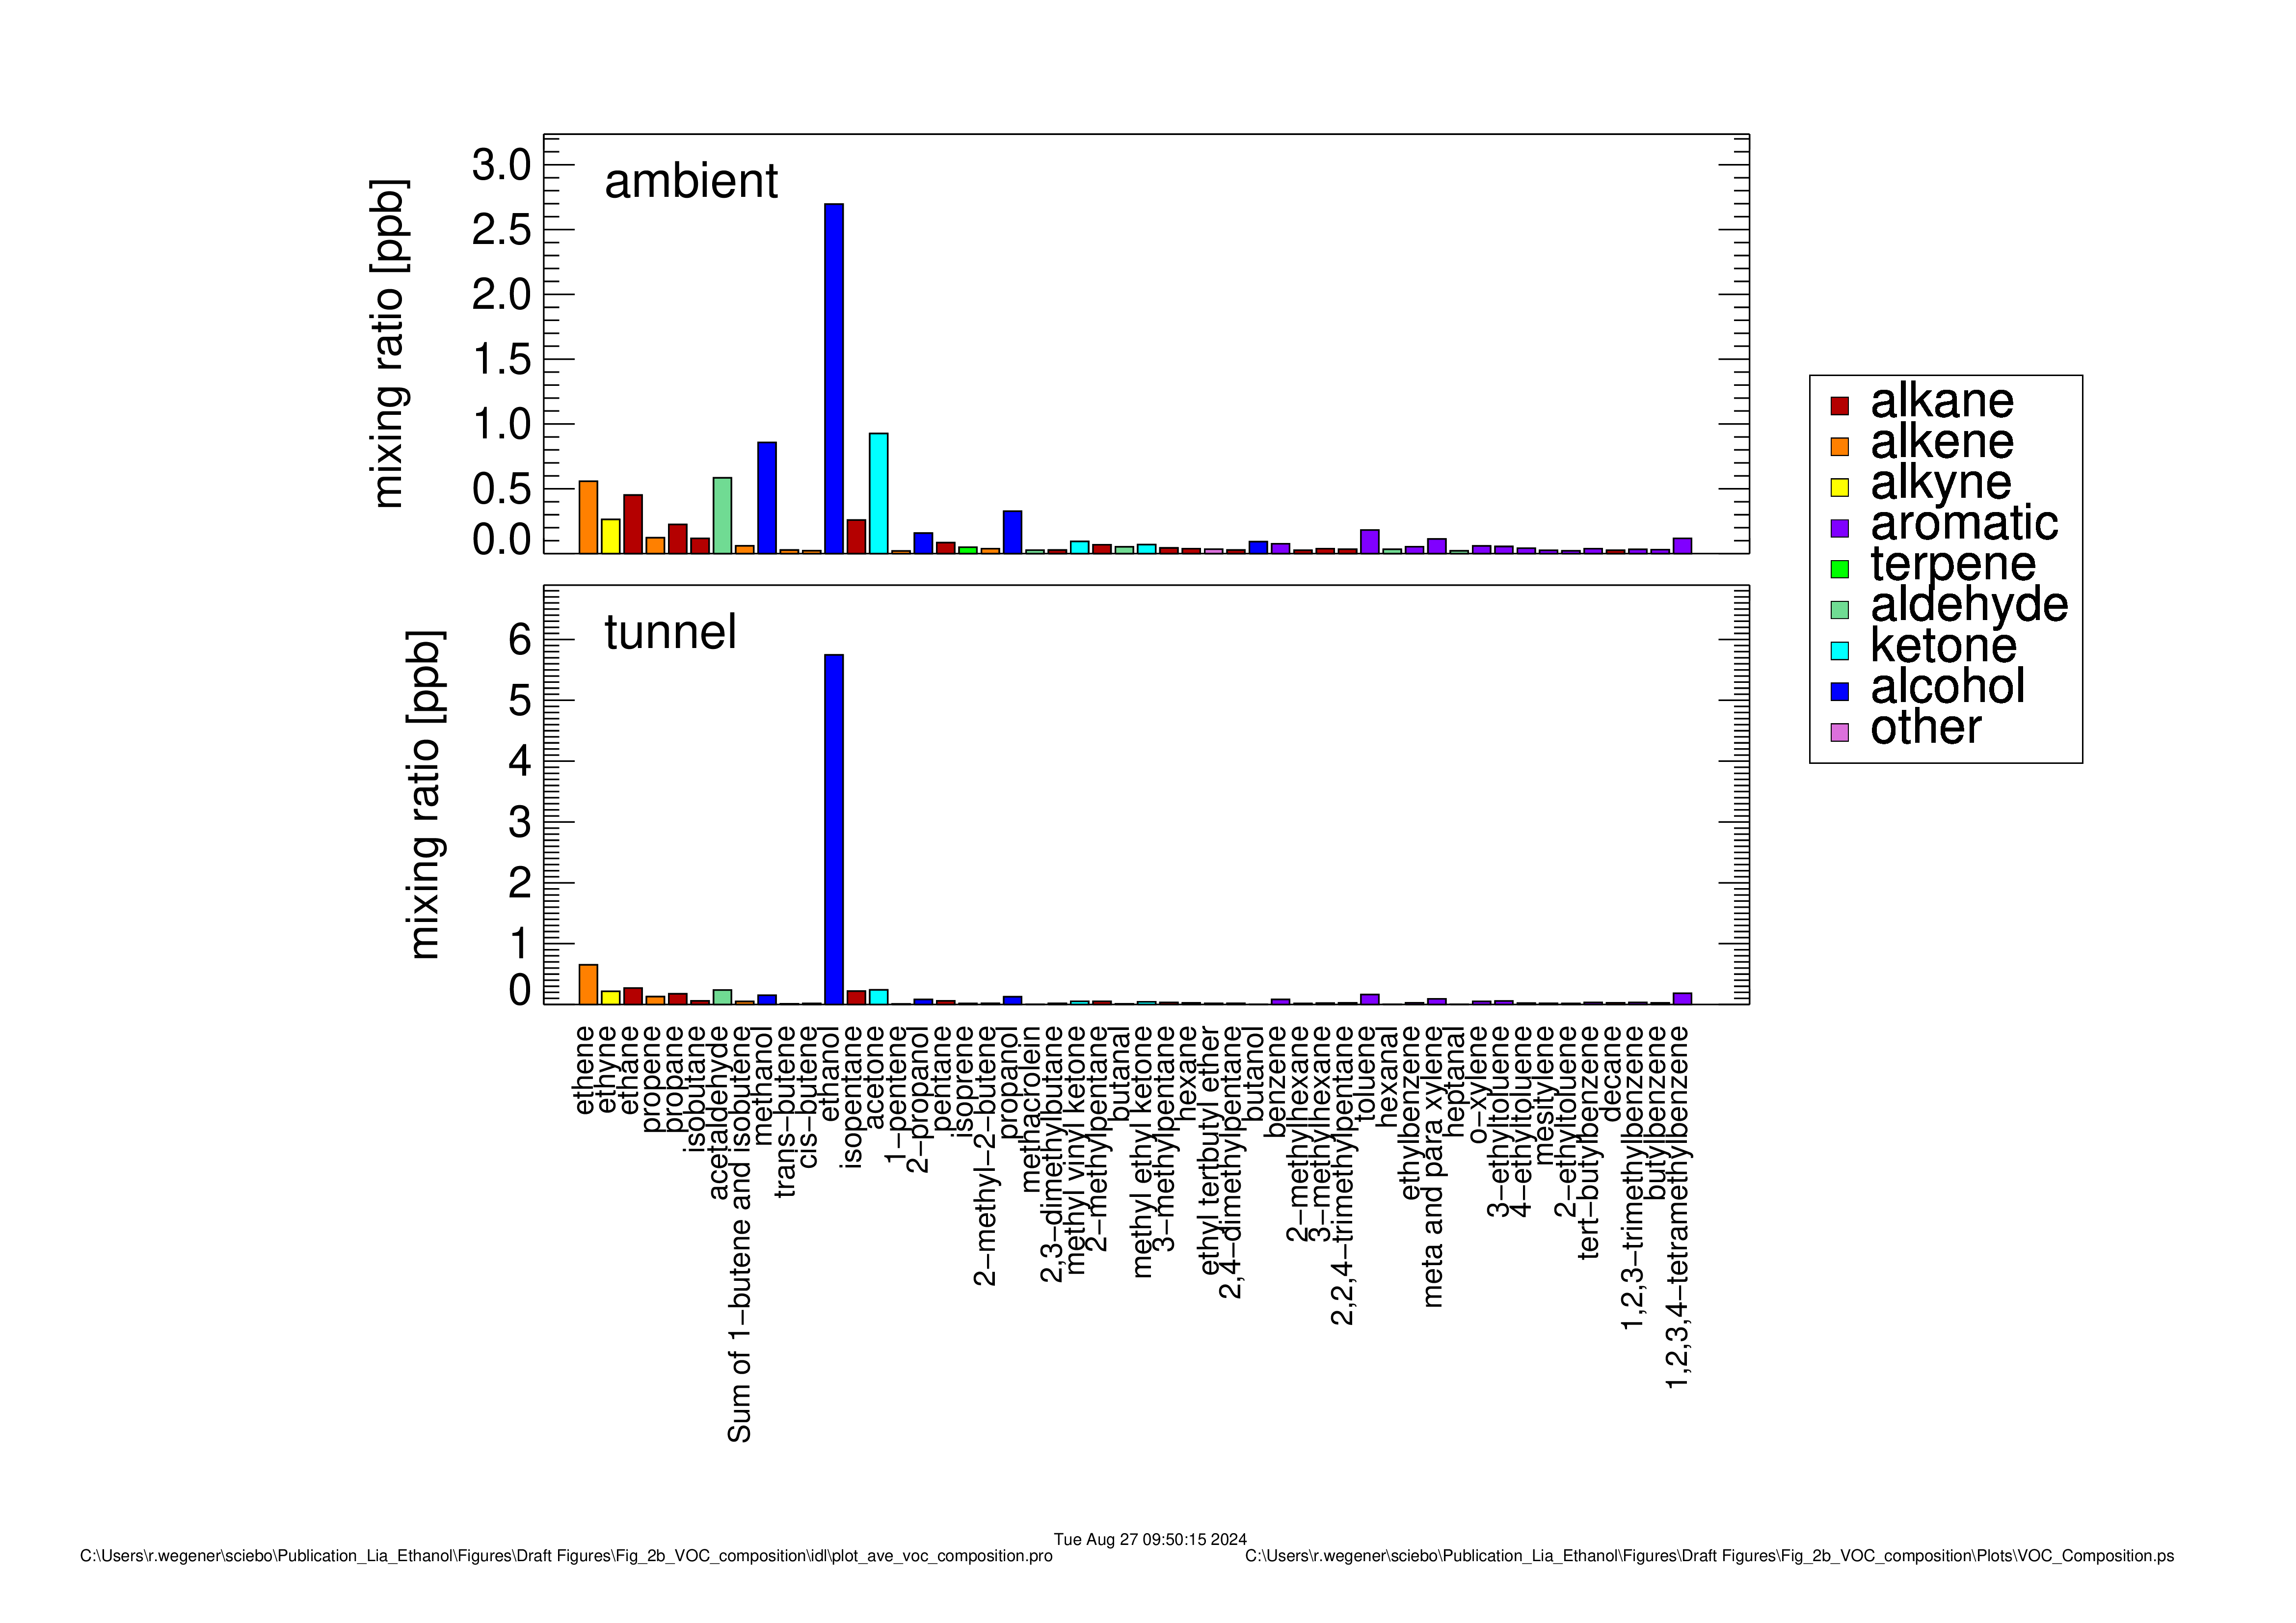
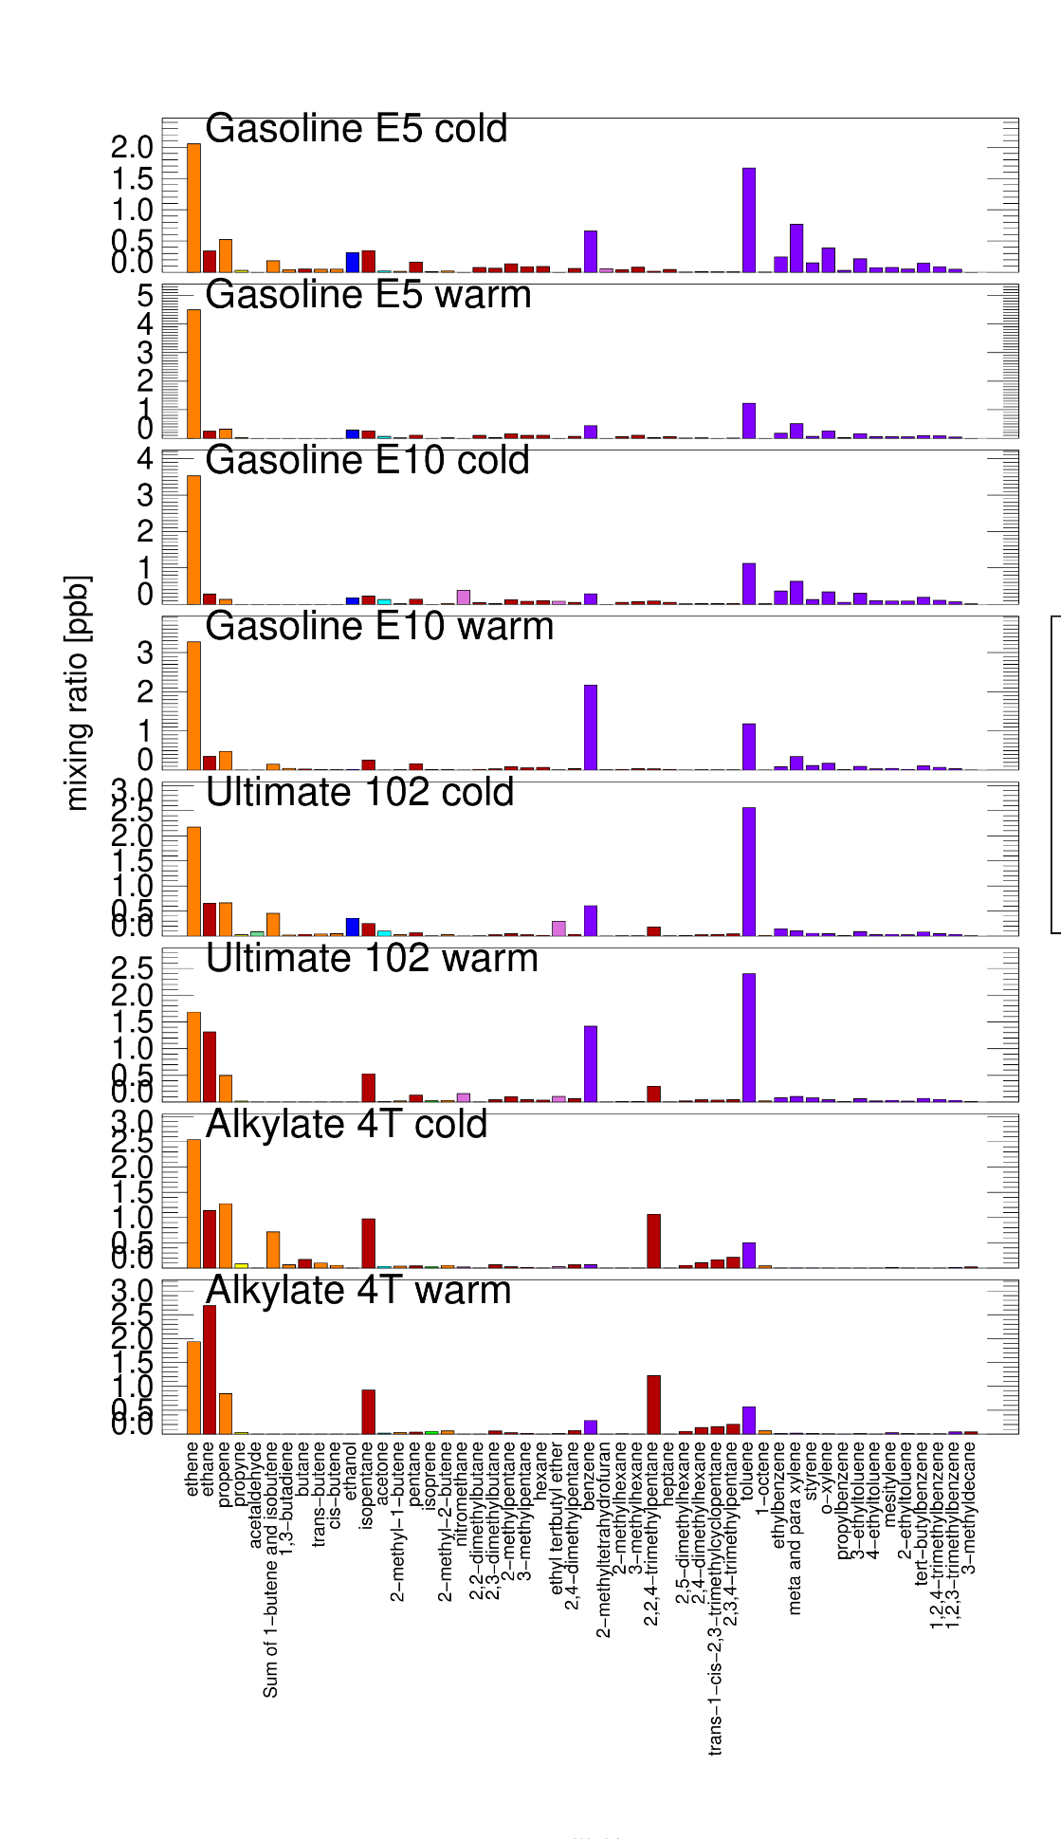
Pollutants of Emerging Concern
New sources of pollutants
Ínner city
Tailpipe emission
Also, the composition of volatile organic compounds have changed
In the past, volatile organic compound have mainly been emitted by vehicles.
This also has changed, as our mobile measurement show. Main component is ethanol, from windscreen washer fluid.
In the past, volatile organic compound have mainly been emitted by vehicles.
In the past, volatile organic compound have mainly been emitted by vehicles.
This also has changed, as our mobile measurement show. Main component is ethanol, from windscreen washer fluid.
The composition of VOC is important for understanding the ozone production.
In the past, volatile organic compound have mainly been emitted by vehicles.
This also has changed, as our mobile measurement show. Main component is ethanol, from windscreen washer fluid.
The composition of VOC is important for understanding the ozone production.
More long-term-measurements are needed
Work by Lia Karadurmus

Slide 11
Horizon Europe
NET4CITIES
Real-Time Monitoring Networks and Transport Emissions for Tailored Zero Pollution Action Plans in European Cities

Slide 12
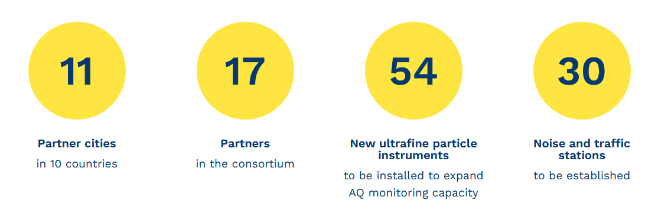
The net4cities project
air and noise pollution monitoring infrastructure will be advanced and expanded in 11 European cities, including transportation hubs such airports and ports.

Slide 13

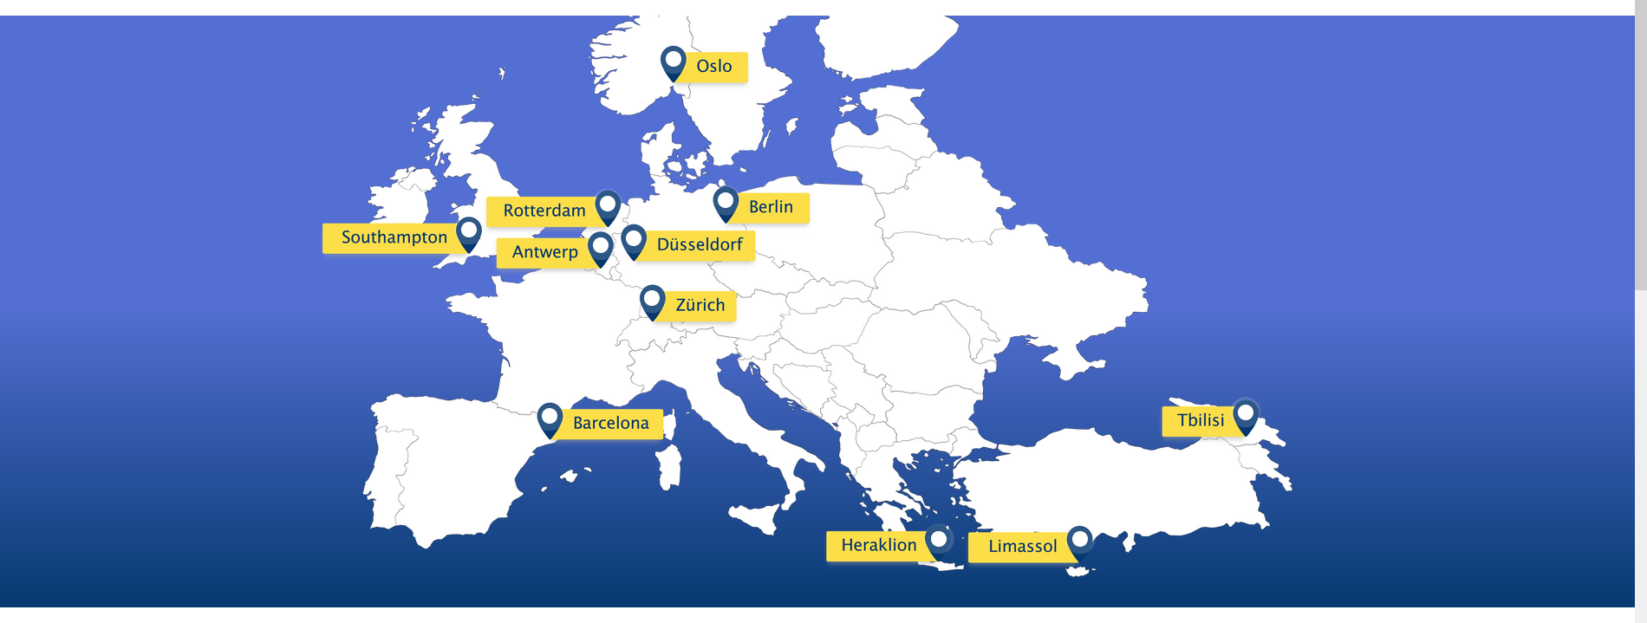
The net4cities project

Slide 14
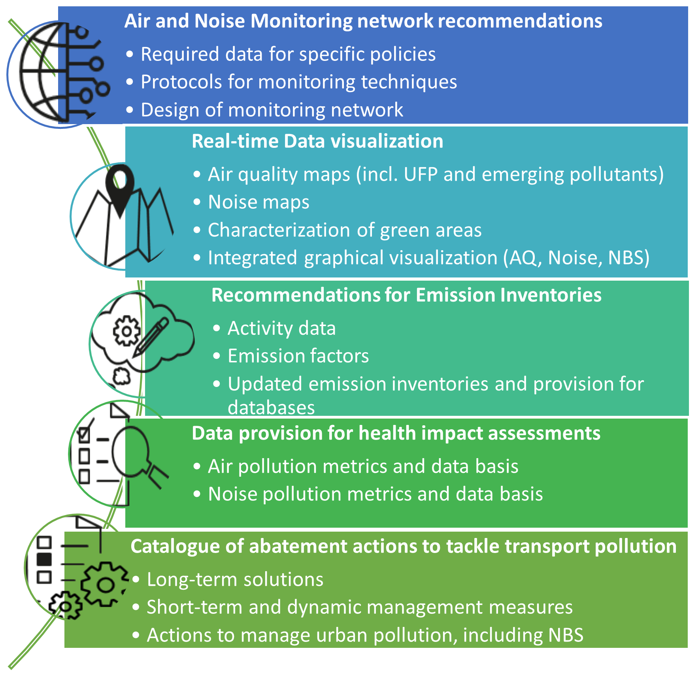
The net4cities project
Project Goals
Net4Cities will co-create evidence-based, tailored policy solutions for effective air and noise pollution reduction plans with the involvement of policy- and decision-makers.
Net4Cities will co-create evidence-based, tailored policy solutions for effective air and noise pollution reduction plans with the involvement of policy- and decision-makers.
Generate data on (emerging) pollutants and noise in cities from contrasting geographical and climatic locations with differing fleet compositions to support source apportionment (SA).
Net4Cities will co-create evidence-based, tailored policy solutions for effective air and noise pollution reduction plans with the involvement of policy- and decision-makers
Generate data on (emerging) pollutants and noise in cities from contrasting geographical and climatic locations with differing fleet compositions to support source apportionment (SA)
Real-time graphical visualization combining air quality, noise and NBS for all 11 partner cities

Slide 15
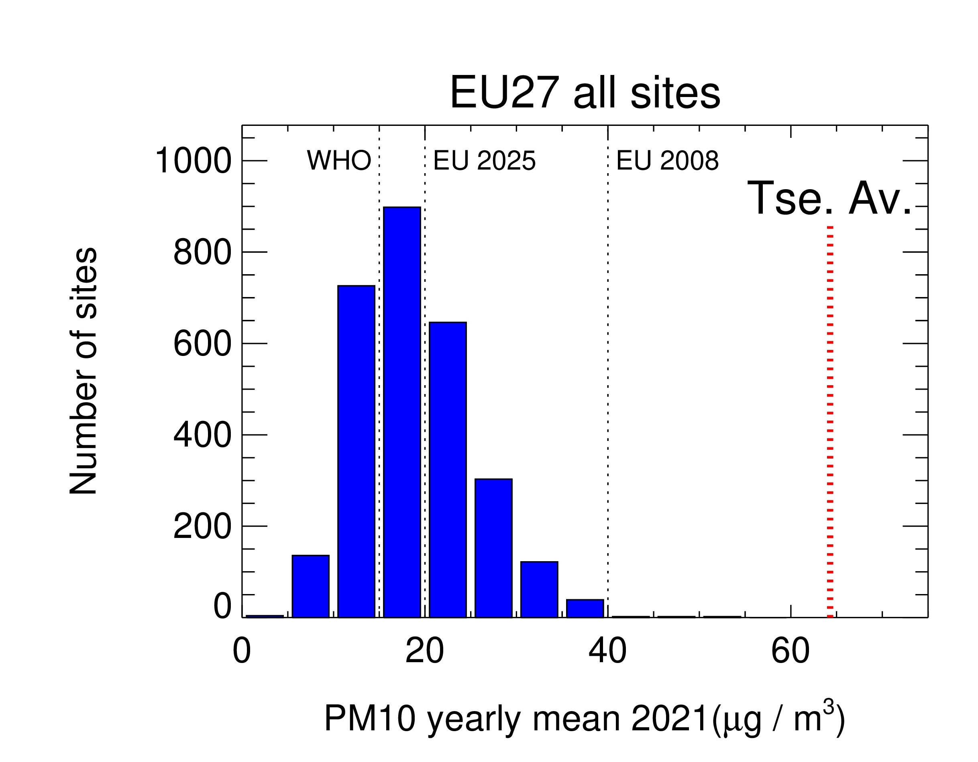
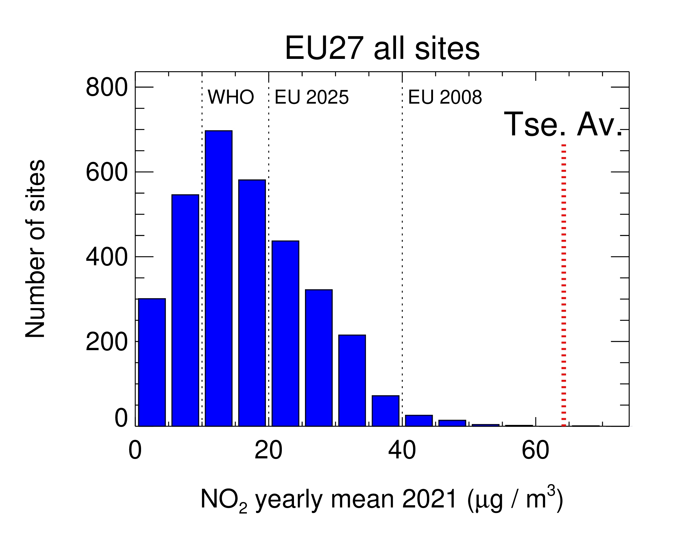
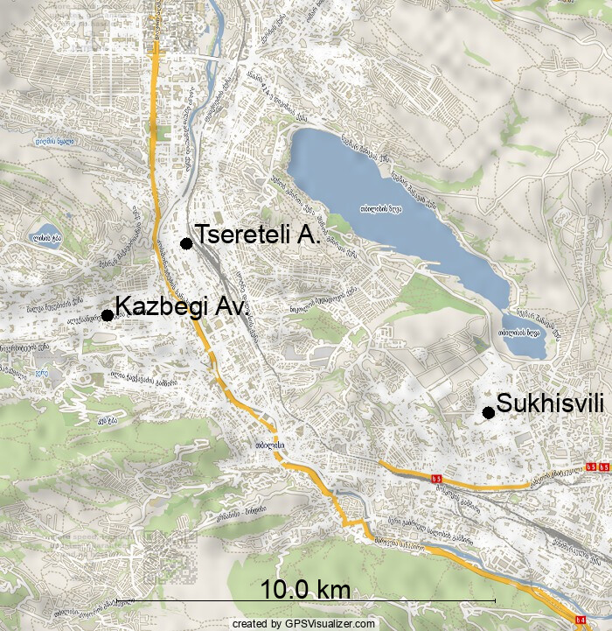
Installations in Tbilisi
Both PM₁₀ and NO₂ concentrations are higher than in the EU

Slide 16
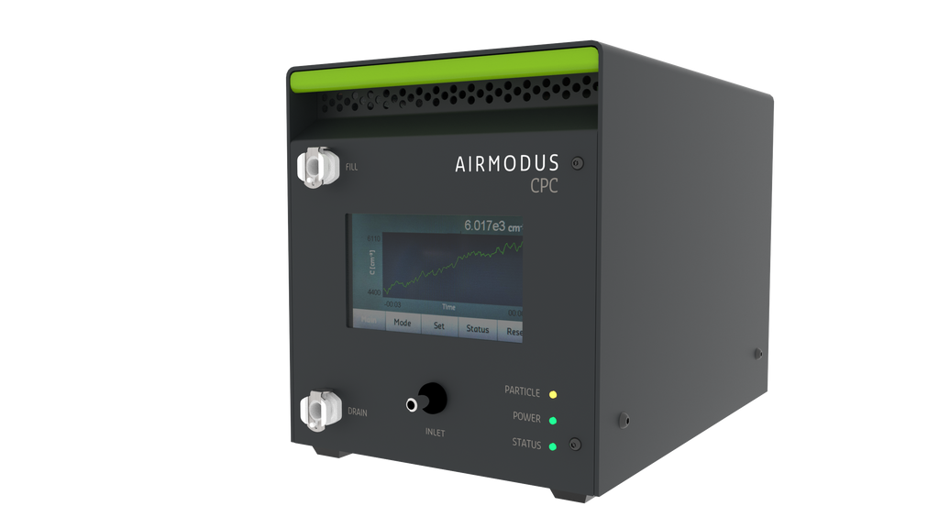
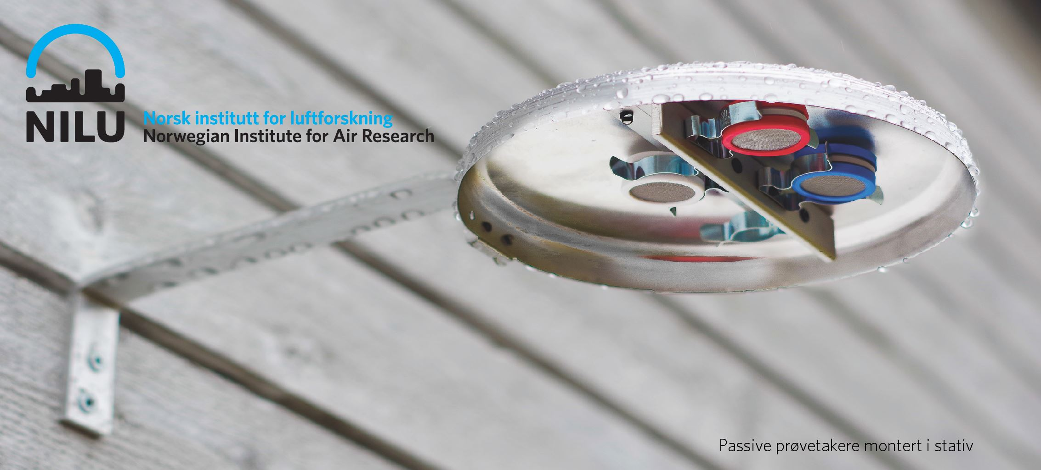
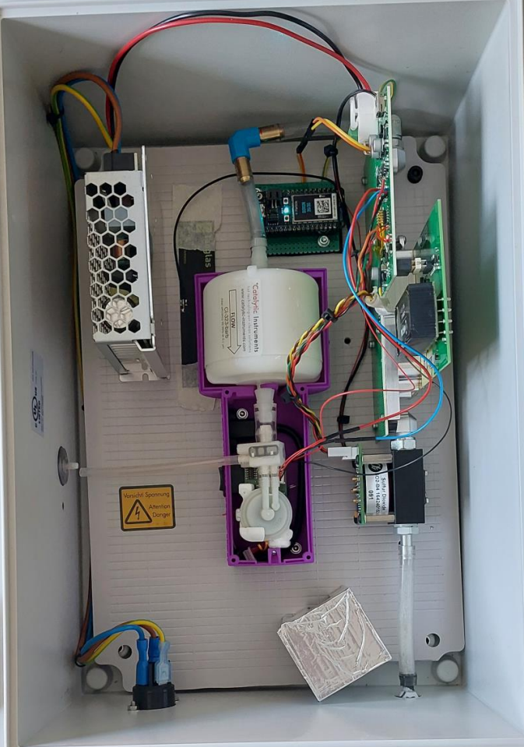
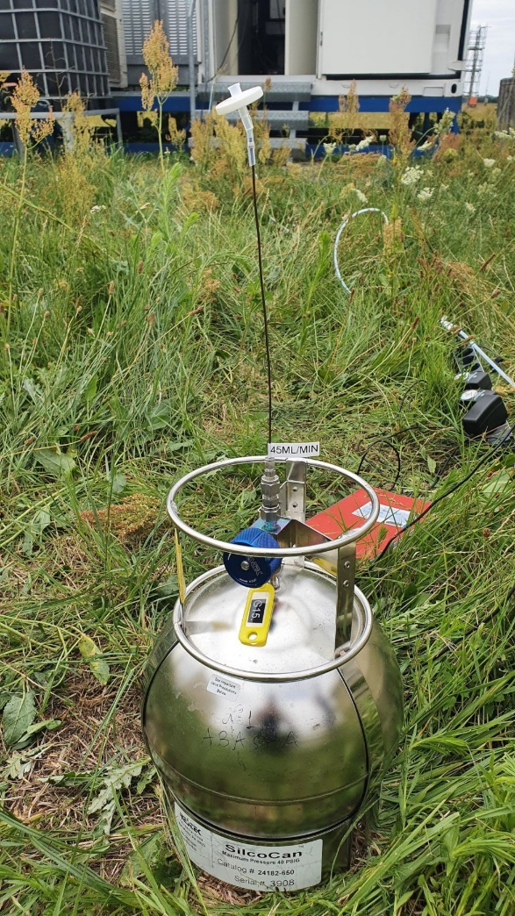
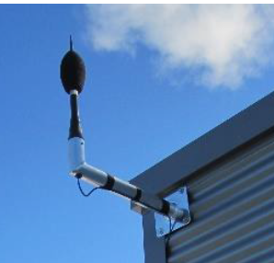
Installations in Tbilisi
Three ultra fine particle monitors
Three ultra fine particle monitors
Three LDSA monitors
Three ultra fine particle monitors
Three LDSA monitors
Three NH₃ samplers
Three ultra fine particle monitors
Three LDSA monitors
Three NH₃ samplers
Canister sampling
Three noise and traffic monitors
Three ultra fine particle monitors
Three LDSA monitors
Three NH₃ samplers
Canister sampling
Cooperation of TSU (AtmoSimLab) and National Environmental Agency nea.gov.ge

Slide 17
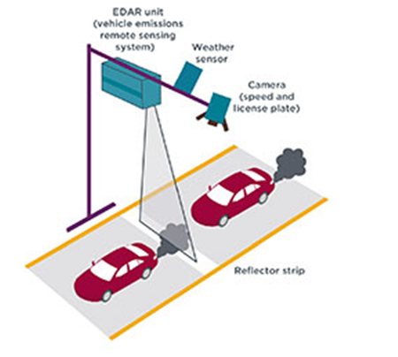
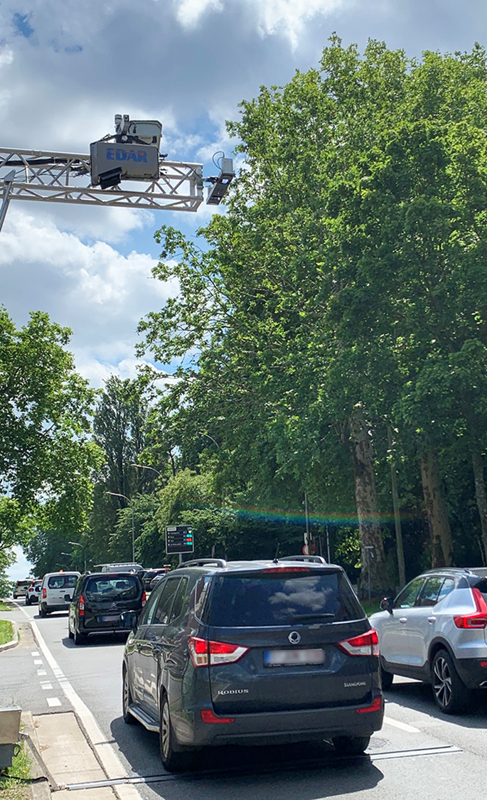
Installations in Tbilisi
Remote sensing system
Remote sensing system (vertical) that measures exhaust plumes of individual vehicles and identifies licence plate to link to vehicle technology
-> Emission Factors
Cooperation of TSU (AtmoSimLab) and National Environmental Agency nea.gov.ge

Slide 18
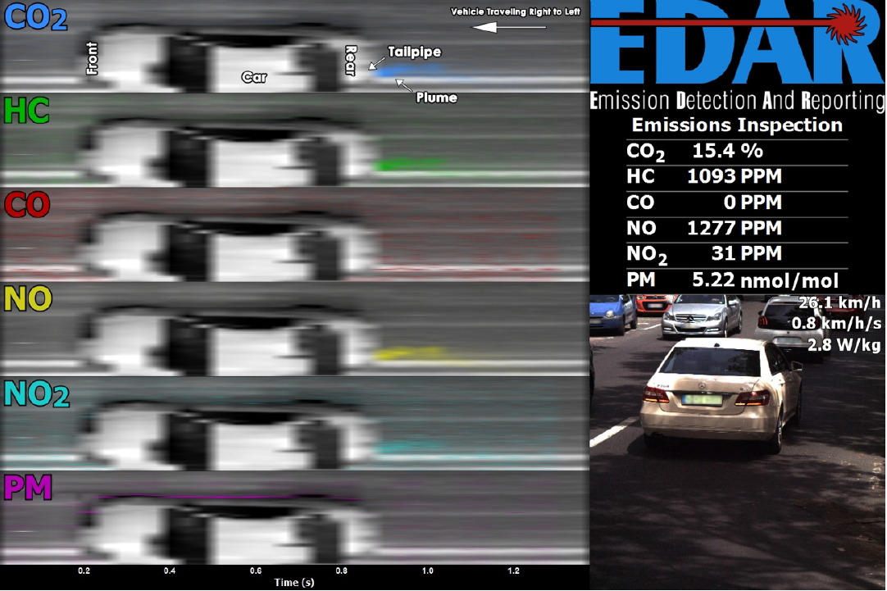
Installations in Tbilisi
Remote sensing system
Remote sensing system (vertical) that measures exhaust plumes of individual vehicles and identifies licence plate to link to vehicle technology
-> Emission Factors
Cooperation of TSU (AtmoSimLab) and National Environmental Agency nea.gov.ge

Slide 19
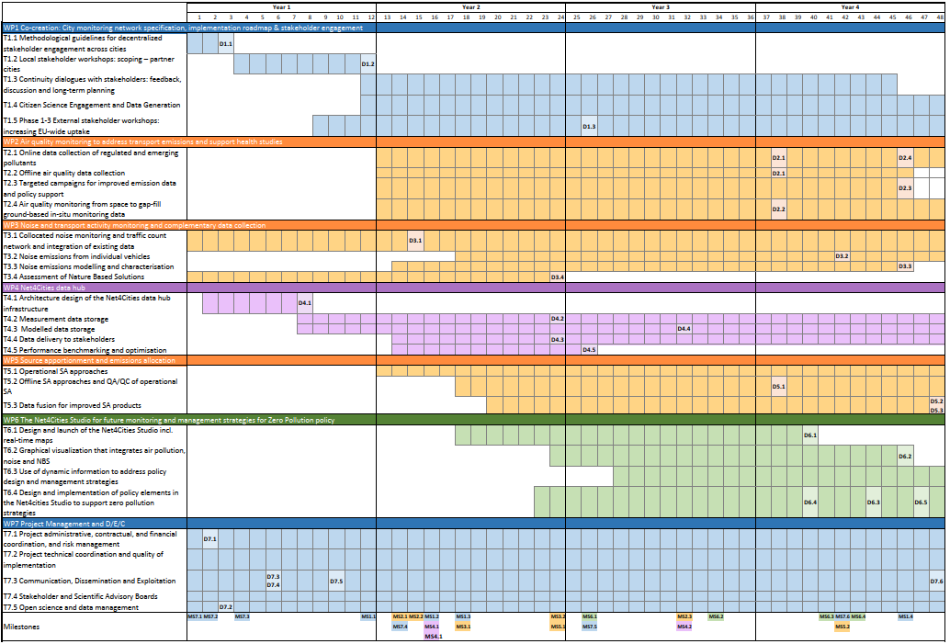
Project Timeline
2024
2025
2026
2027
Measurements
Datahub
Net4cities Studio

Slide 20

https://www.net4cities.eu/
Thank you

