Slide 1
SMART|Medical Imaging Training Lab
Dr. Tamar khechiashvili
J.S.C. “K. Eristavi National Centre of Surgery”
Georgian Technical University
Tamar.Khechiashvili@aversi.ge
10 – September 2024
Notes:
Dear Lady's and gentlemen's I will try to focus your attention next 10 minutes on something very important and excited news, as you see topic of my talk will be about Smart medical imaging lab its structure goal and motivation.

Slide 2
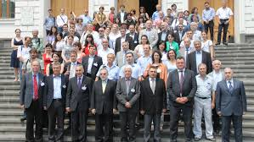
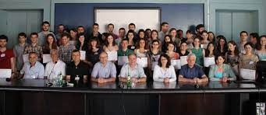
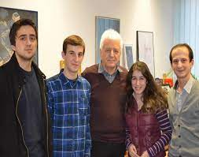
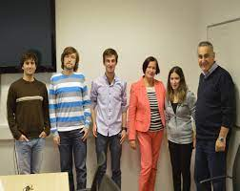
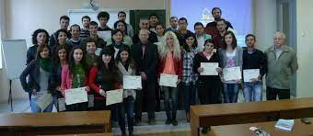
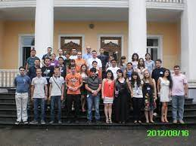
How it started…
Khechiashvili Tamar (Bachelor GTU), INM-4, (10/07-18/09) 2013
Khechiashvili Tamar (Bachelor GTU), INM-4, (24/11-21/12) 2013
Khechiashvili Tamar (GTU), Master INM-4, (08/11-23/11) 2014
Khechiashvili Tamar (GTU), Master INM- 4, 2015
Khechiashvili Tamar (GTU), Master INM 4, (10/04-22/05) 2016
Khechiashvili Tamar (GTU), PhD INM-4, 01/II/2017-31/I/2020
Notes:
Well here is the path way through out the years

Slide 3
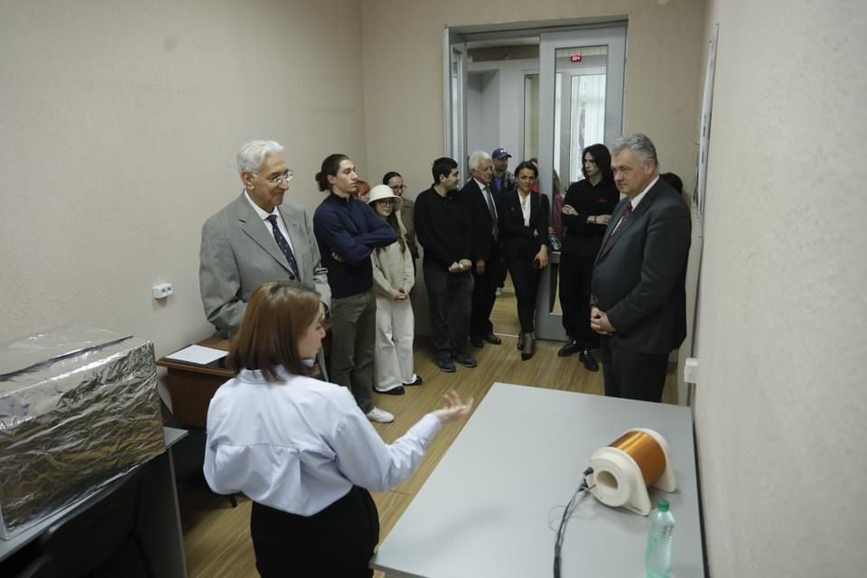
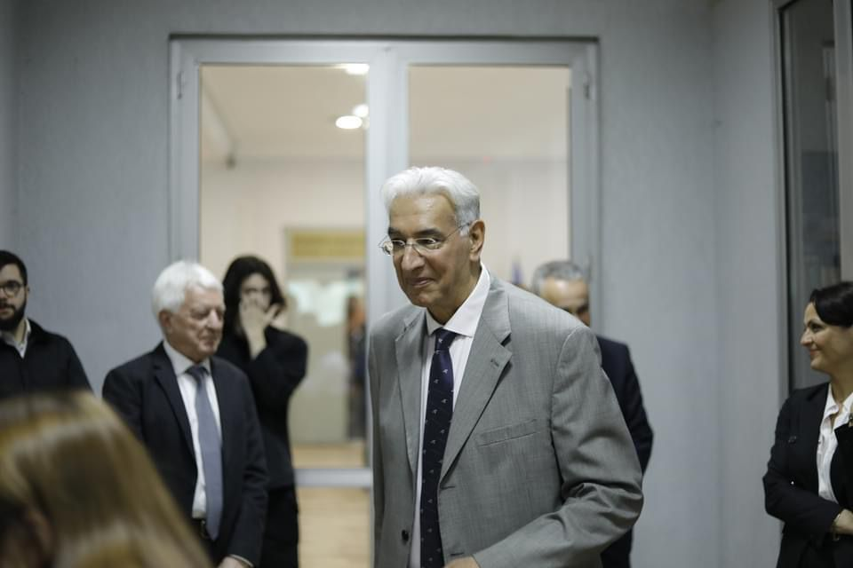
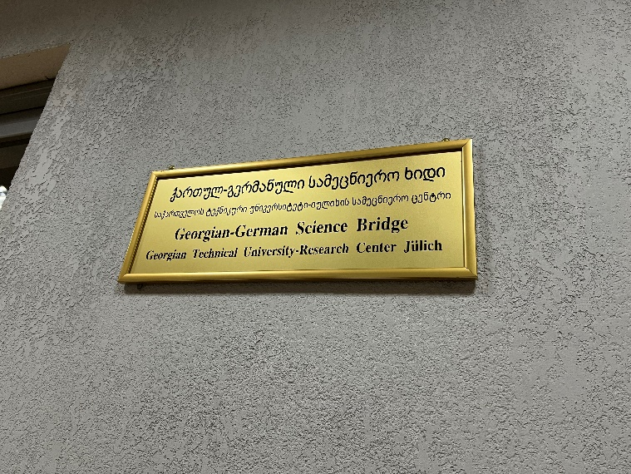
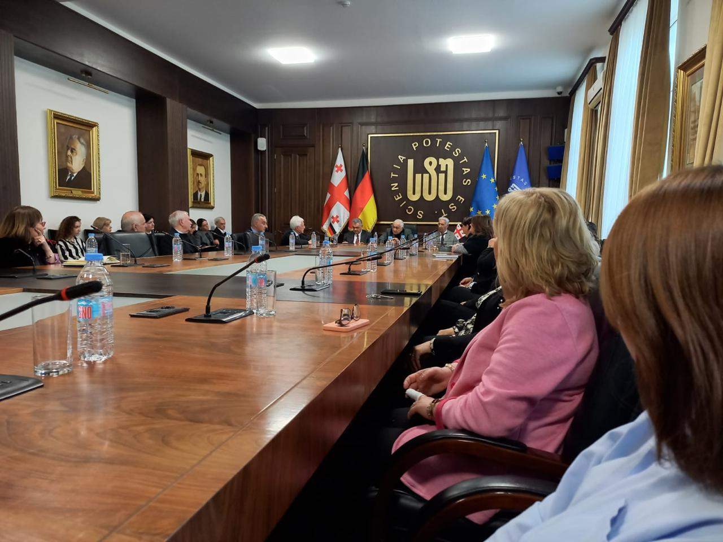
New Smart|Lab is being established
Notes:
In the framework of the Georgian-German Science Bridge (GGSB), a new SMART|Lab is being established. SMART | Labs will support the further development of the Georgian science system and is therefore funded by the Georgian Ministry of Education and Science; they involve the establishment of laboratory centers at Georgian universities for jointly defined scientific projects
SMART |Labs: Options to Return to Homeland
SMART| EDM_Lab
SMART| AtmoSim_Lab
Further SMART| Labs

Slide 4
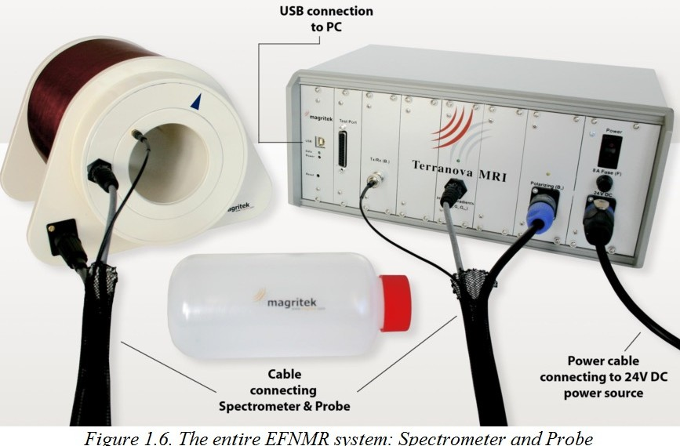
Smart|Lab: Medical Imaging Training Lab
Overall concept: MITL is first training module in medical imaging for students from across Georgia. SMART|Lab will be focused on low field MRI.
Terranova-MRI device donated by FZJ to GTU. Training instrument for students to learn about MRI
Notes:
The SMART|Biomedical Imaging, headquartered in Kutaisi, will also comprise satellite laboratories with specific functions. The first of these satellites is the SMART|Lab: Medical Imaging Training Lab (MITL) based at GTU.
The SMART | Labs are equipped with modern instrumentation by the partners to effectively carry out their activities and meet their (international) objectives within the project. Thematically differently oriented SMART| Labs should be internally linked in order to make best use of synergies at all levels.
Innovative clinical diagnostics of neurological diseases,
Significant educational impact for the next generation of (Bachelor’s, Master’s and PhD) students in imaging.
Emergence and further development of Georgian frontier science and future technology.
Connection with a pertinent scientific or medical question / problem.
Strong technological component with possible applications.

Slide 5
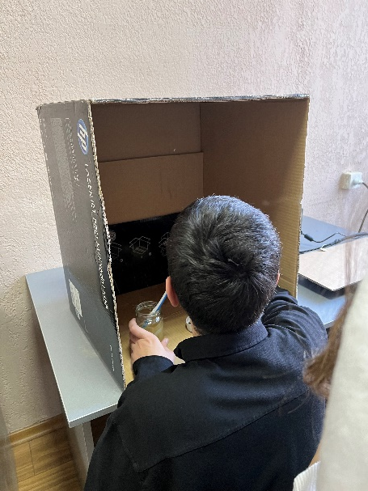
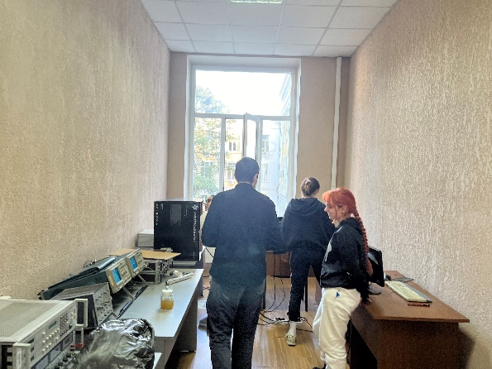
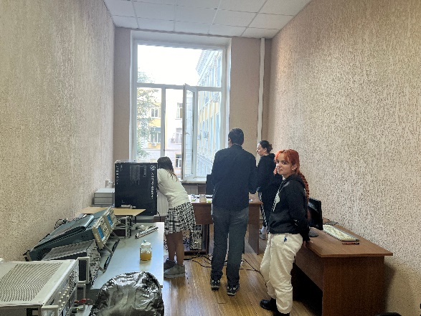
GOALS of MITL
Significant educational impact for the next generation of (bachelors, masters and PhD.) students in imaging.
Connection with a patient scientific or medical data.
...
Notes:
SMART|Lab: Medical Imaging Training Lab will establish a training program in medical imaging for students from across Georgia. Suitably trained students will subsequently engage in research. The first training module will focus on low-field MRI; low-field MRI is predicted to majorly impact clinical diagnostics and clinical care in the setting of intensive care units.
Prepare course in basic MRI by agreement with German side and put some online lectures for students frequent and topics must be decided before. That will involve data analyses of existed experimental data or get input from future partner clinics.
Under the lab suitable trained students will subsequently engage in research.

Slide 6
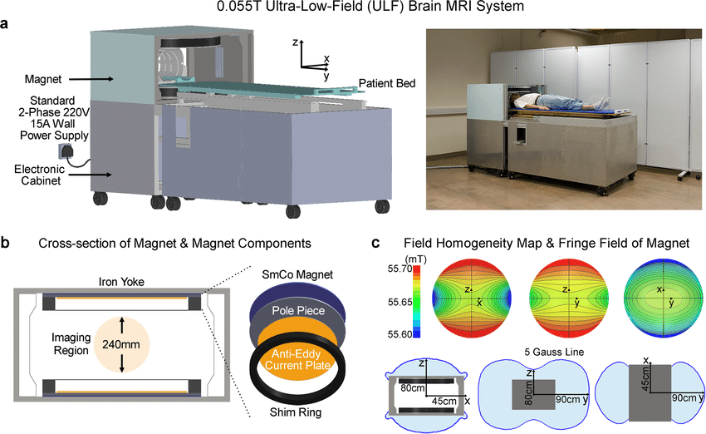
Scientific Background
Prototype of a low-cost low-power and shielding free brain ultra-low-field magnetic resonance imaging (MRI) scanner with homogenous 0.55 Tesla magnetic field and small 5 gauss fringe field. Published 2021.
Notes:
Possibility that we might have! This is a prototype of scanner, With no radiofrequency/magnetic shielding cages, the scanner can be mobile and located on any building ﬂoor with no special siting requirements. It operates from only a standard alternating current (AC) wall power outlet (50 Hz 2-phase 220 V 15 A). b The 0.055 T magnet utilizes an iron yoke, samarium-cobalt (SmCo) plates, polar pieces, anti-eddy current plates and passive shimming rings, and with adequate opening for patient chest and shoulder (29 cm vertical gap and 70 cm width). c The magnet provides a homogeneity <2000 ppm peak-to-peak over 240 mm diameter of spherical volume (DSV), which can be reduced to <250 ppm after additional passive shimming. The 5 Gauss fringe ﬁeld is within 45 cm, 90 cm, and 80 cm in X, Y and Z directions from magnet center.

Slide 7
Machine Learning
Application of deep learning models to experimental dual-acquisition low-resolution 3D brain data sets acquired from 1 healthy volunteer.
“Pushing the limits of low-cost ultra-low-field MRI by dual-acquisition deep learning 3D super resolution.” Published on: 3 April 2023
Notes:
(33 years old male) using a low-cost shielding-free 0.055T MRI head scanner. Two models were trained using synthetic data for T1W and T2W contrasts, respectively. (A) Low-resolution input data sets, LR Acq1 and LR Acq2, are two independent 3D data sets with 3-mm isotropic resolution. Their average, LR, and counterparts before k-space electromagnetic interference (EMI) removal are also shown. The deep learning super resolution output data set, SR, has synthetic 1.5-mm isotropic resolution. Four axial images are shown for each contrast, together with corresponding reference images acquired from the same volunteer using a standard 3T clinical MRI scanner with 1.5-mm isotropic resolution

Slide 8
On-going Research @ FZJ/RWTH
Located in Aachen, this FDA-cleared, low-field scanner is suitable for use on critically ill patients in ICUs. Trainees from Georgia will have the opportunity to participate in research on this instrument.
Training in low field
Participation in clinical imaging research.
Notes:
How it is important to have this studding machine in GTU, its importins is very simple, GET INVOLVED IN SCIETIFIC field that called imaging AND ITS CONSISTNS MRI, programing, engineering, data analyses and many more… Innovative clinical diagnostics of neurological diseases could be topic of our research, there are strict instructed papers how to build the machine for those who are interested in engineering could try project about it some could ensure its programing part electronic part could be separated and could be different students groups who could work on it not only

Slide 9
IMPLEMENTATION
Small group of scientists/engineers and students working with an outstanding young Georgian researcher.
Strong ties with at least one international research partner to assure access to world leading infrastructures.
Georgian senior scientist at the partner institution to ensure communicative and administrative continuity.
Support with start-up resources to set up the Lab and effectively initiate its internal activities.

Slide 10
Deliverables
Trained students.
Path into international research.
Establish low field MRI in Georgia.
Involve students in clinical practice on MRI scanners.
Expend knowledge in nuclear medicine (PET/CT).
Education and knowledge exchange with other Georgian Universities.
Documentation (papers, theses, presentations).
Certificates.

Slide 11
Right responsibilities of MITL
Ensuring the proper operation of the laboratory;
Registration of a training course;
Reading of lectures according to the course with German professors;
Conducting negotiations with local clinics, preparing a memorandum in case of agreement;
Management of current projects;
Management of possible co-projects;
Coordination of international relations;
… all as required.
Notes:
internal regulations What is more important is that in the lab project that we presented as a project proposal Where employment of students in the laboratory is provided. I ideally we want to

Slide 12
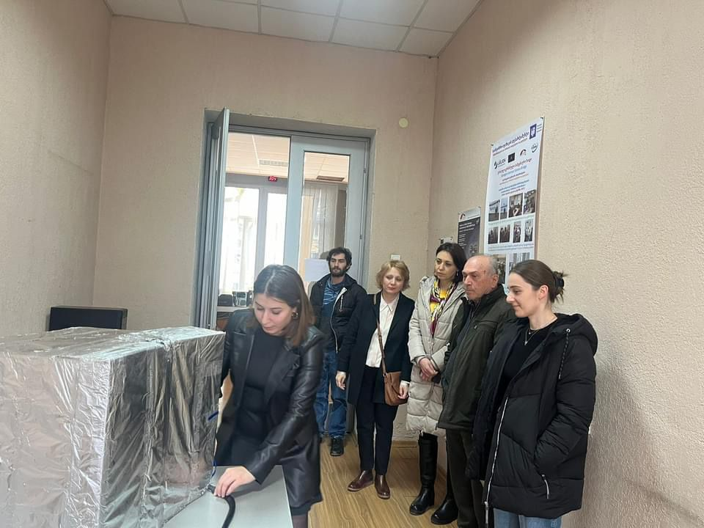
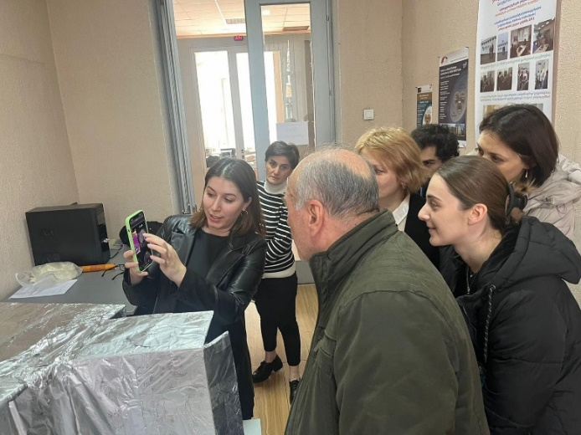
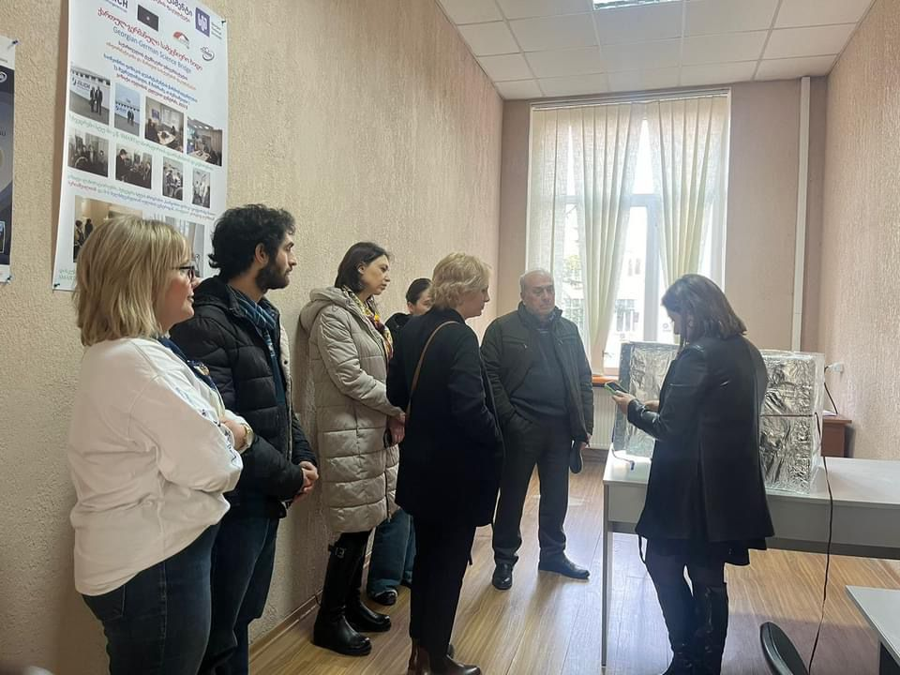
Concrete collaboration with local departments and other Georgian universities.
Biomedical Engineering Department. GTU
Department of artificial intelligence. GTU, ...
Notes:
During this period of time after announcing the establishing Smart lab we where receiving Interested guests and department heads from different fields who already had some vision how to involved this opportunity for common progress, I would like to hardly believe this will not be only wish and it will have a useful development.

Slide 13
Collaborating Partners
- FZJ; RWTH(UKA) (Germany)
- GTU; TSU; KIU (Georgia)

Slide 14
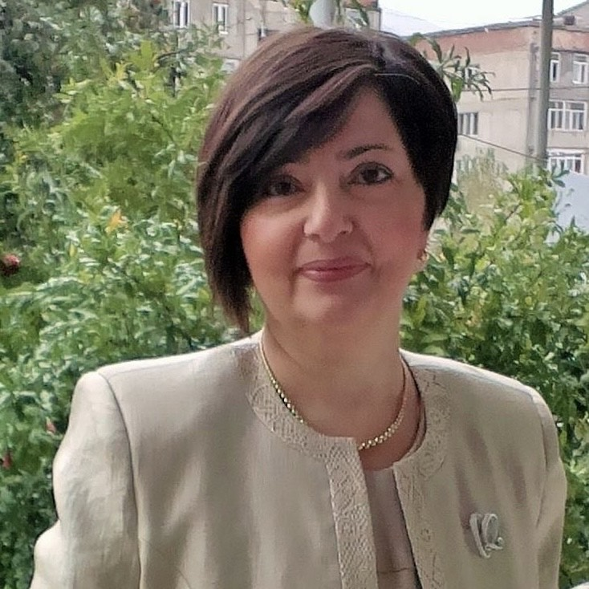
Acknowledgements…
GTU rector: Academician David Gurgenidze.
GTU vice rector: Prof. Tamar lominadze.
GTU Dean of ICS Faculty: Prof. Taliko Zhvania.
Head of the Engineering Physics Department Prof: Akaki Gigineishvil.
GTU administration.
Project leader of GGSB in GTU, Associate professor: Mikheil Chikhredze
SMART|MIT Lab Administrative Supervisor: Ekaterine Megrelishvili.
Dr. Andro Kacharava,
Prof. Dr. Dr. h.c. N. J. Shah,
Prof. Dr. Dr. h.c. mult. Hans Ströher,
Prof. Dr. Sebastian M. Schmidt,
All other supporters...
Notes:
last but not least I would like to thank all those who has worked and made it possible for young students researchers who want know life of scientist. From me personally for all those experiences that I had through this years that got me where I am now.
I believe there must be more other persons who where involved and has impact in this undertaking.

Slide 15
True story behind the successes…
Notes:
Its never easy to accomplish task without difficulties but when you know what this is for it worth it but support and equal dedication to the work is important as well.
my talk and plans that we have for future of this lab could be sound romantic, but eventually not every romance end with happy ending but I truly believe fate of this one is in our practical hand as we write it as it ends, thank you

Slide 16
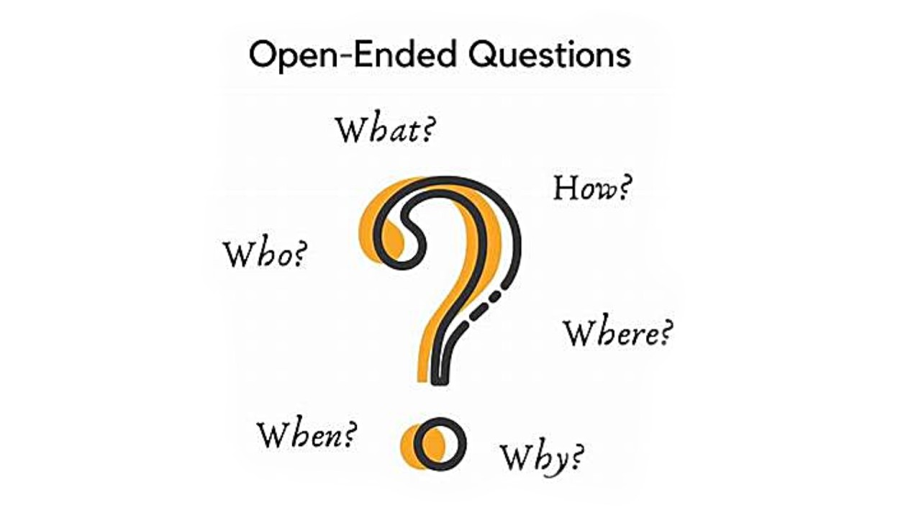

Slide 17
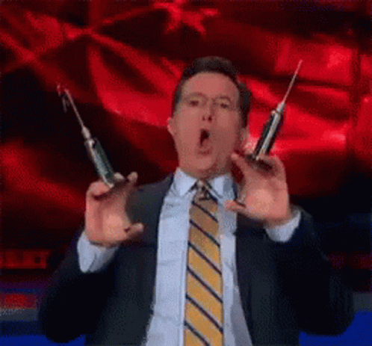
Funny story: Different vision ☺
Notes:
This slide is interpretation of me with my colleagues eyes at 6 AM.

