Slide 1
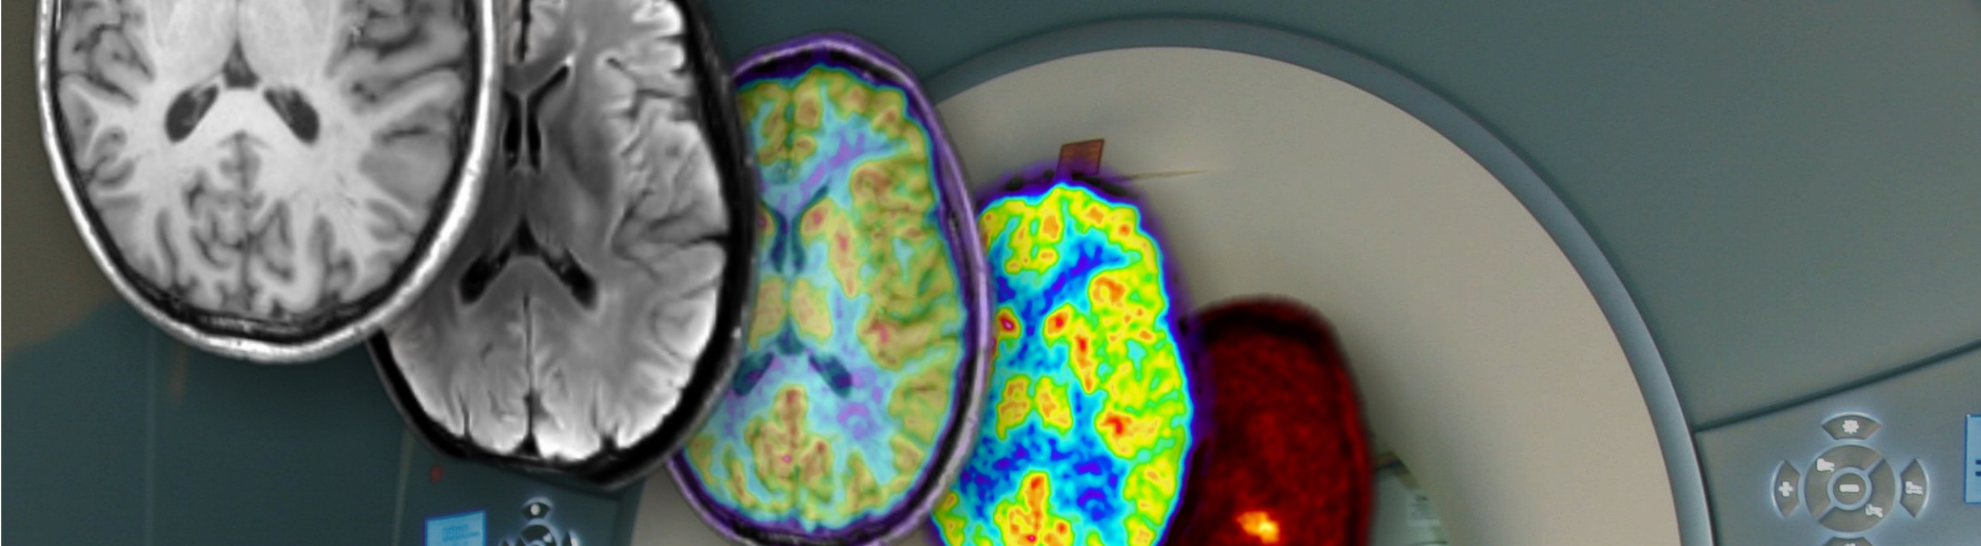
SMART|Bioimaging_Lab @ KIU
N. Jon Shah, Director
Institute of Neuroscience and Medicine - 4
Forschungszentrum Jülich GmbH
Jülich
Professor of MRI Physics Department of Physics
Department of Neurology Faculty of Natural Sciences
Universitätsklinikum Aachen RWTH Aachen
Aachen Aachen
Hanno Scharr and Ramaz Botchorishvili

Slide 2
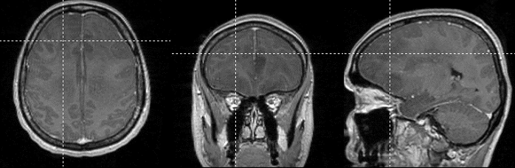
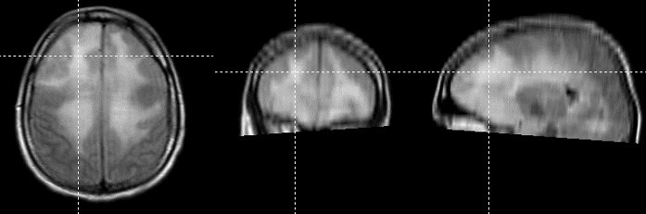
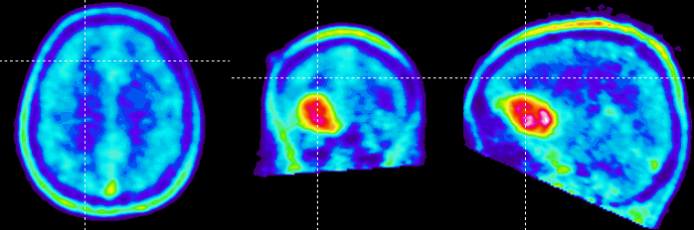
Tumour diagnostics (MRI and PET)
Brain Tumour ?
MR-T1 (CA)
MR-FLAIR
Astrocytoma Grade II
FET-PET

Slide 3
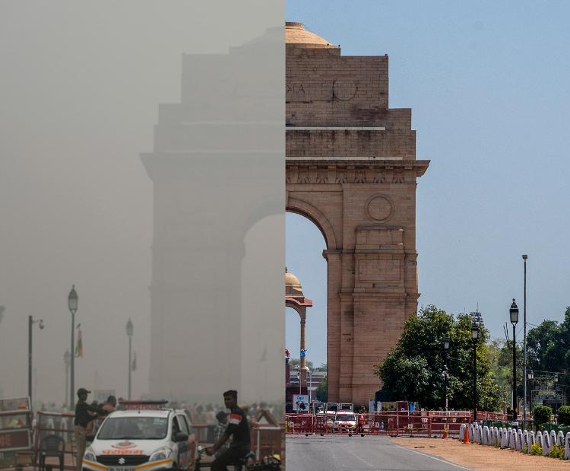
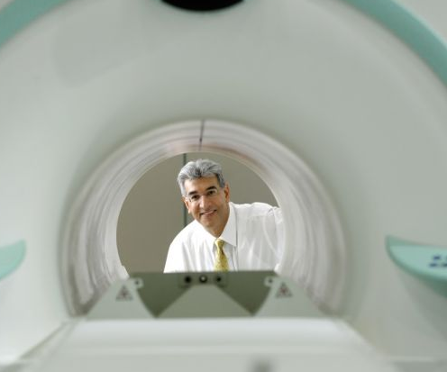
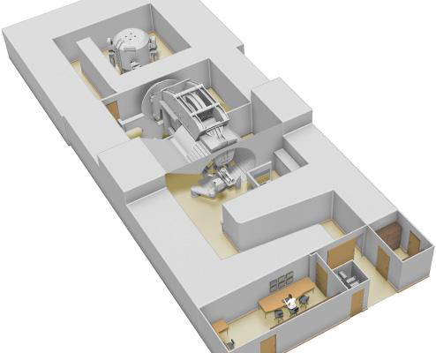


GGSB-PLUS*: “Health as a Global Challenge”
GGSB: Contributions from SMART|Labs in Georgia
Causes
Diagnostics
Treatment
Normal
Visibility
Covid times,
lockdown
without traffic
Environment
(e.g. Air Quality)
Medical Imaging
(MR-PET, Tracer)
Hadron Therapy
(e.g. HTC at KIU)
*Start-up funds: EUR 200,000 from

Slide 4
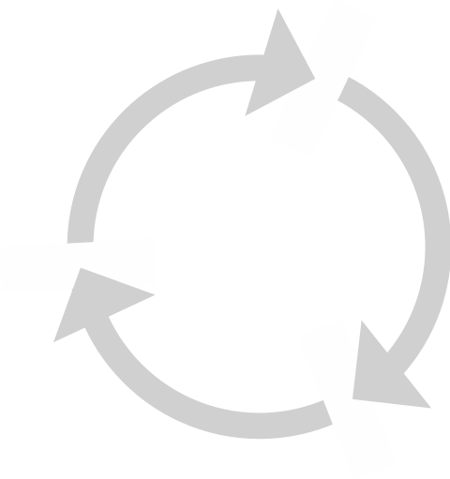
GGSB-PLUS
Research Areas
Biomedical Imaging
  MRI / PET
  Tracers
Novel Machine Learning Software
Clinical Translation - HTC
Platforms
HTC
Computational Resources
Cyclotrons
….
Machine Learning
Animal Laboratory
Novel 7T BrainPET Insert
Applications / Topics
Tumours
Health

Slide 5
SMART_Lab|Biomedical Imaging [Plans]
FZJ* / RWTH* / GSI / HZDR / …..
KUI* / TSU /GTU*/
……
* INM-4
INM-5
IKP
IEK-8
* IAS-8
* ZEA-1
ZEA-2
TSU, GTU, KIU
GSI
HZDR
TSU
GTU
KUI
.......
Medicine
Low-field Training
ML / AI

Slide 6



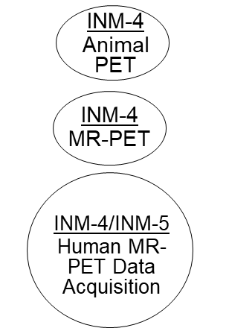




GGSB-PLUS: “Health as a Global Challenge”
Organisation and Partners
Lab Leader:
Advertised
¹ Research directions proposed by initiators: RECTANGLES
² Projects: ELLIPSES
^{n} Partners are welcome to contribute to Projects

Slide 7
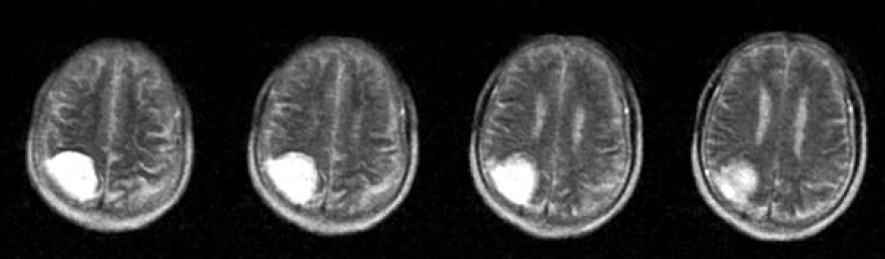
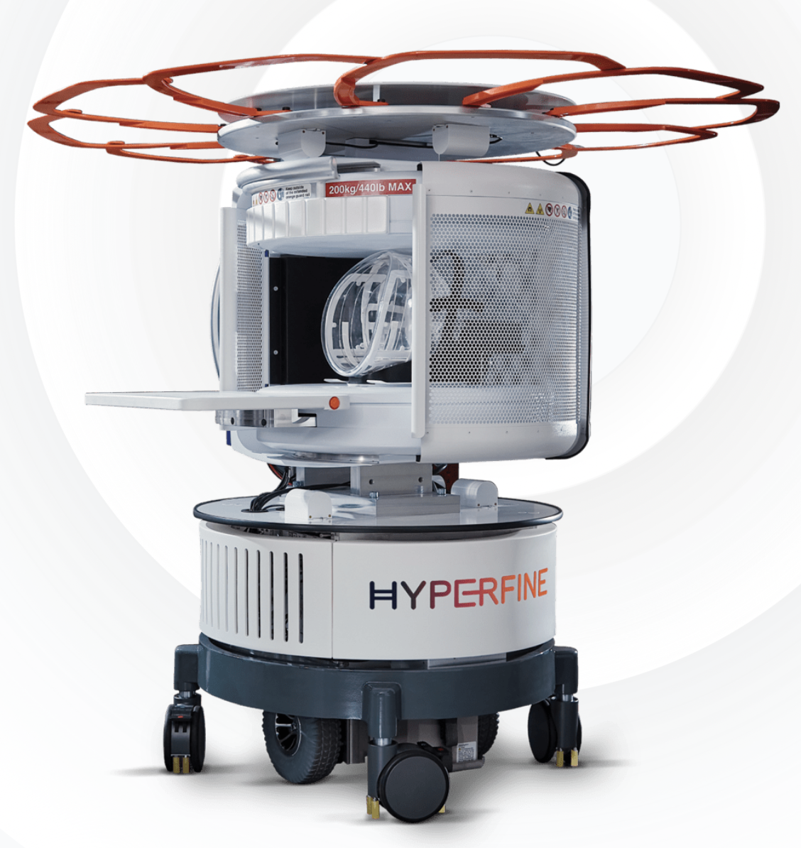
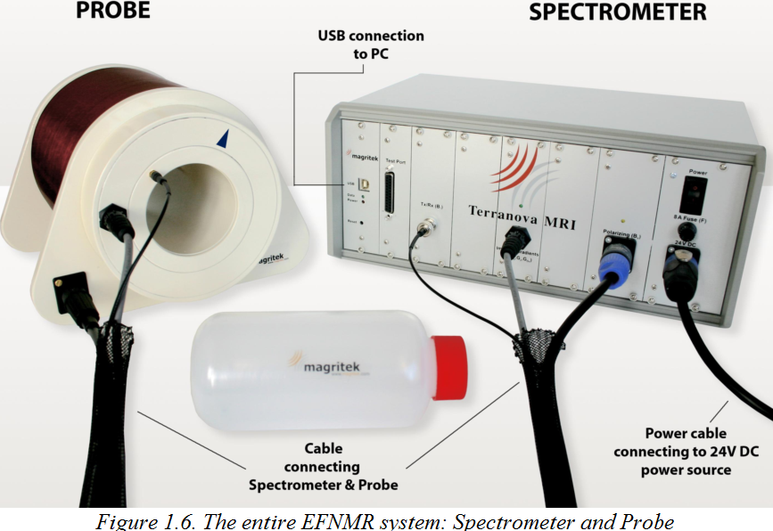
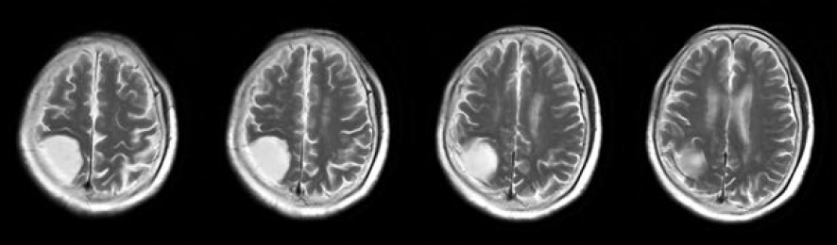
GGSB-PLUS: Low-Field MRI
Cooperation between Georgia and Germany
GTU KIU FZJ / RWTH
0.055T
€200k
3.0T
€2mil
Influence of ML algorithms on the quality of MRI. Compare 0.055T with ML (top) vs 3T without ML
Terranova-MRI device donated by FZJ to GTU (SMART|Sat-Lab: Medical Imaging Training Lab)
Adapted from Liu et al.,NATURE COMM.
doi 10.1038/s41467-021-27317-1 2
FDA-approved MRI scanner in Aachen. Suitable for intensive care units

Slide 8
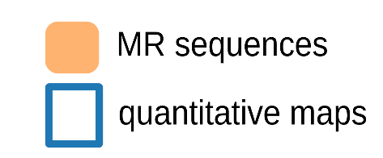
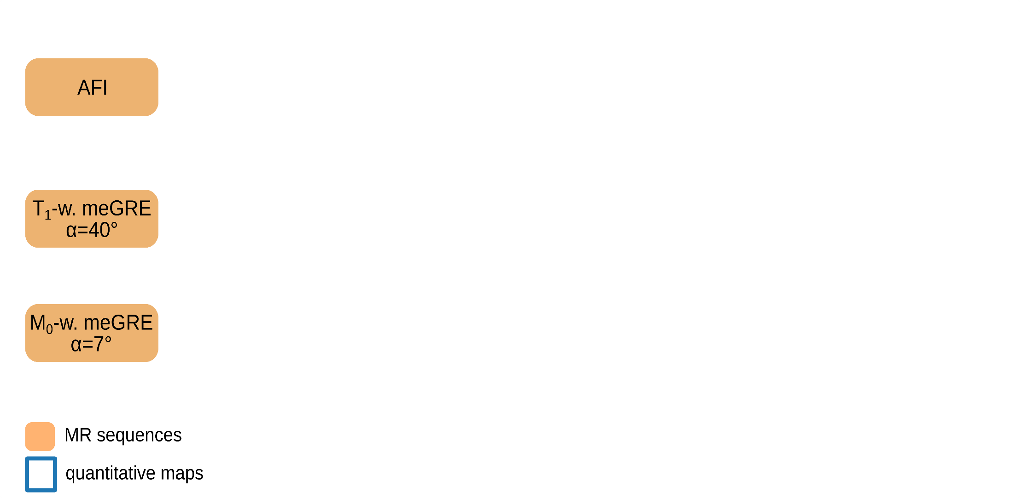
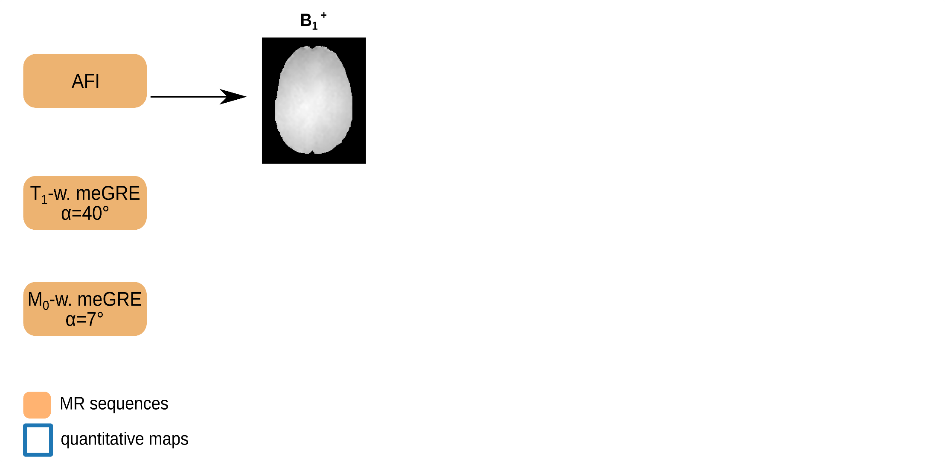
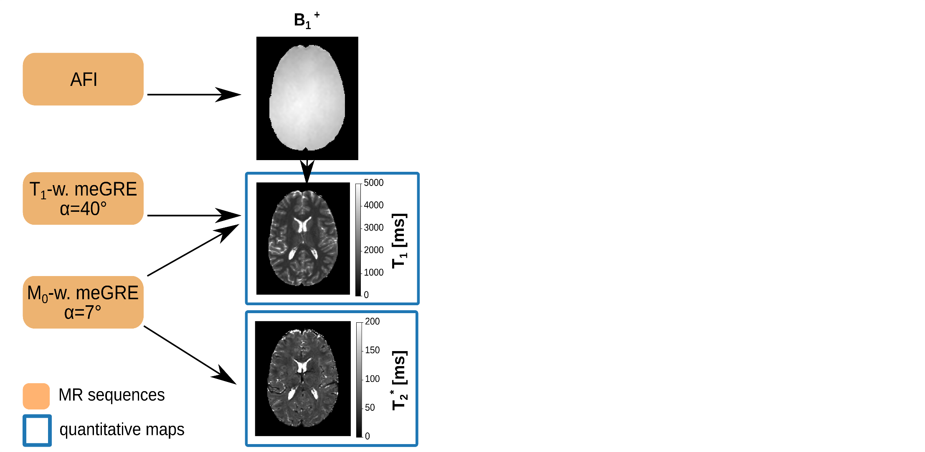
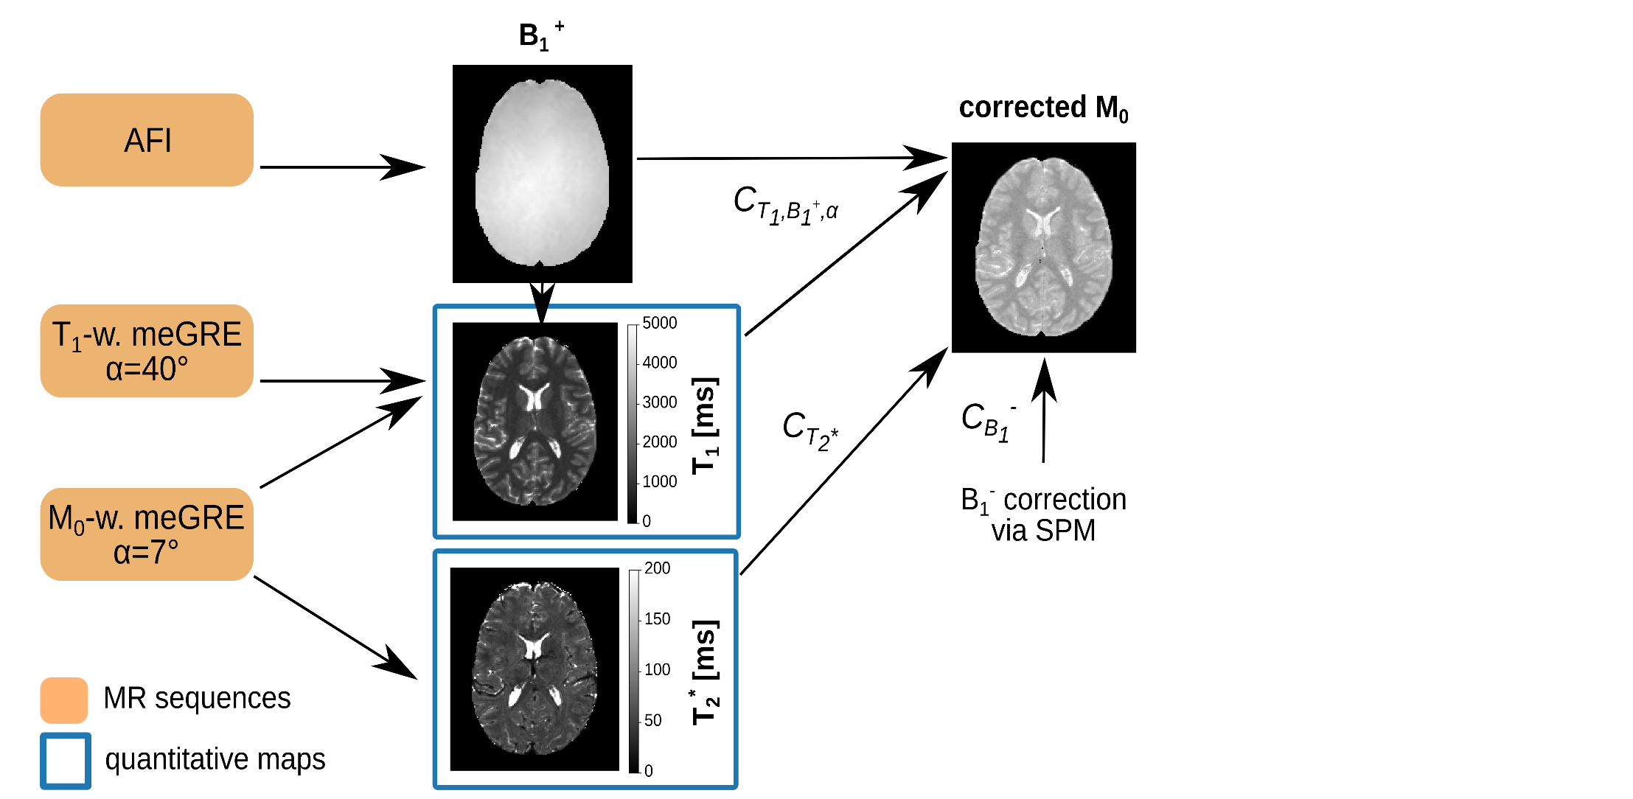
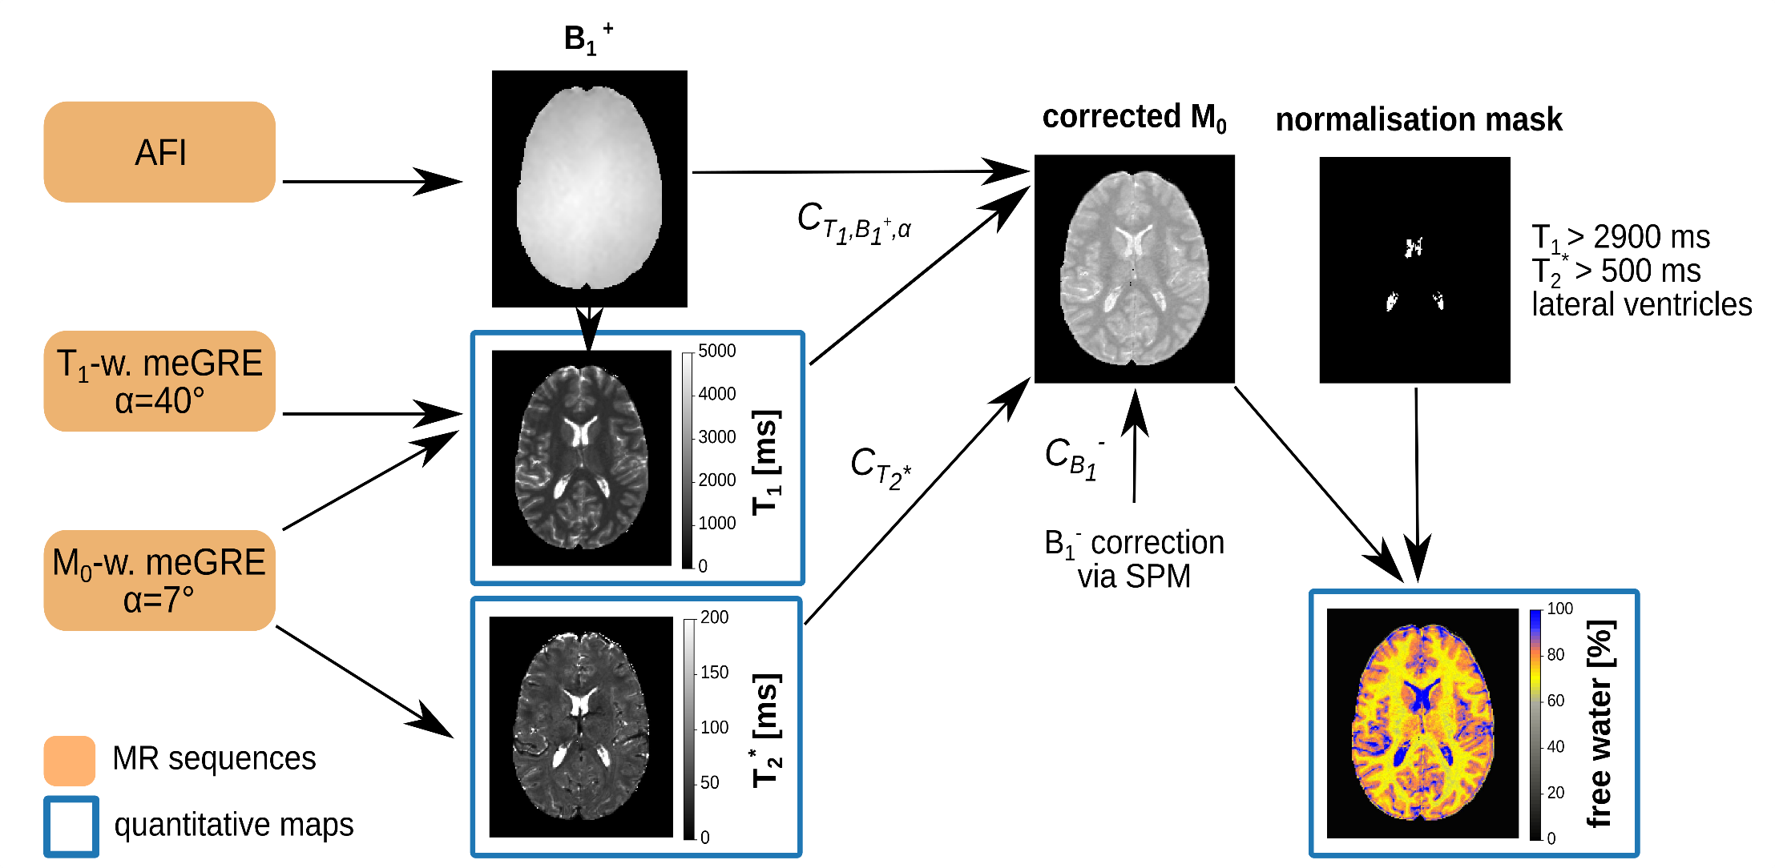
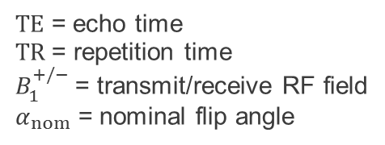
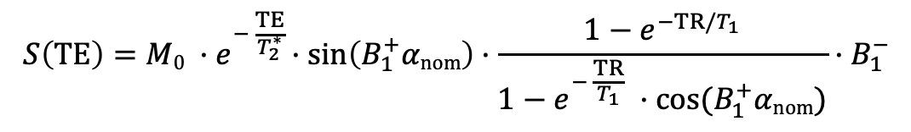

qMRI (Water Mapping)
3D Two-Point (3D2P) VFA Method
$$S\left(TE\right)=M0 {·e}^{− \frac{TE}{T_{2}^{∗}} }·\sin\left(B_{1}^{+}αnom\right)·\frac{1−e^{−TR/T_{1}}}{1−e^{− \frac{TR}{T_{1}}} ·cos⁡(B_{1}^{+}αnom)}·B_{1}^{−}$$
  meGRE signal equation:
$$C_{T_{2}^{∗}}^{−1}∙C_{{T1, B}_{1}^{+}, α}^{−1}∙C_{B_{1}^{−}}^{−1}$$
$TE$ = echo time
TR = repetition time
$B_{1}^{+/−}$= transmit/receive RF field
$α_{nom}$ = nominal flip angle
Schall et al. (2018), PLOS ONE 13(8):1-21
Notes:
Keep TR constant and change alpha for T1 cac
Ventricles contain approx. % water

Slide 9
qMRI
…and again with MT preparation
$TE$ = echo time
TR = repetition time
$B_{1}^{+/−}$= transmit/receive RF field
$α_{nom}$ = nominal flip angle
+ MT pulse
Notes:
Keep TR constant and change alpha for T1 cac
Ventricles contain approx. % water

Slide 10
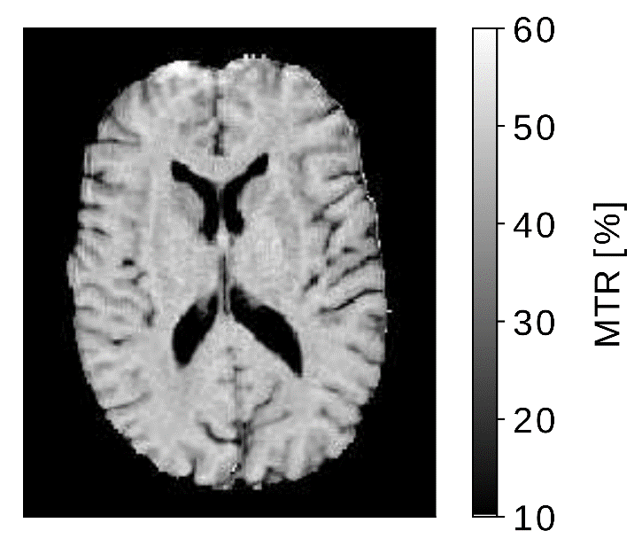
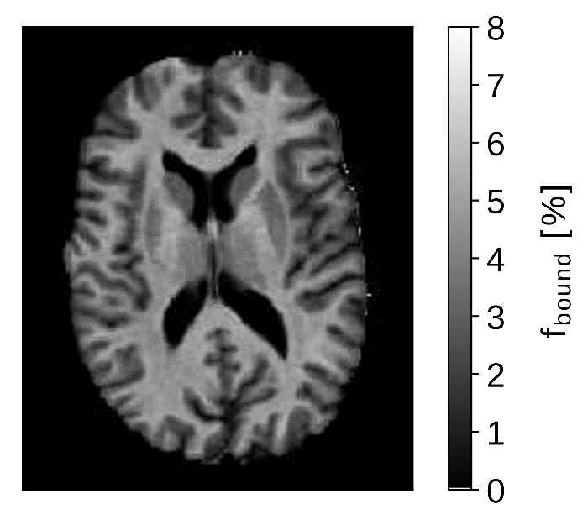
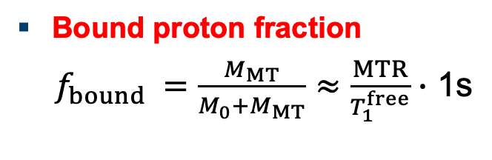
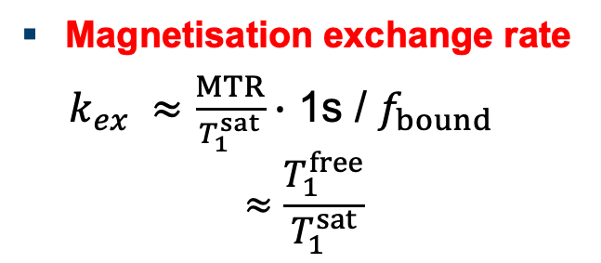
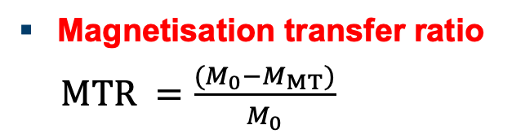
Semi-Quantitative Magnetisation Transfer (qMT) Parameters
Magnetisation transfer ratio
$MTR =\frac{{(M}_{0}−M_{MT})}{M_{0}}$
Bound proton fraction
$f_{bound} =\frac{M_{MT}}{M_{0}+M_{MT}}≈\frac{MTR}{T_{1}^{free}}∙$ 1s
Magnetisation exchange rate
$k_{ex} ≈\frac{MTR}{T_{1}^{sat}}∙$ 1s / $f_{bound}$
$$≈\frac{T_{1}^{free}}{T_{1}^{sat}}$$
in addition to H₂O, T₁ and T₂*
Notes:
MTR more influenced by inflammation

Slide 11
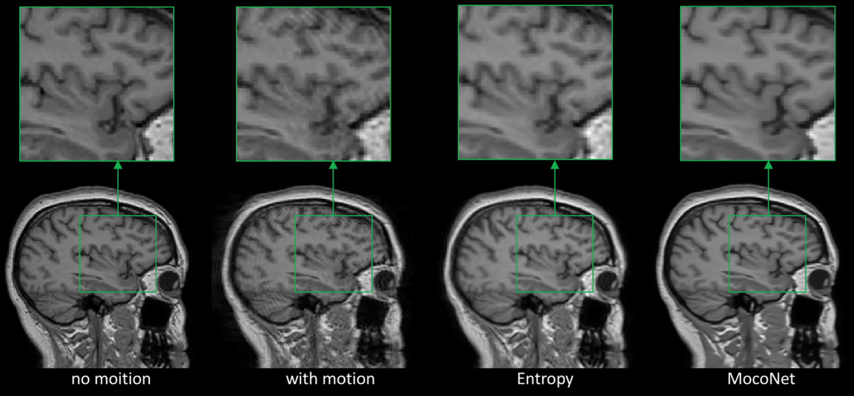
Current Activities in DL / AI
MR Group
Image reconstruction
published paper
DFG grant
Image Reconstruction of Sparsely Sampled Data
Joint MR-PET image reconstruction
grant in AUS successful
MRFingerprinting
being planned
Motion correction
paper, patents
spin-off planned – AUS lead partner
11

Slide 12
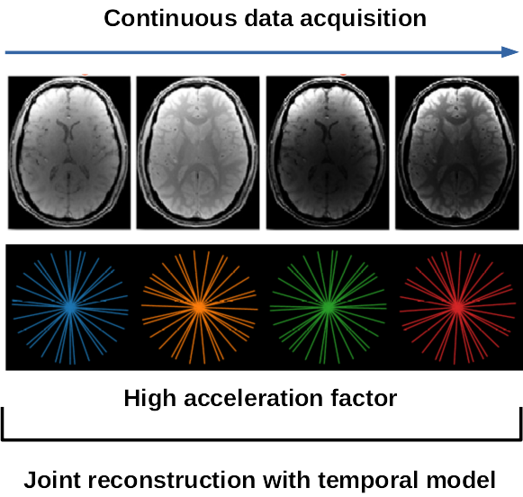
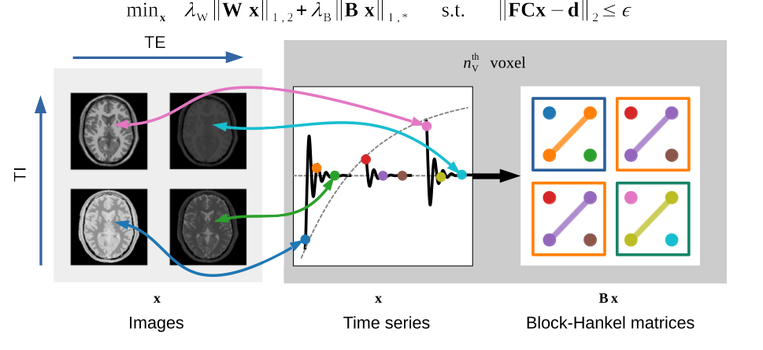
Machine-LEARNING for ULTRA-FAST MRI
Conventional fully sampled sequential imaging
Long measurement time & motion sensitivity
Proposed undersampled continuous imaging
Joint reconstruction of all time points
Machine learning to apply temporal signal model
12

Slide 13
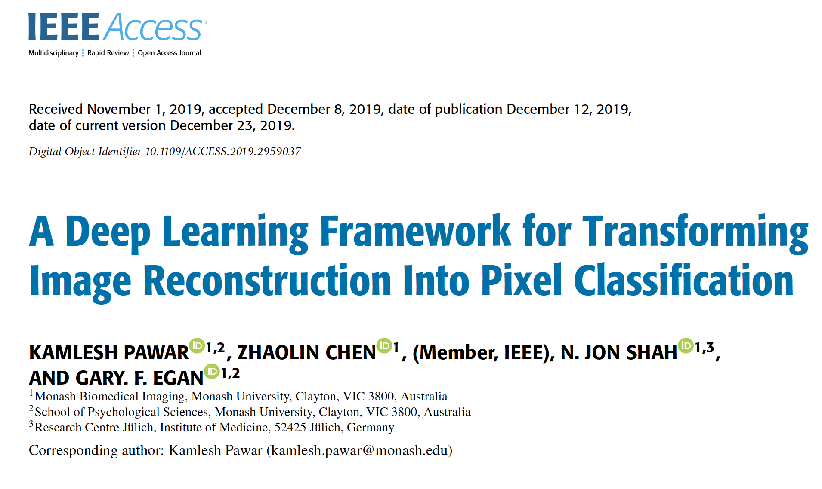
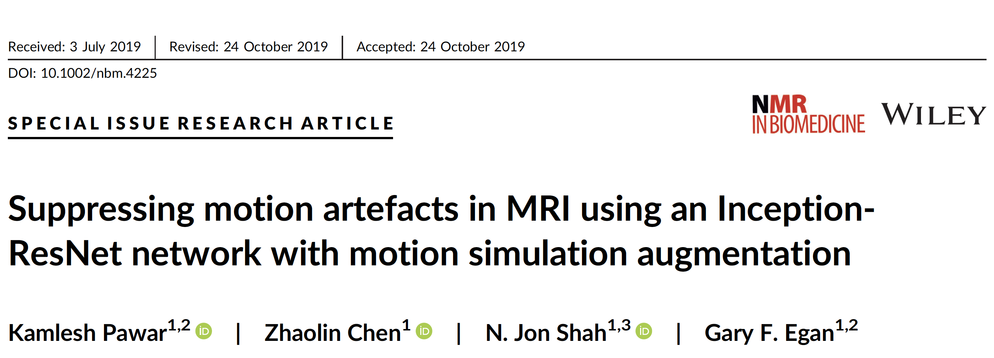
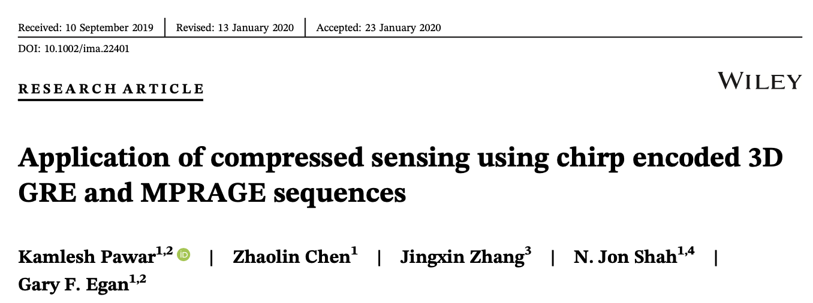
Current Activities in DL / AI
13

Slide 14
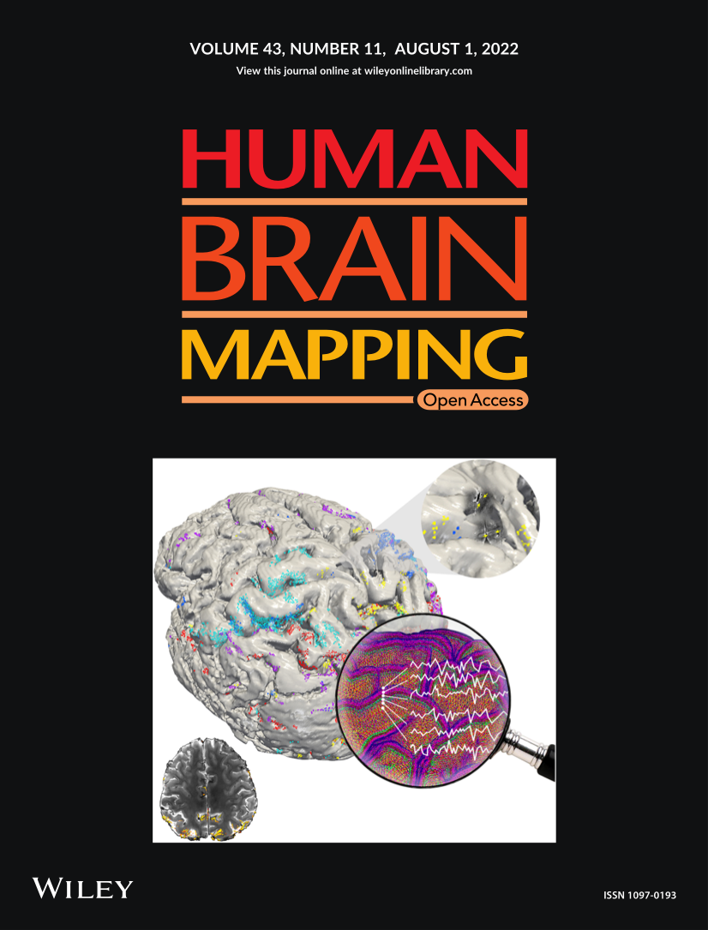
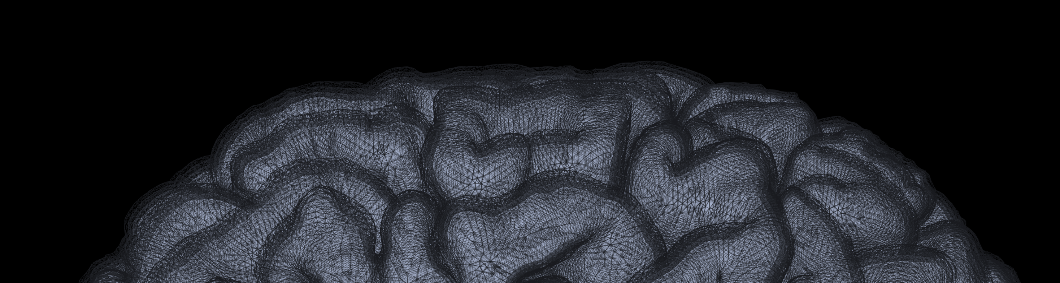


Early diagnosis using machine learning
CSF
I
II/III
depth
IV
V
WM
VI

Slide 15

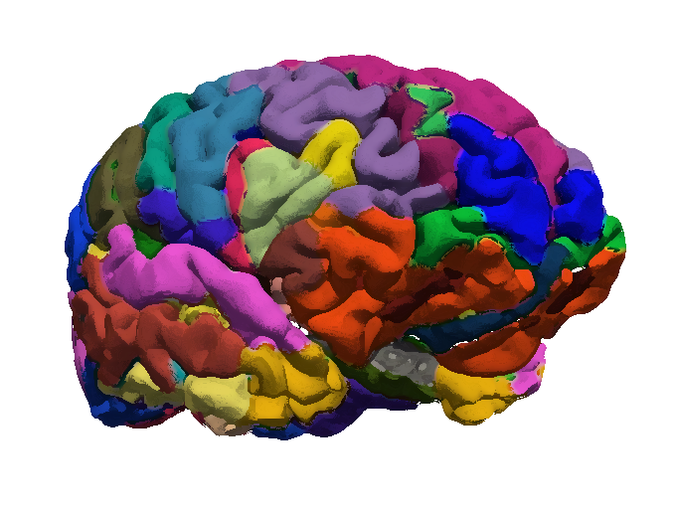
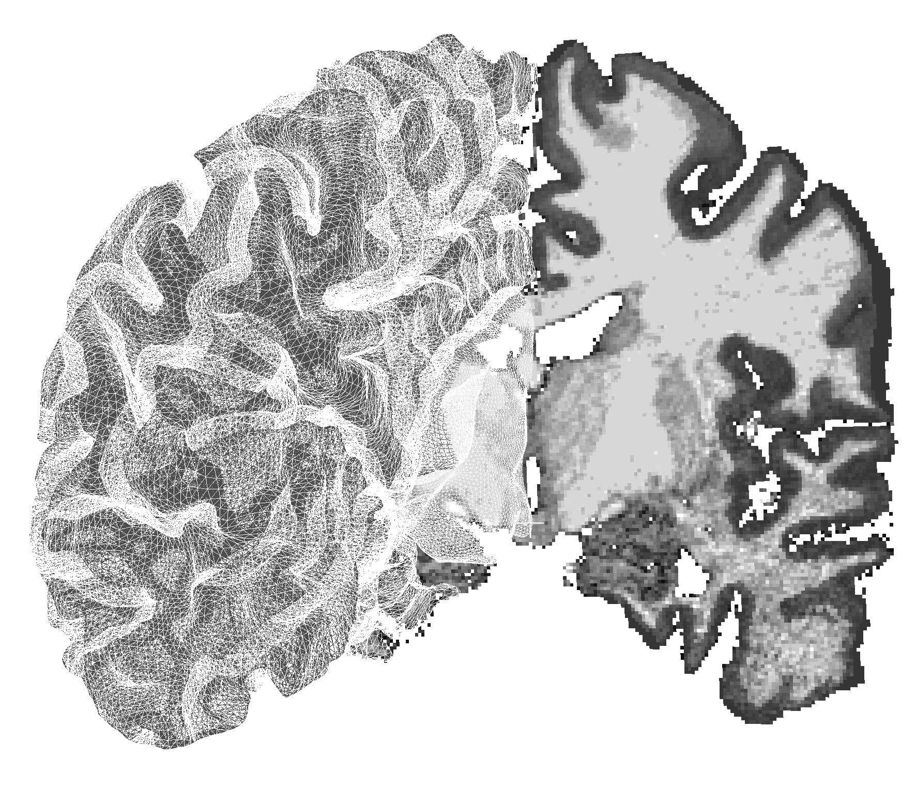
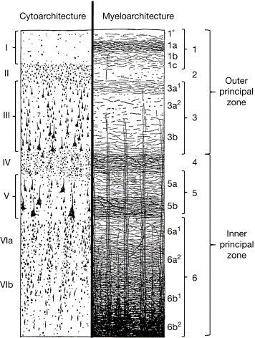
High-resolution fMRI
Studying this cortical dimension (depth) provides additional information in functional studies (“laminar fMRI” or “depth-dependent fMRI”).
Why does it matter?
I
II
.
III
.
IV
.
V
VIa
VIb
The cerebral cortex is heterogeneous
State of the art:
Measure fMRI signal from almost every voxel in the brain
Average the signal of voxels within each ROI
Report ROI-to-ROI connectivity
K Zilles, 2015
Notes:
We believe that studying this dimension could provide important information about how brain areas communicate with each other, and in general about how the brain works.
Importantly, the field is usually called “laminar fMRI”, because we attempt at studying the cortical laminae, but as you can imagine, we don’t really have the resolution to distinguish the actual layers, so we usually divide the cortical depth into a number of territories, e.g. 3, 4 or 6

Slide 16
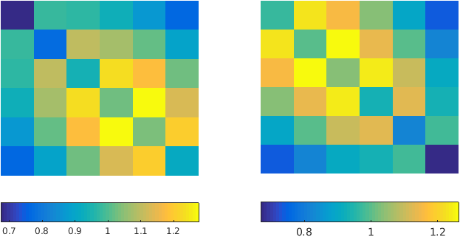

Laminar Dynamic connectivity in Major Depression (EPIK)
Differences in cortical-state prevalence
After treatment, patients who recover
or worsen show a significantly different laminar connectivity preference.
Patients who worsen are significantly different from healthy controls, but patients who recover are not.
The evolution of depression
may be related to changes in the connectivity along the cortical depth.
Mostly super
Prevalence of laminar state 1 vs 2
Mostly deep
Healthy controls | Depression -t1 R / W | Depression -t2 R / W
~ 4 w
Pais-Roldán et al. In preparation

Slide 17
Student Profiles
Physics: All rounders
Medicine: Work in neuroscience studies
IT: Sequence programming / Machine learning
Engineering: Radiofrequency coils / MR-PET hardware
SSS: Students-Stability-Sustainability

Slide 18
GGSB and GGSB-PLUS
Opportunities for Georgia and Germany
Measurables | Win for Georgia | Win for Germany
Hadron Therapy Facility (HTC) at Kutaisi International University (KIU) | German expertise in PET, tracer production, MRI, HTC cyclotrons: Training of HTC personnel | Access to HTC at KIU for German scientists
Imaging Centre (KIU; Tbilisi) Low-field MRI; MR-PET | Access to German expertise; unrivalled MR-PET expertise | Larger clinical studies Trainee manpower / collaborators
Climate Laboratory | Data and forecasts for Georgia | Data sets for modelling for Germany
Education of young scientists and technology transfer | Internationally educated youngsters bringing technological know-how | Bright, enthusiastic young scientists
Georgian funding to match German funding to create a sustainable GGSB | Fund excellent young students; create a pool of educated returnees with international connections | Network of talented young scientists abroad
Request support for SMART|Labs in Georgia

Slide 19
Acknowledgements
Dr. Seong Dae Yun
Dr. Patricia Pais
Prof. Irene Neuner
Dr. Ravichandran Rajkumar
Claire Rick
Nancy Malsbenden
Dr. Tamar Khechiashvili
Prof. Hanno Scharr
Prof. Ramas Botchorisvili
Prof. Alexander Tevzadze
EPIK Sequence programming
Depression patients / data acquisition
GGSB Production Team
SMART_Lab|Biomedical Imaging
19

Slide 20
Georgian-German
Science Bridge:
GGSB 2024
A sustainable and stable
GGSB is a win-win for both
Georgia and Germany

