Slide 1

PET Tracer Development
Otari Gokhadze, Heike Endepols, Bernd Neumaier
Institute for Radiochemistry and Experimental Molecular Imaging
University Hospital Cologne
and Forschungszentrum Jülich GmbH, INM-5

Slide 2
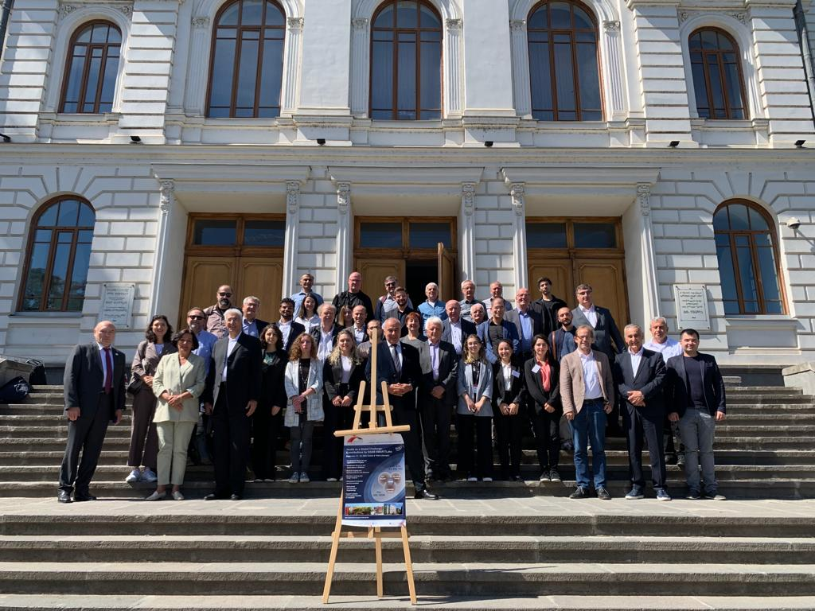

2022

Slide 3
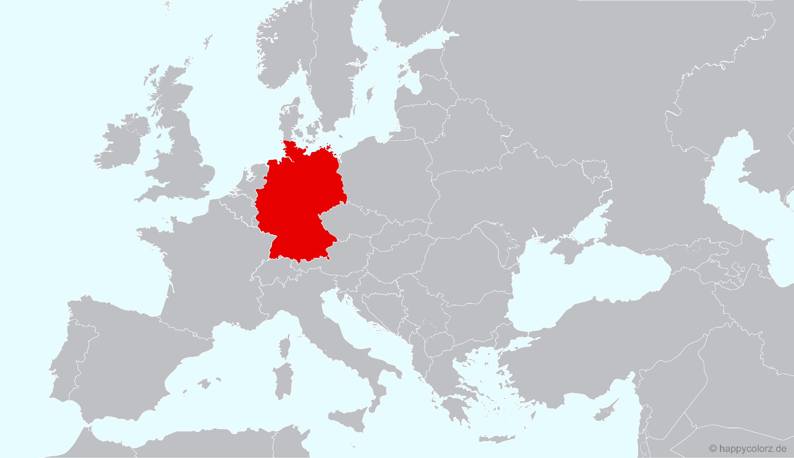

Germany
Georgia

Slide 4
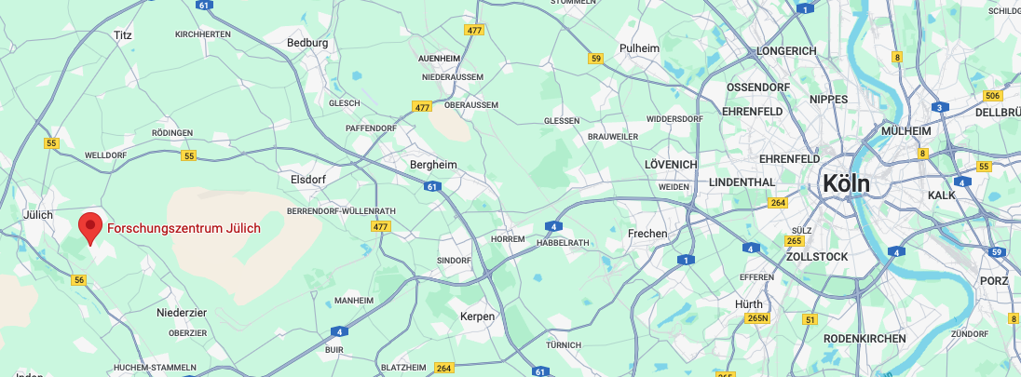
Germany
Georgia

Slide 5




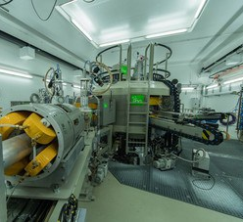
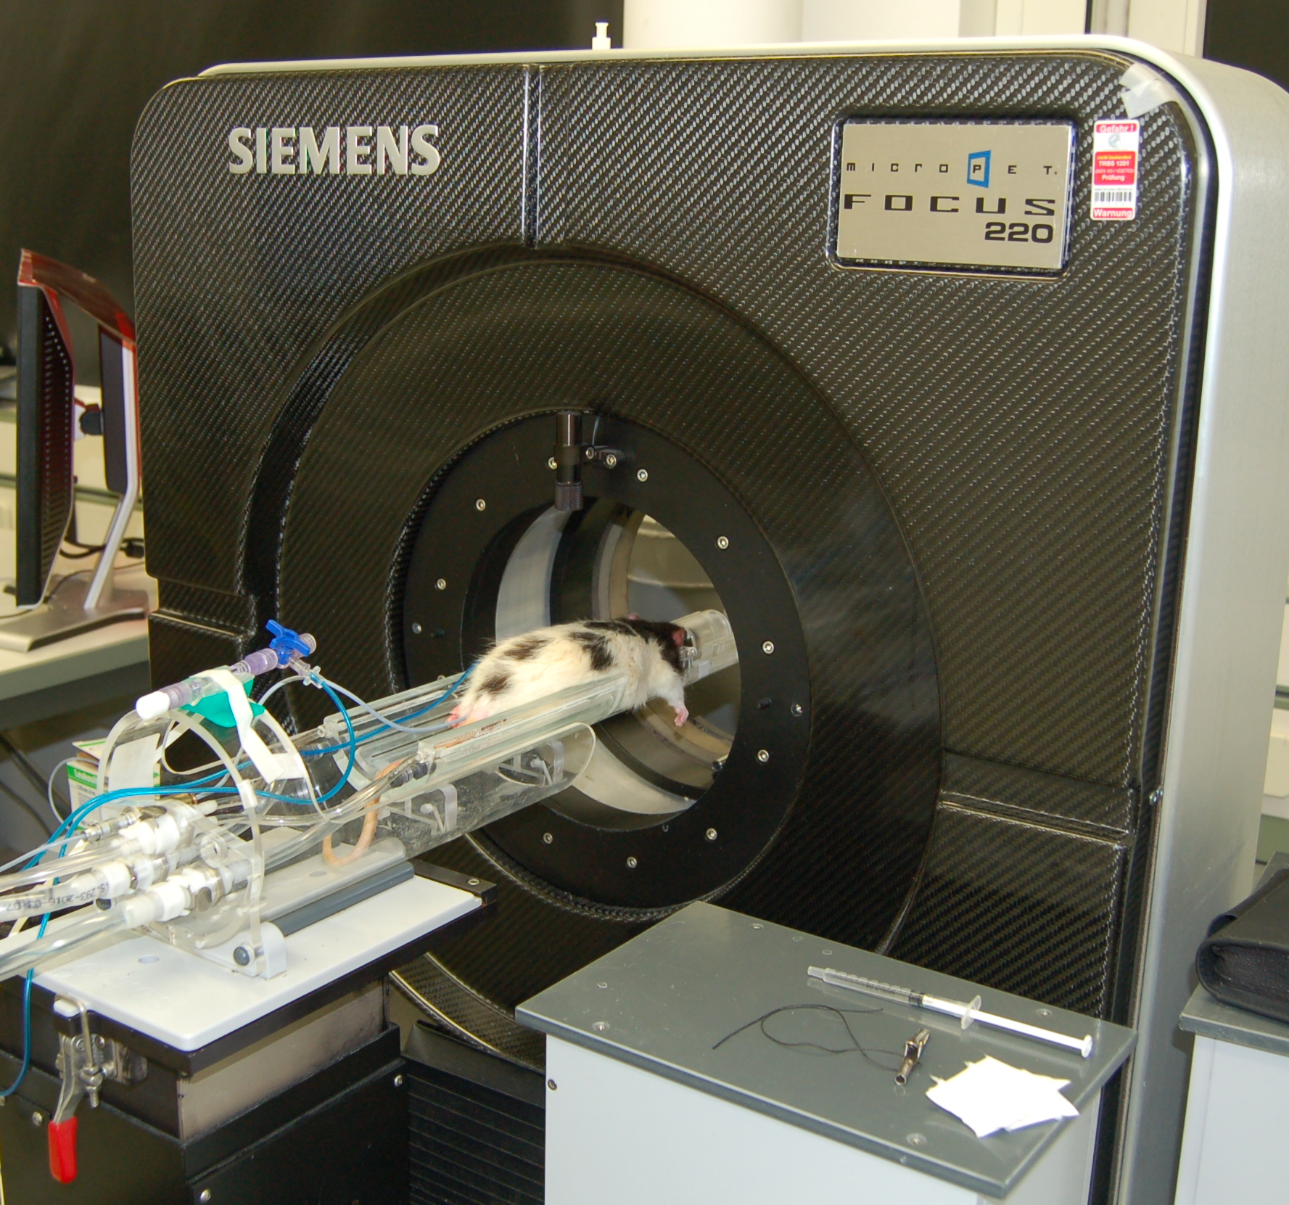

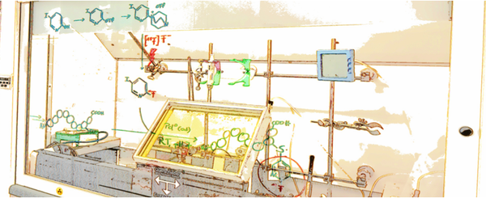
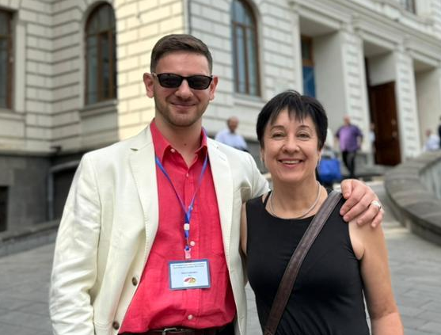
Prof. Dr. Bernd Neumaier
50 km
INM-5
Nuclear Chemistry
IREMB
Preclinical Imaging
University Hospital
Notes:
Historie
Besuch Tbilisi 2022
IREMB arbeitet an ...

Slide 6
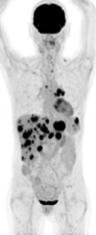
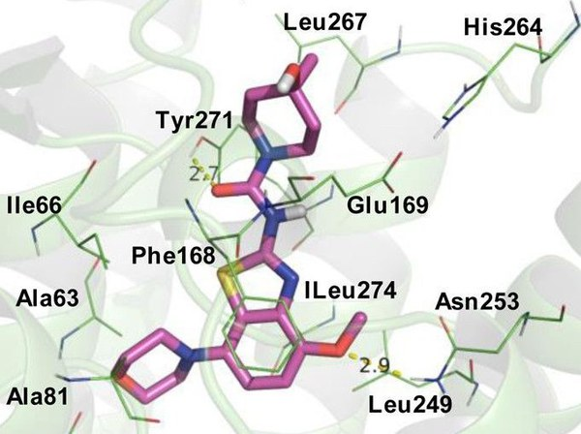
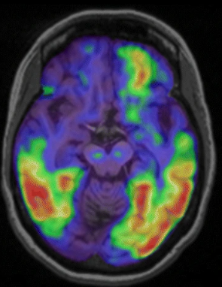
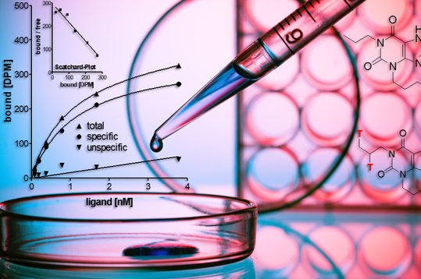
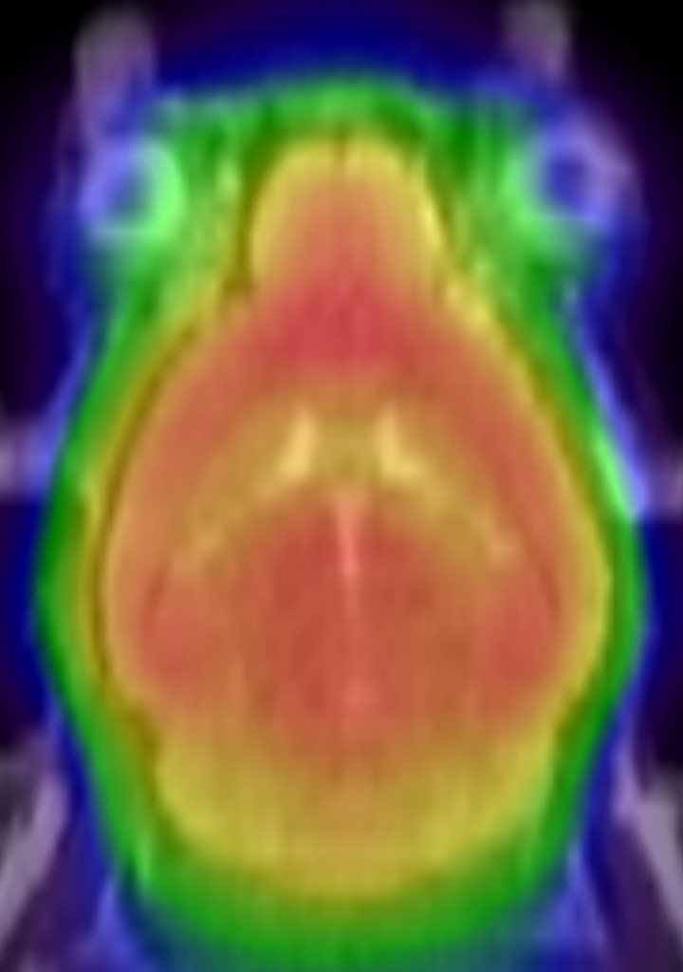
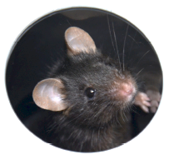
Development of novel PET tracers
Radiochemistry
Pharmacology
Preclinic
Clinic
ligand screening
or modeling,
radiolabeling
in vitro
tumor cell lines
uptake studies
blocking studies
in vivo
animal models
uptake studies
blocking studies
patients
clinical studies
approximate time: 5–15 years

Slide 7
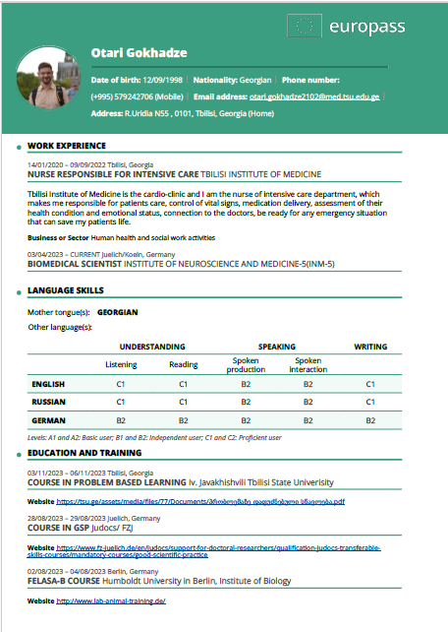
About me
Scientific relations with Forschungszentrum Jülich since 2018;
Internship in Molecular Imaging at University Cologne-2021;
Iv. Javakhishvili TSU – Ph.D. Student – 2022
Shota Rustaveli Foundation NG and Forschungszentrum Jülich joint grant – 2022
Admission at the graduate school Interdisciplinary Program of Molecular Medicine at University of Cologne.
Submitted grant application - Partnerships for sustainable solutions with the countries of the South Caucasus and Central Asia 2024 - Development of bispecific radioligands for PET imaging and radioligand therapy metastatic prostate cancer.
https://europa.eu/europass/eportfolio/api/eprofile/shared-profile/otari-gokhadze/1edc18d5-1466-455f-80d6-95be37a34a9a?view=html
Notes:
Little about me. I am M.D. interested in Radiology and in Nuclear medicine. Since 2018 I have close scientific relations with FZJ. During my studies I had several internship and the last one in 2021 was the most important, because I decided to become a ph.d. student after my M.D. programme. 2022 I became a Doctorant in TSU and gained Georgian german joint grant for three years.

Slide 8

Diagnosis
Molecular Probes for Targeting Tumors
¹⁸F
⁶⁸Ga ⁸⁹Zr
¹¹C
β⁺
Radionuclide
Linker
Ligand
Target
Normal cell
Cancer cell
Notes:
Let’s think that this is cancer cell inside our body. On cancer cells, there are some specific receptors by which they are differ from the normal cells. Or maybe these receptors are just overexpressed on cancer cell surface. This proteins are our targets. As they have their natural agonists –ligands, Ligands must be specific for the receptor, link them with a linker, f.e. inhibitor,. The linkersare labeled with positron emitter radionuclide
8

Slide 9


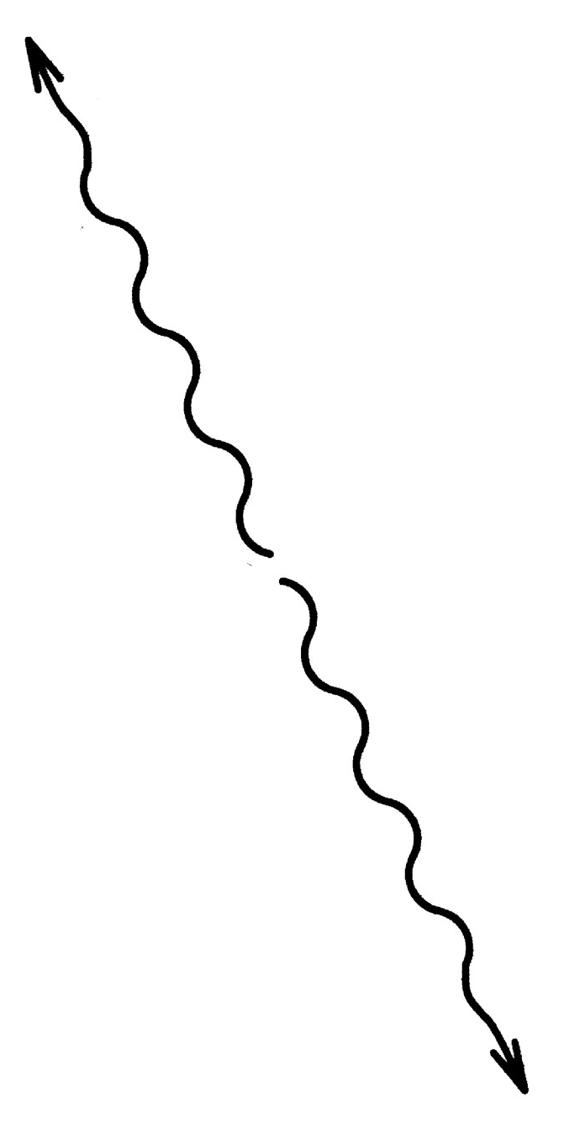
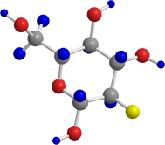
Detection of Molecular probes via PET
511 keV
γ-Photon
¹⁸F
¹⁸O
e⁺
e⁺
γ
e⁻
511 keV
γ-Photon
Notes:
As the radioisotope undergoes positron emission decay, it emits a positron, The emitted positron travels in tissue for a short distance, during which time it loses kinetic energy, until it decelerates to a point where it can interact with an electron.^{[53]} The encounter annihilates both electron and positron, producing a pair of annihilation (gamma) photons moving in approximately opposite directions.

Slide 10
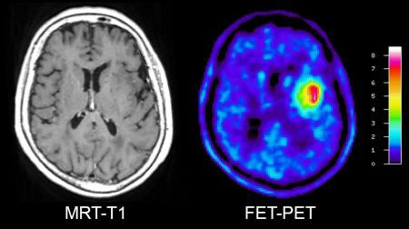
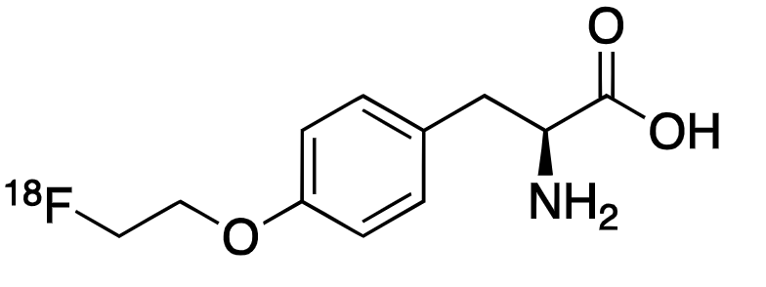
General aims of PET
MRI
Early detection and localization of metastases and therapy monitoring.
Molecular information about protein expression status, mutation status, vascularization, etc.
Fusion of anatomic and metabolic images together (PET/MRT, PET/CT)
Develop a theranostic approach for cancer diagnosis and treatment.
[¹⁸F]Fluoroethyl-L-Tyrosine

Slide 11
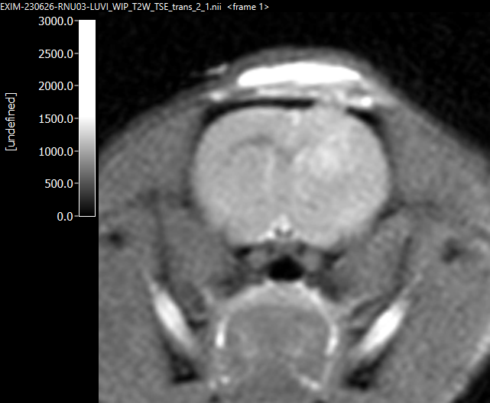
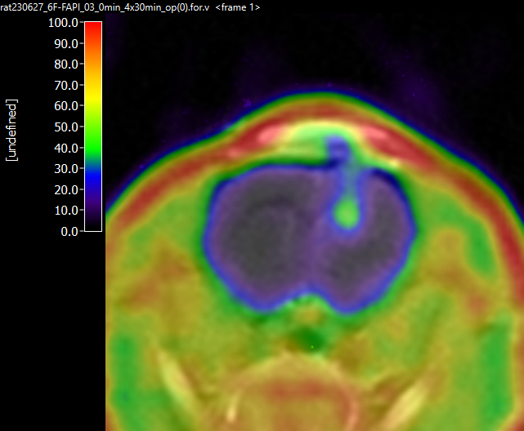
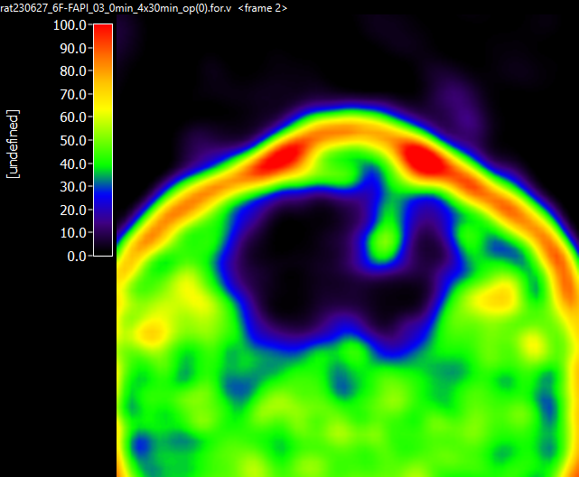
General aims of PET
MRI
Early detection and localization of metastases and therapy monitoring.
Molecular information about protein expression status, mutation status, vascularization, etc.
Fusion of anatomic and metabolic images together (PET/MRT, PET/CT)
Develop a theranostic approach for cancer diagnosis and treatment.
Fusion of PET / MRI
SUVbw
PET
Fusion of PET (6-[¹⁸F]F-FAPI) and MRT (T2w) images; U87 Glioblastoma model
SUVbw

Slide 12
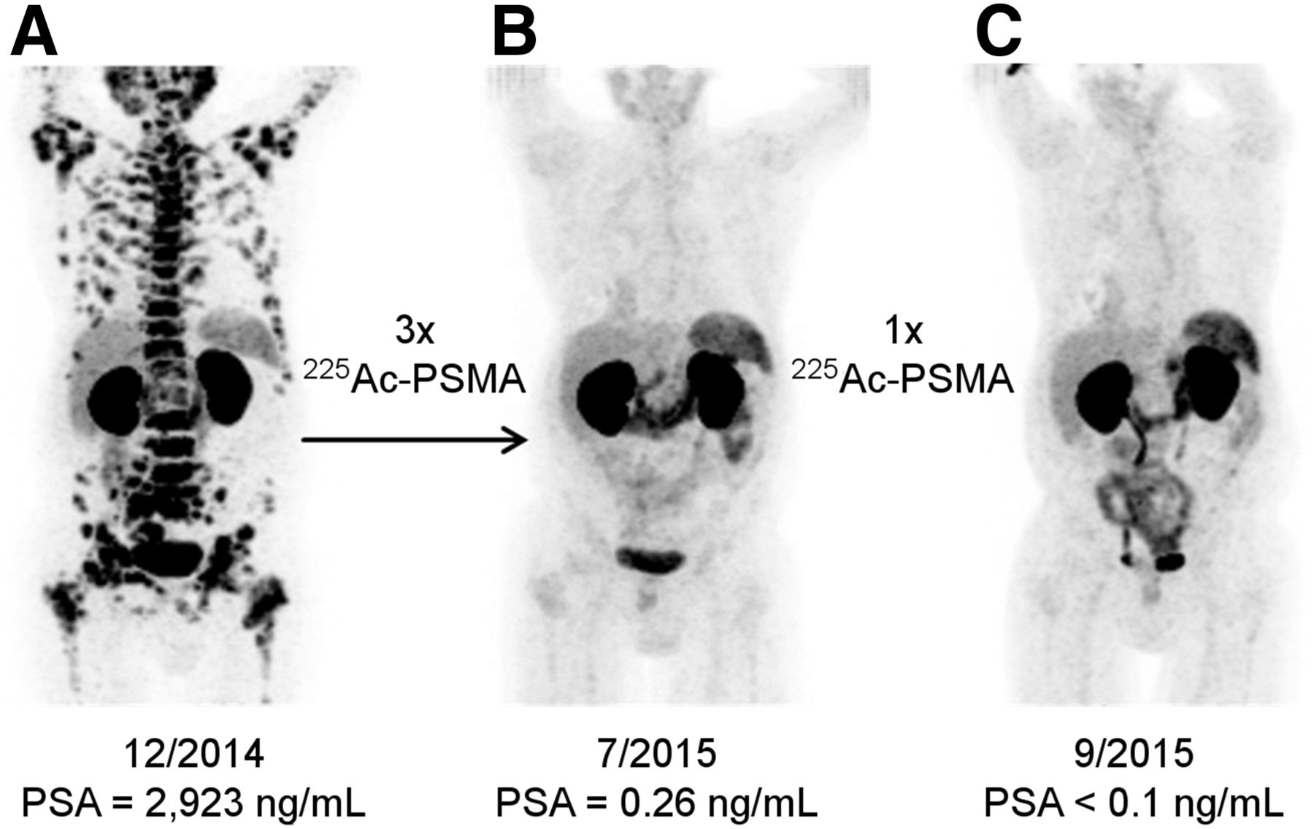
General aims of PET
MRI
[⁶⁸Ga]PSMA
Early detection and localization of metastases and therapy monitoring.
Molecular information about protein expression status, mutation status, vascularization, etc.
Fusion of anatomic and metabolic images together (PET/MRT, PET/CT)
Develop a theranostic approach for cancer diagnosis and treatment. (Same ligand could be labeled with both diagnostic or therapeutic nuclide)
Kratochwil et al. Journal of Nuclear Medicine December 2016, 57 (12) 1941-1944; DOI: https://doi.org/10.2967/jnumed.116.178673

Slide 13
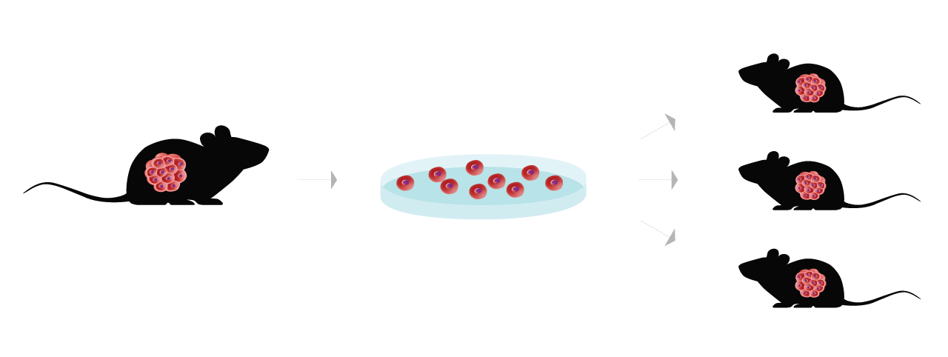
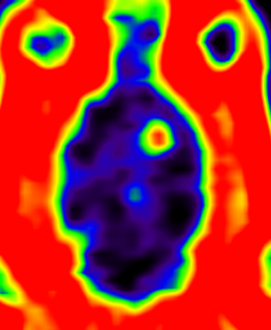
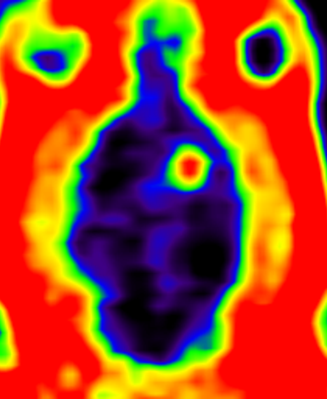
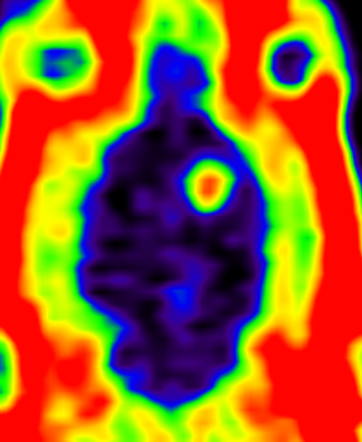
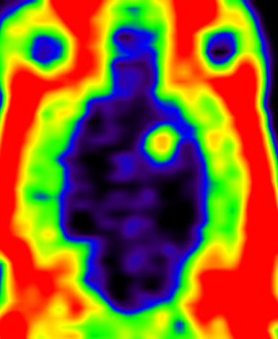
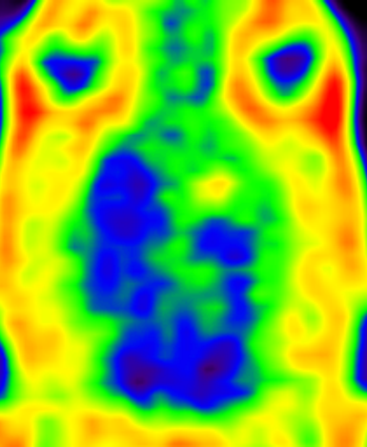
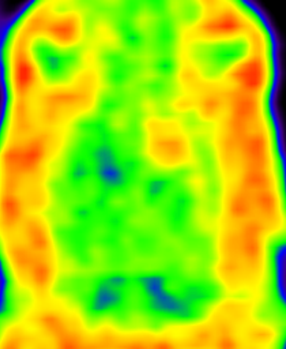
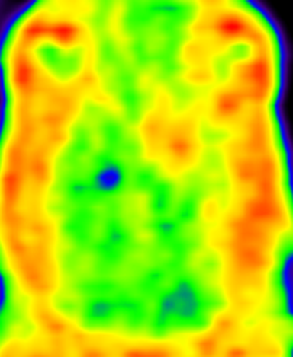
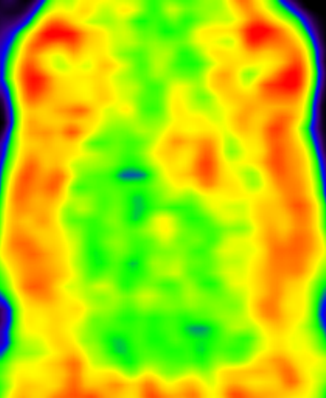

Preclinical Imaging
Pre-clinical model for testing
Pre-clinical evaluation
Comparison with existing standards
6-[¹⁸F]F-FAPI
[¹⁸F]FET
Notes:
Generate disease model system for pre-clinical evaluation of tracers
Plan appropriate PET measurements
Study pharmacokinetics and biodistribution of tracers
Statistical analyses of data pharmacokinetics, Time activity curves.
Comparison to existing standards (MRI, benchmark PET tracers from clinical practice)

Slide 14
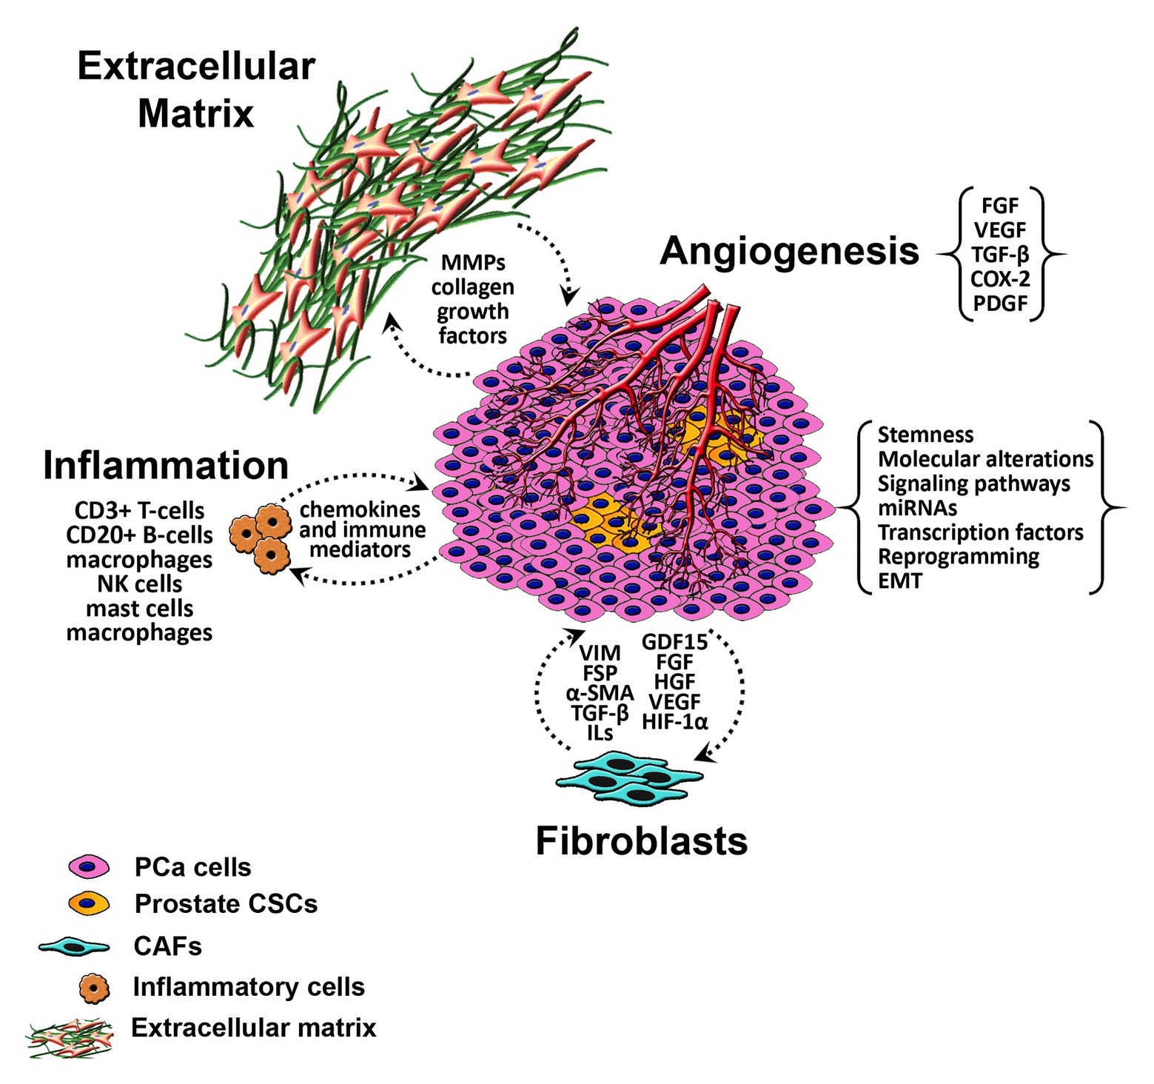
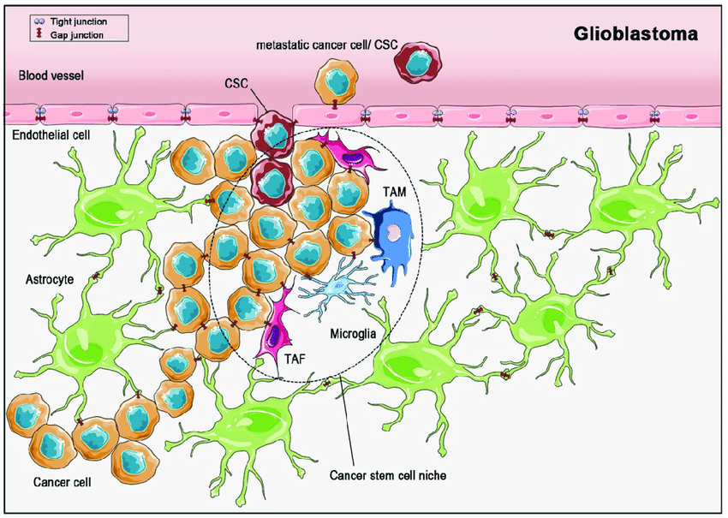
Overexpression of FAP in Glioma and Prostate cancer
1.
2.
Prostate Cancer
Abou-Kheir Wassim et al, Tumor Microenvironment in Prostate Cancer: Toward Identification of Novel Molecular Biomarkers for Diagnosis, Prognosis, and Therapy Development, Frontiers in Genetics, 12 , 2021
JOUR Beckmann et al., 2019/03/01, 288, Facets of Communication: Gap Junction Ultrastructure and Function in Cancer Stem Cells and Tumor Cell,s 11, 10.3390/cancers11030288, Cancers

Slide 15
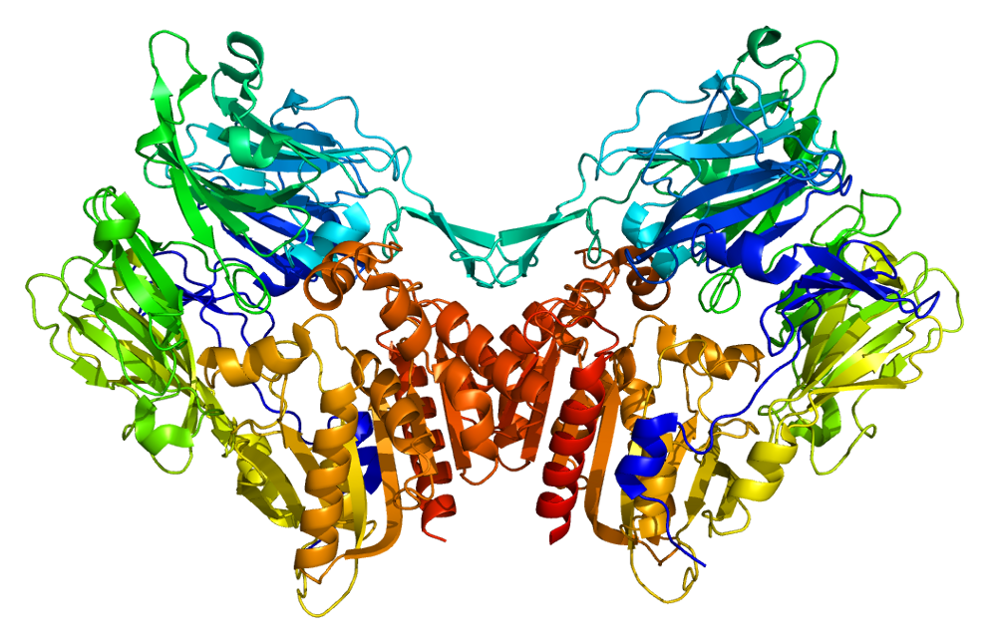
Fibroblast activation protein (FAP)
Type II transmembrane serine protease and consists of
760 amino acids
Belongs to the
prolyl oligopeptidase family
Highly expressed in cancer-associated fibroblasts (CAFs) and absent in normal tissues
→ promising target for radionuclide-based approaches to tumor diagnostics and therapy
Fibroblast activation protein (FAP)
Notes:
For our project as a first target we chose fibroblast activation protein. It is essential to know that this molecule is highly expressed in cancer-associated fibroblasts ans is absent on normal tissue. It is promising target dor radionuclidebased approaches to tumor diagnostic an therapy.

Slide 16
Ligand selection
Molecular Charachteristics
Size of molecule
Affinity
Penetration
Kinetics
Selectivity
  Clinical Perspectives
  High in vivo stability
  Fast excretion
  High and persistent tumour accumulation
IC50(FAP)=3.2 nM
Oral bioavailability in rats 51%
Circulating half-life 3.2 hours
UAMC-1110, Jansen et al.
Notes:
UAMC-1110 is the FAP inhibitor. It blocks the receptor, and we used it as a basis of precursor, after modification of radiolabeling we‘ve got multiple derivativesbasedon UAMC, In clinical research only two of the FAPI s are in studying process.
which is a novel, potent and highly selective inhibitor of fibroblast activation protein (FAP) with IC50 of 3.2 nM; it also inhibits prolyl oligopeptidase (PREP) with an IC50 of 1.8 μM. . The log D values, plasma stabilities, and microsomal stabilities of SP-13786 were found to be highly satisfactory. Pharmacokinetic evaluation in mice of SP-13786 demonstrated high oral bioavailability, plasma half-life, and the potential to selectively and completely inhibit FAP in vivo.

Slide 17
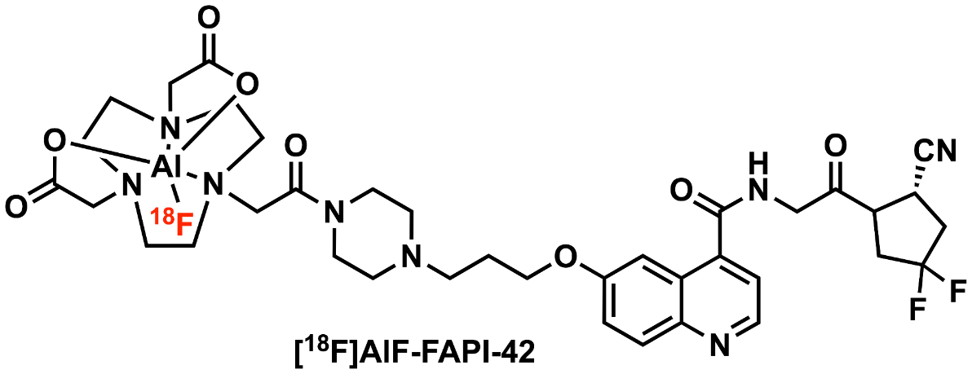
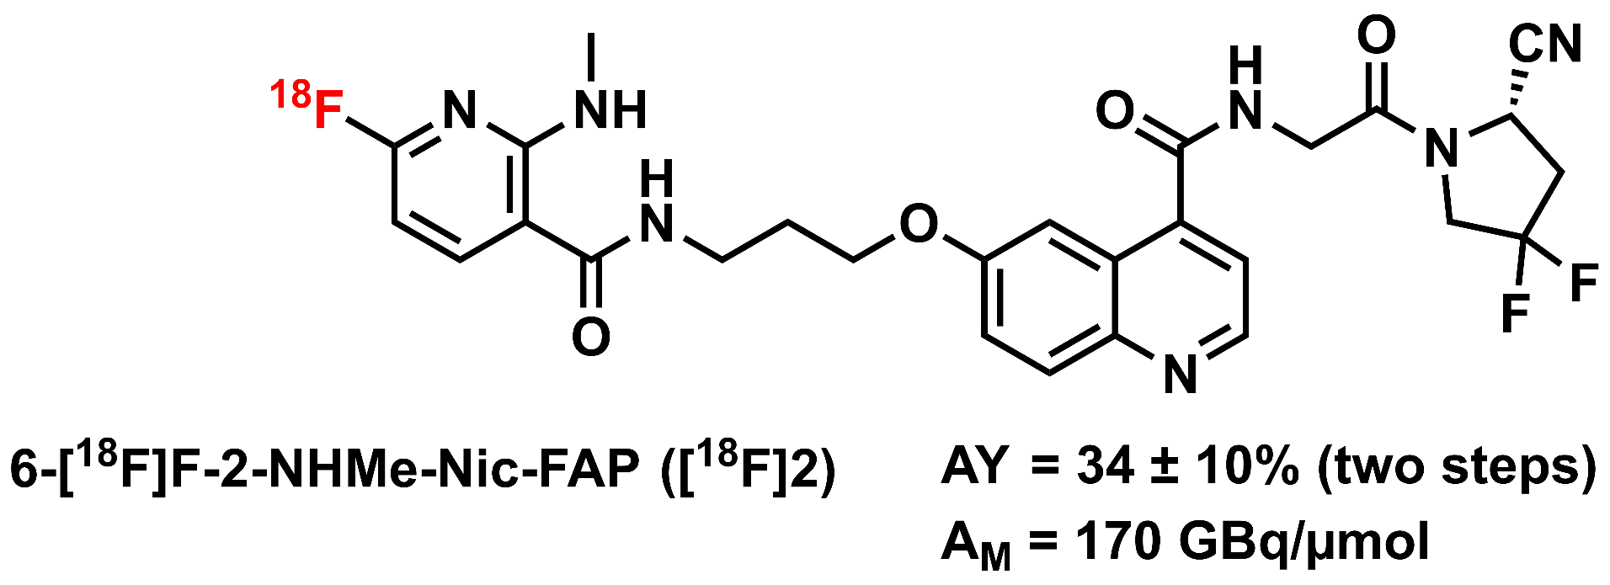
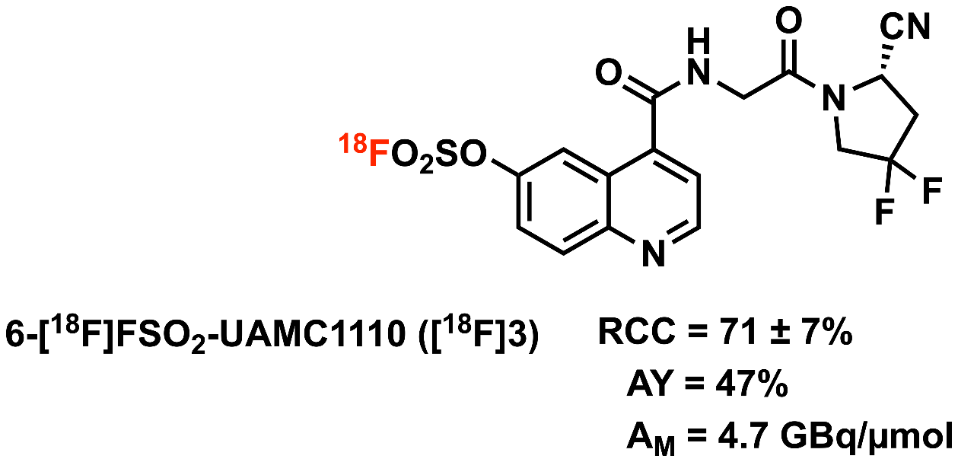
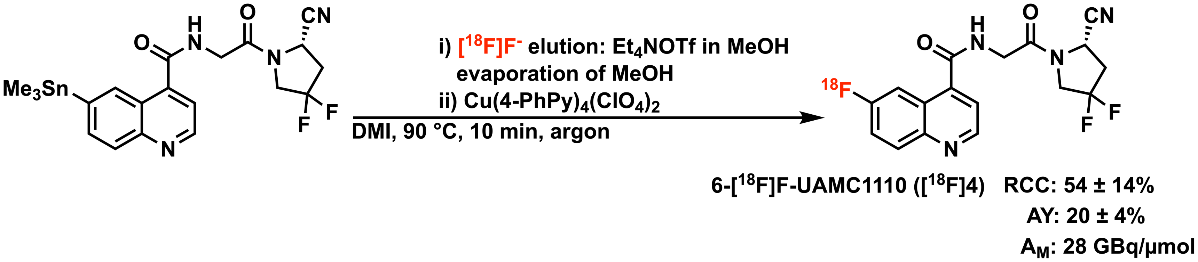
Development of FAP inhibitors
linker
Radionuclide
[¹⁸F]1 (AY 35-40%)
ligand
ligand
Radionuclide
Notes:
In our lab we developed fAP inhibitor with severa strategies. UAMC indirect labeling,which means with chelator, prostethic group or SuFEx, and direct labeling the UAMC.
[¹⁸F]AlF-labeled FAPI derivatives represent powerful tracers for PET. Owing to an excellent performance in PET imaging, and among them ALF-FAPI-42 is one of the best candidate for tumor imageing.
But our goal is to develop new FAPI tracers with same abilities and without chelator. Since factors like molecular size or polar surface area can strongly affect the pharmacokinetics and biodistribution of radioligands, such tracers could have certain advantages (e.g., better tissue penetration, improved passive transfer across the blood-brain barrier ) over existing FAPI-PET ligands.
Radiochemichal conversion
AY = Activity yield
Am = Activity(molar)

Slide 18
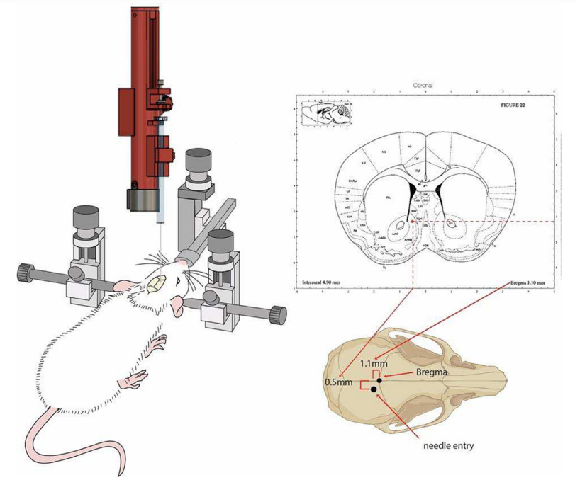
U87 glioblastoma orthotope tumor model
Stereotactic surgery
Implantation of U87 glioblastoma cells.
Evaluation of animal condition with a scoring system.
Salvador Hernández-López et al., Arduino based intra-cerebral microinjector device for neuroscience research,HardwareX, Volume 15,2023
Notes:
For evaluation of newly developed fap inhibitors we chose U87 glioblastoma orthotope tumor model. We usedimunocompromised rats and injected Stereotaxic surgery U87 gB cells. The animal is mounted on the apparatus and the lambda reference point is located, which is the point between the crossing of the sagittal and coronal suture. From this point on, the atlas of stereotaxic surgery maps all the structures of the brain in the three XYZ planes.
In the period of 10 days we evaluated tumors via MRI and check the size of the tumor, if the volume is enough we do PET measurements with

Slide 19


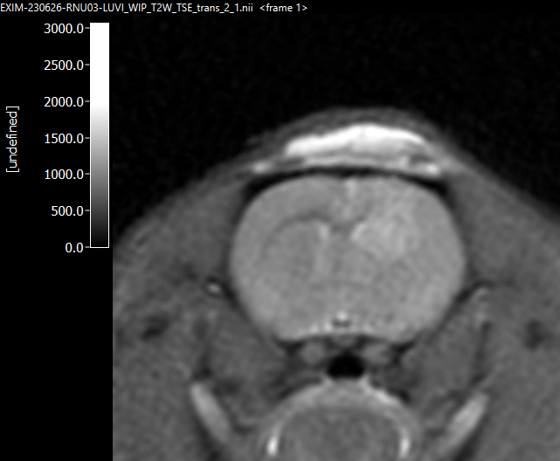
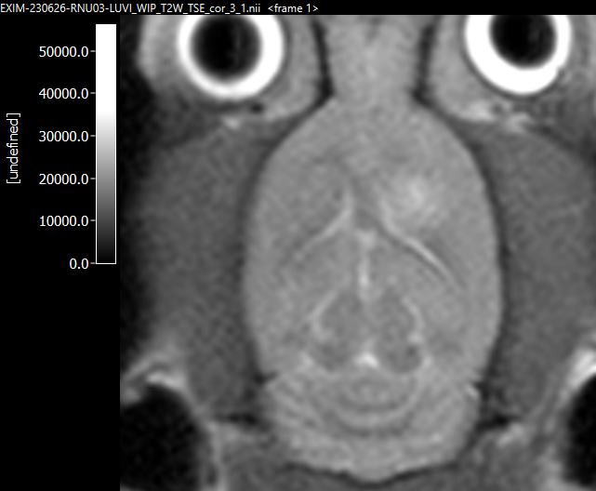

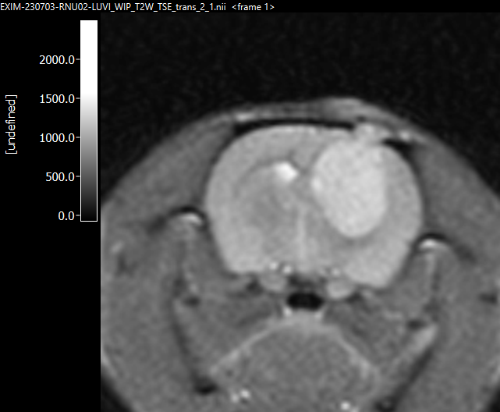
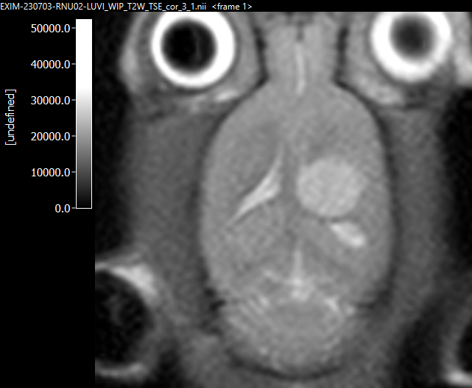
MRI measurements
T
MRI, T2W(anim. 04)
MRI, T2W(anim. 04)
T
T
T
T
MRI, T2W(anim. 02)
MRI, T2W(anim. 02)
Notes:
In the period of 10 days I evaluated tumors via MRI and check the size of the tumor, to be sure that the disease model was done successfuly

Slide 20
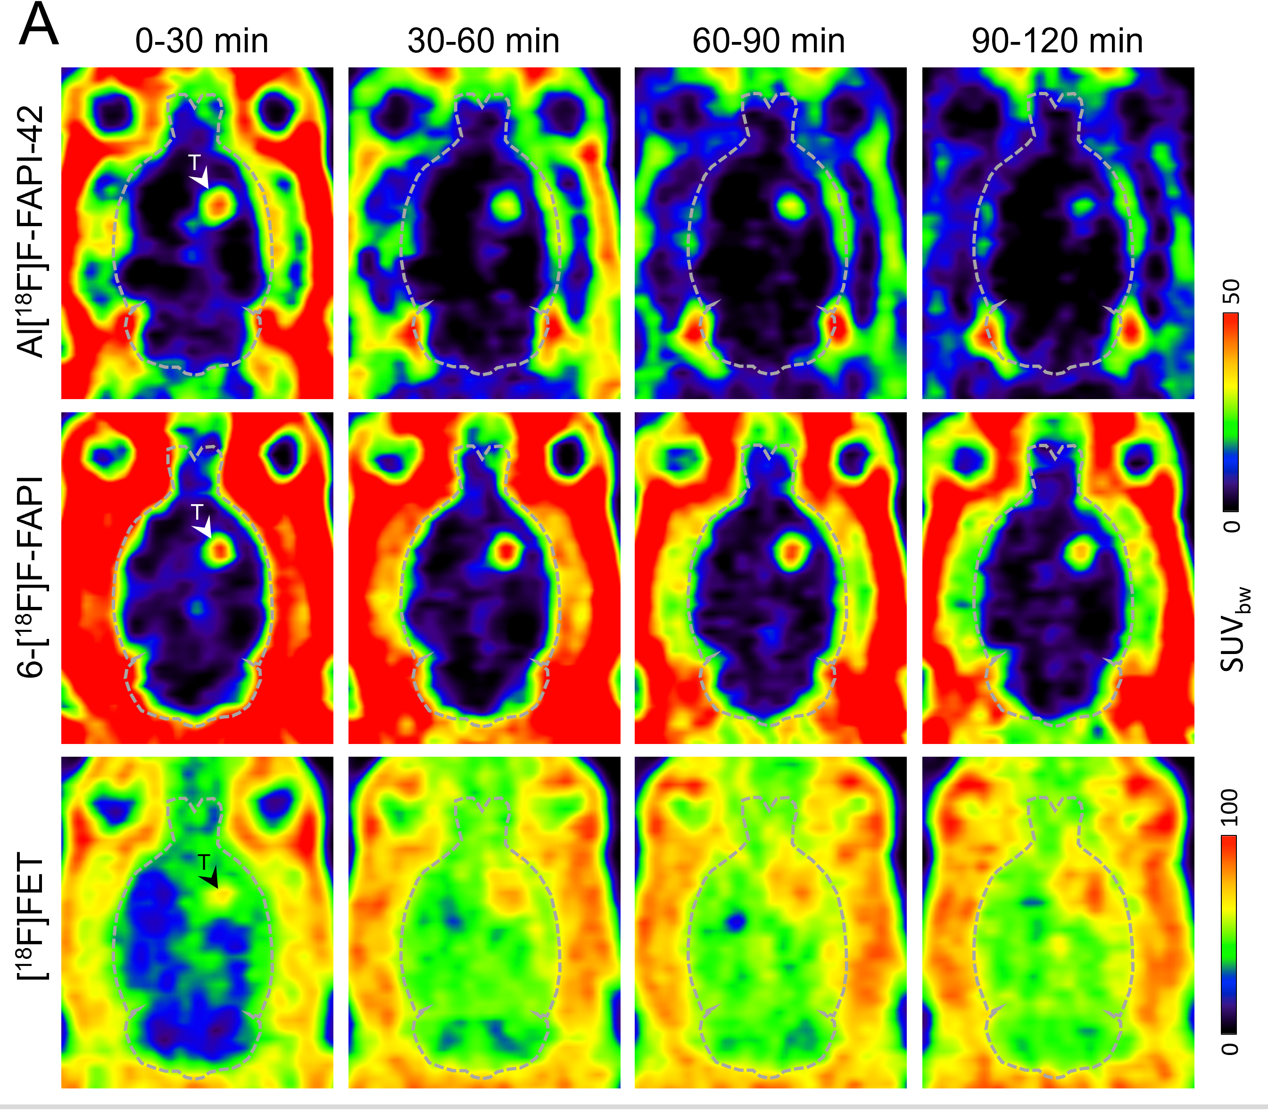
Animal - PET measurements
γ
γ
Analyse images (SUVbw, Volume of Tumor and etc.)
Fuse MRI and PET
γ
β⁺
e⁻
γ
γ
γ

Slide 21

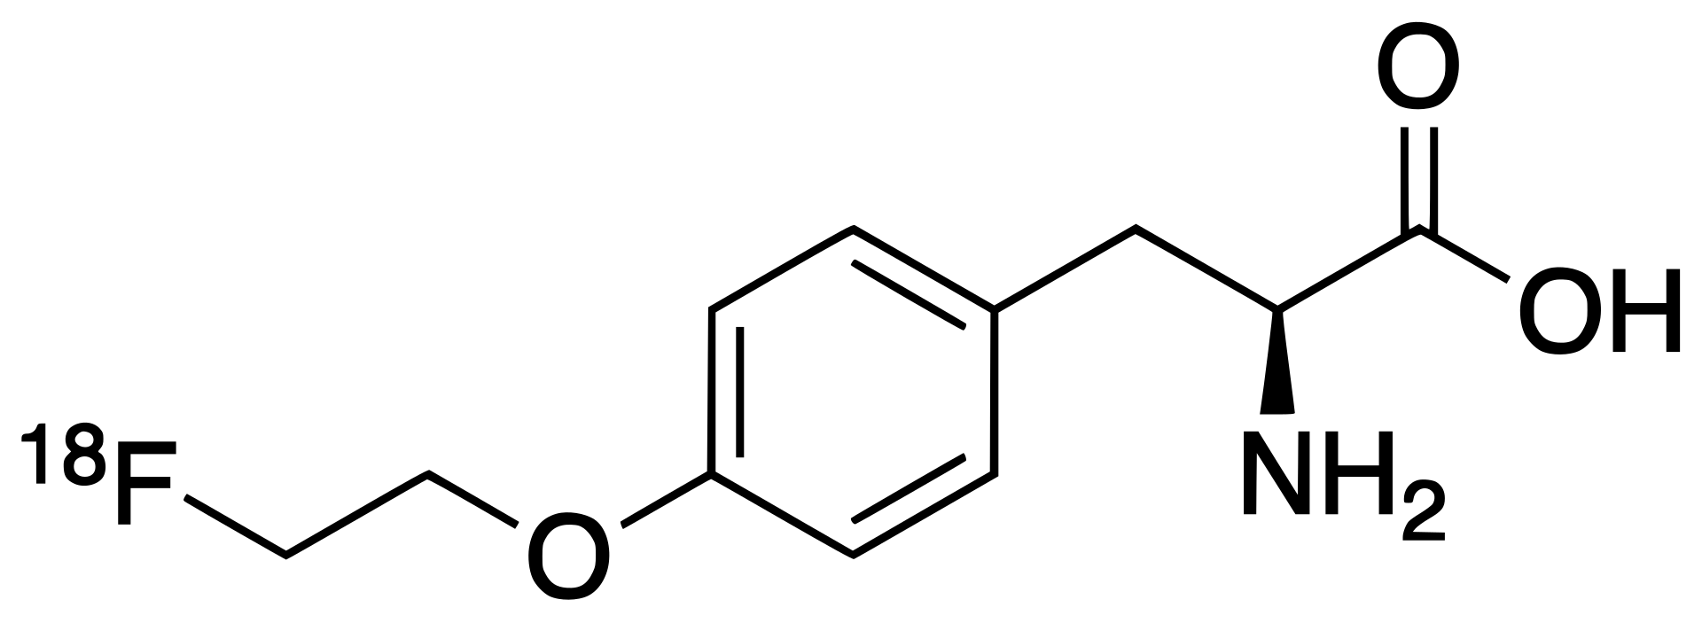
Results
“Gold standard”
Notes:
Here you see PET scannings of three different tracers first two represent FAP inhibitors and the last row FET benchmarked tracers, which shows proteinsynthesis activity in tissue and not special target. In compare to this sacnnings FAP inhibitors show different images and process which could be used for very precise location of tumors. Among fap inhibitors direct labeld FAP inhibitor showed better background brain to tumor ratio , which requires more investigation, if this tracer is specific for CNS tumors.
BBB is damaged in human?????

Slide 22
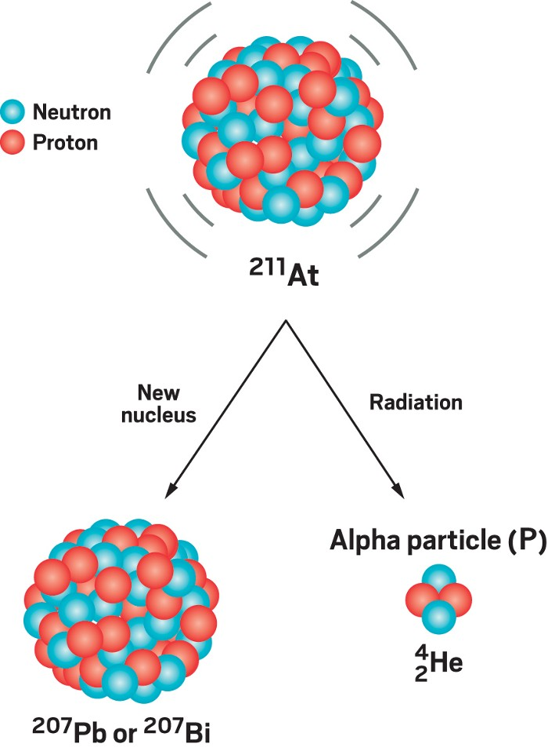
Next steps
Therapy with Astat-211

Slide 25
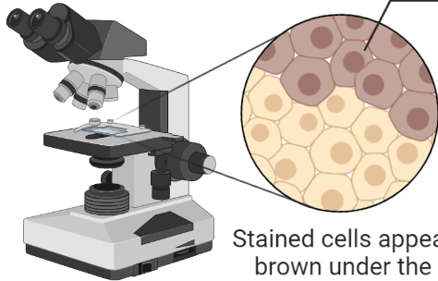
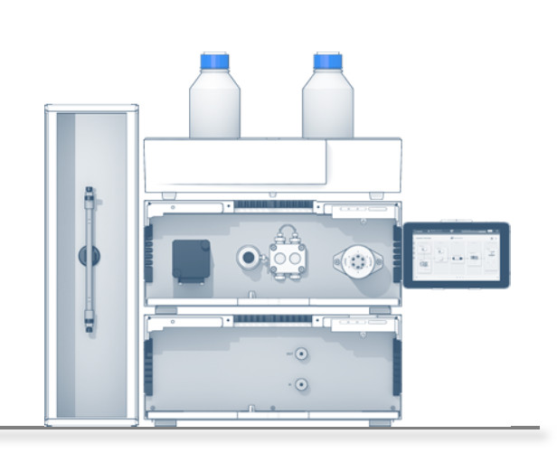
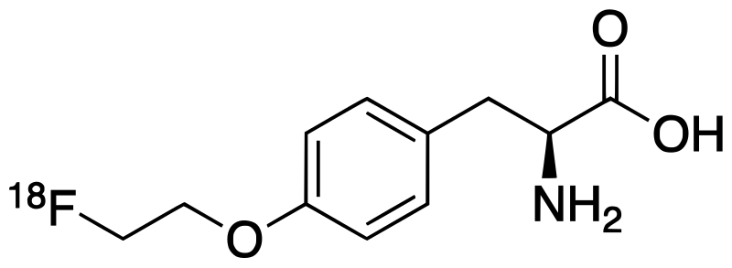
Workflow of Molecular Probe Development
Identification of appropriate molecular targets
Selection of ligand precursor
Development of labelling strategies
Pre-clinical model for testing
Pre-clinical evaluation
Comparison with existing standards
6-[¹⁸F]F-FAPI
[¹⁸F]FET

Slide 26
Outlook
Diagnosis
Therapy
Radionuclide(α,β/γ)
¹³¹I
¹⁷⁷Lu
⁹⁰Y
¹⁵³Sm
β
γ
^{99m}Tc
¹²³I
⁶⁷Ga
¹⁸F
⁶⁸Ga
Linker
Ligand
²²⁵Ac
²²³Ra
α
Therapy+Diagnostics = Theranostics
Modern concept of theranostics
Target(NIS,SSTR, PSMA, NTSR, etc)
Cancer cell
Notes:
However, in the literature, the term theranostics has been more frequently associated with some in vivo nuclear medicine oncologic applications; [3] This process remains the utilization of different radionuclides (i.e. diagnostic nuclides such as ¹⁸F and therapeutic nuclides such as ¹⁷⁷Lu), which are coupled to molecular probes selectively binding to tumor cells or cancer-associated fibroblasts [4]. Positron emission tomography (PET) visualizes the accumulation of ¹⁸F-labeled probes (PET-tracers) in cancerous tissue, while the same probes labeled with a therapeutic nuclide serve as radiotherapeutics to eliminate cancer cells through short range ionizing radiation [3,4].
26

Slide 29
Specific aims of the project
Generate disease model system for pre-clinical evaluation of tracers
Plan appropriate PET measurements
Study pharmacokinetics and biodistribution of tracers
Statistical analyses of data pharmacokinetics, Time activity curves.
Comparison to existing standards (MRI, benchmark PET tracers from clinical practice)

Slide 30
GGSB-PLUS
INM4/IAS-8 & KIU¹
SMART|Biomedical Imaging_Lab
INM-5/IREMB/HZDR & TSU²
SMART|Biomedical Tracer_Lab
KIU
Image Reconstruction/ Processing and Machine Learning
GTU/TSU/NCS
Quantitative Magnetic Resonance Imaging
(qMRI), MRI
Design & Synthesis
Clinical development
xxx
Animal
PET
TSU (Dep. of Organic chemistry)
Precursor synthesis
TSU (Med. Fac. /Institute of Morphology)
Tissue Bank
xxx/GTU
Education and Training Lab
Earth‘s Field MRI
INM-4
MR-PET
INM-4/IAS-8/KIU
Fast Image Reconstruction
TSU (Med. Fac. /Todua Clinic)
Tissue Bank, PET data
INM-4/INM-5
Human MR-PET Data Acquisition
TSU/INM-5/HZDR
Radiosynthesis
INM-4/IAS-8/KIU
Software Development for qMRI
INM-4/NCS/TSU
Clinical Applications and Human Data Acquisition
NCS/Molltek
Cyclotron, PET Data
TSU (Dep. of Morphology)
Animal model, IHC
Notes:
1mm lesions!
30

Slide 31
INM-5/UK-Köln/HZDR/
SMART|Biomedical Tracer_Lab
Design & production
Identification of an appropriate target.
Selection of precursor ligands.
Development of labelling strategies.
Optimization of labelling
GMP conform synthesis
Clinical Development
Definition of clinical need
Establishment of an appropriate pre-clinical model for testing
Evaluation in an appropriate clinical setting
Comparison with existing standards
Documentation of safety and efficacy.
Design & Synthesis
Clinical development
TSU/Dept of phys. & analyt. chemistry
Precursor synthesis (2, 3)
TSU/ Dep. of Morphology (1, I, II )
TSU/INM-5/HZDR
Radiosynthesis (2,3)
TSU/ Med. Fac. / Todua Clinic (1, I, IV)
“Eristavi National Surgery center”/Aversi Hospital/Moltek (I, IV, 3)
TSU/ Med. Fac. /Institute of Morphology (1, I)
Work without radioisotopes
Work with radioisotopes

