Slide 1
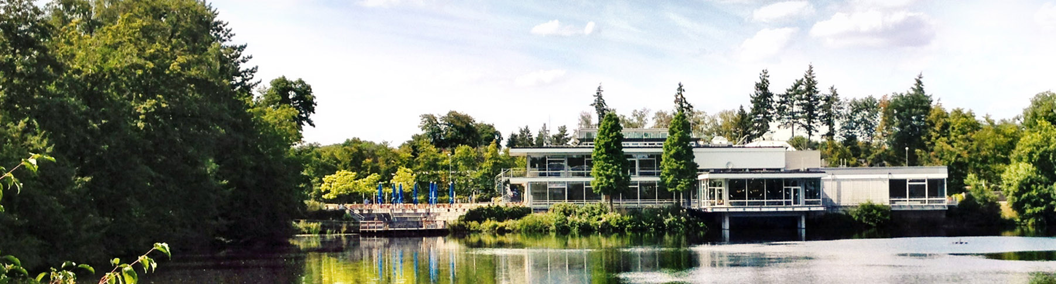
PET and PET/MR in Neuroscience
Quantitative Hybrid MR/PET Imaging
Kutaisi, Georgia, September 12, 2024 I Christoph LErche
Notes:
I would like to thank everyone who has made it here today and who is interested in my presentation

Slide 2

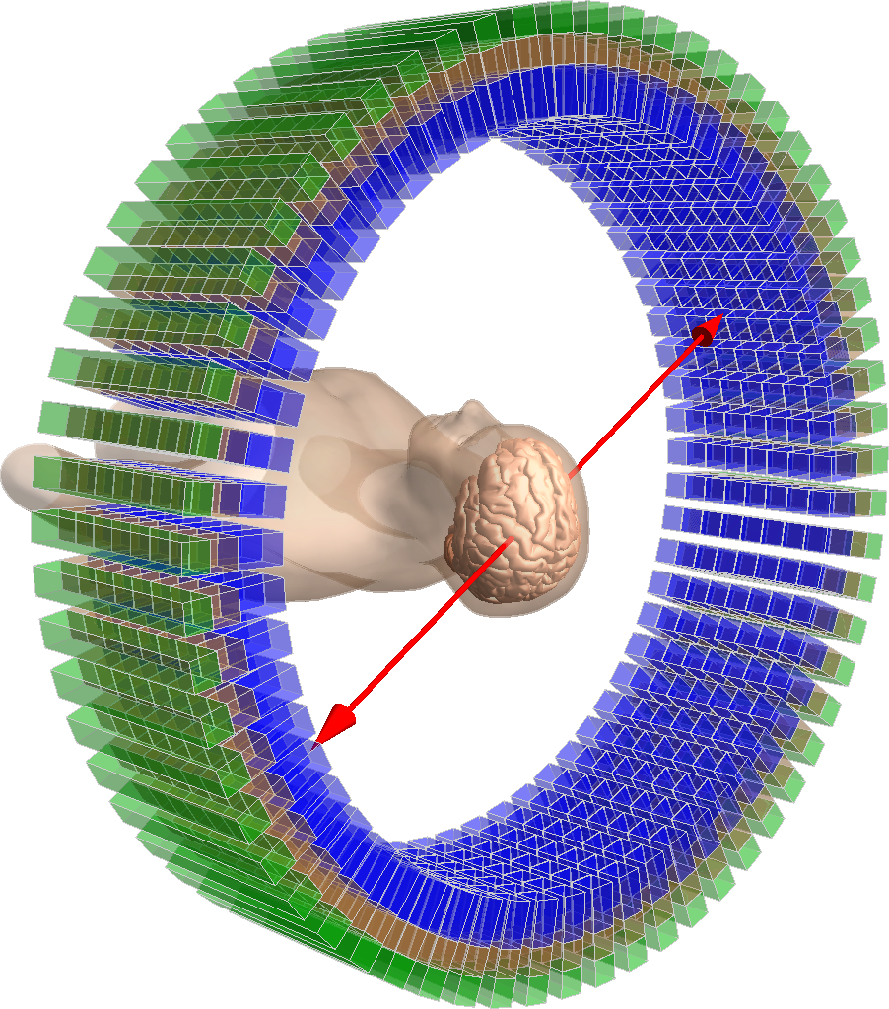
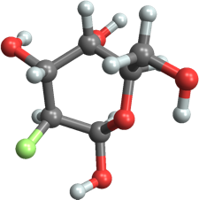

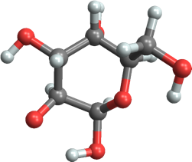




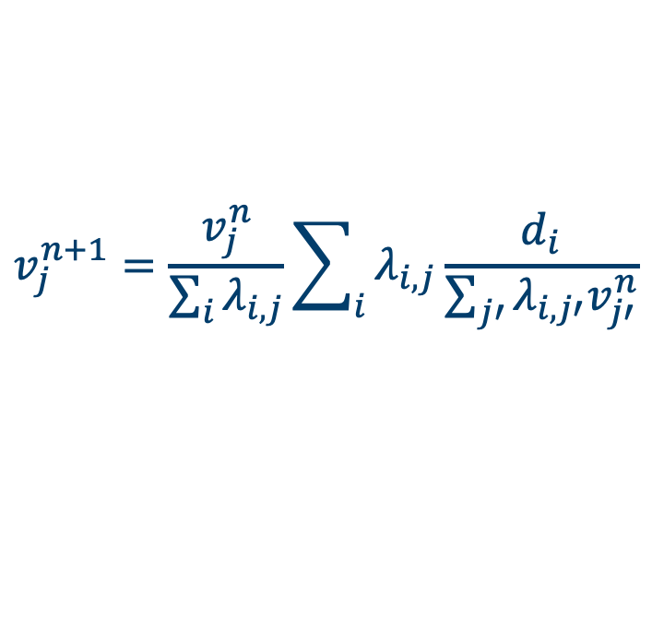




Positron Emission tomography in a Nutshell
Operating Principle of Positron Emission Tomography (PET)
Coincidence Unit
≈ 500･10⁶
Coincidences
LOR histograms
or
Sinograms
$$δt$$
Line of Response
[¹⁸F]FDG (Flourodeoxyglucose)
Image reconstruction (ML-EM)
(Maximum Likelihood – Expectation Maximisation)
(LOR)
Image voxel value j
(decays)
$$γ (511 keV)$$
System matrix
(probability)
Coincidence counts in LOR i
$$v_{j}^{n+1}=\frac{v_{j}^{n}}{\sum_{i}{λ_{i,j}}}\sum_{i}{λ_{i,j}\frac{d_{i}}{\sum_{j′}{λ_{i,j′}v_{j′}^{n}}}}$$
Tracer Principle:
concentration of contrast agent very low
⇒ does not alter biological system
(Nobel Prize Chemistry, 1943, George De Hevesy)
$$e^{+}$$
$$e^{−}$$
Shepp and Vardi. IEEE transactions on medical imaging 1.2 (1982): 113-122.
$$γ (511 keV)$$
Tissue atom
Notes:
Mention tracer principle here

Slide 3
Simplified Receptor Occupancy Theory
Competition between (reversible) tracer and endogenous neurotransmitter release
Endogenous neurotransmitter release (cognitive task)
Neurotransmitter
Radioligand
(tracer)
Neurotransmitter
Radioligand
(tracer)
Neurotransmitter
Synaptic gap
Synaptic gap
Synaptic gap
20 nm
Postsynaptic neuron
Receptors
Postsynaptic neuron
Receptors
Postsynaptic neuron
Receptors
100×100 nm²
Bound activity concentration
total number of synapses in the brain: ~150×10¹²
Base-line (steady state)
⇒ Displacement of reversible tracer
Time
Notes:
Average number of neurons in the brain = 86 billion
Average neuron has about 1000 synapses, total number of synapses ~150×10¹² trillion
Typical size of synaptic cleft : 100 ×100 × 20 nm³

Slide 4
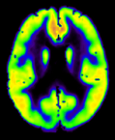
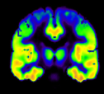
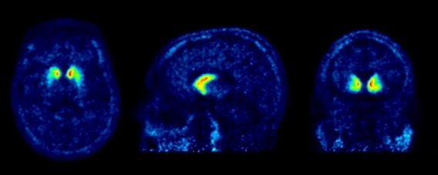
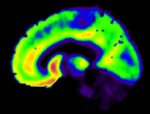
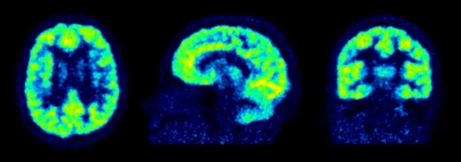
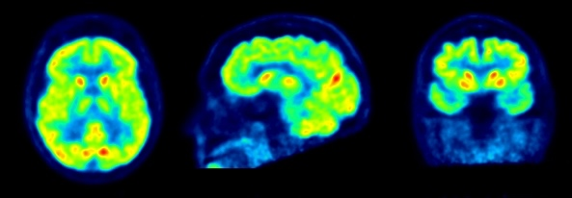
PET Application – Neurology/Neuroscience
Imaging neurotransmitters, neuroreceptors, metabolites, and neuroreceptor occupation
mGluR5: Metabotropic glutamate receptor 5
Glutamate
most abundant excitatory neurotransmitter in the human brain
[¹¹C]ABP688 (mGluR5)
[¹⁸F]Fallypride (D₁/D₂)
Dopamine
relevant in addiction, reward, Parkinson's disease and others
Kim, Song E., et al. Brain Structure and Function 225 (2020): 1805-1816.
GABA
most abundant inhibitory neurotransmitter in the human brain
[¹¹C]FMZ (GABA_{A})
[¹⁸F]FDG (glucose)
Glucose
Brain energy metabolism
GABA: γ-Aminobutyric acid

Slide 5
Depression – Example for A multifactorial Disease
Pathophysiology
Aetiology
Neurotransmitters
5-HT (Serotonin)
DT (Dopamine)
NA (Noradrenaline)
Glu (Glutamate)
GABA (Gamma Aminobutyric Acid)
Genetics
Epigenetics
Stress
Trauma
etc.
Altered connectivity
(prefrontal cortex – limbic)
Inflammation
Hypothalamic-Pituitary-Adrenal axis hyperactivity
Reduced neuroplasticity
Möhler, Hanns. "The GABA system in anxiety and depression and its therapeutic potential." Neuropharmacology 62.1 (2012): 42-53.
Dean, Jason, and Matcheri Keshavan. "The neurobiology of depression: An integrated view." Asian journal of psychiatry 27 (2017): 101-111.
Notes:
suicides Germany approximately 9000, worldwide: 700.000
The economic burden of MDD (major depressive dissorder) in the United States in the year 2000 was estimated to be 83.1 billion dollars, with 26.1 billion dollars (31%) directly related to medical costs, 5.4 billion dollars (7%) related to suicide, and 51.5 billion dollars (62%) due to workplace costs including absenteeism and reduced productivity
The ability of neurons to modify the strength of existing synapses, as well as form new synaptic connections, is called neuroplasticity. Defined in this way, neuroplasticity includes changes in strength of mature synaptic connections, as well as the formation and elimination of synapses in adult and developing brains.

Slide 6
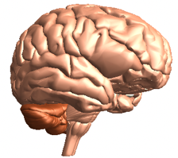
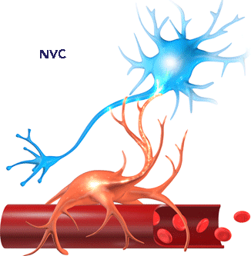
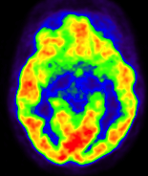
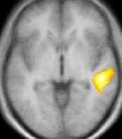
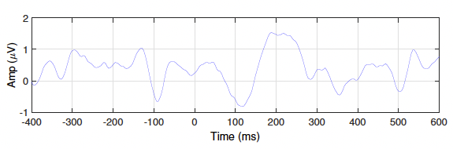
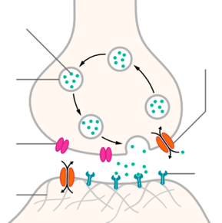
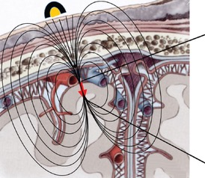
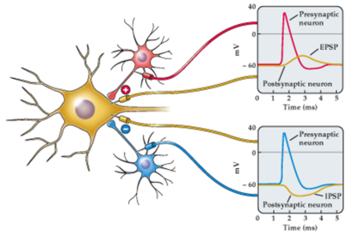
Combining Imaging of the Parts of Cerebral Communication
Functional MRI, PET and EEG
Molecular level
Analysis of chemical neurotransmission
Systemic level
Analysis of centers of cerebral data processing
Domain of PET
(Receptor density/occupancy)
Domain of fMRI (BOLD Effect)
Electrical level
Analysis of temporal signatures of neurotransmission
Neuron
Neurovascular coupling
Domain of EEG
(Evoked potentials)
Neurotransmitter
Axon terminal
Astrocyte
Neurotransmitter
transporter
Electrical field
Synaptic vesicle
Hemodynamic response
Electrode
Cranium
Synapse
Voltage-
gated
channel
Synaptic cleft
Blood vessel
Receptor
Image adapted from https://www.cognitivefxusa.com/blog/neurovascular-coupling-the-secret-to-recovering-from-a-concussion
post synapse
Cortex
Image adapted from S. Beniczky, et al. Epileptic Disorders
22.6 (2020): 697-715 and L. Peicha, “Movement Decoding from EEG:
Target or Direction?”, MSc. Thesis, Institute of Neural Engineering, Graz, (2017)
Notes:
PET: Can be used to measured the receptor availability under different conditions, for instance before and after pharmacologic or cognitive challenges
fMRI: reflects the oxygen extraction from the blood and is therefore expected to be linked to the activity of neurons by oxygen consumption
EEG: reflects voltage changes resulting from synchronous firing of groups of neurons

Slide 7
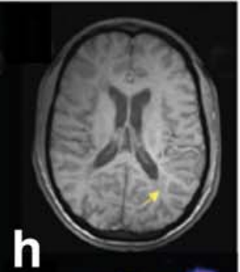
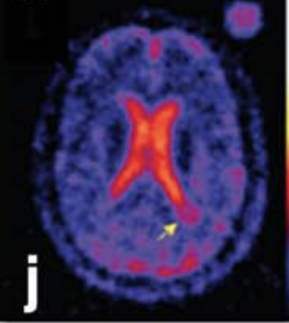
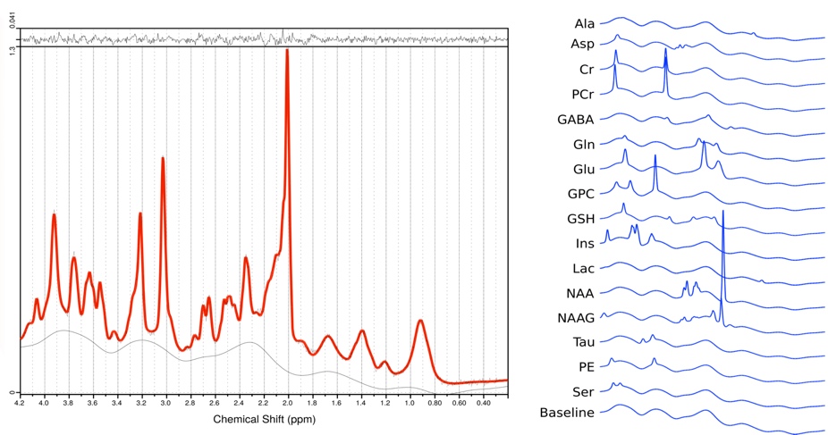
Advanced MRI Methods
functional MRI, Spectroscopy, and X-Nuclei Imaging
fMRI at 7T
MRS at 7T
Nuclei ²³Na, ³¹P, ¹⁹F, …
Energy metabolism
Glucose
Lactate
Alanine
Phosphocreatine
Creatine
Neurotransmitters
Glutamate
Glutamine
GABA
Aspartate
Glycine
Serine
N-acetylaspartate-glutamate
Example: Sodium Imaging
Finger tapping study @ 7T
^{NeuroImage 168 (2018) 181–198}
Madelin, et al. JMRI, 2013
Others:
Structural imaging with excellent spatial resolution and soft tissue contrast
Vessel imaging
Perfusion weighted imaging
Diffusion weighted imaging
(tractography)
Image courtesy of P. País Roldan, INM-4, Forschungszentrum Juelich GmbH
With courtesy of E.Farherr, INM-4, Forschungszentrum Juelich GmbH

Slide 8
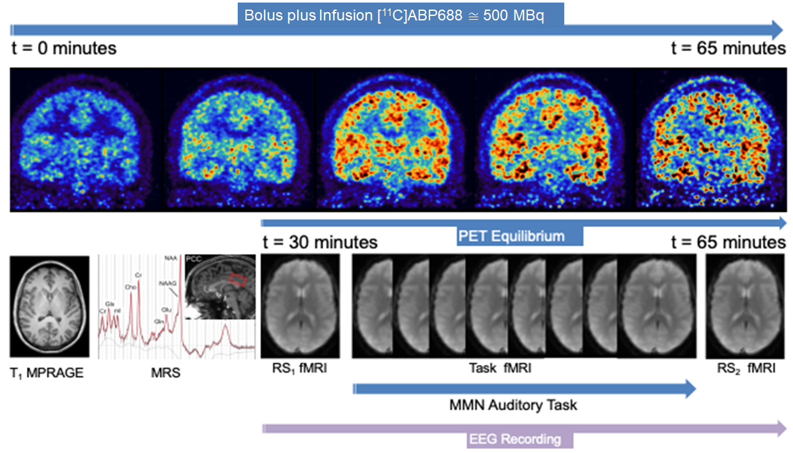
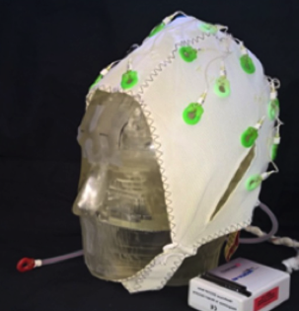
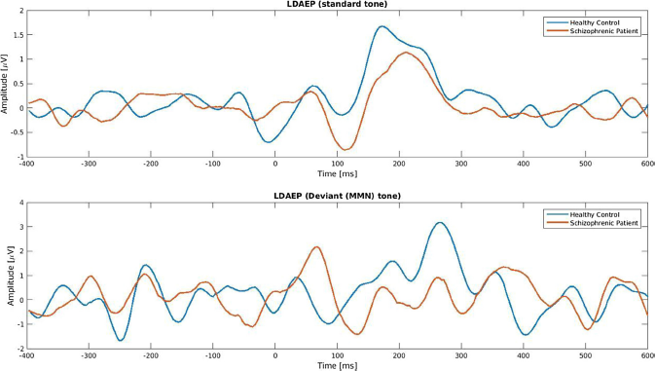
Typical Multimodal MR/PET/EEG Study Protocol
[¹¹C]ABP688 PET + fMRI (Resting state vs. task) + EEG (Event related potentials) + MRS
schizophrenic patient
Challenge
(tone)
healthy control
standard tone
Amplitude [µV]
deviant tone
Amplitude [µV]
C. Régio Brambilla, et al. "mGluR5 binding changes during a mismatch negativity task in a multimodal protocol with [¹¹C] ABP688 PET/MR-EEG." Translational Psychiatry 12.1 (2022): 1-10.
time [ms]
Del Guerra, Alberto, et al. "TRIMAGE: A dedicated trimodality (PET/MR/EEG) imaging tool for schizophrenia." European psychiatry 50 (2018): 7-20.
L. Orth, “Multimodal Metabolic Imaging Using Single Voxel MRS, DTI and [11C]ABP688 PET in Schizophrenic Patients”, Master Thesis, Research Centre Jülich GmbH, Germany

Slide 9
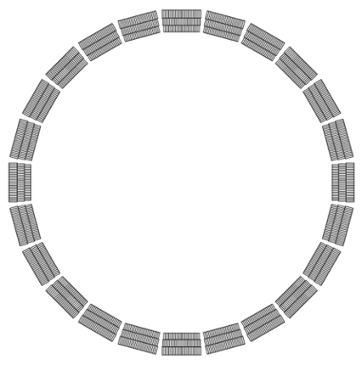
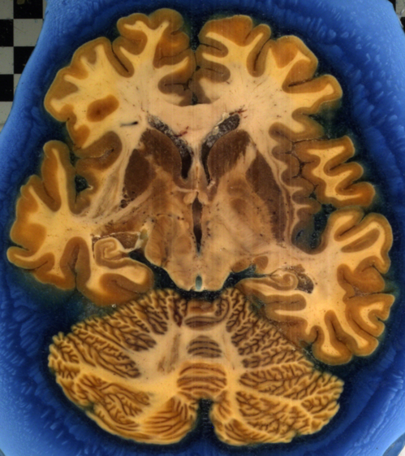
Spatial Resolution And Sensitivity for Brain PET
Receptors mainly located in cortex
(grey matter)
Cholinergic muscarinic M2 receptors in human brain (coronal sections)
Requirement for new Development
Image courtesy of Markus Axer,
Institute of Neuroscience and Medicine 1,
Forschungszentrum Juelich GmbH
15,5 cm
13,5 cm
Autoradiography
Zilles et al., Nature Reviews Neuroscience 11.2 (2010): 139.
Minimize Partial Volume Effect:
2 FWHM (spatial resolution) ≲ imaged structure

Slide 10
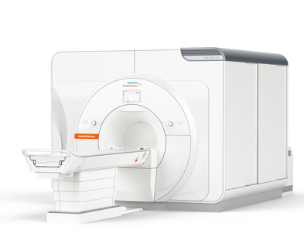
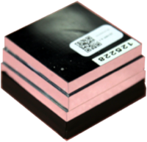
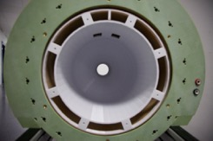
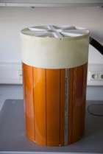
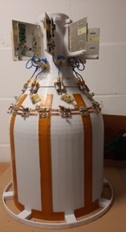
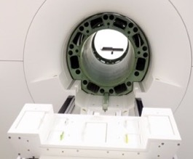
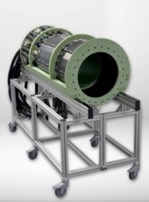
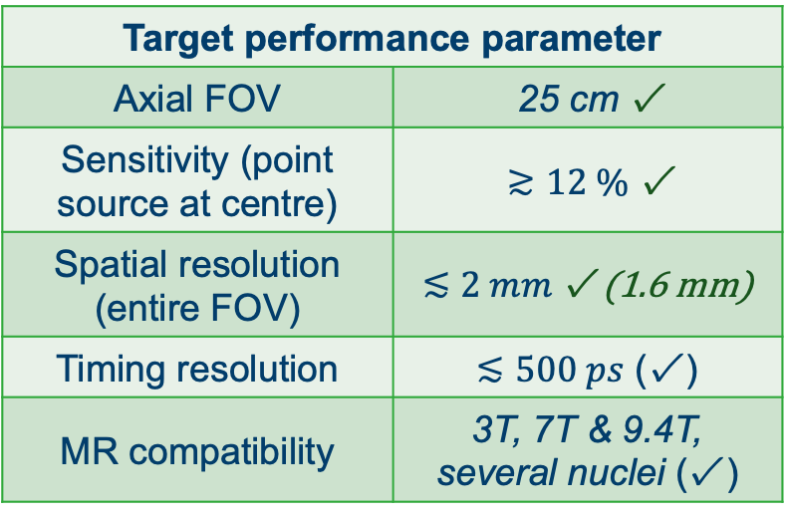
Simultaneous MR-PET-EEG Imaging – 2nd Generation
A high performance Ultra High-Field MR compatible PET insert for neuroscience
High resolution detectors
LSO, 24 mm thickness 3 layers,
2 mm pitch, digital SiPMs
Helmholtz Validation Fund HVF 0051
Innovation Go “BrainPET 7T”
Siemens Magnetom Terra 7T
PET Transparent RF Coil
8 channel dipole TX/RX array, PET transparent
Target performance parameter | 25 cm
Axial FOV | 25 cm ✓
Sensitivity (point source at centre) | $≳12 \%$ ✓
Spatial resolution (entire FOV) | $≲2 mm$ ✓ (1.6 mm)
Timing resolution | $≲500 ps$ (✓ )
MR compatibility | 3T, 7T & 9.4T, several nuclei (✓ )
UHF MR compatible PET Modules
Access to raw data and singles
Long axial FOV gantry
Liquid cooling, suited for neuroscience

Slide 11
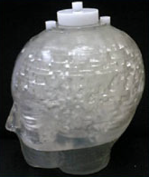
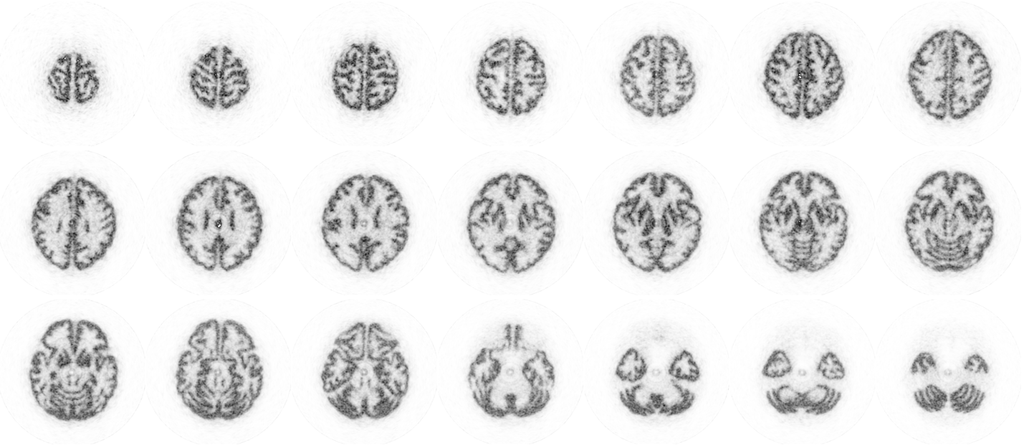
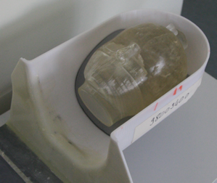
Brain Phantom Images
No normalization, no random correction, no scatter correction (but with attenuation correction)
3D brain phantom with bone & grey matter compartments
Activity: ≈ 45 MBq (avg. act. conc. ≈ 12kBq/ml, ¹⁸F), acquisition time: ≈ 270 sec.
Reconstruction with PRESTO*, (ML-EM, 70 iterations, voxel size 0.65² × 1 mm³)
Iida, Hidehiro, et al. Annals of nuclear medicine 27 (2013): 25-36.
Head holder
*J. Scheins, et al., IEEE transactions on medical imaging 30.3 (2011): 879-892.

Slide 12
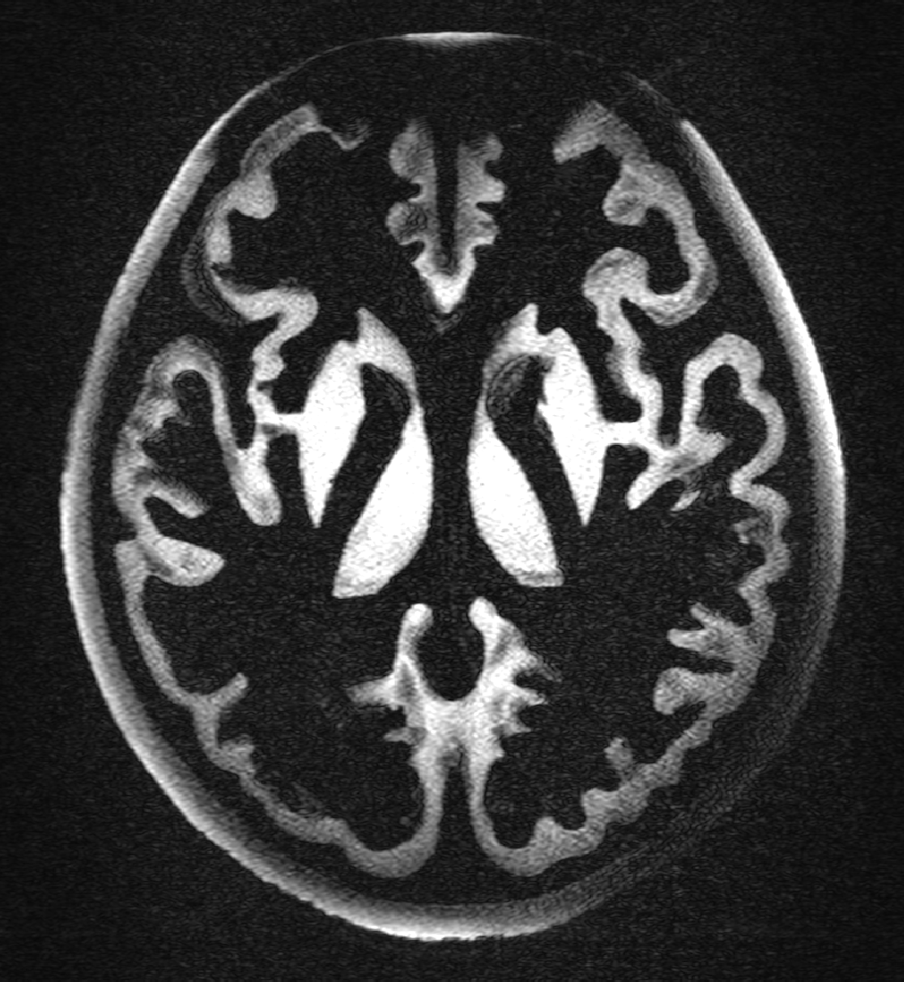
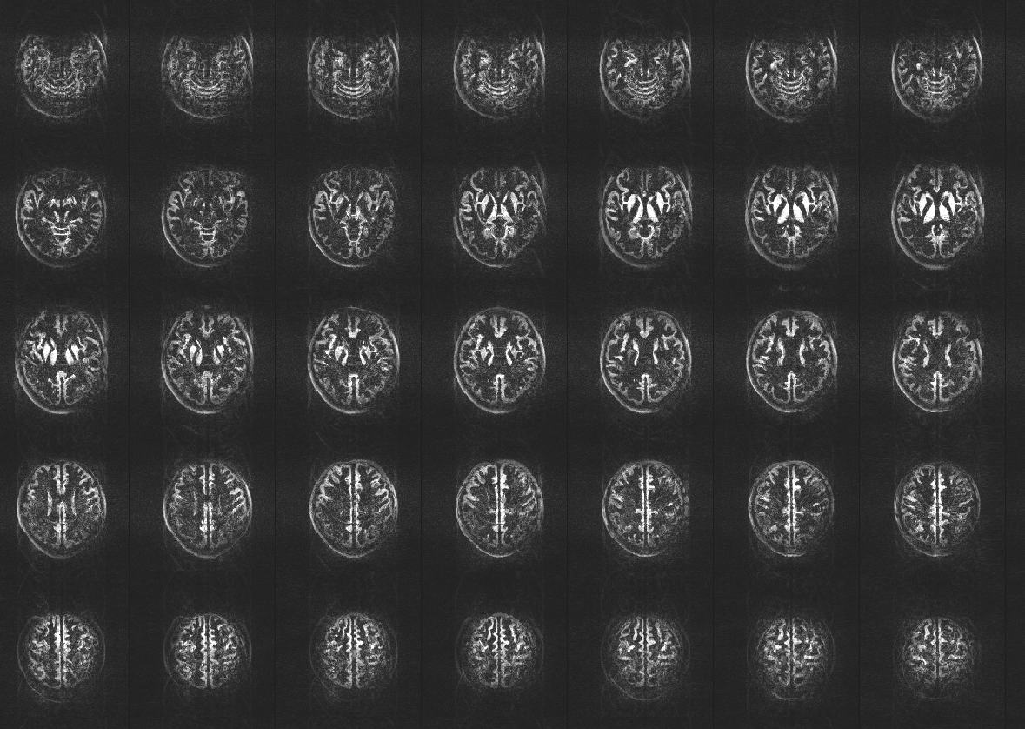
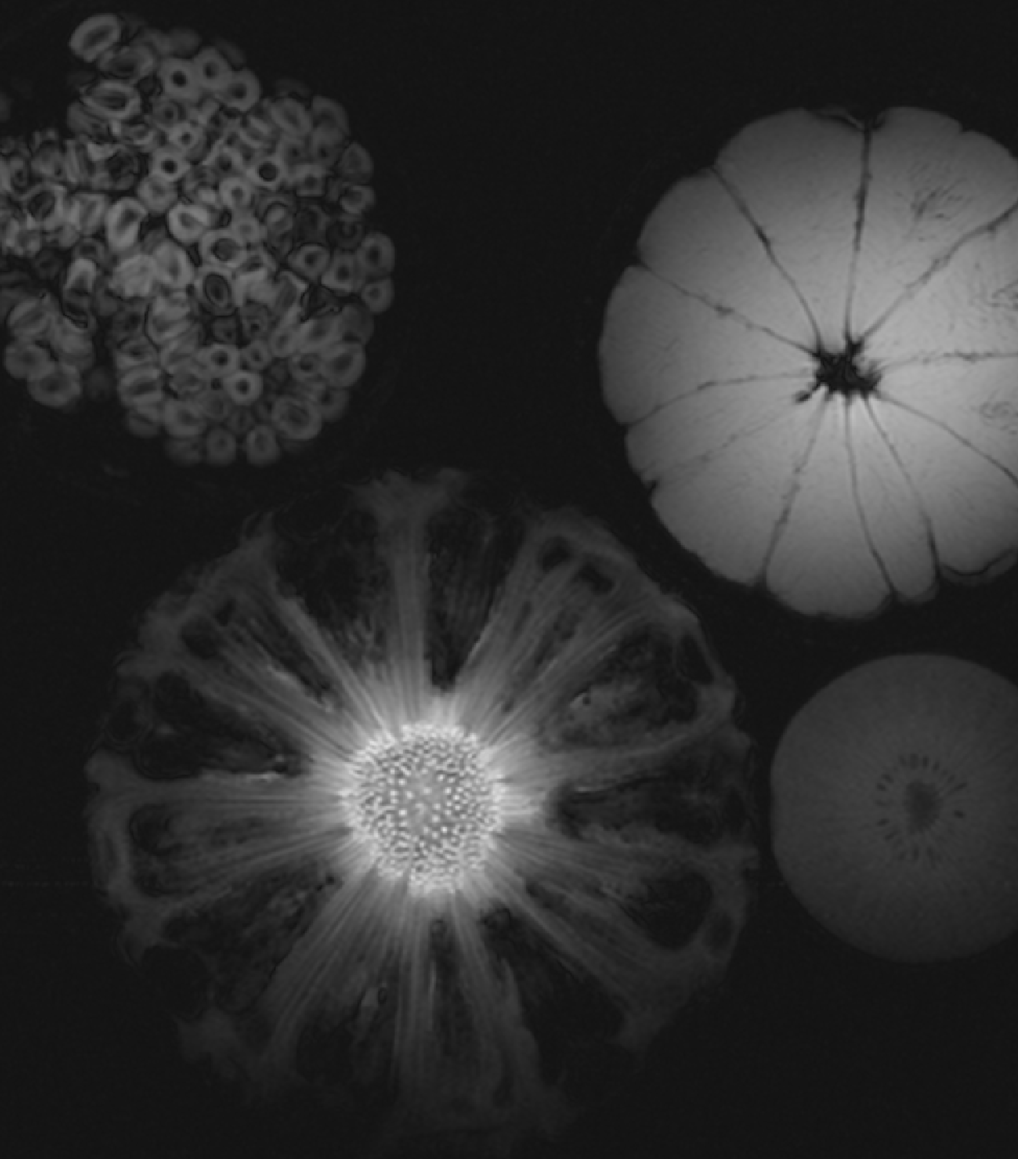
First MR images with running BrainPET 7T
Acquired just last week!
EPI sequence with head phantom
Gradient echo sequence with fruits
Turbo-flash sequence with head phantom

Slide 13
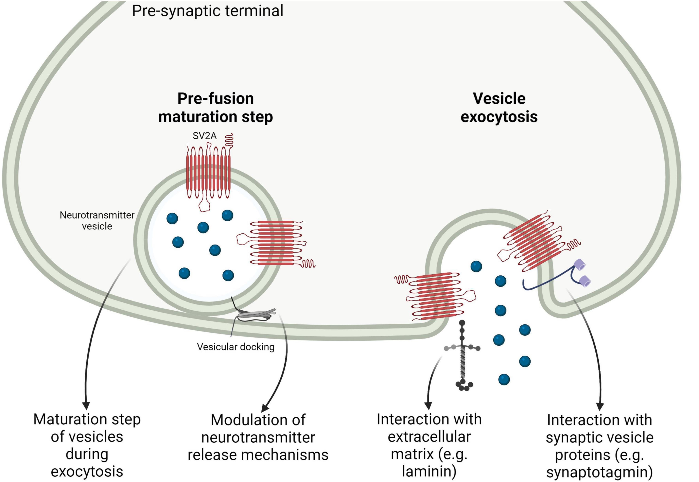
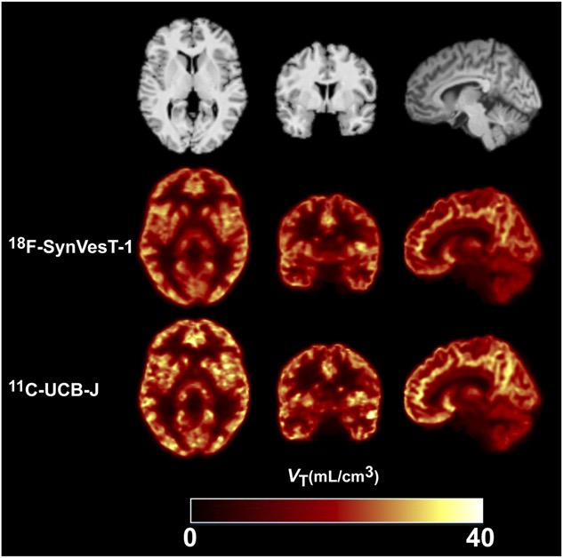
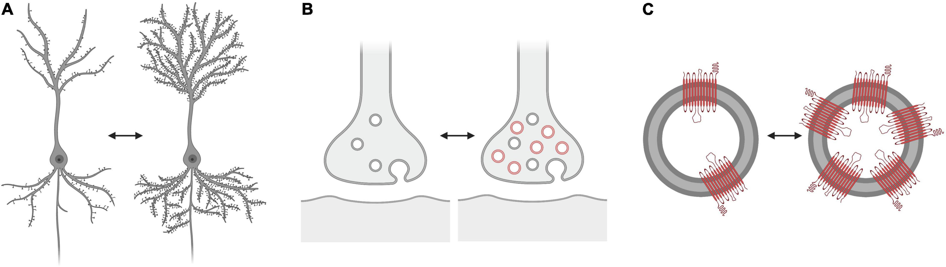
Imaging Synaptic Density
Isoform Synaptic Vesicle Glycoprotein 2A (SV2A) Provides Access to Plasticity
V_{t} measurements with PET
presynaptic synapse terminal
Roles of SV2A
pre-fusion
maturation
vesicle
exocytosis
vesicle
docking
Prefusion during vesicular exocytosis
Modulation of neurotransmitter release
Interaction with laminin
Interaction with other SV proteins, e.g. calcium sensor
Interpretation of reduced binding
Synaptic density
Vesicle density
SV2A protein density
Naganawa, Mika, et al. "First-in-human evaluation of 18F-SynVesT-1, a radioligand for PET imaging of synaptic vesicle glycoprotein 2A." Journal of Nuclear Medicine 62.4 (2021): 561-567.
Rossi, Rachele, et al. "Synaptic vesicle glycoprotein 2A: features and functions." Frontiers in neuroscience 16 (2022): 864514.
Notes:
Summary of the main putative roles of the isoform synaptic vesicle glycoprotein 2A (SV2A). SV2A participates in a pre-fusion maturation step during vesicular exocytosis; SV2A is involved in neurotransmission via multiple mechanisms, e.g., by modulating the coupling between calcium entry and neurotransmitter release or by regulating machinery involved in neurotransmitter release; SV2A interacts with extracellular matrix components, e.g., laminin; SV2A interacts with other synaptic vesicle proteins, such as the calcium-sensor synaptotagmin. Other SV2A possible functions are reported, for example the transport of galactose, mediation of vesicular entry of neurotoxins, interaction with adenine nucleotides and mitochondrial localization and role as fusion or fission factor.
What does “altered SV2A density” represent? Three possibilities: (A) Altered synaptic vesicle glycoprotein 2A (SV2A) tracer binding could be associated with changes in “synaptic density” (exemplified as a change in the number of dendritic spines). (B) Altered SV2A tracer binding could be associated with changes in the number of vesicles in the pre-synaptic terminal, according to the functional state of the synapse, and so with functional properties of the synapses rather than their density. (C) Altered SV2A tracer binding could be associated with changes in the number of SV2A copies in the vesicles. The number of SV2A copies reached by the tracers and thus labeled may also vary. The alternative scenarios (B) and (C) do not necessarily implicate a change in the overall synaptic density.

Slide 14
Depression – Example for A multifactorial Disease
Serotonin:
metabolites are reduced in patients diagnosed with depression
Aetiology
Pathophysiology
Neurotransmitters
5-HT (Serotonin)
DT (Dopamine)
NA (Noradrenaline)
Glu (Glutamate)
GABA (Gamma Aminobutyric Acid)
Genetics
Epigenetics
Stress
Trauma
etc.
Dopamine:
antidepressant agents increase dopamine levels in the brain
Noradrenaline:
medications that inhibit NA reuptake are effective antidepressants
Altered connectivity
(prefrontal cortex – limbic)
Inflammation
Glutamate:
ketamine (receptor antagonist) acts as fast antidepressant
Hypothalamic-Pituitary-Adrenal axis hyperactivity
Reduced neuroplasticity
GABA:
mood amenable to drugs targeting at GABA receptors
Dean, Jason, and Matcheri Keshavan. "The neurobiology of depression: An integrated view." Asian journal of psychiatry 27 (2017): 101-111.
Möhler, Hanns. "The GABA system in anxiety and depression and its therapeutic potential." Neuropharmacology 62.1 (2012): 42-53.
Notes:
suicides Germany approximately 9000, worldwide: 700.000
The economic burden of MDD (major depressive dissorder) in the United States in the year 2000 was estimated to be 83.1 billion dollars, with 26.1 billion dollars (31%) directly related to medical costs, 5.4 billion dollars (7%) related to suicide, and 51.5 billion dollars (62%) due to workplace costs including absenteeism and reduced productivity

Slide 15
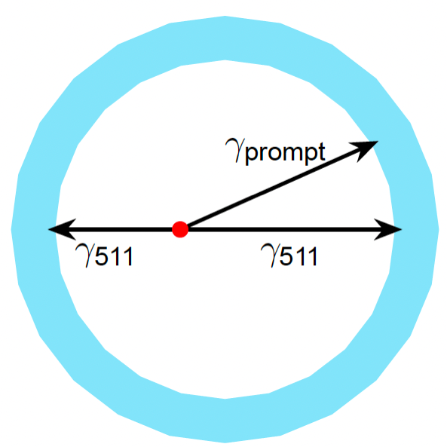
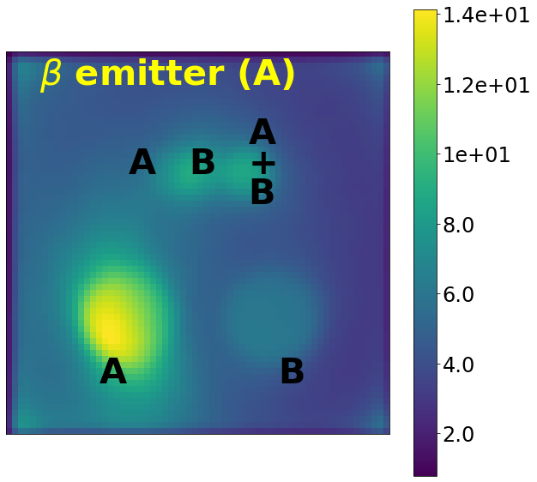
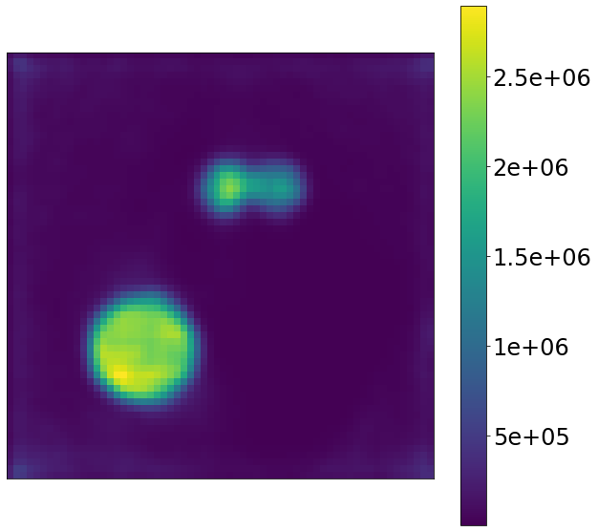
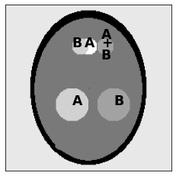
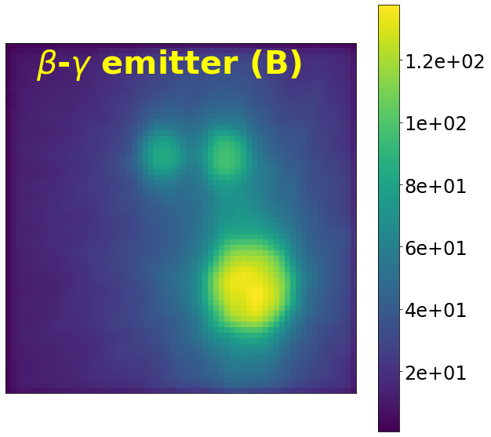
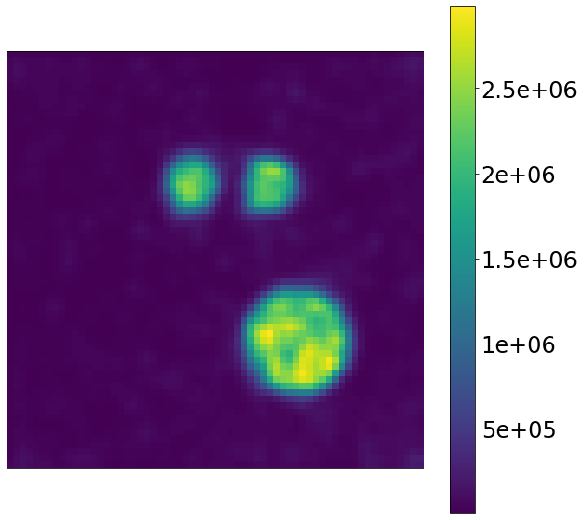

Dual Tracer PET Imaging (Simultaneously)
Prompt gammas allow for source discrimination of the PET tracer!
Quantitative reconstruction algorithm (including attenuation):
$β^{+}γ$ emitter
1 iteration
50 iterations
PET Nuclide
Source distribution
(simulation)
β⁺⇒ 2 γ (511 keV)
γ (specific energy)
Image with courtesy from D.Niekämper, INM-4, FZJ
More details in the next talk!
Simulation mimics head including bone
Pfaehler, E. (2024). ML-EM based Dual tracer PET image reconstruction with inclusion of prompt gamma attenuation (1.0). Zenodo. https://doi.org/10.5281/zenodo.13382960 (preprint)

Slide 16






Layer-specific detection of brain function at 7T
Six cortical layers,
each of which has its particular function
Connectivity
RH
Super
(near CSF)
Deep
(near WM)
layers ROI 8
Cortical depth
layers
ROI 10
correlation
Sensory-Motor
Visual
Default Mode
Yun, Seong Dae, et al. "Mapping of whole‐cerebrum resting‐state networks using ultra‐high resolution acquisition protocols." Human Brain Mapping (2022).
Exec. Control
Images with courtesy of P. País Roldan and Yun, Seong Dae

Slide 17



Receptor Internalization
PET and fMRI time courses contain complementary information about receptor adaptation mechanisms
Blocking study in non-human primates
PET kinetic modelling results
fMRI statistical analysis
functional hemodynamic response ΔH
ΔH = f (receptor occupancy)
functional hemodynamic response can be measured with fMRI, e.g. CBV vs. time
Christin Y. S ander, Simultaneous PET/fMRI for Imaging Neuroreceptor Dynamics, PhD Thesis MIT 2014
Sander, Christin Y., et al. "Imaging agonist-induced D2/D3 receptor desensitization and internalization in vivo with PET/fMRI." Neuropsychopharmacology 41.5 (2016): 1427-1436.
Notes:
Schematic illustrating a compartmental model that describes receptor desensitization and internalization at dopaminergic synapses. The total number of receptors (B_{max}) is composed of available receptors at the postsynaptic membrane, those bound by an injected agonist, those bound by endogenous dopamine and desensitized/internalized receptors. Occupied receptors are in exchange with free ligand in the synaptic space. Receptors that are occupied by an agonist trigger desensitization and internalization. As externalization mechanisms are known to be very slow, we assume that k_{ext}=0 for the duration of time courses we modeled. The parameters that determine the PET and fMRI signal changes are highlighted in bold. This shows that PET and fMRI time courses contain complementary information about receptor adaptation mechanisms. concentr., concentration; DA, dopamine; fMRI, functional magnetic resonance imaging; PET, positron emission tomography.
Time courses of CBV (dotted line) and occupancy (solid line) resulting from exposure to three different pharmacological challenges in animal M2: (a) the high-affinity agonist quinpirole elicits a very short CBV response, whereas PET occupancy stays elevated for the duration of the experiment. (b) The agonist ropinirole has a lower affinity compared with quinpirole and results in a slightly longer, though still short, CBV response, whereas occupancy peaks at 17.8 min and then starts to decrease. Compared with quinpirole, ropinirole displays a larger CBV^{peak} signal at lower occupancy. (c) The antagonist prochlorperazine shows that CBV and occupancy time courses are matched, and demonstrates that CBV can stay elevated for longer durations in time. The antagonist showed a reversed CBV sign and the largest magnitude compared with the agonists. Overall, the discrepancy in time between CBV and occupancy and diminished CBV magnitude for the agonists suggests that RDI affects both PET and fMRI, and can vary with drug affinity and potency. CBV, cerebral blood volume; fMRI, functional magnetic resonance imaging; GLM, general linear model; PET, positron emission tomography; RDI, receptor desensitization and internalization
According to the classical occupancy theory, receptor occupancy by agonist causes a downstream functional response, which can be observed with PET/fMRI. High-affinity agonists are known to cause receptor internalization. The functional hemodynamic response (measured as changes in cerebral blood volume (CBV) in this study) to a D2 agonist can be expressed in terms of changes in receptor occupancies of the agonist (ligand L) and endogenous DA, which is displaced according to the law of mass action. The functional CBV signal can be modeled through a direct coupling relationship with occupancy
Parametric maps showing the results from three injection doses of the agonist quinpirole. All maps show imaging data from two animals, analyzed with a mixed-effects model. Upper row: dynamic-binding potential maps (DBPND peak) show that specific binding of the radiotracer [11C]raclopride in caudate and putamen decreases with increasing quinpirole. Lower row: voxelwise maps showing %CBVpeak changes, windowed by a P-value map with Po0.03. As quinpirole dose increases, the negative CBV signal that is specific to caudate and putamen increases in magnitude. CBV, cerebral blood volume; DBP, dynamicbinding potential.

Slide 18

Take Home Messages
PET Provides Unique Access to Neurotransmission (Chemical Component of Processing)
MR Provides (indirect) Unique Access to Neuron Activity
MR/PET Together allow Simultaneous Multiparametric Functional Imaging
Natural Information Processing in the Brain is Inherently Multiparametric
Most Dysfunctions and Diseases of the Brain are Inherently Multifactorial

Slide 19









Acknowledgements & Collaborations
Partners
Prof. G. Natour
Prof. v. Waasen
Prof. V. Schulz
Prof. G. Egan
Dr. D. Schug
Dr. B. Weissler
Dr. Z. Chen
Dr. P. Gebhardt
Dr. F. Müller
H. Radermacher
J. Colliene
D. Grunwald
M. Lennartz
D. Arutinov
R. Heil
W. Silex
PET Group
Prof. H. Herzog
Dr. C. Régio Brambilla
Dr. C. Li
Dr. J. Scheins
Dr. E. Pfähler
Dr. A. Issa
Dr. Qi Liu
H. Alrukh
N. Beriashvili
D. Niekämper
MR Group
Prof. N. Jon Shah
Dr. P. País Roldan
Dr. S.D. Yun
Dr. C.H. Choi
Dr. J. Felder
Dr. J. Mauler
Dr. E. Farrher
S. Schwan
Multimodal Imaging Group
Prof. I. Neuner
Dr. S. Ramikran
Dr. R. Rajkumar

Slide 20






Questions?
INM-4
Medical Imaging Physics
c.lerche@fz-juelich.de

Slide 21



Artificial Intelligence Is not The new 42
Wikipedia: Science is a strict systematic discipline that builds and organises knowledge in the form of testable hypotheses and predictions about the world.
Science is full of abstractions. A line plot is an abstraction. A false-colour image is an abstraction. Even scientific notation like 6.0 × 1023 is an abstraction. Abstractions like these are central to science, invoked all the time, and easy to understand. (The Goldilocks level of abstraction in science, Ken Hughes)
Britannica: Abstraction, is the cognitive process of isolating, or “abstracting,” a common feature or relationship observed in a number of things, or the product of such a process.
Sciencecouncil.org: A scientist is someone who systematically gathers and uses research and evidence, to make hypotheses and test them, to gain and share understanding and knowledge.
Example: Consider an Exponential function (which is an abstract model for Activity of some radioactive source after some time)
$$o_{l}=φ_{l}\left(\sum_{i_{l}}{w_{i_{l}}x_{i_{l}}}\right), o=o_{1}∘o_{2}∘⋯∘o_{D}$$
4 layers, 7600 parameters
$$φ_{l}$$
$$\sum_{i_{l}}{w_{i_{l}}x_{i_{l}}}$$

Slide 22

Neuroimaging an Artificial Intelligence
Need for growing set of image data sets!
Availability of large labelled datasets enabled solving difficult ML problems as image recognition with datasets of millions of images ⬄medical datasets are much smaller, normally of thousands or hundreds or even less (remember the legal limitations!)
Further obstacles to overcome:
bias is training set: spectrum bias (well defined cohort), image device or imaging condition (e.g. du to legal limitation as radiation protection), labelling errors, lack of understanding
evaluation metrics: normally performance on benchmark data set, no superiority testing as required in clinical trials
robustness to out-of-distribution samples

Slide 23



Some Articles of Interest
https://spectrum.ieee.org/stop-calling-everything-ai-machinelearning-pioneer-says
https://www.inc.com/jason-aten/stop-calling-everything-ai-its-just-computers-doing-computer-stuff.html

Slide 24




Clinical PET Application – Neuro-oncology
Diagnosis, staging, and therapy planning of (cerebral) tumors with MRI, [¹⁸F]FET, and [¹⁸F]FDG
Comparison between FDG and FET
Comparison of MRI and [¹⁸F]FET PET
[¹⁸F]FDG
PET
[¹⁸F]FET
PET
T1-MRI
T2-MRI
[¹⁸F]FET PET
O-(2-[¹⁸F]-Fluoroethyl)-L-Tyrosine (FET)
Increased specificity with PET
[¹⁸F]-2-Fluor-2-desoxy-D-Glucose (FDG)
 | MRI | MRI + [¹⁸F]FET PET
Sensitivity | 96 % | 93 %
Specificity | 53 % | 94 %
cases with increased uptake in tumors:
19 high grade glioma (HGG)
24 low grade glioma (LGG)
[¹⁸F]FDG | [¹⁸F]FET
35% | 86%
Pauleit, Dirk, et al. Brain 128.3 (2005): 678-687.
Pauleit et al., Nucl. Med. Biol. 2009; Vol. 36(7), pp: 779-87

Slide 25
Noise Equivalent Count Rate
Adapted NEMA: Phantom diameter 15 cm, length 40 cm
Start activity: ≈ 110 MBq (¹¹C)
Comparison to other systems for neuroscientific applications
 | Phantom | aFOV | CTR | NECR_{Peak} | SF
BrainPET 7T (this system) | 40 cm 15cm ∅ | 24.8 cm | currently 780 ps | 414 kcps @ 12. kBq/ml | 24%
BrainPET 3T¹ | 70 cm 20cm ∅ | 19.2 cm | 3 – 6 ns | 31 kcps @ 7.4kBq/ml | 38-42%
NeuroExplorer² | 70 cm 20cm ∅⁵ | 49.5 cm | 236 ps | 1.3 Mcps @ 58kBq/ml | 35%
Brain PET insert for 7T (FPGA-only digitization, SNUCM)^{3,4} | 70 cm 20cm ∅ | 16.7 cm | 1.2 ns | 12 kcps @ 2 kBq/ml | 57%
¹Kolb, Armin, et al. European radiology 22 (2012): 1776-1788.
²Li, Hongdi, et al. "Performance Evaluation of a Next-generation Human Brain PET Imager: the NeuroEXPLORER." (Soc Nuclear Med 2023): P801-P801.
³Park, Haewook, et al. "NEMA Performance Evaluation of Long Axial Field-of-View Brain PET Insert with 7T MRI Compatibility." (Soc Nuclear Med 2020): 12-12.
⁴Won, Jun Yeon, et al. IEEE Transactions on Medical Imaging 40.6 (2021): 1579-1590.
⁵Private communication

Slide 26

Sensitivity with RF Coil
NeuroExplorer¹
NEMA: 70 cm long capillary, 1-5 aluminium sleeves
Activity: ≈ 15 MBq (¹⁸F),
acquisition times: ≈ 90 seconds
Comparison to other systems for neuroscientific applications
11.1%
 | aFOV | ∅ | Scintillator thickness | Energy window | Sensitivity at centre
BrainPET 7T (this system) | 24.8 cm | 39 cm | 2.4 cm | 420-650 keV | 57.2 kcps/MBq
BrainPET 3T | 19.2 cm | 39 cm | 2 cm | 420-650 keV | 20.5 kcps/MBq
NeuroExplorer¹ | 49.5 cm | 52.4 cm | 2 cm | unknown | 46.0 kcps/MBq
Brain PET insert for 7T (FPGA-only digitization, SNUCM)² | 16.7 cm | 33 cm | 2 cm | 450-650 keV | 18.9 kcps/MBq
3.8%
¹Li, Hongdi, et al. "Performance Characteristics of the NeuroEXPLORER, a Next-Generation Human Brain PET/CT Imager." Journal of Nuclear Medicine (2024).
²Won, Jun Yeon, et al. IEEE Transactions on Medical Imaging 40.6 (2021): 1579-1590.

Slide 27


Spatial Resolution (Without Corrections!)
No normalization, no random correction, no attenuation correction, no scatter correction
@ ≈ 10 cm from isocentre
Comparison to other systems for neuroscientific applications
Activity: ≈ 22 MBq
(avg. act. conc. ≈ 40 kBq/ml,¹⁸F)
acquisition times: ≈ 2 min.
Isocentre
Off-centre
 | Crystal footprint & length (mm³) | Crystals, APDs / SiPMs | DOI | resolution
BrainPET 7T (this system) | 2.0²×24 | 196080 17280 | 3-layer 7/8/9 mm | 1.8 mm (1.6 mm?)
BrainPET 3T¹ | 2.5²×20 | 27648 1728 | No | 2.5 - 5 mm
NeuroExplorer² | 1.56×3.07×20 | 131328 65664 | light sharing ∽ 3 mm | 1.6 mm
Brain PET insert for 7T (FPGA-only digitization, SNUCM)³ | 2.09²×20 | 31225 13824 | 2-layer 8/12 mm | 2.5 - 4 mm
1.8 mm
Single slice
2.0 mm
1.6 mm
1.0 mm
1.4 mm
1.2 mm
average
7 cm
¹Kolb, Armin, et al. European radiology 22 (2012): 1776-1788.
²Li, Hongdi, et al. "Performance Evaluation of a Next-generation Human Brain PET Imager: the NeuroEXPLORER." (Soc Nuclear Med 2023): P801-P801.
³Park, Haewook, et al. "NEMA Performance Evaluation of Long Axial Field-of-View Brain PET Insert with 7T MRI Compatibility."
(Soc Nuclear Med 2020): 12-12.
(length: 6.6 cm)
Reconstruction with PRESTO
(ML-EM, 120 iterations, voxel size 0.65² × 1 mm³)
*J. Scheins, et al., IEEE transactions on medical imaging 30.3 (2011): 879-892.

Slide 28






BrainPET 7T – Ultra High-Field MR Compatible Components
Heat sink with minimized eddy currents
Heat sink for acquisition electronics
248 mm
12×12 dSiPM array with steering electronics
Hyperion readout electronics
Scintillation detector
RF Blocking feed-troughs
49 mm
Liquid cooling
Image curtesy by RWTH Aachen & Hyperion Imaging Systems GmbH
850 mm
Carbon Fibre Housing

Slide 29

Sensitivity with RF Coil
Transmission scan
with ⁶⁸Ge line source
PET optimized TX/RX coil
NEMA: 70 cm long capillary, 1-5 aluminium sleeves
Activity: ≈ 15 MBq (¹⁸F),
acquisition times: ≈ 90 seconds
Comparison to other systems for neuroscientific applications
11.1%
 | aFOV | ∅ | Scintillator thickness | Energy window | Sensitivity at centre
BrainPET 7T (this system) | 24.8 cm | 39 cm | 2.4 cm | 420-650 keV | 57.2 kcps/MBq
BrainPET 3T | 19.2 cm | 39 cm | 2 cm | 420-650 keV | 20.5 kcps/MBq
NeuroExplorer¹ | 49.5 cm | 52.4 cm | 2 cm | unknown | 46.0 kcps/MBq
Brain PET insert for 7T (FPGA-only digitization, SNUCM)² | 16.7 cm | 33 cm | 2 cm | 450-650 keV | 18.9 kcps/MBq
3.8%
¹Li, Hongdi, et al. "Performance Evaluation of a Next-generation Human Brain PET Imager: the NeuroEXPLORER." (Soc Nuclear Med 2023): P801-P801.
²Won, Jun Yeon, et al. IEEE Transactions on Medical Imaging 40.6 (2021): 1579-1590.

Slide 30









Scintillation Detector with DOI
each layer shifted by $\frac{1}{2}$ pixel pitch along x or y direction
Flood map (irradiation of entire detector)
M. Ito, et al. , 2007 IEEE NSS-MIC Conference Record. Vol. 6. IEEE, 2007.
Top Layer
Middle Layer
Bottom Layer
$$E_{γ}∝\sum_{i,j}{q_{i,j}}$$
$$\left\langle X_{γ}\right\rangle ∝\frac{1}{E_{γ}}\sum_{i,j}{x_{i,j}q_{i,j}}$$
$$\{q_{i,j}\}$$
$$\left\langle Y_{γ}\right\rangle ∝\frac{1}{E_{γ}}\sum_{i,j}{y_{i,j}q_{i,j}}$$
Lenz, Mirjam. Design and characterisation of an MRI compatible human brain PET insert by means of simulation and experimental studies. PhD Thesis, 2021.

Slide 31
Positioning Performance (Single Block)
Centre of gravity (CoG) and Maximum Likelihood Positioning, acquisition with ⁶⁸Ge line source
Signal distributions (avalanche counts):
singles, full 3x3 SiPM neighbourhood, (SiPM)
only photopeak events
script for automatic extraction
COG positions:
singles full 3x3 neighbourhood, (SiPM)
no energy filter
Scintillation pixel index
1st layer (coupled to SiPMs)
2nd layer (middle)
^{3rd} layer (upper)
SiPM index
Scintillation
pixel counts:
all singles
only photopeak events

Slide 32
Energy Resolution
(and Timing Resolution)
Photopeak positions (avalanches) of single detector block
Photopeak position [avalanches]
Scintillation crystal ID
1st layer (coupled to SiPMs)
2nd layer (middle)
3rd layer (upper)
Energy res.: 13% FWHM
Peak position: 509.2 keV
(system wide, measured with ⁶⁸Ge Line source)
CRT: 780ps (FWHM)
(system wide, measured with ⁶⁸Ge line source, skew correction between blocks, but not between SiPMs)

Slide 33

Aim: Improve Quantitation Accuracy
Target: Reduce quantitation errors caused by data correction to $≲$ 1%
Not considered in this study:
Quantitation errors of up to 50% (FDG, SUV)
reconstruction bias at low counts (~20%)
Dead time correction method (~7%)
Attenuation based on conventional (polychromatic) CT (~5%)
Single Scatter Correction (~ 15%)
Triple Random/Prompt gamma contamination (~3%)
Boellaard, Ronald. "Standards for PET image acquisition and quantitative data analysis." Journal of nuclear medicine 50.Suppl 1 (2009): 11S-20S.

Slide 34


PET - Challenge ML-EM reconstruction Bias at low counts
Reilhac, Anthonin, et al. "Simulation-based evaluation of OSEM iterative reconstruction methods in dynamic brain PET studies." Neuroimage 39.1 (2008): 359-368.

Slide 35


PET - Challenge Me-EM reconstruction Bias
Validation of constant true coincidences count framing scheme
Reconstruction frame length
Activity Concentration
Decay experiment with hot sphere phantom
T4 = 4th half-life of ¹¹C
(≈ 60 min p.i to ≈ 80 min. p.i.)
Hot (test) ROI
Warm (ref) ROI
$${BP}_{ND}$$
Expected behaviour
Hot (test) ROI
Warm (ref) ROI
Expected behaviour
C. Régio Brambilla, et al. "Bias evaluation and reduction in 3D OP-OSEM reconstruction in dynamic equilibrium PET studies with 11C-labeled for binding potential analysis." Plos one 16.1 (2021): e0245580.

Slide 36
Image Reconstruction Bias at low counts
Problem of Iterative Image Reconstruction methods, e.g. Maximum Likelihood Expectation Maximisation
Volunteer 1
Volunteer 2
baseline
Task start
Count rate levels for different subjects in same study ([¹¹C]ABP688 for mGluR5 binding)
discard
discard
Maintain true coincidence count in reconstruction frames constant

Slide 37
Controlling bias with constant counts
Comparison smokers/non-smokers (healthy control group of SZ study)
F_{(27,1)} = 15.50 and p = 0.001
constant ¹¹C concentration (decay corrected)
-20 %
-2 %
F_{(30,1)} = 74.72, p < 0.001
Const. 2 min. frames
Const. true coincidence
counts scheme!
Régio Brambilla, et al. Plos one 16.1 (2021): e0245580.
With courtesy of C. Regio Brambilla, INM-4, Forschungszentrum Juelich GmbH
Régio Brambilla, et al. Translational Psychiatry 12.1 (2022): 6.

Slide 38


Improved Dead Time Correction (Block pair-wise)
Issa, Ahlam Said Mohamad, et al. "A detector block-pairwise dead time correction method for improved quantitation with a dedicated BrainPET scanner." Physics in Medicine & Biology67.23 (2022): 235004.

Slide 39









Positron Range Correction (Chong Li, HCOC-Fellow)
Relevant for non-standard positron emitters and systems with high spatial resolution
9 mm
1.6mm
＜2 mm
Maximum range human tissue
20 mm
Shah, N Jon et al. PloS one, 9(4), 2014

Slide 40

















Positron Range Correction - Approach
$$τ=E/{m_{e}c^{2}}$$
$$ν$$
— velocities of positron
$$c$$
— velocities of light
$$m_{e}$$
Fast raytracing method
— electron rest energy
$$I$$
— mean excitation energy
Account for random process in heterogeneous media with applied magnetic field
$$δ$$
— density-effect correction
$$u$$
— atomic mass unit
$$σ$$
— cross section of total (tot), atomic photo-effect (ph), Rayleigh (coh) scattering, Compton (incoh) scattering, and electron-positron production (pair)
Slow down is random process!
Linear stopping power:
$$f\left(E\right)=\frac{dE}{ds}=\frac{0.1535}{ρ β^{2}}\frac{Z}{A}\left\{ln\left[\frac{τ^{2}(τ+2)}{2{(I/{m_{d}c^{2}})}^{2}}\right]+F^{+}\left(τ\right)−δ\right\}$$
$$\int_{E_{1}}^{E_{2}}{\frac{−1}{f(E)}dE}=\int_{S_{1}}^{S_{2}}{dS}$$
Tissue dependency - Attenuation coefficient µ of 511 keV gamma photon:
$$f(E)=μ_{r} × {f(E)}_{Water}$$
$$σ_{incoh}^{Atom}=Z{\tilde{σ}}_{incoh}^{Electron}$$
Tissue types and location
$$\frac{μ}{ρ}=\frac{σ_{tot}}{u A}$$
$$\frac{μ}{ρ}=\frac{Z}{A}\frac{{\tilde{σ}}_{incoh}}{u}$$
$$μ_{Tissue}=μ_{r} × μ_{Water}$$
511keV
$$σ_{tot}=σ_{ph}+σ_{coh}+σ_{incoh}+σ_{pair}≈σ_{incoh}$$
Li, Chong, et al. "Fast 3D kernel computation method for positron range correction in PET." Physics in Medicine & Biology 68.2 (2023): 025004.

Slide 41




Results – Annihilation probabilities in Test Voxels
¹²⁰I – water / ¹⁸F – Lung
¹²⁰I – bone / ¹⁸F – water
1
18
33
Positron emitter
Tissue boundary
Geant4
¹²⁰I
¹⁸F
Proposed method
Li, Chong, et al. "Fast 3D kernel computation method for positron range correction in PET." Physics in Medicine & Biology 68.2 (2023): 025004.

Slide 42








Results – Uncertainties
Relevant relative differences of annihilation probabilities $≲$ 20%
First voxel in water

Slide 43




CT Attenuation Template
Using newest Photon Counting (PC) CT technology for lowest Bias and potential bone quantification improvement
Use virtual monochromatic CT ⇒ avoid scaling from polychromatic average to 511keV
Siemens PC CT
Extra: Material decomposition allows to suppress iodine contrast agent!
⇒ Scans of entire head at high dose (lower bias) possible
Blood vessels with iodinated blood
Electron density phantom for HU to µ conversion
Native CT angiography
Virtual non-contrast image

Slide 44




Scatter Correction - Motivation
Improved Monte Carlo Simulation (MC) Scatter correction
F¹⁸-FET
distribution
FET-PET
simulated
positions of
scatter vertices
preliminary GPU-based simulations running (single GPU):
  throughput/€ ≈ >10 better for GPU vs. CPU
full MC scatter simulation expected time ≈ <120 s./frame
Comparing GPU vs. GATE CPU single thread provides reported acceleration factors of 400-800 (e.g. Ma et.al, 2020, TMI)
PPS approx. 20x faster than GATE (both single thread)
PPS on high-end machine (96 threads) provides acceleration factors of
1600 without multiplexing (2x faster than GPU wo multiplexing)
24000 with multiplexing (30x faster than GPU wo multiplexing)
High performance computation required
Ma, Bo, et al. "Scatter correction based on GPU-accelerated Full Monte Carlo simulation for Brain PET/MRI." IEEE transactions on medical imaging 39.1 (2019): 140-151.

Slide 45





MR-PET Compatibility
Electromagnetic issues (actually all solved)
RF Transmit power: kW range ⇨ Requires RF shielding to assure correct working of PET components.
Varying B (B₀+(G_{x},G_{y},G_{z})) ⇨ Eddy currents ⇨ Distorts gradient fields (spatial encoding!) ⇨ affects advanced applications like MRS.
PET Cassette with RF shielding
Eddy currents
RF Interference: $U=\oint_{∂Ω}^{ }{E∙dl}$ = $\oint_{∂Ω}^{ }{\frac{∂B}{∂t}∙dΩ}$
⇨ shielding -60 dB, Tx power 1 kW leads to 1mA • 1V behind shield
⇨ G strength 15mT/100µs, 1cm² enclosed area leads to 150 mV noise.
G_{x}, G_{y}, G_{z}
B₀
RF Rx coil signal: µV without resonance, mV with resonance ⇨ no clocks close to 𝜔₀, low noise power supplies.

Slide 46

Image Reconstruction Bias at low counts
Problem of Iterative Image Reconstruction methods, e.g. Maximum Likelihood Expectation Maximisation
All detected coincidences
Image voxel value j
(decays)
Coincidence counts in LOR i
System matrix
(probability)
$$v_{j}^{n+1}=\frac{v_{j}^{n}}{\sum_{i}{λ_{i,j}}}\sum_{i}{λ_{i,j}\frac{d_{i}}{\sum_{j′}{λ_{i,j′}v_{j′}^{n}}}}$$
Reconstruction Bias at low counts
Always positive (due to Poisson nature)
Pharmacologic challenge
Cognitive task
Activity concentration
Ligand equilibrium

Slide 47

PET - Task Effect Analysis of [¹¹C]ABP688 PET
Healthy control subjects, bolus-infusion protocol + MNN Task + comparing against Motor Cortex
p-value | Effect size (Kendall’s W) | ${ΔB}_{ND} [\%]$
0.001 | 0.255 | -6 ± 2
0.001 | 0.347 | -11 ± 6
0.001 | 0.307 | -7 ± 3
0.193 | 0.035 | -
Task control region
no effects expected
C. Régio Brambilla, et al. "mGluR5 binding changes during a mismatch negativity task in a multimodal protocol with [¹¹C] ABP688 PET/MR-EEG." Translational Psychiatry 12.1 (2022): 1-10.
Notes:
The motor cortex was taken as a task-reference region for the analysis because, due to the nature of the MMN elicitation, it is not expected to be activated or show tracer displacements during the MMN task.

Slide 48













Positioning Method (Maximum Likelihood)
Combined algorithm for determining hit scintillator pixel and calibrated energy
$$Q=\sum_{j}^{N_{q}}{q_{j}}$$
Scintillating pixel and
$\hat{i}$ $\text{(}\text{most} \text{likely} \text{scintillating} \text{pixel}\text{)}$
$$ℒ\left(i,Q|\left\{q_{j}\right\}\right)=\sum_{j}^{N_{q}}{q_{j}log\left(p_{i,j}Q\right)−p_{i,j}Q}$$
$i^{th}$ scintillator array pixel
$$\hat{i}=\underset{i}{arg max}{ℒ\left(i,Q|\left\{q_{j}\right\}\right)}$$
Measured charge distribution
Likelihood $ℒ$ values for all crystals
Charge distribution with highest $ℒ$
$p_{i,j}$: probability for detecting light from scintillator pixel $i$ in SiPM $j$
Photodetector pixel (SiPM)
$N_{q}$ detected charges $\left\{q_{j}\right\}$ i.e. triggered SiPM
C. Lerche et al., Physics in Medicine & Biology 61.4 (2016): 1650.

Slide 49

Current Work (DFG proposal in Evaluation)
Implementation of B₀ Field
¹⁸F
⁶⁸Ga
⁸²Rb
Compression along the vertical direction
Larger compression for high energy isotopes
Image with Courtesy of C. Li

