Slide 1
Climate research at FZJ and perspectives at TSU Is urban air pollution now coming from the broom closet?
nana khundadze

Slide 2
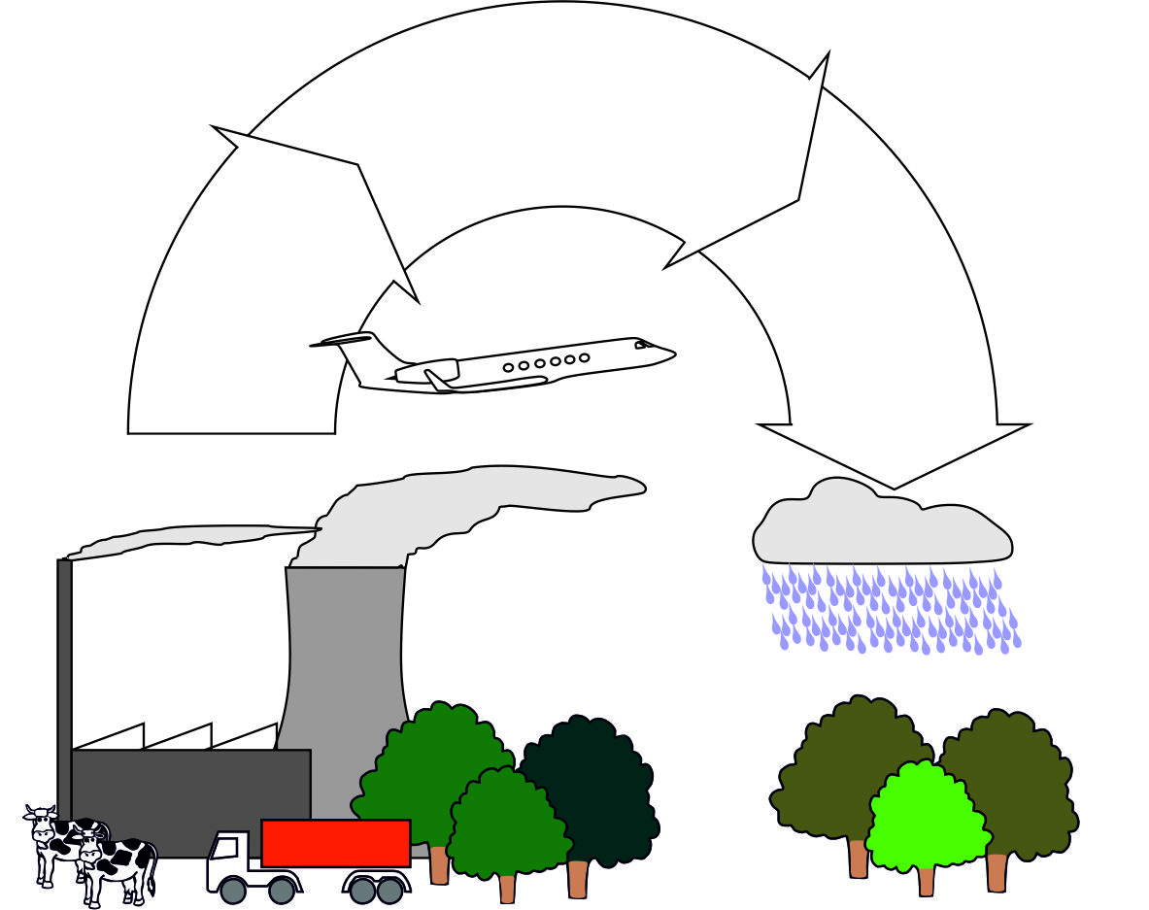
VOCs: impact on air quality
Oxidation
chemistry
O₃, CH₄
Short-lived
greenhouse
gases
+OH
Primary air
pollution
Secondary air
pollution
CO, CH₄, NO_{x}, SO₂, VOC
O₃, particles
SMOG !
Emissions:
anthropogenic / biogenic
Deposition/Acidification/
Eutrophication

Slide 3
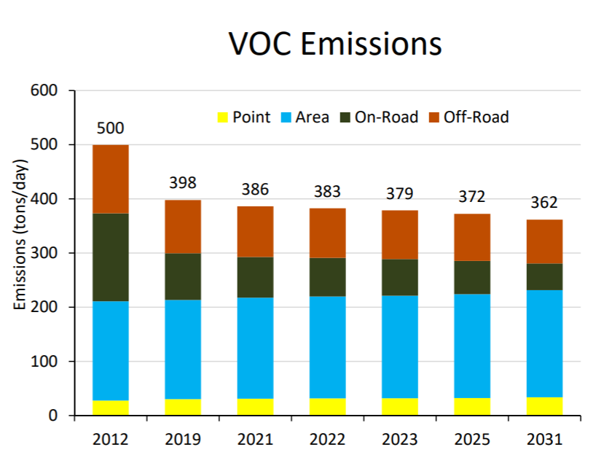
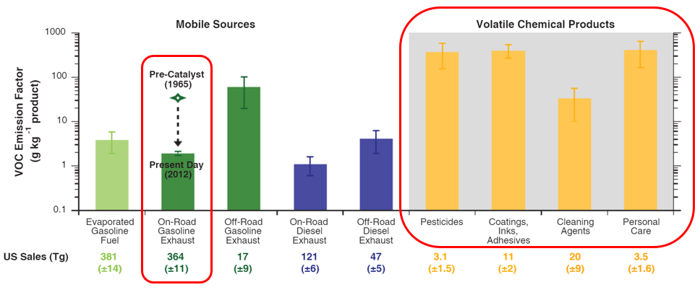
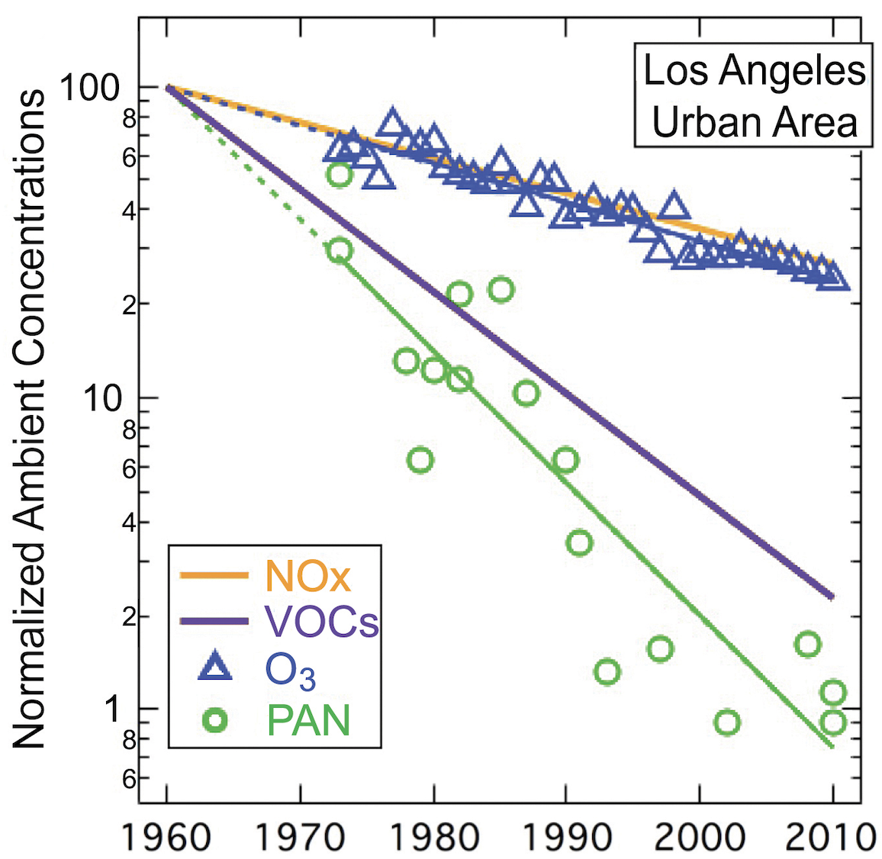
Traffic-related VOC reduction
Emission Trends in the South Coast Air Basin
Mcdonalds et al., 2018, Science
Parrish et al., (2016)

Slide 4
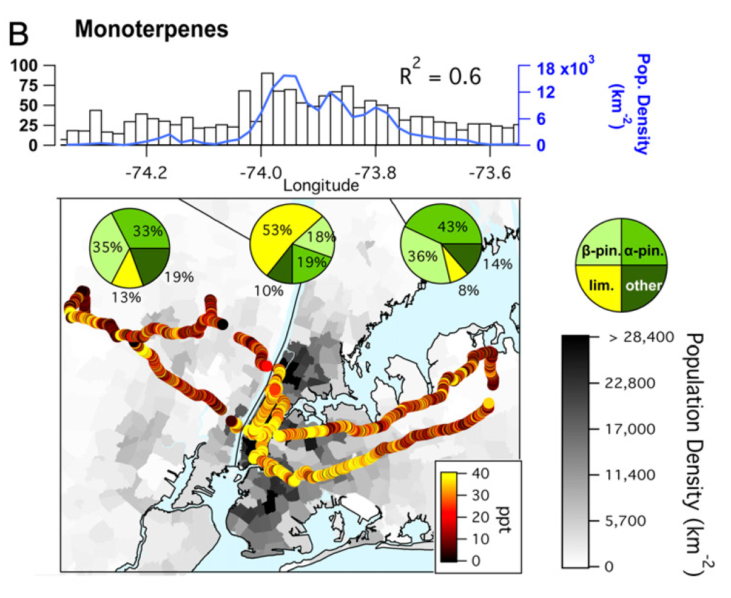
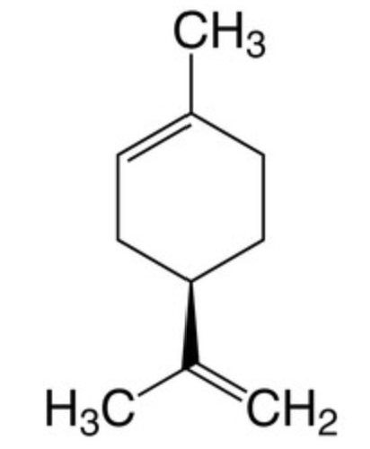
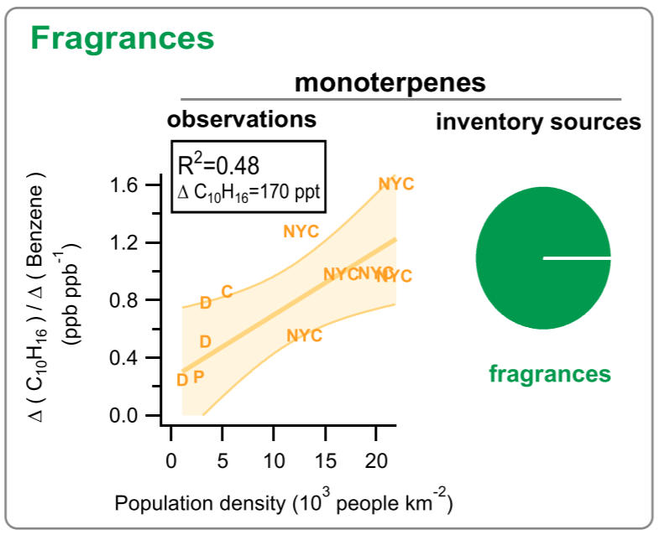
limonene
Coggon et al., PNAS2021
Gkatzelis et al., 2020, ES&T
12 Sept 2024

Slide 5
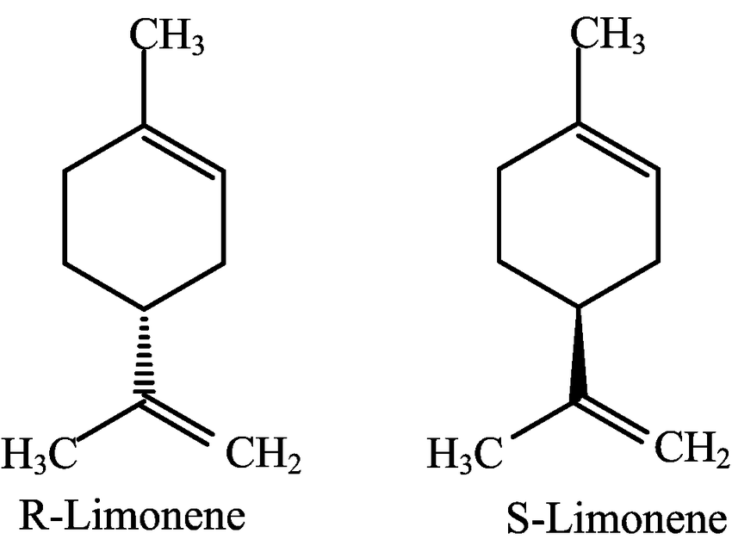
Biogenic vs. vcp limonene
- Quantitatively estimate of the relative contribution from biogenic vs. VCP sources
Enantiomer studies
+ Stable Isotopes ?
(+) Limonene | (-) Limonene
shampoos, shower gels, scrubs | slash, loblolly pine oils
96-99% | ~100%
courtesy Shan Gu (Celia Faiola group, UCIrvine)
12 Sept 2024

Slide 6
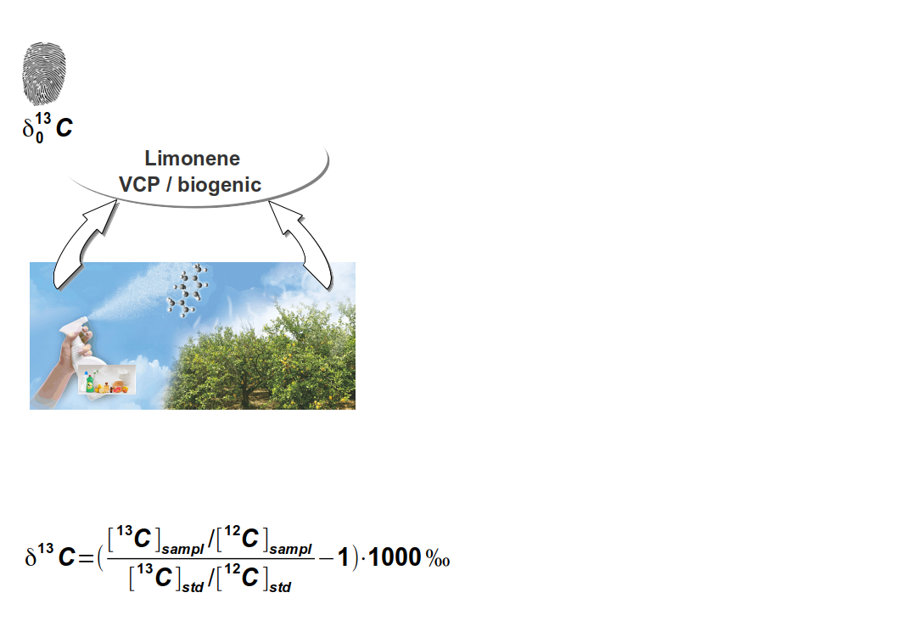
Isotopic signature of the sources
Notes:
Limonene in the atmosphere

Slide 7
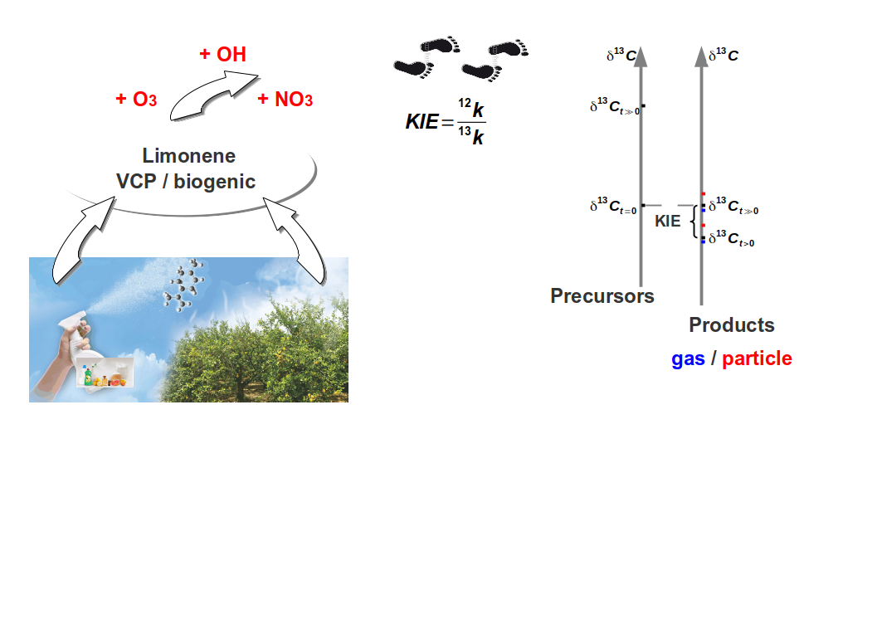
Specific isotopic fractionation during reaction

Slide 8
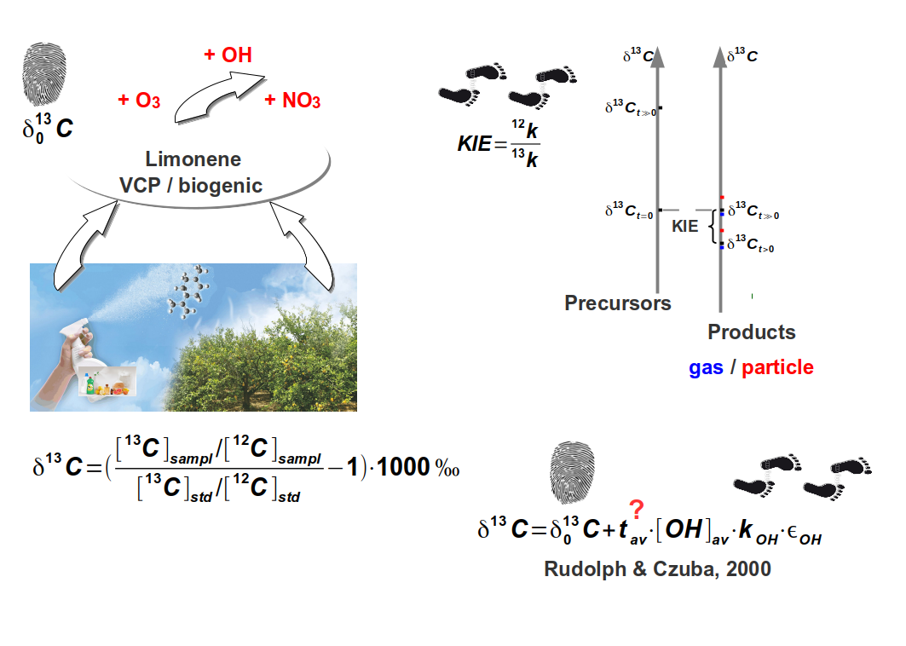
Isotopic hydrocarbon clock

Slide 9
Objectives
Analyze source specific stable carbon isotope ratios of
biogenic and VCP limonene
Methodology development for sampling limonene emissions from care and cleaning products as well as from trees in a simulation plant chamber
TD-2D-GC-IRMS method development for limonene δ¹³C measurements (limonene standards)
Compound specific δ¹³C measurements of biogenic vs. VCP limonene

Slide 10
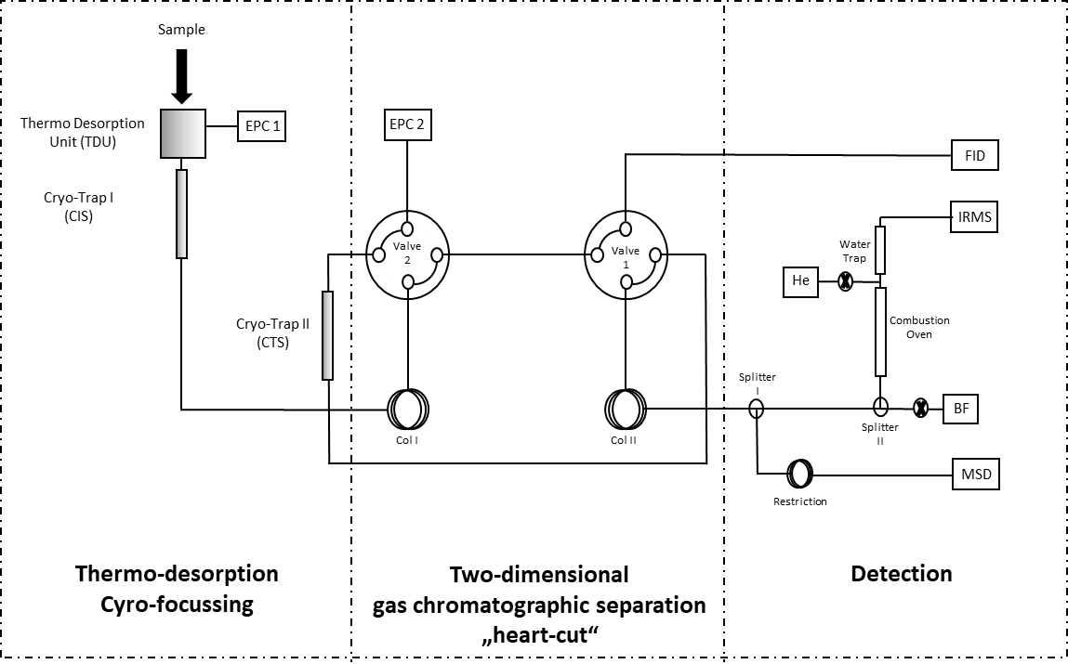
TD-2DGC-IRMS Measurement technique

Slide 11
Quality Control of the Heart Cut TD-2DGC-IRMS measurements
Compound | δ ¹³C (‰) /Method
 | TD-2DGC-IRMS (n=25) | EA-IRMS (n=8)
(-)-limonene | -33,0 ± 0,5 | -33,7 ± 0,1
(+)-limonene | -30,0 ± 0,7 | -30,2 ± 0,1

Slide 12
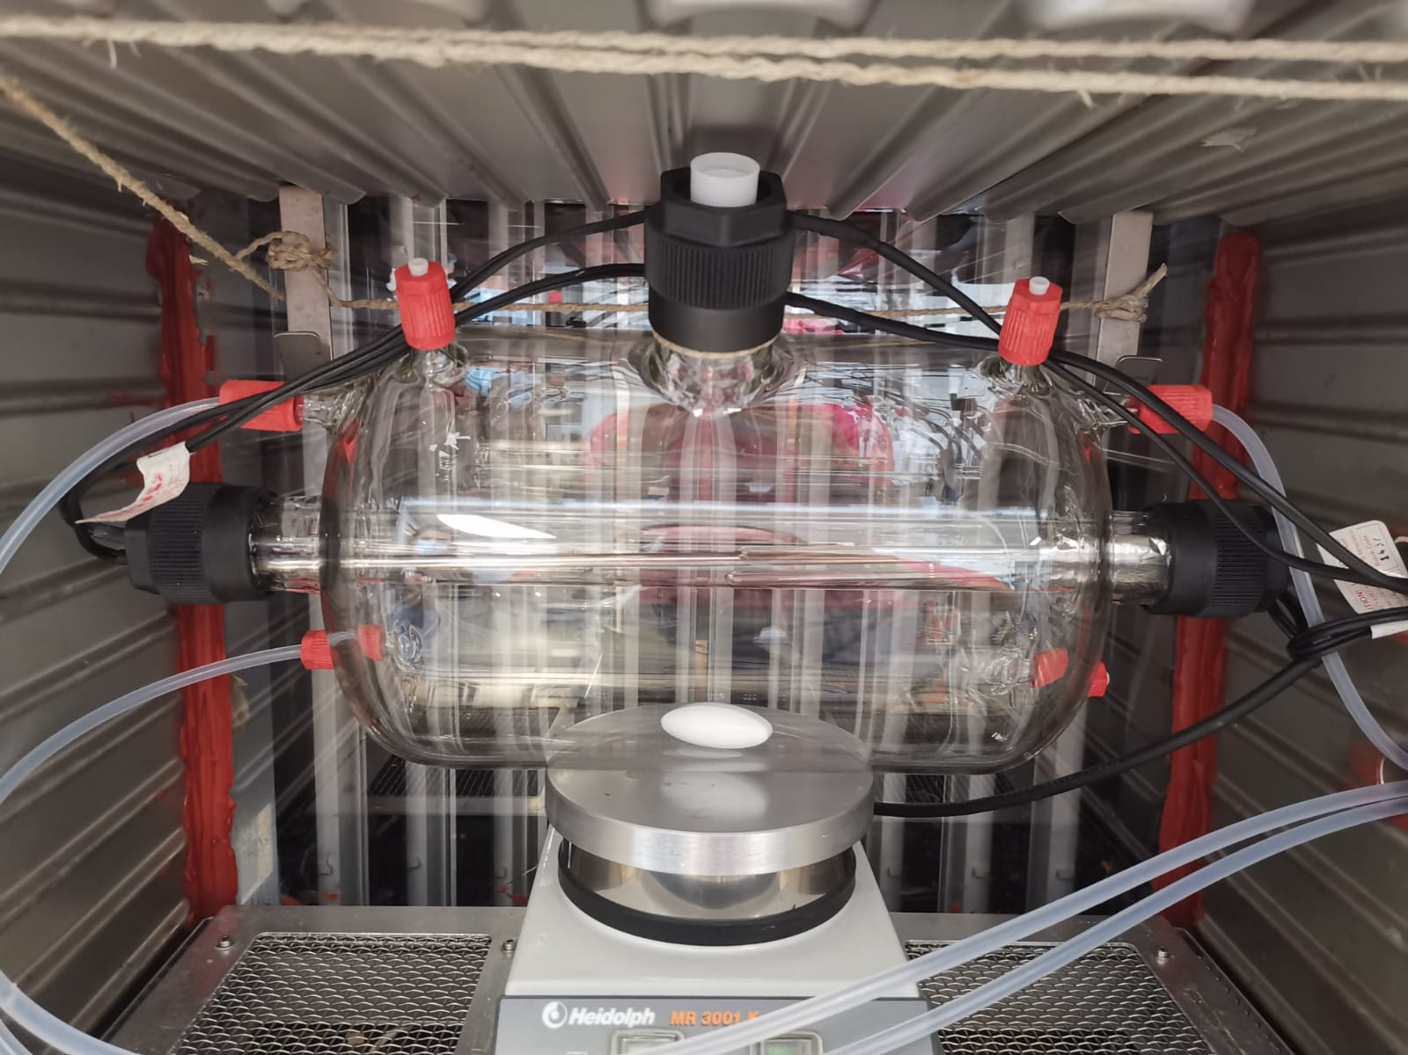
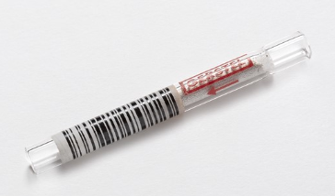
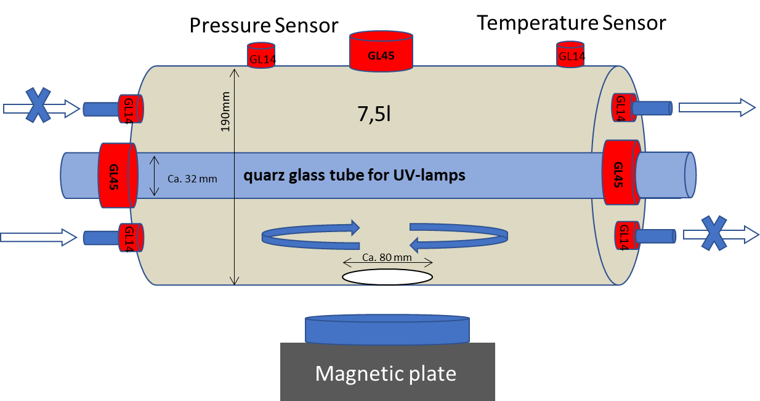
Standard samples for method development
12 Sept 2024

Slide 13
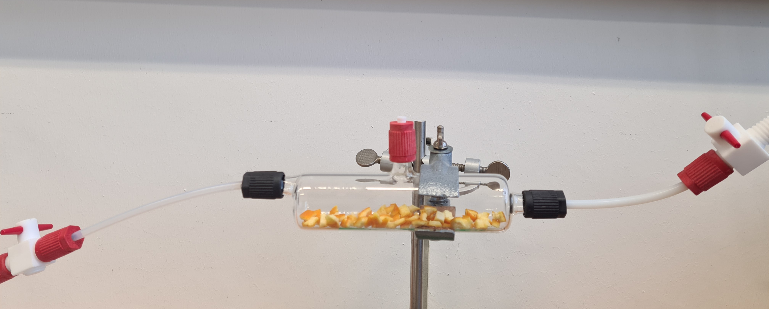
Sampling VCP limonene from gas mouse
ON/OFF Ventil
ON/OFF Ventil
TENAX Tube
Synth Air
90°C

Slide 14
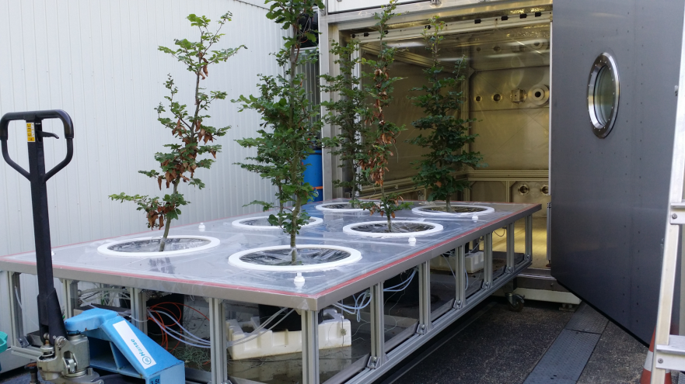
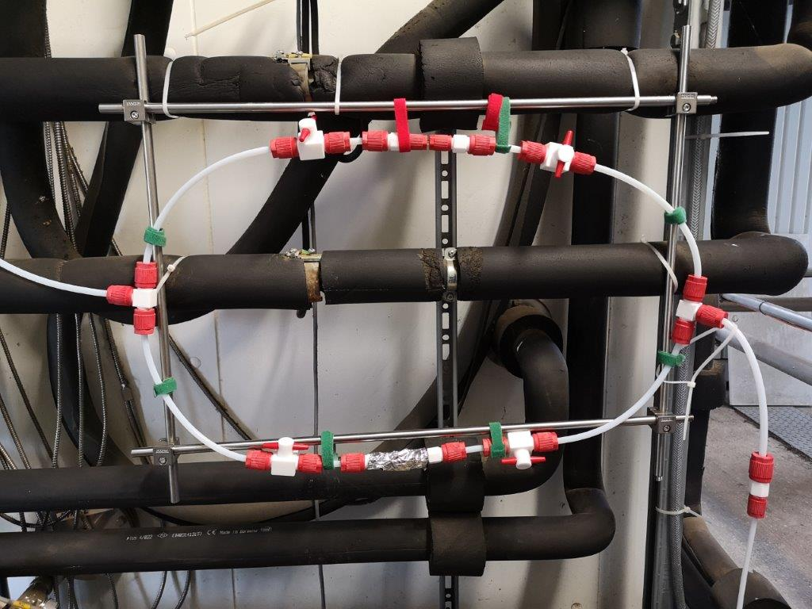
Sampling of real plant emissions at SAPHIR PLUS
Sampling Flow Control by MFC
Quick Sample Change
12 Sept 2024

Slide 15
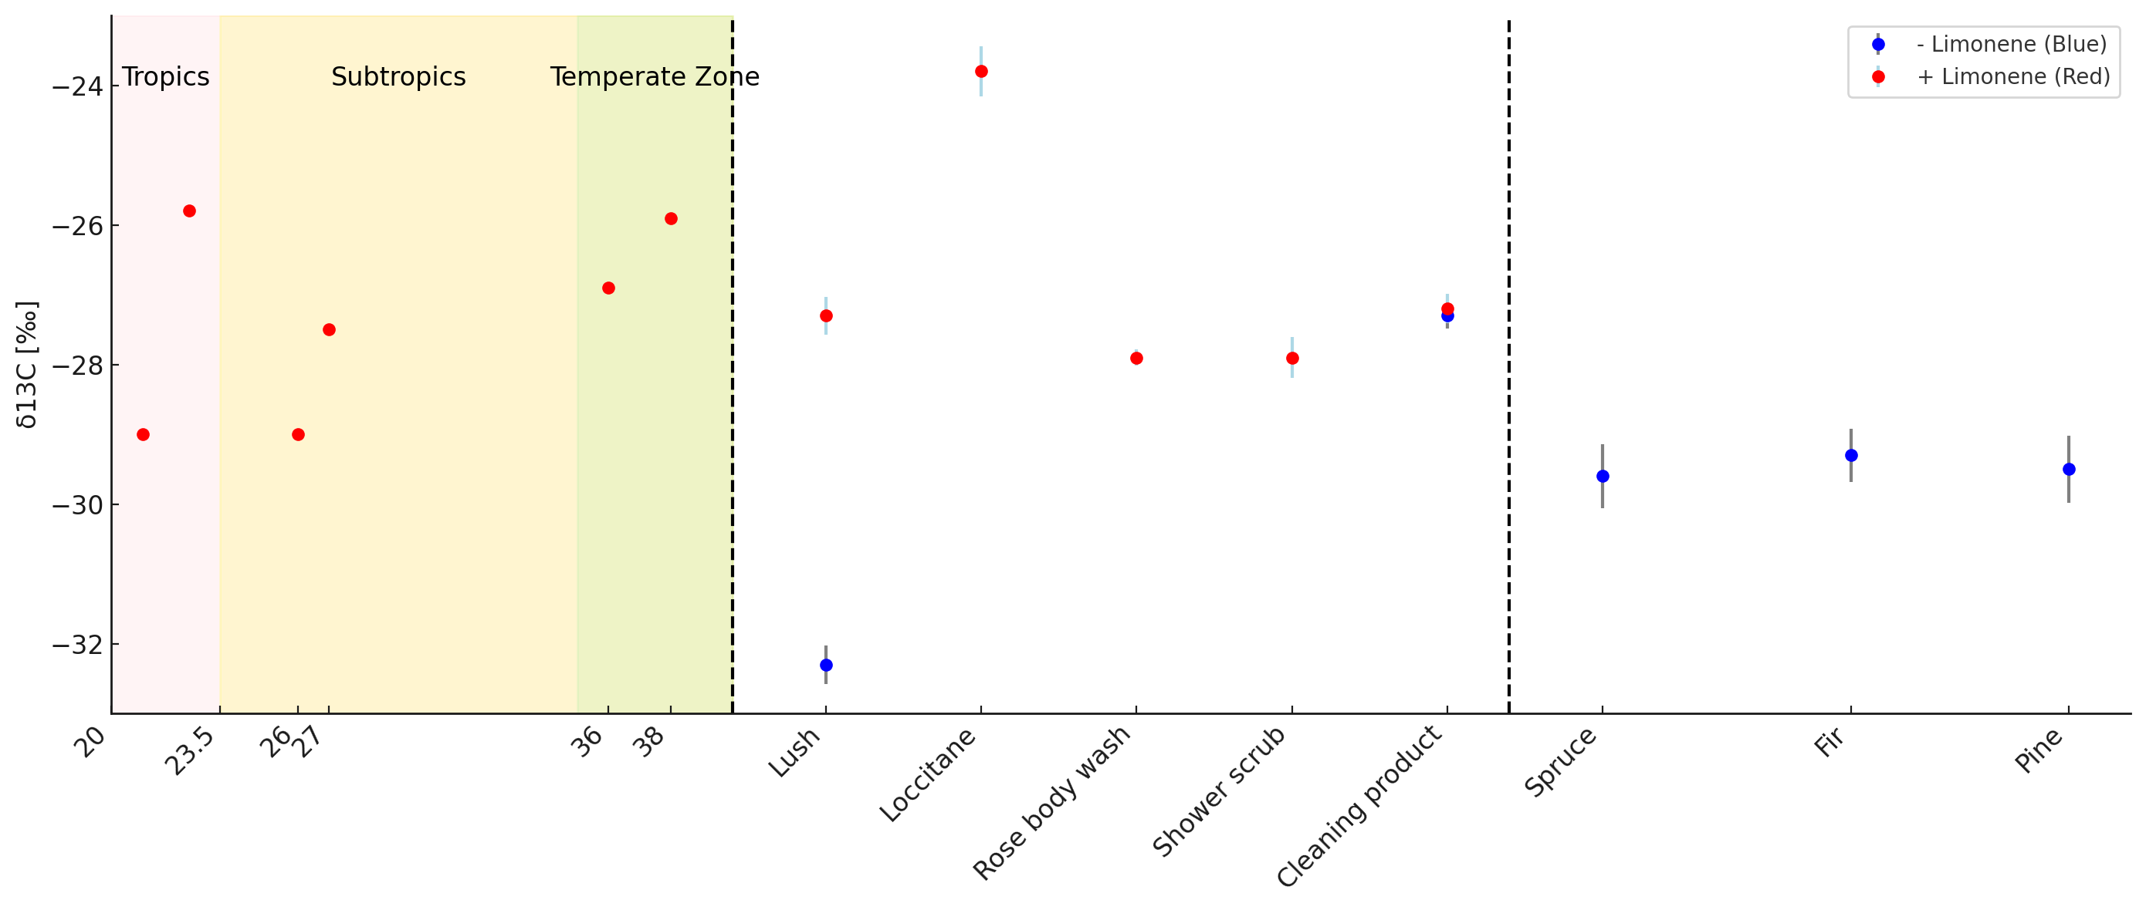
Results
Latitude
Essential oils
Care products
Trees
Notes:
Latitude

Slide 16
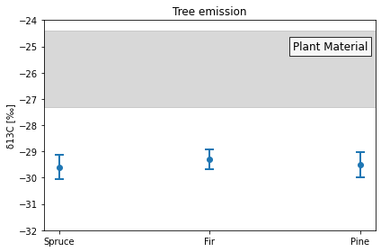
Results – emission from trees
Isotopic ratios of isoprene emissions - only one study (Sharkey et.al 1991) – 2 ‰ more negative than plant material
Isotopic ratios of bulk plant material of conifer wood from -27.3 to - 24.4 per mil

Slide 17
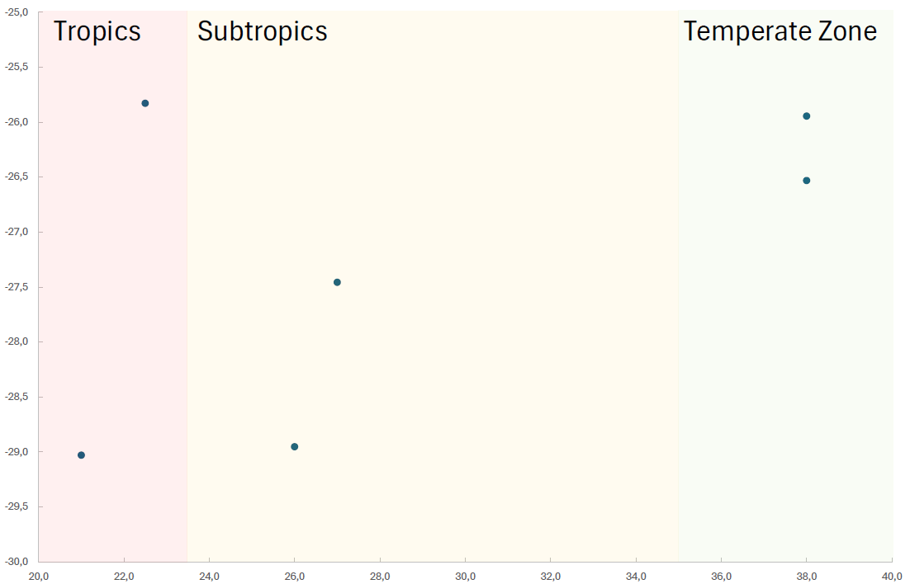
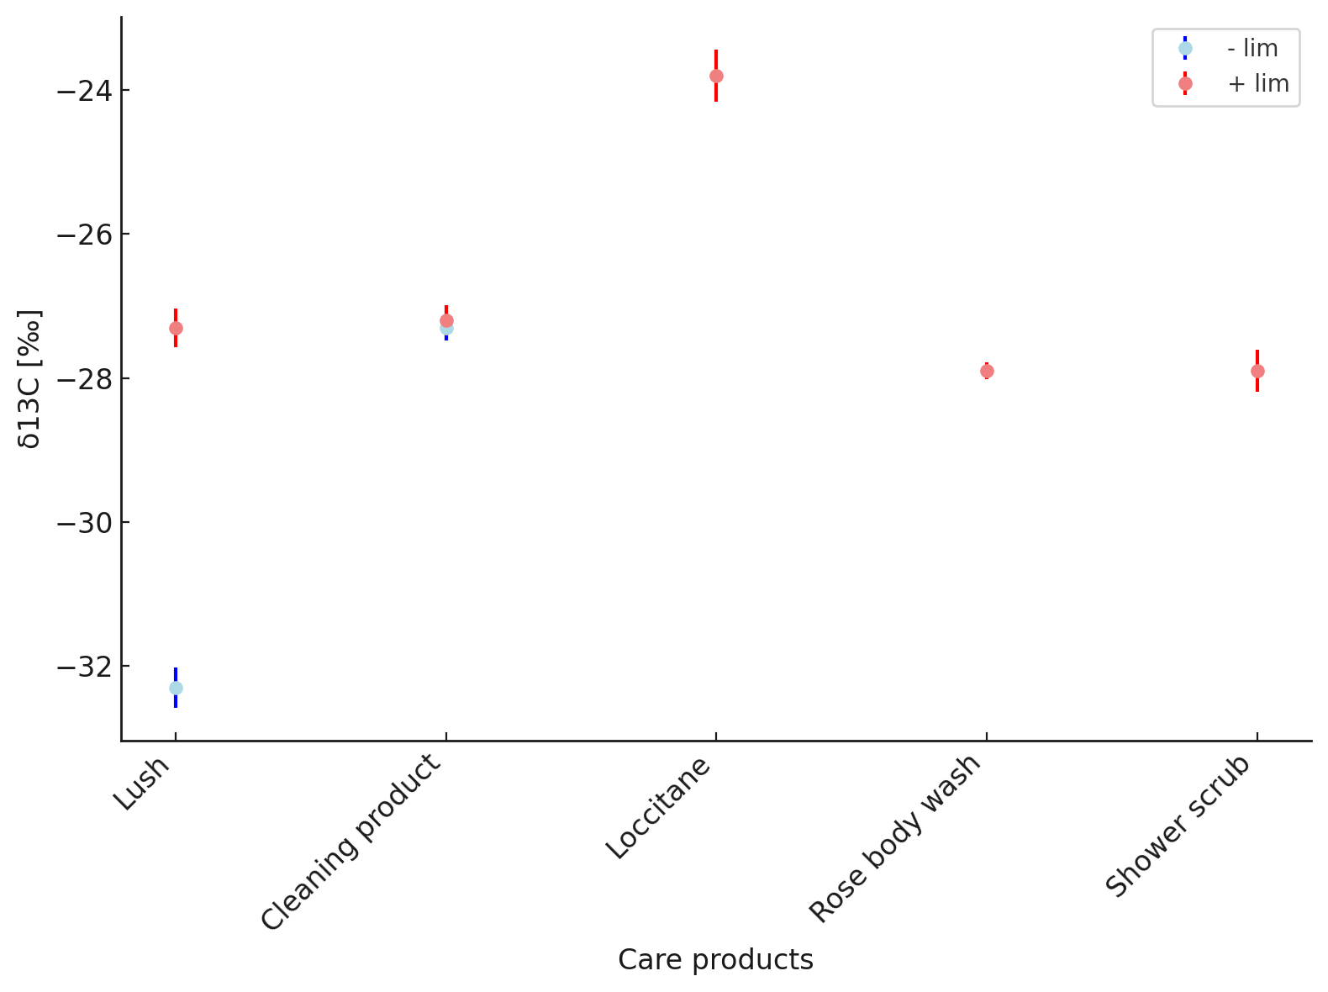
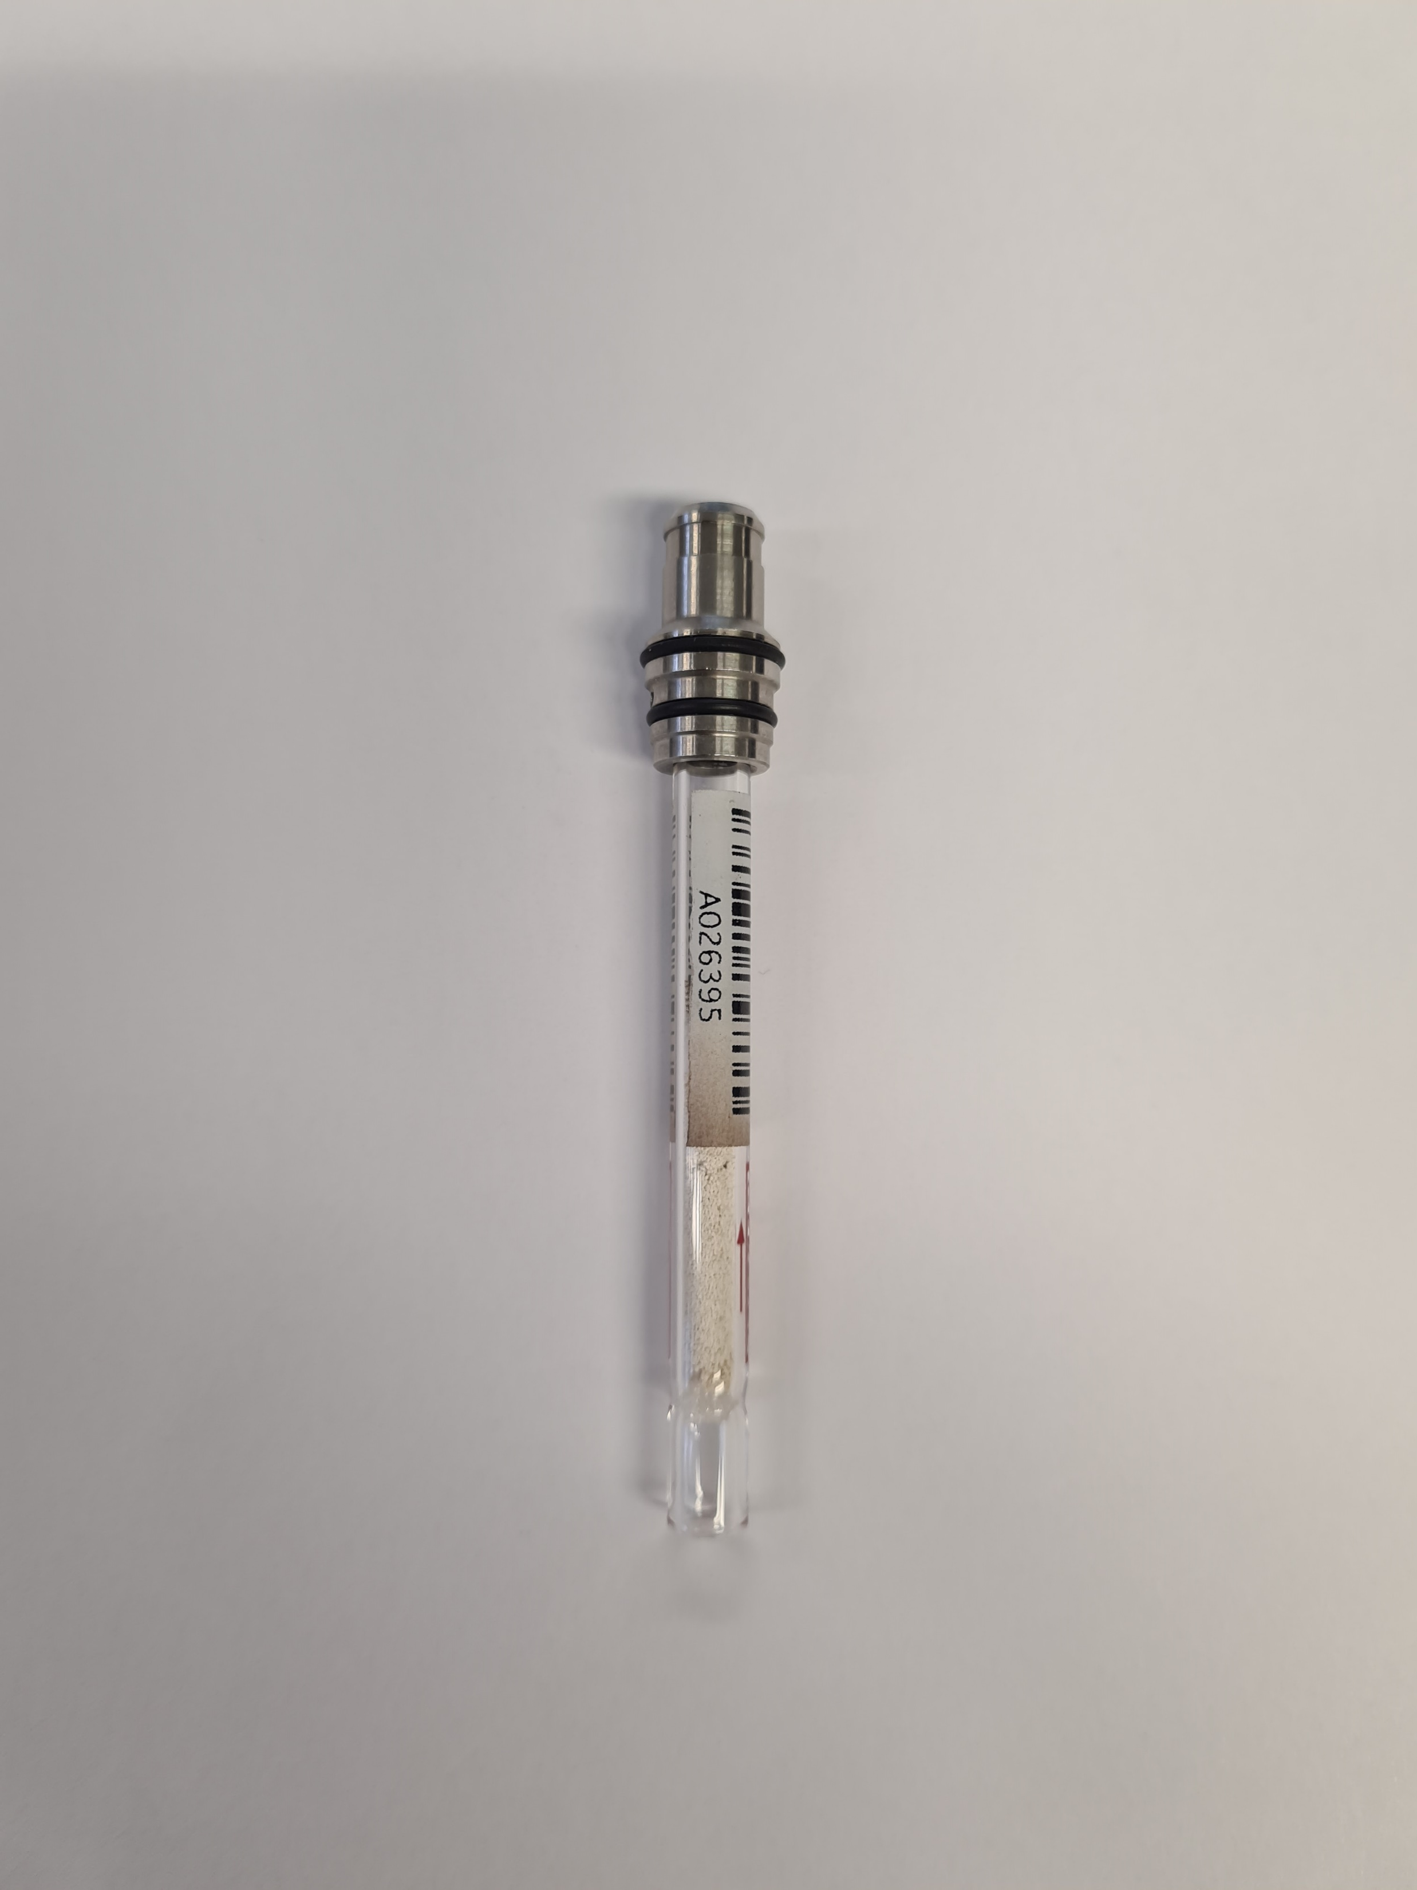
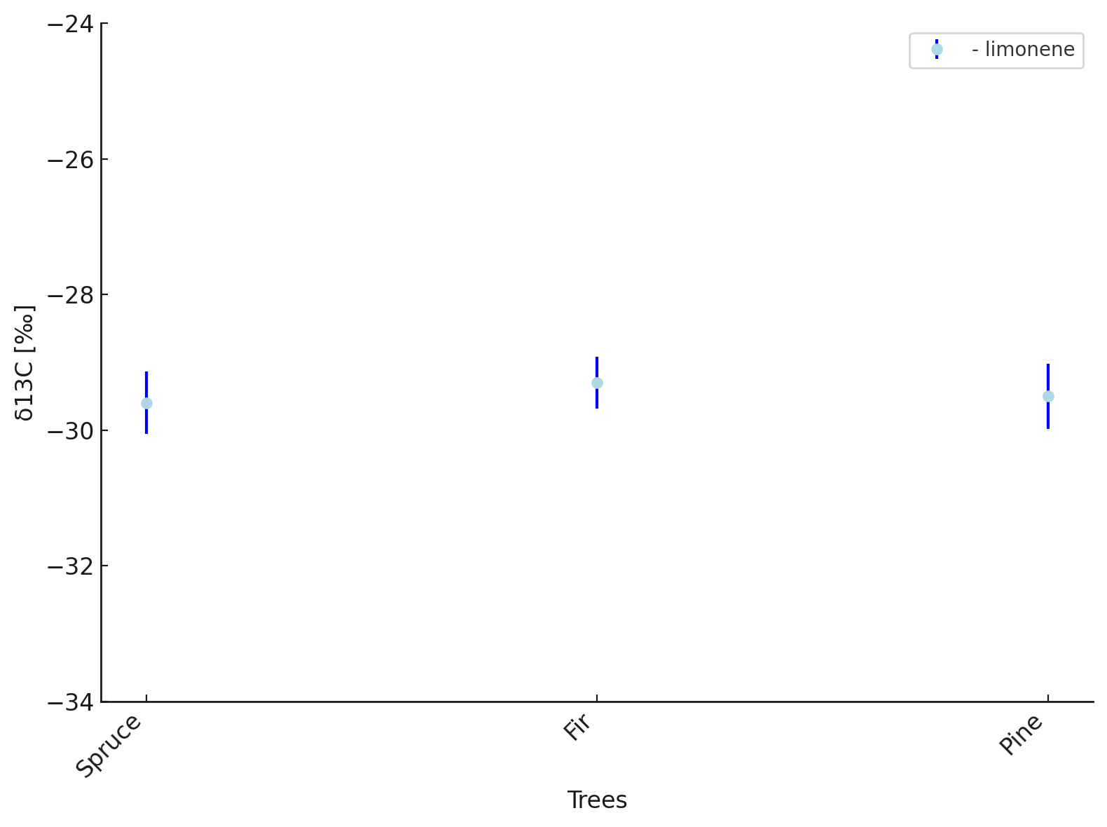
summary
δ¹³C measurements of biogenic vs. VCP limonene
Sampling
methodology
development
δ¹³C / ‰
Latitude
Higher δ¹³C values –
reactions by industrial processing
Limonene in biogenic emissions lighter than plant material
TD-2DGC-IRMS method development

Slide 18
Thank you for your kind attention

Slide 19
Steps for production of industrial limonene
Collecting of Citrus peels and waste
Ectraction
Cold pressing
Distilation
Solvent exctraction
Purification and isolation
Formulation and packiging
Concentration
Chemical reactions
Enrichment in C13
Notes:
Enrichment in C13

Slide 20
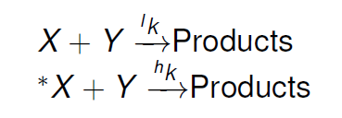
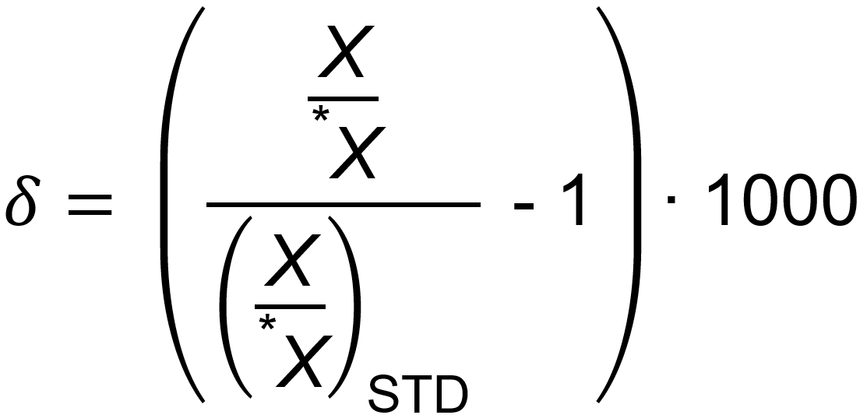
Isotopic Fractionation
Products
Products
Pseudo first order reaction rate:
(1)
(2)

Slide 21
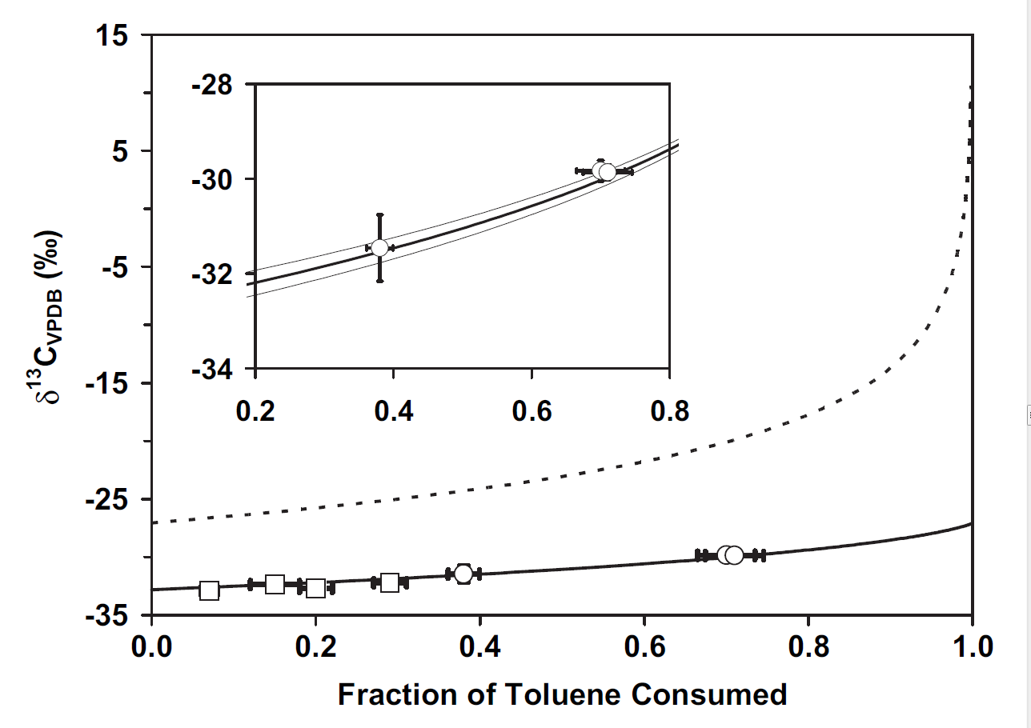
Changing of δ¹³C during the reaction
δ¹³C
δ¹³C
X
Toluene
Y
∙ OH
δ¹³C_{t >> 0}
Toluene + OH
δ¹³C_{t = 0}
δ¹³C_{t >> 0}
KIE
δ¹³C_{t > 0}
Reactants
Products
Irei et al., 2011

Slide 22
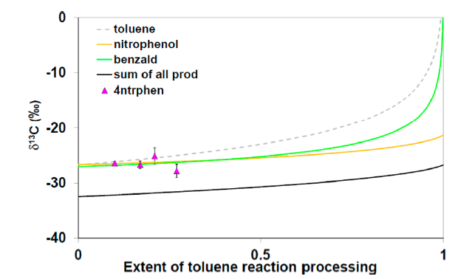
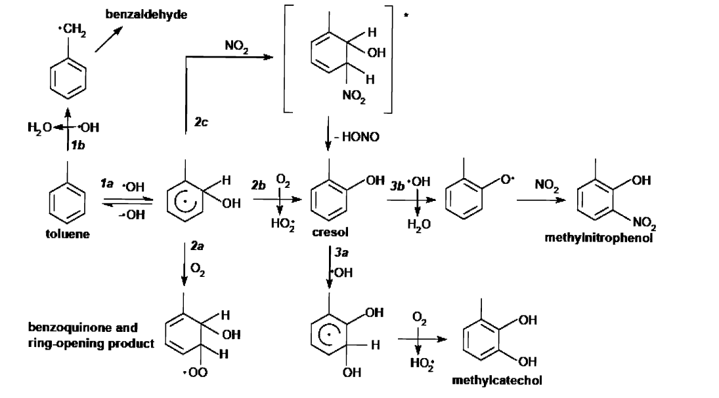
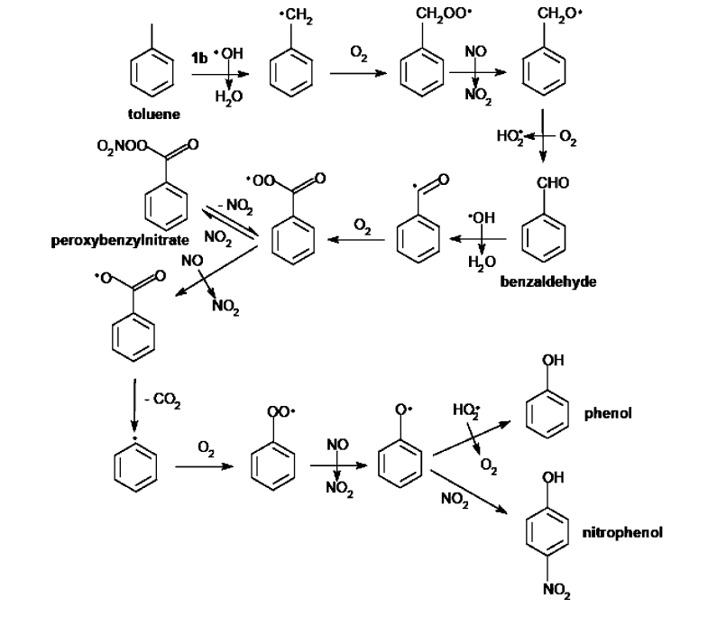
Compound Specific Isotopic Analyses
OH addition
channel
${\text{ℇ}}_{add}$=6.31‰
H abstraction
channel
${\text{ℇ}}_{add}$=6.31‰
${\text{ℇ}}_{abs}$=2.67‰

Slide 23
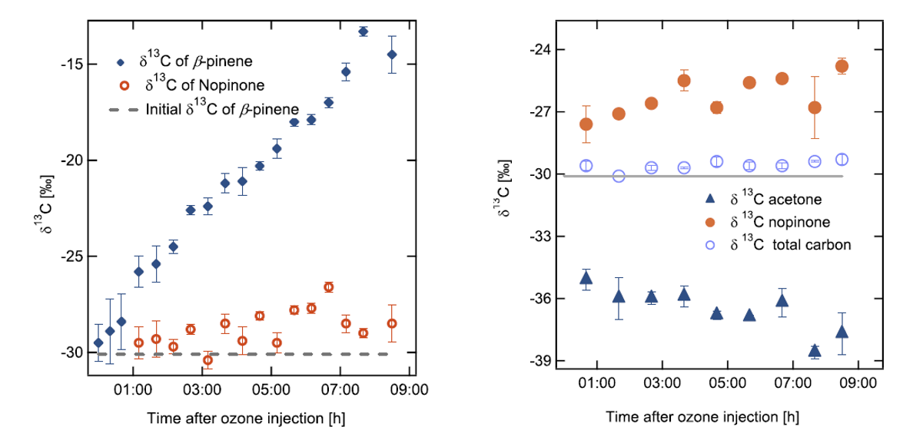
First- vs. Later-Generation Products
${\text{ℇ}}_{add}$=6.31‰
Fisseha et al. JGR 2009
- Nopinone -first-generation
product
- Acetone - later-generation products
Notes:
Finally, isotopic measurements make possible differentiating among first- and later-generation products.
Fiseha et al. measured the temporal evolution of isotope ratios in products of β-pinene ozonolysis. Nopinone shows the expected increasing trend for a first-generation product. Contrarily, acetone, which likely arises during the stepwise thermal desorption of high molecular weight compounds, becomes lighter during the reaction, which is an evidence that these compounds belong to later generations.

Slide 24
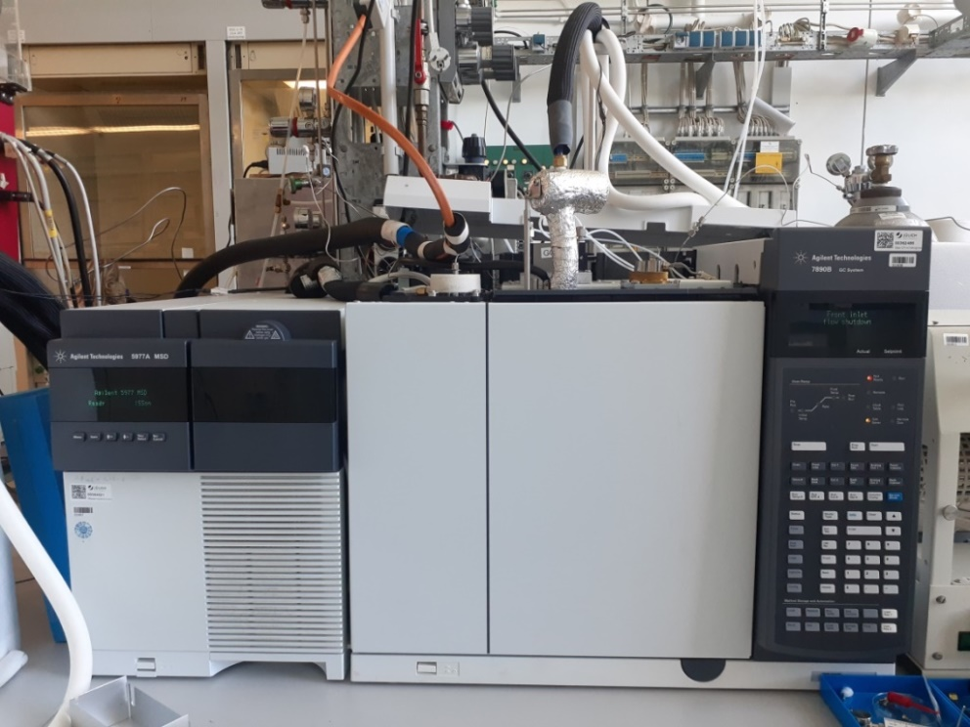
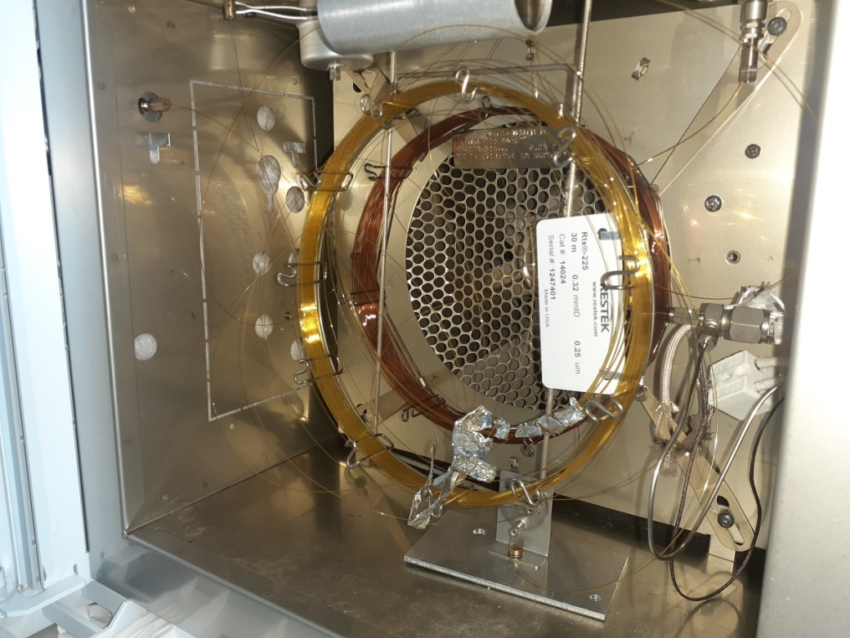
Thermal Desorption - Gas Chromatography - Isotope Ratio Mass Spectrometry (TD-GC-IRMS) with temperature-controlled reaction chamber
Notes:
Rtx-1301
Rtx-1701
Since our goal is to optimally separate complex mixtures, we plan to use 2D-GC. We intend to test different GC column pairs to cover a broad range of selectivity. Therefore, we introduce an additional cryotrap between the columns. The additional cryo-trapping unit allow for detailed investigations of different time intervals of the reaction. Fractions of the first column eluent, containing targeted analytes will be focused on this interface, to be injected onto the second column for a base line separation. GC operating conditions such as the temperature program and GC-column used will be optimized.
The GC is equipped with two columns with different polarities. The first very low polar column, which is connected to the FID, helps us to determine the retention times of the compounds of interests. The second column should improve resolution and selectivity for the polar compounds.

Slide 25
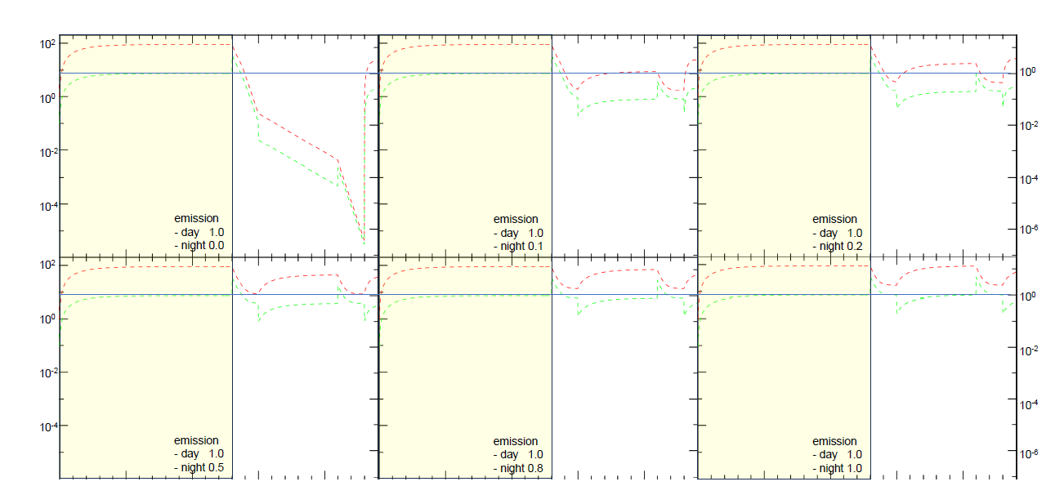

Slide 26
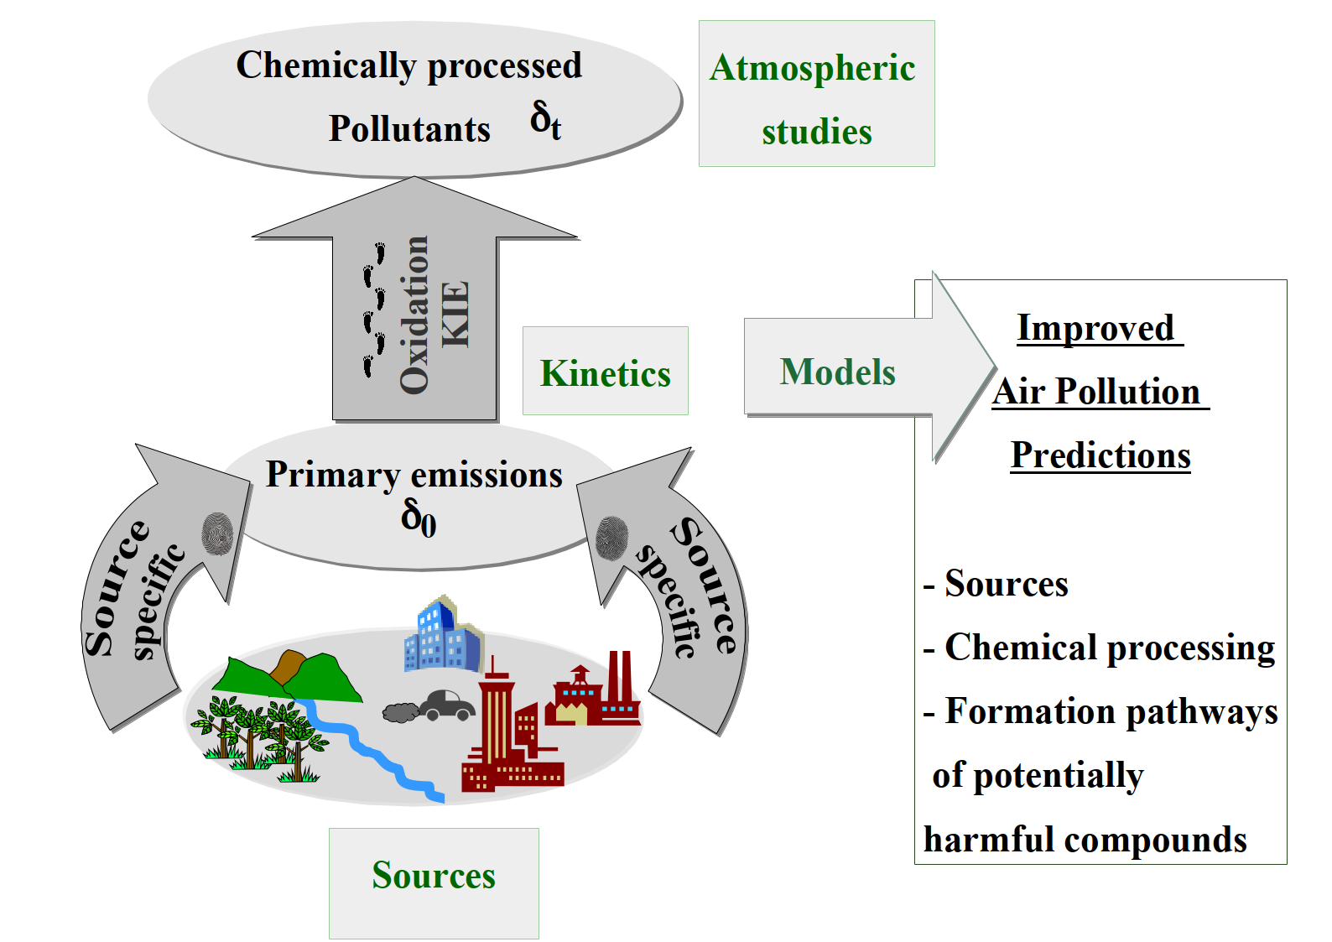
Isotopic fractionation

Slide 27
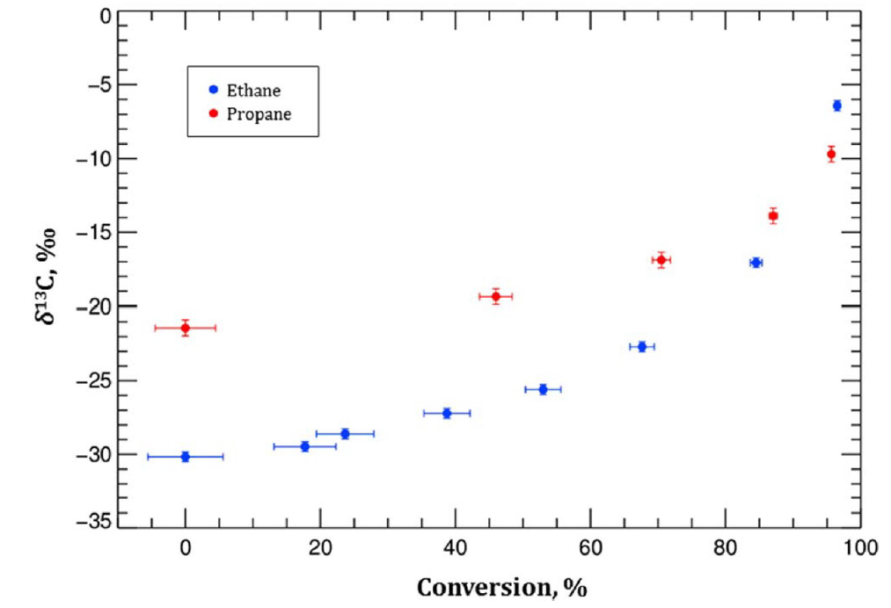
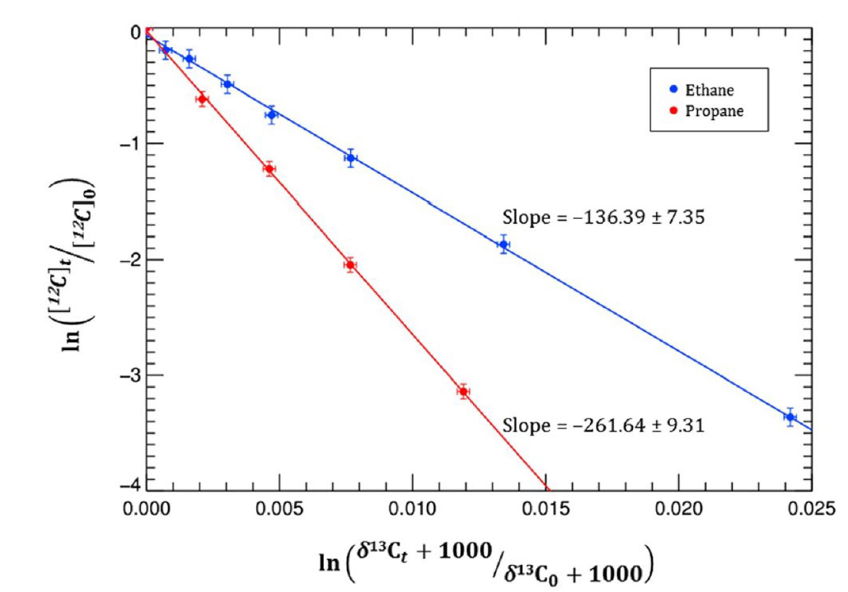
Kinetic Isotope Effect (KIE)
$$\text{KIE}\text{ = }\frac{\text{12}\text{k}}{\text{13}\text{k}}$$
Piansawan et al., 2017
Piansawan et al., 2017

Slide 28
Isotopic fractionation

Slide 29
First results
Chromatogram of rush shower scrub sample from
gas mouse
(+)-Limonene
Chromatogram of
spruce sample from
Saphir Plus
(-)-Limonene
Notes:
δ13C [‰]

Slide 30
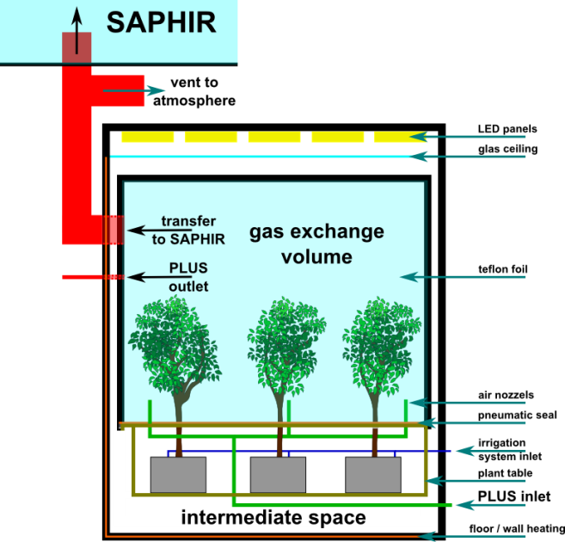
Sampling of real plant emissions at SAPHIR PLUS
12 Sept 2024

Slide 31
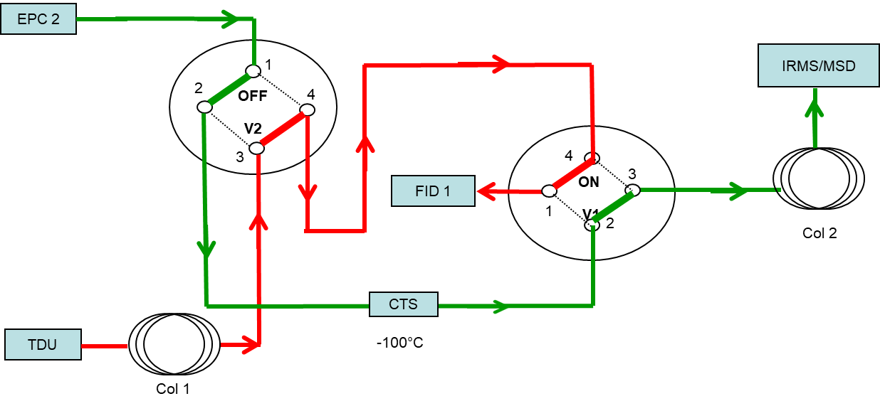
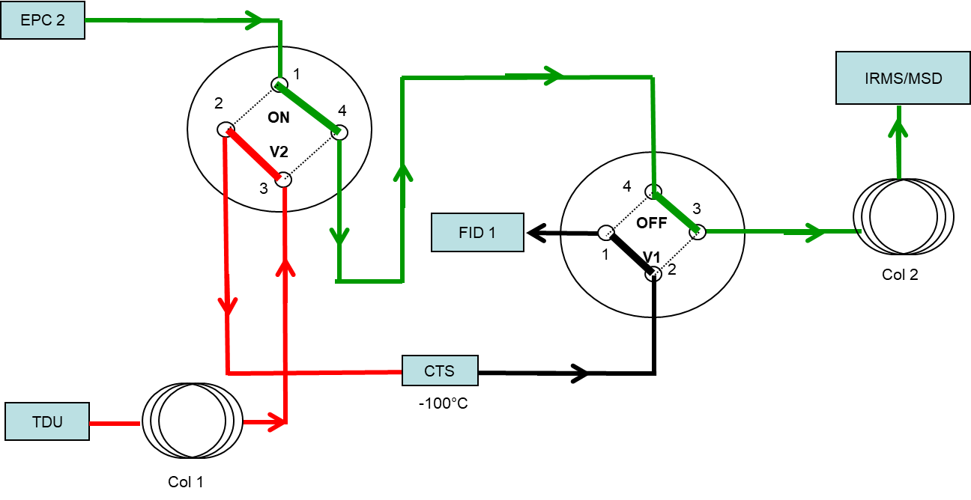
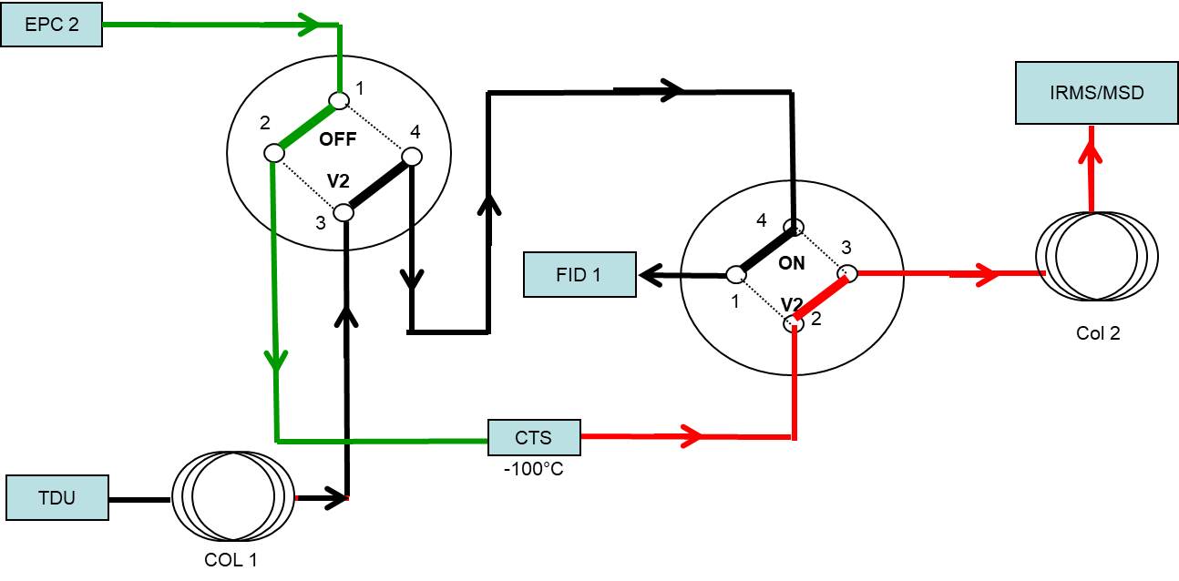
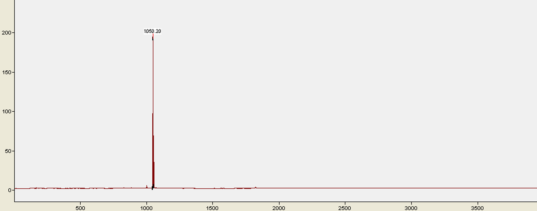
method Adaption – 2DGC – heart cut
1) Transfer
2) Trapping
3) Sepparation
FID Chormatogram
RT Limonene
-(-)Limonene Standard
Transfer
Sepparation
Trapping
Notes:
enlarge

Slide 32
Results Limonen Standard
IRMS Chromatogram
Ref. Peaks
Ref. Peaks
-(-)Limonene -26,47‰
Notes:
enlarge

Slide 33
Results Dishwashing liquid
IRMS Chromatogram
Limonene -28,66‰
β-Pinen
FID Chromatogram
cutting window
Notes:
enlarge

Slide 34
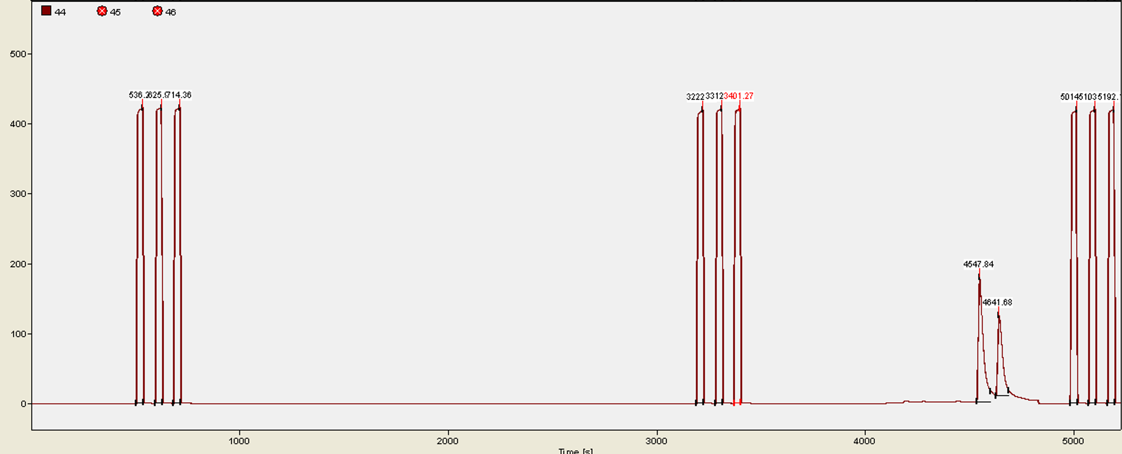
Results Limonene Standard
Col 2
RTX 1701
30 m length, 0.32 mm i.d.,
0.25 μm film thickness)
(-)-Limonene
(+)-Limonene
Col 2
Supelco Astec Chiraldex B-PM
30 m length, 0.25mm i.d.,
0.12 μm film thickness
(-)-Limonene
(+)-Limonene
Col 2
Supelco Astec Chiraldex B-DM
50 m length, 0.25mm i.d.,
0.12 μm film thickness
(-)-Limonene

Slide 35
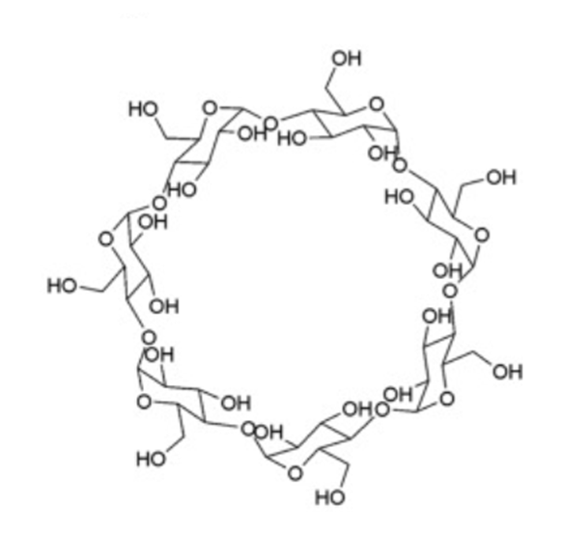
appendices

Slide 36
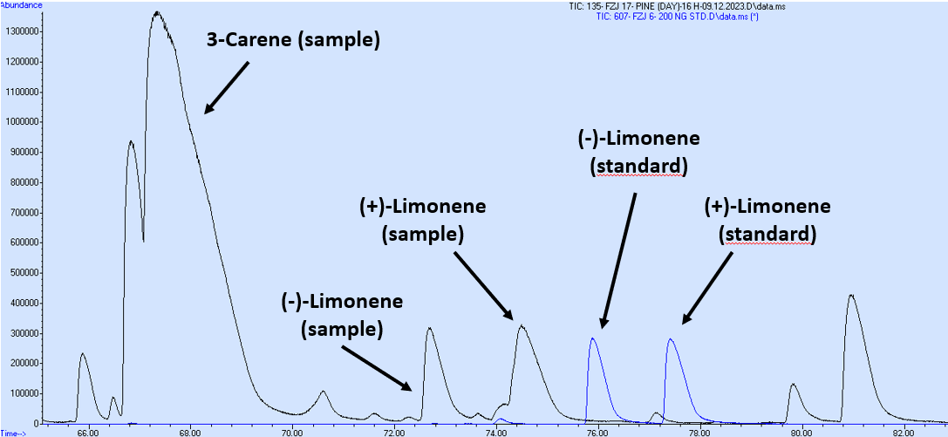
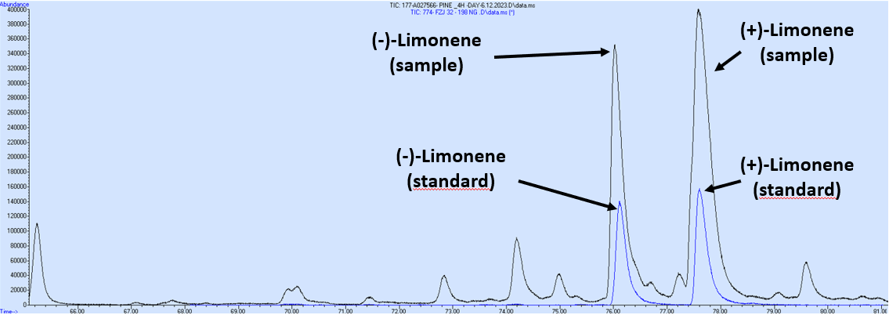
appendices
overlay MSD-chromatogram heart cutting GC window 8.0 min to 14.0 min
overlay MSD-chromatogram heart cutting GC window 9.8 min to 12.0 min

Slide 37
appendices
IRMS Chromatogram
β-Pinen
Limonene -28,660‰
FID Chromatogram
cutting window

