Slide 1
Atmospheric Research at SMART|AtmoSim_LAB
Dr. Giorgi Jibuti
Assistant Professor
Tbilisi State University

Slide 2
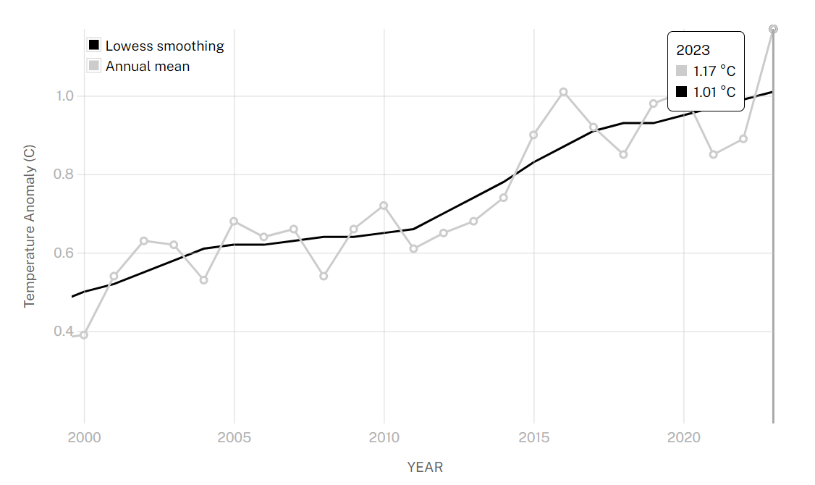
02

Slide 3
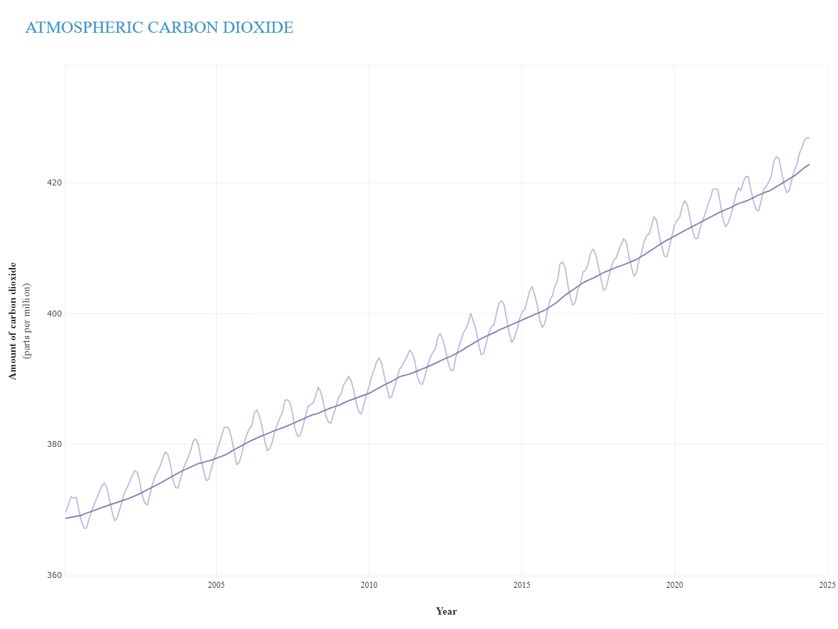
04

Slide 4
SMART|AtmoSim_LAB
29 September 2017-Opening ceremony of SMART|AtoSim_LAB
03
Notes:
Founding, GGSB, 2nd smartlab
Bezhan and Ramaz,
Andreas, Astrid, Franz

Slide 5
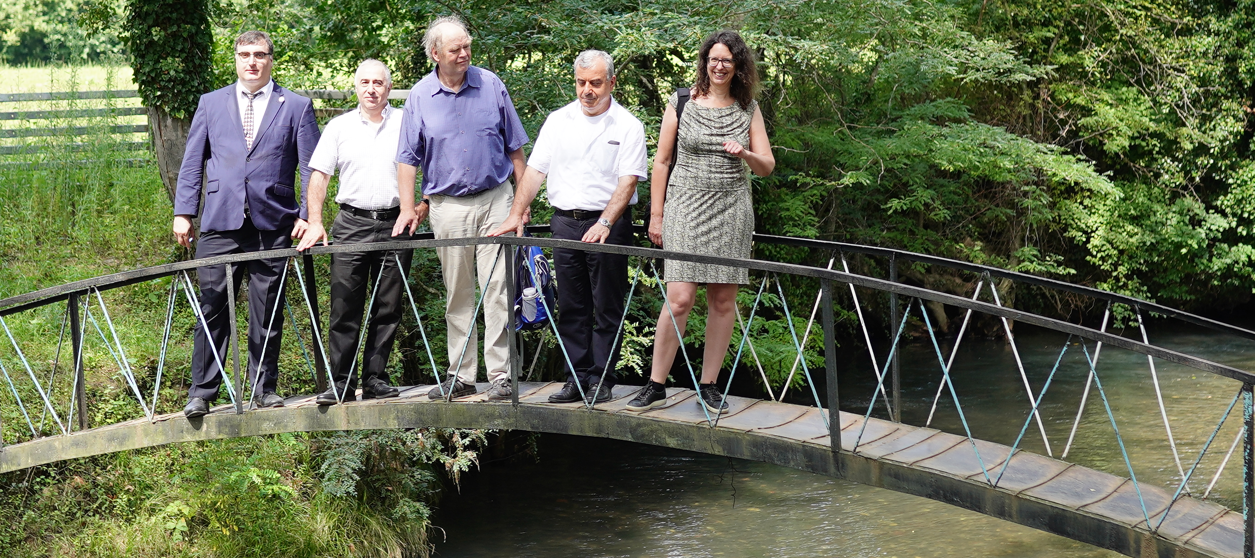
Abasha, 2019
05

Slide 6
SMART|AtmoSim_LAB - instrumentations
•ECO PHYSICS CLD 780 TR (for NO and NO₂ measurement)
•Environment S.A O₃ 41 M- (for ozone measurement)
•PICARRO CRDS G2401 (for CO, CO₂, CH₄, H₂O measurement)
•Grimm Aerosol Technik 1.129 OPC (for aerosol measurement)
06
Notes:
+Drone,+ sensors

Slide 7
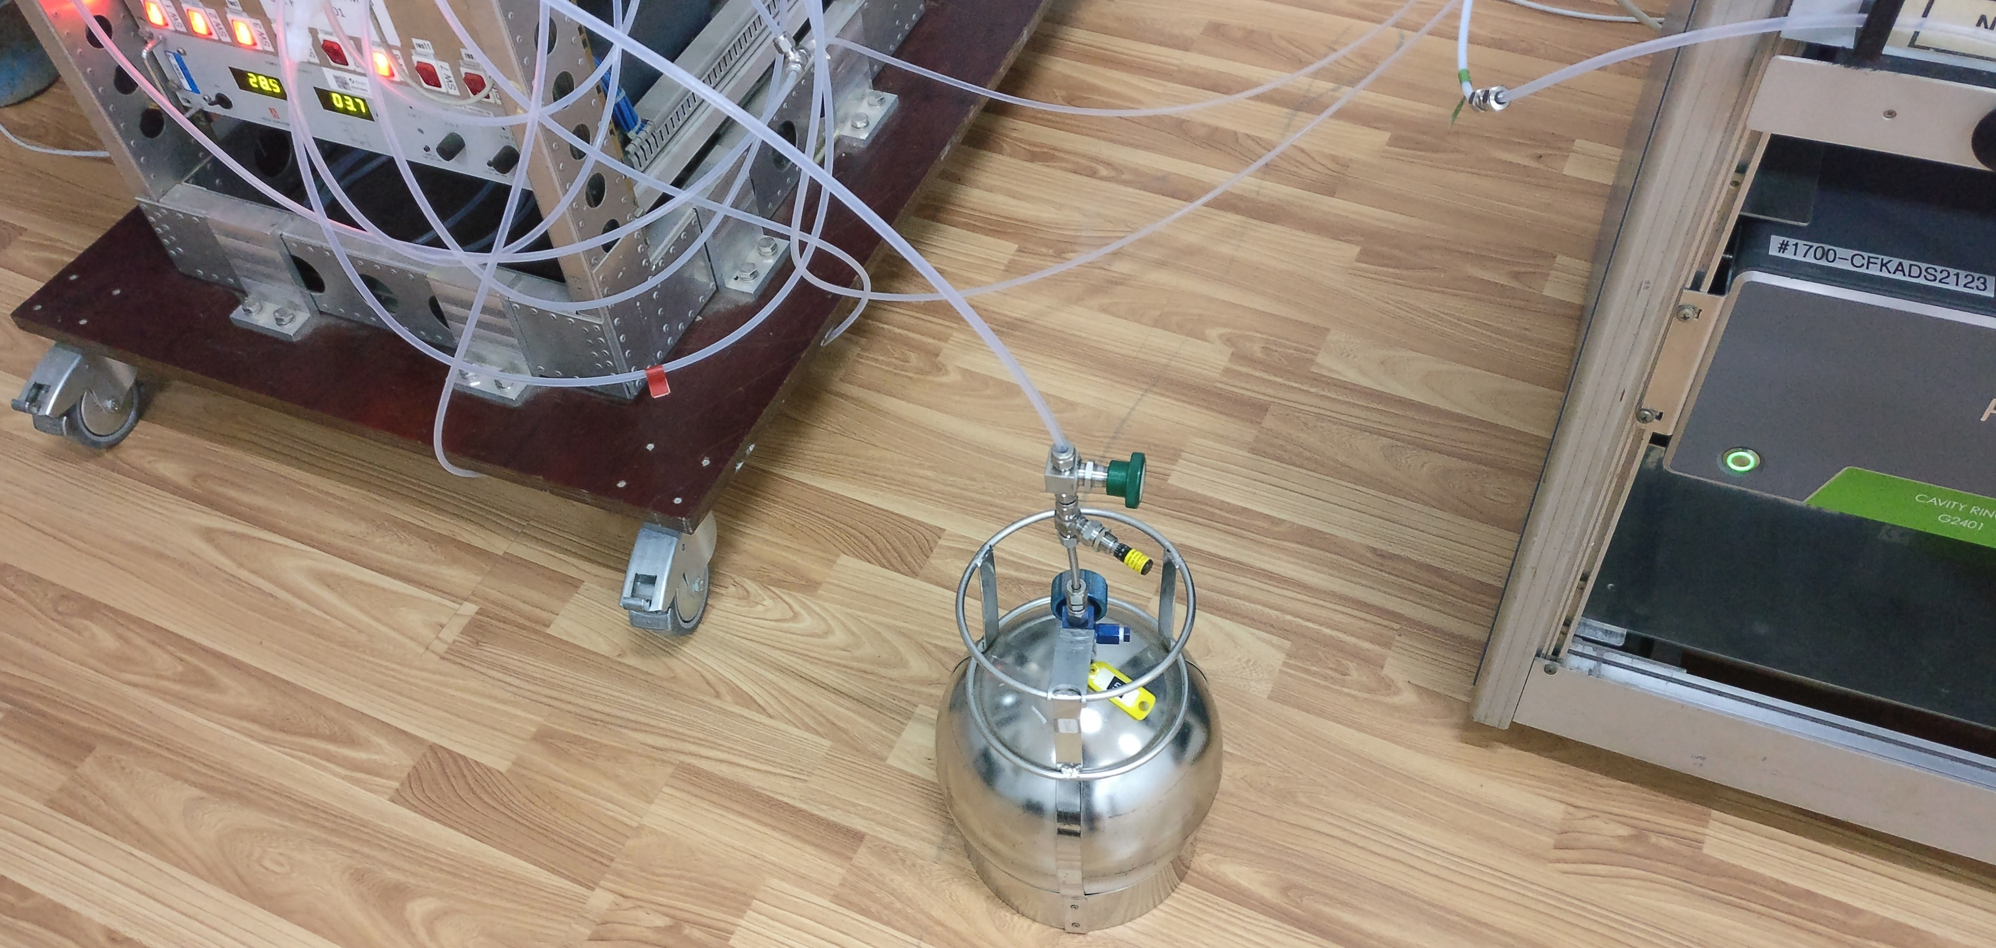
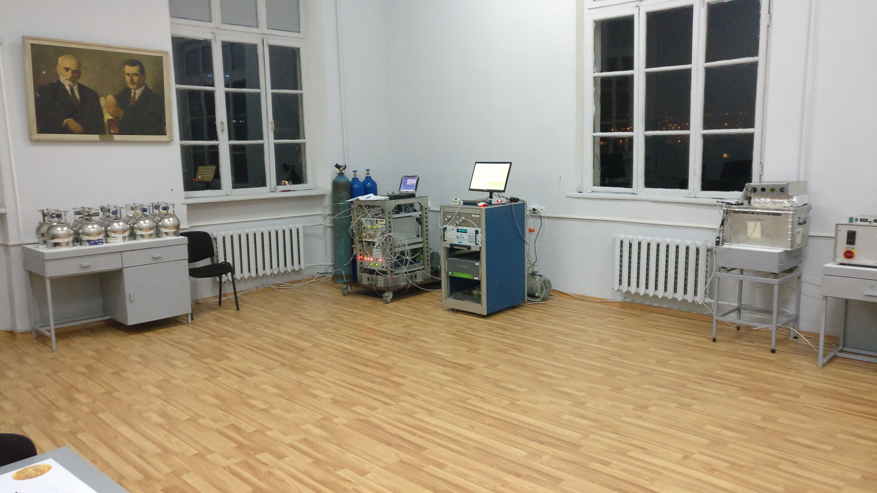
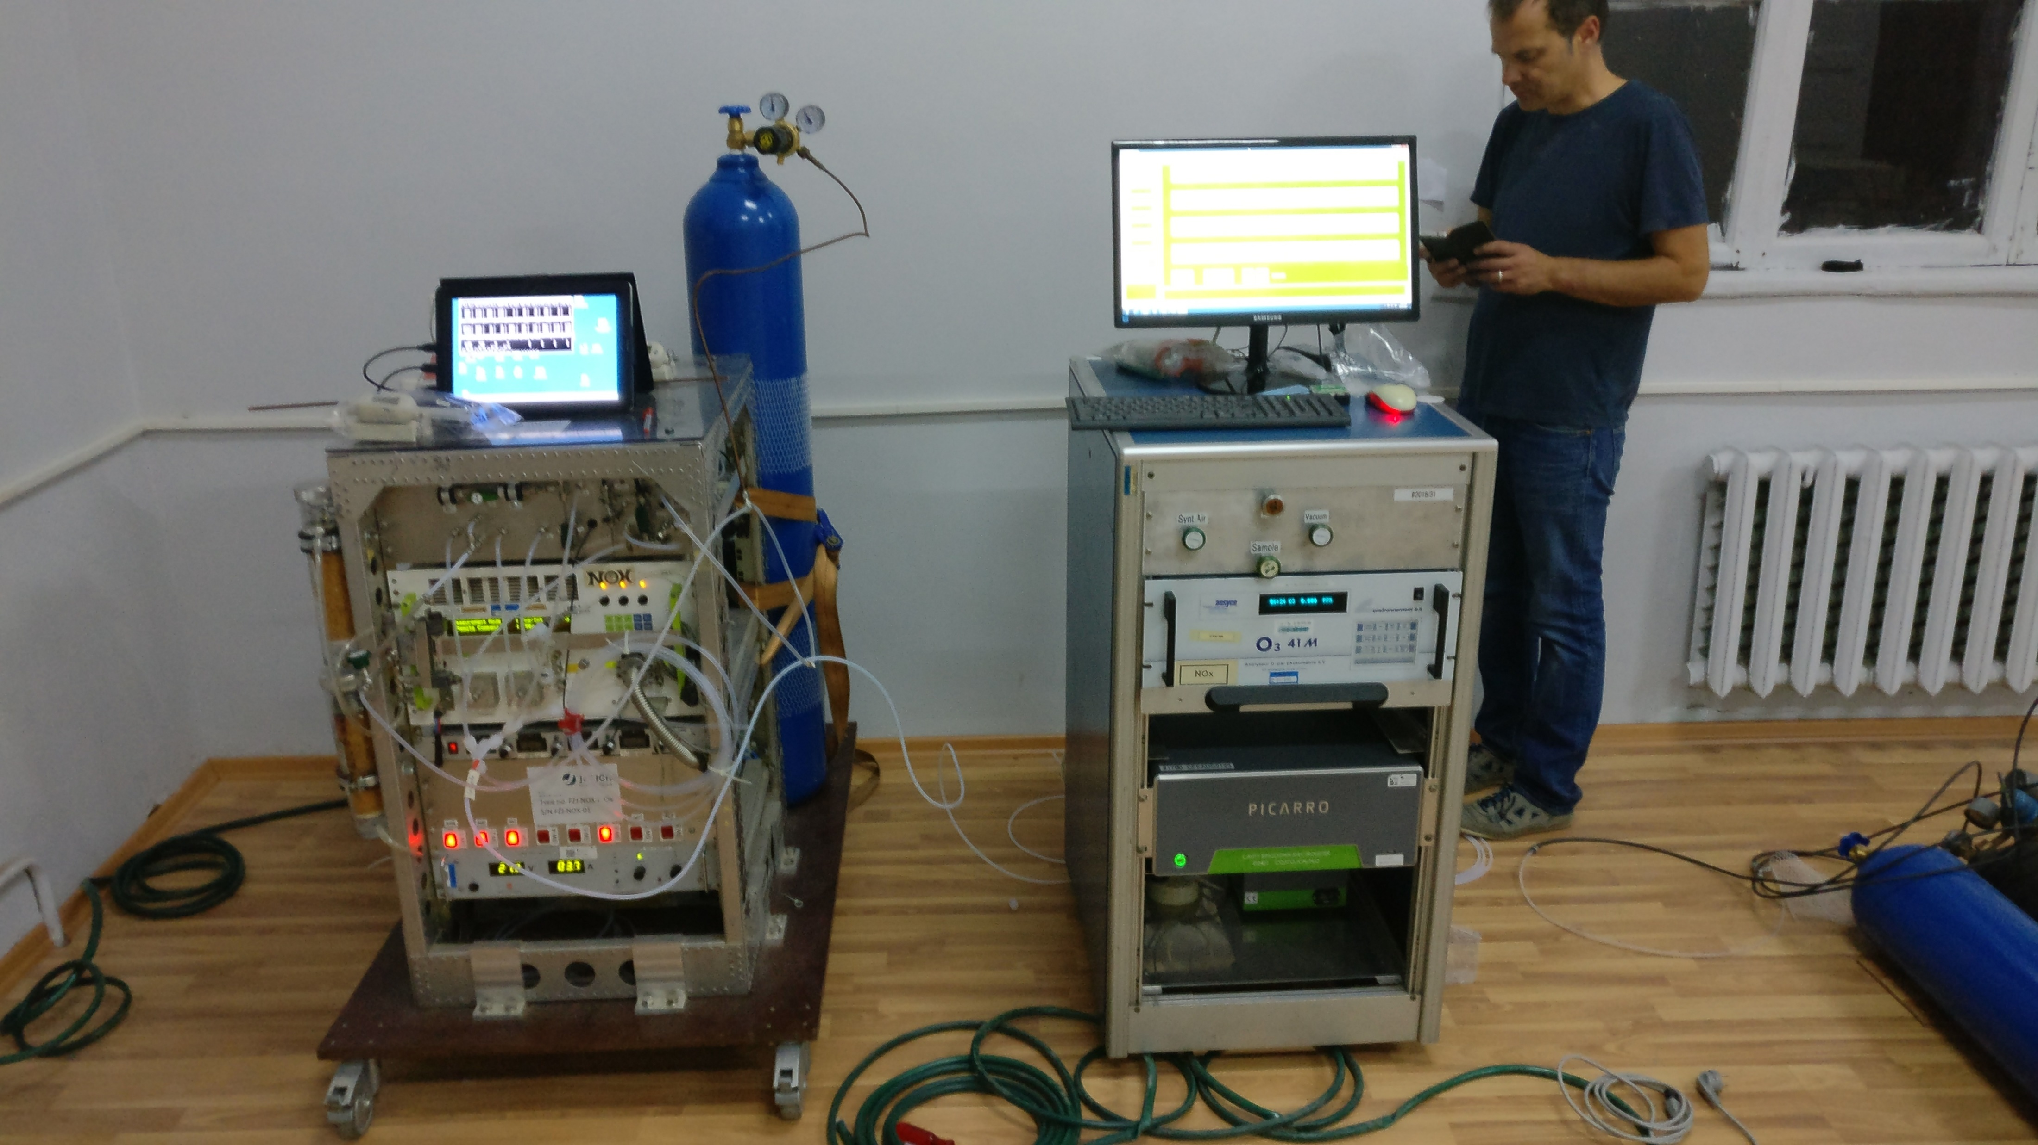
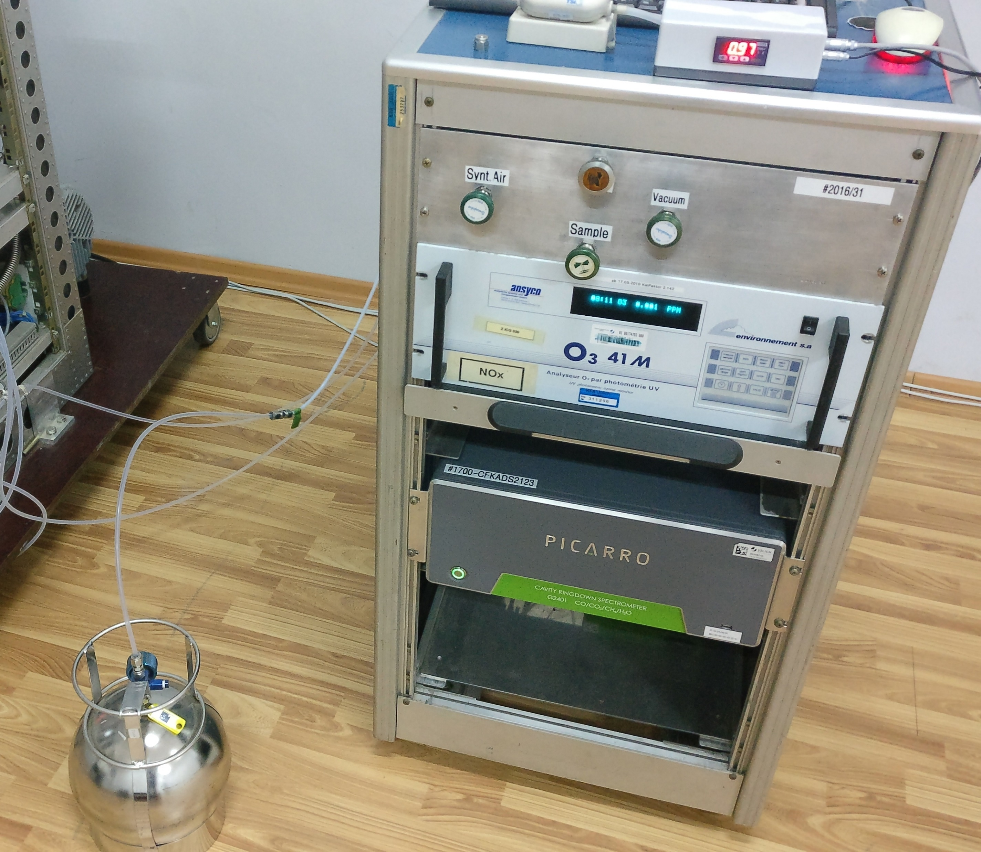
07

Slide 8
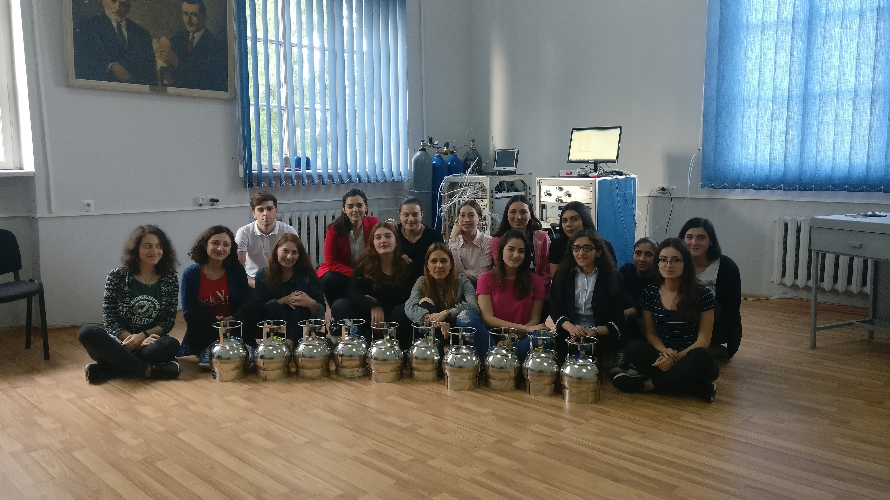
08
Notes:
Lab team
Drones+ Sensors

Slide 9
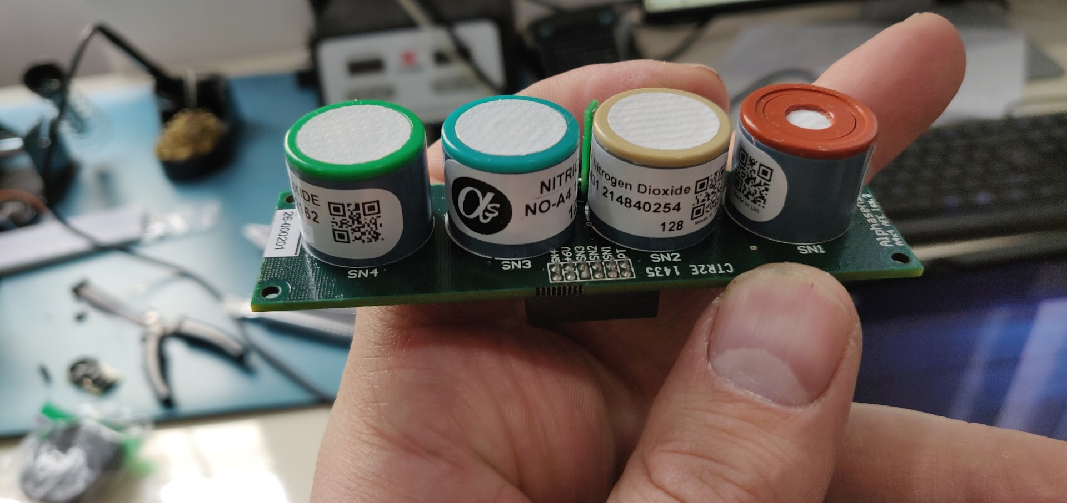
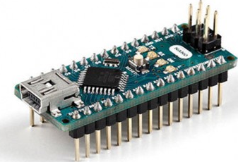
Collaboration with SMART|EDM_LAB
Gas sensor model | Detected gas
CO-A4 | Carbon monoxide (CO)
NO-A4 | Nitrogen monoxide (NO)
NO2-A43F | Nitrogen dioxide (NO₂)
OX-A431 | Ozone and nitrogen dioxide (O₃+NO₂)
Arduino Nano Microcontroller to record sensor data
09
Notes:
Interdisciplinary collaboration
Semiconductor and electrochemical sensors

Slide 10
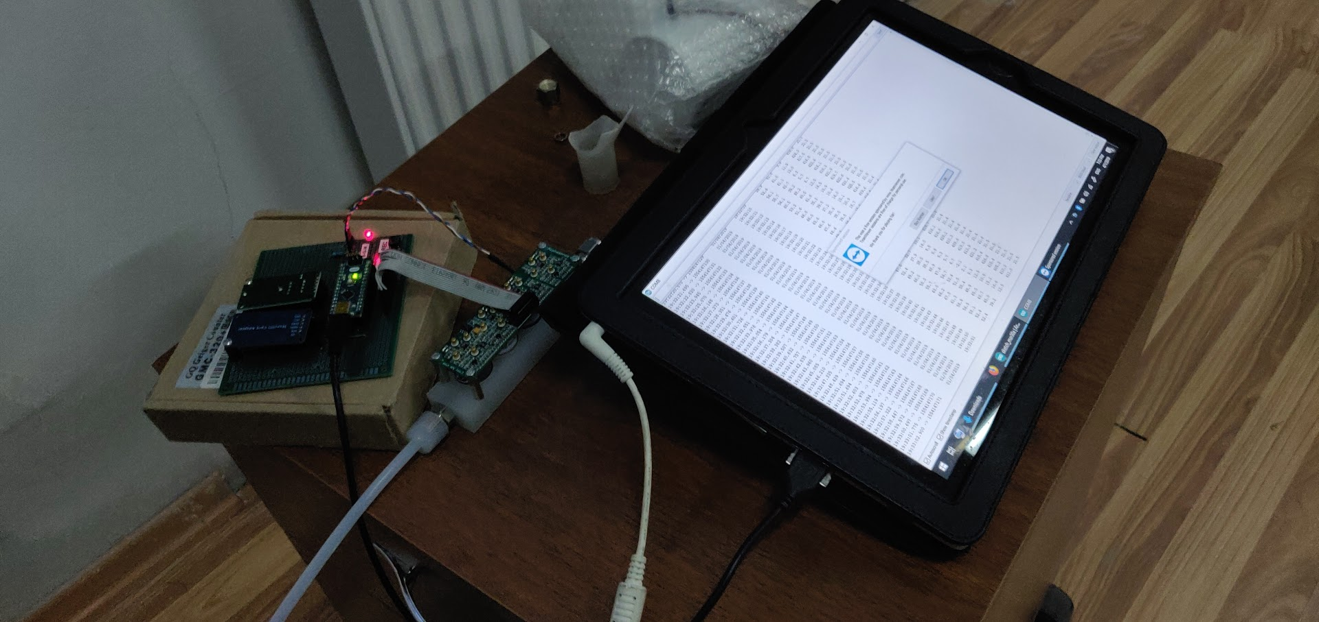
Comparative studies of sensors
10
Notes:
David Mchedlishvili

Slide 11
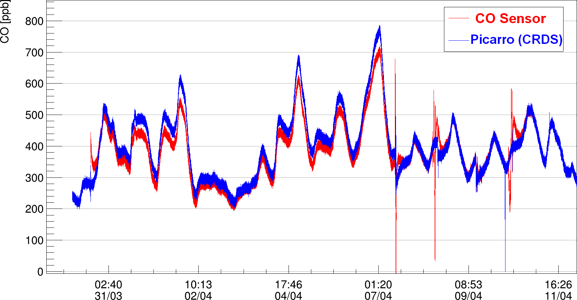
Carbon dioxide sensor evaluation
11

Slide 12
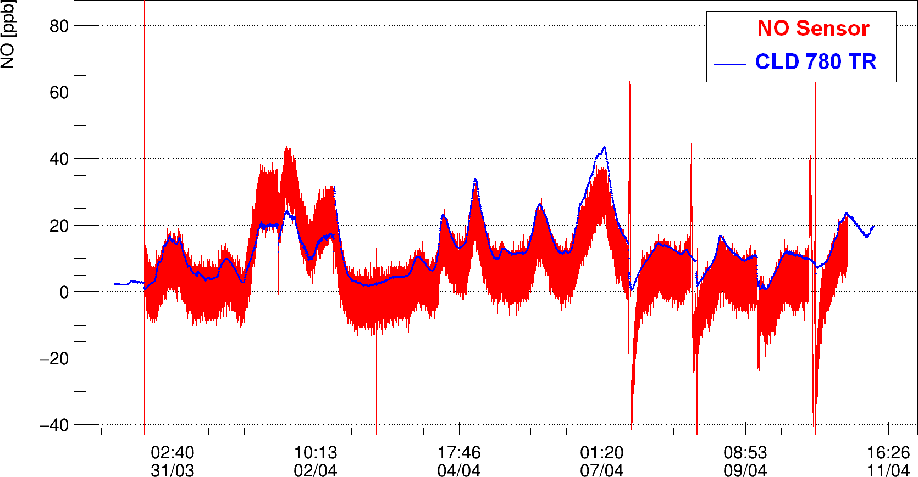
Nitrogen monoxide sensor evaluation
12

Slide 13
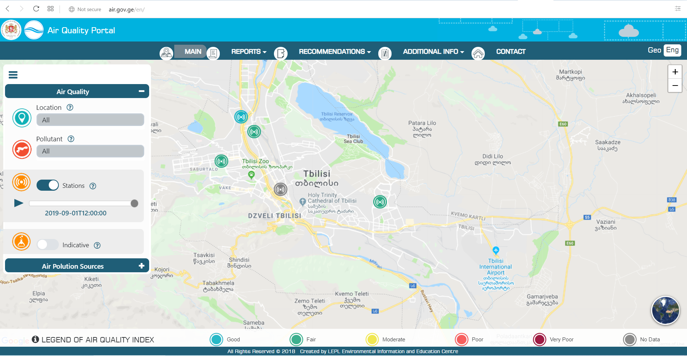
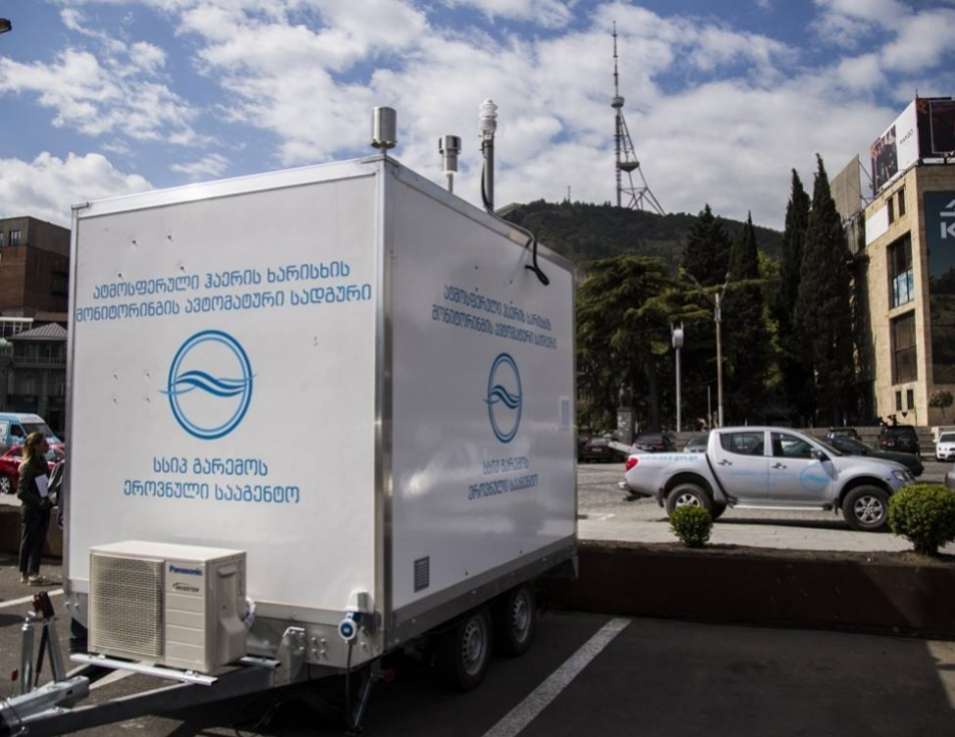
Collaboration with National Environmental Agency
13

Slide 14
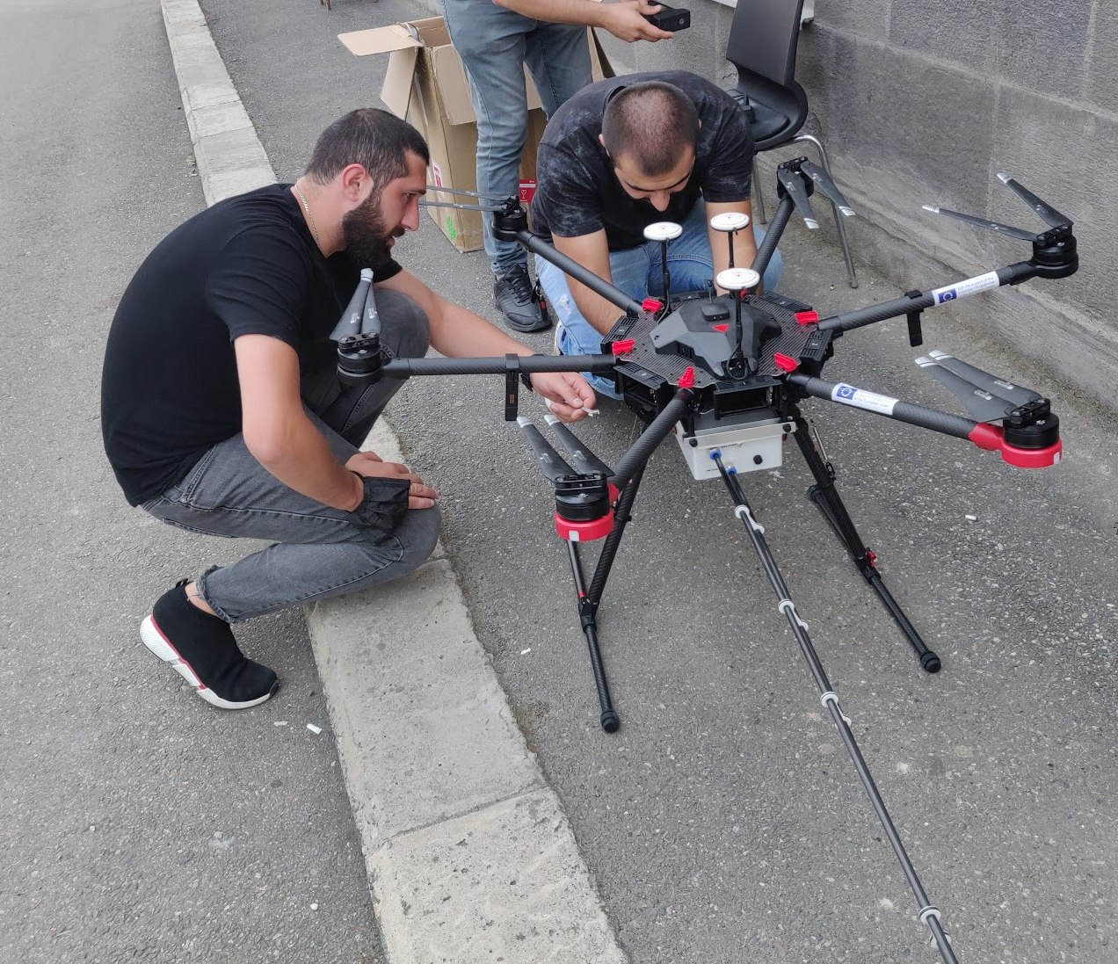
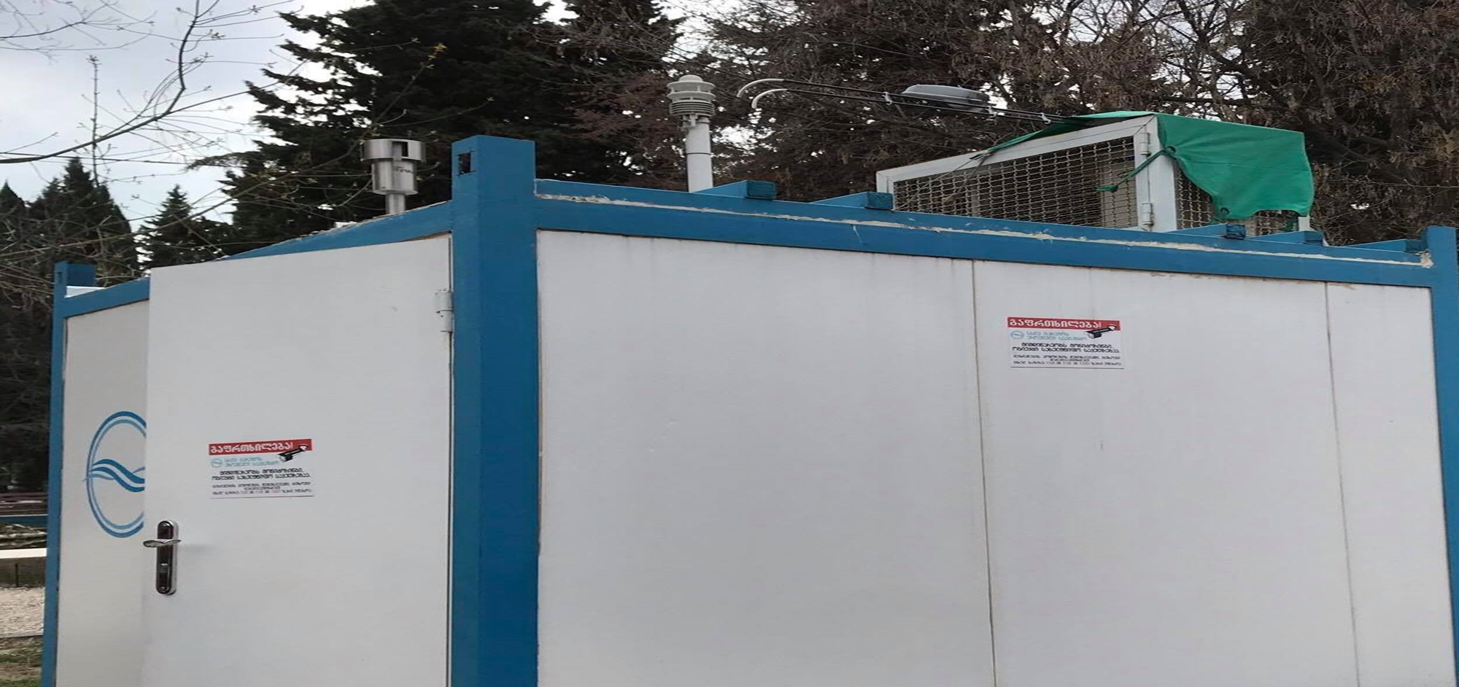
Commercial Sensor platform testing
SOWA Flying laboratory
NEA ambient air station
Educational for Drone (eDrone)
574090-EPP-1-2016-1-IT-EPPKA2-CBHE-JP
14

Slide 15
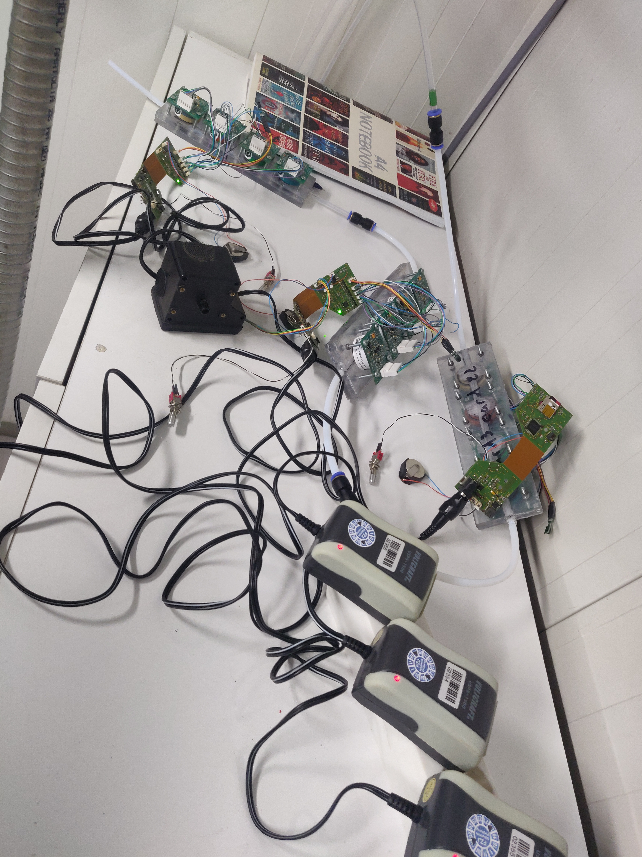
FZJ Sensor systems testing
15

Slide 16
NO₂ Sensor mean = 0.027 mg/m³
NO₂ Station mean = 0.029 mg/m³
Bsc. Student of San Diego State University Georgia
Lika Kirtadze
Correlation Coefficient = 0.3
Date and Time
16

Slide 17
03/04/2021 27/05/2021 NO₂ mg/m³
Correlation Coefficient = 0.448
14
17

Slide 18
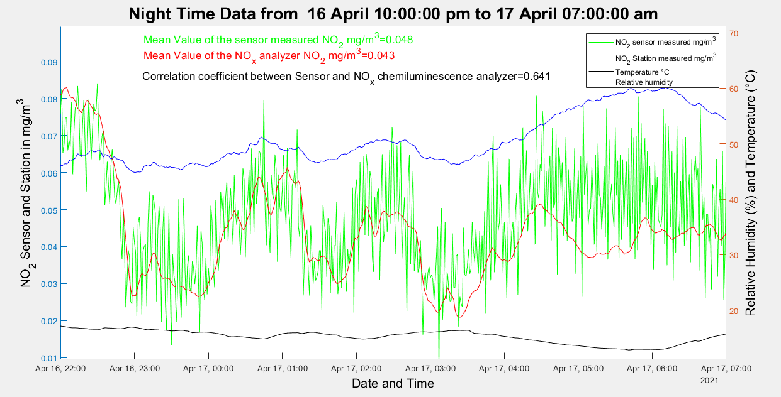
Lika Kirtadze
18

Slide 19
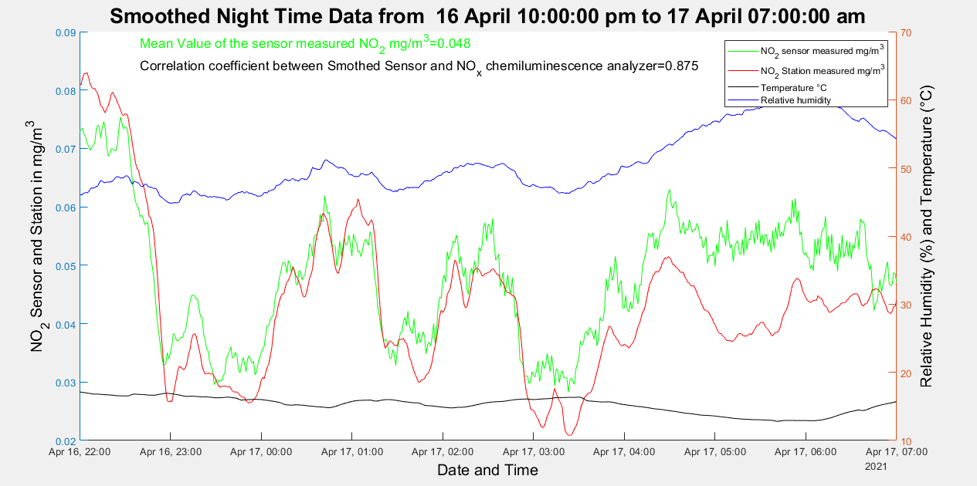
Lika Kirtadze
19

Slide 20
Ozone 17.06.2021 – 07.07.2021
Average O₃ concentration (Station)- 55 μ/m³
Average O₃ concentration (Sensor) - 57 μ/m³
Correlation coefficient- 0.3
TSU Master Student
Levani Turmanidze
20
Notes:
Problem with DA

Slide 21
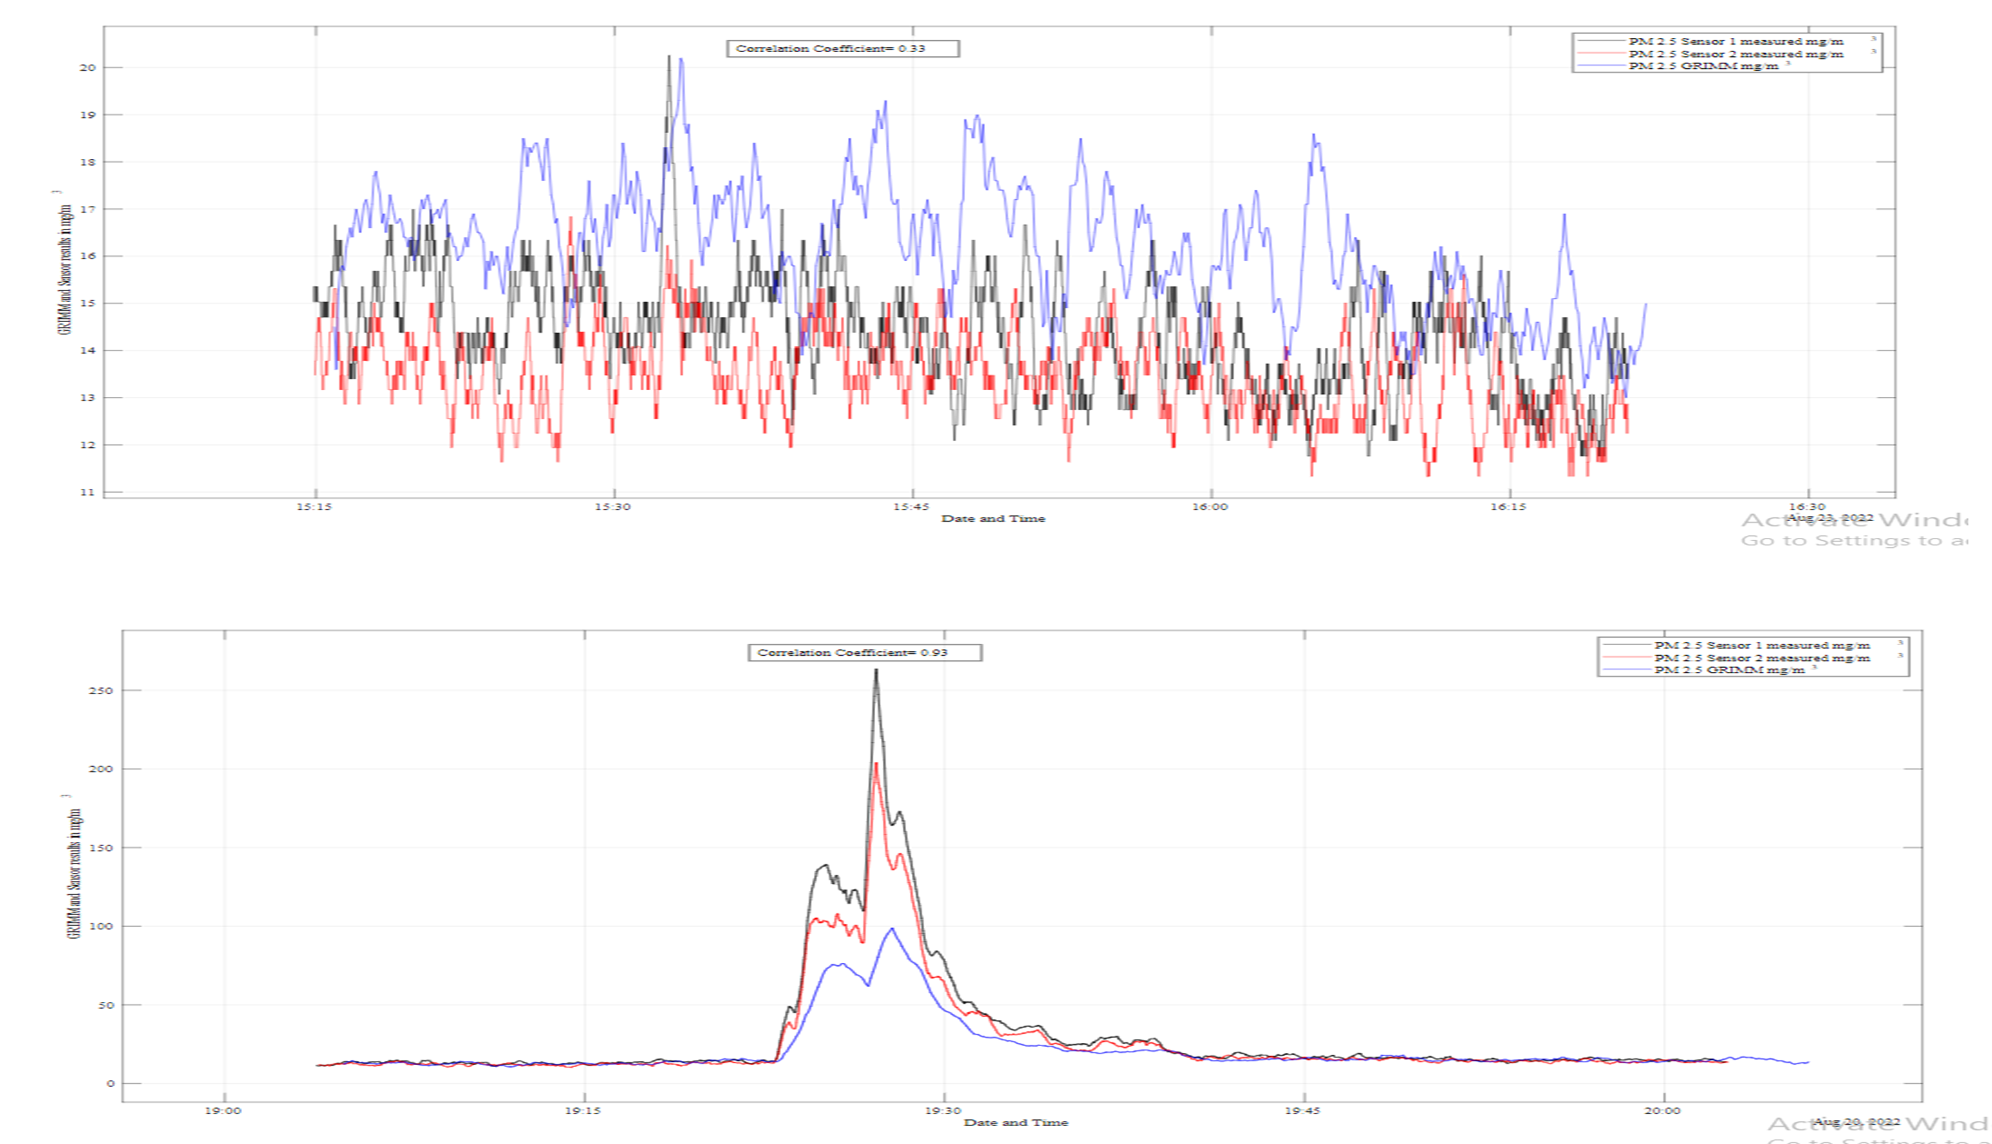
Comparison of OPC measurements
TSU BCs students
Ani Rurua
Mariam Shanidze
Nino Jajanidze
Lika Kirtadze
Mariam Akhvlediani
21

Slide 22
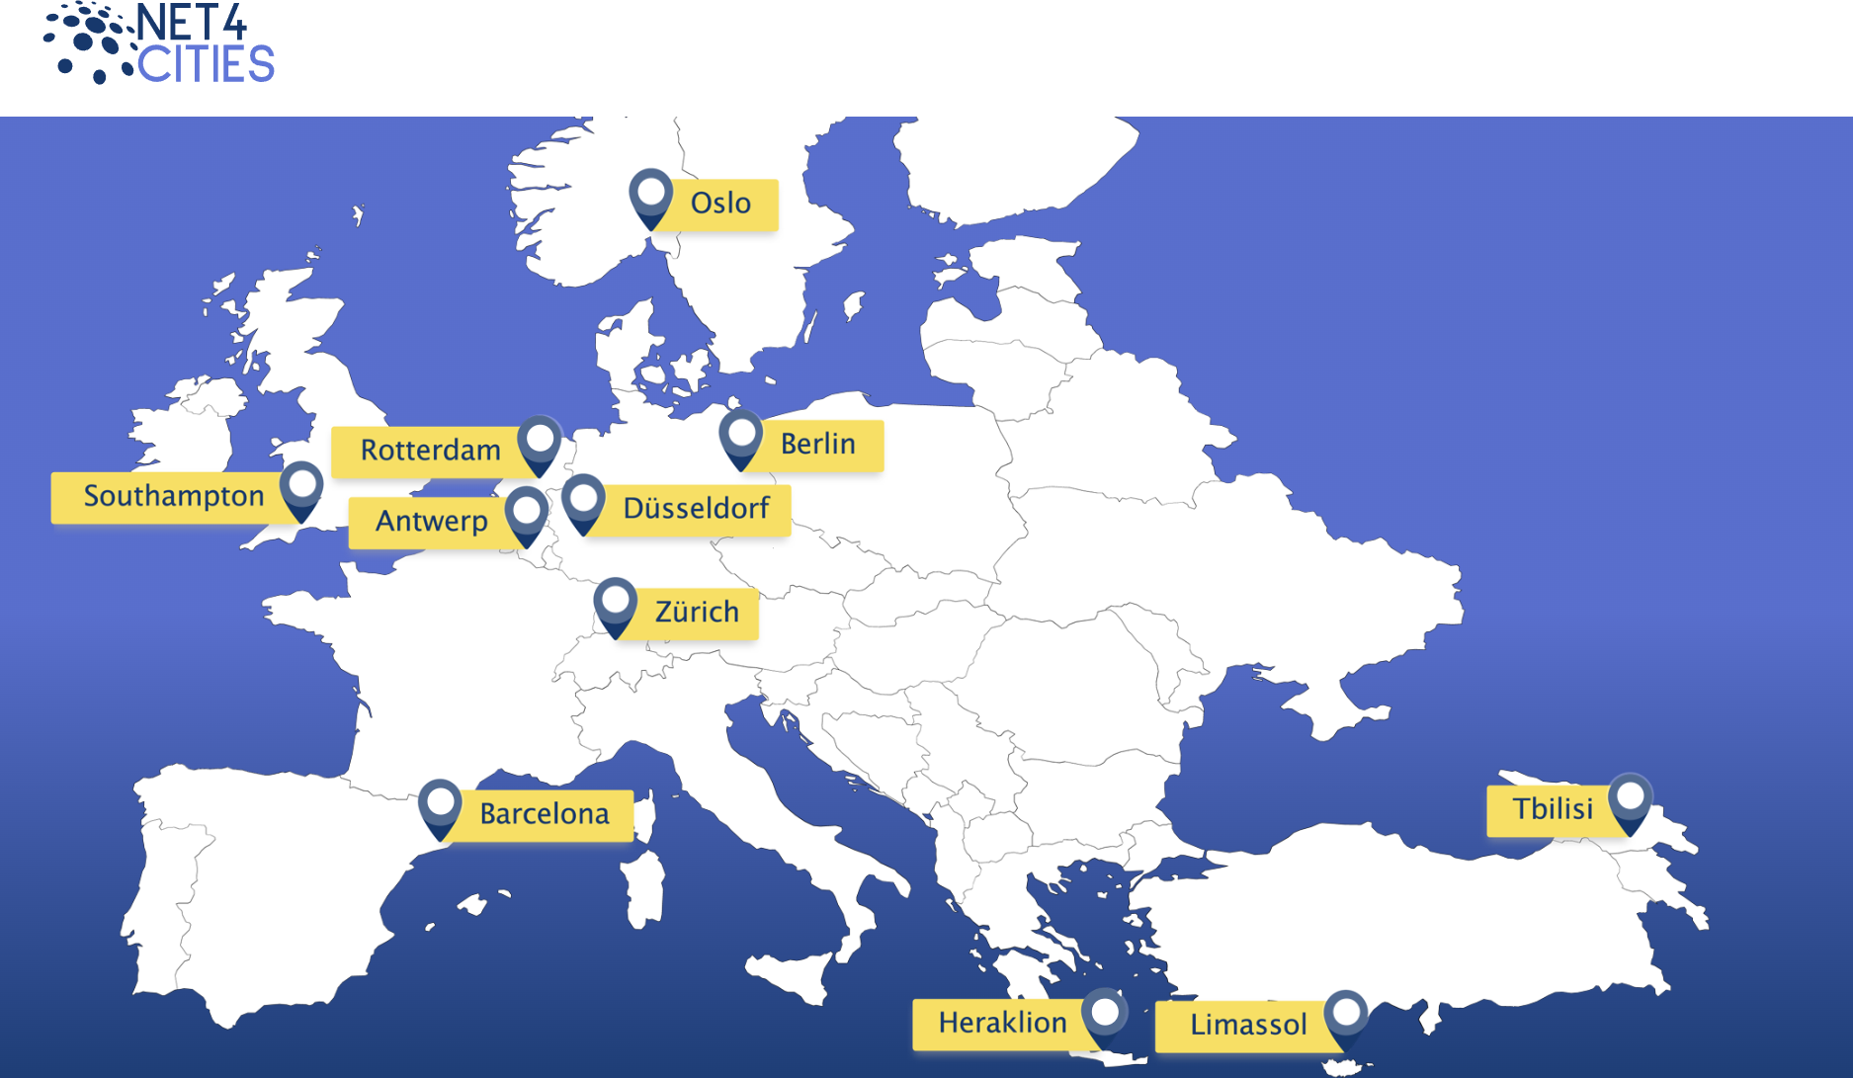
https://www.net4cities.eu/
22
Notes:
Research Institute for Sustainability – Helmholtz Centre Potsdam (RIFS)

Slide 23
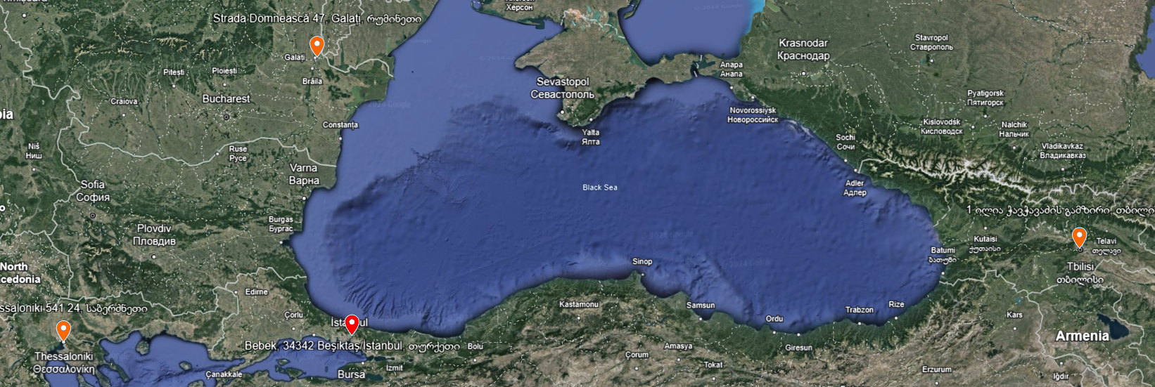
Alliance for the Protection of Black Sea Community Health through integrated Air Quality Early Warning Systems
AIRBASE
23
Notes:
BSB01291
Boğaziçi University
“Dunarea de Jos” University of Galati
ARISTOTELIO PANEPISTIMIO THESSALONIKIS-EIDIKOS LOGARIASMOS KONDILION EREVNAS

Slide 24
SMART|AtmoSim_LAB’s Contribution to Science and education
(some figures)
2 bachelor and 15 master degree diploma were completed at SMART|AtmoSim_LAB
Up to 40 presentations given at local and international scientific conferences
More than 20 students visited FZJ from Chemistry department
1 master diploma was completed at FZJ
1 PhD diploma was completed 2 PhD students are currently finishing their diplomas at FZJ
Joint workshops/summer schools at TSU
24
Notes:
Future outlook:
Prolonging project
Smart Sensors
Financial sources for permanent/semi permanent staff

Slide 25
Thank you for your attention!

