Slide 1


GGSB´24 Science Fest
20 Year Anniversary of the Georgian-German Science Bridge
Hans Ströher

Slide 2

The Quest to
(better) understand the World
What we achieved within GGSB in fundamental research

Slide 3
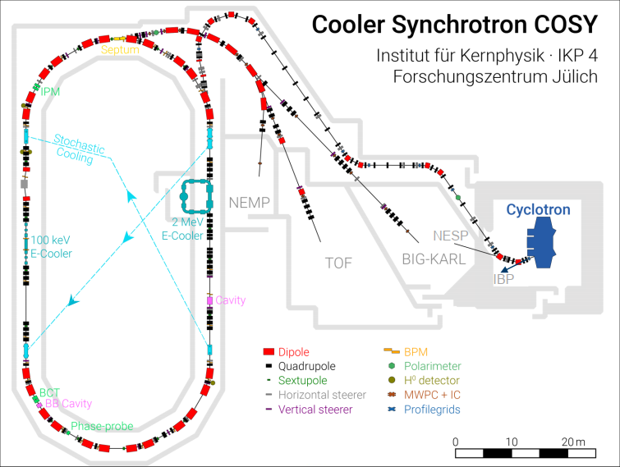
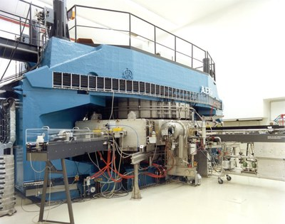
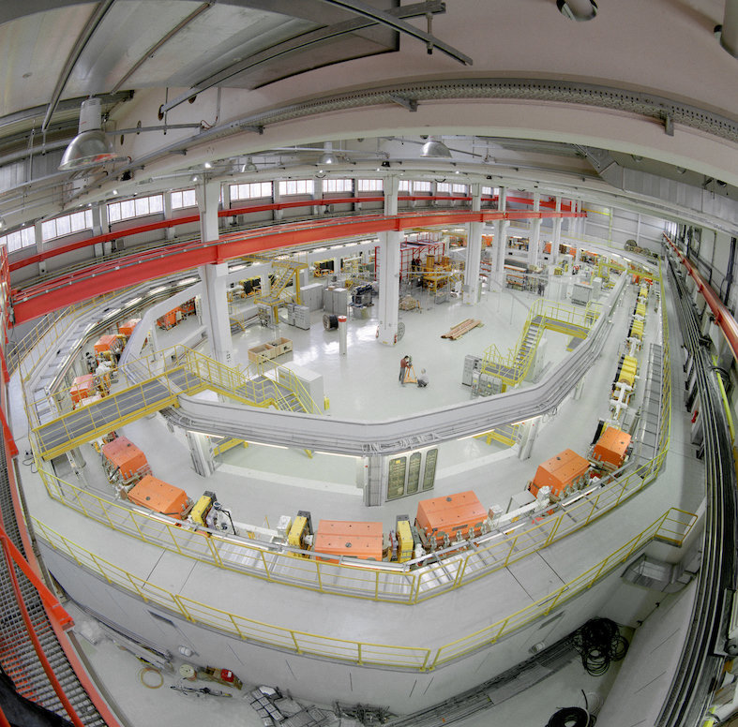
COSY – Cooler Synchrotron Storage Ring
Decommissioned end of 2023
ANKE Nucleon-nucleon interaction
WASA Exotic bound quark systems
PAX Polarization of anti-protons
JEDI Electric Dipole Moments

Slide 4
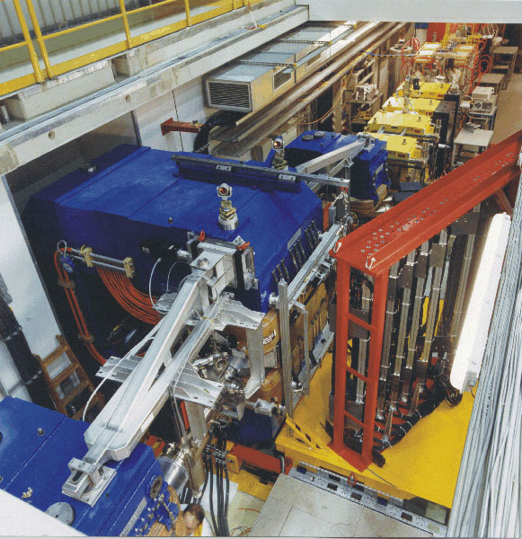
ANKE Spectrometer

Slide 5
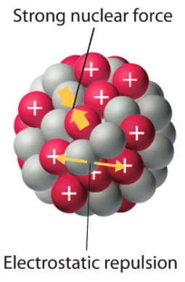
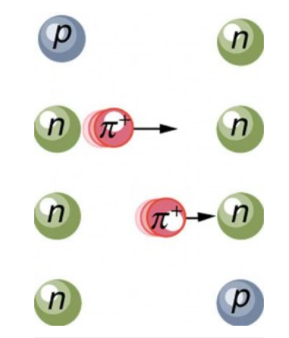
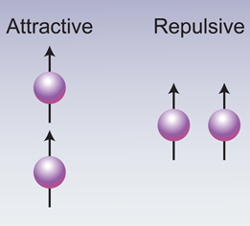
ANKE Spectrometer
How do protons and neutrons (nucleons) interact with each other? → Background
t
Spin
Interaction is very complex – phenomenology (meson exchange); no fundamental theory exists yet

Slide 6
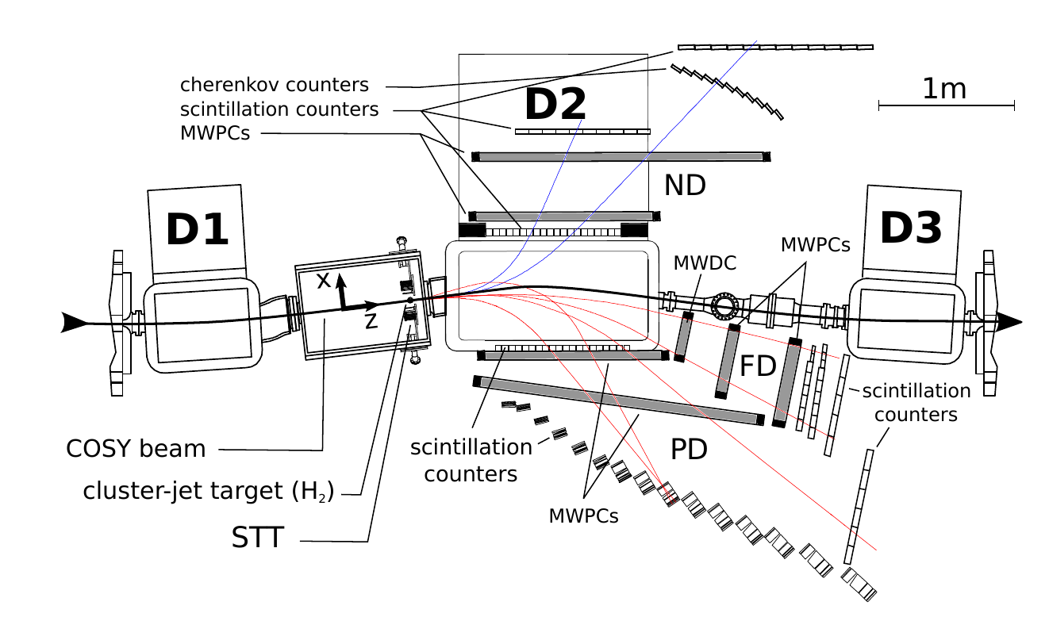
ANKE Spectrometer
How do protons and neutrons (nucleons) interact with each other? → Experiments
Many systematic investigations at COSY (also other detectors)

Slide 7

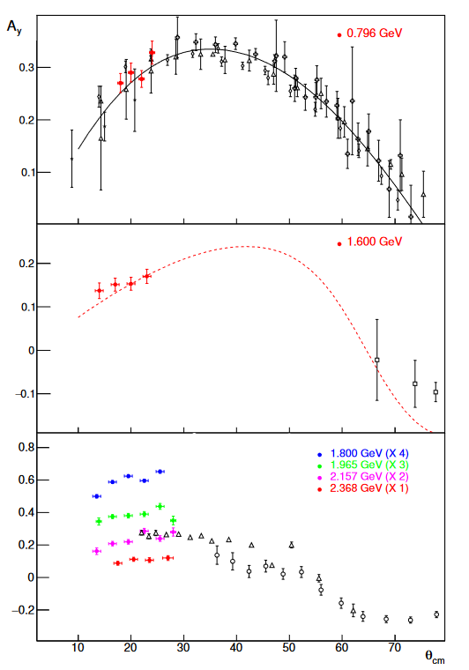
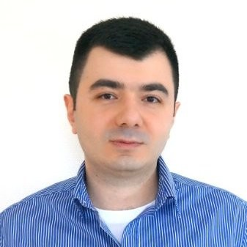
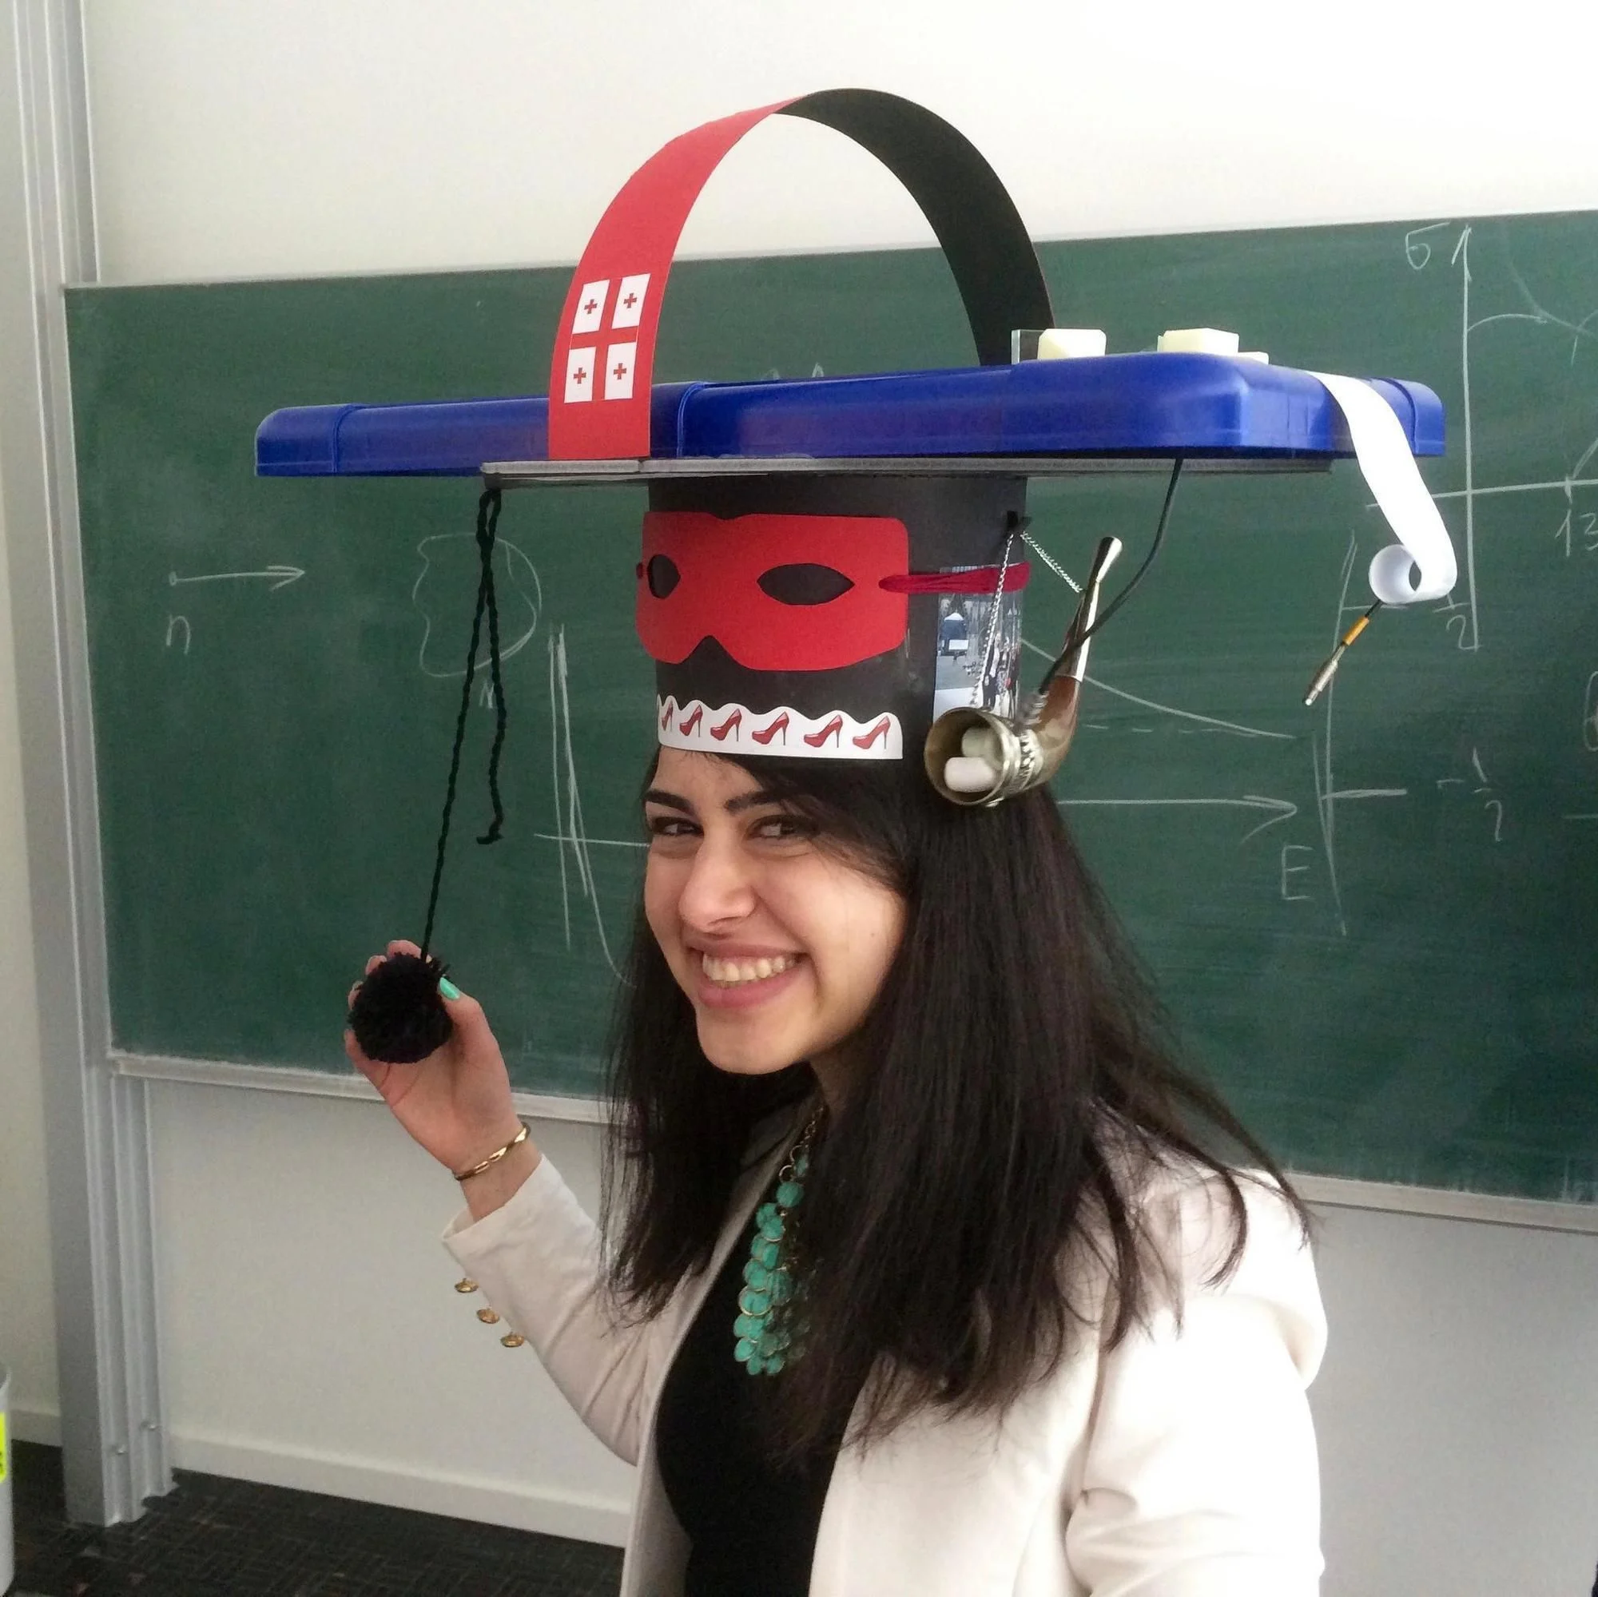
ANKE Spectrometer
How do protons and neutrons (nucleons) interact with each other? → Results
David Chiladze, PhD Thesis, TSU, 2008
Phys. Rev. ST-AB, 9, 050101 (2006)
PLB 637, 170-175 (2006)
Eur. Phys. J. A40, 23 (2009)
David Mchedlishvili, PhD Thesis, TSU, 2013
Phys. Lett. B 726, 145 (2013)
Eur. Phys. J. A 49 (2013), 49
Phys. Lett. B 755, 92-96, (2016)
Nuclear Physics A 977, 14-22 (2018)
Zara Bagdasarian, PhD Thesis, Cologne/TSU, 2016
Phys. Lett. B 739, 152 (2014)
Further co-authors from Georgia:
D. Chiladze, A. Kacharava, I. Keshelashvili, N. Lomidze, G. Macharashvili,
D. Mchedlishvili, M. Nioradze, D. Shergelashvili, M. Tabidze
Major contributions by GGSB (IKP - HEPI-TSU)

Slide 8
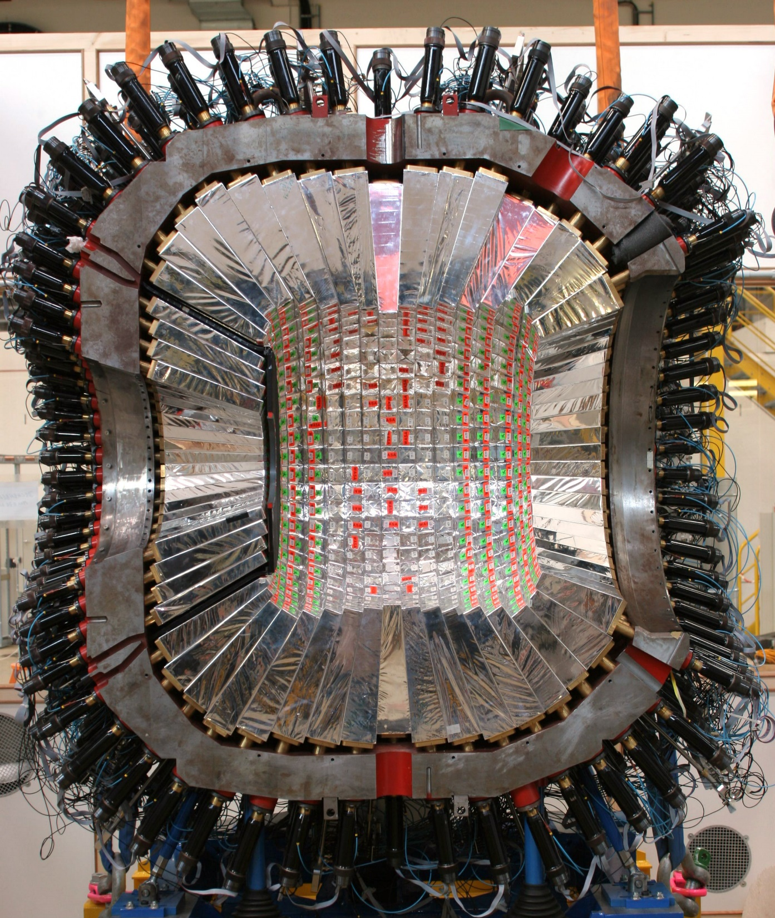
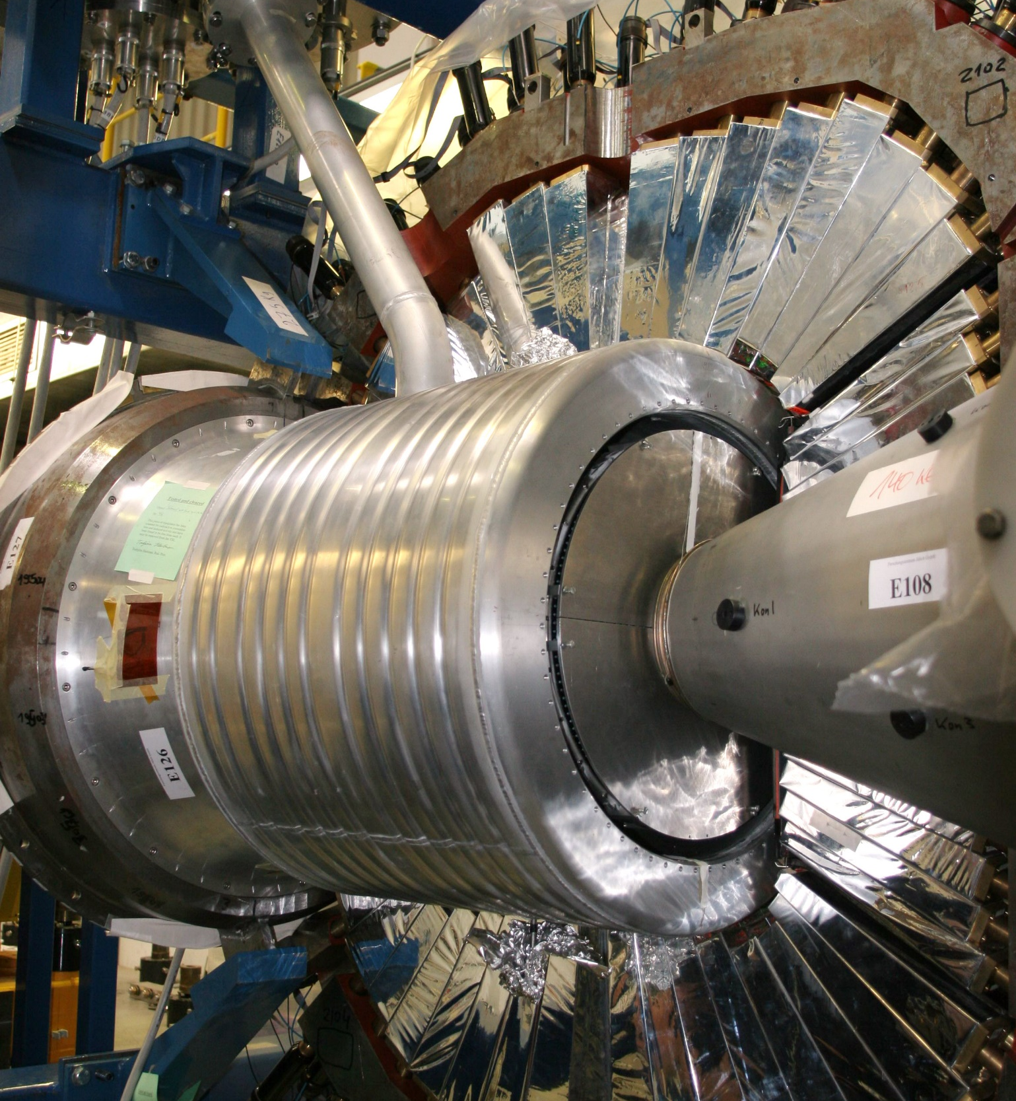
WASA Spectrometer

Slide 9
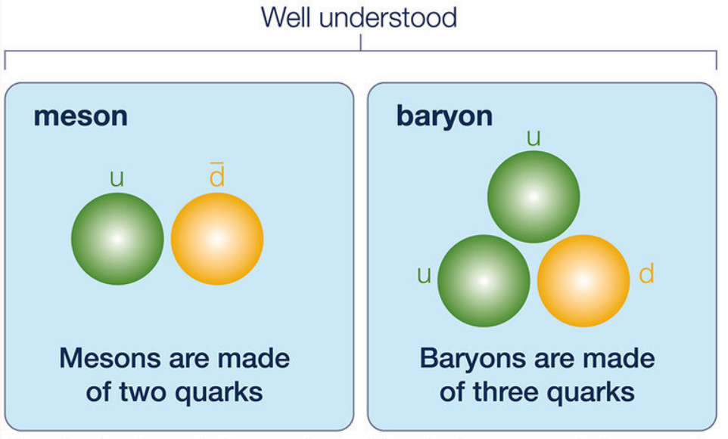
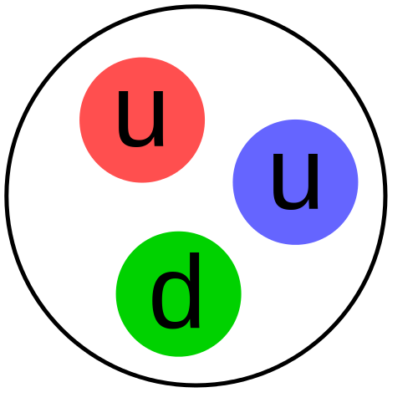
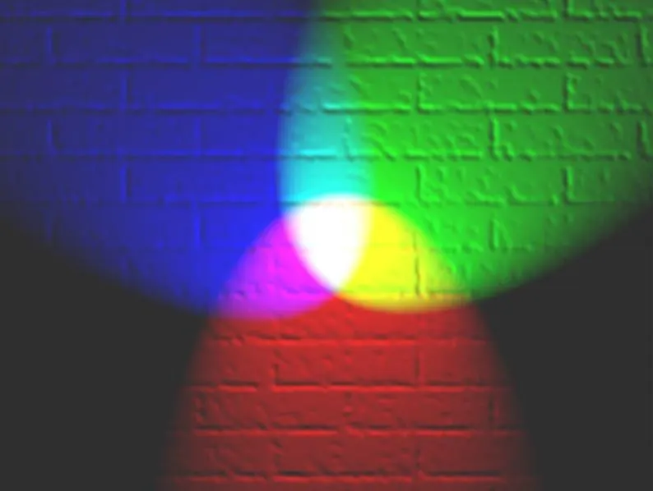
WASA Spectrometer
Which bound-quark states are realized in Nature? → Background
Protons and neutrons are made of quarks
color
Proton (uud)
6 quarks: u,d,c,s,t,b
pion
proton
Could there be other, e.g. meson-meson (tetraquark), meson-baryon (pentaquark), baryon-baryon (hexaquark)?

Slide 10
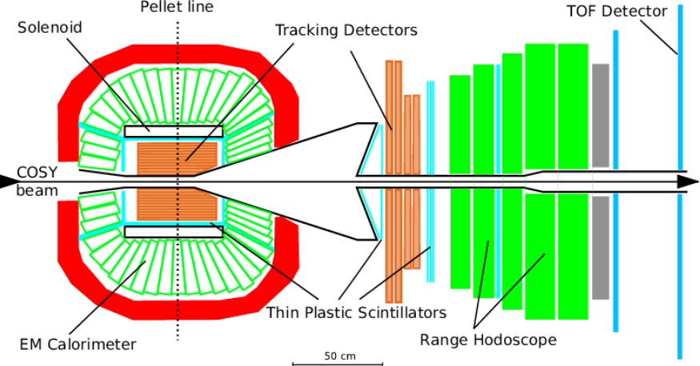
WASA Spectrometer
Which bound-quark states are realized in Nature? - Experiments
Many systematic investigations at COSY (also other detectors)

Slide 11
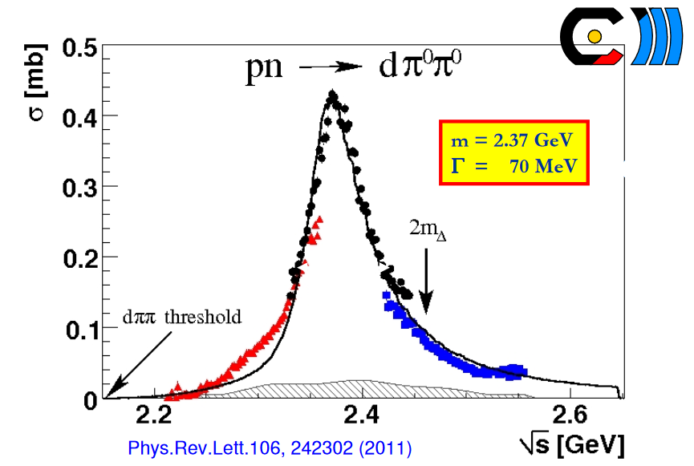
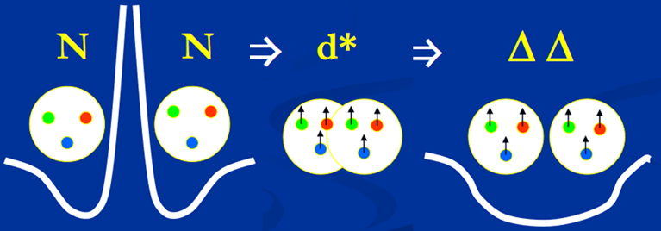
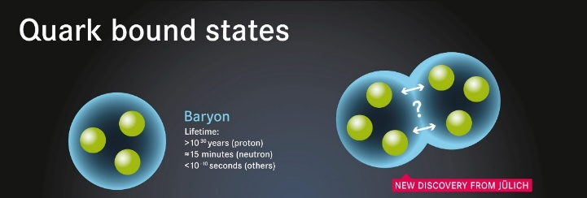
WASA Spectrometer
Which bound-quark states are realized in Nature? - Results
Molecule vs. hexaquark
Major project at IKP (FZJ); from Georgia only Irakli Keshelashvili involved …

Slide 12
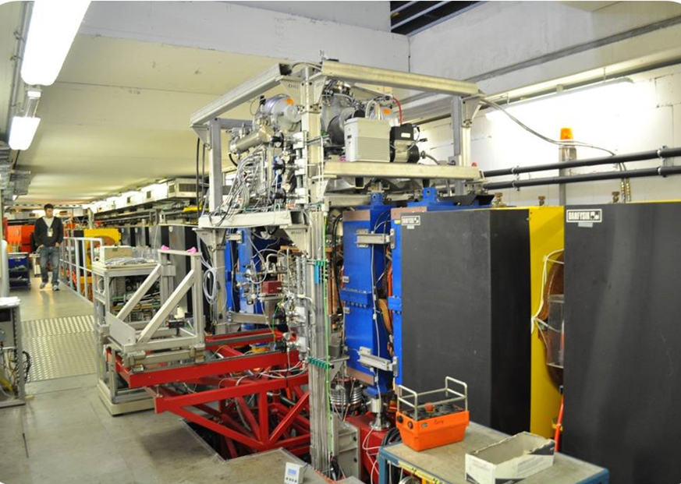
PAX Detector in COSY-Ring

Slide 13
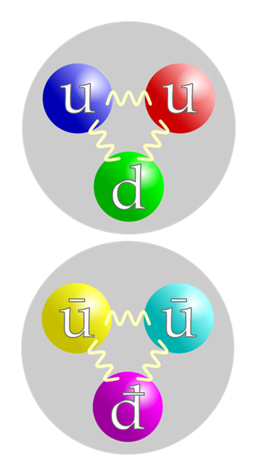
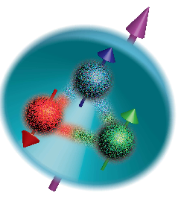
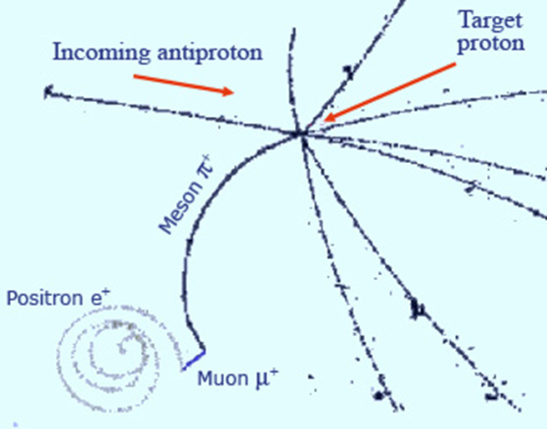
PAX
How can one produce (a beam of) polarized anti-protons? → Background
Proton
(quarks)
Anti-
Proton
(anti-
quarks)
Spin;
polarization
Contact of proton and anti-proton
→ Destruction (annihilation)
Annihilation with matter makes this a nontrivial task

Slide 14
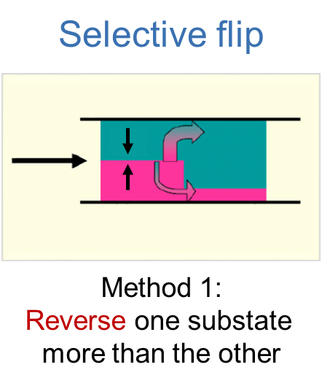
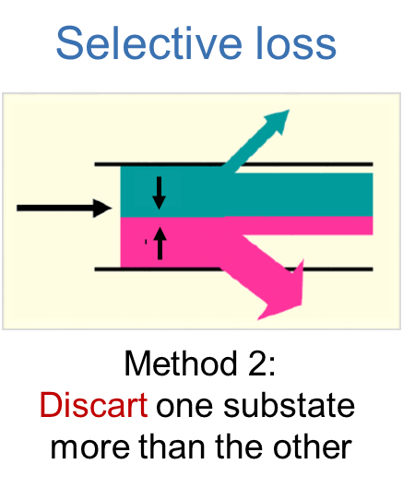
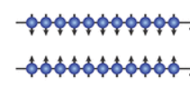
PAX
How can one produce polarized anti-protons? → Method
Beam of particles,
separated into spin
„up“ (+) and „down“ (-)
Annihilation with matter makes this a nontrivial task

Slide 15
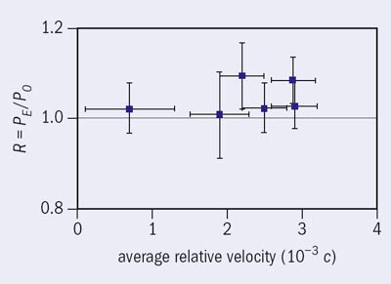
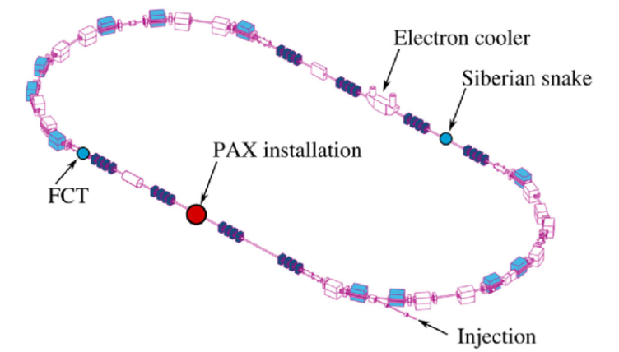
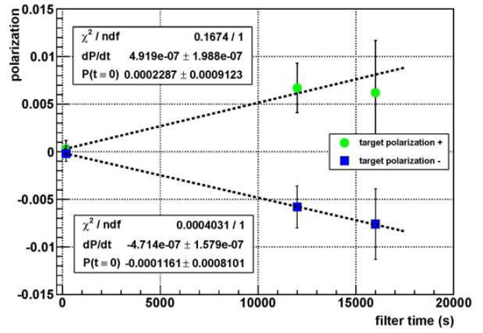
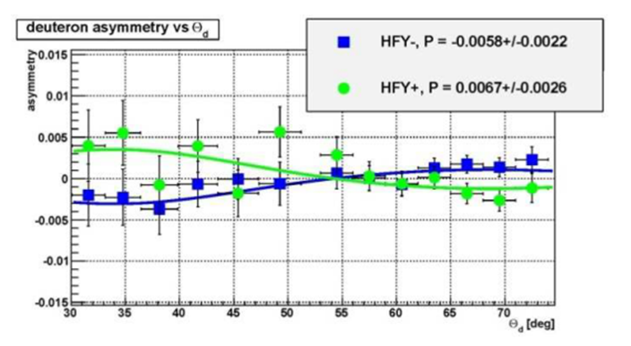
PAX
How can one produce polarized anti-protons? → Results
Spin-flip
Doesn´t work!
Collaborators from Georgia:
D. Chiladze, A. Garishvili,
Kacharava, N. Lomidze,
G. Macharashvili, D. Mched-
lishvili, M. Nioradze, D. Sher-
gelashvili, M. Tabidze
Contributions by GGSB (IKP - HEPI-TSU)

Slide 16
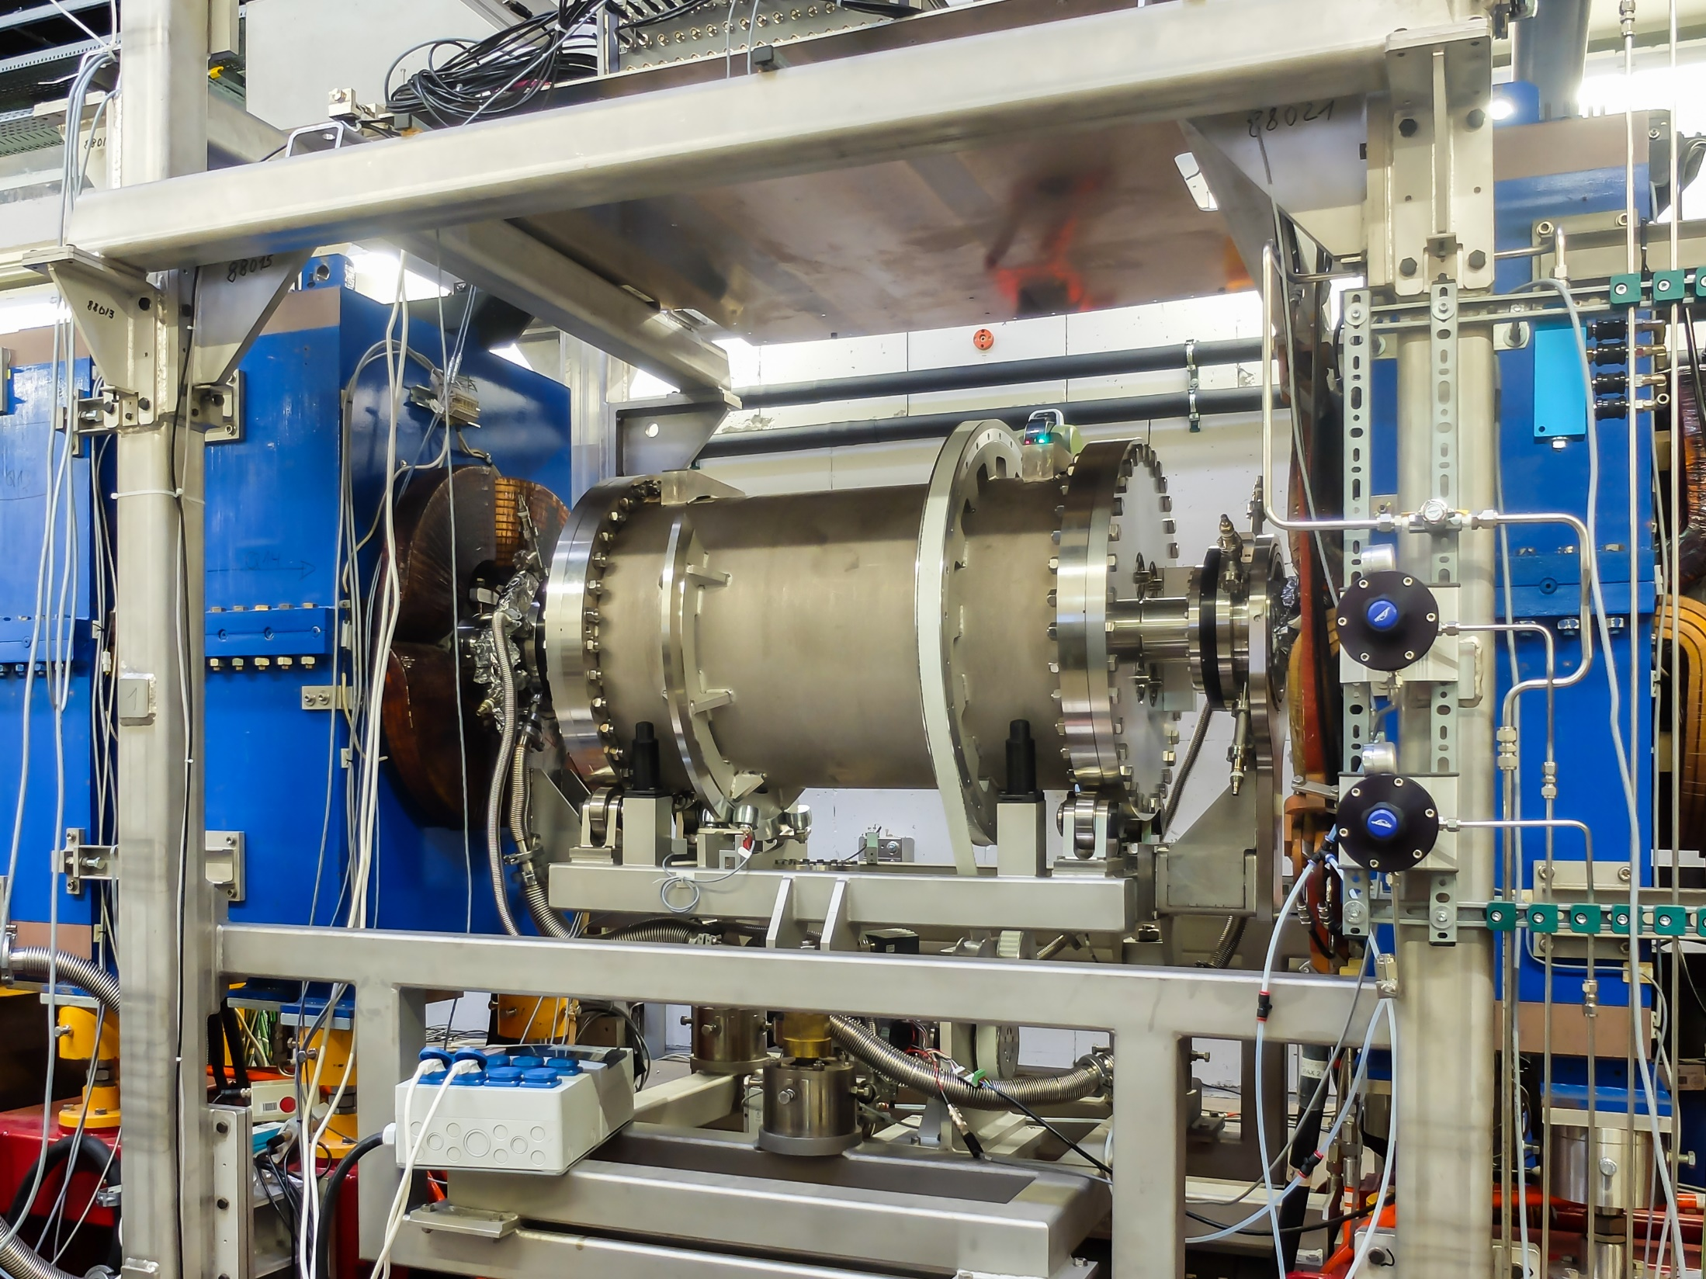
JEDI Device inside COSY

Slide 17
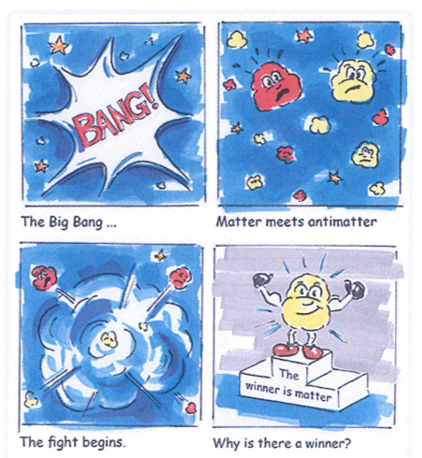
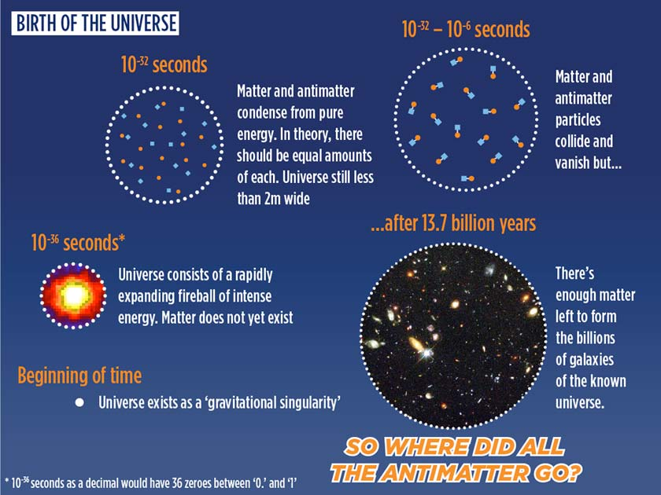
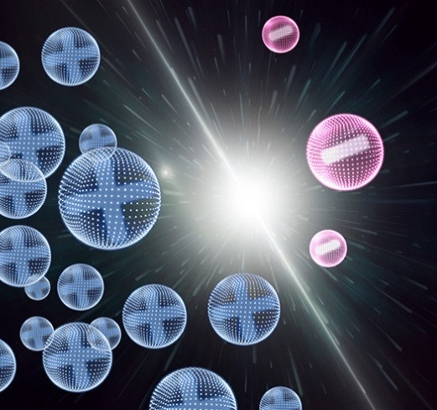
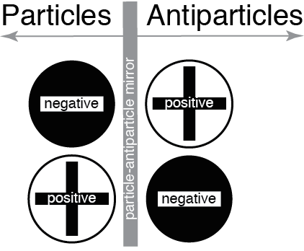
JEDI
How did matter win over anti-matter? What is Dark Matter? → Background
Big Bang
Today
Only light !
Equal #´s of
particles &
anti-particles
Annihilation
into photons
But: Matter – only Matter,
no Anti-matter
The Puzzle of our Existence

Slide 18
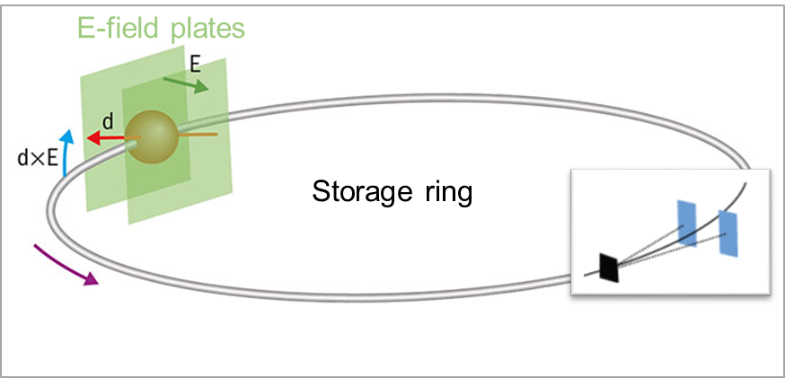
JEDI
How did matter win over anti-matter? What is Dark Matter? → Experiments
Polarimeter
to observe
the vertical
polarization
build-up
due to EDM
Search for (static / oscillating) Electric Dipole Moments (EDM) at storage rings

Slide 19
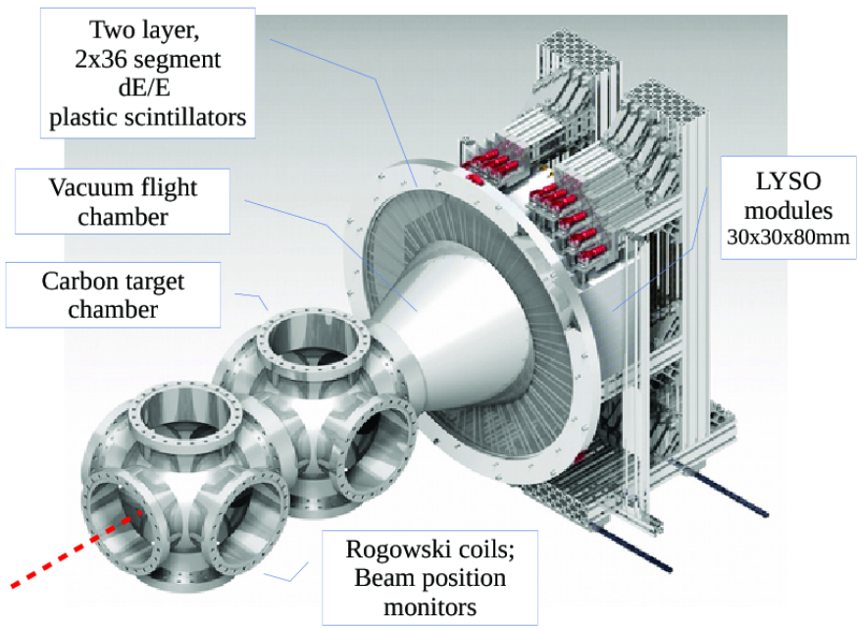
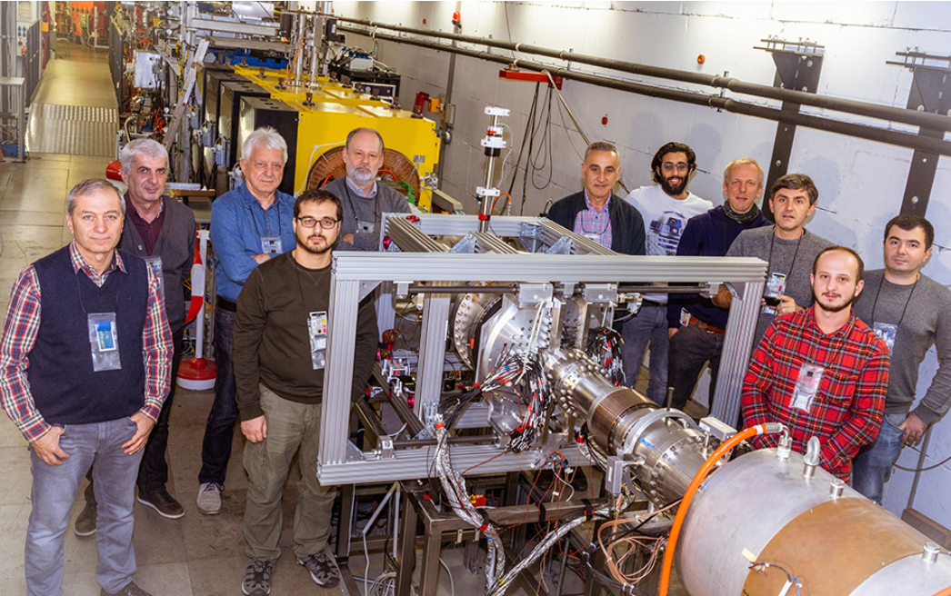
JEDI
How did matter win over anti-matter? What is Dark Matter? → Experiments
Major hardware contributions by GGSB (IKP - HEPI-TSU, AUG): JePo

Slide 20
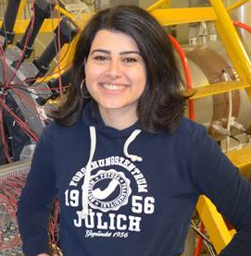
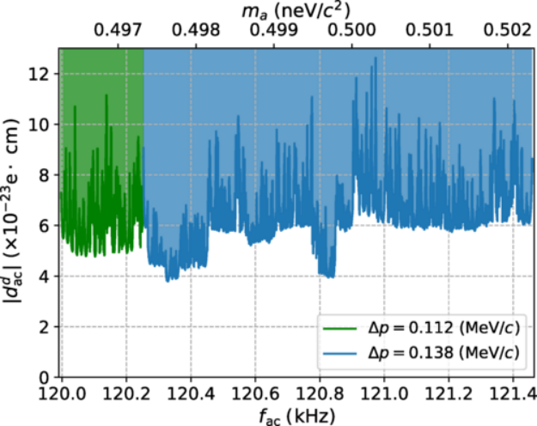
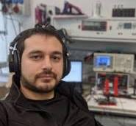
GGSB: 20 years on
JEDI
How did matter win over anti-matter? What is Dark Matter? → Results
Mariam Abuladze, Master Thesis, AUG, 2019
Zara Bagdasarian
Phys. Rev. ST Accel. Beams 17, 052803 (2014)
Eur. Phys. J. A 56 (2020) 211
Otari Javakhishvili, PhD Thesis, AUG, 2022
Nucl. Instr. Meth. A 977 (2020) 164337
Jour. of Instr. 15, P12005 (2020)
Further collaborators from Georgia:
D. Chiladze, M. Gagoshidze, A. Kacharava, I. Keshe-
lashvili, N. Lomidze, G. Macharashvili, D. Mchedlishvili,
Z. Metreveli, D. Shergelashvili, M. Tabidze
Proof-of principle
experiment for
Dark Matter search
Major contributions by GGSB (IKP - HEPI-TSU, AUG)

Slide 21

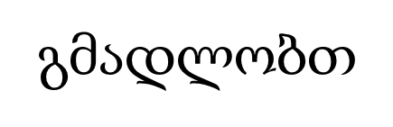

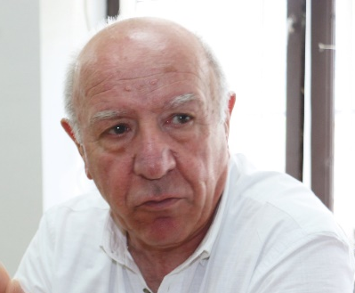

GGSB: 20 years on
JEDI
Mikheil Nioradze
HEPI-TSU
David Mchedlishvili
SMART|EDM_Lab
Fundamental research: a scientific success story of GGSB

