Slide 1
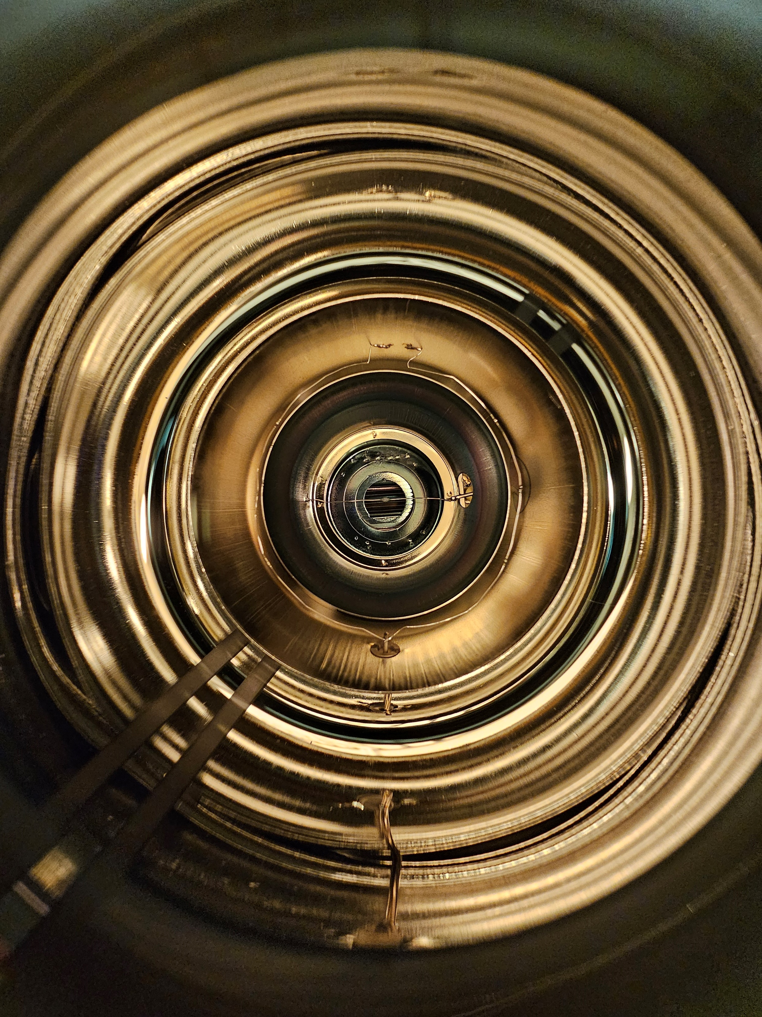
Neutron detection at mCBM
Dachi Okropiridze
1

Slide 2
Outline
About me
CBM Introduction
Ph.D. Project
Introduction
Hardware
DAQ
Simulations
Beamtimes – Analysis
GGSB contributions
2

Slide 3
About me
High School:
Physics & Mathematics school “Komarovi”
Kettle Run High school, VA, USA (“Future Leaders Exchange Program”)
Free University of Tbilisi – Physics
Georgian Technical University - Engineering Physics (BA, M.Sc.)
Free University of Berlin – Physics (M.Sc.)
Ruhr University of Bochum – Physics (Ph.D.) – in progress
3

Slide 4
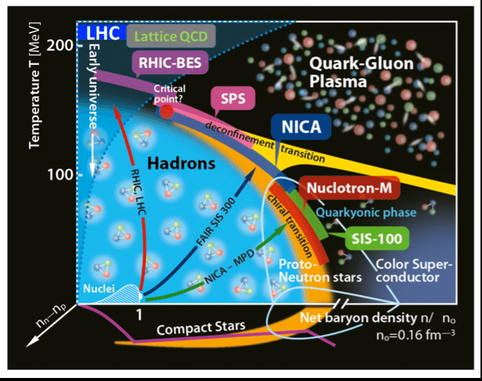
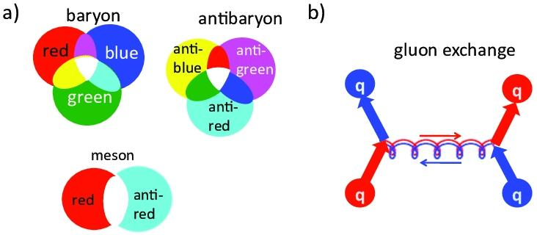
Introduction – QCD Phase diagram
Hadronic (confined) matter is made of quarks
Gluons are strong force carriers
Quarks come in 6 different flavors – UDTBCS and antiparticle versions, they possess color charge – RGB an particles CMY
Quarks come in triplets – Baryons or with antiquark pairs – Mesons, they don’t like to be alone.
Quark-gluon plasma (deconfined)
High Pressure– High energy/baryonic densities
High Temperatures – High avg. particle kinetic energies
Quarks can live alone
Neutron stars and Early Big Bang
4
Notes:
High Pressure in Heavy-Ion Collisions:In heavy-ion collisions, such as those studied at the Large Hadron Collider (LHC) or RHIC, high pressure occurs when two nuclei collide at nearly the speed of light, generating an incredibly dense and hot environment.During these collisions, the energy deposited in the collision zone is extremely high, leading to tremendous pressure gradients.These pressures are on the order of gigapascals (GPa) or even higher, far beyond anything experienced in ordinary matter. In terms of energy, the pressure is linked to the energy density (measured in GeV/fm³, where 1 GeV = 10⁹ electron volts, and 1 fm³ is a cubic femtometer, meters).
High Temperature → Particle Energy:Temperature in a QCD system (or in general physics) refers to the average kinetic energy of the particles in the system. This can be expressed in either:Kelvin (K), which is the standard unit for temperature in thermodynamics, orMeV (Mega-electron volts), which is commonly used in particle physics to describe the energy scale of subatomic particles.In high-energy physics (like in quark-gluon plasma or nuclear collisions), temperature is often expressed in MeV because we are dealing with extremely high temperatures (on the order of K) where it is more practical to use energy units.For example, the critical temperature for quark-gluon plasma formation is around 150–170 MeV, which corresponds to several trillion Kelvin.\text{1 MeV} \approx 1.16 \times 10^{10} \text{ Kelvin (K)}High temperature means the particles have high kinetic energy. This temperature reflects the average energy per particle in the system, which determines how energetic the quarks, gluons, and hadrons are.Summary:High pressure in a QCD system means high energy density, where a large amount of energy is packed into a small region, creating strong interactions.High temperature reflects the average kinetic energy of particles, and is expressed in either Kelvins (K) or MeV. Higher temperature means particles are moving faster and have more energy.In particle physics:High energy density (pressure) relates to how much energy is packed into a volume.High temperature is the average energy per particle, expressed in MeV for practical purposes in high-energy physics.

Slide 5
Introduction – Compressed Baryonic Matter – CBM experiment
Goal – CBM experiment aims to study QCD phase diagram into high temperature high pressure deconfined Quark gluon plasma region
Collide high energy, high momentum particles to mimic the environment
Fully reconstruct the collision, produced particles their trajectories, energies and momentum
Higher Collision centrality – Smaller impact parameter – Larger overlap – Higher Multiplicity – Larger collision energy
Collective flow: Radial Flow, Directional flow – uniform and non uniform distribution of multiplicities
5
Notes:
1. Collective Flow:Collective flow is not necessarily unidirectional, but rather it describes the coordinated motion of particles that emerge from a high-energy collision, moving in a preferred pattern based on the pressure gradients in the system.Elliptic flow (for example) is not purely unidirectional, but reflects how particles tend to move more in certain directions due to the anisotropic shape (the almond-shaped overlap region) created in a non-central collision.There are different types of flow:Radial flow: Particles move outward in all directions from the collision center.Elliptic flow: Particles show preferential movement along the short axis of the overlap region.Directed flow: Particles move sideways relative to the beam, influenced by the initial momentum of the colliding nuclei.In short, collective flow is about the pattern of particle motion after a collision, driven by the conditions and geometry of the collision, rather than a simple unidirectional movement.2. Collision Centrality:Collision centrality describes the degree of overlap between the two colliding nuclei.Central collisions (small impact parameter): The nuclei collide nearly head-on, resulting in maximum overlap of the nuclei.Peripheral collisions (large impact parameter): The nuclei collide more at the edges, resulting in less overlap.Centrality is often represented as a percentage:0% centrality means the most central collision (maximum overlap).100% centrality means the most peripheral collision (least overlap).3. Relationship Between Centrality and Multiplicity:Yes, if the centrality is close to 0%, meaning the collision is almost perfectly head-on, this typically results in the highest multiplicity of produced particles (including neutrons).In central collisions, a large number of nucleons (protons and neutrons) from both nuclei interact, which means more particles are produced overall. This leads to higher multiplicity.Peripheral collisions (close to 100% centrality) have lower multiplicity because fewer nucleons participate in the interaction, meaning fewer particles are produced.Summary:Collective flow refers to the coordinated motion of particles, influenced by the geometry and pressure gradients of the collision. It is not strictly unidirectional, but reflects patterns of motion like radial, elliptic, or directed flow.Collision centrality measures the degree of overlap between the colliding nuclei. 0% centrality indicates the most head-on collisions, where maximum overlap occurs, while 100% centrality means the most peripheral, glancing collision.When centrality is close to 0%, the multiplicity is highest because more nucleons participate in the collision, leading to the production of more particles.So, the closer the centrality is to 0%, the more particles you will have (higher multiplicity), and collective flow reflects how these particles move in response to the collision dynamics.

Slide 6
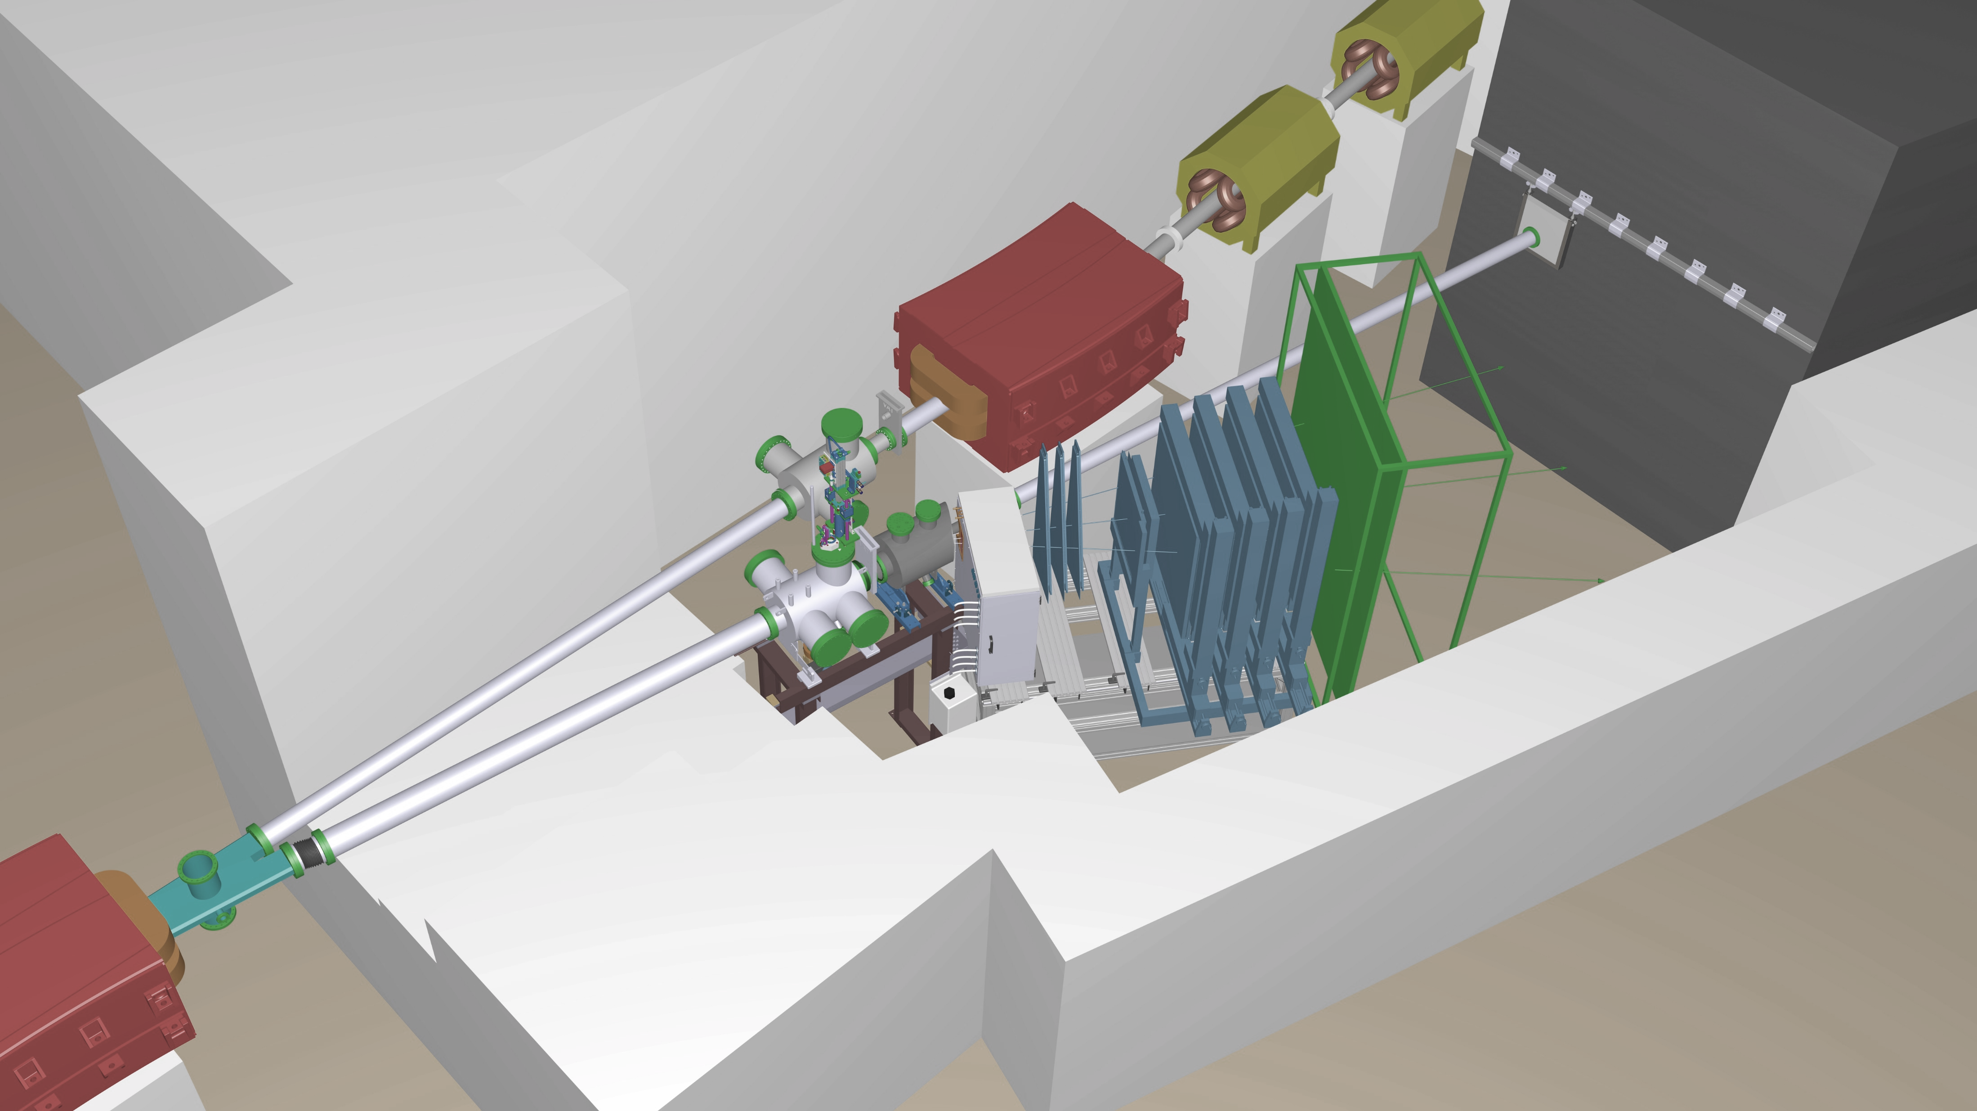
Introduction – Neutron Detection at mCBM
Ph.D. Project - Neutron Detection at mCBM, SIS18 CBM, GSI FAIR
Neutrons don’t possess charge, therefore don’t interact with EM force. Neutrons are less likely to interact with the matter
Previous $pp→pnπ^{+}$ reaction channel at 2.7GeV/c momentum resulted 40% efficiency on neutron detection using same systems [1]
Improved Forward Spectator Detector (FSD) determination of collision centrality and collective flow [2]
6
Notes:
Radial Flow and High Multiplicity:In head-on (high-centrality) collisions, where there is maximum overlap between the two nuclei, the system is highly compressed, leading to significant energy release and a high number of produced particles. This high overlap and pressure result in strong radial flow, where particles are emitted symmetrically in all directions. Since more nucleons (protons and neutrons) participate in the collision, there is higher multiplicity (more particles produced overall).Because radial flow is symmetric, the multiplicity is uniformly distributed across all directions in the transverse plane.So, you can say:In head-to-head collisions (high centrality), radial flow dominates, resulting in higher and more uniformly distributed multiplicities due to the large overlap and the symmetric outward expansion of particles.
Directed Flow and Lower, Anisotropic Multiplicity:In non-central collisions (with less overlap), directed flow can dominate. Here, the overlap between the nuclei is smaller, leading to lower overall multiplicity (fewer particles are produced).Because directed flow involves a sideward motion of particles, there is a preference for particle emission in certain directions, meaning the multiplicity is anisotropic. Instead of being uniform like in radial flow, more particles are emitted in specific directions, and fewer are emitted in others.The result is that multiplicity is lower overall compared to radial flow and concentrated in preferred directions rather than being uniformly spread out.So, you can say:In non-central collisions with directed flow, multiplicity is lower and more anisotropic, with a preference for certain directions, reflecting the momentum asymmetry and smaller overlap.Putting It Together:1. Radial Flow:Higher multiplicity because of the large overlap in head-on collisions.Uniform distribution of particles in all directions (symmetric flow).2. Directed Flow:Lower multiplicity because of less overlap in non-central collisions.Anisotropic distribution of particles, with a preference for emission in certain directions (sideward).Summary:Radial flow in head-on collisions produces higher multiplicity that is uniformly distributed because of the large overlap and symmetric expansion.Directed flow in non-central collisions produces lower multiplicity, with an anisotropic distribution showing a preference for certain directions due to the smaller overlap and momentum asymmetry.This explanation captures how multiplicity and flow patterns change depending on the centrality and type of collective flow in the collision.

Slide 7
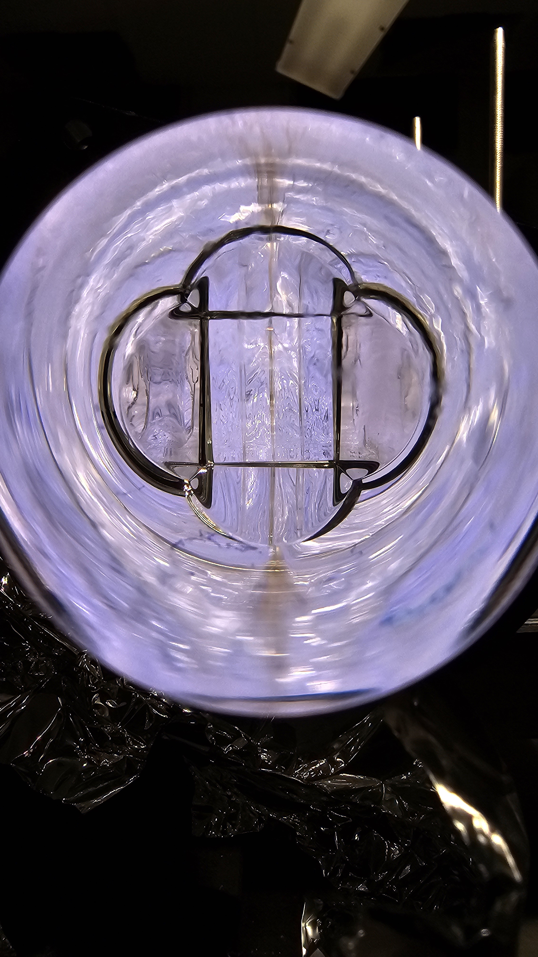
Objectives
Detector Design and Development: For mCBM experiment two identical detectors need to be designed, each consisting of 7 identical neutron detection modules, one placed behind FSD close to the beam for high multiplicities and the other behind TOF further away for track reconstruction
PP simulations in Geant4
Installation and Integration: Devices need to be mounted inside the mCBM cave, one behind FSD. DAQ systems need to be selected and integrated with the mCBM environment
System Calibration and Testing
Data Acquisition during Beamtime(s) 2024 on…
Data Analysis and Interpretation
7
7

Slide 8
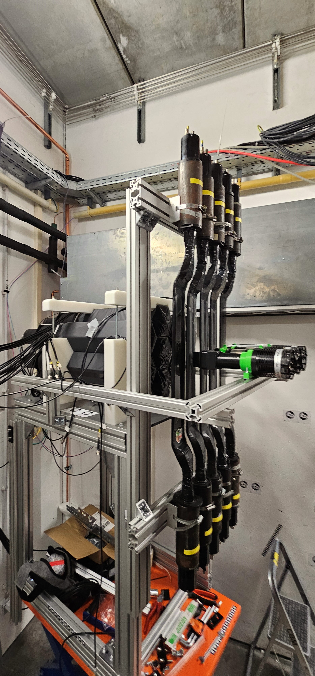
Hardware at mCBM
NCAL – Neutron Calorimeter Detector
VETOs plates
FSD – Forward Spectator detector
8
8

Slide 9
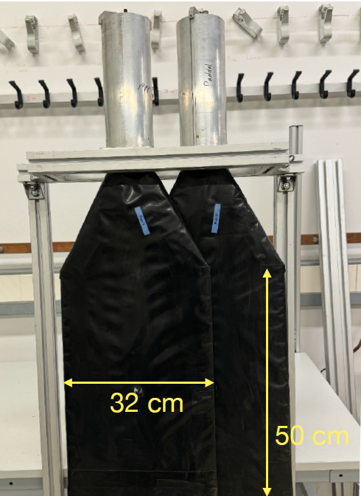
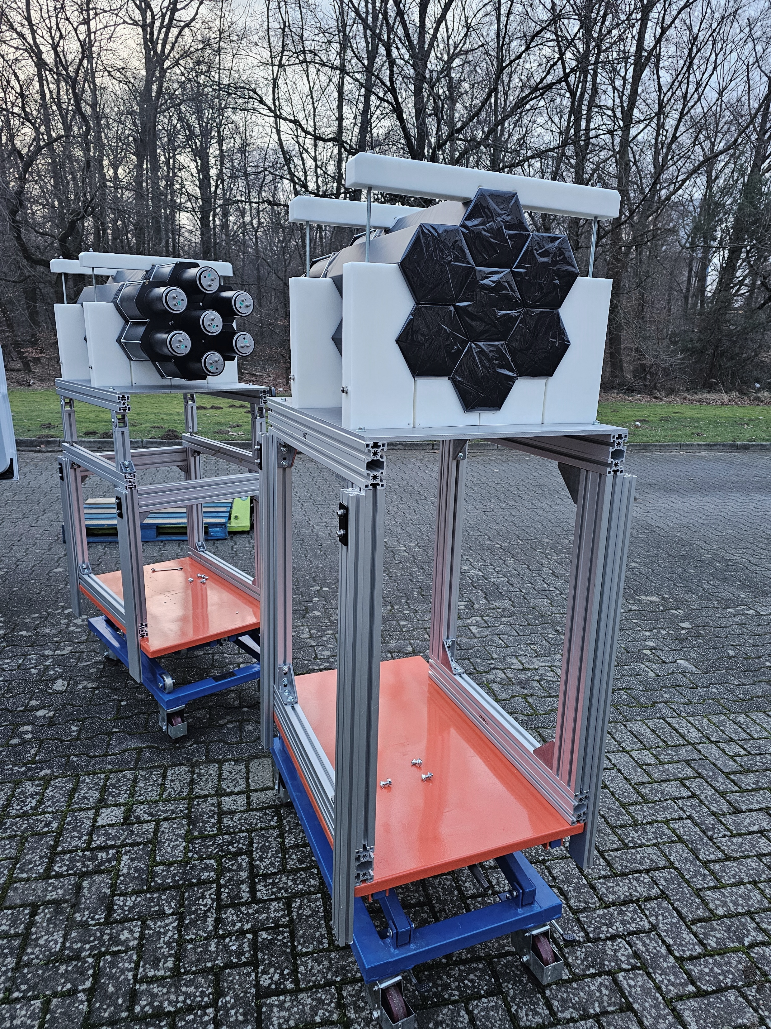
9

Slide 10
Hardware – Module
Plastic scintillator BC-416 - hexagonal shape with a side length of about 8cm and a length of 45 cm resulting in an area of about 1200 cm2 $[3]$
Photomultiplier Photonics XP4592/PA - outer diameter of about 130 mm $[3]$
Assembly:
Scintillator wrapped in several layers of light-insulating tape
Silicon based gel used in between the PMT and scintillator contact
Scintillator and PMT fixed together using plastic ring and outer metal frame
10

Slide 11
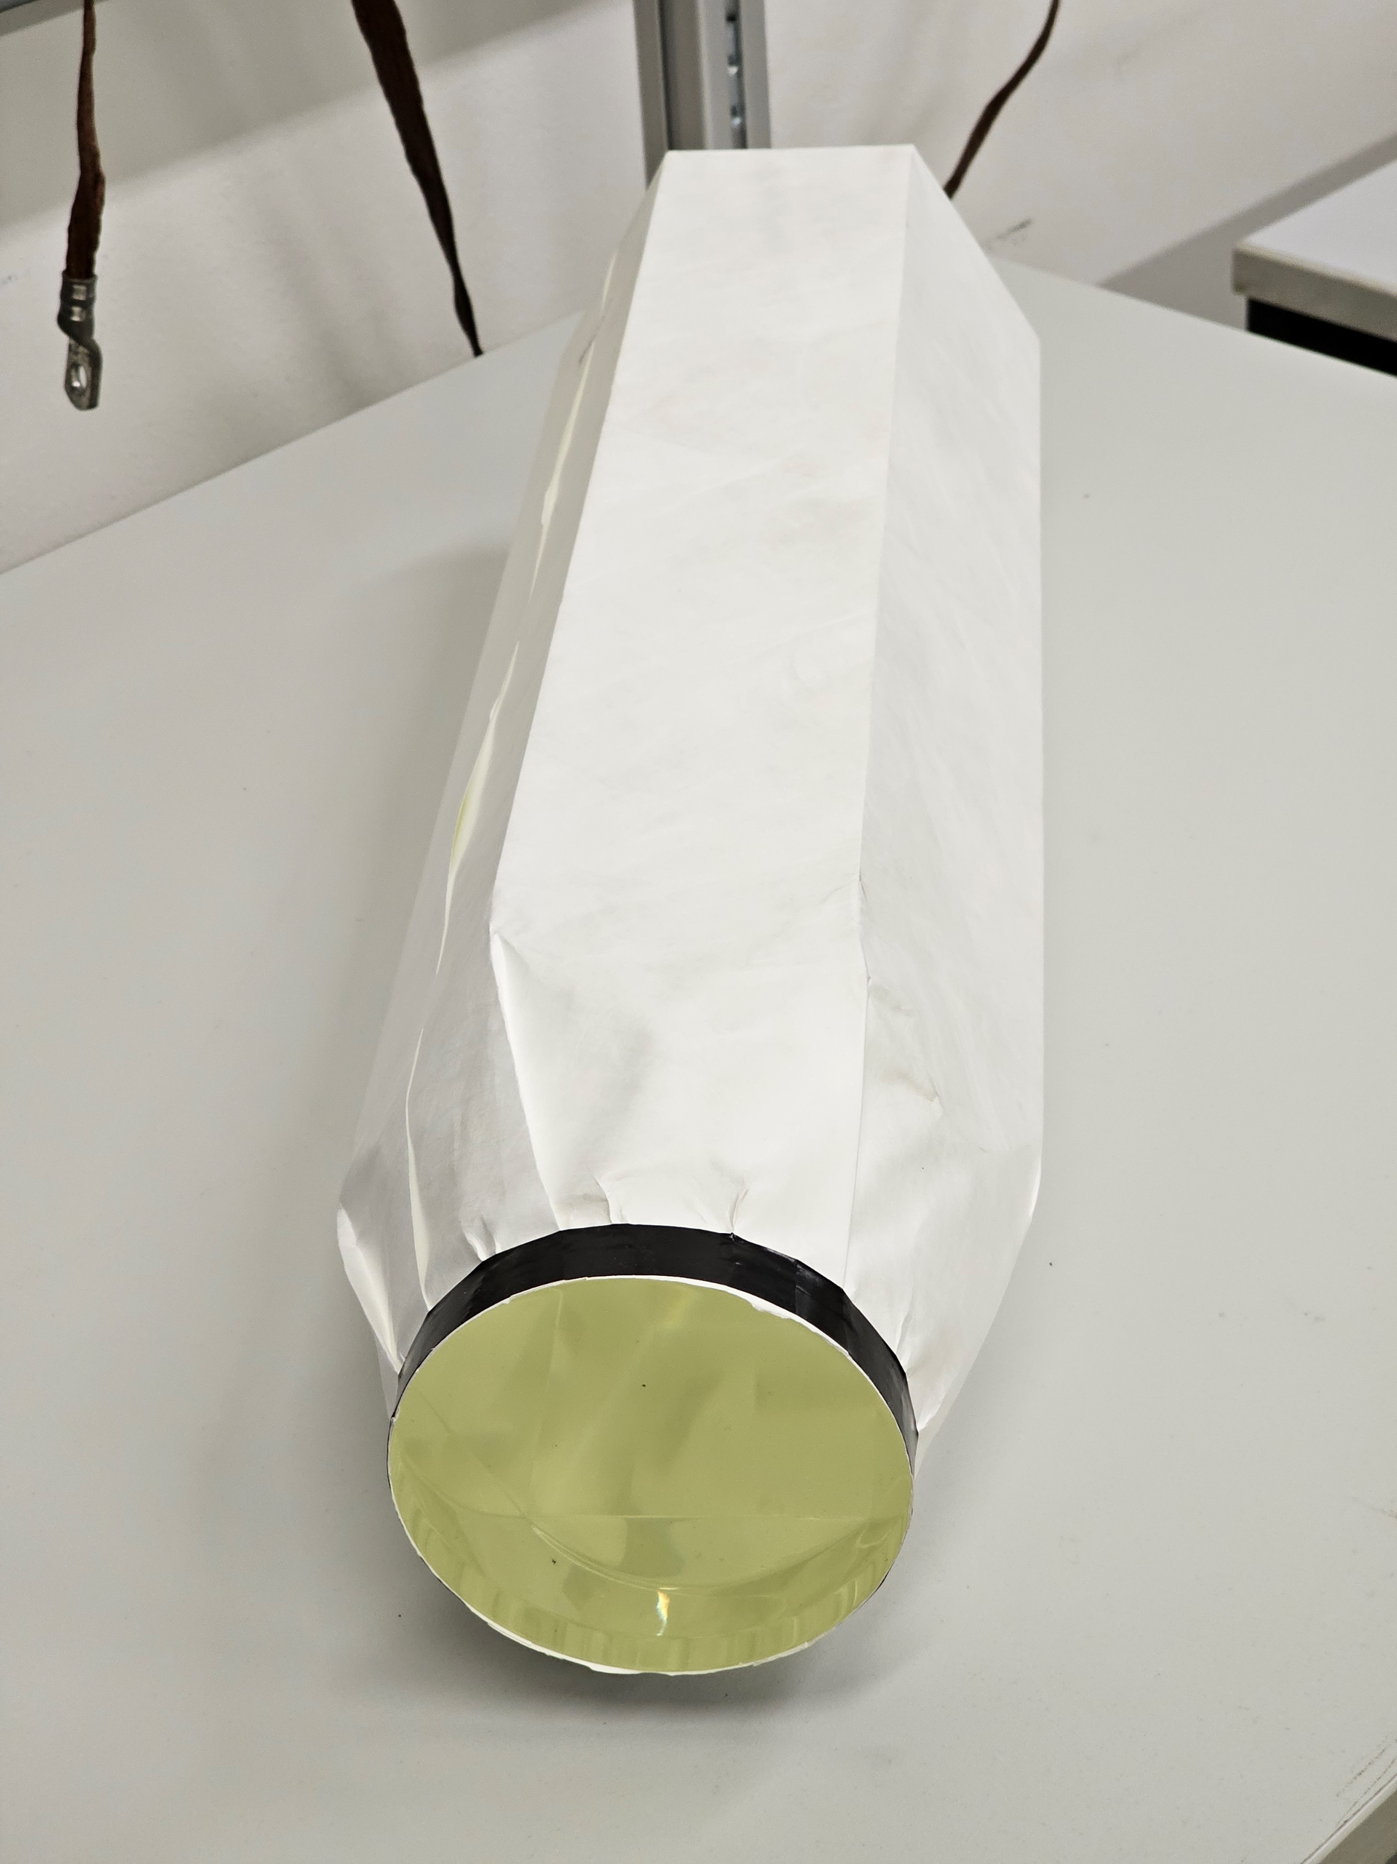
NCAL module
11

Slide 12
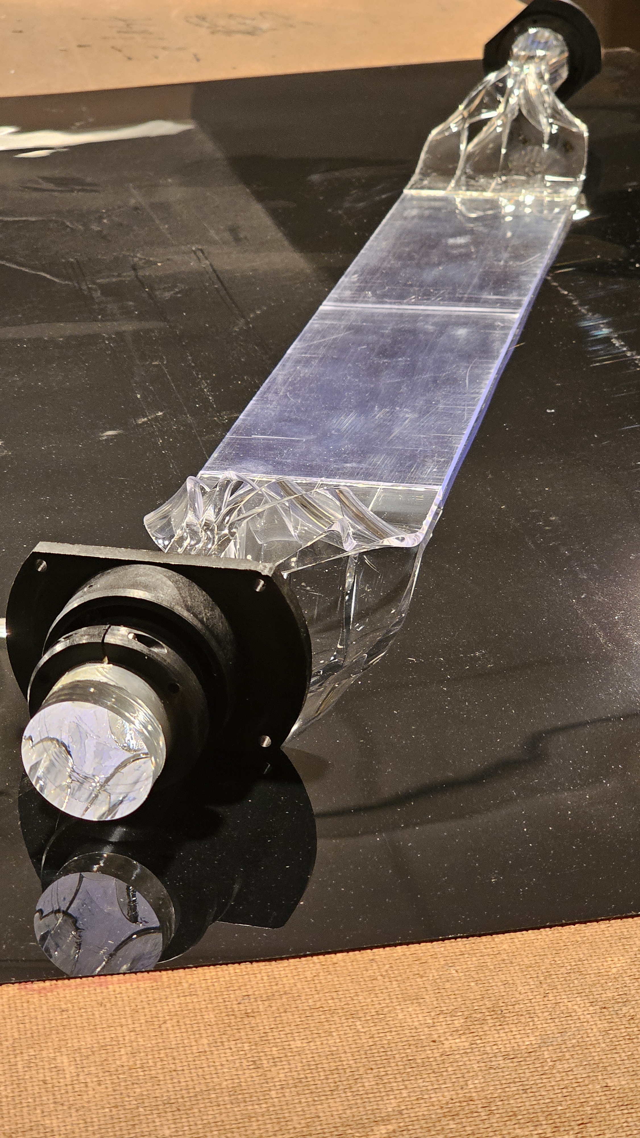
VETO module
NCAL module
12

Slide 13
DAQ - Readout System Selection
Two Candidates: DiRich & TOF PADI
Both measure time over threshold (TOT)
Objective is to measure energy of a particle and to choose the most suitable device for the task
Two independent readout tests have been set up in Wuppertal and at GSI using Neutron Detector modules
13

Slide 14
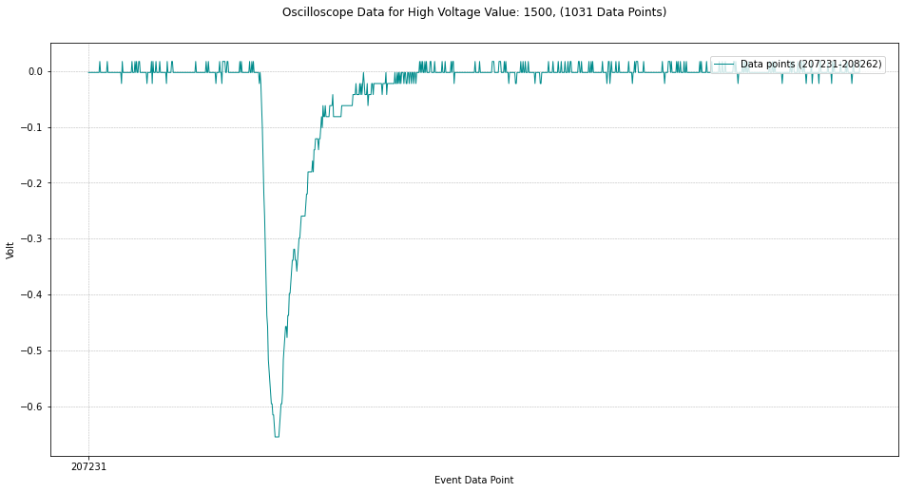
DiRich tests – Plots
Oscilloscope waveform data
14

Slide 15
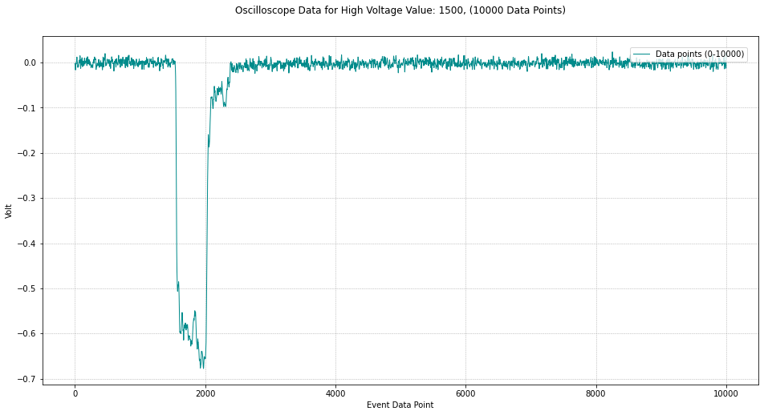
DiRich tests – Plots
Oscilloscope waveform data for square waveform (binary output TOF PADI)
15

Slide 16
DiRich tests - setup
50 Ω splitter
Att. Board
Att 470x
High Voltage Supply
Ch1
Att 182x
DiRich
Oscilloscope
Ch3
TRB3C
Go4 Analysis Software
PMT
Ch1
trigger
DiRich TOT data
Att 390x
Ch5
Ch7
N-det Module
Att. Board
Att 108x
Oscilloscope Waveform data
16

Slide 17
DiRich tests – Analysis tree
Oscilloscope waveform data
3.1 Correlating Charge Integrals and DiRich ToTs
matching, the size and shifting according to the peak correlation
DiRich TOT data
1.1 Data Baseline identification, fitting with constant
2.1 Extracting ToT DiRich data for all channels
3.2 Plotting Charge Integrals and Channel ToTs
1.2 Data base shifting to 0, Correcting window, exporting as CSV
1.3 Plotting oscilloscope Data
3.3 Plotting Integral vs DiRich TOT correlated distribution
2.2 Plotting DiRich ToT data from DiRich channels
1.4 Identification of group peaks and plotting
3.4 Plotting Integral vs DiRich TOT correlated distribution and fitting with Function
1.5 Generating CSV file with charge integrals
3.6 Statistical Analysis (Spread characterization with stdv)
1.6 Plotting charge integral data from CSV
3.5 Generating Calibration model and plotting Model vs real integral data
17

Slide 18
TOF PADI tests - setup
splitter
TOF PADI
High Voltage Supply
Ch2
Oscilloscope
PMT
Oscilloscope Waveform data for square waveform (binary output)
Ch1
N-det Module
Oscilloscope Waveform data for PMT
18

Slide 19
TOF PADI tests – Analysis tree
Oscilloscope waveform data for PMT
3.1 Correlating charge integrals and TOF PADI ToTs
matching, the size and shifting according to the peak correlation
Oscilloscope waveform data for square waveform (binary output TOF PADI)
1.1 Data baseline identification, fitting with constant
2.1 Generating TOT data from oscilloscope waveform files
3.2 Plotting charge integrals and channel ToTs
1.2 Data base shifting to 0, correcting window, exporting as CSV
1.3 Plotting oscilloscope data
3.3 Plotting integral vs TOT correlated distribution
2.2 Plotting TOF PADI ToT data
1.4 Identification of group peaks and plotting
3.4 Plotting integral vs TOF PADI TOT correlated distribution and fitting with function
1.5 Generating CSV file with charge integrals
1.6 Plotting charge integral data from CSV
3.5 Generating calibration model and plotting model vs real integral data
3.6 Characterizing model vs charge integral scatter with Gaussian distributions
19

Slide 20
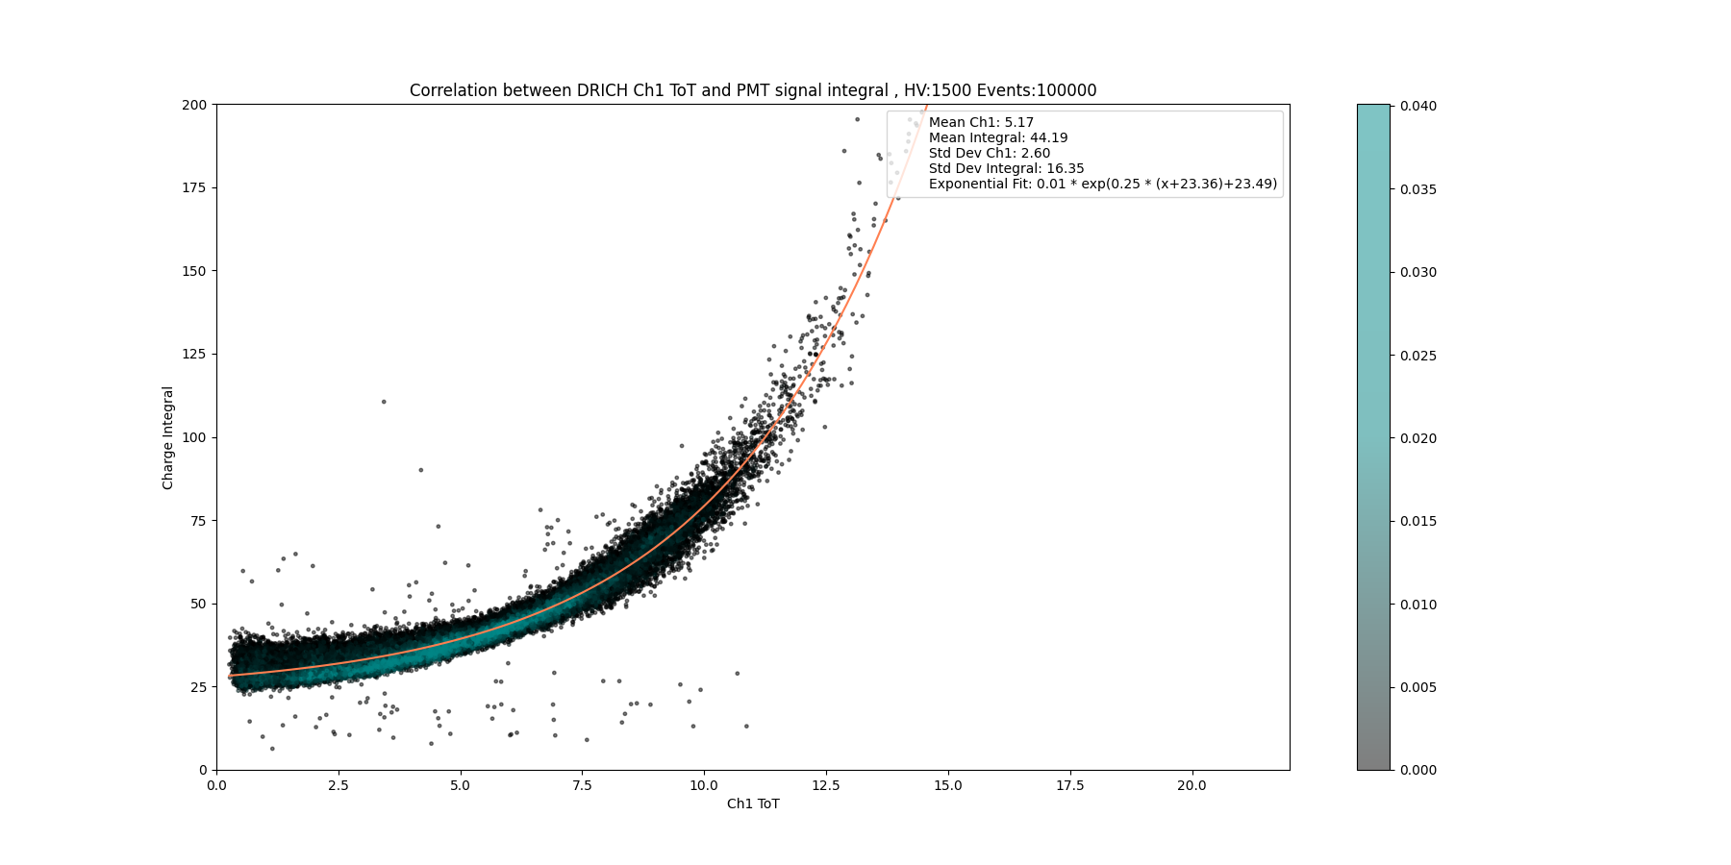
DiRich tests – Plots
3.4 Plotting Integral vs DiRich TOT correlated distribution and fitting with Function
20

Slide 21
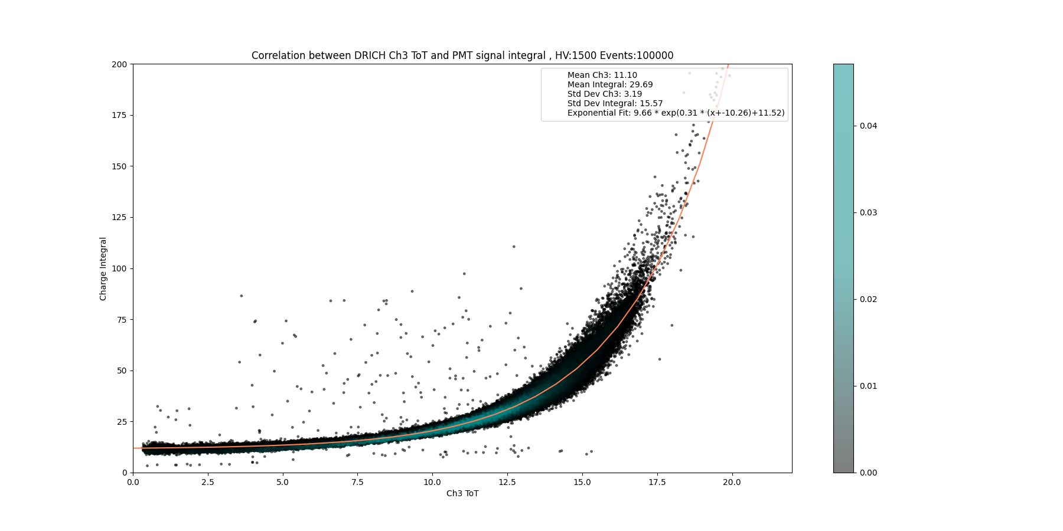
DiRich tests – Plots
3.4 Plotting Integral vs DiRich TOT correlated distribution and fitting with Function
21

Slide 22
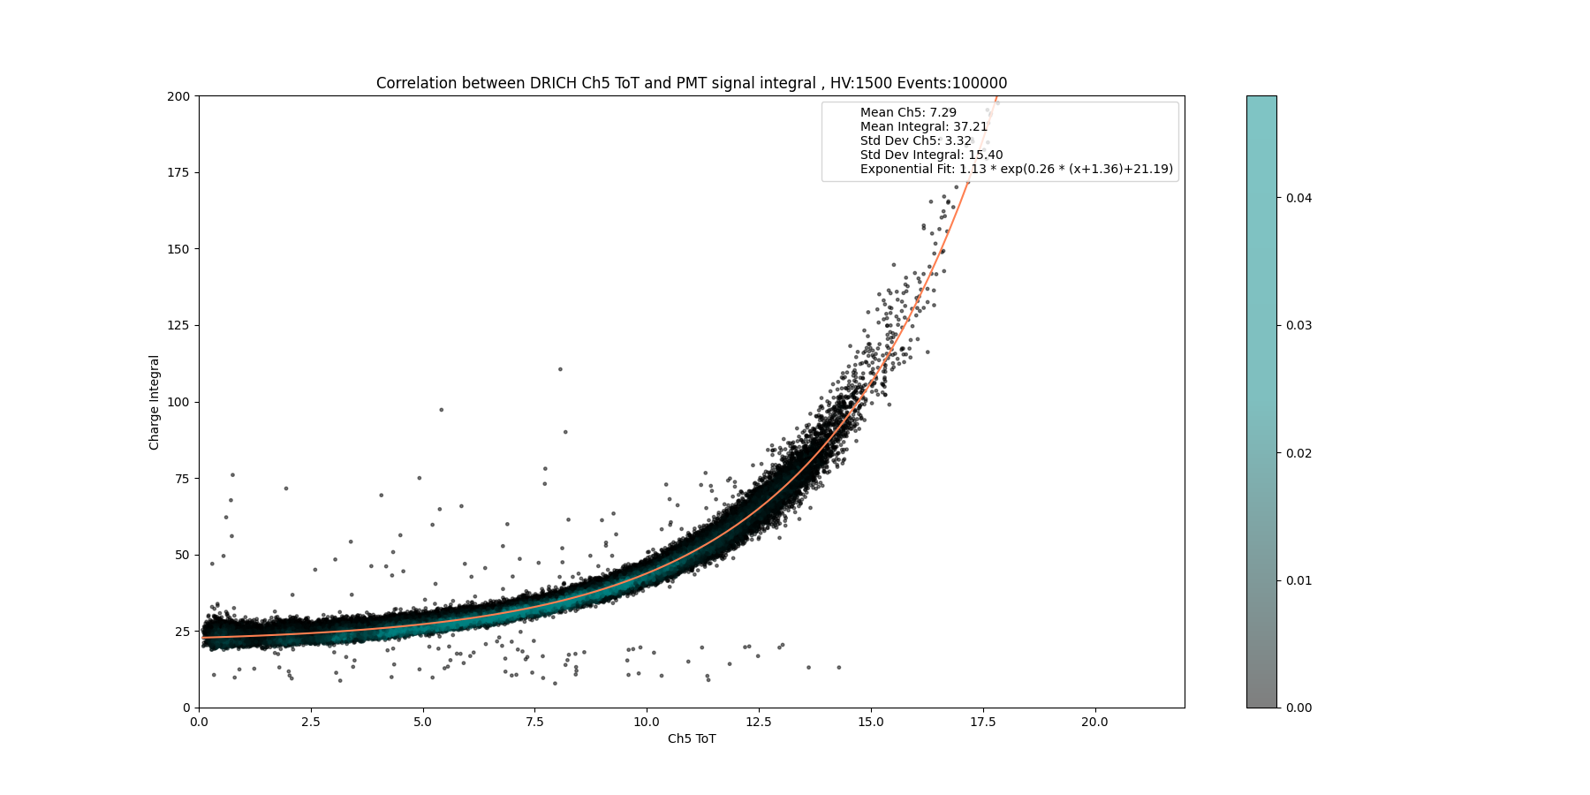
DiRich tests – Plots
3.4 Plotting Integral vs DiRich TOT correlated distribution and fitting with Function
22

Slide 23
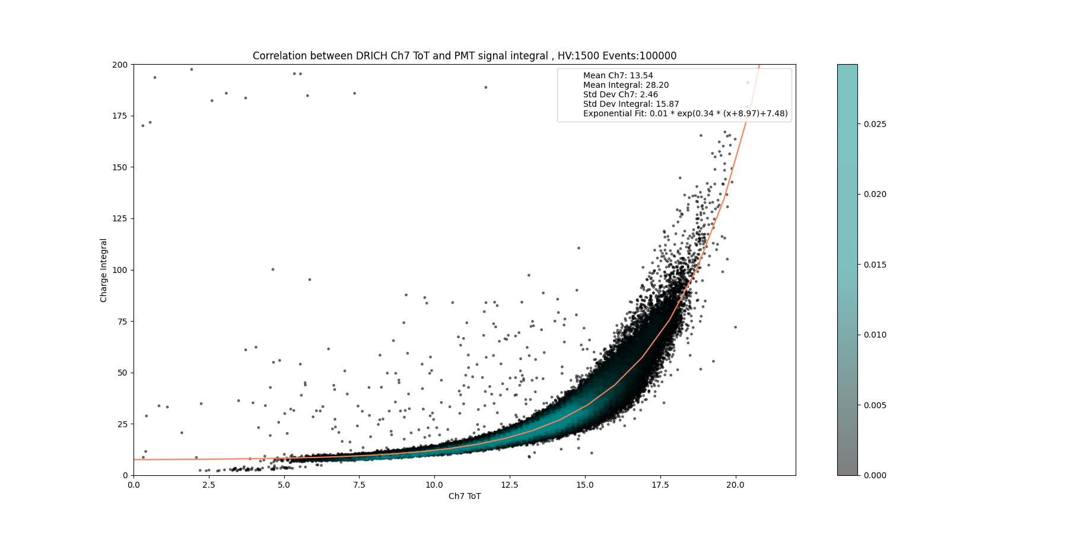
DiRich tests – Plots
3.4 Plotting Integral vs DiRich TOT correlated distribution and fitting with Function
23

Slide 24
DiRich tests – Analysis tree
Oscilloscope waveform data
3.1 Correlating charge integrals and DiRich ToTs
matching, the size and shifting according to the peak correlation
DiRich TOT data
1.1 Data baseline identification, fitting with constant
2.1 Extracting ToT DiRich data for all channels
3.2 Plotting charge integrals and channel ToTs
1.2 Data base shifting to 0, Correcting window, exporting as CSV
1.3 Plotting oscilloscope Data
3.3 Plotting integral vs DiRich TOT correlated distribution
2.2 Plotting DiRich ToT data from DiRich channels
1.4 Identification of group peaks and plotting
3.4 Plotting integral vs DiRich TOT correlated distribution and fitting with function
1.5 Generating CSV file with charge integrals
1.6 Plotting charge integral Data from CSV
3.5 Generating calibration model and plotting model vs real integral data
24

Slide 25
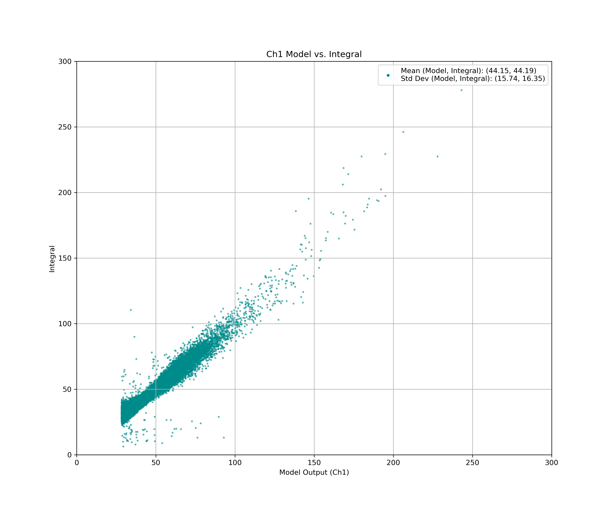
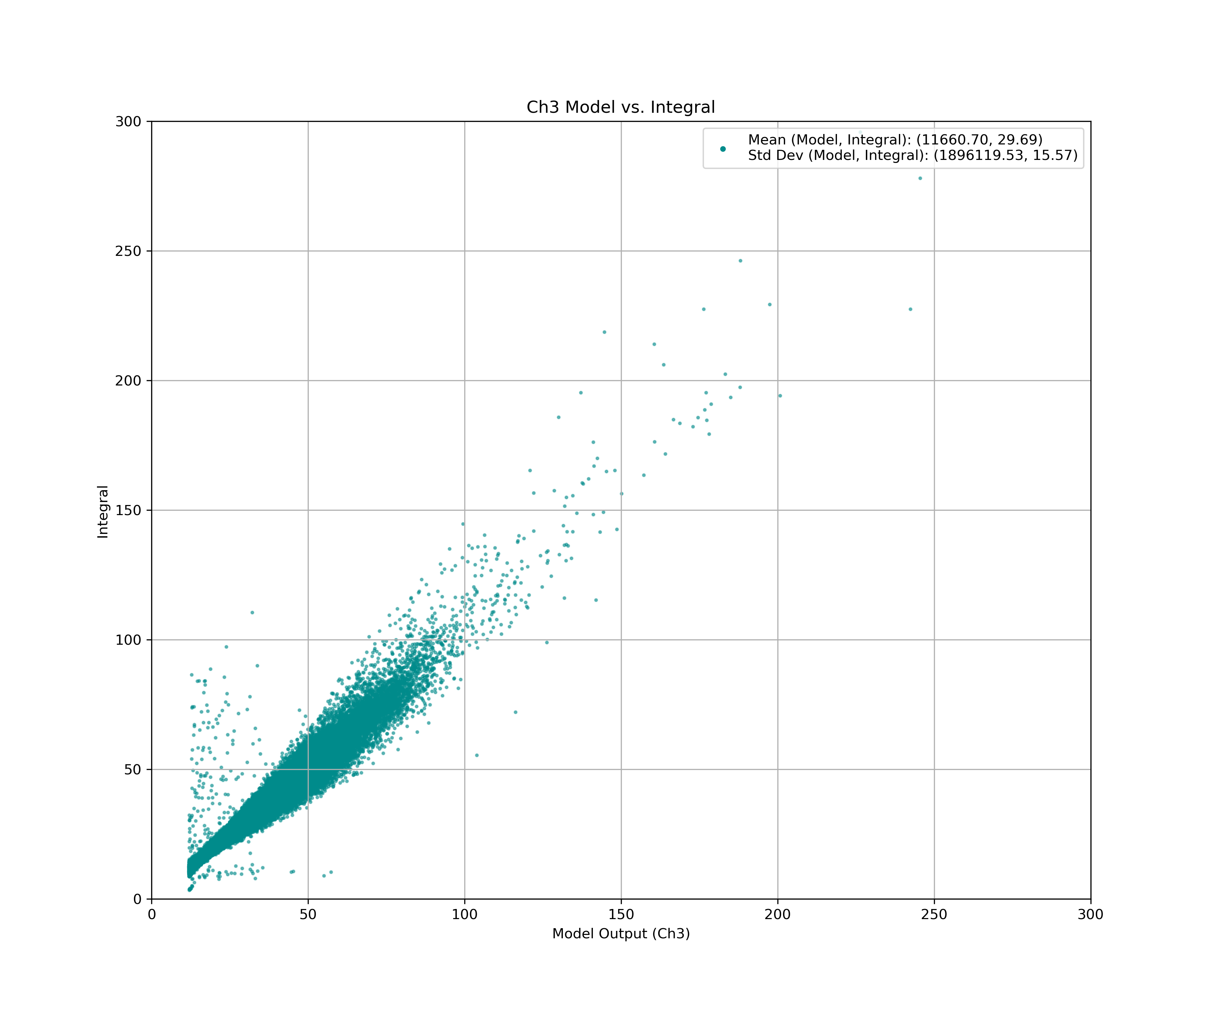
DiRich tests – Plots
3.5 Generating calibration model and plotting model vs real integral data
25

Slide 26
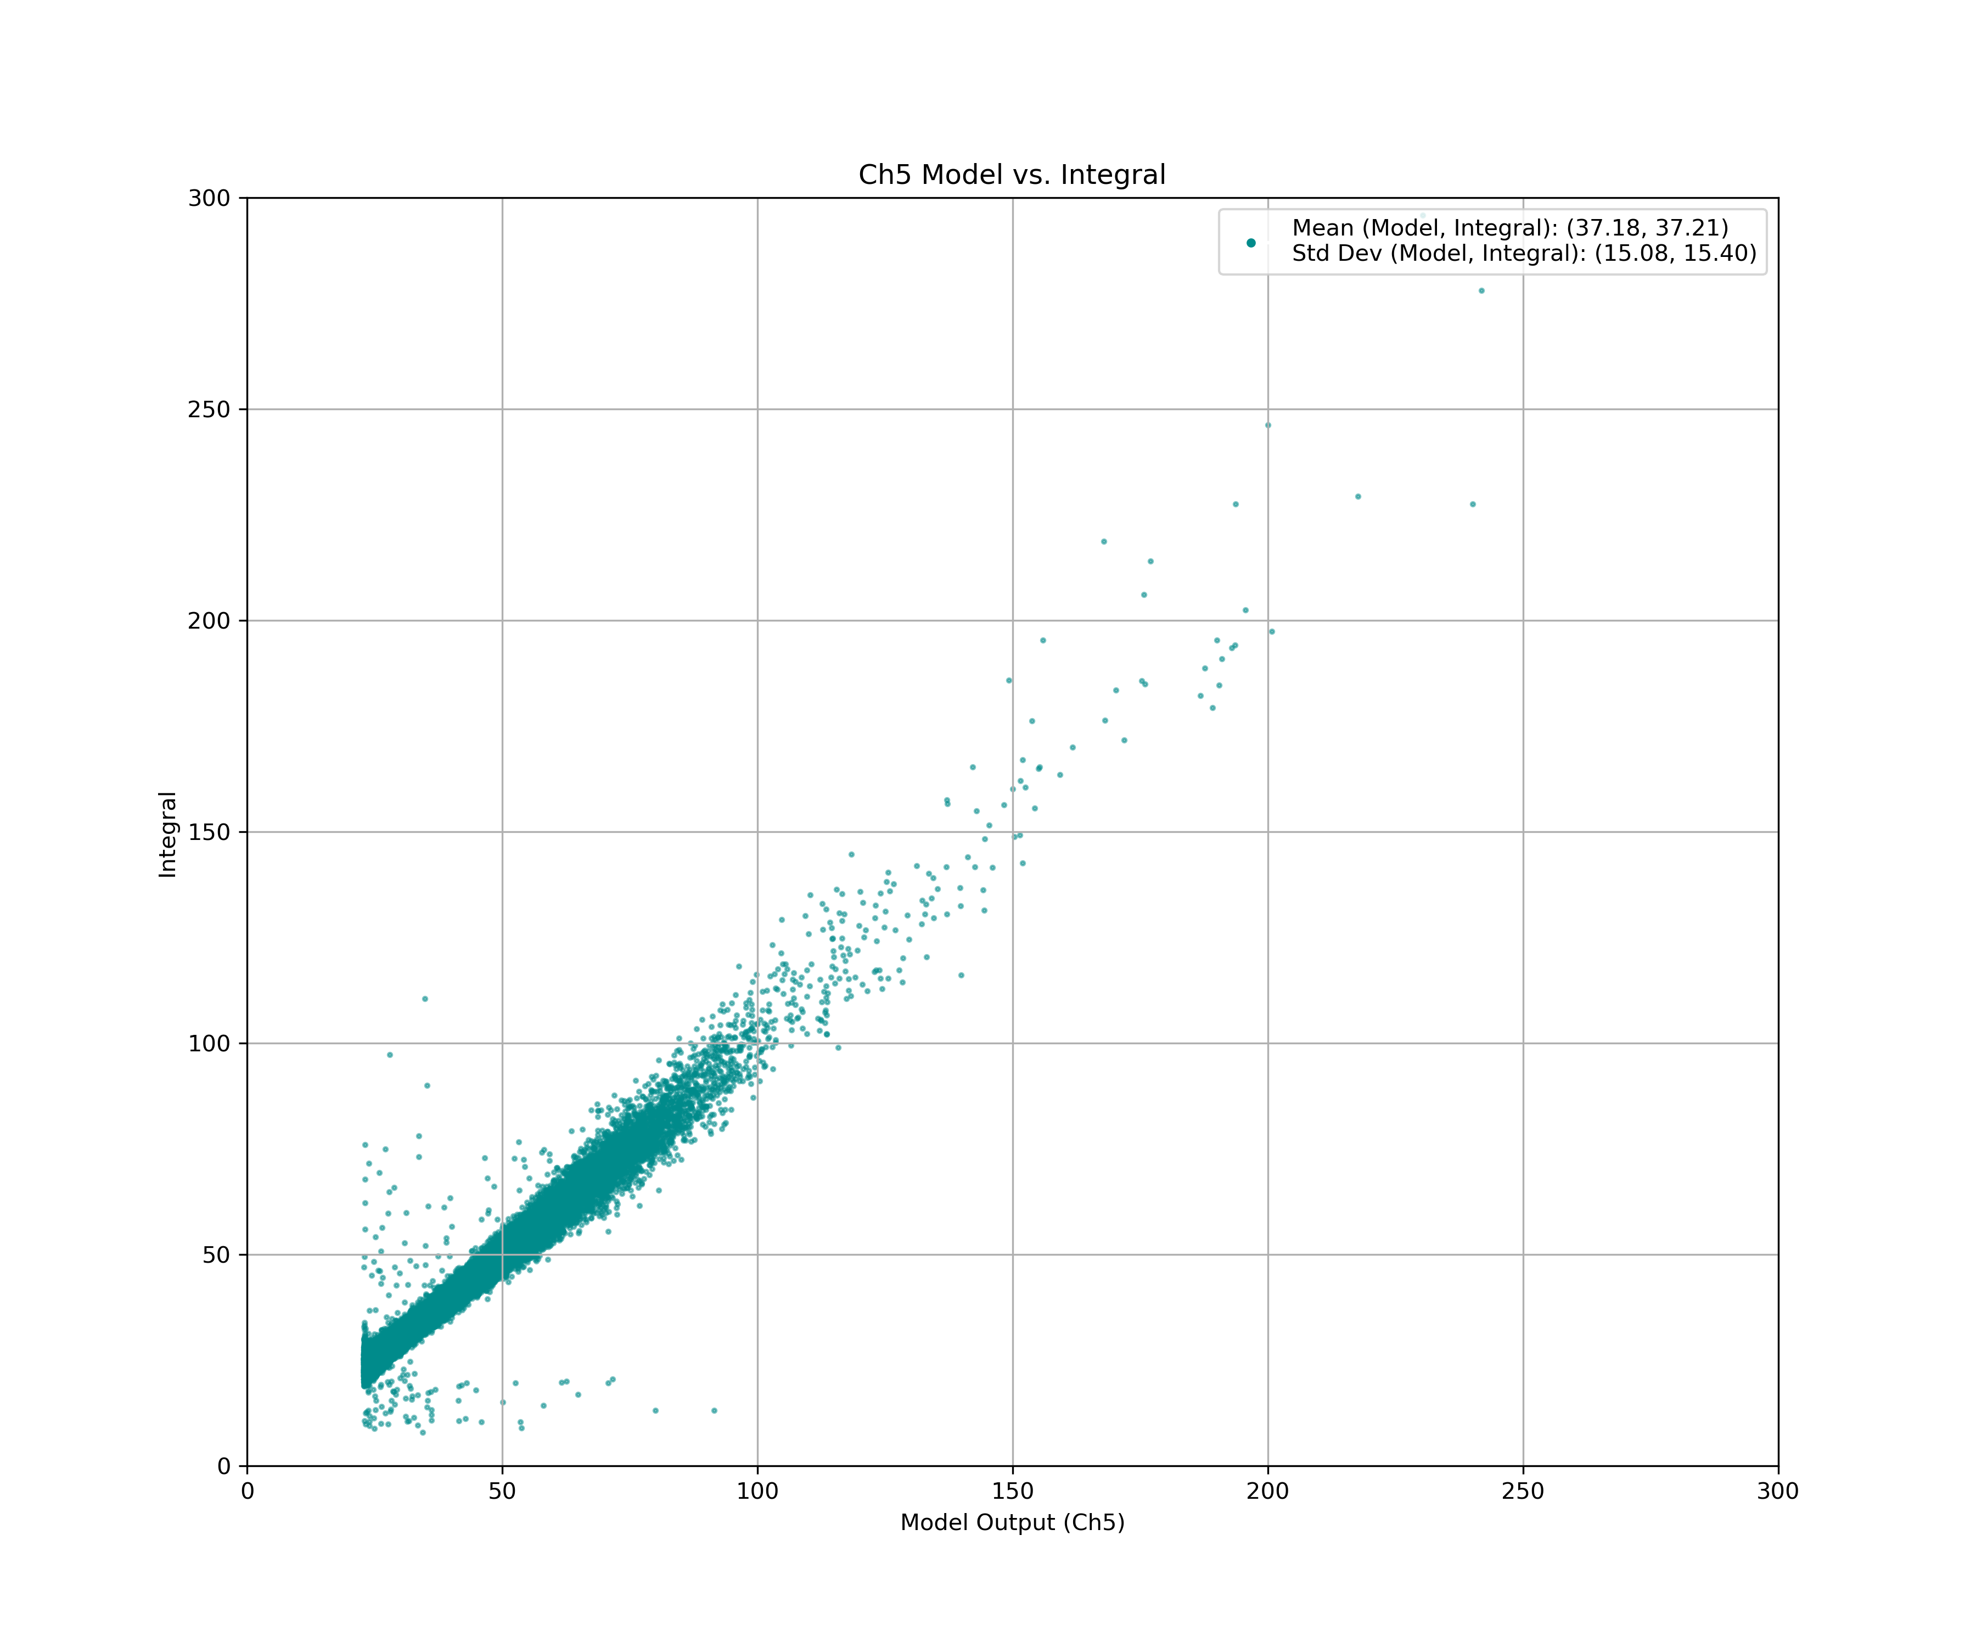
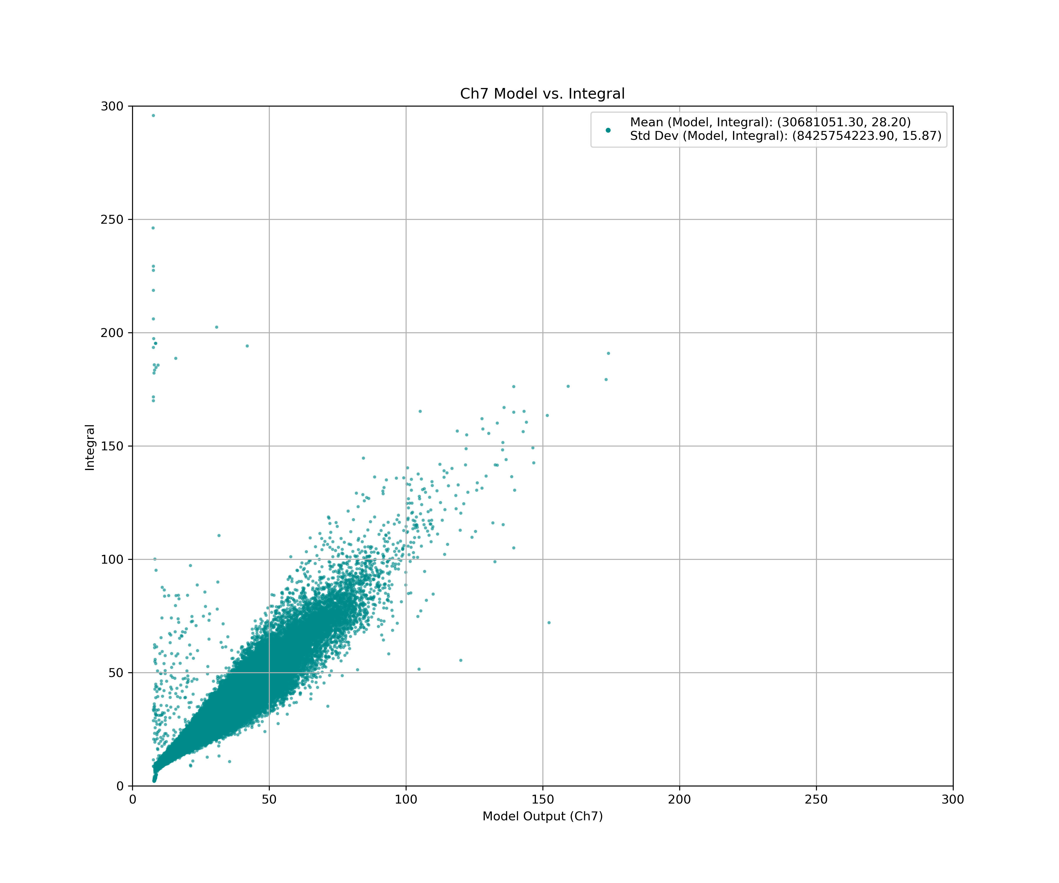
DiRich tests – Plots
3.5 Generating calibration model and plotting model vs real integral data
26

Slide 27
TOF PADI tests – Analysis tree
Oscilloscope waveform data for PMT
3.1 Correlating charge integrals and TOF PADI ToTs
matching, the size and shifting according to the peak correlation
Oscilloscope waveform data for square waveform (binary output TOF PADI)
1.1 Data baseline identification, fitting with constant
2.1 Generating TOT data from oscilloscope waveform files
3.2 Plotting charge integrals and channel ToTs
1.2 Data base shifting to 0, correcting window, exporting as CSV
1.3 Plotting oscilloscope data
3.3 Plotting integral vs TOT correlated distribution
2.2 Plotting TOF PADI ToT data
1.4 Identification of group peaks and plotting
3.4 Plotting integral vs TOF PADI TOT correlated distribution and fitting with function
1.5 Generating CSV file with charge integrals
1.6 Plotting charge integral data from CSV
3.5 Generating calibration model and plotting model vs real integral data
3.6 Characterizing model vs charge integral scatter with Gaussian distributions
27

Slide 28
TOF PADI tests - setup
splitter
TOF PADI
High Voltage Supply
Ch2
Oscilloscope
PMT
Oscilloscope Waveform data for square waveform (binary output)
Ch1
N-det Module
Oscilloscope Waveform data for PMT
28

Slide 29
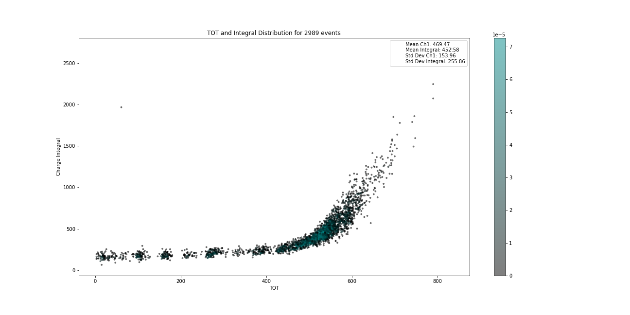
TOF tests – Plots
3.3 Plotting integral vs TOT correlated distribution
29

Slide 30
Geant4 Simulations
30

Slide 31
Accomplished tasks
16 Modules have been removed from the 20+ ton detector TOF at COSY and assembled into detector modules
Two systems each consisting of 7 modules have been mounted on the movable and height adjustable crates
Both detectors have been transported to GSI and now are located in/near mCBM cave
Added 5 pieces of VETO scintillators, each having two PMT-s on both ends for reliable veto particle identification
Data acquisition system selection in progress…
Two candidates: DiRich & TOF PADI
Single modules set up for readout tests in Wuppertal for DiRich and at GSI for PADI
31

Slide 32
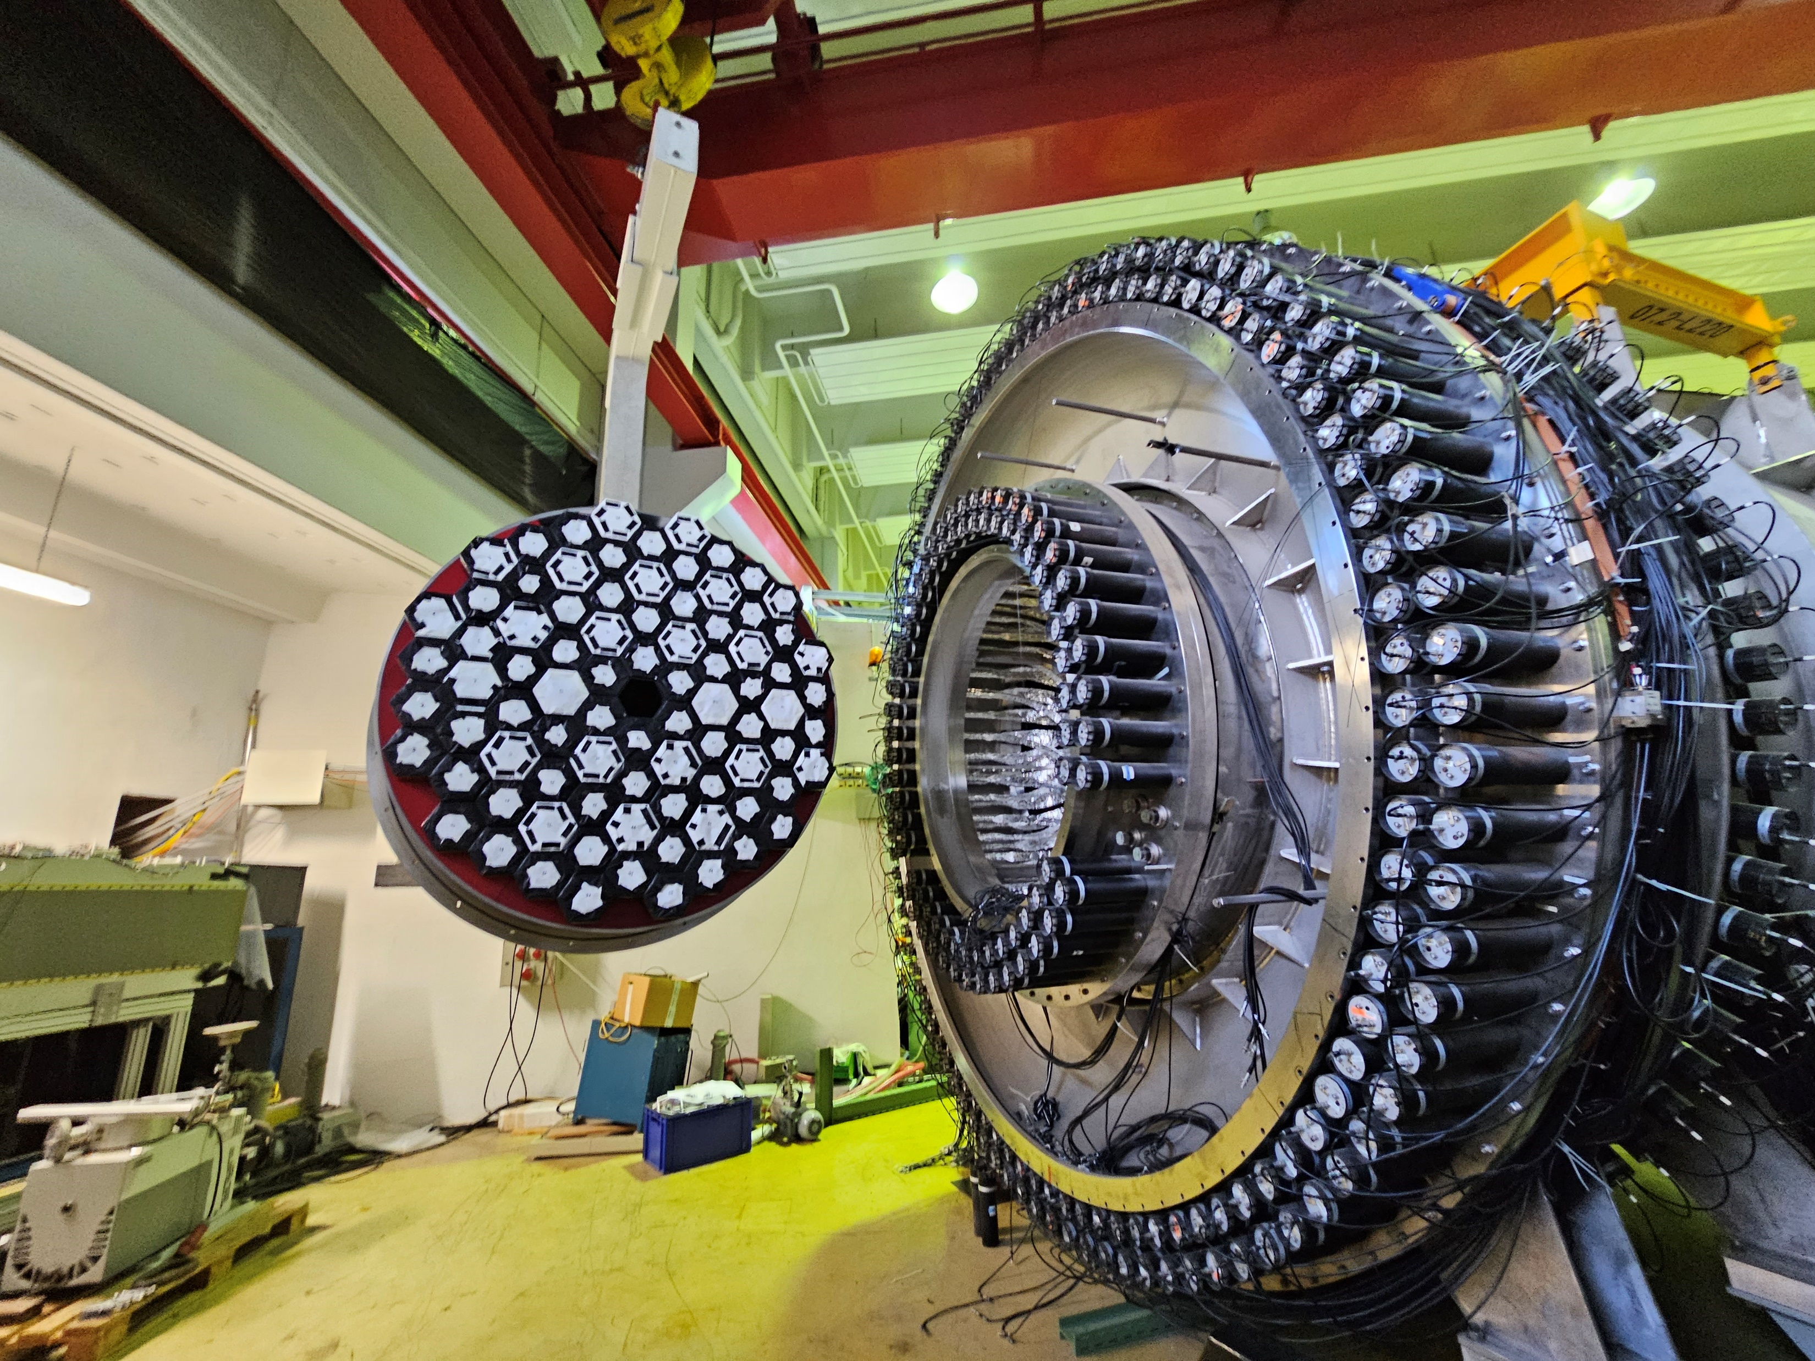
Summary
16 Modules have been removed from the 20+ ton detector TOF at COSY
Two systems each consisting of 7 modules have been assembled mounted on the movable and height adjustable crates
Both detectors have been transported to GSI and with upgraded VETO modules now are located in/near mCBM cave
Data acquisition system selection in progress…
Two candidates: DiRich & TOF PADI
Single modules set up for readout tests in Wuppertal for DiRich and at GSI for PADI
Geant4 Simulations …
Beamtime data-taking and analysis
Possible tests in Czech republic CANAM cyclotron facility
32

Slide 33
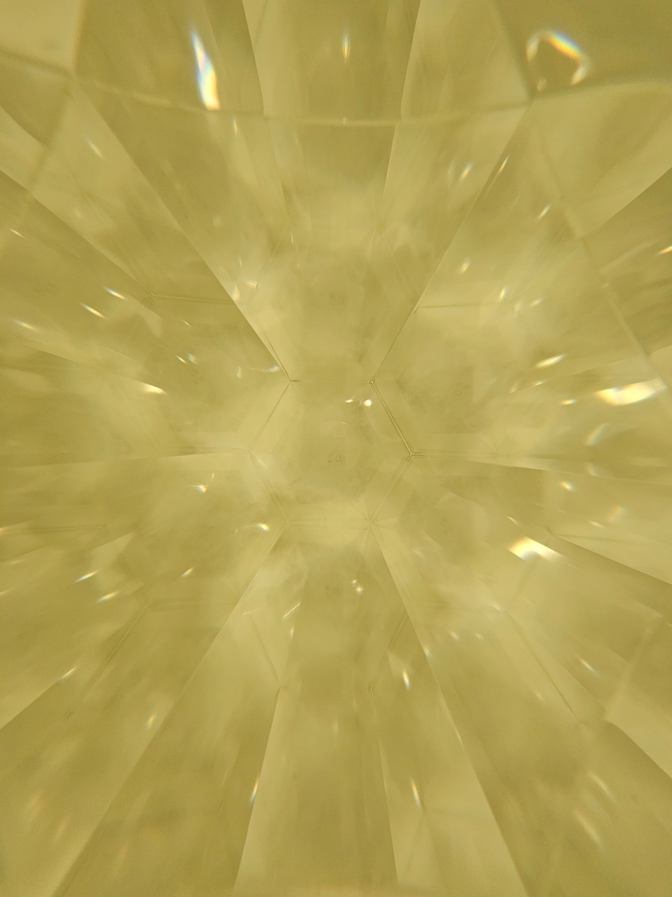
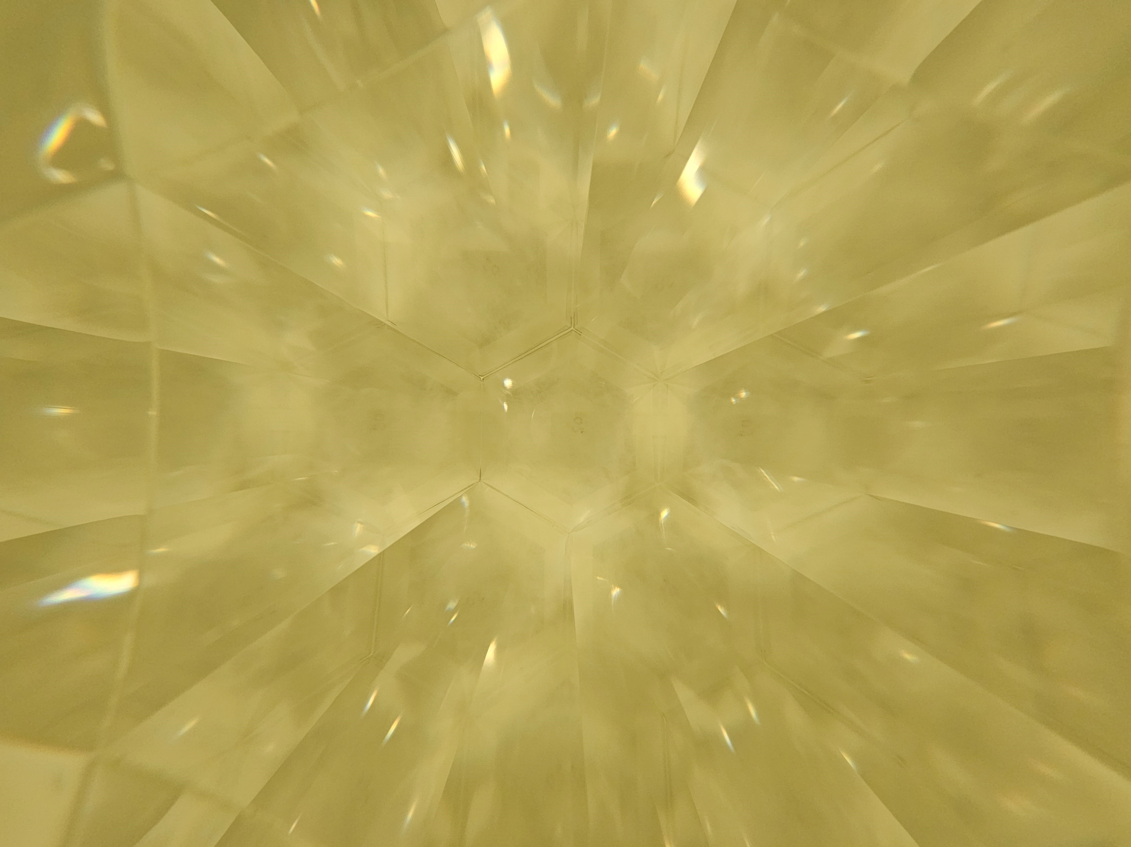
Outlook
Completing selection process of readout systems and making a decision
pp Geant4 simulations
Detector commissioning
Data taking on upcoming beamtimes
Analysis, conclusions
33

Slide 34
GGSB for me
Participant of 2019 Autumn sessions at Forschungszentrum Juelich
Contributions at SMART Lab in Tbilisi
Beamtimes at COSY accelerator, IKP, FZJ
Wider perspectives, greater opportunities
Safer, more advanced, progress-oriented scientific atmosphere to tackle fundamental challenges of the mankind
Community of Junior and Senior scientists, that feels like home. People who are always eager to support and share their experiences
34

Slide 35
GGSB for Germany and for Georgia
Highly skilled and motivated young generation to contribute into Germany’s top research institutes and projects, who admires European values and respects German culture
Great possibility of expanding scientific ties, collaborations and partnerships on different fields of science
Opportunities for hundreds of Georgian students and scientists to:
Access to world class scientific facilities, research centers and infrastructure
Work alongide the world’s best scientists, take & share experience and knowledge and contribute into the world’s scientific challenges
Keep the new generation up with the newest technologies and discoveries
Keep the science alive back home!
35

Slide 36
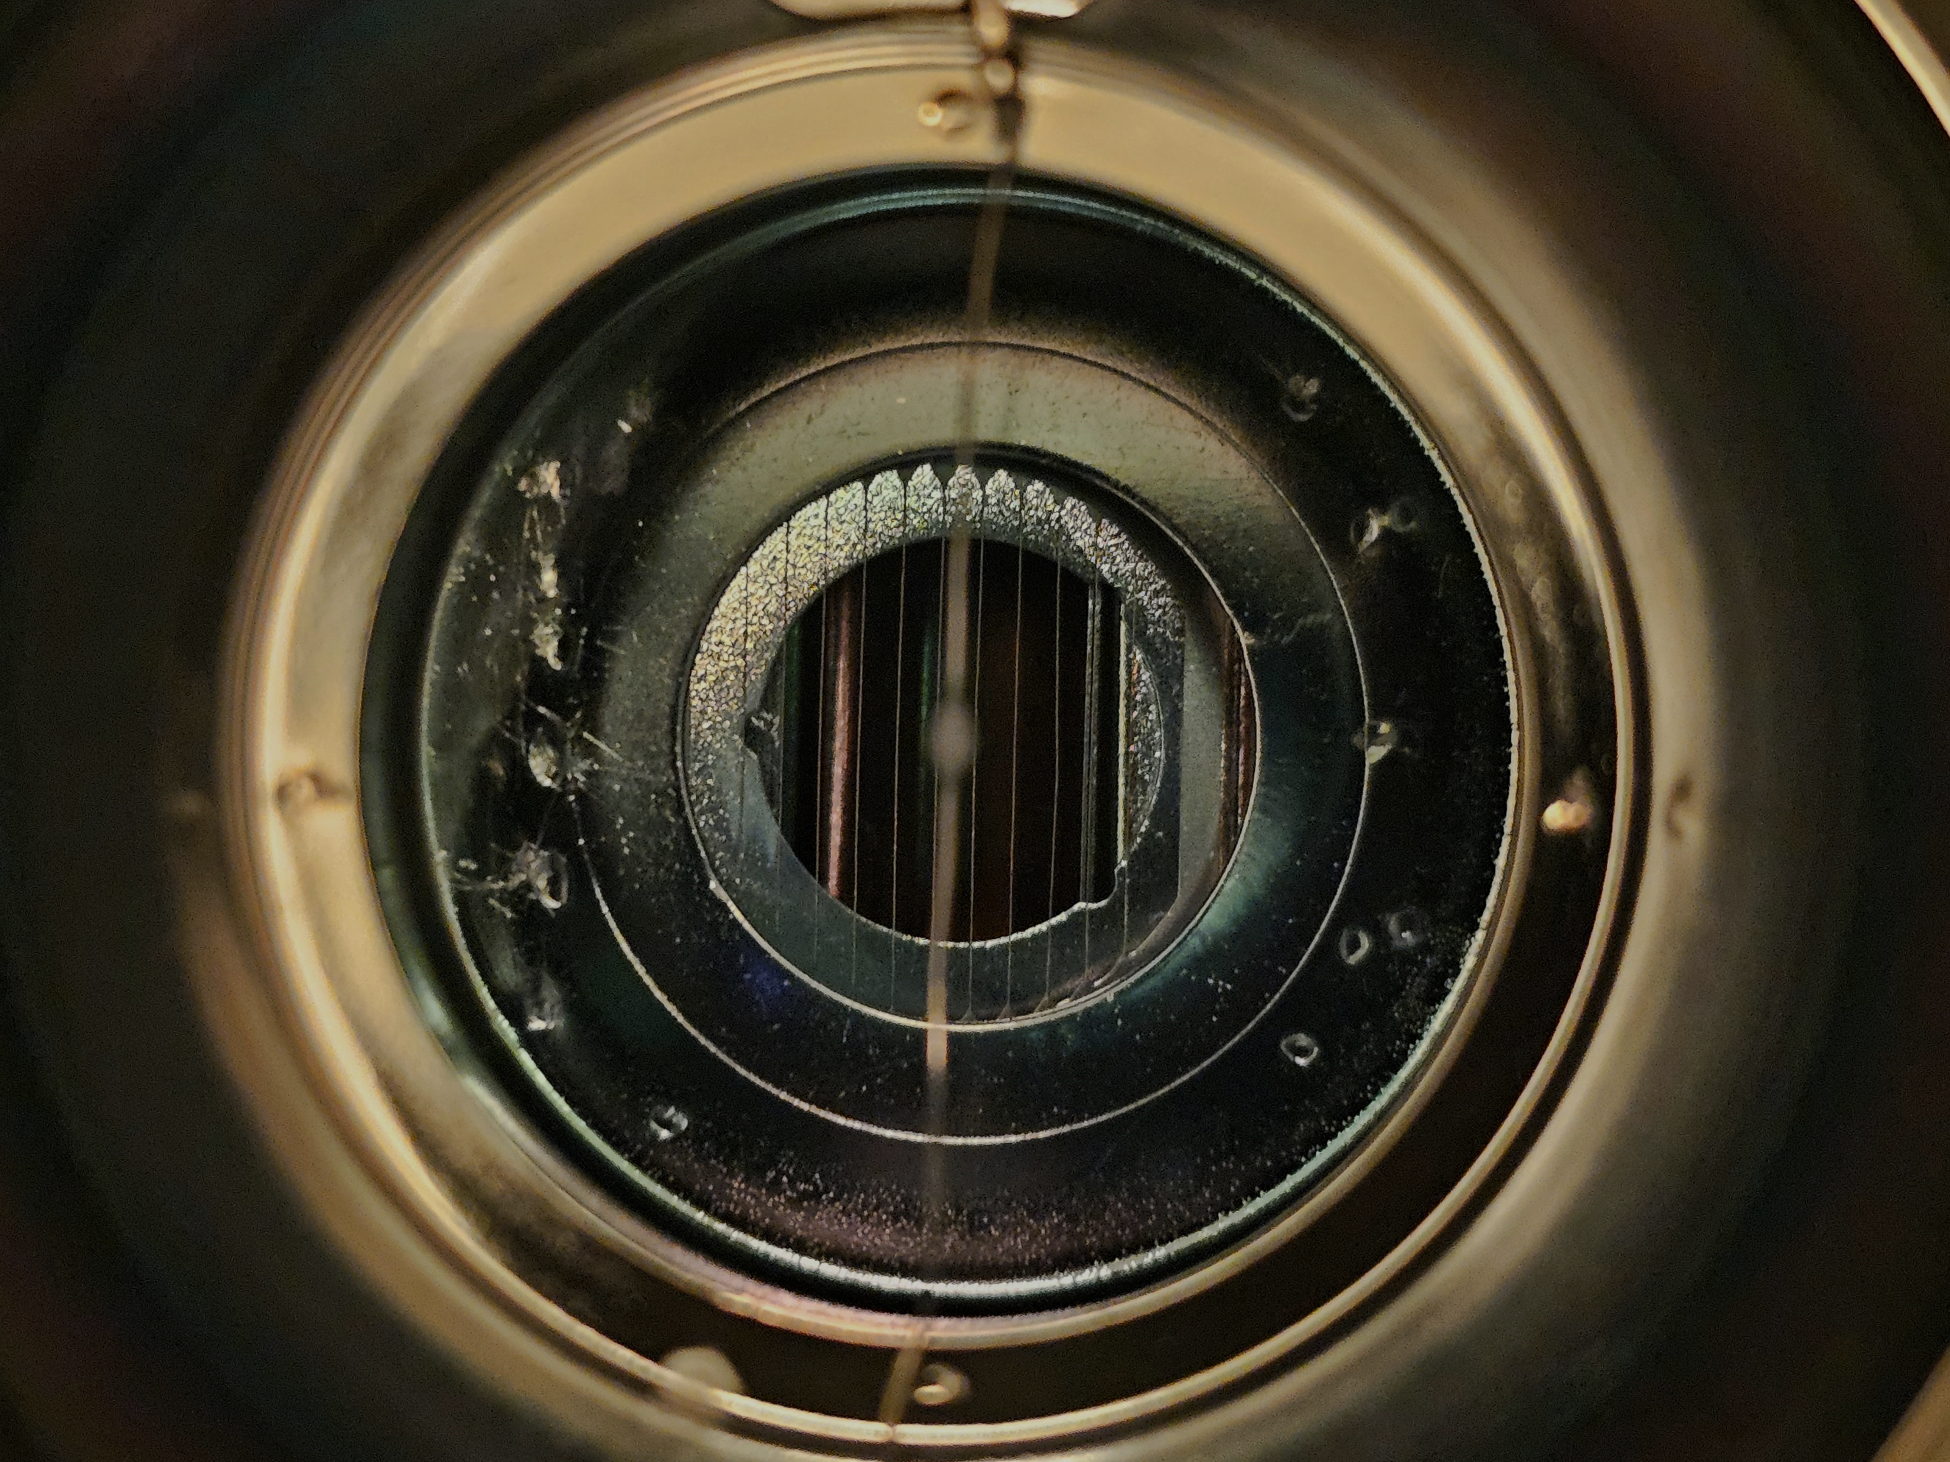
Thank you for your attention!
Special thanks to:
Dr. Andro Katcharava, Prof. Dr. Ketevan Kotetishvili, Dr. Irakli Keshelashvili, Prof. Dr. James Ritman, Prof. Dr. Hans Stroher, Dr. Dieter Grzonka, Dr. David Mchedlishvili, Dr. Mirian Tabidze, Dr. Nodar Lomidze, Prof. Dr. Gogi Matcharashvili, Dr. Manana Megrelishvili, Dr. Otar Javakhishvili, members of IKP1/2 and GSI CBM collaboration, and my friends: Maia, Natia, Lado, Eka, Giorgi, Rati, Tamta, Nana. And to my Family: Lela, Lia and Nia and to many, many other brilliant people …
36

Slide 37
References
E. Roderburg, IKP annual report 2011.
D. Grzonka, et al., Preparation of test modules for neutron detection at mCBM, 2023
J. Kreß, PhD thesis, University Tübingen, 2003.
37
Notes:
asdasd

