Slide 1
Heatmap Prediction on Breast Cancer(IDC) Dataset
Ivane Javakhishvili Tbilisi State University
Author: Dato Nefaridze
Virtual Event, November 27, 2020

Slide 2
What is our goal?
Our Goal is to produce heatmaps from breast cancer images, heatmaps give us reasoning tool about why neural network made certain decision, which is crucial in medical field.

Slide 3
Visualizing examples from cats vs dogs dataset

Slide 4
What I have used
Transfer learning with Densenet (why?)
Kaggle dataset
Data augmentation (why?)
Google Cloud.

Slide 5
First common approach is CAMs:
Photo is taken from: https://towardsdatascience.com/demystifying-convolutional-neural-networks-using-class-activation-maps-fe94eda4cef1

Slide 6
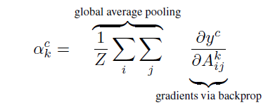
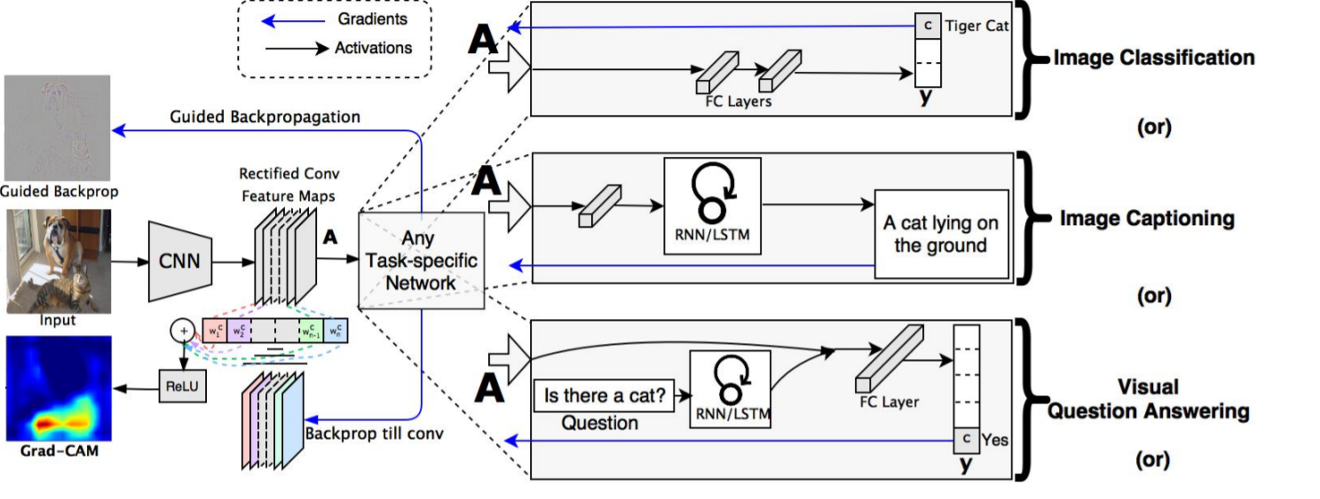
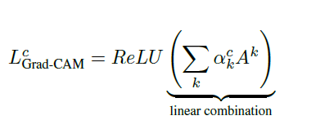
Second and better approach Grad Cam
All the photos are taken from: https://towardsdatascience.com/demystifying-convolutional-neural-networks-using-gradcam-554a85dd4e48
Idea is taken from this paper: https://arxiv.org/pdf/1610.02391.pdf

Slide 7
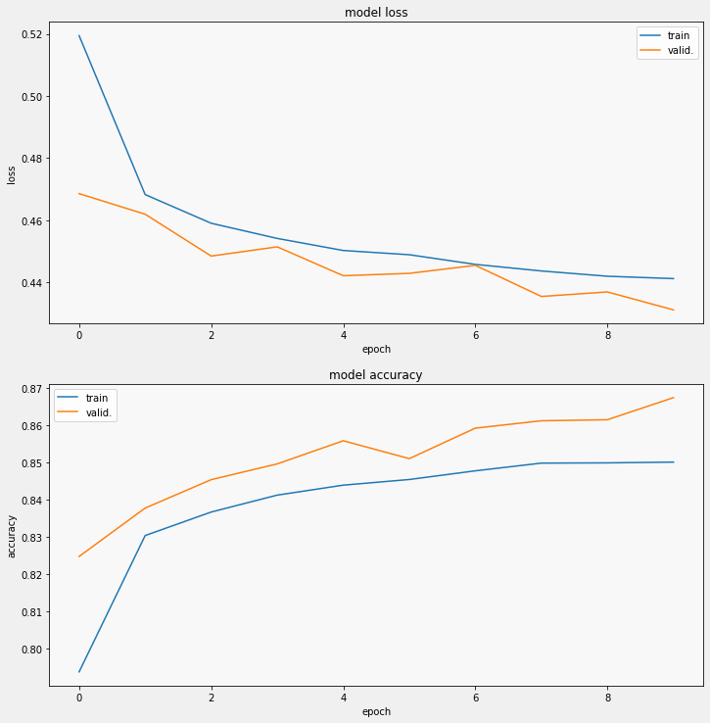
Model results:
Epochs: 10
Training samples: 153,809
validation samples:3,540
Trainable parameters:1,106,114
Non trainable parameters:18,321,984
Dataset was taken from : https://www.kaggle.com/paultimothymooney/breast-histopathology-images/notebooks

Slide 8
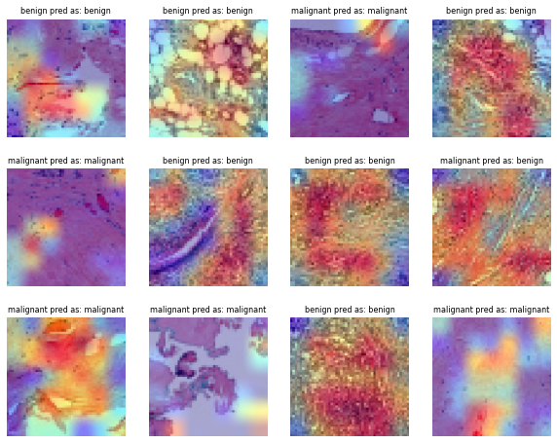
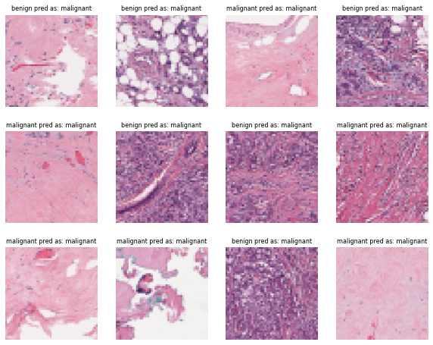
Model analysis:
During the training phase the best:
validation loss was - 0.4312
Validation accuracy was - 0.8675
Samples wasn’t skewed, number of malignant images and benign Images were same (I normalized dataset).

Slide 9
Future plans
Taking the idea from Vision Transformer and apply it on breast cancer dataset and also draw heamaps.
Reference for Vision Transformer: https://arxiv.org/pdf/2010.11929v1.pdf

Slide 10
Thanks for your attention

