Slide 1
CO measurements from high precision and low cost sensors, comparison, visualization and clustering
Student: Marta Melia – Master (1st year) in Pure Mathematics, Ivane Javakhishvili Tbilisi State University
Supervisor : Ramaz Botchorishvili, Kutaisi International University
GGSB 2020: Student Presentations at Kutaisi International University, Virtual Event, November 27, 2020

Slide 2
Outline
Sensors and data
Cleaning the data
Comparison and visualization
Weighted average (Moore-Penrose Inverse)
Clustering (k-means)

Slide 3
Types of sensors and initial data
Alphasense (low cost):
five boards
4 sensors on each board: CO,NO, NO₂,and O₃+NO₂.
in three boards data was recorded in 2000 year and/or in January,
In two boards data was recorded from 8 February to 12 March and 19-20 for hours per day
Data in binary format.
Picarro:
3 sensors: CO, H₂O and CH₄.
Data was recorded from 1 February to 7 and from 10 February to 12 March and for 22-23 hours per day
Data in .dat format
Source: Smart AtmoSimlab
Doctor Giorgi Jibuti

Slide 4
Common data for Alphasense and Picarro sensors
Common period of time: From 10 February 2020 to 12 March 2020
Common hours per day: 15-16 hours
Common sensor: CO sensor

Slide 5
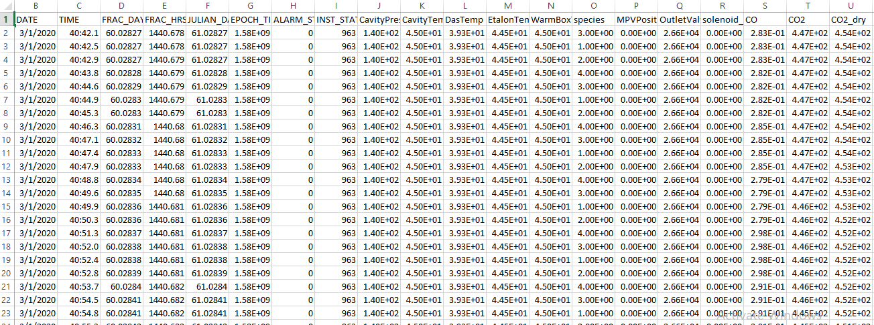
Raw data (Picarro measurements)

Slide 6
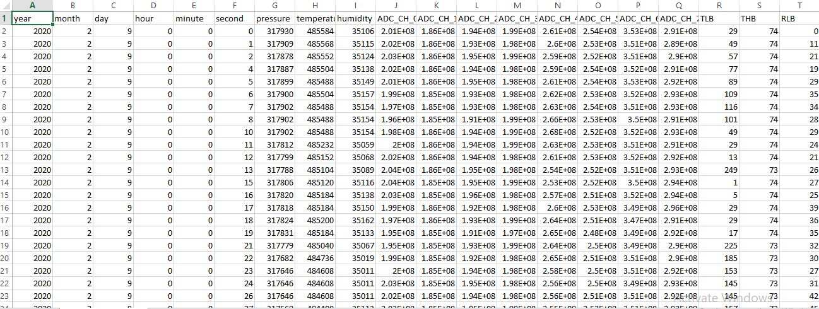
Raw data (Alphasense measurements)

Slide 7
Adjusting Picarro data to Alphasense
Different date formats
Several instances for each second(for different milliseconds) in Picarro

Slide 8
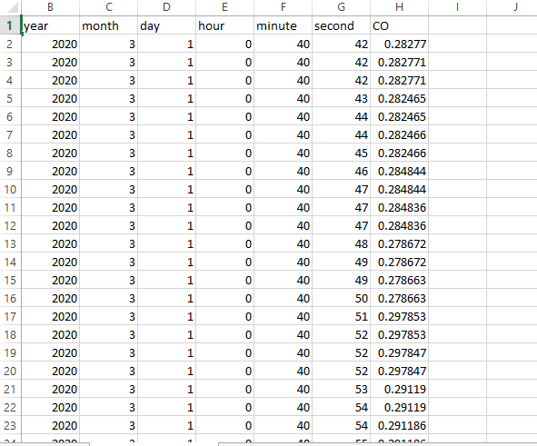
Adjusted Picarro data to Alphasense

Slide 9
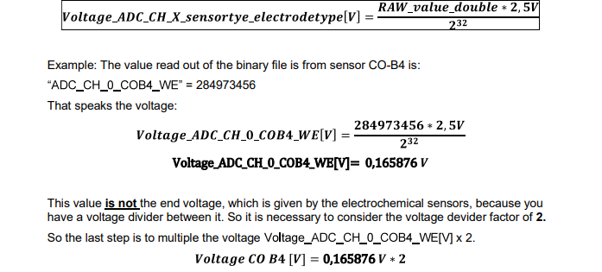
Conversion of the data (Alphasense)
Converting formula for Voltages
Converting formula for humidity and temperature

Slide 10
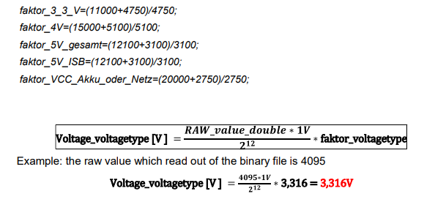
Conversion of the data (Alphasense)
Converting formula for the sensors

Slide 11
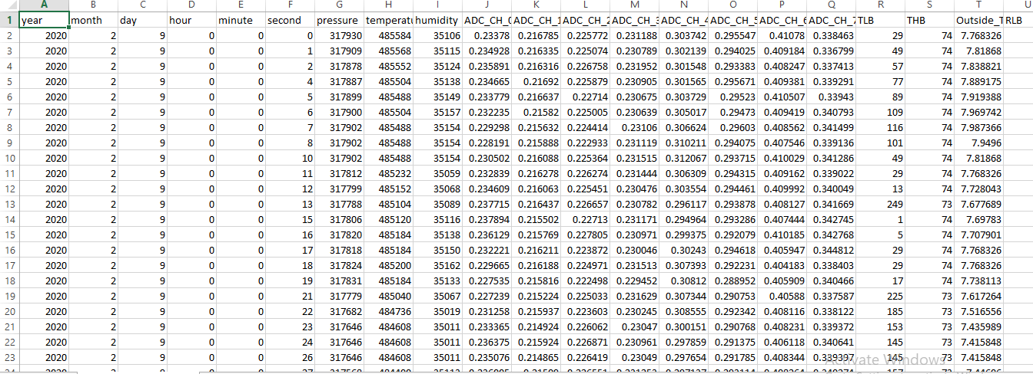
Converted data (Alphasense)

Slide 12
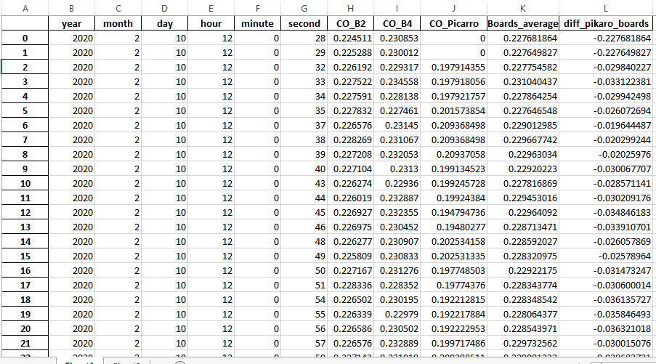
Processed data (Alphasense and Picarro merged data in seconds)

Slide 13
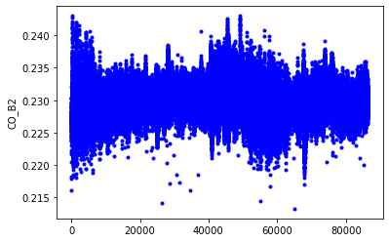
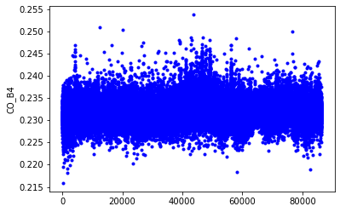
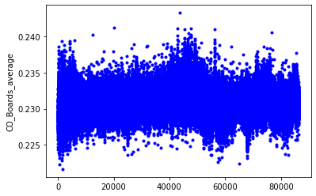
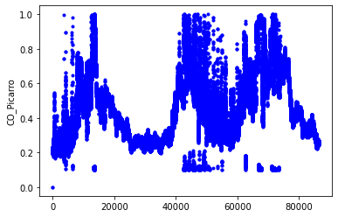
Processed data in seconds (for 24hours)

Slide 14
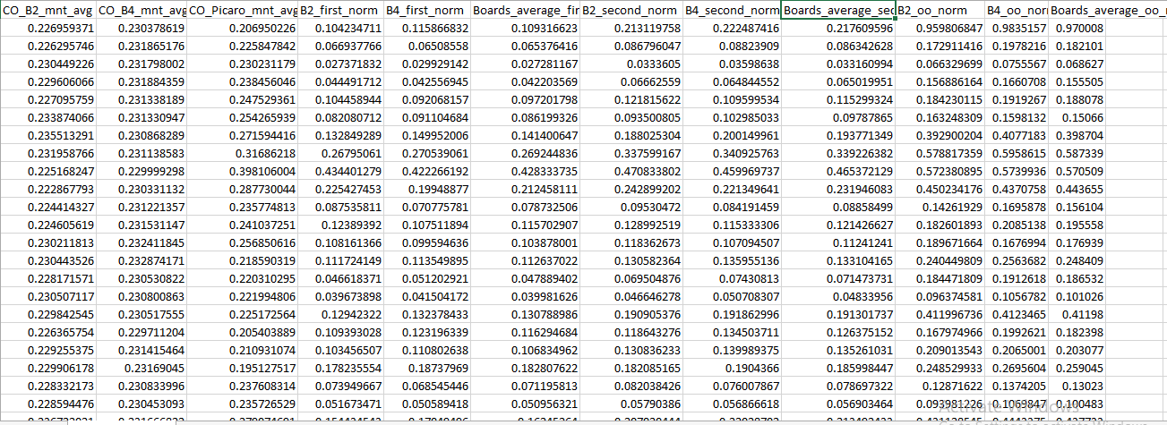
Processed of the data (Alphasense and Picarro merged data in minutes Averages and Norms)

Slide 15
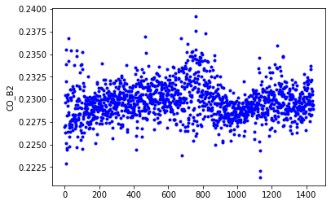
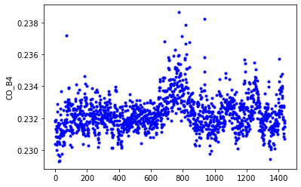
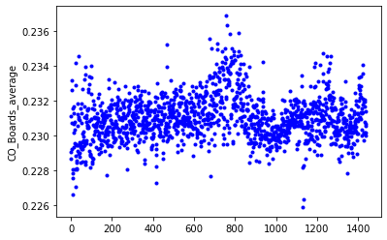
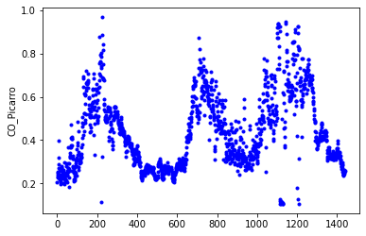
Processed data in minutes (for 24hours)

Slide 16
Errors Between Boards average and Picarro
Relative error of B2 and B4 boards average with respect to Picarro using 1st norm≈48,9%
Relative error of B2 and B4 boards average with respect to Picarro using 2nd norm ≈ 59,1%
Relative error of B2 and B4 boards average with respect to Picarro using infinity norm ≈77,6%

Slide 17
Is taking averages the most efficient way?
There is a significant error between average of Alphasense boards and Picarro. Is there any way to minimize the error? We will use Moore-Penrose method to find the best fit

Slide 18
Moore-Penrose Formula for overdetermined system
AW=B
A^{T}AW=A^{T}B
(A^{T}A)⁻¹A^{T}AW=A^{T}B
W=A⁺B
where, A⁺= (A^{T}A)⁻¹A^{T}
A is a matrix of CO_B2 and CO_B4 data
W is a matrix of w1 and w2 (weights)
B is a matrix of CO_Picarro data

Slide 19
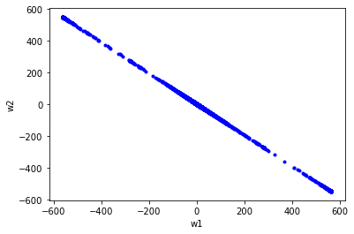
Moore-Penrose averaging weights for 2 seconds

Slide 20
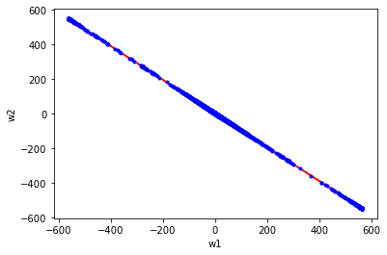
Regression weight and best linear fit for 2 seconds
k=-0.96, b=1.77

Slide 21
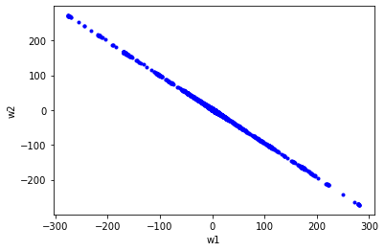
Moore-Penrose averaging weights for 4 seconds

Slide 22
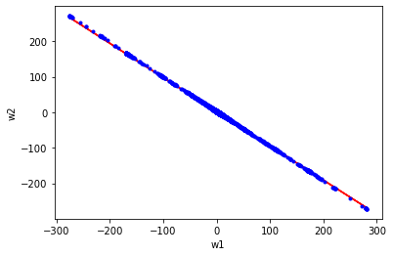
Regression weight and best linear fit for 4 seconds
k=-0.96
b=1.74

Slide 23
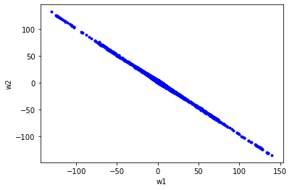
Moore-Penrose averaging weights for 8 seconds

Slide 24
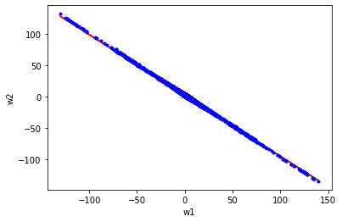
Regression weight and best linear fit for 8 seconds
k=-0.97
b=1.75

Slide 25
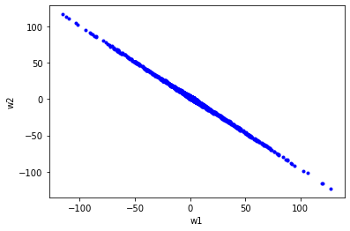
Moore-Penrose averaging weights for 16 seconds

Slide 26
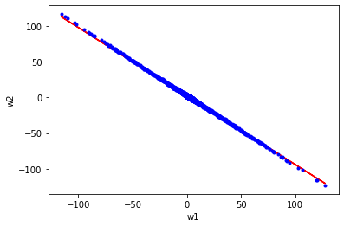
Regression weight and best linear fit for 16 seconds
k=-0.96
b=1.74

Slide 27
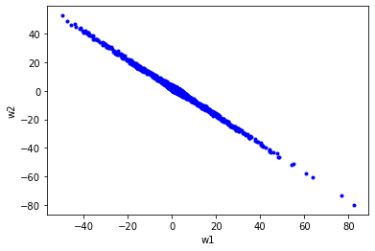
Moore-Penrose averaging weights for 32 seconds

Slide 28
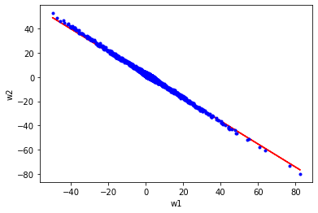
Regression weight and best linear fit for 32 seconds
k=-0.95
b=1.73

Slide 29
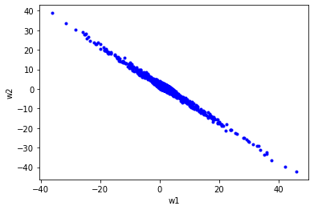
Moore-Penrose averaging weights for 1 minute

Slide 30
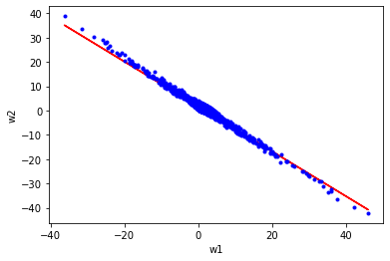
Regression weight and best linear fit for 1 minute
k=-0.92
b=1.70

Slide 31
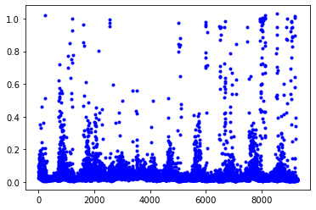
Relative error with 1st norm (M.P and Picarro)

Slide 32
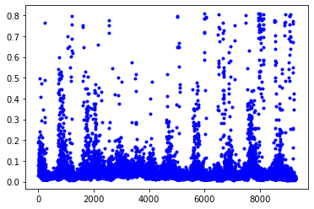
Relative error with 2nd norm (M.P and Picarro)

Slide 33
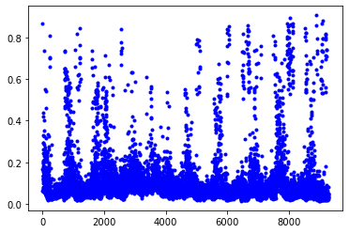
Relative error with infinity norm (M.P and Picarro)

Slide 34
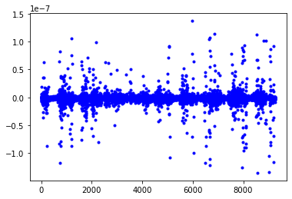
Mean absolute Average (M.P and picarro)

Slide 35
Relative Error (infinity norm) | New method = Moore-Penrose average, number of points ​ | Boards average, number of points.
e<10% | 6467 ≈ 69.8% | 131 ≈ 1.4%
10%<e<20% | 1847 ≈ 19.9% | 813 ≈ 8.8%
20%<e<40% | 498 ≈ 5.4% | 2838 ≈30.6%
e>40% | 457 ≈ 4.9% | 5487 ≈ 59.2%

Slide 36
K-means clustering
k-means clustering is a method of vector quantization, originally from signal processing, that aims to partition n observations into k clusters in which each observation belongs to the cluster with the nearest mean (cluster centers or cluster centroid)

Slide 37
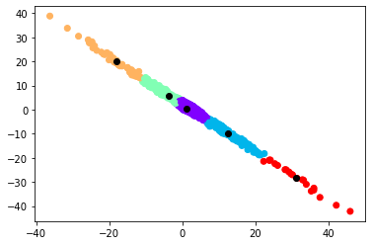
K-means clustering
Centroids: (1.17286031 0.59580922),(12.48973903 -9.81092916),(-3.59394734 5.65709119),(-18.02185182 19.90635311),(31.27683687 -28.33612773)

Slide 38
Thank you for attention!

