Slide 1
RNN for Classification of Measurements
Students: Gigia Aptsiauri, Salome Shekiladze – MS in Computer Science(1st year), Tbilisi State University Supervisor: Ramaz Botchorishvili – Kutaisi International University
GGSB 2020: Student Presentations at Kutaisi International University, Virtual Event
27 November, 2020

Slide 2
Measurements
Collected from SMART AtmoSim Lab by Dr. Giorgi Jibuti
Measurements from three sources:
Picaro instrument – high-accuracy sensor
Two Alphasense sensors – low-accuracy sensors
Measurements were filtered and preprocess was done by Marta Melia

Slide 3
Description of Problem
Given – Measurements from Picaro(high-precision) and two Alphasense sensors(low-precision):
Sensor data point values are always less than Picaro’s.
Is It possible to increase precision in Alphasense sensors’ measurements?

Slide 4
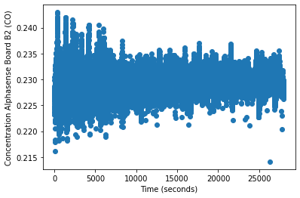
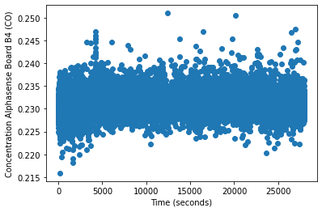
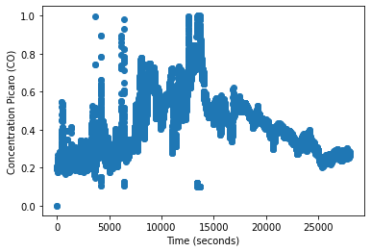
Measurements of CO
Aphasense Sensor (B2) – low-accuracy
Aphasense Sensor (B4) – low-accuracy
Picaro – high-accuracy

Slide 5
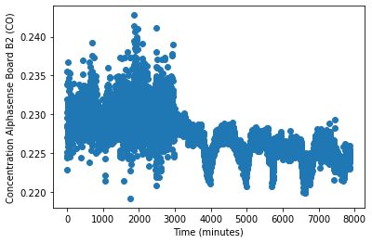
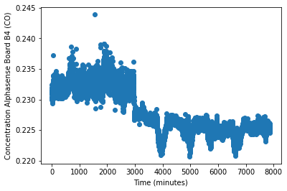
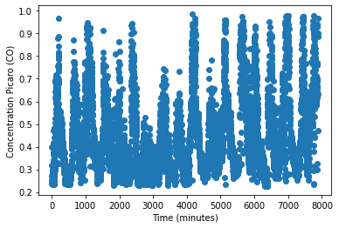
Measurements of CO minute averaged
Aphasense Sensor (B2) – low accuracy
Aphasense Sensor (B4) – low accuracy
Picaro – high-accuracy
Approximately 42% of given measurements’ errors are less than 35%.
Approximately 50% of given measurements’ errors are between 35%-70% .
8% of data measurements’ errors are more than 70%.

Slide 6
Approach
Classify error of measurements in group of two types:
percentage of error is less than 35%
percentage of error is more than 35%
If error is in a second category, 35% should be subtracted from the noise.

Slide 7
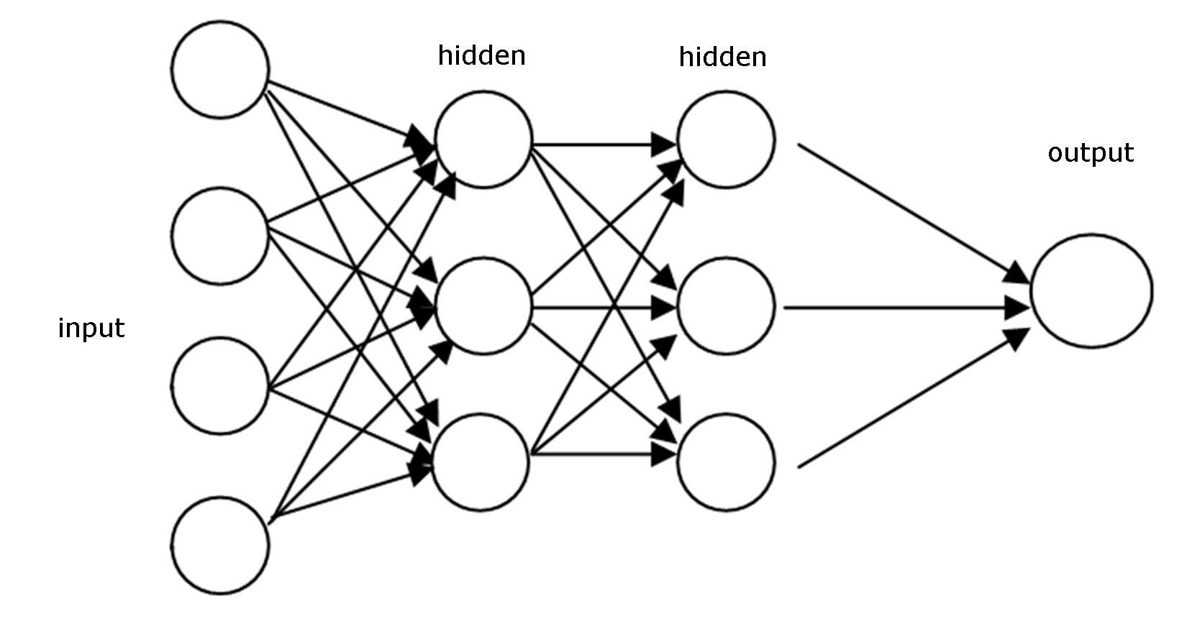
Feed Forward Neural Network
https://deepai.org/machine-learning-glossary-and-terms/feed-forward-neural-network

Slide 8
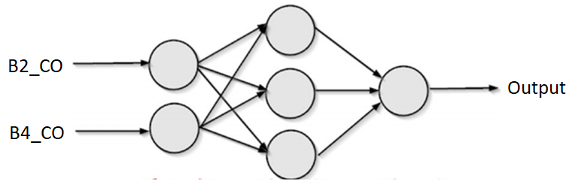
Feed Forward Neural Network Model and Results
Description of Model:
Parameters – 49
Hidden Layers – 1
Activation Functions:
Sigmoid
Relu
1 – if the percentage of error is less than 35%
Output
0 – if the percentage of error is more than 35%
Accuracy – 58%

Slide 9
Feed Forward Neural Network Model and Results
Description of Model:
Parameters – 182
Hidden Layers – 2
Activation Functions:
Sigmoid
Relu
1 – if the percentage of error is less than 35%
Output
0 – if the percentage of error is more than 35%
Accuracy – 60%

Slide 10
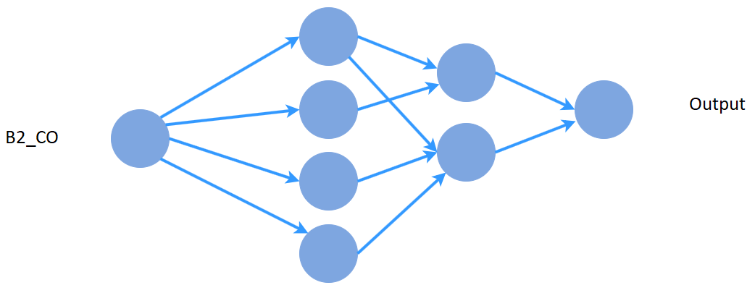
Feed Forward Neural Network Model and Results
Description of Model:
Parameters – 145
Hidden Layers – 2
Activation Functions:
Sigmoid
Relu
1 – if the percentage of error is less than 35%
Output
0 – if the percentage of error is more than 35%
Accuracy – 53%

Slide 11
Feed Forward Neural Network Model and Results
Description of Model:
Parameters – 145
Hidden Layers – 2
Activation Functions:
Sigmoid
Relu
B4_CO
1 – if the percentage of error is less than 35%
Output
0 – if the percentage of error is more than 35%
Accuracy – 54%

Slide 12
Feed Forward Neural Network Model and Results
Description of Model:
Parameters – 145
Hidden Layers – 2
Activation Functions:
Sigmoid
Relu
Average of Boards
1 – if the percentage of error is less than 35%
Output
0 – if the percentage of error is more than 35%
Accuracy – 57%

Slide 13
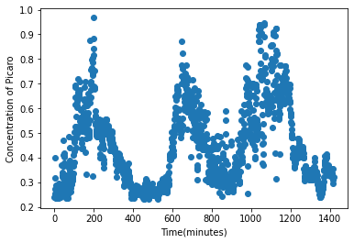
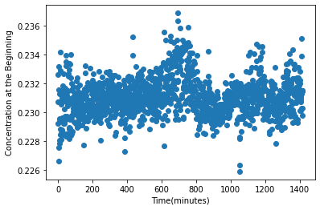
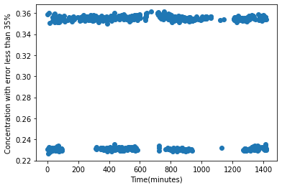
Results
Picaro Measurements – high accuracy
Averaged(B2 and B4) – low-accuracy
Results after Transformation
Before
Approximately 42% of given measurements’ errors are less than 35%.
Approximately 50% of given measurements’ errors are between 35%-70% .
8% of data measurements’ errors are more than 70%.
After
Approximately 51% of given measurements’ errors are less than 35%.
Approximately 49% of given measurements’ errors are between 35%-70% .
0% of data measurements’ errors are more than 70%.

Slide 14
Recurrent Neural Network
https://towardsdatascience.com/recurrent-neural-networks-d4642c9bc7ce

Slide 15
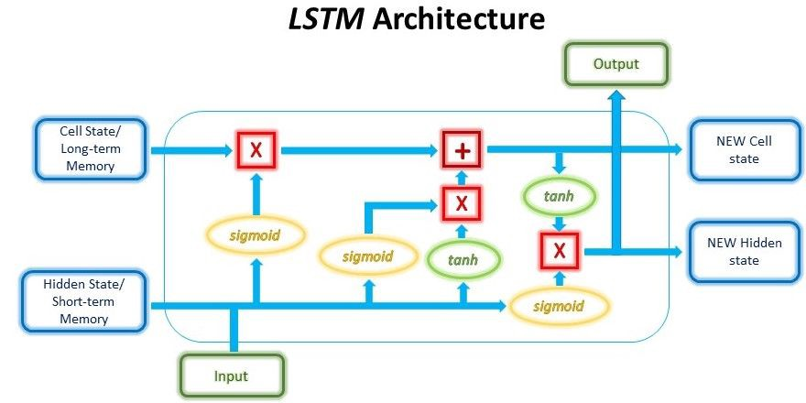
Long-Short Term Memory Neural Network
https://medium.com/analytics-vidhya/transformer-vs-rnn-and-cnn-18eeefa3602b

Slide 16
Long-Short Term Memory Neural Network Model and Results
Description of Model:
Input Length – 5
Parameters – 82
Activation Functions:
Sigmoid
Relu
B2_CO
B4_CO
1 – if the percentage of error is less than 35%
Output
Accuracy – 65%
0 – if the percentage of error is more than 35%

Slide 17
Long-Short Term Memory Neural Network Model and Results
Description of Model:
Input Length – 5
Parameters – 221
Activation Functions:
Sigmoid
Relu
B2_CO
B4_CO
1 – if the percentage of error is less than 35%
Output
Accuracy – 67%
0 – if the percentage of error is more than 35%

Slide 18
Long-Short Term Memory Neural Network Model and Results
Description of Model:
Input Length – 5
Parameters – 178
Activation Functions:
Sigmoid
Relu
B2_CO
1 – if the percentage of error is less than 35%
Output
Accuracy – 62%
0 – if the percentage of error is more than 35%

Slide 19
Long-Short Term Memory Neural Network Model and Results
Description of Model:
Input Length – 5
Parameters – 178
Activation Functions:
Sigmoid
Relu
B4_CO
1 – if the percentage of error is less than 35%
Output
Accuracy – 63%
0 – if the percentage of error is more than 35%

Slide 20
Long-Short Term Memory Neural Network Model and Results
Description of Model:
Input Length – 5
Parameters – 178
Activation Functions:
Sigmoid
Relu
Average of Boards
1 – if the percentage of error is less than 35%
Output
Accuracy – 65%
0 – if the percentage of error is more than 35%

Slide 21
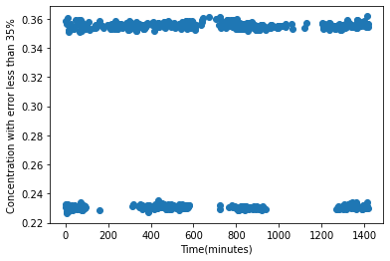
Results
Picaro Measurements high-accuracy
Averaged(B2 and B4 boards) – low-accuracy
Results after Transformation
Before
Approximately 42% of given measurements’ errors are less than 35%.
Approximately 50% of given measurements’ errors are between 35%-70% .
8% of data measurements’ errors are more than 70%.
After
Approximately 54% of given measurements’ errors are less than 35%.
Approximately 46% of given measurements’ errors are between 35%-70% .
0% of data measurements’ errors are more than 70%.

Slide 22
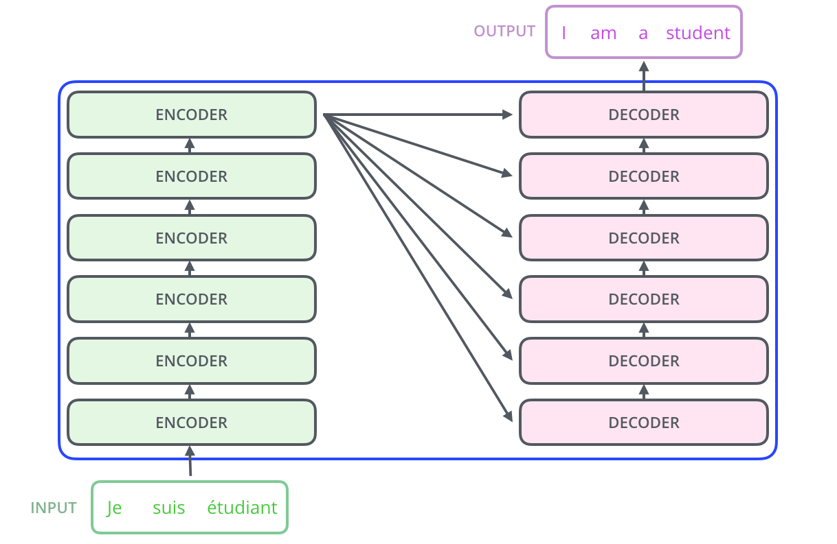
Transformer
https://towardsdatascience.com/transformers-141e32e69591

Slide 23
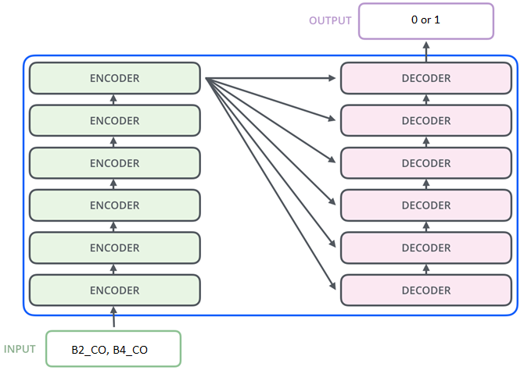
Transformer Model and Results
Description of Model:
Input Length – 5
Parameters – 145
Activation Functions:
Sigmoid
Relu
1 – if the percentage of error is less than 35%
Output
Accuracy – 68%
0 – if the percentage of error is more than 35%

Slide 24
Transformer Model and Results
Description of Model:
Input Length – 5
Parameters – 251
Activation Functions:
Sigmoid
Relu
1 – if the percentage of error is less than 35%
Output
Accuracy – 68%
0 – if the percentage of error is more than 35%

Slide 25
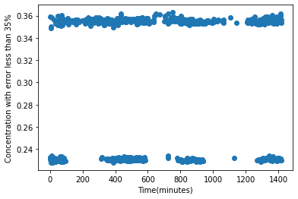
Results
Picaro Measurements – high-accuracy
Averaged(B2 and B4 boards) – low-accuracy
Results after Transformation
Before
Approximately 42% of given measurements’ errors are less than 35%.
Approximately 50% of given measurements’ errors are between 35%-70% .
8% of data measurements’ errors are more than 70%.
After
Approximately 56% of given measurements’ errors are less than 35%.
Approximately 44% of given measurements’ errors are between 35%-70% .
0% of data measurements’ errors are more than 70%.

Slide 26
Conclusions
With increase of number of hidden layers (consequently parameters) the accuracy of models increases slightly or stays the same (in the three models: Feed Forward, LSTM, Transformers).
ReLu Activation Function had better results of accuracy .
It is known that Recurrent Neural Networks works much better with time series in comparison with Feed Forward Neural Networks, and we have seen the same results with our models
Transformers use better attention method than LSTM, therefore results are slightly better, but increase of parameters does not affect it’s result.
Overall accuracy increased by 14% in the best case (Transformer model).
Transformer’s result’s included 93% of other model’s results.

Slide 27
Tools

Slide 28
Thank you for attention!

