Slide 1
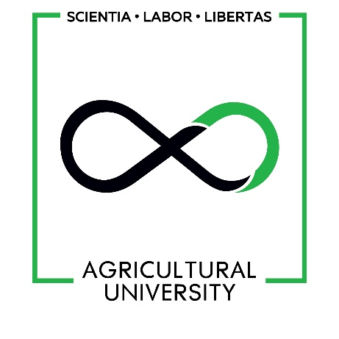
Transition Metal Salen Complexes:
Synthesis and Biological activity
Tamar Khatisashvili
Bachelor’s degree in Chemistry, Agricultural University of Georgia
E-mail: tkhat2016@agruni.edu.ge
Supervisor: Prof. E. Elizbarashvili
November 18th, 2020

Slide 2
Introduction
N,N′-ethylenebis (salicylimine)
Salen
General structure of Schiff Bases
General structure of Salen-type ligands

Slide 3
Introduction
R
R
1
1
R
N
H
+
O
C
R
C
+
3
2
3
H
O
N
R
2
Primary amine
Ketone
or aldehyde
R
2
2
Schiff base
Synthesis of Schiff bases
Synthesis of Salen ligand

Slide 4
Introduction
Synthesis of Metal Salen complexes

Slide 5
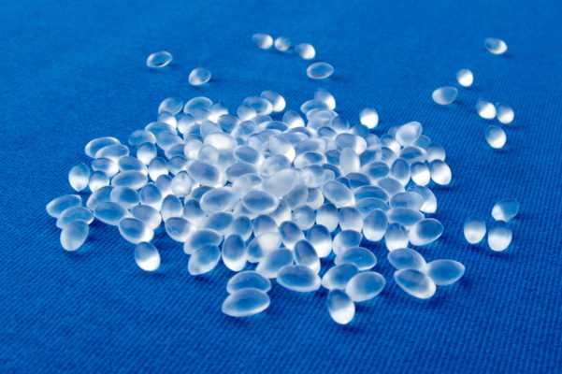
Introduction
Advantages:
Ease and flexibility of synthesis process
High thermal stability
Fields of use :
Catalysis
Medicine and Biochemistry
Thermoplastic Polyurethane (TPU) synthesis
Thermoplastic Polyurethane (TPU)

Slide 6
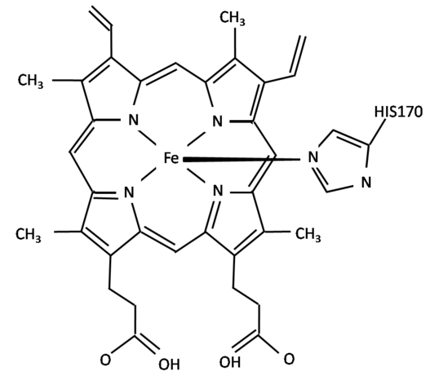
Introduction
Biological activity of Salen complexes
Antibacterial
Antifungal
Anti-inflammatory
Antitumor
„Enzyme Mimics“
Metal Salen complex
Active site of Peroxidase enzyme

Slide 7
Introduction
Biological activity of Salen complexes
Free radical elimination mechanism of enzymes
Superoxide-dismutase
Peroxidase
Catalase

Slide 8
Junior Project
Synthesized Compounds
Copper(II) Salen
Cobalt(II) Salen
Nickel(II) Salen
Iron(III) Salen

Slide 9
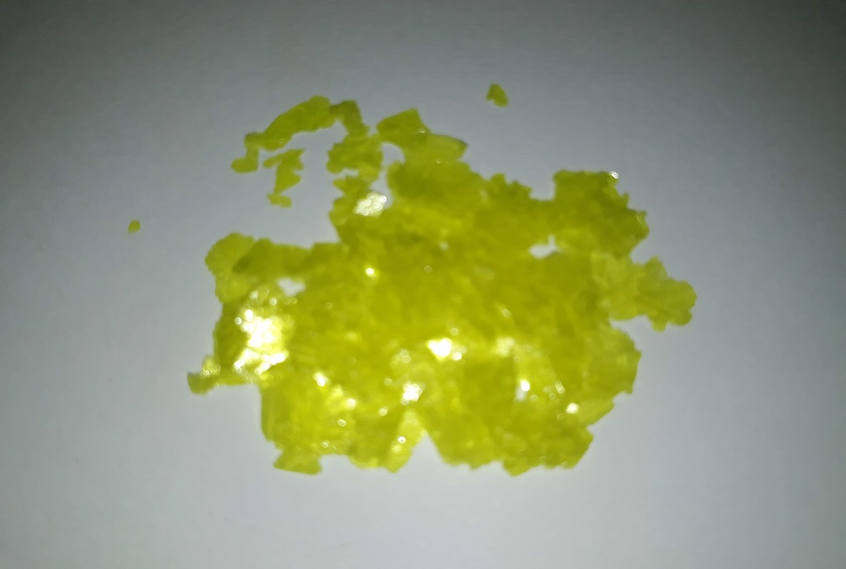
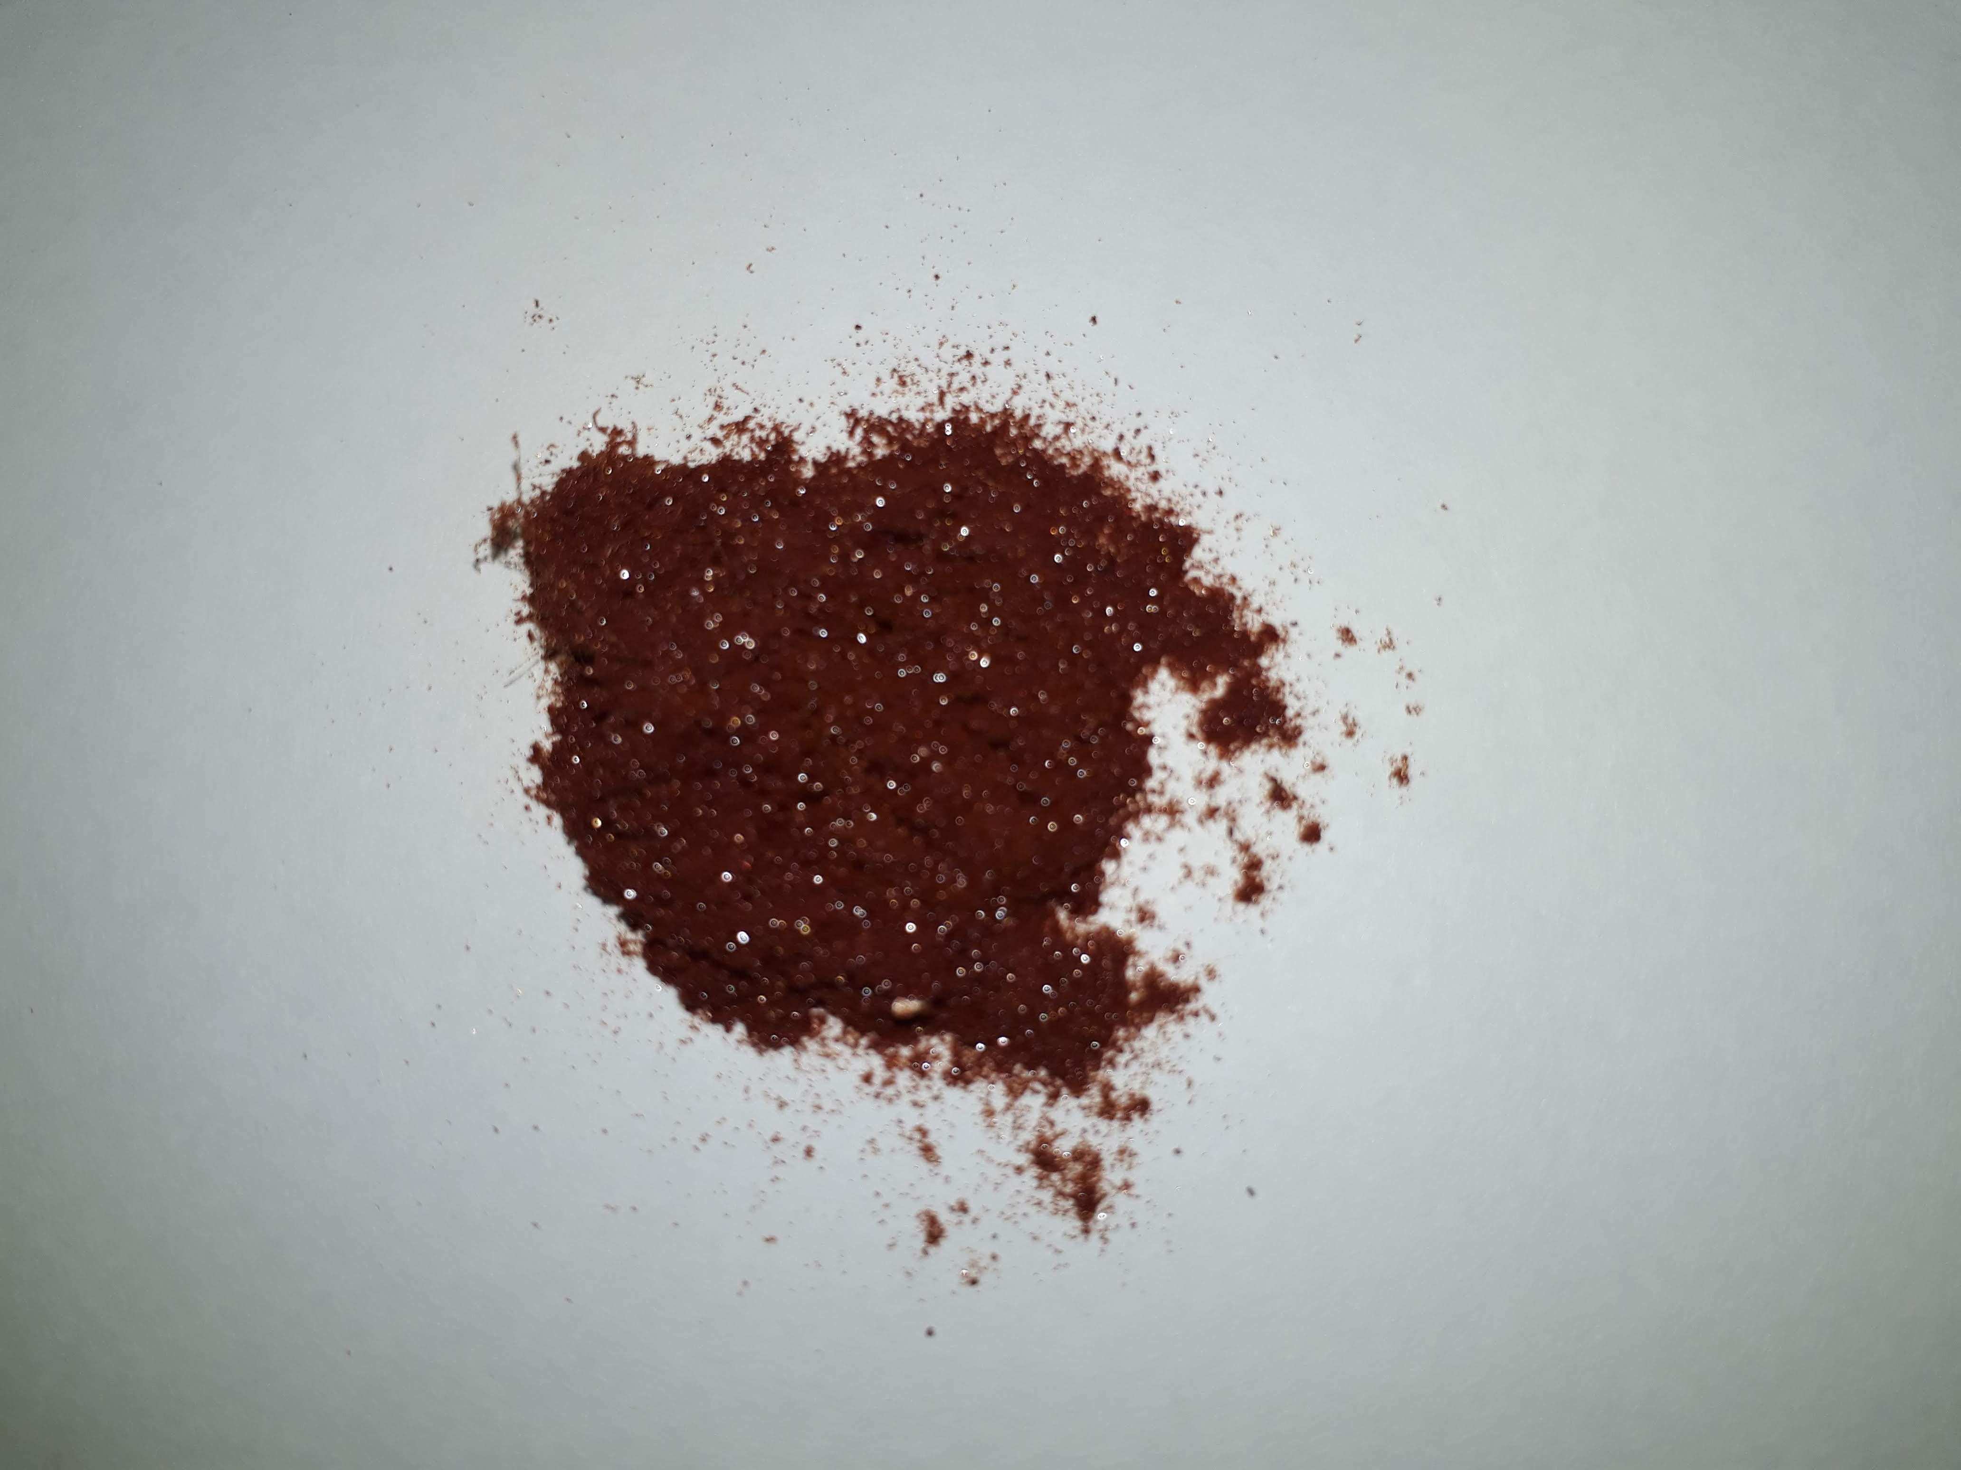
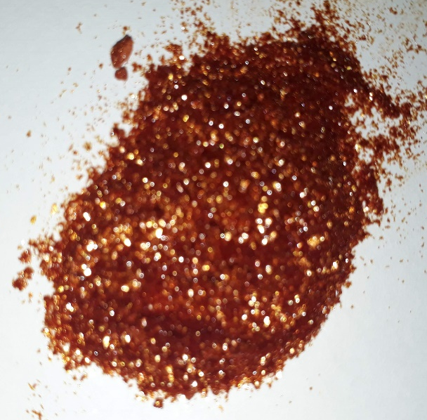
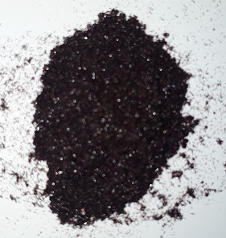
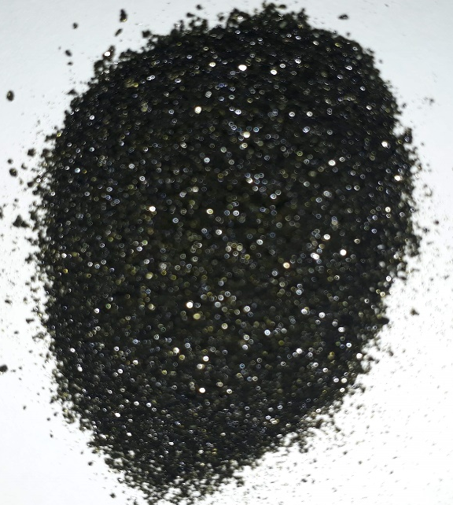
Synthesized compounds
Product | Yield, %
Salen | 88
Nickel(II) Salen | 85
Cobalt(II) Salen | 67
Copper(II) Salen | 61
Iron(III) Salen | 65
Salen
Iron(III) Salen
Nickel(II) Salen
Cobalt(II) Salen
Copper(II) Salen

Slide 10
Senior project objective:
Synthesis of water soluble Salen-type ligands

Slide 11
Scheme of synthesis

Slide 12
Synthesis of ligand precursor
Carbonylation (Reimer–Tiemann reaction):
4-Hydroxybenzene-1,3-disulfonic acid
5-formyl-4-hydroxybenzene-1,3-disulfonic acid sodium salt

Slide 13
Synthesis of ligand precursor
Sulfonation:
Salicylaldehide
3-formyl- 4-hydroxybenzenesulfonic acid sodium salt
Salicylaldehide
3-formyl- 4-hydroxybenzenesulfonic acid sodium salt

Slide 14
Synthesis of ligand precursor
Protection of carbonyl group and further sulfonation:
Salicylaldehyde
Aniline

Slide 15
Synthesis of ligand
Precursor condensation with diamines:
Precursor condensation with diamines
(Alternative reaction):

Slide 16
Synthesis of ligand
Direct sulfonation of salen ligand:

Slide 17
Conclusions
Transition metal (Ni, Co, Cu, Fe) Salen complexes were successfully synthesized with high Yield.
Biological activity results weren’t valid because of organic solvent’s toxic effect.
From water soluble groups sulfonate group has the lowest toxicity, is natural to human body and is easily metabolized.
4-hydroxybenzenesulfonic acid carbonylation with Reimer-Tiemman reaction has very low yield. This may be explained by sulfonic acid group effect on benzene ring, which is lowering ability to nucleophilic reaction.
It is shown, that predominant product of sulfonation of salicylaldehyde with concentrated sulfonic acid is 2-hydroxyl-5-benzenesulfonic acid. This may be explained with oxidation of carbonyl group to carboxyl.
Results have shown, that the most efficient way of synthesizing sulfonated salicylaldehyde is using protection for carbonyl group right before sulfonation. After sulfonation protecting group is removed by basic hydrolysis. Yield: 88%
Sulfonated salicylaldehyde condensation reaction products aren’t water soluble, that can be explained with sulfonic acid group to be reacting with basic reagents.

Slide 18
THANK YOU
FOR
YOUR ATTENTION!

