Slide 1
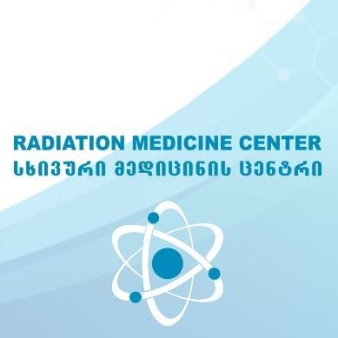
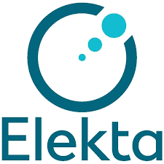
from planning to Setup in RMC
Natia Beriashvili
Supervisor: Prof. Ketevan Kotetishvili

Slide 2
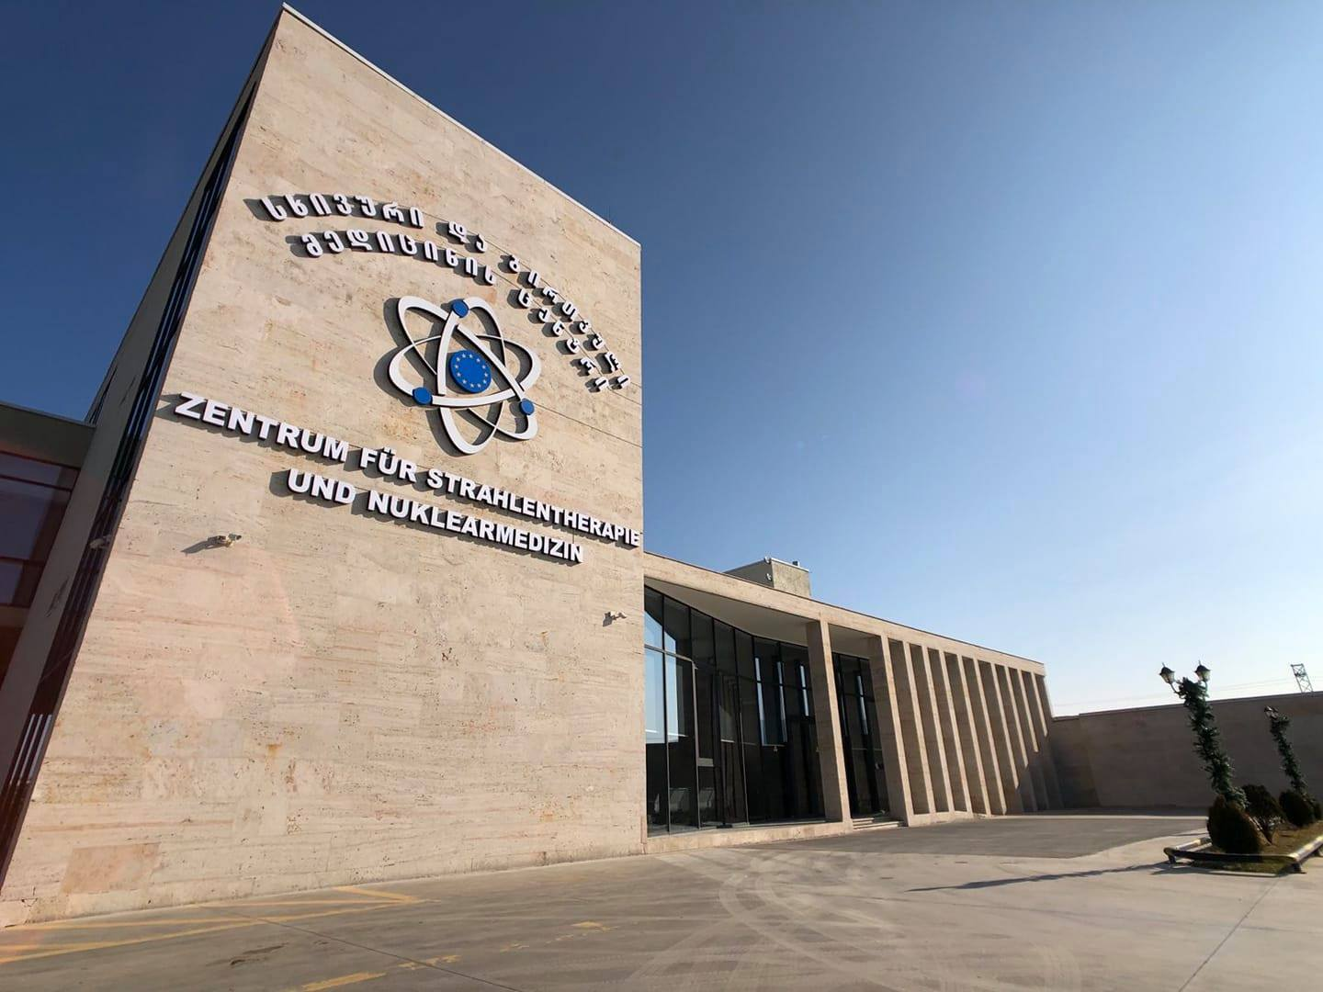
Zentrum fur strahlentherapie und nuklearmedizin
RMC was founded in 2016 in Tbilisi, Georgia.
Type of equipment
⁶⁰Co teletherapy units
UJP TERABALT 100 (Co-60)
Linear accelerators
Elekta Versa HD
Elekta Synergy Platform
Low activity and high activity brachytherapy
Treatment Options from 2D to SRS

Slide 3
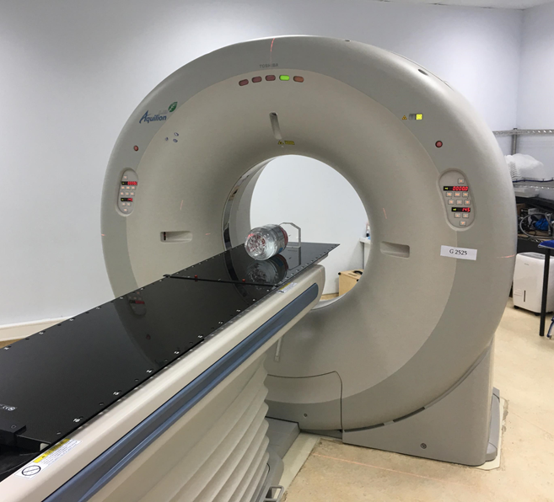
Qa on Ct scanner (Toshiba Aquilion LB CT (90 cm))
Warm Up of the System
QA Phantom Measurement
Water Phantom Measurement
Checking Artifact
Checking Table Motion

Slide 4
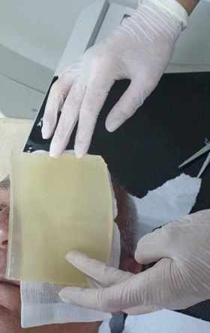
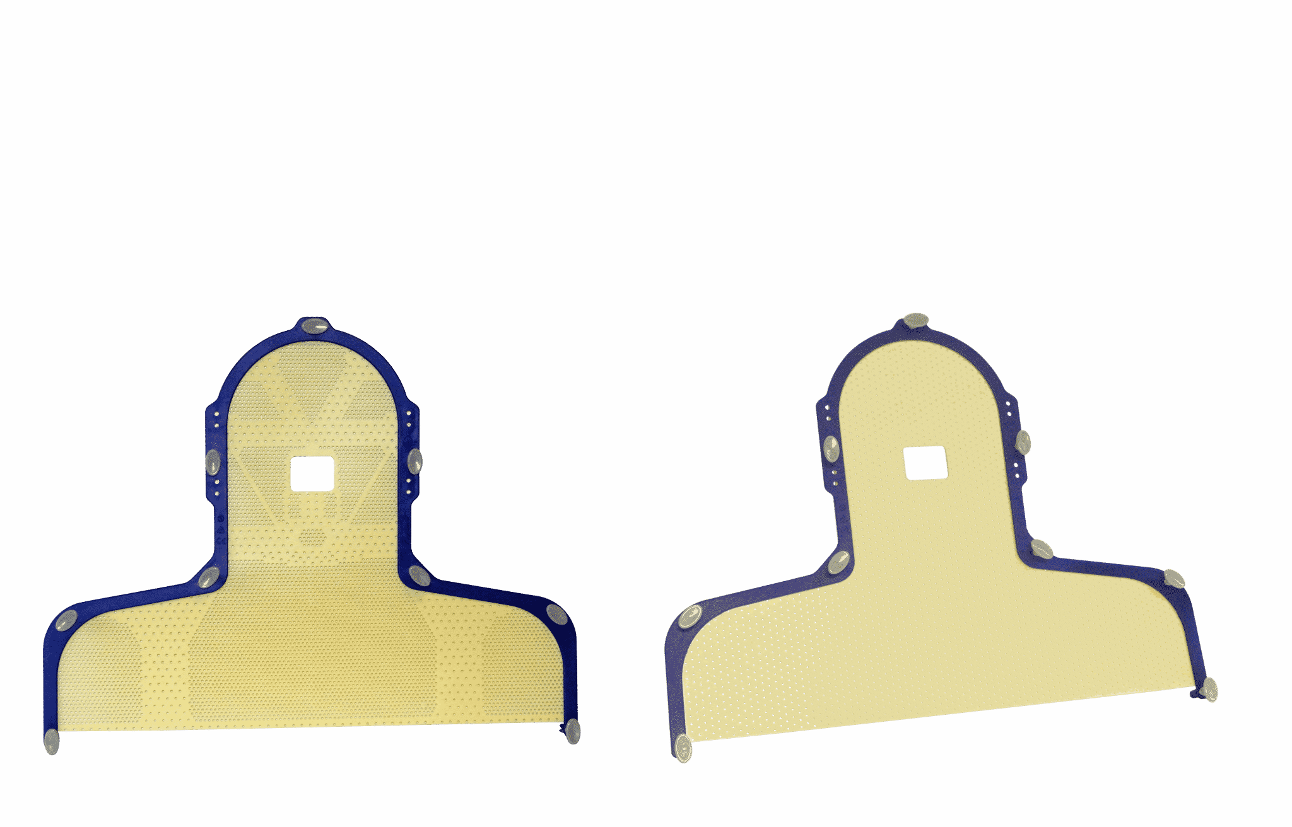
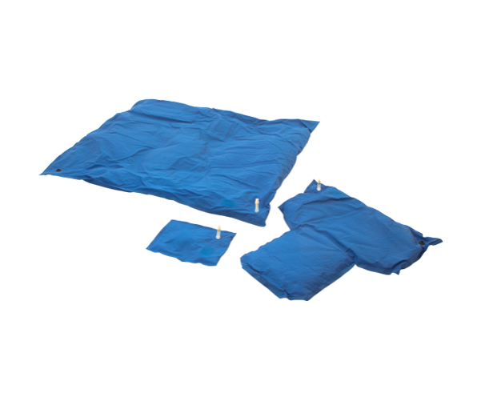
First simulation
Elekta & Qfix Immobilization tools including abdomen pressure
Determining the optimal position for the treatment
Using customized special pads/vacuum pillows
Doing marks on patient’s body
A bolus is a tissue equivalent material placed directly onto or into irregular tissue contours to produce a more homogenous dose distribution.

Slide 5
(sBrt)stereotactic body radiation therapy
Stereotactic Body Radiation Therapy (SBRT), also known as stereotactic ablative radiotherapy, administers very high doses of radiation, using several beams of various intensities aimed at different angles to precisely target the tumor.
Multiple Bilateral Lung Met
3 Isocenter
10 targets
3 base plan
Full dose coverage
Protection of all critical structures

Slide 6
Conturing
GTV-Gross Tumor Volume
visible/palpable or imaging detectable (macroscopic) tumor
CTV- Clinical Target Volume
potential microscopic tumor spread (“subclinical” in this case involves margin for gross tumor and lymph nodes at risk)
PTV - Planning Target Volume
encloses the clinical target volume (CTV) with anisotropic margins to account for possible uncertainties in beam alignment, patient positioning, organ motion, and organ deformation

Slide 7
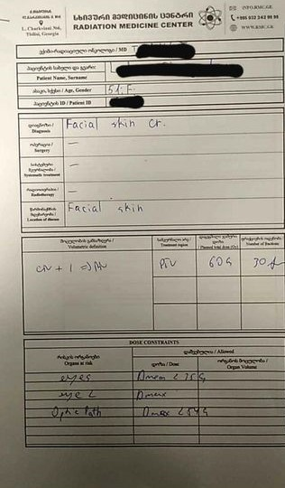
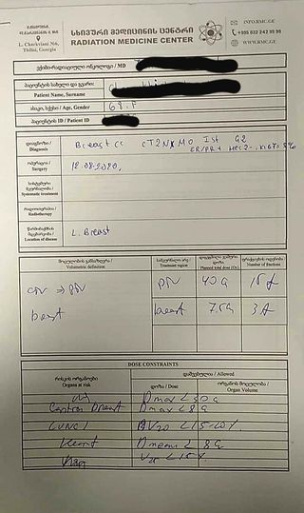
Medical records
Fraction dose
Boost (an extra boost of radiation to the area in the breast where the cancer was removed (called the tumor bed) to help prevent it from coming back in that area).
Determining Volumes
Max or Allowable doses for risk organs
(RTOG 0815 protocol)

Slide 8
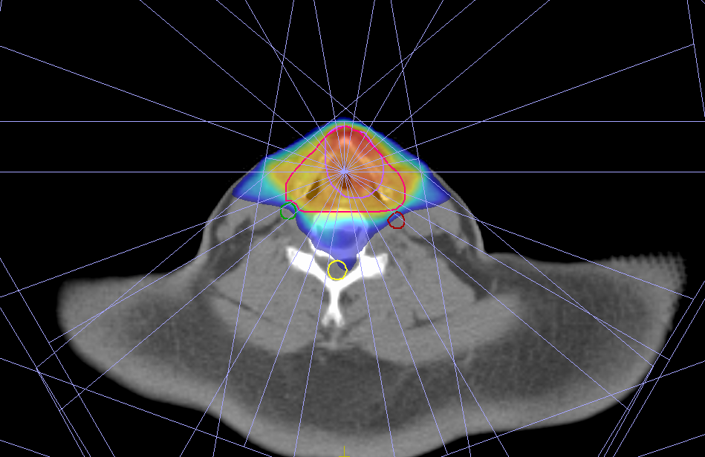
Planning proccess
VMAT- Volumetric Modulated Arc Therapy is a novel radiation therapy technique that delivers the radiation dose continuously as the treatment machine rotates. This technique accurately shapes the radiation dose to the tumor while minimizing the dose to the organs surrounding the tumor
IMRT - Intensity-Modulated Radiotherapy safely deliver precise radiation to a tumor while minimizing the dose to surrounding normal tissue. Each field is subdivided into subfields.
3 D CRT – 3 Dimensional Conformal Radiatetherapy- is based on 3-D anatomic information and use dose distribution that conform as closely as possible to the target volume in terms of adequate dose to the tumor and minimum possible dose to adjacent normal tissue
Carotid Sparing IMRT plan
Simultaneous Integrated Boost
Full Dose Coverage
60% dose drop on carotids

Slide 9
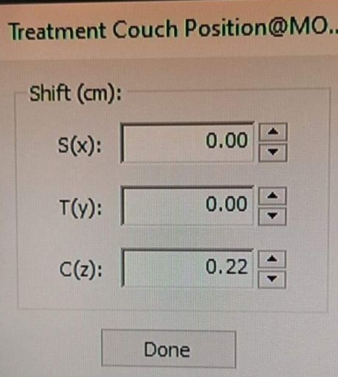
Fixation materials
Marking part of the fixation not to have lose of dose!
Adding couch

Slide 10
Planning
ELEKTA’s Monaco (treatment planning with Monte Carlo simulations)
With a suite of optimization tools, the Monaco software is designed to generate plans that spare as much healthy tissue as possible, while maximizing dose to the target.
It has three biological constraints:
Target EUD cell sensitivity
Parallel
Serial
six physical constraints:
target penalty
quadratic overdose
overdose DVH
under dose DVH
maximum dose
quadratic under
The organ at risk (OAR)
ELEKTA’s Mosaiq,
Equipment maintenance and record keeping

Slide 11
The organ at risk can be set as serial or parallel constraints depending on the properties of the tissue.
Target Penalty - defines dose and minimum volume coverage.
Maximum Dose – control hotspots, very rigid constraint.
Quadratic overdose- defines maximum dose but less rigid than “maximum dose”.

Slide 12
planing
The organ at risk can be set as serial or parallel constraints depending on the properties of the tissue.
• PTV Right Breast
• 50Gy in 25 fractions
Organs at risk:
• Lungs – serial
• Heart – serial
• Spinal Cord – maximum dose
• Right Breast – maximum dose
Body- Quadretic overdose (control high dose outside PTV)
Serial organs | Parallel organs
Spinal cord | Lungs
Brain stem | liver
Optic structures | Kidneys

Slide 13
Doctors control and set up
Multiple Met Brain SRS
Several close targets
1 Isocenter
Full Dose Coverage
High Dose Divergence around
Protection of chiasm & lenses (<8 Gy)

Slide 14
Doctors control and set up
MULTI-ISO IMRT PLAN
Multiple Bone Met
2 Isocenter
3 Targets
1 base plan
No hot points
Full Dose Coverage
healthy tissues are protected

Slide 15
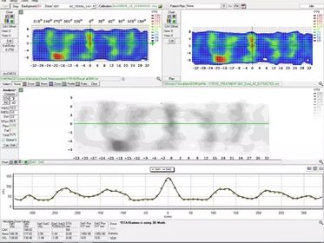
QA on linac
Sun Nuclear MapCheck2
Sun Nuclear ArcCheck

Slide 16
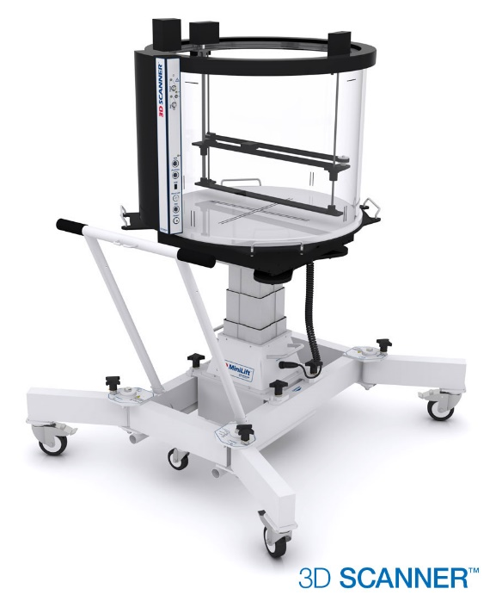
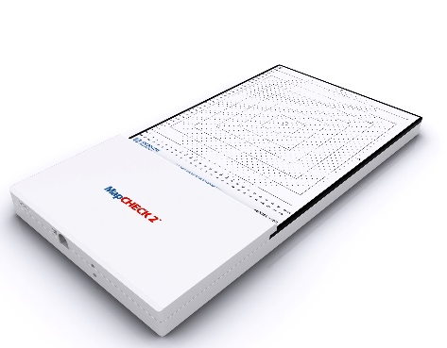
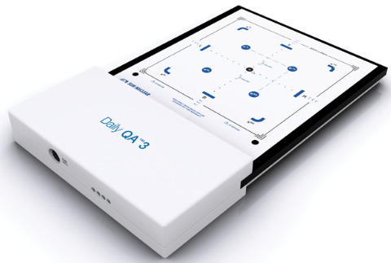
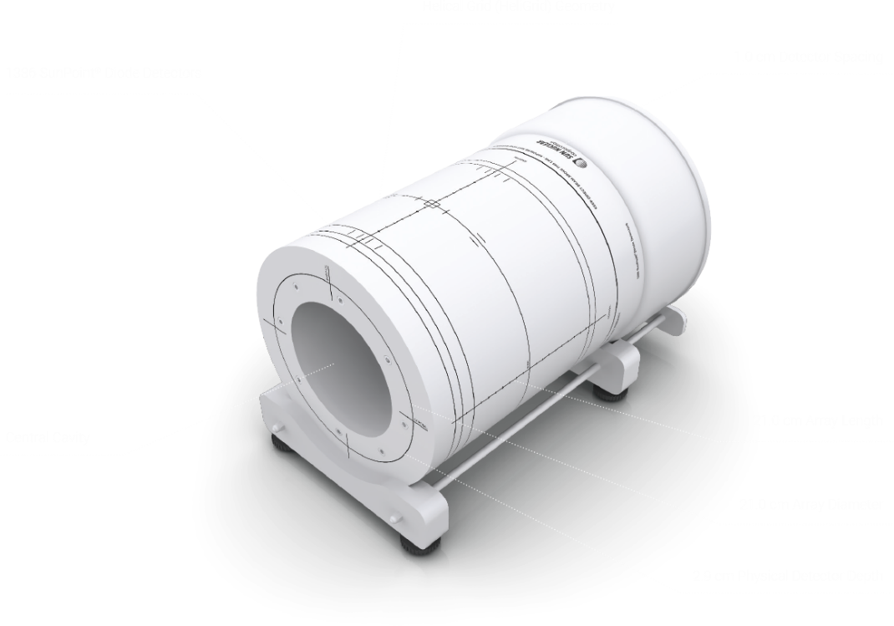
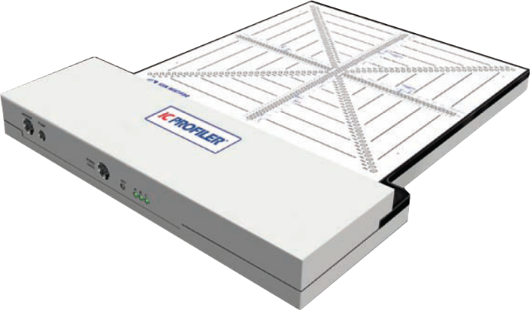
Our Equipment for Treatment Quality Assurance and Quality Control
SNC 3D scanner water phantom
PTW stationary water phantom
Solid water phantom
SNC IC profiler
SNC Map Check 2
SNC Daily QA 3
SNC machine
SNC and PTW ion chambers and EDGE detectors

Slide 17
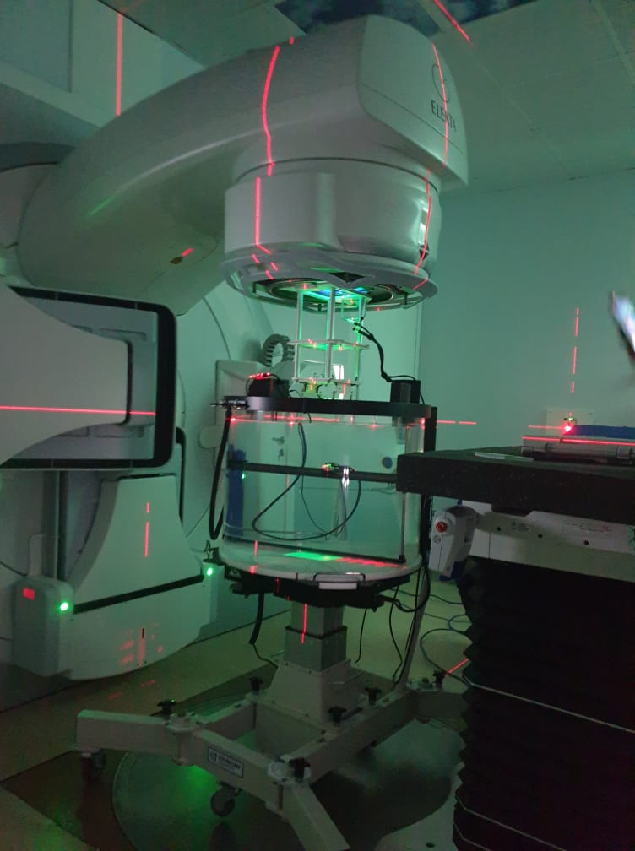
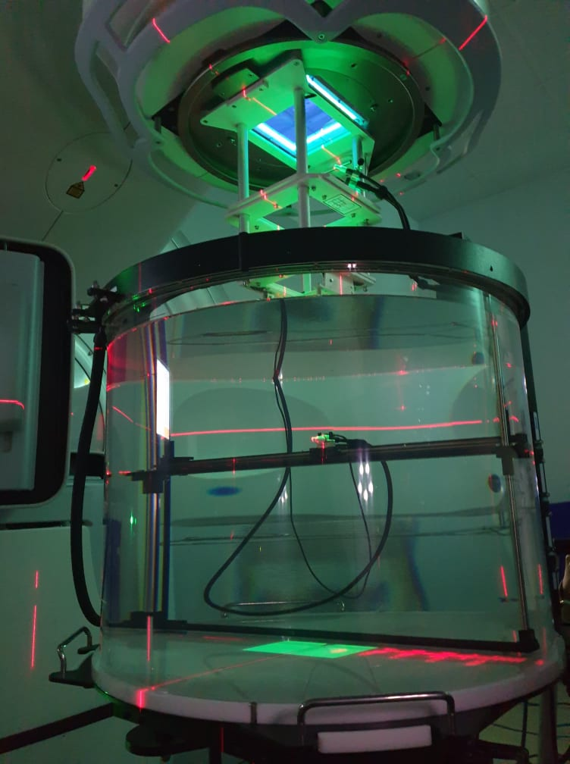
Safety barriers (qa)
Equipment aspects
Calibration of dosimetry equipment – PTW water phantom
Acceptance tests and commissioning – Sun Nuclear 3D water phantom
Quality control – Sun Nuclear ArcCheck, MapCheck 2, DailyQA 3, IC Profiler
Records keeping – Sun Nuclear software, Mosaiq
Good practices – daily, weekly, monthly and annual checks
Written procedures and protocols
IAEA TRS-398, AAPM TG-51
Elekta Monaco beam data collection
Quality audits
Annual test audits are conducted by regulatory body
(Agency for Nuclear and Radiation Safety)

Slide 18
Prevention of Unintended Medical Exposure
Internal reporting of incidents and near incidents
All radiation incidents are reported to radiation safety officer and then to the regulatory body of the country (Agency for Nuclear and Radiation Safety)
External reporting
According to conventions between Georgia and IAEA incidents caused by radioactive and nuclear materials are reported to IAEA

Slide 19
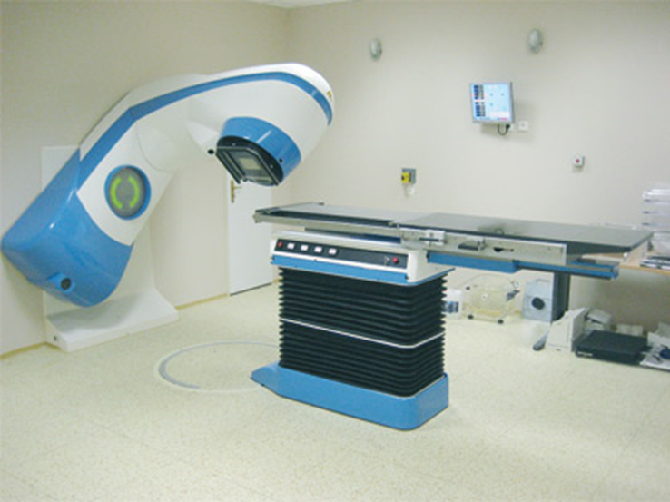
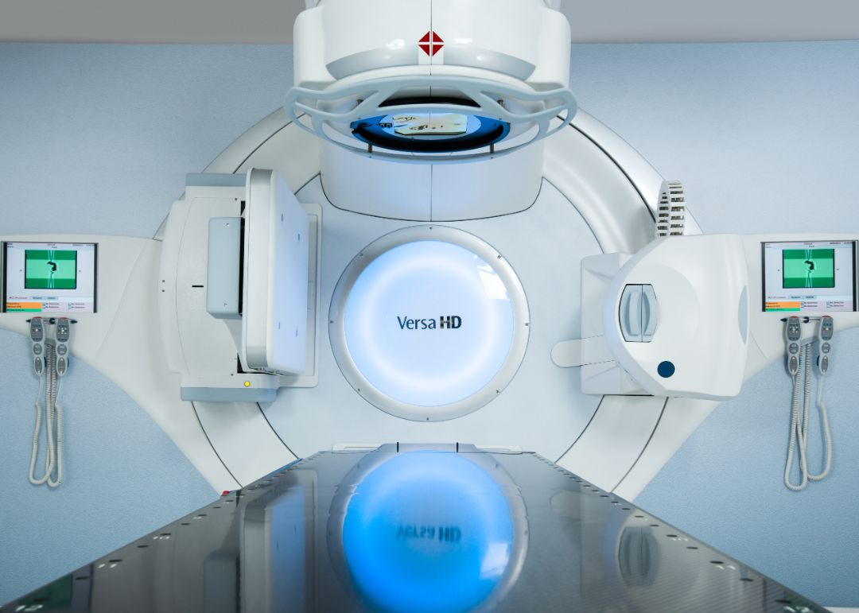
Thank you for your attention

