Slide 1
Positron
emmision
tomography
Mariam Khizanishvili
II year student in Engineering Physics

Slide 2
01
PET imaging
02
Technical aspects and uses of PET
03
Hybrid PET : CT-PET and MR-PET
04
MRI Spectroscopy

Slide 3
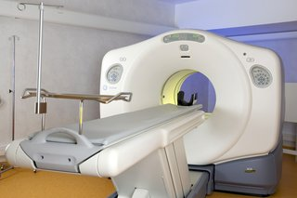
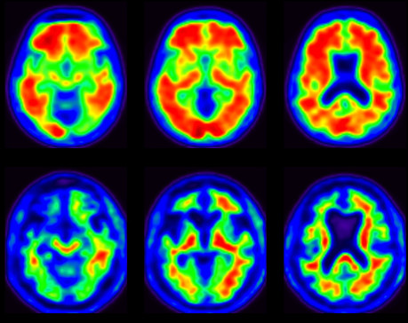
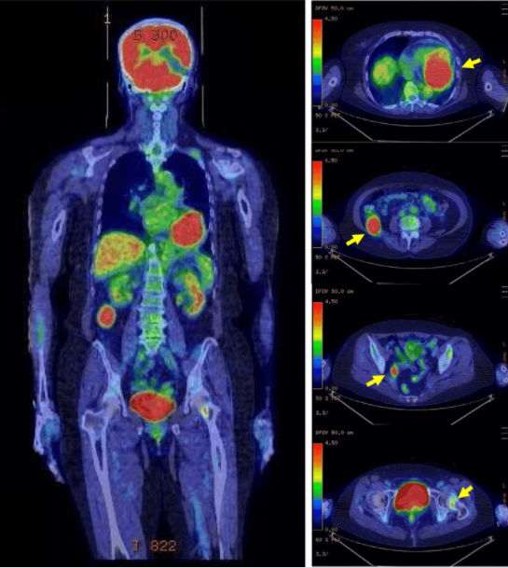
PET is a nuclear imaging technology
The technique detects pairs of gamma-rays
Tracer is injected into vein
Sensitive detector pannels capture gamma ray emissions
Uses software to plot the source of emissions
PET
imaging
Alzheimer’s disease and amyloid PET imaging
18-F-fluorodeoxy
PET imaging

Slide 4
Uses of PET
Oncology
Small animal imaging
Neuroimaging
Musculo imaging
Cardiology
Skeletal imaging
Infectious diseases
Bio-distribution studies

Slide 5
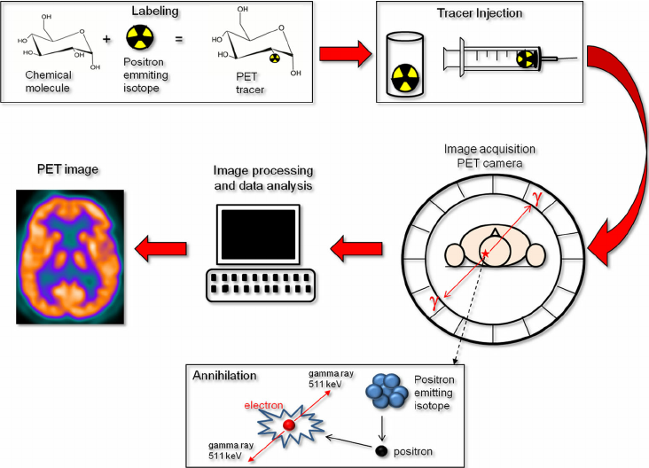
Technical aspects
Consists a detector ring with
60 cm diameter and 20 cm length
Consists scintillation detectors
with scintillation crystals
The radiation causes light pulses
within the scintillation rystals
light is converted to electrical
Signals

Slide 6
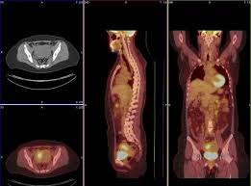
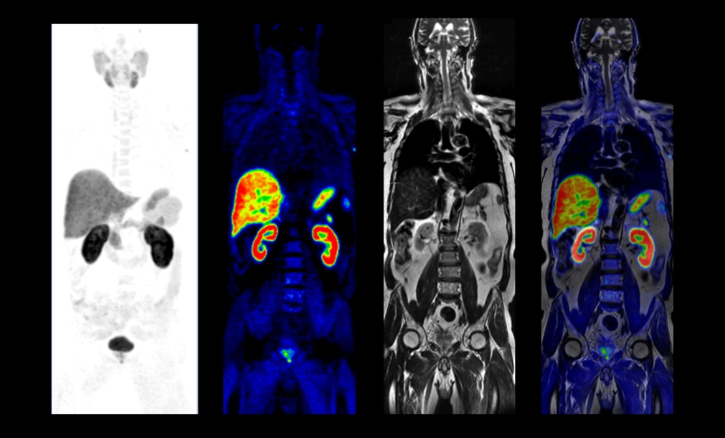
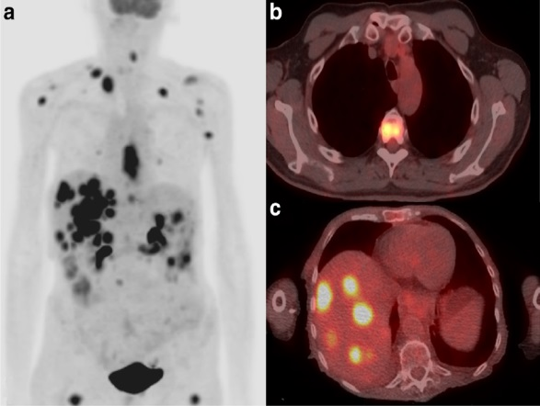
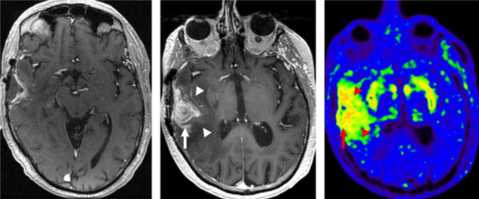
Hybrid PET
PET-CT
MR-PET

Slide 7
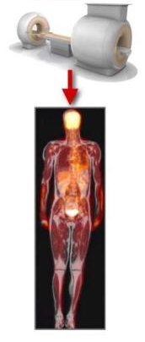
MR-PET
MR-PET
MRI
PET

Slide 8
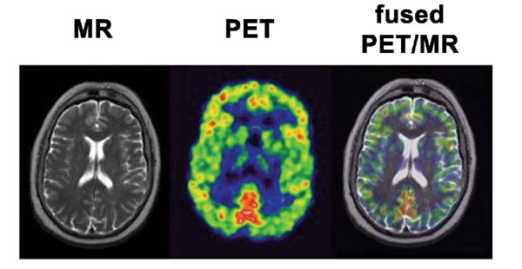
Strengths and
limitations
of MR-PET
Strengths
Improved soft tissue contrast
Increased available time to collect PET data
Better motion correction
No ionizing radiation from MRI component
Convenience and time savings with combined exams
Limitations
Exams may take 1 hour or longer
Protocols and indications still in development

Slide 9
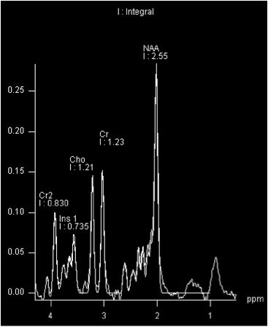
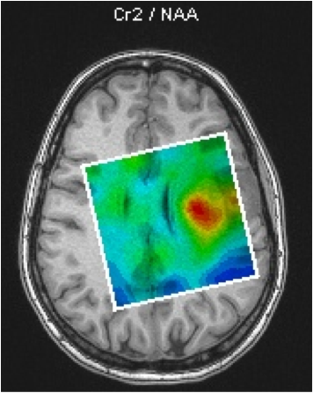
MRI Spectroscopy
The aim of this project is to produce concentration
(colored) maps of brain metabolites.
Spectroscopy is a very sensitive MRI technique and a
large range of artifacts can corrupt the measured
spectrum.
This information can then be used in the diagnosis of
brain related diseases and in treatment planning.
Example of a brain metabolites concentration map

Slide 10
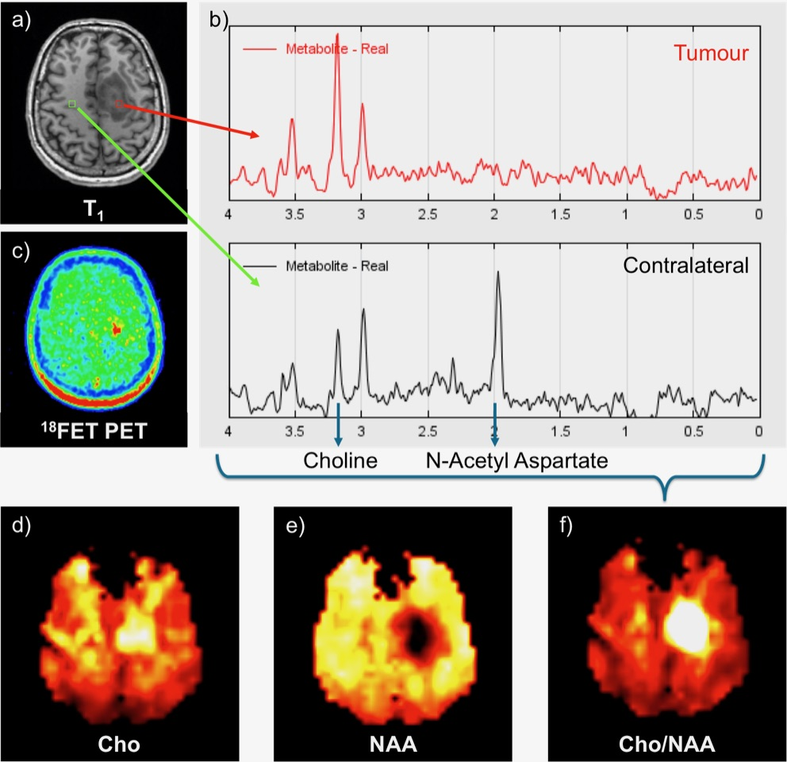
The total measurement time can
be reduced to 15 min.
After the measurement, an
automated processing pipeline
reconstructs the data.
The various whole brain metabolite
distributions can be compared with
other imaging modalities, such as 1
8F-fluoro-ethyl-tyrosine-PET uptake.

Slide 11
Thank you
for your attention
მადლობა ყურადღებისათვის

