Slide 1
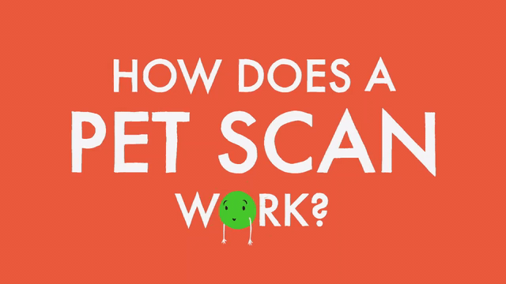
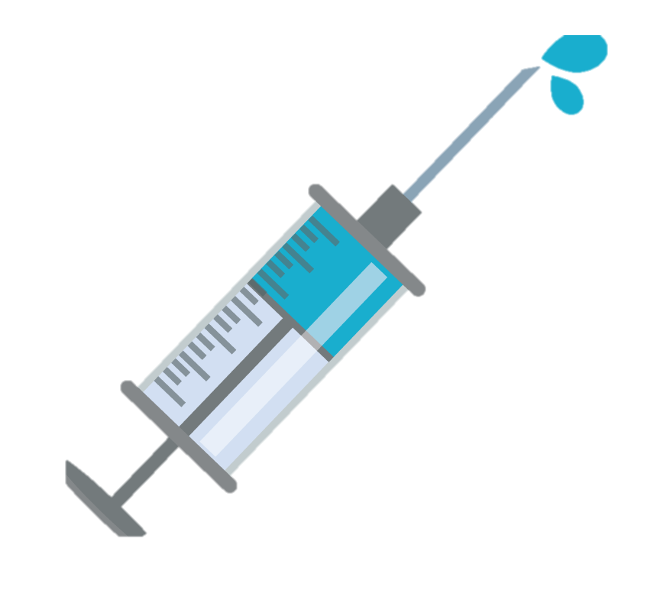
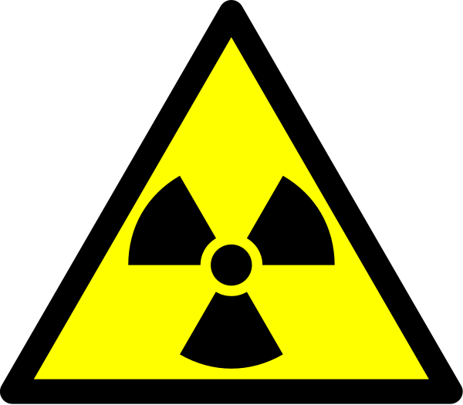
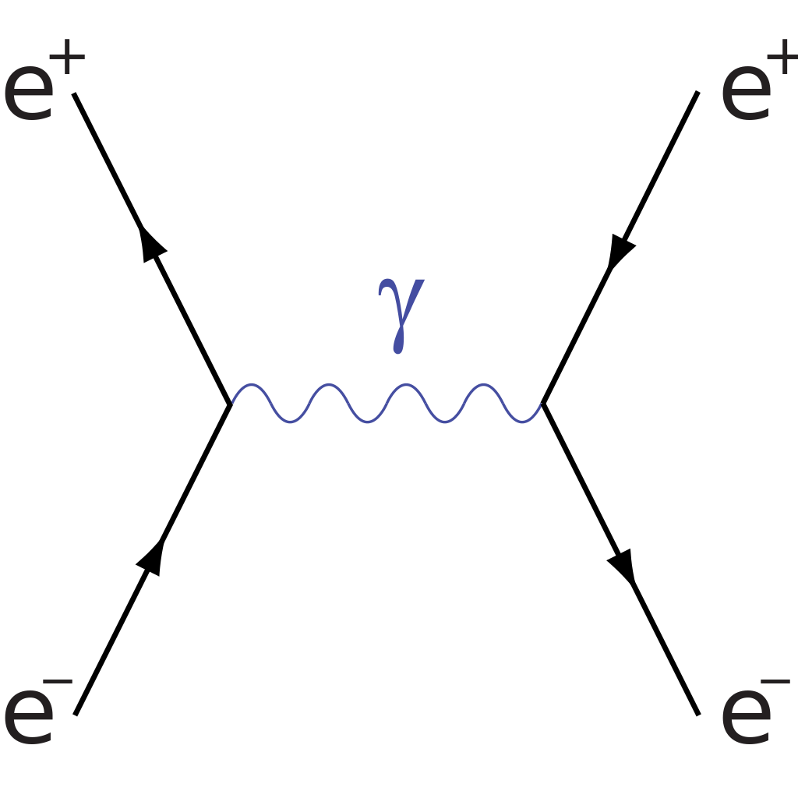
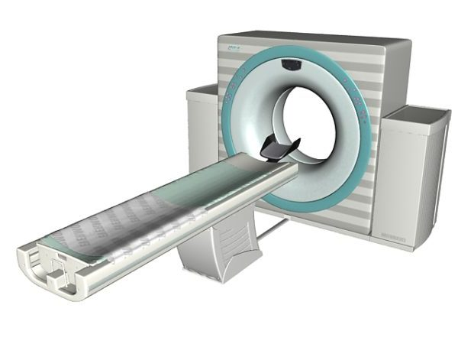
Aleksandre Maisuradze

Slide 2
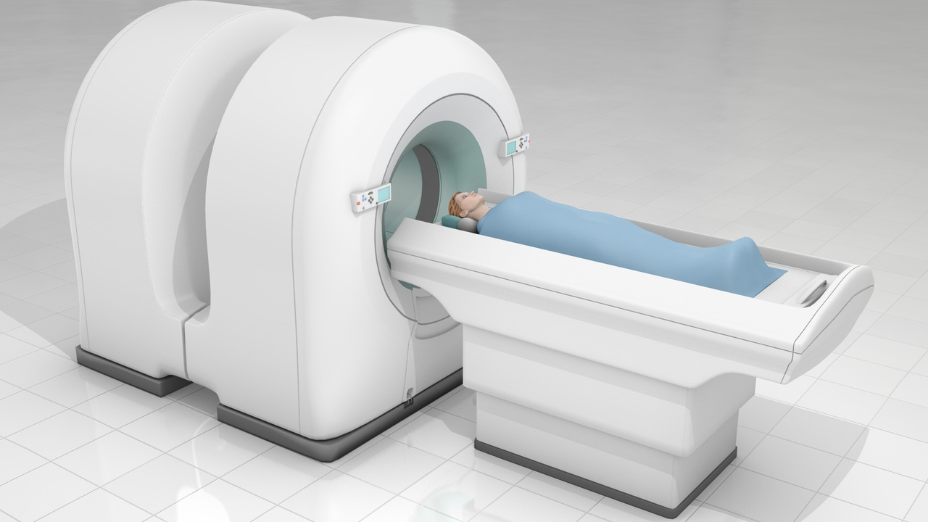
What is a PET Scan?
A positron emission tomography (PET) scan is an imaging test that helps reveal how your tissues and organs are functioning.
Radioactive Tracers
Tracers are swallowed, inhaled or injected
Tracer produces gamma rays
The radiotracers are made using a particle accelerator (cyclotron)
Outpatient procedure

Slide 3
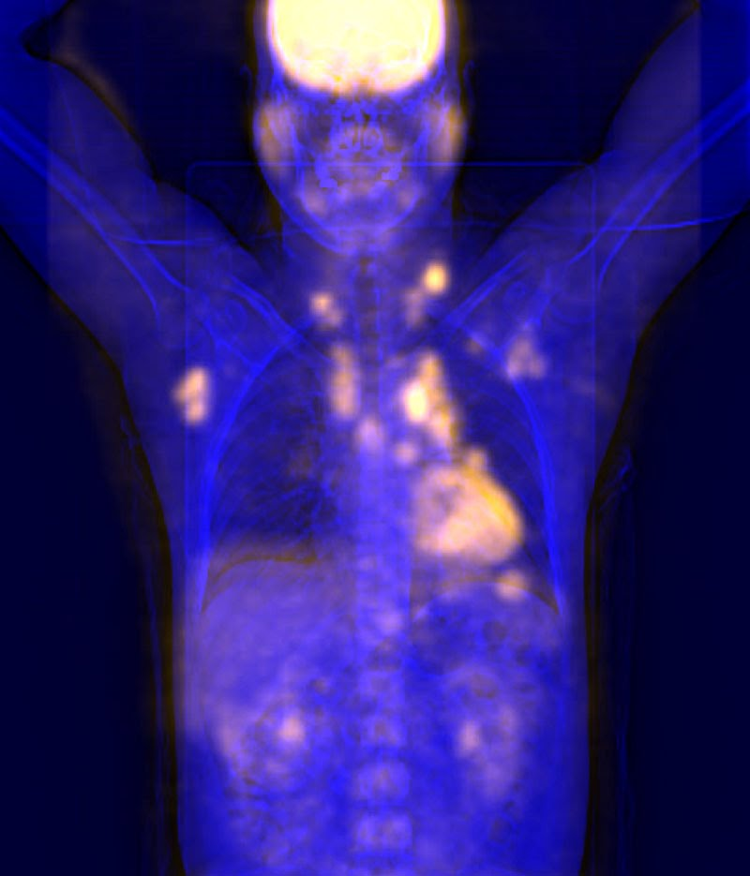
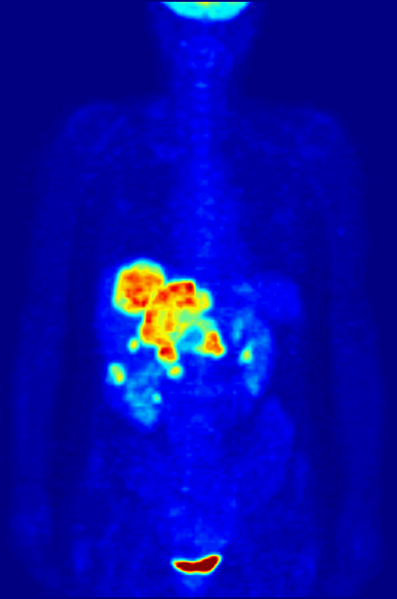
Why is a PET Scan Performed?
PET scan can inspect your blood flow, your oxygen intake, or the metabolism of your organs and tissues.
PET scans are commonly used to detect:
Cancer
Heart Problems
Brain Disorders

Slide 4
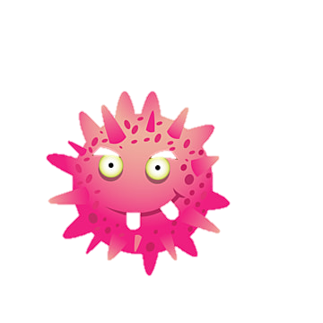
Cancer
PET Scans are useful both for detecting cancer and for:
Seeing if the cancer has spread
Seeing if the cancer treatment is working
Checking for a cancer recurrence
Heart Problems
PET scan can diagnose coronary artery disease and damage due to a heart attack.
PET scans can show healthy and damaged heart muscle.
Brain Disorders
PET scans are used to help diagnose and manage many central nervous system (CNS) disorders, including:
Alzheimer’s disease
Depression
Epilepsy
Head Trauma
Parkinson’s disease

Slide 5
What risks are involved with a PET scan?
For your PET scan, a radioactive drug (tracer) will be put into your body. Because the amount of radiation you're exposed to is small, the risk of negative effects from it is low. But the tracer might:
Cause a major allergic reaction, in rare instances
Expose your unborn baby to radiation if you are pregnant
Expose your child to radiation if you are breast-feeding

Slide 6
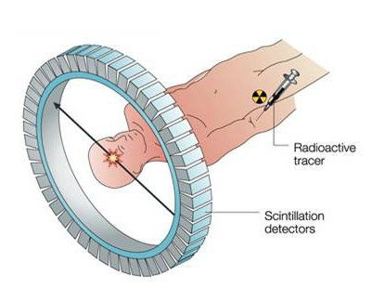
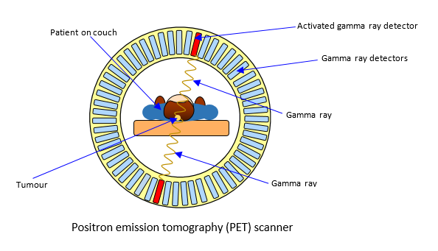
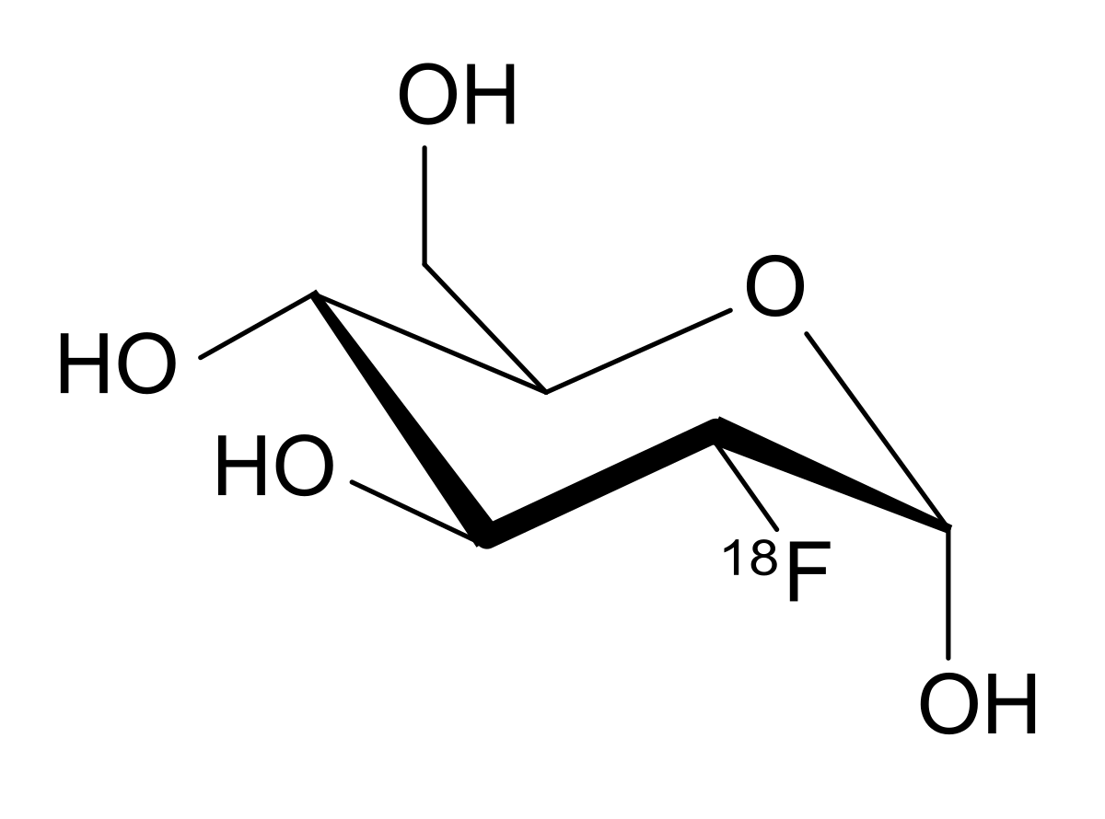
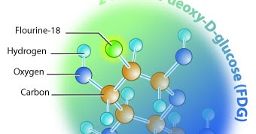
How Does PET Scan Work?
(PET) works by using a scanning device to detect photons emitted by a radionuclide in the organ or tissue being examined.

Slide 7
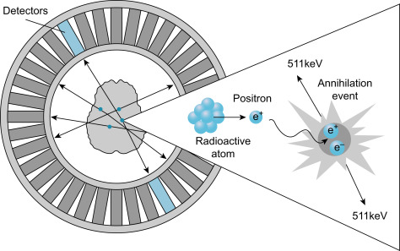
Physics behind PET scan
Annihilation of electron and positron produces two gamma rays with 511 kev

Slide 8
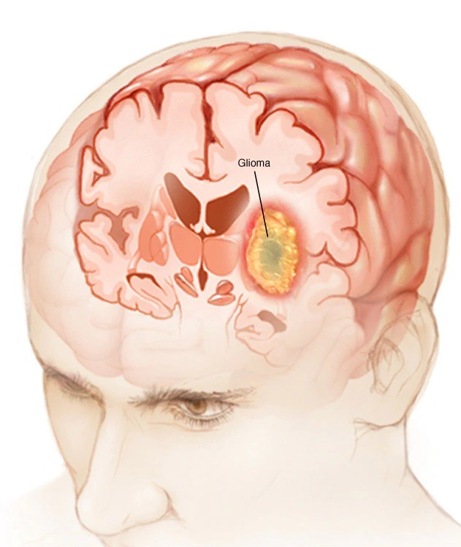
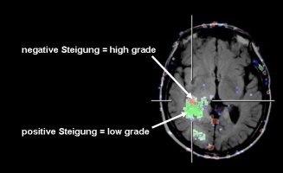
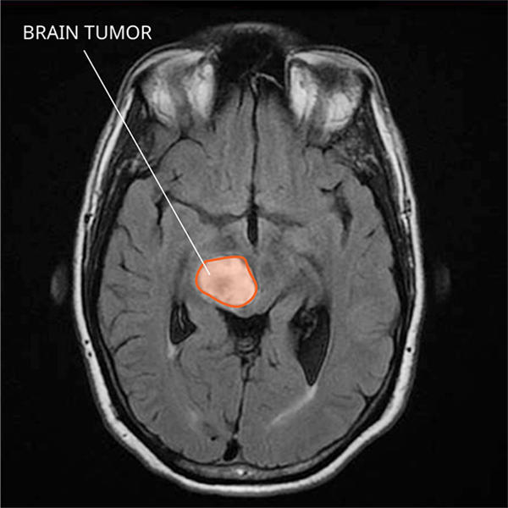
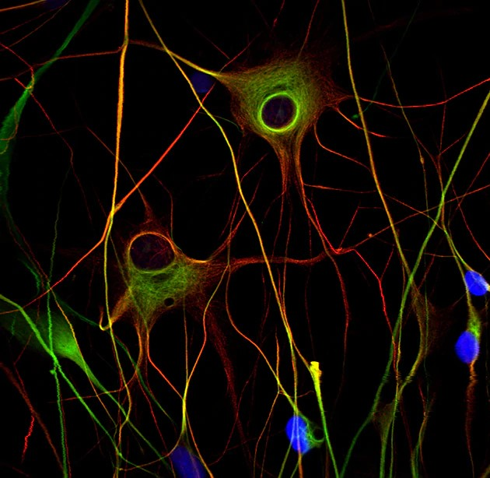
Research – Modeling the tracer [18F]
Glioma is a primary tumor of brain
FET provides information on tumor grade in cerebral gliomas.
High grades (III & IV) – 10-15 min

Slide 9
How Does PET Scan compare to other Test?
In many cases, it is possible to receive either a PET-CT and PET-MRI scan
CT scan uses X-ray equipment to produce pictures of the inside of the body.
MRI scans use magnetic fields and radio frequency pulses to create images of internal structures such as organs, soft tissues and bone.

Slide 10
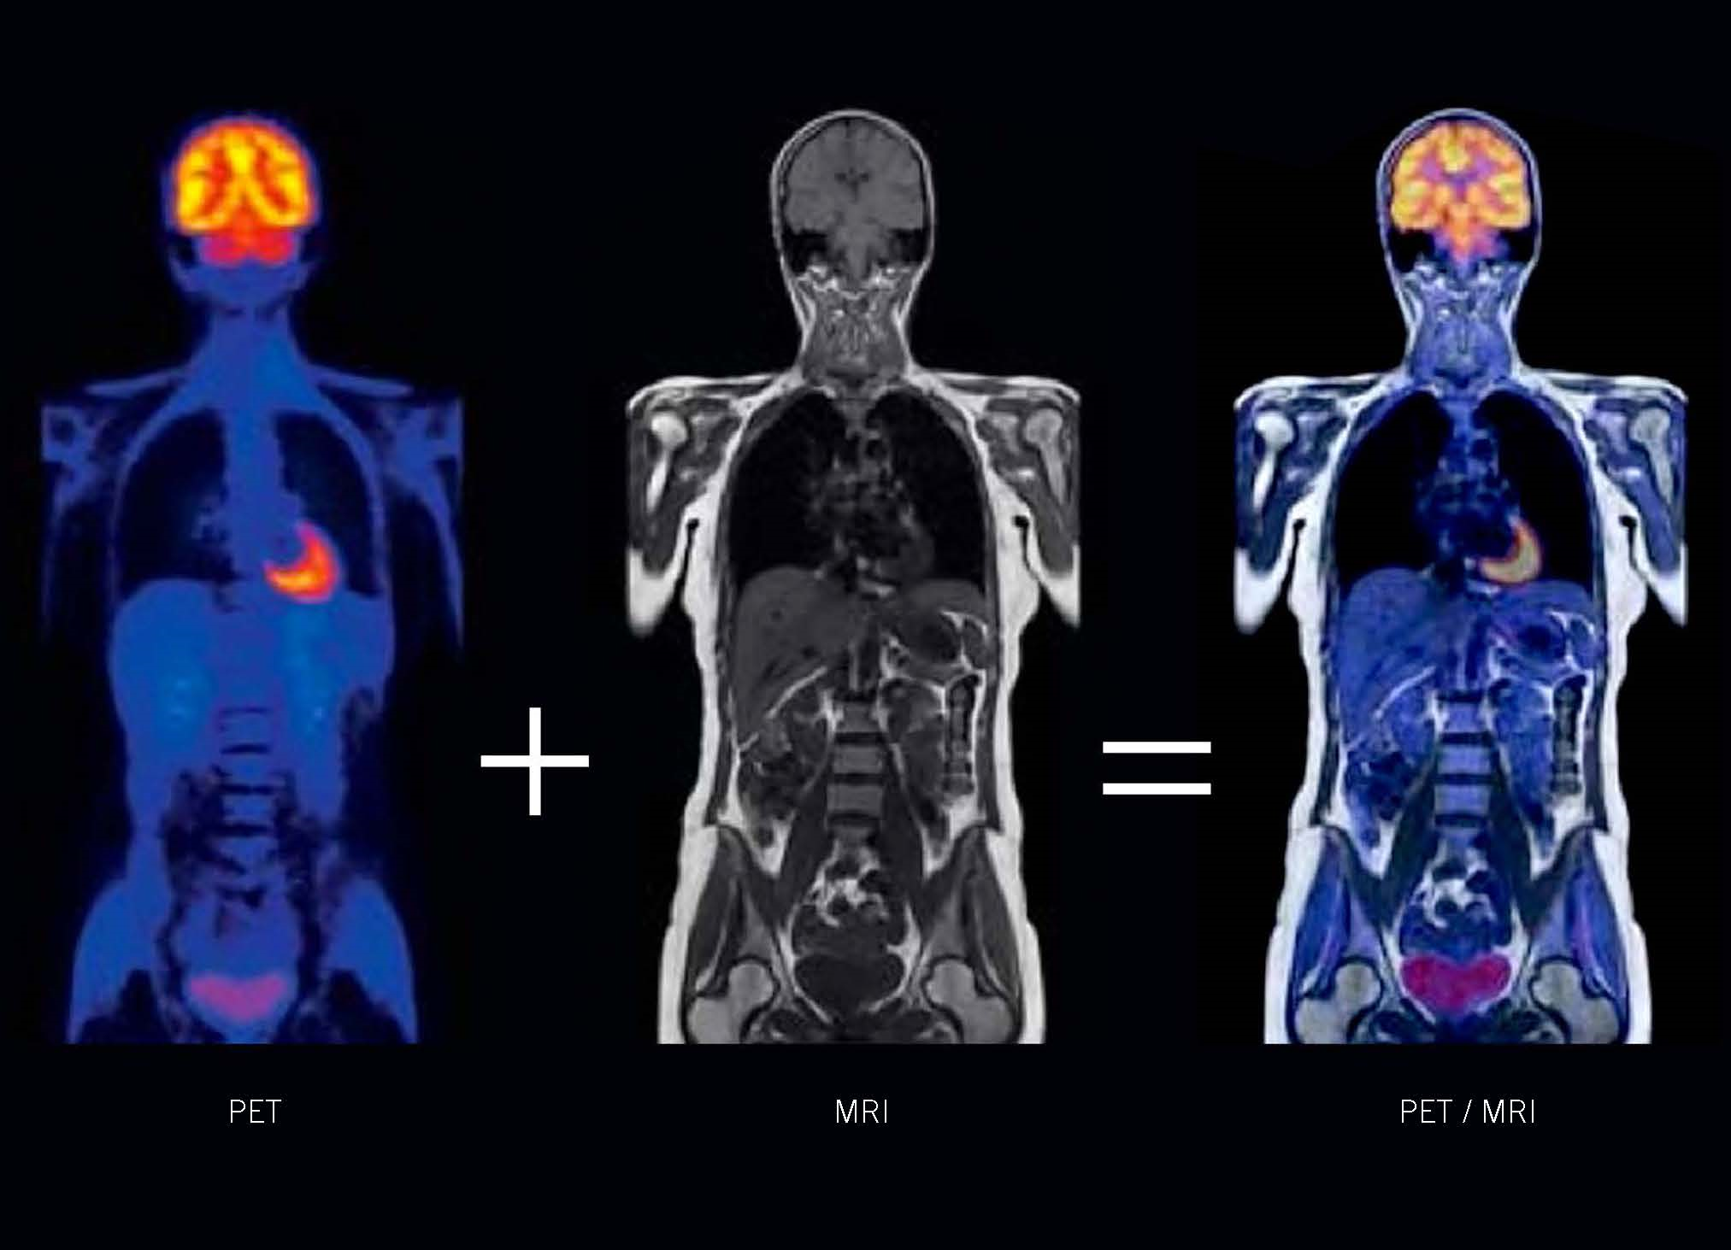
PET-MRI Hybrid Scan
PET/MRI brings cutting-edge technology to the clinic. This new technology combines time-of-flight PET with MRI for exceptional image quality, more conclusive diagnosis, and lower radiation in a single exam. The powerful combination of molecular, functional and anatomic information provides essential data for critical treatment decisions.

Slide 11
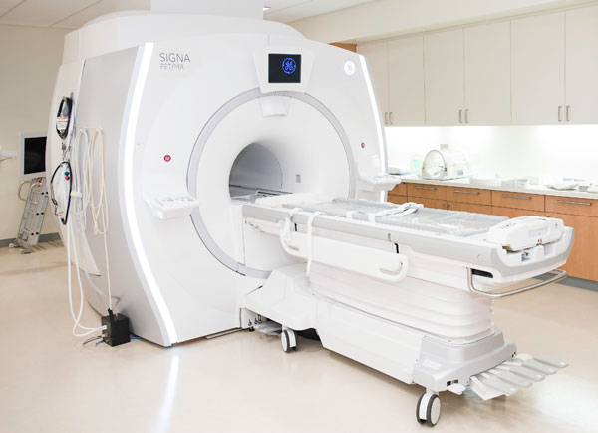
Benefits of PET-MRI Hybrid Scan
There are major benefits to PET/MRI scans:
More accurate diagnosis and treatment options
Improved safety from significantly reduced radiation exposure
Convenience of two scans in one

Slide 12
There are two Positron Emission Tomography scanners in Tbilisi
There are many CT and MRI scanners at hospitals
There is no cyclotron in Georgia
For my master thesis I have a desire to join a research at FZJ (INM-4), this helps me to gain a big experience in my career.

Slide 13
Thanks for your attention

