Slide 1
13/11/2020 third course Atmosphere and Aerosols
Author
Tamar kuljanishvili

Slide 2
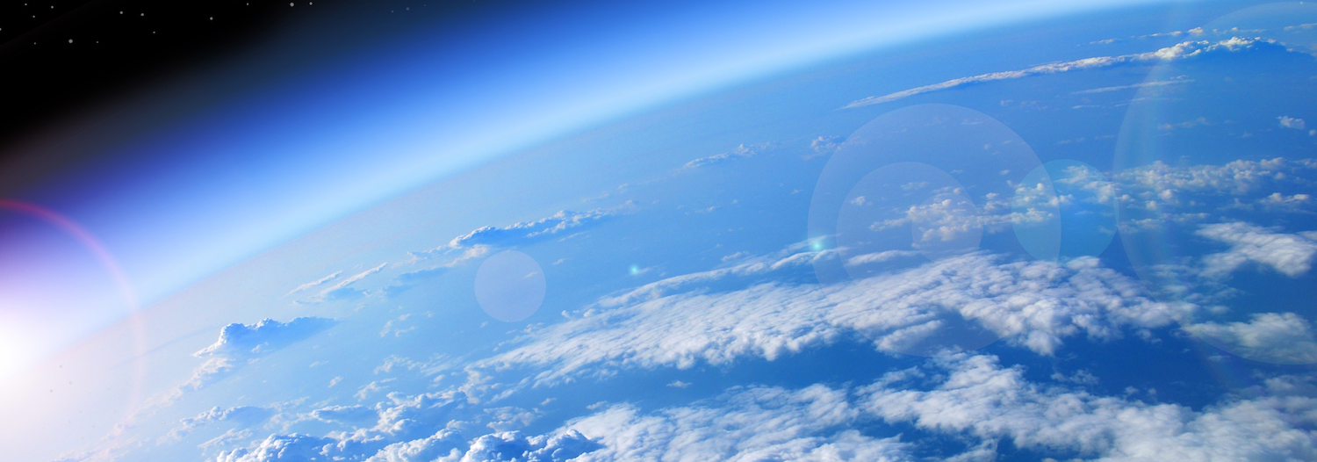
Atmosphere
We live at the bottom of an invisible ocean called the atmosphere, a layer of gases surrounding our planet. Nitrogen and oxygen account for 99 percent of the gases in dry air, with argon, carbon dioxide, helium, neon, and other gases making up minute portions.

Slide 3
volcano eruption

Slide 4
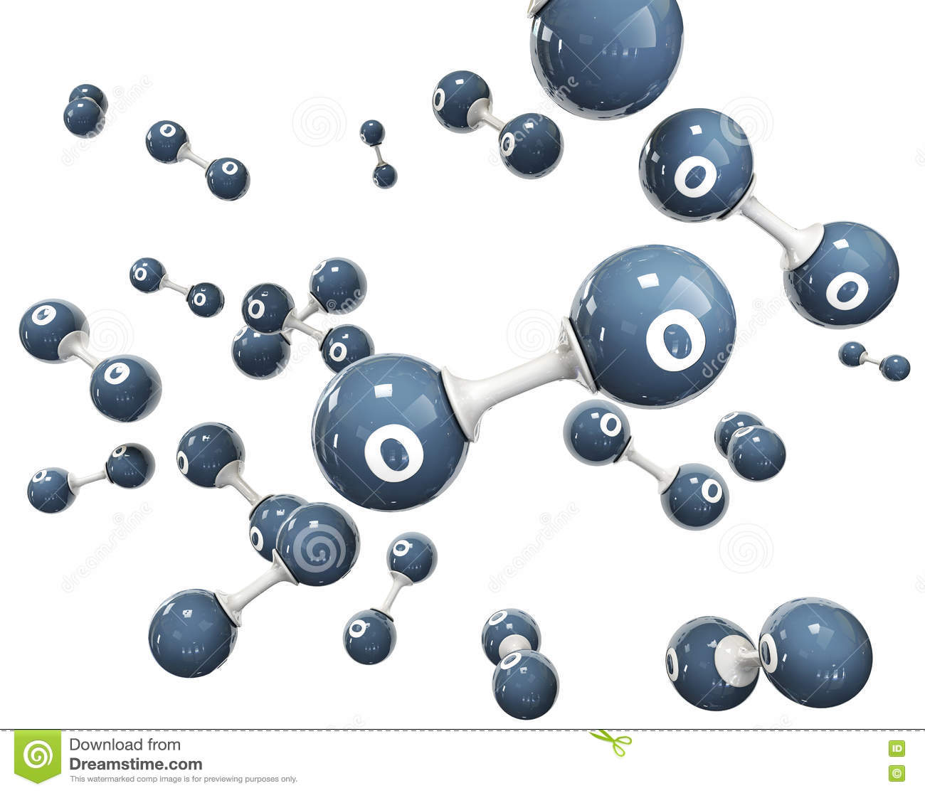
photosintesis

Slide 5
Earth’s atmosphere has a layered structure. From the ground toward the sky

Slide 7
The atmosphere of Earth is composed of nitrogen, oxygen ,argon ,carbon dioxide and other gases in trace amounts.
Oxygen is used by most organisms for respiration; nitrogen is fixed by bacteria.
The ozone layer ranges in altitude between 15 and 35 and is where most of the ultraviolet radiation from the Sun is absorbed.

Slide 8
What aerosols are?

Slide 9
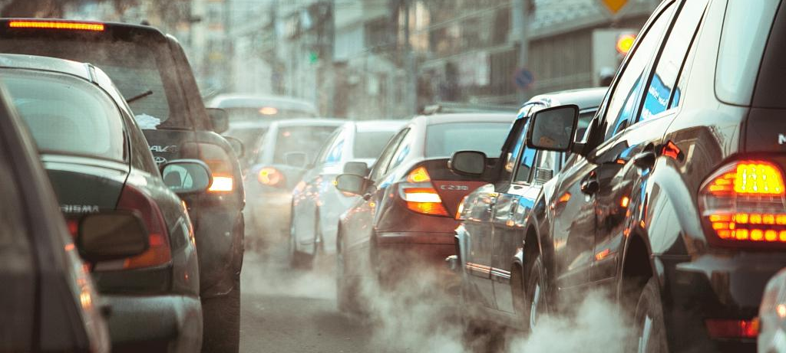
Source of aerosols antrophogenic

Slide 10
Natural sources

Slide 11
Secondary Organic Aerosols
Secondary Organic Aerosols(SOAs)are air pollutants emitted from natural and man-made sources. SOAs are a major component of fine particle pollution (PM2.5), which has been found to cause lung and heart problems . SOAs are under investigation because there is much that is not known about how they contribute to air pollution overall

Slide 12
Richard Feynman
As noted earlier,the propensity of organic molecules and oxidants to remain at the air-water interface leads to high reaction probability at the interface
“There is plenty of room interface at the bottom”
(replaced room with interface). In other words, the air–water interface is a rich area for further research in atmospheric systems.

Slide 13
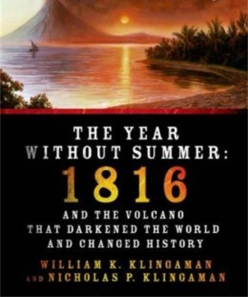
What do aerosols do to climate?
The effect can be dramatic: The Mt. Pinatubo volcanic eruption in 1991, in the Philippines, spewed the equivalent of 1.2 square miles of tiny, reflective rock particles into the high stratosphere—cooling the planet for two full years afterward. The 1815 Tambora eruption, similarly, spawned an epic, globe-spanning “Year without a Summer” so cold and bleak it inspired Mary Shelley’s dark horror novel, Frankenstein.

Slide 14
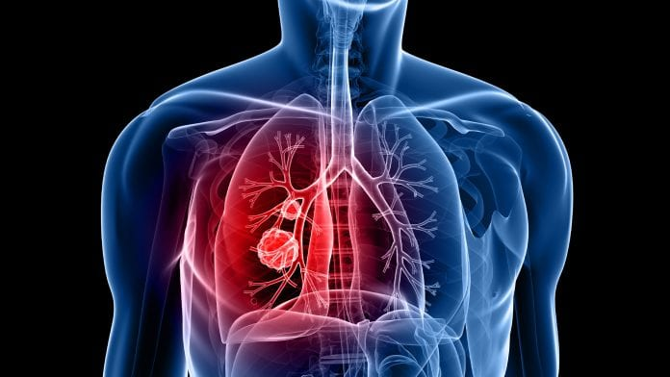
Human health
Air pollution has been linked to increased risk of heart disease, stroke, lung disease, asthma, and more
The health risks from fine-particle exposure are highest in China and India, particularly in urban areas.

Slide 15
REFERENCE
Mass Transport and Chemistry at the Air–Water Interface of Atmospheric Dispersoids. Kalliat T. Valsaraj, Franz S. Ehrenhauser, Aubrey A. Heath,Mickael Vaitilingom (December 2015)
Advanced micro- and nanoscale characterization techniques for carbonaceous aerosols. Shahadev Rabha and Binoy K. Saikia. (October 2019)
Formation and cycling of aerosols in the global troposphere .Frank Raes, Rita Van Dingenen, Elisabetta Vignati, Julian Wilson,Jean-Philippe Putaud, John H. Seinfeld, Peter Adams. https://doi.org/10.1016/S1352-2310(00)00239-9 (26 July 2000)

Slide 16
Thank you for your attention

