Slide 1
Environmental Research of Air Pollution
Air monitoring specificity carried by Georgian National Environmental Agency
Magda Aptsiauri, B.Sc.
E-mail: magdaptsiauri@gmail.com
13th Nov., 2020
1

Slide 2
Environmental Pollution and Atmospheric Air Monitoring specificity in Georgia– How we started and what we do?
2

Slide 3
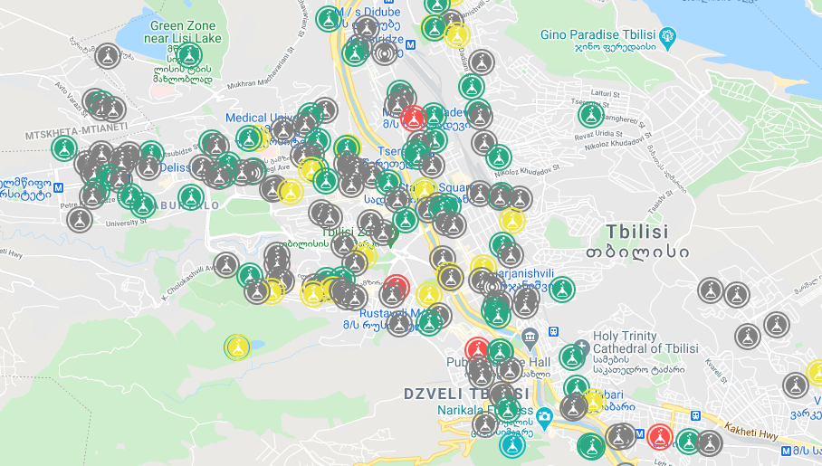
Pollutants measured by all automatic ambient air quality stations:
Solid-weighted particles (PM10, PM2,5),
Nitrogen oxides (NO, NOx, NO₂),
Sulfur dioxide (SO₂),
Carbon monoxide (CO)
Ozone (O₃).
3

Slide 4
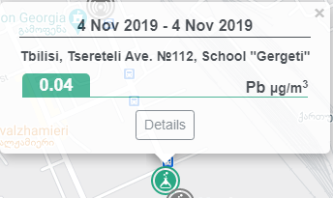
Additionally, atmospheric air pollution is monitored by a non-automatic observation point, on the following pollutants:
Dust,
Sulfur,
Nitrogen,
Manganese Dioxides,
Carbon Dioxide
Nickel
Lead
4

Slide 5
→ There are two types of identifiers on the map. They reflect the location of ambient air quality monitoring places.
The colors match the air quality indicator in the monitoring hour.
The index determines the level of pollution for six pollutants according to the following scheme.
5

Slide 6
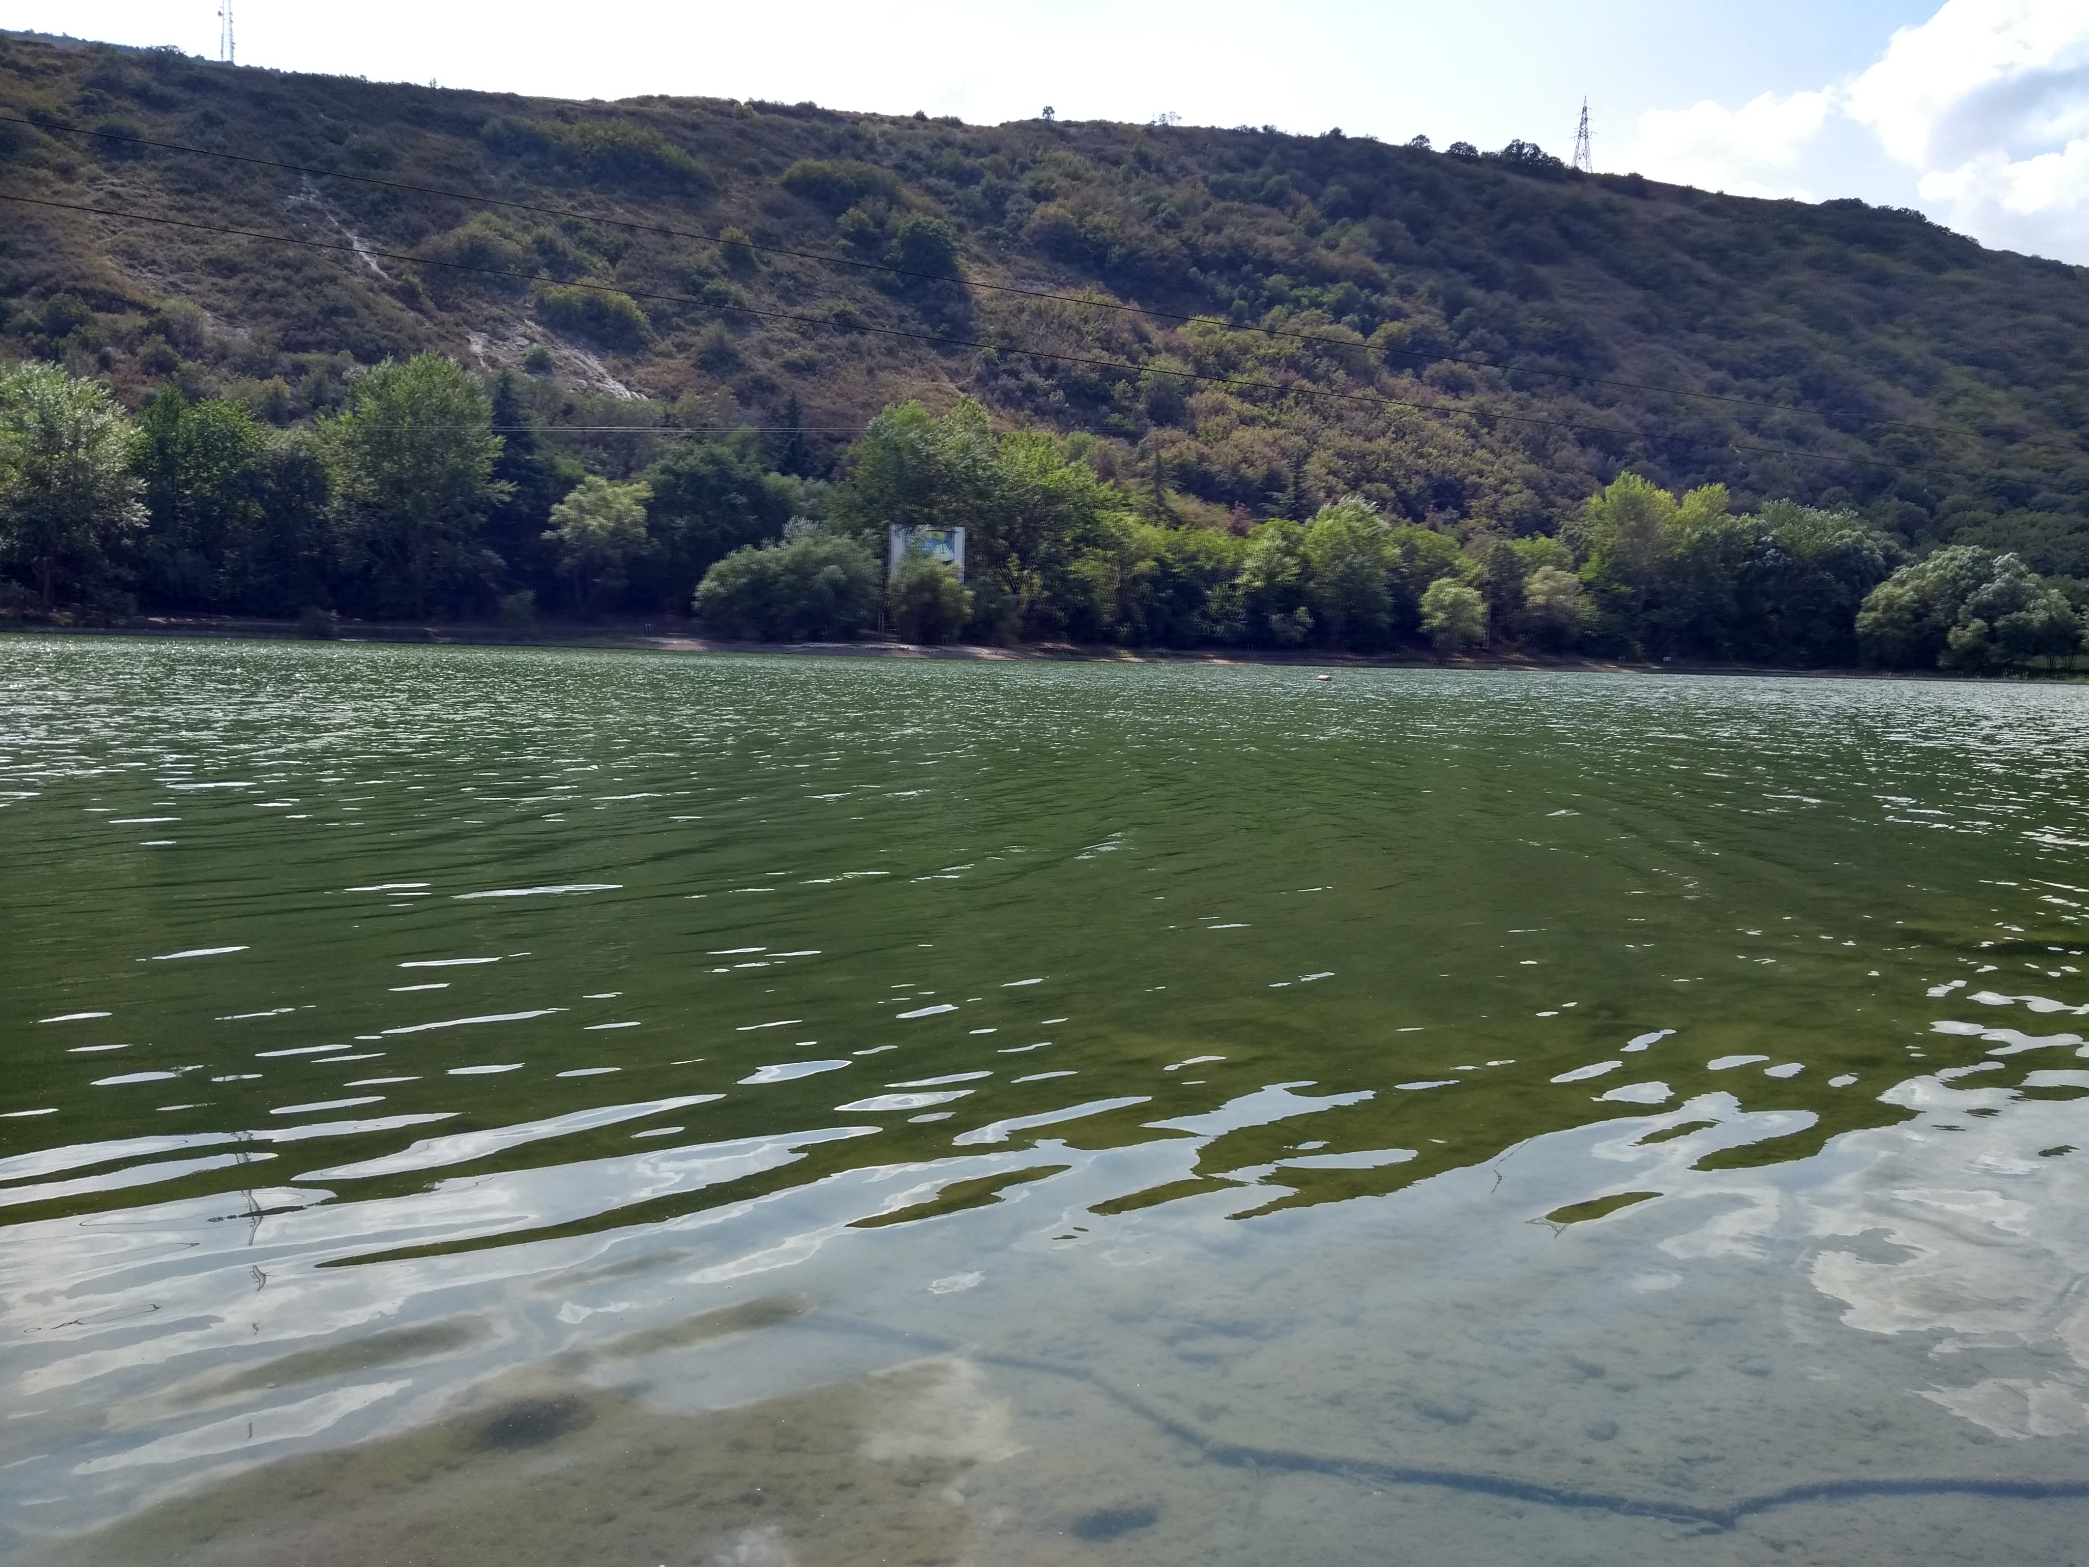
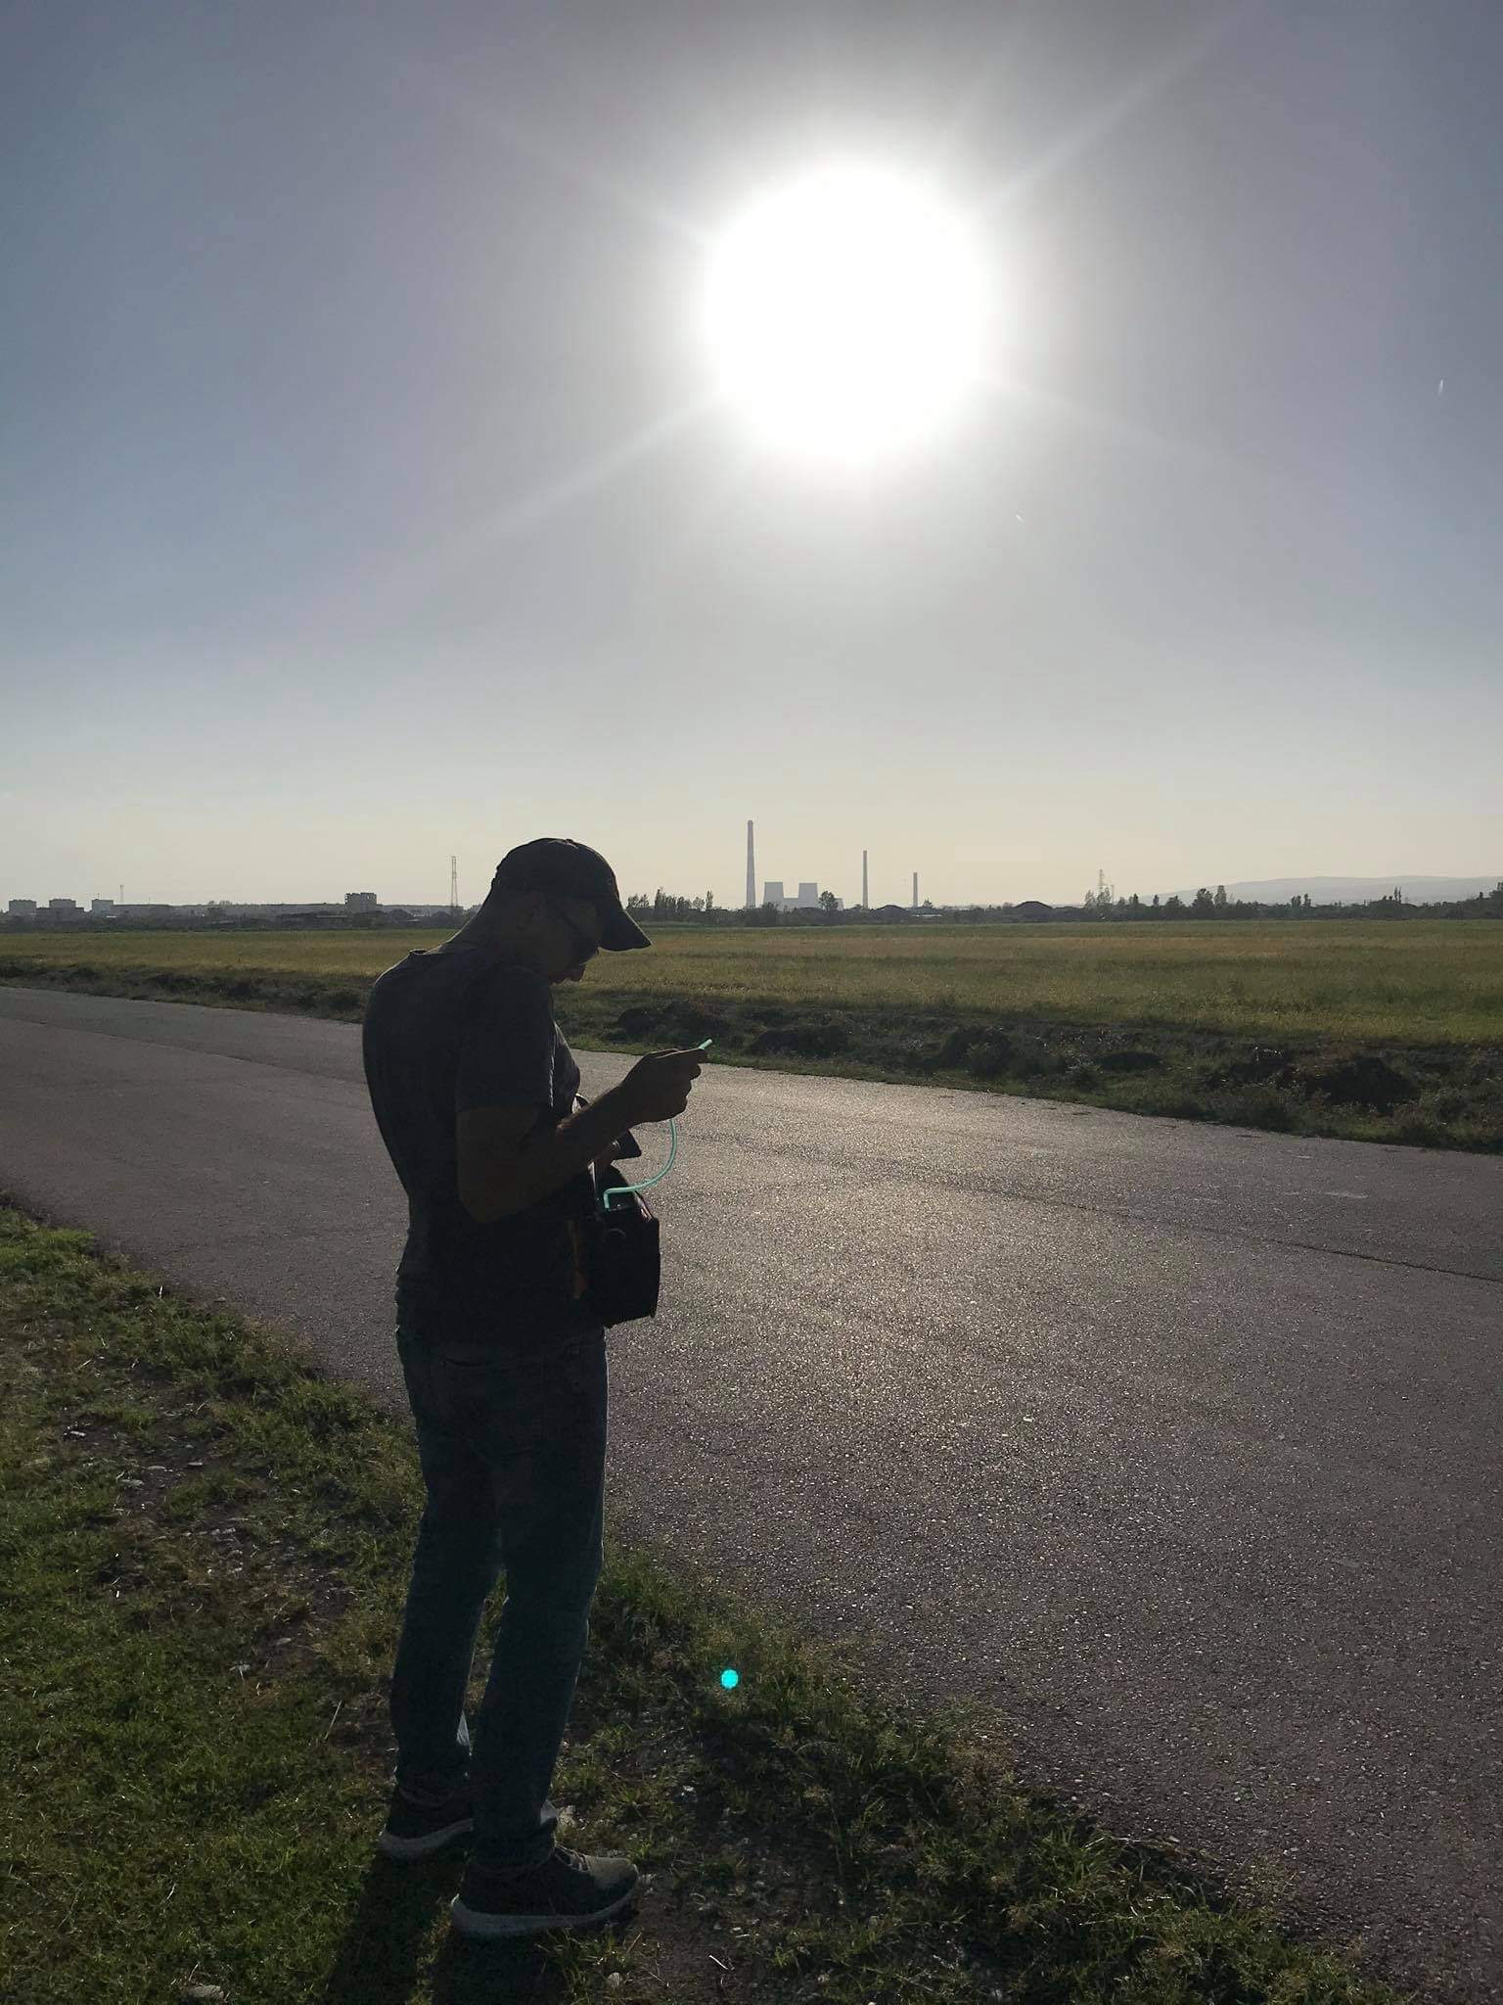
The Agency conducts sampling at various locations in Tbilisi, as well as at stations located in Kutaisi, Batumi and Rustavi to determine lead content.
Ambient Air Quality (Automatic Station Data) is assessed by the Government of Georgia Resolution N 383 of 27 July 2018 on “Technical Regulation - Approval of Ambient Air Quality Standards” which is in accordance with the DIRECTIVE 2008/50/EC OF THE EUROPEAN PARLIAMENT AND OF THE COUNCIL of 21 May 2008 on ambient air quality and cleaner air for Europe.
6

Slide 7
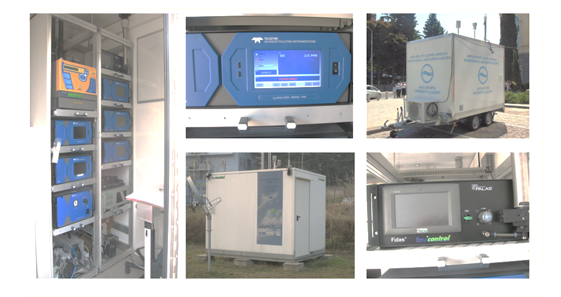
Instrumentation
Teledyne T100 (SO₂ Analyzer);
Teledyne T200 (NO₂, NO, NO_{x} Analyzer);
Teledyne T300 (CO Analyzer);
Teledyne T400 (O₃ Analyzer);
Teledyne T701 (Zero Gas Generator);
Palas Fidas 200 (Solid Particle Detector);
Ogawa Seiki Co., Ltd (PM10, PM2.5, SO₂, NO₂, NO, NO_{x} O₃, CO analyzer);
CPR-KA (PM10, PM2.5, SO₂, NO₂, CO analyzer).
7

Slide 8
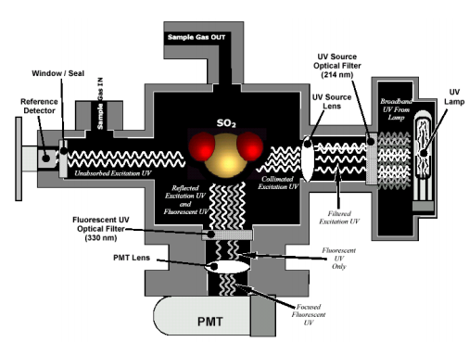
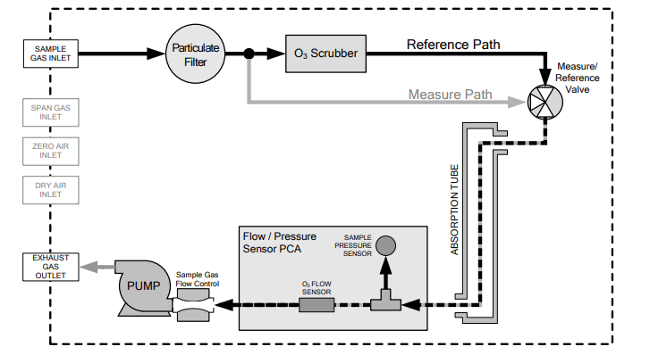
T400 - Photometric Ozone
Analyzer
T100 – UV Fluorescence ${SO}_{2}$ analyzer

Slide 9
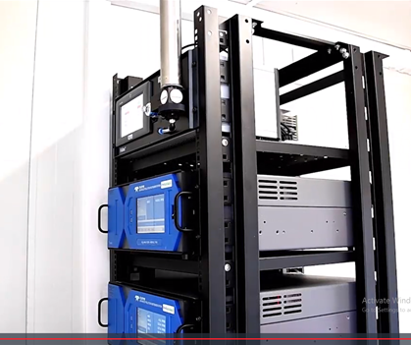
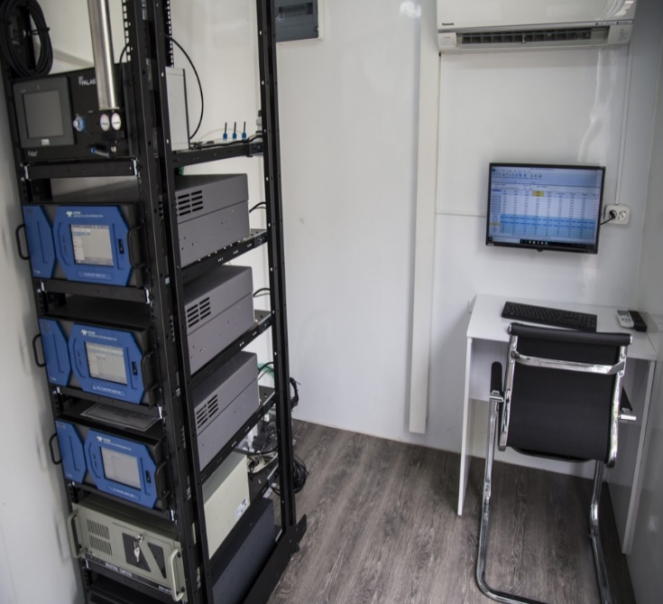
Methodology
Solid particle (PM10) daily bulletin contains 1h data and 24h data, with a 24h intermediate concentration - 50 μg/m³;
Nitrogen dioxide (NO₂) daily bulletin contains concentrations obtained for 1 h intervals, with a limit value of - 200 μg/m³;
Sulfur dioxide (SO₂) daily bulletin contains concentrations obtained between 1h and 24h; The limit value for 1 h concentration is 350 μg / m³, and the limit value for the 24 h intermediate concentration is 125 μg/m³;
Carbon monoxide (CO) concentration of 8 h per day, with a limit value of - 10 mg/m³;
Ozone (O3) daily bulletin - maximum daily 8-hour mean concentrations, with a limit value of - 125 µg /m³;
8

Slide 10
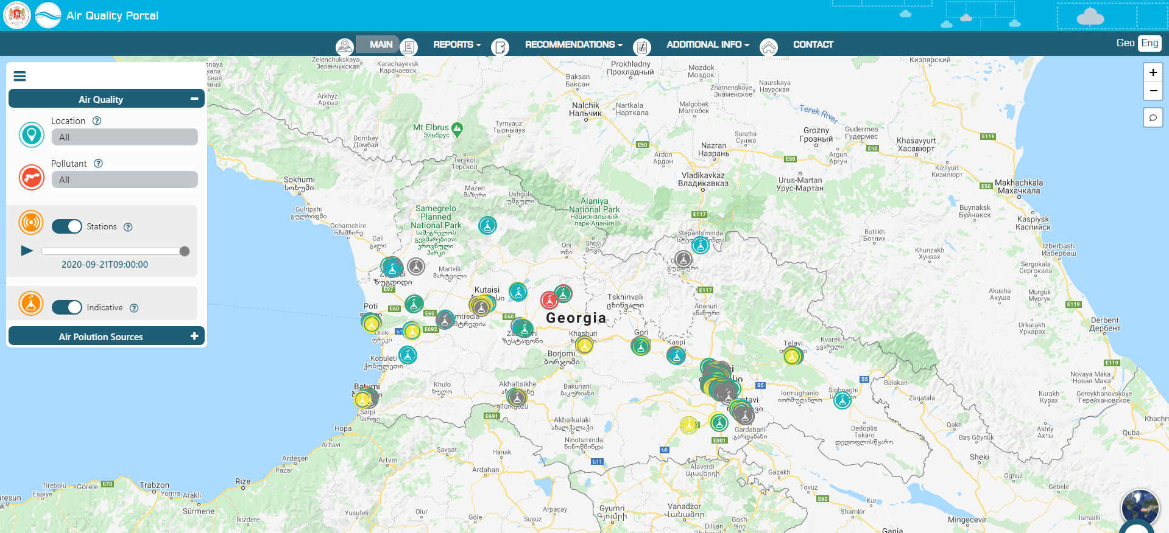
The air quality portal: air.gov.ge
9

Slide 11
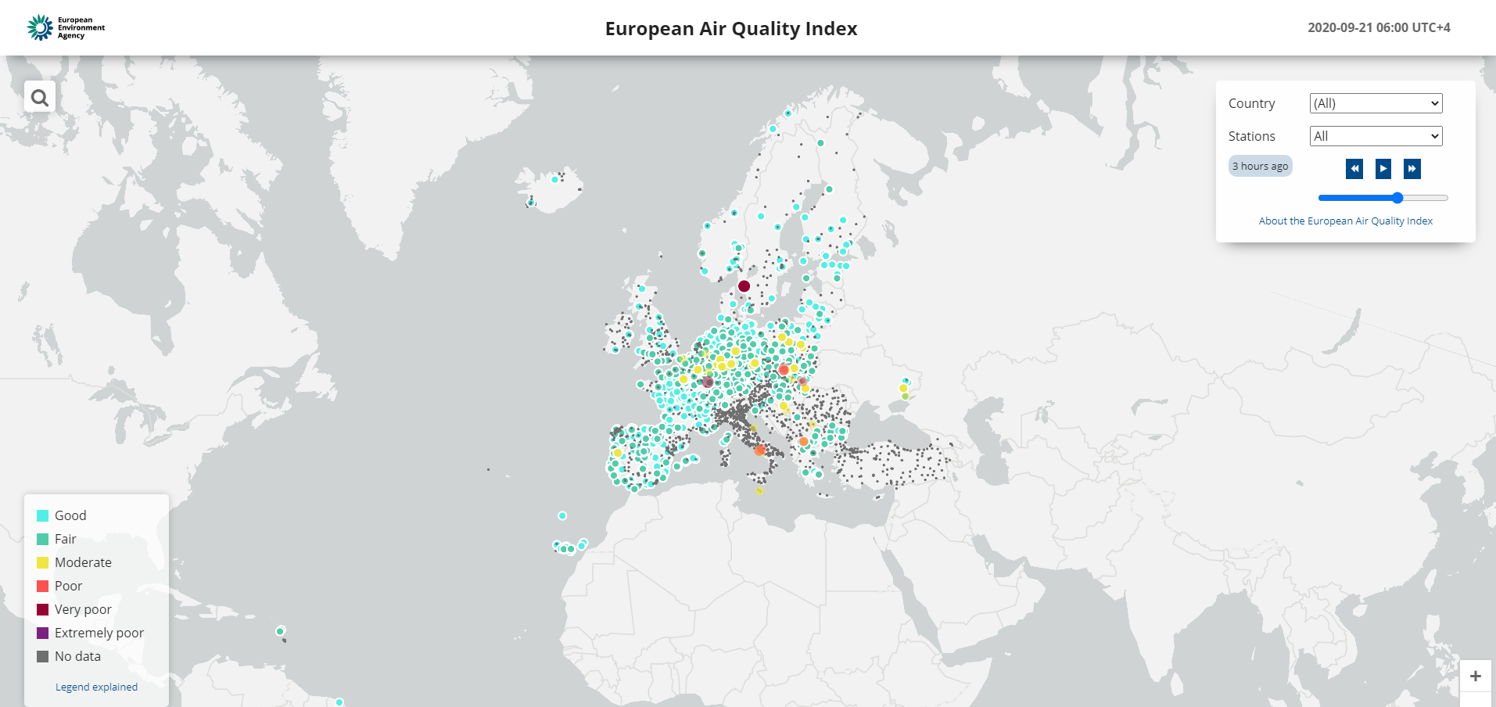
The European Environment Agency's Air Quality Portal at airindex.eea.europa.eu
10

Slide 12
Thank you for listening! Any Questions?
11

