Slide 1



Analysis of Hydrocarbons in the Atmosphere
Tbilisi State University, Tbilisi, Georgia
Faculty of exact and natural sciences
Department of physical and analytical chemistry
9th semester bachelor student: Lela Bukhnikashvili

Slide 2
Following Analytical Techniques for Atmospheric Measurement will be discussed:
Mass Spectroscopy in Atmospheric chemistry
  Coupled GC-MS
  The Isotope Ratio MS
Gas Chromatography
Thermal Desorption for Monitoring Air Indoors and Inside Vehicle Cabins

Slide 3
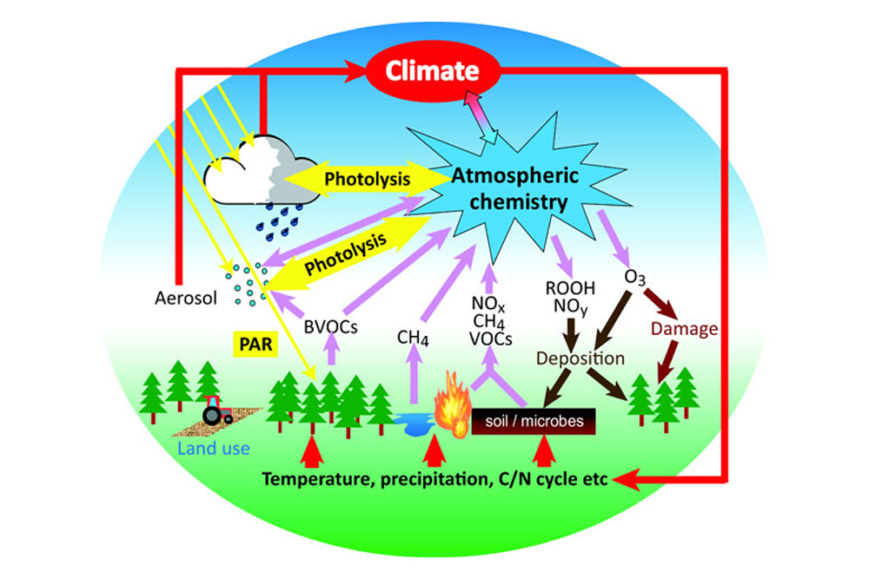
Why it is important to study hydrocarbons in the atmosphere ?
Hydrocarbons react with OH in presence of NO_{x} and forms ozone and photochemical smog
Halogenated species act as precursors for ozone destruction
Hydrocarbons have importance as greenhouse gasses
Influence on Global climate and temperature change

Slide 4
Coupled GC-MS
Combination of GC with MS is the most powerful tool for the analysis of complex mixtures, such as ambient air
Ionisation can be achieved via EI and CI
Analysis take typically 1hour limit, that is contrast with CIMS methods, where on-line measurements are available
The studies of man-made HCFCs, that are replacement of stratosphere ozone depleting CFCs
GC-MS can contribute to the long term assessment of the global oxidising capacity
GC-MS can measure trace gas species at extremely low mixing ratios e.g HALON
With GC relatively small emissions of long-lived species can be measured

Slide 5
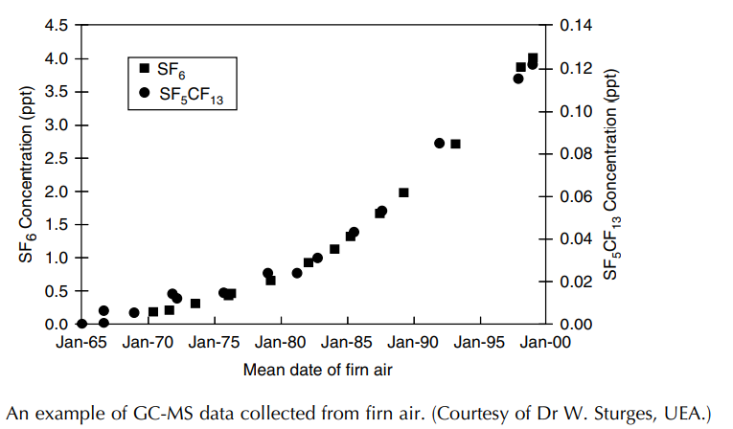
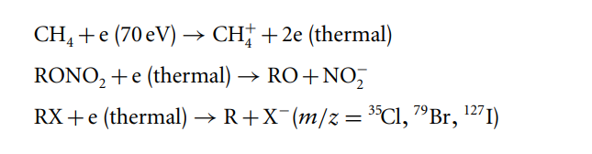
GC-MS with EI source discovered SF₅CF₃
Figure shows the atmospheric mixing ratios of SF₆ and SF₅CF₃ since January 1965. The air for this analysis was pumped up from where it was naturally trapped in consolidated deep snow, in eastern Antarctica. Air from 1965 was determined to be 100 m below the snow surface, where after freezing in the ice matrix it has remained isolated from mixing with present-day air.
Reference: Atmospheric Measurement - Wiley Blackwell
With negative EI, thermalized electrons interact with organohalogens and organonitrate species and the can be determined
Such measurements are interesting over the open ocean, where emissions of organohalogen and alkyl nitrates have been identified

Slide 6
Isotope Ratio MS
Definition of isotope ratio of gas phase compound: ratio of less abundant isotope to the most abundant isotope
From the knowledge of isotopic composition of trace gas species we may learn it’s SOURCE and CHEMISTRY.
Gases emitted from certain sources have characteristic isotope ratios.
Oxygen abundance is most accurately determined on IRMS
In IRMS mass resolution is sacrificed to optimise precision.

Slide 7
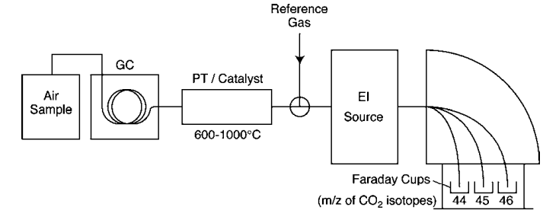
A series of Fixed Fraday Cups are used as detector system with one cup being allocated for each ion
Reference: Atmospheric Measurement - Wiley Blackwell
Faraday Cups are superior in IRMS because : high count rates needed for high precision measurements are in the normal operating range, whereas ion currents would damage an electron multiplier
Faraday Cups are stable and have a long working lifetime

Slide 8
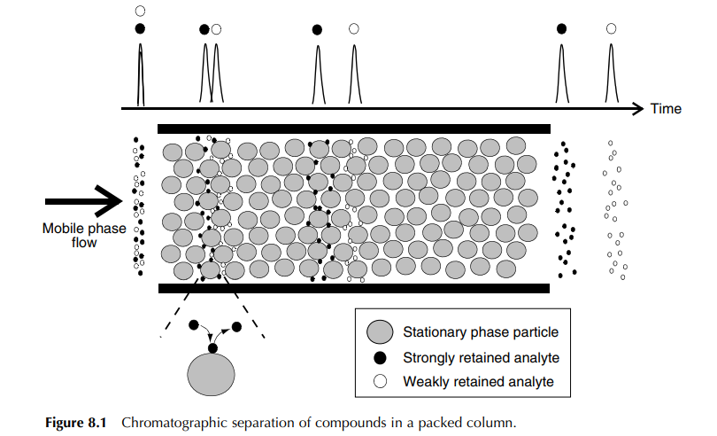
Chromatography
Chromatography - is the method of seperating complex mixtures into their consistuent components
Some atmospheric species such as organic acids, peroxides and aldehydes are measured using HPLC, When majority of organic species are analysed using Capillary chromatography
Many organic species in the atmosphere are bound to the particles and are in AEROSOL form e.g. Polycylic aromatic hydrocarbons (PAH); dioxans [GC-MS]

Slide 9
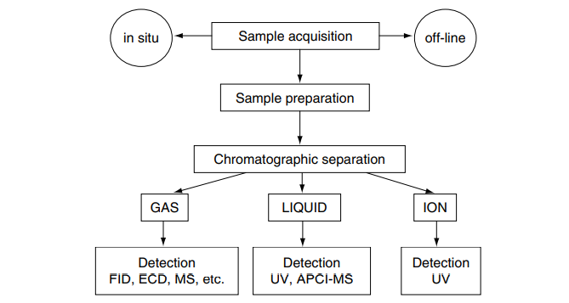
Characteristics of mobile phase
In GC as the mobile phase highly diffusive gas is used to solvate and transport components within the mixture.
The gas phase should have high diffusion coefficient to ensure maximum number of gas-stationary phase interactions.
Maximum separation efficiency is achieved using lighter gases (H₂, He)
Reference: Atmospheric Measurement - Wiley Blackwell

Slide 10
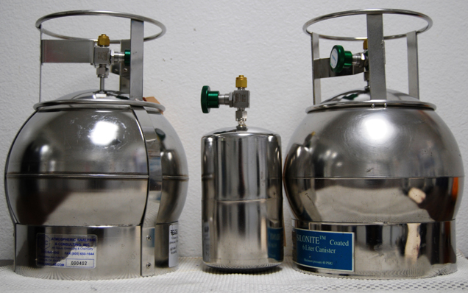
STORING - CO, CFCS, methane can be stored in vessels for many weeks, while for Alkanes, monoterpens, DMS- storage leads to analyte loss
Canisters are used for atmospheric sample acquisition, there must be minimal interaction of sample with canister walls.
To coat the walls electropolishing method, silica or Teflon coatings are used
Reference: Atmospheric Measurement - Wiley Blackwell

Slide 11
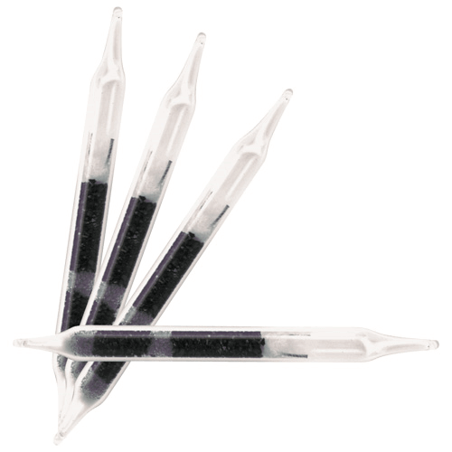
For lower volatile species- solid phase adsorbents are used.
Carbon based adsorbents are suitable for a wide range of species from volatile hydrocarbons , CFCs to organic Nitrates.
Polimeric materials are mainly used for concentration of lower volatile species such as aromatics, monoterpens
Analysis of Low molecular weight and oxygenated compounds is difficult, because of irreversible retention of polar compounds onto absorbents and losses onto canister walls.
Charcoal Sorbent Tubes
Reference: Atmospheric Measurement - Wiley Blackwell

Slide 12
SAMPLE PREPARATION, IMPORTANCE TO REMOVE WATER
Beneficial: when water occupies active sites on canister walls
Negative: effects separation reproducibility and detectors
  PLOT columns are affected with moisture (occures changes in stationary phase)
  MS detector is affected with moisture, we may result high background noise
  FID can be affected with injection of water, flame may be extinguished when water eluets from column
Water removal methods:
Condensation traps or stripping coil
Inorganic sorbents such as Potassium carbonate and magnesium perchlorate
The use of Nafon membrans

Slide 13
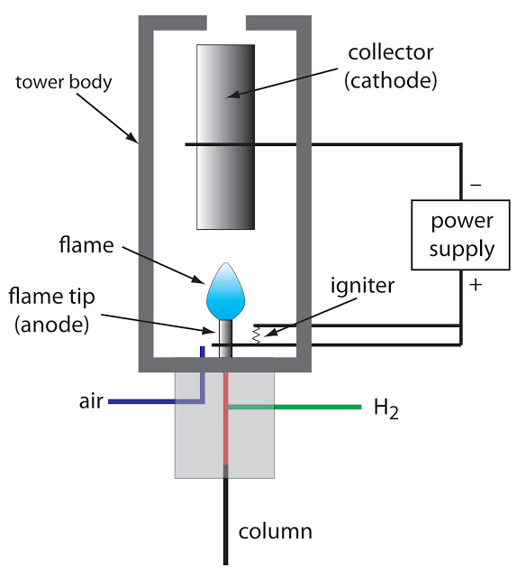
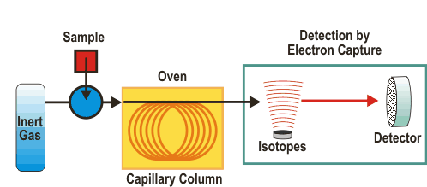
Detection:
Flame ionisation detector (FID)- high sensitivity, linearity, very long term reliability and response
Electron capture detector (ECD)- was designed for halogen measurement in atmosphere. Offers high sensitivity to electrophilic compounds. Analysis of Nitrogen containing species (PAN) analysis
GC coupled with sulphur selective detector – DMS
HID- helium ion detector may be used in future with GC
Portable aircraft GC- study of the acetone and O-VOCs
O-VOCs act as a source of free radical species when photolysed
Reference: Atmospheric Measurement - Wiley Blackwell

Slide 14
Thermal Desorption for Monitoring Air Indoors and Inside Vehicle Cabins (TD)
Definition- Thermal desorption is automated gas extraction technology based on standard gas Chromatography parameters
The process of TD involves extraction of volatile or semi-volatile organic compounds from a sorbent by heating a sample in the flow of inert gas. Extracted analytes are than tranferred to the analyser
TD is used to measure trace VOCs
Air can be sampled and analysed on-line, to study indoor air pollution
Vapor can be sampled in canisters, bags, or sorbent tubes
The volatile content of solid and liquid samples using direct thermal desorption and than GC/MS

Slide 15
Sampling options :
Passivated canisters- for ultra volatile chemicals, isn’t suitable for sampling polar or less volatile compounds.
Tedlar begs – Offer limited storage stability (<24h). They aren’t reusable
Sampling onto sorbent tubes – Sample tubes can be used either empty or packed with sorbent for retaining vapour phase organics
Sorbent strength: selected sorbent must be strong enough to retain target analytes and weak enough to release them efficiently during the thermal desorption phase
Weak sorbents- less volatile analytes should be trapped
Medum
Strong sorbents- more volatile analytes should be trapped

Slide 16
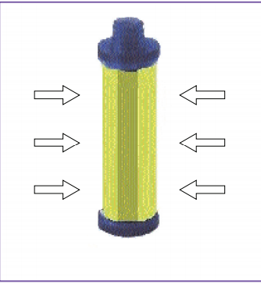
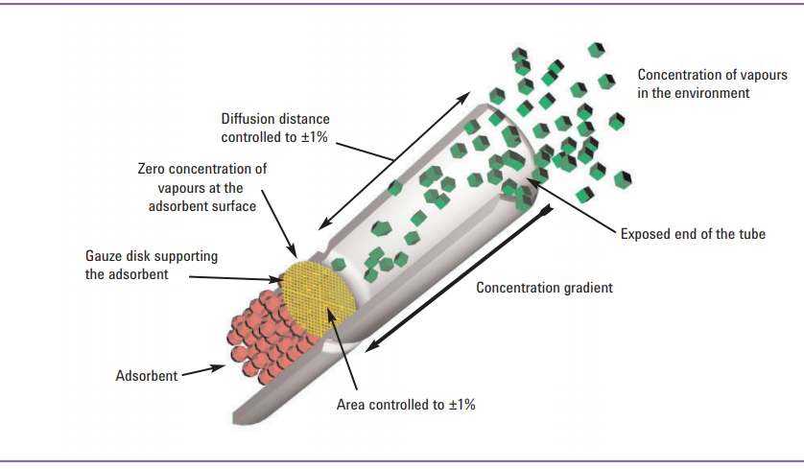
Diffusive sampling: Axial and Radial samplers
They can be used for short term air monitoring (0.5-0.6h) and at ambient/indoor levels
Axial sorbent tubes may be used in diffusive mode for both short term monitoring (1-8 hours) in high concentration areas and long term (3 days to 4 weeks) monitoring of ‘typical’ indoor and ambient air.
Reference: Thermal Desorption Technical Support- Agilent Technolgies

Slide 17
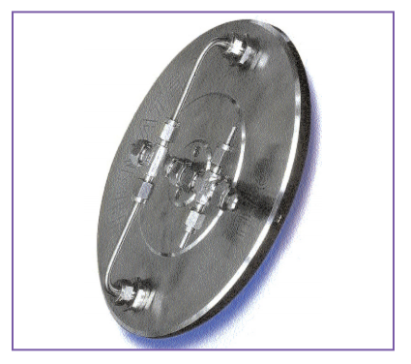
The Field and Laboratory emissions Chamber (FLEC)
FLEC- is a piece of sampling apparatus for testing VOC emissions for construction products and other materials used indoors
The use of FLEC- it is placed onto the surface of planar material and air is passed uniformly over the surface. Exhaust gasses are collected onto sorbent tubes and than analyzed using standard TD-GC-MS
Reference: Thermal Desorption Technical Support- Agilent Technolgies

Slide 18
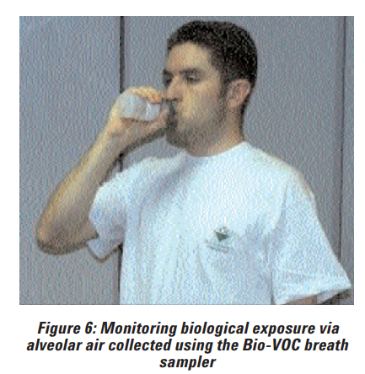
Breath sampling as a tool for investigating biological exposure
The Bio-VOC Breath Sampler is a disposable device used, to collect a 100 ml sample of end-tidal air and then to transfer it to a sorbent tube. Analysis is typically by conventional thermal desorption - GC/MS.
Bio-VOC can be used for:
Chronic personal exposure monitoring
For clinical and lifestyle studies
Reference: Thermal Desorption Technical Support- Agilent Technolgies

Slide 19
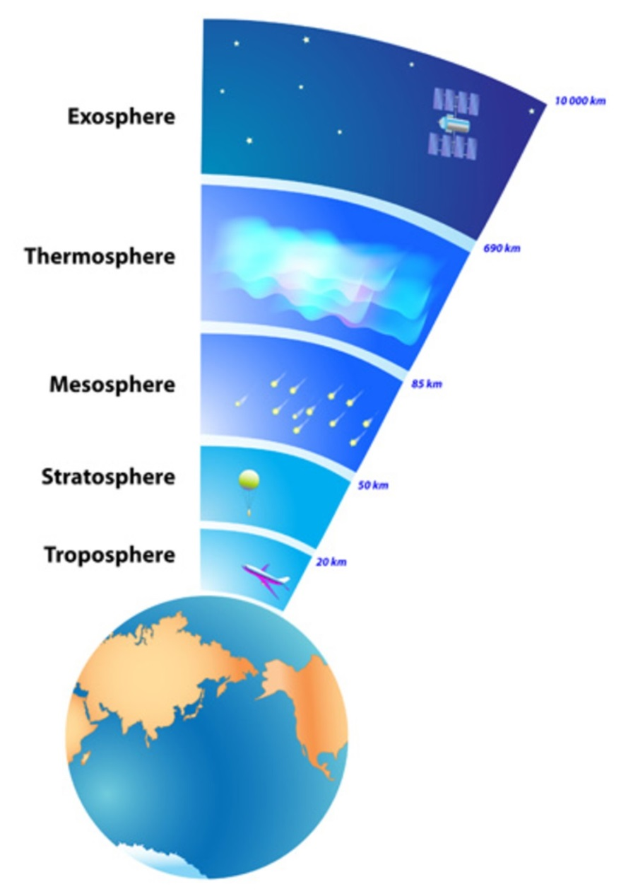
Thank you for your attention!
Reference:
Atmospheric Measurement - Wiley Blackwell
Thermal Desorption Technical Support- Agilent Technolgies
19

