Slide 1
Tbilisi State University
Project for Institute of Energy and Climate Research , Troposphere (IEK-8)
Tbilisi State University Bachelor of Chemistry Student Giorgi Abashidze
Giorgi Abashidze

Slide 2
tROPOSPhERe AND anthropogenic eFFECTS
General knowledge
Trace gases
research

Slide 3
Structure of atmosphere
What is atmosphere ?
The atmosphere of Earth is the layer of gases, commonly known as air, retained by Earth’s gravity, surrounding the planet Earth and forming its planetary atmosphere.
atmosphere
Source from NASA

Slide 4
Layers of atmosphere
Air pressure and density decrease with altitude in the atmosphere. However, temperature has a more complicated profile with altitude and may remain relatively constant or even increase with altitude in some regions (see the temperature section, below). Because the general pattern of the temperature/altitude profile, or lapse rate, is constant and measurable by means of instrumented Balloon soundings,
www.worldatlas.com

Slide 5
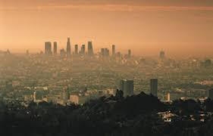
troposphere
“The troposphere is the lowest layer of Earth's atmosphere. It extends from Earth's surface to an average height of about 12 km (7.5 mi; 39,000 ft), although this altitude varies from about 9 km (5.6 mi; 30,000 ft) at the geographical poles to 17 km (11 mi; 56,000 ft) at the Equator, with some variation due to weather. The troposphere is bounded above by the tropopause, a boundary marked in most places by a temperature invesion (i.e. a layer of relatively warm air above a colder one), and in others by a zone which is isothermal with heigh”
Troposphere Place of pollution

Slide 6
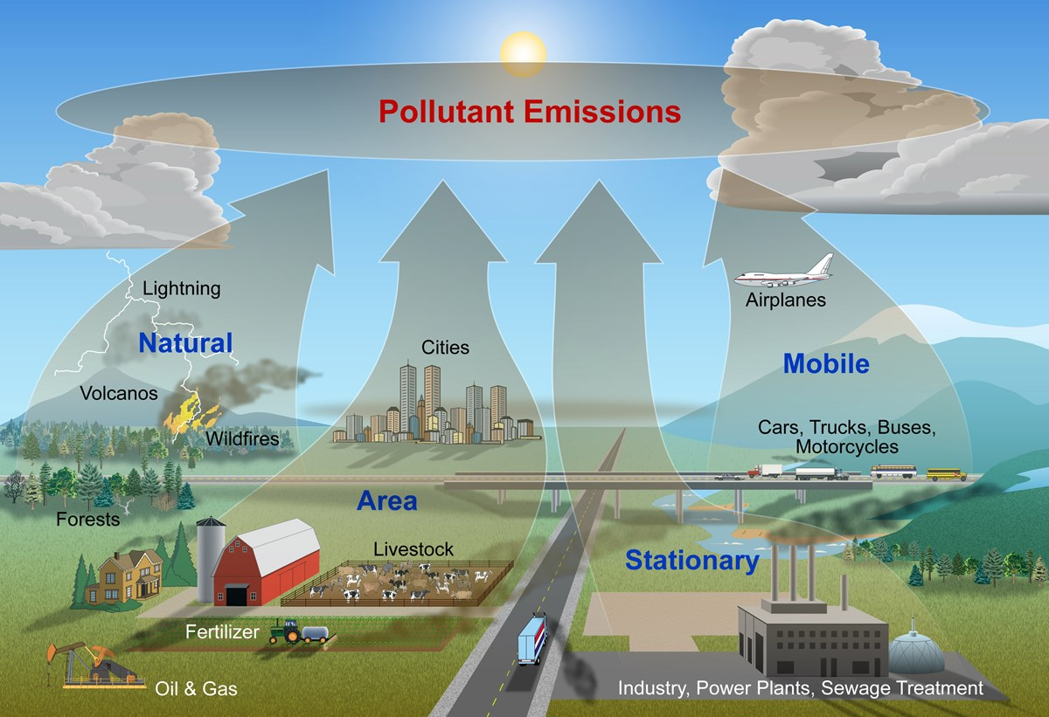
Types of air pollution
mobile sources – such as cars, buses, planes, trucks, and trains
stationary sources – such as power plants, oil refineries, industrial facilities, and factories
area sources – such as agricultural areas, cities, and wood burning fireplaces
natural sources – such as wind-blown dust, wildfires, and volcanoes
www.nps.gov

Slide 7
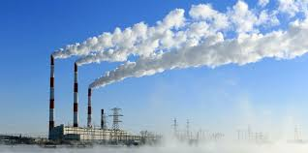
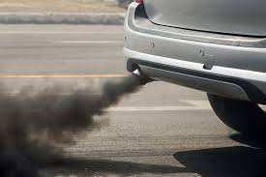
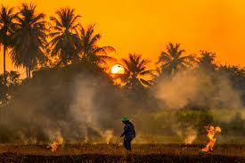
Human activities that are major sources of outdoor air pollution, include:
Fuel combustion from motor vehicles
Heat and power
Industrial facilities Municipal and agricultural waste sites and waste incineration/burning
Residential cooking, heating, and lighting with polluting fuels

Slide 8
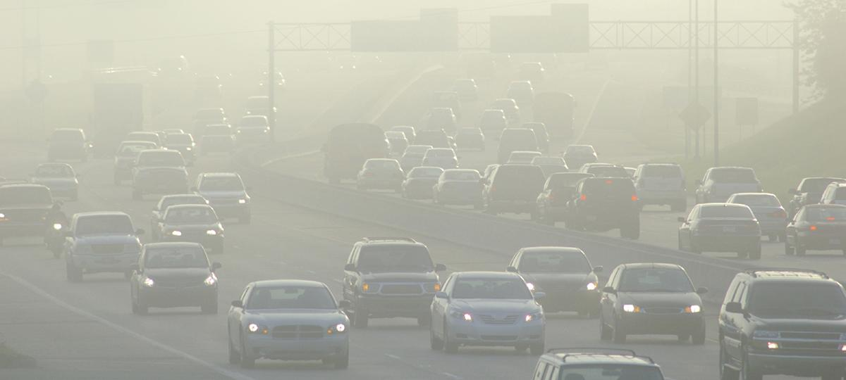
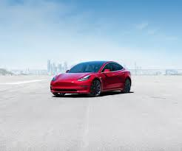
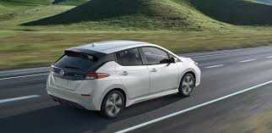
Pollution of cars
The ingredients of air pollution
Emission from heavy duty vehicle
www.ucsusa.org
Electric vehicles (EV)
Zero-emission
Tesla model 3
Nissan leaf

Slide 9
Trace gases
Ozone: column (total) ozone and ozone vertical profiles with a focus on the stratosphere and upper troposphere;
Greenhouse gases: carbon dioxide CO₂ (including ¹⁴C, ¹³C and ¹⁸O in CO₂, and O₂/N₂ ratios), methane CH₄ nitrous oxide N₂O, halogenated compounds SF₆;
Reactive gases: surface and tropospheric ozone, carbon monoxide (CO), Volatile Organic Compounds (VOCs), nitrogen oxides (NOx), sulphur dioxide (SO₂) and molecular hydrogen (H₂);
Atmospheric Wet Deposition (focused largely on major ions);
UV Radiation;
Aerosols (including physical properties, size distribution and chemical composition).

Slide 10
Common methods used for atmosphere research
Example of satellite observation
Weather balloon
Satellite observation

Slide 11
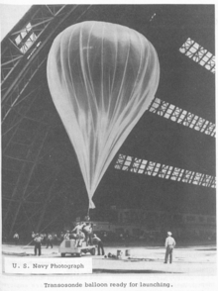
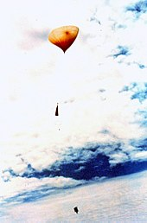
Weather balloon
A weather balloon also known as sounding balloon is a balloon (specifically a type of high-altitude balloon) that carries instruments aloft to send back information on atmospheric pressure, temperature, humidity and wind speed by means of a small, expendable measuring device called a radiosonde.
Source united States Navy

Slide 12
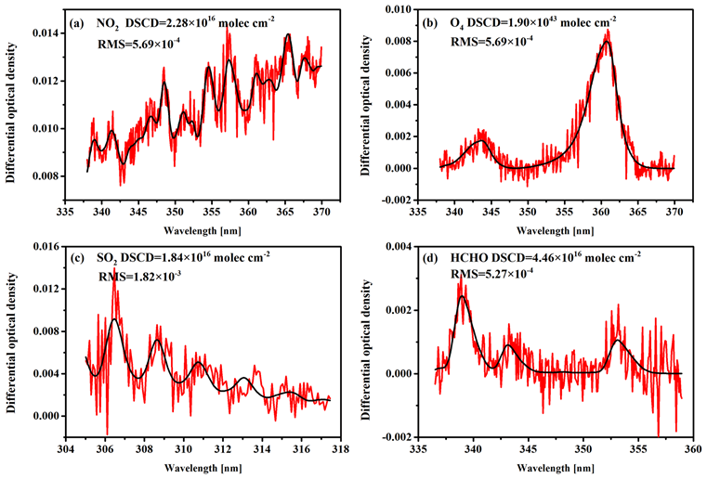
Advantages of satellite observation
The capability of satellite instruments to measure the tropospheric pollution first became apparent by measurements of GOME on NO2 ( 2001) and MOPITT on CO (2004). These instruments enabled for the first time global measurements of pollutants in the troposphere in the form of maps of monthly or yearly averaged concentrations. Up to that point, only models provided such information

Slide 13
Thank you for your attention
Giorgi Abashidze

