Slide 1
Tatia Gonashvili Prof. Keti Kotetishvili
process of RT: Patient-Specific QA
Image Guided Radiation Therapy (IGRT) approach is implemented for cancer treatments with
Intensity Modulated Radiation Therapy(IMRT)
Stereotactic Radiosurgery(SRS) and
Stereotactic Body Radiation Therapy(SBRT) external radiotherapy techniques.

Slide 2
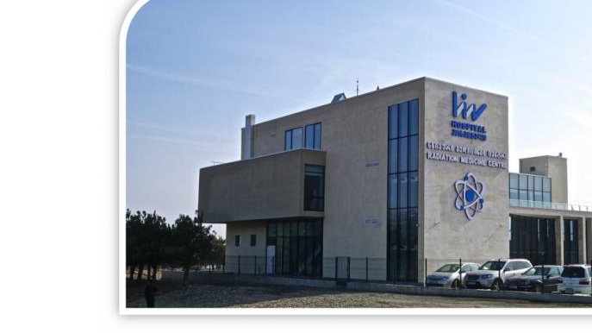
TERABALT 100 - Cobalt
ELEKTA SYNERGY® PLATFORM
ELEKTA VERSA HD
TERASIX Convantional Simulator
CT Simulator
CT Simulation / Conv. Sim
Contouring
Planning
QA
Set-up & Treatment

Slide 3
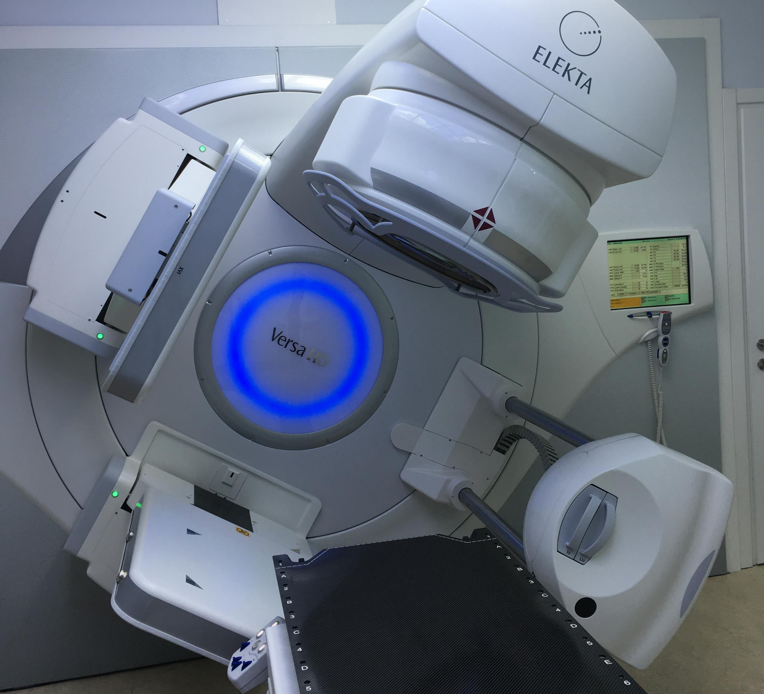
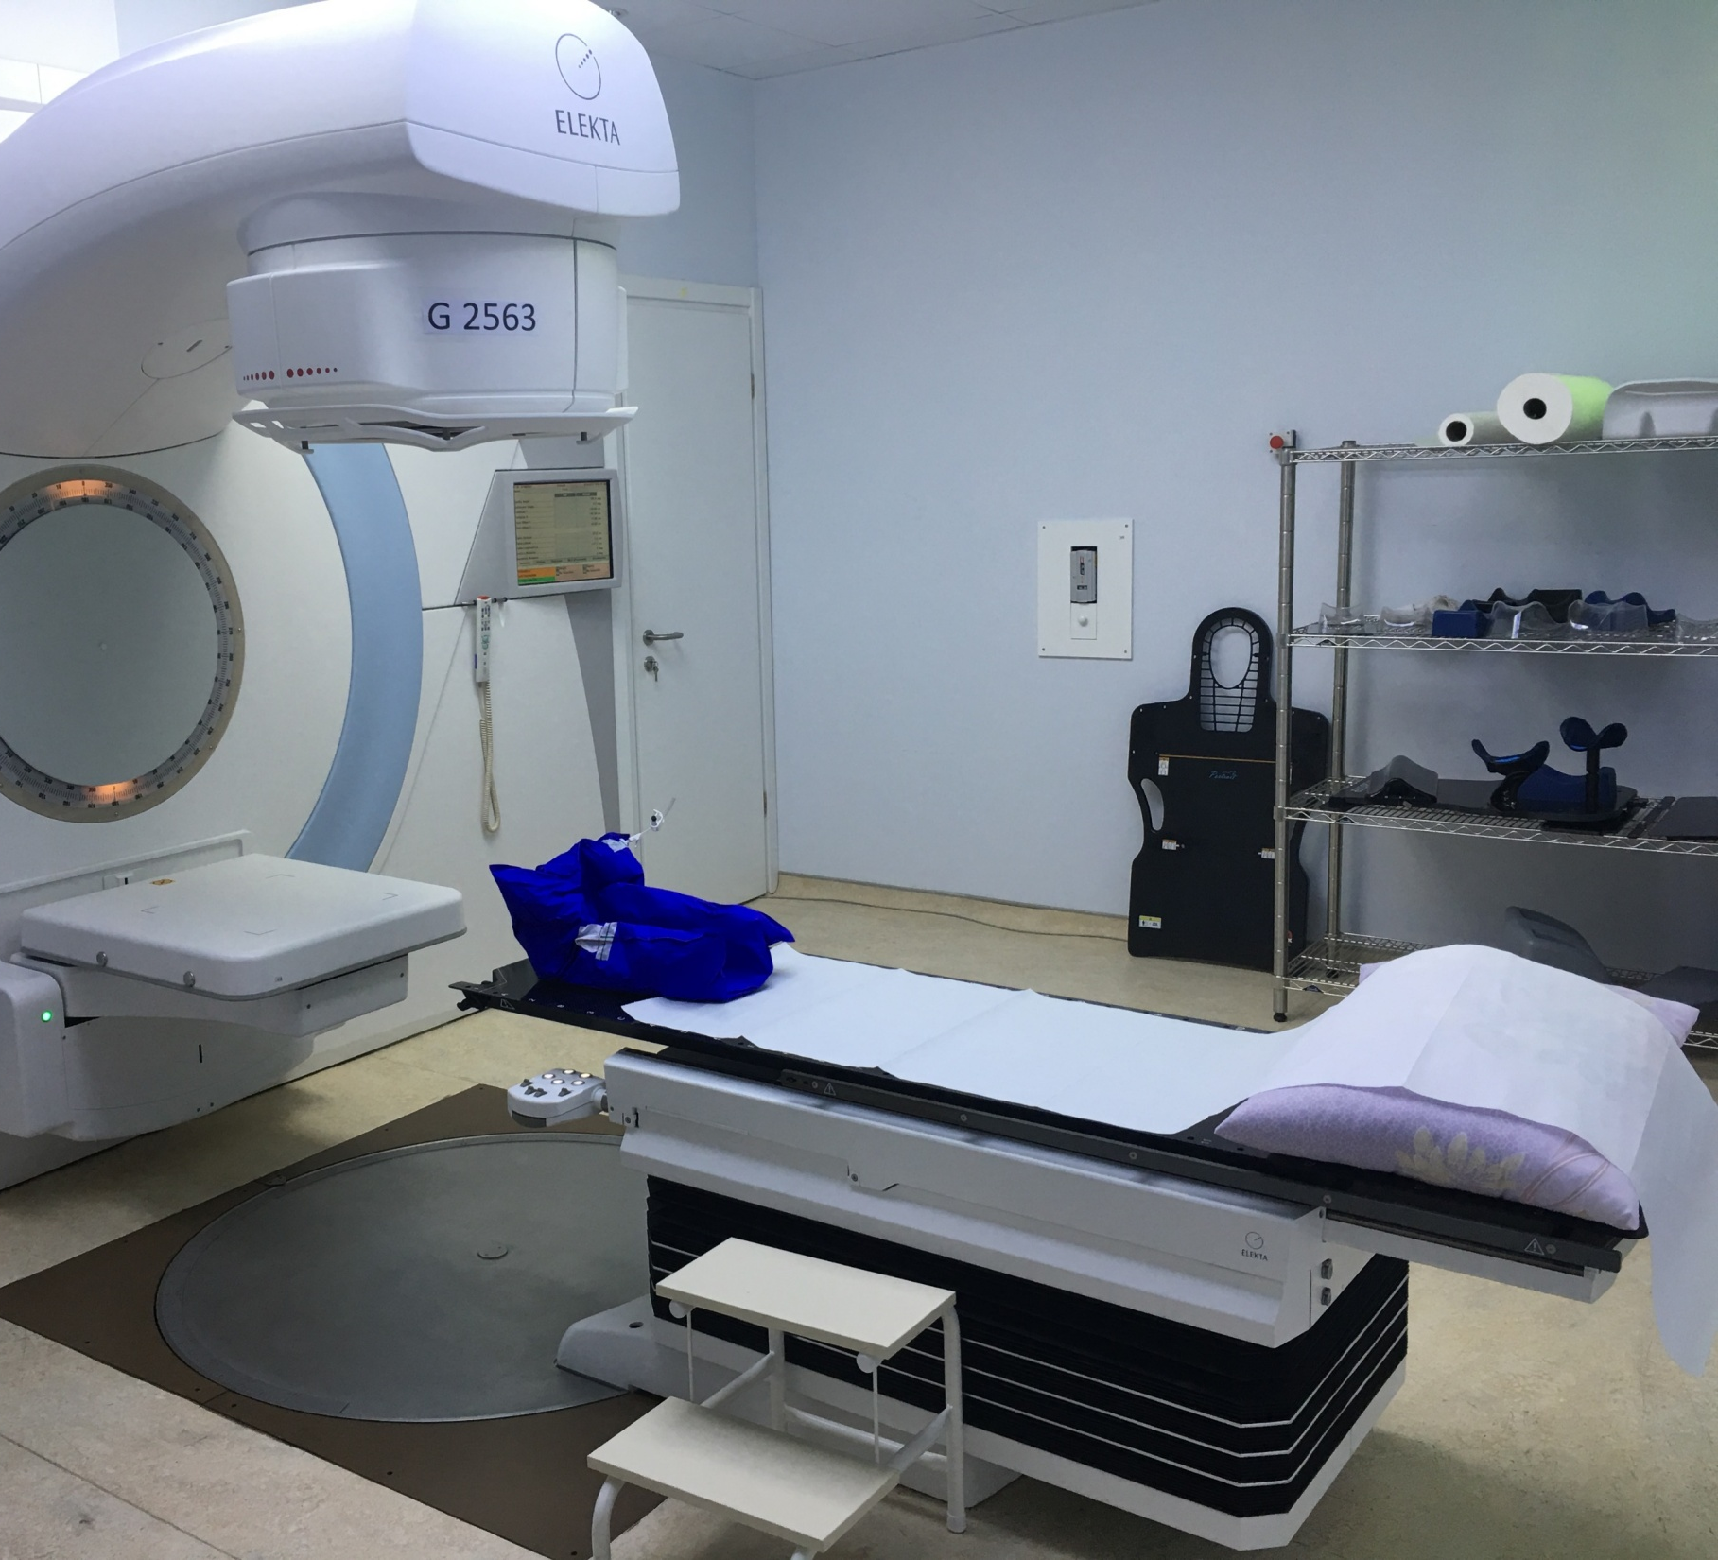
LH RMC - Synergy
LINNER ACCELERATORS

Slide 4
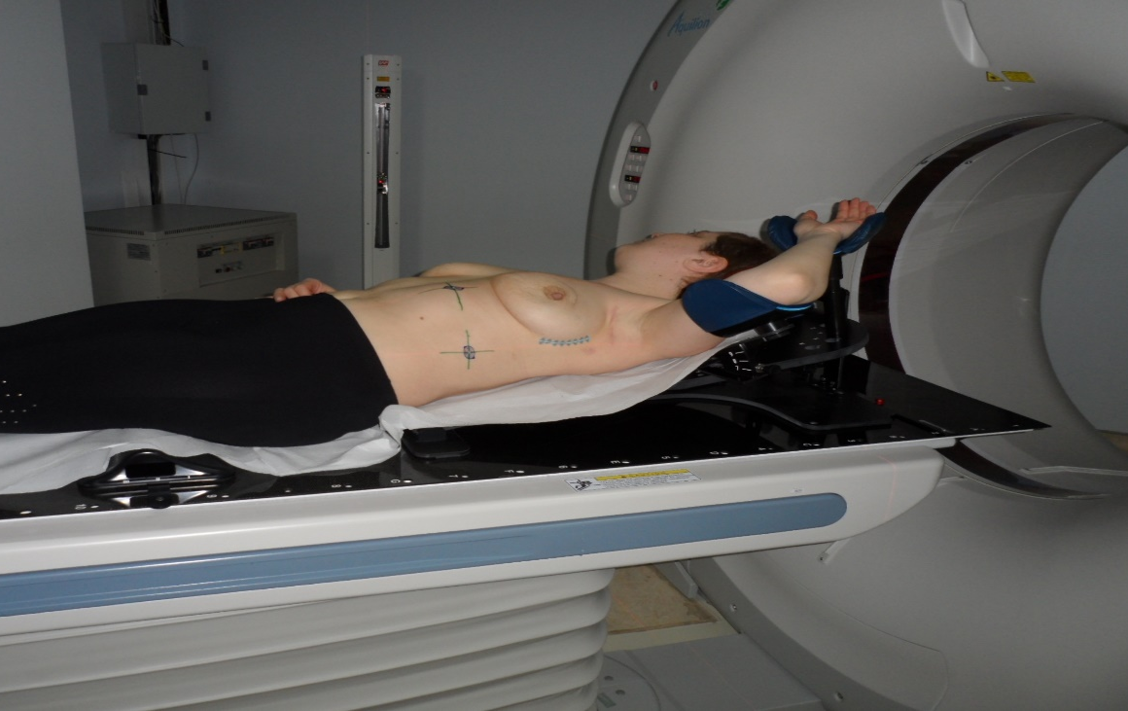
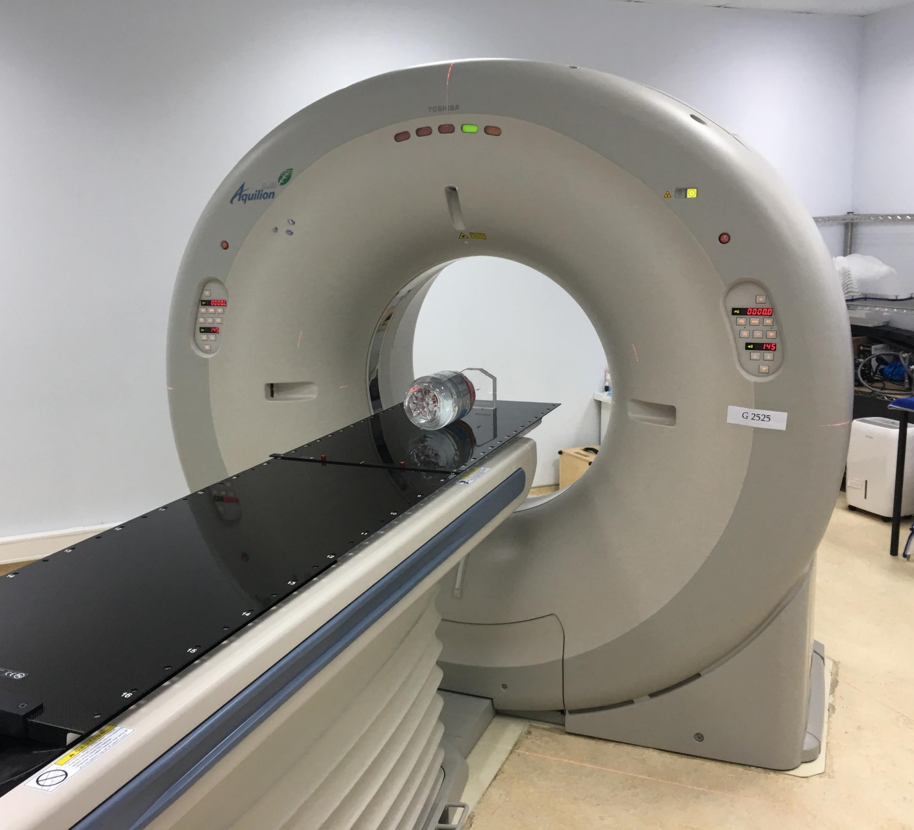
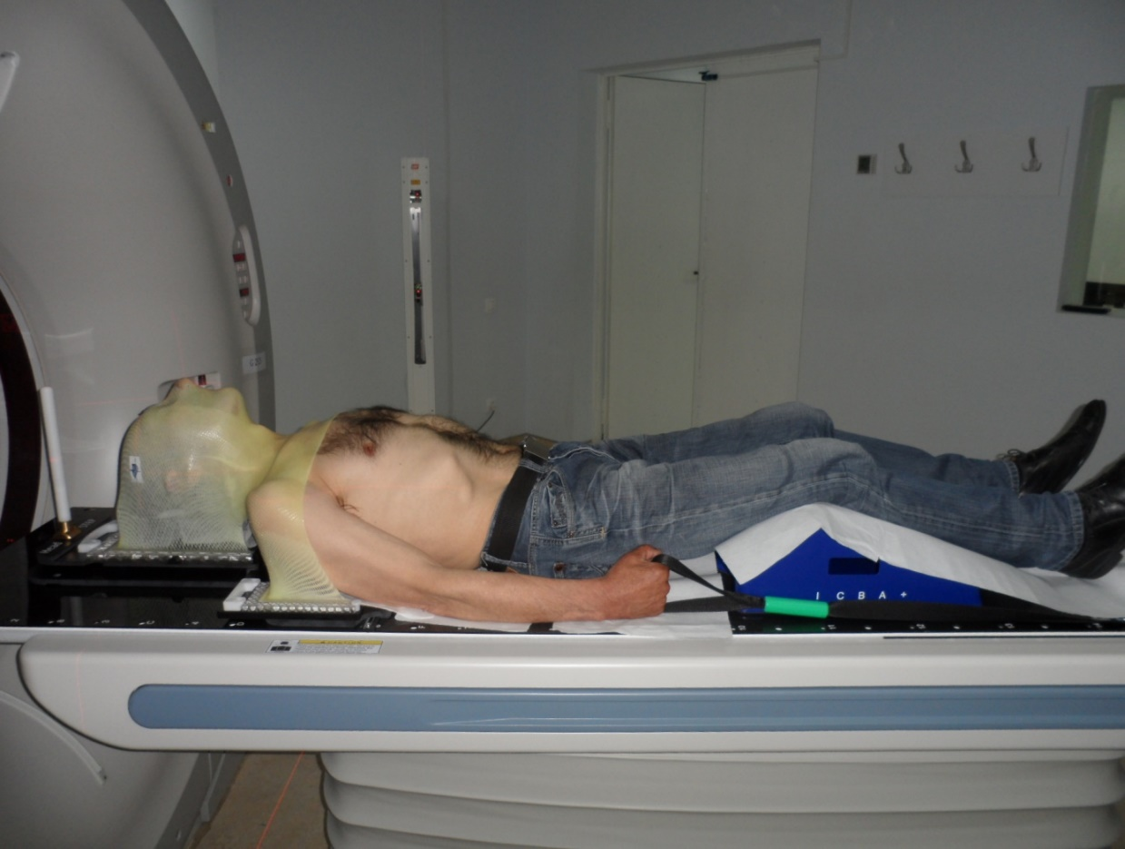
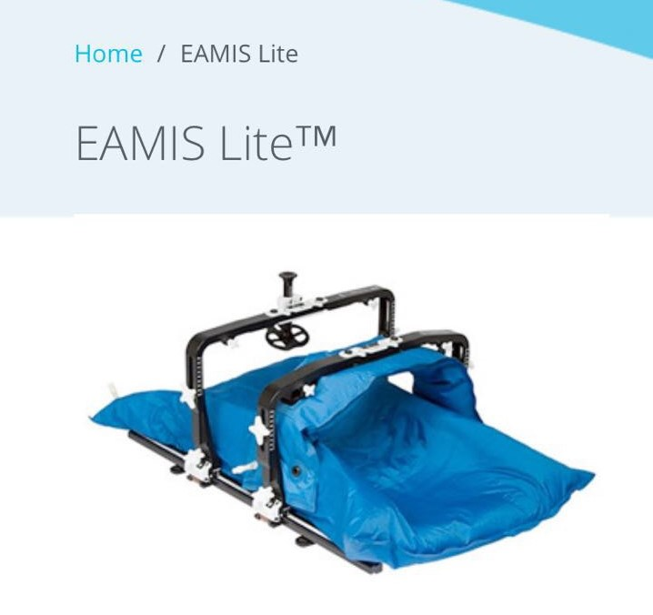
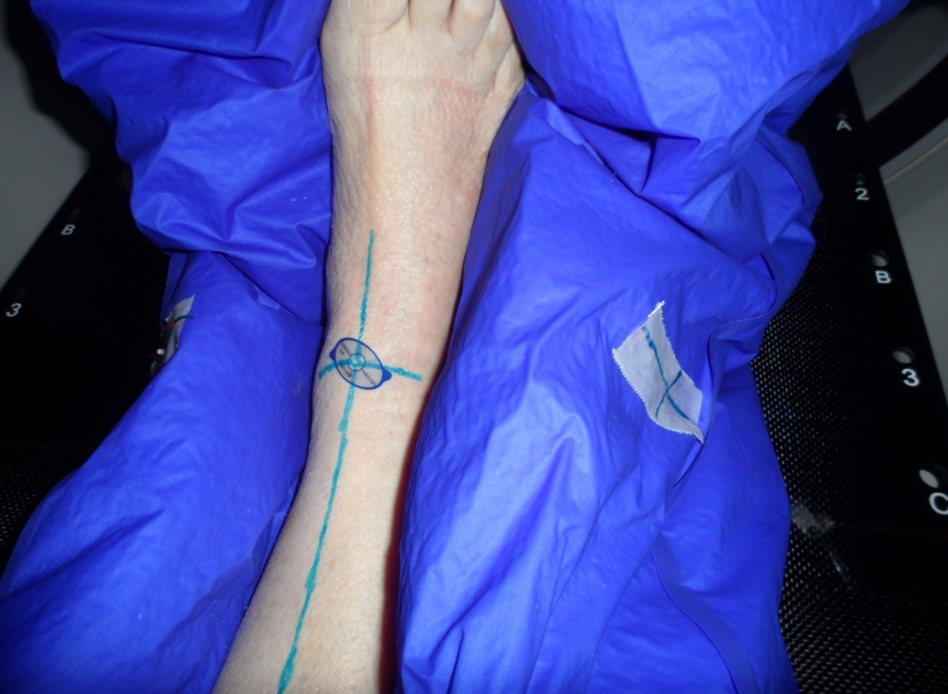
Simulation
Positioning is extremely important in radiation therapy.
Patient must be positioned carefully in order to get the best radiation treatment.
Patient must be in the same position during every treatment.
Easy and comfortable positon for ptns
Repeatable every day

Slide 5
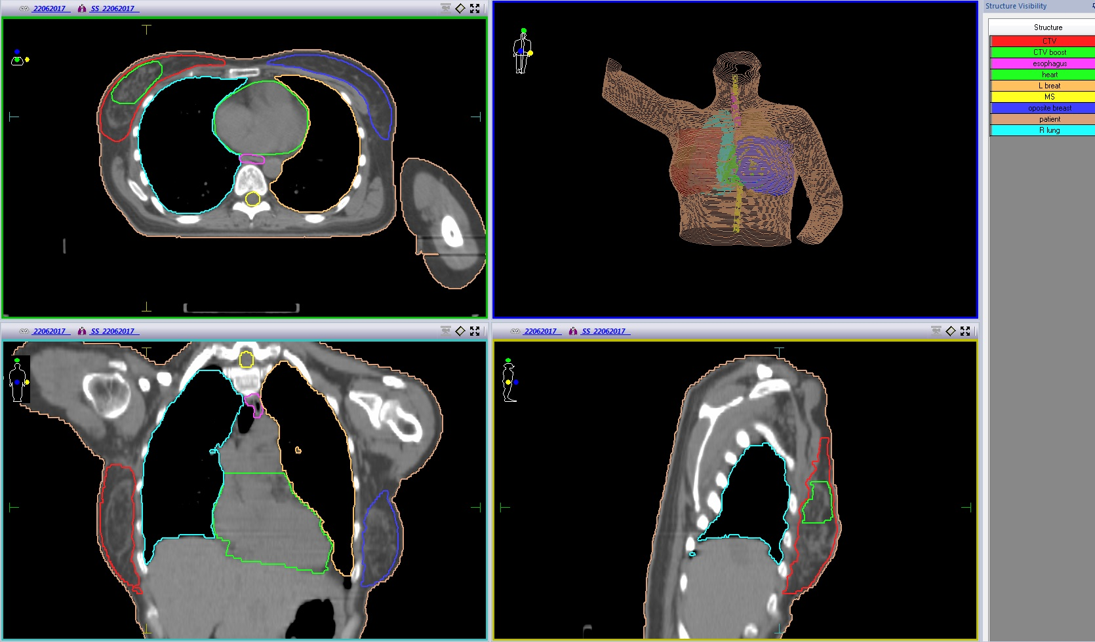
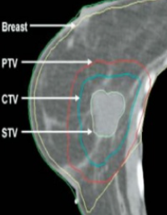
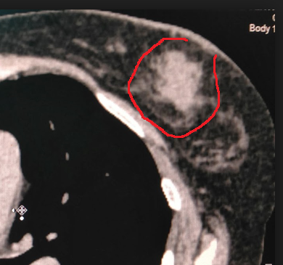
Contouring

Slide 6
LIV HOSPITAL RMC - Planning

Slide 7
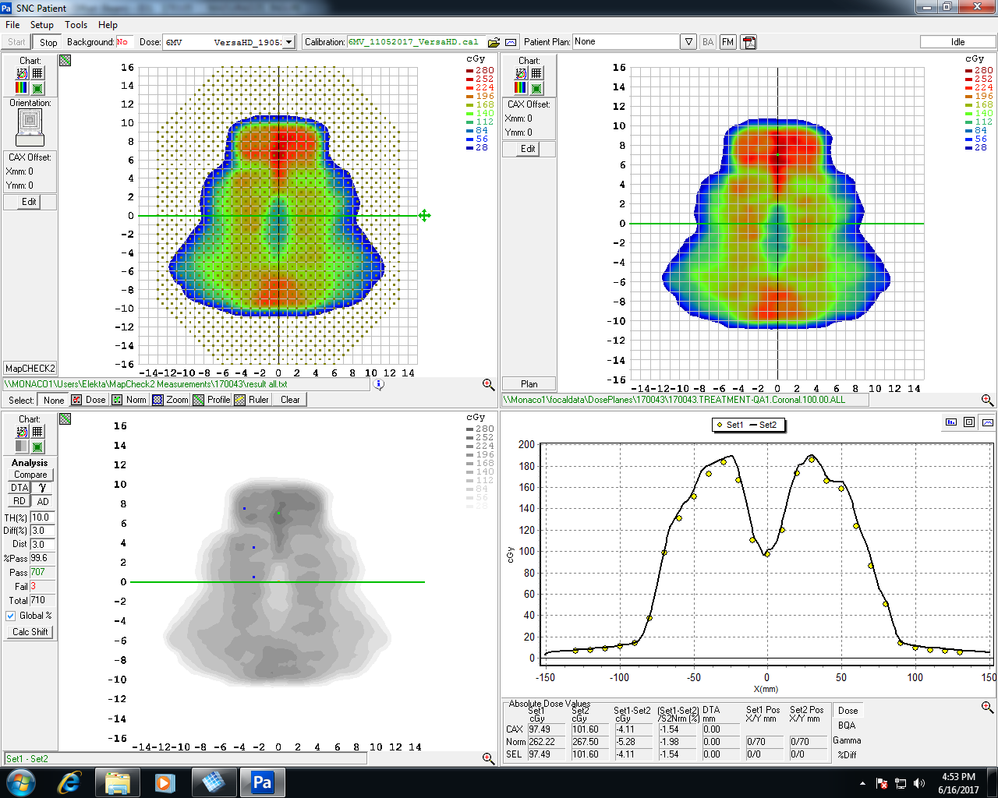
Coronal Plane Dose Analysis Sun Nuclear MapCheck 2

Slide 8
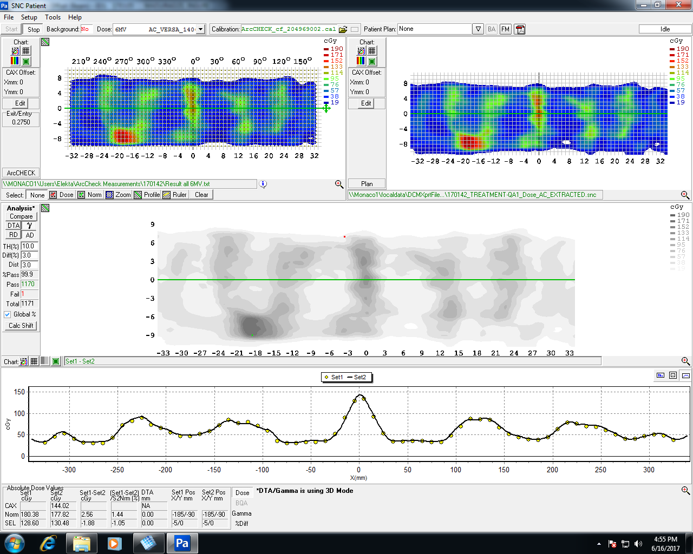
3D Dose Analysis Sun Nuclear ArcCeck

Slide 9
LH RMC – Set-up

Slide 10
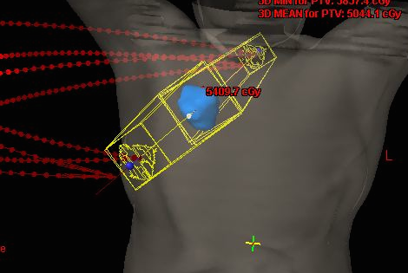
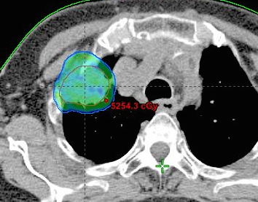
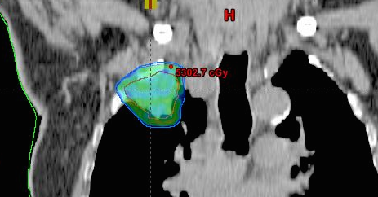
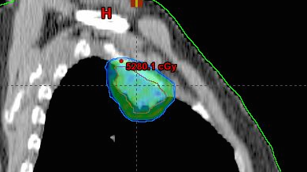
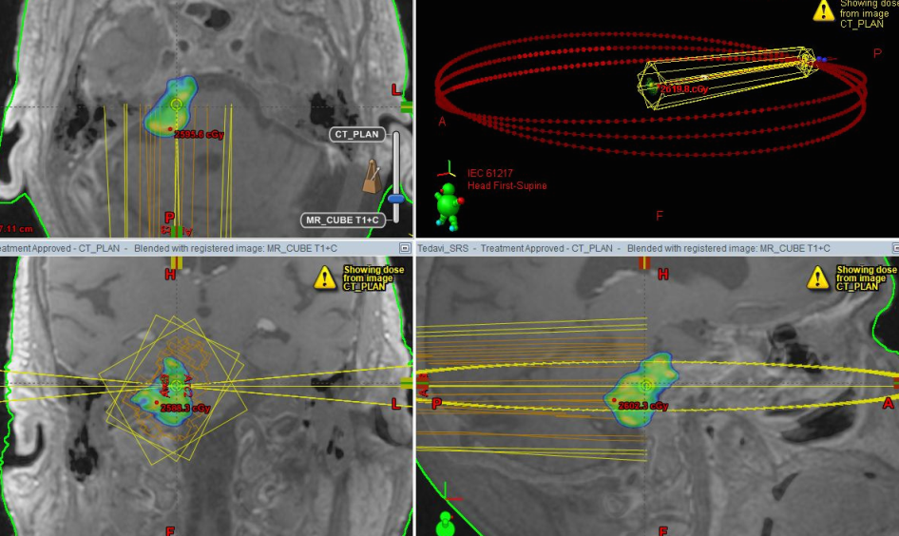
LH RMC - Treatments
Stereotactic RT SRS/SBRT
So the tumor receives a high dose of radiation and the tissues around it only receive a low dose.
This lowers the risk of side effects.
Primary Lung cancer
Primary Liver Cancer
Metastases (brain, lung, liver)
Acoustic schwannomas
Meningiomas

Slide 11
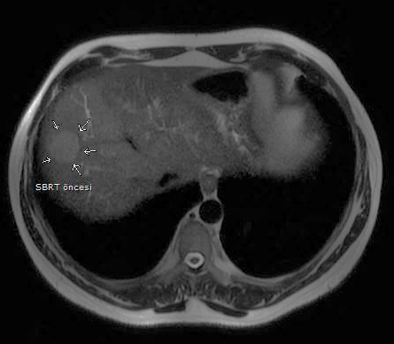
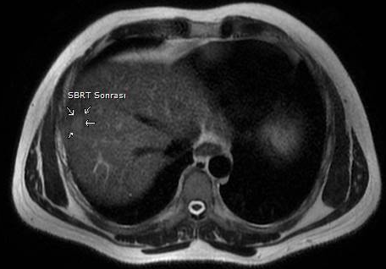
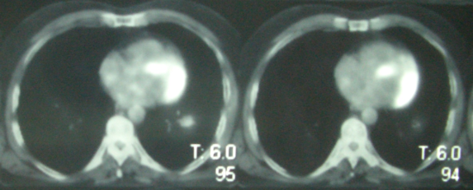
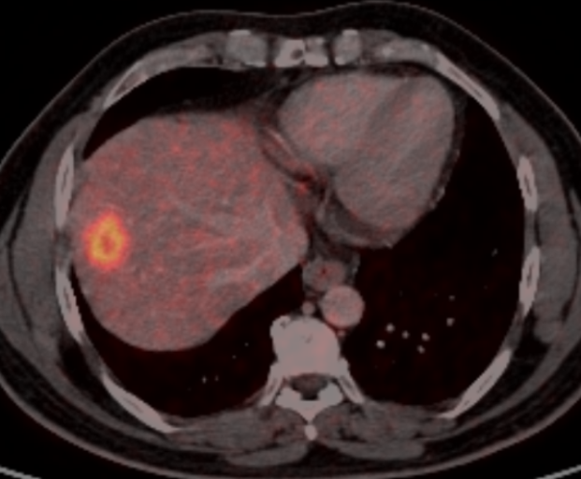
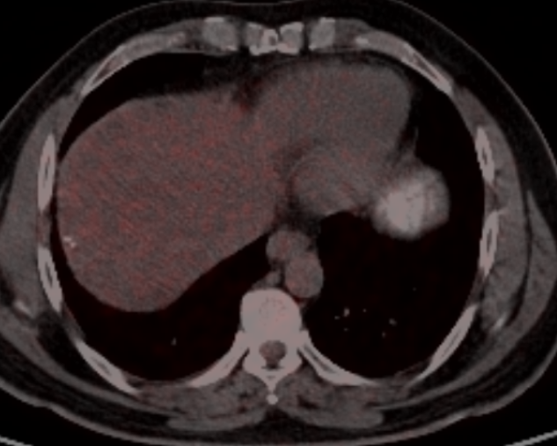
before
Stereotactic RT SRS/SBRT
er

Slide 12
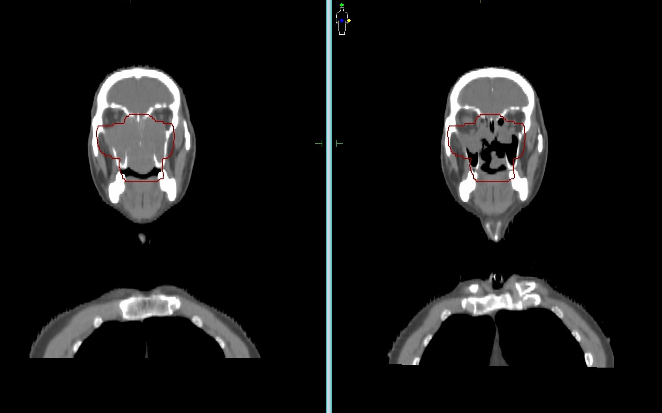
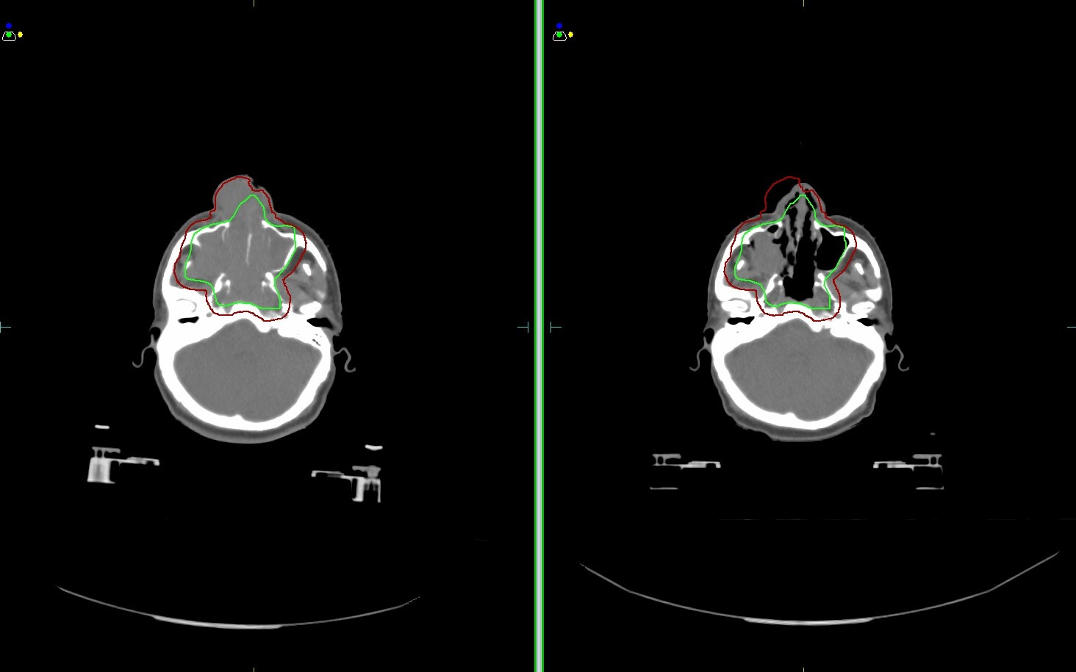
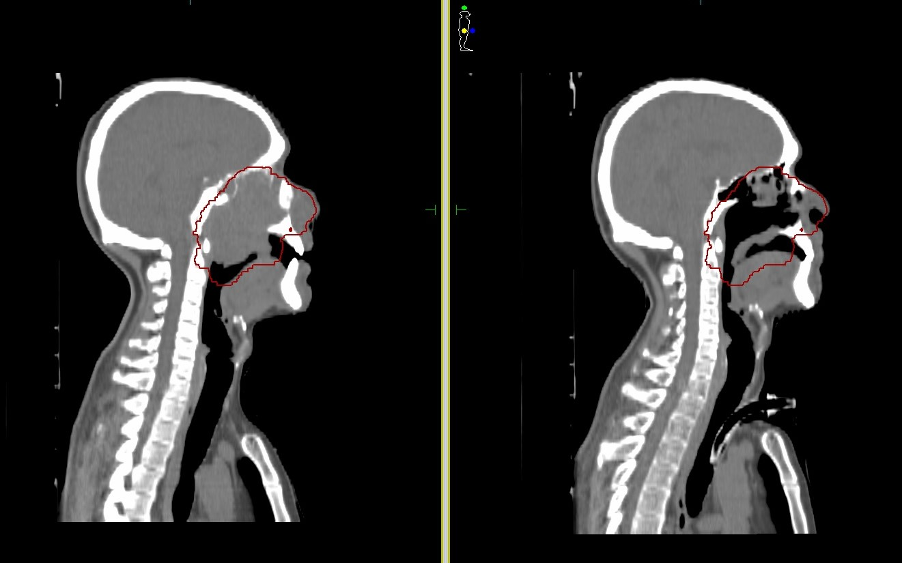
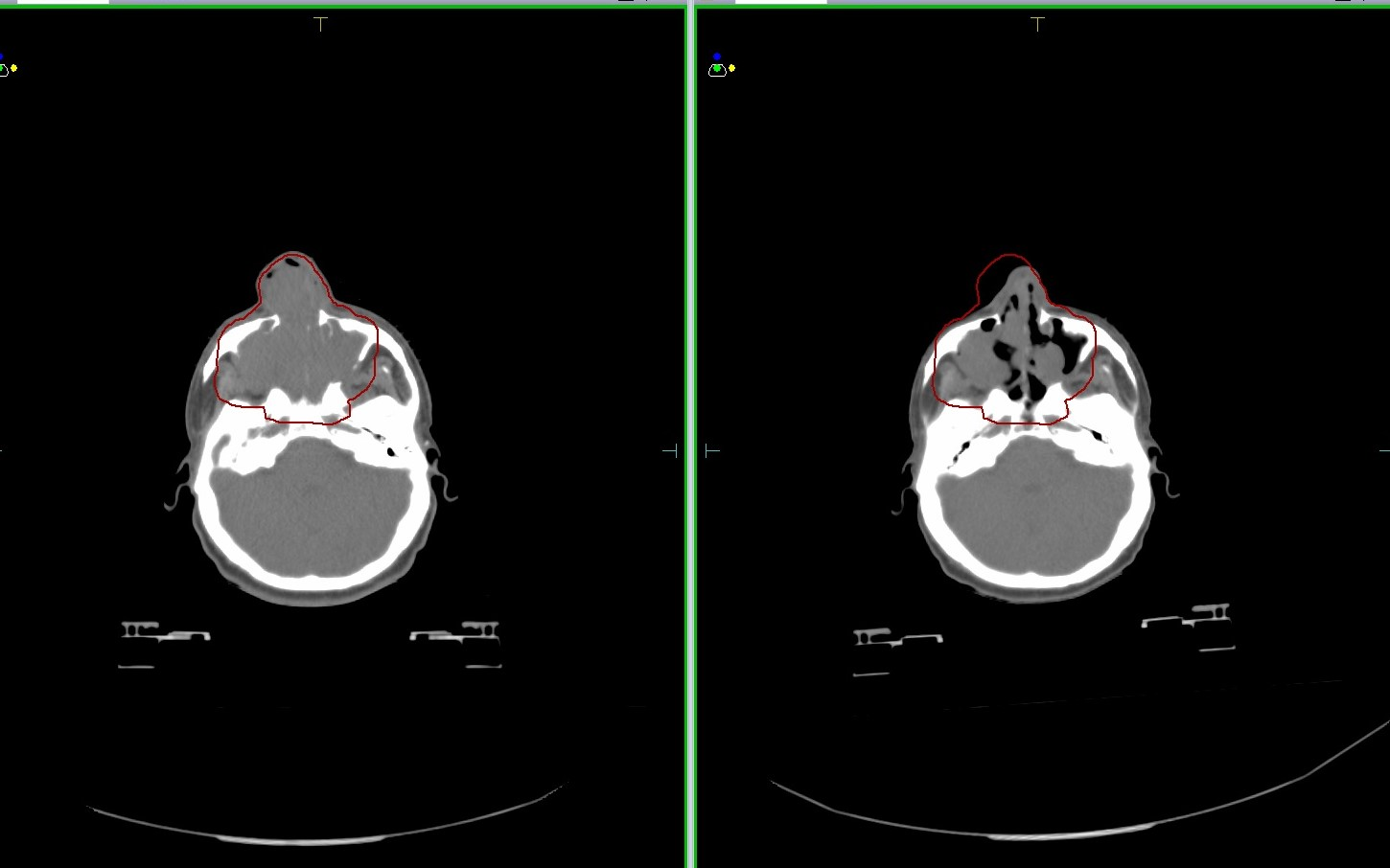
Thank you for attantion
!

