Slide 1
Nuclear processes and It’s role in medicine
Zurab Saralidze
Georgian Technical University
Supervisor-Prof. Dr. Ketevan Kotetishvili

Slide 2
Nowadays, medicine is difficult to imagine without physics, because recent inventions and processes that are being researched by physics quickly introduced in medicine .
Almost all brunches of physics are used in medicine , but at present I would like to speak about the nuclear and radiation processes that are widely used in medicine.

Slide 3
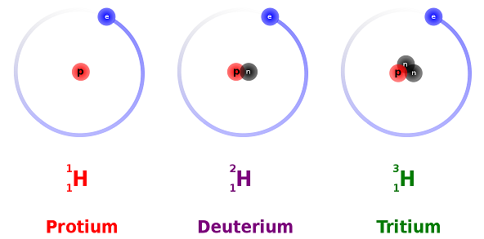
Radiaton was discoverd by Anri Bekerel in 1896.
It was thought that it was an unknown process in a substance that had some kind of radiation and of course it is so.
Illumination is any type of radiation but right now we are speaking about the radiation that is emitted as a resuet of nuclear devision and processes.
What is radiation? Where does it come from?
In the nature around us there are chemical elements that are mainly in stable condition but all these elements have their own isotops that are radio active-radionuclid.

Slide 4
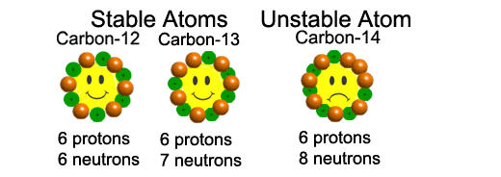
What is radioactivity?
All kinds of matter consists of atoms and molecules, molecules consist of atoms, as for atoms we can consider them as planetary models, where we have a nucleus and electrons moving around it . The nucleus consists of protons and neutrons that identifies the substance, its mass and accordingly its chemical and physical features, as well as radioactivity. Different changes or nuclear reactions can start in the nucleus under certain conditions. These reactions can be of various types and all of them emit some kind of energy.

Slide 5
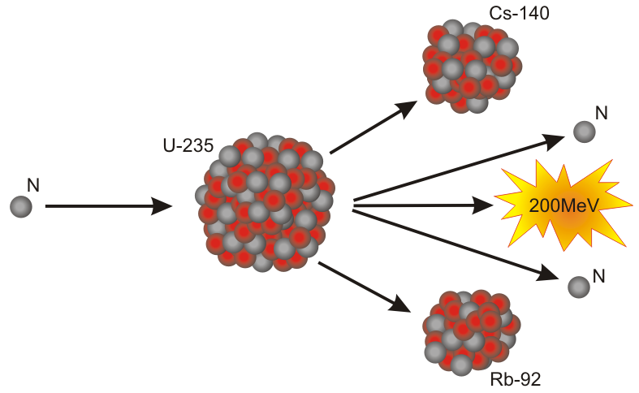
One kind of nuclear reaction is a nuclear splitting. During the process we get some nucleus development , particle and energy radioation. The emitted energy is a mass defect. The starting mass product is more than we got as a result of the nuclear splitting. ${E=mc}^{2}$

Slide 6
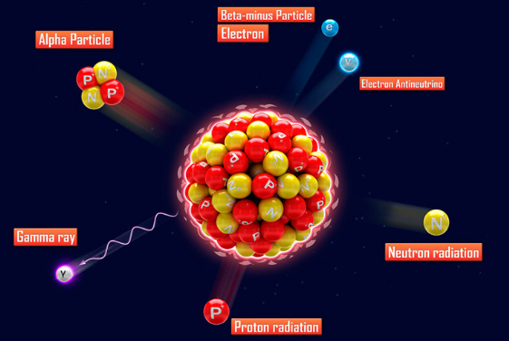
Besides nuclear splitting the nucleus can scatter neutron, electron, positron, proton, helium nucleus or hight energy electromagnetic waves. The result is either a whole change of the chemical element or it becomes a different isotope, having different characteristics.

Slide 7
There are two types of radiation after nuclear splitting: particle radioation and electro-magnetic. During the particle radioation particles have a mass, as for electromagnetic y and high energy x rays. They have only the mass of moving.
Types of particle radiation are:
$α$-helium nuclear, 2 protons, 2 neutrons, -$β$ electrone, +$β$positron. Its contact with an electron causes annihilation and the result is the disappearence of positrons and electrons and 2y quant illumination. Neutrons are fast, slow, hot.
All above mentioned radiations have very small sizes in comparison with they energies. It’s the very reason why they have destructive effect on living beings.

Slide 8
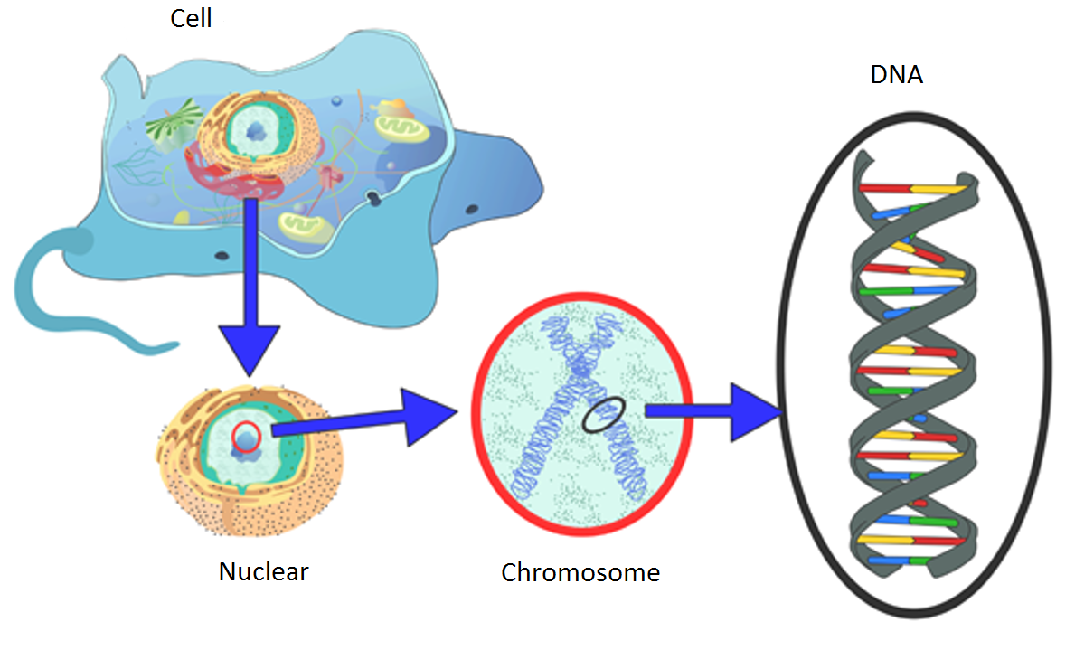
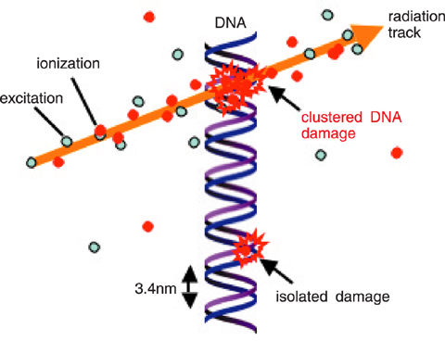
Nowadays it’s considered that radiation has a bad effect in living beings because it can give a huge energy to such small and important parts like DNA and if DNA is damaged it’s impossible to recover it. The transmission of high energy to the nuclear of the cell causes it’s ionization and formation of radicals in it. And that damages the DNA chain. It is the chain that is impossible to reconstruct the human body somehow manages to reconstruct, sometimes it can’t. in the result it the death of this cell or degradation there is a damage of different parts of she body due to the damage of different cells.

Slide 9
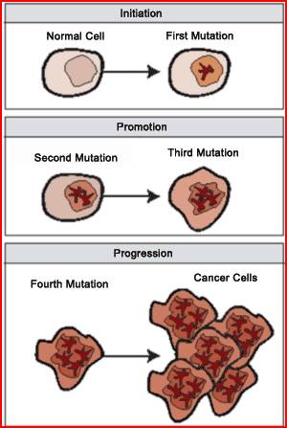
Radiation is widely used in oncology to destroy cancer cells. What is a cancer cells? In an ordinary case here is a limit of multiplication of healthy cells, after which it stops reproduction. As for cancer cells they can reproduce continually, rapidly and especially in a human body. And in the process of reproduction the number of chromosomes is double.

Slide 10
As we have already mentioned cancer calls reproduce constantly and rapidly and besides this type of cells have the highest density of chromosomes. Let’s see these two pictures to prove why radiation is destructive for cancer cells. In one case there is one target and in the other case there are two targets. The possibility to hit the target is more in the second case so we will need less shoots. The radiation has a similar effect less radiation is used to kill cancer cells. There is always possibility for radiation to damage cells but as for cancer cells they are more vulnerable.

