Slide 1
Georgian-German School and Workshop in Basic Science (GGSWBS)
Richard Kibler
Georgian Technical University
Department of Engineering Physics and Medical Physics
Supervisor: Prof. Dr. Ketevan Kotetishvili

Slide 2
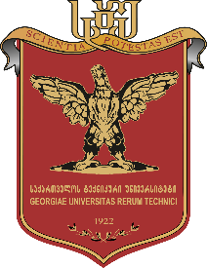
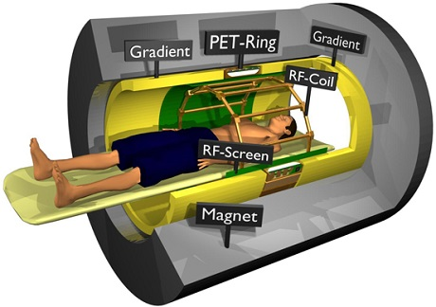
Combination of Imaging Techniques MR-PET

Slide 3
Presentation Outline
Few words about Magnetic Resonance Imaging (MRI)
The Physics of MRI
Few words about Positron Emission Tomography (PET)
β+ Decay
How does PET works?
Hybrid MRI-PET
Challenges - PET/MRI

Slide 4
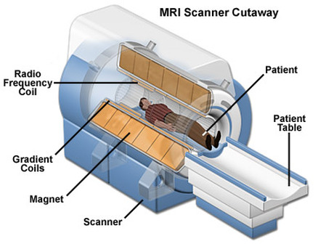
Few words about MRI
Magnetic resonance imaging (MRI) is a spectroscopic imaging technique used in medical settings to produce images of the inside of the human body.
MRI is based on the principles of nuclear magnetic resonance (NMR), which is a spectroscopic technique used to obtain microscopic chemical and physical data about molecules.
In 1977 the first MRI exam was performed on a human being. It took 5 hours to produce one image.
The components: A magnet which produces a very powerful uniform magnetic field.
Gradient Magnets which are much lower in strength.
Equipment to transmit radio frequency (RF).
A very powerful computer system, which translates the signals transmitted by the coils.

Slide 5
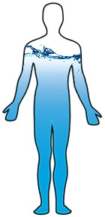
The Physics of MRI
The atoms that compose the human body have a property known as spin(a fundamental property of all atoms in nature like mass or charge).
Spin can be thought of as a small magnetic field and can be given a + or – sign and a mathematical value of multiples of ½.
Components of an atom such as protons, electrons and neutrons all have spin.
Human body is mainly composed of fat and water, which makes the human body composed of about 63% hydrogen.
The atom that the MRI uses is the hydrogen atom It has a single proton and is the most strongly affected by the Magnetic field – it is more likely to line up than other atoms the magnetic.
Protons and neutron spins are known as nuclear spins.
An unpaired component has a spin of ½ and two particles with opposite spins cancel one another.
In NMR it is the unpaired nuclear spins that produce a signal in a magnetic field.

Slide 6
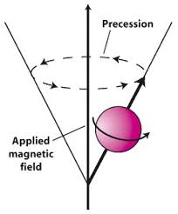
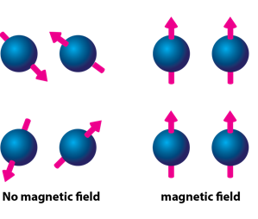
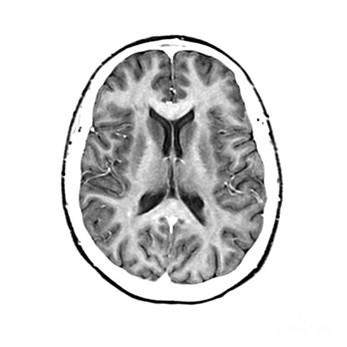
The Physics of MRI
Protons alignment
Fourier transform
RF Pulse
Inside the magnetic field the protons are lined up. The MRI scanner releases a Radio Frequency that is only picked up by hydrogen. This RF makes the protons spin at a particular frequency, in a particular direction. This is the Resonance bit. The resonance frequency, is referred to as the Larmor frequency. When the RF is turned off, the nuclei start to lose the energy and return to where they were in the magnetic field.
The coil now picks up that excess energy and sends the signals to the computer – which receives mathematical data, which is converted through the use of a Fourier transform into an image.

Slide 7
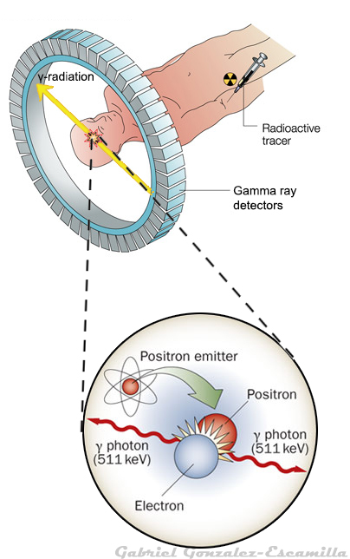
Few words about PET
Non-invasive Medical Imaging Techniques:
Anatomical:
X-ray
CAT
MRI
Ultrasound
Functional:
PET
SPECT
PET is a noninvasive, diagnostic imaging technique for measuring functional activity of cells in the human body.
It was the first scanning method to give functional information about the brain.
It measures metabolic activity, physiology and pathology of human body.
It works with the positron
Tracer is entered in body
PET is used in following areas – Neuroimaging, Clinical oncology (medical imaging of tumors), Musculo-skeletal imaging, Cardiology, Pharmacology, Neuropsychology

Slide 8
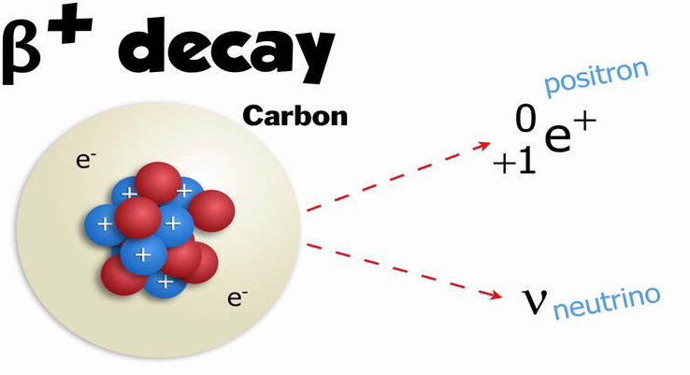
β+ Decay
What is a Positron?
A Positron is an anti-matter electron, it is identical in mass but has an apposite charge of +1.
Positron can come from different number of sources, but for PET they are produced by nuclear decay.
Nuclear decay is basically when unstable nuclei are produced in a cyclotron
β+ Decay Neutron-deficient isotopes can decay by emitting positrons
Net effect: one proton replaced by -neutron -anti-neutrino -positron

Slide 9
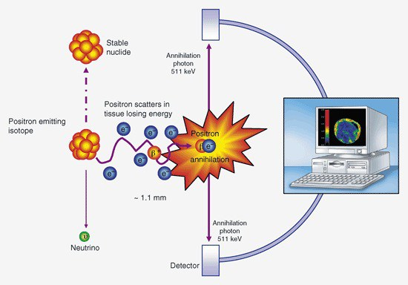
How does PET works?
Positron emitting tracer is injected into the body which emits positrons. After traveling a short distance (1-3mm), the positron emitted encounters an electron from the surrounding environment. The two particles combine and "annihilate" each other, resulting in the emission of two gamma rays in opposite directions of 511keV each.
511keV is the ideal rest state annihilation value.
These rays are detected by opposing detectors. The incident photon is converted into light and converted into electrical signals by PMTs. Then these signal is transfer to amplifier and other electronic circuit.

Slide 10
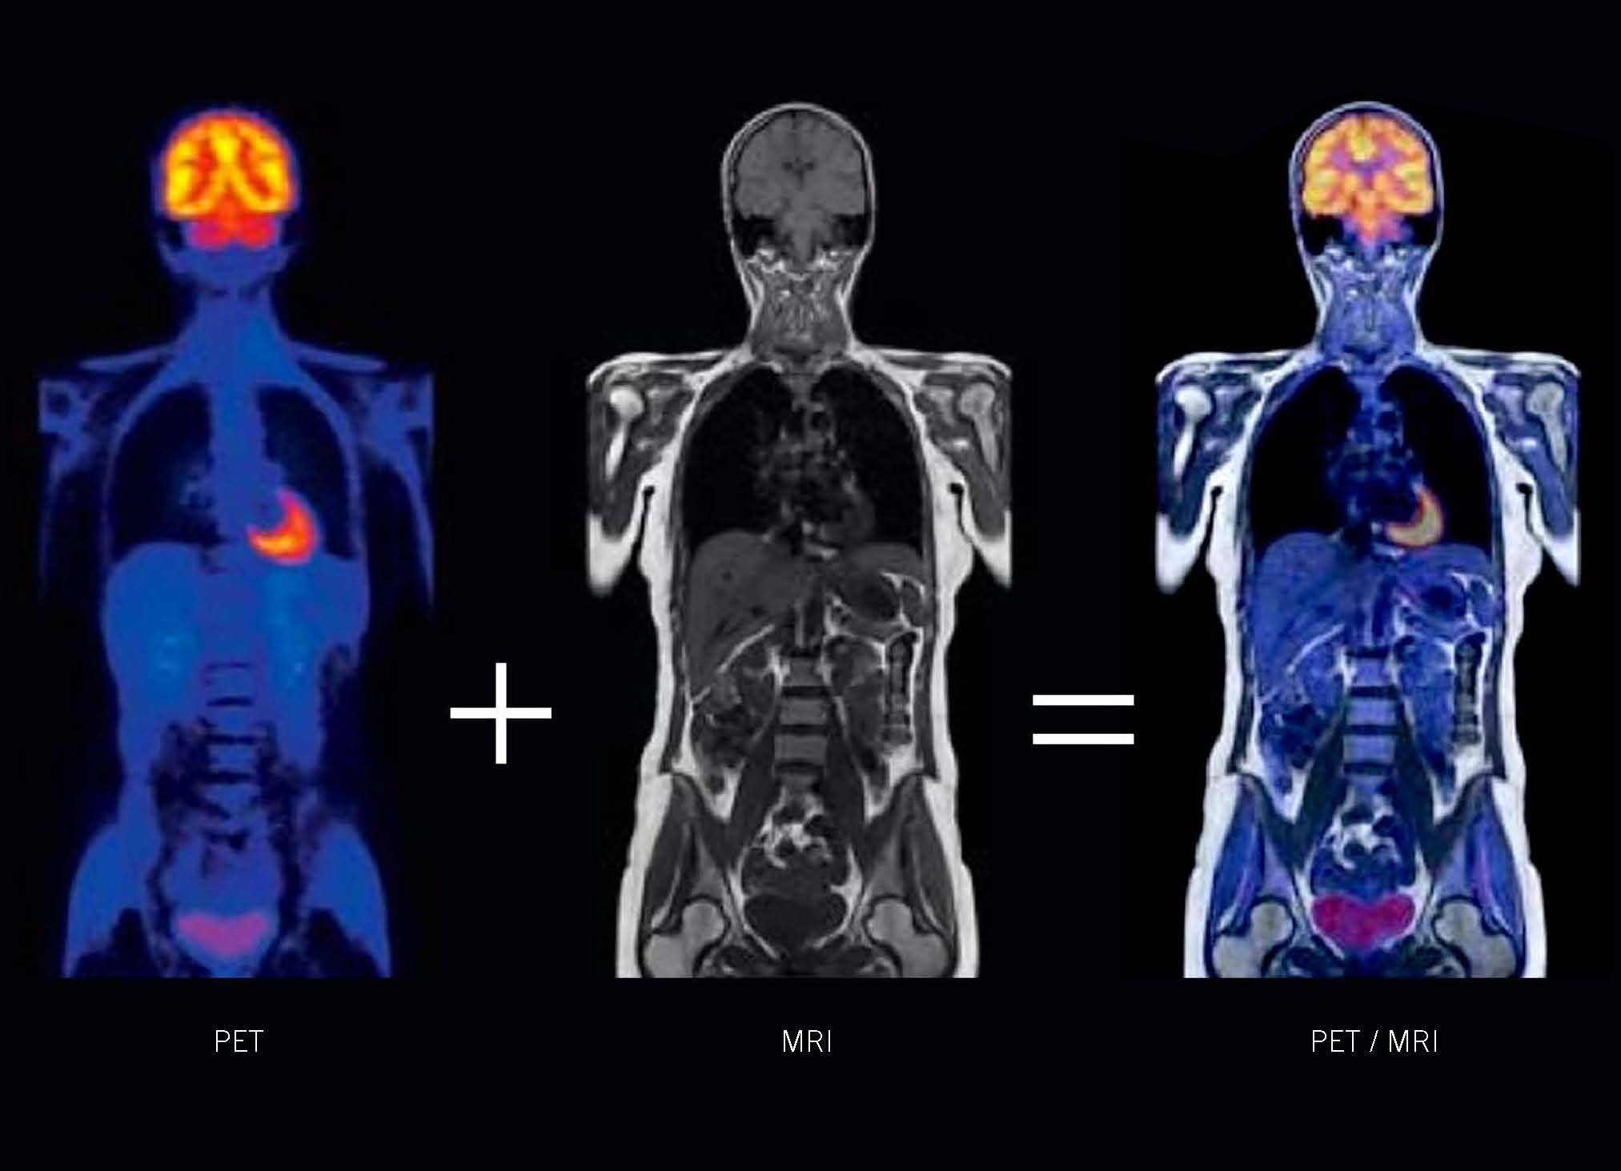
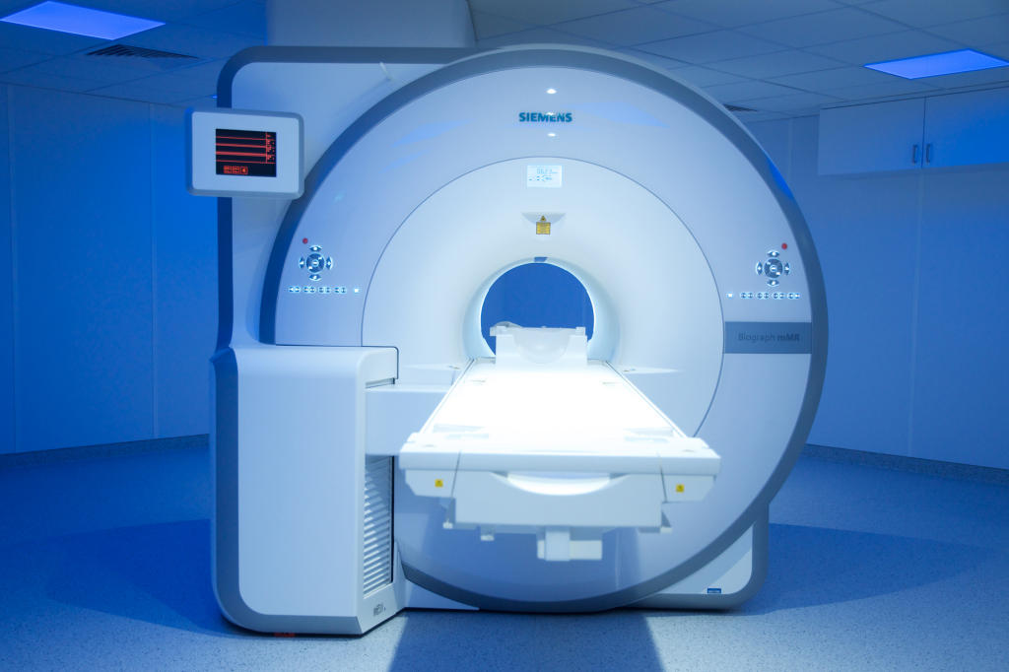
PET/MRI Hybrid
PET/MRI is a hybrid imaging technology that combines the molecular and functional information of PET with the soft-tissue contrast of MRI.
The idea to combine PET and MRI arose as early as the mid 1990s, even before PET/CT was introduced and the first brain-only prototype PET/MRI imaging system was installed by Siemens for research use in the late 2000s.
Over the last decade, the combination of PET and MRI in one system has proven to be highly successful in basic preclinical research, as well as in clinical research.

Slide 11
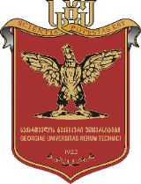
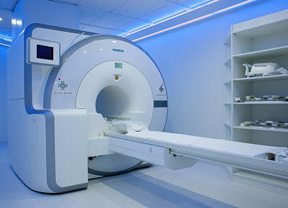
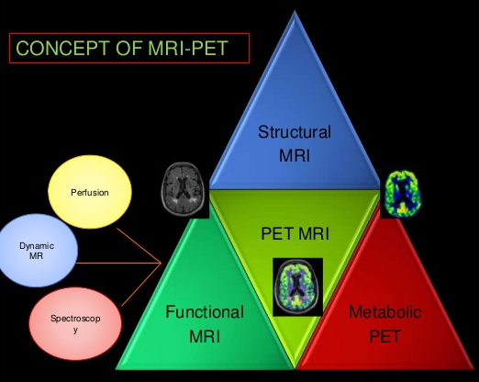
PET/MRI Hybrid
The PET/MRI combination requires 3 risky technologic steps that modify state-of-the-art PET and MRI. 1. First, the photomultiplier technology must be replaced with magnetic field–insensitive photodiodes. 2. Second, compact PET detectors must be constructed so that it shouldn't interfere with the field gradients or MR radiofrequency. 3. Finally, the MRI scanner must be adapted to accommodate the PET detectors and to allow simultaneous data acquisition without mutual interference.
CLINICAL POTENTIAL OF PET/MRI
It is reasonable to expect that brain PET/MRI will provide new insights in the field of neuroscience and neurologic disorders, such as neuro degeneration, brain ischemia, neuro oncologyor seizures .
It is feasible with current prototypes and future-generation systems to simultaneously study brain function, metabolism, oxygen consumption, and perfusion.
In oncology, an accurate spatial match between PET and MRI data is mandatory for both radiation therapy planning and biopsy guidance.

Slide 12
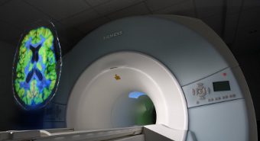
Motivation & Challenges - PET/MRI Hybrid
Challenges of PET-MR:
A fundamental problem to overcome is that photomultiplier tubes (PMTs) do not function within the strong magnetic field required for MR imaging (MRI).
Development and optimisation of MR-PET applications.
Challenges of PET: Radiochemistry - better tracers
Imaging Physics - better images by
• Detector design
-Better Sensitivity
• Image processing -Corrections for physical effects
-Image reconstruction algorithms
Data Analysis & Biological Modeling - better interpretation of images
In Forschungszentrum Juelich locates the hybrid scanner 3TMR-PET which consists of a high resolution BrainPET, newly constructed by Siemens, and a commercial 3T MAGNETOM Trio MRI scanner. Also, the 9.4TMR-PET which combines the BrainPET with a 9.4TMRI developed through collaboration between the Forschungszentrum Juelich and Siemens.

Slide 13
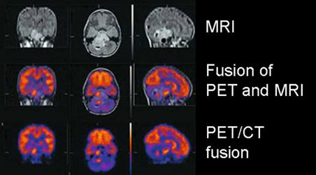
PET/MRI Hybrid
Advantage of PET/MRI over PET/CT
is not associated with significant radiation exposure
has a much higher soft tissue contrast.
MRI allows for additional techniques - such as angiography, functional MRI, “diffusion” spectroscopy.

Slide 14
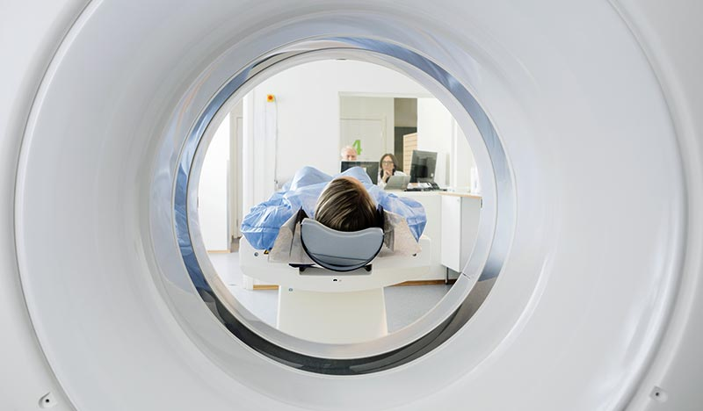
Thank you for your attention !

