Slide 1
MEDICAL IMAGING TECHNOLOGIES
Natia Beriashvili
Adviser: Prof. Dr. Ketevan Kotetishvii

Slide 2
Contents
Introduction to MRI physics
Relaxations and Sequences
MRI Scan Purpose
Differences Between CT MRI and PET

Slide 3
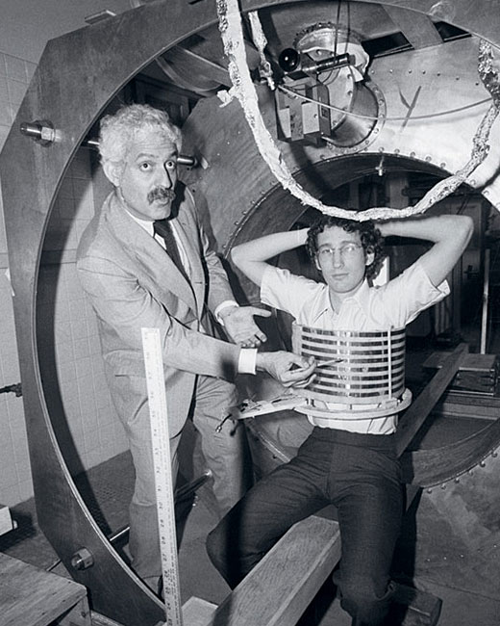
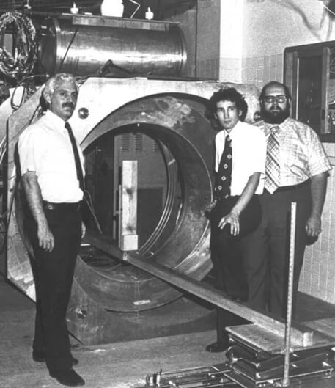
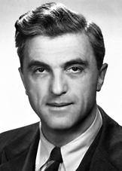
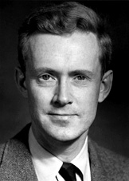
History of MRI
Discovered simultaneously by two physicists in 1947
The Nobel prize in physics 1952 was awarded jointly to
Felix Bloch
and
Edward Mills Purcell

Slide 4
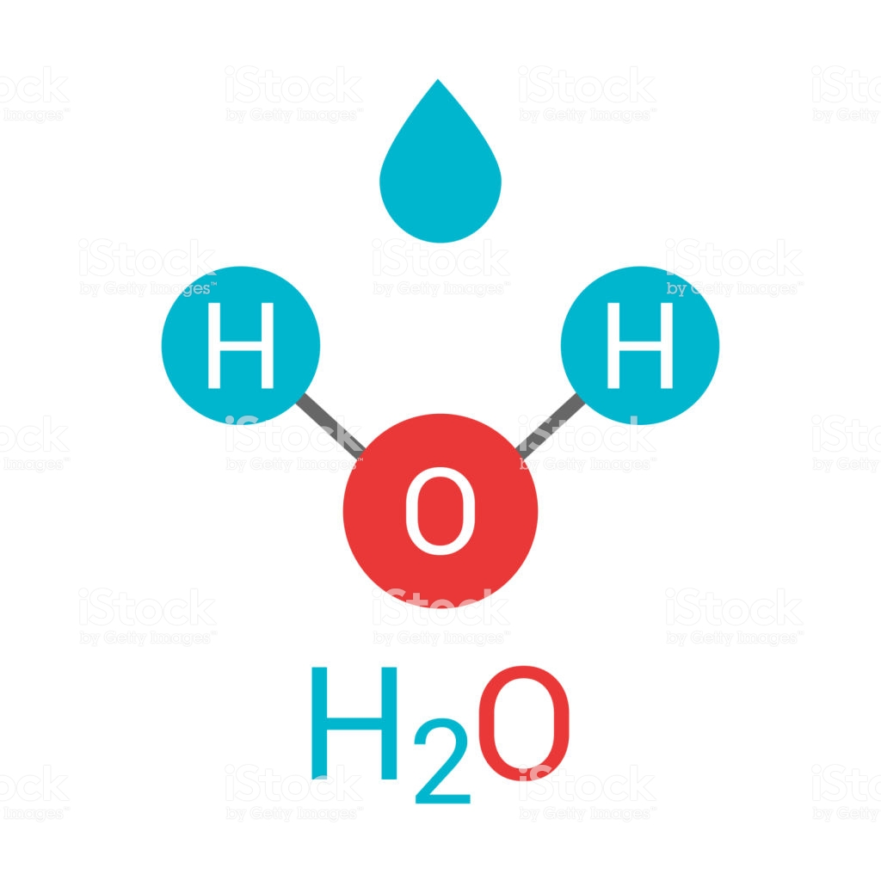
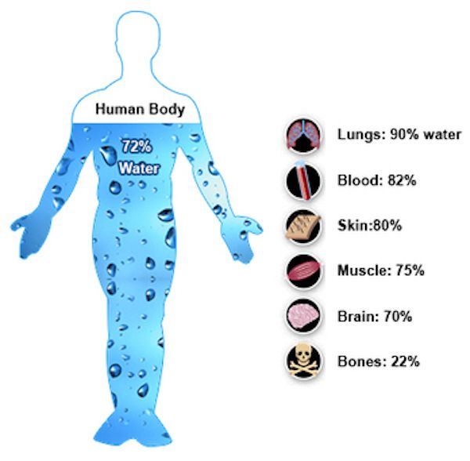
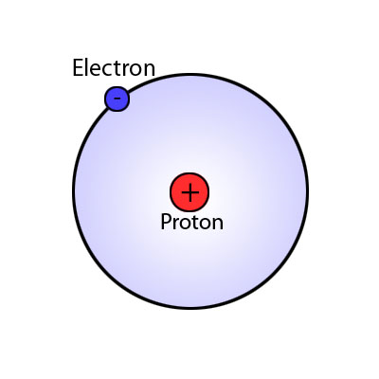
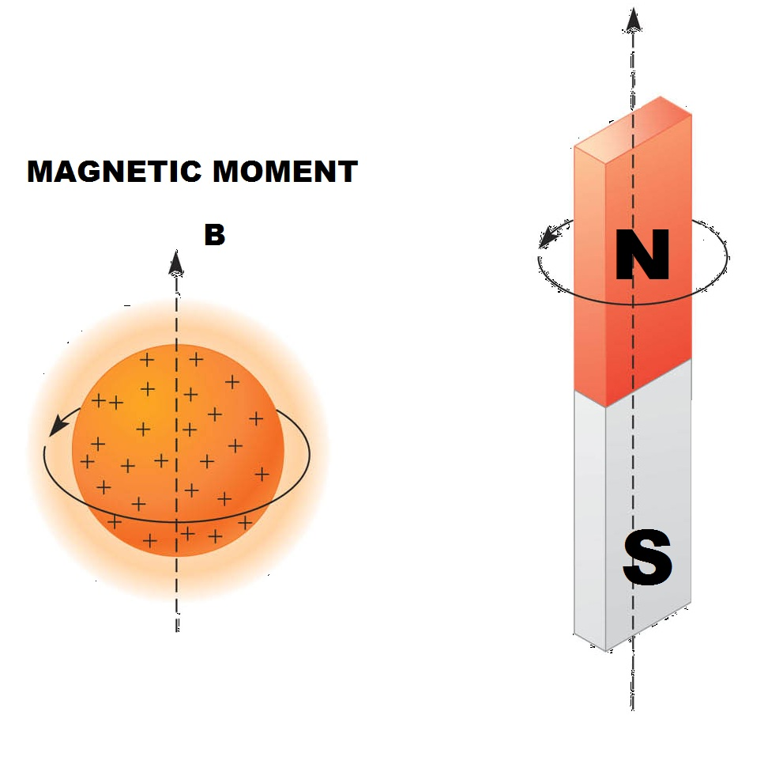
Our body consists approximately
60 – 70% Water
Water in itself includes Hydrogen which has highest sensitivity to magnetic resonance

Slide 5
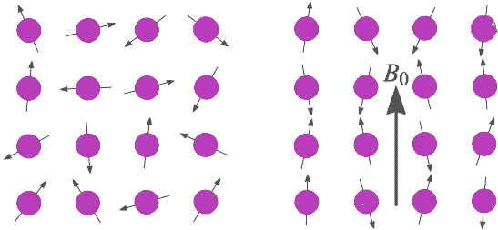
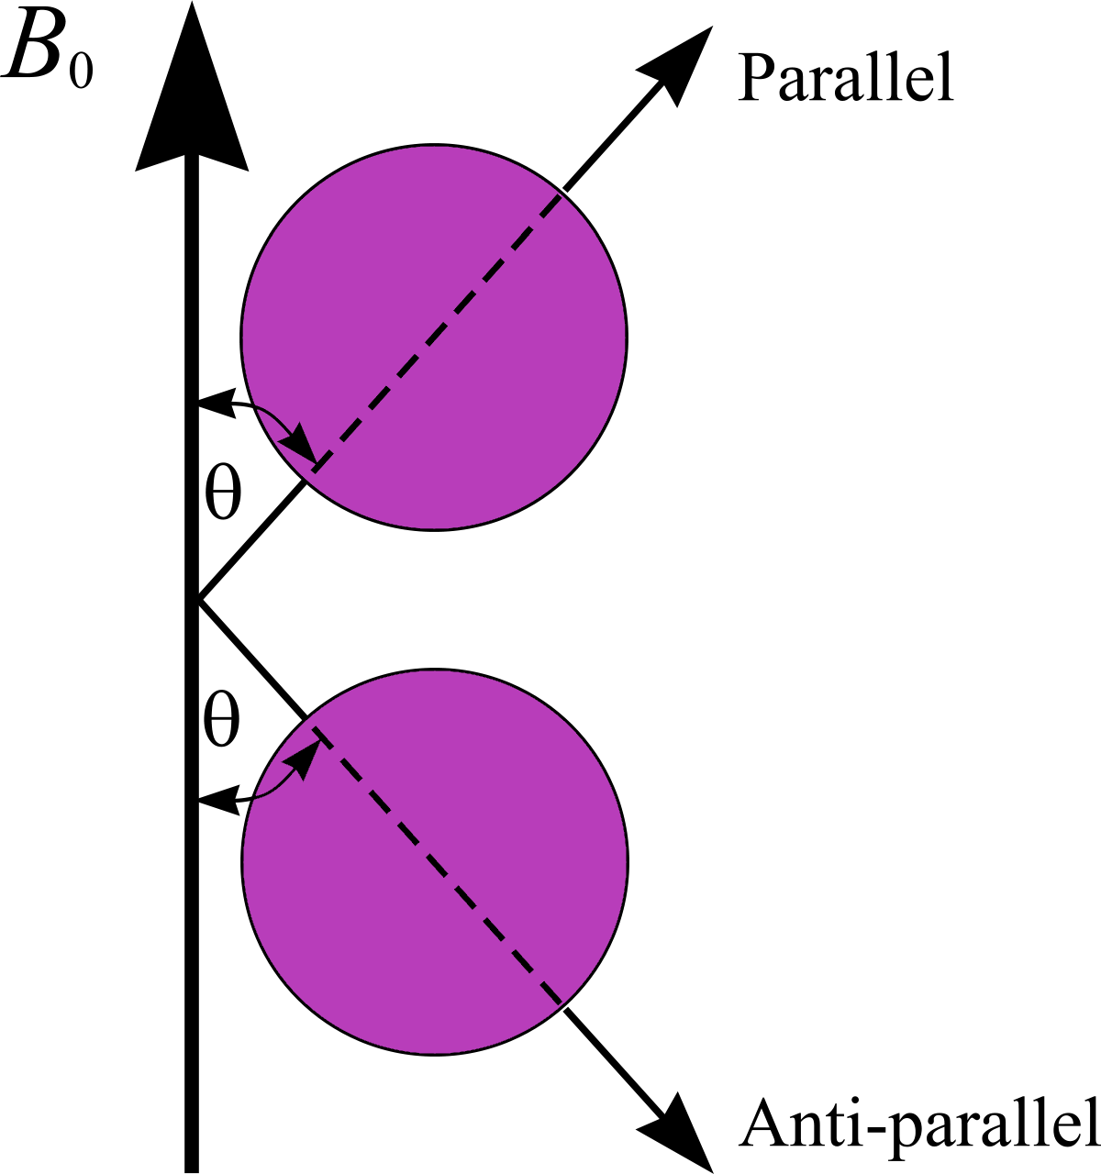
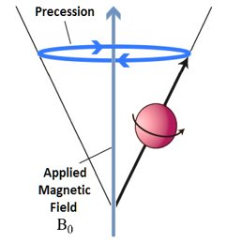
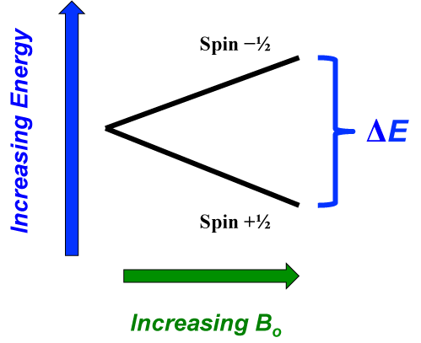
No External Magnetic Field
Applied External Magnetic Field B0
RF Pulse
ΔE=2µzB0

Slide 6
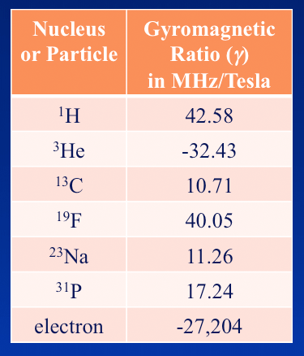
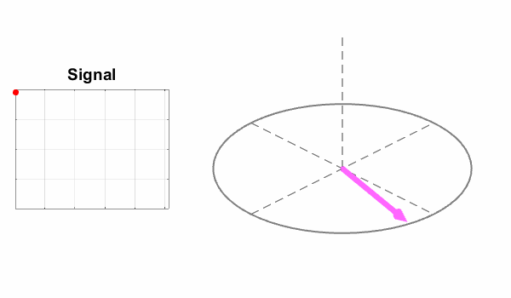
Larmor Frequency
Frequency of precession of magnetic moments given by Larmor equation. The Larmor or precessional frequency in MRI refers to the rate of precession of the magnetic moment of the proton around the external magnetic field

Slide 7
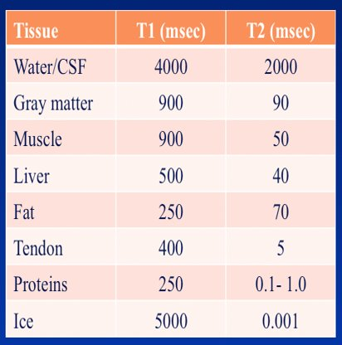
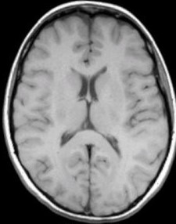
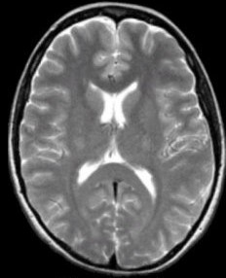
Relaxation
When RF pulse is stopped the higher energy gained by protons is retransmitted and hydrogen nuclei is relaxed by two mechanisms
T1-longitudinal (spin-lattice) relaxation-by which original magnetization (Mz) begins to recovery
T2-transverse (spin-spin) relaxation- by which the transverse components of magnetization (Mxy) decay or dephase.
Fat
T2<<T1
CSF
White Matter

Slide 8
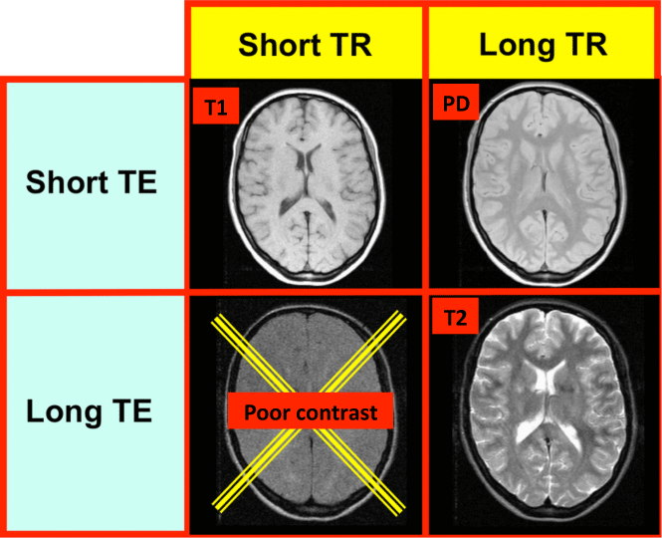
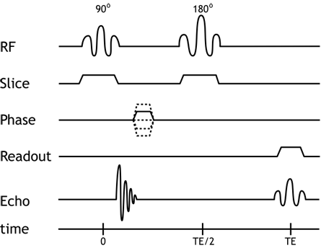
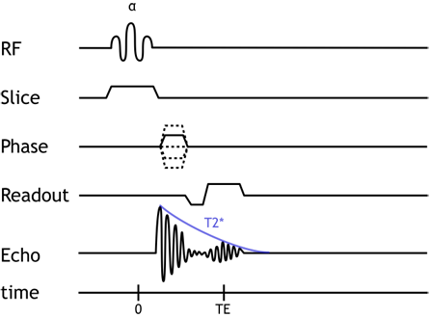
Sequences
SE is generated by two successive RF-pulses, typically 90 – 180 pair
GRE signal generated by RF + gradient reversal

Slide 9
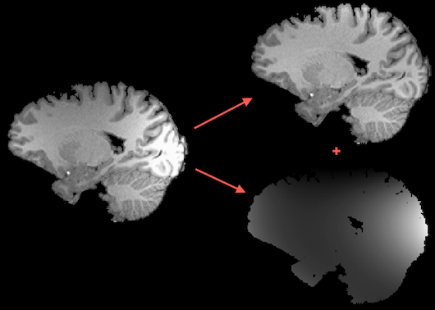
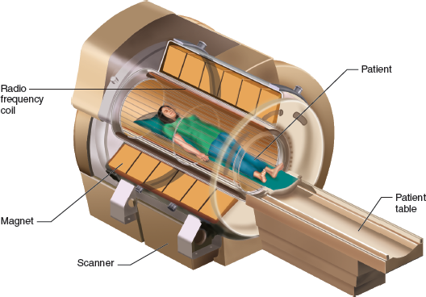
Structure of MRI machine
Permanent magnets
Resistive magnets
Superconducting magnets

Slide 10
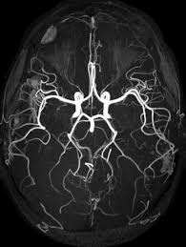
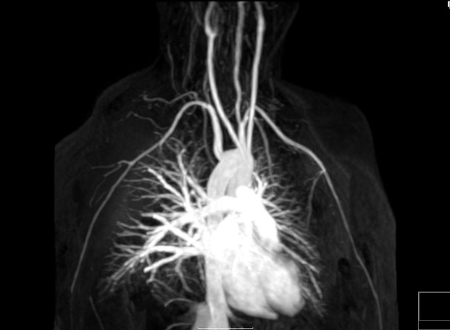
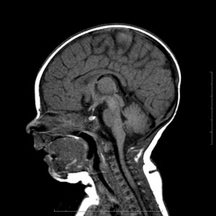
MRI Scan Purpose
Brain and spine
Blood vessels in the brain for stroke
Musculoskeletal disorders and injures
Congenital heart defects in neonates
Certain types of cancer treatment
Bone marrow disease
Cardiovascular system
Urinary tract

Slide 11
Differences
MRI | CT
Detailed pictures in soft tissues | Less detailed compared to MRI scan
Bony structures are less detailed compared to CT | Bony structures are more clear and detailed
No known side effects on radiation and very few side effects on MRI contrast scans | Little side effects. Frecquent radiations with CT scans might rarely cause cancer
Due to the structure and sound, claustrophobia patients may need to take anethstesia | Scan procedure is very simple and does not require anesthesia
Duration of MRI scans is much longer than CT | CT scan procedure is quick compared to MRI
Hight cost | CT scans are less expencive than MRI scans
Patients with metals or certain medical implants are not able to undergo MRI's due to the magnetic fields pulses | CT scan can be performed with no risk to medical implant or metal
PET
Less detailed than MRI scans
Shows extent of disease
Ionising radiation. Not recommended in routine clinical practice
Can help in monitoring treatment and shows it's effectivness
Reveals disease earlier, can diagnose faster
Can detect whether a mass is benign or malignant
Can detect abnormalities before there is an anatomical change

Slide 12
Thank you for your attention

